Slide 1
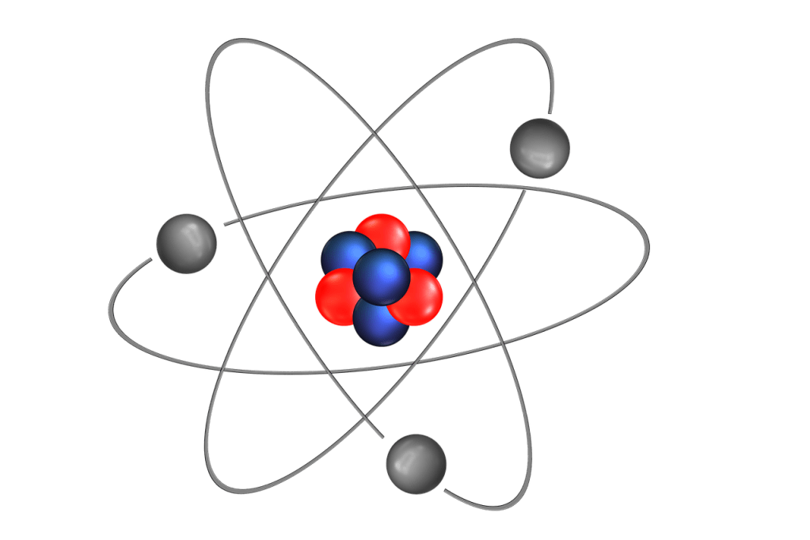
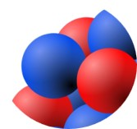
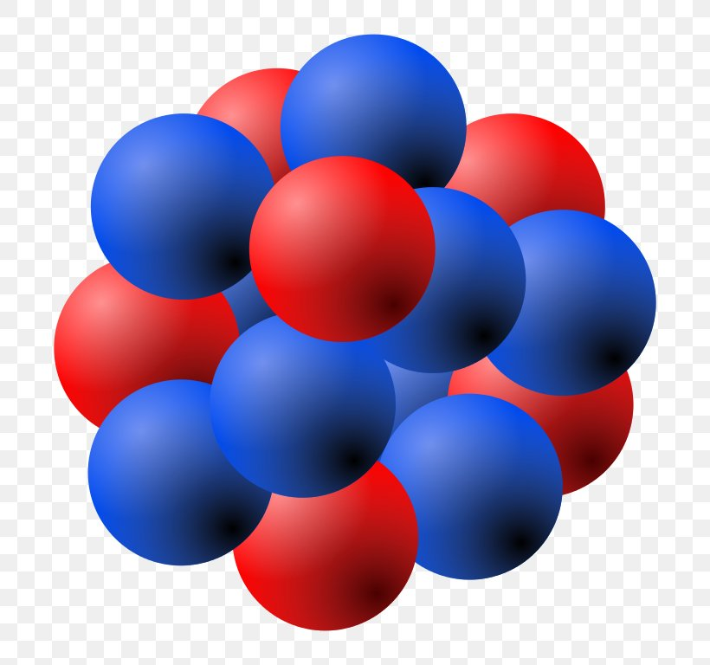
Muon beams for nuclear physics
James Cubiss – University of Edinburgh
Atomic sizes: 10⁻¹⁰ m
Nuclear sizes: 10⁻¹⁴ to 10⁻¹⁵ m
Thallium, Z=81
Promethium, Z=61

Slide 2
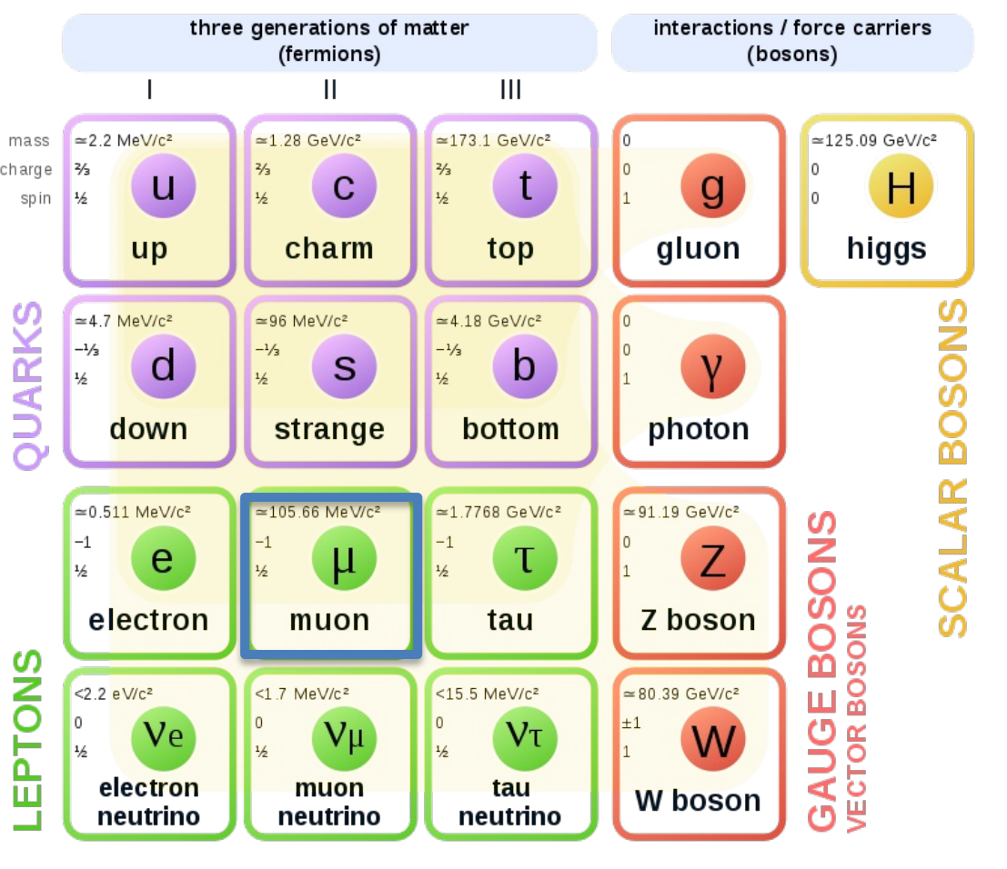
Overview
Why muons? - Muon overview - Nuclear physics with muons - Physics cases
Where for muons? - Proposed experiment at RAL’s ISIS facility - What they currently do - What we plan to do
WARNING(s)!!!
I am a nuclear physicist, not a muonist(?)
Physics cases are at nuclear-particle-atomic interface.
We have not done the experiments (yet!)

Slide 3
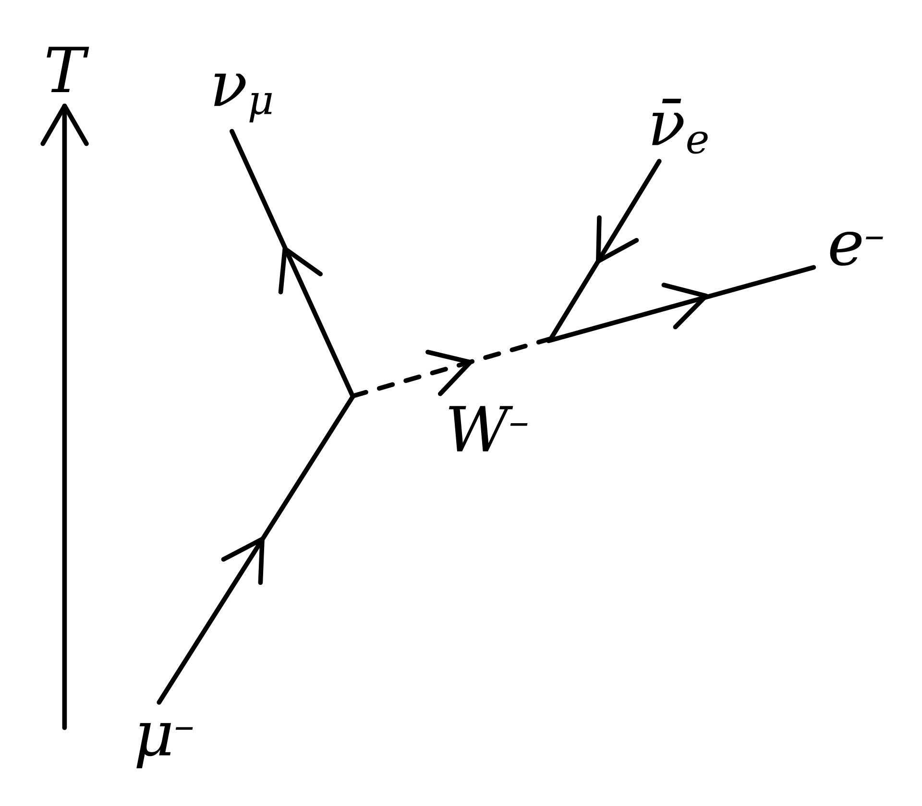
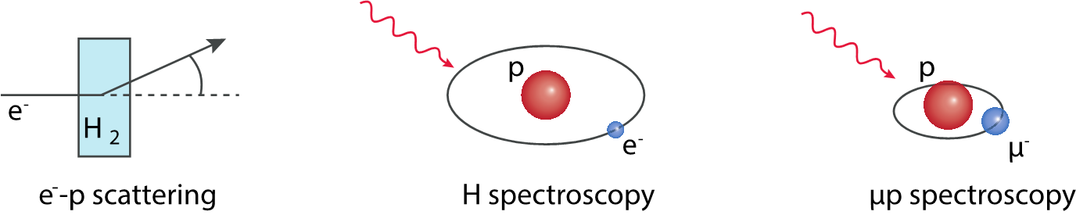
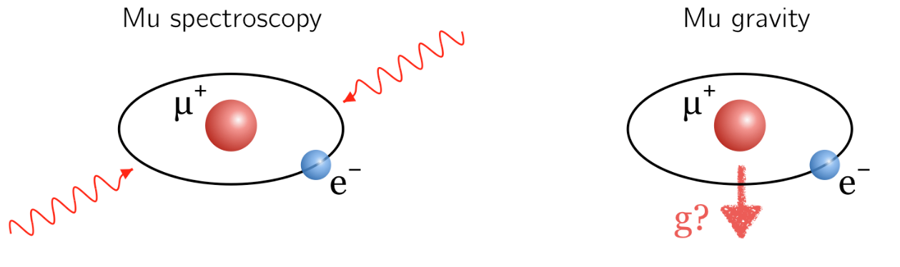

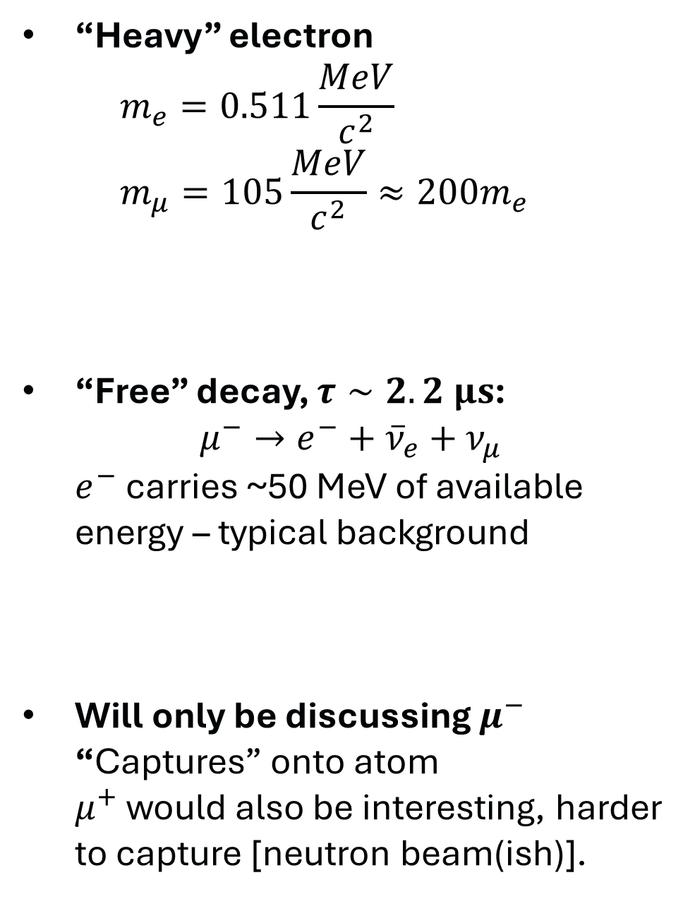

What is a muon?
“Heavy” electron $m_{e}=0.511\frac{MeV}{c^{2}}$ $m_{μ}=105\frac{MeV}{c^{2}}≈200m_{e}$
“Free” decay, $τ∼2.2 μs$: $μ^{−}→e^{−}+{\overline{ν}}_{e}+ν_{μ}$ $e^{−}$ carries ~50 MeV of available energy – typical background
Will only be discussing $μ^{−}$ “Captures” onto atom $μ^{+}$ would also be interesting, harder to capture [neutron beam(ish)].
Nucleus & $μ^{−}$ studied with muonic atoms
$μ^{+}$ properties through (muium or muonium)

Slide 4
Why muons?

Slide 5
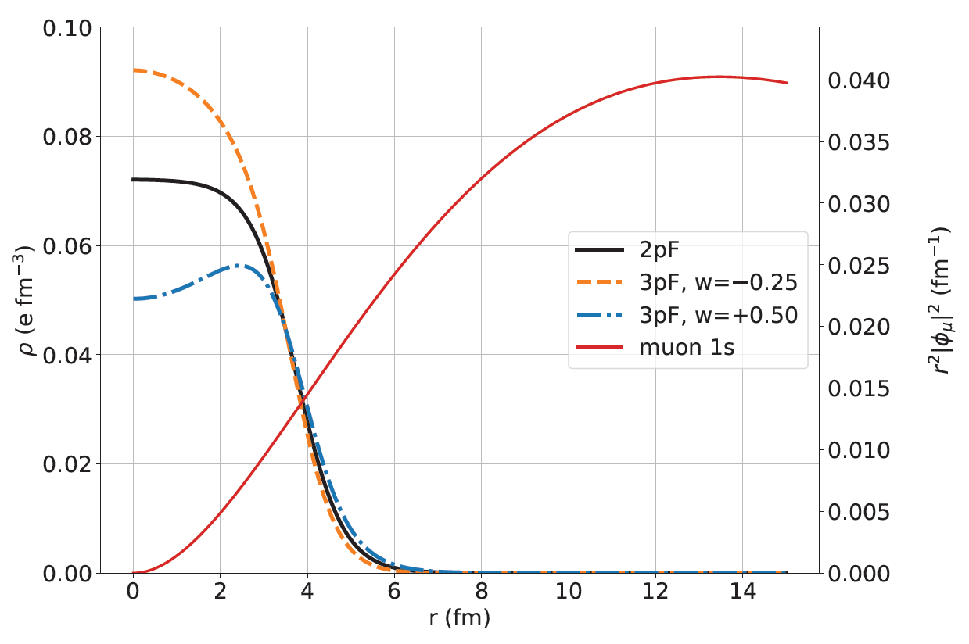
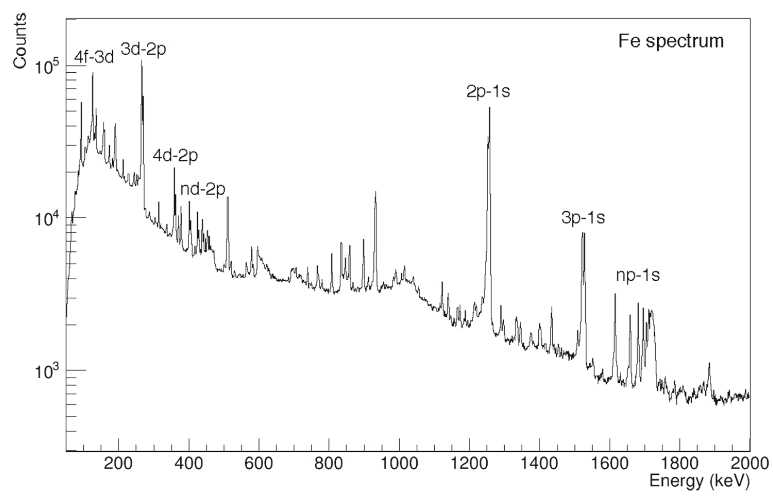
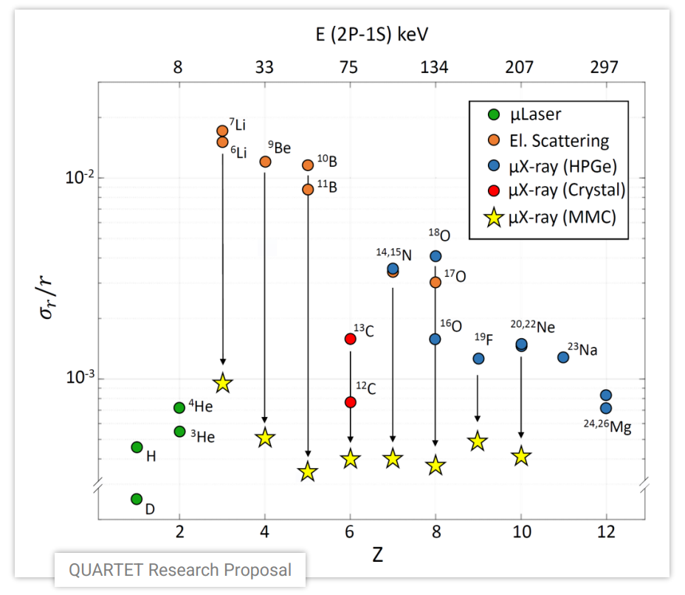
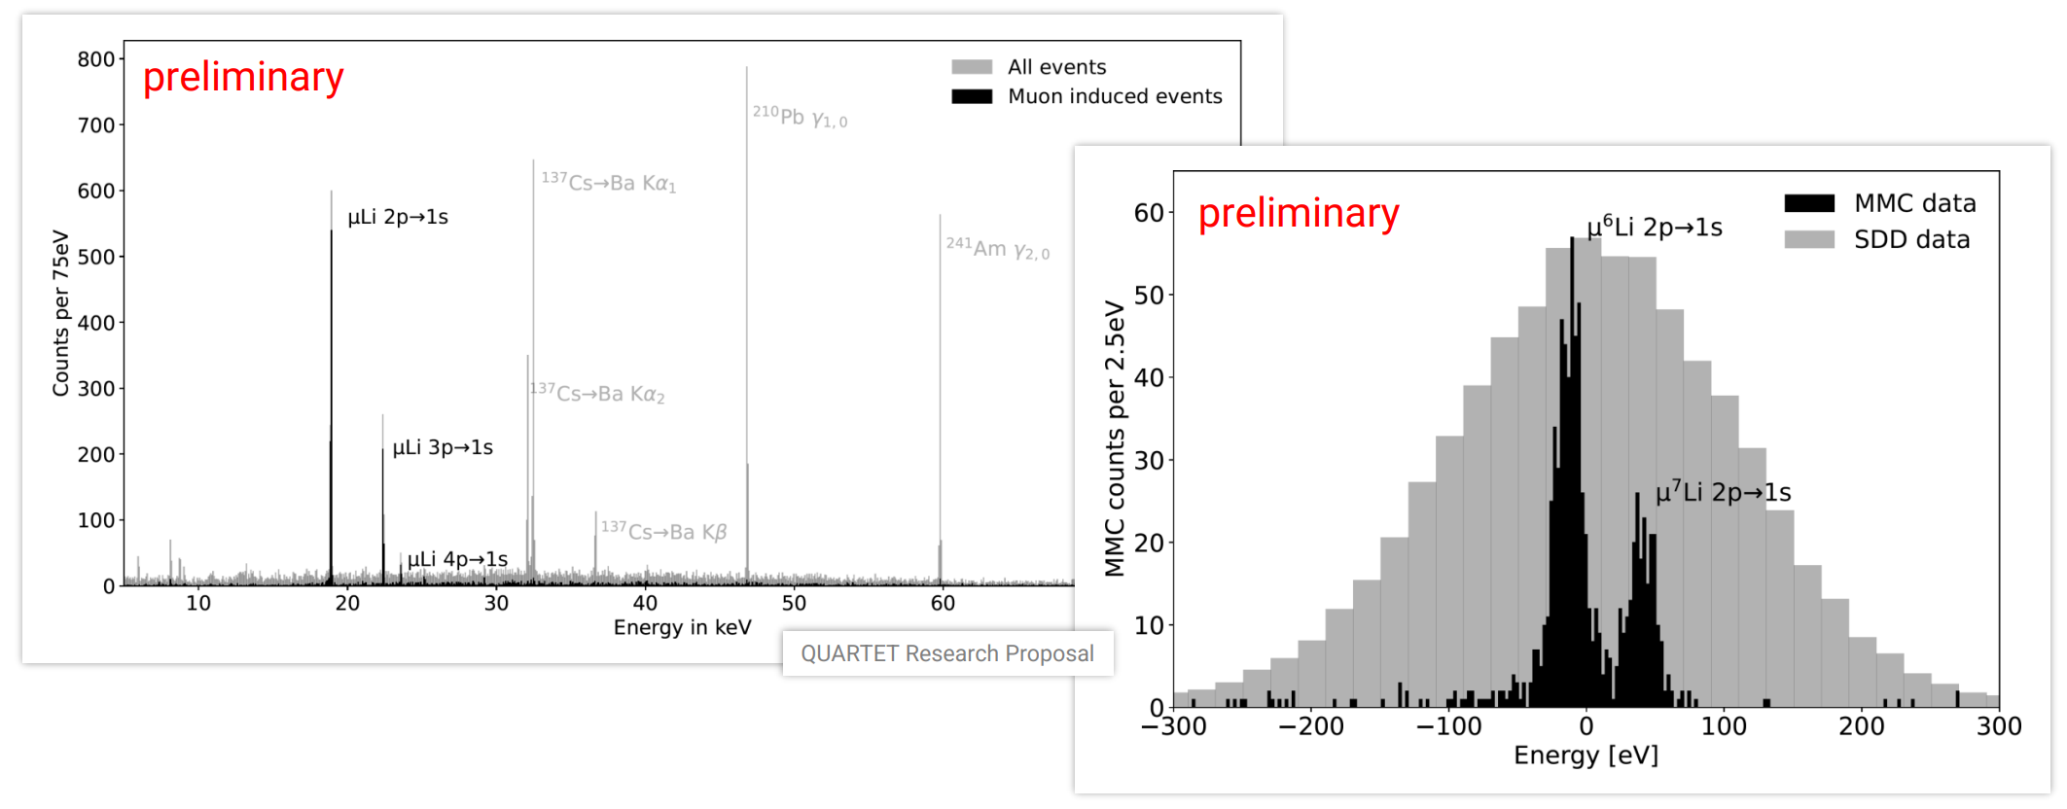
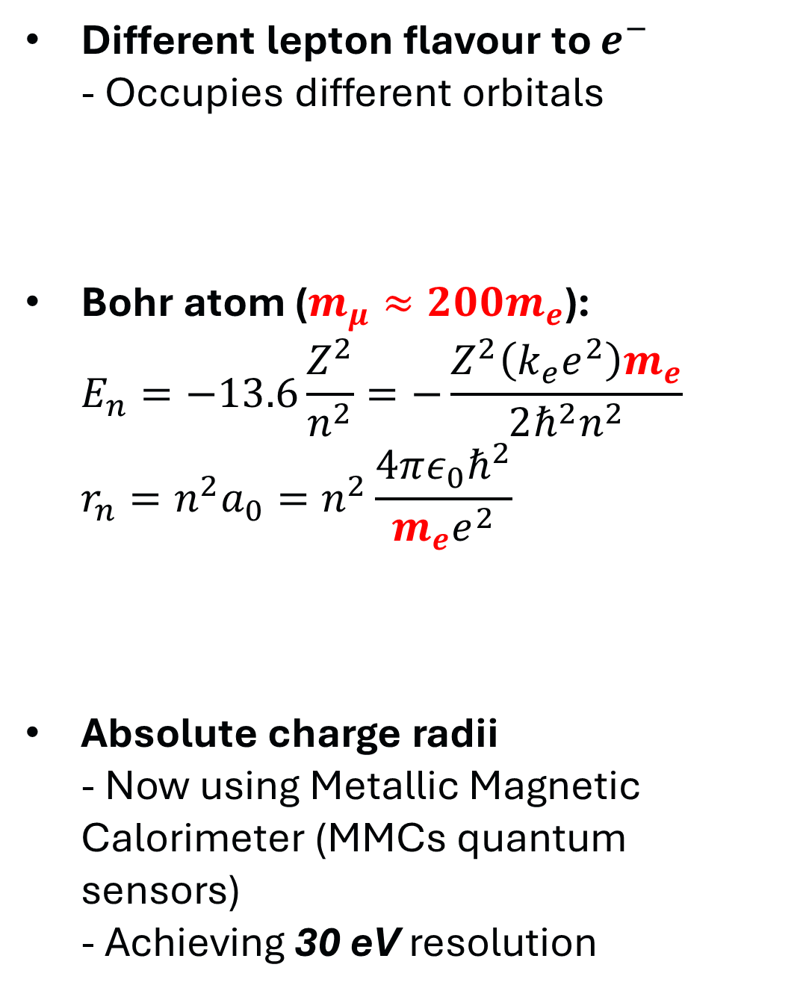
Muonic atoms
Different lepton flavour to $e^{−}$ - Occupies different orbitals
Bohr atom ($m_{μ}≈200m_{e}$):
$$E_{n}=−13.6\frac{Z^{2}}{n^{2}}=−\frac{Z^{2}\left(k_{e}e^{2}\right)m_{e}}{2ℏ^{2}n^{2}} \\ r_{n}=n^{2}a_{0}=n^{2}\frac{4πε_{0}ℏ^{2}}{m_{e}e^{2}}$$
Absolute charge radii - Now using Metallic Magnetic Calorimeter (MMCs quantum sensors) - Achieving 30 eV resolution
M. Heines, PhD thesis (2026)
Knecht+, EPJ+ (2020) 135:777

Slide 6
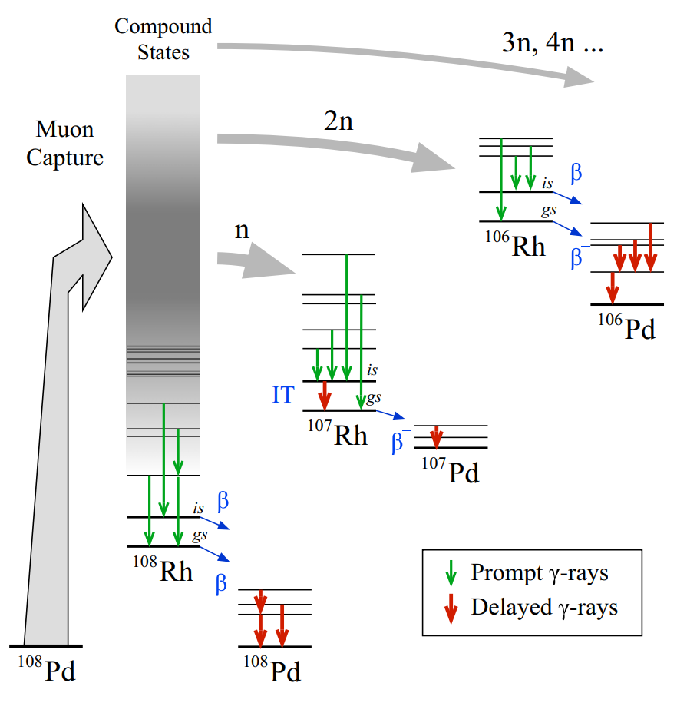
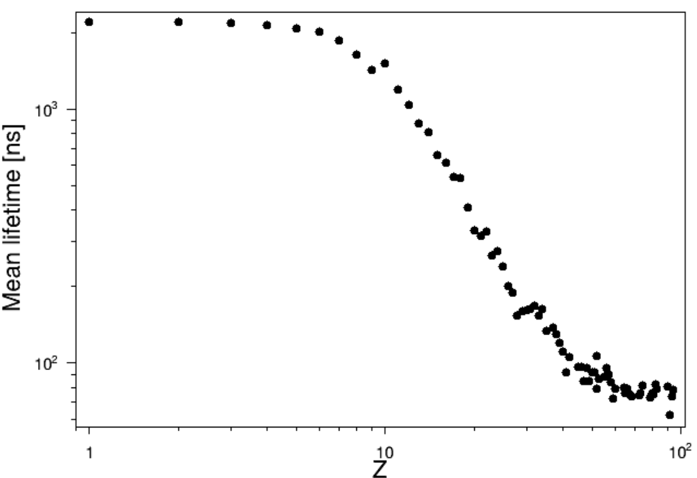
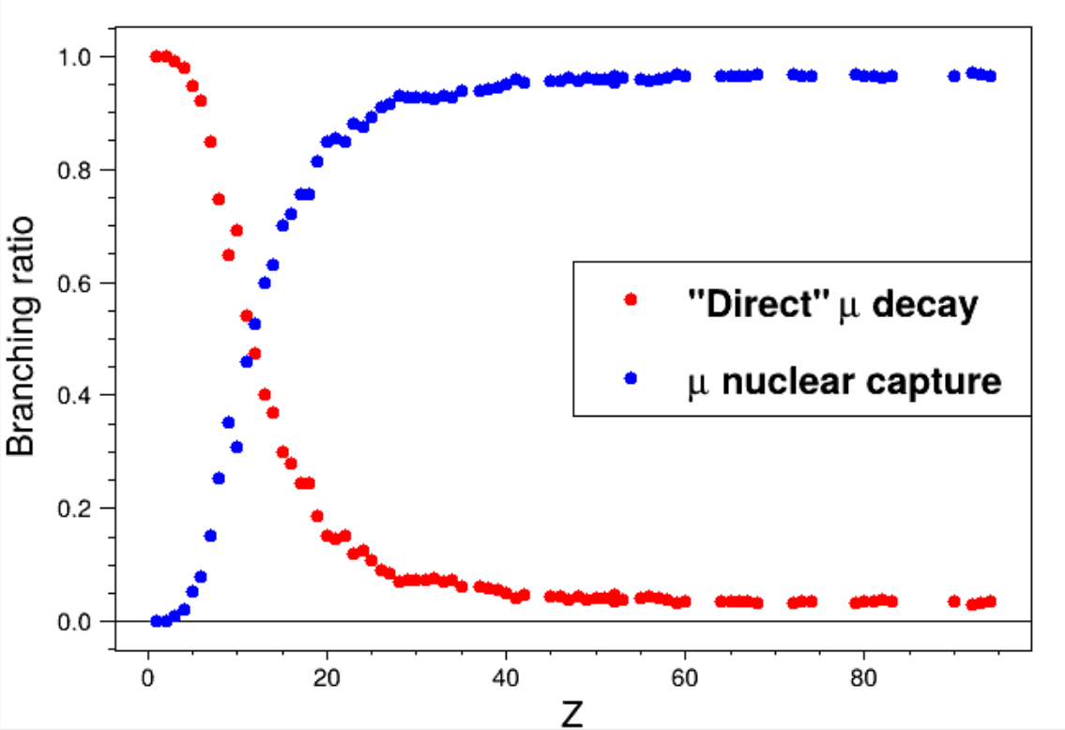
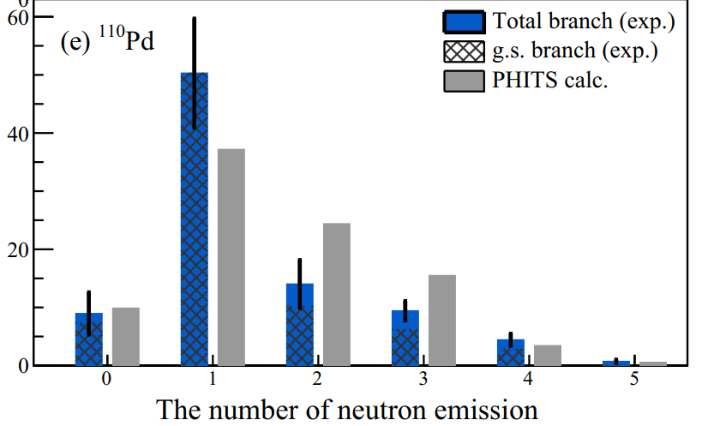
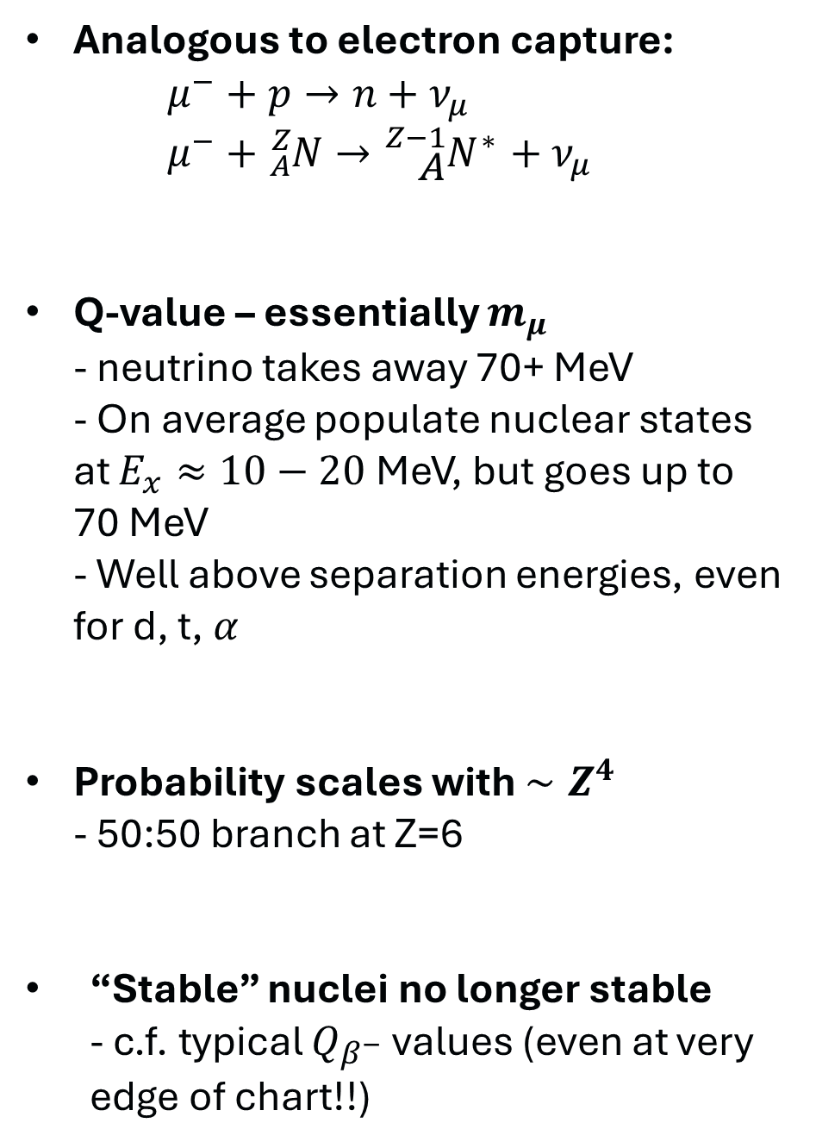
Muon capture on nucleus
Analogous to electron capture: $μ^{−}+p→n+ν_{μ}$ $μ^{−}+{}_{A}^{Z}N→{}_{A}^{Z−1}{N^{∗}}+ν_{μ}$
Q-value – essentially $m_{μ}$ - neutrino takes away 70+ MeV - On average populate nuclear states at $E_{x}≈10−20$MeV, but goes up to 70 MeV - Well above separation energies, even for d, t, $α$
Probability scales with $∼Z^{4}$ - 50:50 branch at Z=6
“Stable” nuclei no longer stable - c.f. typical $Q_{β^{−}}$ values (even at very edge of chart!!)
Data from Suzuki+, PRC 35, 2212 (1987)
Niikura+, PRC 109, 014328 (2024)

Slide 7
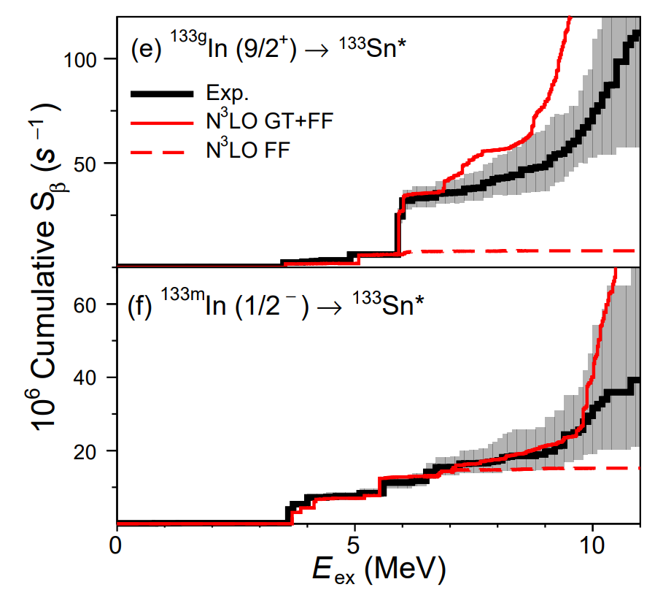
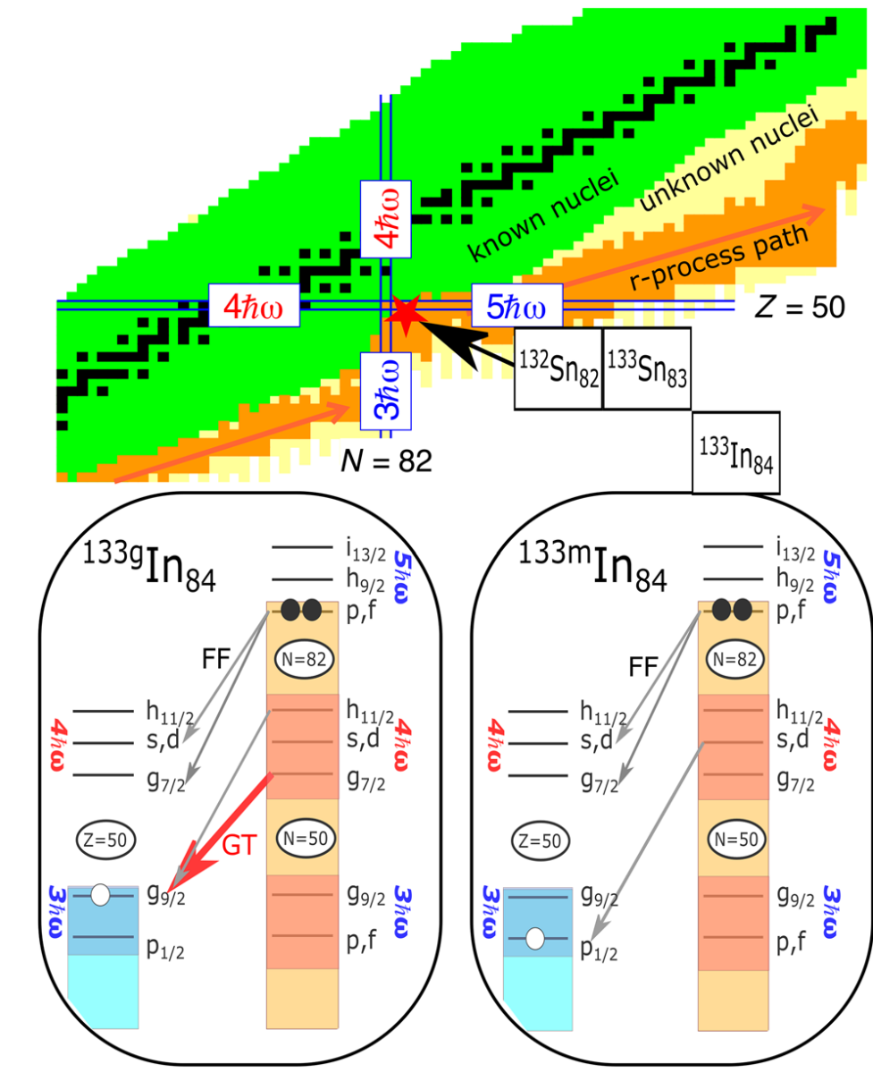
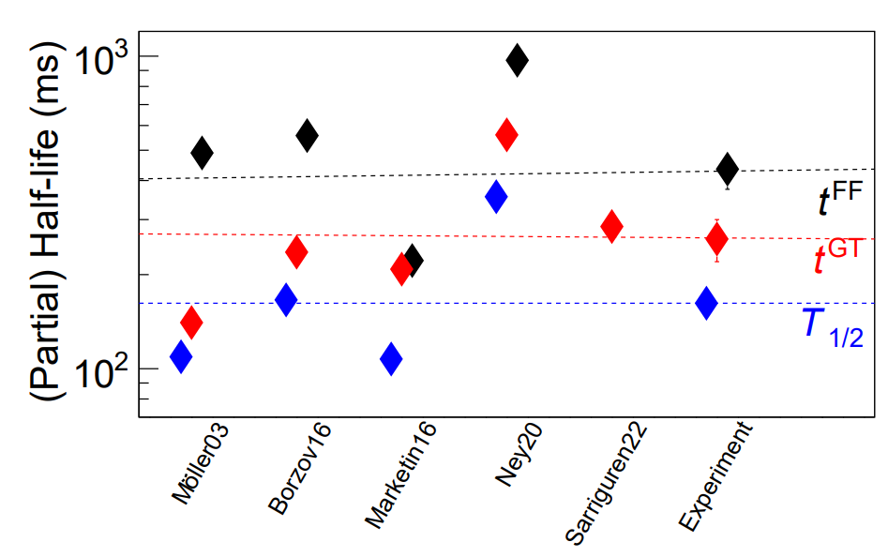
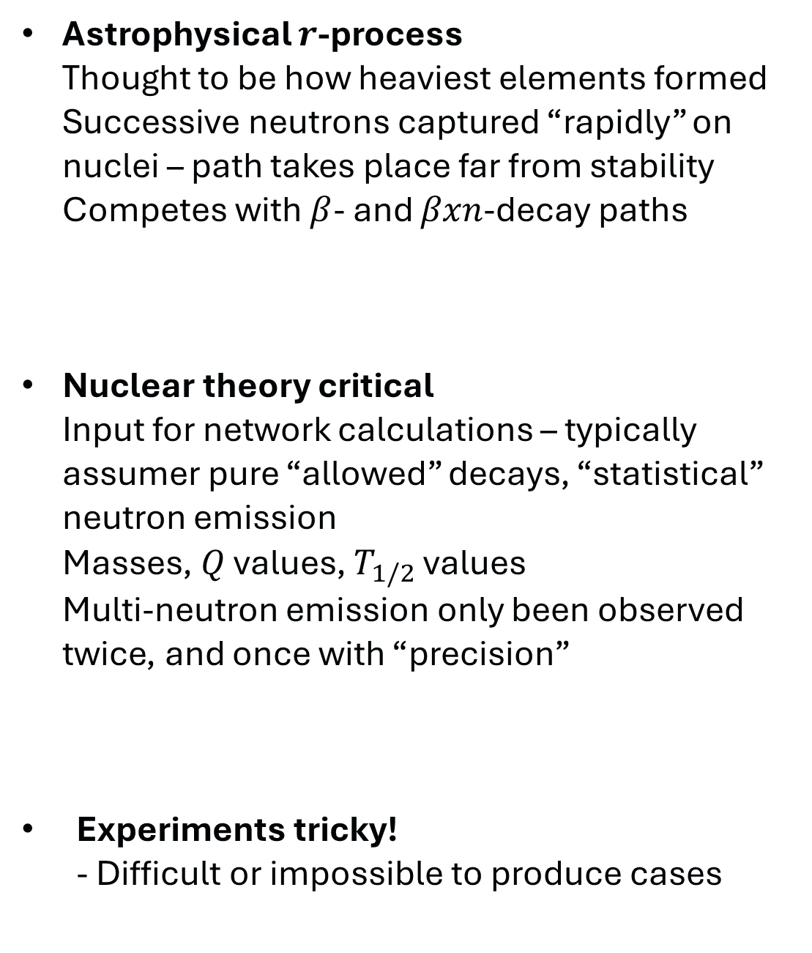
Muon capture as proxy for $r$-process modelling
Astrophysical $r$-process Thought to be how heaviest elements formed Successive neutrons captured “rapidly” on nuclei – path takes place far from stability Competes with $β$- and $βxn$-decay paths
Nuclear theory critical Input for network calculations – typically assumer pure “allowed” decays, “statistical” neutron emission Masses, $Q$ values, $T_{1/2}$ values Multi-neutron emission only been observed twice, and once with “precision”
Experiments tricky! - Difficult or impossible to produce cases
Xu+, PRL 131, 022501 (2023)

Slide 8
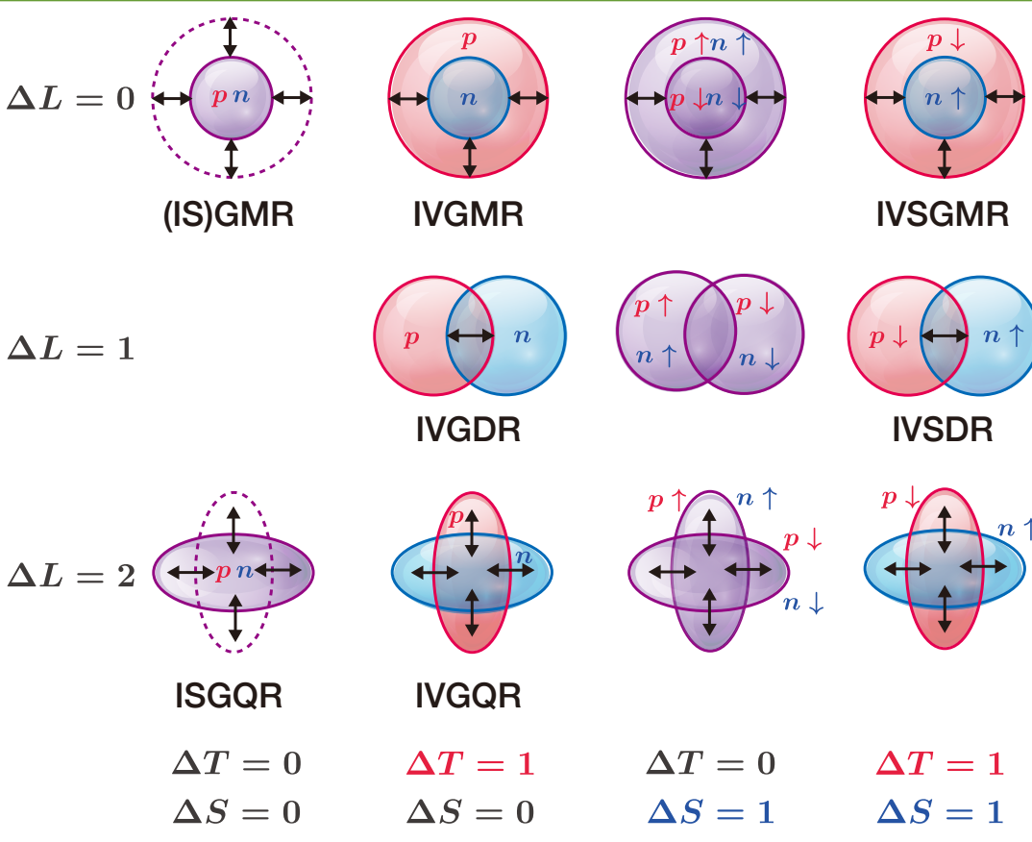
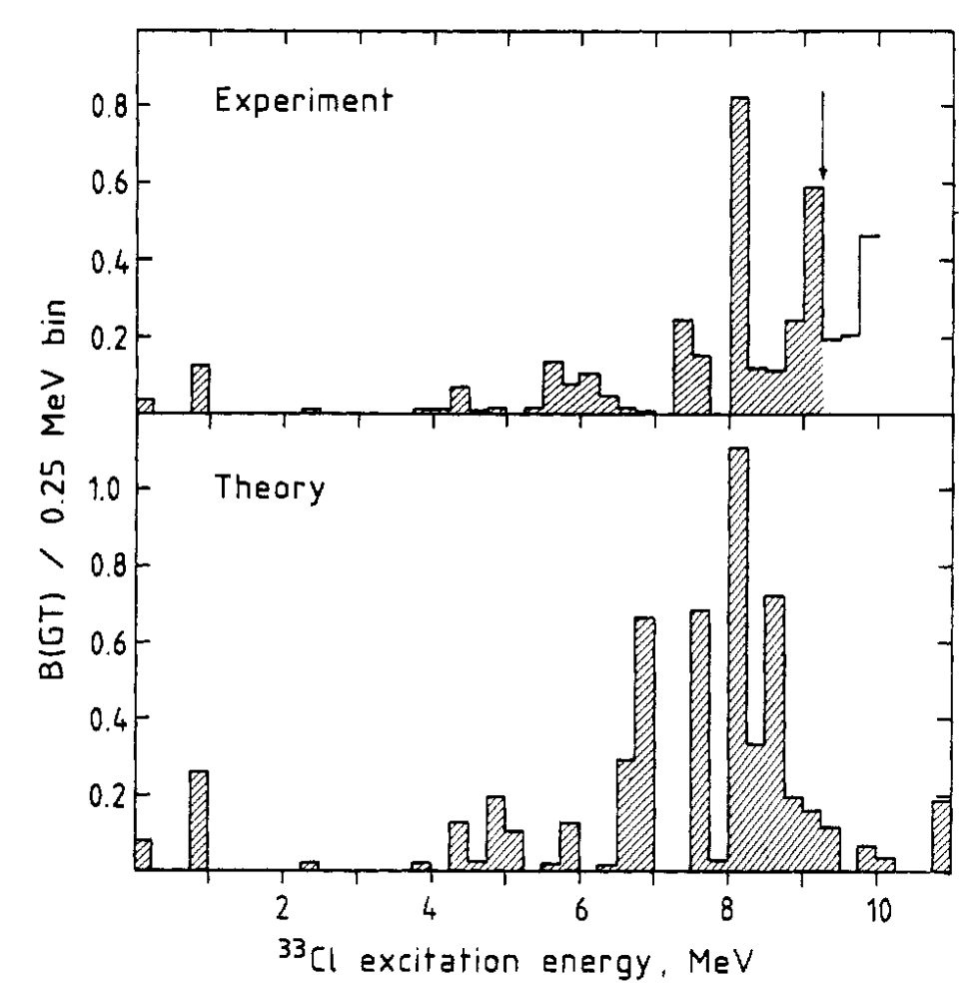
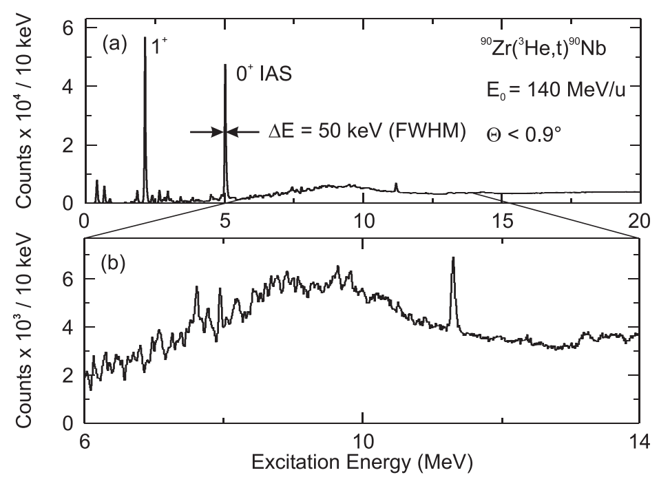
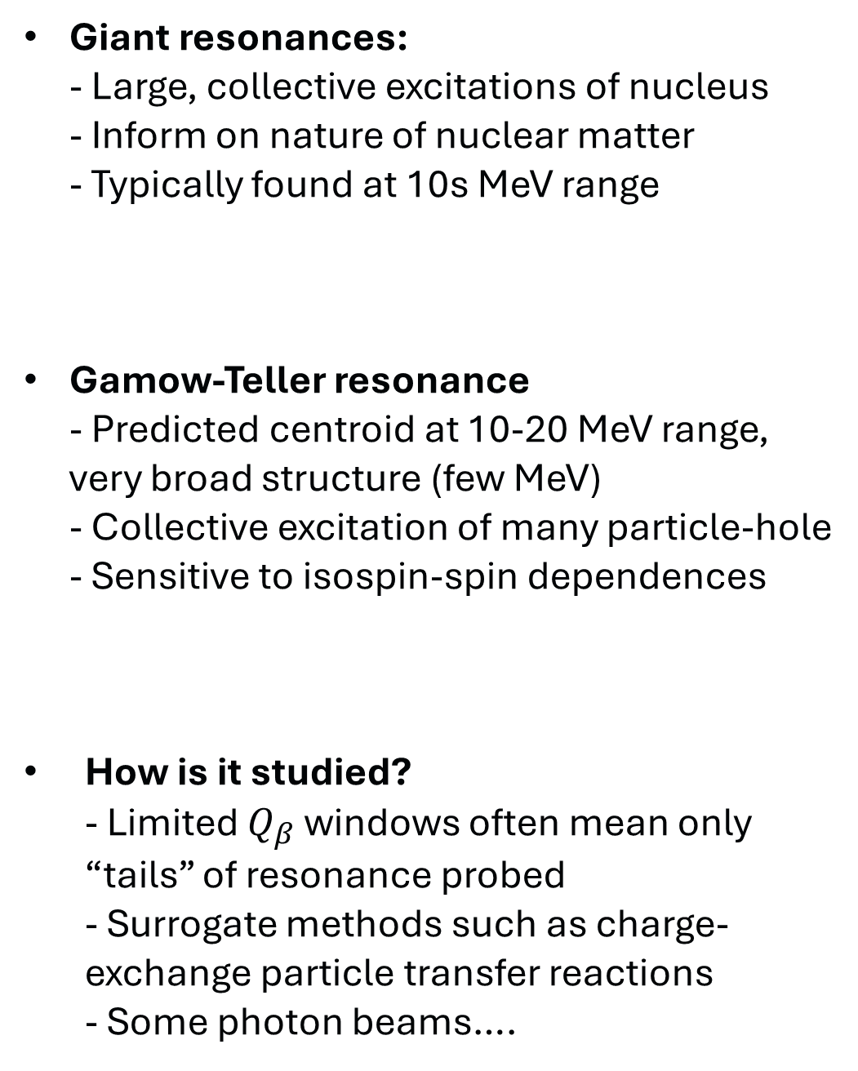
GT strength distribution and the GT Giant Resonance
Giant resonances: - Large, collective excitations of nucleus - Inform on nature of nuclear matter - Typically found at 10s MeV range
Gamow-Teller resonance - Predicted centroid at 10-20 MeV range, very broad structure (few MeV) - Collective excitation of many particle-hole - Sensitive to isospin-spin dependences
How is it studied? - Limited $Q_{β}$ windows often mean only “tails” of resonance probed - Surrogate methods such as charge-exchange particle transfer reactions - Some photon beams….
Borge+, Phys. Scrip. 36, 218-223 (1987)
Kalmykov+, PRL 96, 012502 (2006)

Slide 9
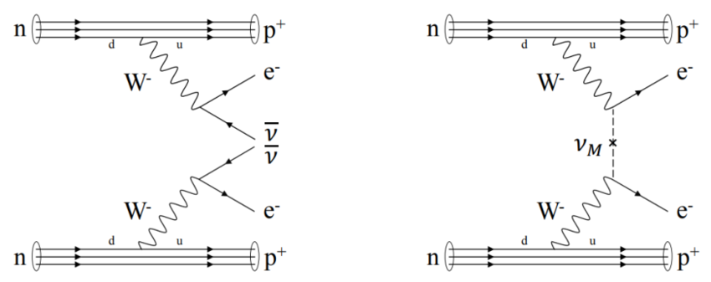
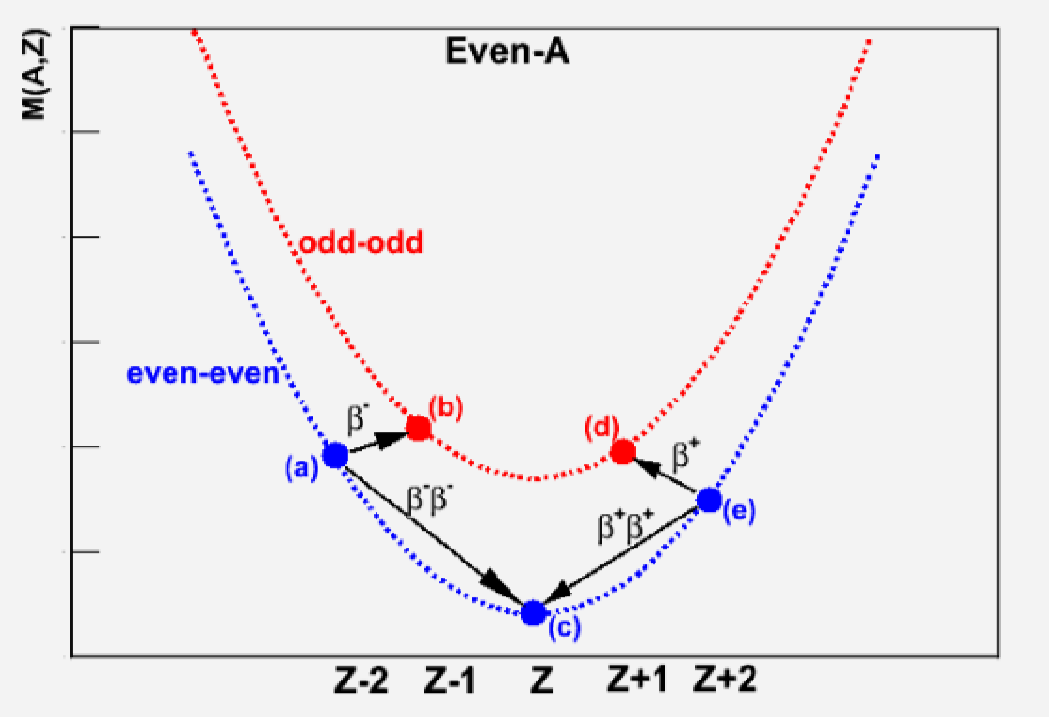
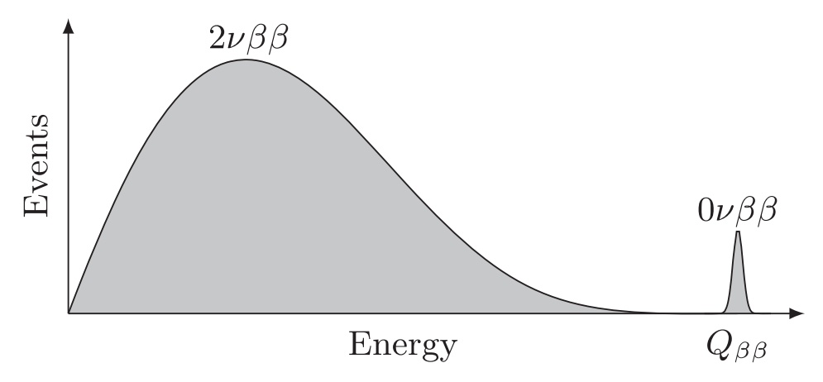
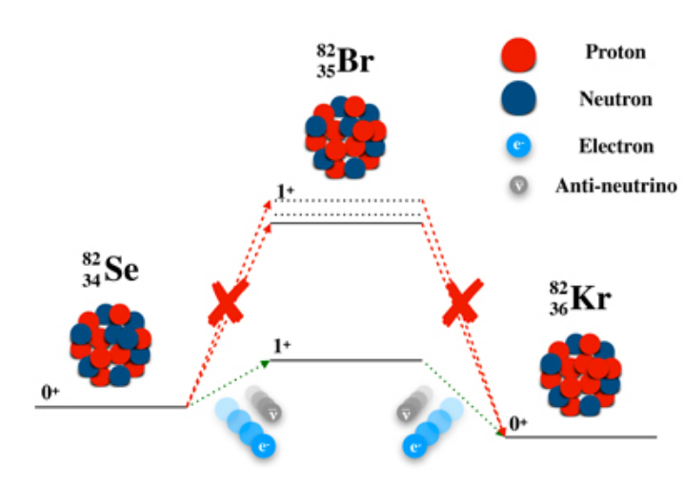
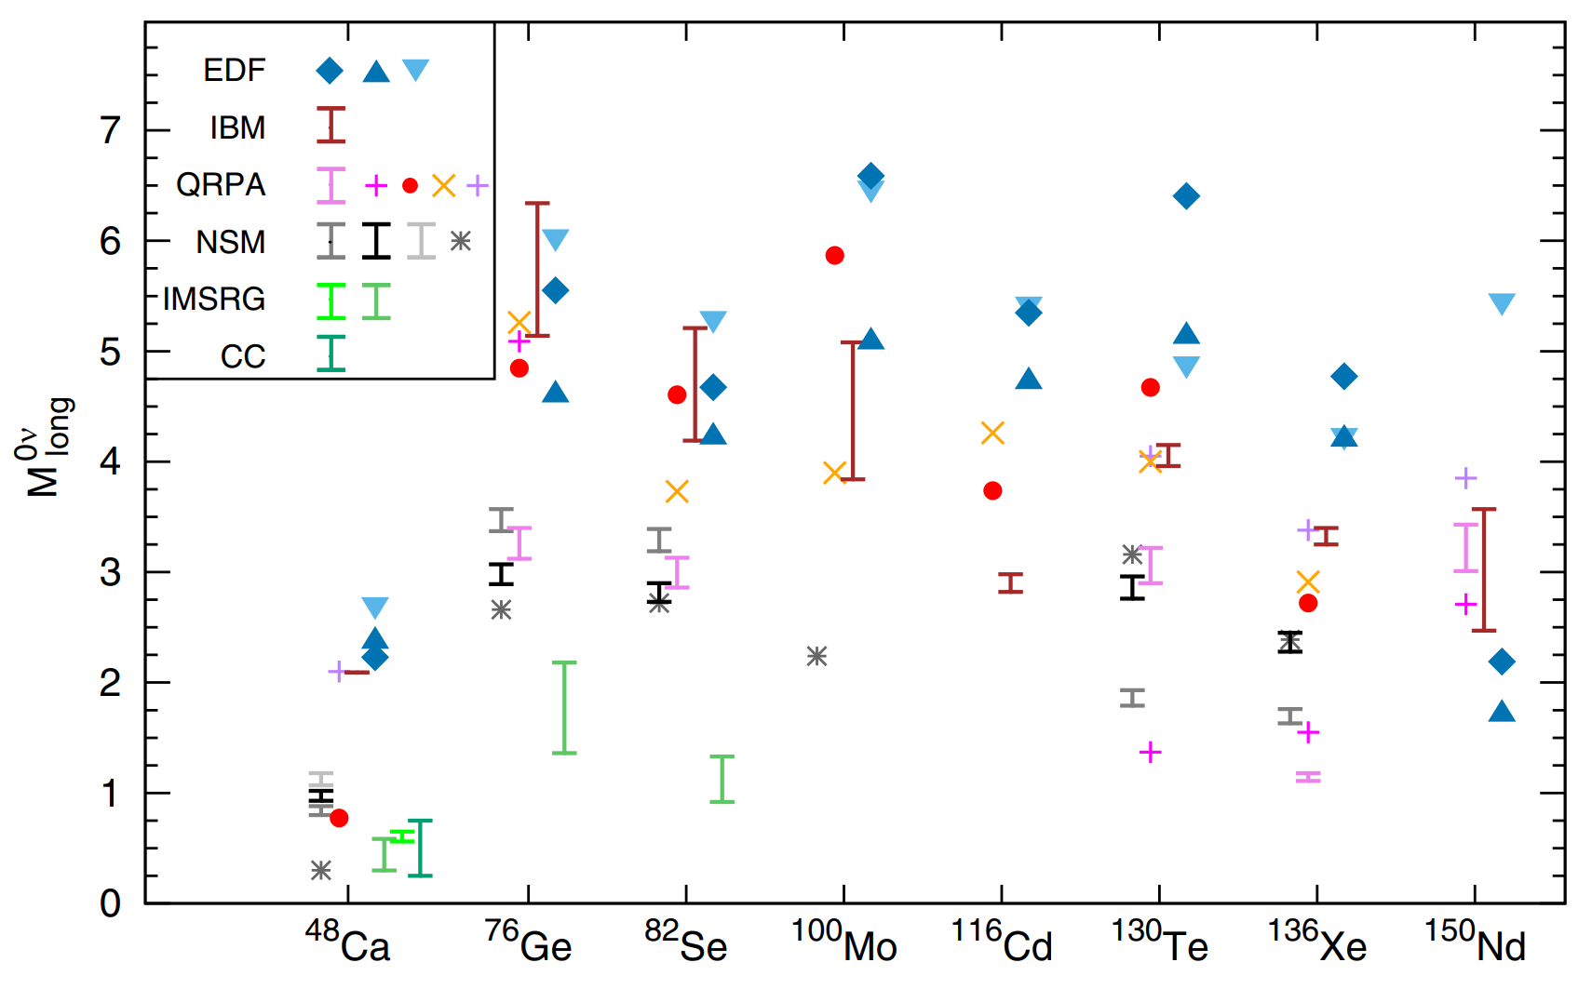
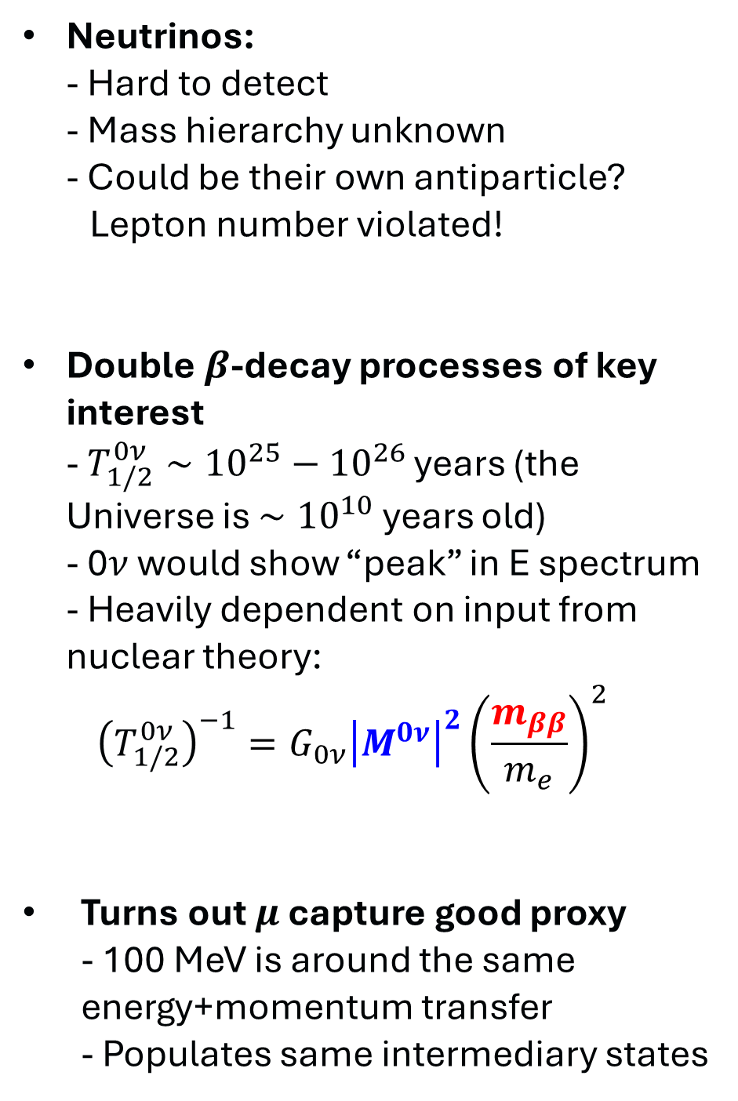
Muons for $0ν2β$decay
Neutrinos: - Hard to detect - Mass hierarchy unknown - Could be their own antiparticle? Lepton number violated!
Double $β$-decay processes of key interest - $T_{1/2}^{0ν}∼{10}^{25}−{10}^{26}$ years (the Universe is $∼{10}^{10}$ years old) - 0$ν$ would show “peak” in E spectrum - Heavily dependent on input from nuclear theory: ${\left(T_{1/2}^{0ν}\right)}^{−1}=G_{0ν}{\left|M^{0ν}\right|}^{2}{\left(\frac{m_{ββ}}{m_{e}}\right)}^{2}$
Turns out $μ$ capture good proxy - 100 MeV is around the same energy+momentum transfer - Populates same intermediary states
Agostini+, Rev. Mod. Phys. 95, 025002 (2023)

Slide 10
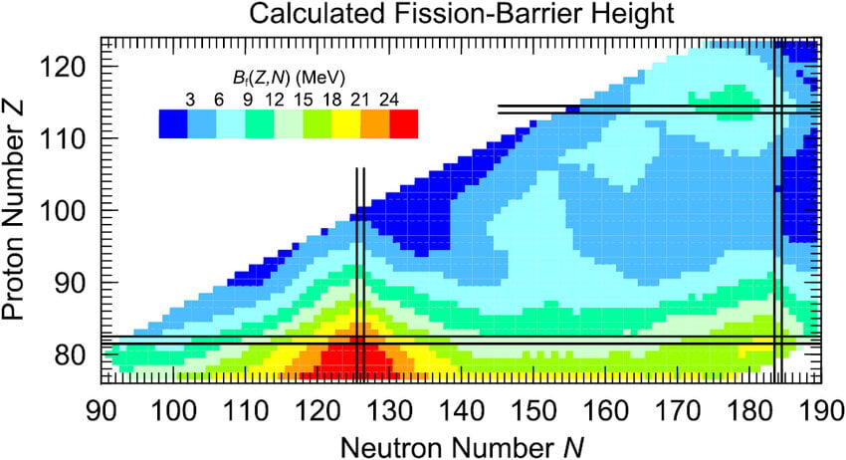
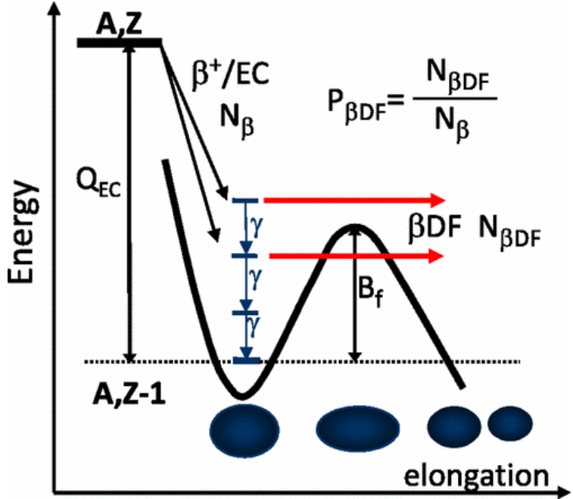
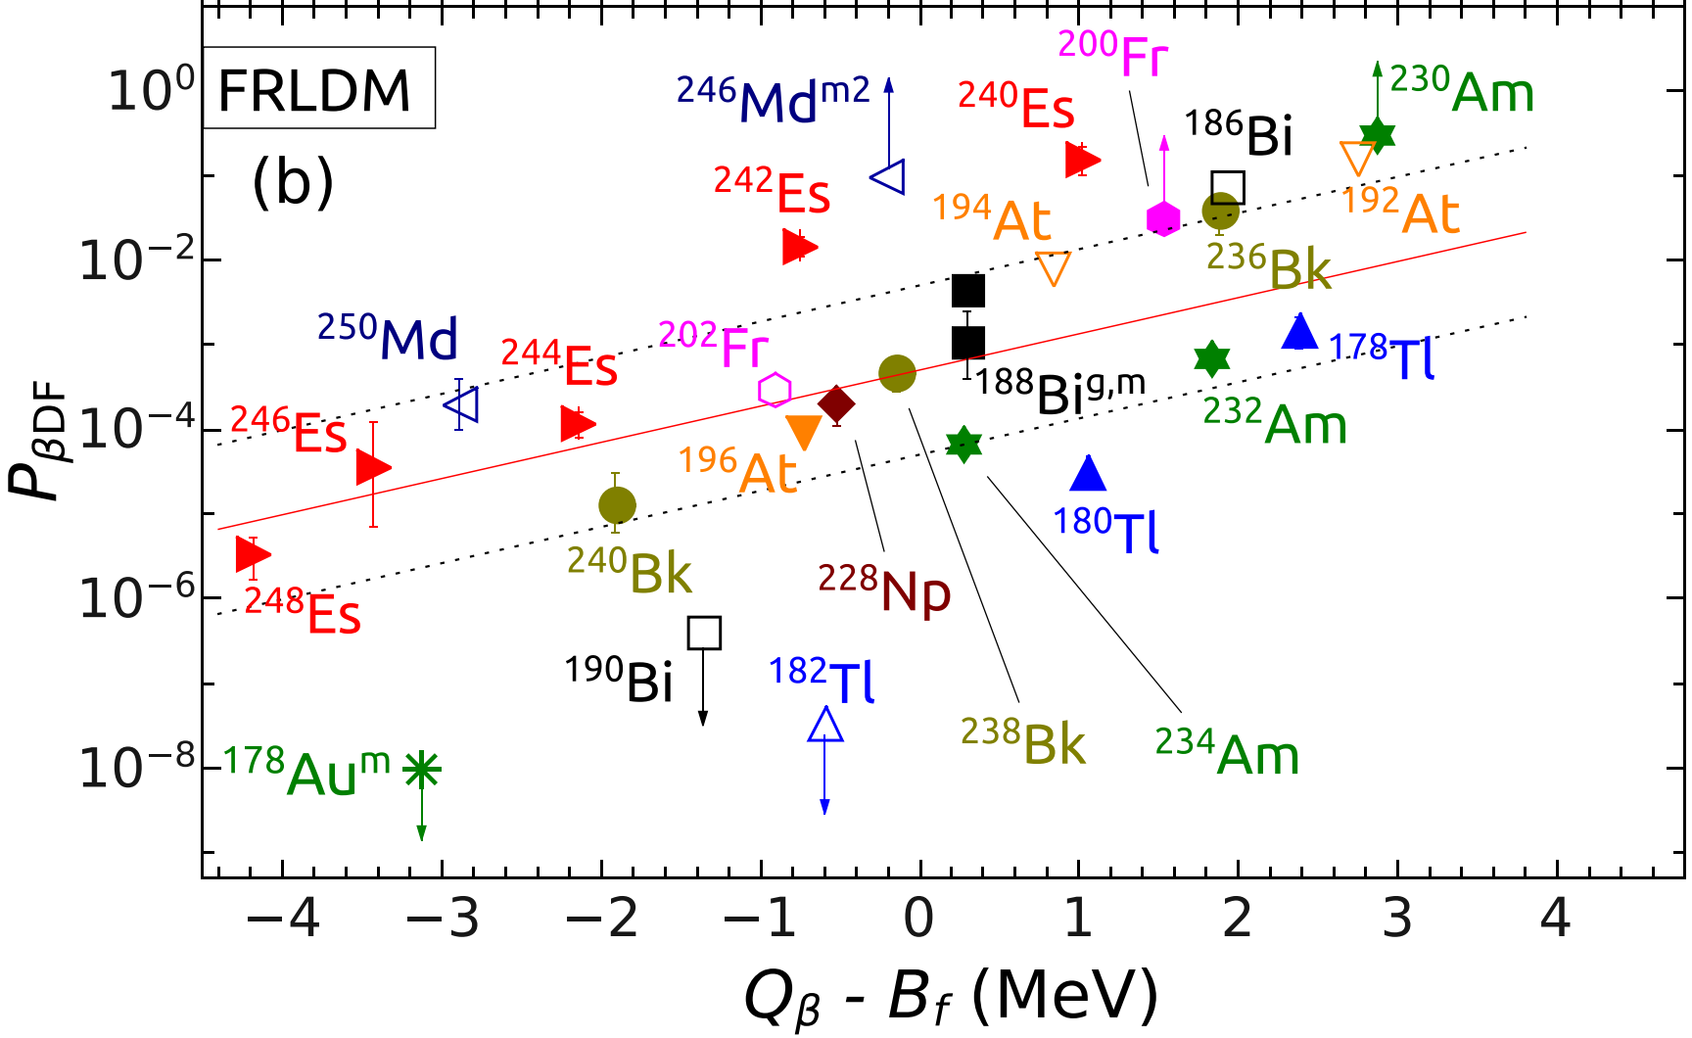
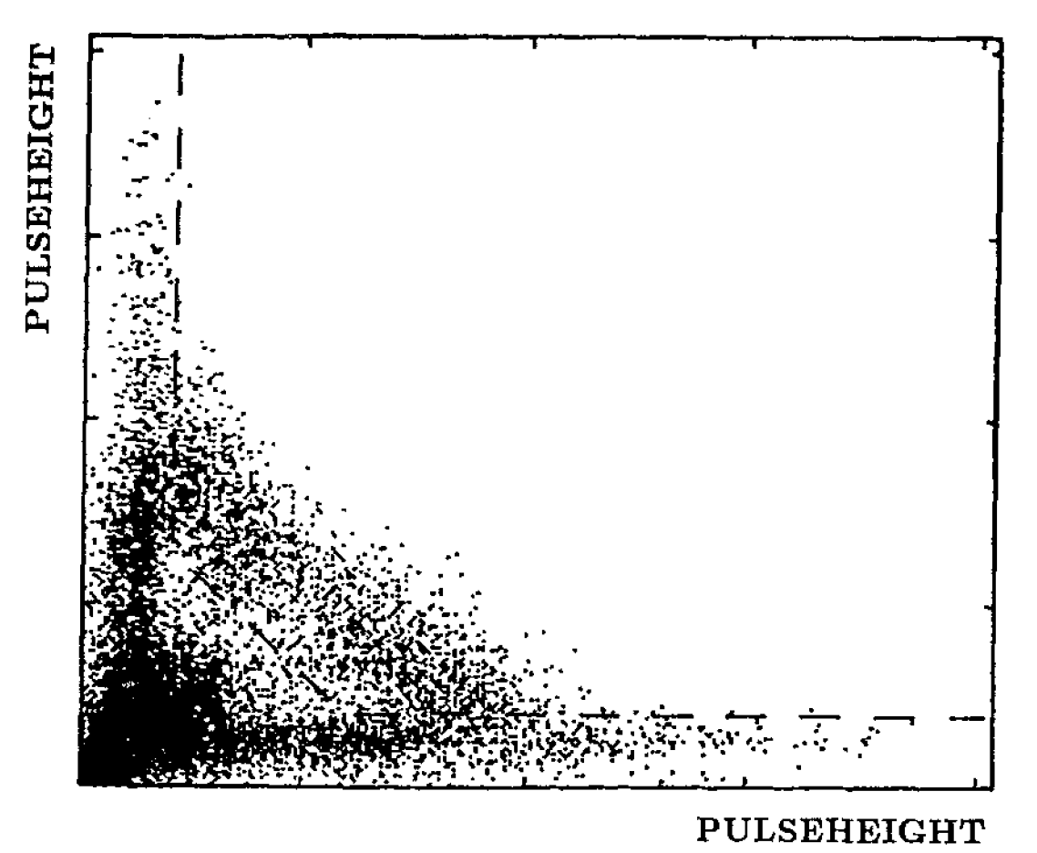
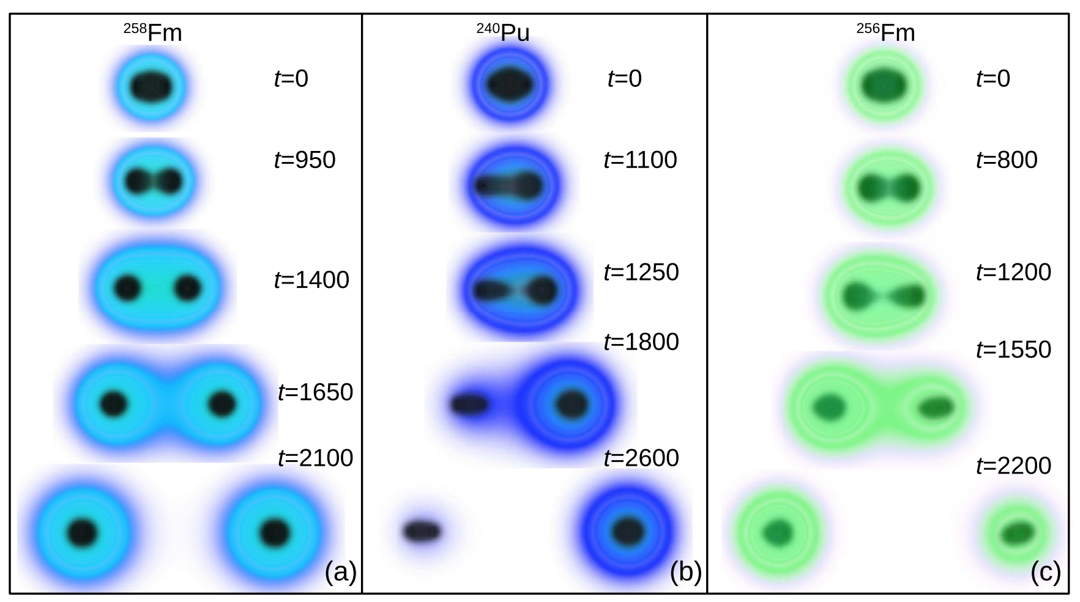

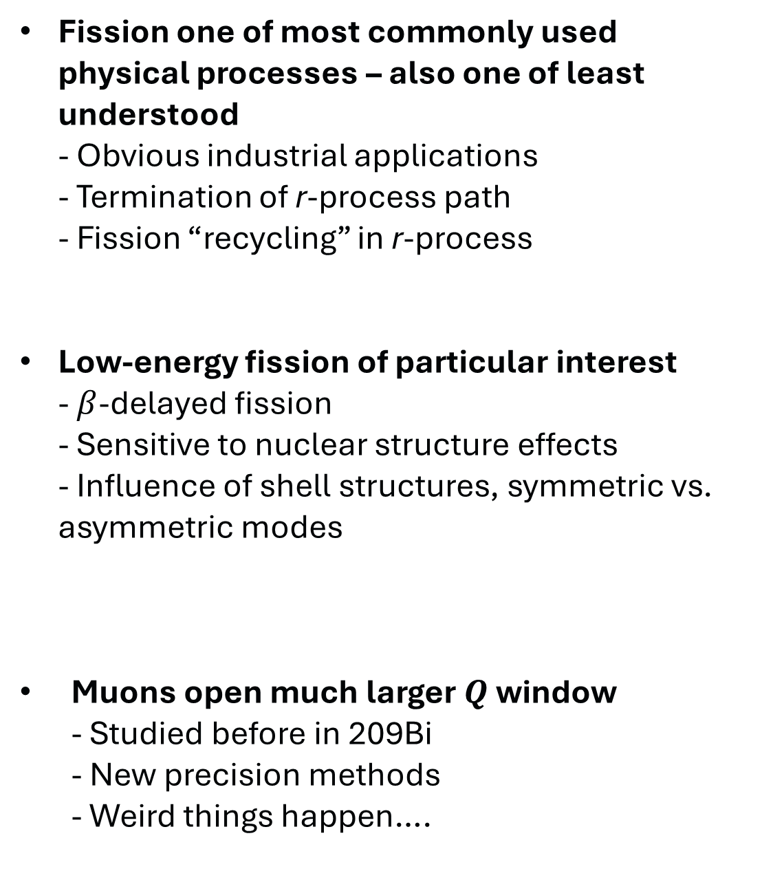
208Pb – can muons break it?
Moller+, PRC 91, 024310 (2015)
Fission one of most commonly used physical processes – also one of least understood - Obvious industrial applications - Termination of r-process path - Fission “recycling” in r-process
Low-energy fission of particular interest - $β$-delayed fission - Sensitive to nuclear structure effects - Influence of shell structures, symmetric vs. asymmetric modes
Muons open much larger $Q$ window - Studied before in 209Bi - New precision methods - Weird things happen….
Andel+, PRC 113, 014325 (2026)
Previous measurement 209Bi Paganetti+, Z. Phys A 343, 113-118 (1992)
$P_{f}=4.2\left(7\right)×{10}^{−5}$
Ross and Umar, PRC 112, L011601 (2025)

Slide 11
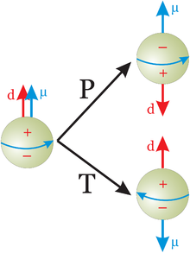
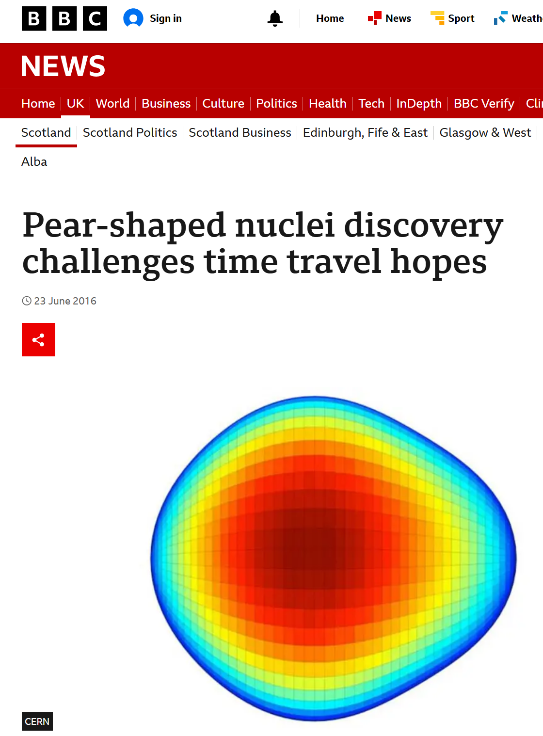
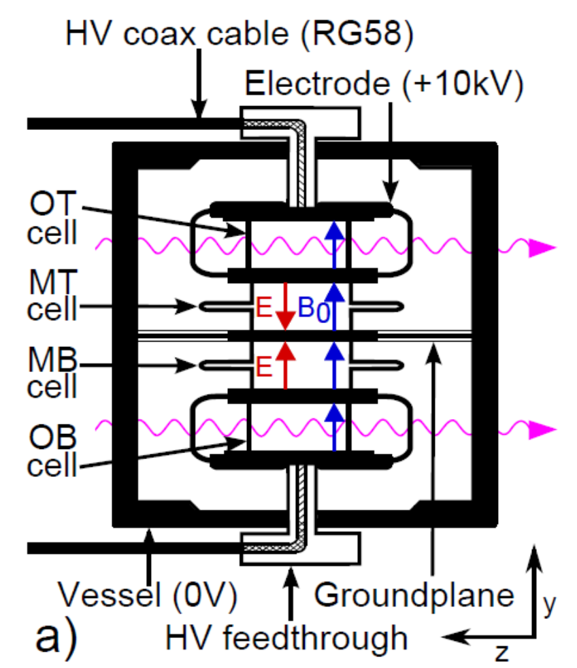
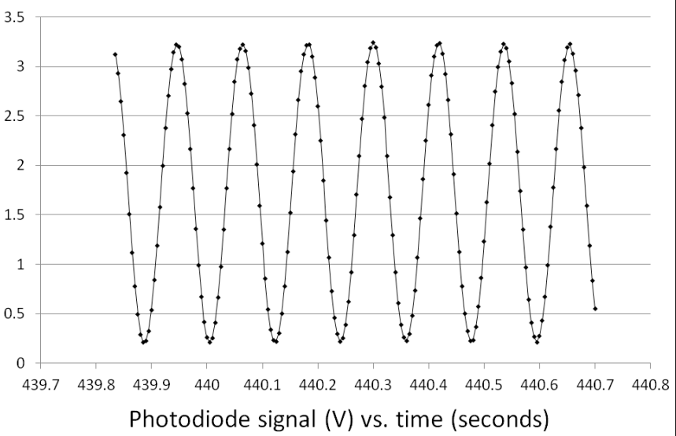
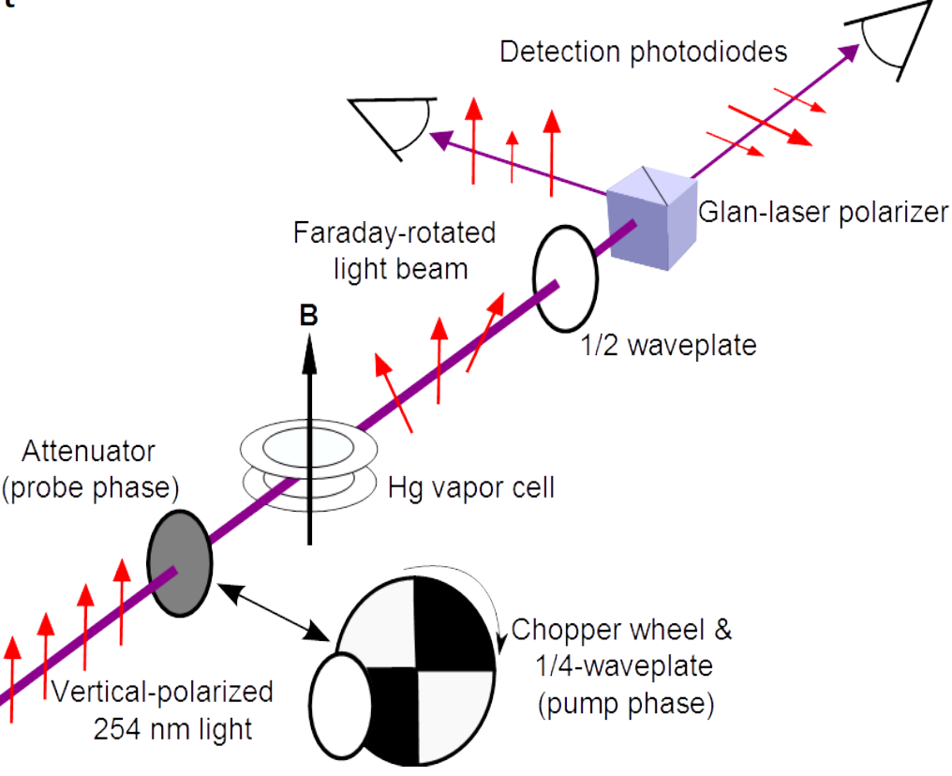
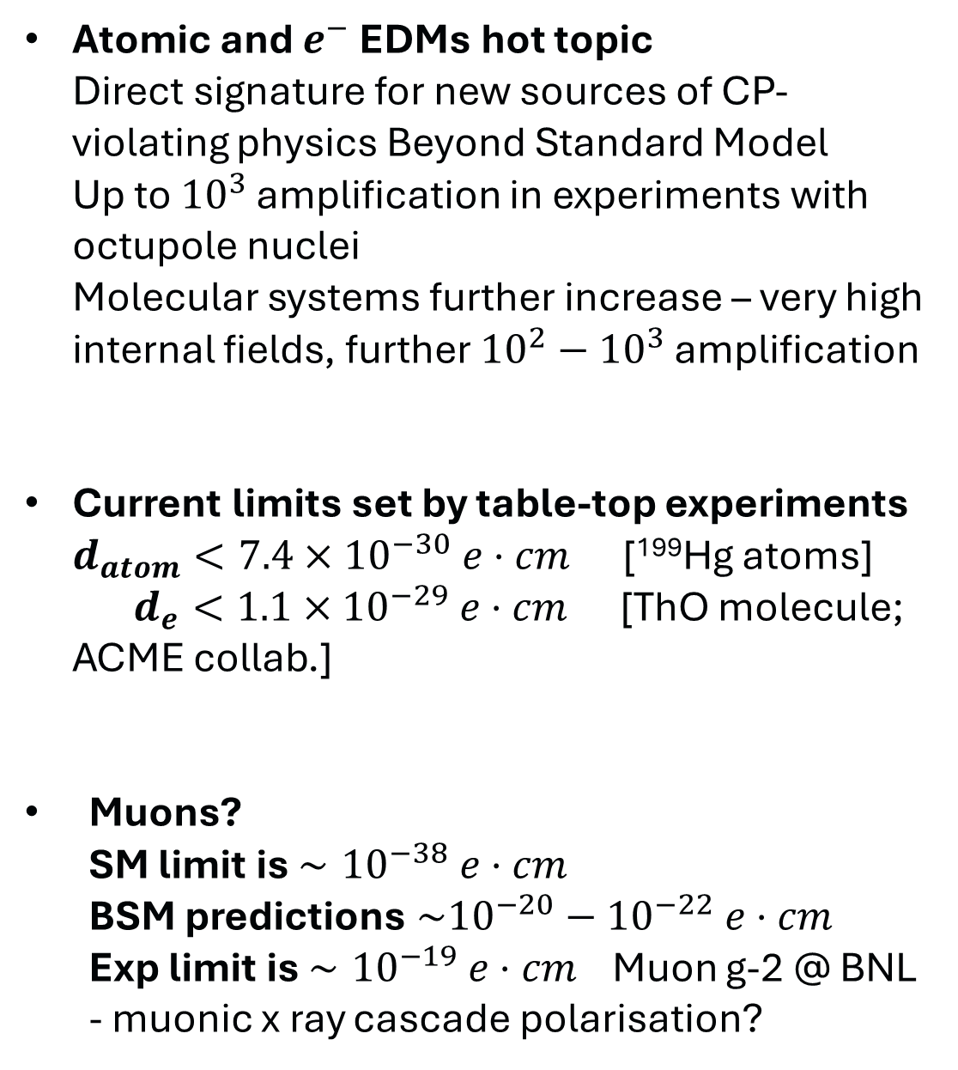
EDM of the muon
Atomic and $e^{−}$ EDMs hot topic Direct signature for new sources of CP-violating physics Beyond Standard Model Up to ${10}^{3}$ amplification in experiments with octupole nuclei Molecular systems further increase – very high internal fields, further ${10}^{2}−{10}^{3}$ amplification
Current limits set by table-top experiments $d_{atom}<7.4×{10}^{−30} e⋅cm$ [¹⁹⁹Hg atoms] $d_{e}<1.1×{10}^{−29} e⋅cm$ [ThO molecule; ACME collab.]
Muons? SM limit is $∼{10}^{−38} e⋅cm$ BSM predictions $\sim {10}^{−20}−{10}^{−22} e⋅cm$ Exp limit is $∼{10}^{−19} e⋅cm$ Muon g-2 @ BNL - muonic x ray cascade polarisation?
c.f. Gaffney+, Nature 497, 199-204 (2013)
Graner+, Phys. Rev. Lett. 119, 119901 (2017)

Slide 12
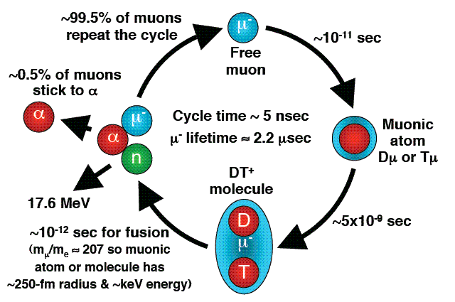
Muon catalysed fusion

Slide 13
Where for muons?

Slide 14
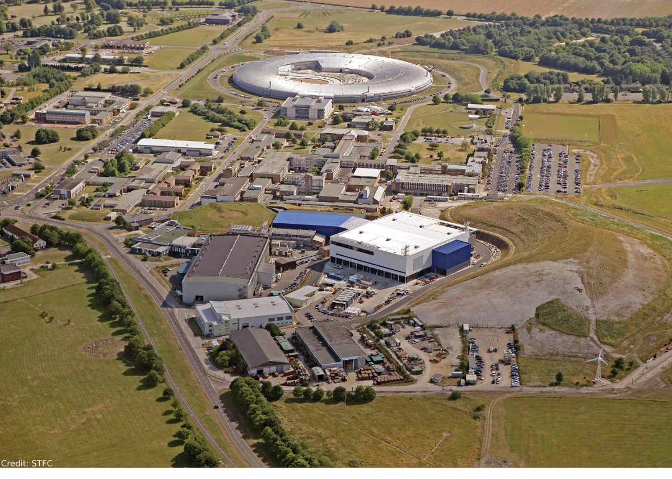
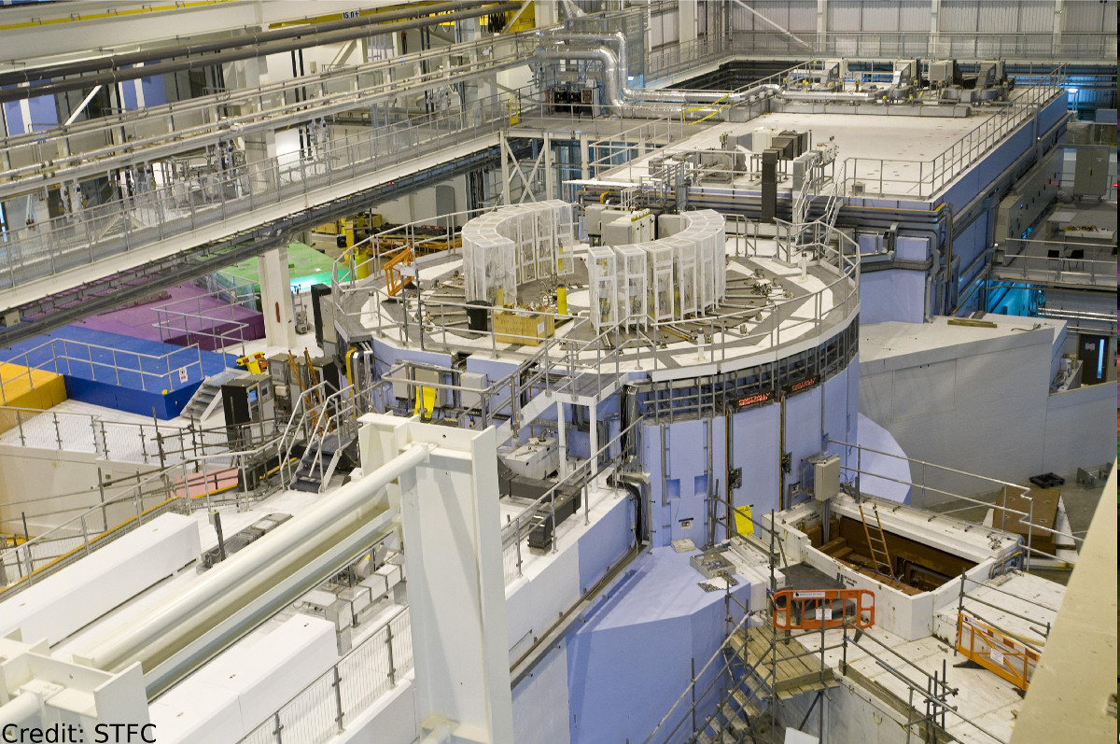
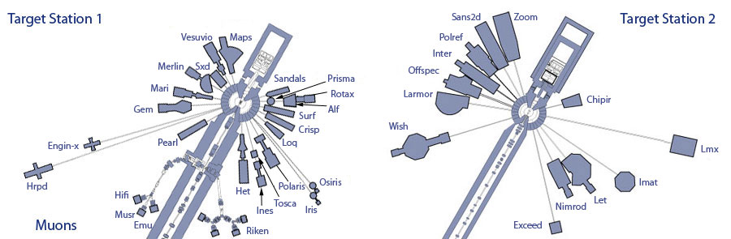
STFC’s ISIS facility

Slide 15
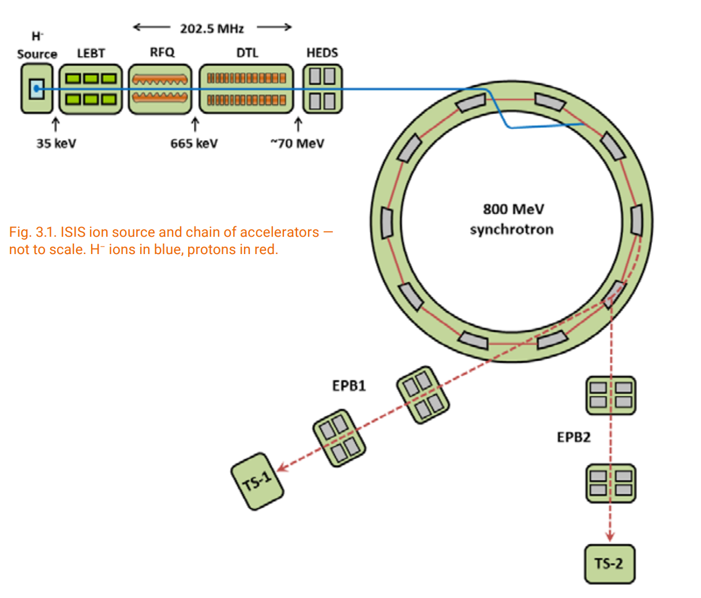


STFC’s ISIS facility
Neutron and $μ$ beam facility at Rutherford Appleton Laboratory (near Oxford) - Synchrotron produces 800 MeV protons, 180 $μ$A - Pulsed structure, 50 Hz repetition, shared between two targets - TS1 is where we’re at – effectively provided 40 Hz protons - Protons fired onto neutron spallation source used for material sciences
$μ$ production and beamline - proton beam passes through intermediary graphite target, pion shower created - Momentum selected: $p=28 MeV/c$ - Around 10 $μ$ per pulse - High instantaneous rates! Up to ~10 kHz! - “Small” decay setup - Primarily used for material science (~few mm penetration) - Also, a lot of heritage science! - Challenges they face “solved” by NP community (autofill, high-channel digitisers, data processing, etc.)

Slide 16




Muon capture on 93Nb
93Nb (Z=41, N=52) - Near the Z=40 subshell and N=50 shell closure - Large-Scale Shell model calculations possible - Monoisotopic target foils - No $β$-decaying products
“Typical” decay setup for nuclear physics - 4-12 Large volume germaniums ($μ$ x rays and $γ$ rays) - Fast CeBr scinitillators - A menagerie of neutron detectors, PSD vital…
Scoping experiment to get idea of - Rates - Facility operation/capabilities - Detector performance, particularly neutron detectors
Backenstoss+, Nuc. Phys. A, 162(3):541–551 (1971).

Slide 17






The $μ$TANTS project $μ$ Total Absorption Nuclear Transition Spectrometer
Total Absorption Spectrometer (TAS) - Circumvents problems of the “Pandemonium” effect - Measures total $γ$ energy released - Tells you $β$ ($μ$ capture) feeding strengths - Complementary to high-resolution decay spec.
Requirements for setup: - Segmentation - Pulse Shape Discrimination - Fast! - Efficient and large volume - Augmentable with other detector types
Transportable? - Nuclear astrophysics - Nuclear data

Slide 18


Conclusions and summary
Muon beams offer exciting opportunities for nuclear physics studies - Large $Q$ value opens up several opportunities - Previous studies quite rudimentary setups
A lot of ideas presented… - Many related to fundamental nature of weak interaction - Not “free”, complications from $p∼100$ MeV transfer - Too many for us to do alone, many more not in slides - Noteworthy: small but active theory community - High-energy colleagues are interested
Domestic nuclear physics programme - ISIS provides muon beams that complement other facilities - Very welcoming of new physics ideas (but not actinides…) - Happy to explore isotope production! - 800 MeV, 200 uA proton beam very interesting…. - Future ISIS-II upgrade going to GeV, mA regime!
Thank you for listening

