Slide 1
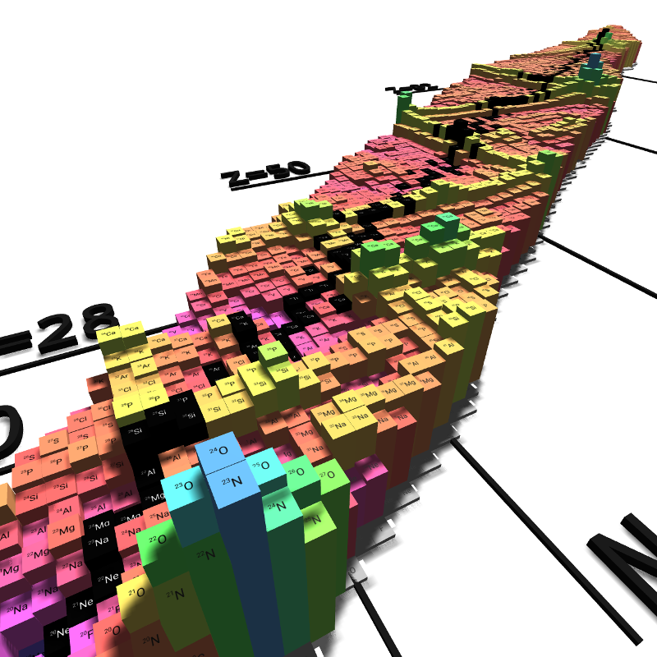
UK Nuclear Physics Early Career Research Forum 2026
16 April 2026
Recent Progress in Nuclear Structure Theory with Nuclear Energy Density Functionals
Esra Yüksel
School of Mathematics and Physics, University of Surrey, Guildford, UK
In collaboration with: N. Paar A. Ravlić, T. Nikšić, A. Kaur
Miriam Davies, Paul Stevenson (Surrey)

Slide 2
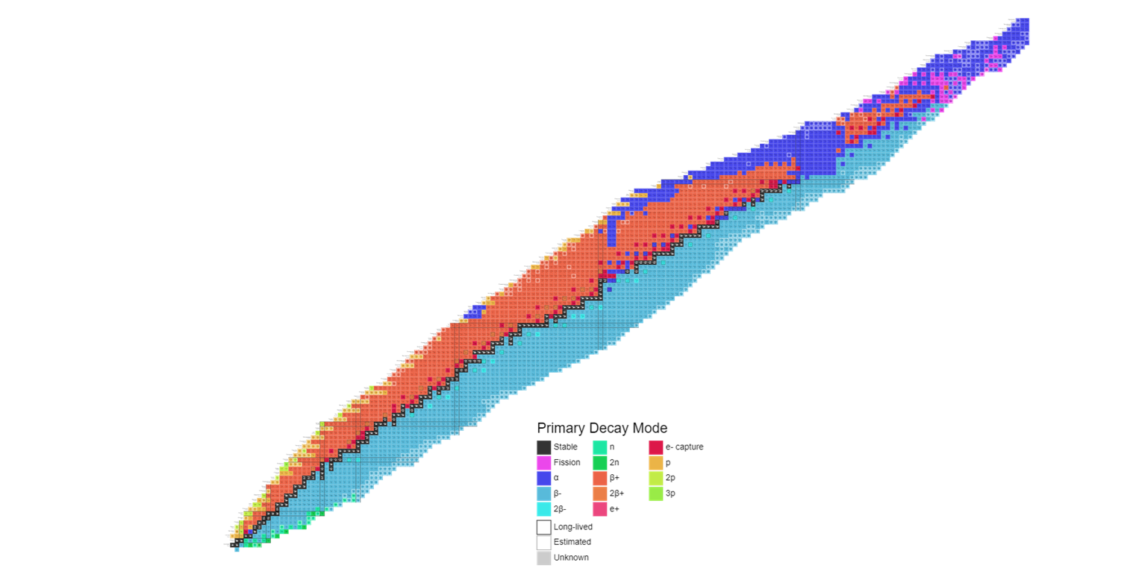
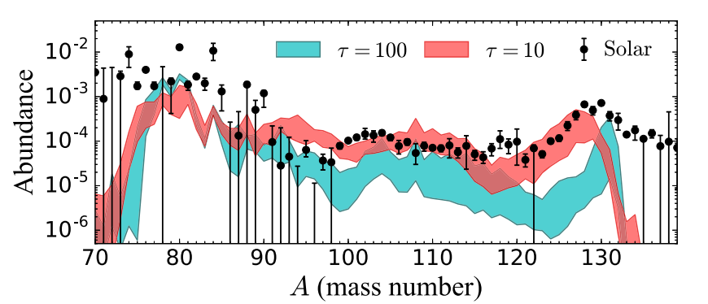
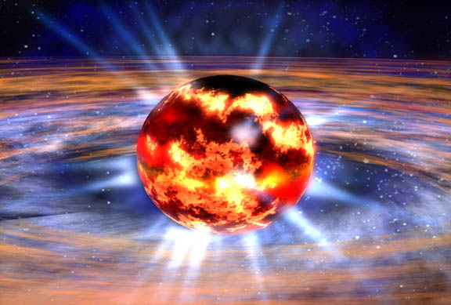
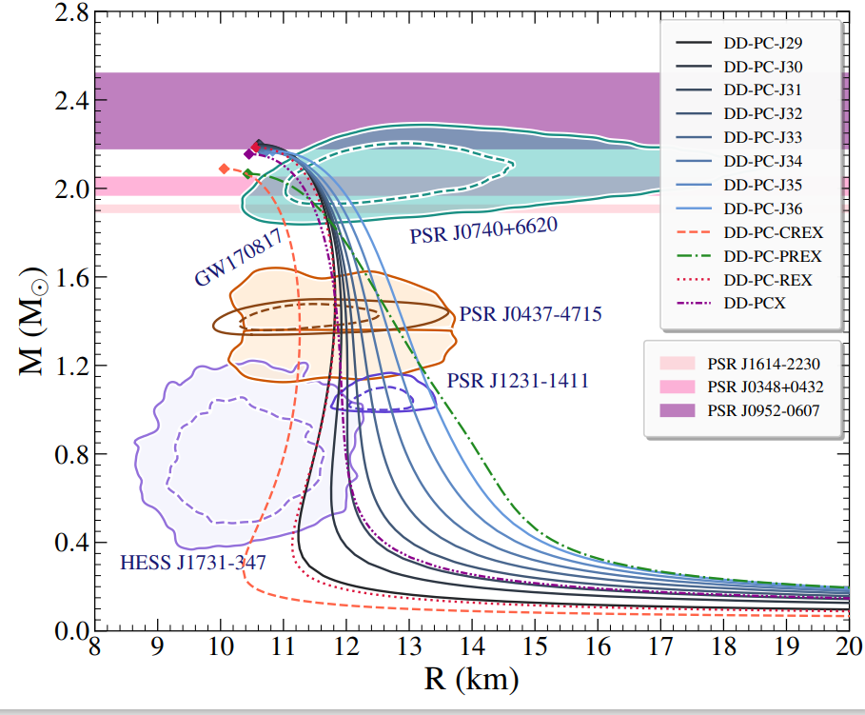
Nuclear Landscape
Nuclear energy density functionals (EDF): The many-body problem is mapped onto a one body problem without explicitly involving inter-nucleon interactions!
Studying the changes in nuclear properties under extreme conditions is not only important for nuclear physics, but also for some astrophysical events.
What can we learn using nuclear EDFs?
Static and dynamic properties of atomic nuclei across the nuclide map
Nuclear processes and reactions
Equation of state (EOS)
A neutron star. Image: NASA
The Astrophysical Journal, 855:99 (9pp), 2018
PS Koliogiannis, E Yuksel, N Paar,arXiv preprint arXiv:2412.15936
Proton number
In stellar environments nuclei appear at finite temperatures, becoming extremely hot in core-collapse supernovae and neutron-star mergers.
How do nuclear properties change with increasing neutron number and temperature?
How the nuclear drip lines evolve?
Neutron number
Credit for the figure: Colourful Nuclide Chart (anu.edu.au)

Slide 3
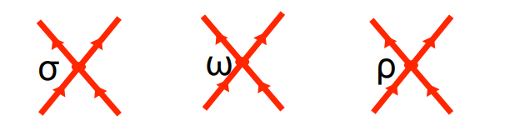
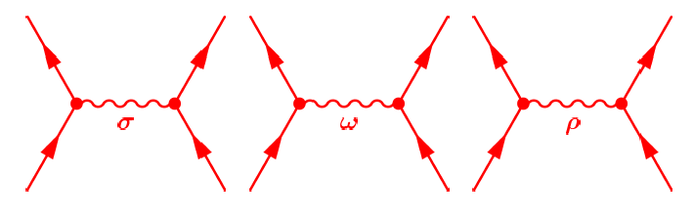
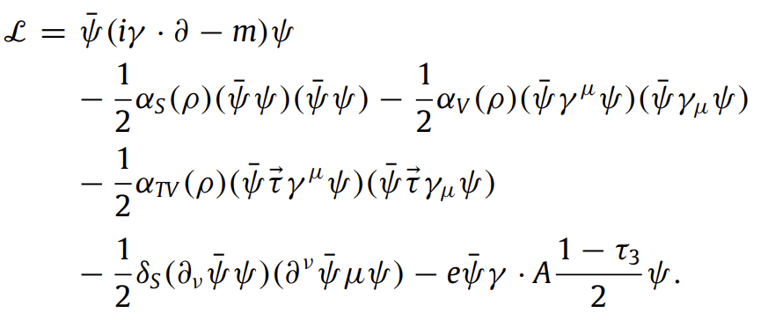
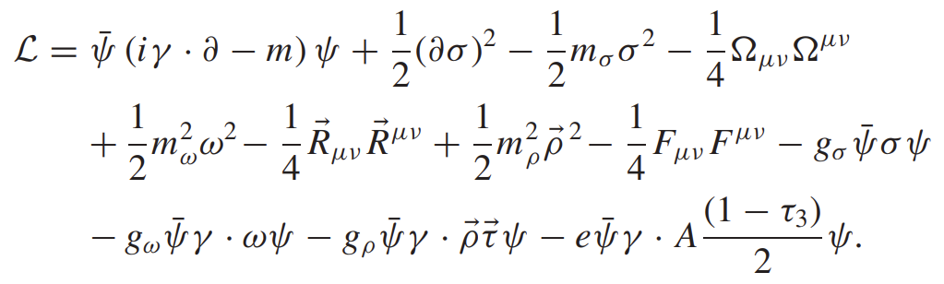
Relativistic nuclear energy density functionals (REDF)
Nuclear Energy Density Functionals are successful in the description of static and dynamic properties of nuclei.
Interaction between nucleons is represented by a functional which depends on the densities and currents.
Meson-exchange models: the isoscalar–scalar σ meson, the isoscalar–vector ω meson, and the isovector–vector ρ meson build the minimal set of meson fields for the description of nuclei description of bulk and single-particle nuclear properties
Point coupling models: Effective Lagrangian with four-fermion (contact) interaction terms; isoscalar-scalar (S), isoscalar-vector (V), isovector-vector (TV), derivative term
*T. Nikšic, N. Paar, D. Vretenar, and P. Ring, Comput. Phys. Commun. 185, 1808 (2014).
3

Slide 4
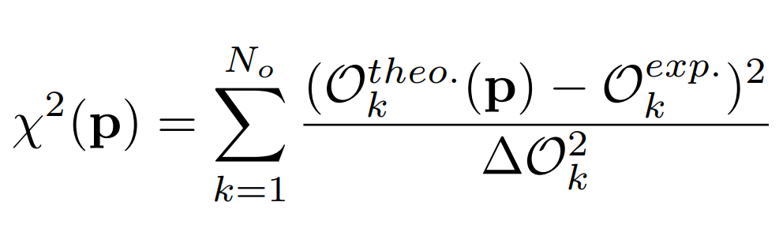

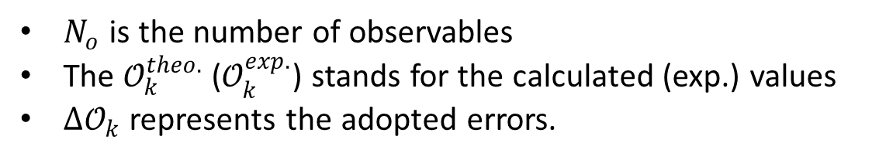
HOW DO WE CONSTRAIN THE NUCLEAR EDFs?
How do we constrain the nuclear edfs?
The new interactions are optimized by minimizing the $χ^{2}$ function.
Exp. data on the ground-state properties of nuclei: mass, radii, s.o splitting, deformation properties, etc.
$N_{o}$ is the number of observables
The $𝒪_{k}^{theo.}$ ($𝒪_{k}^{exp.}$) stands for the calculated (exp.) values
${∆𝒪}_{k}$ represents the adopted errors.
These observables are not sufficient to constrain the isovector channel of the effective interaction, which is particularly significant for neutron-rich nuclei, neutron skins, symmetry energy, and neutron stars.
Symmetry energy is not well constrained!
We need relevant observables to constrain the isovector channel of the effective interactions!

Slide 5

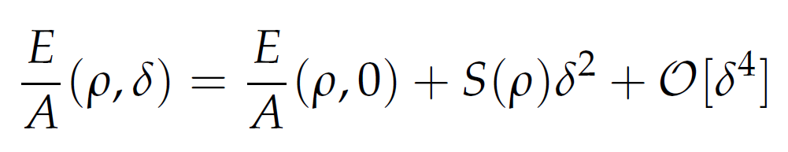
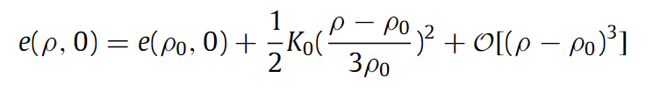
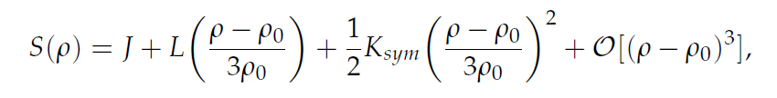


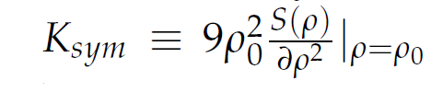
Nuclear equation of state and symmetry energy
The binding energy per particle around the saturation density can be expanded as power series around $δ→0$
EoS of symmetric nuclear matter
Symmetry energy
Figure 1: Equation of state of symmetric nuclear matter and pure neutron matter.

Slide 6
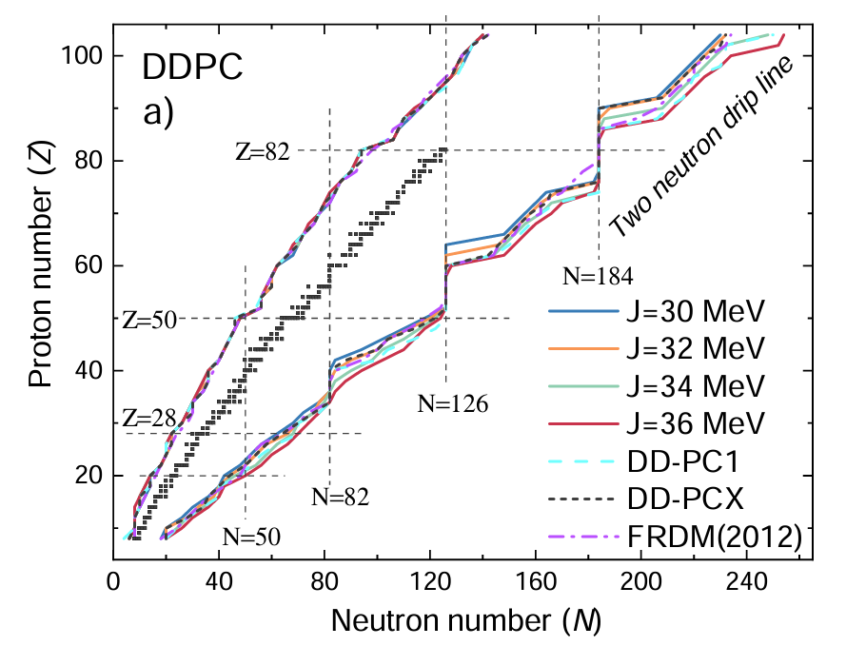
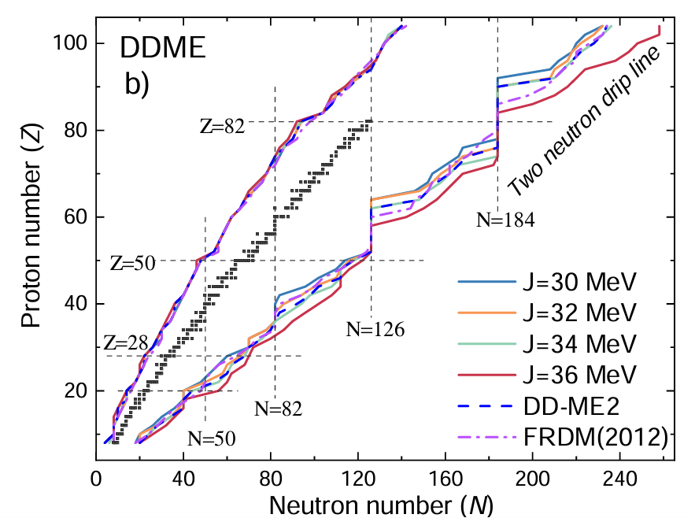
Two-proton and two-neutron drip lines for nuclei

Slide 7
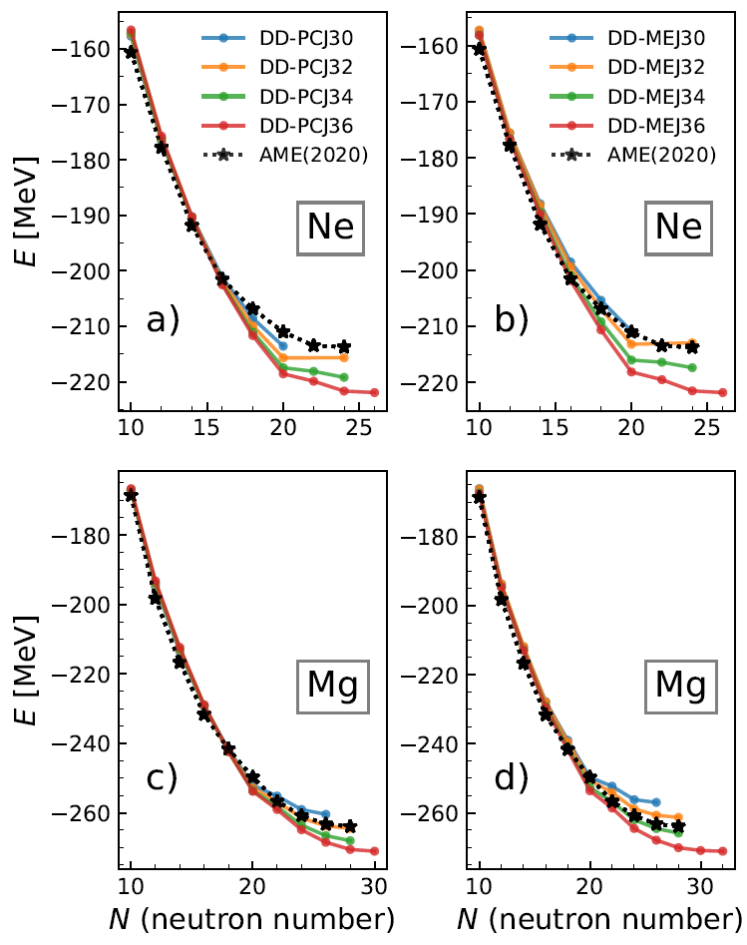
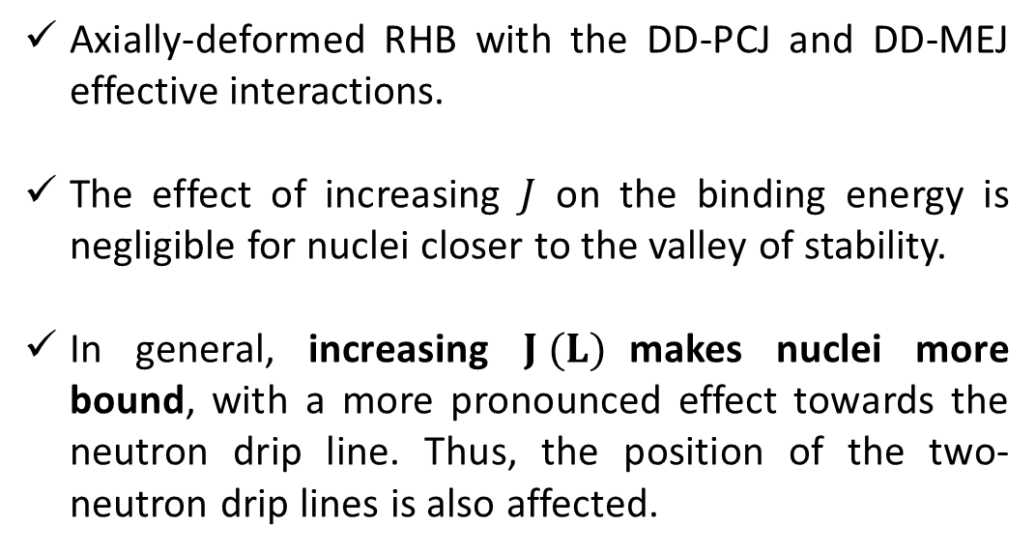
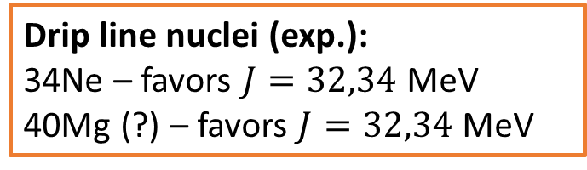
Influence of the symmetry energy on the binding energies
Axially-deformed RHB with the DD-PCJ and DD-MEJ effective interactions.
The effect of increasing $J$ on the binding energy is negligible for nuclei closer to the valley of stability.
In general, increasing $J (L)$makes nuclei more bound, with a more pronounced effect towards the neutron drip line. Thus, the position of the two-neutron drip lines is also affected.
Drip line nuclei (exp.):
34Ne – favors $J=32,34$MeV
40Mg (?) – favors $J=32,34$MeV
A. Ravlić, E. Yuksel, T. Nikšić, N. Paar, Phys. Rev. C 108, 054305 (2023).
7

Slide 8
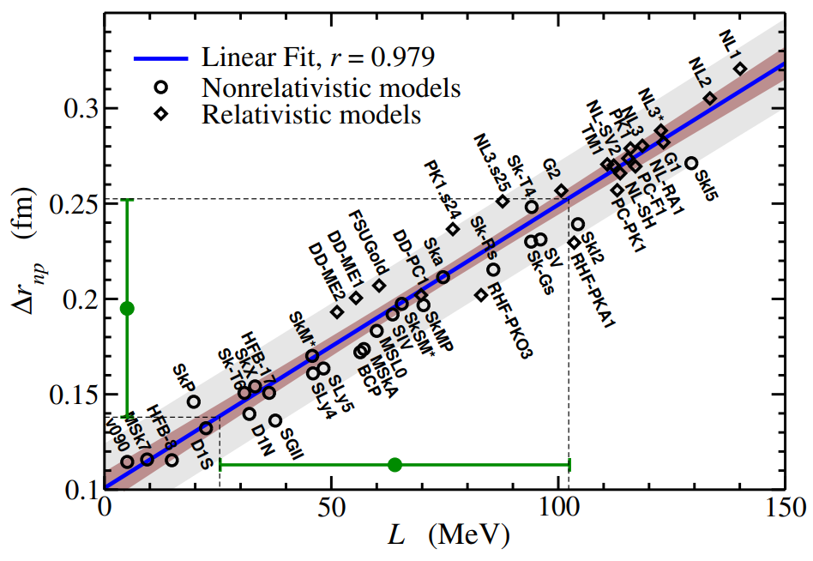
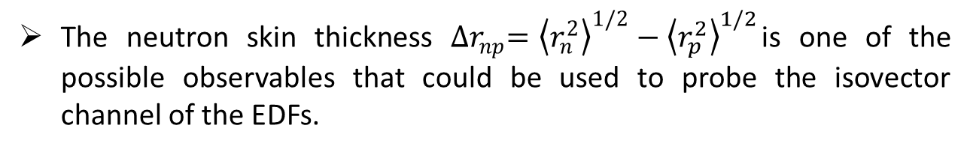

How do we better constrain the nuclear edfs?
The neutron skin thickness ${∆r}_{np}={\left\langle r_{n}^{2}\right\rangle }^{1/2}−{\left\langle r_{p}^{2}\right\rangle }^{1/2}$is one of the possible observables that could be used to probe the isovector channel of the EDFs.
The neutron skin thickness ${∆r}_{np}$ → Experimental data has large uncertainties and model dependent!
Nuclear collective excitations can provide important constraints for the EDFs
X. Roca-Maza, et al, Phys. Rev. Lett. 106, 252501, 2011.
Isoscalar Excitations
Isoscalar giant monopole resonance
Isoscalar giant dipole resonance
Isoscalar giant quadrupole resonance
Isovector Excitations
Isovector GDR, Dipole polarizability
Pygmy dipole strength
Isovector GQR
Charge-exchange modes
Isobaric analog resonance
Gamow-Teller resonance
Spin-dipole resonance
Excitations in nuclei and EOS are related to each other!

Slide 9
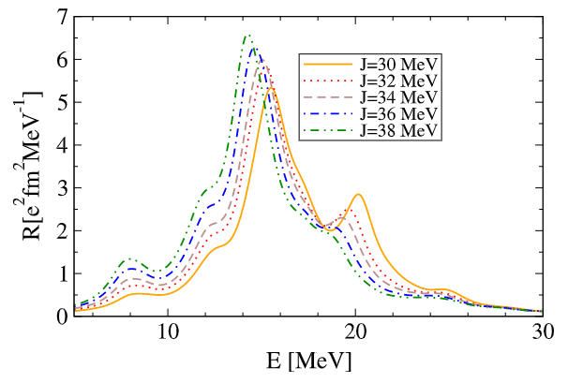
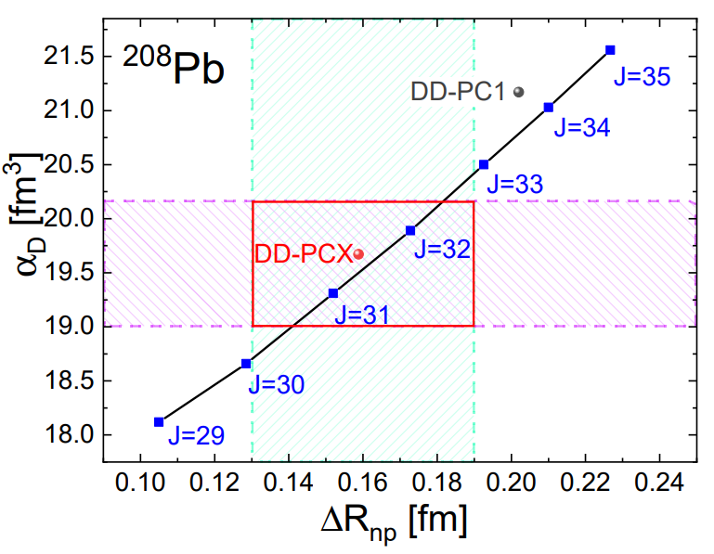
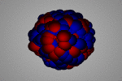
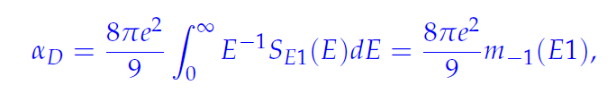
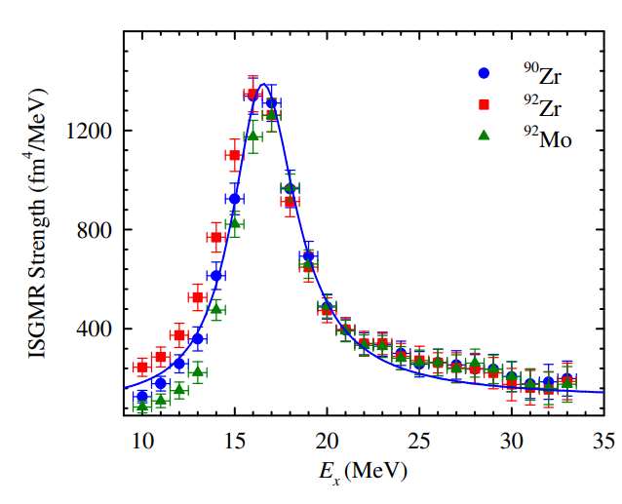
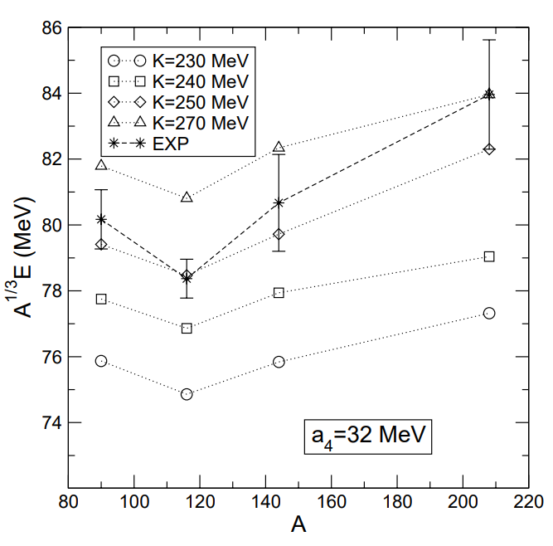
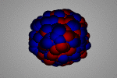
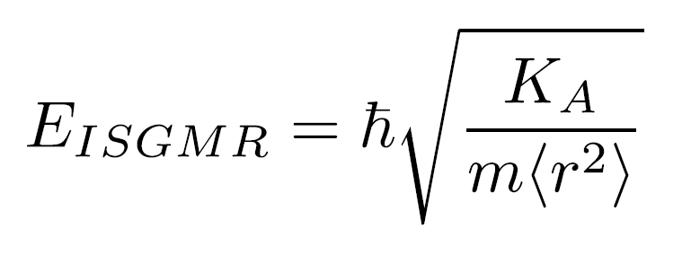
Excitations in nuclei and eos
Giant dipole resonance and Dipole polarizability are sensitive to the properties of symmetry energy and can be used in the optimization of the EDFs.
D. Vretenar, et.al, Phys. Rev. C, 68, 024310, 2003.
Yüksel, et.al., Universe 7, 71, 2021.
The isoscalar monopole resonance properties are essential to constrain the incompressibility of nuclear matter.
Y. K. Gupta et. al., Phys. Lett., B760:482–485, 2016.
Kernphysik Homepage( H.J.Wollersheim ) (gsi.de)
19/10/2023
9

Slide 10
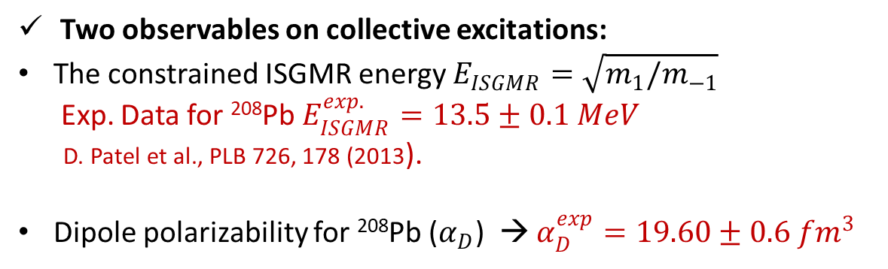
OPTIMIZATION OF THE DD-PCX
A unified computational framework of the RHB model and self-consistent relativistic (Q)RPA is established to constrain the 12 model parameters by minimizing the $χ^{2}$objective function.
Ground-state properties of selected nuclei
Binding energies (34 nuclei)
Charge radii (26 nuclei)
Mean pairing gaps (15 nuclei) of the selected open-shell nuclei
DD-PCX
The first EDF constrained by nuclear ground state properties, dipole polarizability and ISGMR excitation energy
+
Two observables on collective excitations:
The constrained ISGMR energy $E_{ISGMR}=\sqrt{m_{1}/m_{−1}}$
Exp. Data for ²⁰⁸Pb $E_{ISGMR}^{exp.}=13.5±0.1 MeV$
D. Patel et al., PLB 726, 178 (2013).
Dipole polarizability for ²⁰⁸Pb ($α_{D}$) → $α_{D}^{exp}=19.60±0.6 {fm}^{3}$
Correct Symmetry energy
and
Nuclear matter incompressibility
E. Yüksel, T. Marketin, and N. Paar, Phys. Rev. C 99, 034318 (2019).
A. Tamii et al. PRL 107, 062502 (2011)
A. Tamii (private communication (2015)

Slide 11
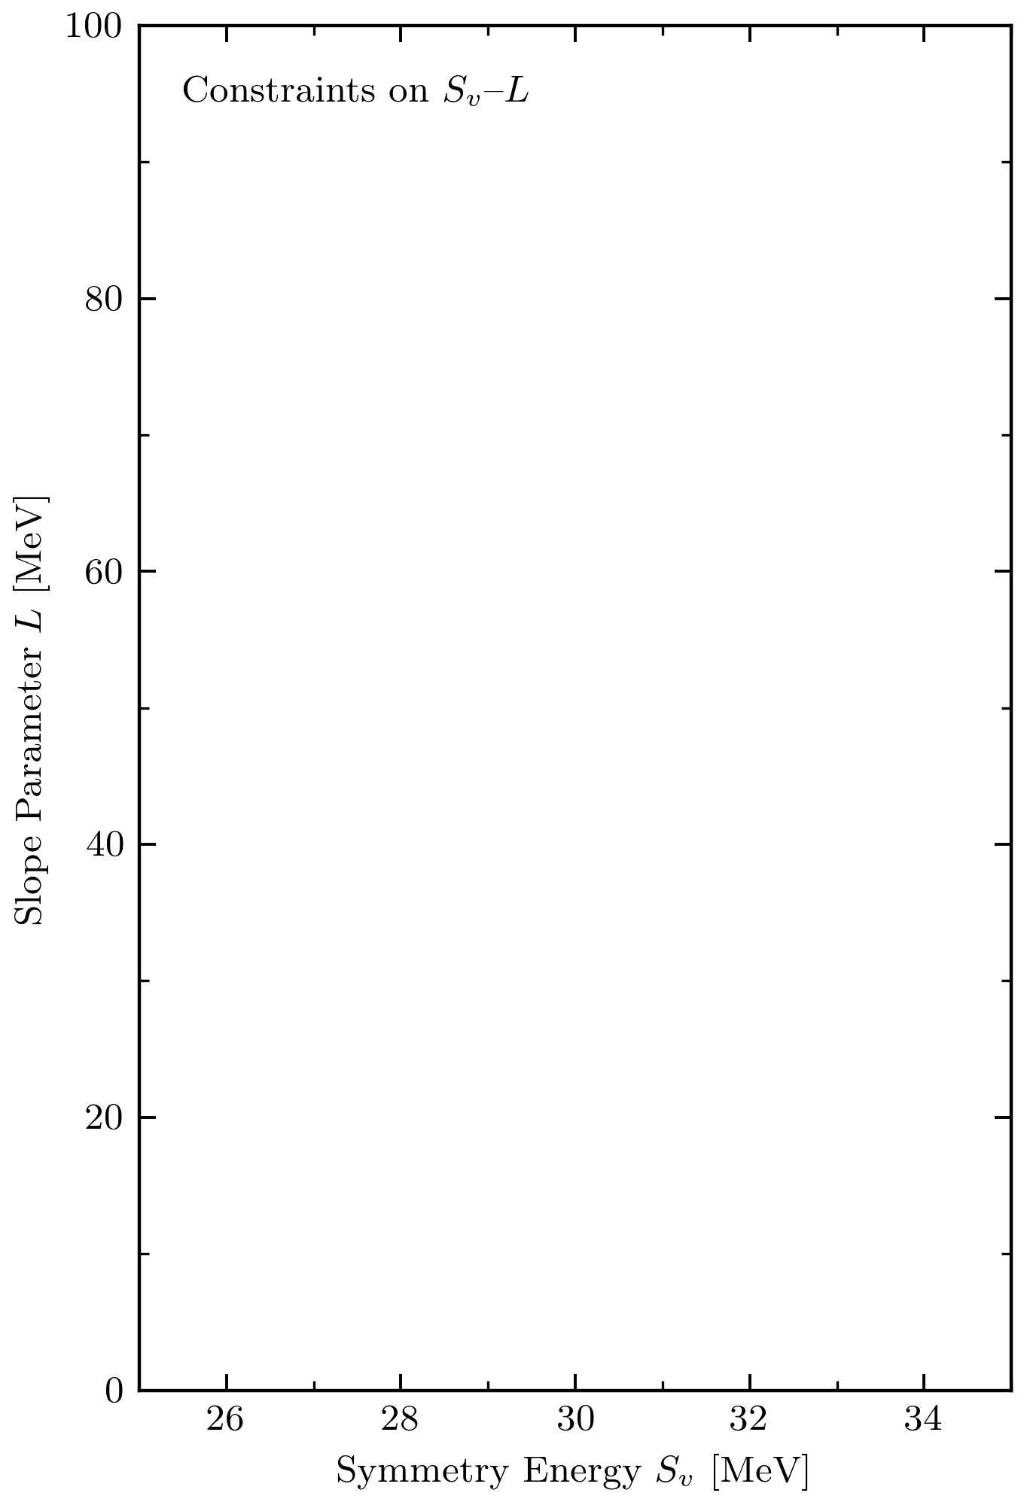
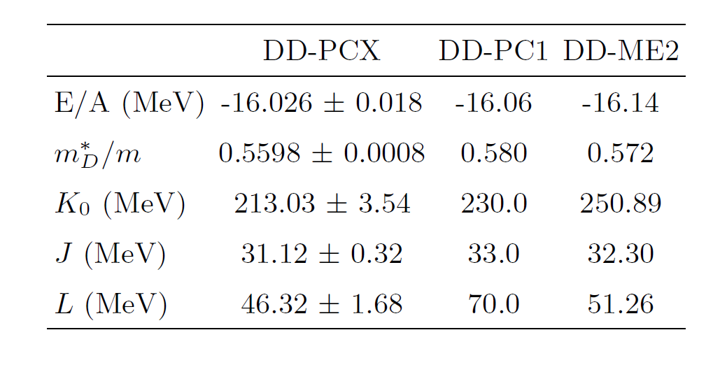
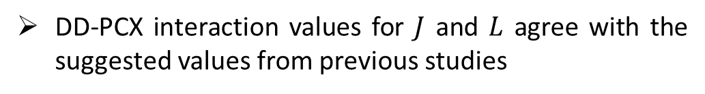
DD-PCX : Nuclear Matter Properties
The properties of nuclear matter around the saturation point for the DD-PCX, DD-PC1 and DD-ME2 interactions.
DD-PCX
DD-PCX interaction values for $J$ and $L$ agree with the suggested values from previous studies
E. Yüksel, T. Marketin, and N. Paar, Phys. Rev. C 99, 034318 (2019).
C. Drischler, R. J. Furnstahl, J. A. Melendez, and D. R. Phillips PRL, 125, 202702, 2020.
https://github.com/buqeye/nuclear-matter-convergence/tree/master/analysis/Esym-L

Slide 12
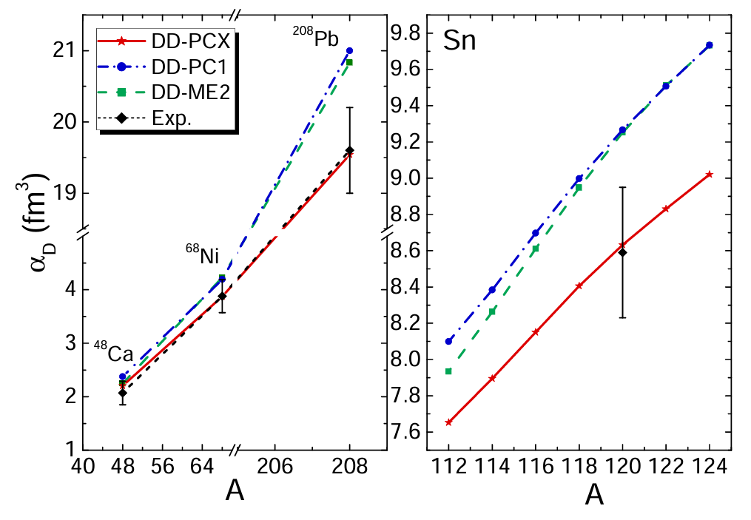
DD-PCX : DIPOLE POLARIZABILITY
Only the DD-PCX interaction better reproduces the experimental results for all nuclei under consideration, while the DD-ME2 and DD-PC1 interactions mainly overestimate the measured values.
Experimental Data
48Ca - J. Birkhan et al., PRL 118, 252501 (2017).
68Ni -D. M. Rossi et al., PRL 111, 242503 (2013).
112-124Sn –S. Bassaueret al., PLB 810, 135804 (2020).
208Pb –A. Tamiiet al., PRL 107, 062502 (2011); A. Tamii (priv. comm.) (2015).
E. Yüksel, T. Marketin, and N. Paar, Phys. Rev. C 99, 034318 (2019).

Slide 13
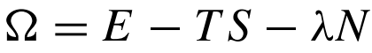
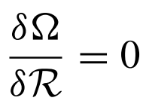
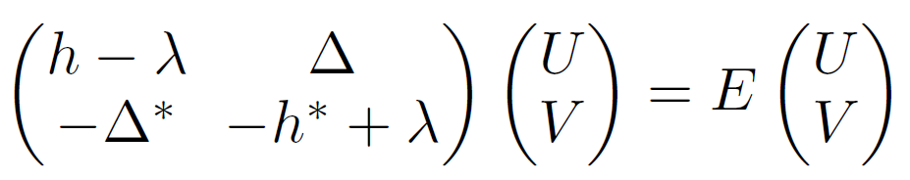
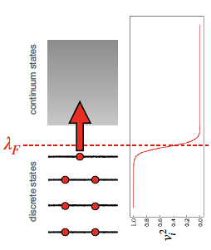
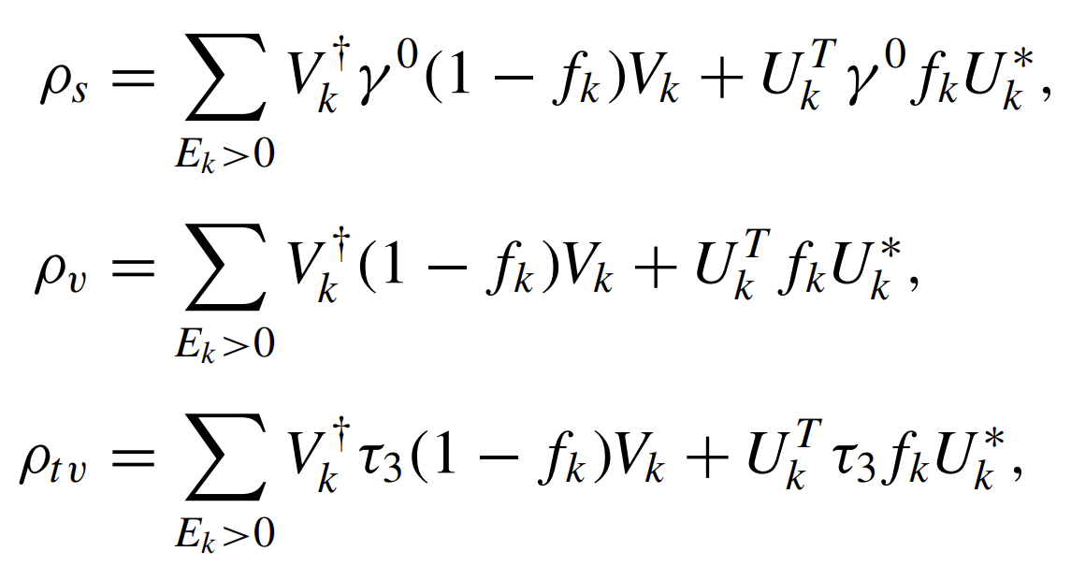

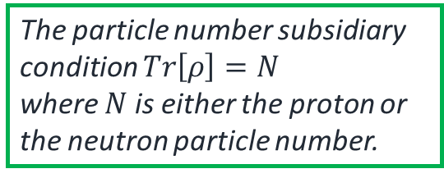
Finite temperature RHB
Nuclei at finite temperature can be treated as open systems that exchange both heat and particles described within the grand-canonical ensemble. Such a system is characterized by its grand-potential:
Variation of the grand-canonical potential with respect to the density:
This leads to the finite-temperature relativistic Hartree Bogoliubov (FT-RHB) equations
The particle number subsidiary condition $Tr\left[ρ\right]=N$
where $N$ is either the proton or the neutron particle number.
$$f_{k}=\frac{1}{1+\exp^{{E_{k}}/{k_{B}T}}}$$
A. L. Goodman, Nucl. Phys. A 352, 30 (1981); A. L. Goodman, Nucl. Phys. A 352, 45 (1981); A. L. Goodman, Phys. Rev. C 34, 1942 (1986); J. Egido, P. Ring, and H. Mang, Nucl. Phys. A 451, 7

Slide 14
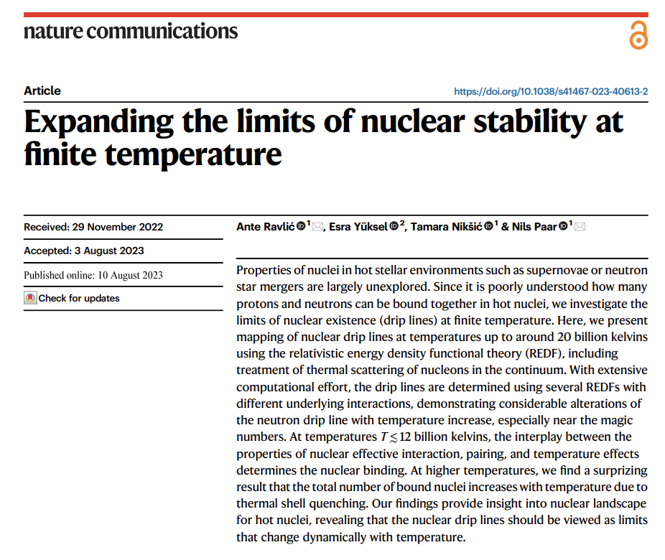
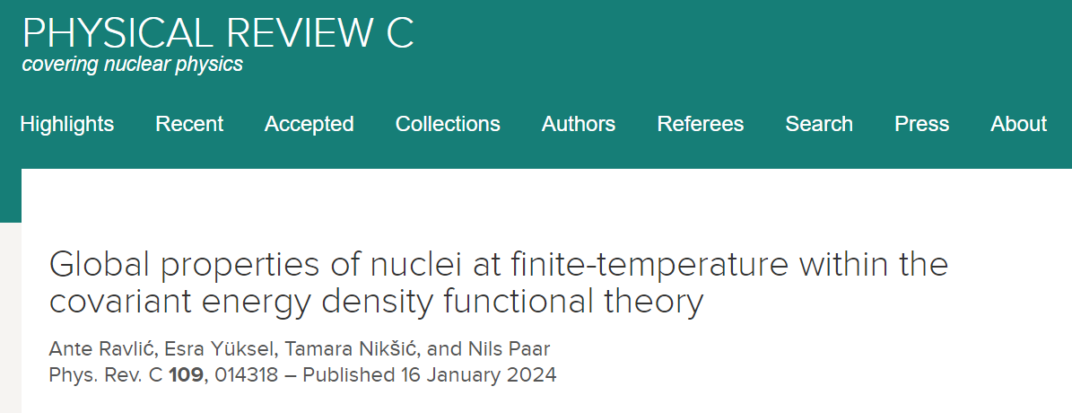




Slide 15
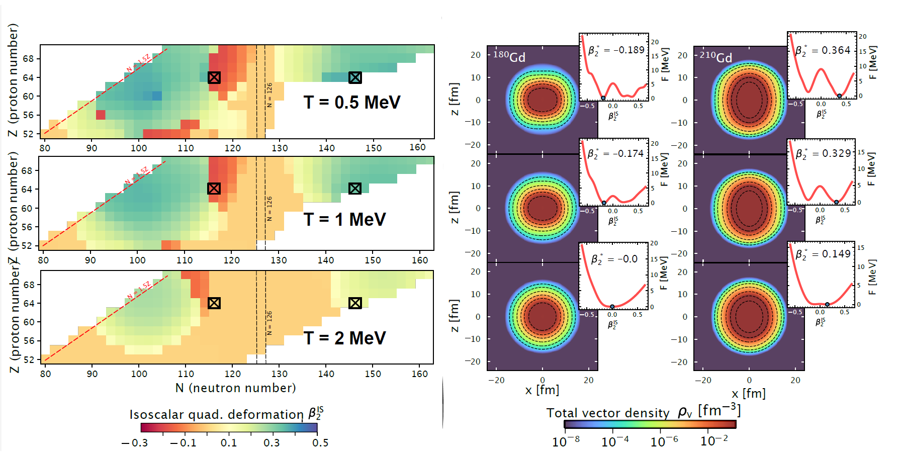
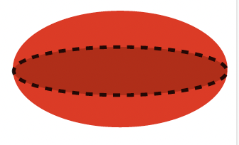

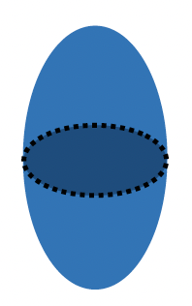








How do the nuclear properties change with increasing temperature?

Slide 16
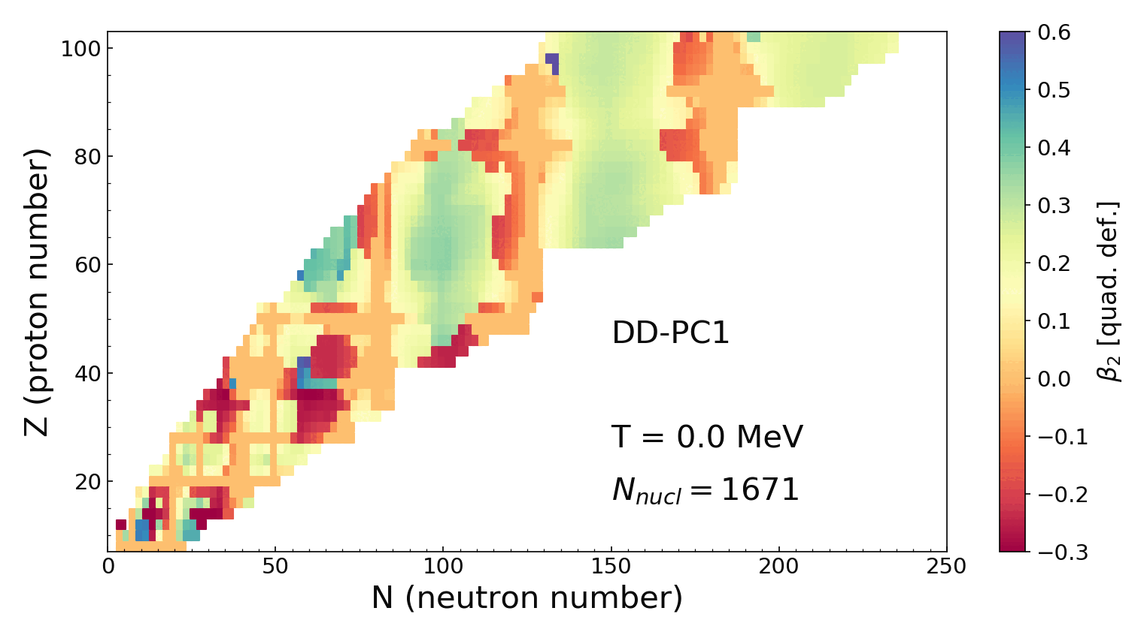

How do the nuclear properties change with increasing temperature?
PROLATE
SPHERICAL
OBLATE
Expanding the limits of nuclear stability at finite temperature
Ante Ravlić, Esra Yüksel, Tamara Nikšić & Nils Paar , Nature Communications volume 14, Article number: 4834 (2023)
16

Slide 17
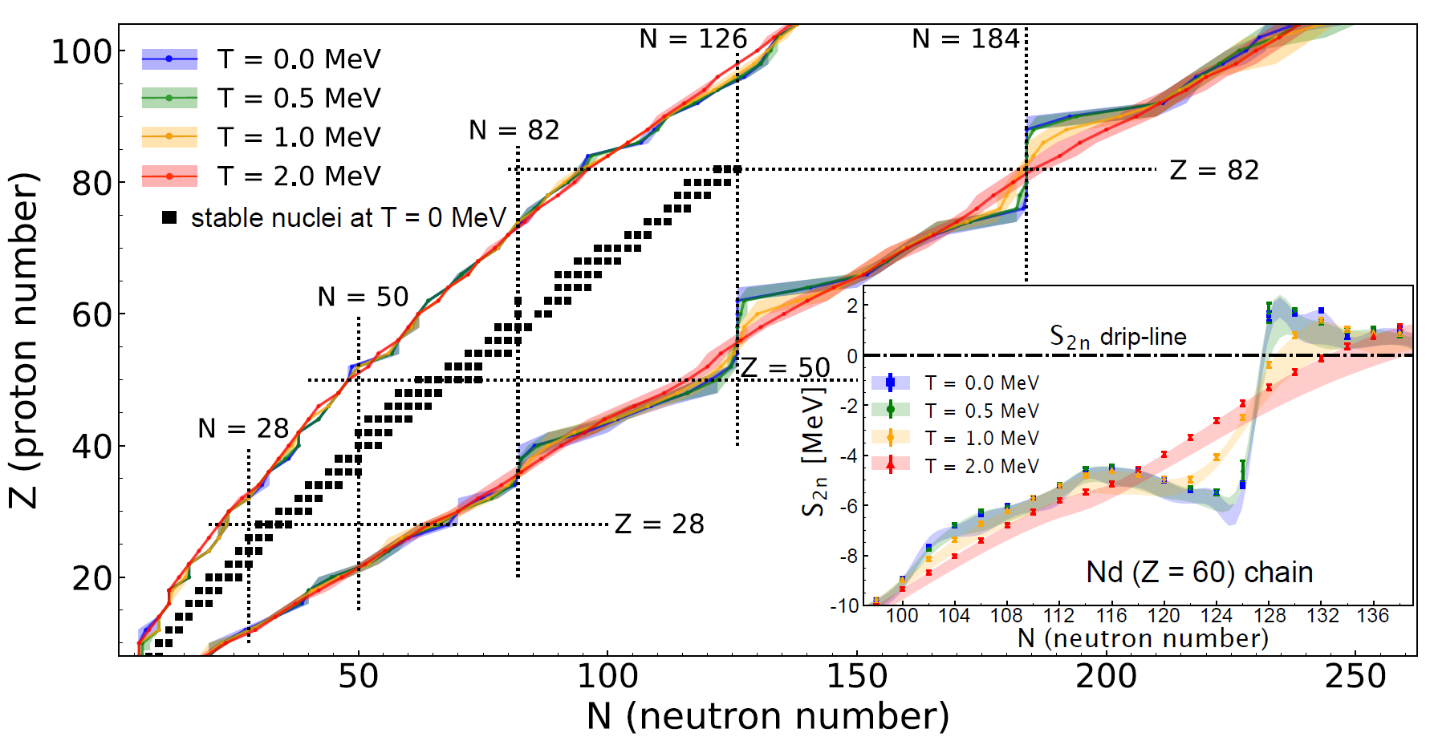
The limits of the nuclear landscape at finite temperature
DD-ME2
DD-PC1
DD-PCX
Expanding the limits of nuclear stability at finite temperature
Ante Ravlić, Esra Yüksel, Tamara Nikšić & Nils Paar , Nature Communications volume 14, Article number: 4834 (2023)
17

Slide 18
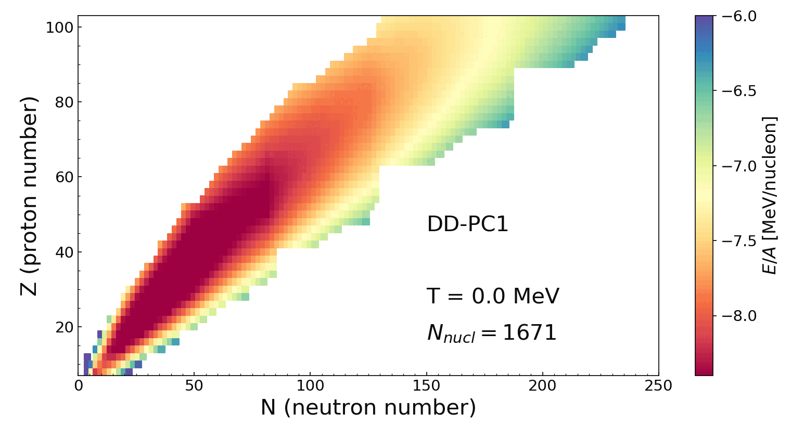
The limits of the nuclear landscape at finite temperature
One step further in our understanding the evolution of nuclei in hot stellar environments
“The nuclear drip lines should be viewed as limits that change dynamically with temperature.”
18

Slide 19
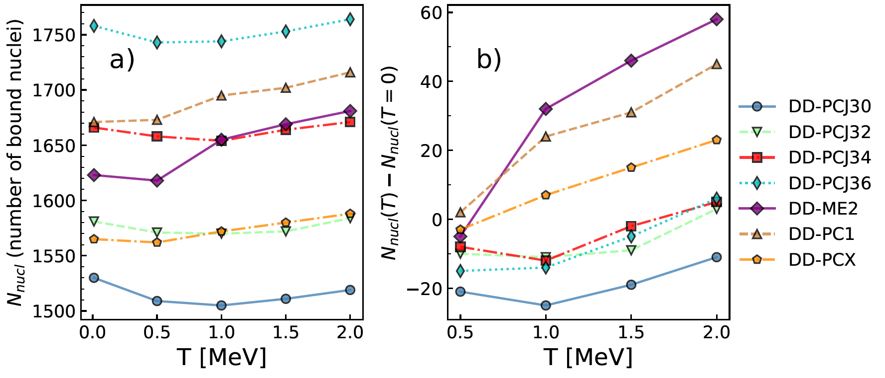
Impact of temperature on the number of bound nuclei
At higher temperatures, the total number of bound nuclei increases with temperature due to thermal shell quenching
Expanding the limits of nuclear stability at finite temperature
Ante Ravlić, Esra Yüksel, Tamara Nikšić & Nils Paar , Nature Communications volume 14, Article number: 4834 (2023)
19

Slide 20



Electric and magnetic γ-ray strength functions
A. Kaur, E Yüksel, N Paar, Electric and magnetic -ray strength functions at finite-temperature, Physical Review C 112 (1), 014307)

Slide 21


Temperature evolution of FT-RQRPA calculated E1+M1 γSFs (f1) from T = 0 to 1.5 MeV.
The high-energy GDR region shows excellent agreement with the (p, p′ ) data.
The Oslo data is also consistent with the low-energy region, particularly the $Eγ ≈ 4–10$ MeV range.
The pygmy dipole strength dominates the tail of the gamma strength function, especially above 4 MeV.
However, no enhancement ‘or’ upbend is seen as we approach $Eγ = 0$MeV at zero temperature; instead, the f1 curve gets smaller.
From T = 0.5 to 1.5 MeV, the low energy region is highly sensitive to temperature effects.
A. Kaur, E Yüksel, N Paar, Electric and magnetic -ray strength functions at finite-temperature, Physical Review C 112 (1), 014307)

Slide 22

Electric and magnetic γ-ray strength functions
Oslo data I, II and III represent the lower, recommended and upper limits of experimental measurements normalized within or at the limits of the range of uncertainties.
A. Kaur, E Yüksel, N Paar, Electric and magnetic -ray strength functions at finite-temperature, Physical Review C 112 (1), 014307)

Slide 23

β-decay half-lives in stellar environments
In the majority of the nuclide map, a decrease in the $β$-decay half-lives is obtained with increasing temperature.
Nuclei showing the most change are those with initially long half-lives (magic, semi-magic, and close to the valley of stability).
A. Ravlić, E. Yüksel, Y. F. Niu, N. Paar, PRC 104, 054318 (2021)
23

Slide 24

Clustering or Localization in nuclei
See Miriam Davies’ talk this afternoon.

Slide 25
Conclusions
We implemented the experimental data in the optimization of the RNEDfs
Clearly, the optimization of the isovector channel of the REDFs is of utmost importance to better describe the nuclear properties, especially near the drip lines.
DD-PCX → The first EDF constrained by nuclear ground state properties and collective excitation properties. Findings for the NM properties around the saturation densities agree with the expectations form previous studies.
We developed self-consistent Finite temperature RHB+BLV code to study the properties of nuclei and nuclear drip lines at finite temperatures
It has been found that for the correct description of nuclear properties at finite temperatures, the continuum subtraction procedure is essential, especially for nuclei near the drip lines and at high temperatures
The temperature leads to changes in nuclear structure, excitation properties of nuclei and weak interaction processes.
The main outcome is that the nuclear drip lines should be viewed as limits that change dynamically with temperature.
Thanks for listening!
Any questions?

