Slide 1
A vision for UK Nuclear physics in 2050
Towards an exact model of the atomic nucleus
Jack Henderson
ECR forum 16/04/2026

Slide 2
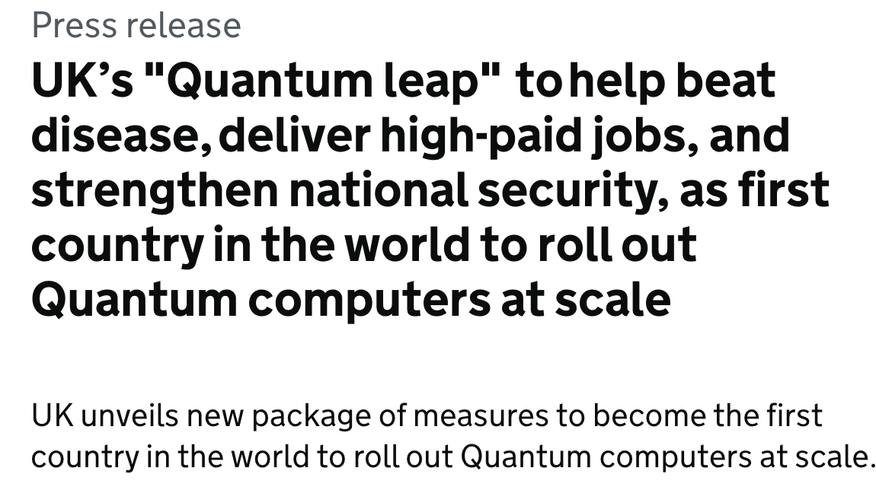

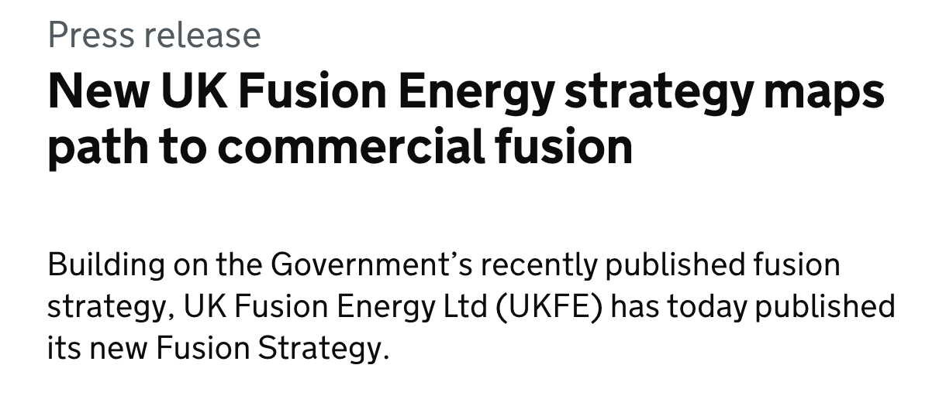
National investment in quantum computing, AI/ML, fusion, …
How do we maximise the impacts of these investments on nuclear physics
How do we maximise the impact of nuclear physics on these investments

Slide 3
Intro & background
Involved in initial discussions:
Jack Henderson (JH), Kara Lynch (KL), Tom Day-Goodacre (TDG), Jack Bishop (JB), Matthew Williams (MW), Philippos Papadakis (PP), Ragan Singh-Sidhu (RSS), Carlo Bruno (CB), James Gerald Cubiss (JC), Matteo Vorabbi (MV), Robin Smith (RS), Rachel Montgomery (RM), Pascal Reiter (MPR), Liam Gaffney (LPG), Toby Wright (TW), Esra Yuksel (EY)
At the meeting at the IoP:
Andy Briscoe, Frank Browne, Chris Cousins, Siddharth Doshi, Jacob Heery, Calum Jones, Joseph O'Neill, Connor O'Shea, Jagjit Singh

Slide 4
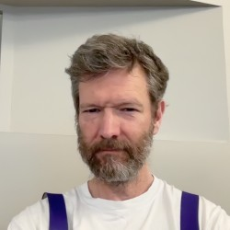

Quantum computing
Paul Stevenson (Surrey)
Contacts: JH, MV

Slide 5
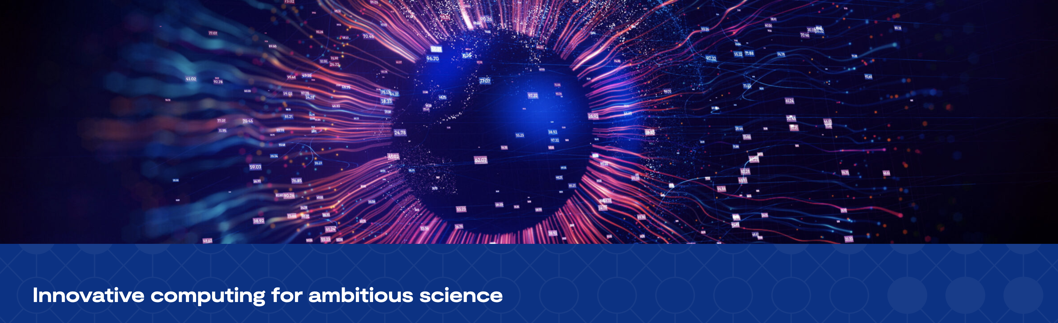

Data MEthods
How can we use modern methods in data science to improve nuclear science? For example: can we use ML to develop first-principles nuclear Hamiltonians?
How can we improve nuclear data for applications by coupling cutting-edge nuclear physics and data science

Slide 6
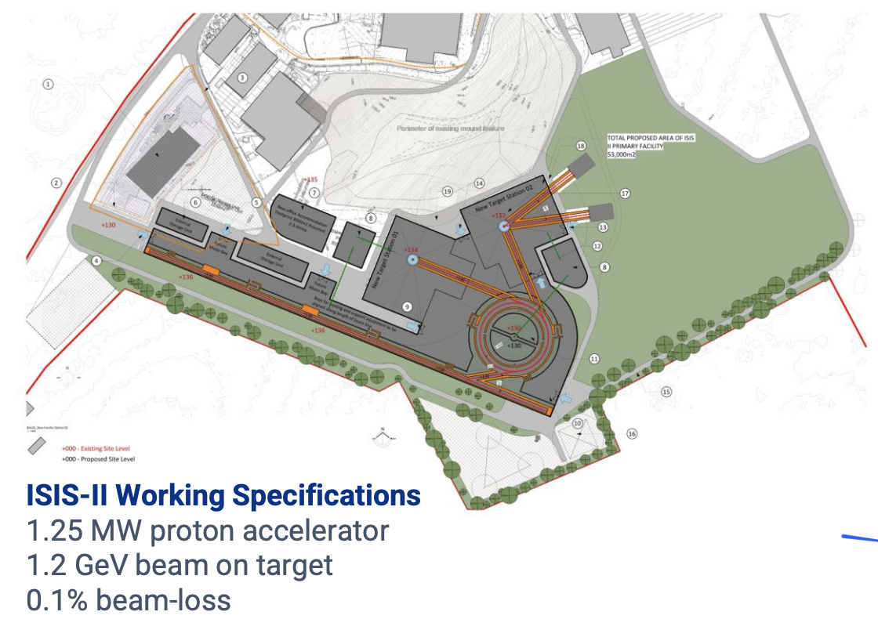
ISOL @ RAL?
Conventional fragmentation/ISOL likely reaching the limits of their reach – novel approaches are required (discovery or precision): Now is the time to think about next-generation technologies.
ISIS-II upgrade:
Is there a route for an ISOL-like (IGISOL?) facility? Neutron-induced spallation?
Would also provide access to studies of novel radioisotopes
Contacts: TDG, JC, JH

Slide 7

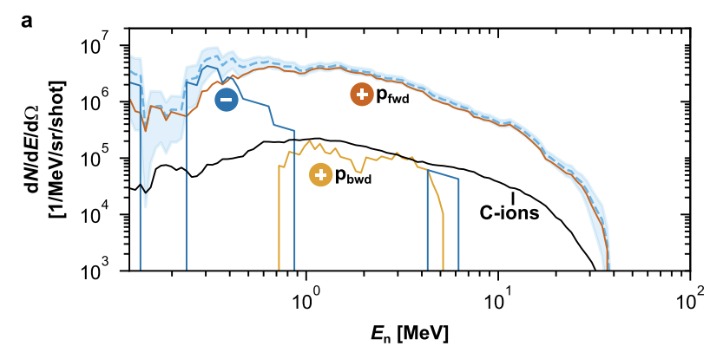
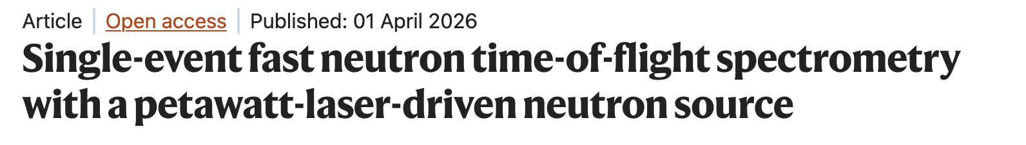
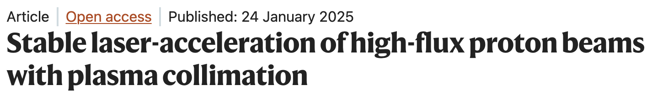
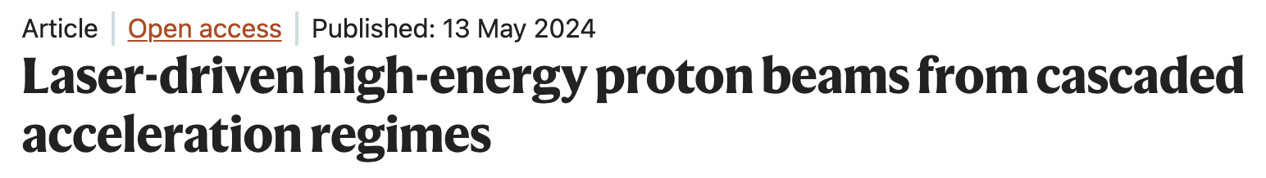
Laser driven beams?
Contacts: JC, JH, MW
Conventional fragmentation/ISOL likely reaching the limits of their reach – novel approaches are required (discovery or precision): Now is the time to think about next-generation technologies.
Area of UK leadership – laser accelerated ion/electron[photon] beams

Slide 8
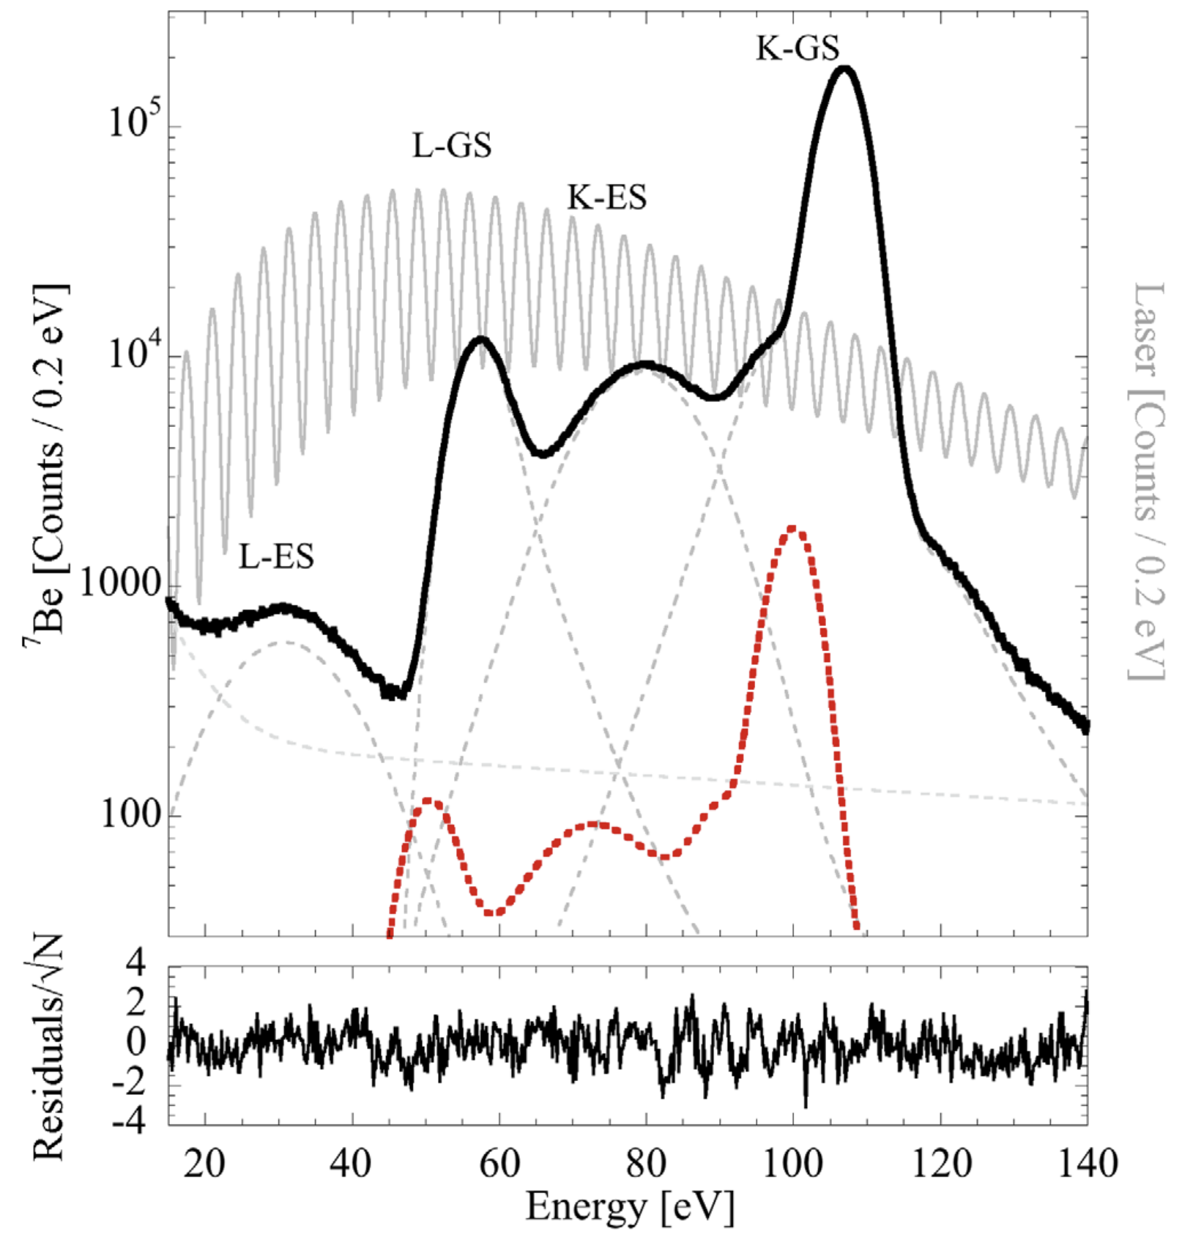
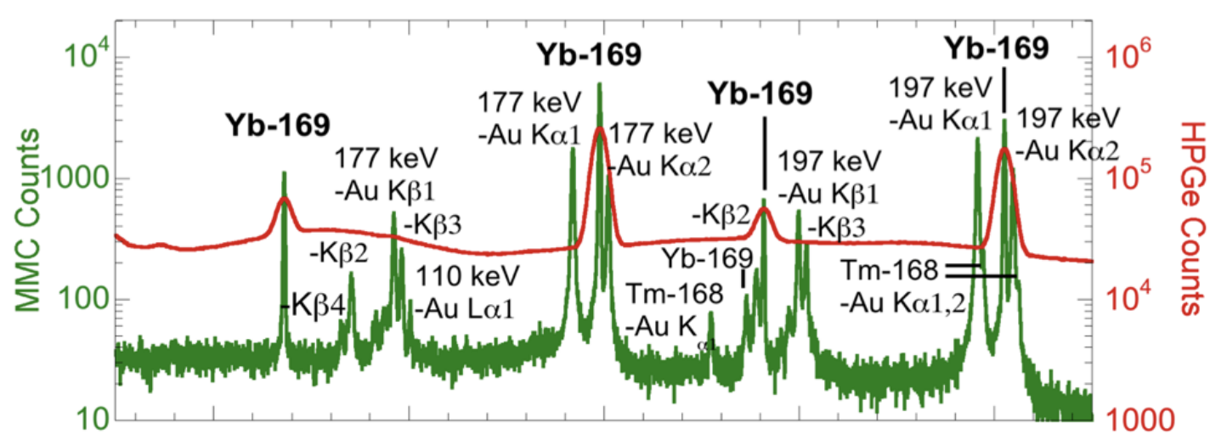
Quantum sensors?
Contact: JH
Conventional fragmentation/ISOL likely reaching the limits of their reach – novel approaches are required (discovery or precision): Now is the time to think about next-generation technologies.
Friedrich PRL 126 021803 (2021)
Quantum sensors (STJs & MMCs) provide exceptional resolution and sensitivity.
At present: very limited UK capacity (NPL).
90
100
110
120
130
Friedrich LLNL-CONF-819945 (2021)
Energy (keV)

Slide 9
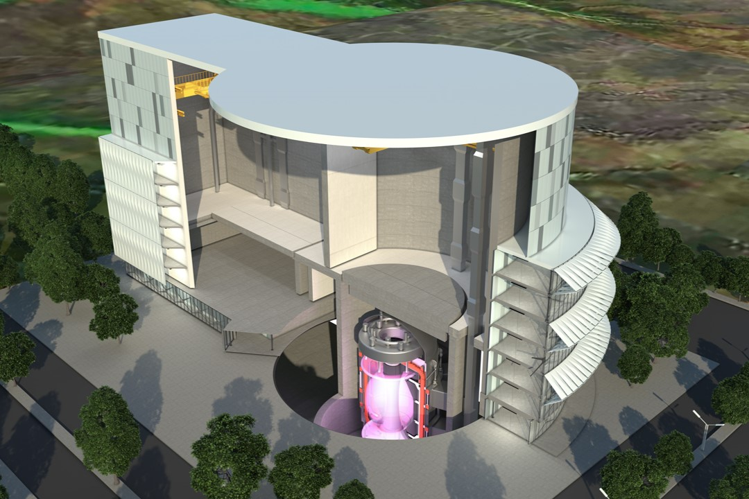
[FUSion] reactors as a driver?
Novel method for medical radioisotope production
Evitts et al. App. Rad. Iso. 226 112163 (2025)
Can you put an (IG)ISOL target in a Tokomak?
What isotopes would it produce?
Can we do the (weak) r-process in the lab?
14 MeV neutrons from a fusion reactor:
10¹⁸ / cm² / s
At the blanket (energy generation point)
Contact: JH, JB, RS

Slide 10
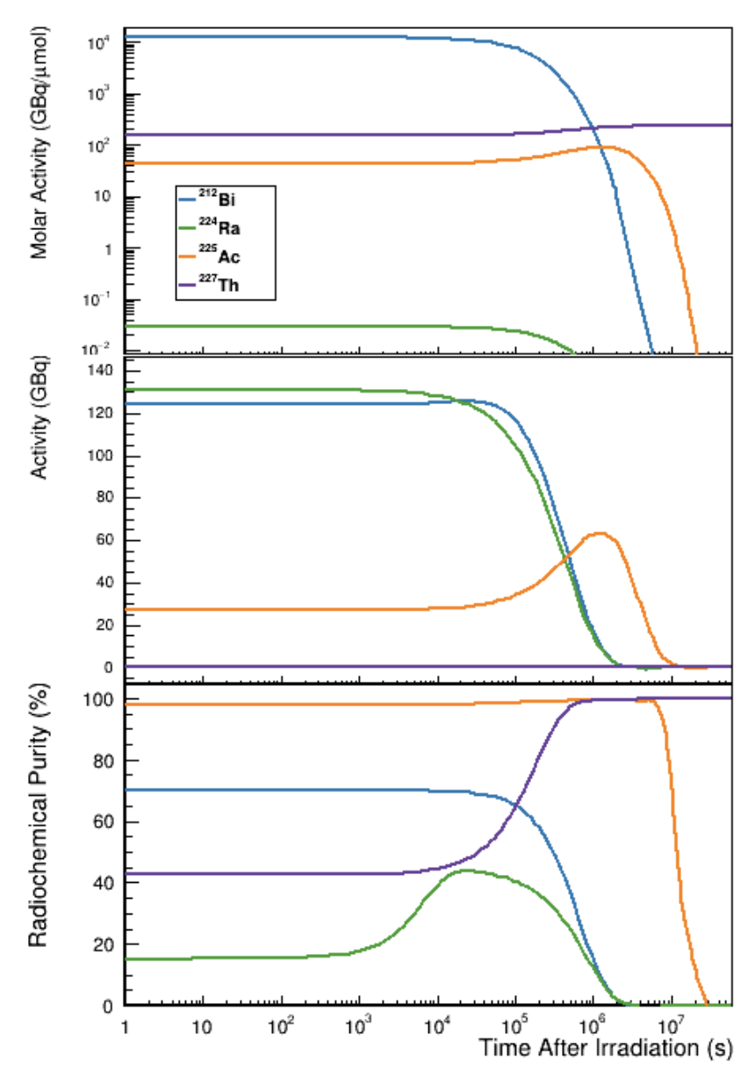
[FUSion] reactors as a driver?
Novel method for medical radioisotope production
Evitts et al. App. Rad. Iso. 226 112163 (2025)
Can you put an (IG)ISOL target in a Tokomak?
What isotopes would it produce?
Can we do the (weak) r-process in the lab?
Contact: JH, JB, RS

Slide 11
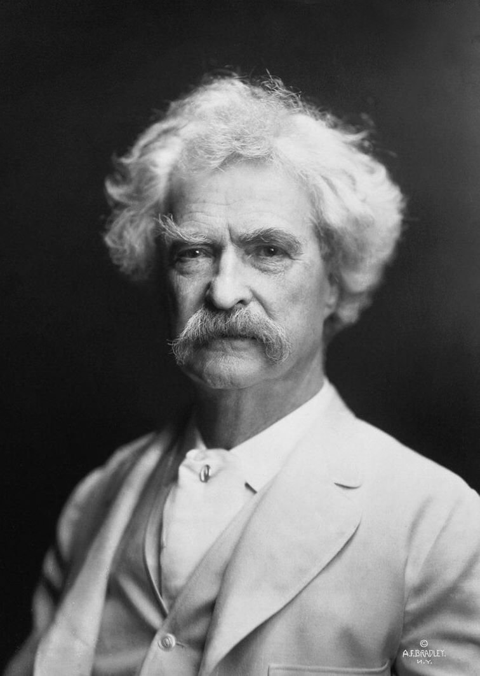
[FUSion] reactors as a driver?
Novel method for medical radioisotope production
Evitts et al. App. Rad. Iso. 226 112163 (2025)
See also: a fission driver
Has been considered before e.g. MAFF (Munich) and PIAFA (ILL)
Might also be possible? SMR/AMRs will be coming online in the coming decade – some might have quite different neutron spectra to traditional reactors
Can you put an (IG)ISOL target in a Tokomak?
What isotopes would it produce?
Can we do the (weak) r-process in the lab?
Contact: JH, JB, RS

Slide 12
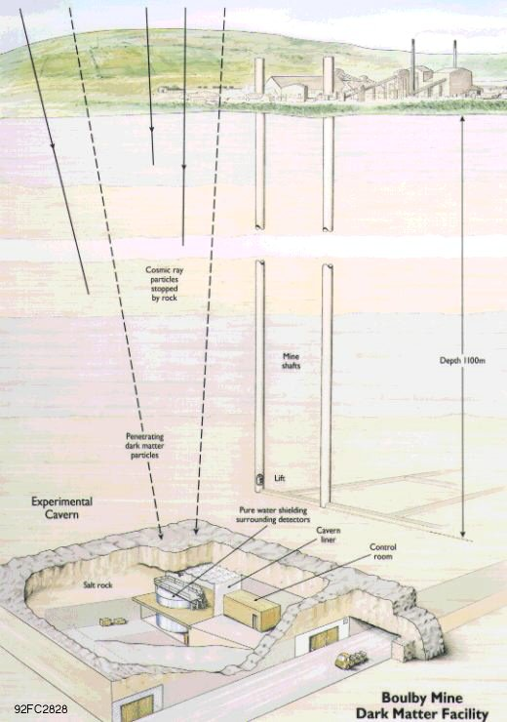

Going underground?
Historical discussions about low-background facility in Boulby for nuclear astro measurements
Probably not internationally competitive now
Other uses for low-backgrounds:
Rare-event searches (neutrino-induced events?)
Quantum science? Decoherence of quantum systems from cosmic radiation
…
Contacts: RSS, CB, PP

Slide 13
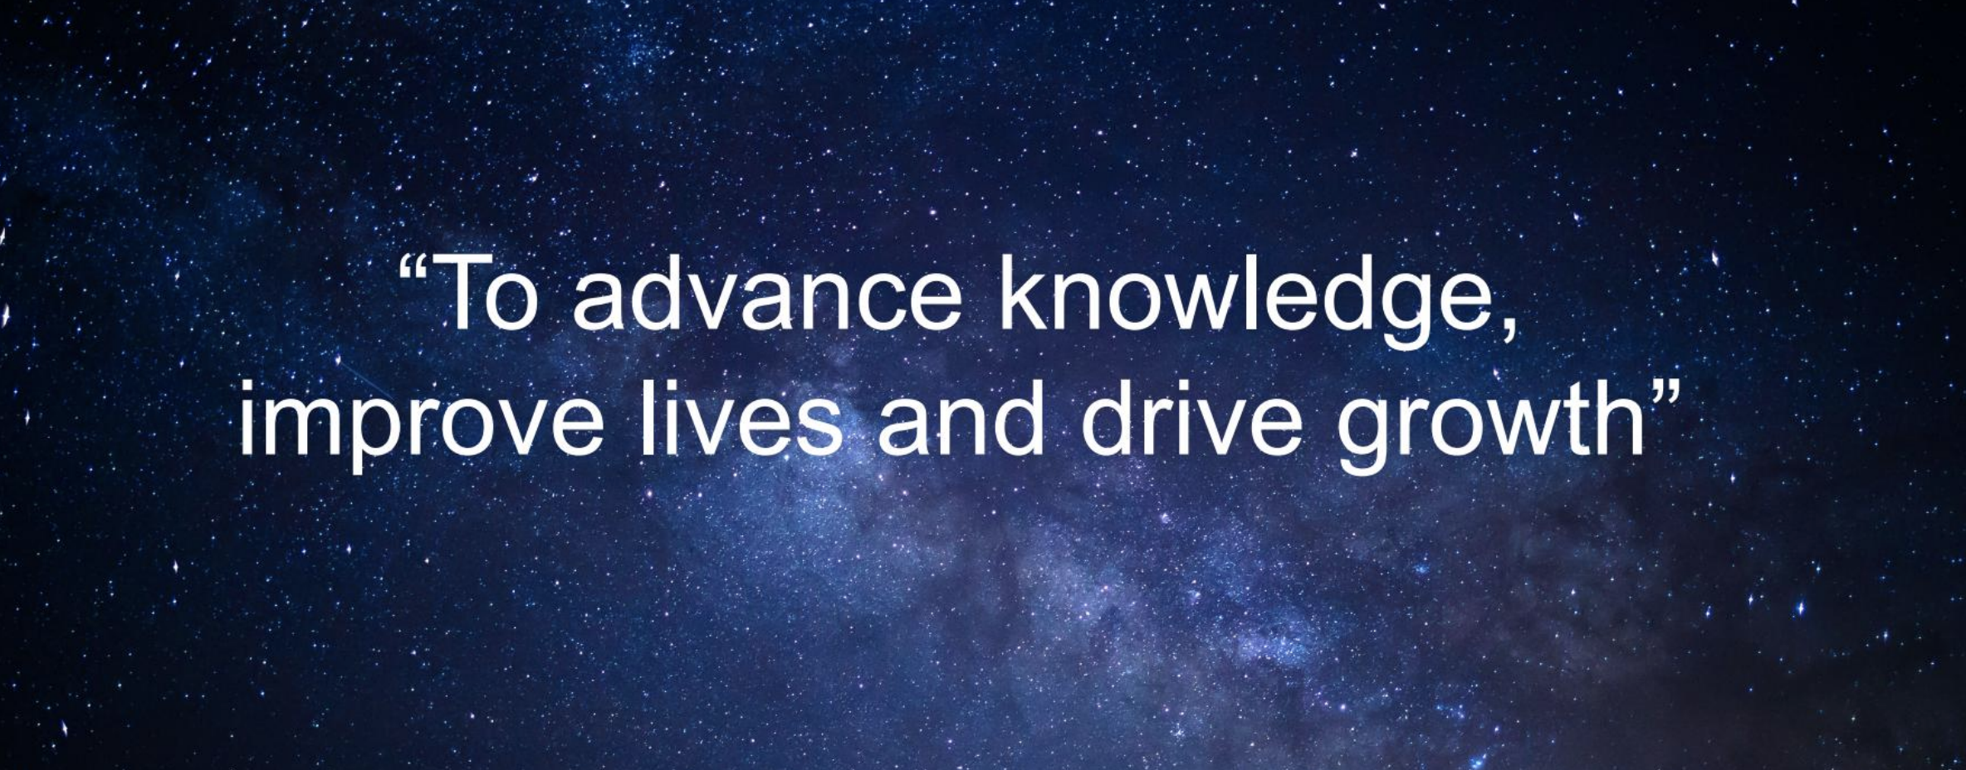
Conclusions

