Slide 1



XML2VHDL – GUI
- UDP From XML
Jack Day
Detector Systems Group
Notes:
The abstract pattern can be removed or repositioned if required. Be careful to ‘Send to Back’ so that it does not obscure any important information.

Slide 2

Rough Agenda
The problem the tool solves
What does the tool do?
Using the tool
Future plans
Credit AI for this lovely Logo ☺
Image © STFC John Dawson
Notes:
To replace photo with one of your own. 1) Send the geometric shape overlay to the back – Right-Click > Send to Back > Send to Back. 2) Replace image – use the guides provided to correctly position it. 3) Send your image to the back so that the geometric overlay re-appears over the image. Remember to delete the image credit if using your own image.

Slide 3
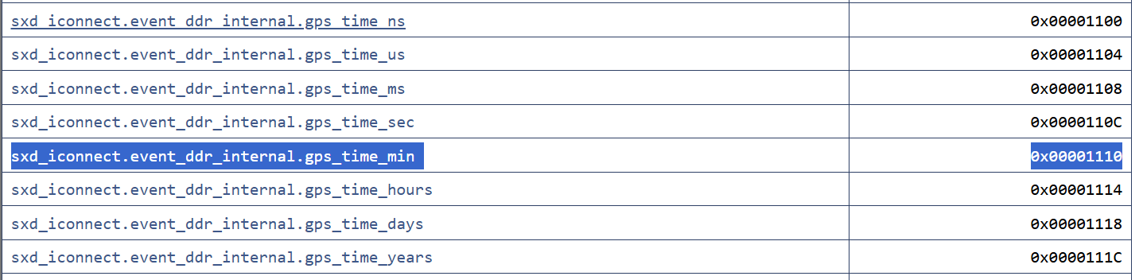
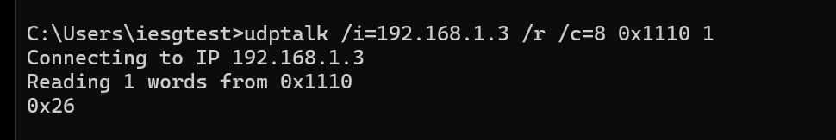
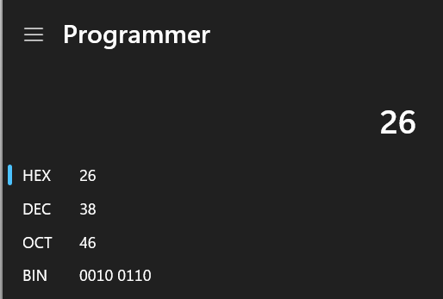
Problem
DSG support a wide range of boards across ISIS, many of which use memory maps, accessed via the UDPCore, to control and configure
These memory maps differ board to board
Can be time consuming for staff to read/write multiple values using UDPTalk – time switching between the memory map and CMD
Sometimes additional time spent changing data format – Hex -> Int or Hex -> Binary -> Apply bit mapping
We can do better!
Example for reading GPS time (Mins) from a board on ISIS
Image © STFC John Dawson
In this case: 38 Mins
3 steps, then repeat for years, days, hours, seconds etc
Notes:
To replace photo with one of your own. 1) Send the geometric shape overlay to the back – Right-Click > Send to Back > Send to Back. 2) Replace image – use the guides provided to correctly position it. 3) Send your image to the back so that the geometric overlay re-appears over the image. Remember to delete the image credit if using your own image.

Slide 4
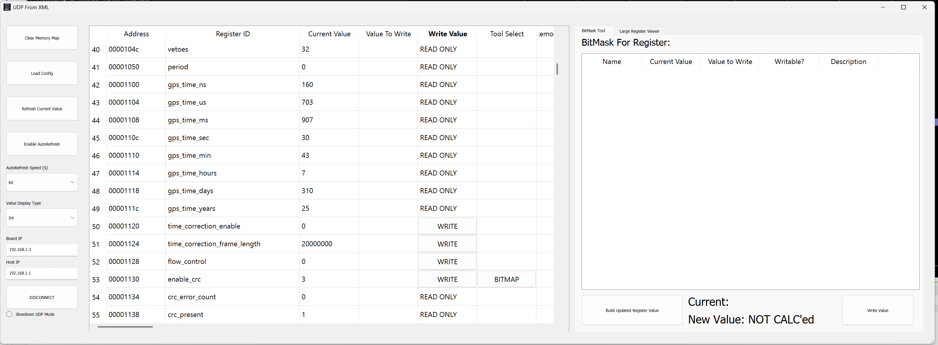
What does the tool do?
GUI interface for reading, writing and decoding data from an XML Memory Map using UDPCore
Implemented in python, using existing DSG code – eg: UDP functions for reading/writing – built to .exe
Able to quick change how data is displayed
Refresh at various intervals when monitoring systems
Decode a “BitMask” for a given register – more on this later
Same example as before
Notes:
To replace photo with one of your own. 1) Send the geometric shape overlay to the back – Right-Click > Send to Back > Send to Back. 2) Replace image – use the guides provided to correctly position it. 3) Send your image to the back so that the geometric overlay re-appears over the image. Remember to delete the image credit if using your own image.

Slide 5
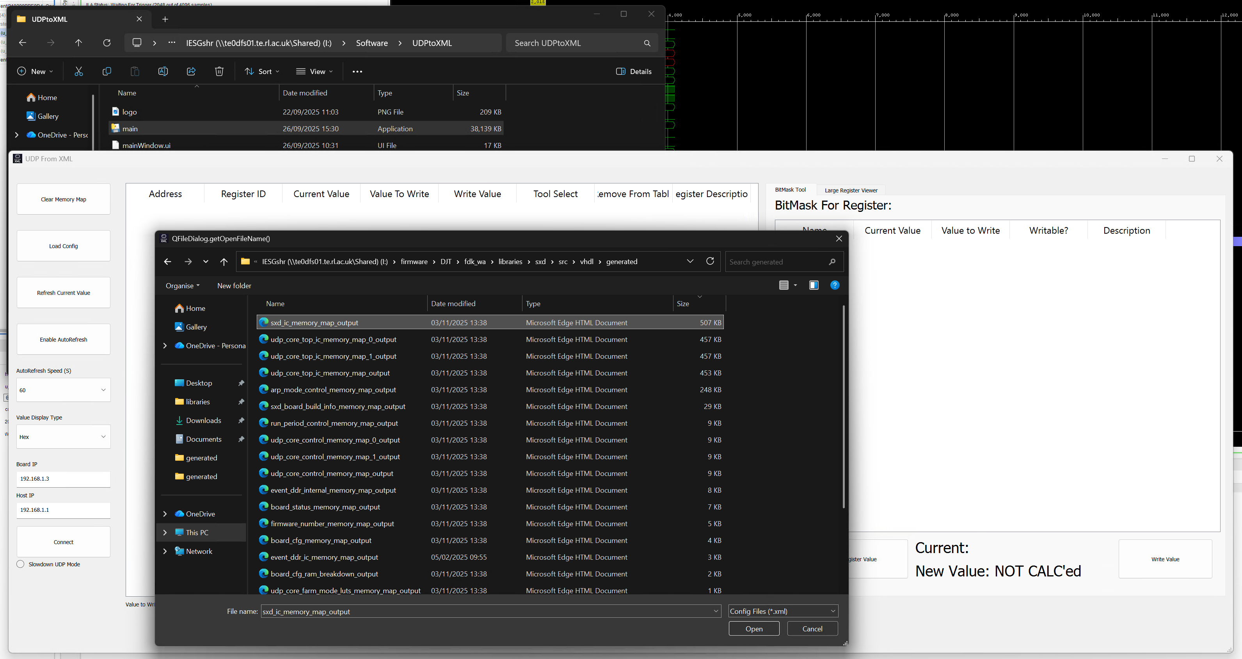
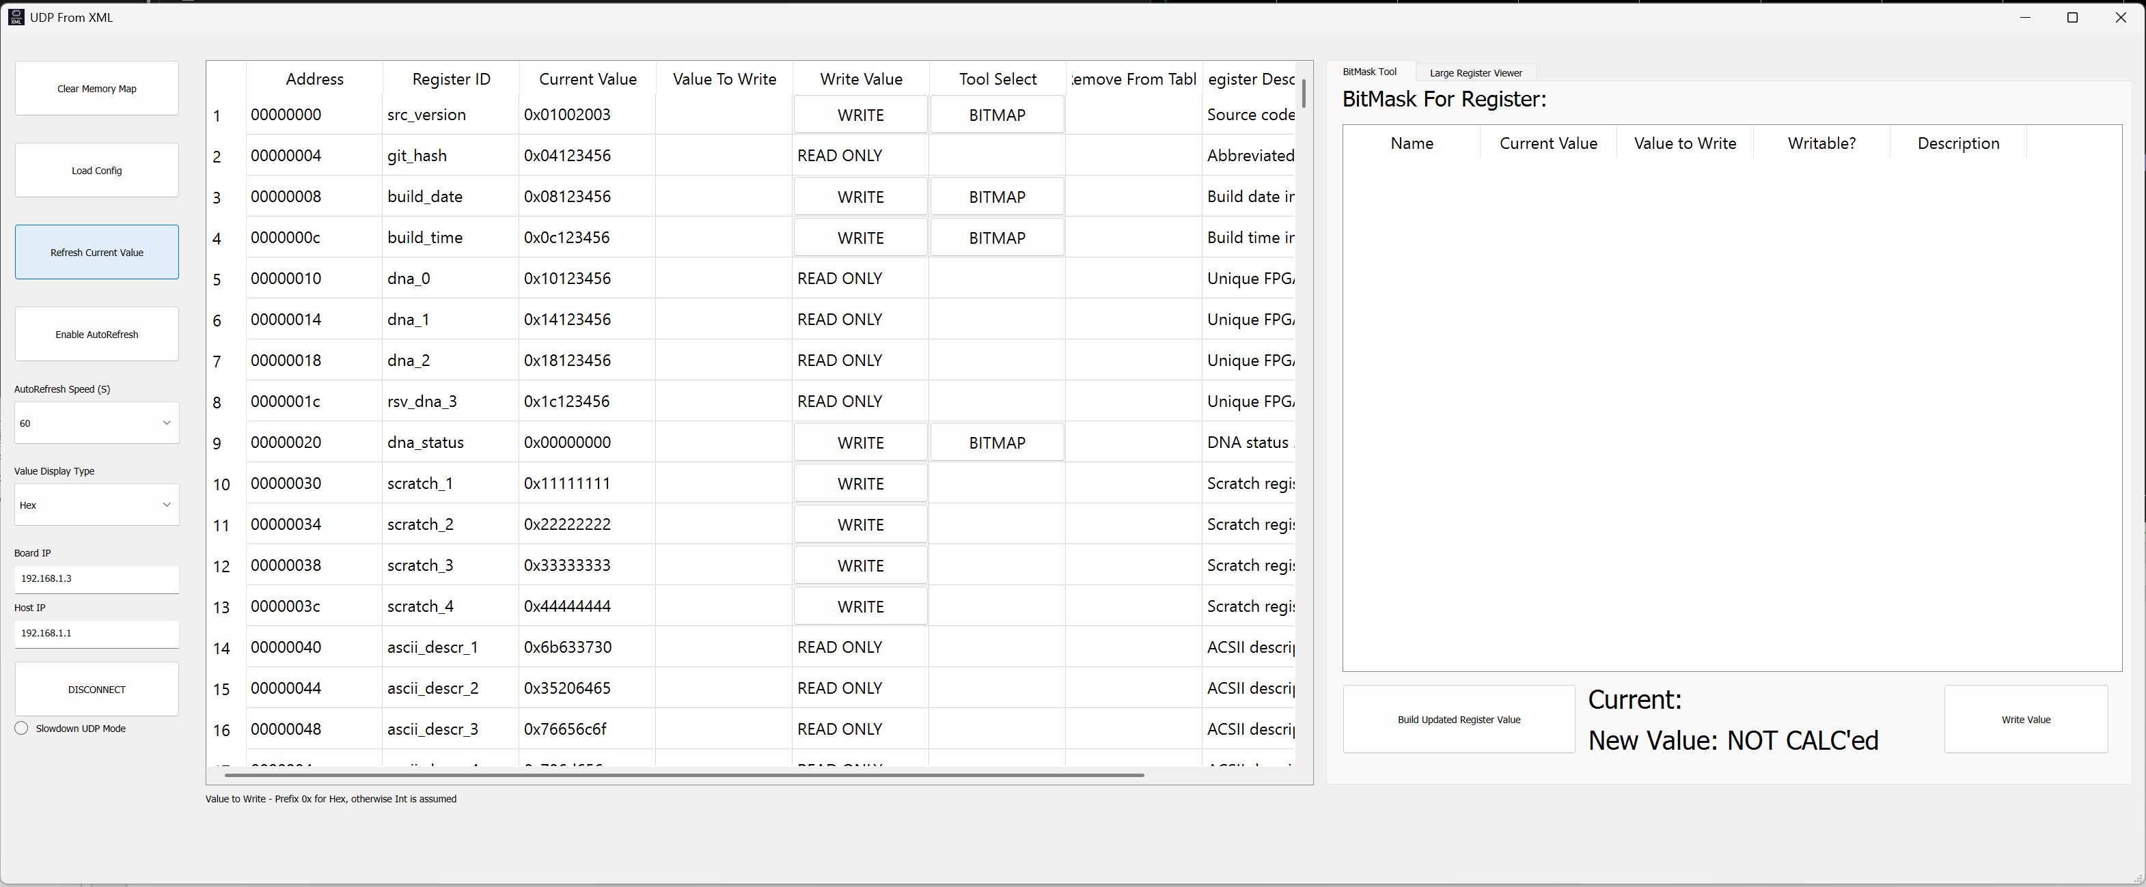
Using the tool
Run built .exe
Load Config – find the XML Map to use, normally just the largest in the folder
Enter IP information – Host IP, Board IP
Connect!
If connected to a board when the config is loaded all values are pulled, if not click refresh to get them all
1
2
3
4
5
Notes:
To replace photo with one of your own. 1) Send the geometric shape overlay to the back – Right-Click > Send to Back > Send to Back. 2) Replace image – use the guides provided to correctly position it. 3) Send your image to the back so that the geometric overlay re-appears over the image. Remember to delete the image credit if using your own image.

Slide 6
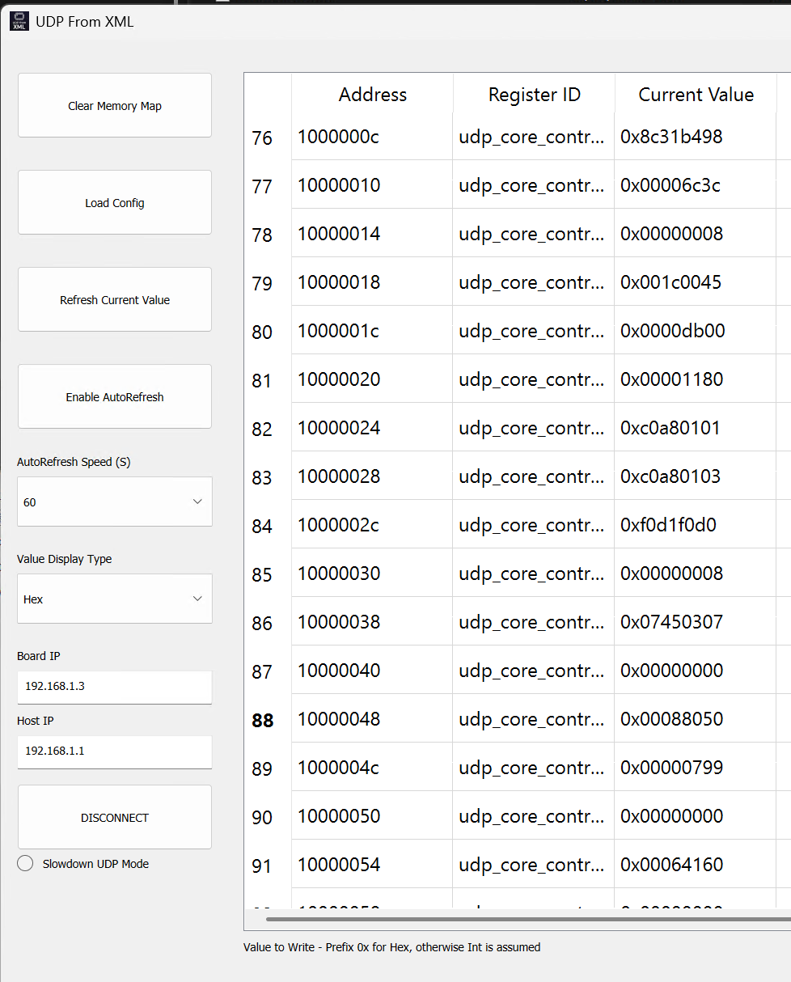
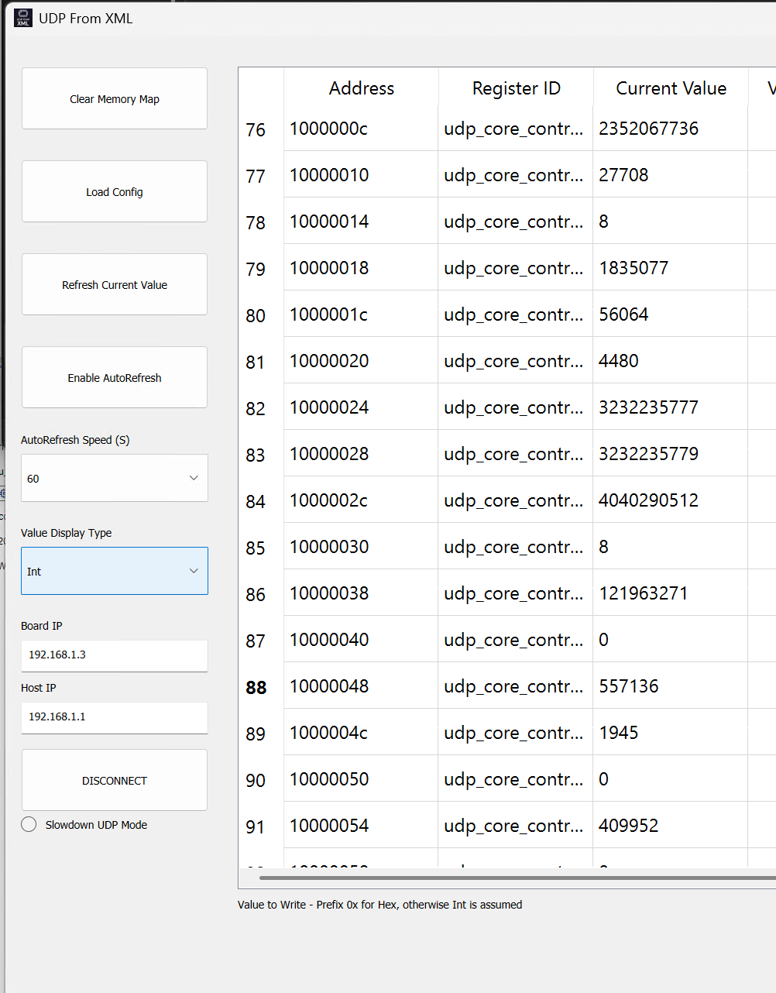
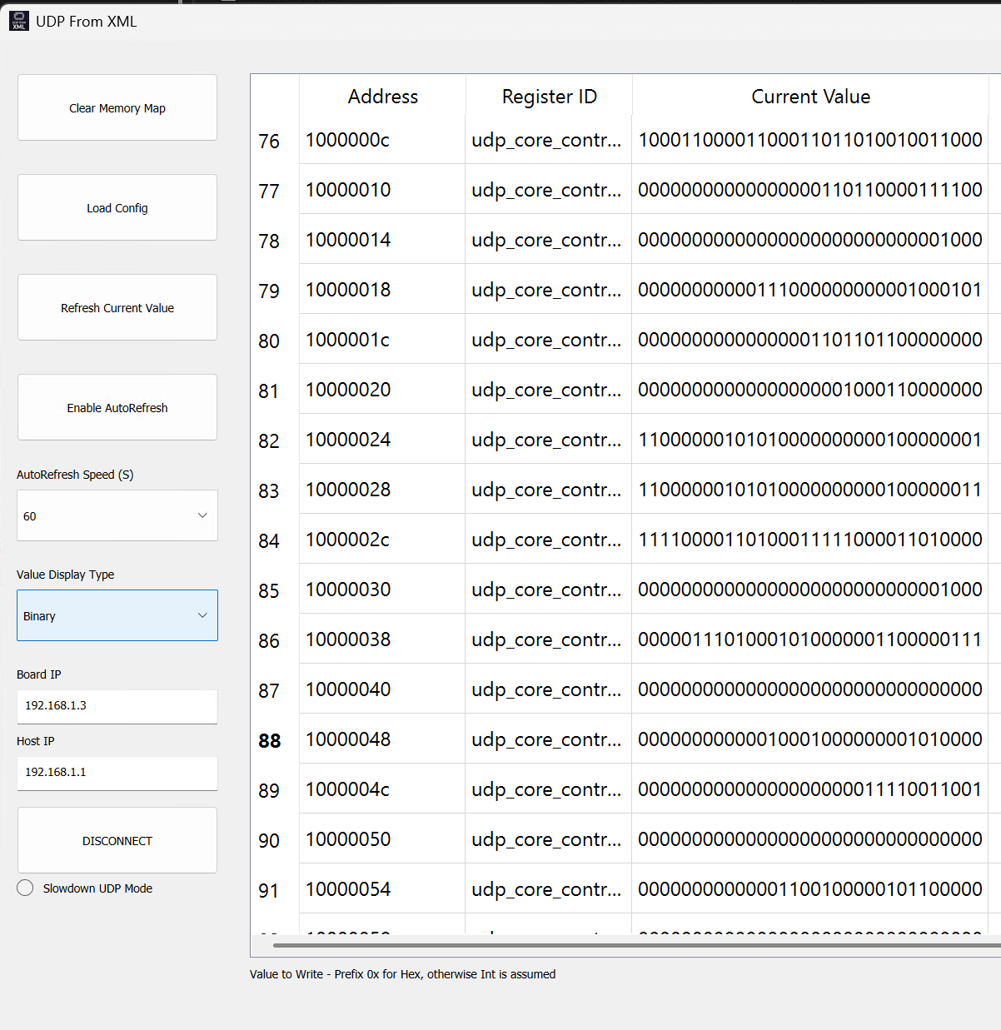
Using the tool – Display Type
Combo box for Hex, Int and Binary
Notes:
To replace photo with one of your own. 1) Send the geometric shape overlay to the back – Right-Click > Send to Back > Send to Back. 2) Replace image – use the guides provided to correctly position it. 3) Send your image to the back so that the geometric overlay re-appears over the image. Remember to delete the image credit if using your own image.

Slide 7
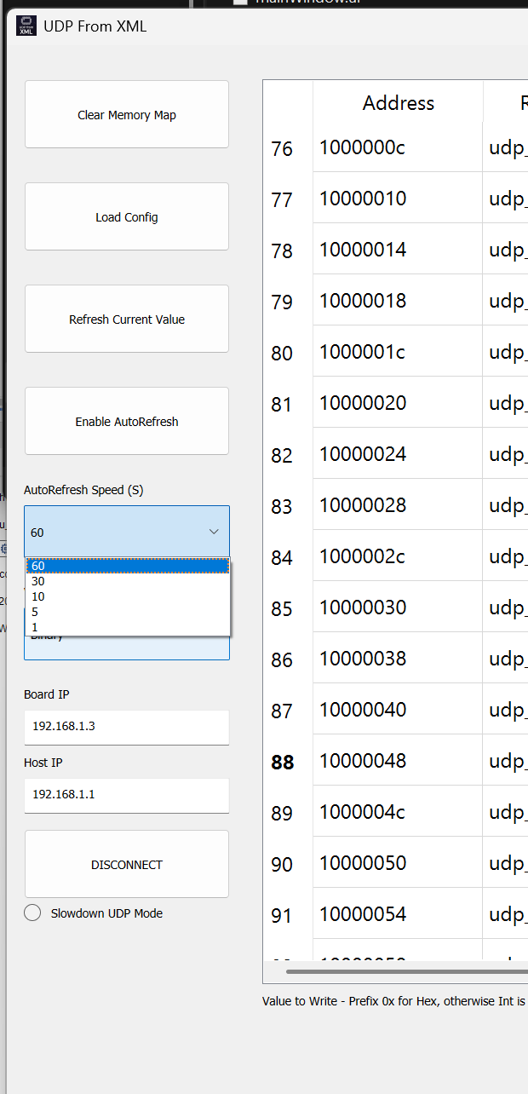
Using the tool – Refreshing
Enable AutoRefresh button – enables refresh cycle
Combo box to set speed
Notes:
To replace photo with one of your own. 1) Send the geometric shape overlay to the back – Right-Click > Send to Back > Send to Back. 2) Replace image – use the guides provided to correctly position it. 3) Send your image to the back so that the geometric overlay re-appears over the image. Remember to delete the image credit if using your own image.

Slide 8
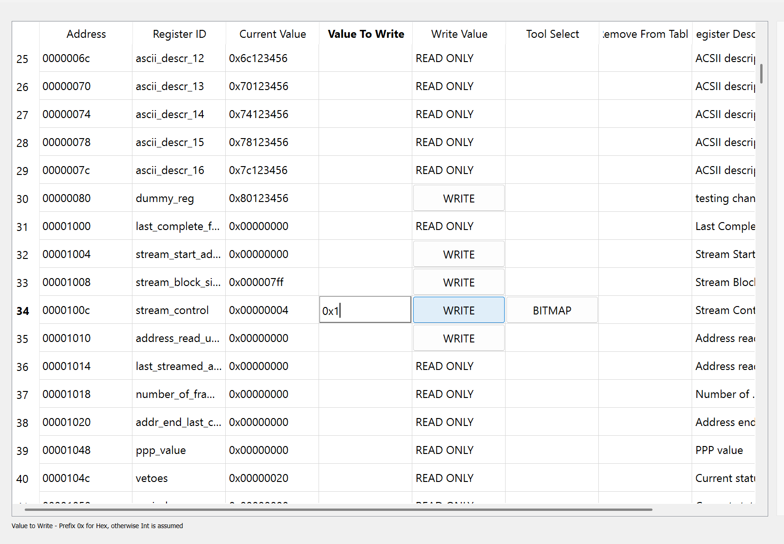
Using the tool - Writing
If the value can be written to – “WRITE” button in Write Value
Enter new value in Value to Write
Press Write
The tool will then read back the value to update with the new register value
Note: Prefix 0x if new value is hex, if not the tool assumes it is an Int
Notes:
To replace photo with one of your own. 1) Send the geometric shape overlay to the back – Right-Click > Send to Back > Send to Back. 2) Replace image – use the guides provided to correctly position it. 3) Send your image to the back so that the geometric overlay re-appears over the image. Remember to delete the image credit if using your own image.

Slide 9
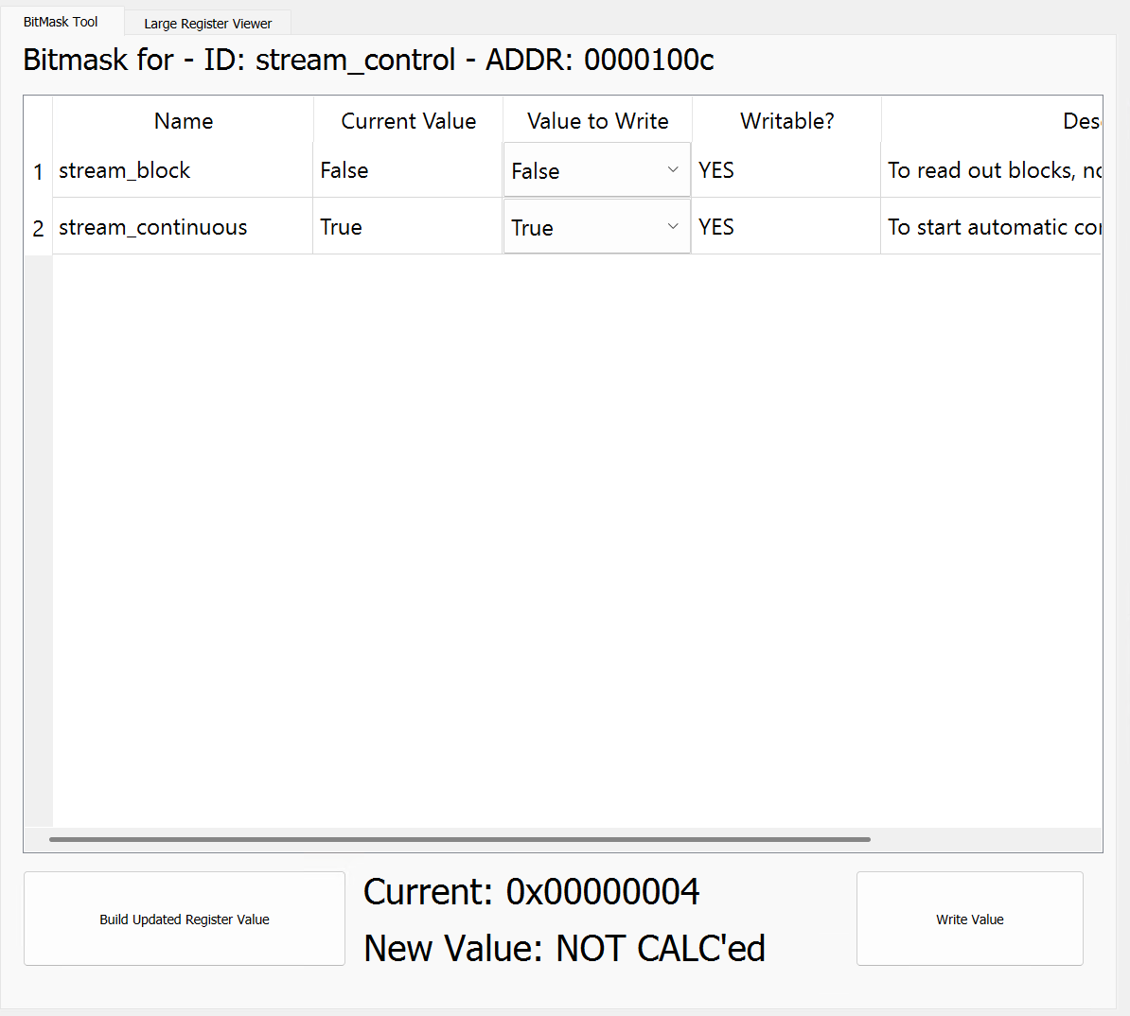
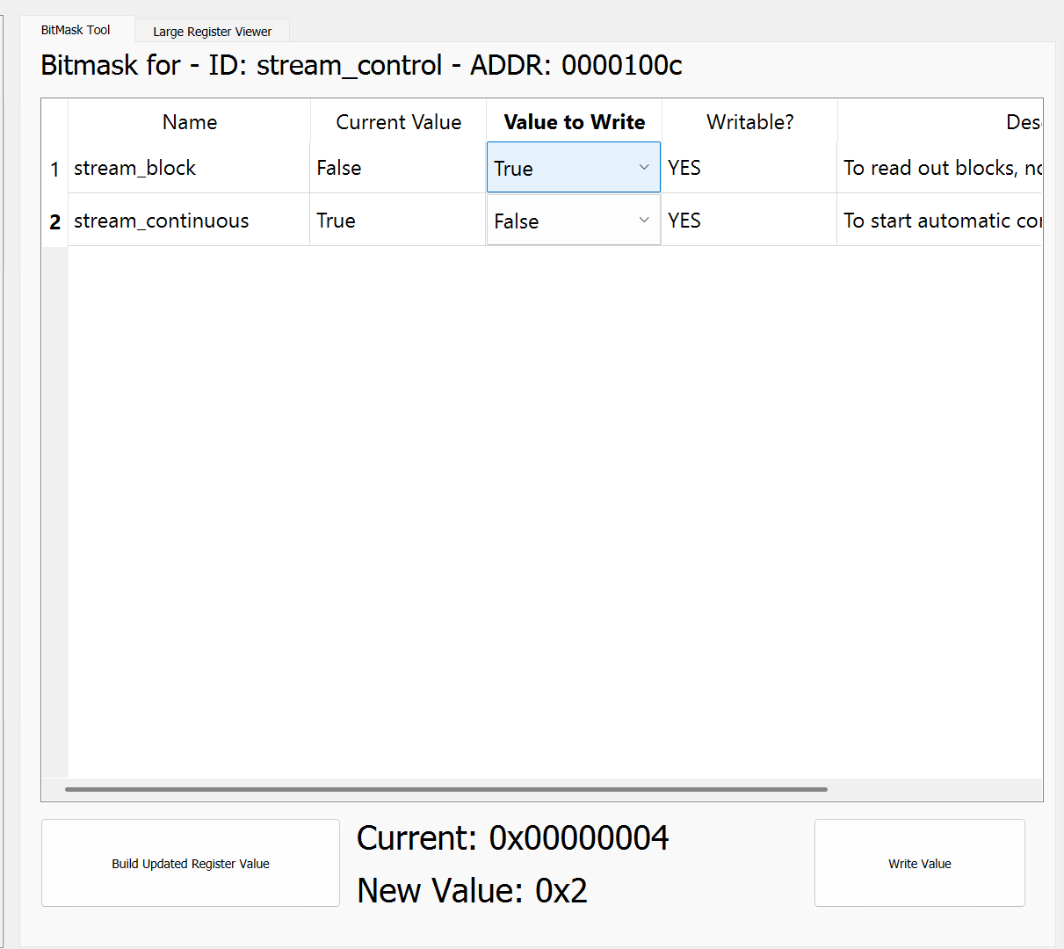
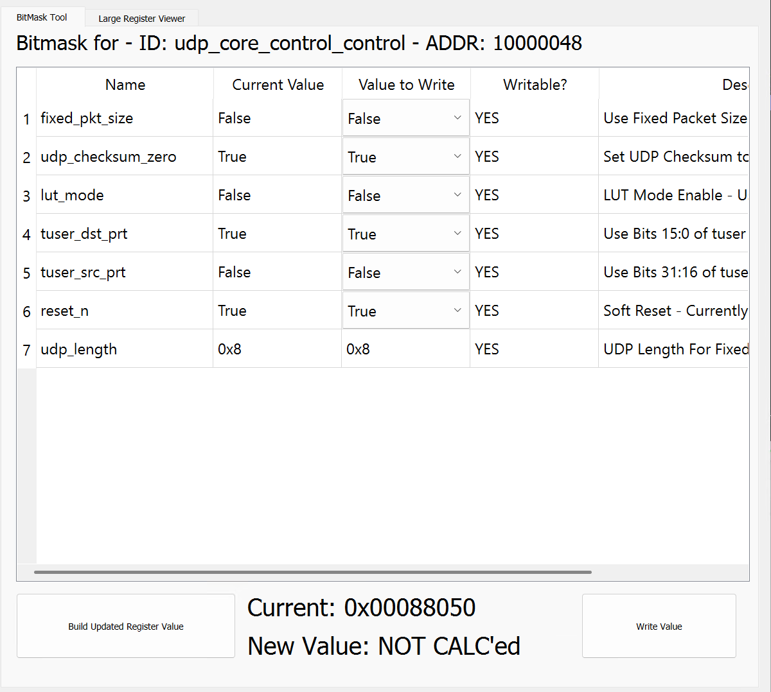
Using the tool - BitMask
BitMask sidebar for when a single register can be split into multiple different parts
Reads information from XML map and is able to split out the data
Then able to build a new register value, for one or more changes
For 1-bit wide values changes display type to true/false mode
Display type also applies to these values
Example for the same streaming control register – Changing to streaming block not continuous
Example showing different types in one
Notes:
To replace photo with one of your own. 1) Send the geometric shape overlay to the back – Right-Click > Send to Back > Send to Back. 2) Replace image – use the guides provided to correctly position it. 3) Send your image to the back so that the geometric overlay re-appears over the image. Remember to delete the image credit if using your own image.

Slide 10
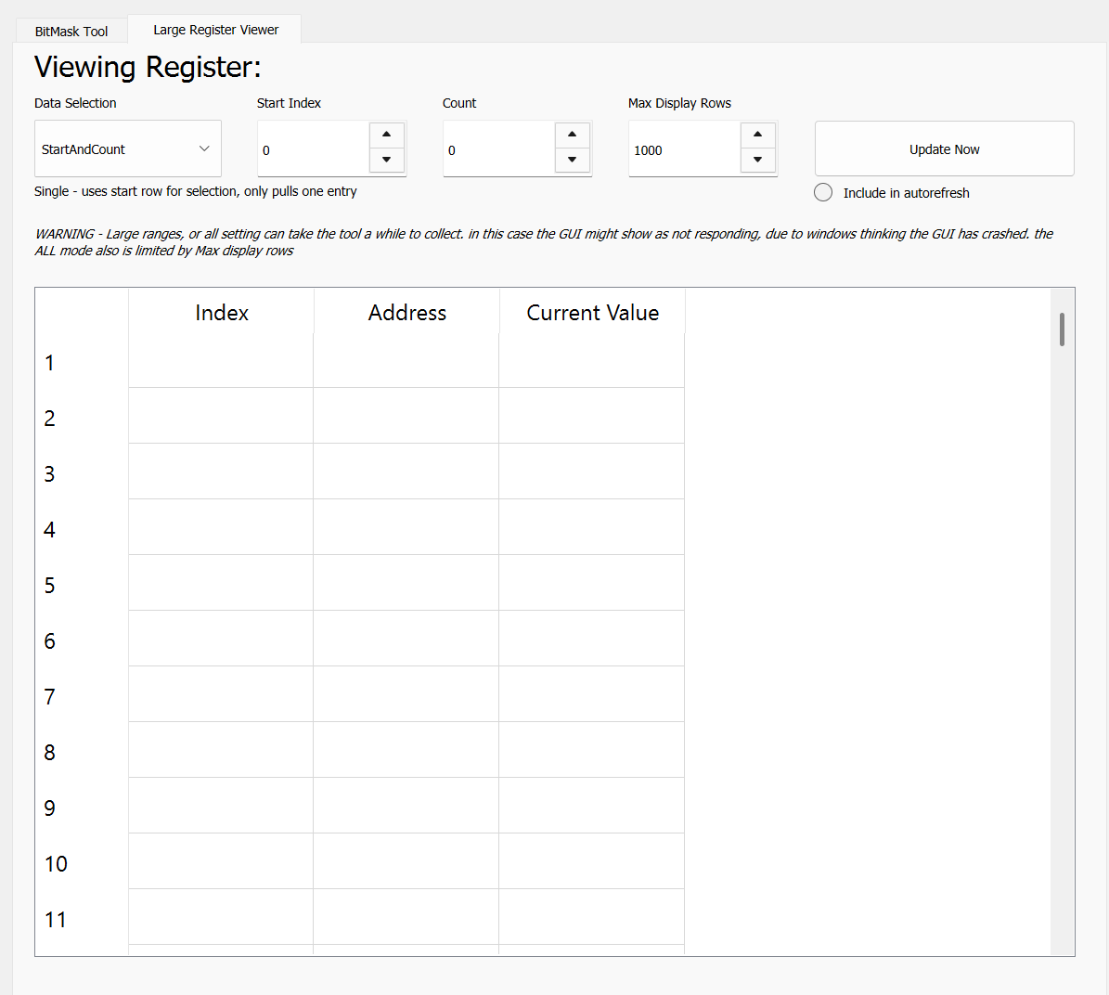
Future Plans - Core
Use background thread for UDP Coms/Processing – Main then has GUI
For large maps the tool currently hangs, and windows assumes it has crashed so changes to the not-responding state
Large Register Viewer – Tool for viewing larger blocks, eg: reading out DDR contents
Scripting – Run a configurable list of read/write commands, Eg: setting a board to stream requires several different writes
Different coms interfaces – expand to more than just UDP
These may or may not happen, and likely not very quickly. The tool works well enough, and with other higher priority work allocated time will likely be minimal
Notes:
To replace photo with one of your own. 1) Send the geometric shape overlay to the back – Right-Click > Send to Back > Send to Back. 2) Replace image – use the guides provided to correctly position it. 3) Send your image to the back so that the geometric overlay re-appears over the image. Remember to delete the image credit if using your own image.

Slide 11





Thanks for
Listening
https://gitlab.stfc.ac.uk/isis-detector-systems-group/software/python/udp-from-xml
Science and Technology Facilities Council
@STFC_matters
Science and Technology Facilities Council
Notes:
The abstract pattern can be removed or repositioned if required. Be careful to ‘Send to Back’ so that it does not obscure any important information.

