Slide 1



XML2VHDL
Closing the Loop
Matt Roberts
6th November 2025

Slide 2
Agenda
XML2VHDL Overview
XML2RDMA Control Overview
Firmware Monitoring and Control ←→ Python
Introducing Buselisk
Example Designs

Slide 3
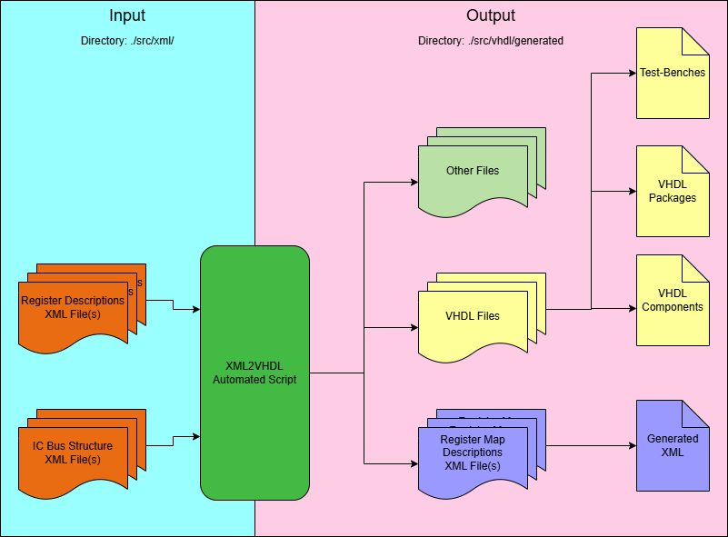
XML2VHDL Overview
XML2VHDL should bridge firmware and control software – consistently!
A software framework to generate VHDL AXI4-Lite Memory-Maps
Originally developed for SKA-Low TPM firmware
University of Oxford
STFC|TD|DED|EDSG
Hierarchical Tree Structure
Generates:
XML
VHDL Packages/Components/TBs
HEX, HTML
Designer still needs to insert into HDL

Slide 4
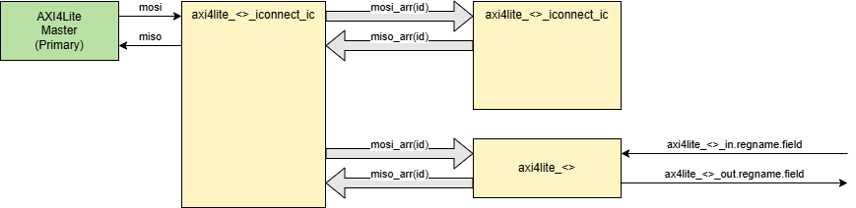
XML2VHDL Generated VHDL
MOSI and MISO record (axi4.axi4lite_pkg.all) based records and arrays
Inter-Connect (iconnect_ic) components can connect to:
AXI4Lite generated registers
Other Inter-Connects
MOSI/MISO arrays can be indexed by Inter-Connect ID
MISO/MISO In/Out records expand to register name and/or register name.field

Slide 5
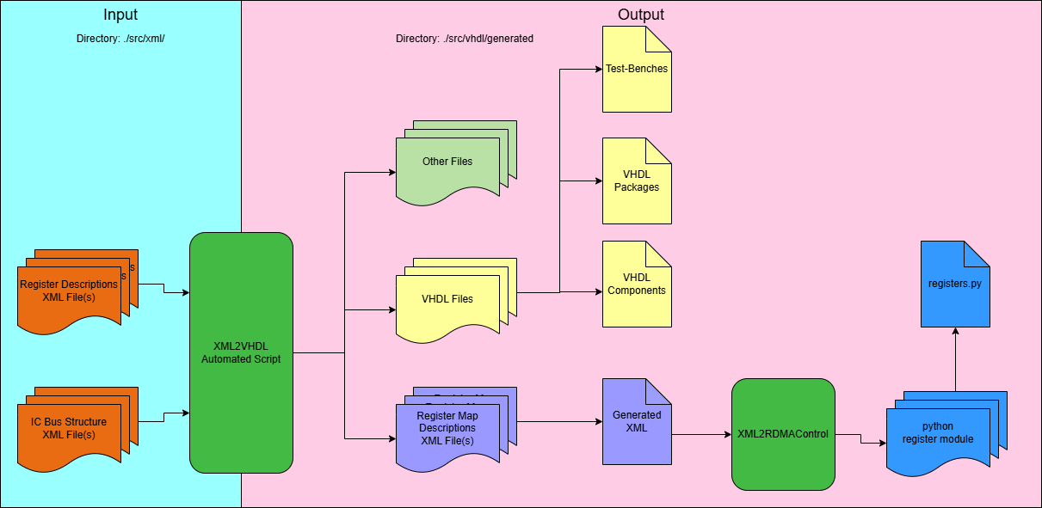
XML2RDMA Control Overview
Remembering:
XML2VHDL should bridge firmware and control software – consistently!
Control software should be based off XML2VHDL generated output
XML2RDMA Control takes XML2VHDL output and creates a python module
Import register and interconnects details in control software
Keeps HDL and Control in Sync

Slide 6
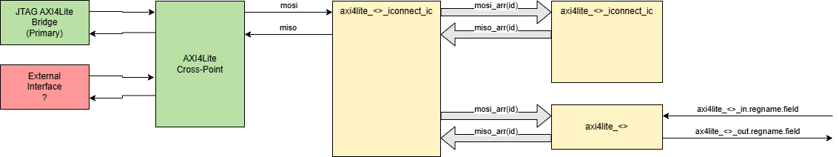
Firmware Monitoring and Control ←→ Python
Putting everything together:
JTAG bridge provides access via Hardware Manager using read_axi/write_axi
However, the external interface is undefined and hardware specific…

Slide 7
Introducing Buselisk
A collection of python tools to connect to XML2VHDL supported libraries
https://gitlab.stfc.ac.uk/tech-esdg/tools/buselisk
http://www-local.technology.stfc.ac.uk/ESDG/documentation/tools/buselisk/0.2.5/index.html
Installable via the ESDG public pypi repository:
https://gitlab.com/stfc-tech-esdg/pypi/-/packages
Other python modules:
changelogger-stfc | xml2rdmacontrol | boardcfgstatus | drp-util | udpcore

Slide 8
Reminder
When committing to any ESDG git repository please remember to use conventional commit messages:
https://www.conventionalcommits.org/en/v1.0.0/
This really helps with documentation and release messages.

Slide 9
Example Design
To demonstrate this in action, refer to:
VCU118 Example Designs
http://www-local.technology.stfc.ac.uk/ESDG/documentation/example_designs/vcu118_rev2_0/
Of note:
VHDL Libraries are now manged as git submodules
Python modules are managed using poetry
Documentation for all dependencies can be found here:
http://www-local.technology.stfc.ac.uk/ESDG/documentation/

