Slide 1



Knowledge Sharing and Continuous Improvement (KSCI)
ESDG Group Meeting
Thursday, 30th October 2025
Adam Barcock

Slide 2
Problem Definition
Duplicate developments have occurred across the group. Inefficient use of staff effort.
Introduced a series of meetings in the 23/24 and 24/25 review periods to improve communication and avoid duplicate developments.
    Initially, a fortnightly meeting.
    Then, ad hoc and user driven.
Notes:
Highlight why previous attempts to address the issue have yielded unsatisfactory results. Therefore, proposing a new approach in this presentation.

Slide 3
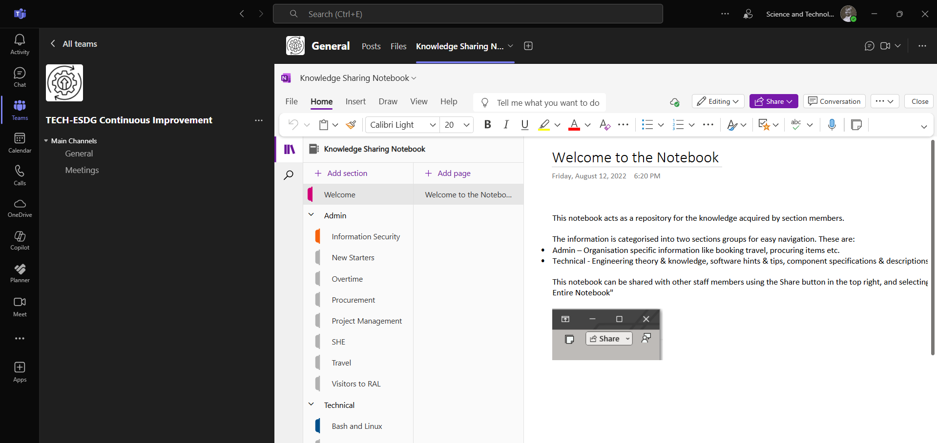
Progress
Notes:
Despite being unable to effectively address the duplication of effort across the group, the previous attempts to solve the problem have produced some useful results. Many good discussions and problems solved in the meetings. Highlight the existing Teams and OneNote. The OneNote has proven very useful.

Slide 4
Criteria for the New Solution
Essential:
    Captures duplicate developments before they occur.
    Is a lightweight process that does not burden anyone.
Desirable:
    Reduces development time and improves quality of developments.
    Development of common best practice.
    Accelerates the development of early-career staff.
Notes:
Present the requirements for the new solution.

Slide 5
Plan, Do, Check, Act (PDCA)
1. Plan
2. Do
3. Check
4. Act
Foundation of Lean, Agile and the Toyota Way.
1951 - Japanese Union of Scientists and Engineers.
Probably execute stages 1-3.
New solution will modify stage one and introduce a fourth stage.
Notes:
When researching continuous improvement methodologies find lots of example frameworks: Lean, Just-In-Time, Six Sigma, Agile and the Toyota Way etc. These frameworks are designed to be applied to a whole project or production line. This is not possible in our case with everyone distributed on different projects.
Foundation of many frameworks is the PDCA cycle. A project or process can be broken down into one, or many cycles. This scales to the work of a single engineer. You probably have a plan or specification for your work, even if it is informal. You work to meet that specification and then verify you have satisfied those requirements before delivery to the customer or integrating into the larger system.
The proposed solution will formalise the plan phase and add and act phase to what you are already doing.

Slide 6
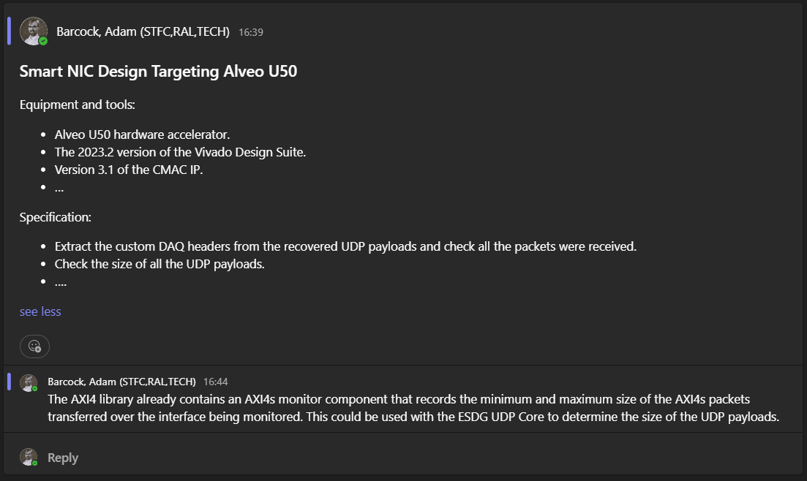
Modified Plan Phase
Notes:
In the plan phase, post a message explaining what you intend to-do in the dedicated Teams channel. Everyone will be able to see your post, and will give useful advice about existing components, potential pitfalls with the chosen hardware etc.
Original author can reply to their own post as the work progresses to request assistance or give updates. Hopefully, a self-documenting process.
Encourage individuals to keep posts short and informal not asking for a detailed design document. Just enough information to give useful help and identify potential duplications before developments start. Will provide a template for a post.
Similarly, do not want you to post about every small piece of work. Recommend adding a post if the activity will take a month or more staff effort to deliver.

Slide 7
Act Phase
Three-point retrospective.
  What did you achieve? What was not achieved?
  What went well?
  What could be improved?
Highlight reusable aspects of your work.
Improvements could focus on automating tedious part of the design process, adopting or revising best practice, streamlining deployment or improving the user experience.
Notes:
At the end of your developments complete a three-point retrospective. Answer these questions on PowerPoint slides. A template will be provided. Focus on any aspects of your work that might have transferrable value and areas for improvement.

Slide 8
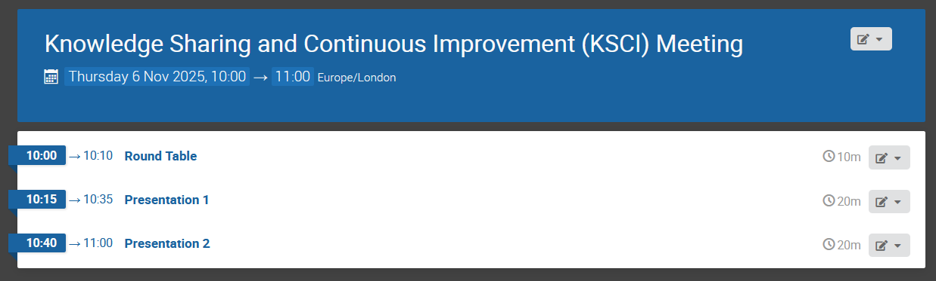
Act Phase (Continued)
Opportunity to present at the monthly Knowledge Sharing and Continuous Improvement (KSCI) Meeting.
Round table followed by informal demonstrations with a Q&A.
Notes:
Your three slides and an informal demonstration along with Q&A will fill the allocated 20 minutes. Should not be a large overhead preparing for this presentation.
Round table used to get small snippets of useful information: “I found a good website” or “useful Linux command” etc. People to signup to the round table on Indico ahead of time.

Slide 9
Sanity Check
Attend all KSCI Meetings. No meeting in Dec or Jan. (10 hrs)
Post six times in MS Teams. (7.4 hrs)
Prepare a demonstration for three KSCI meetings. (14.8 hrs)
Then approx. 32 hrs spent engaging with this process.
Assume 223 working days in a year after annual leave. Then approximately 2% of time spent engaging with this process.
Notes:
Checking new solution meets criteria on slide four. Inflated estimates of amount of time spent engaging with process.

Slide 10
Summary
Start a project with a post on Teams. Template will be provided.
Conclude with a quick retrospective. Template will be provided.
Monthly meeting on the first Thursday of the month.
    Announcement to be made in the ESDG Group meeting a week prior.
    Agenda to be organised and communicated in advance.
Notes:
Attendance is optional and can make an informed decision as subject matter will be communicated in advance.
Highlight that engaging with this process and helping others demonstrates behaviours that can be rewarded through Instant and In Year award schemes.

