Slide 1
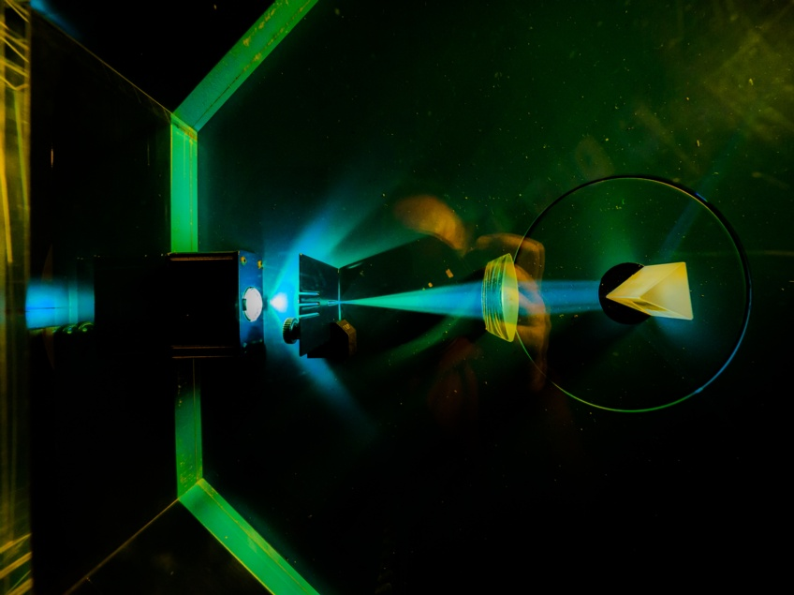


Electronic System Design Group
Management Update
Group Meeting, 30 October 2025
CR03 & Zoom
Image © STFC Alan Ford
Notes:
To edit the background image, select ‘Format’ from the PowerPoint menu and ‘Slide Background’ from the drop-down menu. Within the new list of options that appears on the right of the screen, select the ‘File’ button under ‘Insert picture from’ and select your image from your file browser. Please remove or amend the image credit if you are using a different image to the one provided.

Slide 2
Fire Alarm!
A reminder: the fire alarm in this room will probably be tested at some point in this meeting
  For which, apologies
  You may remain seated

Slide 3
Group Organisation & Staff Changes
Ian Brawn
Ronnie Brumfitt
Joseph Hindmarsh
Weiming Qian
Kelvin Gascoyne
John Holden
William John
Simon Moorby
Zhen Ha Ng
Geoffrey Betts
Matt Roberts
Chad Silk
Joshua Davies
Mohamed Siyad
Saeed Taghavi
Dave Templeman
Piers Coode
Jack Day
Martin Torbet
John Coughlan
Adam Barcock
Sooraj Pradeep
Hajira Bazaz
Berk Bilgin
Peter Furey-Duffin
Lucie Sharpe
No changes this month
Graduate Recruitment round this year
  66 applicants
  Shortlisting in progress
  Interviews & tour 11 December
Thanks to all who volunteered for recruitment fairs

Slide 4
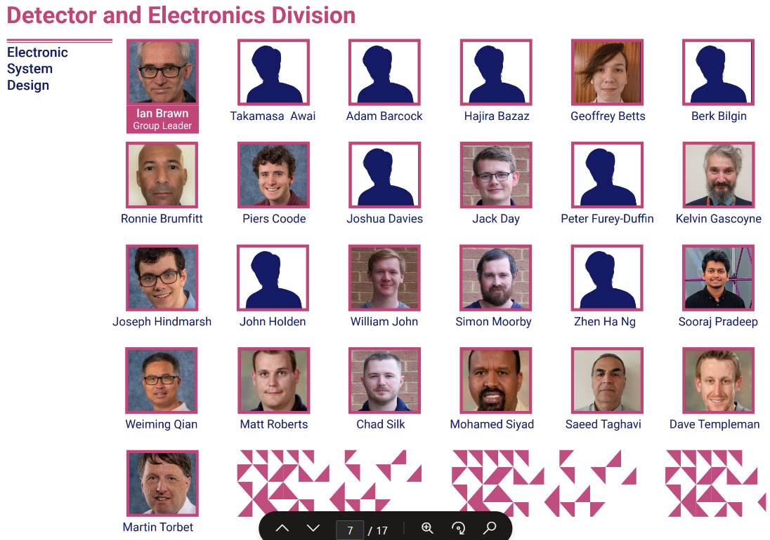
Departmental Organogram
From Dept. Organogram
Portrait sessions
  Normally 1st Wednesday of month
    See Viva Engage, All Company
  9:30—12:30
  R3 Photo Studio, G32
Photos → Kat Lewin-Williams
Current organogram dates from June

Slide 5
Projects 2025–26
Slightly Approximate
Fully employed this FY
Next FY: Await funding results for SKA & ATLAS
Notes:
Numbers from
H:\ESDG_business\EffortProfiles\EffortProfile_Projection_2025_d3

Slide 6
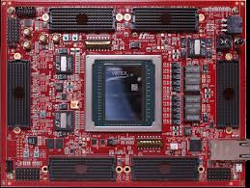
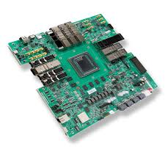
Development Boards
£50k Capital available for dev boards
  Capital items ≥£25k
Target boards
  HTG-960 £30k)
    Xilinx Ultrascale+ VU19P
    High-density FMC
  VPK180 (£18k)
    Xilinx Versal Premium VP1802

Slide 7
ESDG Accommodation in R68 & R66
R68
2.19
2.21
2.22
2.23
2.24
2.25
Stair
Well
2.28
2.29
2.30
2.31
2.32
Lab 2
Lab 1
IB
JH
AB
MS
ST
SP
JH
LS
WQ
GB
MR
ZN
HB
Stair
Well
BB
PFD
Technology
SERVERS
2.15
2.14
MSC
TR3
2.10
MSC
TR1
MSC
TR2
2.09
2.08
Lift
RALSP
Lab
RALSP
Office
RALSP
Office
RALSP
Office
RALSP
Office
New furniture contract now in place
2nd desk for 2.24 ordered
Storage office: R66, G07
  Rejected 1st quote for shelves (too small)
  Requested bigger

Slide 8

Xilinx Licenses &Training
Xilinx Licences & Training credits renewed
  4 Floating licenses for ESDG
  1 Floating license for IESG
  40 Training Credits for ESDG
  Bundled into Xilinx Productivity Agreement for discount
Licenses & training now received
  But not yet the invoice
    Chasing… because I need to ‘journal’ some of cost to IESG

Slide 9
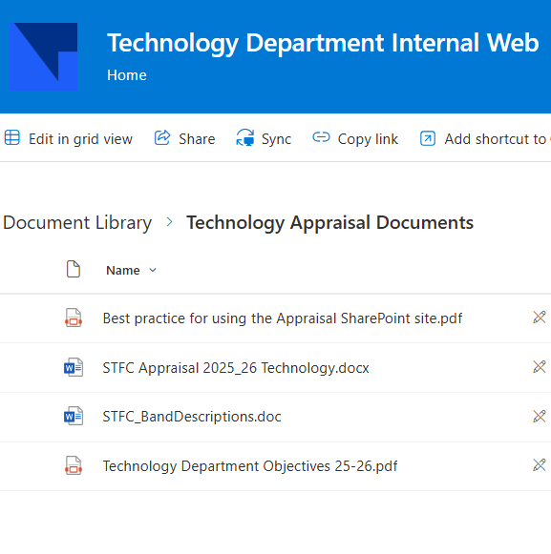
APR
Mid-term reviews are upon us
TD resourses here →
ESDG guidance here
You should have received link to Sharepoint area to upload your form
Deadline for mid-term comments is end of October

Slide 10
Annual Leave
Please check you’re A/L balance in Fusion
  (Check Balance as of 31/12/2035 to include future leave & )
  Many instances of this being wrong
    If so, raise a Help Desk Request
      Help Desk → My Help → Create Request
Requesting carry-over of >10 days (740 hours)
  Deadline = 14 November
  Request via Line Manager (→tddirectorsapproval@stfc.ac.uk )
    Must be good case
    Habitual under-users of leave will not be looked upon favourably

Slide 11

Overseas Travel Approval (OTAP)
  All overseas travel requires pre-approval by STFC
    In addition to any approval required by project/budget holder
  “The former Overseas Travel Approval Process at STFC was not fit for purpose, so a new process has been designed”
  New system opened 5 October: OTAP
    “Saves staff time!”
    Approver = Line Manager
    Carbon calculator

Slide 12
STFC News Sources
In Brief – weekly email, but also here
News and events STFC sharepoint page
Searching The Source will often reveal links to news
Take forms & procedures from The Source rather than local copies, because they change

Slide 13
Upcoming Meetings
Meeting | Date | Start Time | Location
ESDG Group Meeting | Thursday 28 August | 10:30 am | CR03
ESDG Group Meeting | Thursday 25 September | 10:30 am | CR03
DED Forum | Tuesday 7 October | 3:00 pm | CR12
ESDG Group Meeting | Thursday 30 October | 9:30 am | CR03
ESDG Group Meeting | Thursday 27 November | 10:30 am | CR03
ESDG Christmas Party | Friday 28 November | 12.30 pm | Royal Oak & Rickety Press
DED Forum | Wednesday 3 December | 3:00 pm | Visitor Centre

Slide 14






AOB
technologysi.stfc.ac.uk
@STFC_matters
Science and Technology Facilities Council
Science and Technology Facilities Council
Notes:
The abstract pattern can be removed or repositioned if required. Be careful to ‘Send to Back’ so that it does not obscure any important information.

