Slide 1

Dates for your diary …
Ken Long
27 February 2026

Slide 2
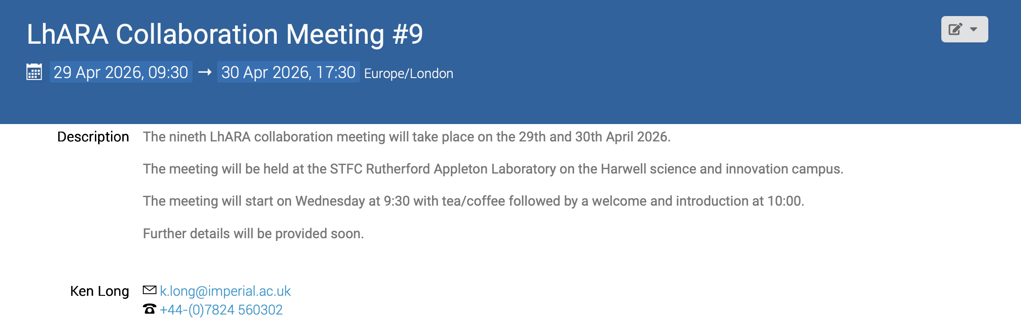
https://indico.stfc.ac.uk/event/1783/
Afternoon session: 30Apr26;
Rutherford Lecture: Radiobiology in novel regimes; laser-driven ions for biomedical applications
Public lecture
Developing the LhARA initiative:
Targeted, strategic discussion session

Slide 3
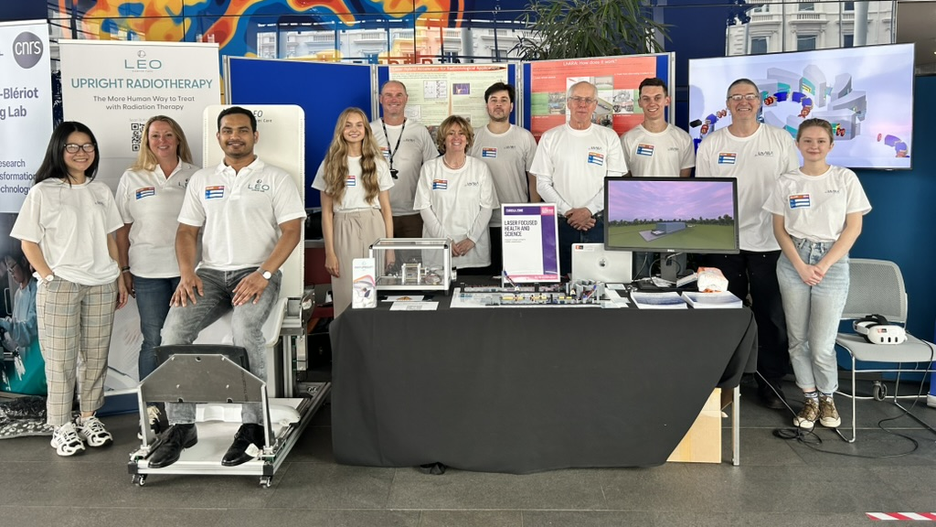


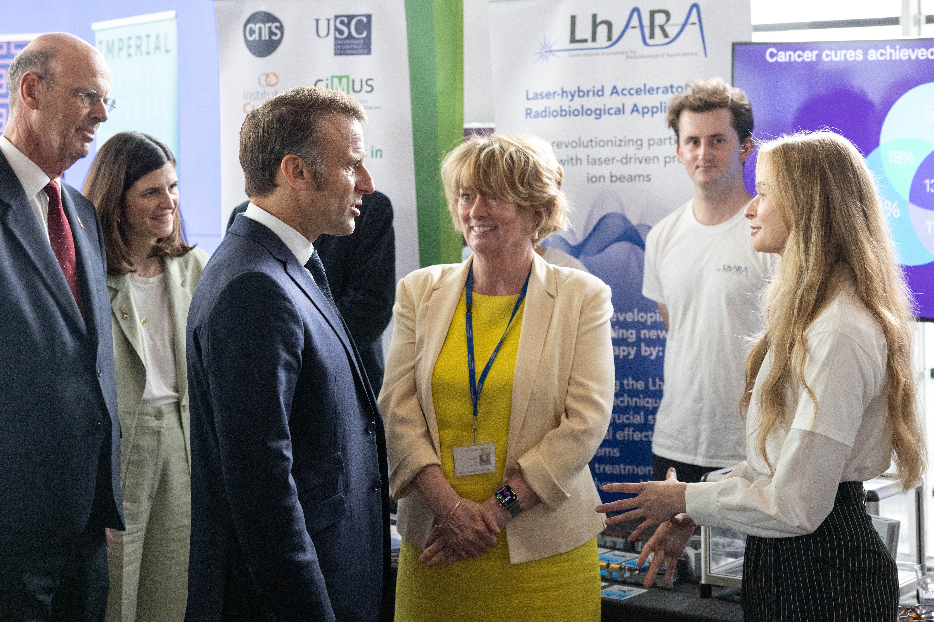
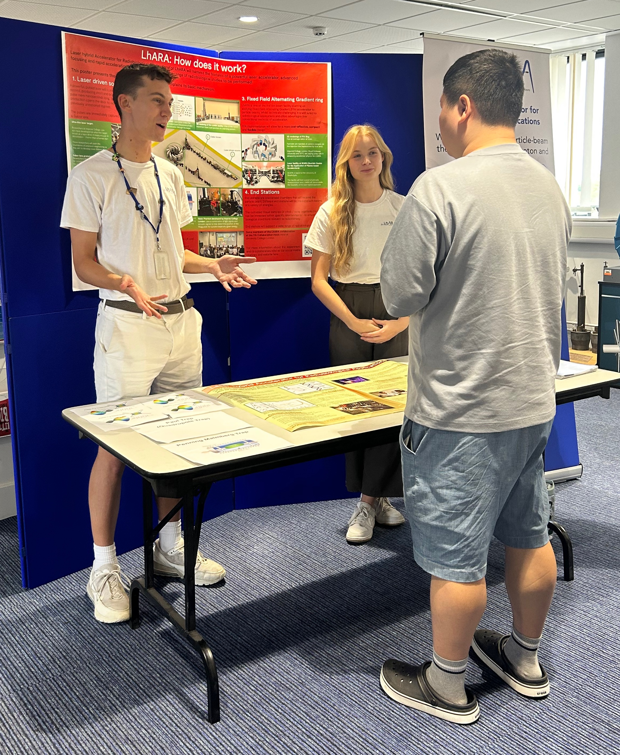
8/9Jun25
30Jun—05Jul 2026
Co-creation
Aug25
Jul25

