Slide 1
Welcome!
Ken Long
27 February 2026

Slide 2
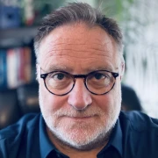
Thanks …
To all for being here or online …
To presenters for their contributions … and …
To:
Richard Amos

Slide 3
http://purl.org/net/epubs/work/64272701

Slide 4
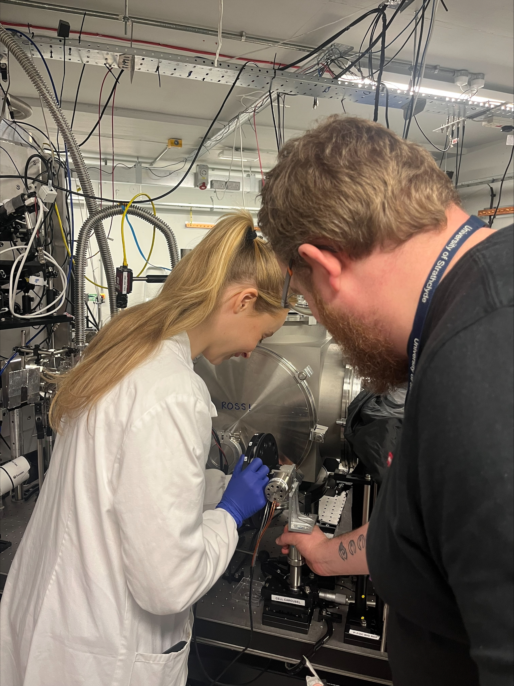
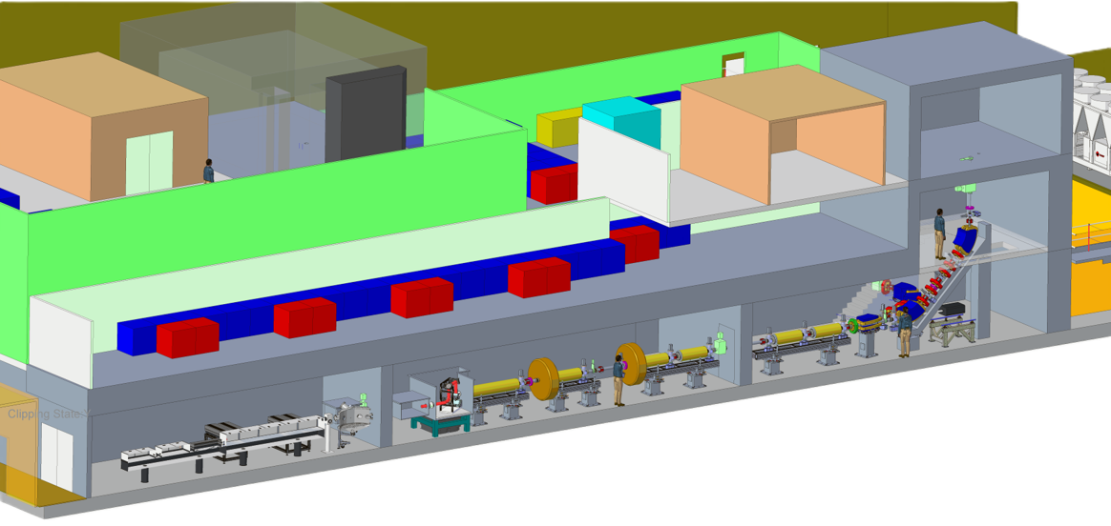
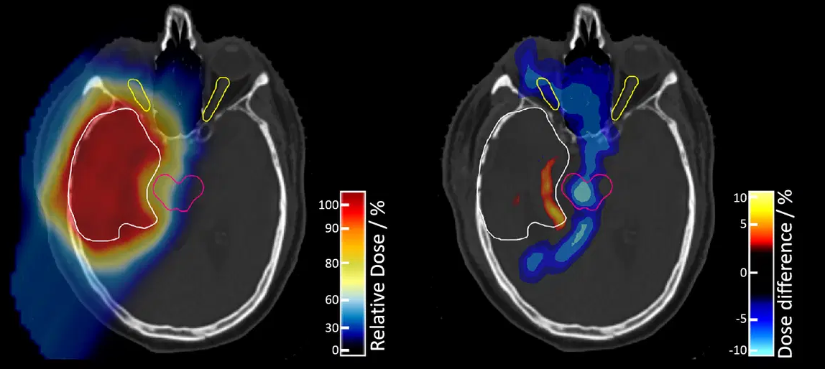
The LhARA initiative
RADIOBIOLOGY
LhARA
Co-creation

Slide 5
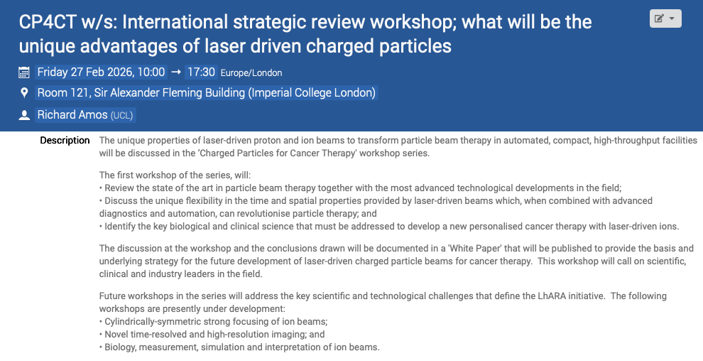

Slide 6

https://www.cp4ct.org

