Slide 1
Translating Innovative Radiotherapy Technology into Clinical Practice
Rock Mackie, PhD
Emeritus Professor
UW-Madison
UW-Madison Is on the Shores of Lake Mendota

Slide 2
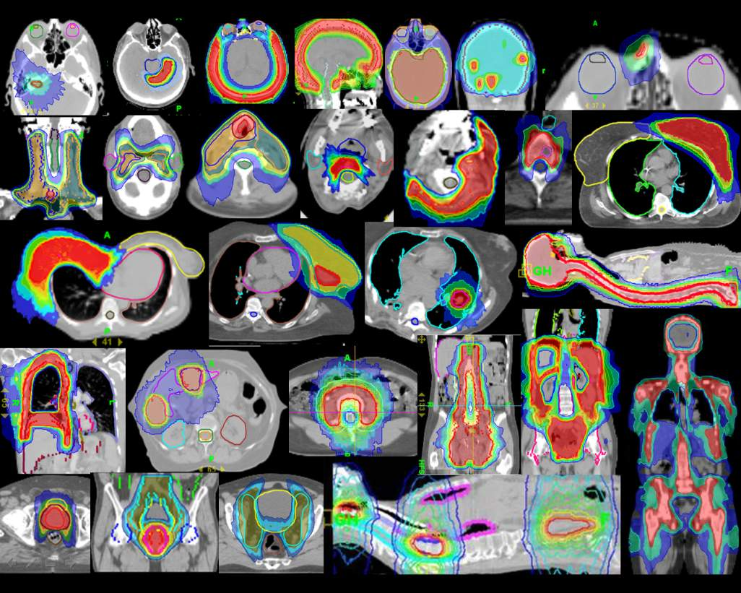
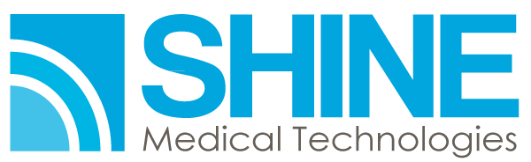
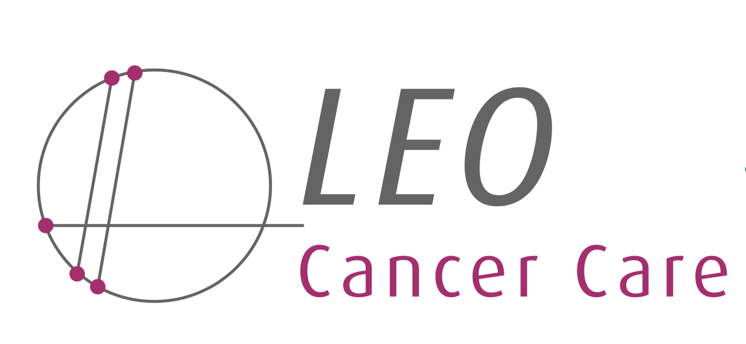


Disclosure and Potential
Conflicts of Interest Statement
I am a board member and investor in Shine Medical TechnologiesTM, a company developing a new technology for high specific activity medical radioisotopes.
I am a co-founder of Asto CTTM, a company developing an equine CT scanner. I am Chairman of the Board of Directors, and have ownership in the company.
I am a board member and investor in Leo Cancer CareTM, a company developing an upright radiotherapy system for proton and x-ray radiotherapy. I am Chairman of the Board of Directors and have ownership in the company.
I am an investor in ImageMoverMDTM, a medical image connectivity solution company.
I am an investor in OncoraTM, a company developing predictive analytics for radiation oncology.

Slide 3
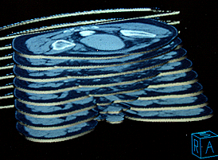
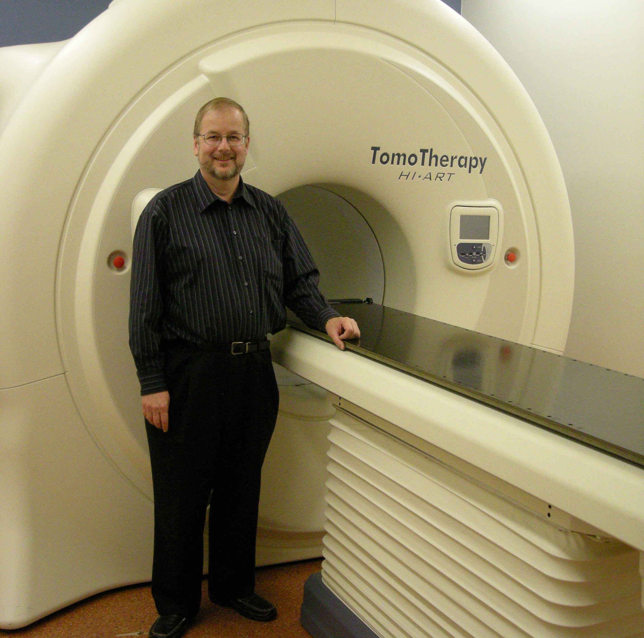
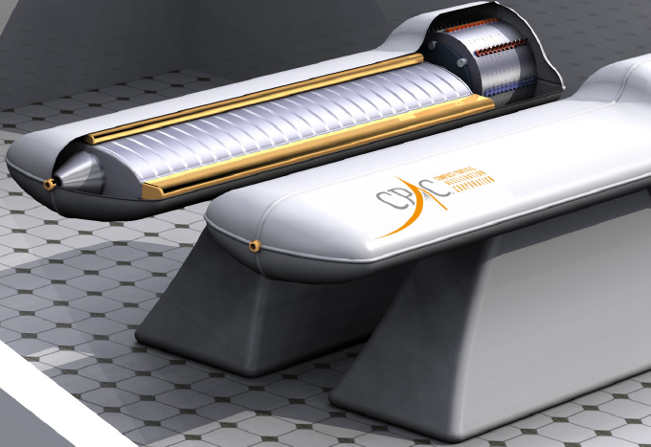
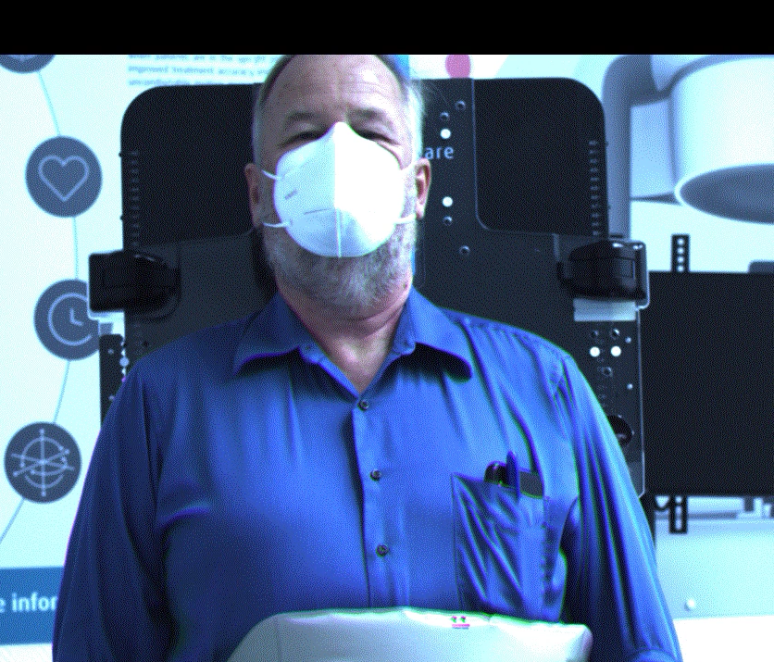
Radiotherapy Technologies I Have Co-founded
Geometrics
(Pinnacle RTP)
TomoTherapy
Leo Cancer Care
CPAC

Slide 4
University of Wisconsin Medical Physics Dept. Spin-Offs
Lunar Corporation
(Now GE)
Radiation
Measurements
Inc.
(Now Sun Nuclear)
Geometrics
(Now Philips Medical)
AIQ
Thervoyant
Voximetry
Bone Care
TomoTherapy
(Now Accuray)
Mazess
Fellowship
Medical
Physics
Publishing
Corporation
Standard
Imaging
CPAC
WiSolve
Sonic Foundry
Medical
Physics
Foundation
Ultravisual
(Now IBM)
Medical
Engineering
Innovations
Advanced
Medical
Publishing
OnLume
Not-For-Profit
Novashield
Foundation
Asto CT
Leo Cancer Care
For-Profit
HealthMyne
ImageMover
Notes:
University of Wisconsin, Department of Medical Physics academic spin-off companies as well as the creation of other companies in the Madison Metro area from their faculty founders (continuous lines) or executives (dashed lines). Lunar Corporation developed the first bone mineral density scans. Radiation Measurements Inc and Standard Imaging produce quality assurance products for radiation oncology and radiology. Geometrics produced the Pinnacle radiation oncology treatment planning systems which is used on about one million patients per year worldwide. TomoTherapy pioneered rotational intensity modulated radiotherapy and CT image guided therapy. Many of these companies are now owned by multinational public corporations but still operate in Madison WI. Most of these companies employed Medical Physics trainees and former staff members. Not shown is General Electric Medical Systems, Shine Medical Technologies and Phoenix Nuclear Laboratories which also employ our trainees but were not founded by Medical Physics faculty.

Slide 5

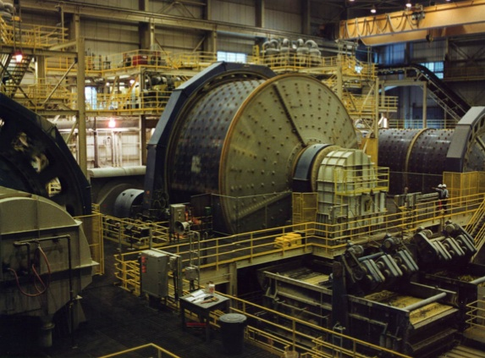
Role of Academia and Industry
Breakthrough ideas tend to come from academia and get implemented and refined in a company.
The University is the Mine
The Company is the Mill
A mill won’t last long if there is no mine, but a mill is required to get the product to market.

Slide 6
Who Are the Most Entrepreneurial Faculty in a University?
Business School Faculty?
Life Sciences Faculty?
Engineers?
Medical Researchers?
Fine Arts Faculty?
Rare
100%

Slide 7
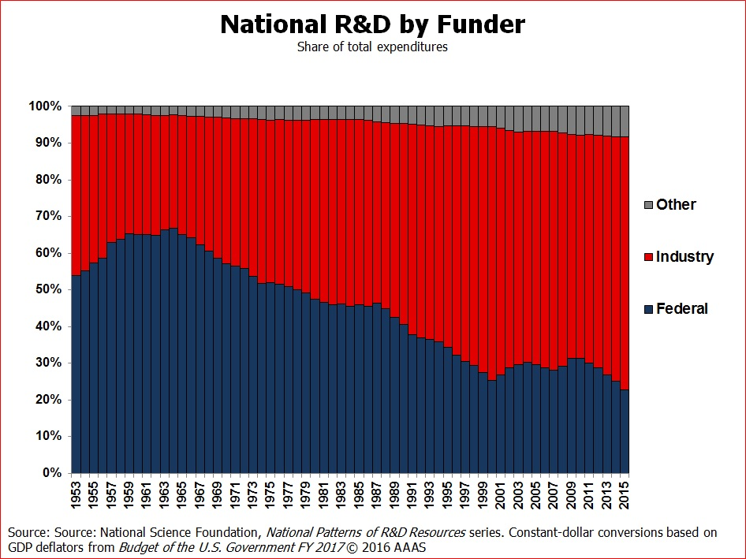
History of US Research Funding 1953-2015
At Cold War Peak, 70% of R&D was Funded by the US Federal Government
Today about 75% of R&D is Funded by Industry
Don’t look to Governments for Clinical Development
Cold War Peak
Cold War ”Over”

Slide 8
Regulatory Approval, Market Release and Post Market Surveillance Requires a Company
Substantial Equivalency
Medical devices can receive a designation of “substantial equivalency” if there are is no new biology/medicine to prove and obviate the need for the clinical trial phase.

Slide 9
How To Judge Innovations?
Formulate hypotheses and concentrate on tests that falsify the hypotheses (Karl Popper’s Falsifiability Principle)
In medicine, and other applied sciences, the hypotheses revolve around:
Works better (better outcomes like fewer complications)
Cost (less) or reimbursement (more)
Easier to use (less complicated or less prone to error)
Two out of three (e.g., better and easier to use) could be disruptive.
Three out of three always is disruptive.
Innovations, especially disruptive ones at first, run up against:
“We have always done it this way.”

Slide 10

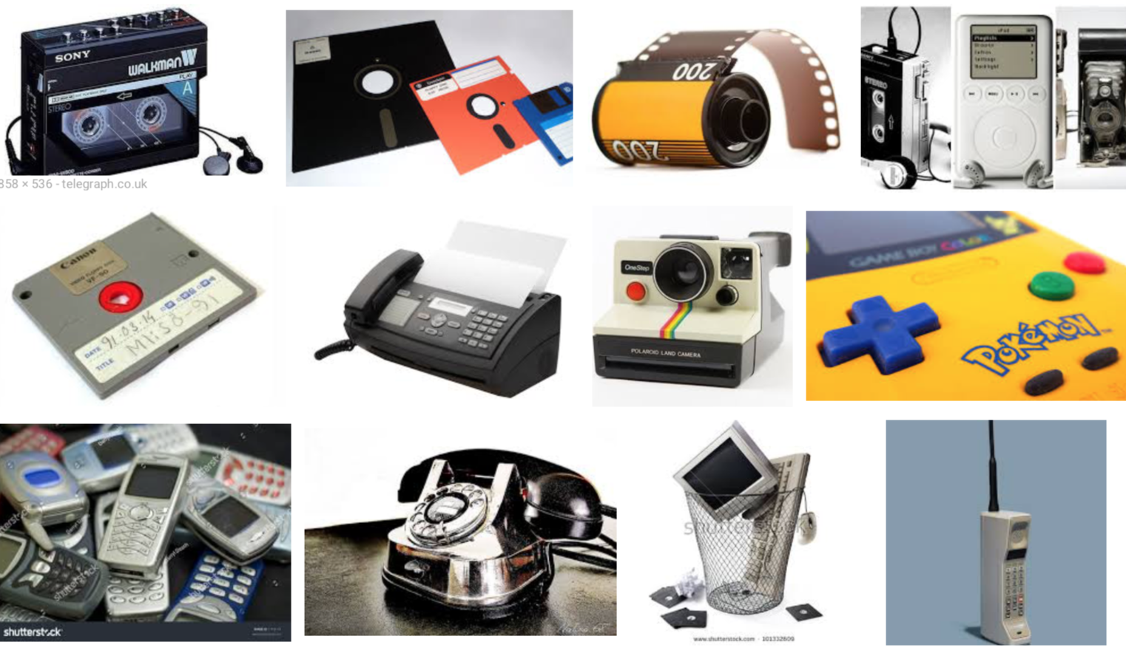
“We Have Always Done It This Way”
Music player, data storage, camera, fax, game player, internet browser, pager, telephone, etc., …
A Cell Phone Cannot Replace All Features but
Expands Horizons

Slide 11
Flow Chart for Company Formation
Identify an important problem.
Arrive at a technical solution to the problem and see if there is a patent or the solution is known.
If there isn’t, file a patent.
Will sufficient customers like your solution?
Do investors like your business plan?
Identify a Problem
Develop a Solution
Protect Intellectual
Property
Test Business Plan With Customers
Get Investment

Slide 12
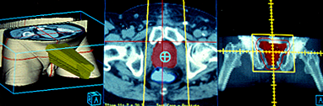
Startup Scenario for Geometrics
Problem to Solve: First FDA Cleared 3D CT-based radiation therapy treatment planning (RTP).
Solution: Convert university-backed stereotactic radiosurgery system to general RTP and get FDA clearance.
IP Protection: Copyright on source code.
Customers Consulted: Only UW-Madison medical physicists and radiation oncologists.
Investor: Adac Corp. supplied advance against royalties (like a book deal).
How’s It Going?: Sold at a fraction of its value to Adac who named it Pinnacle³ and then Adac sold to Philips Medical. Hundreds of thousands of patients per year had Pinnacle³ plans at the peak of use. Withdrawn from market in 2021 after 25 yrs.

Slide 13
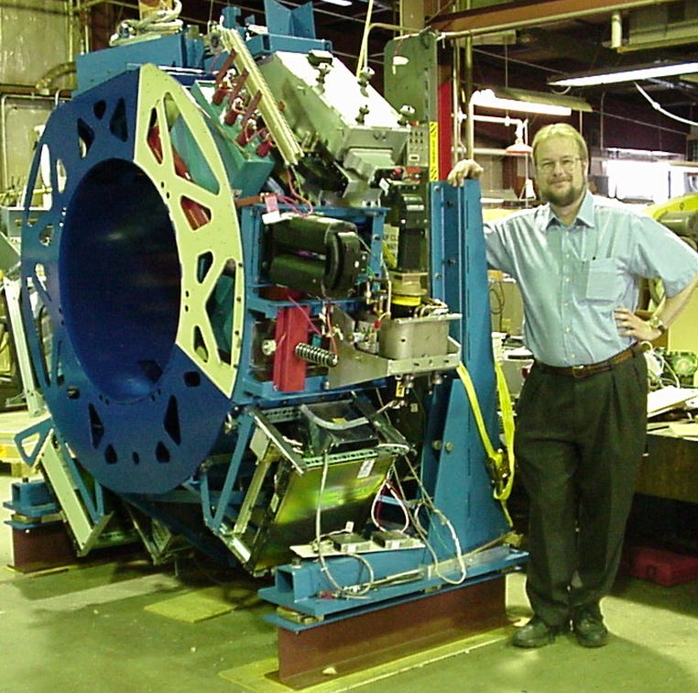
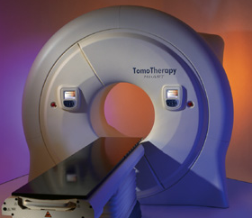
Startup Scenario for TomoTherapy
Problem to Solve: Develop an IMRT and IGRT workhorse machine.
Solution: Helical tomotherapy (fan beam IMRT) and CT system.
IP Protection: University technology transfer organization, Wisconsin Alumni Research Foundation (WARF).
Customers Consulted: Previous tomotherapy customers (NOMOS serial tomotherapy).
Investor: Mainly Wisconsin investors including WARF.
How’s It Going?: TomoTherapy did an ~ $ 1 billion IPO in 2007 and merged with Accuray in 2011. >100,000 patients/yr are treated with this technology.

Slide 14
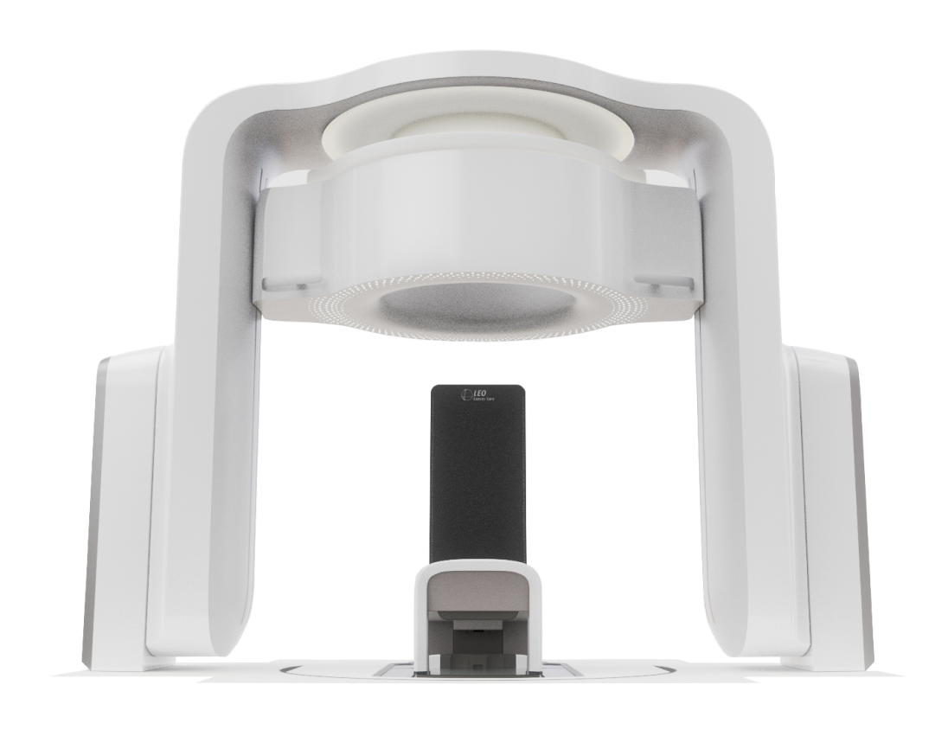
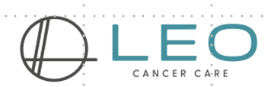
Enabling Technology for Upright Radiotherapy
Marie®
FAN BEAM CT
A Dual-Energy CT Capable Of Imaging Head & Neck, Breast & Lung, Prostate
UPRIGHT POSITIONING
An Upright Positioning System Treating from Head to Thigh

Slide 15
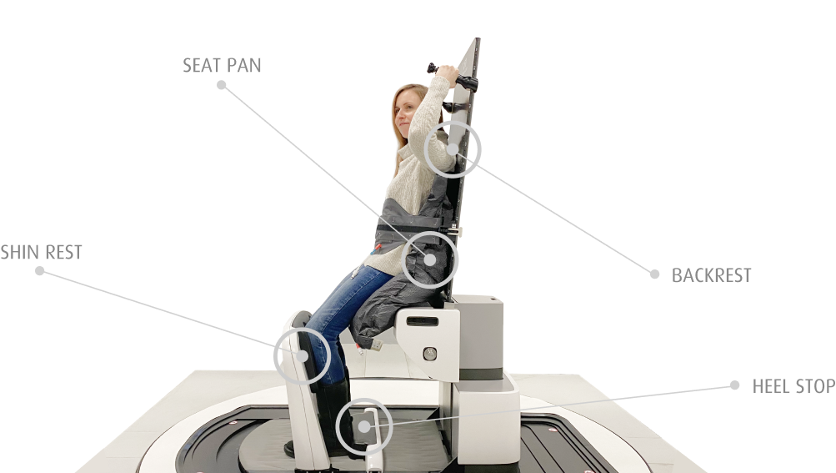
Muscles Relax and Hard to Move Around
SEAT PAN
Comfort, Stability and Faster to Setup
SHIN REST
BACKREST
HEEL STOP

Slide 16
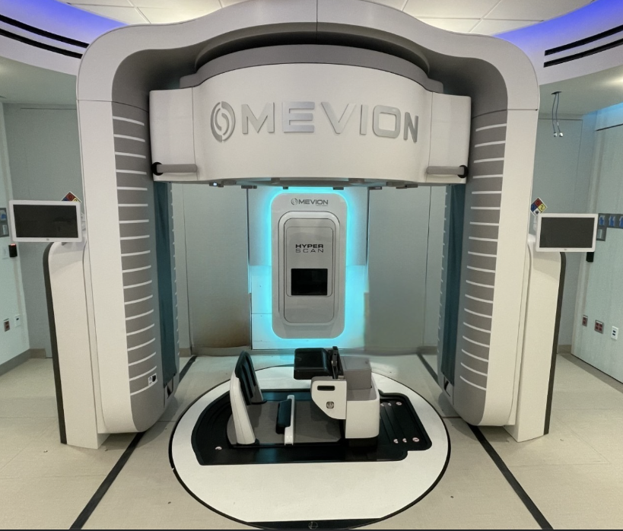
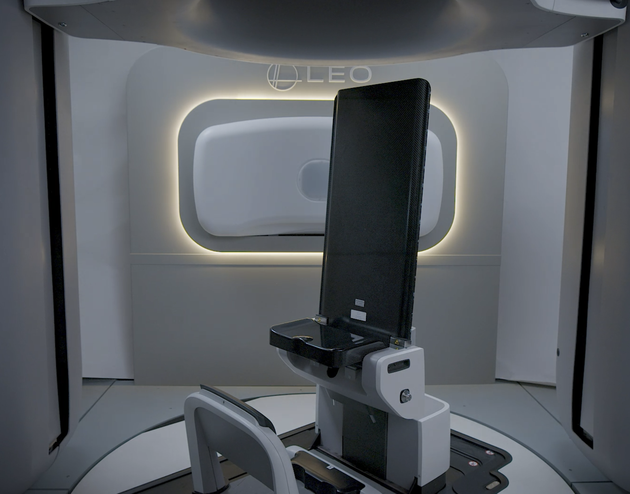
Make Proton Beams Seem Like Photon Beams
Mevion Fit® 250 MeV Proton Beam
in A Photon Vault
Leo Grace® 6 MV FFF Photon Beam

Slide 17
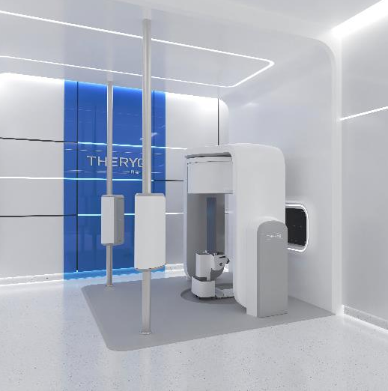
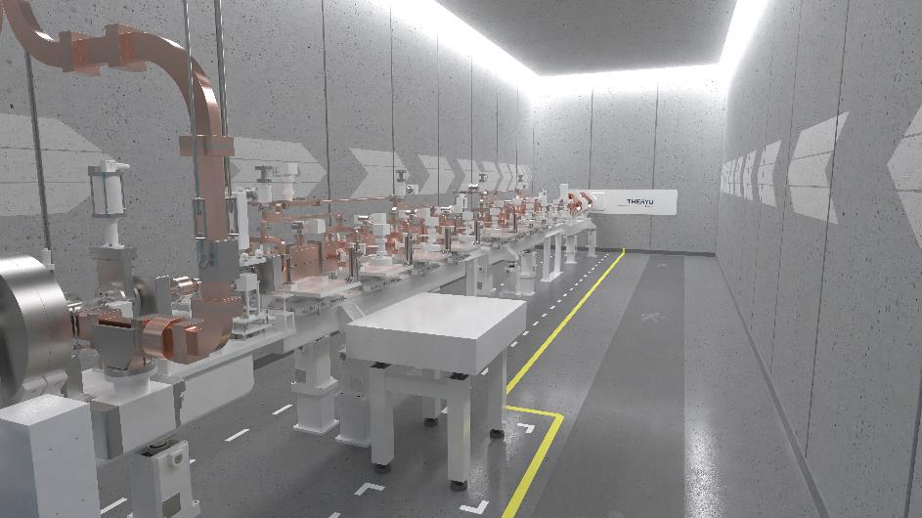
Much Easier to Advance New Treatment Modalities Like Flash Radiotherapy
Leo Marie® in a Theryq Vault
Theryq High-Energy Electron Beamline

Slide 18
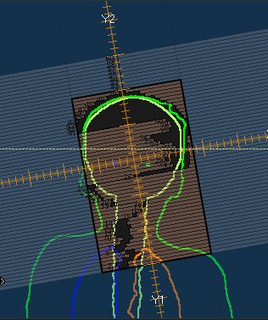
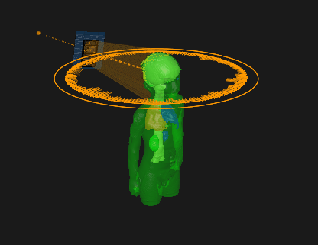
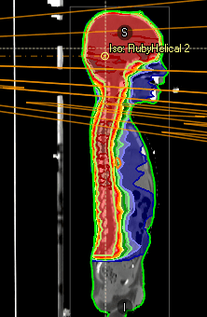
UPRIGHT PHOTON BEAM ROTATION PLANNING IN RAYSTATION
Helical treatments
3 Revolutions, collimator angle 10 degrees
Similar plan quality as 3 VMAT beams with different isocenters

Slide 19
Startup Scenario for Leo Cancer Care
Problems to Solve: Lower cost, usually better posture, easier to setup, higher throughput.
Solution: Design upright positioning system with multiple postures and a CT scanner that can scan in treatment position.
IP Protection: Company patents.
Customers Consulted: Customers that could not afford particle therapy who wanted an opportunity to cut cost by half.
Investors: Global investors.
How’s It Going?: Proton RT sales, FDA cleared, photon version launched.
SEAT
PAN
BACKREST
SHIN REST
HEEL
STOP

Slide 20
The Problems with Particles
Size and cost limits patient access.
Need to put protons into a photon vault – few clinics can afford new construction, and nobody wants a three-story vault.
Uncertainty in proton dose distributions and lack of good image verification means that it is not a yet a universal solution for radiotherapy.
Particle radiotherapy can be made better but there is little coordinated demand like there was for 3D planning or IMRT because the gain in therapeutic ratio is not commensurate with cost.

Slide 21
Dielectric Wall Accelerator* (DWA)
Optical Coupling
Laser
High
Gradient
Insulator
Proton Source
Focusing
SiC Optical Switches
Monitor
Stack of Blumleins
*Lawrence Livermore National Laboratory, Livermore CA

Slide 22
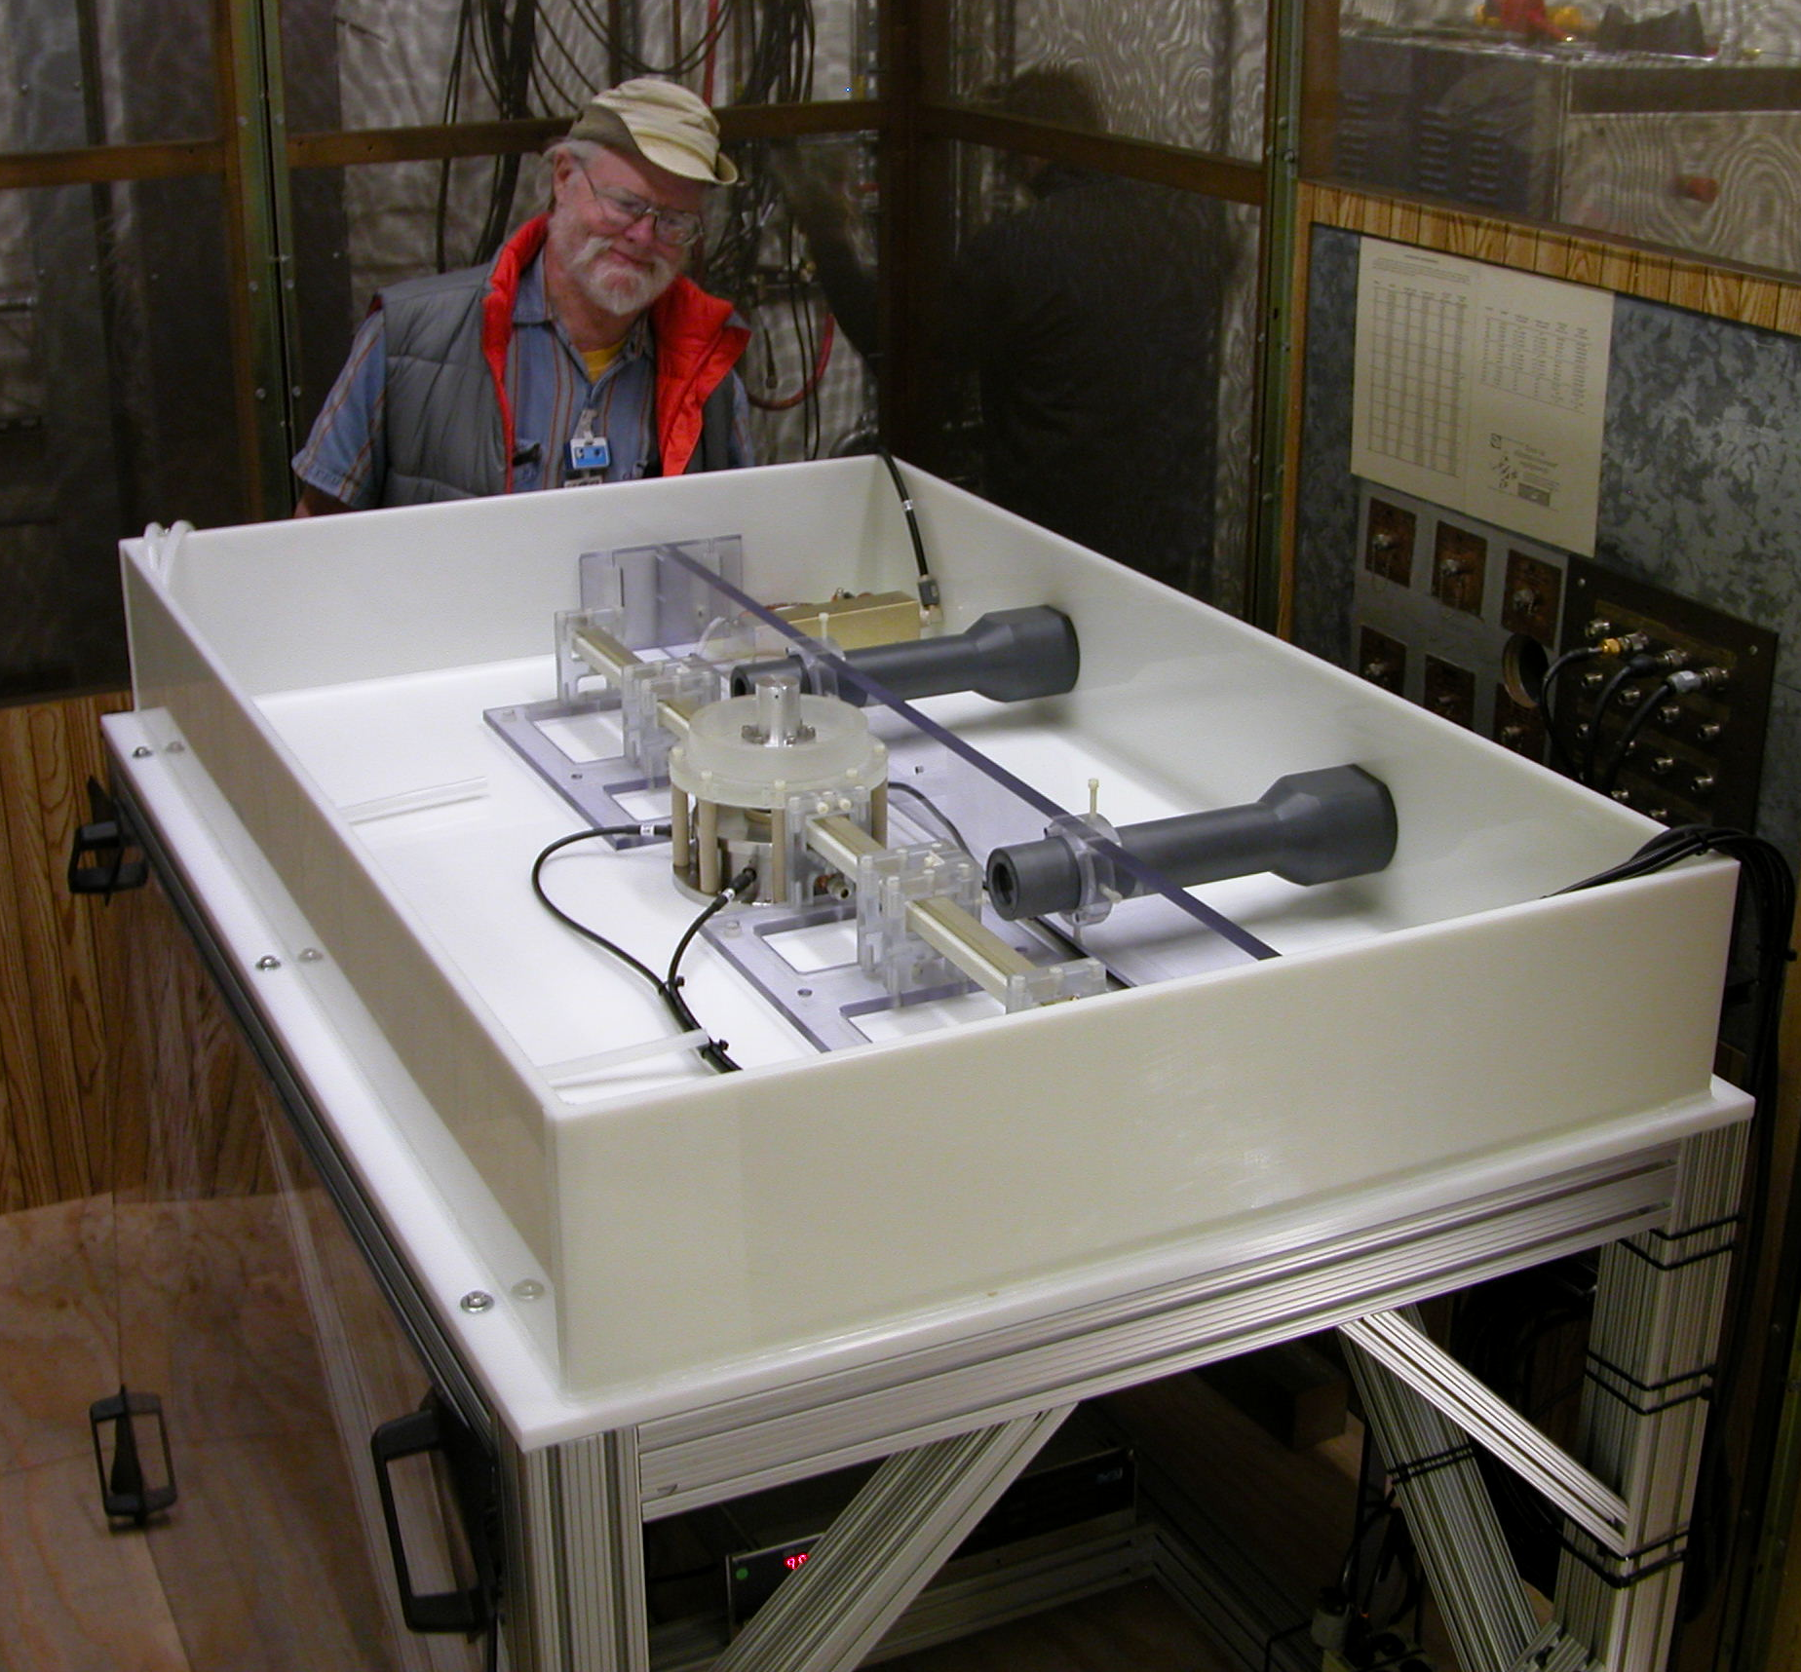
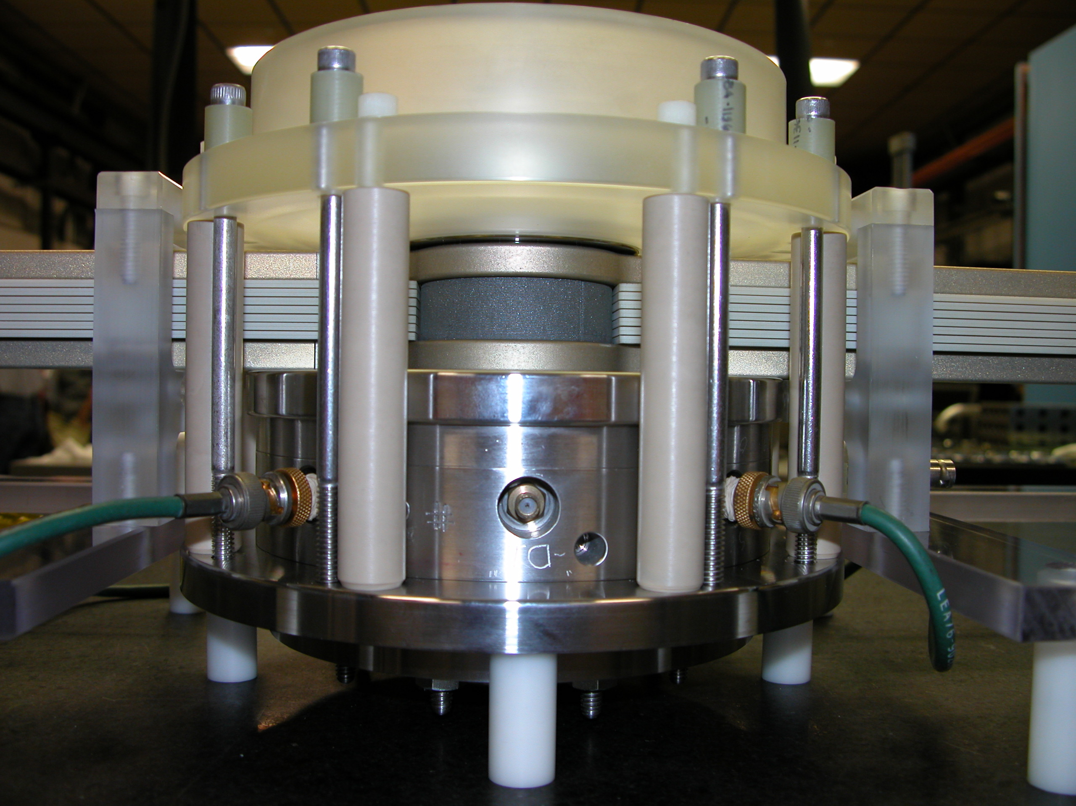
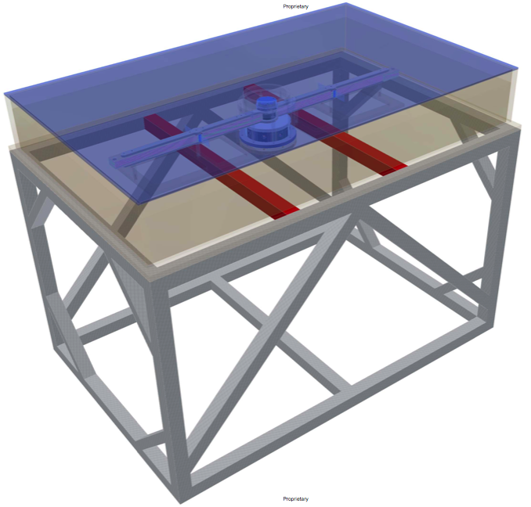
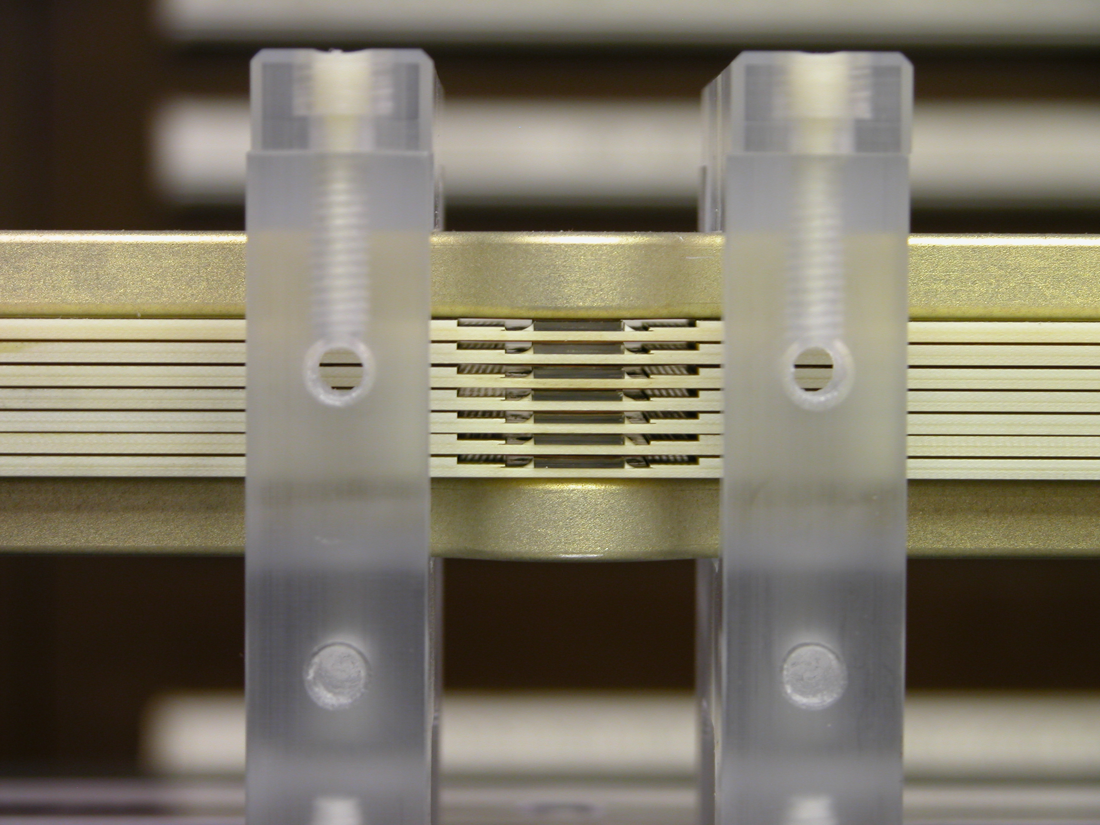
Compact Particle Accelerator Corporation (CPAC) Licensed the DWA from Livermore
Cooperative research and development agreement between CPAC and Lawrence Livermore

Slide 23
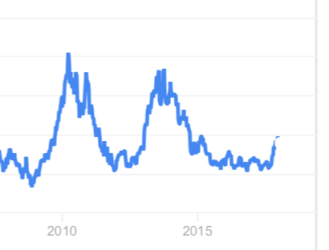
Major Lessons Learned from CPAC
Technology licensed from LLNL was not beyond the research stage.
Cree, the maker of the world’s best SiC got busy with the consumer diode business and decided not to address the high-voltage potential of the material.
Cree Share Price ($)
Interest
Disinterest
100
80
60
40
20
0
2010
2015
Source: Google Finance

Slide 24
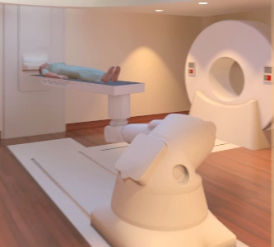
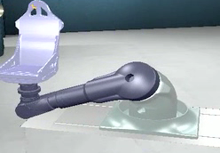
Patient Positioning System
Laser system
Interchangeable Robotic Couch and Chair
6 Degrees of freedom
Anti-collision System
Ocular setup for chair
Integrated with delivery system
Tolerances for SRS
Standard immobilization device attachment

Slide 25
Startup Scenario for CPAC
Problem to Solve: Cost of particle therapy too high so make the accelerator less expensive.
Solution: Develop a compact particle accelerator with a high energy gradient.
IP Protection: Lawrence Livermore National Laboratory, California.
Customers Consulted: A few proton customers.
Investor: TomoTherapy and some of their investors.
How’s It Going?: The Livermore science was immature (license when only the scaleup engineering is left). The high voltages switches failed to work as anticipated and the company went bankrupt. Don’t rely on one supplier for a critical component.

Slide 26
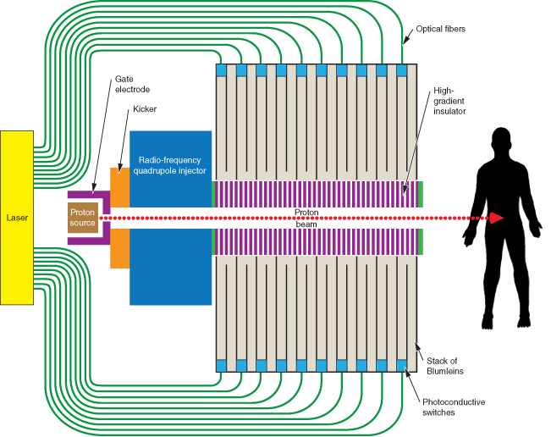
Not Promising to Lower Cost
Target
Electron cloud creates
intense electric field
Wakefield/Laser Accelerators
Dielectric Wall Accelerators
Blow off
plasma
Use a short laser pulse to ionize a target with high Z and hydrogen
Large energy and angular distribution
Laser Beam
Difficult Research Directions
Fast protons
Generate a high gradient in an accelerator with fast acting switches
The switch lifetime is too short
Courtesy Richard Maughn, University of Pennsylvania

Slide 27
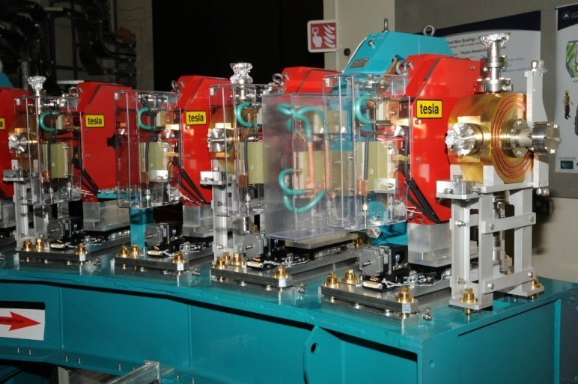
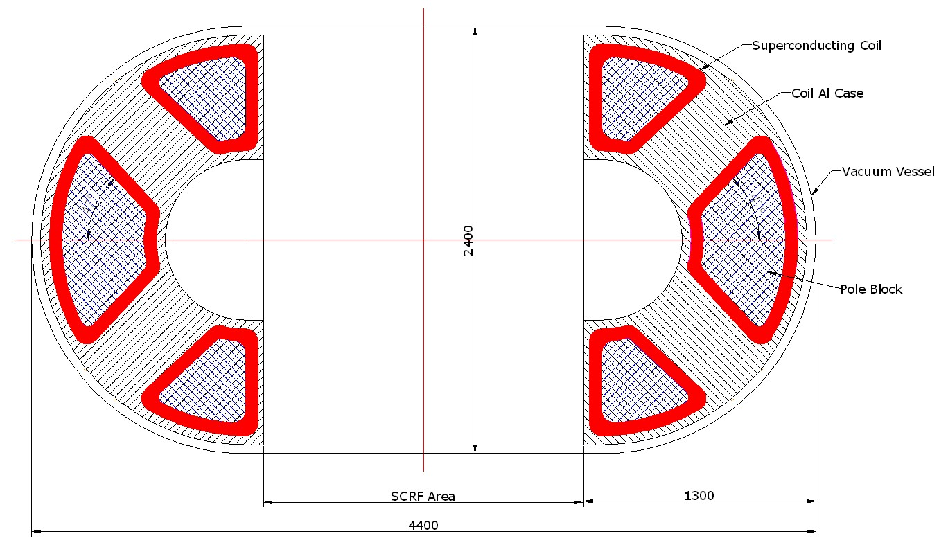
Evolution of the Fixed-Field Alternating Gradient (FFAG) Accelerator
Simultaneously invented by Tihiro Ohkawa in Japan, Keith Symon at the UW-Madison and Andrei Kolomensky in the USSR in 1950’s. The most intensive early studies were carried out by Symon, Donald Kerst and others at the UW-Madison.
70 - 430 MeV/nucleon Ion FFAG
< 3 m
PAC
Particle Accelerator Corp
EMMA,
Daresbury Laboratory, U.K.
< 5 m
PAC ns-FFAG design is a compact accelerator producing variable–energy ~DC beam up to 330-MeV for proton and 430 MeV/nucleon for ion therapy
World’s first ns-FFAG
Adapted from Carol Johnson, FermiLab

Slide 28

Take Away Thoughts
Breakthrough technologies come from academia.
The most important problem is finding a big enough problem to solve.
The big problems to solve and their solutions are only obvious in hindsight.
Ask enough potential customers if your problem and solution are viable.
Don’t expect government, including national labs, to fully fund non-military development projects.
Companies are required to get regulatory clearance.
Will find a market if the product is less costly, better, and easier to use.
It takes a community.

