Slide 1
Radiation chemistry insights into FLASH radiation:
A novel interpretation of FLASH
Prof Dr. Joao Seco, DKFZ Heidelberg
London, UK, February 27, 2026

Slide 2
Impact of Radiation on Water and Biological Systems

Slide 3
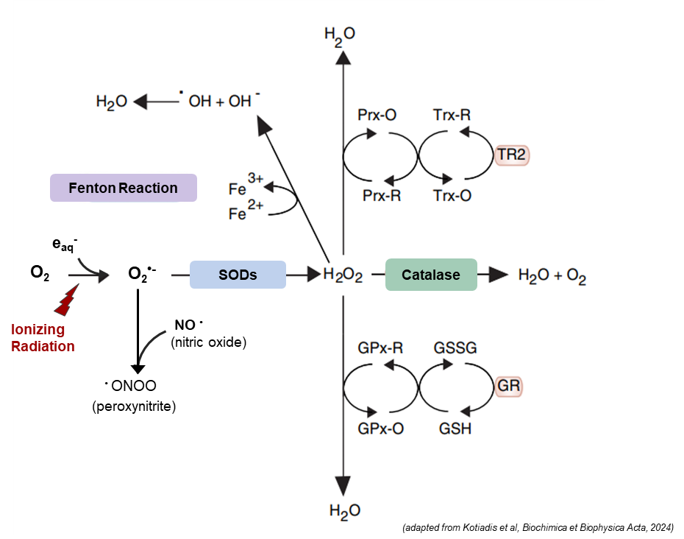
Radiation, Radicals, and the Relevance of H₂O₂
Ionizing radiation generates a spectrum of radicals
H₂O
HO· e⁻_{aq} O₂· ⁻ H₃O⁺ OH⁻
H₂O₂
Ionizing Radiation
Long-lived
Diffusible
Biologically Active
CONV Dose Rates
Formation and Decay follow
well-studied kinetics patterns
UHDR Dose Rates
Altered radical decay and
spatiotemporal chemistry
H₂O₂ very important signaling molecule
Notes:
Ionizing radiation generates a burst of water radiolysis products:among the downstream species, H₂O₂ is the longest-lived and most diffusible, capable of acting both damaging and signaling.

Slide 4
Cellular generation of H₂O₂
Endogenous Sources:
Mithocondria (ETC, complexes I,II,III) → O₂^{•-} → H₂O₂ Xantine Oxidase System,
NADPH oxidases (NOX): NADPH → O₂^{•-} → H₂O₂ Peroxisomal oxidases, ER ERO1
Exogenous Sources:
Xenobiotics
Ionizing Radiation:
SOD
O₂ ​+ e_{aq}⁻ → O₂^{•-}
2O₂^{•-} + 2H⁺ → H₂​O₂ ​+ O₂​
Reaction catalyzed by the enzymes: SUPEROXIDE DISMUTASES (SOD)
highly conserved antioxidant enzymes
the frontline defense against Reactive Oxygen Species (ROS)
The balance between O₂•⁻ and H₂O₂ strongly depends on SOD activity

Slide 5
Superoxide Dismutase enzyme (SOD)
Structural Features: Metal cofactors, Isoforms and Localization (in human)
SOD1 (Cu/Zn) (homodimer) → cytosol
SOD2 (Mn) → mitochondria
SOD3 (Cu/Zn) (dimer) → extracellular space
Cu²⁺
Zn²⁺
Zn²⁺
Cu²⁺
SOD1
SOD1 Homeostasis and Tumor Redox
Normal Cells: SOD helps to maintain a stable redox balance → better antioxidant defense systems and H₂O₂ detoxification
Tumor Cells: High ROS and impaired detox systems (altered SOD dynamics) → more vulnerable to oxidative damage
SOD1 in cancer
high or low expression
SOD1 overexpression: tumor cell protection from IR damage
Radiation triggers SOD expression
→
Radioresistance

Slide 6

Can SOD inhinibition modulate H₂O₂ levels and induce radio-protection?
The balance between O₂•⁻ and H₂O₂ strongly depends on SOD activity
Hypothesis
SOD1 inhibition AT THE TIME of IR might prevent toxic H₂O₂ buildup resulting in protective effects
Aim
To evaluate whether SOD1-H₂O₂ axis modulation can mimic FLASH-like protection also under CONV-IR
Methodology
Pharmacological inhibitors or genetic approaches?
Direct or indirect SOD inhibition
Reduced treatment time
Transient inhibition

Slide 7
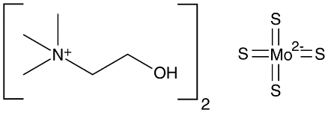
Pharmacological SOD1 Inhibition
COPPER Chelator and SOD inhibitor
ATN-224 (choline tetrathiomolybdate) is a Copper (Cu²⁺)-chelating agent investigated for the treatment of Wilson’s disease (genetic disorder manifested by Cu accumulation
ATN-224 inhibits superoxide dismutase enzyme (SOD1)
Low toxicity in clinical trials
Studied for anticancer applications → altered redox balance
TETA-4 (trientine tetrahydrochloride) is an Cu²⁺-chelating drug used to treat Wilson's disease in adults, adolescents and children (clinically approved drug)
COPPER Chelator but NOT SOD inhibitor

Slide 8
RESULTS: SOD inhibition in CONV and UHDR
in collaboration with:
University of Antwerp (Belgium)
University and Hospital in Pisa (Italy)

Slide 9
In vitro Irradiation Studies: COPPER Chelator and SOD inhibitor
Cell line models
HaCaT cells
(healthy keratinocytes)
SAS cells
(H&N cancer, from human tongue)
Drug treatment
ATN-224
1.5 h

Slide 10
SOD inhibition after short-term ATN-224 exposure
SOD recovery after ATN removal:
Approximately 12 hrs
(unpublished data – please do not duplicate and share)

Slide 11


Irradiation Experimental Conditions
@ UA (Belgium)
Cell line models
IR Dose Rates
HaCaT cells (healthy keratinocytes)
SAS cells
(H&N cancer, from human tongue)
Drug treatment
Electrons
CONV-IR
UHDR-IR
ATN-224
1.5 h before IR
Electron – IR (eIR) (ElectronFlash LINAC – SIT S.p.A.) 9 MeV energy
 | eCONV | eUHDR
Doses [Gy] | 2, 5, 10, 14.6 | 2, 5, 10 14.6
Pulse Rate [Hz] | 1 | 200
Pulse Length [μs] | 1 | ~1.6
Dose per Pulse [Gy] | ~0.063 | ~1.05
Mean Dose Rate [Gy/s] | ~0.06 | ~220 - 400

Slide 12
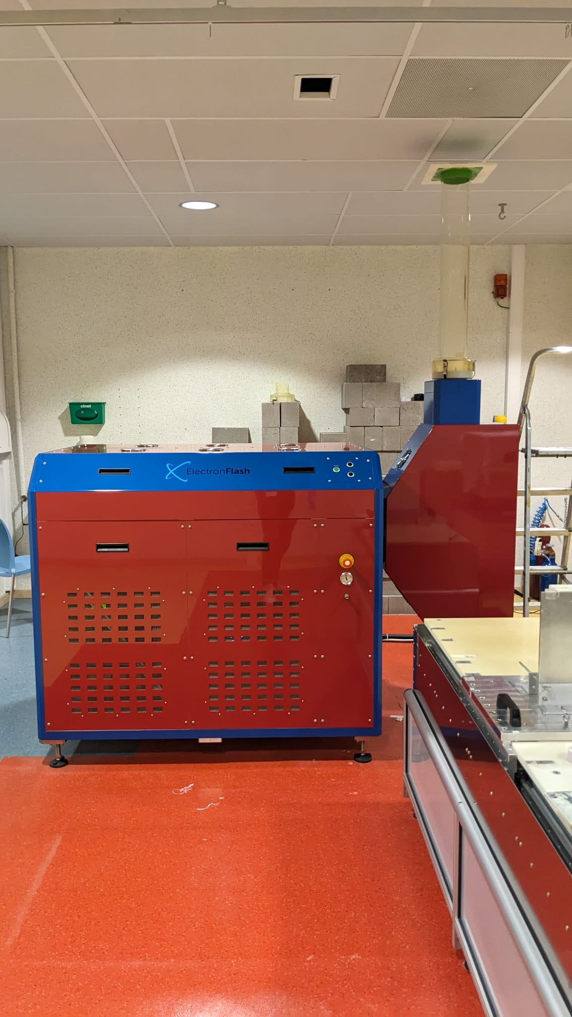
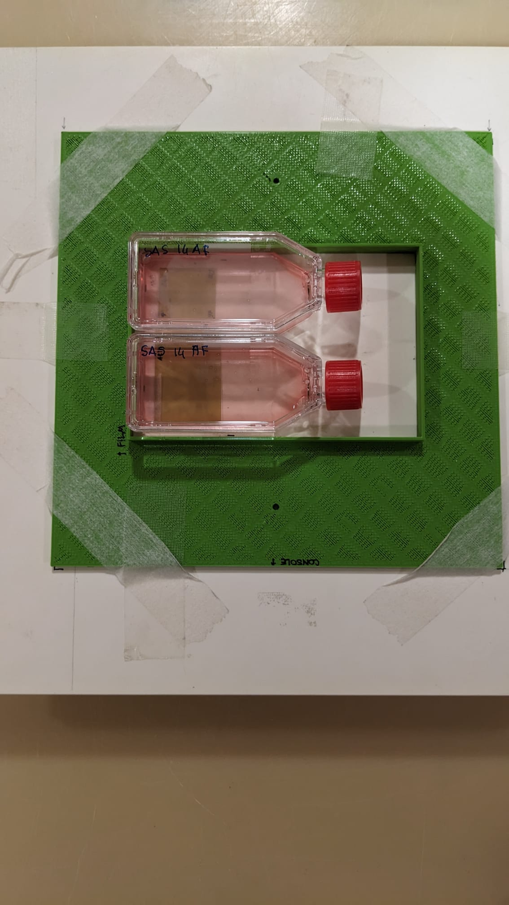
eCONV-IR and eUHDR-IR @ University of Antwerp
SURVIVAL CURVES
HaCaT 14.6 Gy -eIR
Irradiation set-up
SAS 14.6 Gy -eIR
(unpublished data – please do not duplicate and share)

Slide 13
TETA-4 treatment: Cu²⁺ Chelator but NOT SOD inhibitor
No SOD1 inhibition observed with TETA-4 at tested conditions
(unpublished data – please do not duplicate and share)

Slide 14
Survival Ability after SOD inhibition: eCONV-/eUHDR-IR
Copper chelation alone is not enough to account for the observed healthy cell protection
(unpublished data – please do not duplicate and share)
Notes:
Suggesting that The protective effect might be linked to SOD inhibition, not to generic metal chelation

Slide 15
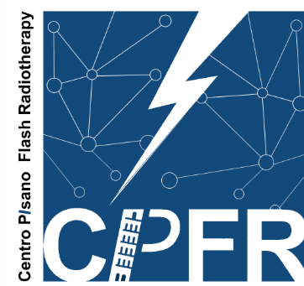



A Pilot In Vivo Study: CAM Model
eCONV-IR and eUHDR-IR @University of Pisa and CPFR
Chicken chorioallantoic membrane (CAM)
Notes:
HBE are highly sensitive to radiation
Survival fraction (SF) drops sharply already at 2 Gy.
At 8–12 Gy, survival is nearly zero
HBE16 cells benefit from UHDR irradiation (greater survival = FLASH sparing)

Slide 16
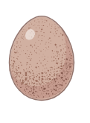
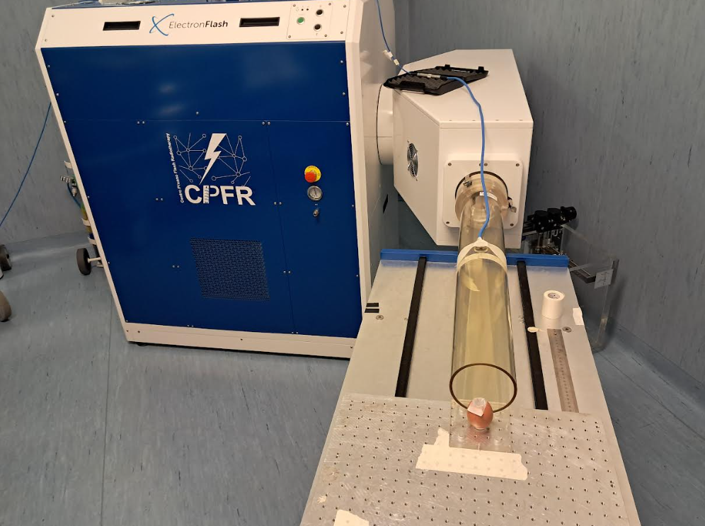
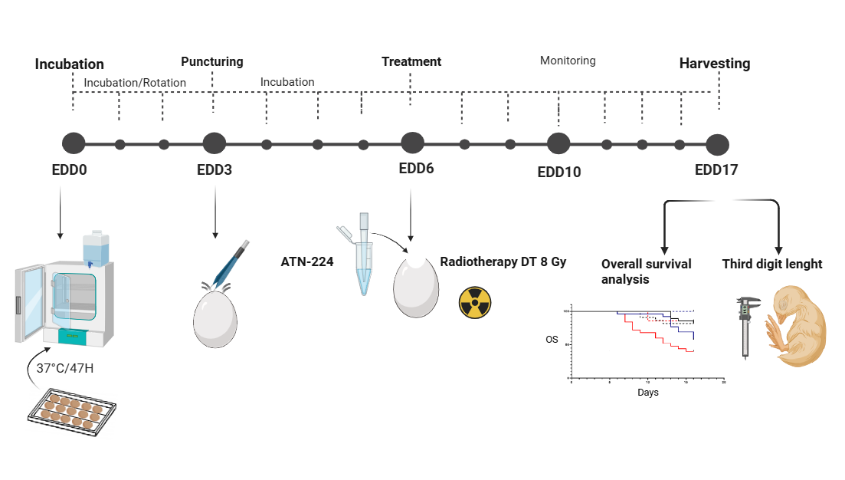
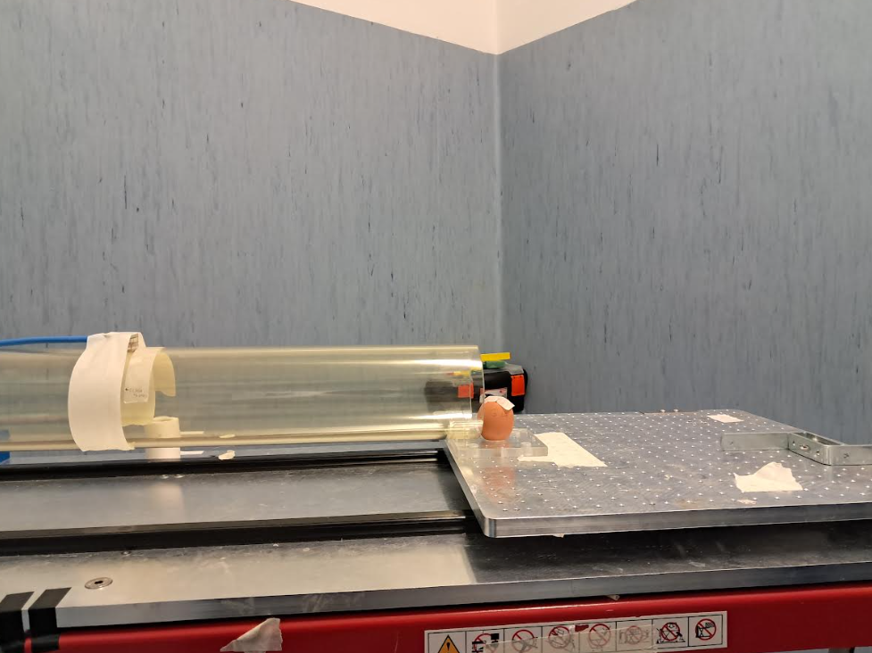

Effects of ATN-224 and IR on healthy eggs
Egg Survival Dose-Response
Irradiation set-up
Irradiation treatment protocol
<<<<<<<
<
100 µM
ATN-224
(unpublished data – please do not duplicate and share)

Slide 17


Effects of ATN-224 and IR on healthy eggs
Increased
Survival
ATN -IR
UHDR-IR
CONV-IR
Forget radiation biology!
We need
Redox Chemistry
(unpublished data – please do not duplicate and share)
Notes:
FLASH irradiation is less toxic and preserves survival compared to CONV (but the graph does NOT show statistical significance between them (ask Giovanni to recheck). Both IRs protect
ATN treatment protects and improves survival in CONV compare to CONV alone
CONV alone is the most damaging but in combination with ATN protects better and similarly to FLASH (isoefficacy)

Slide 18
CONCLUSIONS
The healthy cell lines: responded to UHDR with a “FLASH-like” effect resulting in increased survival
The cancer cell lines: did not respond with a “FLASH-like” effect resulting in no difference in survival vs CONV-IR
ATN-224 pre-treatment: ALL cells responded to CONV-RT and UHDR with a “FLASH-like” effect resulting in increased survival
Selective modulation of the redox environment can differentially affect healthy and cancerous cells
Reducing H₂O₂ via SOD inhibition could shift the oxidative balance and offers protection also in CONV-RT
SOD-dependent ROS dynamics might play a central role
Notes:
HBE are highly sensitive to radiation
Survival fraction (SF) drops sharply already at 2 Gy.
At 8–12 Gy, survival is nearly zero
HBE16 cells benefit from UHDR irradiation (greater survival = FLASH sparing)
→ this may help to expand therapeutic window

Slide 19
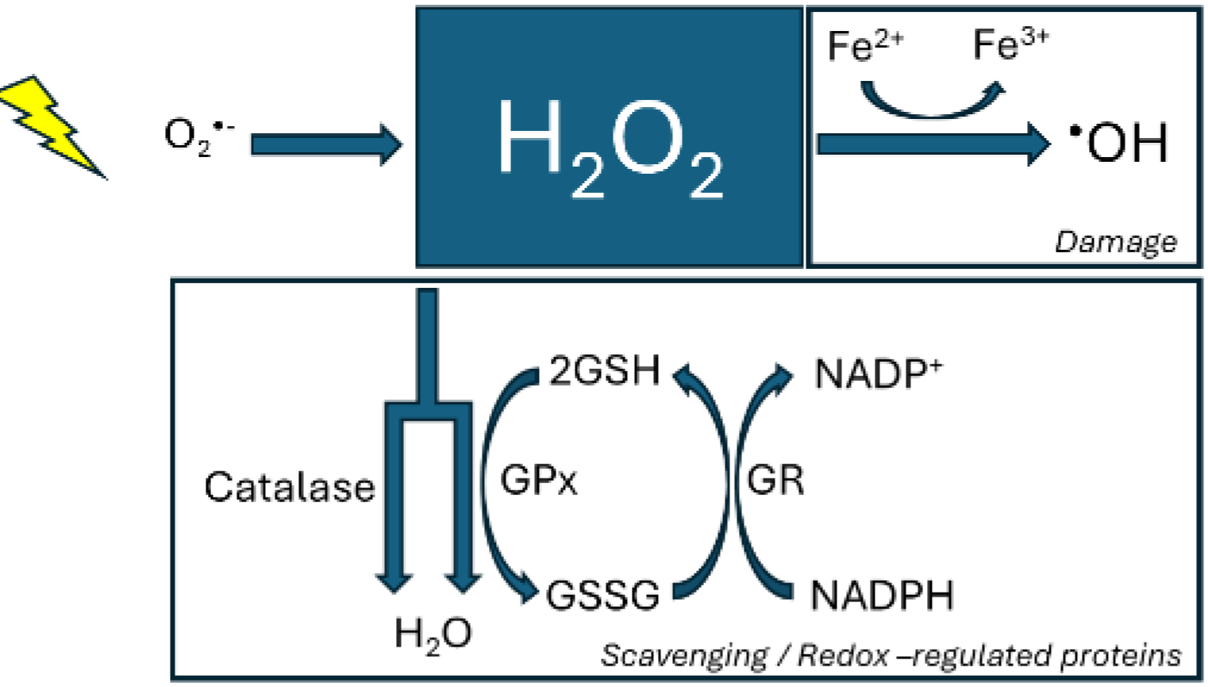
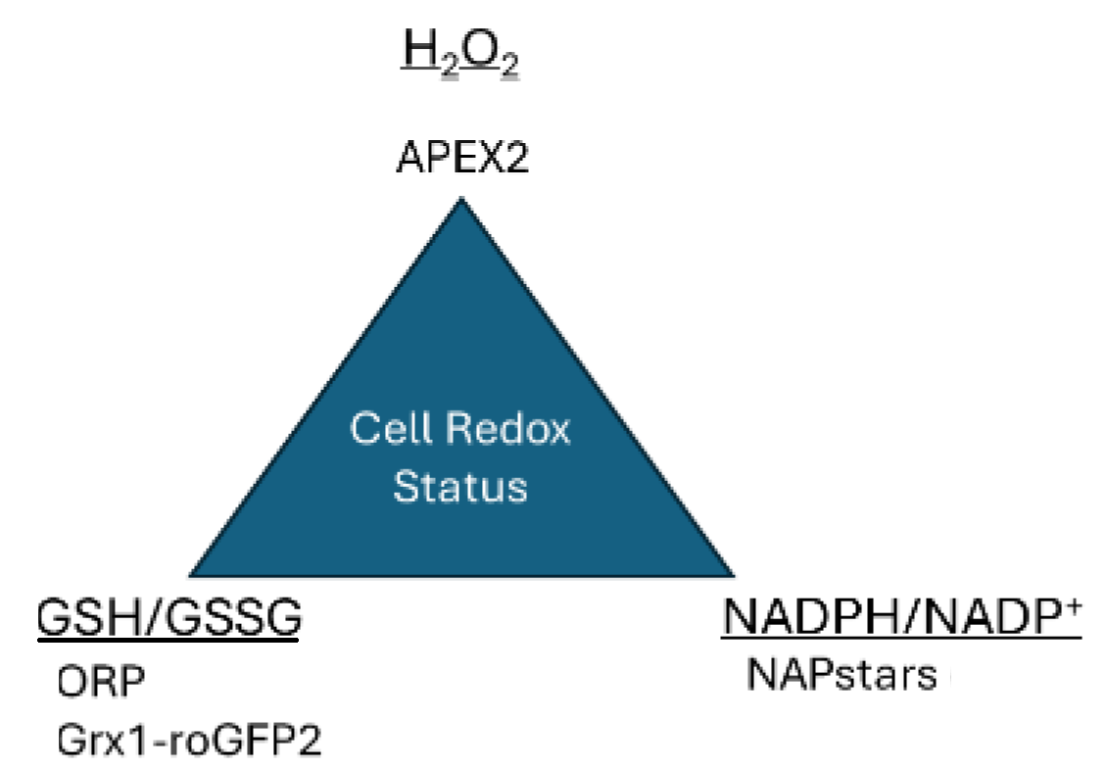
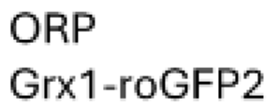
Working with UHDR from Laser Beams
UHDR laser beams allow mean dose rates up to 10¹⁰ Gy/s, making them ideal for radiation-chemistry studies (we are looking for partners)
It is important to study the following redox cycle:
Redox Cycle
Redox Probes
Notes:
HBE are highly sensitive to radiation
Survival fraction (SF) drops sharply already at 2 Gy.
At 8–12 Gy, survival is nearly zero
HBE16 cells benefit from UHDR irradiation (greater survival = FLASH sparing)

Slide 20








Acknowledgments
Prof. Pierre Montay-Gruel
Adrien Arrigo
Dr. Alessia Gasperini
Louize Brants
Dr Francesca Pagliari
Dr. Daniel Garcia
Maria Rebouta
Anna Becker
Chiara Tagliavini
Rafael Cepeda Lopes
Niklas Jung
Elpida Theodoridou
Prof. Valerio Voliani
Prof. Fabiola Paiar
Dr. Giovanni Gadducci
Dr. Noemi Giannini
Dr. Alessandra Gonnelli
Dr. Fabio Di Martino
Prof. Simone Capacciolix
Patent: WO2024208828 –Radioprotection by inhibition of Supeoxide dismutase 1
Pagliari Francesca, Jansen Jeannette, Garcia Daniel, Seco Joao, Knoll Jan

Slide 23
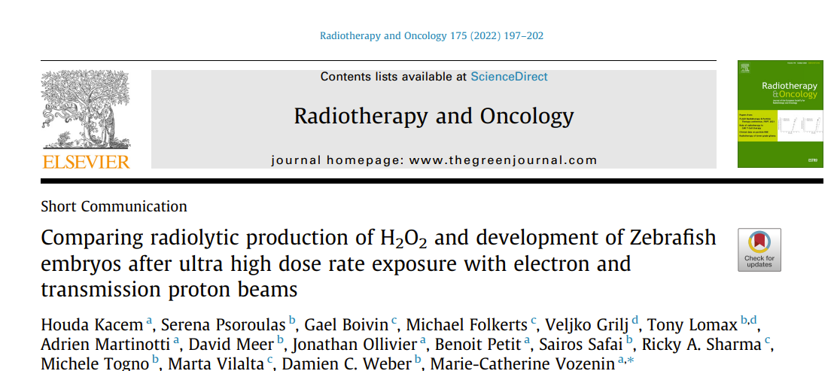
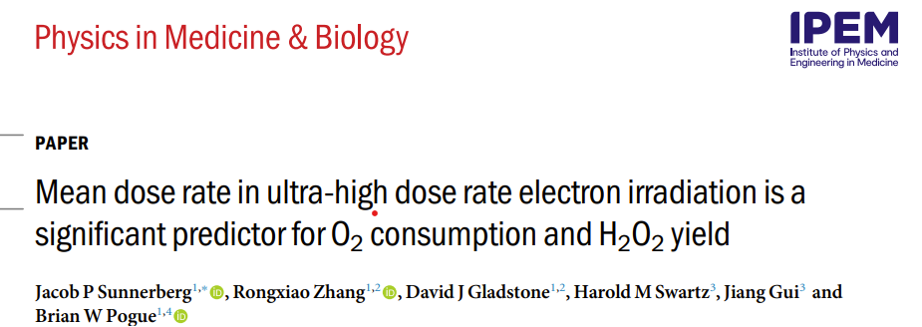
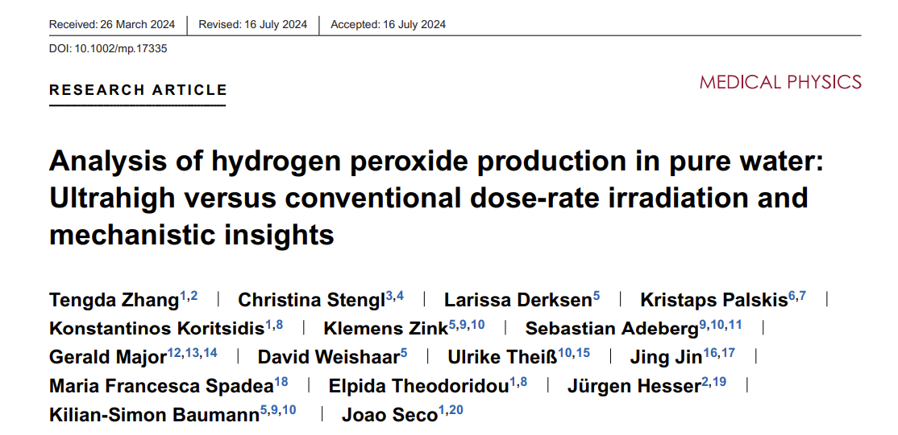
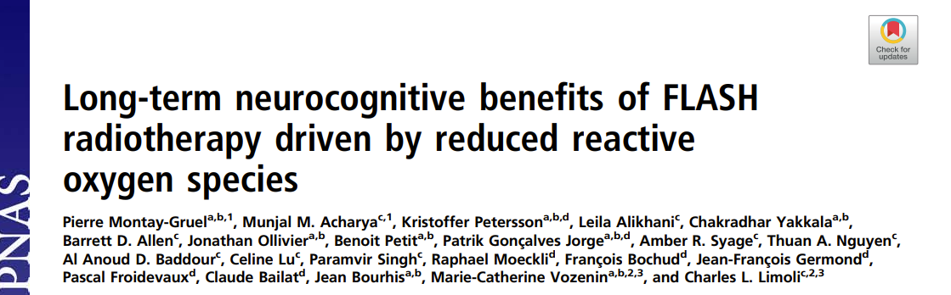
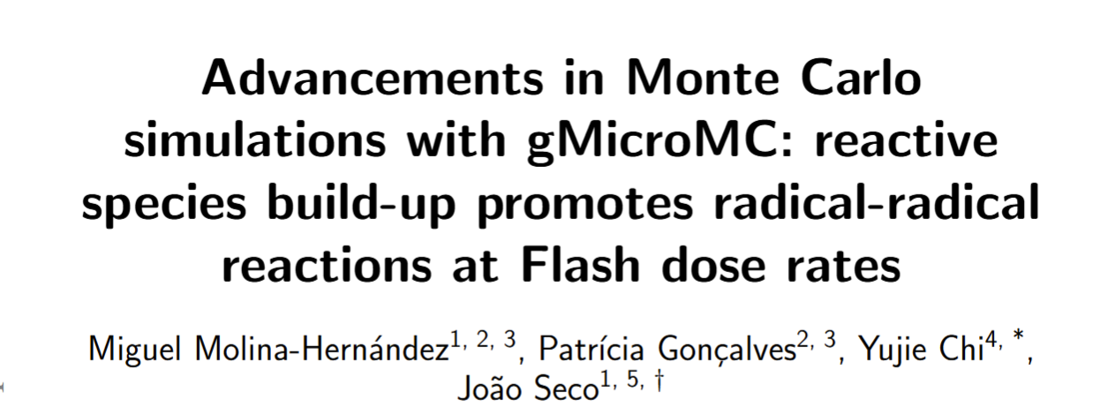
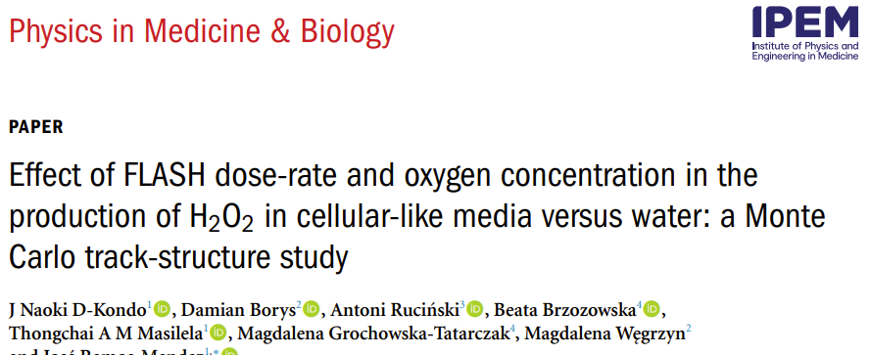
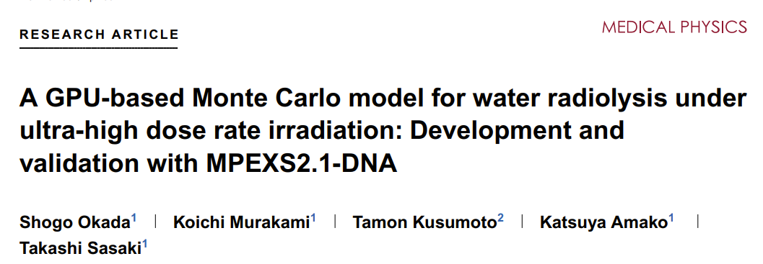
Conflicting Evidence on H₂O₂ Production in UHDR Radiotherapy
Reduced H₂O₂:
Experimental measurements (pure water and simple model systems): show lower H₂O₂ yields at UHDR than at conventional dose rates, for electrons, X-rays, protons and carbon ions [Montay-Gruel et al. (2019), Kacem et al. (2022), Sunnerberg et al. (2023), Zhang et al. (2024), etc...]
Increased H₂O₂:
Simulation studies: predict equal or even higher H₂O₂ yields at UHDR due to reactive species build-up and enhanced radical–radical reactions [Molina-Hernández et al. (arXiV, 2025), D-Kondo et al. (2025), Okada et al. (2025), etc…]
Combination of physics of radical production and how biological systems subsequently process them influences H₂O₂ outcomes
Notes:
highlighting that the combination of high intensity (pico7nanosecond pulses) and UHDR is crucial for the FLASH effect
Evidence from pure water radiolysis, buffered solutions, and biological-relevant media increasingly shows lower H₂O₂ (ROS) yields at UHDR / FLASH than at conventional dose rates.
suggesting that rapid energy deposition alters initial chemical events, impacting later biological responses.
The impact seems dependent on environment (oxygen, solutes), suggesting that the FLASH effect might rely on chemical context, not only delivery parameters.

Slide 24
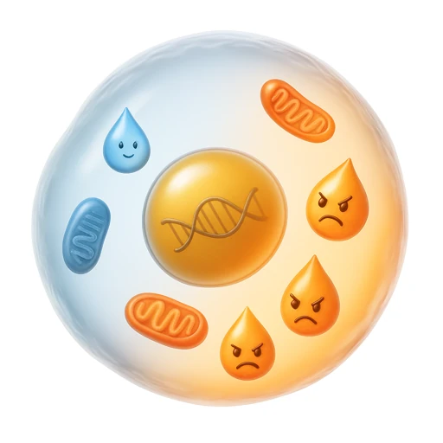


H₂O₂ in Biological Systems: a useful messenger, a potential threat, a tightly regulated molecule
Signaling Molecule
Controls: proliferation, differentiation, migration
Modulates redox-sensitive proteins
Damage Agent
Drives lipid peroxidation, protein oxidation, and DNA damage
Can initiate apoptotic and necrotic cell death pathways
Synergizes with metal ions (Fenton chemistry → •OH generation)
Stress Response Regulator
Coordinates responses to oxidative stress (e.g., NRF2 pathway)
Triggers antioxidant defenses
Involves in inflammatory responses (immune cells)
Regulation
Detoxification systems (catalase, peroxiredoxins and glutathione peroxidases)
Superoxide dismutases (SODs) convert superoxide into H₂O
H₂O₂ levels are not passive outputs of radiolysis, but the result of dynamic enzyme networks

Slide 25
Protein expression levels after short-term ATN-224 exposure (60 µM)
(unpublished data – please do not duplicate and share)

Slide 26
ATN-224 treatment does not impair cell viability
SOD inhibition after short-term ATN-224 exposure
(unpublished data – please do not duplicate and share)

Slide 27
SOD1 (Cu/Zn)
SOD2 (Mn)
SOD recovery after ATN removal
SOD recovery after CuSO₄ addition
SOD recovery after MnSO₄ addition
(unpublished data – please do not duplicate and share)

Slide 28
SOD expression levels immediately after eIR
SOD activity at 72 h after eIR

Slide 29
2. Irradiation Experimental Conditions
@DKFZ (Germany)
Cell line models
IR Dose Rates
HaCaT cells (healthy keratinocytes)
SAS cells (H&N cancer, from human tongue)
Drug treatment
X-rays
CONV-IR
ATN-224
1.5 h before IR
X-ray – IR (xIR)) (Multirad 225 - Precision)
 | xCONV
Doses [Gy] | 2, 5, 10, 14
Cu Filter [mm] | 0.5
Peak Energy [keV] | 200
Current [mA] | 17.8
Dose Rate [Gy/s] | 0.036

Slide 30
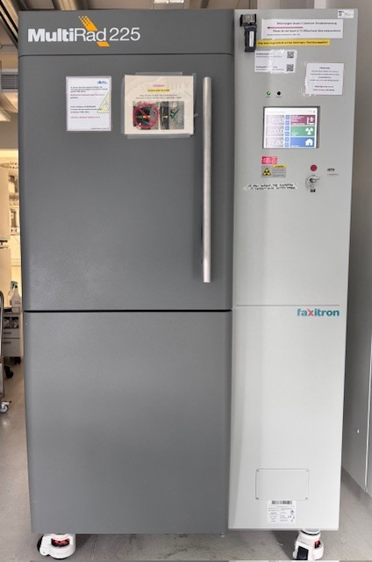
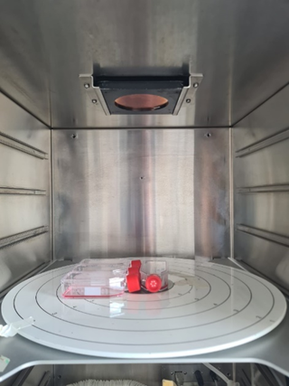
xCONV-IR @DKFZ SURVIVAL CURVES
Irradiation set-up
(unpublished data – please do not duplicate and share)

Slide 31
TETA-4 treatment: Cu²⁺ Chelator but not SOD inhibitor
Viability: 1.5 h TETA-4 treatment before removal
SOD inhibition: TETA-4 dose-response, T=1.5h
Concentration Range:
0.06–12 mM
SOD inhibition: TETA-4 no removal
No SOD1 inhibition observed with TETA-4 at tested conditions
(unpublished data – please do not duplicate and share)

Slide 32
SOD expression levels immediately after xIR
SOD activity at 72 h after xIR

Slide 33
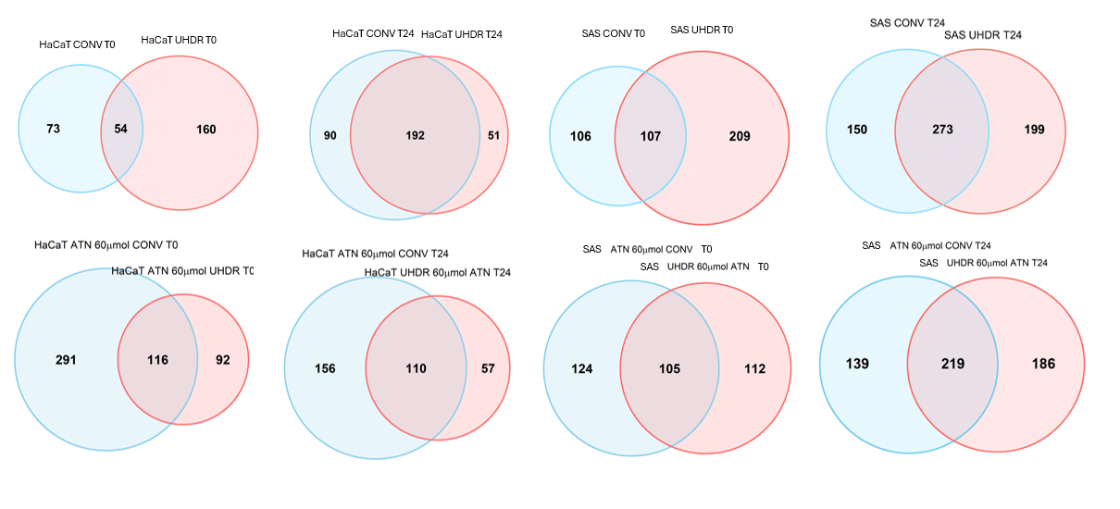
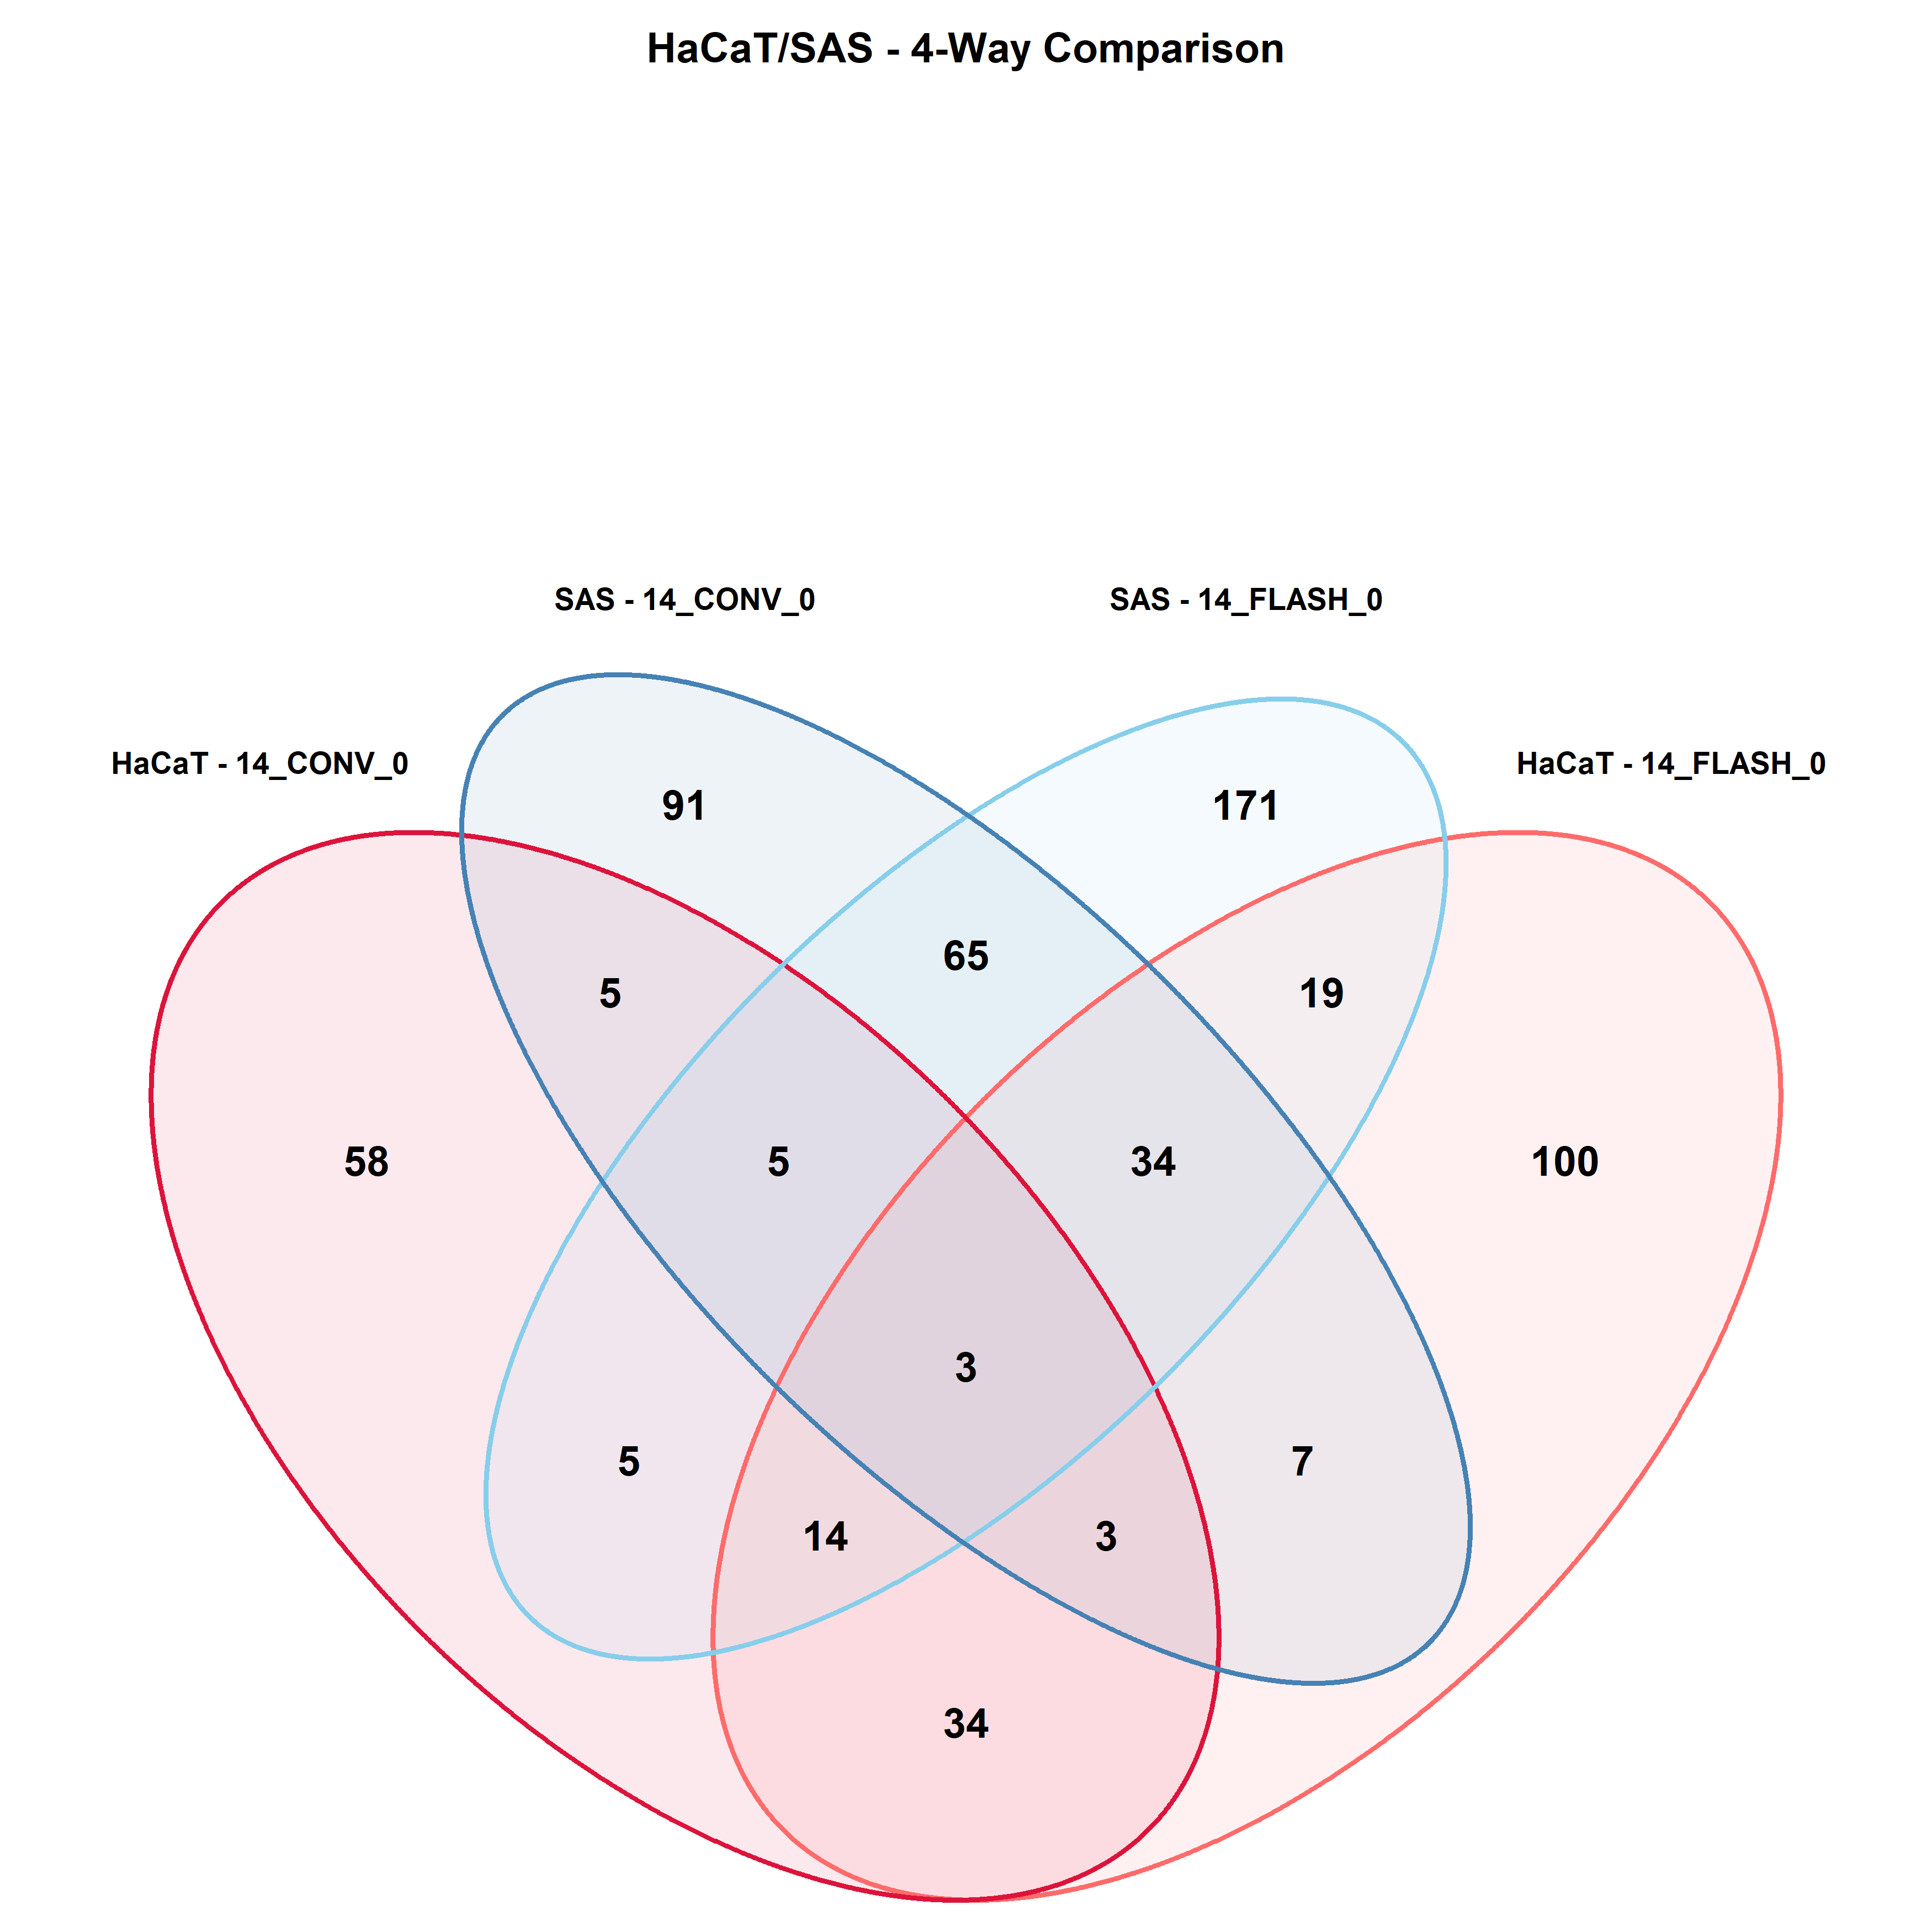
Preliminary Proteomics Data Analysis – Specific Protein Fold Change
HaCaT
SAS
HaCaT vs SAS
SAS – 14 Gy CONV T0
SAS – 14 Gy UHDR T0
HaCaT – 14 Gy CONV T0
HaCaT – 14 Gy UHDR T0
Notes:
By comparing only the dose rates, 19 proteins are changing in the uhdr independently on the cell line, but between the 2 cell lines there are specific proteins in uhdr and in conv...

Slide 34
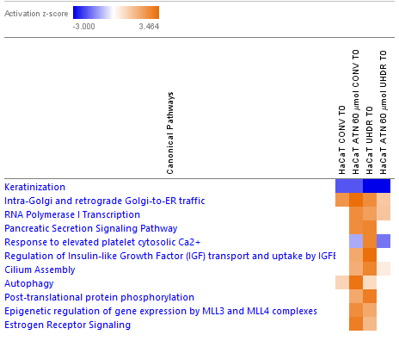
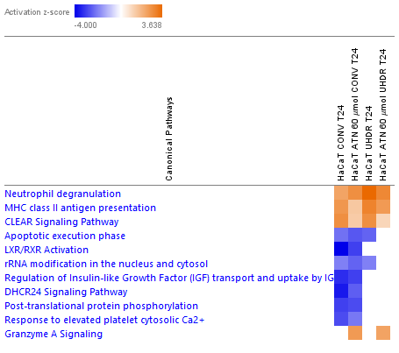
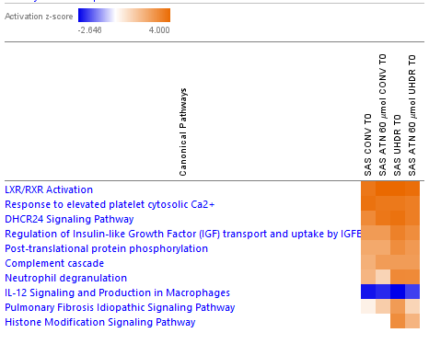
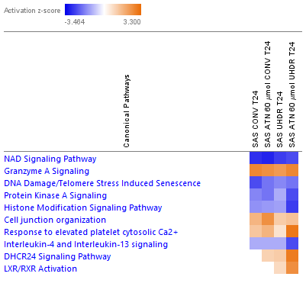
Ingenuity Pathway Analysis (IPA)
T0 h
T24 h
HaCaT
SAS
(unpublished data – please do not duplicate and share)
Notes:
Activation inhibition

Slide 35
eCONV-IR and eUHDR-IR – independent validation
@ University of Pisa and CPFR (Italy)
Cell line models
IR Dose Rates
16HBE cells (healthy human bronchial epithelium)
SCC25 cells (H&N cancer, from human tongue)
Drug treatment
Electrons
CONV-IR
UHDR-IR
ATN-224
1 h before IR
Electron – IR (eIR) (ElectronFlash LINAC developed at CPFR) 7 MeV-9 MeV Energy
 | eCONV | eUHDR
Doses [Gy] | 2, 8, 12 | 2, 8, 12
Pulse Rate [Hz] | 5 | 240
Pulse Length [μs] | 4 | 4
Dose per Pulse [Gy] | ~0.02 | 1
Mean Dose Rate [Gy/s] | ~0.1 | ~240 - 400

Slide 36
CAM Model
Chicken chorioallantoic membrane (CAM) is a simple, highly vascularized extraembryonic membrane useful as a in vivo model for studying angiogenesis, drug delivery and tumor biology
Key Advantages:
Highly vascularized platform ideal for assessing radiation-induced tumor and vessel responses
Early immunodeficiency allows reliable engraftment of human tumors without rejection
Low cost & reduced ethical/regulatory constraints before day 17
Rapid experimental timeline with measurable RT effects within days
Limitations:
Short experimental window limits long-term follow-up
Technical variability (embryo positioning, tumor placement, or irradiation angle) requires strict procedural consistency
Notes:
HBE are highly sensitive to radiation
Survival fraction (SF) drops sharply already at 2 Gy.
At 8–12 Gy, survival is nearly zero
HBE16 cells benefit from UHDR irradiation (greater survival = FLASH sparing)
can be engrafted on the vascularized chorioallantoic membrane (CAM) with high efficiencies regardles

Slide 37
eCONV-IR and eUHDR-IR @ University of Pisa
SOD inhibition
Clonogenic Survival
16HBE
SSC25
(unpublished data – please do not duplicate and share)
Notes:
HBE are highly sensitive to radiation
Survival fraction (SF) drops sharply already at 2 Gy.
At 8–12 Gy, survival is nearly zero
HBE16 cells benefit from UHDR irradiation (greater survival = FLASH sparing)

