Slide 1

Immunological evidence supporting different mechanisms of action
Marco Durante
CP4CT Workshop, London, 27.2.2026

Slide 2
(Bold) opening statements
Combining with immunotherapy is radiotherapy's paramount challenge
Charged particle beams holds the key physical and biological advantages to meet it
Unlocking this potential is our most urgent pre-clinical mandate

Slide 3
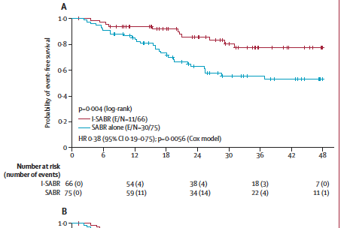
PACIFIC trial – stage III NSCLC
Benefits of radiotherapy + immunotherapy
Stage I-II NSCLC treated with SABR
Chang et al., Lancet 2023
Antonia et al., New Eng. J. Med. 2017

Slide 4
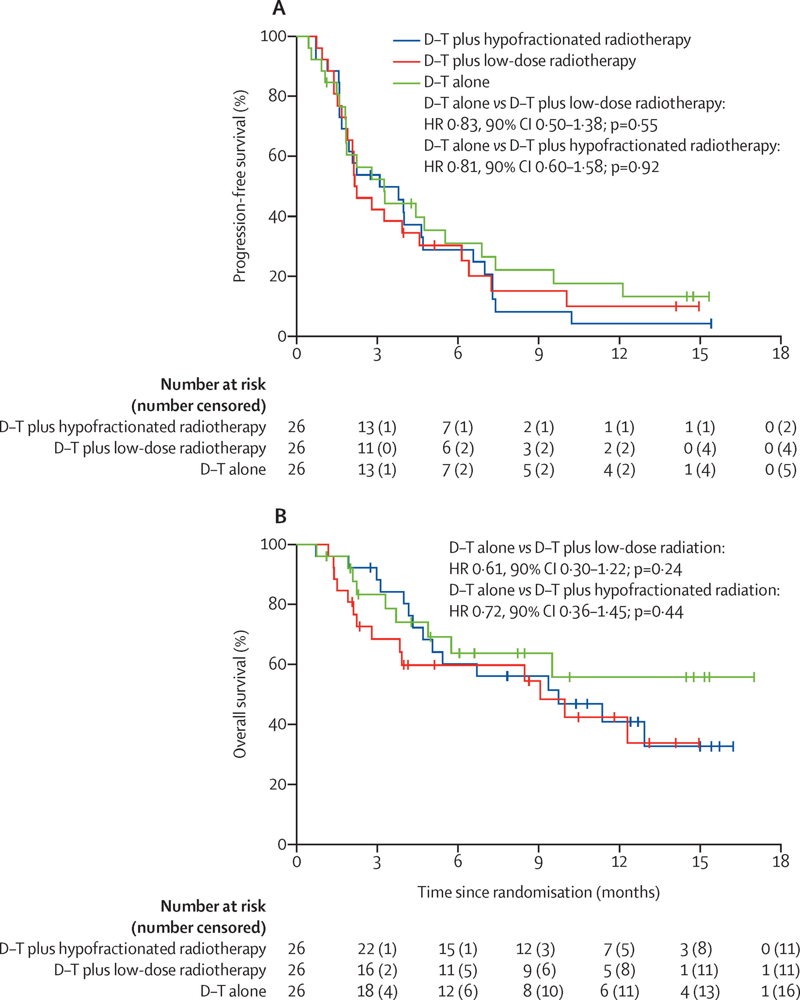
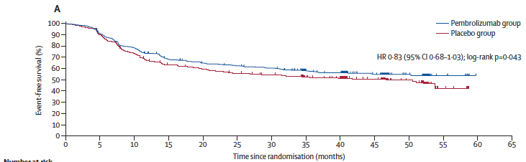
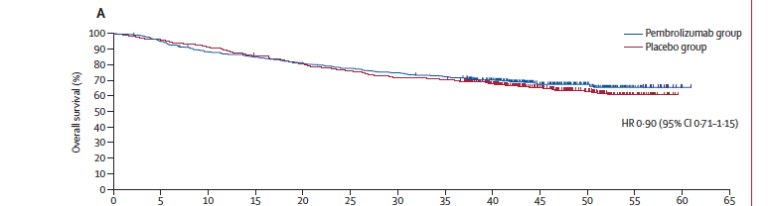
KEYNOTE and ETCN negative trials
Locally advanced H&N SCC
Machiels et al., Lancet Oncol. 2024
Metastatic NSCLC
Schoenfeld et al., Lancet Oncol. 2022

Slide 5
Why it doesn’t (always) work?
Timing and sequencing: Neoadjuvant - concurrent – adjuvant administration can dramatically alter immune effects.
Radiation fractionation and quality: Standard radiotherapy regimens may not optimally stimulate immune responses.
Tumor microenvironment: “Cold” tumors and heavily pre-treated disease respond poorly to checkpoint stimulation
Biomarker absence: Lack of patient selection by PD-L1 levels, T-cell infiltration, or other immune signatures may blunt measurable benefits.
Chemoradiotherapy is immunosuppressive: the combination can fail simply because we destroy the immune system
Helm et al., Int. Rev. Cell Mol. Biol. 2023

Slide 6
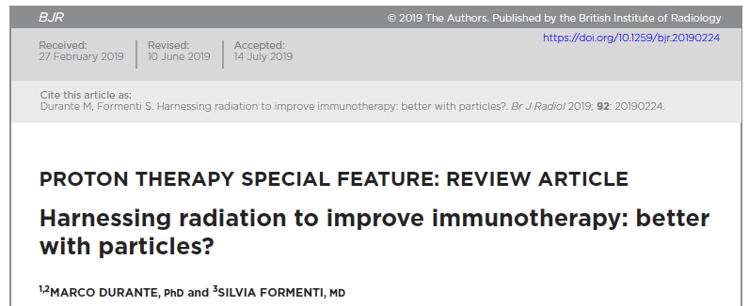

Particle therapy + immunotherapy

Slide 7
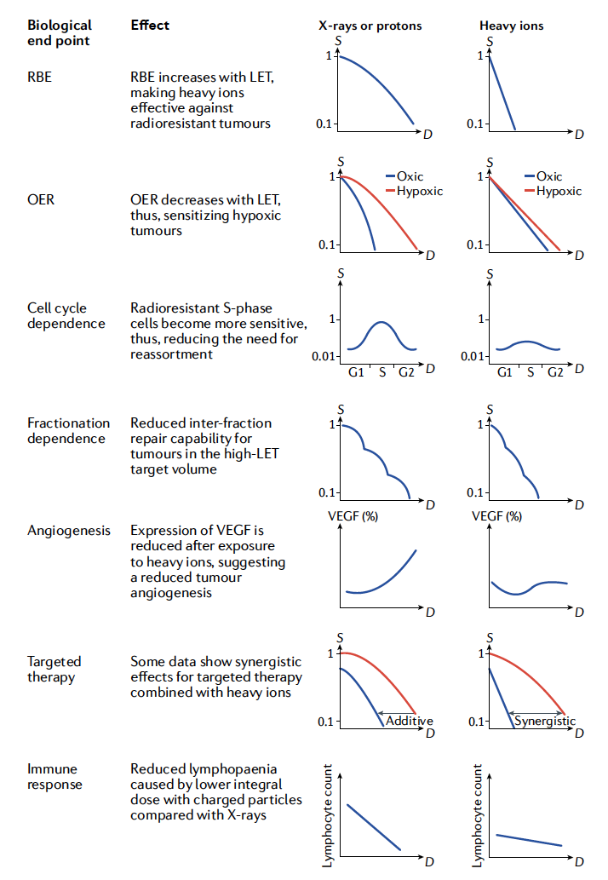
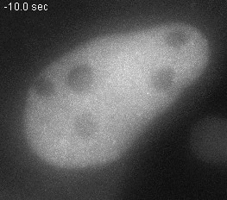
Biological advantages of particle therapy
Durante et al., Nat. Rev. Phys. 2021

Slide 8
Potential biological advantages of high-LET radiation
Different cell death patterns (p53 independent apoptosis, necroptosis, ceramide pahways…)
Increased antigenicity (radiation-induced mutations, more frequently induced at high-LET per unit dose, can transform cold tumors in hot tumors)
Increased adjuvanticity (higher release of HGMB1,…)
Possibility to increase the target physical dose (maintaining the NTCP) or reduce it (maintaining TCP) depending on whether we want to exploit high-dose or low-dose immunogenicity
Helm et al., Exp. Rev. Mol. Med. 2022

Slide 9
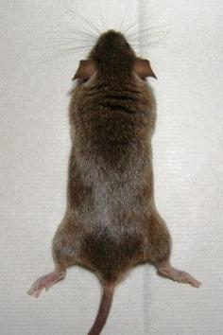
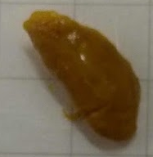
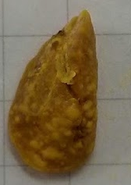
Lung metastasis
CIRT+CPI
Negative control
Assessment of superficial nodules after fixation in Bouin‘s solution
Helm et al., Int. J. Radiat. Oncol. Biol. Phys. 2021
NC = negative control
CPI = check point inhibitors only
CIRT = C-ions only, 10 Gy
XRT = photons, 10 Gy

Slide 10
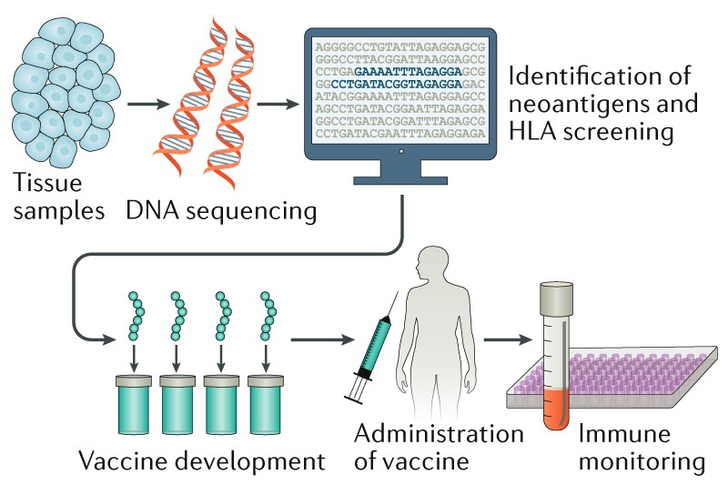


RNA-LPX neoantigen vaccination synergizes with radiotherapy to restrict tumor growth in mouse
control or neoAg RNA-LPX
XRT(12 Gy)/ CIRT(10 Gy)
d7
d13
d16
d21
MC38 murine colorectal cancer cells
d0
d31
MC38
blood
See poster session
Salomon et al.
Salomon et al, Int. J. Radiat. Oncol. Biol. Phys. 2024

Slide 11
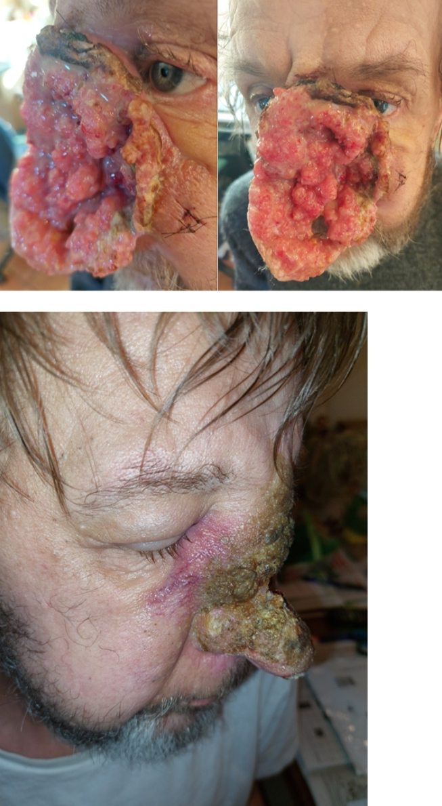
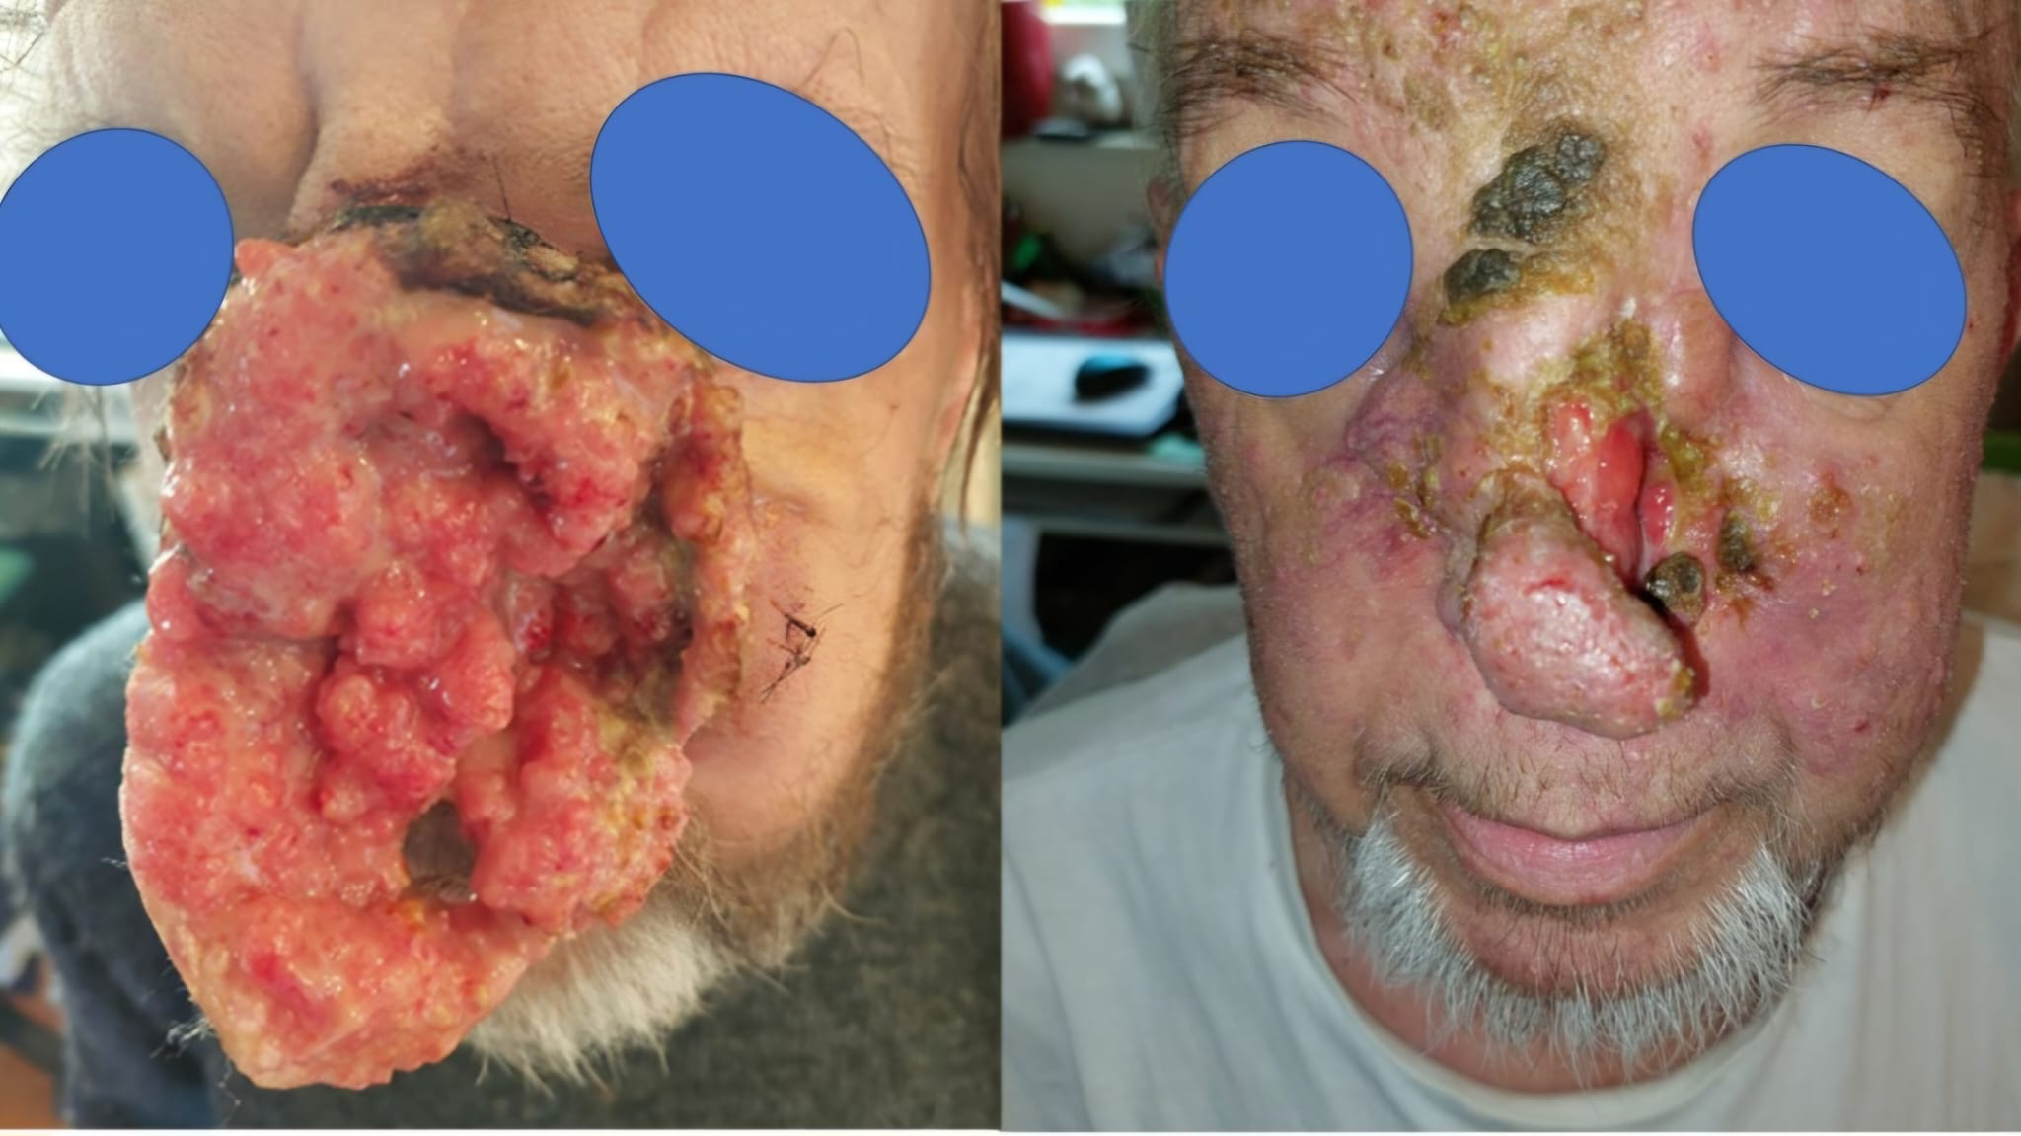
Treating difficult patients with heavy ions – exploiting the immune system
Unresectable bulky squamous cell carcinoma. Treated with 2 lines systemic therapy, constantly PD. Underwent Carbon-PATHY, 3 fractions. Outcomes following 7 weeks:
Courtesy of Slavisa Tubin, Vienna

Slide 12
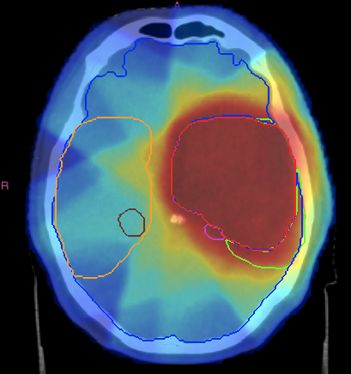
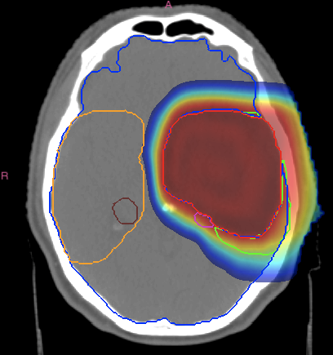
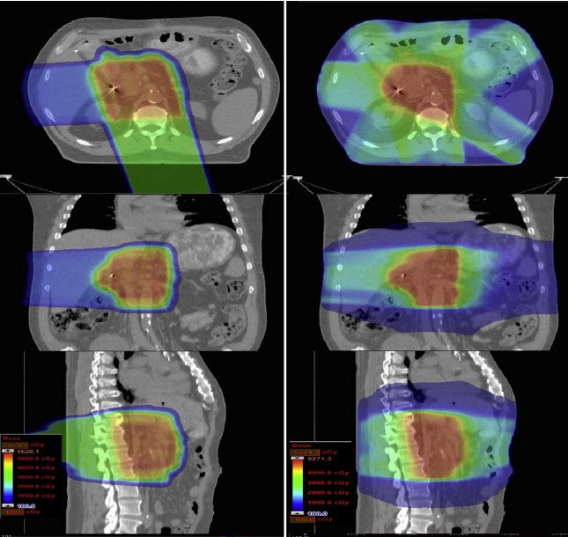
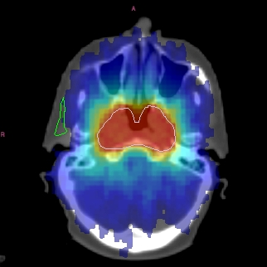
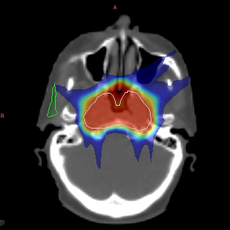
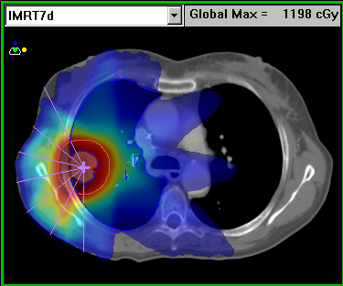
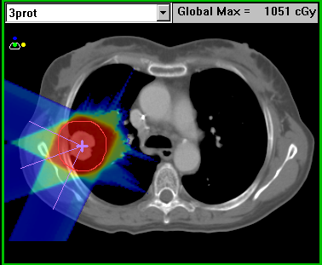
Physics advantages of particle therapy
CNS
ABDOMEN
H&N
PELVIS
LUNG
Durante et al., Phys. Rep. 2019

Slide 13
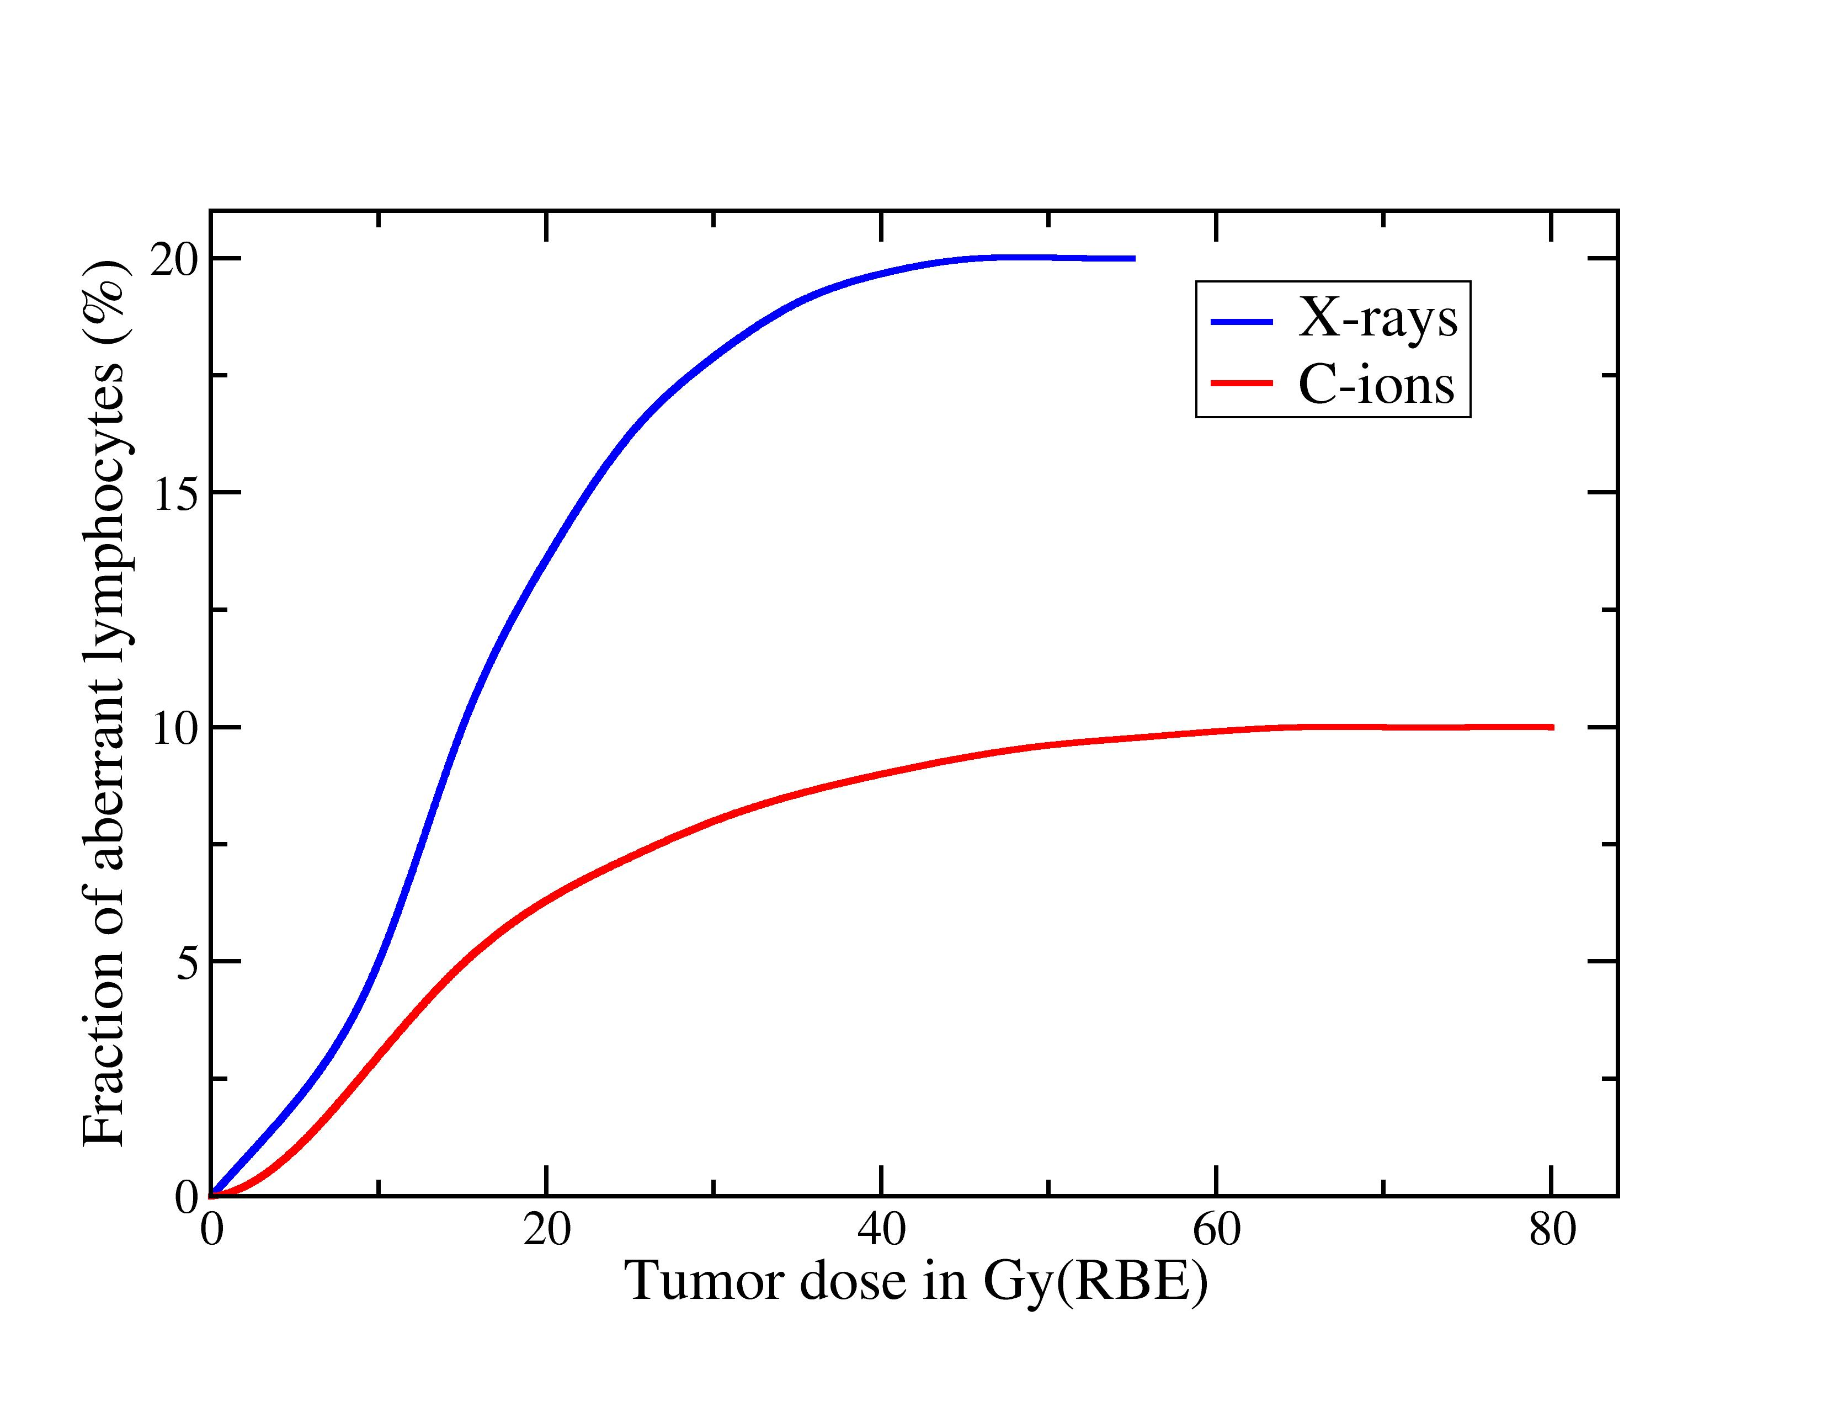

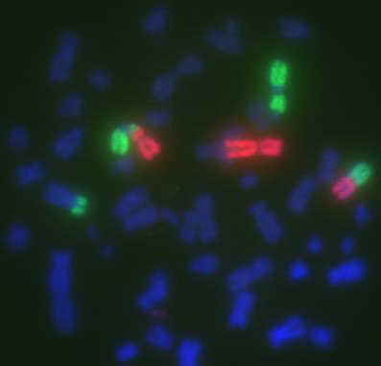
Chromosomal aberrations measured in patients treated with X-rays or C-ions for esophageal or uterus cancer
Durante et al., Int. J. Radiat. Biol. Phys. 2000

Slide 14
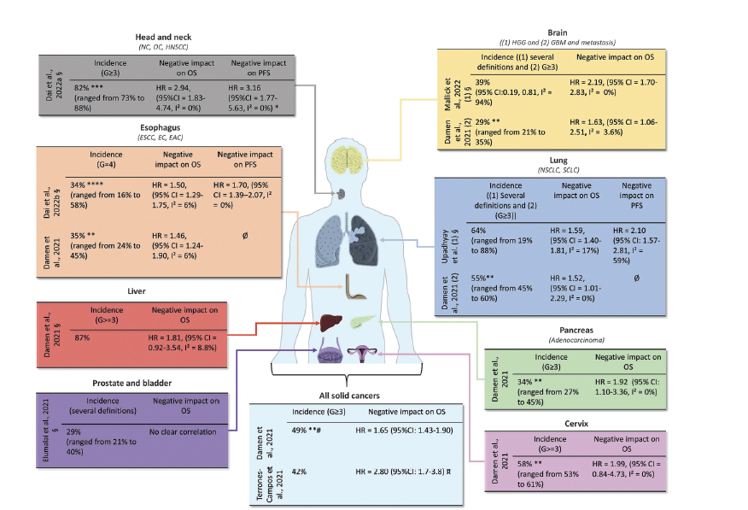

The prognostic value of lymphopenia in radiotherapy
de Kermenguy et al., Int. Rev. Cell Mol. Biol. 2023

Slide 15
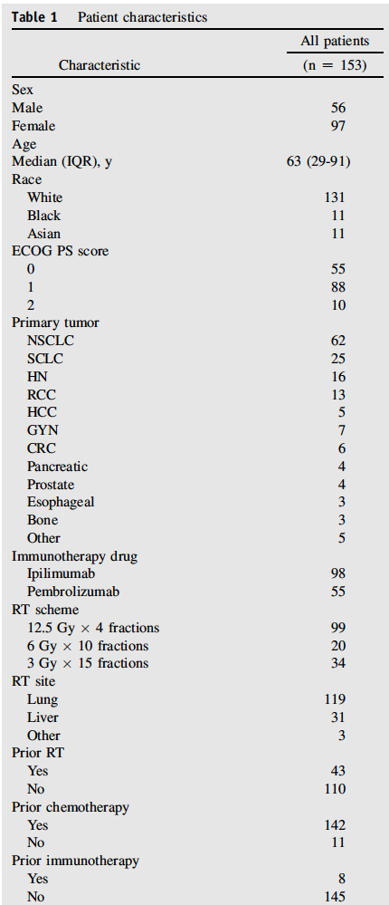
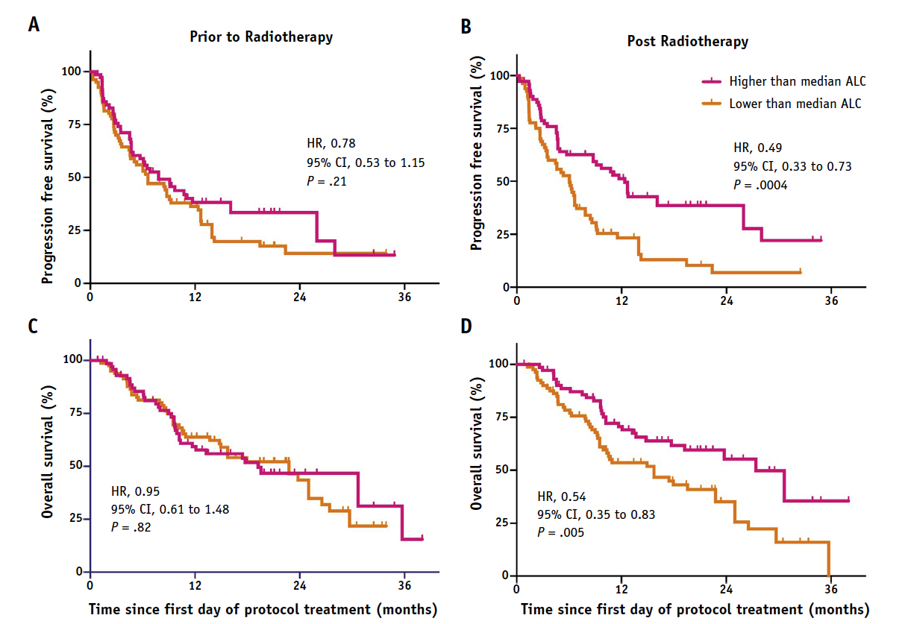

Prognostic value of lymphopenia in radioimunotherapy
Chen et al., Int. J. Radiat. Oncol. Biol. Phys. 2020

Slide 16
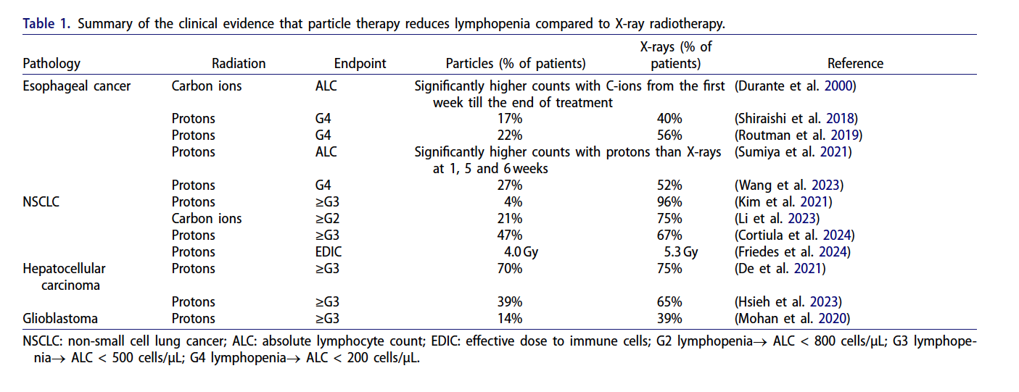
Particle therapy reduces lymphopenia
Durante, Int. J. Radiat. Biol. 2024

Slide 17
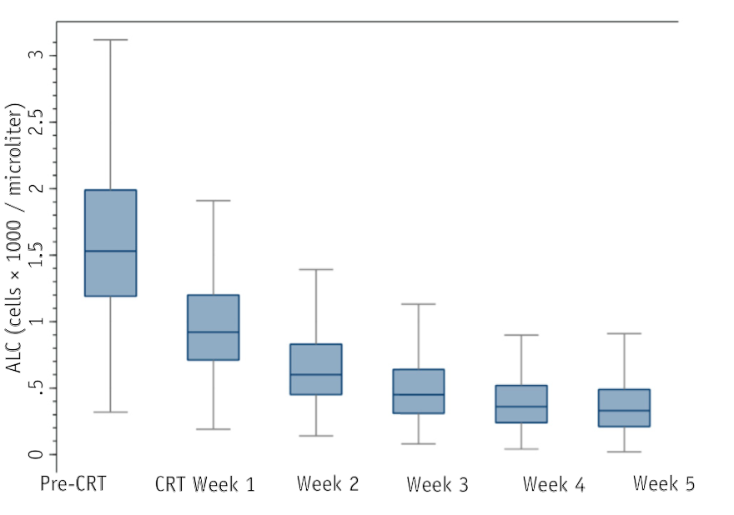
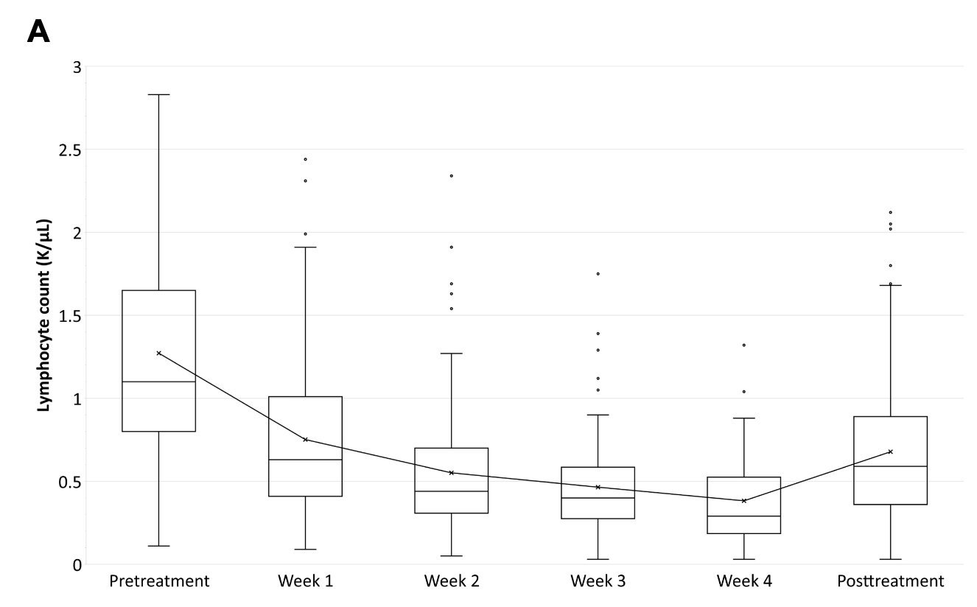
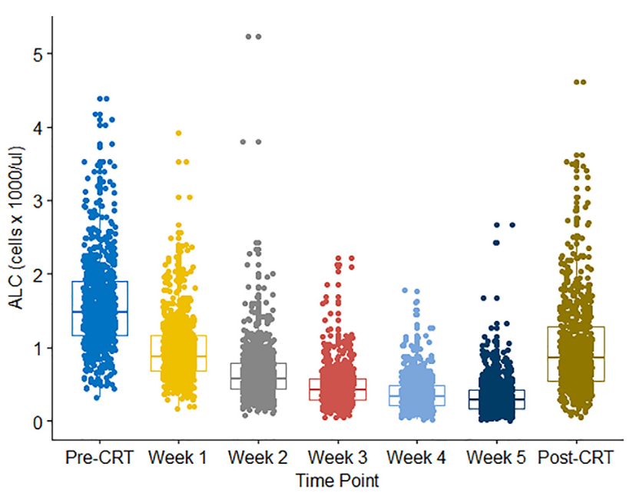
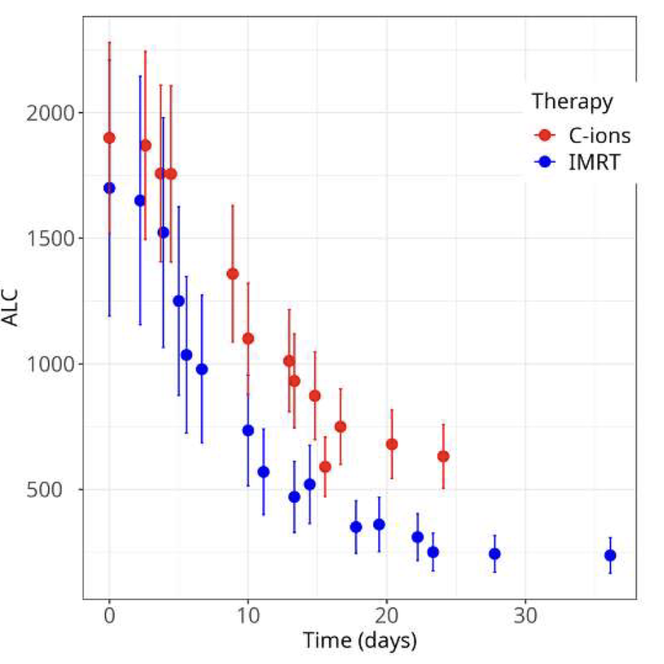

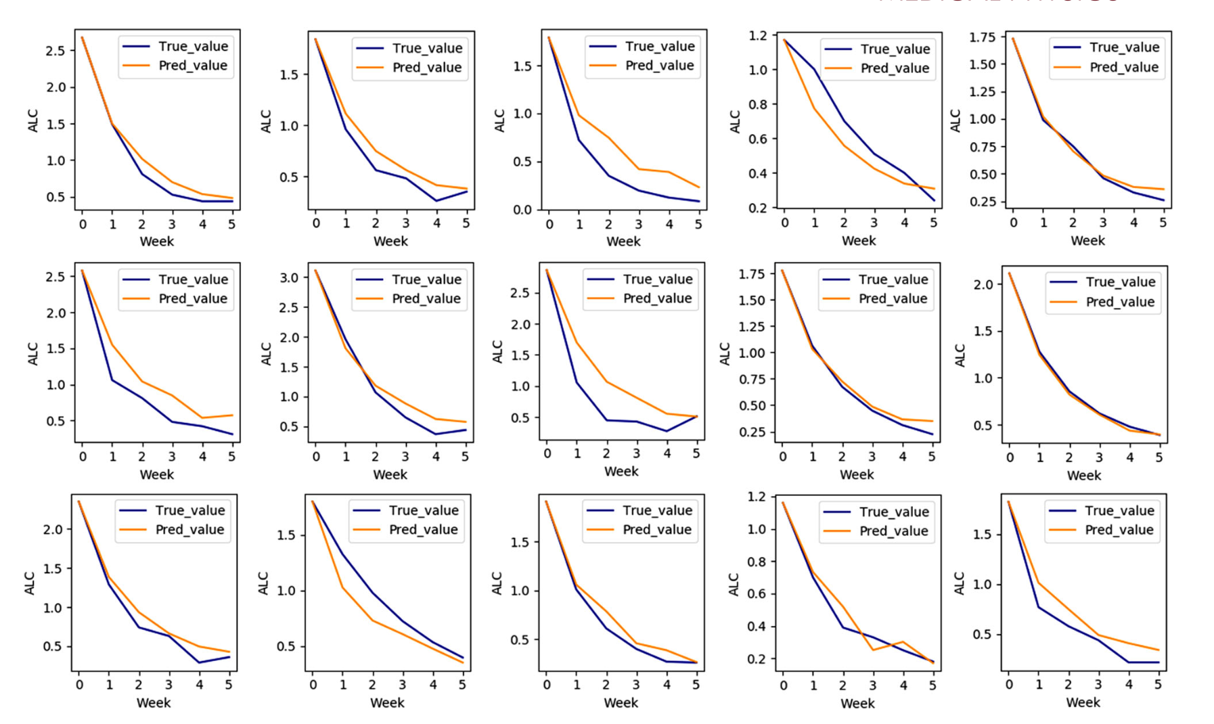
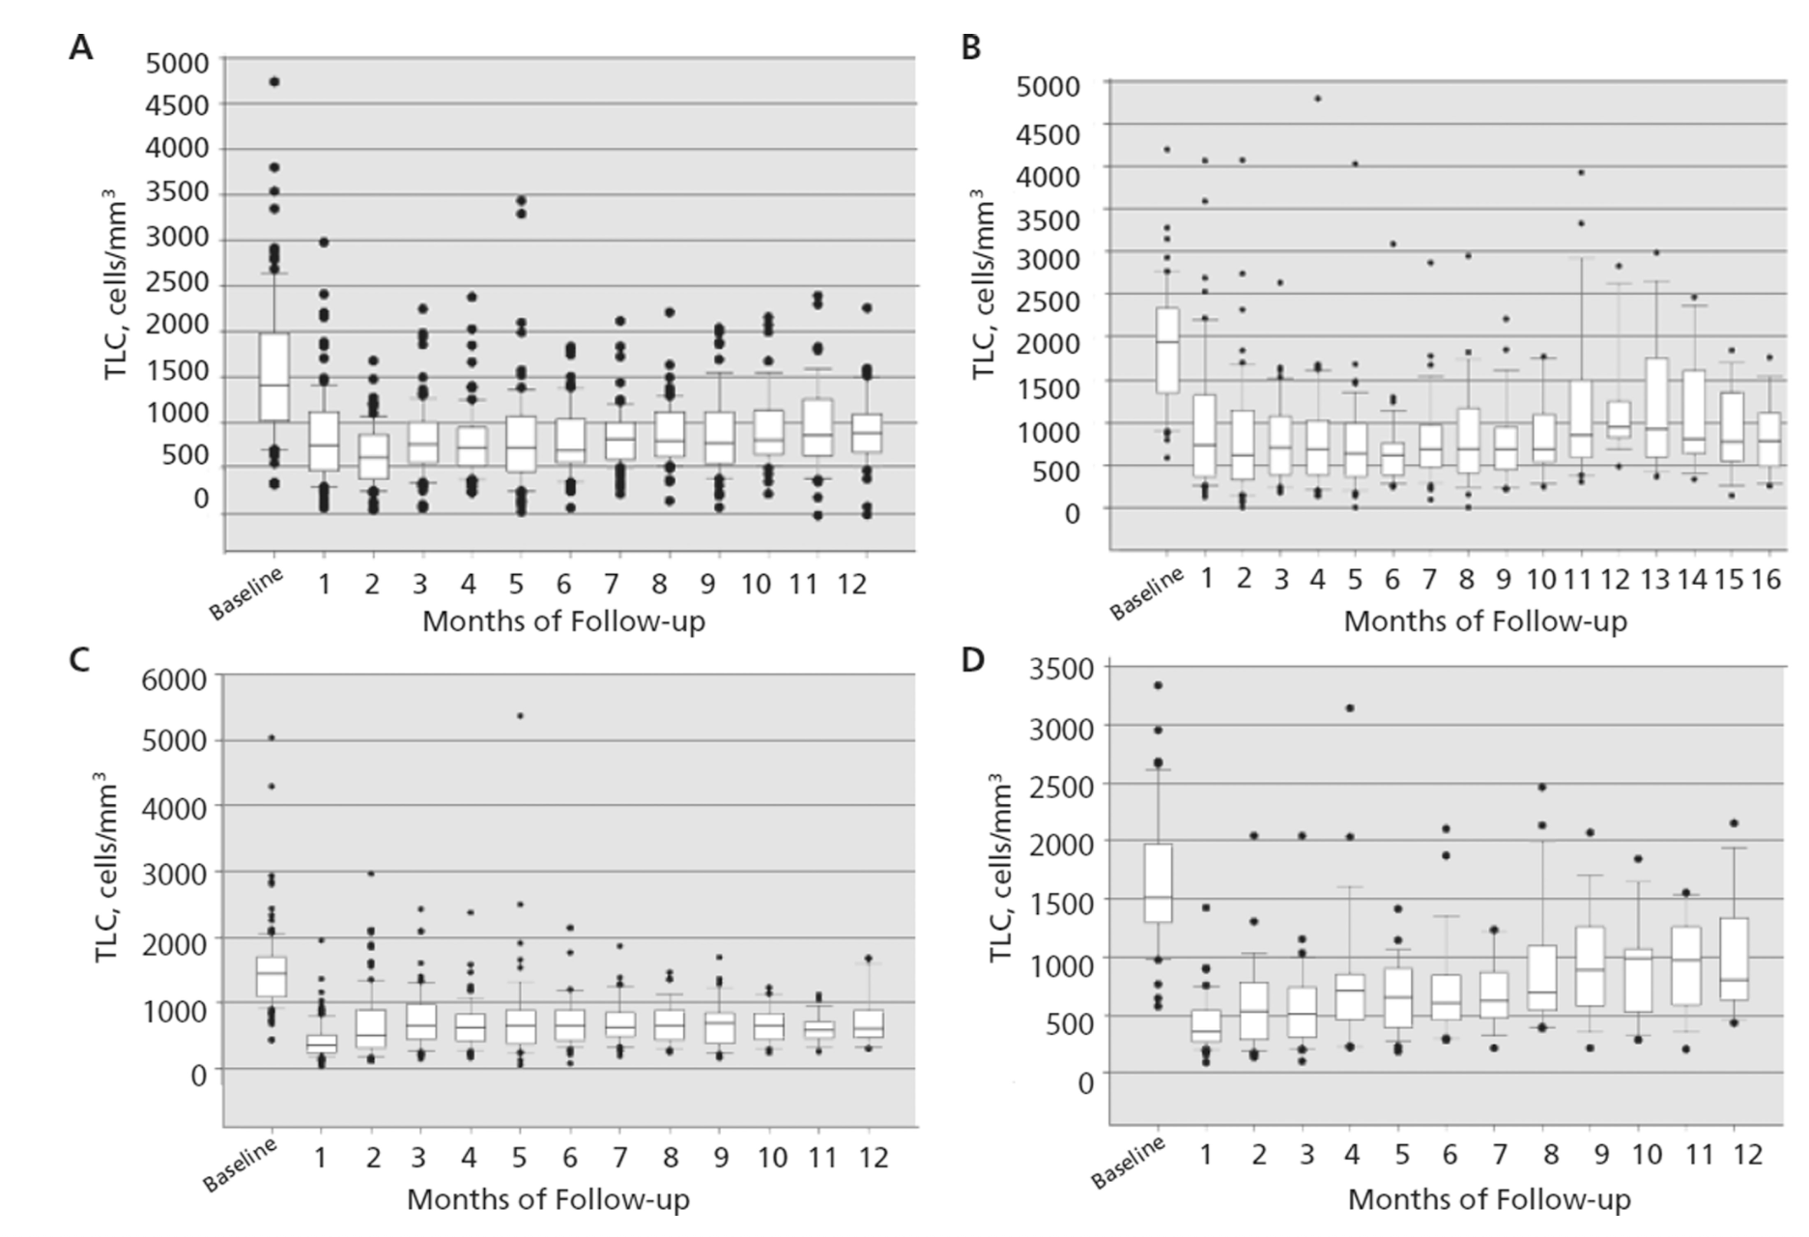
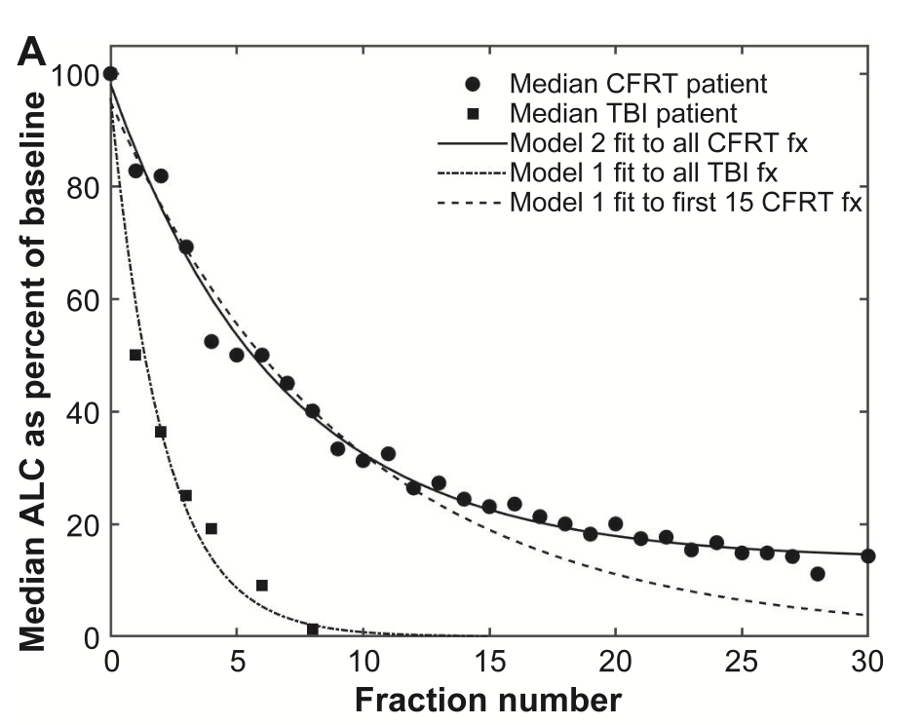
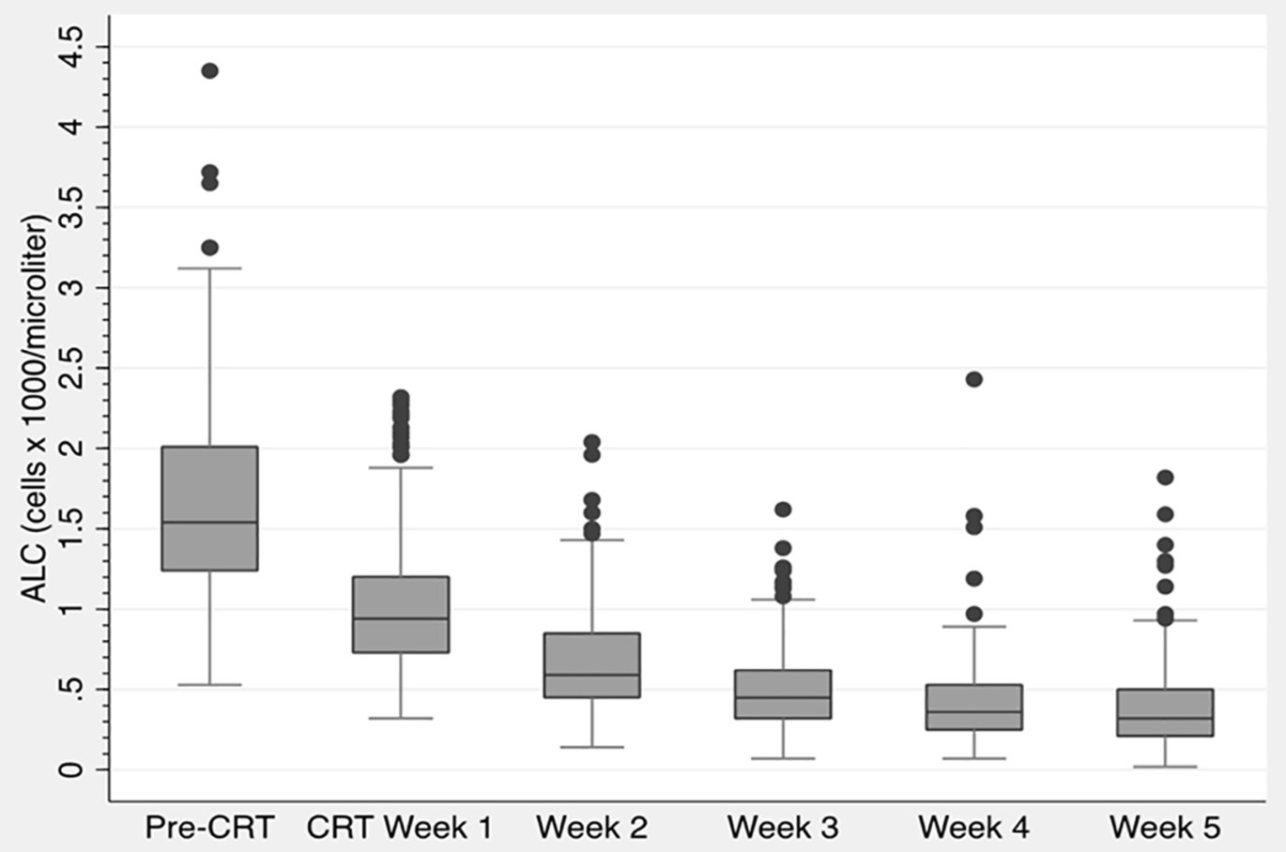
GSI ALC Database
Sandul et al., Int. J. Part. Ther. 2025
Davuluri et al., Int J Radiat Oncol Biol Phys. 2017.
De et al., J Hepatocell Carcinoma. 2021.
Deng, Wei et al., Radiother Oncol. 2019.
Durante, Int J Radiat Biol. 2024.
Contains information about dynamics of lymphocyte counts during and after therapy
142 datasets on lymphocyte counts from 52 publications
Covers various cancer sites, patient profiles, radiotherapy modalities, therapy durations, fractionation schemes, particle types, etc.
Freely available at www.gsi.de/bio-alc
Ellsworth et al., Radiat Res. 2020.
Fang et al., Radiother Oncol. 2018
Grossman et al., J Natl Compr Canc Netw. 2015.
Ebrahimi et al., Med Phys. 2022.
Notes:
Collage of plots -> animation -> they converge into GSI ALC database

Slide 18
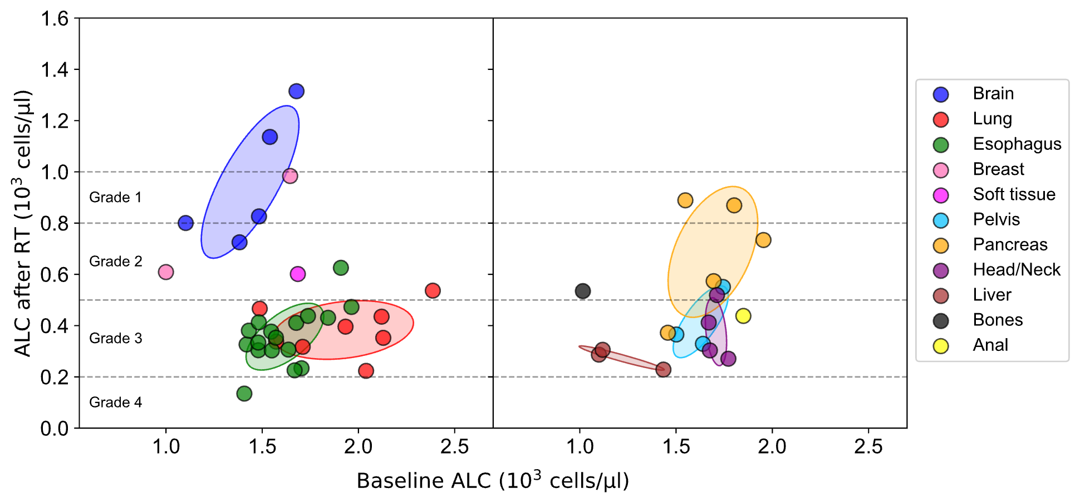
ALC before and after therapy across cancer sites
Each cancer type shows a characteristic range of ALC before and after therapy
1 point = 1 dataset
High ALC after RT
Brain
Breast
Pancreas
Head&Neck
Lung
Pelvis
Esophagus
Liver
Sandul et al. Clin. Trans. Radiat. Oncol. 2026
Low ALC after RT

Slide 19
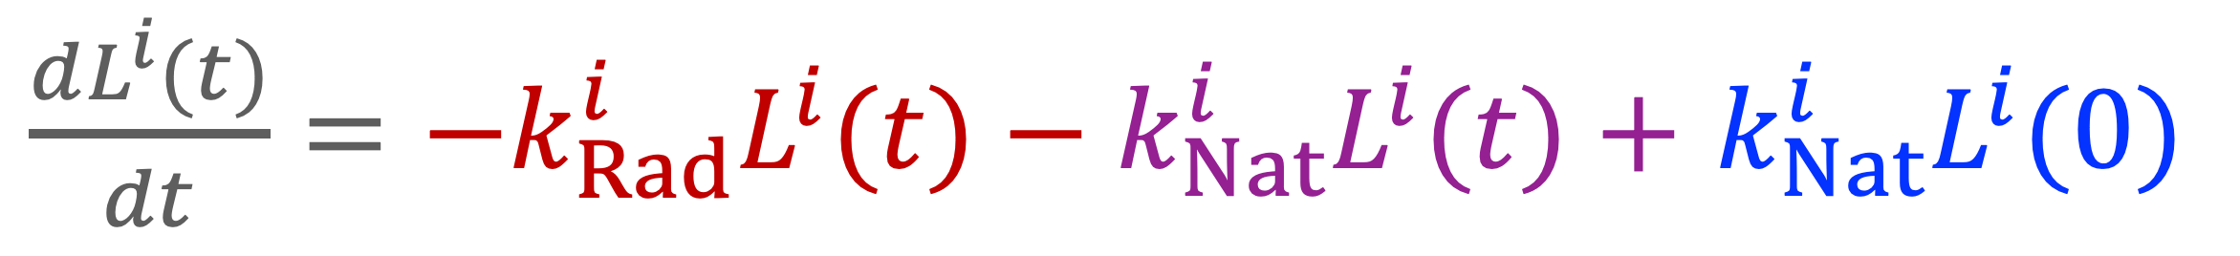
$\frac{dL^{i}(t)}{dt}=−k_{Rad}^{i}L^{i}(t)−k_{Nat}^{i}L^{i}(t)+$ $k_{Nat}^{i}L^{i}(0)$
Lymphocyte change
Radiation death
Natural death
Reproduction
Exponential lymphocyte depletion during treatment
Plateau at a non-zero ALC level near end of therapy
Fast recovery phase post-treatment
Slow long-term recovery
Sandul et al. Clin. Trans. Radiat. Oncol. 2026
Notes:
Anumations: plots getting pale, and curves appear

Slide 20
Particle therapy sparing effect: esophageal cancer case
kRad_{photons} = 0.455 wk⁻¹ kRad_{ions} = 0.32 wk⁻¹ L0 = 1.75 cells/nl T = 5.6 wk
PostRT ALC, Photons (18% of L0)
PostRT ALC, Ions (28% of L0)
Baseline ALC

Slide 21
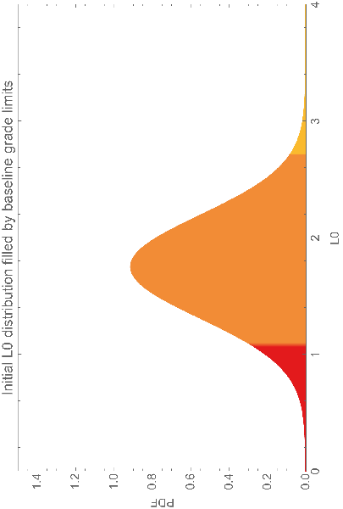
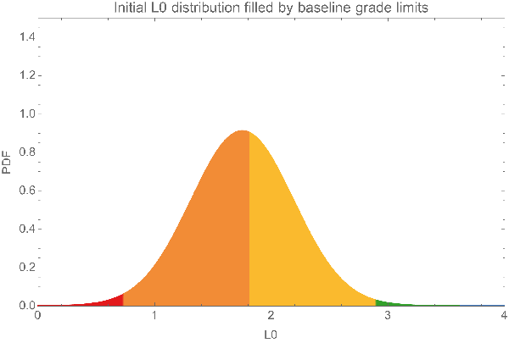
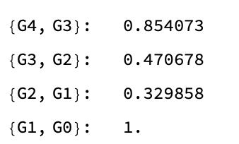
Predicted distribution of lymphopenia severity after X-rays or charged particles
Photons
RIL Grade improvement (what part of patients with particular grade in photon RT would get 1 grade less with ions RT)
Ions
G2
G1
G2
G2
G3
G2
G3
G3
G4
G3
About 50% of G3 RIL patients would have it reduced to G2 with charged particles
G4
G4

Slide 22
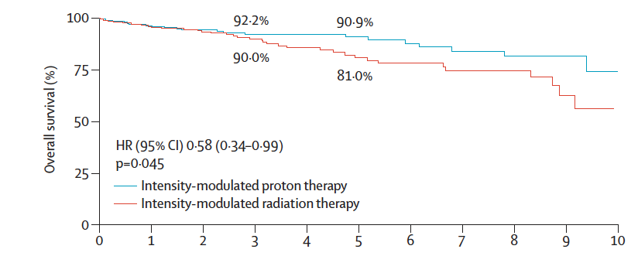
Clinical evidence of improvement on OS?
Phase III Trial of IMPT vs IMRT for Head and Neck Oropharyngeal Cancer
Frank et al. Lancet 2025

Slide 23

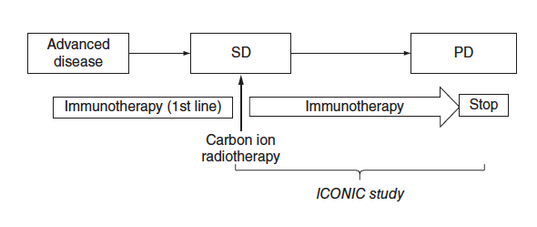
ICONIC TRIAL
The ICONIC (Immune checkpoint inhibitors and Carbon iON radiotherapy In solid Cancers with stable disease) trial at CNAO with GSI participation (Cavalieri et al. Future Oncol. 2023).

Slide 24
CONCLUSIONS
Charged particle have potential biological and physical advantages compared to X-rays in terms of immune response
The main physical advantage coming from particle physics is the reduced integral dose that leads to reduced lymphopenia
Biological advantages point to increased immunogenicity and the possibly of cold-to-hot switch
Pre-clinical studies are essential to address timing and sequencing, and the differences caused by radiation quality
The impact of physical and biological properties of charged particles in radioimmunotherapy remains to be determined in clinical trials

Slide 25
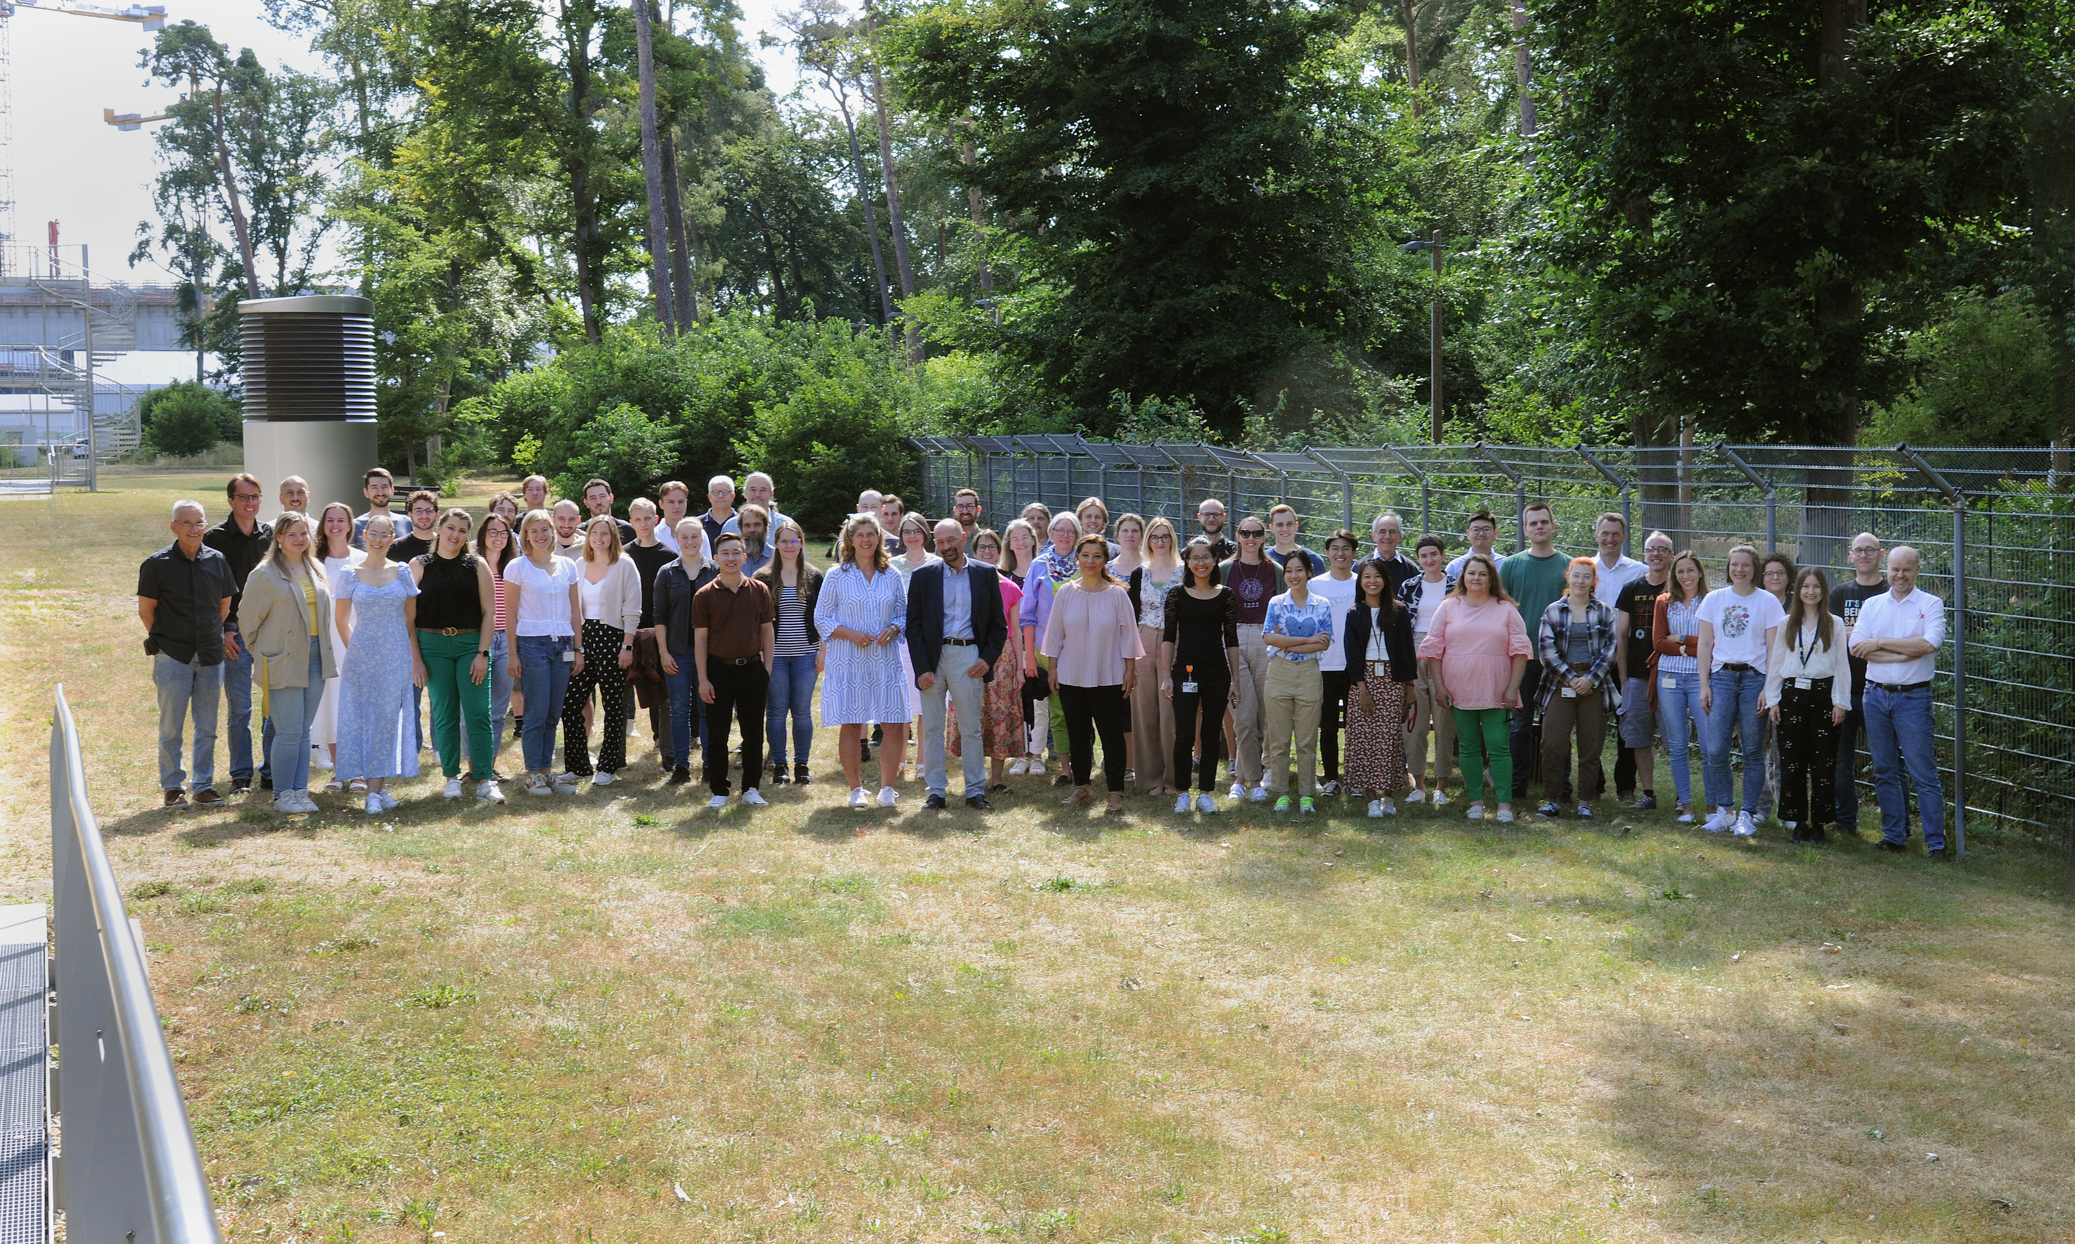
Thank you very much!
www.gsi.de/biophysik

Slide 26










Thank you!
Funding
agencies

Slide 27

We look forward to seeing you at PTCOG64!

