Slide 1

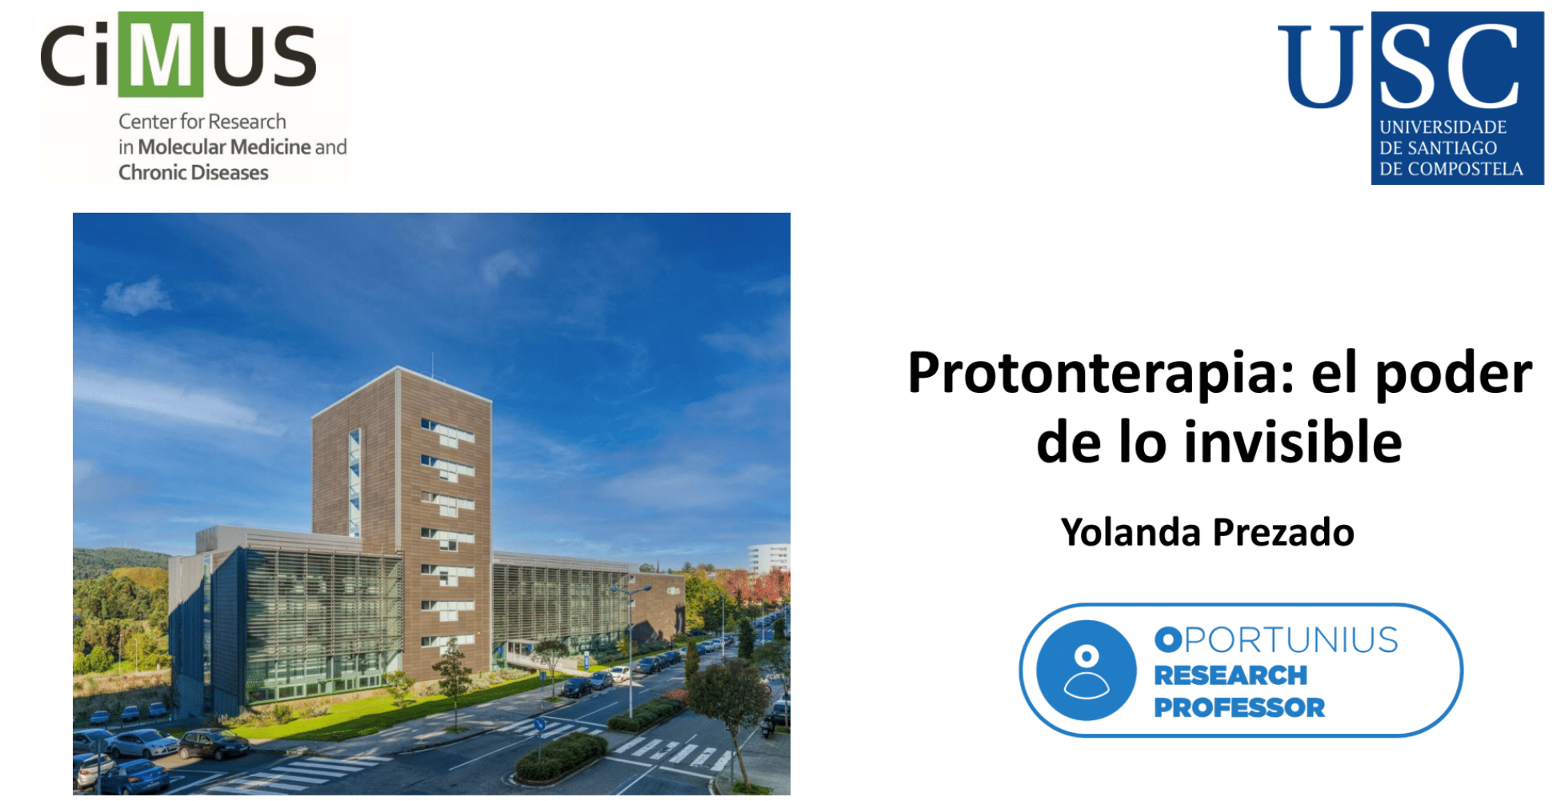

Novel insights into proton Minibeam Radiation therapy
Yolanda Prezado
Poner lo del prpgramaOportunius

Slide 2
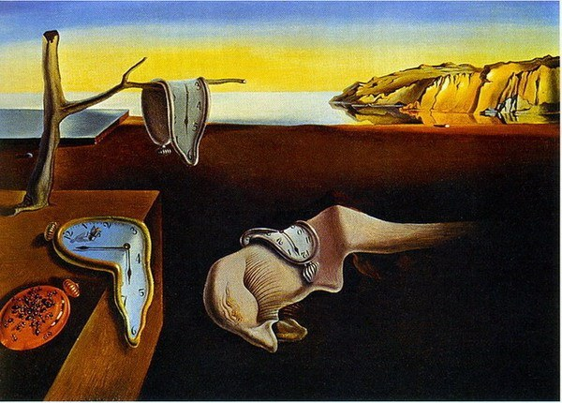
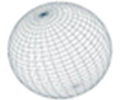
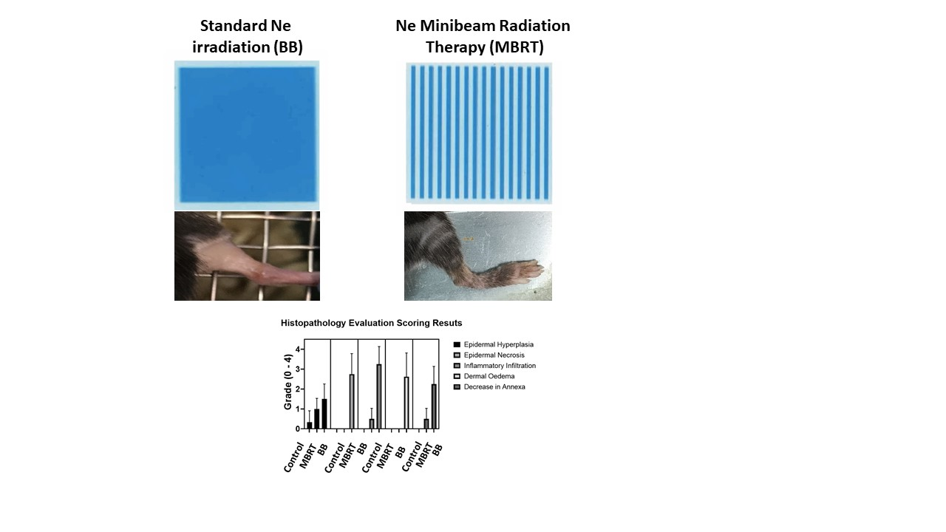
Radiotherapy: a paradigm shift in the 21th century
Fractionation
Dose rate
Pulse structure
Photons
Protons
Heavy ions
TIME
PARTICLE
Standard RT
SPACE
ENERGY

Slide 3

Exploration of the influence of the different parameters on the biological response
TIME
PARTICLE
Clinical accelerators = non-flexible
Protons/heavy ions facilities= low accessibility
New flexible accelerators are needed
SPACE
ENERGY

Slide 4
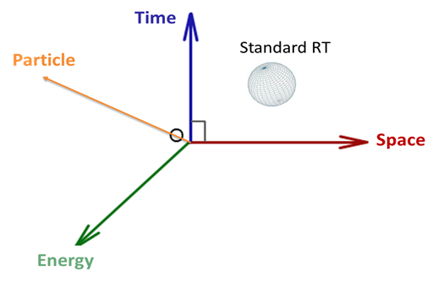
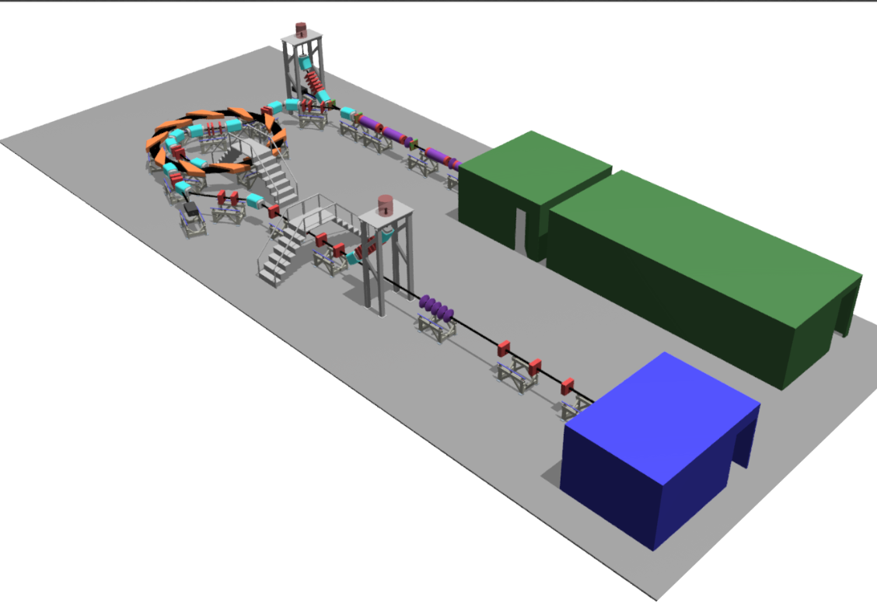
Laser Hybrid Accelerator for radiobiology applications
G. Aymar et al. Frontiers in Physics
Notes:
Nanorain

Slide 5
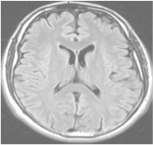
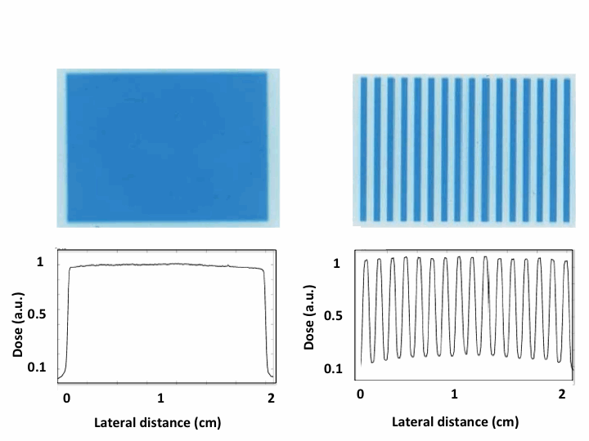
Spatially Fractionated Radiation Therapy (SFRT)
large fields (≥ 1 cm)
laterally homogeneous dose distributions
field composed of smaller beamlets
laterally heterogeneous dose distributions (peaks and valleys)
➜ increase of normal tissue tolerance
Standard RT
≥ 1 cm
beamlet
peak valley
SFRT

Slide 6
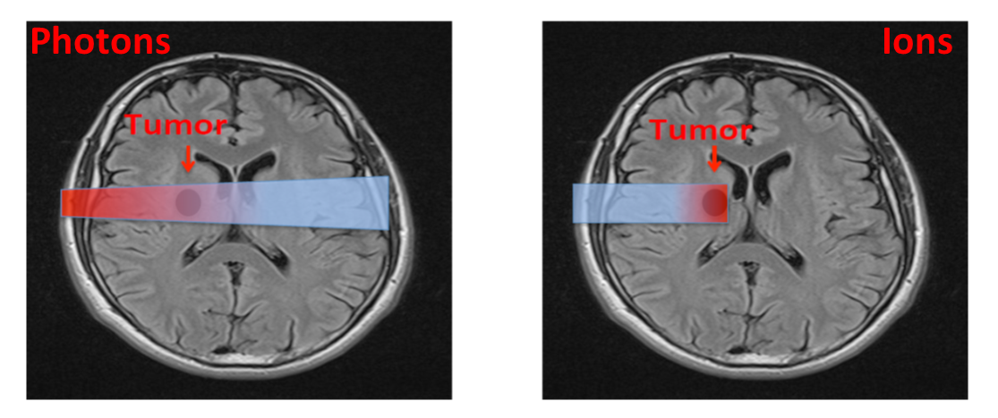

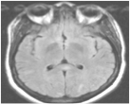
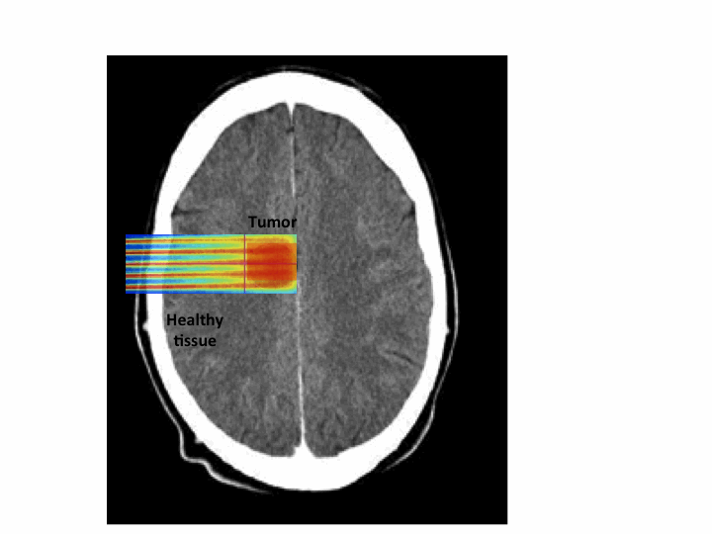
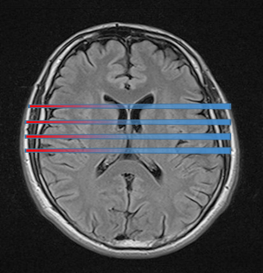
PROTONMBRT: an innovative therapeutic approach
Proton MBRT
Charged particles
Tumor
Prezado et al. 2013
ERC consolidator grant
Grant agreement No 817908
Beam width ≤ 1 mm
Minibeam radiation therapy (MBRT)

Slide 7
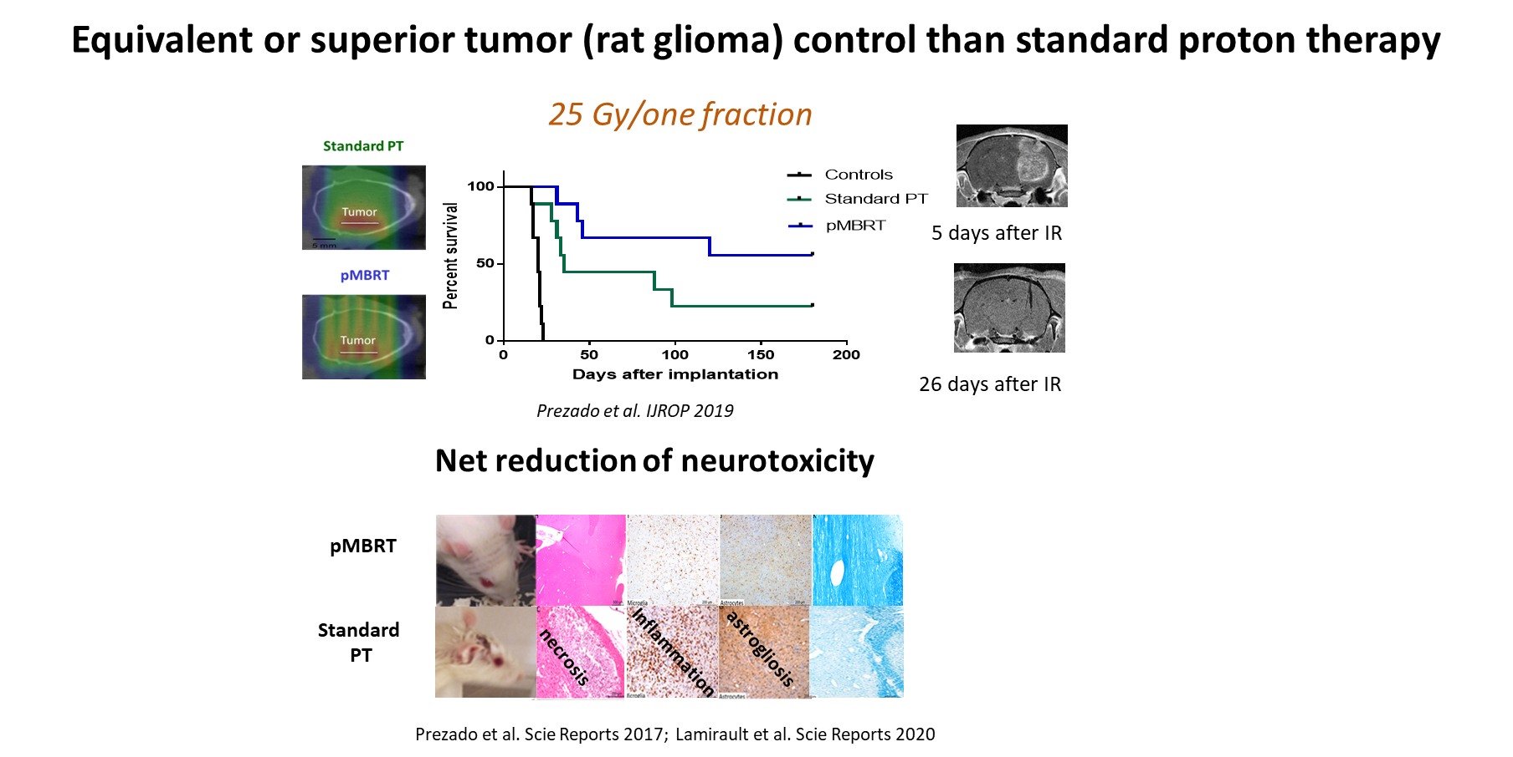
pMBRT increases the therapeutic index for high-grade gliomas
demyelination

Slide 8
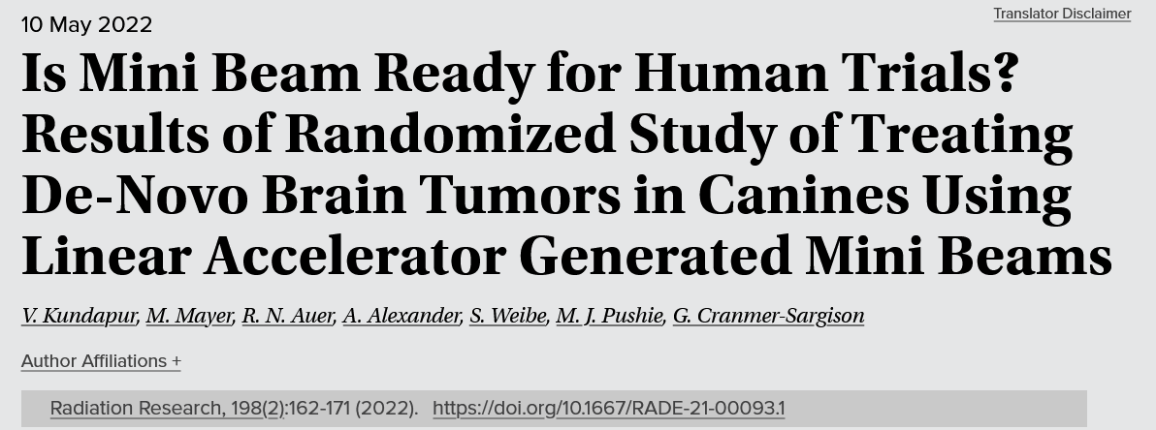
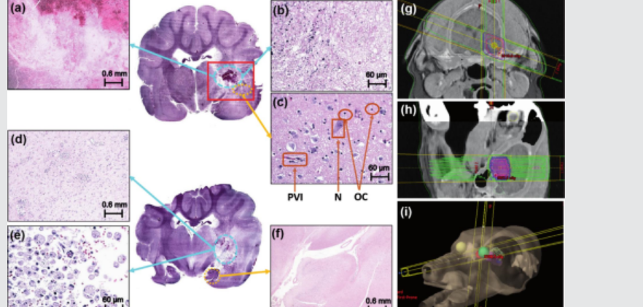
First pet treated…
N=8 dogs in MBRT ( 26 Gy mean dose)
N=8 dogs in conv RT arm (9 Gy in 3 fractions)
-71% complete pathological remission in MBRT versus 0% in Conv RT
-Sparing of normal tissue in the study arm, compared to Conv RT
SFRT: TYPES

Slide 9
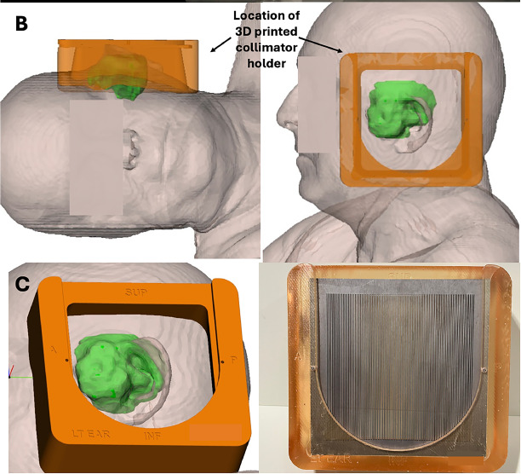
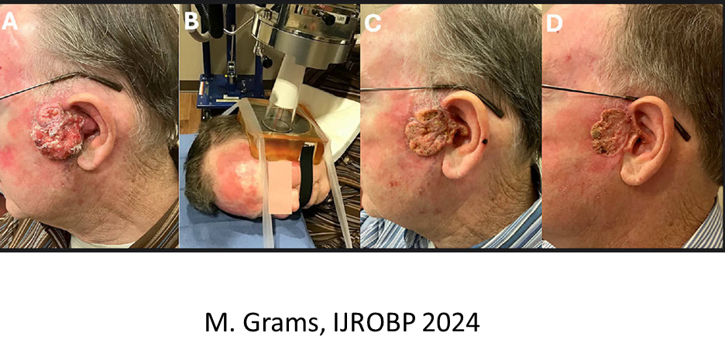
MBRT: first patients

Slide 10
SFRT radiobiology: what we know and don’t
Differential effect tumor versus normal tissue
Normal tissues | Tumor
Immune system
Reduced inflammation | Immune infltration/activation
Vascular effects
Prompt vascular repair | Vascular damage
Cell signalling
Positive “bystander”-like effects | Cytotoxic “bystander”-like effects
Cell migration, hyperplasia and proliferation | Different biochemistry
Prezado, Exp. Rew Mol Medicine 2022

Slide 11
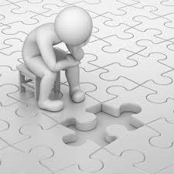
Open questions
Missing the weigth and interelation of each of the potential participants and how they are modified depending on physical parameters
Deeper understanding at molecular level (DNA repair, etc) needed.
Vascular damage
?
?
Bystander effects
Immune infiltration
?

Slide 12
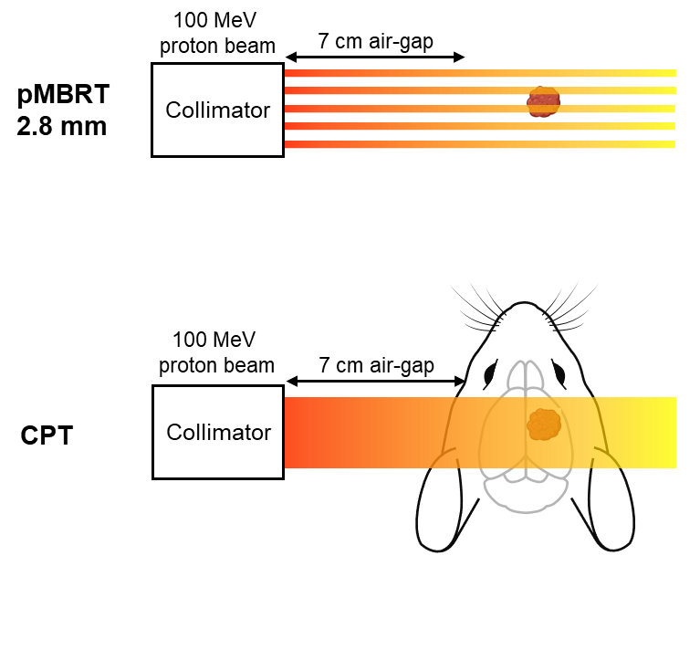
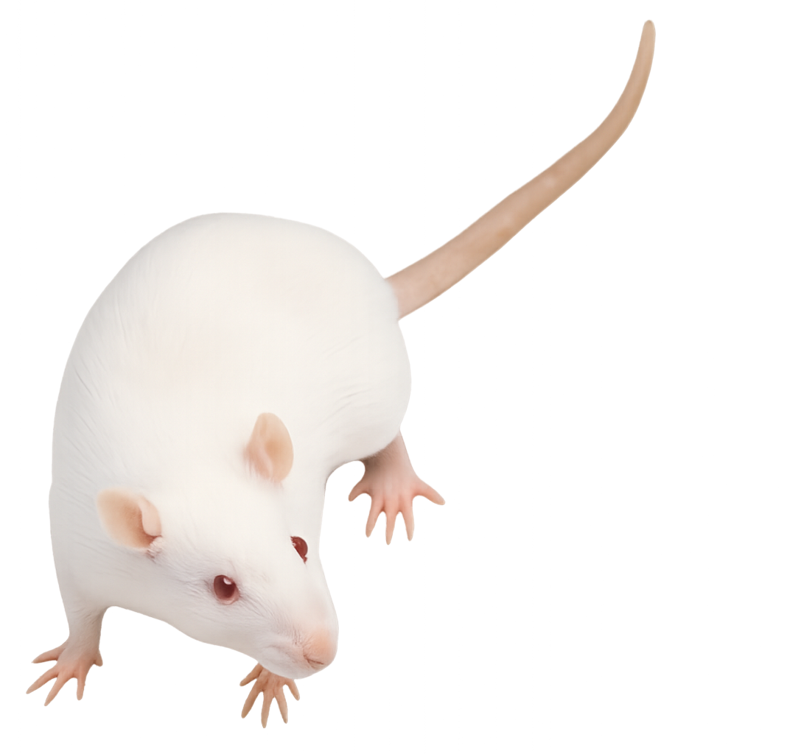
Animal model and irradiation conditions
Syngeneic RG2 cells (rat glioma type 2 cell line)
Orthotopic Rat cells in the brain of Fischer 344 rats
Rat model of aggressive brain tumors
Cauth & Barth, J Neuro-Oncol, 2009
Low immunogenicity
Aas et al., J Neuro-Oncol, 1995

Slide 13
SFRT radiobiology: what we know and don’t
Differential effect tumor versus normal tissue
Normal tissues | Tumor
Immune system
Reduced inflammation | Immune infltration/activation
Vascular effects
Prompt vascular repair | Vascular damage
Cell signalling
Positive “bystander”-like effects | Cytotoxic “bystander”-like effects
Cell migration, hyperplasia and proliferation | Different biochemistry
Prezado, Exp. Rew Mol Medicine 2022

Slide 14
SFRT radiobiology: what we know and don’t
Differential effect tumor versus normal tissue
Normal tissues | Tumor
Immune system
Reduced inflammation | Immune infltration/activation
Vascular effects
Prompt vascular repair | Vascular damage
Cell signalling
Positive “bystander”-like effects | Cytotoxic “bystander”-like effects
Cell migration, hyperplasia and proliferation | Different biochemistry
Prezado, Exp. Rew Mol Medicine 2022

Slide 15
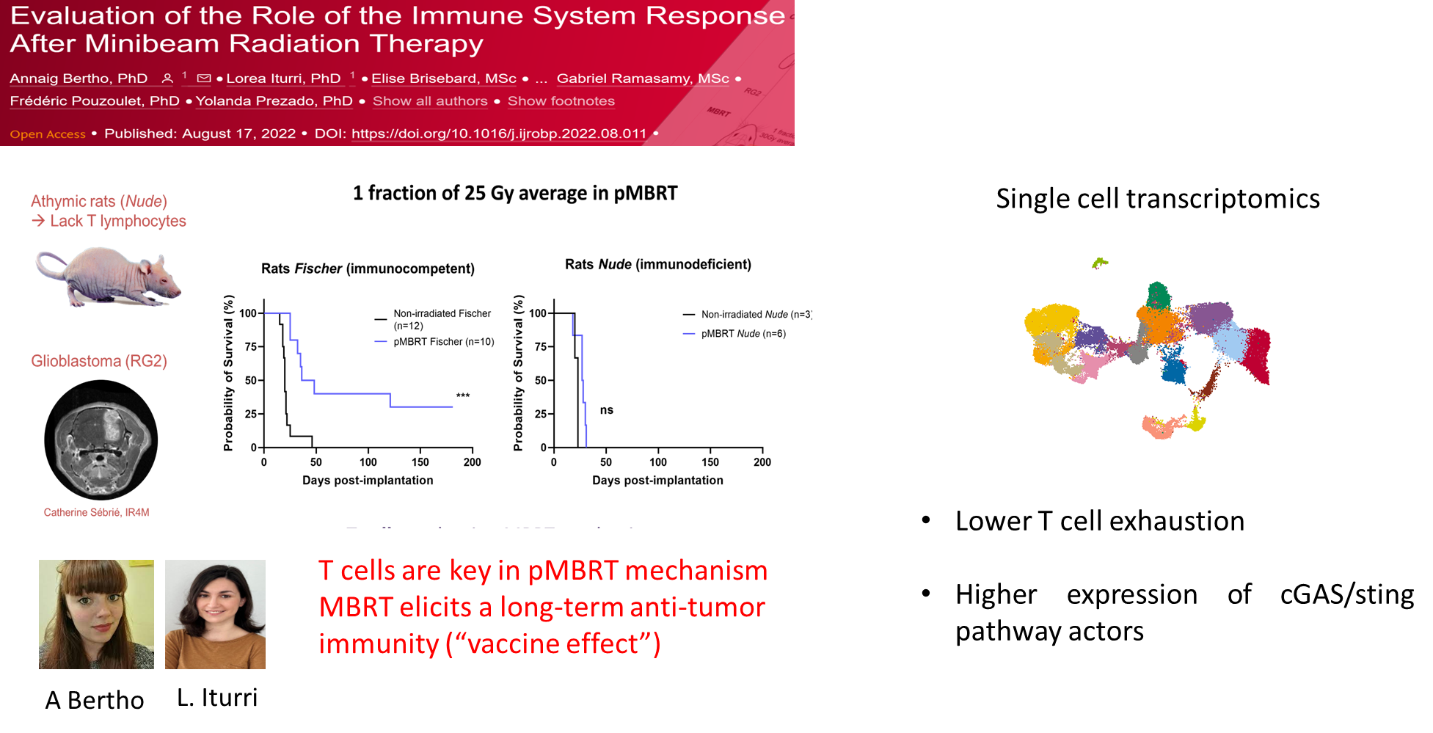
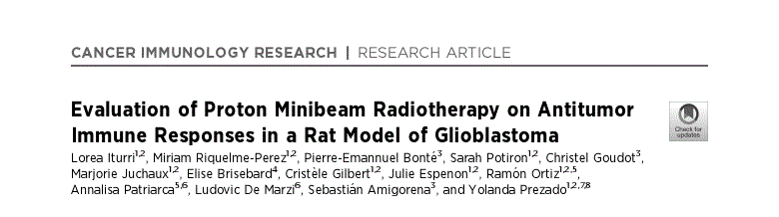

Slide 16
MBRT leads to a different spatio-temporal recruitment
Center
Adjacent
Periphery
Spatial distribution of immune cells
Immunofluorescence
T cells
Periphery
Adjacent
Center
B cells
pMBRT induces the recruitment of T cells in the center of the tumor
and B cells in the adjacent tissue and the periphery of GB
RADIOBIOLOGY

Slide 17
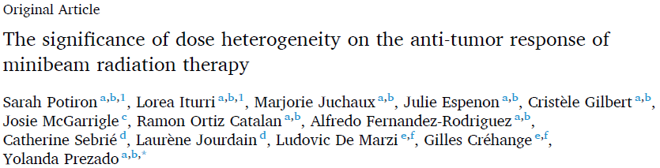

Dose heterogeneity increases survival and reduces
immune suppressive cells
A T cells
B CD4⁺ T cells
C CD8⁺ T cells
D CD4⁺ Treg
E CD8⁺ TRM
J CD43⁺ monocytes
Sarah Potiron
Notes:
We designed two minibeam configurations that conserved the same valley dose, but different center-to-center distance and peak doses. The 2 mm collimator had closer beams but with a lower dose in the peaks, while the collimator 2,8 mm had more distance between the peaks and higher peak doses, and this is the configuration that was used in the previous experiments. A nonsignificant difference in survival was observed between the 2 configurations. However, we obtained more long-term survivors in the configuration with the higher peak dose (2.8).
Then, we assessed the immune infiltration within the tumor microenvironment by flow cytometry at 7 days post-irradiation and determined an increase of T cell density in both treated groups, as well as an antigen memory establishment due to Tissue Resident Memory T cells. However, the only difference was in the infiltration of regulatory T cells and CD43+ monocytes in the 2.0 mm group, indicating an immunosuppression. So the physical & dosimetric parameters of pMBRT can influence the immune infiltration.

Slide 18
Macrophages phenotyping after pMBRT

Slide 19
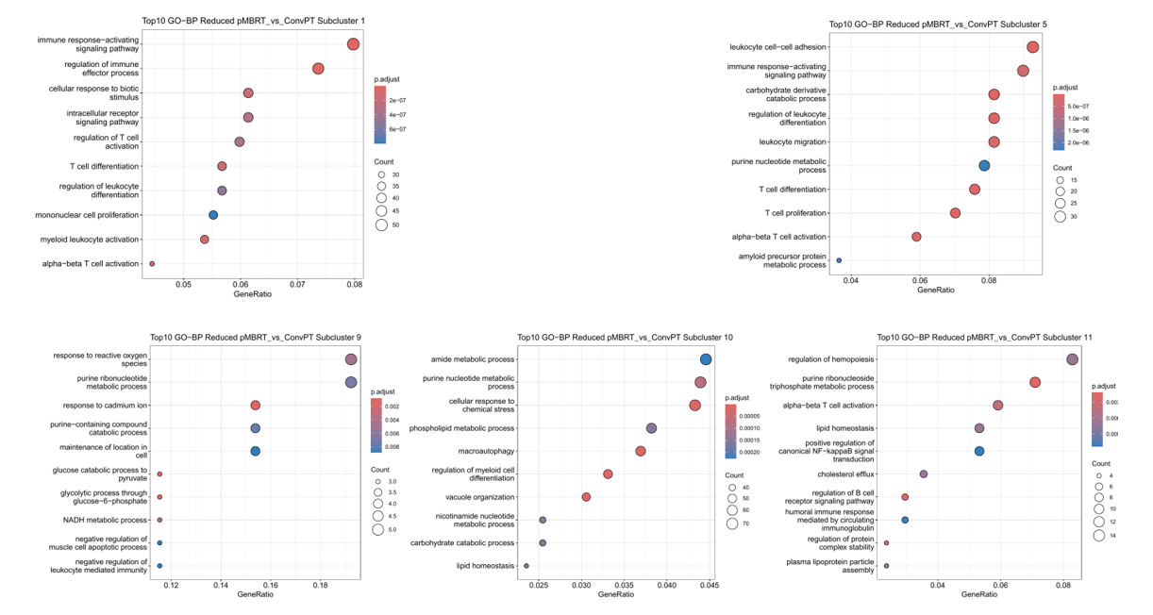
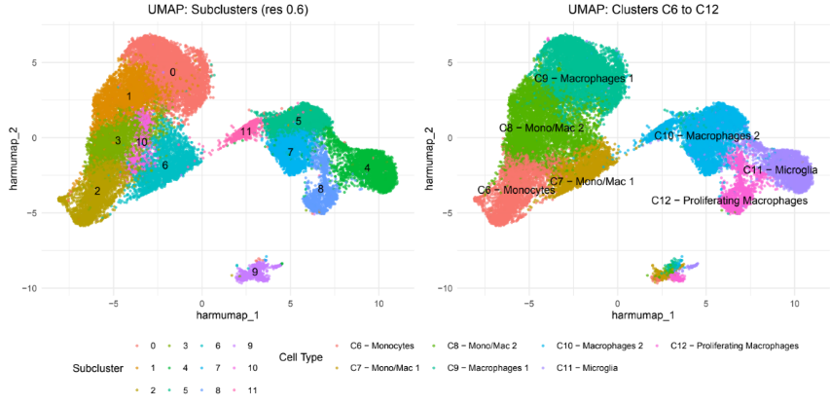

Macrophages phenotyping after pMBRT
MBRT:
increases expression of M1-like macrophage markers and interferon-regulated genes, including ISG15, IFIT3, MX2, and IRF7
upregulates of chaperone proteins and DNA repair machinery such as HSPA1B, DNAJA1, and FAM111A
Iturri et al. Canc Immunol Research 2025
Maria Teresa Frascino
UniPv
Notes:
systemic reinforcement of innate immunity and suggest that MBRT facilitates a tumoricidal shift in macrophage phenotype.
→ systemic reinforcement of innate immunity and suggest that MBRT facilitates a tumoricidal shift in macrophage phenotype.

Slide 20
Macrophages phenotyping after pMBRT
Scale bar = 10 μm.

Slide 21
Macrophages phenotyping after pMBRT
CD206⁺ CD163⁺ TAM
FolR⁺ Trem2⁺
ICAM-1⁺
PD-L1⁺
Flow cytometry at 7 dpi
Red: CPT
Blue: pMBRT
Immune evasion through PD-L1
Structural support through ICAM-1
PD-L1⁺
CD206+ CD163neg TAM
FolR+ Trem2+
ICAM-1+
Stronger infiltration of anti-inflammatory TAMs (M2-like) after CPT irradiation than pMBRT

Slide 22
SFRT radiobiology: what we know and don’t
Differential effect tumor versus normal tissue
Normal tissues | Tumor
Immune system
Reduced inflammation | Immune infltration/activation
Vascular effects
Prompt vascular repair | Vascular damage
Cell signalling
Positive “bystander”-like effects | Cytotoxic “bystander”-like effects
Cell migration, hyperplasia and proliferation | Different biochemistry
Prezado, Exp. Rew Mol Medicine 2022

Slide 23
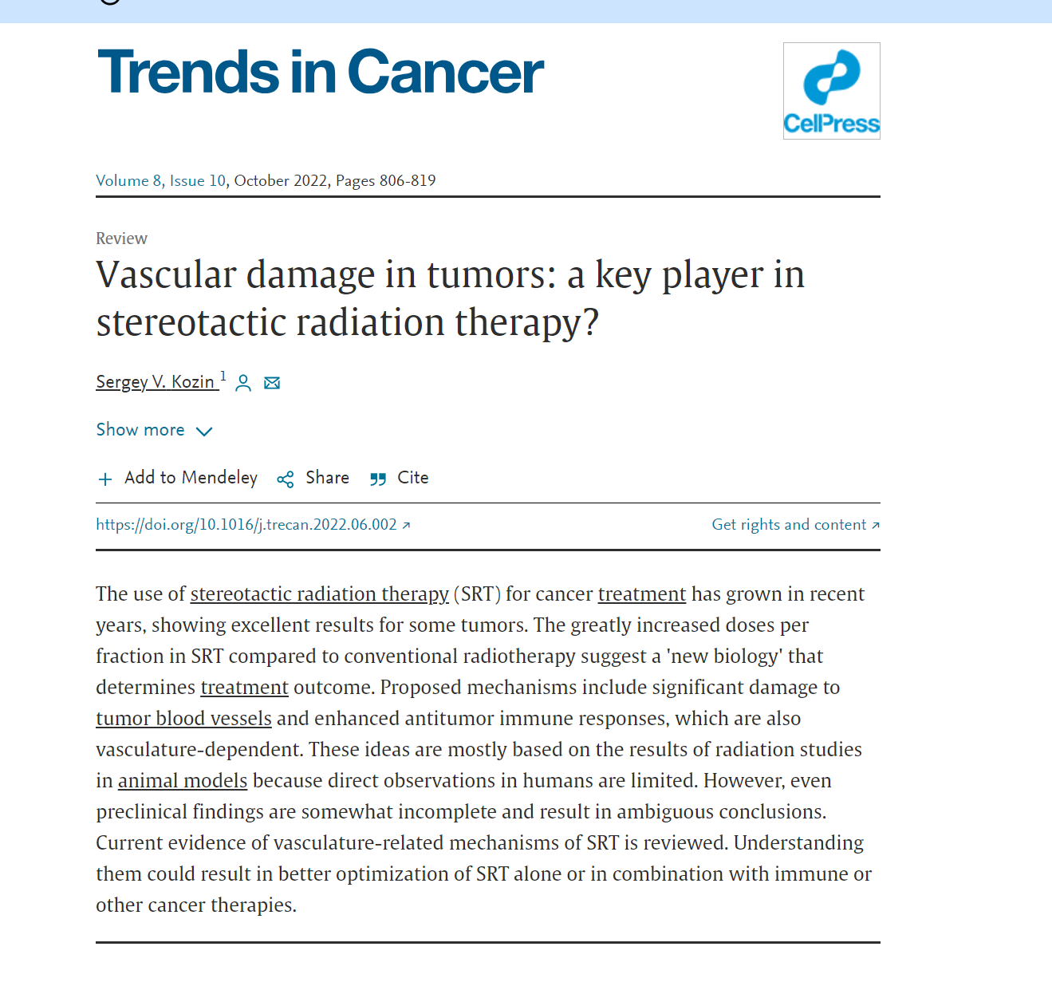
SFRT results in a similar vascular damage as in radiosurgery?
High-dose (>8–10 Gy) irradiation preferentially targets endothelial cells lining tumor blood vessels by activating an acid sphingomyelinase (ASMase)-mediated apoptotic pathway.
The tumor response at such high doses is predominantly due to secondary cell death caused by severe vascular deterioration.
RADIOBIOLOGY

Slide 24
SFRT: a similar vascular damage as in radiosurgery?
Indirect observations in GRID and Lattice therapy
GRID therapy (patients)
63 % of responders increase secretory sphingomyelinase (SSMase)
75 % increase in ceramide levels
.
Lattice (rodents)
Increased ASMase in the serum of Lewis Lung carcinoma bearing mice.
Kanagavelu et al 2014
Sathishkumar el at. 2005
Vascular effects mainly evaluated in MRT
RADIOBIOLOGY

Slide 25
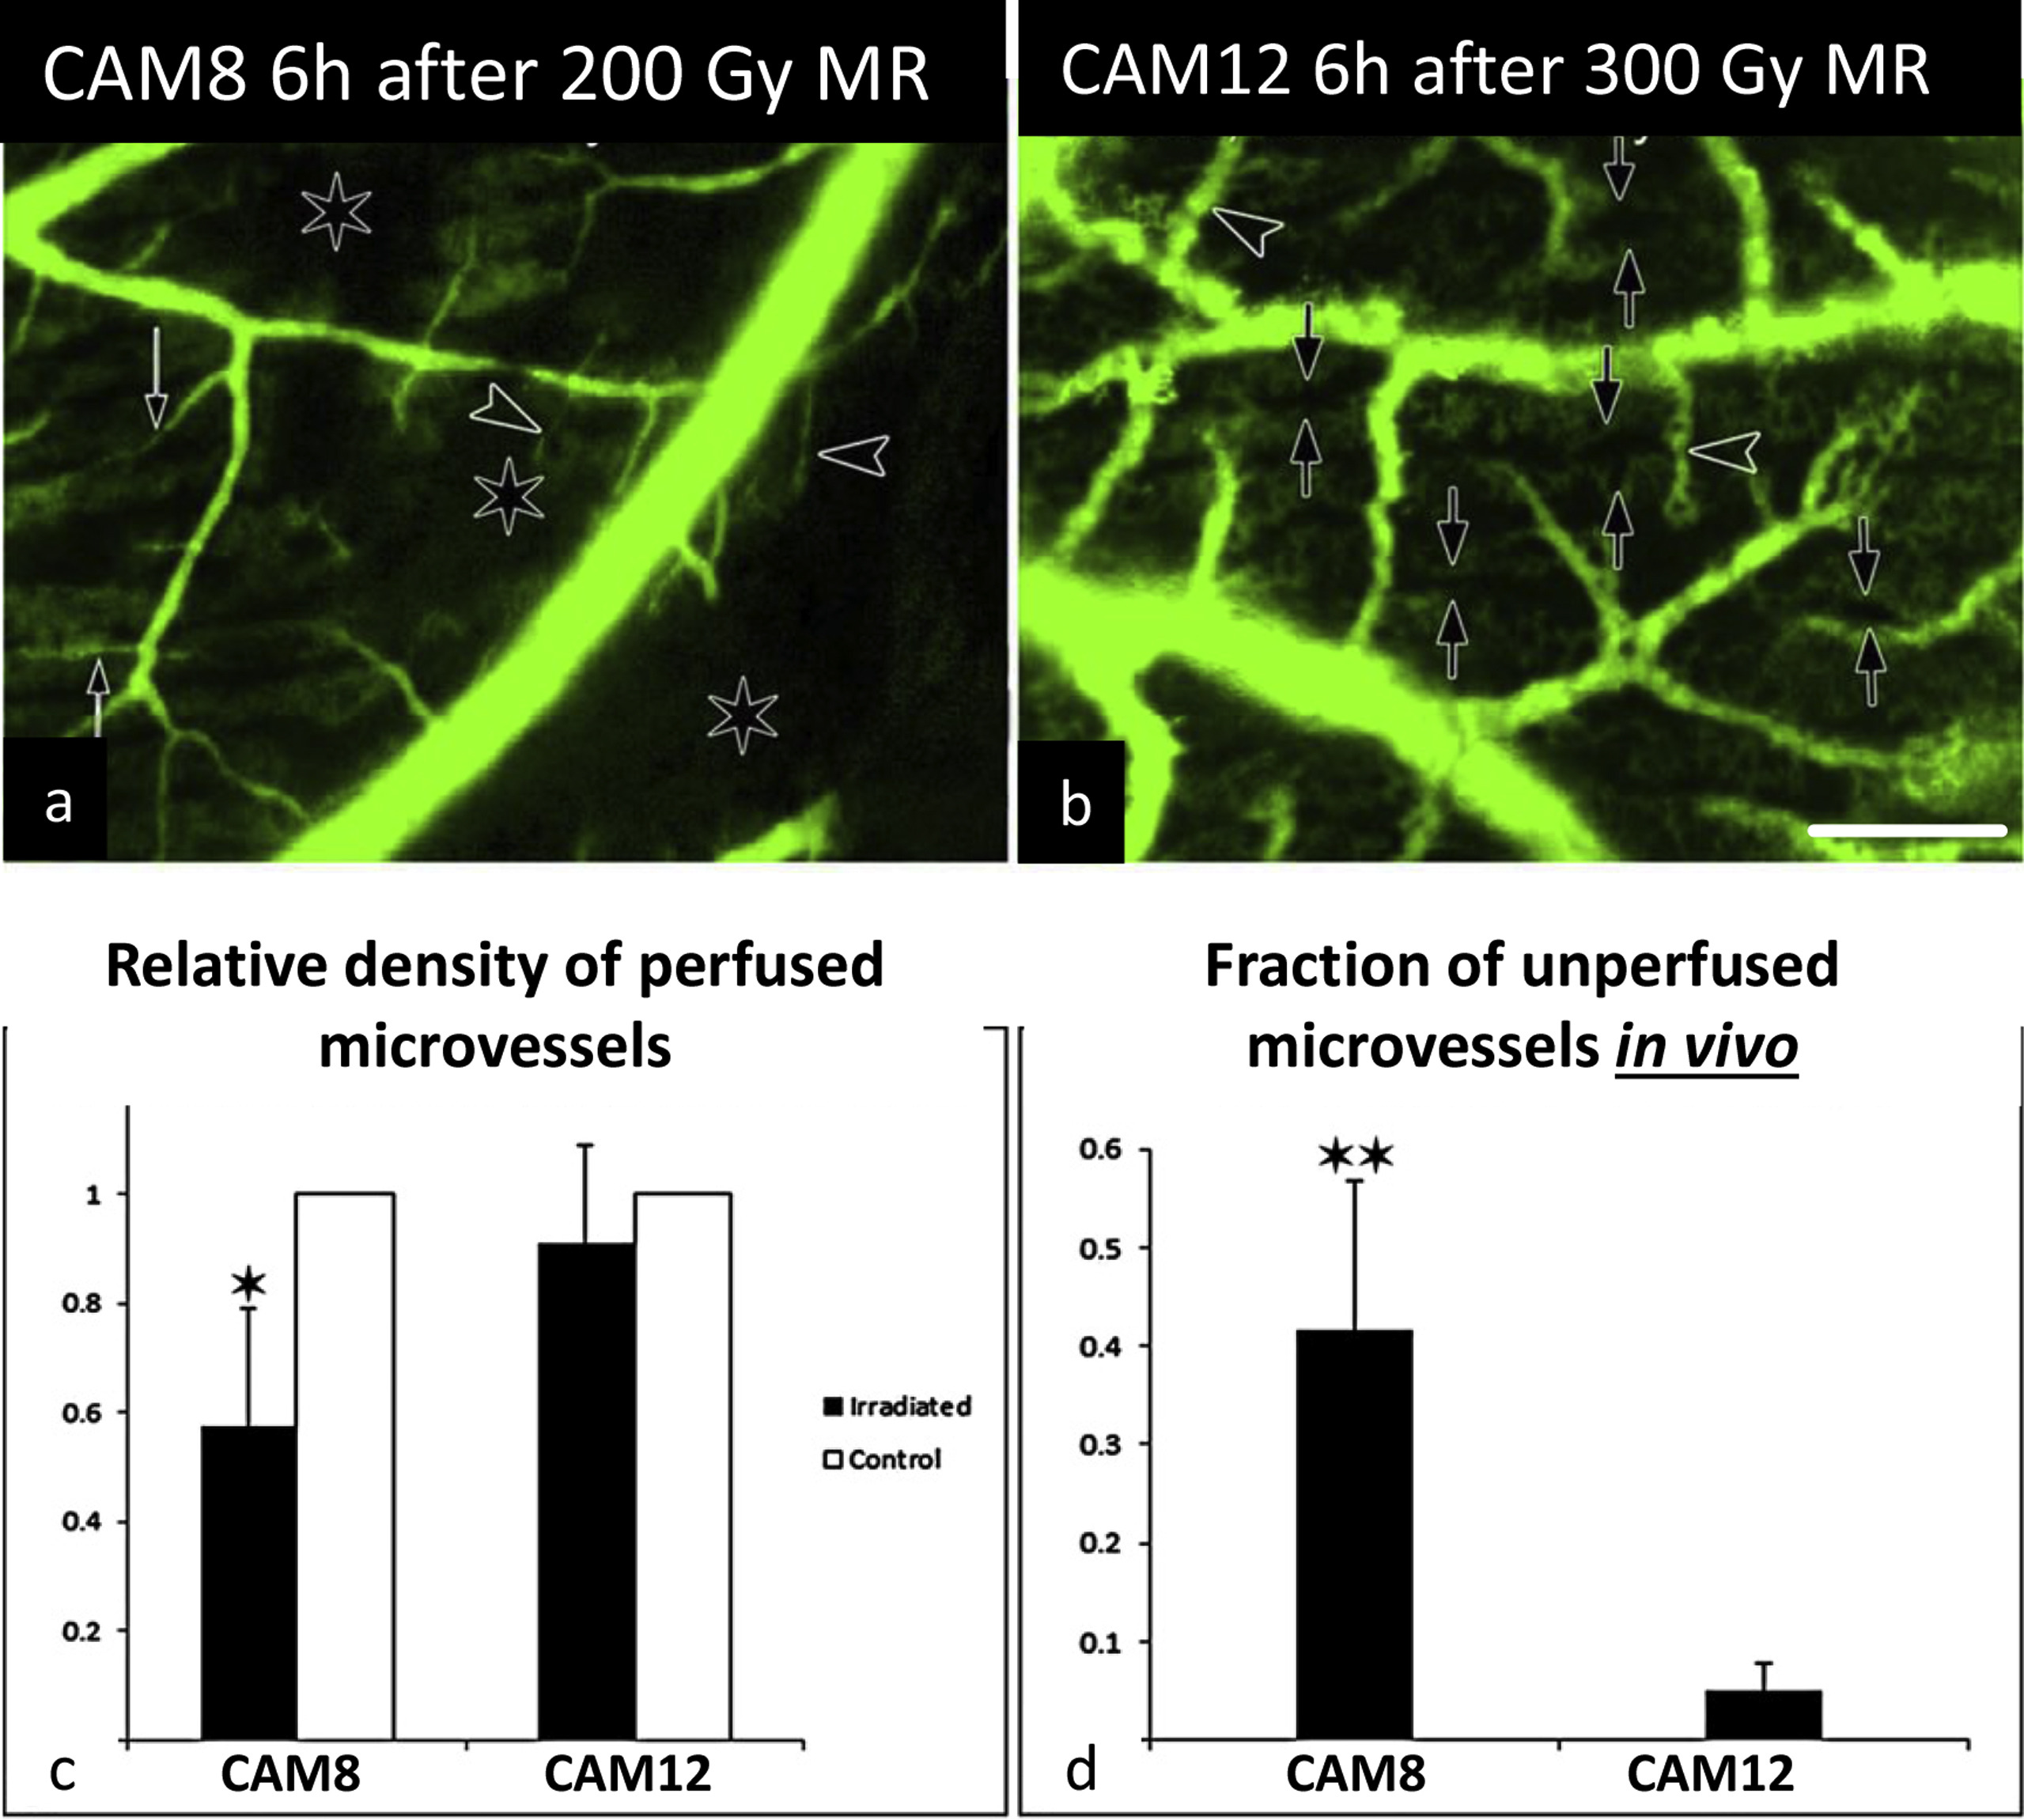
Vascular effects in MRT
Normal tissues
Preferential effect on immature vessel
Prompt vascular repair (< 60 min)
Vascular tumor damage
Altered blood vessel integrity and significantly reduced blood perfusion
Potez et al 2019
Sabatasso et al 2011
MRT (Peak dose 407 Gy, valley 6.2 Gy)
vs BB (6.2 Gy)
CAM= chick chorioallantoic membrane
RADIOBIOLOGY

Slide 26
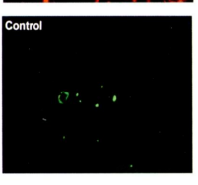
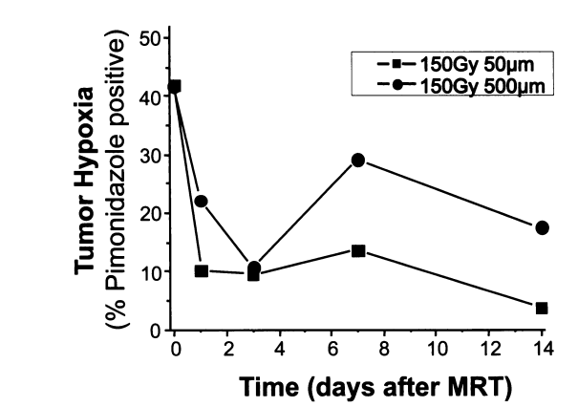
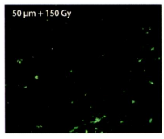
BUT MRT also observed to lead to tumor vascular normalisation
Pericytes
4T1 tumors
RJ Griffin et al. Rad Research 2012
4T1 tumors, 50 Gy
Fontanella et al Rad Research 2015
RADIOBIOLOGY
Notes:
ssels initially oriented parallel to the beam length were replaced by vessels running perpendicular to the irradiation portion of the tumor. Blood flow analysis showed no apparent loss of vascular function within the window after microbeam irradiation, as indicated by the detection of normal microvessel blood velocities.

Slide 27
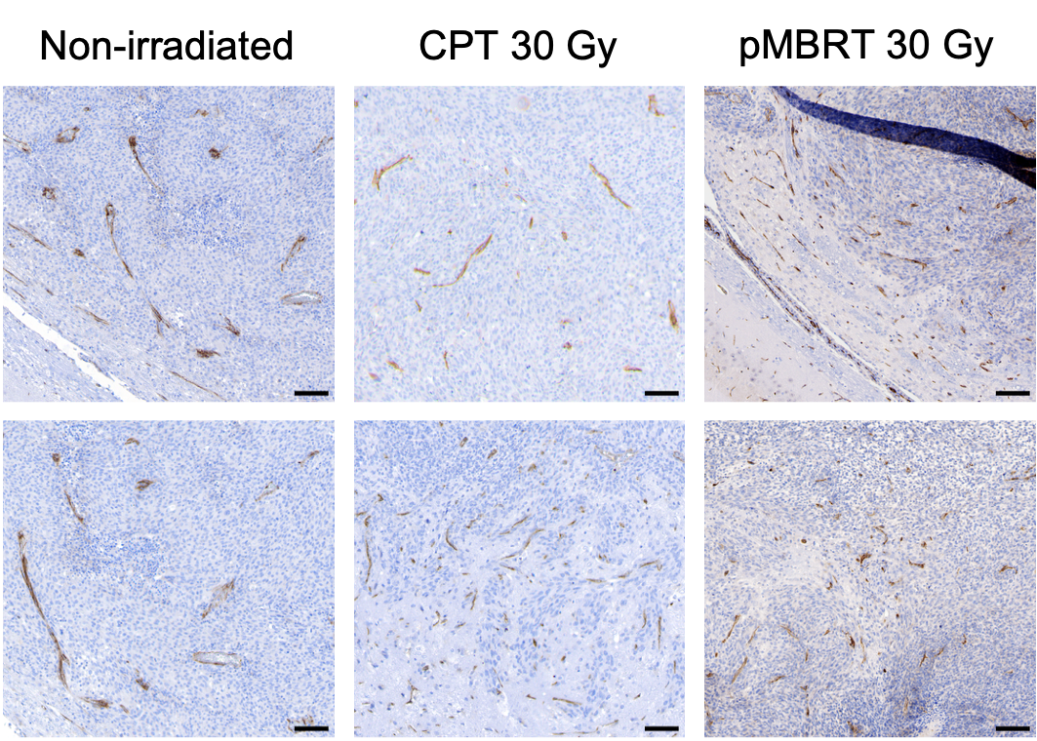
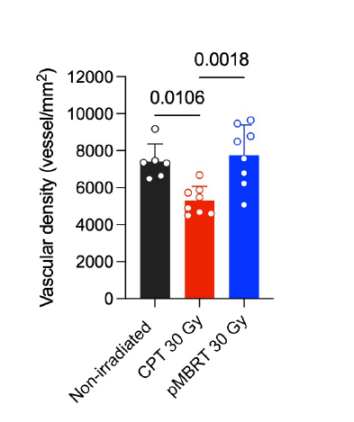
Vascular effects in MBRT
Tumor Vascular density
(vessels/mm²)
Normal Vascular density
(vessels/mm²)
24 hpi
7 dpi
7 dpi
Endothelial cells (CD31 staining)
after 24 hpi and 7 dpi
Sarah Potiron

Slide 28
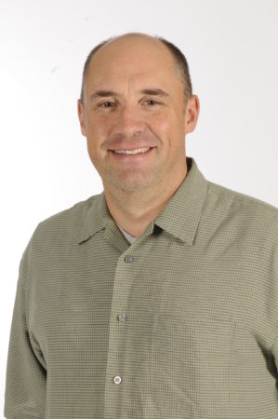
Vascular-Immune Interactions in pMBRT (7 days after IR)
Scale bar = 20 μm
CD31⁺
CD3⁺ T cells
CD31⁺ CD3⁺
CD8⁺ T cells
CD31⁺ CD3^{neg}
CD8⁺ Macrophages
pMBRT
Enhances immune infiltration associated to blood vessels
Sarah Potiron
R. Griffin

Slide 29
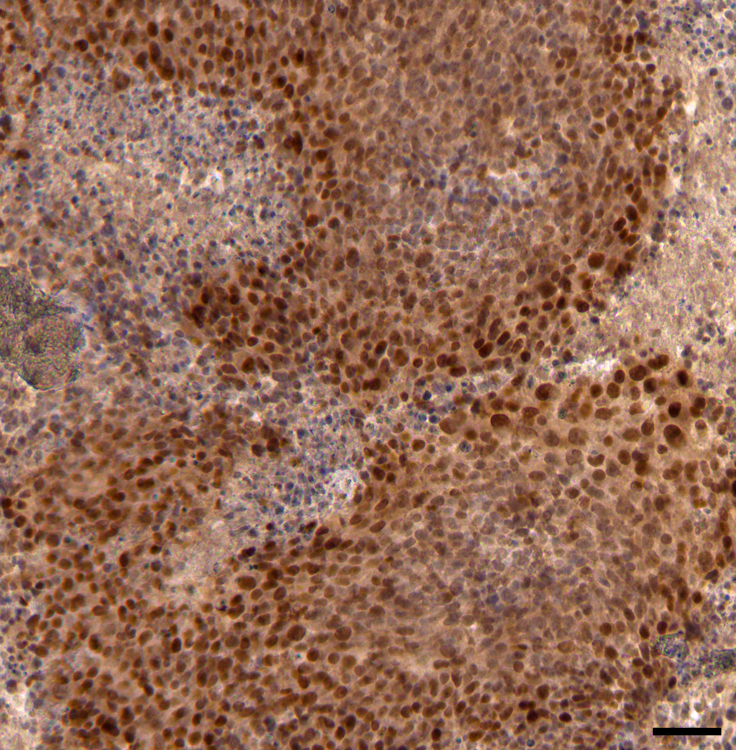
Vascular-Immune Interactions in pMBRT (24 h after IR)
HIF1α evaluation
Scale bar = 50 μm
pMBRT limits the development of hypoxia
Sarah Potiron
R. Griffin

Slide 30
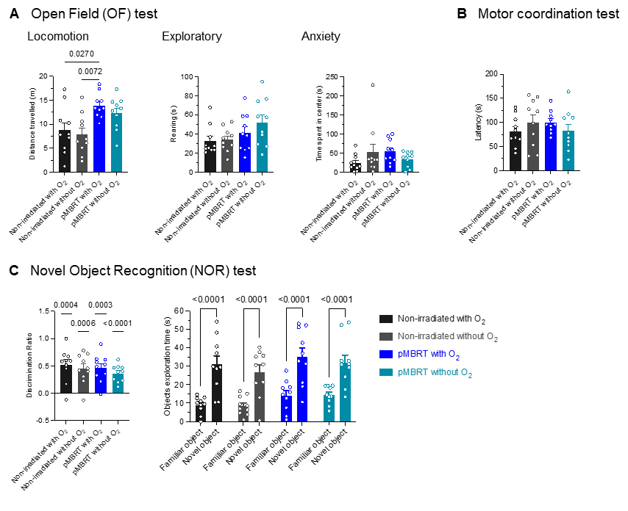
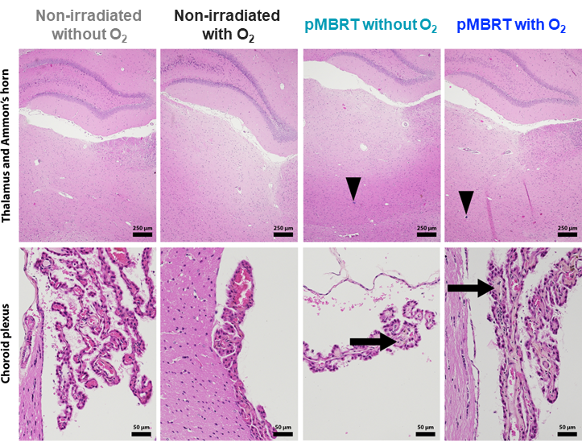
Reduced O₂ anesthesia supplementation dependence in healthy tissues after pMBRT
Rats’ brain irradiations
Potiron et al, Redjournal 2025

Slide 31
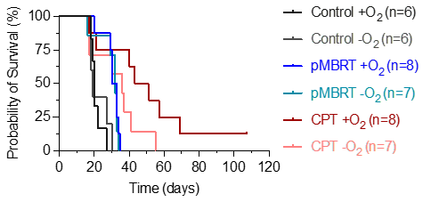
Reduced O₂ anesthesia supplementation dependence in tumor response after pMBRT
Glioma bearing rats
Potiron et al, Redjournal 2025

Slide 32
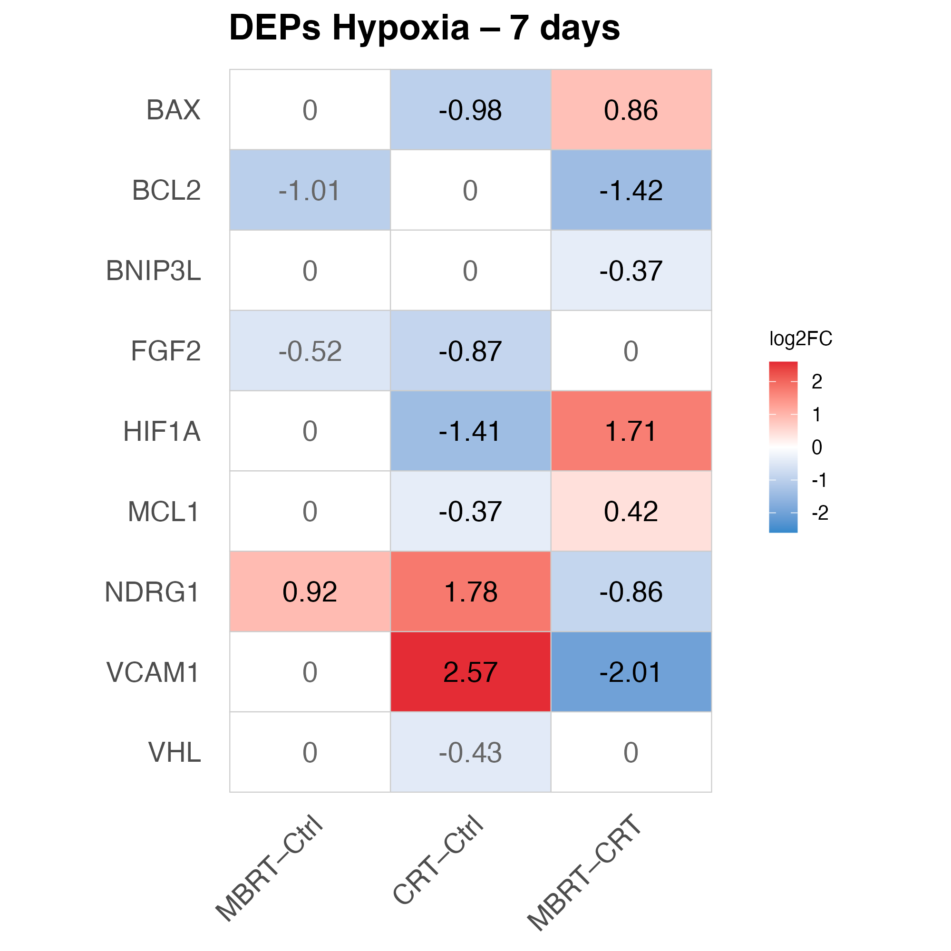

Proteomics (7 days after IR): focus on hypoxia-related proteins
MBRT preserves adaptive hypoxia signaling and limits inflammation.
Whereas CRT suppresses HIF1A, strongly upregulates NDRG1 and VCAM1, generating a stressful, chronic, and potentially pro-tumoral hypoxic microenvironment.
Ana Perez

Slide 33

Proteomics at 7 days after pMBRT
GB – Top 10 pathways for each group
pMBRT vs CPT : TOTAL DEPs in GB (7 dpi)
CPT
vs Control
pMBRT
vs Control
pMBRT
vs CPT
Vanin-1
Glutamine
Synthetase
LogFC
KEGG: Pantothenate and CoA Biosynthesis
KEGG: Nitrogen metabolism
-2
0
2
Number of proteins:
-log₁₀(q-value)
Top 10 pathways:
50
25
75
100
Overlap with other groups:
CPT vs Control
pMBRT vs Control
pMBRT vs CPT

Slide 34
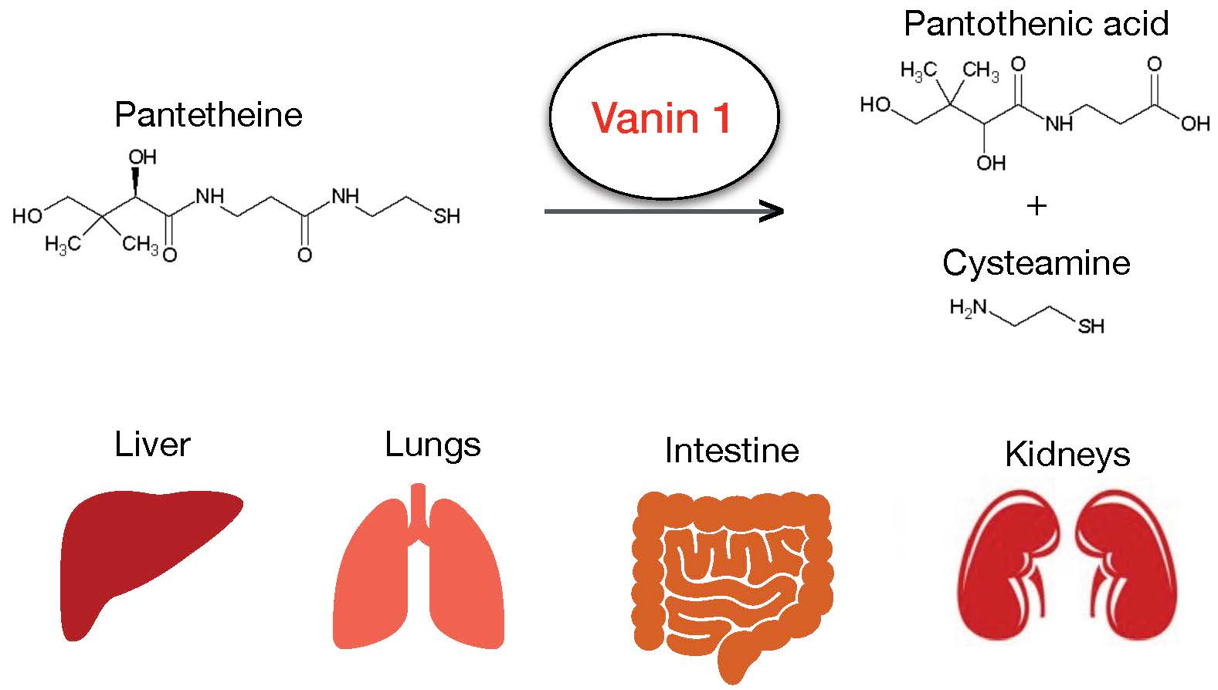
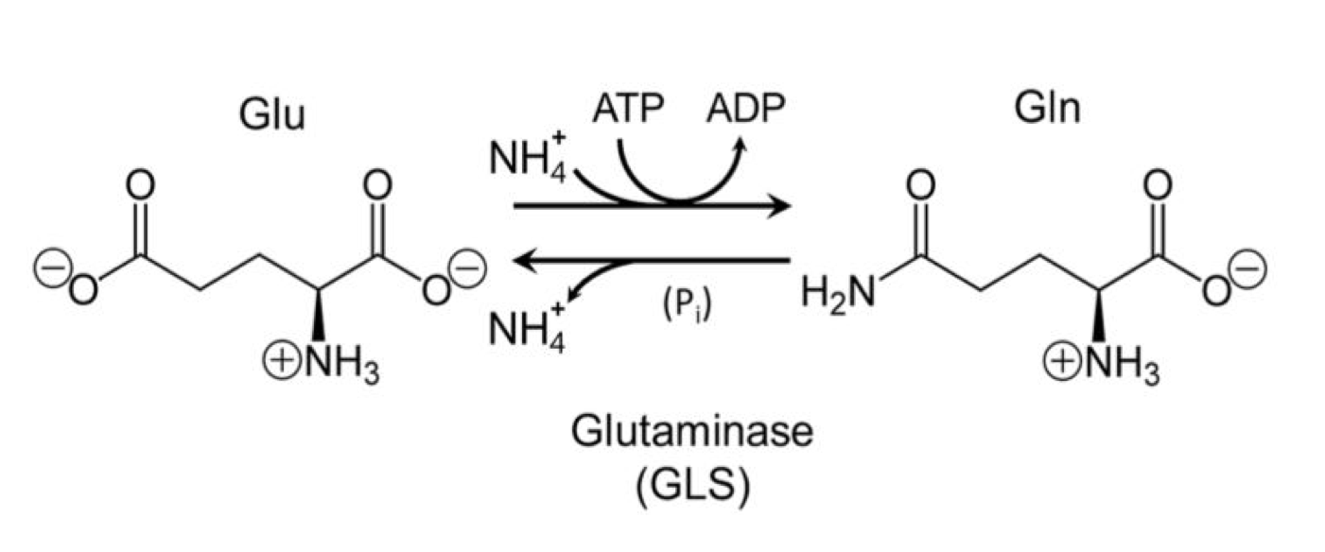
Proteomics at 7 days after pMBRT
Pantetheine
↓ Glutamine Synthetase
Glutamate
↓ Glutamine
↑ Vanin-1
↑ Pantothenic acid
+
↑ Cysteamine
Glutaminase
Inhibits GB growth and radioresistance by impairing DNA repair^{2,3}
+ Glutamate accumulation : ferroptosis sensibilisation?
Inhibits migration and invasion through matrix metalloproteinases downregulation in GB¹
²Tardito et al. (2015). Nature cell biology, 17(12), 1556–1568.
³Fu et al. (2019) Cell reports vol. 28,5: 1136-1143.e4.
¹Jung et al. (2024). Cancers, 16(11), 2029.

Slide 35
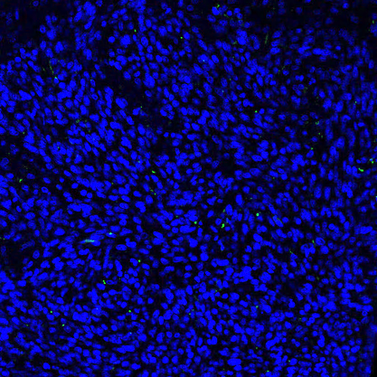
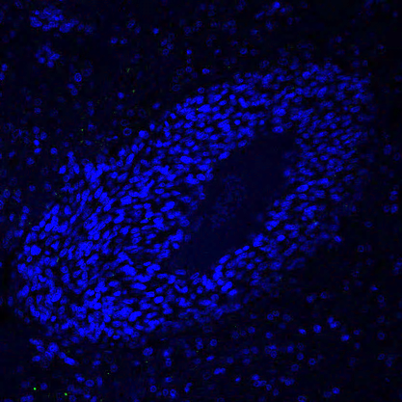
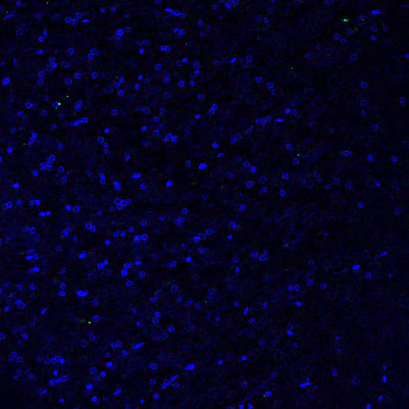
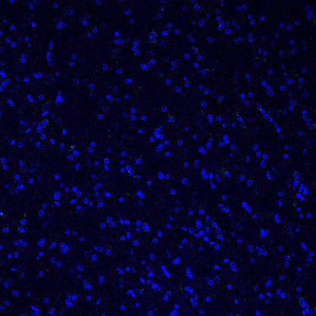
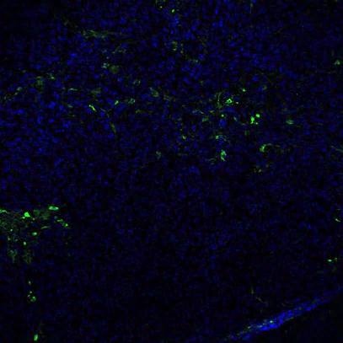
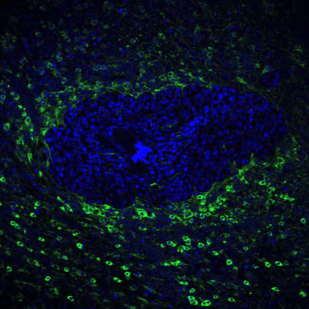
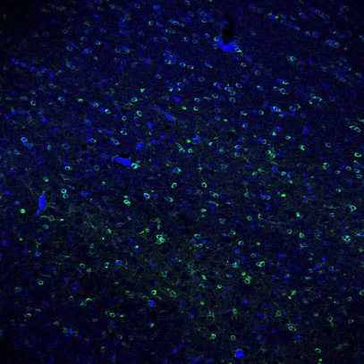
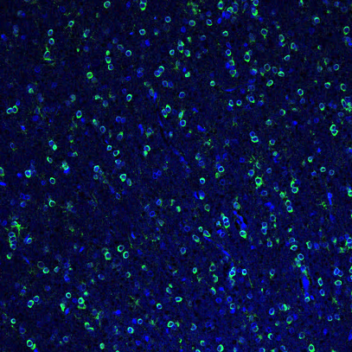
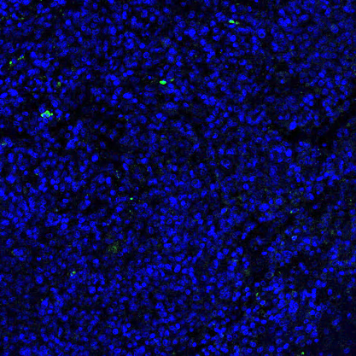
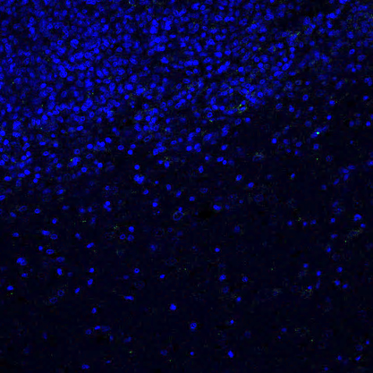














Ex vivo validation
Vanin-1 (7 dpi)
Glutamine Synthetase (7 dpi)
Intratumoural
Tumour border
Ipsilateral
Contralateral
Intratumoural
Tumour border
Ipsilateral
Contralateral
Control
Control
CPT
CPT
pMBRT
pMBRT
DAPI Vanin-1
DAPI GS

Slide 36


Spatial transcriptomics (48 h after IR)
MBRT modulates neutransmissor signalling in normal brain: GABA-B signaling pathway
TAM becomes a strong sender of CXCL signal after MBRT. In contrast, CRT completely terminates the CXC signaling among the tumor cell population.

Slide 37



Intracellular communication network
CTRL
MBRT
CRT
Number of interaction
Number of interaction
Number of interaction
Oligodendrocyte
Neuron
Oligodendrocyte
Neuron
Oligodendrocyte
Neuron
1
Neuron
Neuron
Neuron
1
1
Astrocyte
Astrocyte
Astrocyte
RG2
0
RG2
0
RG2
0
RG2
Vascular
cells
RG2
Vascular
cells
RG2
Vascular
cells
Microglia
RG2
Microglia
RG2
Microglia
RG2
Interaction weights/strength
Interaction weights/strength
Interaction weights/strength
Oligodendrocyte
Neuron
Oligodendrocyte
Neuron
Oligodendrocyte
Neuron
Neuron
Neuron
1
1
Neuron
1
Astrocyte
Astrocyte
Astrocyte
0
RG2
RG2
0
0
RG2
RG2
Vascular
cells
RG2
Vascular
cells
RG2
Vascular
cells
Microglia
RG2
Microglia
RG2
Microglia
RG2
MBRT maintains similar pattern of interaction as the non-irradiated group
CRT reduces & disperses these interactions: potential disruption of communication between cell populations
Unpublished data, do not reproduce
Notes:
Then, the intercellular communication networks between each cell population within the CTRL, MBRT, and CRT conditions. Each dot represents a cell population, with the connection arrows showing proportionally to its thickness, the number and strength of interactions. The analysis revealed a complex network of interactions between the different healthy and tumoural cell populations. Across conditions, tumour cell populations (RG2 (C0), RG2 associated with endothelial gene markers (C4), and RG2 associated with macrophages (C7)) not only exhibited strong intratumoural interactions but also interacted with microglia (C5). Healthy cell populations, including neurones (C1 and C6), oligodendrocytes (C2), and astrocytes (C3), display numerous interactions. MBRT maintains a similar pattern of interaction to CTRL 48 hours post-irradiation

Slide 38
SFRT radiobiology: what we know and don’t
Differential effect tumor versus normal tissue
Normal tissues | Tumor
Immune system
Reduced inflammation | Immune infltration/activation
Vascular effects
Prompt vascular repair | Vascular damage
Cell signalling
Positive “bystander”-like effects | Cytotoxic “bystander”-like effects
Cell migration, hyperplasia and proliferation | Different biochemistry
Prezado, Exp. Rew Mol Medicine 2022

Slide 39


EV-Mediated Bystander-like Effects in MBRT
Indirect communication between cells receiving higher, lower or no dose
Several routes such as extracellular vesicles (exosomes)
Protein, DNA and RNA are cargos for recipient cells
A focus on microRNA (miRNA), non-coding RNA known to alter negatively gene expression of recipient cell
Peak dose exposure
Valley dose exposure
Jenkins et al., J. Semradonc, 2024
41/50
Notes:
Bystander-like effects are off-target effects from signals sent by irradiated cells to non-irradiated cells or cells which have received a lower dose
This could result in several routes of signals, such as extracellular vesicles, also called exosomes
Those extracellular vesicles or EV contains proteins, DNA and RNA to modulate the behavior of recipient cells
In this study, I focused my work on microRNA which are small non-coding RNA known to mostly alter negatively the gene expression of cells

Slide 40


EV-Mediated Bystander-like Effects in MBRT
Size
Protein expression
CD9 and CD63
CD9 and CD81
Validation of sEV
44/50

Slide 41
EV-Mediated Bystander-like Effects in MBRT
24 hpi
Sequencing of microRNA-contained small extracellular vesicles
Only CTX-TNA2 showed significant results
Non-irradiated vs CRT 10 Gy
Non-irradiated vs MBRT 10 Gy
DNA damage miR-93-5p, miR-25-3p
Hypoxia-like signaling miR-210-3p, let-7 family
Survival pathways miR-124-3p, miR-132-3p
A first preliminary investigation of miRNA signatures after MBRT
Sarah Potiron
45/50
Notes:
Thus, by doing the sequencing of microRNA contained in small EV, we have not observed any significance changes in the glioma cell lines
However, significant changes in expression were observed in CTX-TNA2 cell line
Among the miRNA expressed differentially, some are involved in DNA damage pathways, other in hypoxia-like signaling, and other in survival pathways, suggesting an astrocytic small EV response driven by common stress programs.
This is the first preliminary investigation of miRNA signatures after MBRT

Slide 42
Conclusions: what have we learnt lately?
MBRT induces a more favourable immune phenotype:
Higher T infiltration (notably cytotoxic T cells, less exhausted) and a more pro-inflammatory macrophages phenotype (M1-like). Kinetic study needed.
The higher the dose heterogeneity, the lower number of Tregs and monocytes.
MBRT→ vascular renormalization and favourable immune-vascular dialog.
MBRT→ appears to reduce hypoxia response and O₂ dependence.
potential positive bystander-like effects?
Further evaluations are needed.
MBRT→indications of a reduced invassiveness Further validations needed.

Slide 43


Peaks and valleys
peak
centre-to-centre (ctc)
valley
peak-to-valley dose ratio: $PVDR= \frac{D_{peak}}{D_{valley}}$
.

Slide 44





CIMUS: a new kid on the block
Laser L2A
Proton therapy
Mini-GRID. Acuna et al 2025

Slide 45


New Approaches in Radiotherapy team
Institut Curie
CIMUS

Slide 46

Thank you very much for your attention!
yolanda.prezado@usc.es
46

