Slide 1



CP4CT w/s: International strategic review workshop
What will be the unique advantages of laser driven charged particles
Current status of particle therapy
and
priority areas for development
Alejandro Mazal, Stephanie Bolle, Juan Castro
In behalf of the team of
Centro de Protonterapia Quironsalud
Madrid, Spain
London, February 27th, 2026

Slide 2
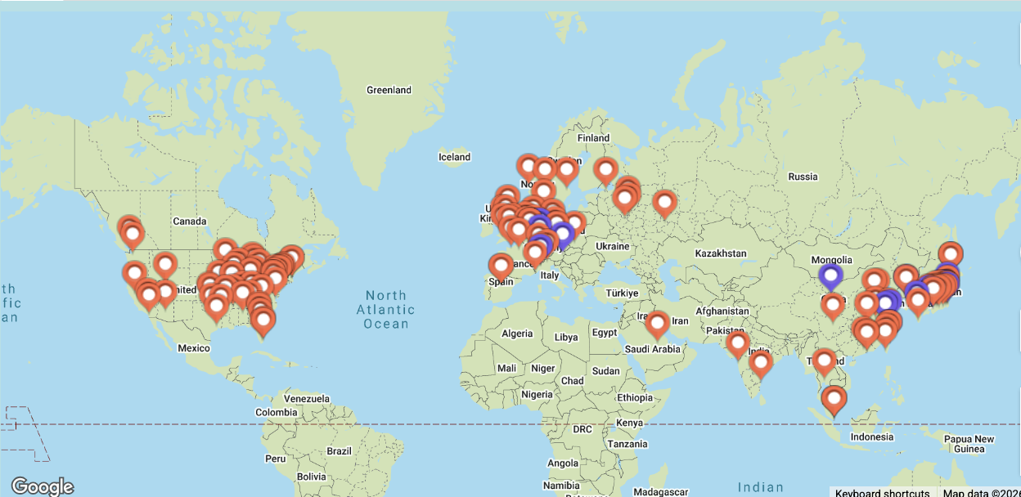
For a “current status” of PT nothing better than… PTCOG!
Number of operating facilities in the world 2025
PTCOG (M.Jermann): 137 facilities in operation, 35 in construction, 37 planned…

Slide 3
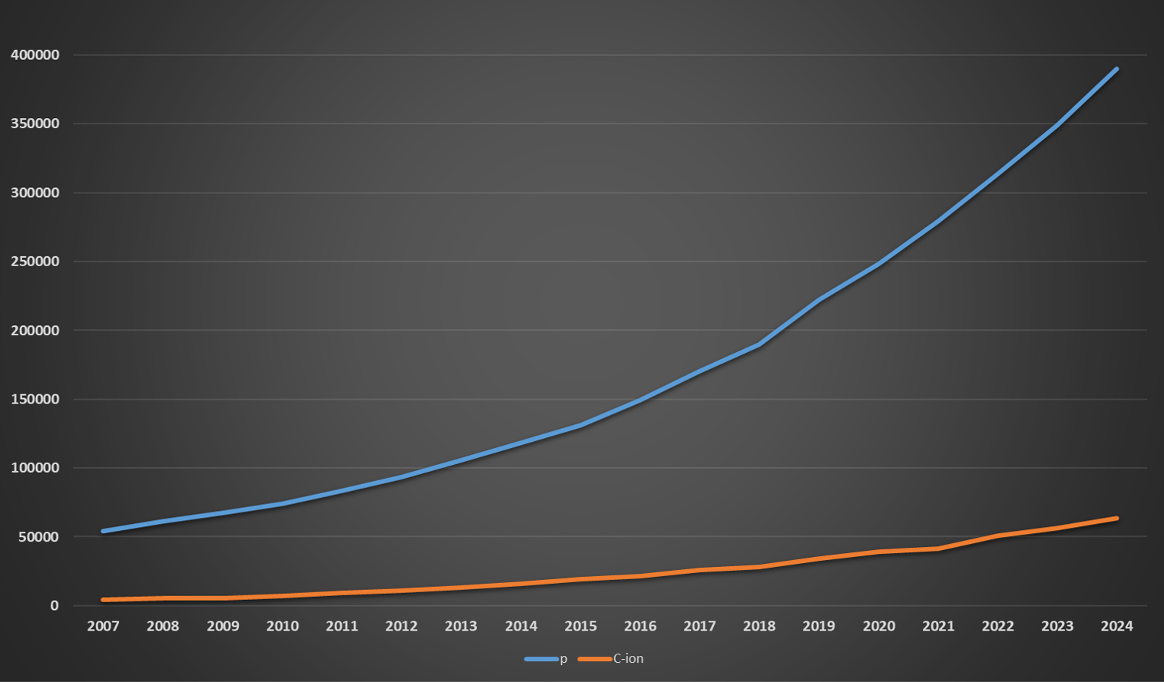
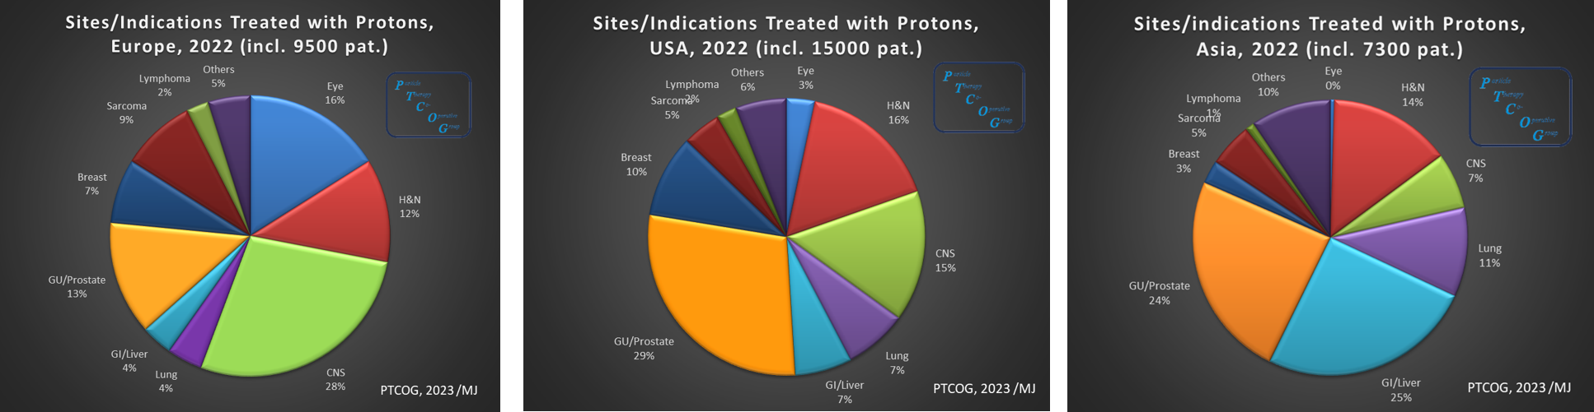
PTCOG (M.Jermann):
Patients treated with Protons and Carbon worldwide 2007-2024
400.000 pats w/protons
(35-40.000 per year)
65.000 pats w/Carbon
Prostate
CNS
Liver

Slide 4
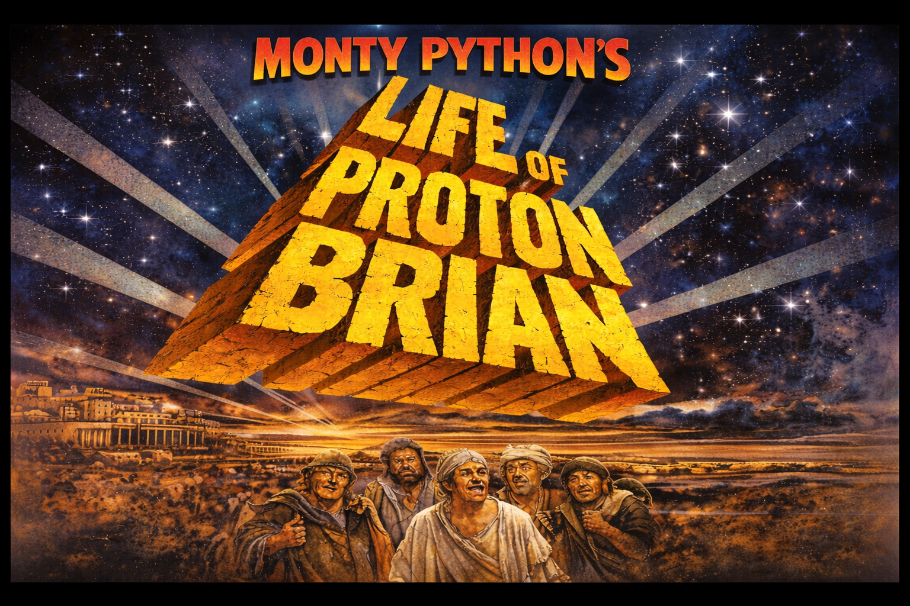
Let´s see it in the finest British understatement tradition...
Directors:
Kenneth Long,
Patricia Price,
Richard Amos,
Iain McNeish
Starring:
Alejandro Mazal
Sandro Rossi
Yolanda Prezado
Joao Seco¶
Marco Durante¶
Manjit Dosanjh
Konrad Nesteruk¶
Rock Mackie¶
Alex Gerbershagen¶
Kenneth Long

Slide 5
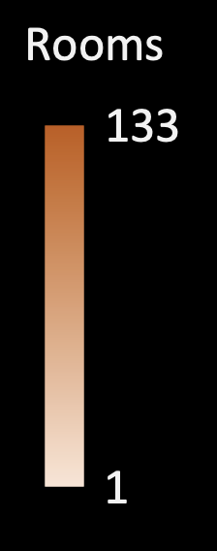
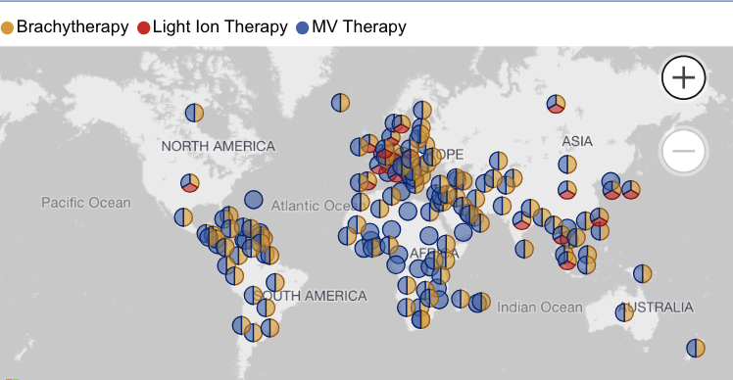


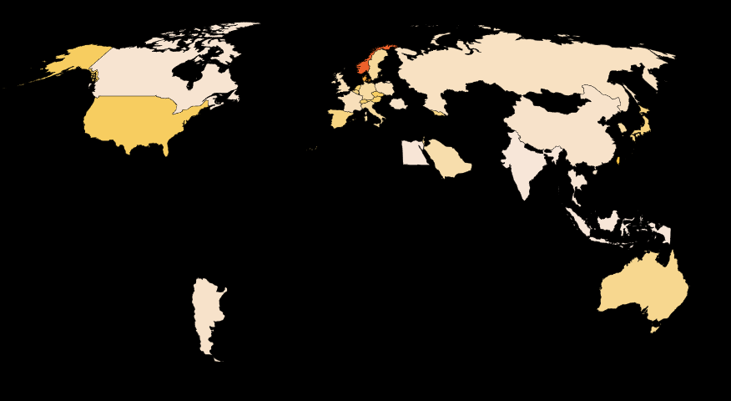
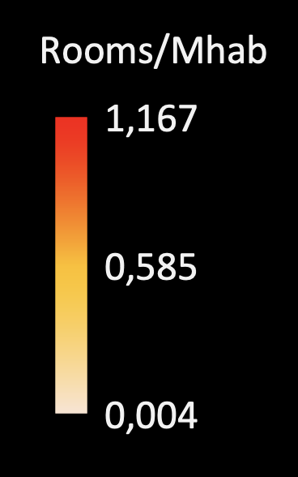
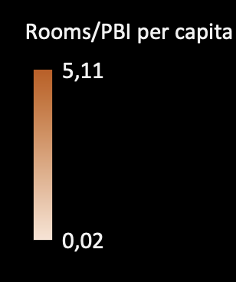
USA
2025
Ratio 2
0,5 % of patients treated with RT
< 2 % in developped countries
Norway
Per capita
China
Singapore

Slide 6
Global Growth of Proton Therapy
A Reality Check
“Exponential growth in centers worldwide”
  ~2% of RT patients in countries having protons
  Growth ≠ scale transformation

Slide 7
Throughput
The ”Wave”: Patients per room per year end 2019 in the world
“roof” 250 pats/(year.room)
mean: 170 pats /(year.room)
3 years rampup
YEAR OF
START CLINICAL
< 2013
2014
2015
2016
2017
2018
2019

Slide 8
Throughput in 2022: comparing with benchmarks
Case mix: centers with >30% paediatrics
QS
Note: when making the same analysis in 2025, mean values still in the same order,
a few outliers, but the rampup seems to be shorter (~2 y)

Slide 9
Center Throughput
Typical saturation: ~250 patients/year per room
  Need to evaluate the bottleneck: number of fractions/year?
  Hypofractionation proposed as solution, but there is no clear evidence protons hypofractionate always better than photons.
  Throughput is more related to image-guided and adaptive tools and uptime, modularity for upgrades… than on accelerator specs
  Throughput constraints remain still structural

Slide 10

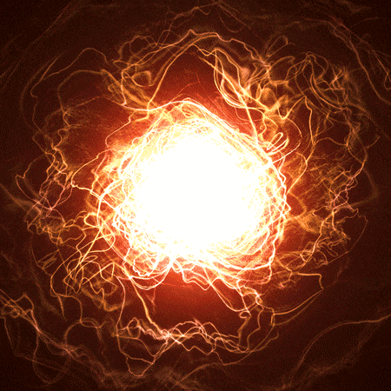
WHICH IS THE FUTURE
OF PROTONTHERAPY…?
Will replace photons?(linac & cobalt)
Minor applications?(electrons)
Will disappear...? (neutrons)

Slide 11
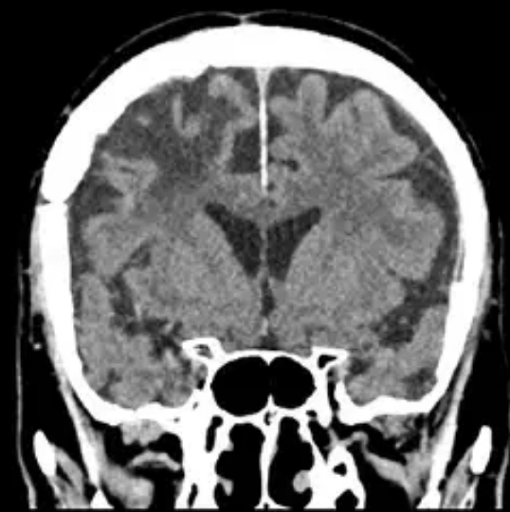
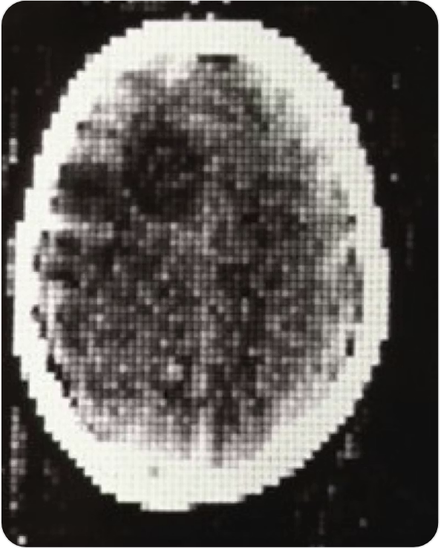
We are here with a lot of pioneers, innovators, first users,
who knows the long path between first principles, prototypes and evolution
First generation CT
(early 1970s)
Present generation CT
(single photon counting))

Slide 12
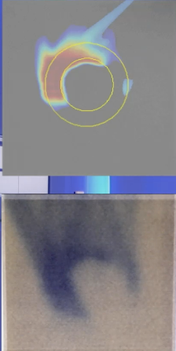
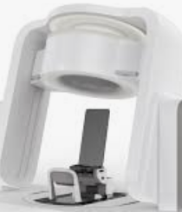
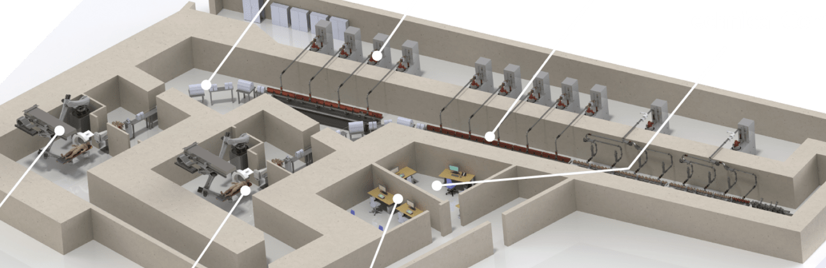
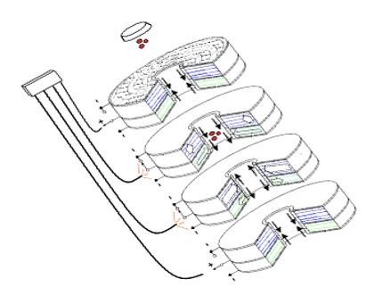
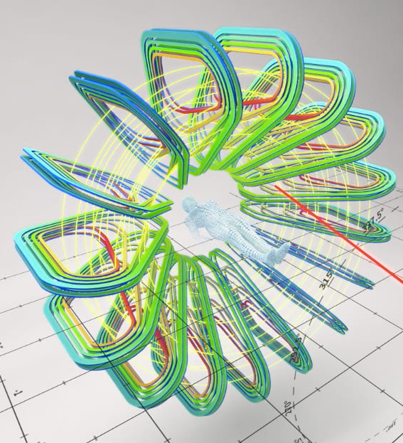
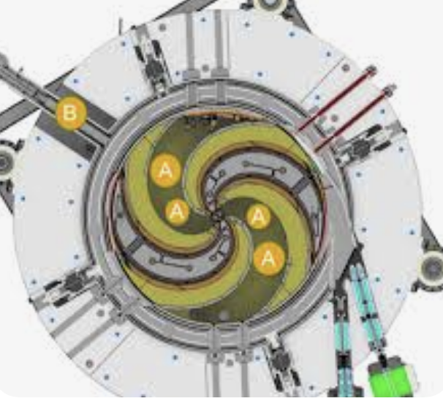

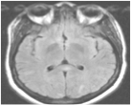
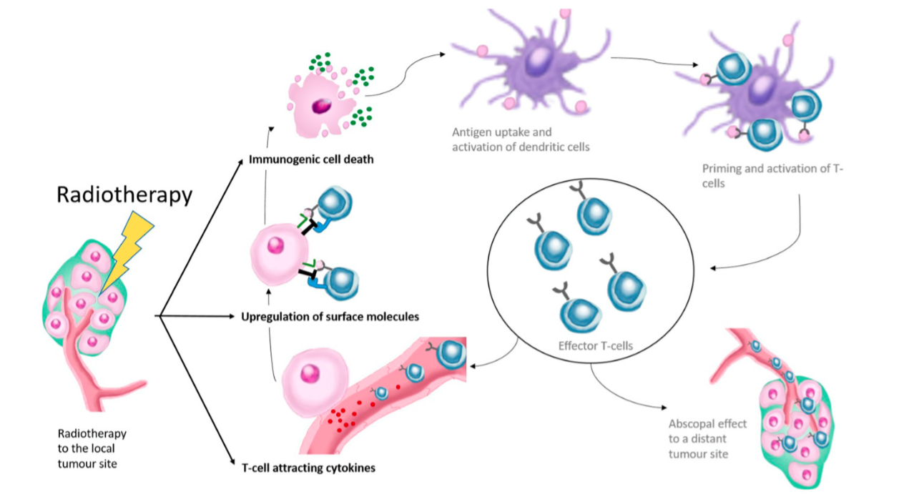
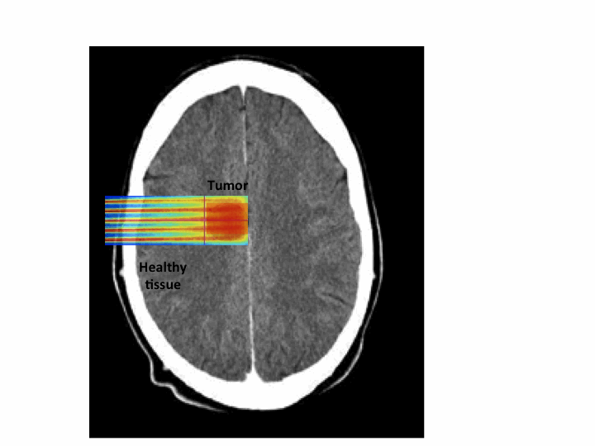
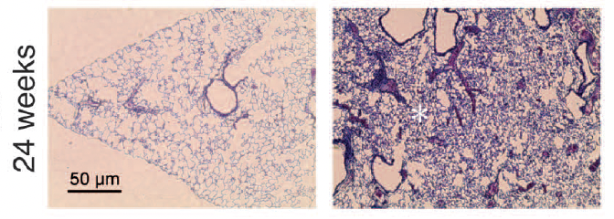
A large field of innovations in hadrontherapy in parallel with laser-based solutions
Technical proposals
Proton Linac
Proton Arcs
Gantryless-upright
Carbon cyclotron
Dielectric Wall
Magnetic gantry
Radiobiological modulation strategies in time and space
FLASH !
RT-immuno synergy
Tumor
Minibeams
Ding, Schreuder, INFN, Jongen, Mackie, CERN, Favaudon, Prezado, van Limbergen,…

Slide 13
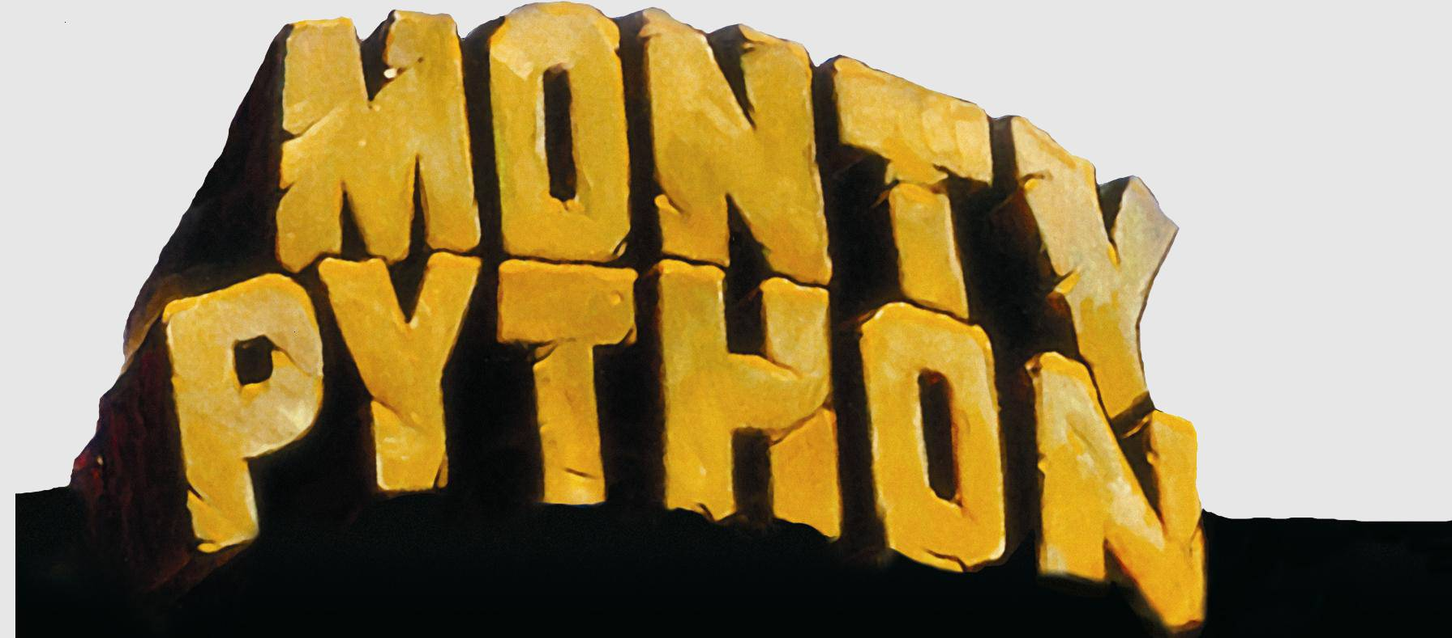
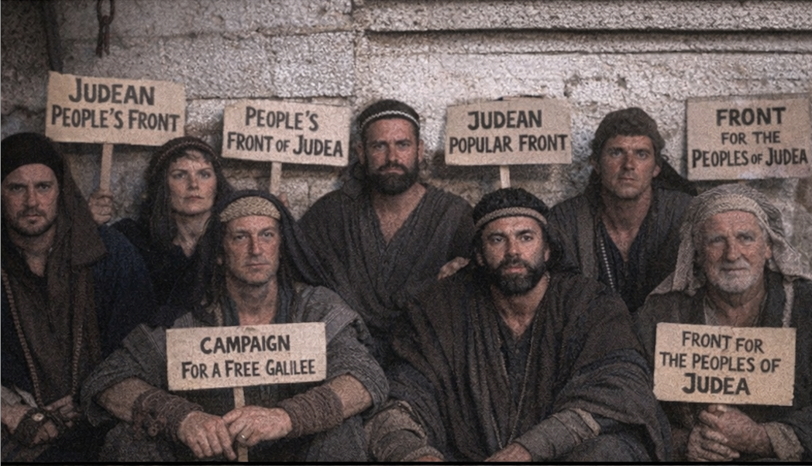

Slide 14
Inmunology and Clinics
Chemistry and
Biology
Physics and Technology
$$$$$$
COST!

Slide 15
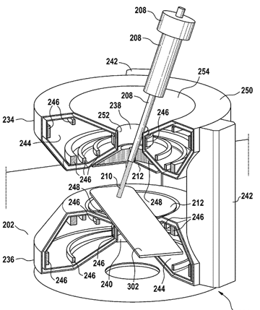
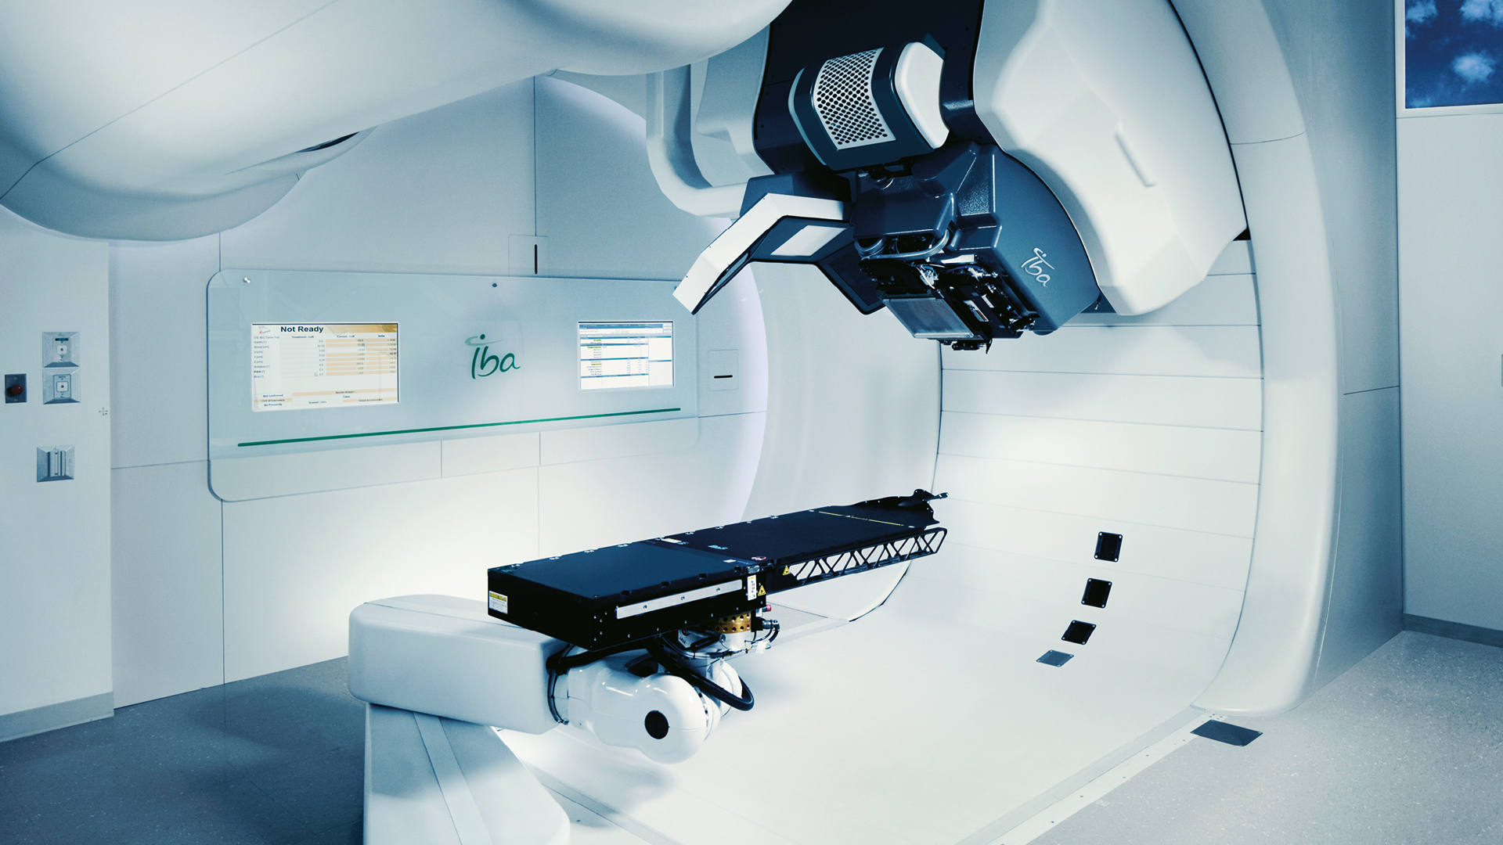
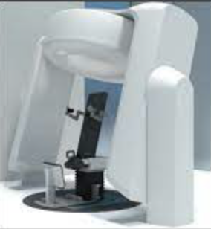
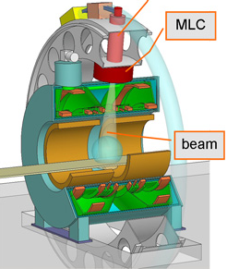
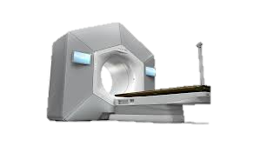
Cost technology for 1 Room
(qualitative)
[ ˜ M€ ]
Capital Cost
Hospital based
PT-MRI
Industry
Single room
PT
And similar with Operational Costs!!
Gantryless PT
Linac MRI
Pioneers
AI in linacs

Slide 16





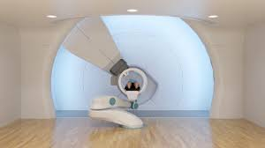
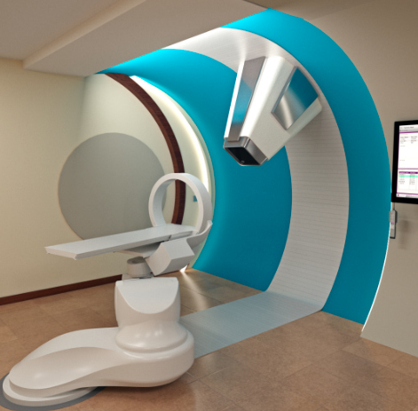
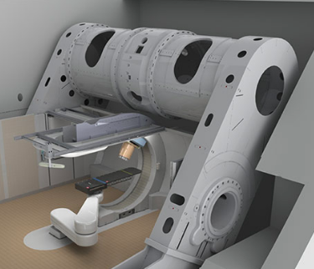







COMPANIES
Risk analysis:
stability
Cost and risk
are not alone..

Slide 17
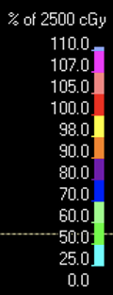
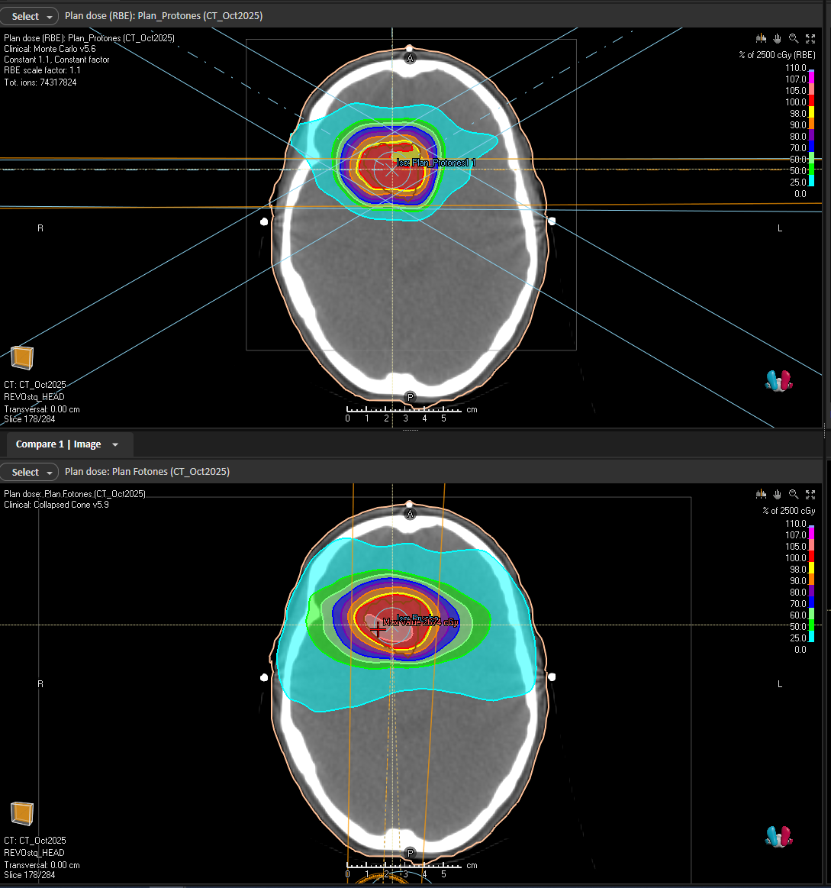
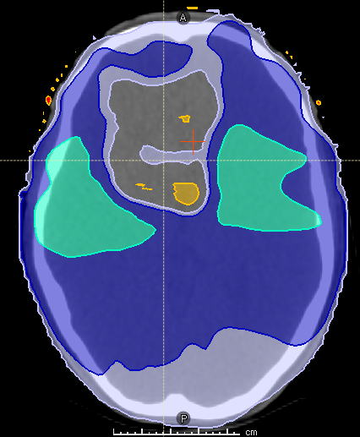
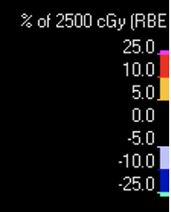
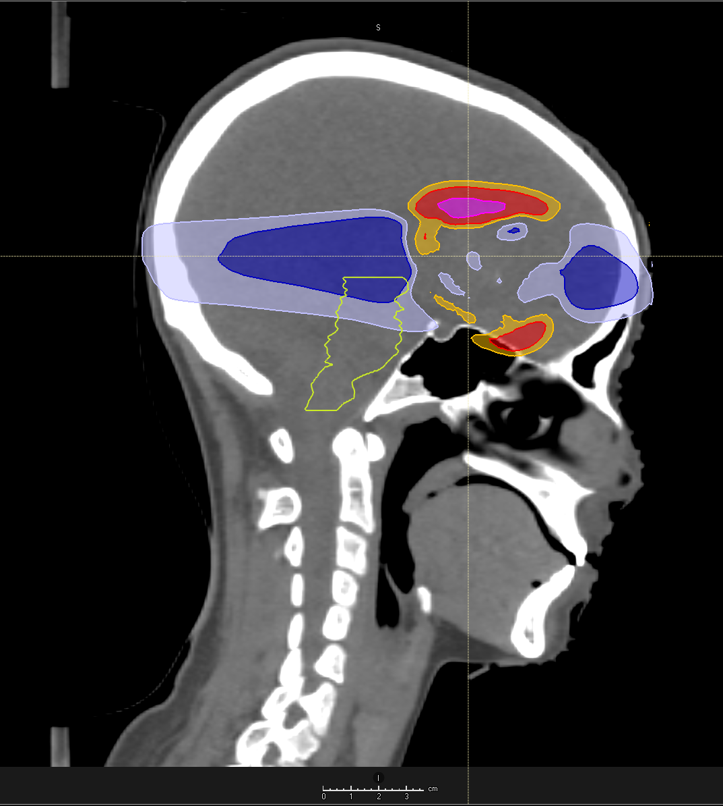
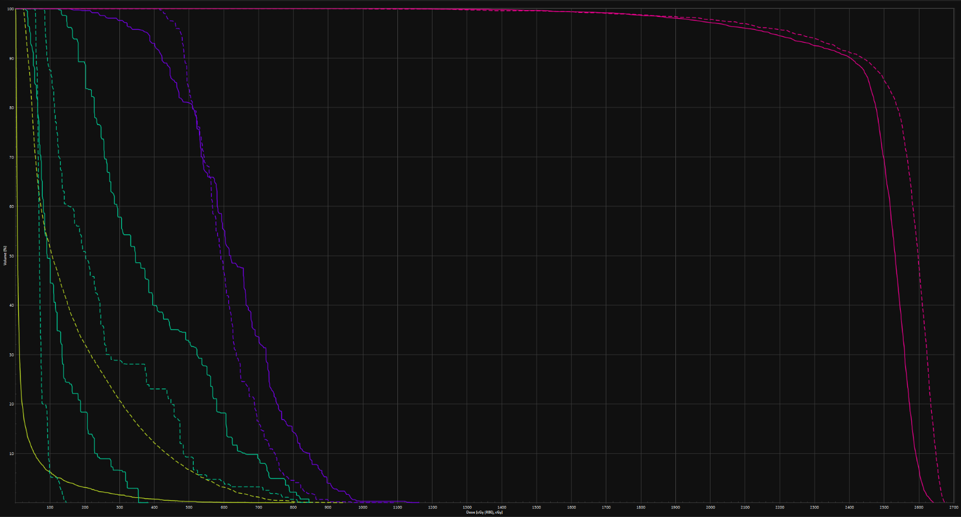
In the daily practice: Case report (glioma)
Protons 5 beams
Photons 2 arcs
Differences
If Proton Robustness:
2 mm ; 3.5%
Photons is a better choice
p+
phot
Chiasma
Optical nerve
p+
phot
(What if 1,5mm/2%, and apertures?)

Slide 18
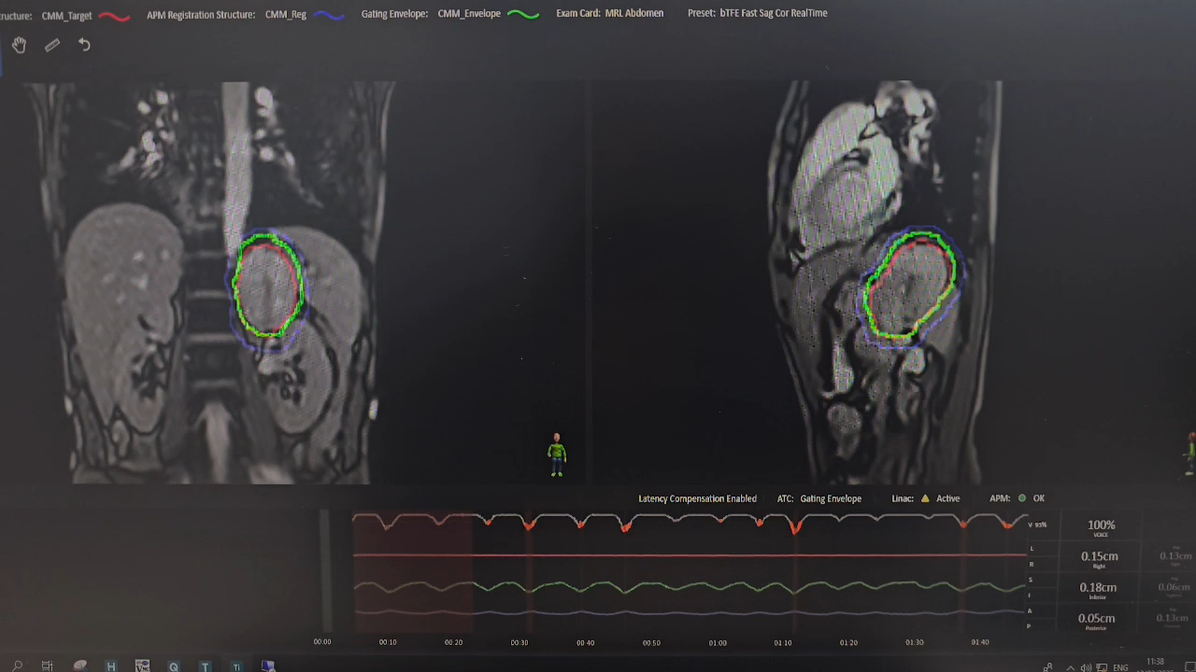
And what is better? :
see and hit a moving and deformable target with a MR-linac,
or reduce the lymphopenia with protons?
Note: the LinacMR first ideas 2000 (Raaymakers, Langendijk…)
Today around 140 devices treating 35.000 pats/y, the same as protons?
The cost is 6-8 times lower.
And linac-PET is coming for Biological Guided Adaptive RT !?

Slide 19
“Protons are better… than Radiation Therapy”
😱
Proton therapy is RT. Protons are not always better than photons (lateral penumbra, margins, organ movements and deformations…), some of those parameters are directly linked to the technical specs.
It is important to arrive to a stable industrial production.
Arc, FLASH, minibeams requires high delivered dose rate and spatial stability, among others more restricted specs than the present status
Mid and low doses reduction are always a real benefit for protons (lymphopenia → immunology)
  Innovation must preserve biological advantages and be driven by clinical parameters of choice

Slide 20
Technical Specifications. (table generated by AI…)

Slide 21
Laser-Driven Beams – Design Drivers
Basic technical Specs
  Multi-energy spectrum & beam divergence
  Shot-to-shot variability
  Delivered vs instantaneous dose rate
  …..
  WE need to think about system-level solutions
Notes:
.

Slide 22
In CLINICS is more and more important… the proofs!
PTCOG: Clinical Trials for Particle Therapy. (M. Jermann)
Indication: | Loc: | Links to protocols (clinicaltrials.gov & UMIN-CTR):
Pediatrics | CNS, RMS, Meduloblastoma, H&N, Brain | MDA, NCC, NCC, NCC, JUDE, JUDE, JUDE,JUDE, MGH, MGH, MGH, MGH, MGH, MGH, MGH, MGH, MGH, MGH, NCI, SMC, UW, UW, CGM, TSUKU, GUNMA, CURIE, WUSTL, MAYO,
Head & Neck | Nasal Cavity, Nasopharynx, Oropharynx, ... | MGH, MGH, MGH, NIRS, NIRS, NIRS, NIRS, HIT, HIT, HIT, MDA, MDA, MDA, MDA, MDA, TUD, SPHIC, SPHIC, SPHIC, SPHIC, SPHIC, IRCCS, IRCCS, iROCK, iROCK, MAYO, HCL, SAGA, GUNMA, GUNMA, GUNMA, MSKCC, MSKCC, UOM, UOM, CNAO, LEID, SAMSUNG,
Lung | NSCLC | LL, MDA, MDA, MDA, MDA, MDA, MDA, UF, UF, UF, MRO, MRO, MRO, MGH, MGH, RTOG, UP, UP, UP, UP, UP, MGH, MGH, MGH, UW, UW, UW, YU, NHS, NIRS, TUD, HOKK, SHIZ, iROCK, SAGA, SAGA, SAGA, GUNMA, GUNMA, MAYO, LOUV, PSI,
CNS | Base of Skull, Spine, ... | MDA, MDA, RTOG, COG, RTOG, NRG, UP, UP, MGH, MGH, MGH, MGH, MGH, MGH, MGH, HIT, HIT, HIT, HIT, HIT, MRO, UF, NCC, NCC, RTOG, RTOG, RTOG, UF, UW, GUNMA, TUD, TUD, UPP, MAYO, NRGO, MSKCC,
Breast | Partial Breast, Lymph-Nodes, Hodgkins, ... | UP, UP, UP, UP, IU, UF, UF, UF, MGH, MGH, MGH, LL, LL, PCG, PCG, MDA, MAYO, MAYO, MAYO, MPTRC, FUKUI, NIRS, GUNMA,
GI | Liver | LL, LL, LL, LL, MGH, MGH, MGH, NCC, NCC, NCC, NCC, MDA, UW, SMC, SMC, CG, iROCK, PBTC, GUNMA, GUNMA, GUNMA, GUNMA, GUNMA, GUNMA, SPHIC, TSUKU, TSUKU, TSUKU, HOKK, HOKK, HYOGO, SAGA, NRGO,
 | Pancreas | MGH, MGH, MGH, MGH, NCC, NCC, UF, UF, UF, UF, LL, HIT, PMRC, HYOGO, HYOGO, HYOGO, NIRS, NIRS, NIRS, UM, SPHIC, UTS,
 | Upper GI, Esophageal, Rectum | UP, MDA, MDA, MDA, LL, UW, HIT, NCCK, NIRS, NIRS, UOC, SMC, HIT, UF, NCC, WUSTL,
GU | Prostate | IU, NCC, NCC, UP, UP, UP, MGH, PCPT, UF, UF, UF, UF, UF, UF, UF, UF, MDA, MDA, MDA, MDA, LL, PCG, PCG, PCG, EIO, HIT, NCI, iROCK, iROCK, iROCK, iROCK, AIZAWA, PMRC, PMRC, SPHIC, SPHIC, SPHIC, TSUKU, HOKK, HOKK, NIRS, NIRS, GUNMA, GUNMA, TUD, MAYO, MAYO, EBG, UC,
 | Bladder | UP,
GYN |  | NCC, GUNMA, NIRS, NIRS, NIRS, SPHIC, CNAO, CNAO
Lymphoma | Hodgkin Lymphoma | IU, UF, UF, MGH,
Sarcoma | Chordoma, Chonrosarcoma, Spine, Retroperitonial, ... | UF, UF, UF, MGH, MGH, MGH, MGH, MDA, MDA, UP, UP, UP, HIT, HIT, KSA, JUDE, LL, iROCK, SAGA, SAGA, GUNMA, HCL, CNAO,
Eye | Melanoma, Retinoblasoma, Macular Degeneration | MEEI, UF, UC, UC, CAL, CAL, CAL, JUDE, CU, CURIE,
General | not specified | EBG, HOKK, NIRS, CNAO, CNAO, CNAO
Thanks to Fatine Giap, David Shia, Bosco Giap, Kyle O'Meara, Alex Tyner, Phuong Vo, Alex Issa and Steven Liu for helping to update the data.
https://www.ptcog.site/index.php/clinical-trials-protocols

Slide 23
Clinical Trials Ecosystem – Perspective
~100–200 proton trials worldwide
  Several Hundreds or thousand in photon RT
  Thousands in chemo/immunotherapy
  Stakeholders require evidence, the generation is asymetric
“Randomised trials are not ethical with PT”
  A Phase III trial in oropharyngeal cancer made a recent shock and broke historical ethical narrative.
  Evidence must guide expansion

Slide 24
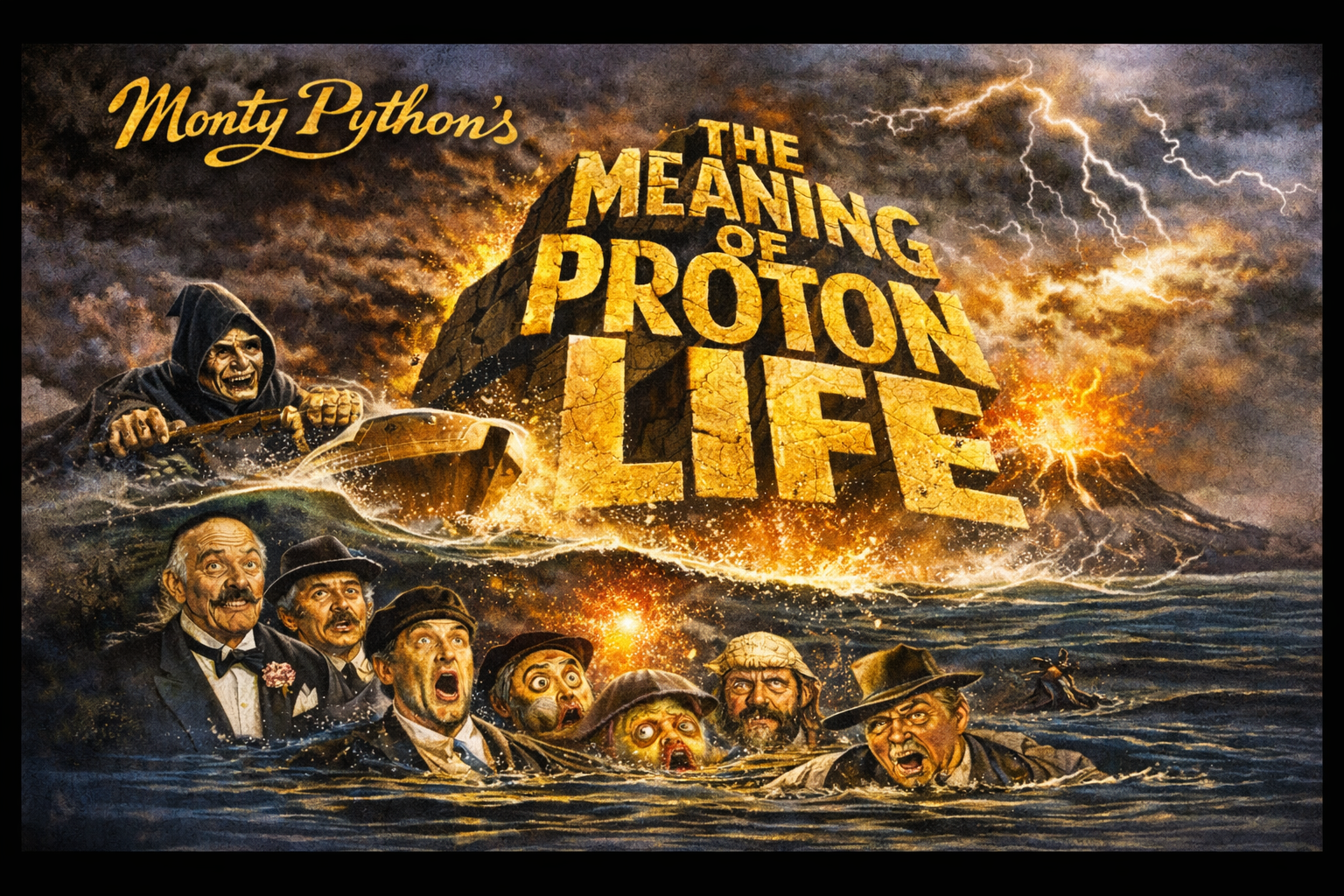

Slide 25
Some Global Priority Areas for Development
1. Industrial Stability and Cost Control
Sustainable capital and operational costs
Uptime and reliability
Vendor ecosystem robustness
2. Throughput Optimization
Image guidance
Adaptive tools
Workflow engineering
Robustness specifications
3. Clinical Evidence Generation
Randomized trials
Biomarker-driven selection
Transparent comparative studies vs photons
4. Biological Modulation with Specification Integrity
FLASH
Minibeams
Preserve conformality and mid/low-dose advantages
Avoid degrading present proton specs
5. System Integration
MRI, PET, QA
Immunotherapy synergy
Hospital integration

Slide 26
Closing Statement
Technology is not the endpoint.
Clinical benefit is the metric and must drive specifications.
Proton systems must be:
  Robust
  Integrated
  Spec-preserving and evolving
  Biologically aware
  Economically sustainable
  Never less demanding than the photon world.
  Transformative –
  but only when can measure a clinical value

