Slide 1
Medical Physics and Radiation Biology Research at PARTREC
Prof. Alexander Gerbershagen
Head of Particle Therapy Research Center (PARTREC, Groningen) Associate Professor (JAI, University of Oxford)
a.gerbershagen@umcg.nl, alex.gerbershagen@physics.ox.ac.uk

Slide 2


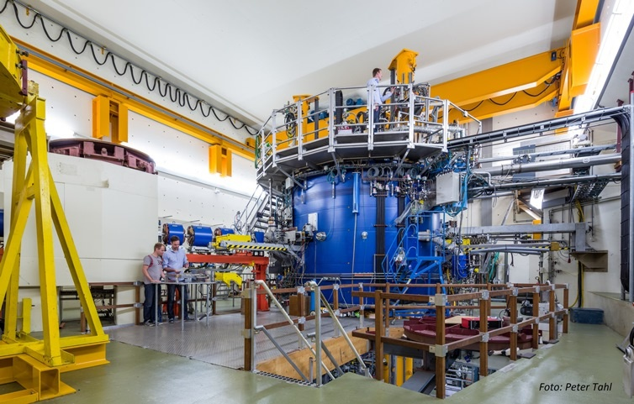
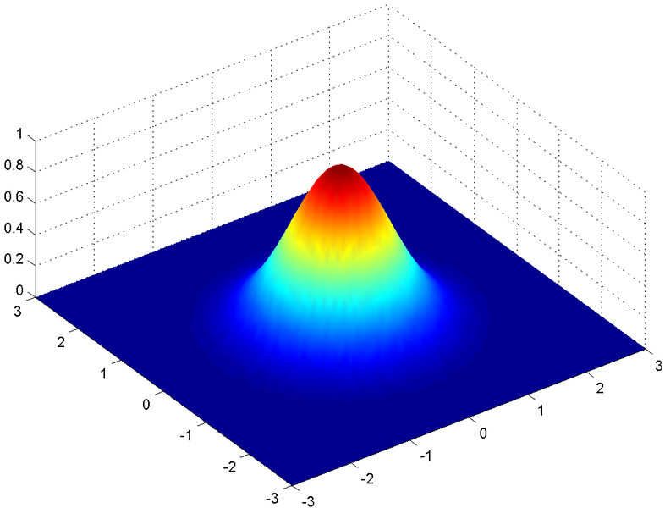
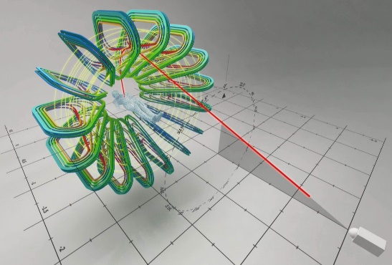
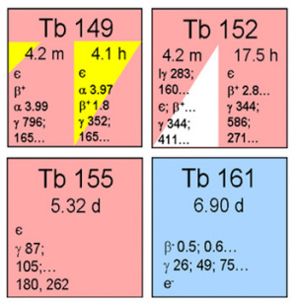
Contents
Introduction:
UMCG and PARTREC
Our accelerator
Our team, services and users
Research at PARTREC
Previous research
Clinical Translation Example
Minibeams
Ongoing projects
Boron Proton Capture + FLASH
Theranostics
Pharmacotherapy
Dose Verification
mbar
N₂ gas
thin foil

Slide 3
Contents
Introduction:
UMCG and PARTREC
Our accelerator
Our team, services and users
Research at PARTREC
Previous research
Clinical Translation Example
Minibeams
Ongoing projects
Boron Proton Capture + FLASH
Theranostics
Pharmacotherapy
Dose Verification
mbar
N₂ gas
thin foil

Slide 4
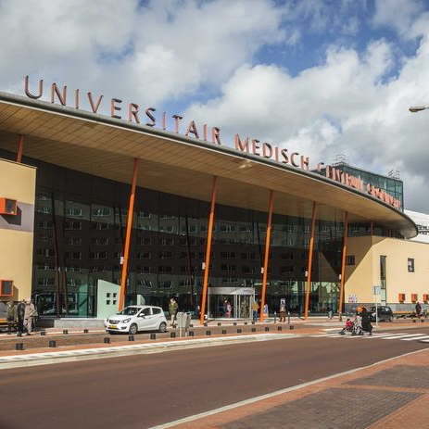
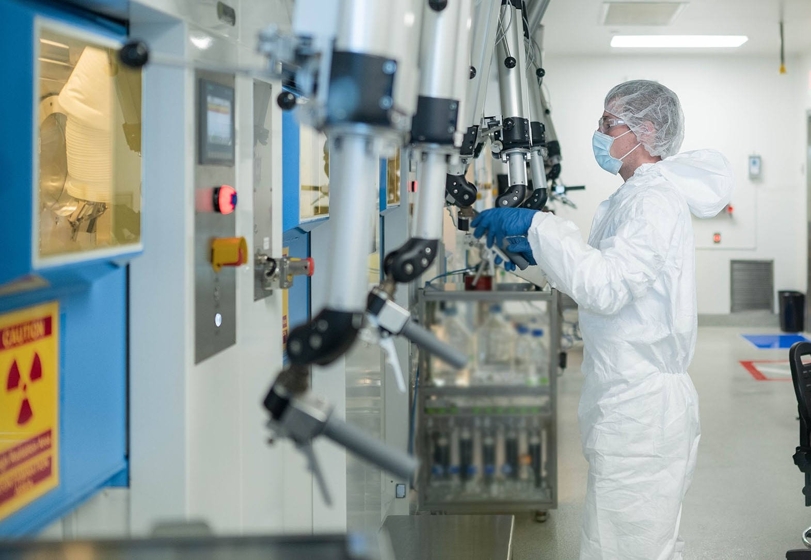

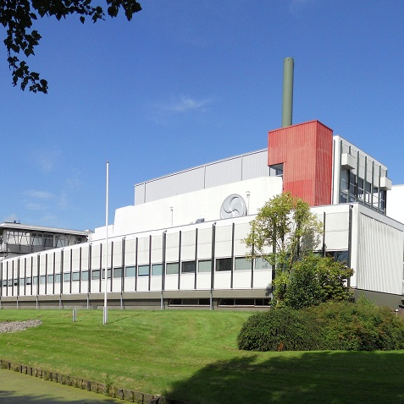
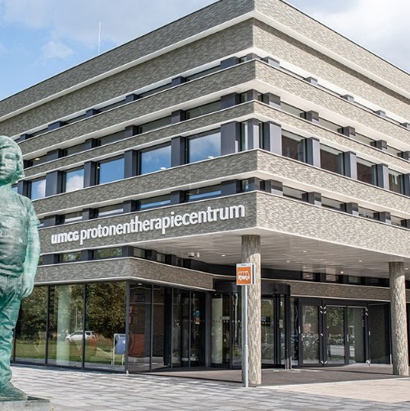
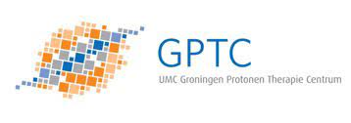
Integrated with Medical Faculty of University of Groningen
Clinical production
of radio-isotopes
Integrated into UMCG in 2019
First patient in 2018

Slide 5

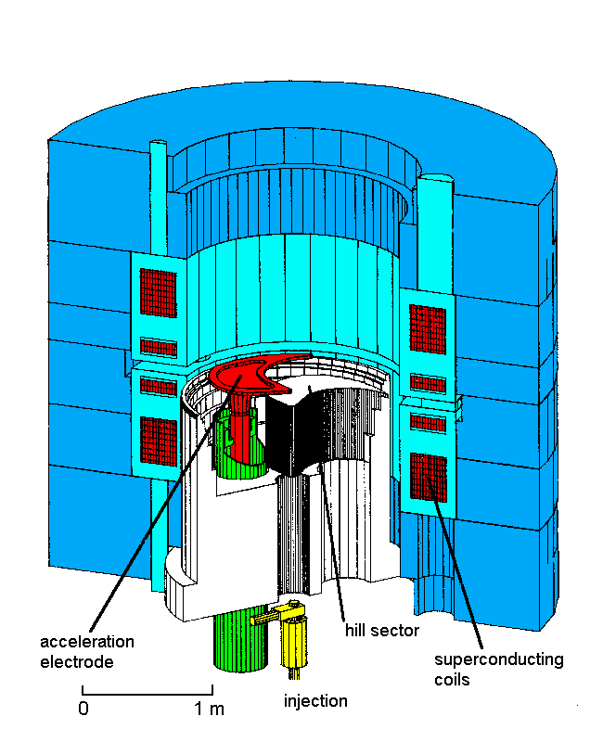
AGOR Cyclotron
Superconducting AGOR cyclotron is a multi-particle, variable energy AVF-cyclotron
French-Dutch collaboration built 1987 – 1994
Operational since 1996
Magnetic field (1.7 to 4.1 T) produced by
Two pairs of superconducting main coils
fifteen trim coils
three iron hill sectors for focussing
3 halfwave RF cavities, 24 - 62 MHz; h = 2, 3 or 4
Three external ion sources (two ECR sources for protons and heavy ions, multi-cusp source for light ions) are axially injected
Extraction
300 - 500 turns depending on harmonic mode
extraction radius 870 - 890 mm depending on E/A
turn separation at extraction 2 - 3 mm ~ beamwidth

Slide 6
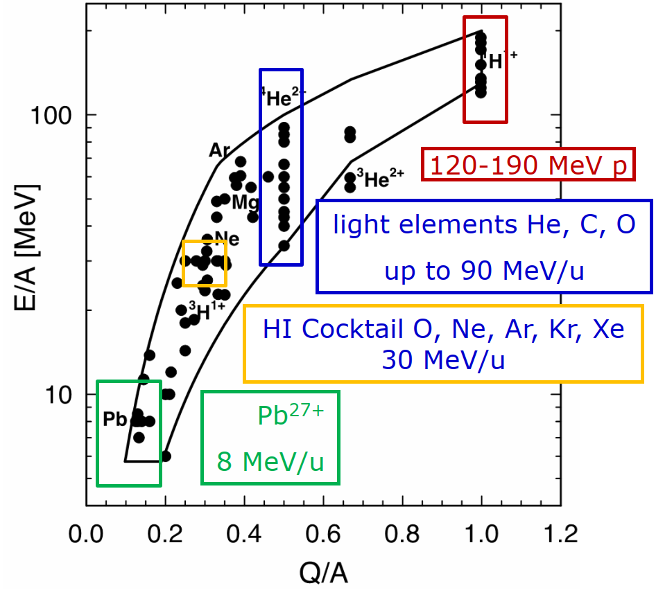
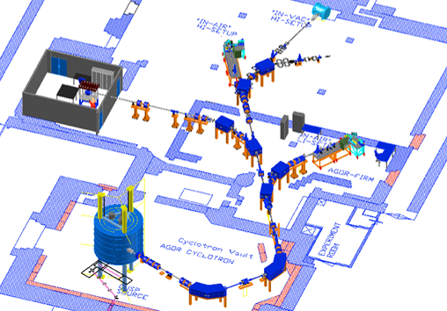
Beams and Test Rooms
AGOR can deliver beams of all elements up to Xe
Large in-vacuum irradiation setup
Nuclear physics experiment (NEXT)
New animal facility IMPACT (A-cell)
Experimental Room (H-cell)
Accelerator (AGOR)

Slide 7
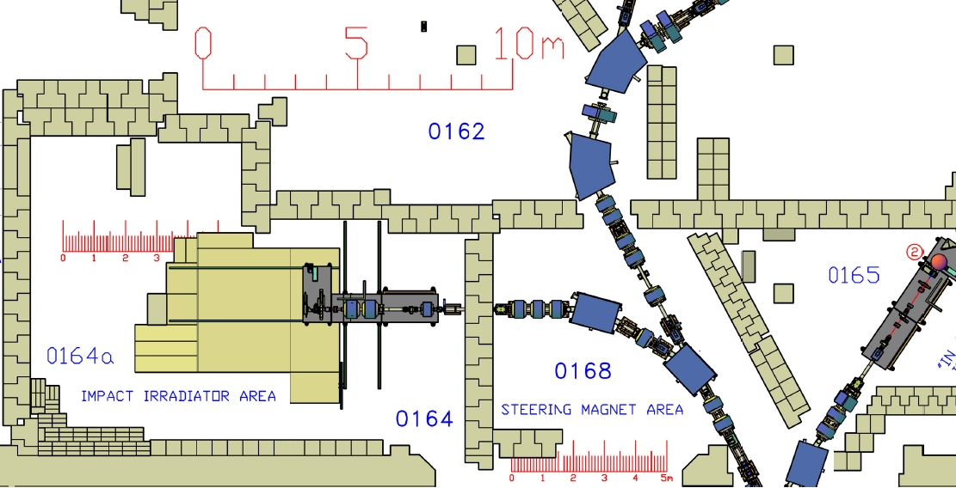
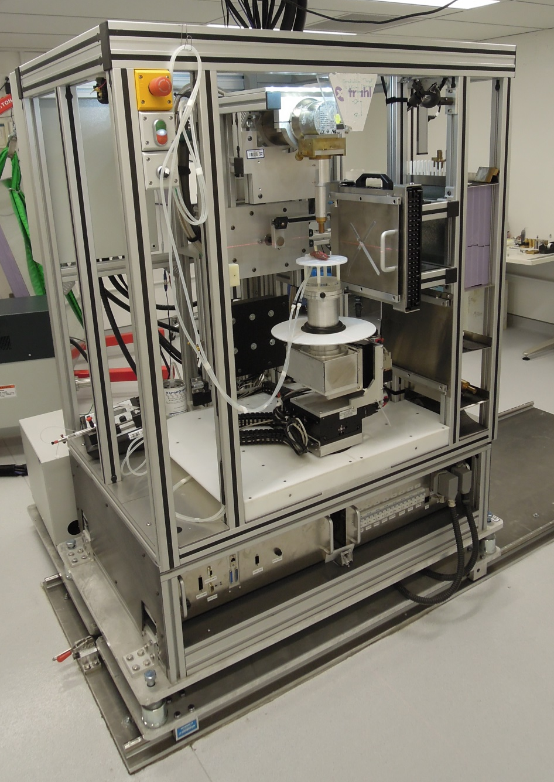
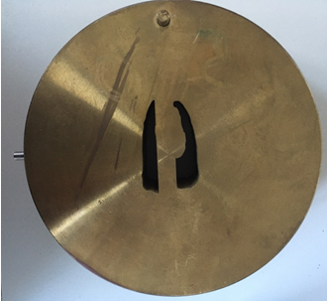
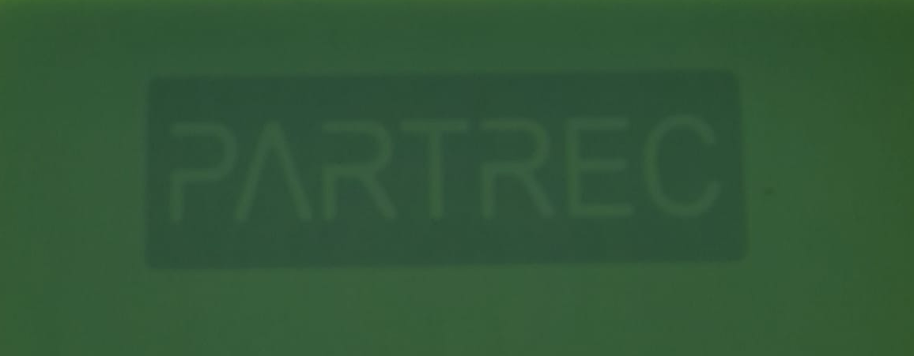
IMPACT Beam Line
>3 MEUR grant from KWF
Designed for small animals
New beam line
Pencil beam scanning (10 cm x 10 cm)
Shoot-through or SOBP
Collimator for penumbra
Combined on-line 3D X-ray imager and X-ray irradiator
Irradiation planning
First beam: 04.10.2024
Fully operational: March 2026

Slide 8
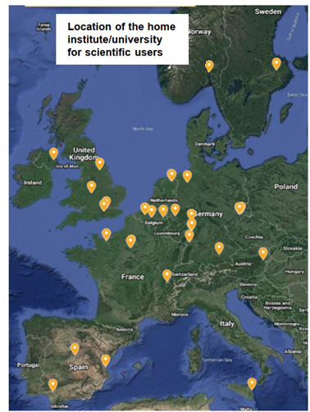
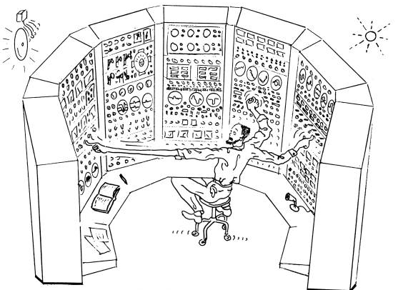
Our Team
Faculty (4)
Post-doc, PhD-students (~10)
Technical staff (25)
Operators
Experimental and project support
Cryogenics, cooling and vacuum
Design/Mechanical
Electronics
IT Support
Operational 120 hours/week, 26 weeks/year
Users: Medical Physics, Radiobiology, ESA, Detectors, Commercial
Beam requests: irradiations.partrec@umcg.nl

Slide 9
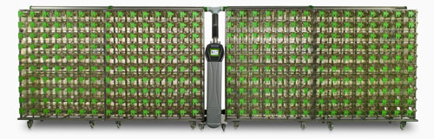
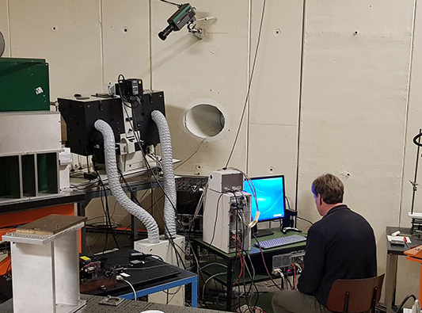
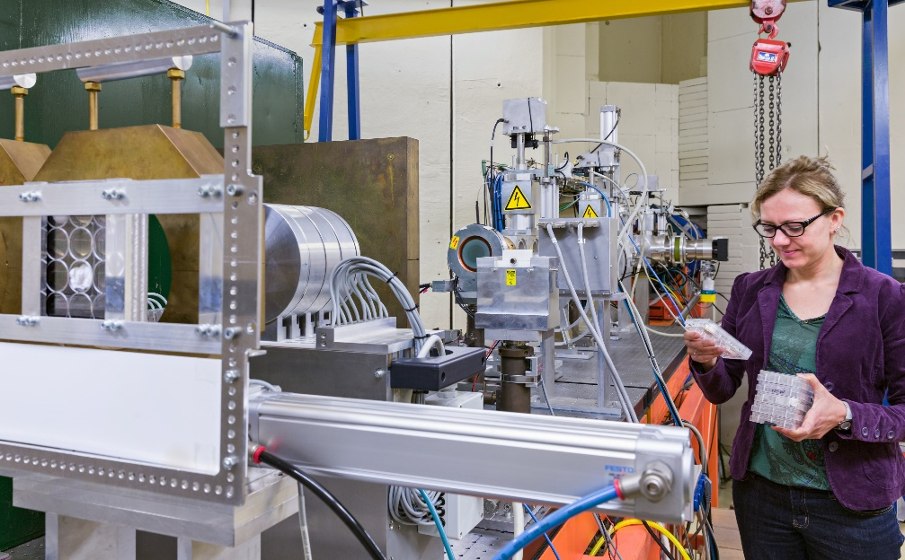
One Stop Shop
Experiment development
Ethics authorisation process
Animal procurement logistics
On site animal accommodation with IVCs
capacity 200 rats and mice
no long term stay
two additional accommodations planned
“Twin Beam” Irradiation
Laboratory for animal handling prior and post irradiation
GronSAI imaging center: optical, molecular, CT, MRI, PET
Data management facilities

Slide 10
Contents
Introduction:
UMCG and PARTREC
Our accelerator
Our team, services and users
Research at PARTREC
Previous research
Clinical Translation Example
Minibeams
Ongoing projects
Boron Proton Capture + FLASH
Theranostics
Pharmacotherapy
Dose Verification
mbar
N₂ gas
thin foil

Slide 11
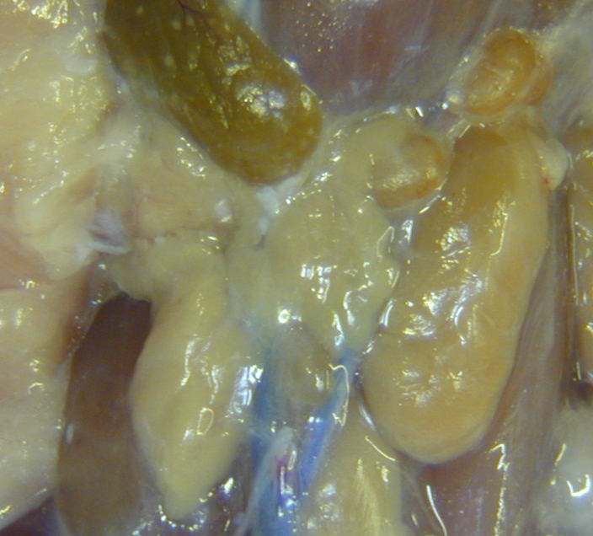
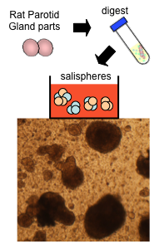
Stem cell sparing radiotherapy
Rat model
Patients
Centre of the glands is rich in organ-specific stem cells.
Irradiation of this sub-volume results in degeneration of the entire gland.
Irradiation of the other parts only causes local damage
Retrospective analysis of a Canadian patient cohort
dose to the centre of the gland is the best predictor of post-treatment saliva production.
Validated in a trial at UMCG.
Currently implemented as the standard approach to minimize the risk of radiation-induced xerostomia in patients
Outside
Outside
Center
Outside
Stem cell region
van Luijk et al. Sci. Trans. Med 2015
Steenbakkers et al. IJROB 2022

Slide 12
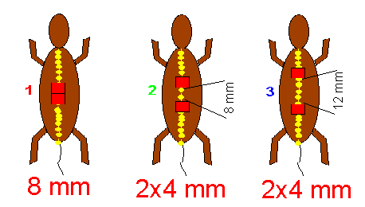
Spinal cord: inhomogeneous dose distribution
ED50:
25 Gy
46 Gy
42 Gy
=> 2 x 4 ≠ 8
(1x 4 mm: ED50=53 Gy)
Volume-Effect ? Configuration determines outcome
Bijl et al. Int J Radiat Oncol Biol Phys. 2003

Slide 13
Spinal cord: include repair in model
“diffusion length”
=> large impact on small irradiated volumes
migrating cells
=> repair
brain
brain
brain
brain
C1
C1
C1
C1
C2
C2
C2
C2
C3
C3
C3
C3
C4
C4
C4
C4
C5
C5
C5
C5
C6
C6
C6
C6
C7
C7
C7
C7
damaged volume decreases
T1
T1
T1
T1
T2
T2
T2
T2
Damaging dose
Non-damaging dose, still disabling repair
van Luijk et al. Int J Radiat Oncol Biol Phys. 2005

Slide 14
Contents
Introduction:
UMCG and PARTREC
Our accelerator
Our team, services and users
Research at PARTREC
Previous research
Clinical Translation Example
Minibeams
Ongoing projects
Boron Proton Capture + FLASH
Theranostics
Pharmacotherapy
Dose Verification
mbar
N₂ gas
thin foil

Slide 15
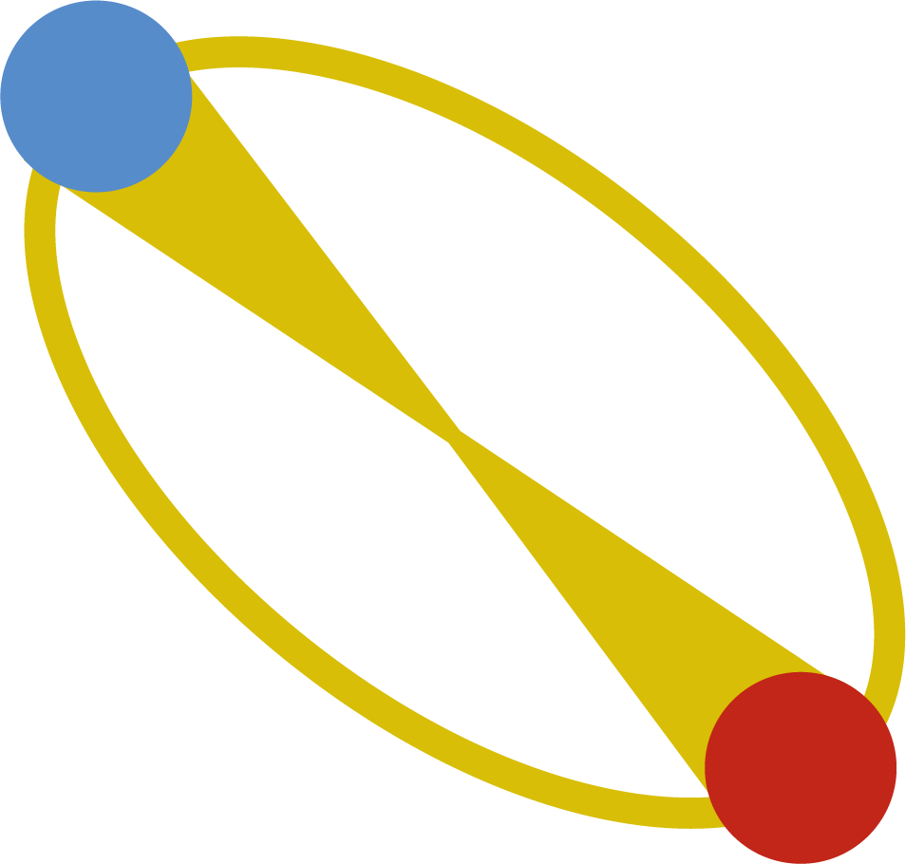
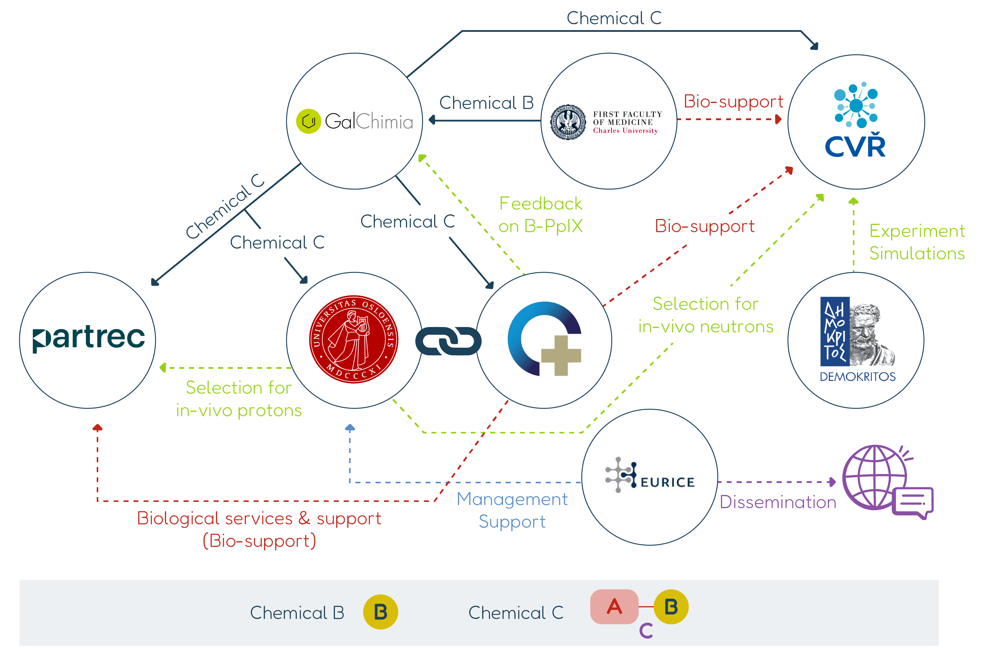
NuCapCure
Consortium of eight parties
Goal: Treat Glioblastoma (presently <10% 5-year survival)
Envisaged radiation effect:
Higher in tumour due to boron proton capture
Lower in healthy tissue due to FLASH
> 5 MEUR from EIC Pathfinder Open 2023
Ranked 1st (788 proposals submitted, 56 funded)

Slide 16
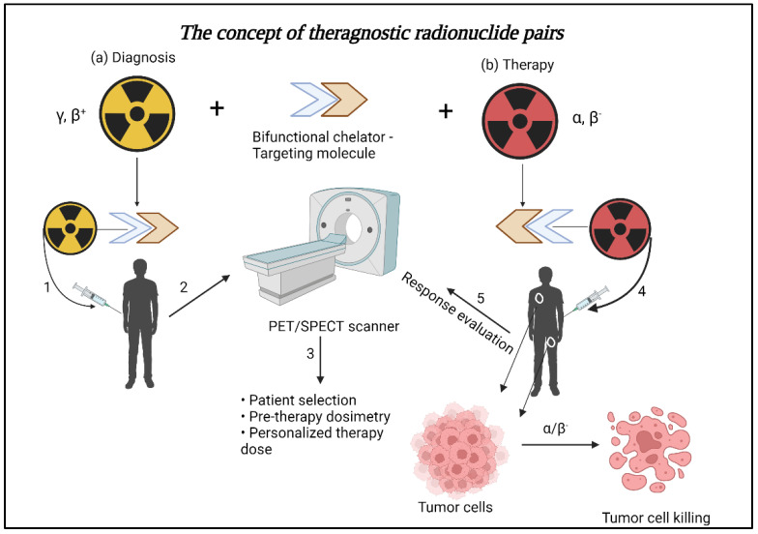

Terbium Theranostics
>10 MEUR grant from IPCEI
Produce four Terbium isotopes for patient diagnostics and treatment
Partners: SHINE, UMCG

Slide 17
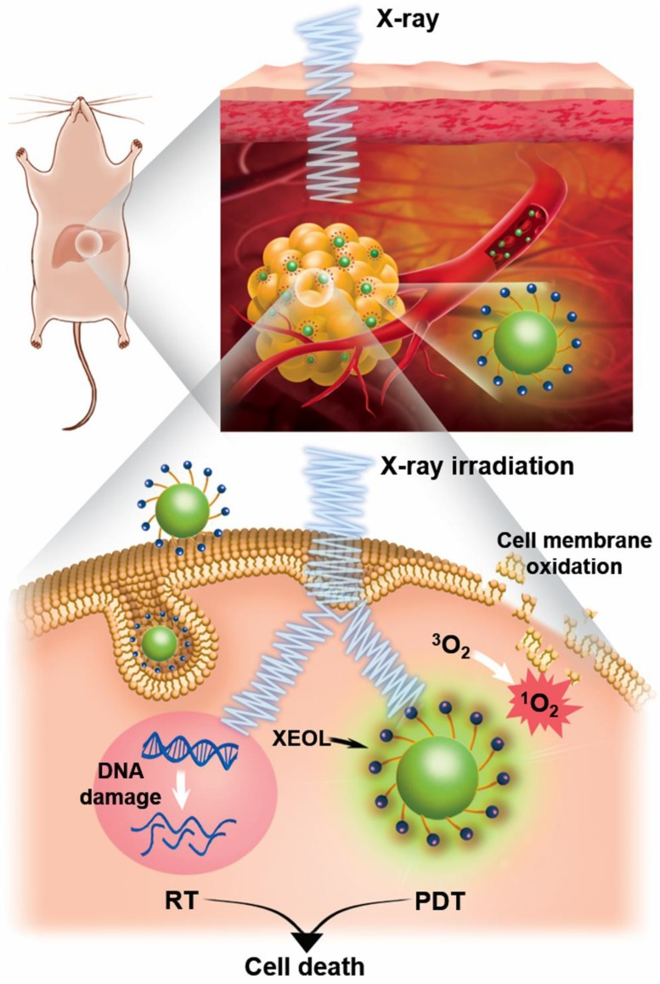
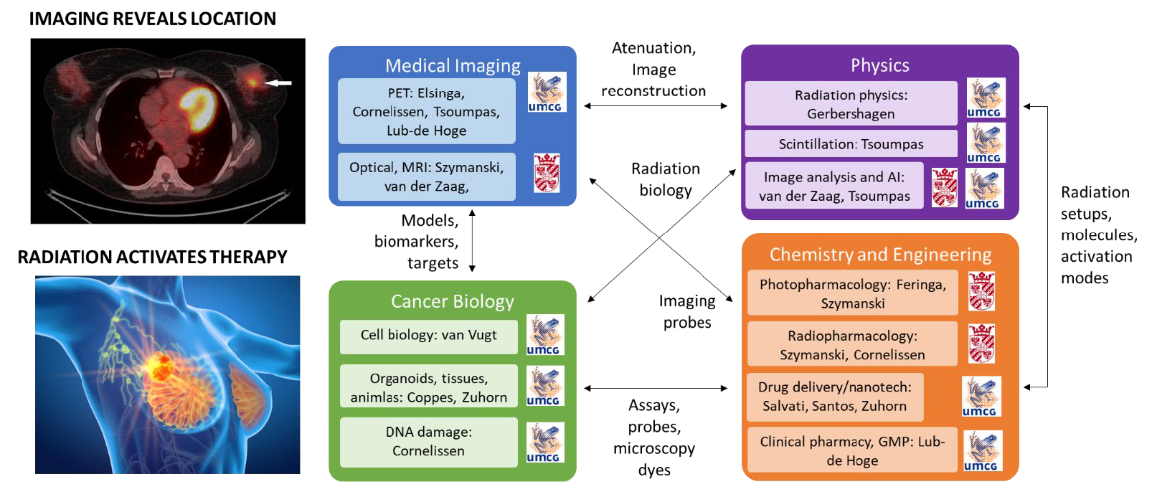
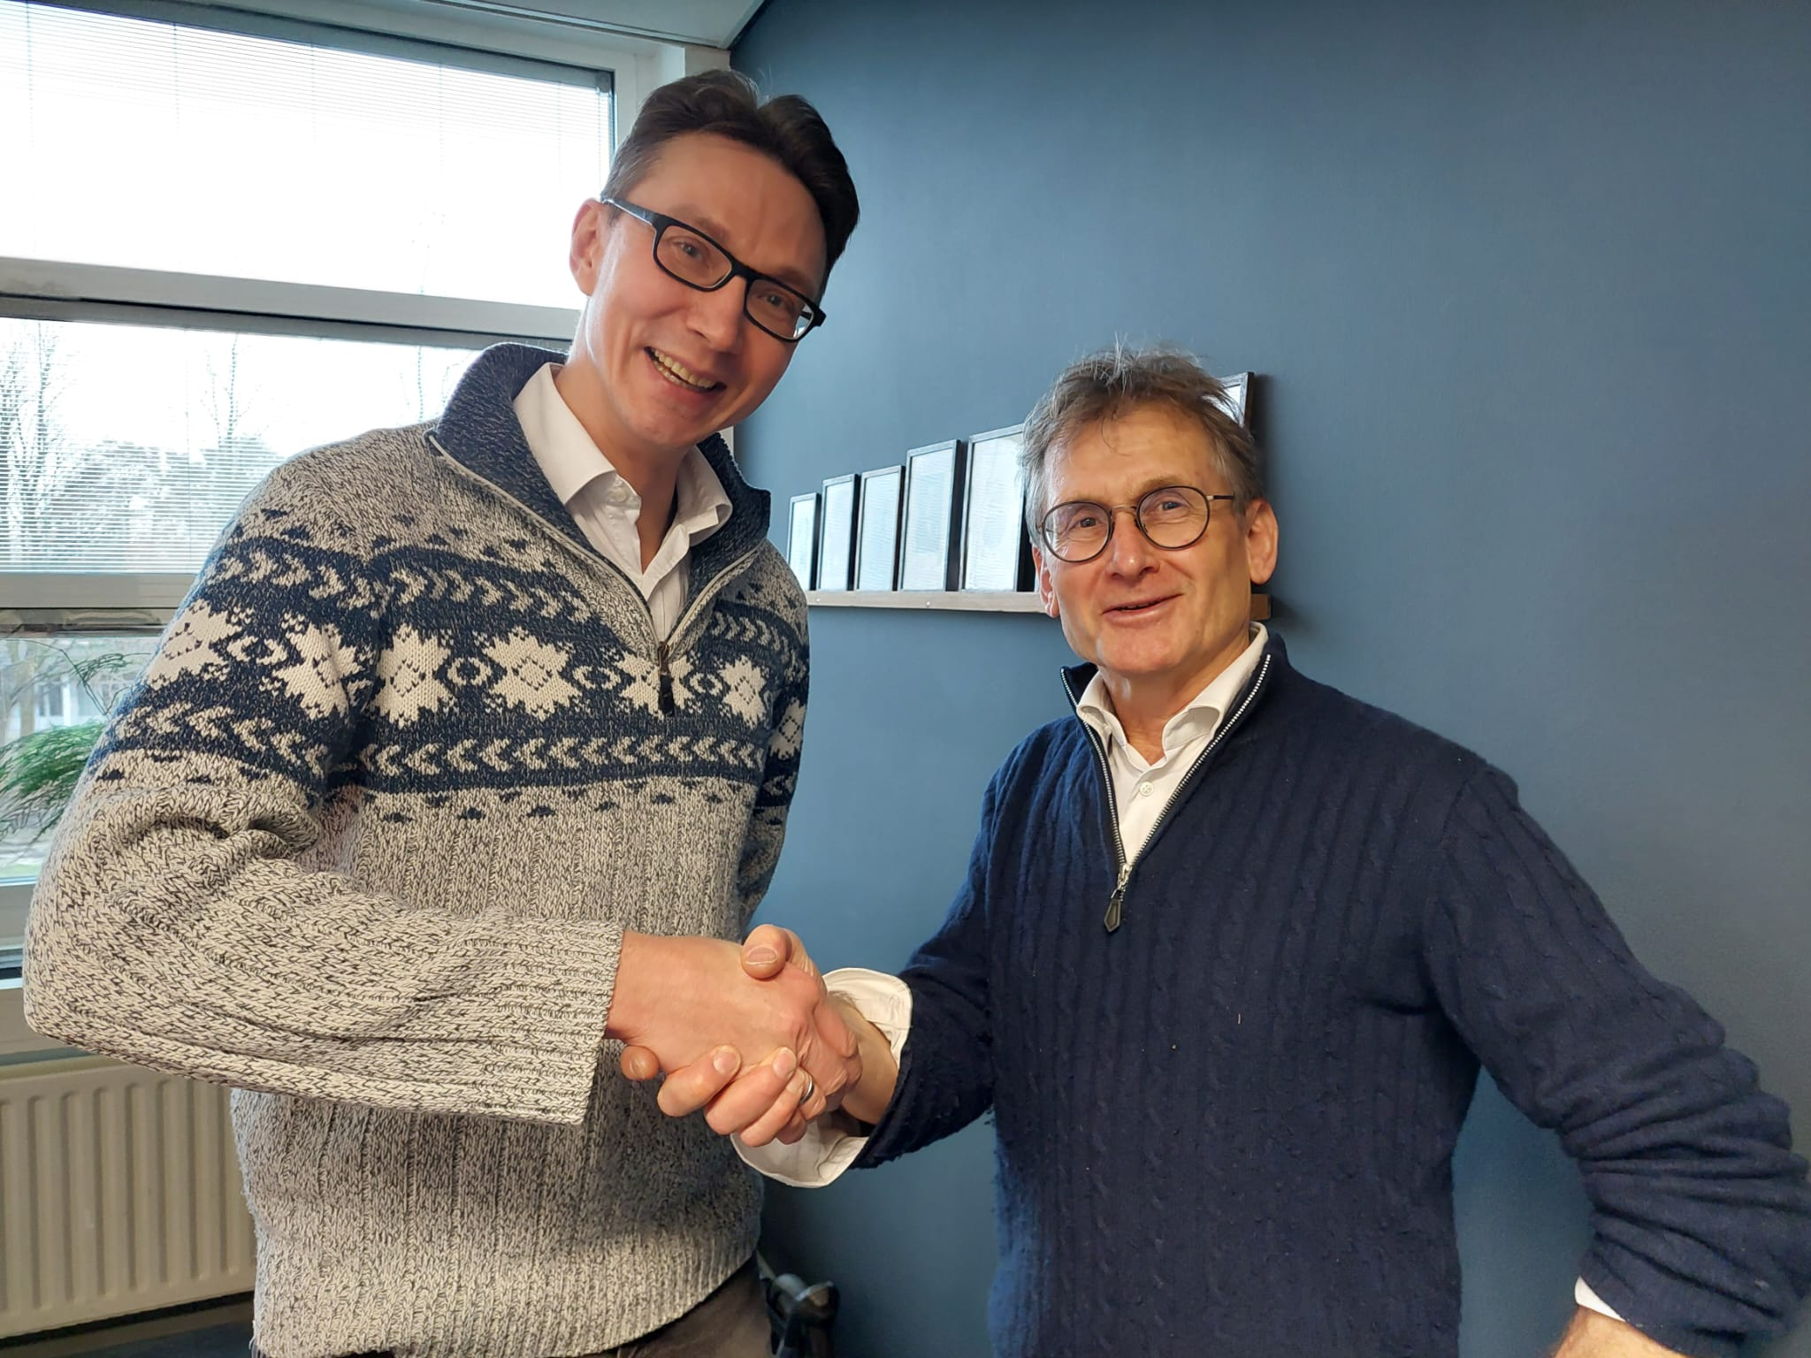
Image-Guided Pharmacotherapy
18 MEUR grant from HTRIC x UEF
Proposal headed by Prof. Ben Feringa, Nobel prize laureate

Slide 18
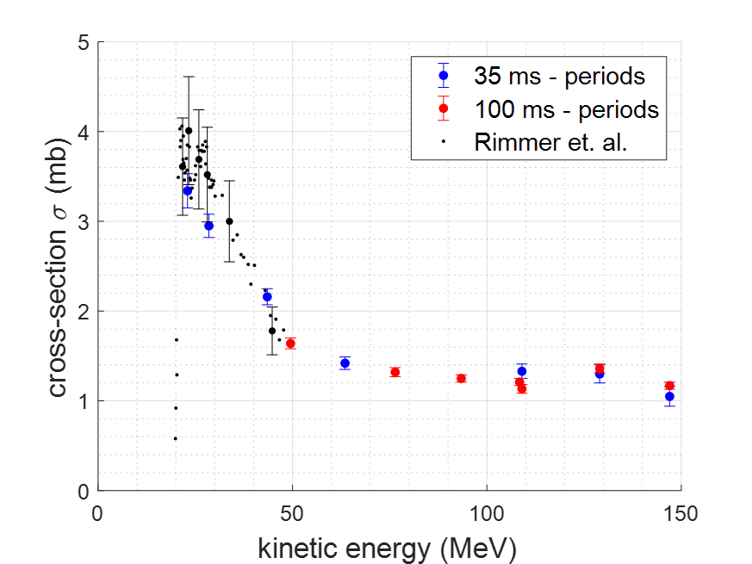
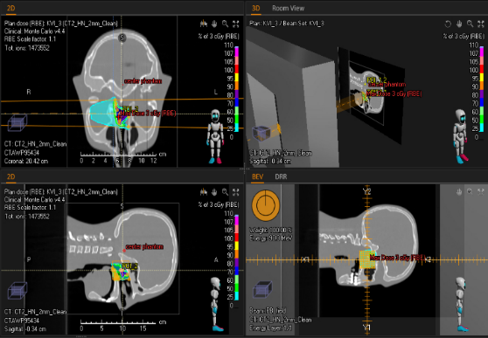
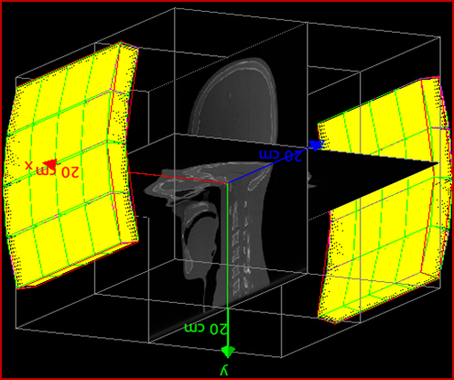
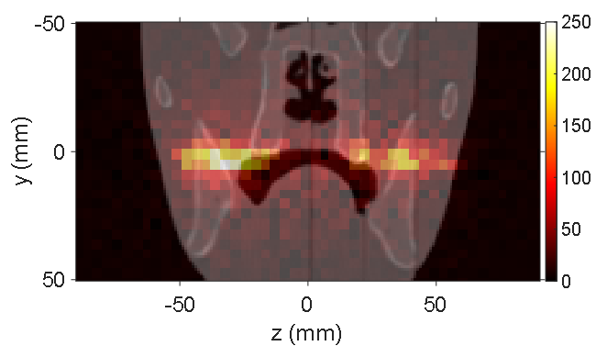
Real-time In-vivo VERification of proton therapy (RIVER)
Aim: “reducing treatment planning safety margins without reducing treatment safety”
How ?
PET imaging of the short-lived isotope N-12 (T_{1/2} = 11 ms)
Range determination per pencil beam spot
Patient benefit
reduced safety margins lead to
less dose to organs-at-risk
less complications
better quality of life
Research focus
experiments with a head phantom
mimic clinical workflow from TPS via Monte Carlo prediction to comparison with experimental PET images
experiments at PARTREC
calculations/simulations
N-12 production cross section
N-12 production in RayStation
N-12 image in 10 s (10¹⁰ protons)
PET imaging in GATE
anthropomorphic
head phantom

Slide 19






Summary
UMCG has unique combination of treatment facility (GPTC) and research center accelerator facility (PARTREC)
PARTREC delivers protons and ions (He, C, O and others)
PARTREC has team of 40 people
Ongoing research topics are:
Radiation Biology, Microdosimetry, Minibeams, Ultra-fast Irradiations, Gantries, Patient Imaging, Nuclear Medicine
Acknowledgement
Research funding
Access funding
Host institutions and all colleagues for contributing
medical physics cell cultures (animals)
animals
Prof. Alexander Gerbershagen
Head of Particle Therapy Research Center (PARTREC)
a.gerbershagen@umcg.nl

