Slide 1

ND3 Backgrounds
QUEST-DMC Liverpool Meeting - 16/10/2025
Lizzie Bloomfield

Slide 2
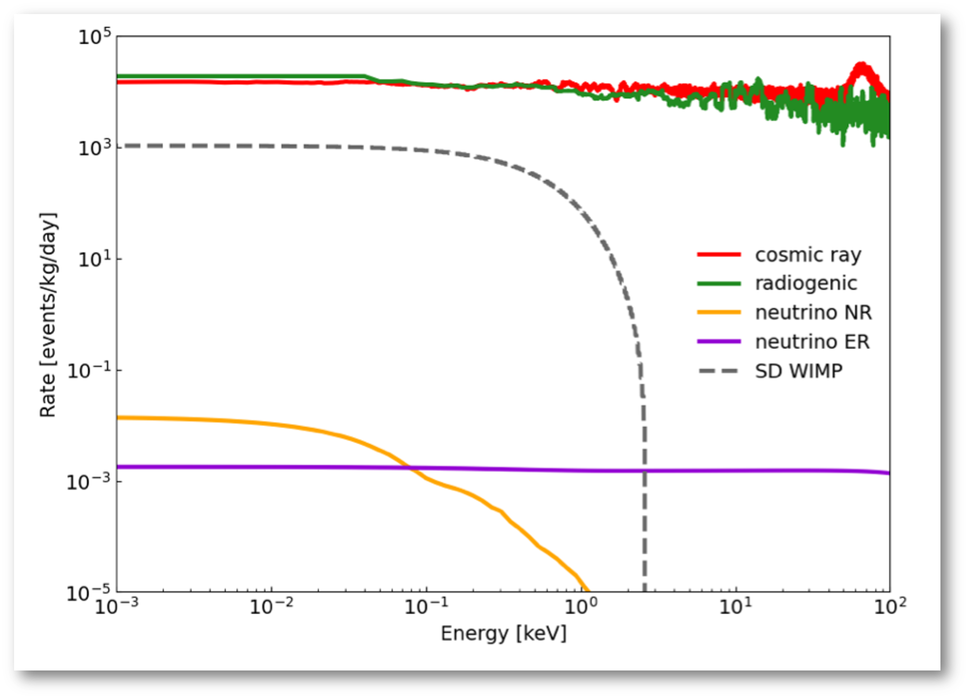
ND3 Backgrounds - General Backgrounds
Prominent radiogenic and cosmic background expected (taken from sensitivity paper).
Background includes cosmic rays, radiogenics, and solar neutrinos (both ER and NR).
QUEST-DMC Liverpool Meeting - 16/10/2025

Slide 3
ND3 Backgrounds - Radiogenics
Gamma radiation dominates the radiogenic background in ND3.
Gamma background comes from 2 main sources:
  Material/Detector components.
  Ambient gamma sources.
QUEST-DMC Liverpool Meeting - 16/10/2025

Slide 4
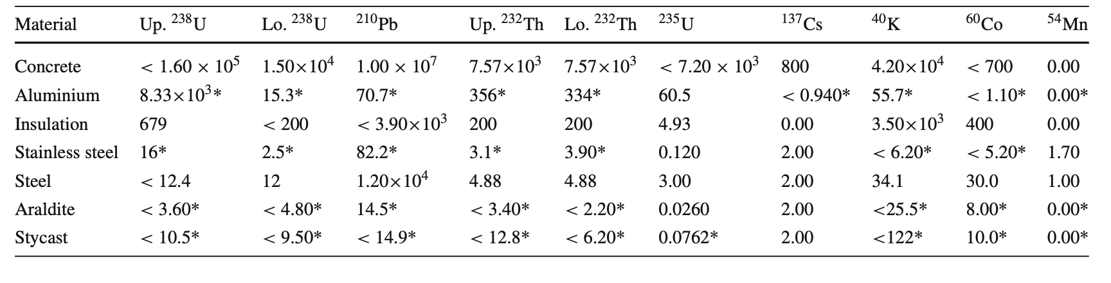
ND3 Backgrounds - Radiogenics
Material/Detector Sources:
Background from material/detector components in ND3 has been modelled from the gamma ray spectroscopy assay at Boulby & material radioassay results from the SNOLAB radiopurity database.
Table 1: Activity of materials comprising the bolometer, cryostat and surrounding area
QUEST-DMC Liverpool Meeting - 16/10/2025

Slide 5
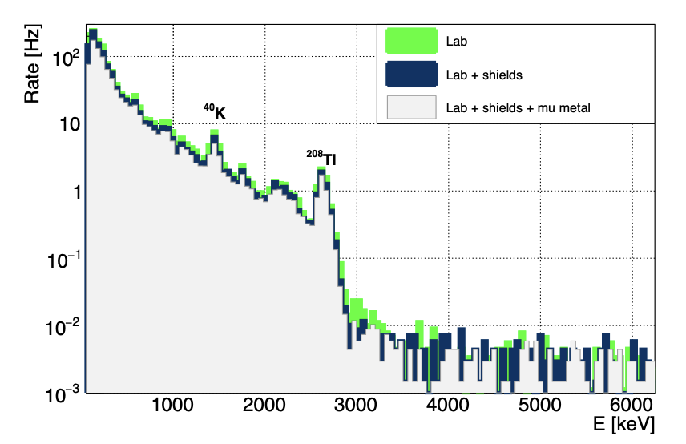
ND3 Backgrounds - Radiogenics
Ambient Gamma Sources:
Cardani measurements of gamma background in LNGS using an NaI detector gives idea of expected sources
K-40 and Tl-208 expected significant sources (from natural deposits in materials and the Th-232 decay chain).
Energy spectrum of the γ-ray flux measured using a 3” portable NaI spectrometer.
L. Cardani (INFN, Rome) et al. (2023), “Disentangling the sources of ionizing radiation in superconducting qubits”, DOI: 10.1140/epjc/s10052-023-11199-2
QUEST-DMC Liverpool Meeting - 16/10/2025

Slide 6
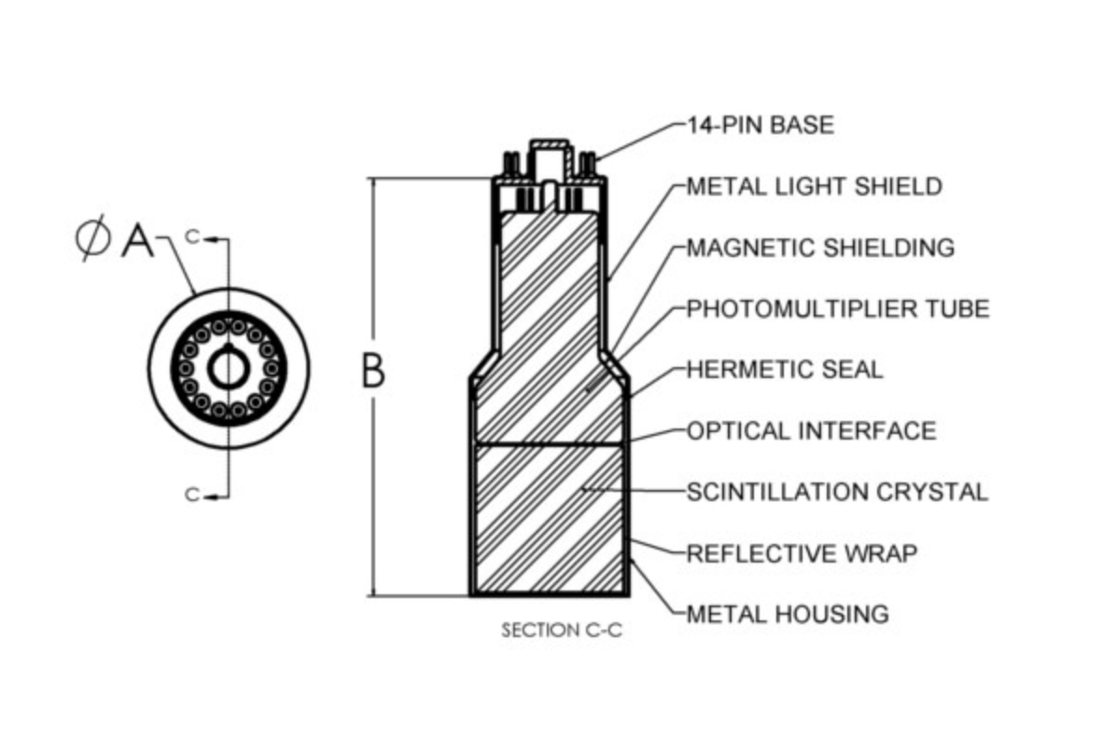
ND3 Backgrounds - Gamma Measurements
Schematic of NaI detector
Sodium iodide (NaI) detector, 3”x3” crystal with attached PMT.
Calibration was done using two known sources: Co-60 and Cs-137.
QUEST-DMC Liverpool Meeting - 16/10/2025

Slide 7
ND3 Backgrounds - Gamma Measurements
Schematic of NaI detector
Sodium iodide (NaI) detector, 3”x3” crystal with attached PMT.
Calibration was done using two known sources: Co-60 and Cs-137.
QUEST-DMC Liverpool Meeting - 16/10/2025

Slide 8
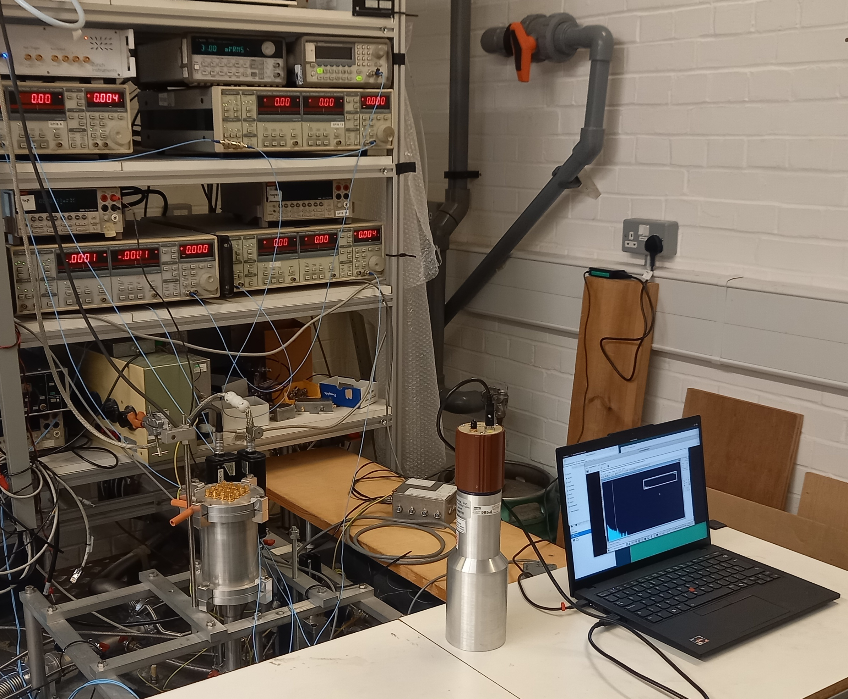
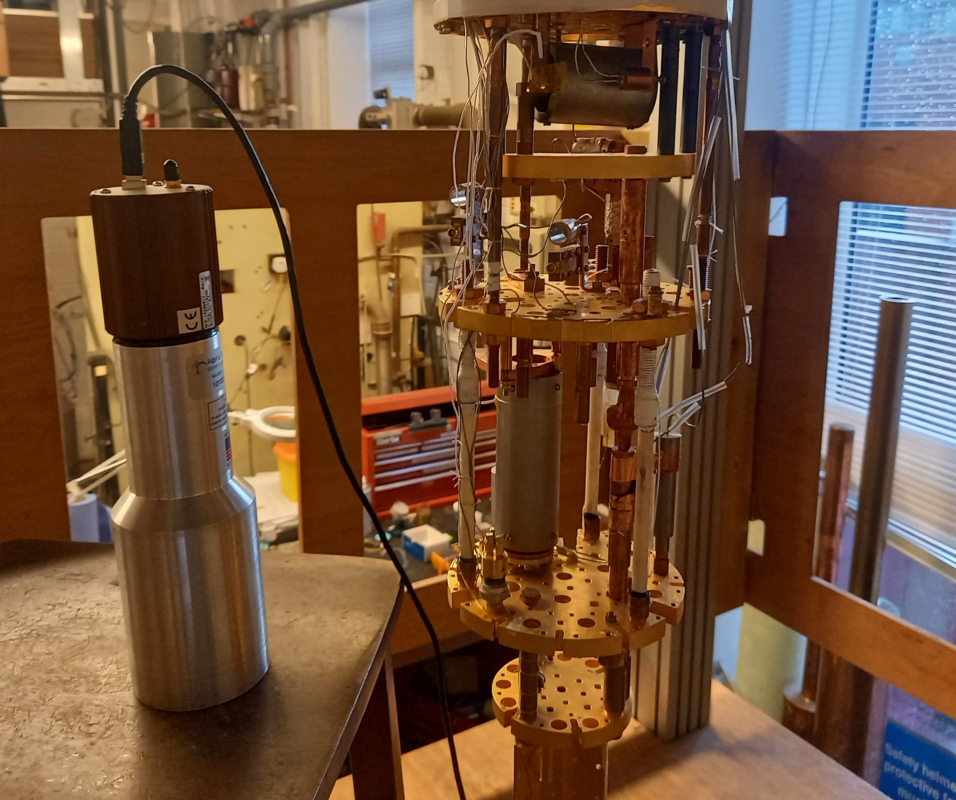
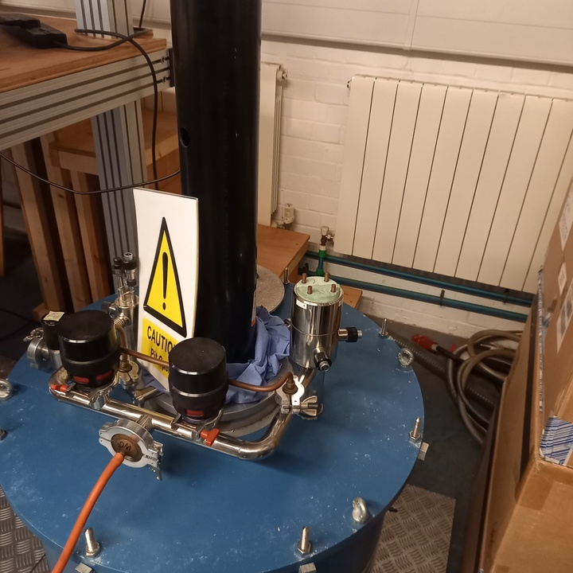
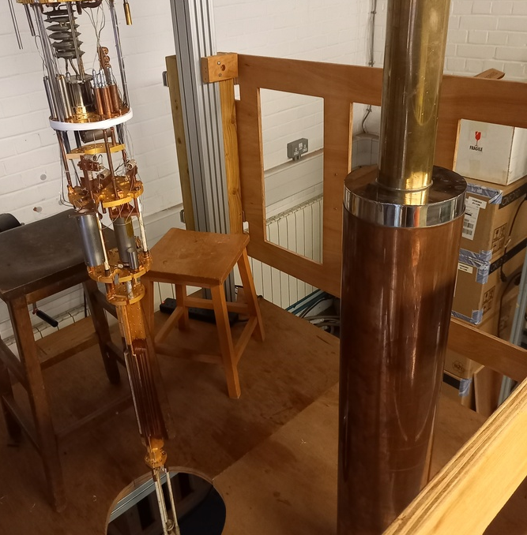
ND3 Backgrounds - Gamma Measurements
Data was taken over the course of 5-7 days in each location.
Took data in 4 locations:
    Lab (upstairs)
    Lab (downstairs)
    IVC
    Dewar
Upstairs
Downstairs
Dewar
IVC
QUEST-DMC Liverpool Meeting - 16/10/2025

Slide 9
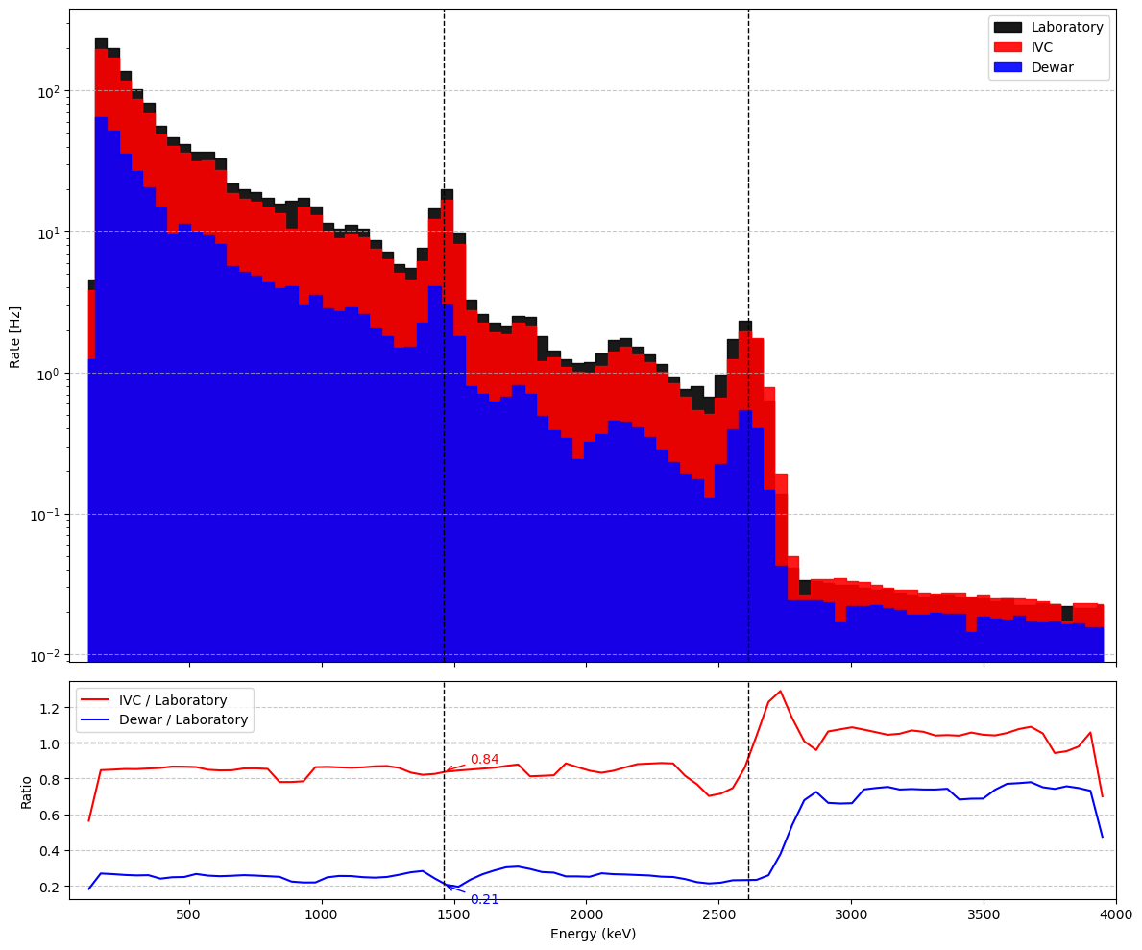
ND3 Backgrounds - Gamma Measurements
Pb-214
Tl-208
K-40
Gamma radiation energy spectra in RHUL Lab
Bi-214
Tl-208
Bi-214
Ratio of γ attenuation between fridge components and laboratory background
QUEST-DMC Liverpool Meeting - 16/10/2025

Slide 10
Geant4 Simulation
QUEST-DMC Liverpool Meeting
QUEST-DMC Liverpool Meeting - 16/10/2025

Slide 11
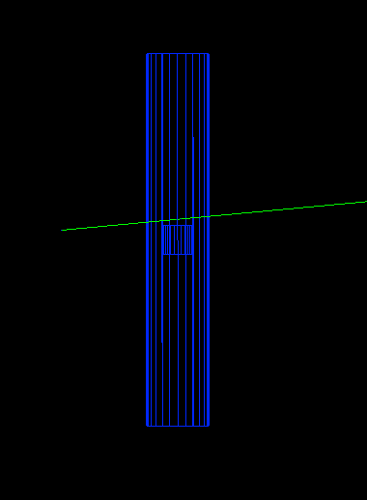
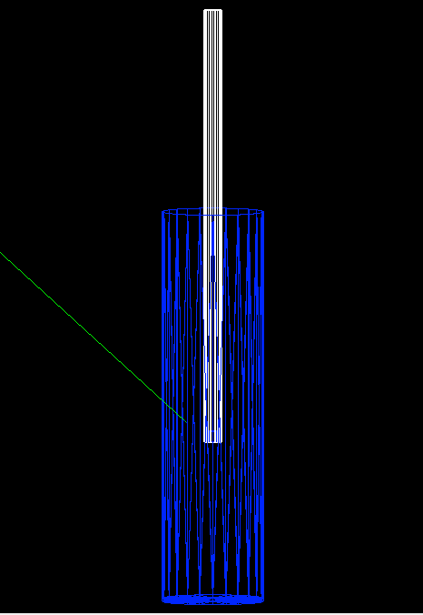
ND3 Backgrounds - Geant4 Simulation
From the work on the measured radiogenics, I created a similar smaller-scale Geant4 geometry of only the IVC and dewar, in order to recreate the data-taking setup.
IVC
Dewar
QUEST-DMC Liverpool Meeting - 16/10/2025

Slide 12
ND3 Backgrounds - Geant4 Simulation
Simulation:
  Used the background spectra from the NaI measurements as a gamma generator.
  Ran monoenergetic , isotopic gammas.
  Accounts for photon attenuation, Compton scattering, and photoelectric absorption.
IVC
Dewar
QUEST-DMC Liverpool Meeting - 16/10/2025

Slide 13
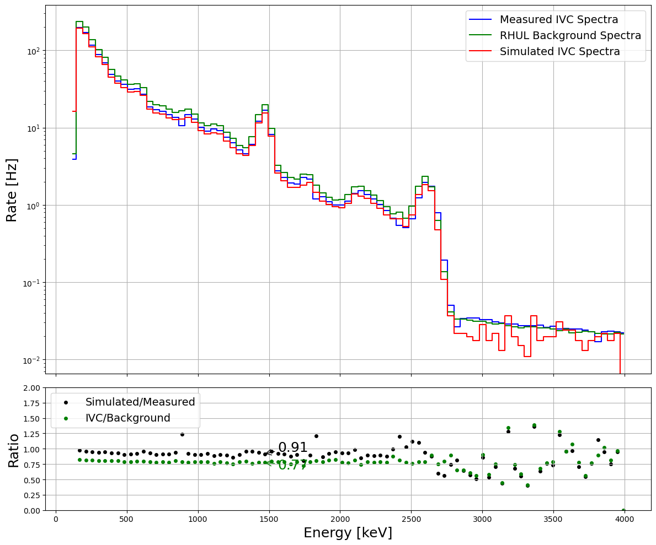
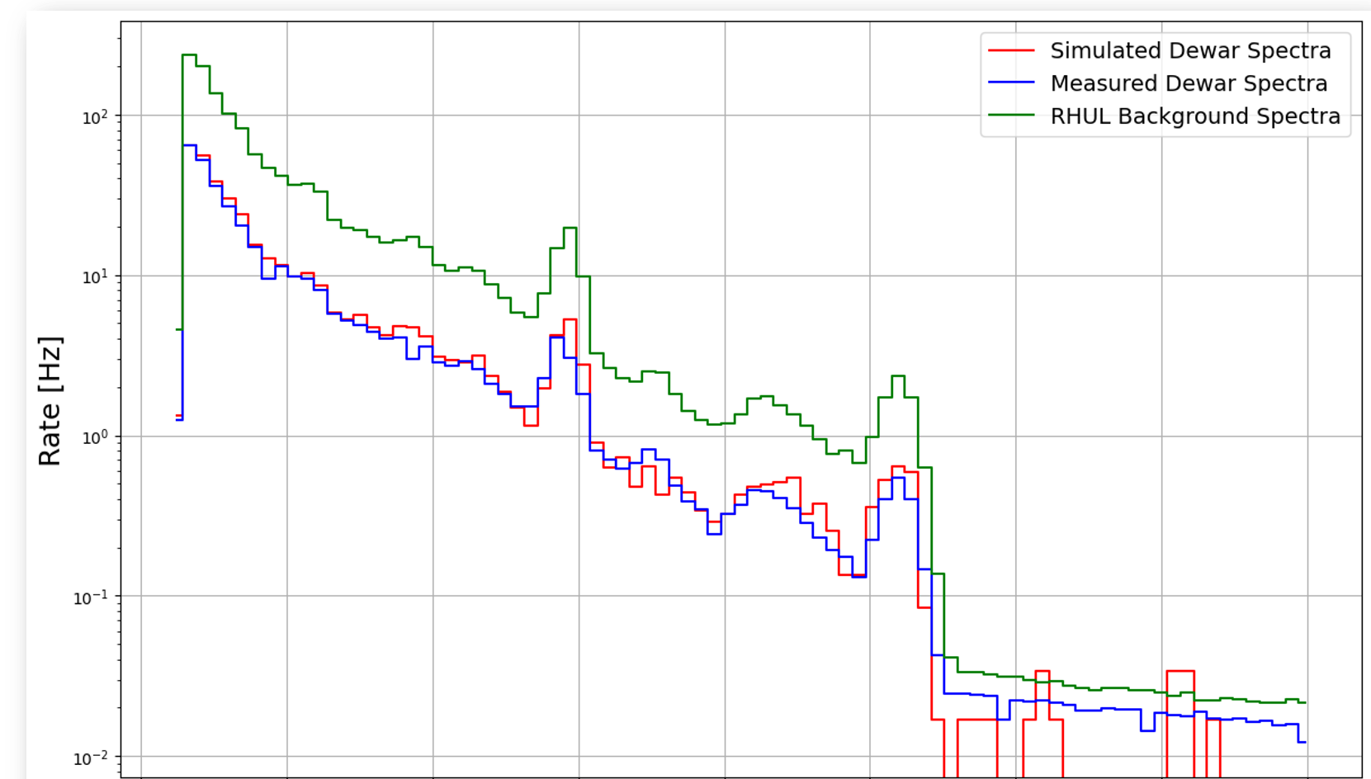
ND3 Backgrounds - Geant4 Simulation
IVC Measured & Simulated Gamma Spectra
Dewar Measured & Simulated Gamma Spectra
Add dewar and IVC plots here
QUEST-DMC Liverpool Meeting - 16/10/2025

Slide 14
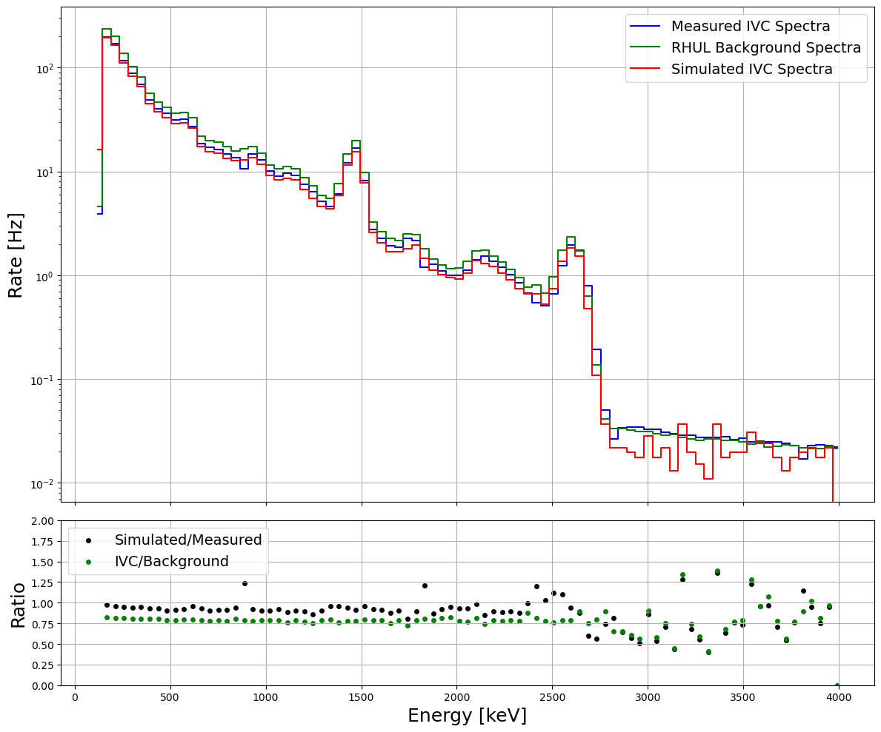
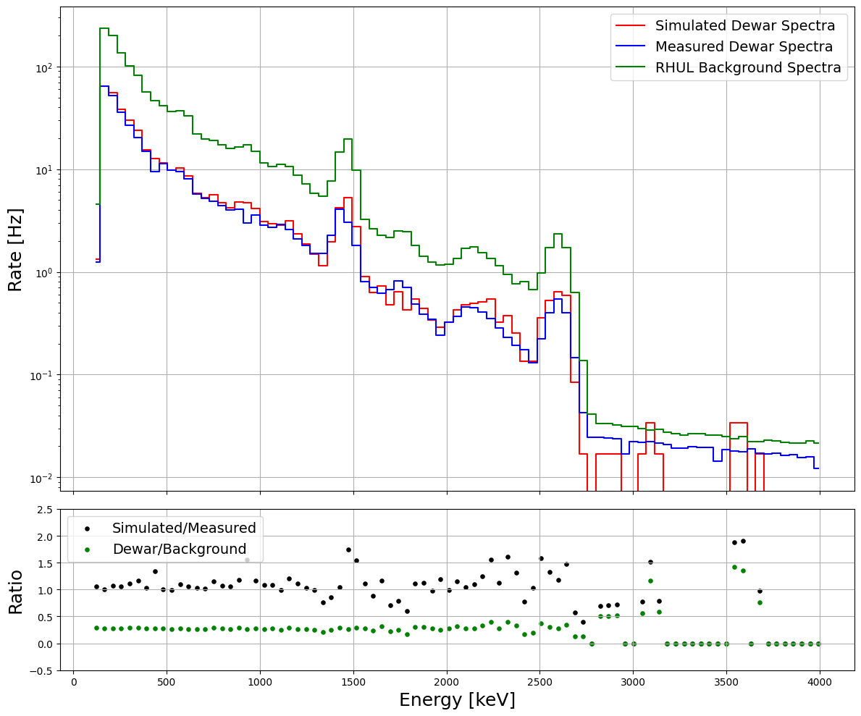
ND3 Backgrounds - Comparison
IVC Measured & Simulated Gamma Spectra
Dewar Measured & Simulated Gamma Spectra
Add dewar and IVC plots here, with ratio subplot
QUEST-DMC Liverpool Meeting - 16/10/2025

Slide 15
ND3 Backgrounds - Comparison
IVC Measured & Simulated Gamma Spectra
Dewar Measured & Simulated Gamma Spectra
Add dewar and IVC plots here, with ratio subplot
Av. Ratio of Agreement:
0.91 ± 0.008
QUEST-DMC Liverpool Meeting - 16/10/2025

Slide 16
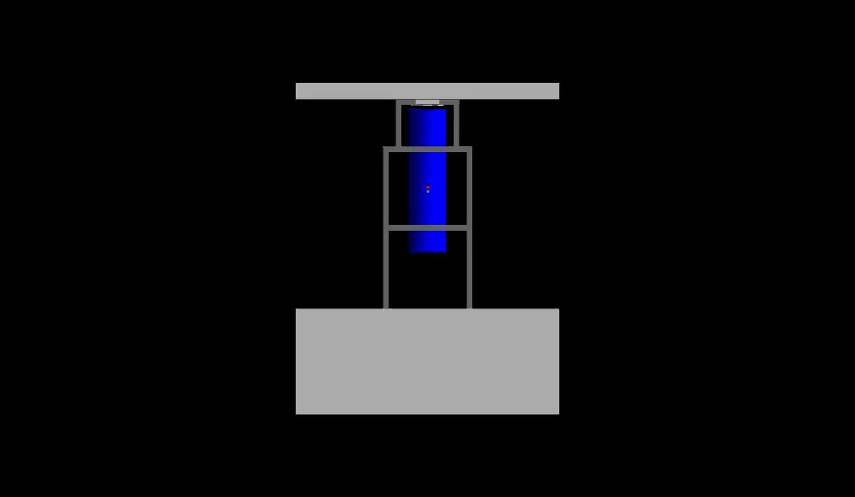
ND3 Backgrounds - Geant4 Simulation
Visualisation shows the fully rendered Geant4 geometry for ND3 (done by Elizabeth), now validated by the results of the measured data recreation.
QUEST-DMC Liverpool Meeting - 16/10/2025

Slide 17
Ongoing Work
QUEST-DMC Liverpool Meeting
QUEST-DMC Liverpool Meeting - 16/10/2025

Slide 18
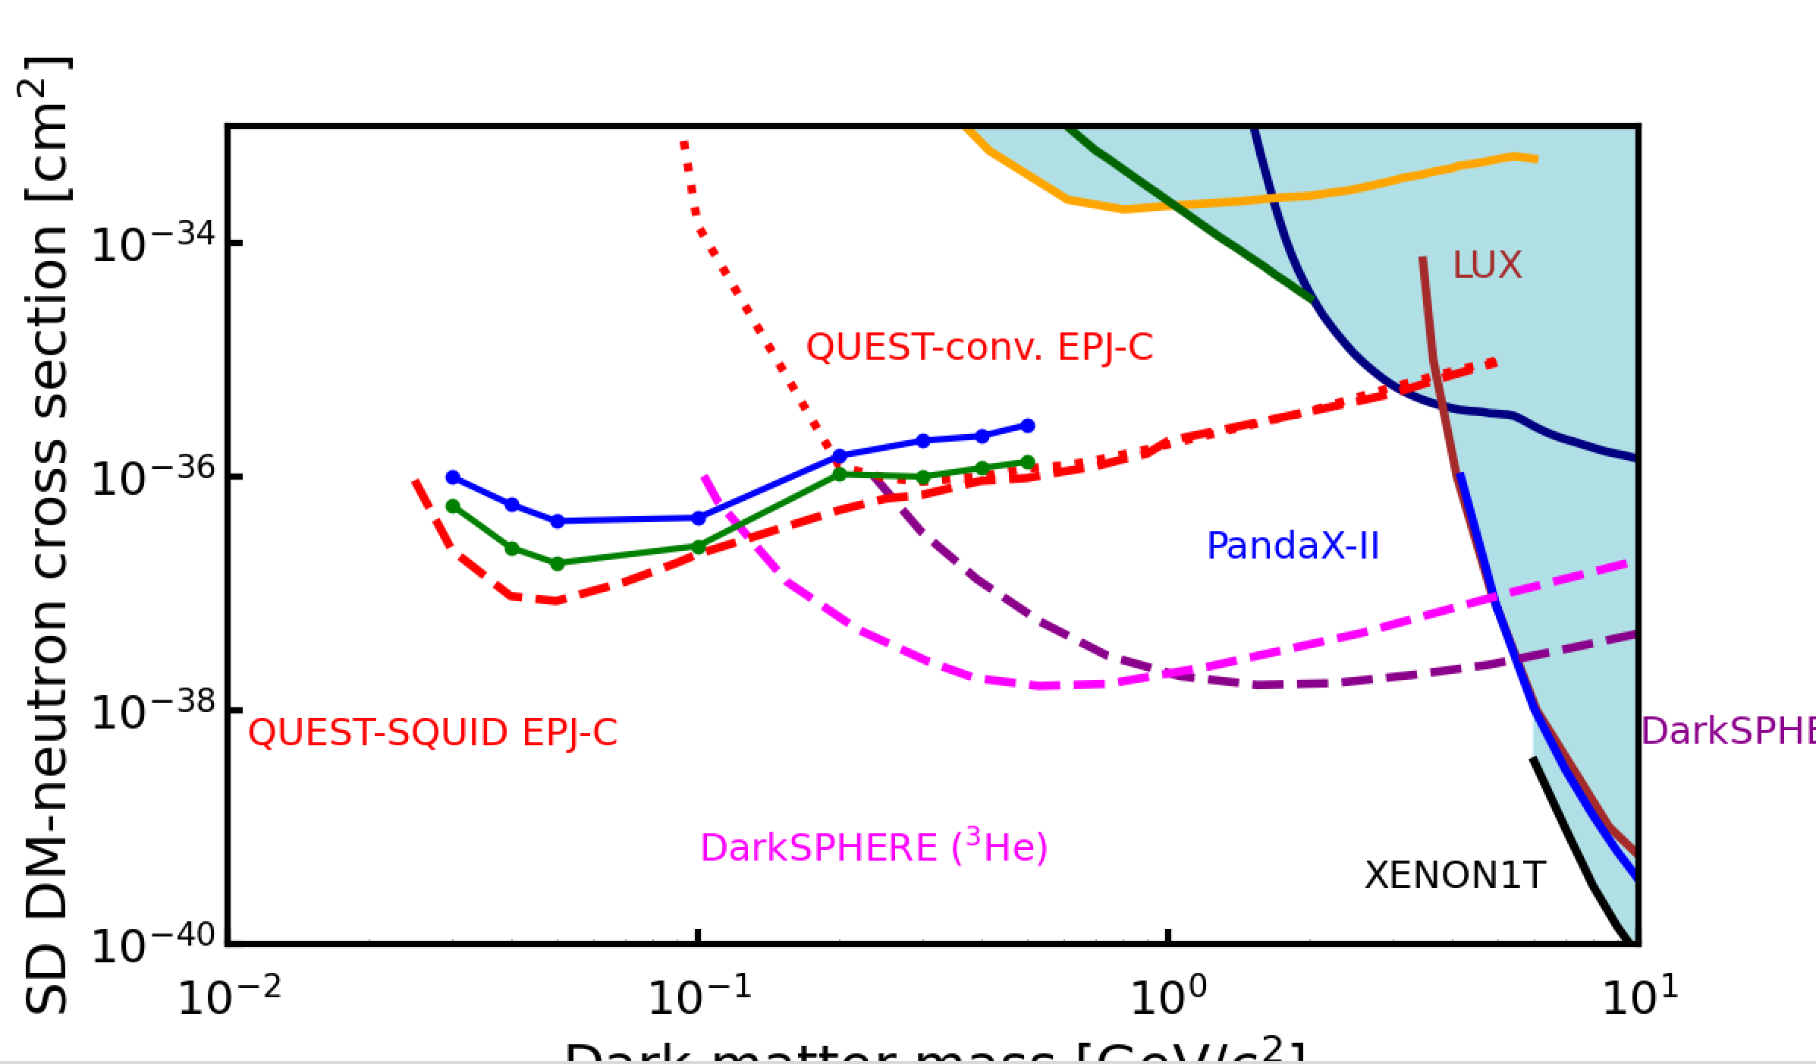
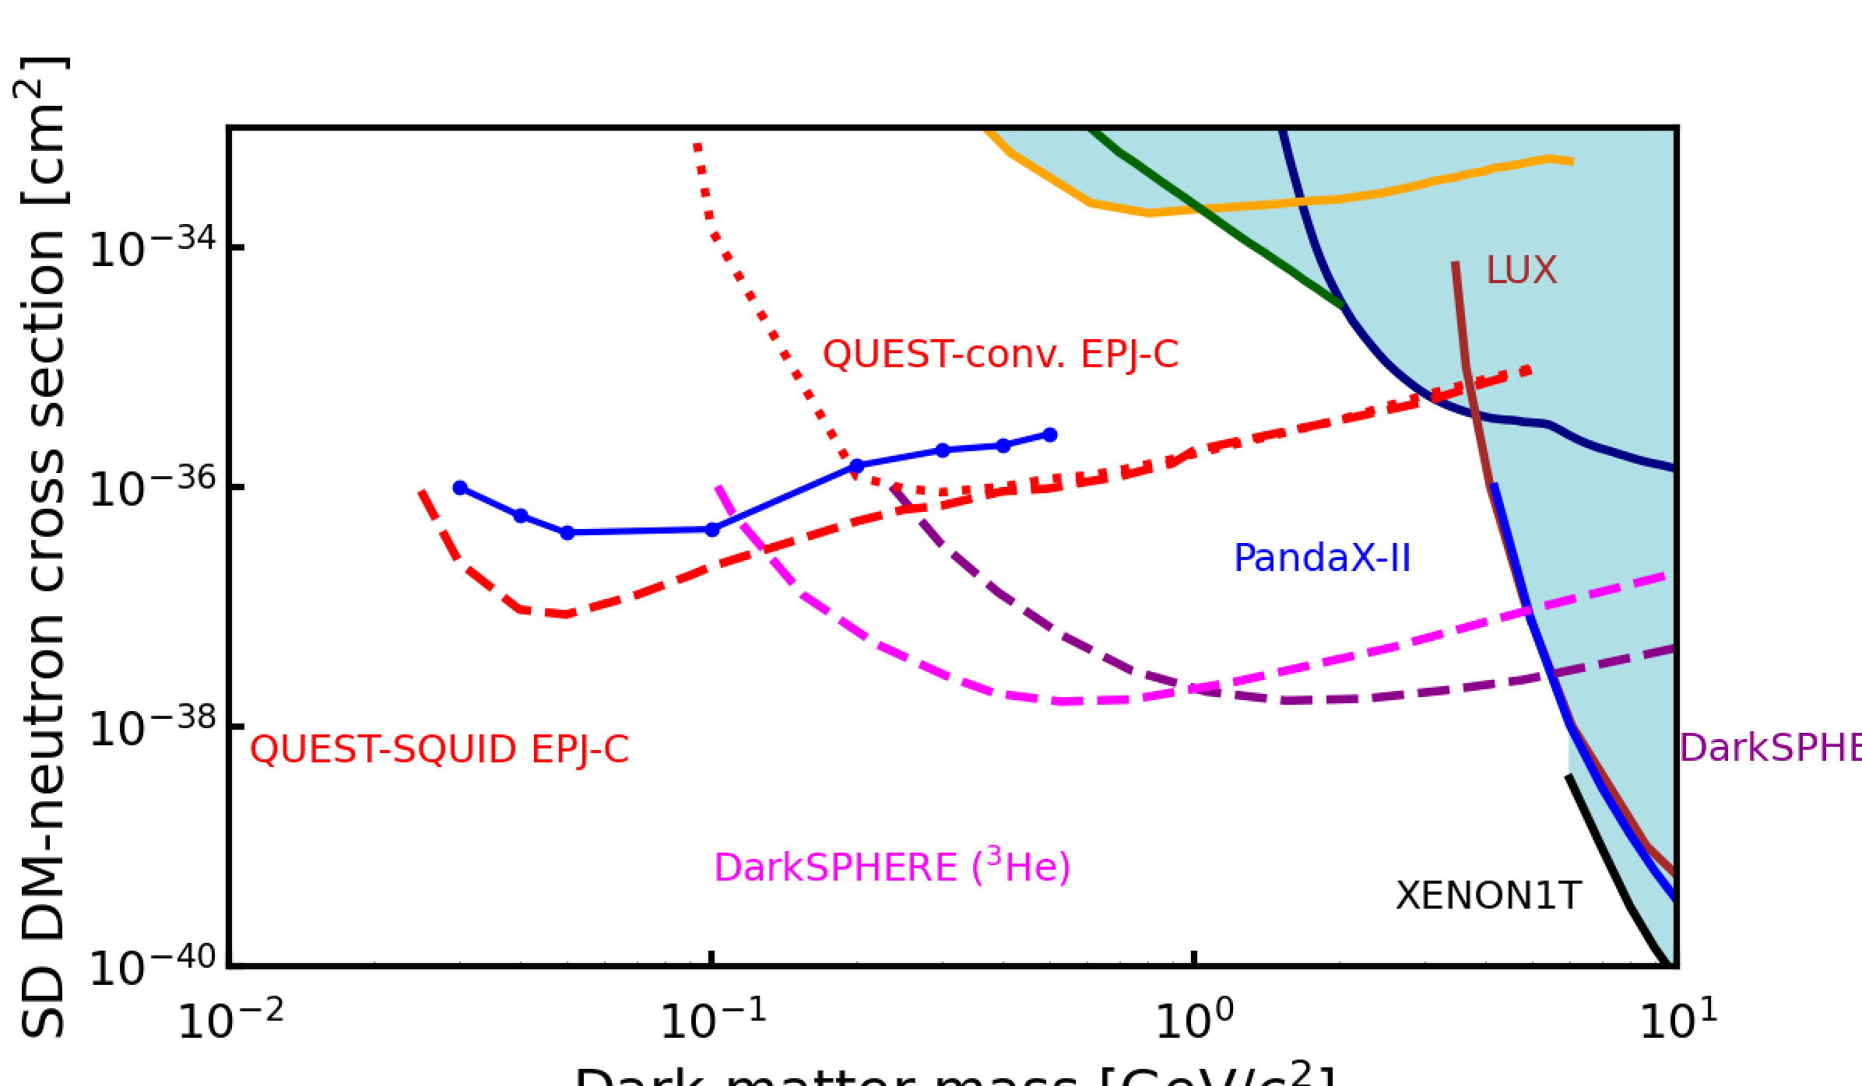
ND3 Backgrounds - PLR Progress
Investigated the effects of scaling the radiogenics background up by a factor 10.
Overlaid plot of scaled backgrounds (for a projected SQUID readout) and their effect on QUEST’s sensitivity.
Work in progress
Add squid gamma scale plot
QUEST-DMC Liverpool Meeting - 16/10/2025

Slide 19
ND3 Backgrounds - Future Work
Create full ND3 background model, including detector effects.
Now investigating the effects of acoustic noise on the QUEST sensitivity limit.
Aiming to investigate:
    The effects of raising the threshold to 100eV and 1keV.
    The effects of scaling the acoustic background pdf by factor 10 to confirm the need to reduce said background.
QUEST-DMC Liverpool Meeting - 16/10/2025

Slide 20
Thanks & Questions!
QUEST-DMC Liverpool Meeting
QUEST-DMC Liverpool Meeting - 16/10/2025

