Slide 1
About me
Matt Wilson
ESDG Group Meeting
25th of September

Slide 2
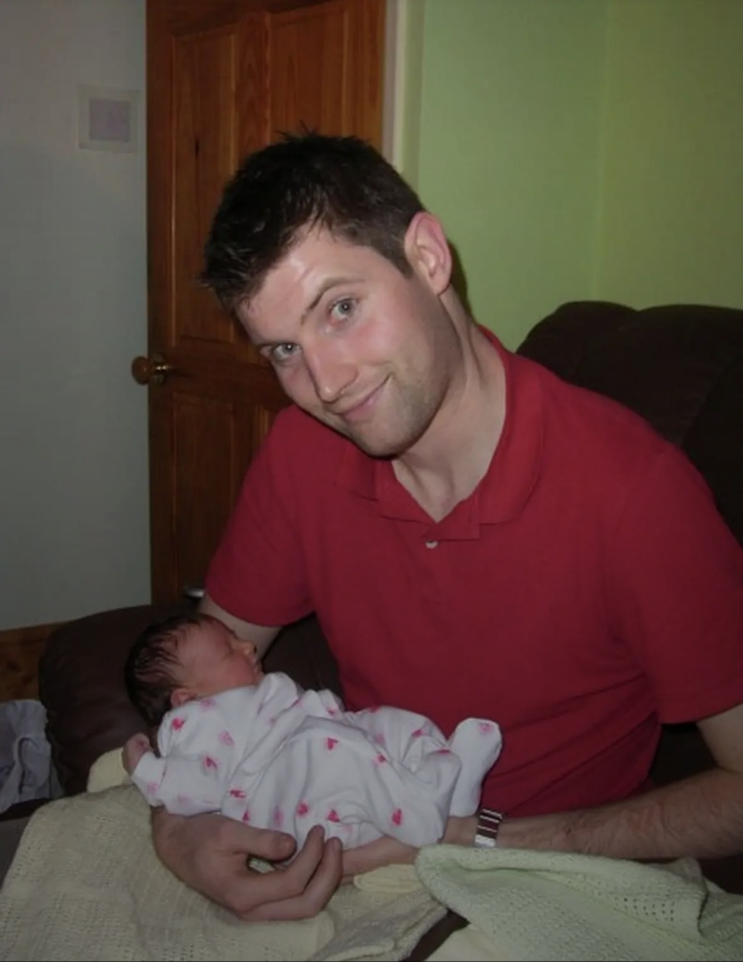
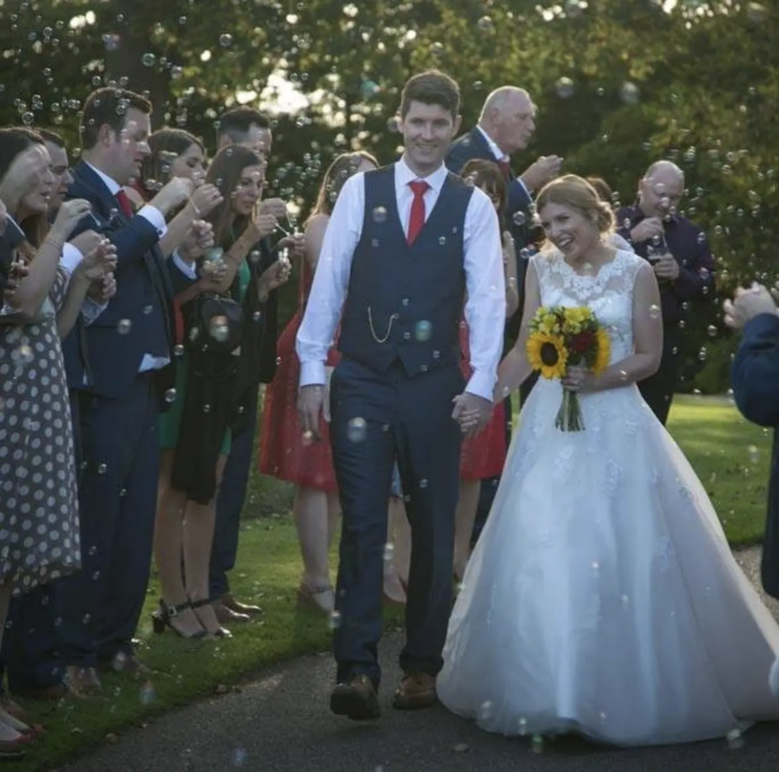

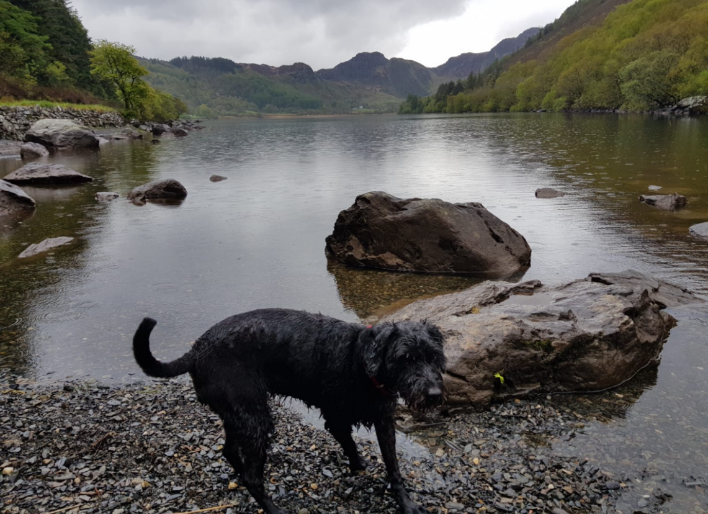
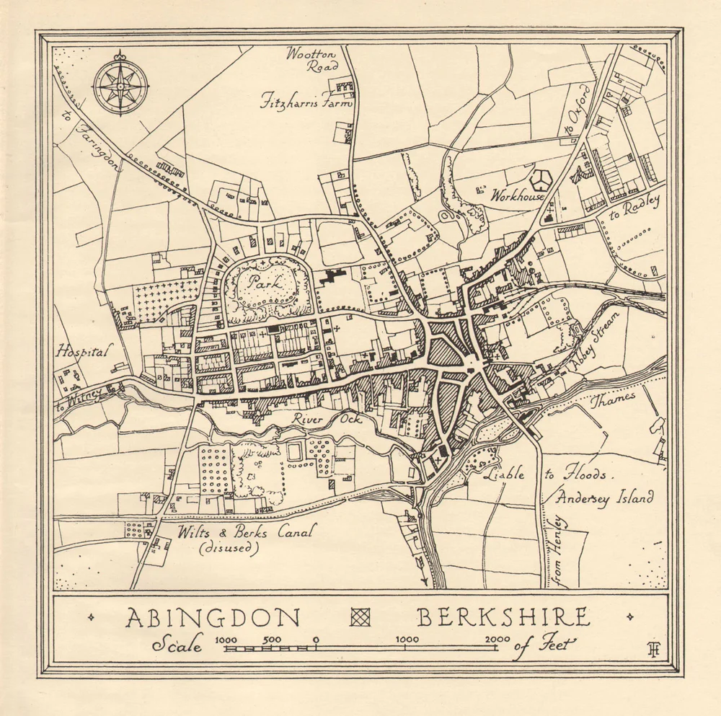
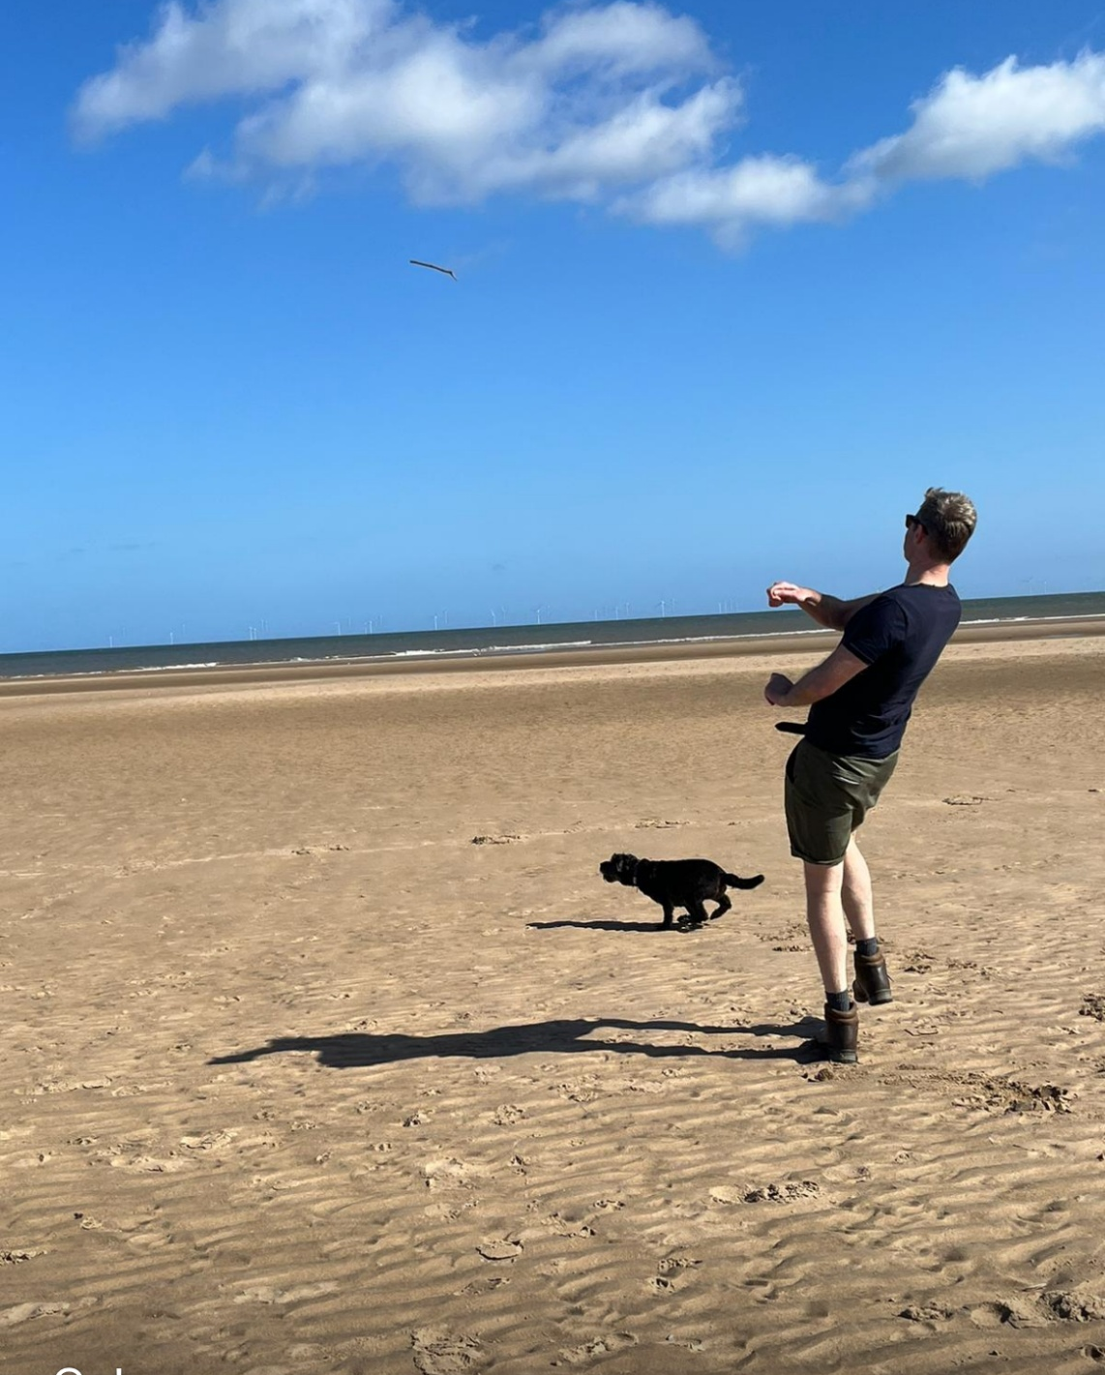
About me
Niece – started university last week
Nephew’s – 16,12,4,3 and 1/2
9 years last week
No cats
…but here’s Molly

Slide 3

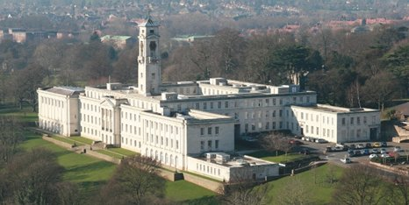
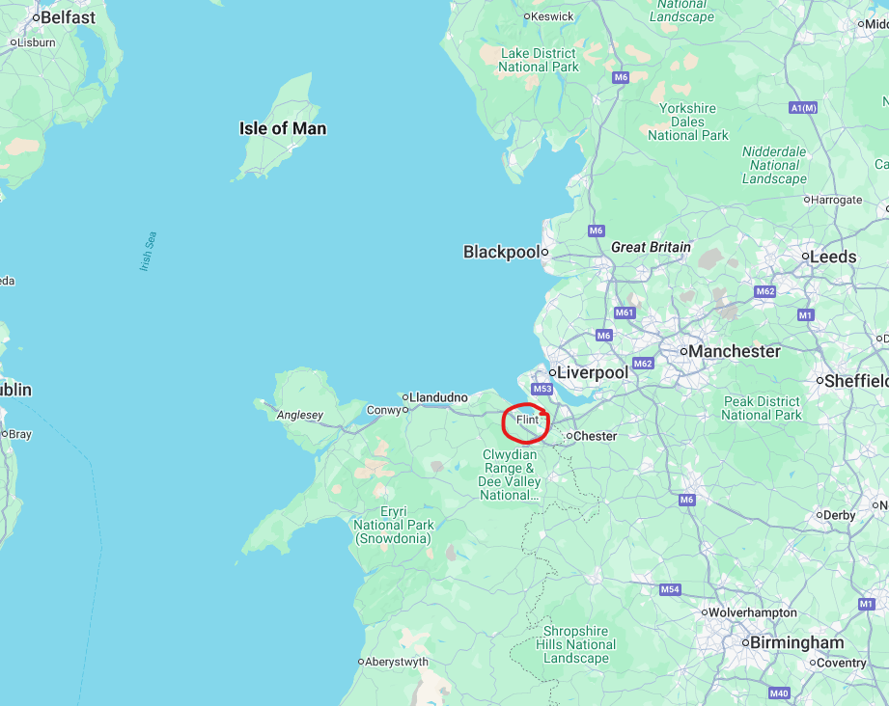
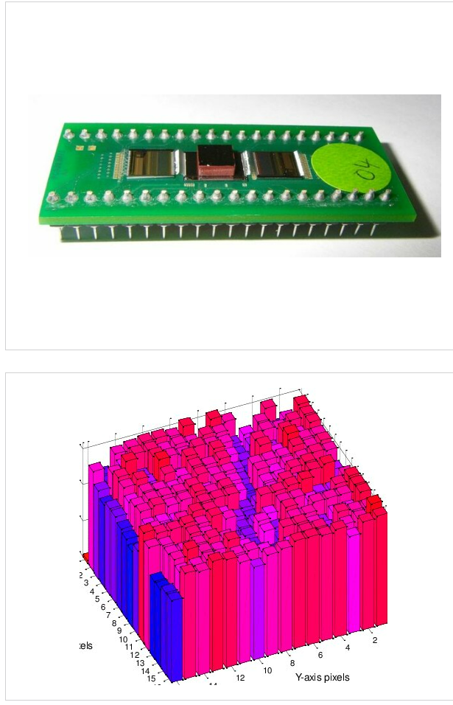


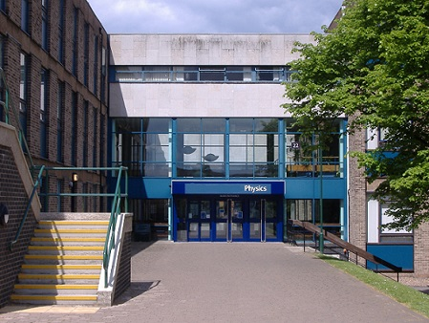

Background
19 years ago!

Slide 4
Career Progression
Graduate Scheme
2006-08
CPhys 2011
Advanced Development Scheme 2014-16
Part of project team
Extra training and mentoring
On the job experience
Formal Training
Supervise Students
Running Work Packages
Build experience
Leadership, corporate
Secondments
IoP Mentoring
2006-11
Senior Scientist 2011-14
Principle Scientist 2016-18
Rounded professional development
Building Collaborations
Starting small projects
Managing teams
Delivering Instruments
Group Leader 2018
Strategy and planning
Managing resources
Keep projects progressing
People development
Notes:
STFC is good for career progression – great with good managers
Grad scheme and then work towards chartership – Cphys or Ceng
Become an expert in your field
Build relationships with people around the world and you can become a leader
Not only deliver science or technology for people to do science but set the future direction

Slide 5
What motivates me?
Making science happen
Working with inspiring people
Delivering something unique
Seeing the impact it has

Slide 6
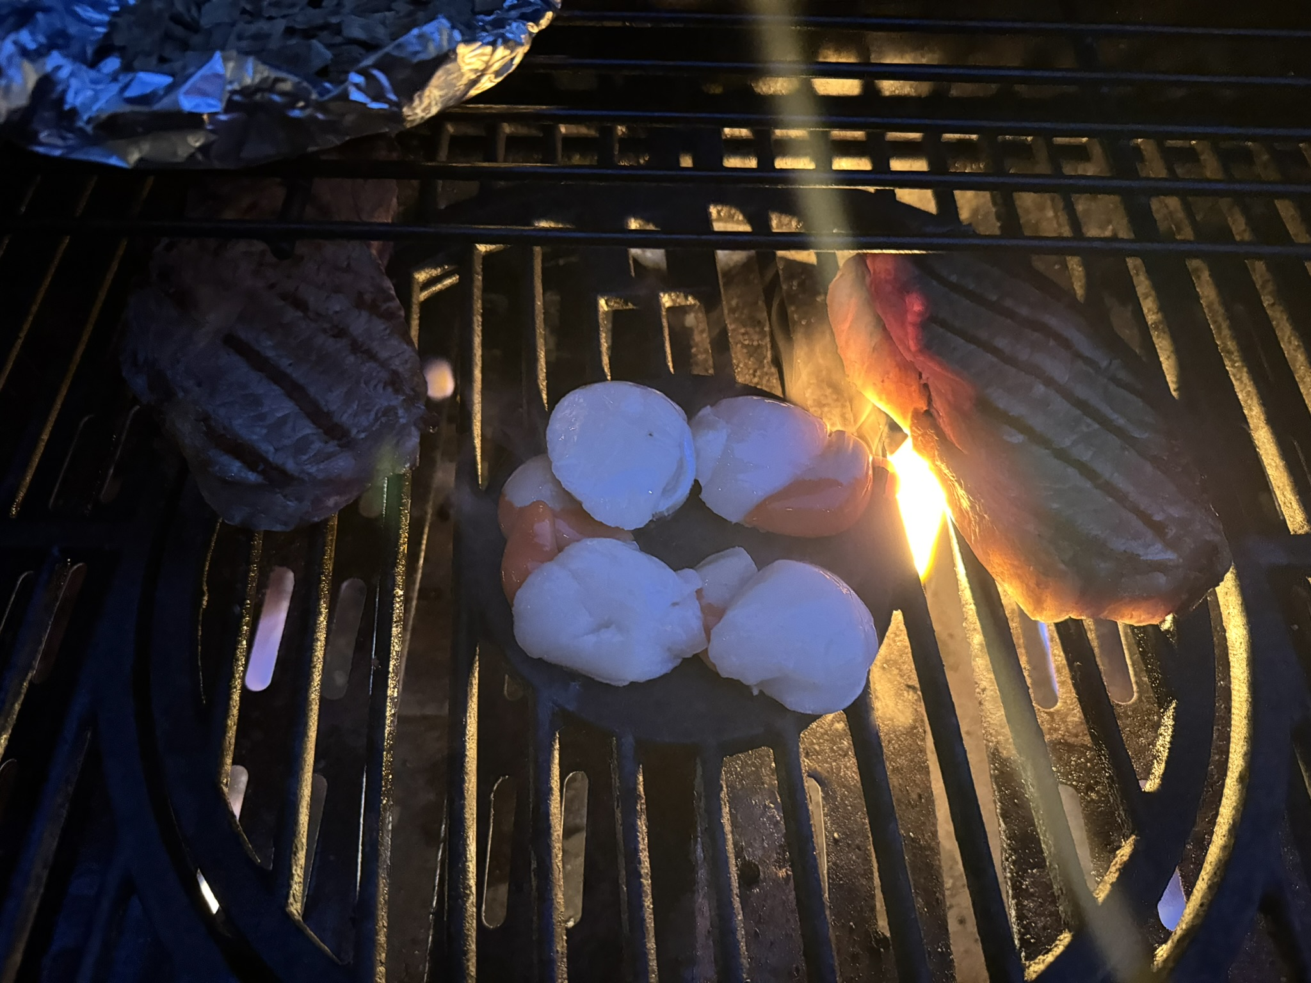
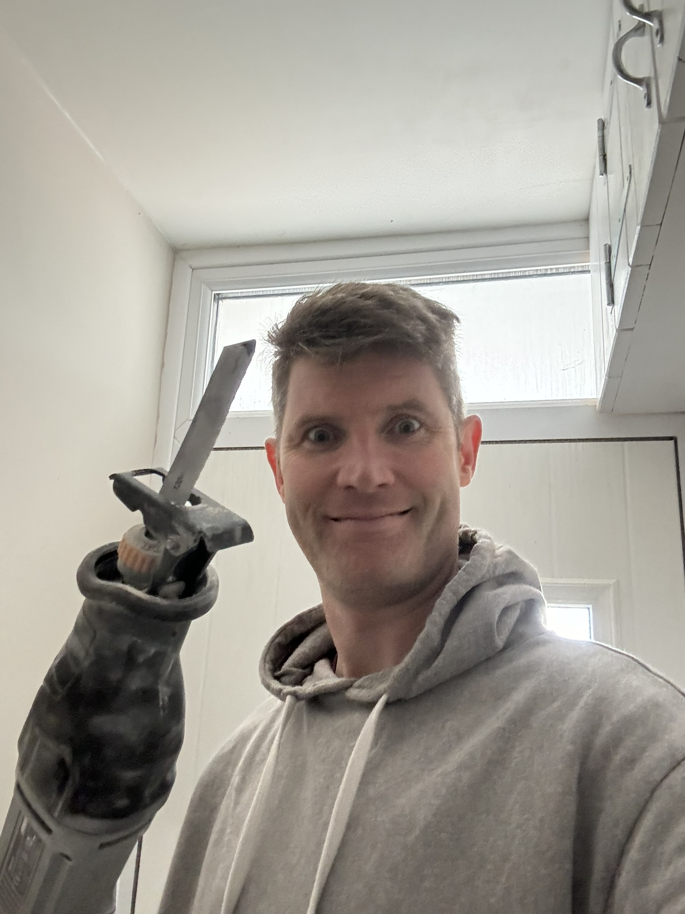
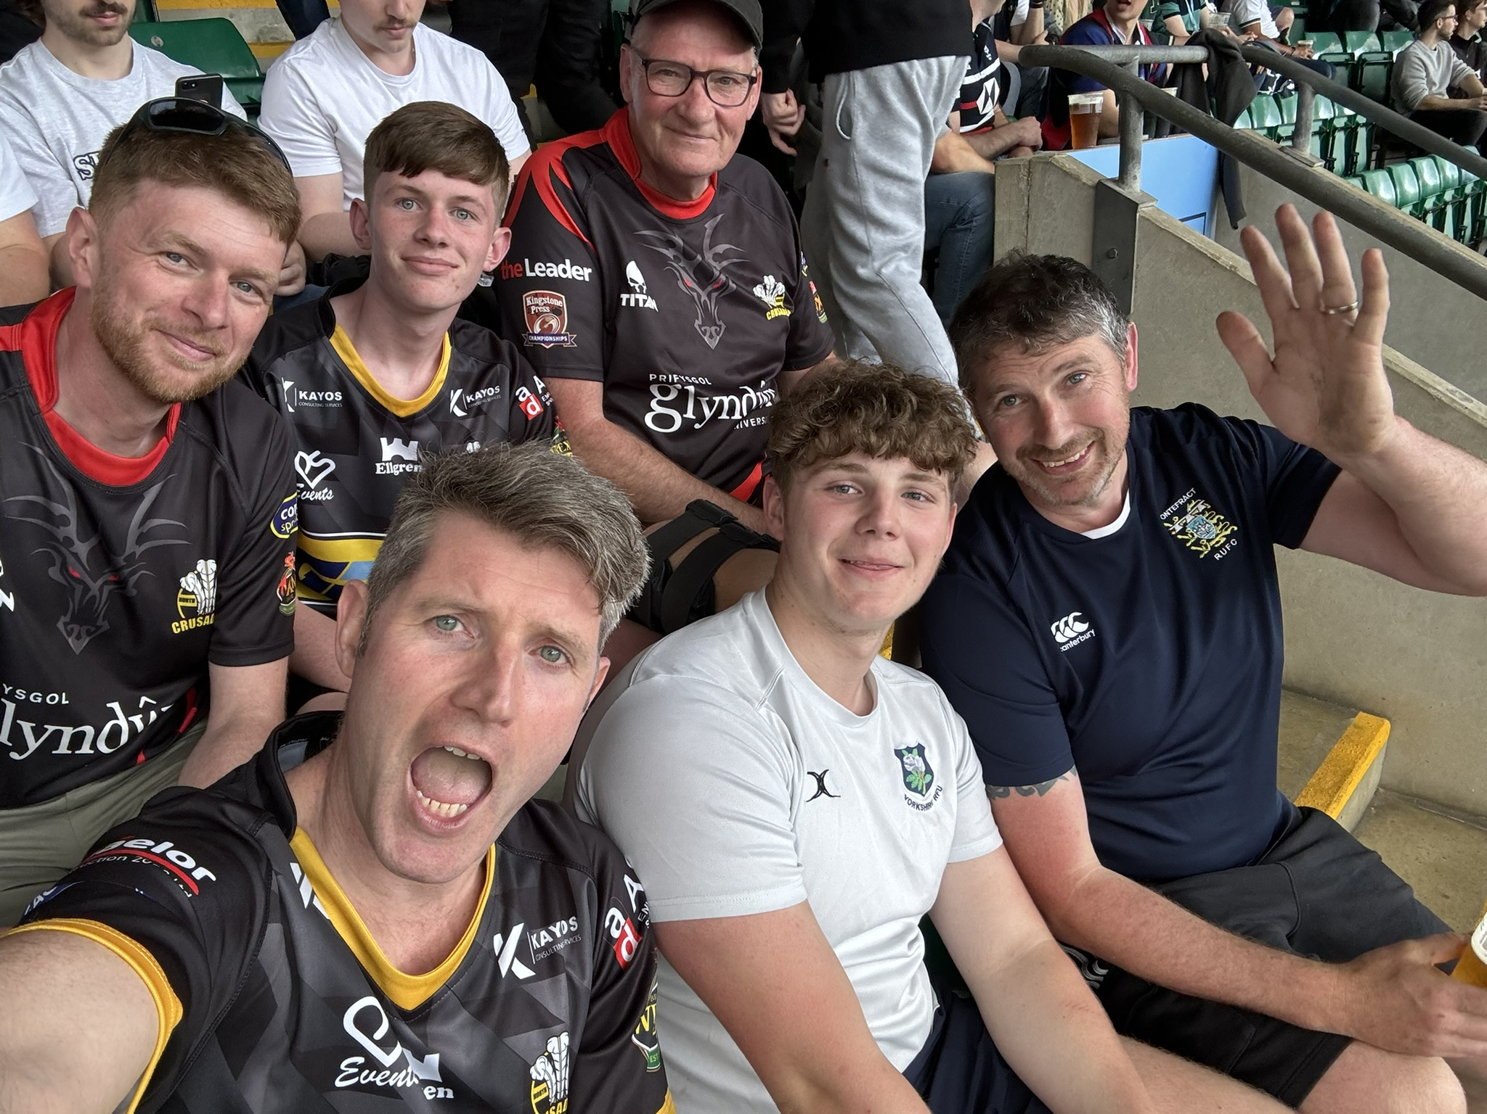
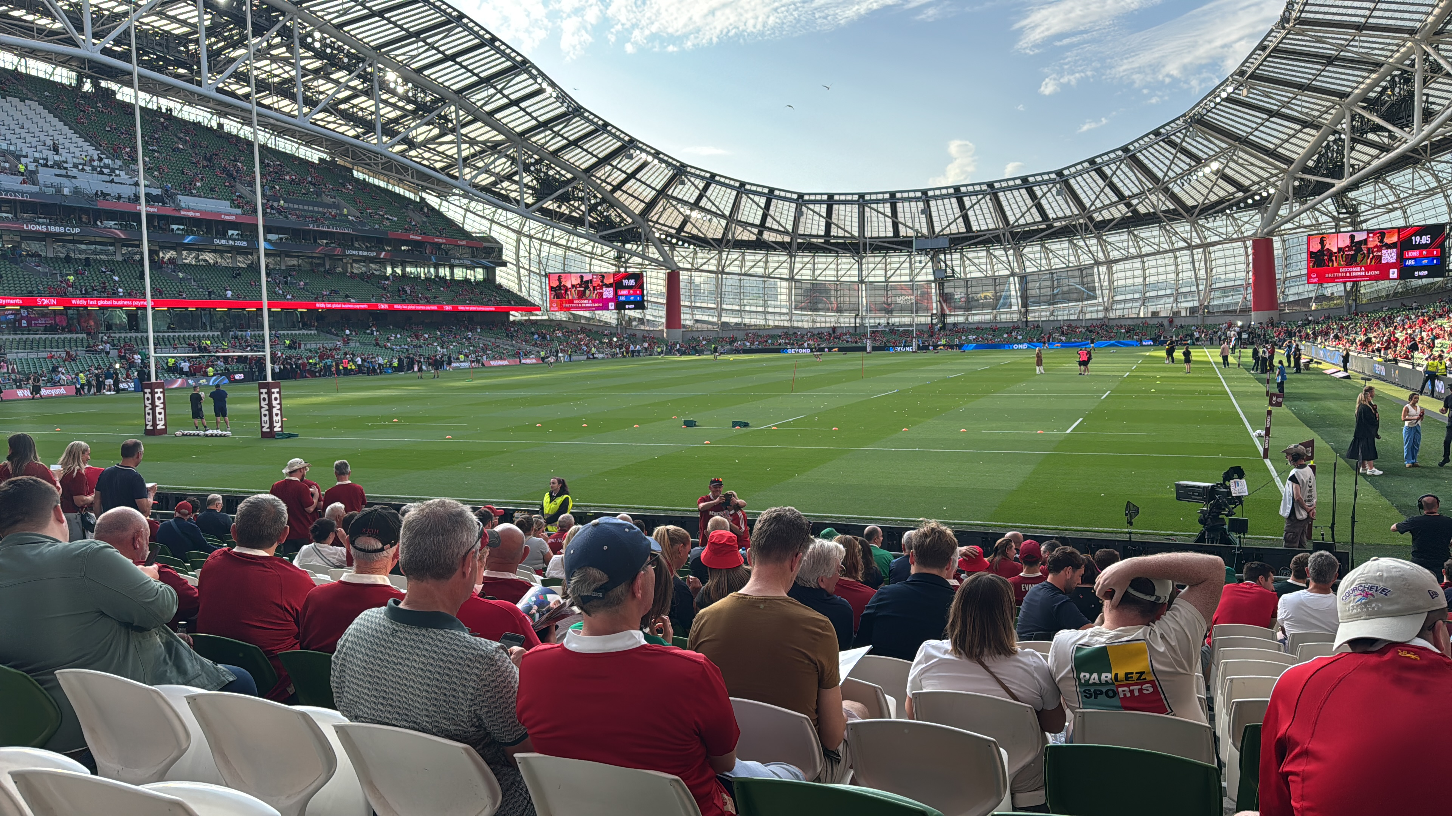
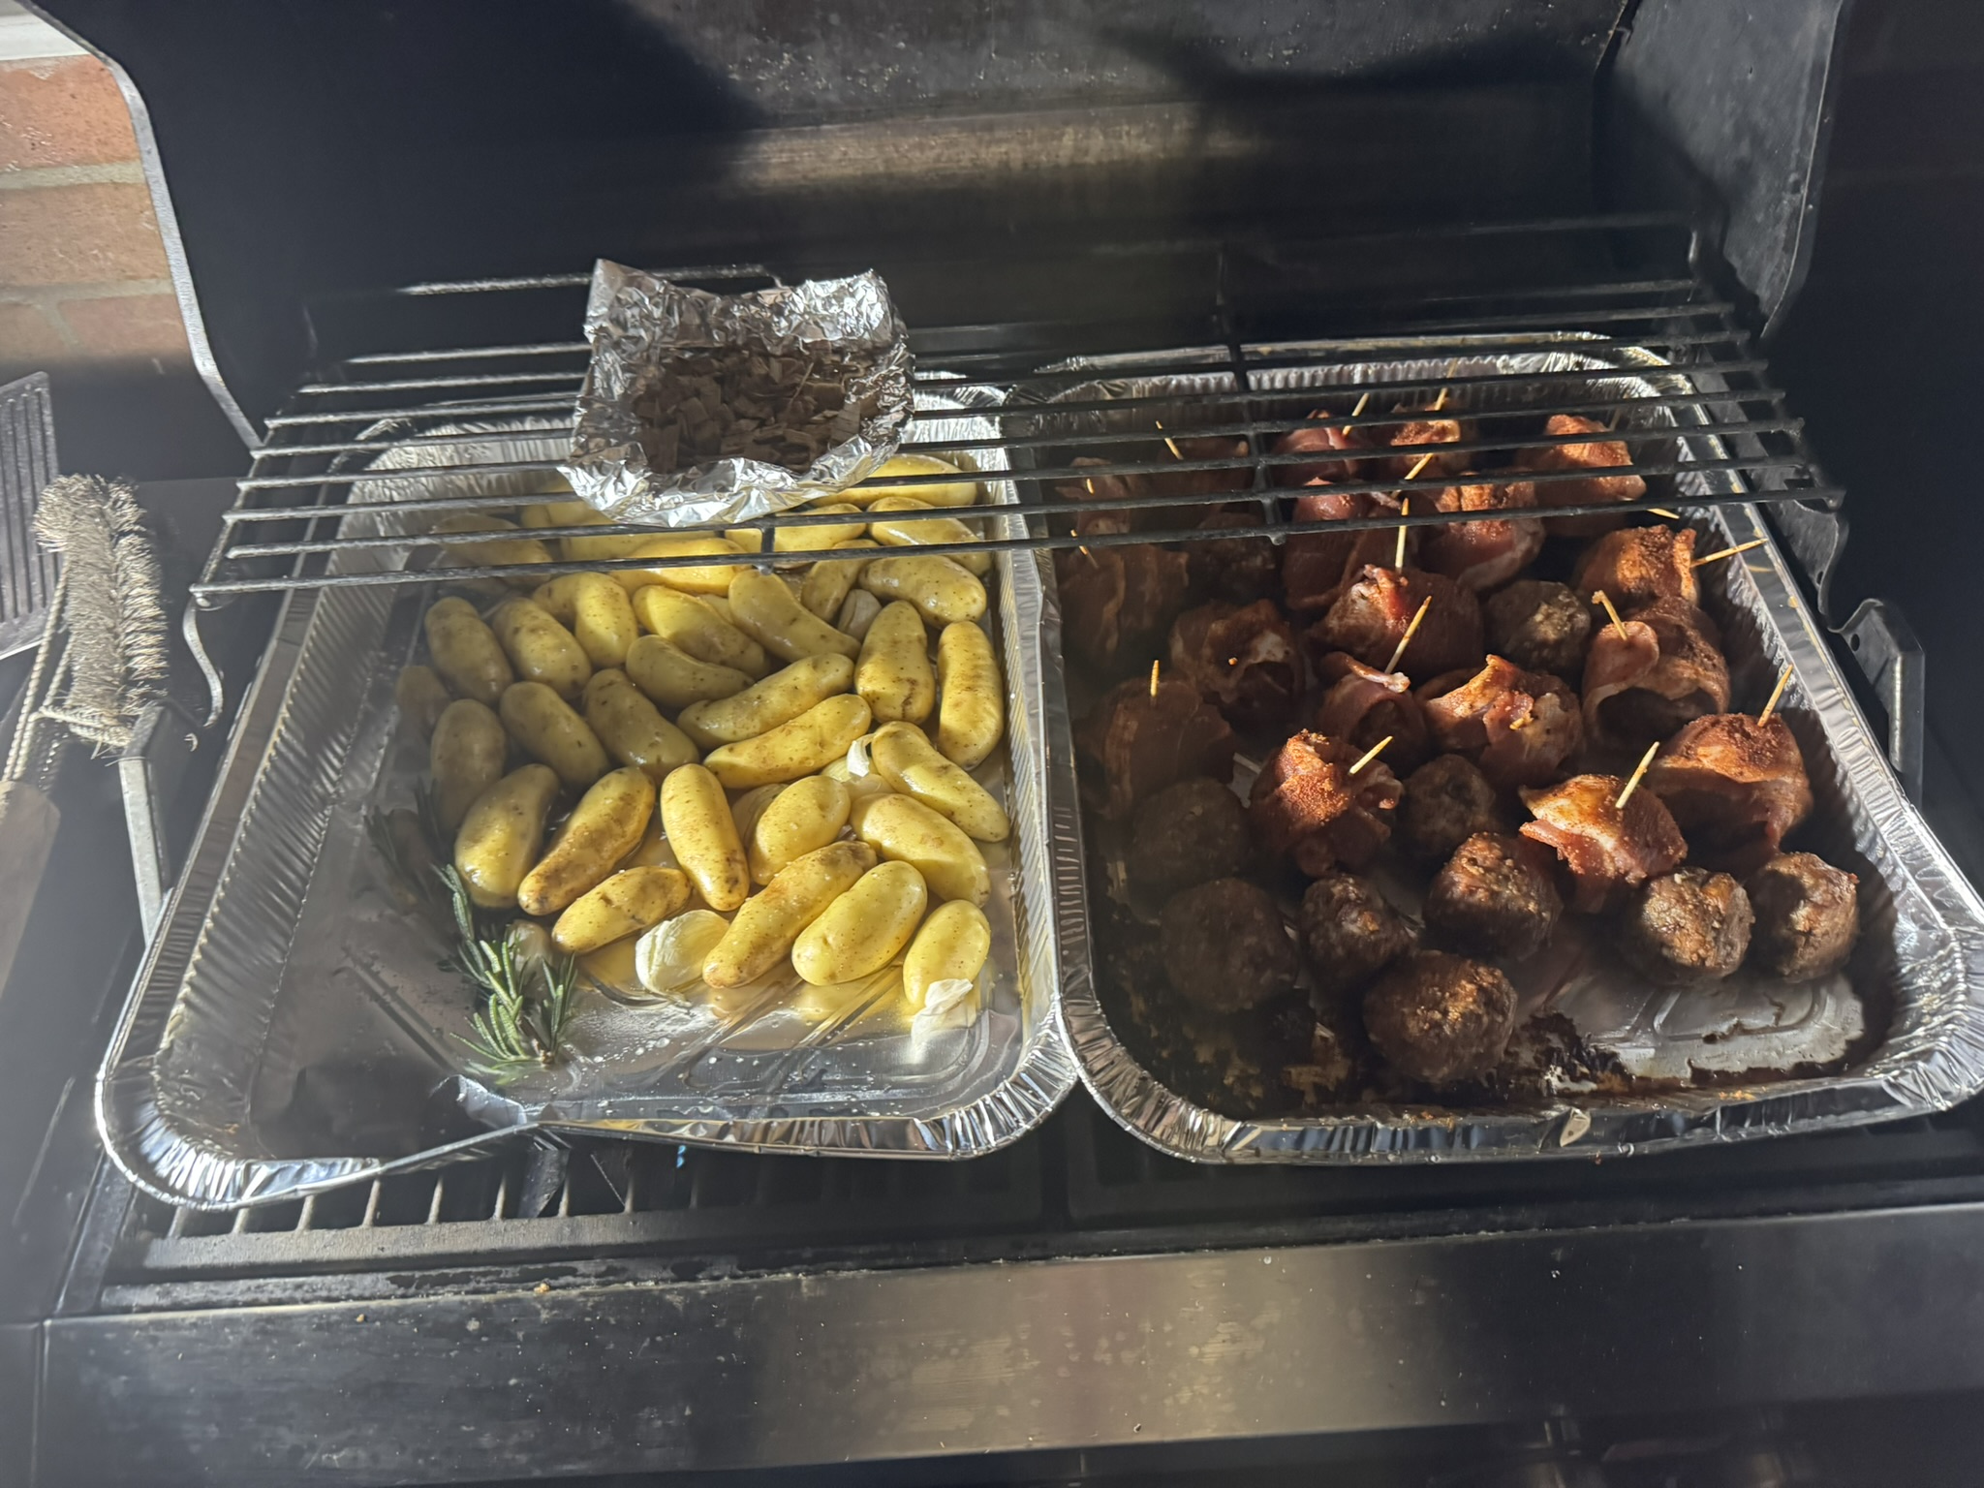
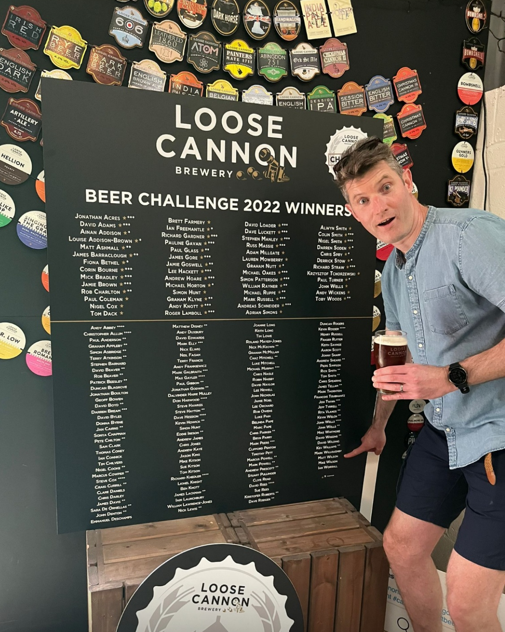
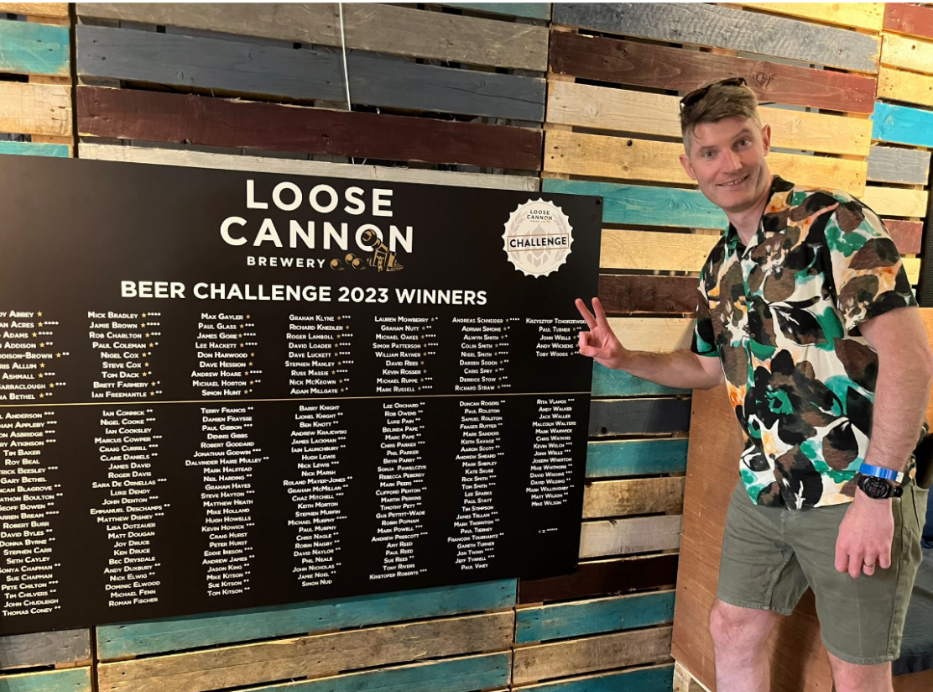
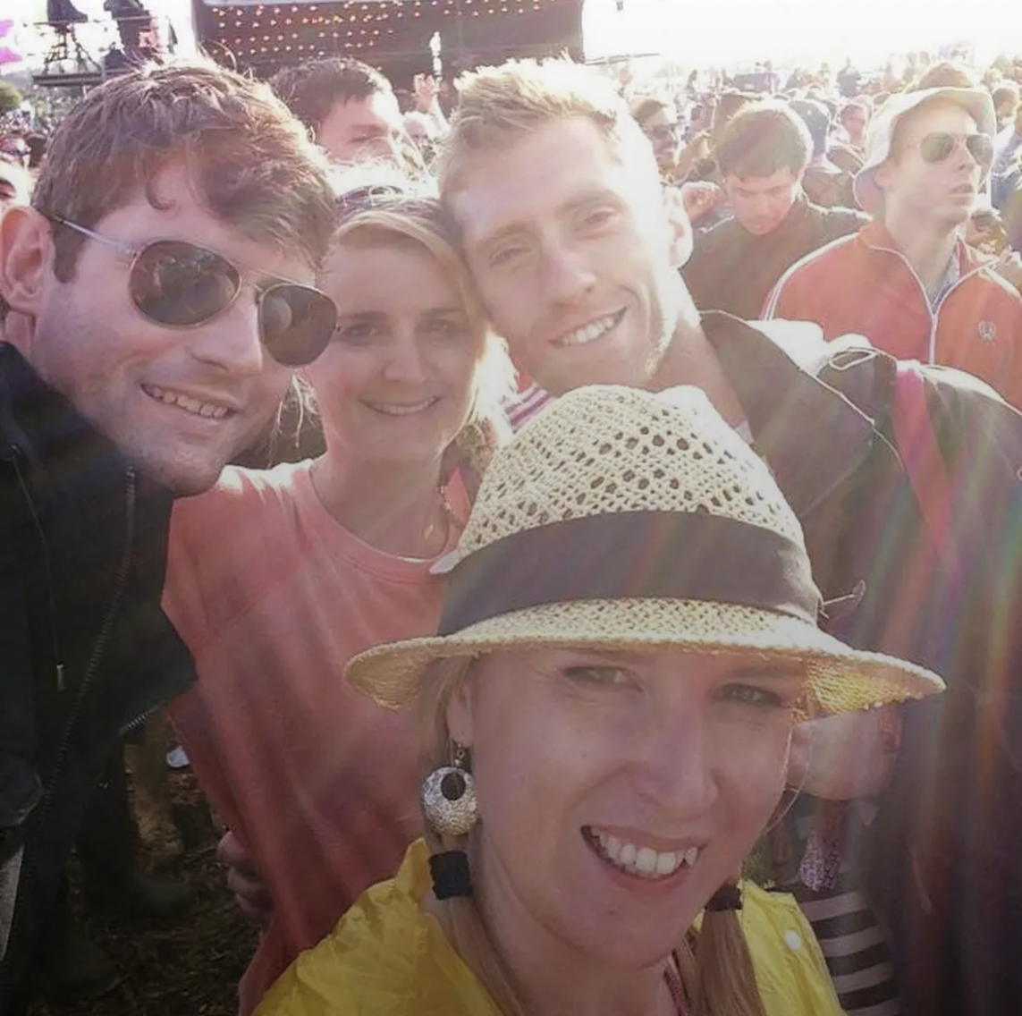
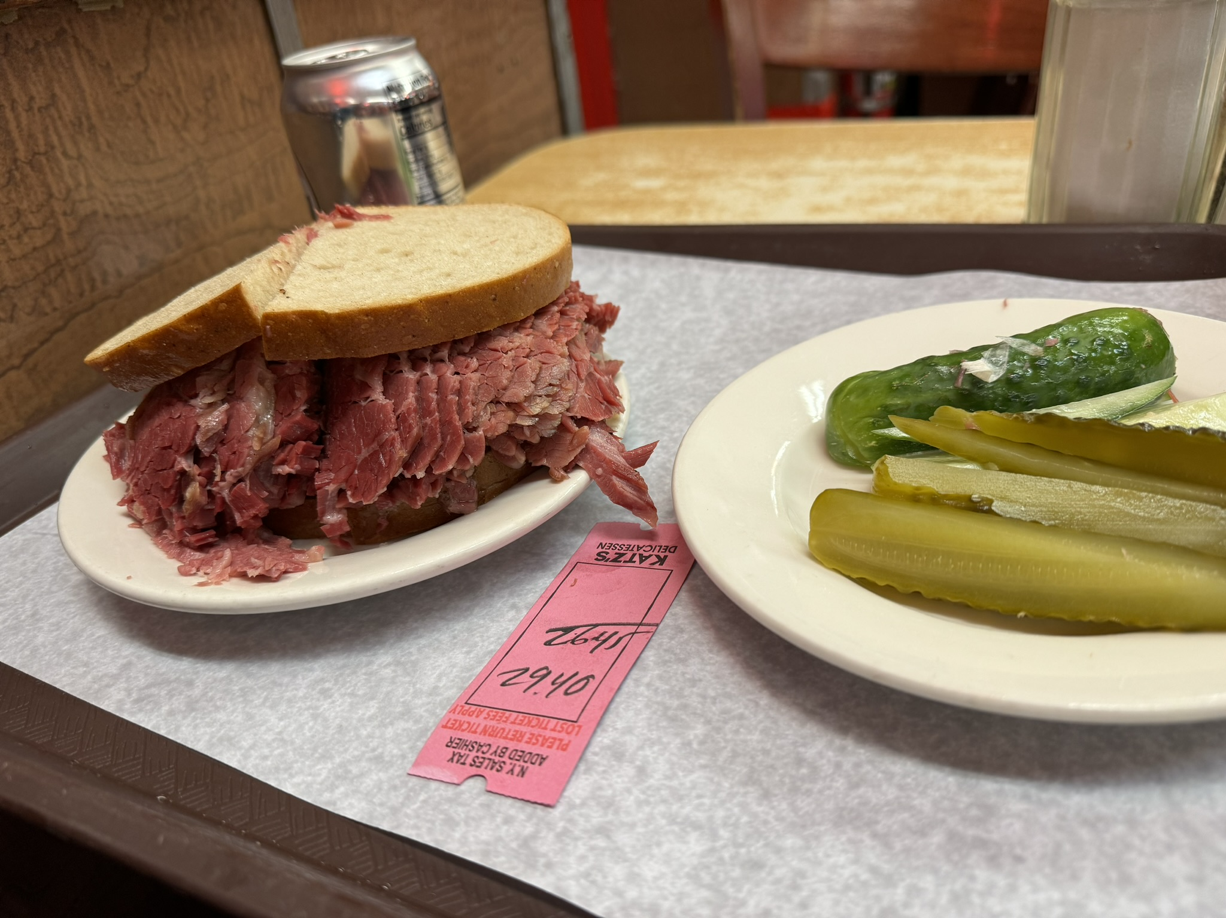
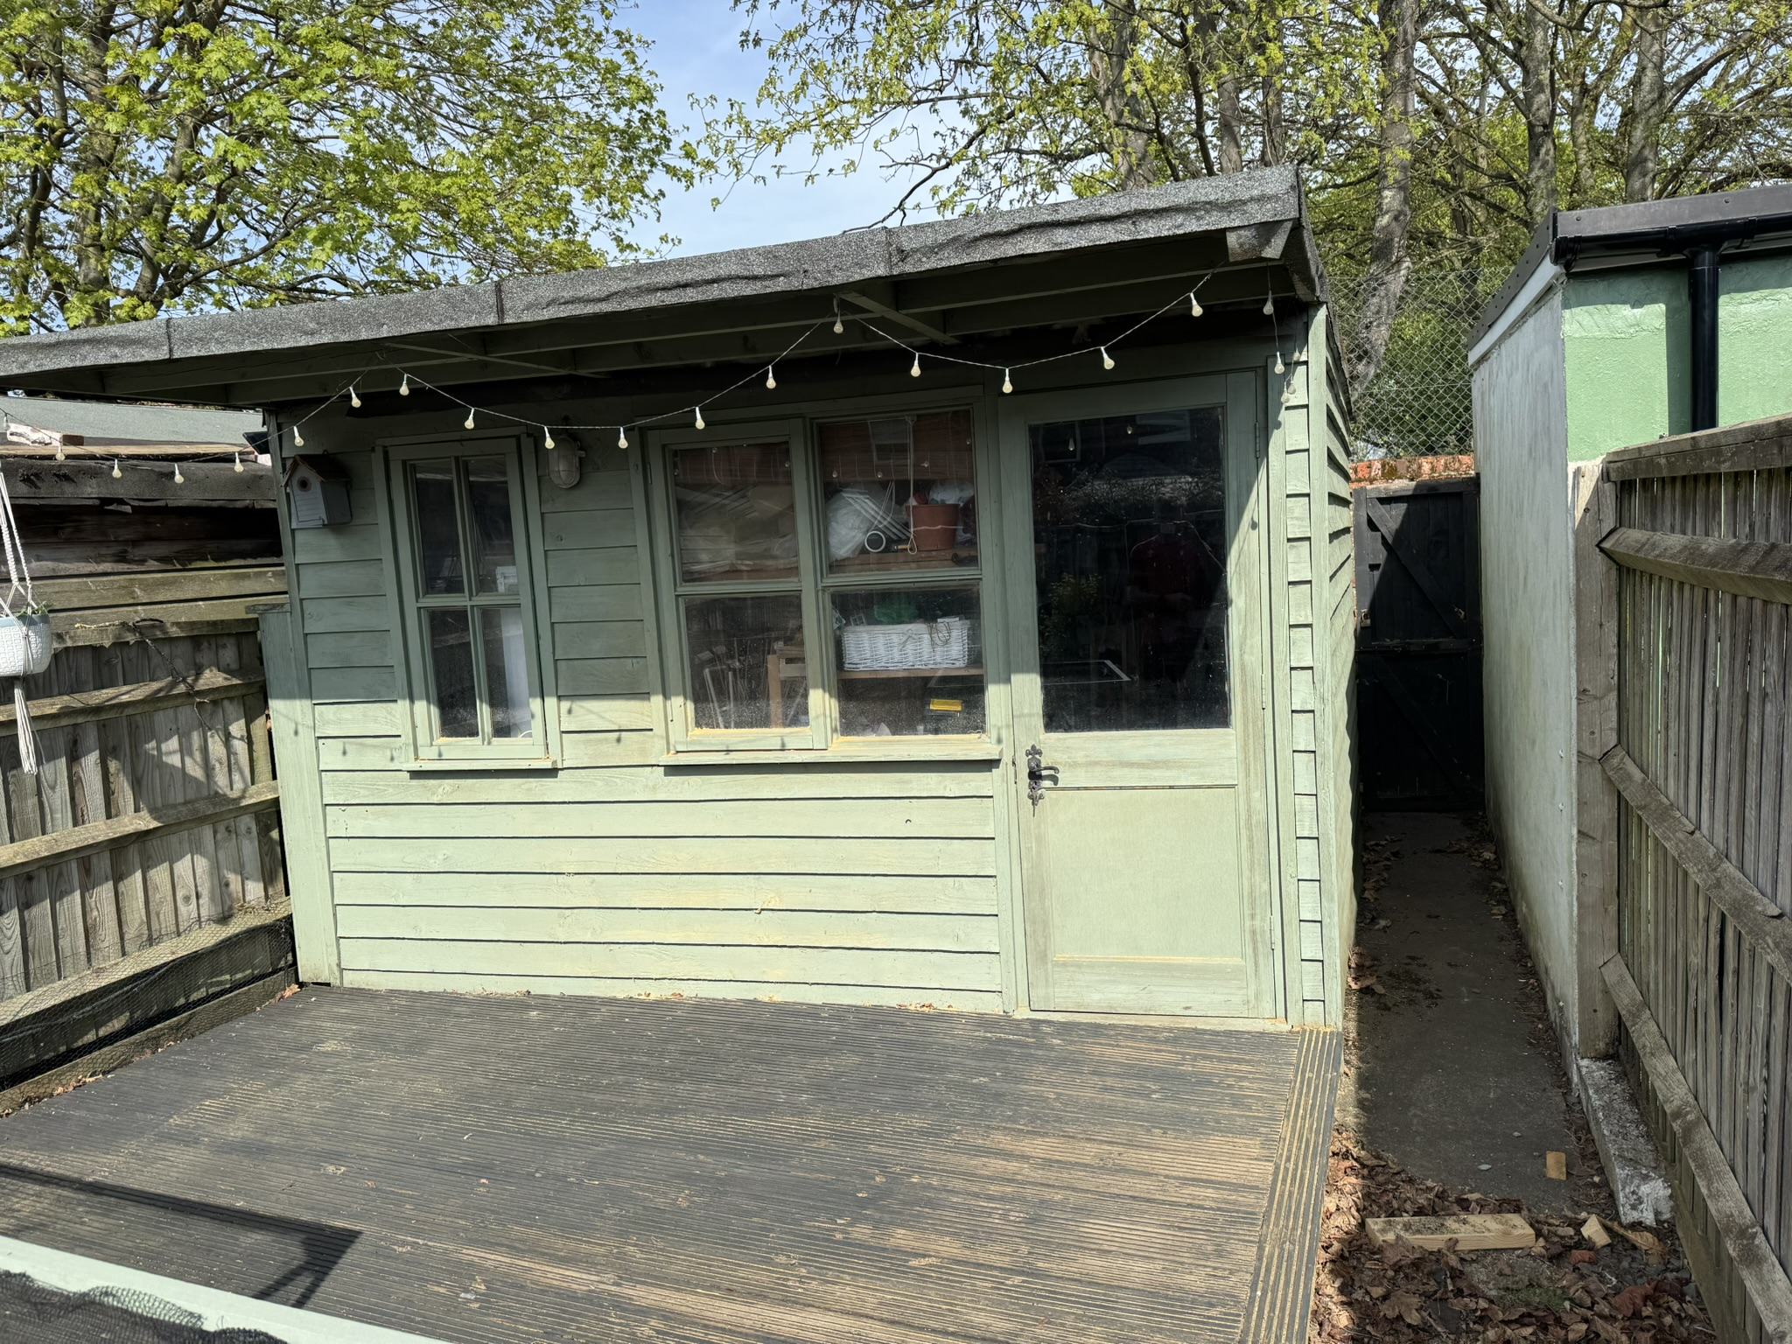
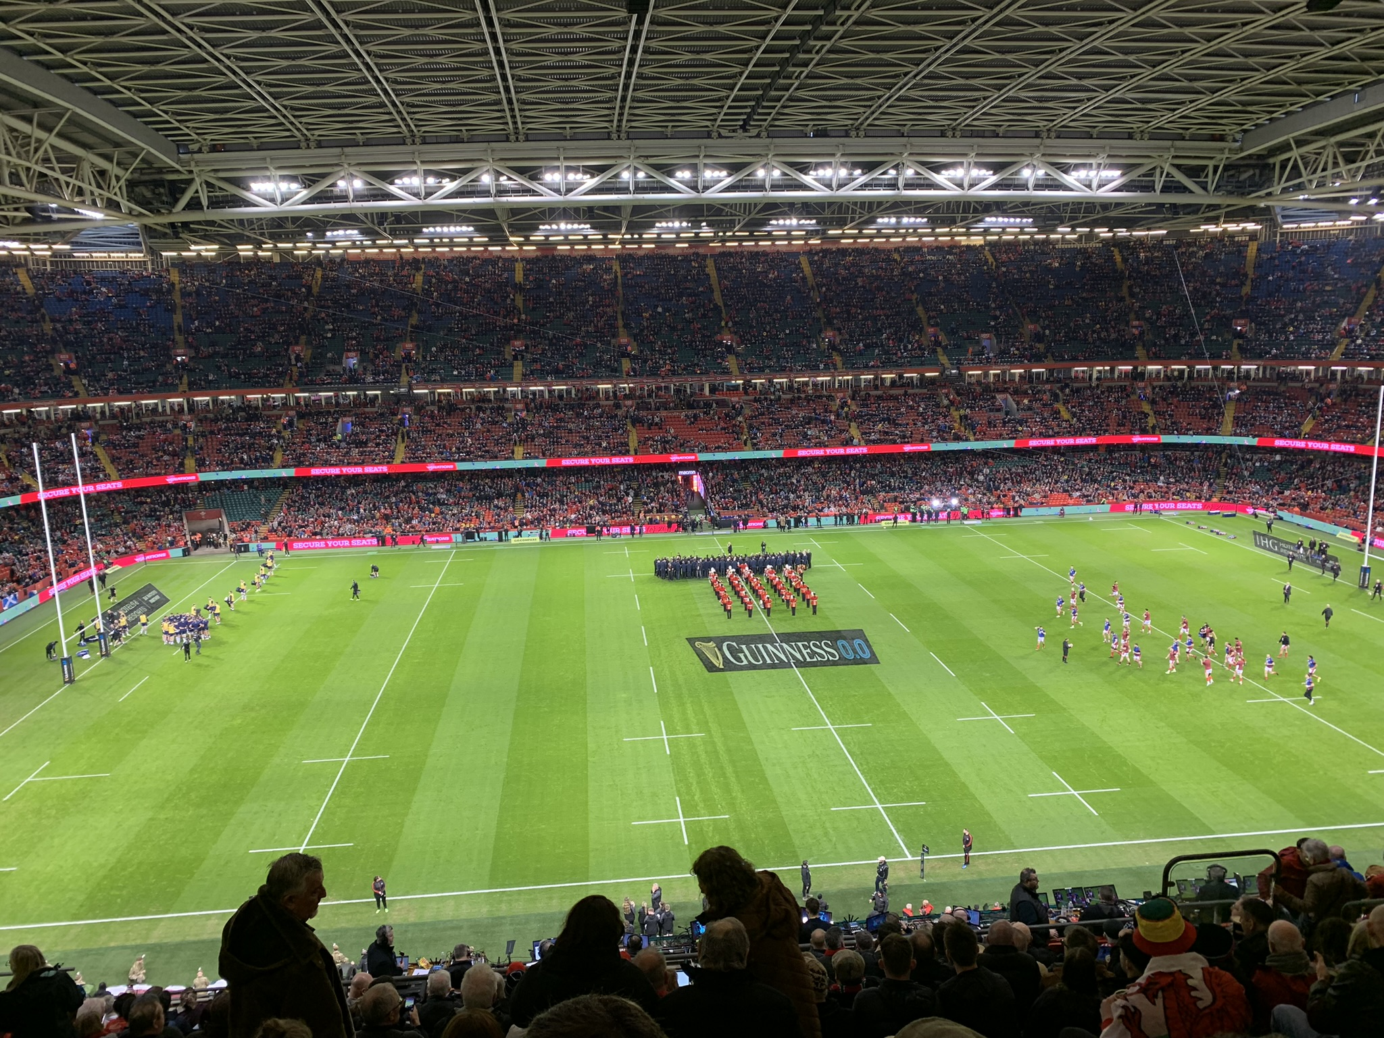
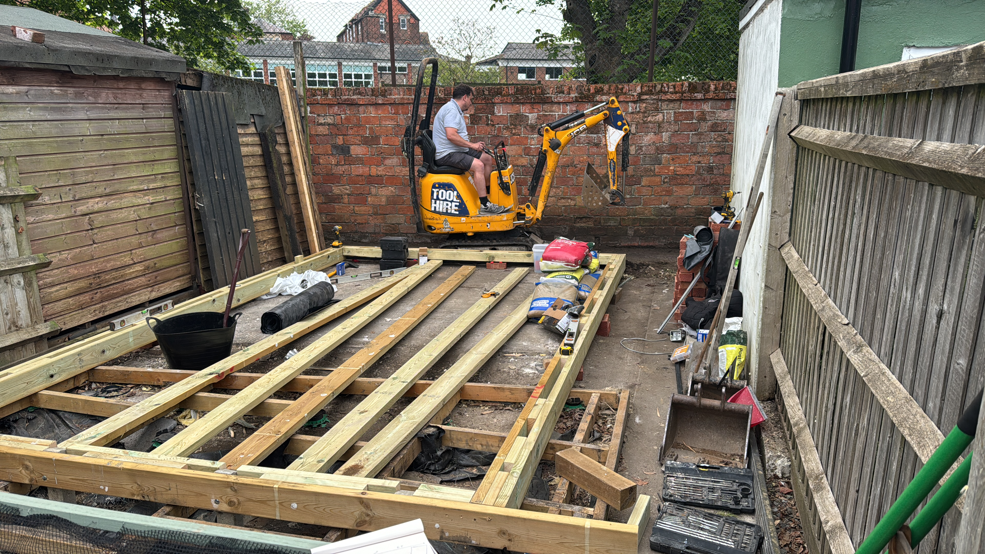
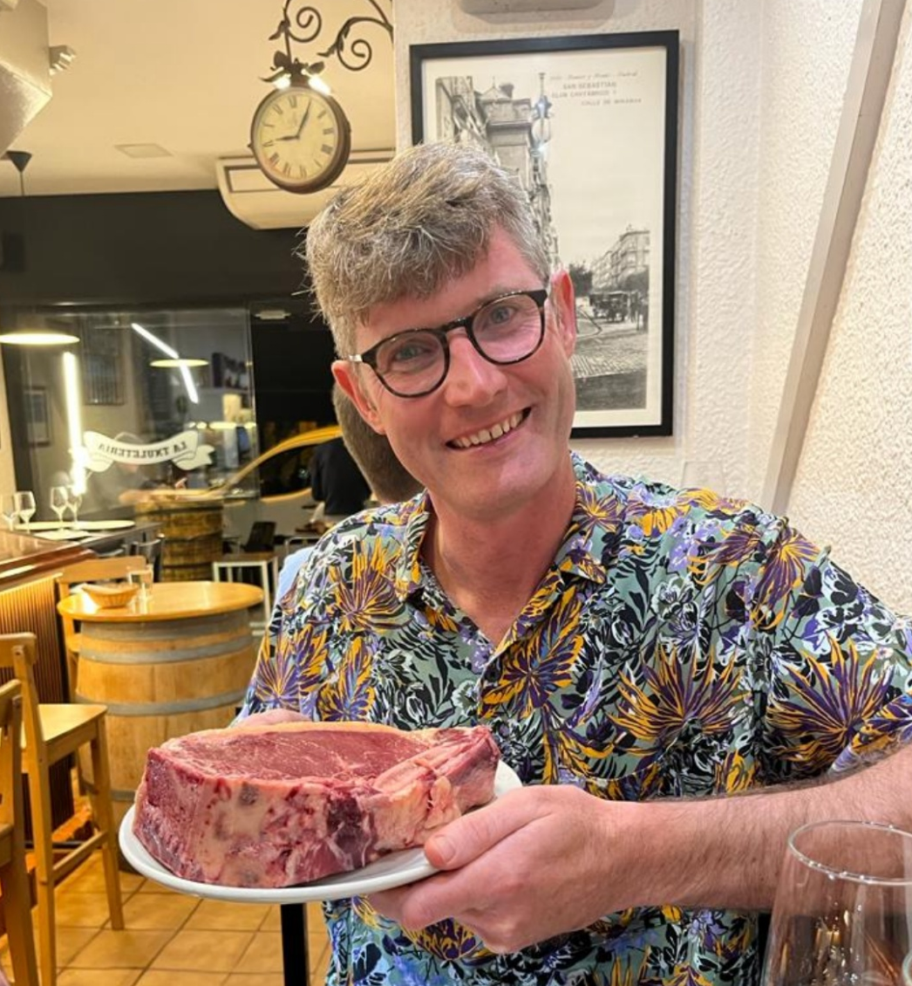
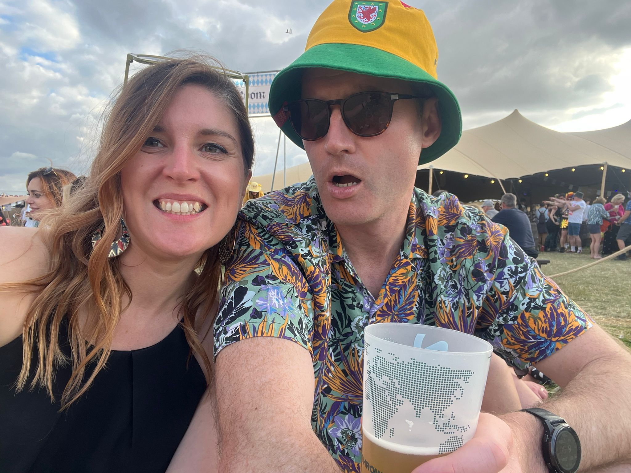
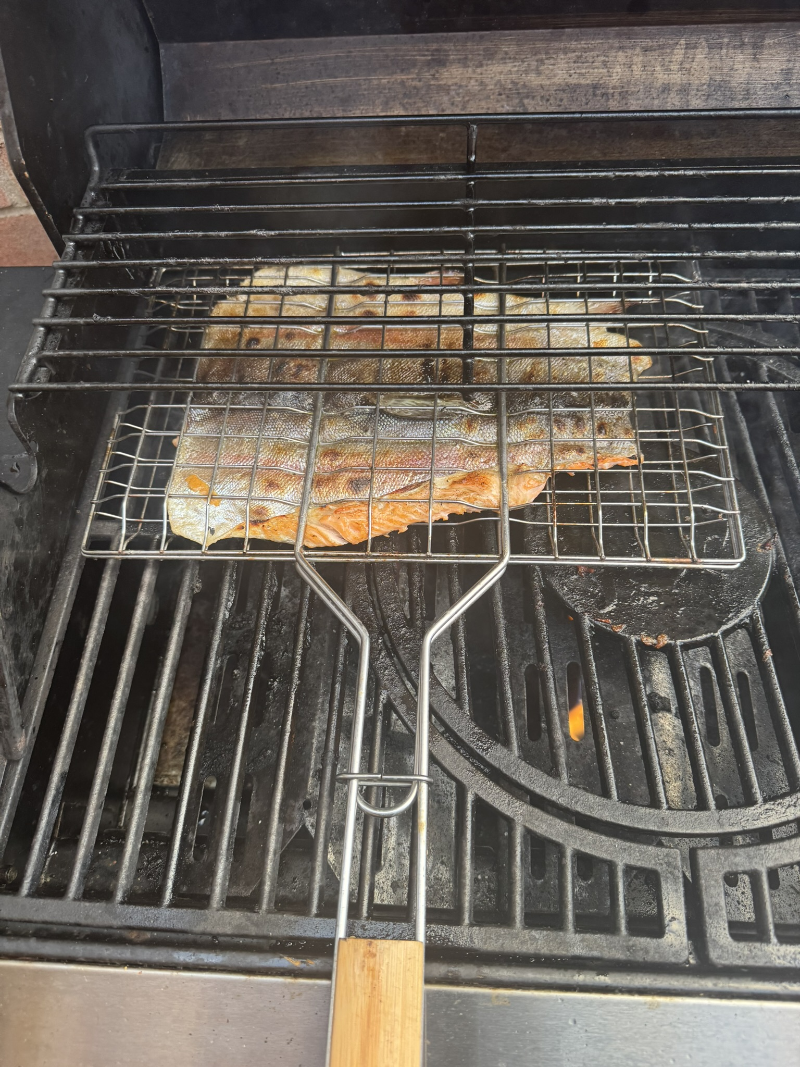
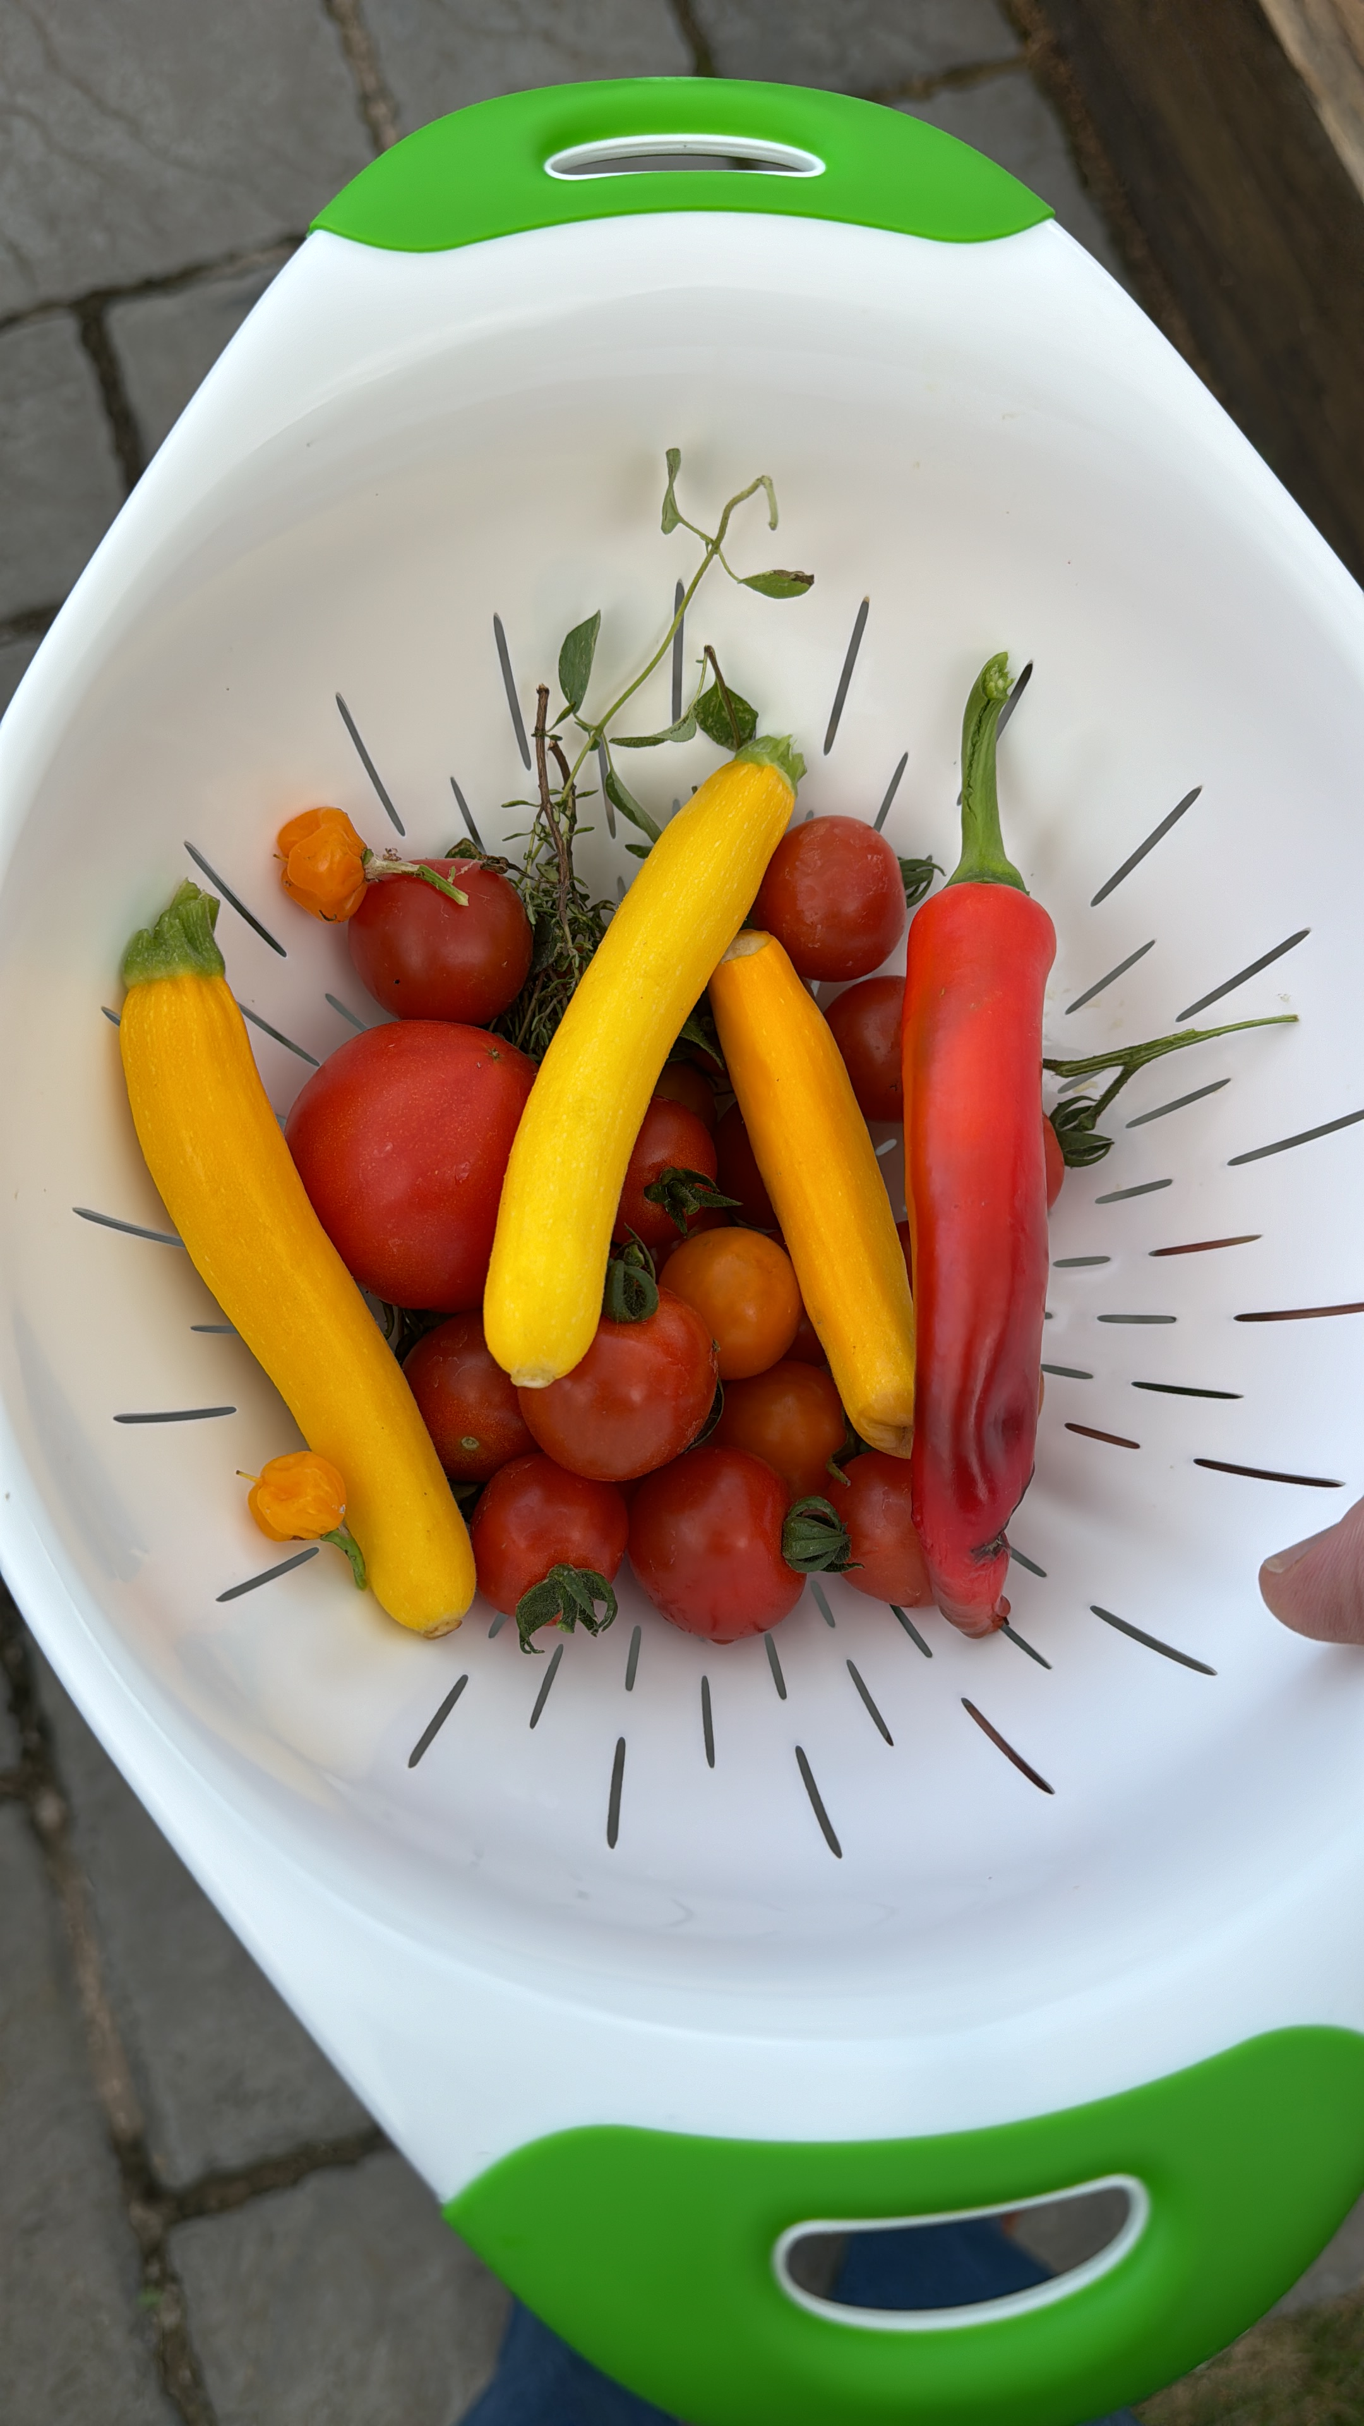
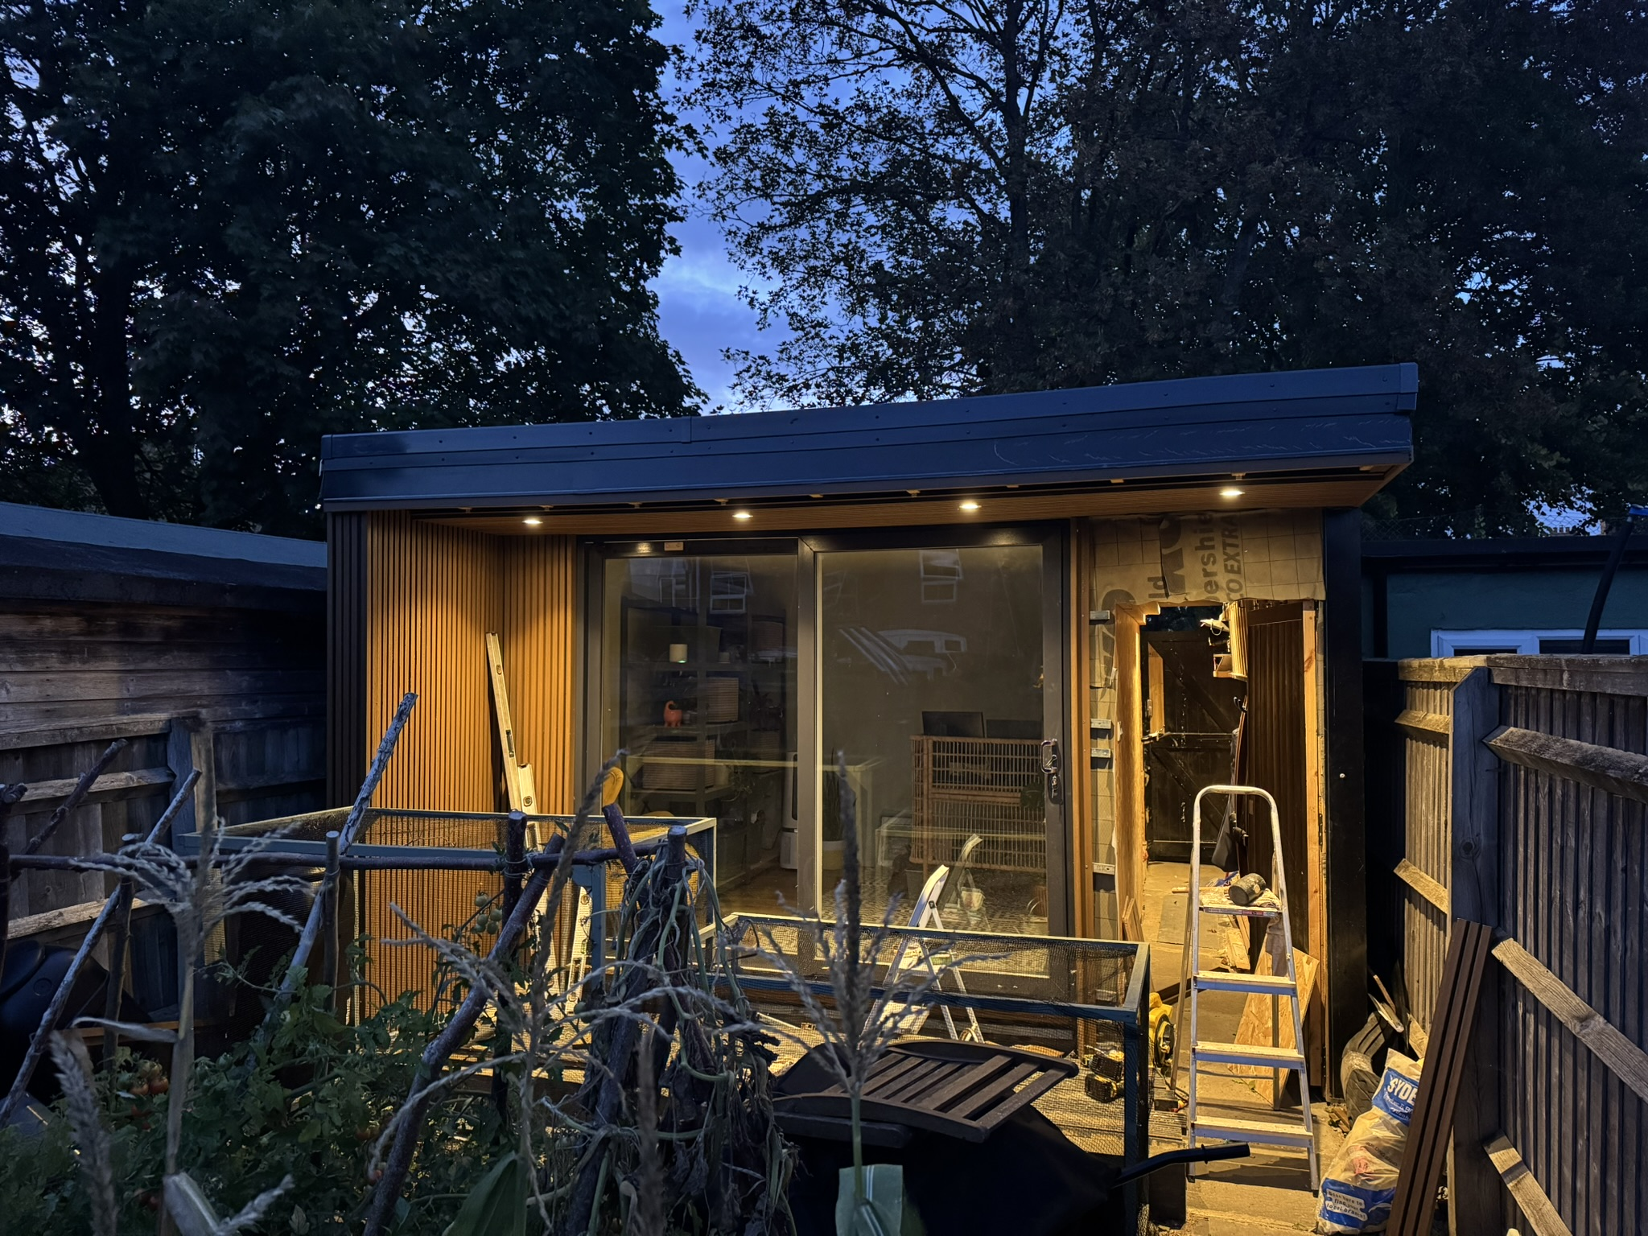
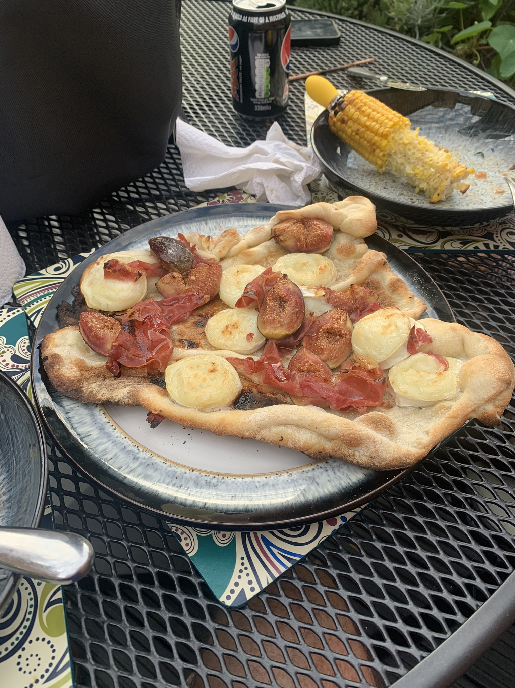
About me

Slide 7
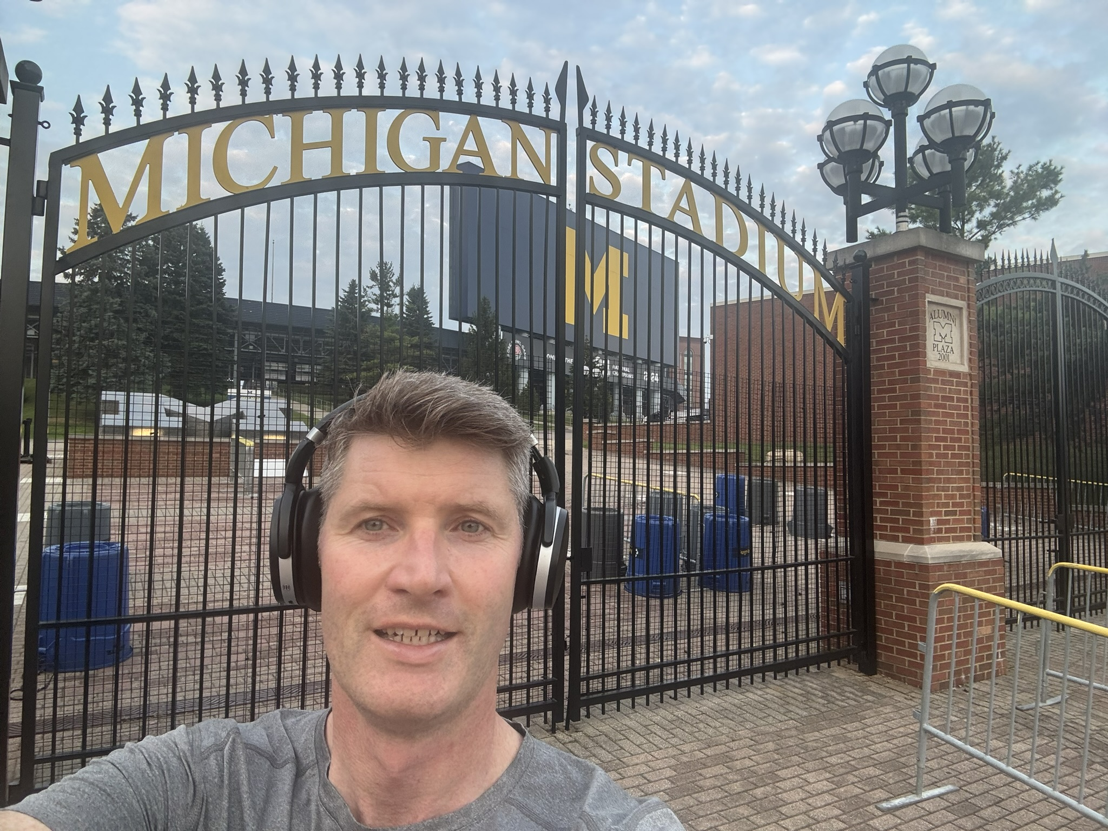
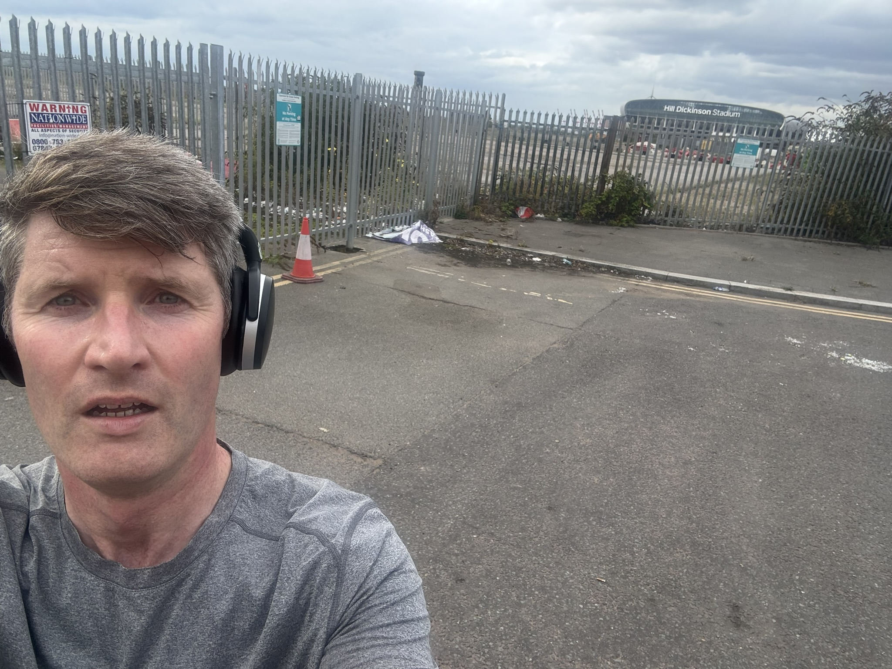
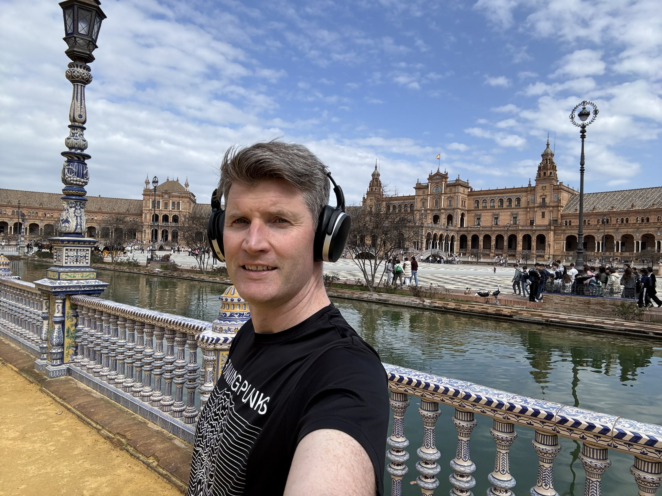
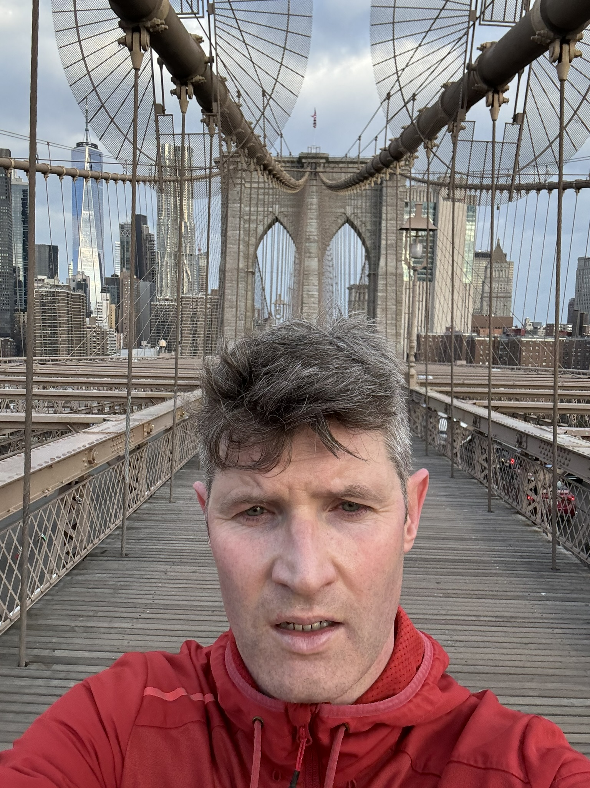
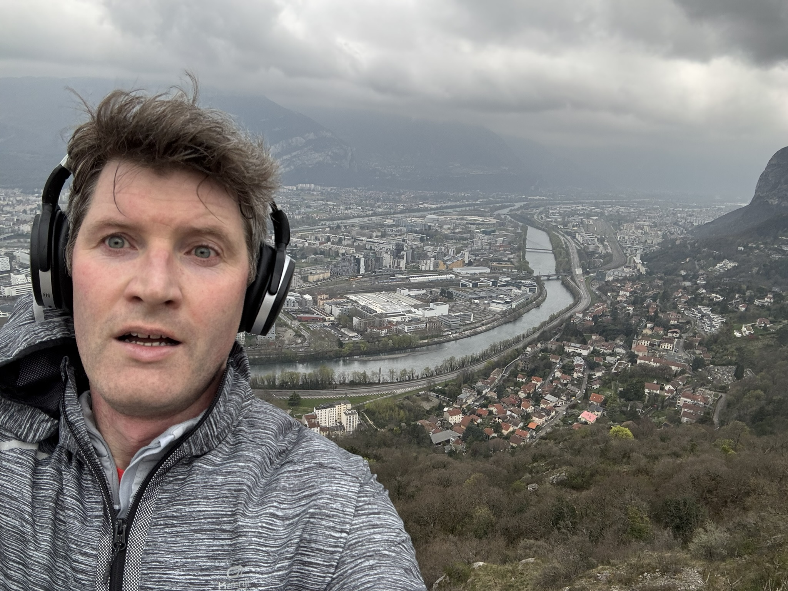
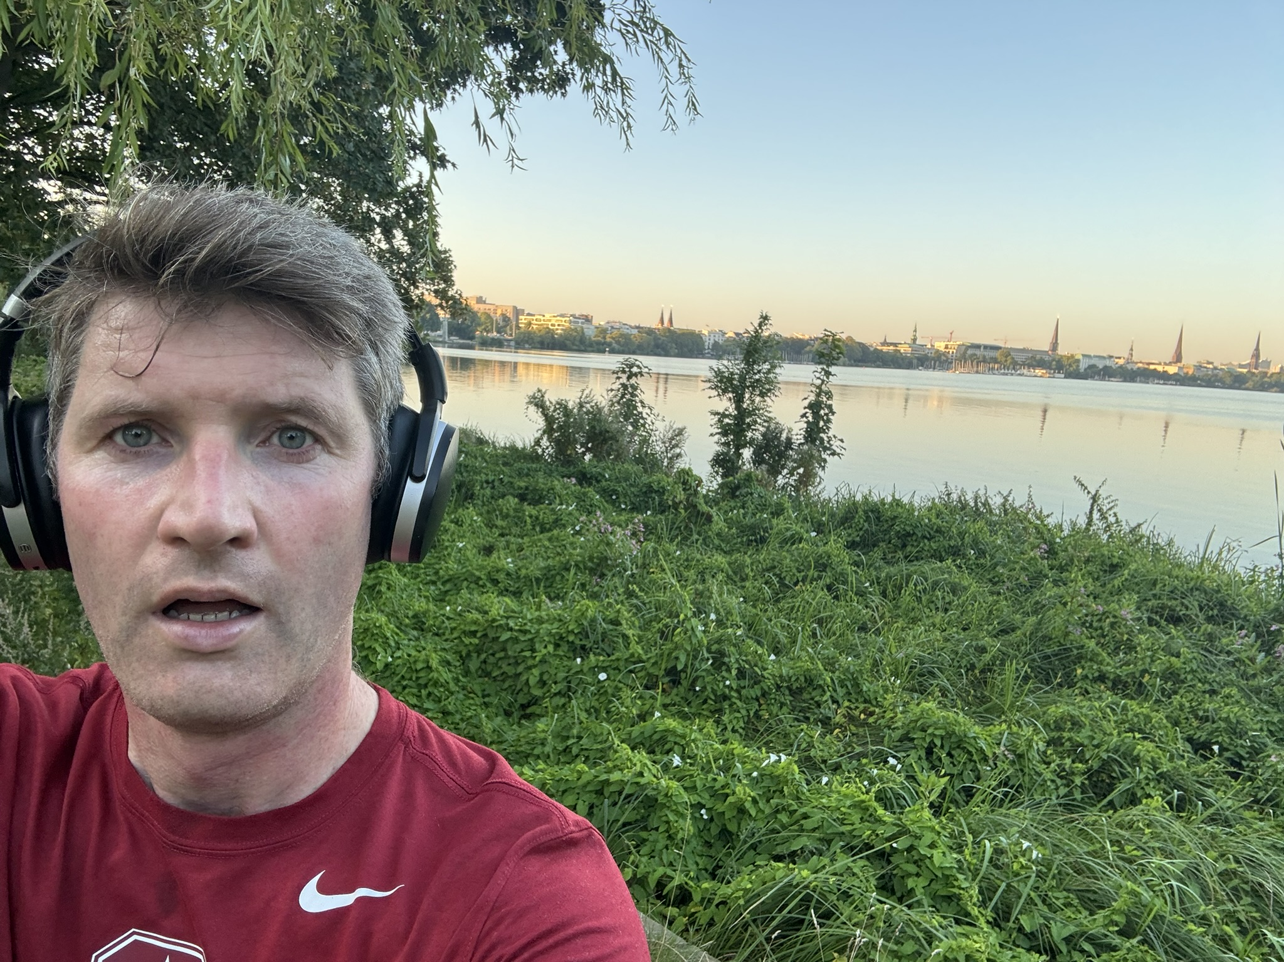
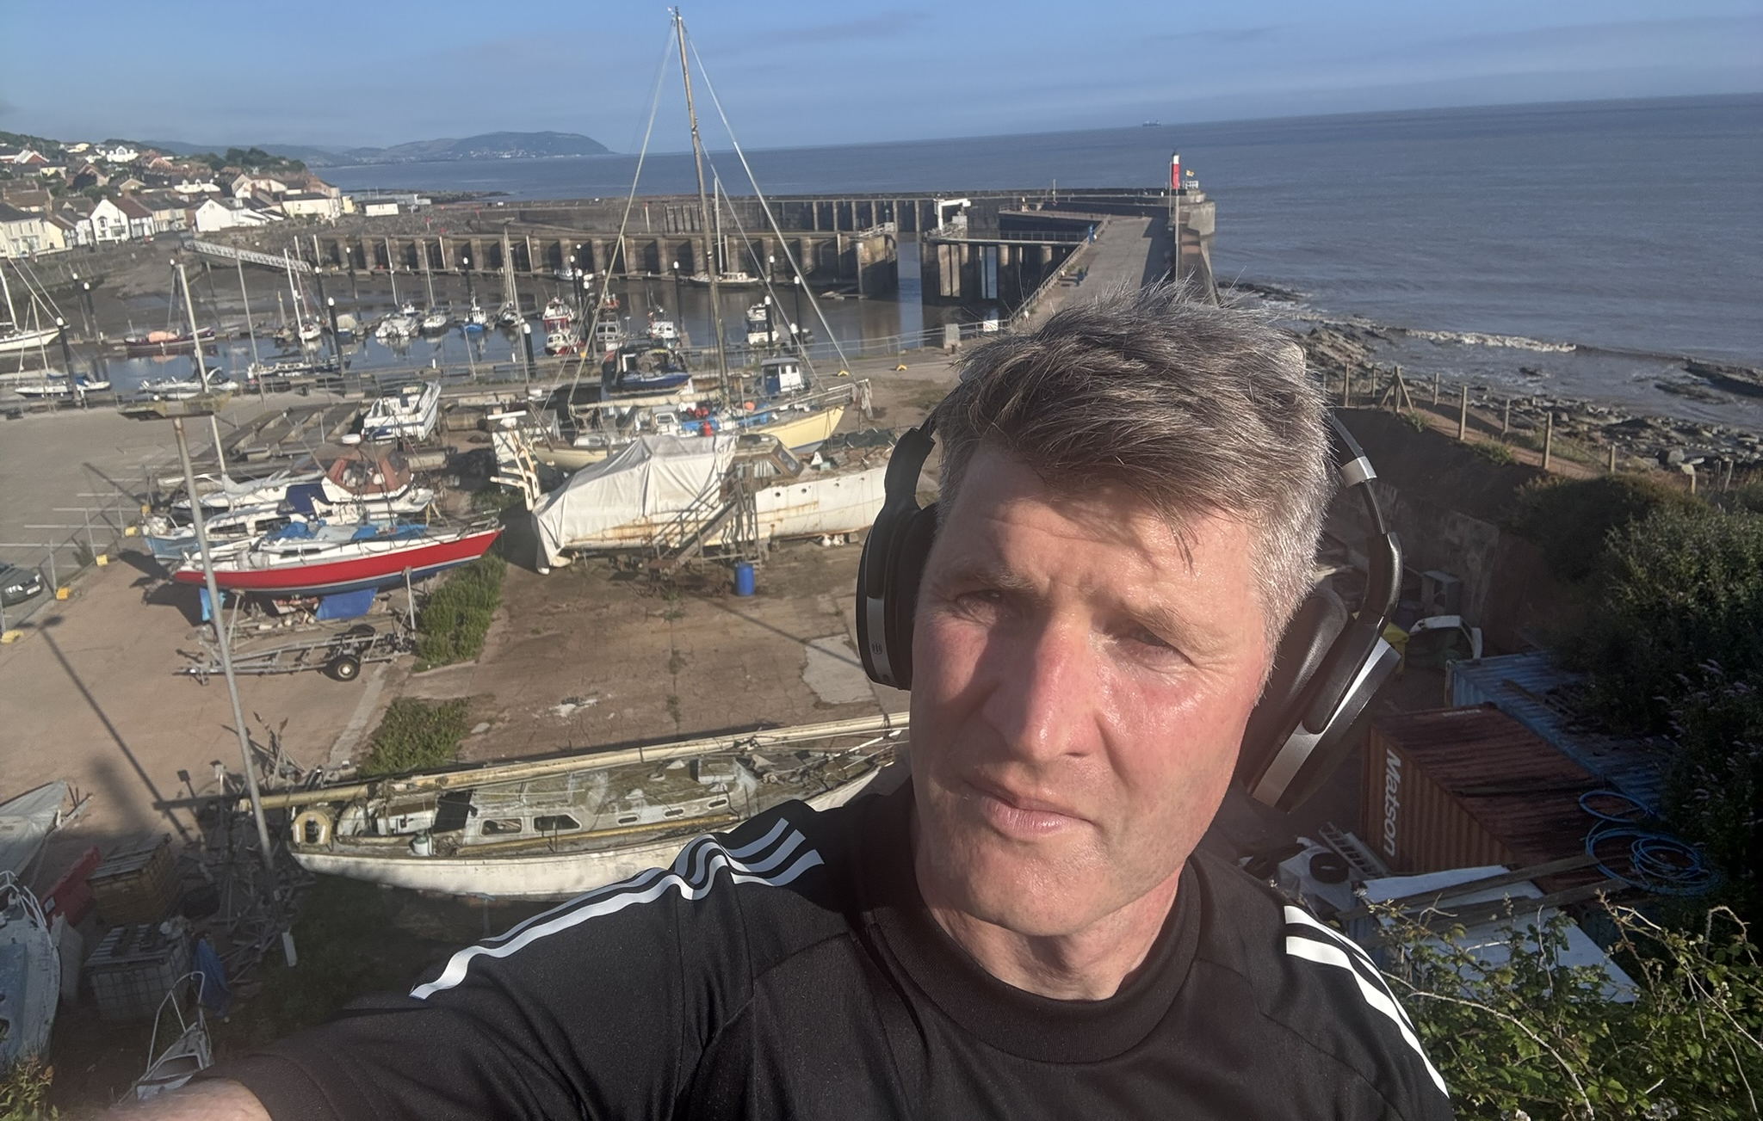
Jog (not run) …make the most of travel

Slide 8
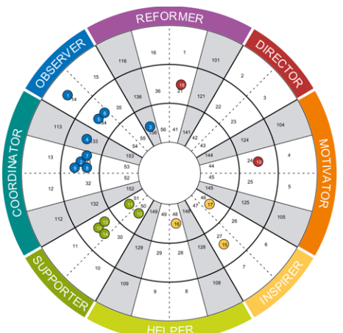
More about me
Me

Slide 9





More about me…
“He prefers to be direct, results orientated and thorough,
whilst not always taking the time to give real consideration to others.”
“…enthuse with others to be involved in his projects…
…He can be exceedingly stubborn”

Slide 10
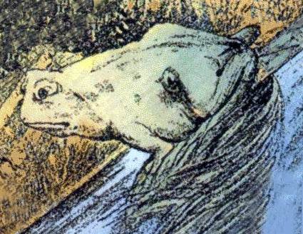

Slide 11
Last word
DED is pretty unique with everything we can do as one team
Challenges = Opportunities
Not just my personality type!...
Breadth of skills, customers, ability to demonstrate impact and income
Want to bring groups together more
Geography, awareness, personal links
Line up how we do DAQ and meet the needs of bring-up, demo, integration
Celebrate success internally
Open to ideas and suggestions
More and different divisional forum, repository of papers, talks…

