Slide 1



SKA-Low
Signal Processing System
Peter Furey-Duffin
Electronic System Design Group
25th September 2025

Slide 2
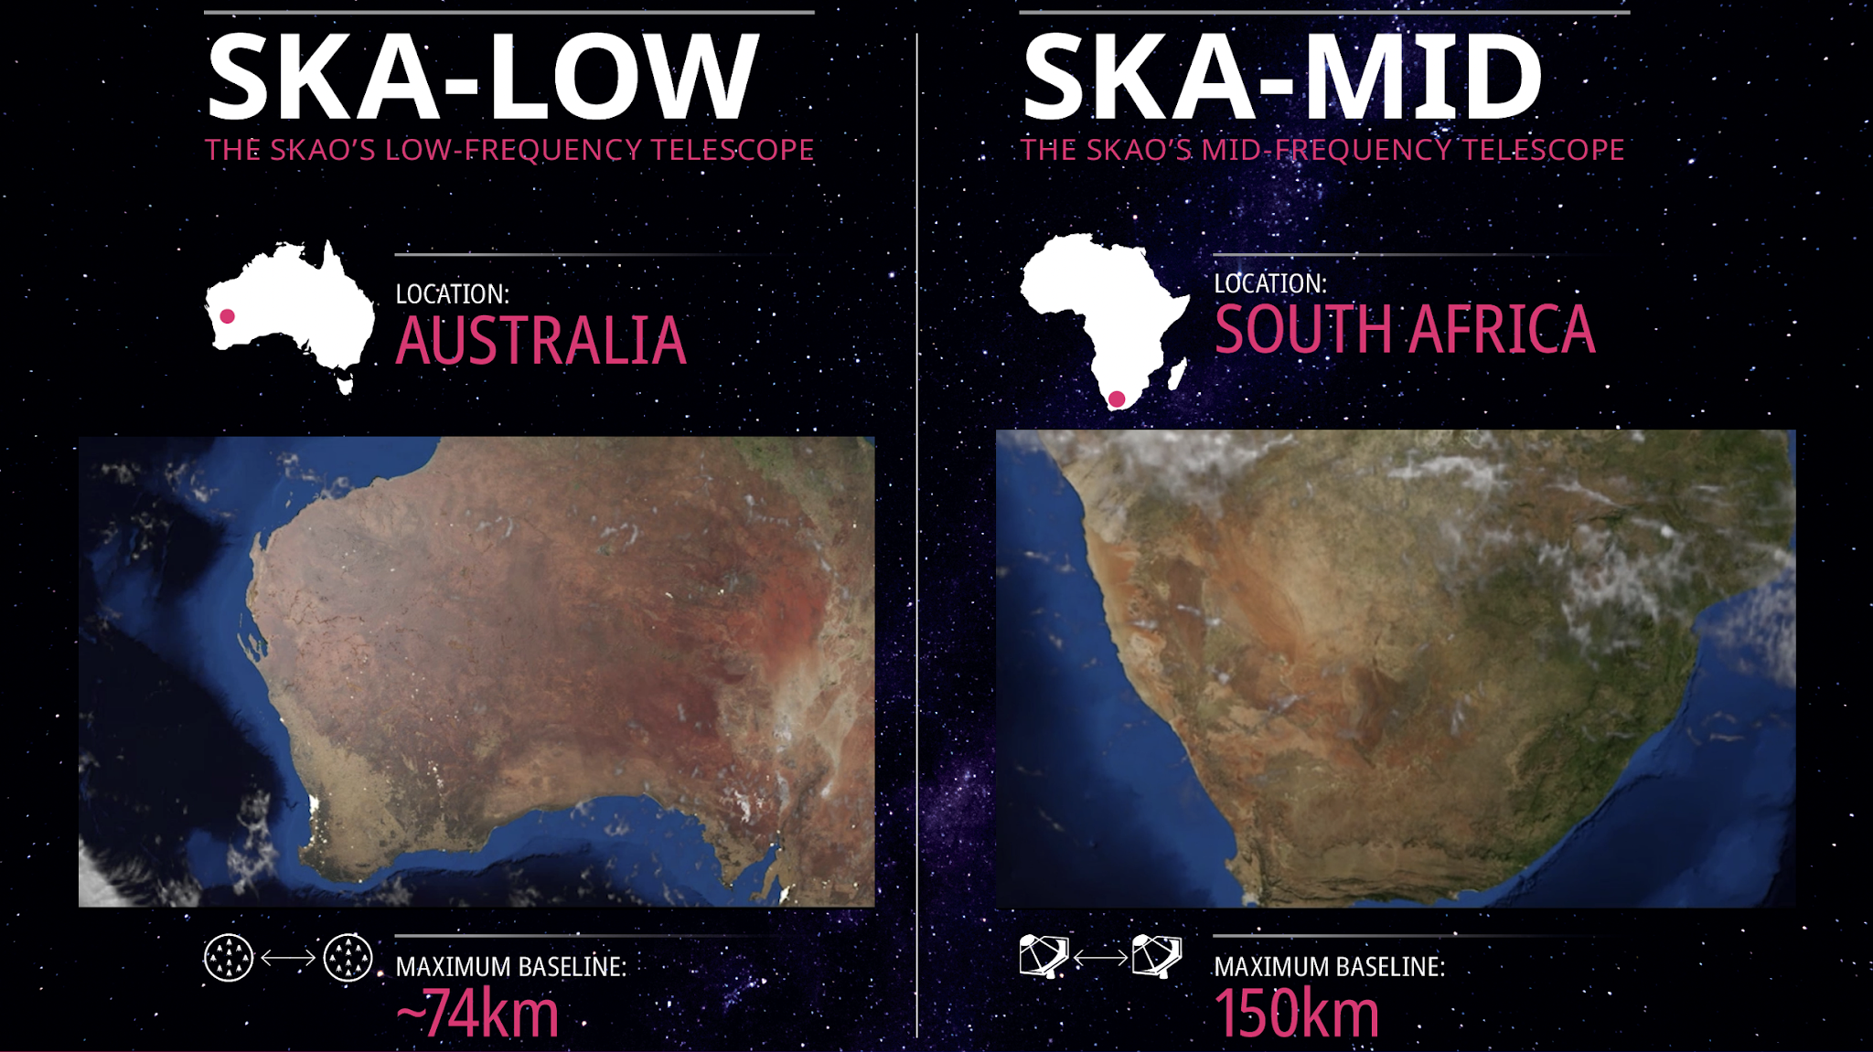
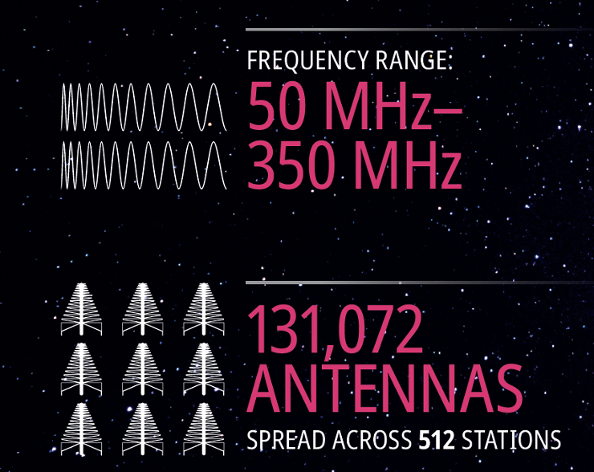
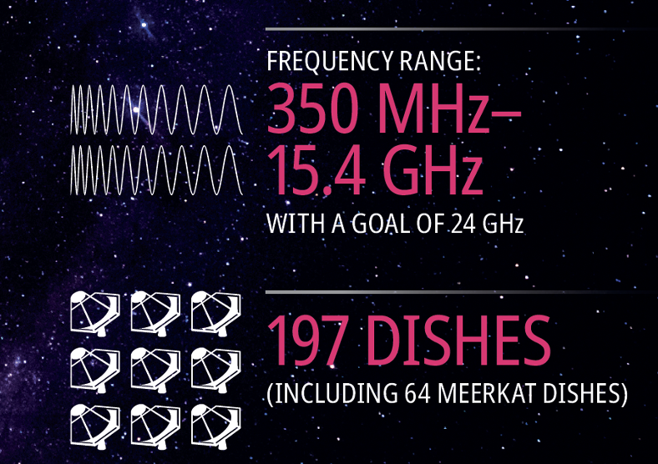
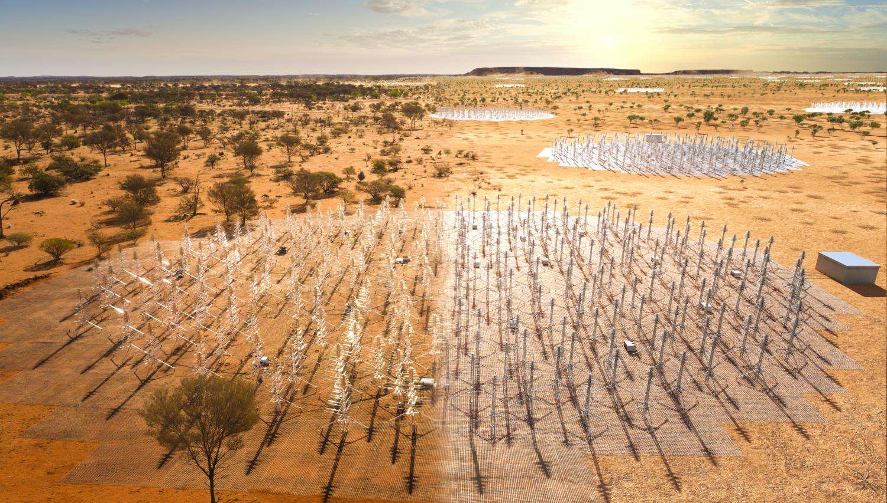
“We are building the two largest radio
telescope arrays in the world, located in
Australia and South Africa, supported by
institutions and facilities around the globe.”
“One global observatory
Two telescopes
Three sites.”
Courtesy of SKAO https://www.skao.int

Slide 3

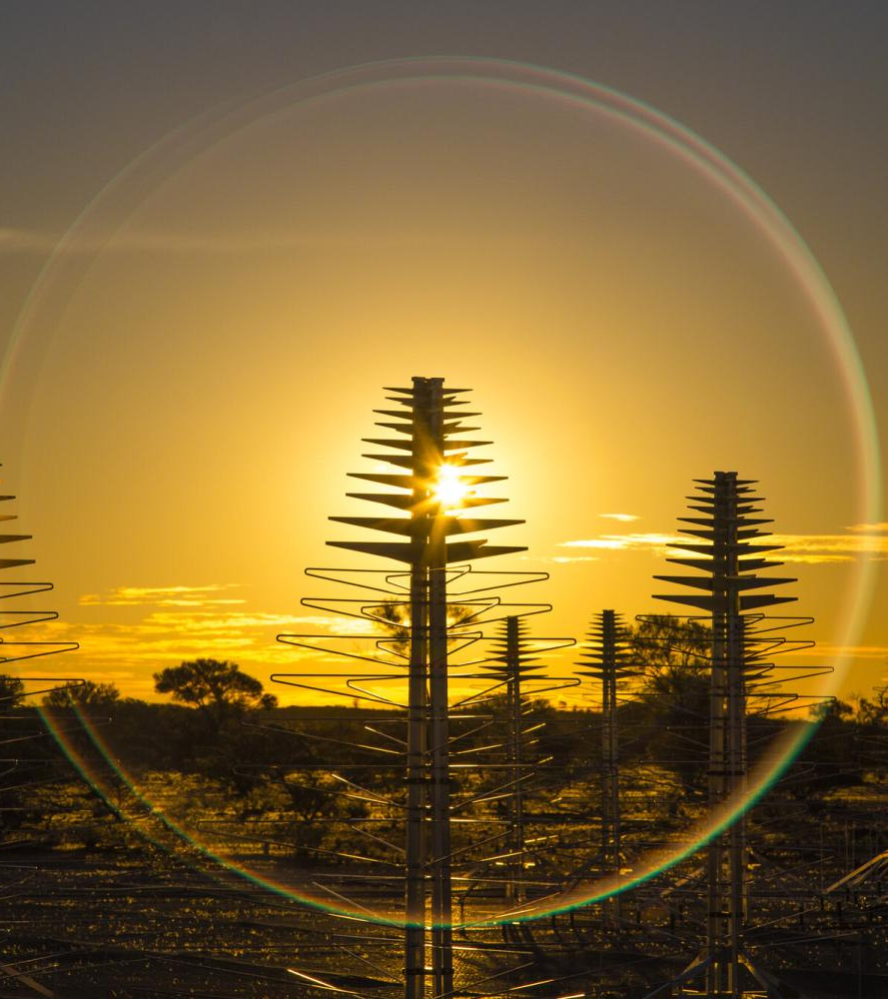
SKA-Low
131,072 Dual Polarization Antennas Grouped into Stations of 256 antennas.
16 Tile Processing Modules per Station
Each responsible for 16 antennas.
8192 Tile Processing Modules
Responsible for digitizing, channelizing and beamforming 262,144 RF signals.

Slide 4
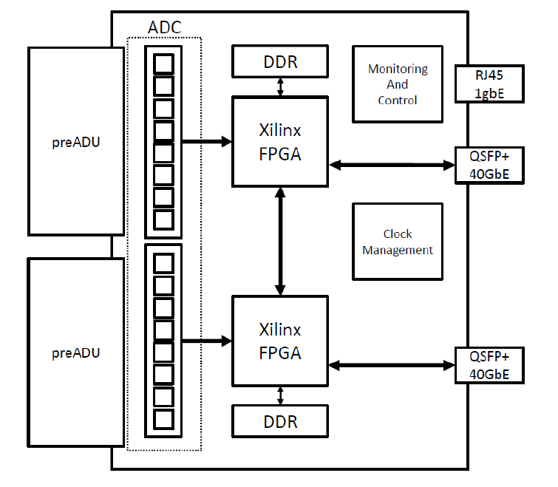
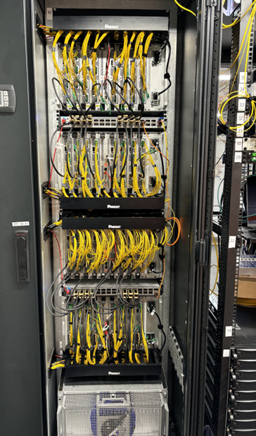
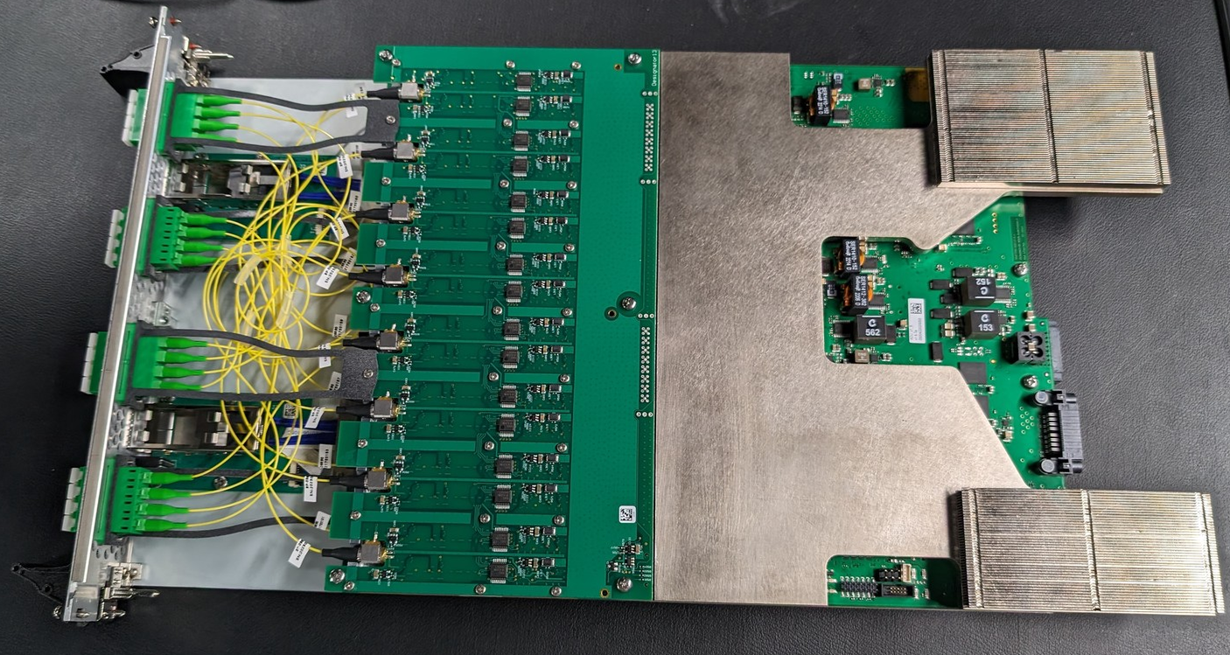
Hardware Architecture
Tile Processing Module 2.0.5
Complete mechanical and PCB rework
50% form factor
Power consumption 100 W
Larger, more power efficient FPGAs
More power efficient ADCs
Replacement of end-of-life components
DDR4 Memory Capacity 32GB
Tile Processing Module Hardware Overview

Slide 5


Team Janus
Team Composition
Person | Country of Residence
Peter Furey-Duffin | United Kingdom
Adam, Barcock | United Kingdom
Giovanni Comoretto | Italy
Zhen Ng | United Kingdom
John Holden | United Kingdom
Simone Chiarucci | Italy
Jubin Mitra | United Kingdom
Berk Bilgin | United Kingdom
Hajira Bazaz | United Kingdom
Sam Bolton | United Kingdom
Sean Calingasan | Australia
“Janus is the god of beginnings, gates, transitions, time, duality, doorways, passages, frames, and endings. Usually depicted as having two faces.”

Slide 6
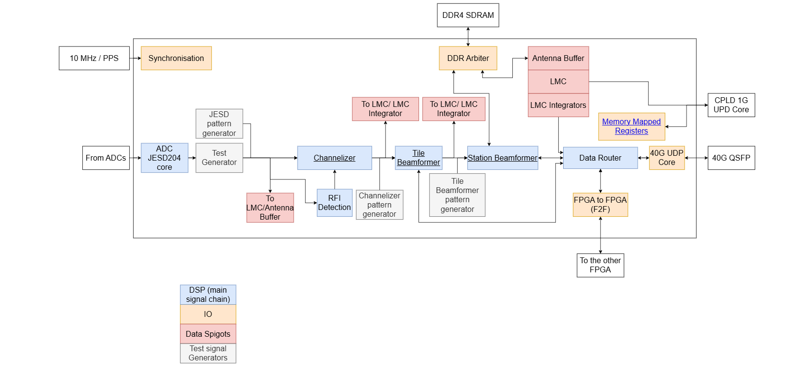
Team Janus Responsibilities
TPM FPGA Firmware

Slide 7
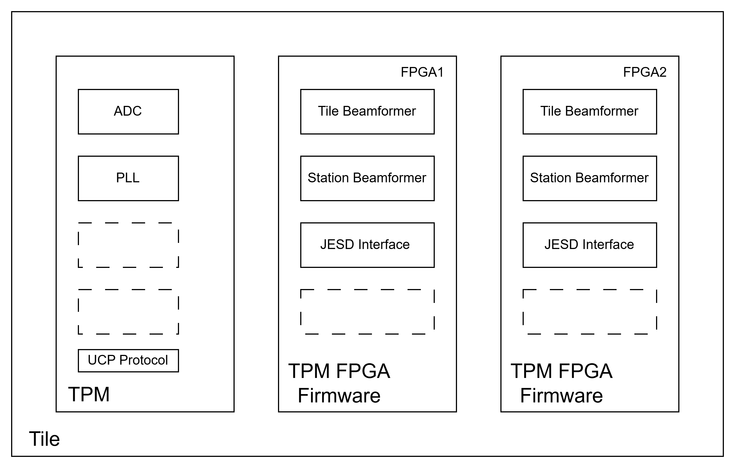
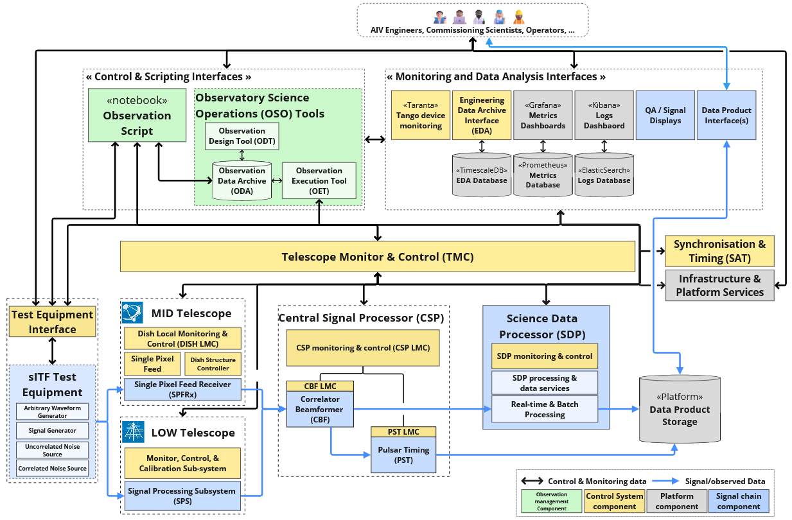
Team Janus Responsibilities
TPM Python API

Slide 8
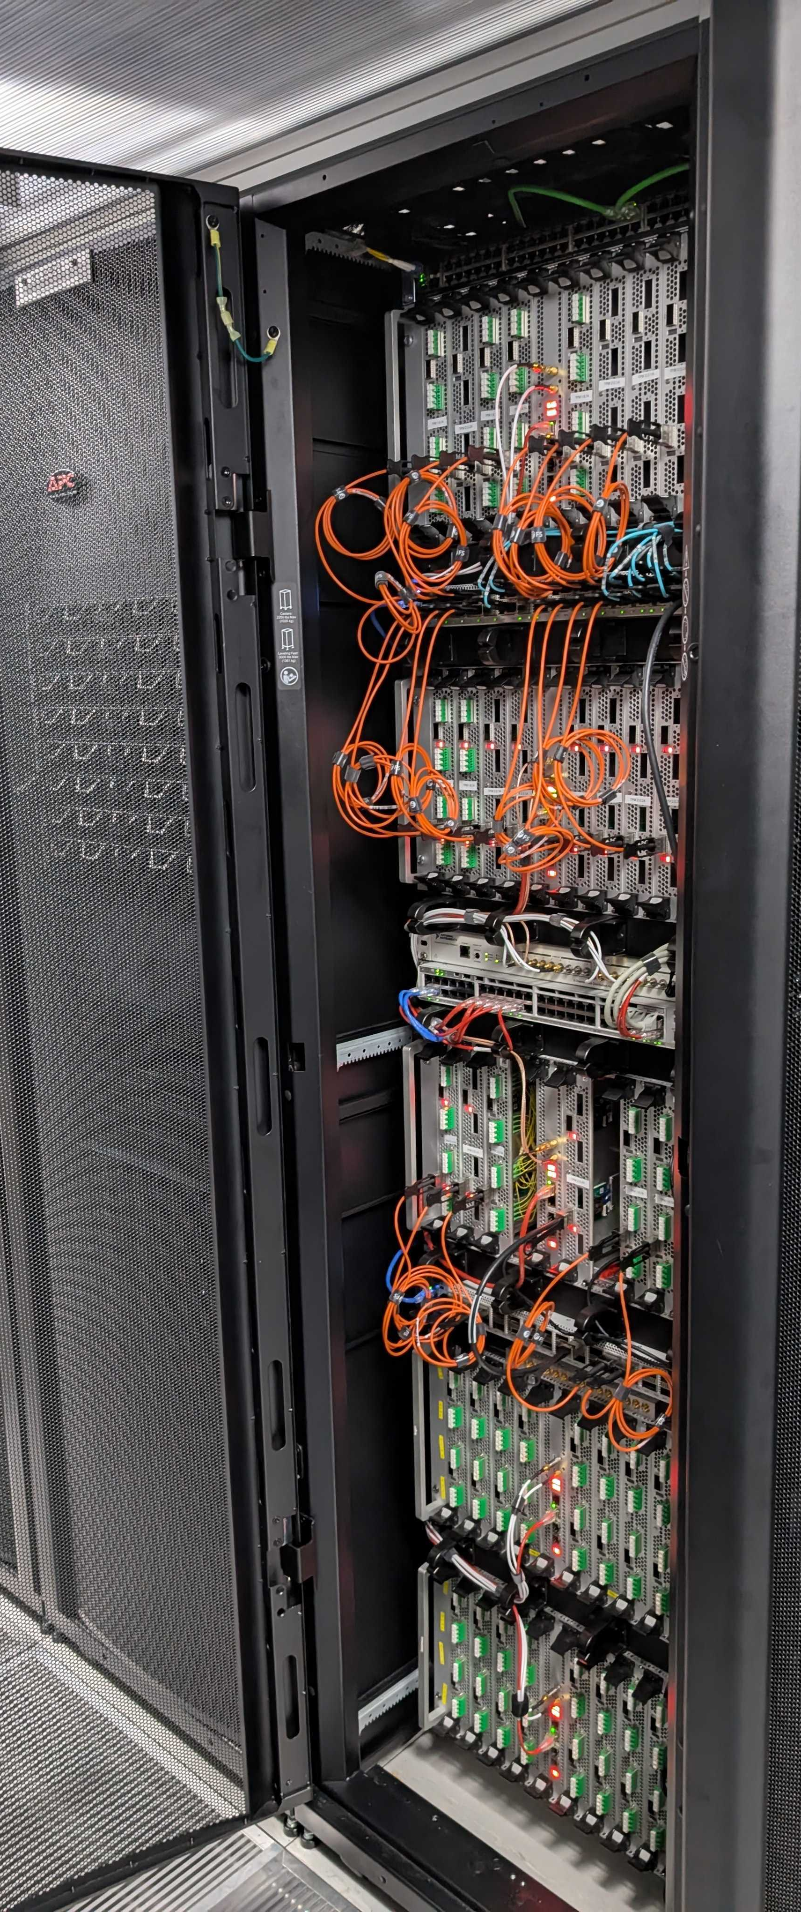
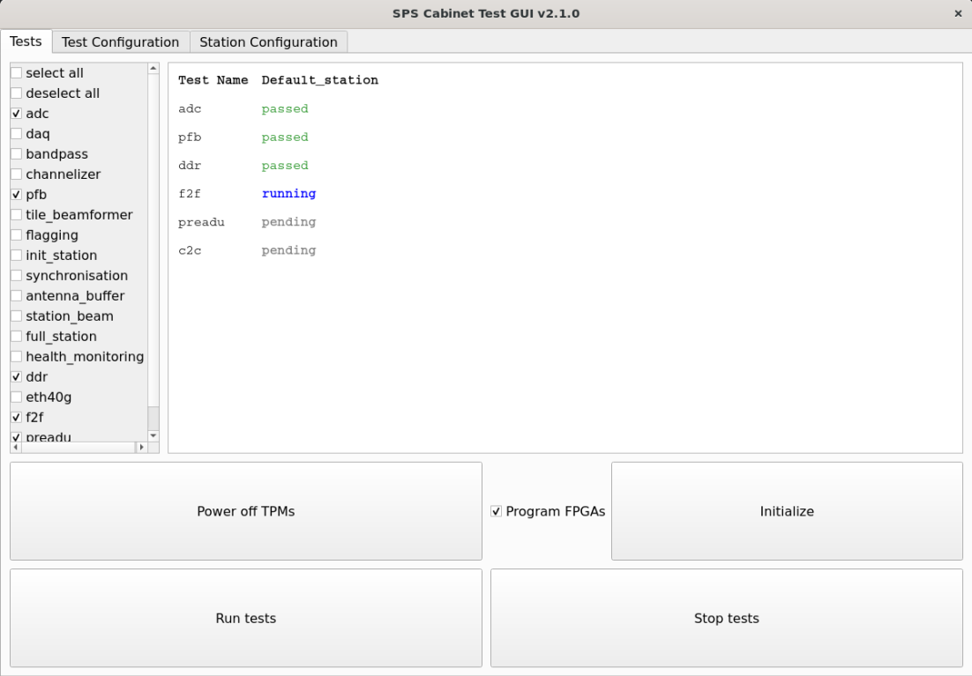
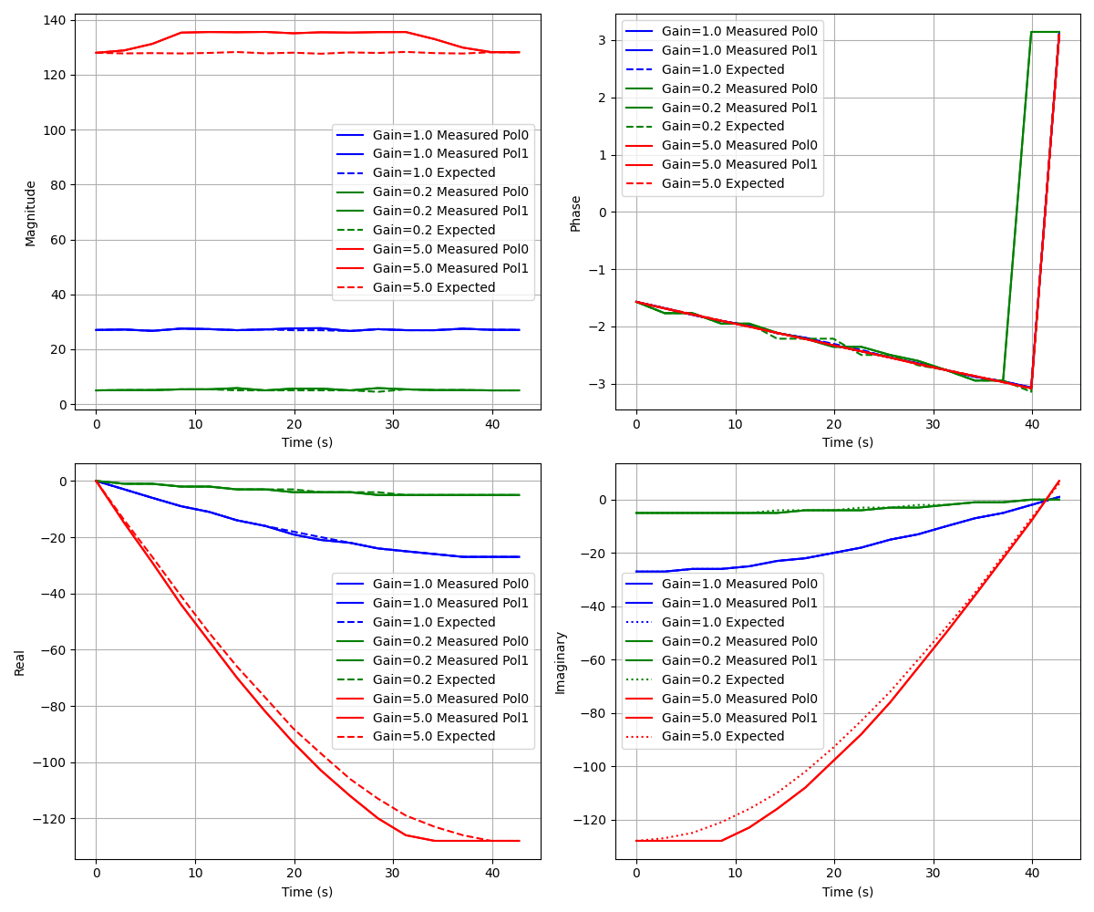
Team Janus Responsibilities
SPS Python Test Suite

Slide 9
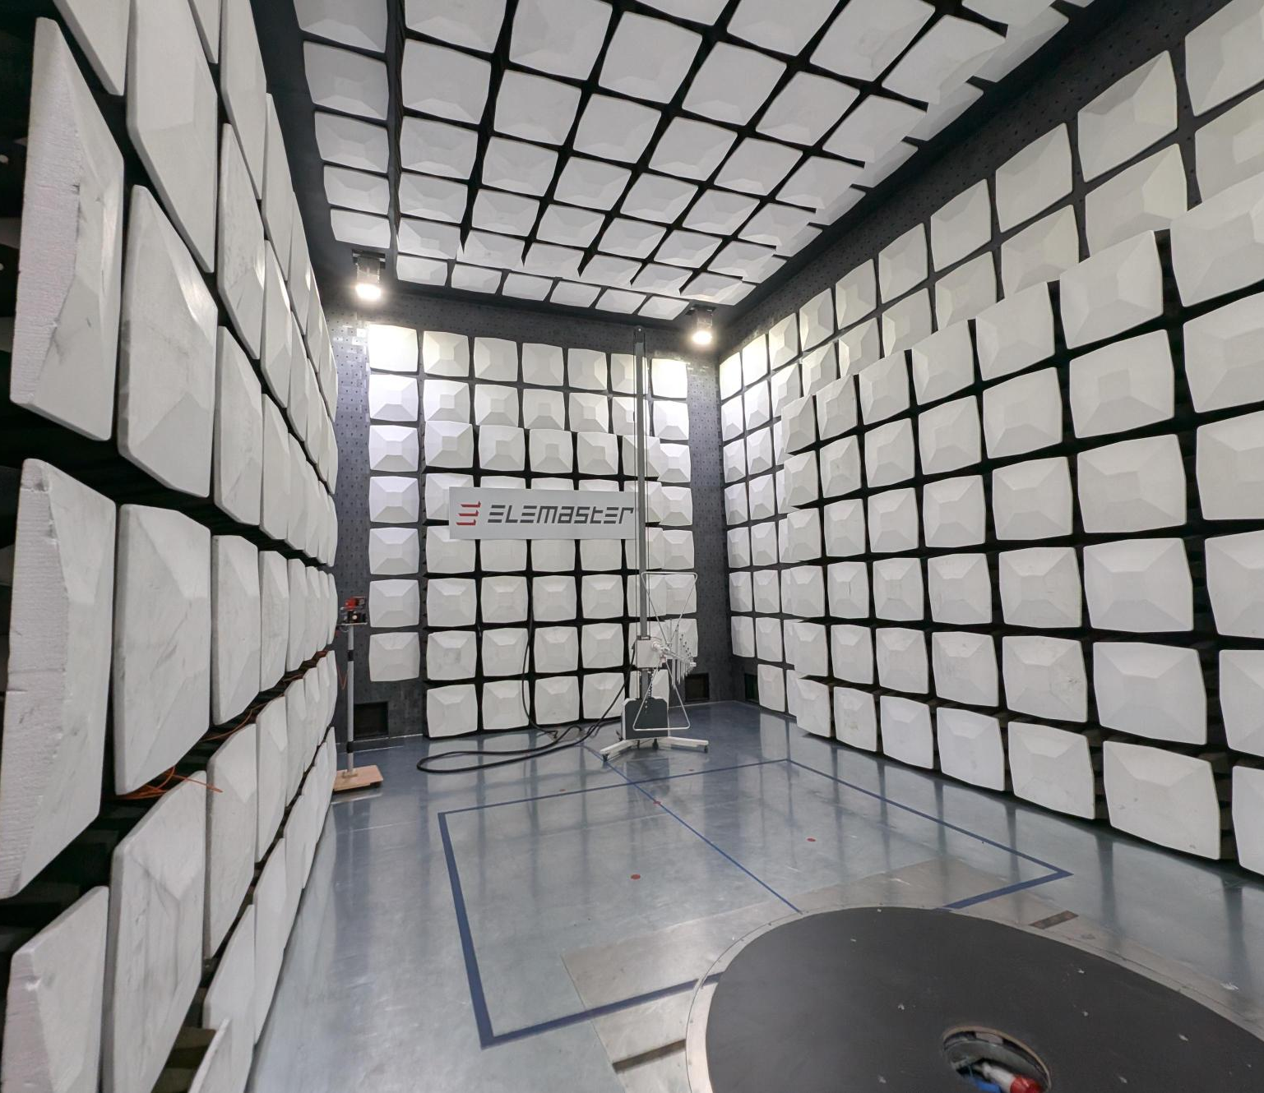
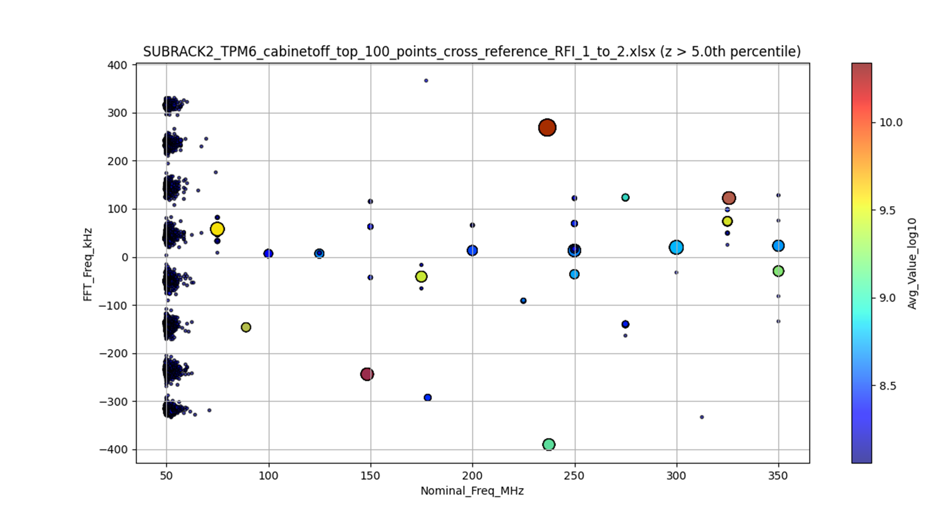
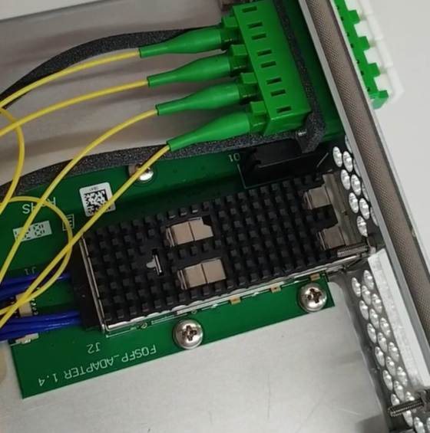
Team Janus Responsibilities
Collaboration: Italian Tier 1 Supplier

Slide 10
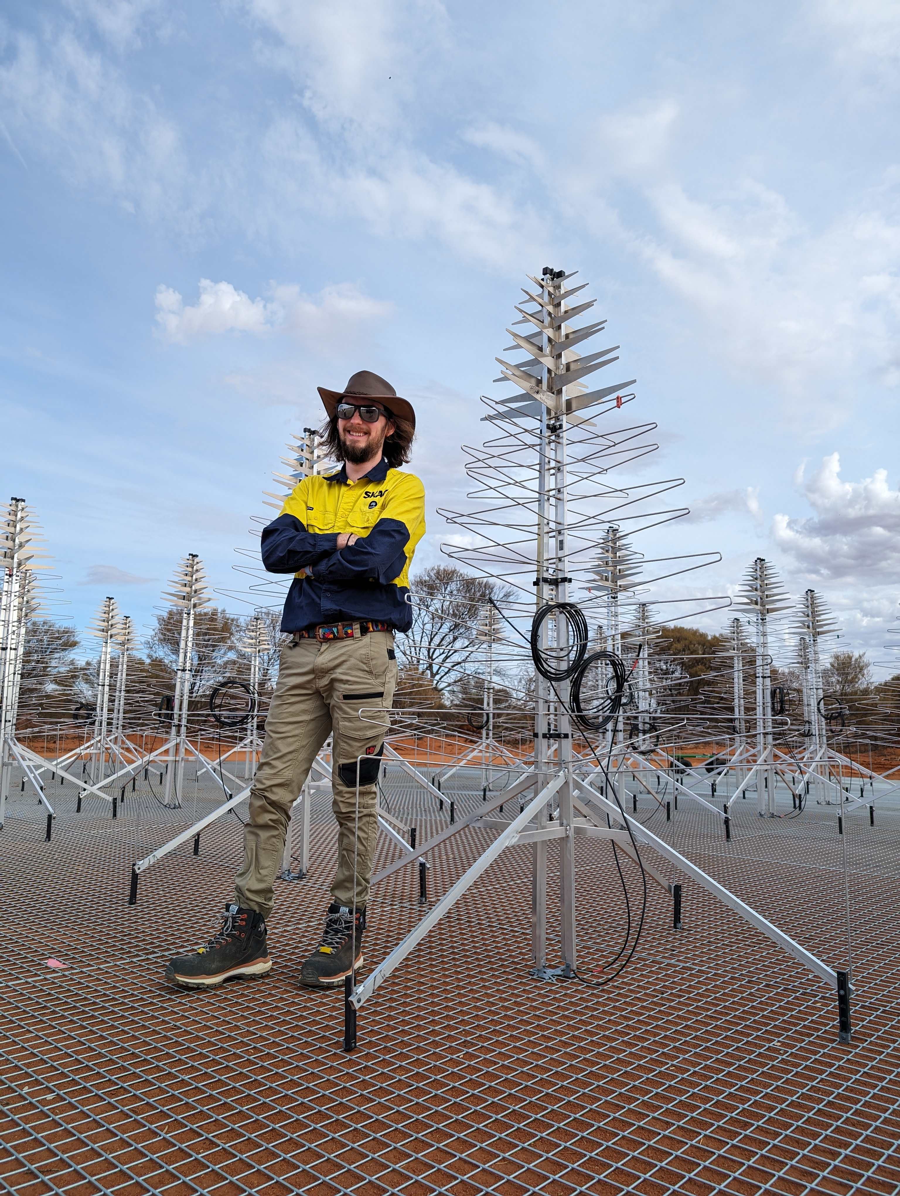
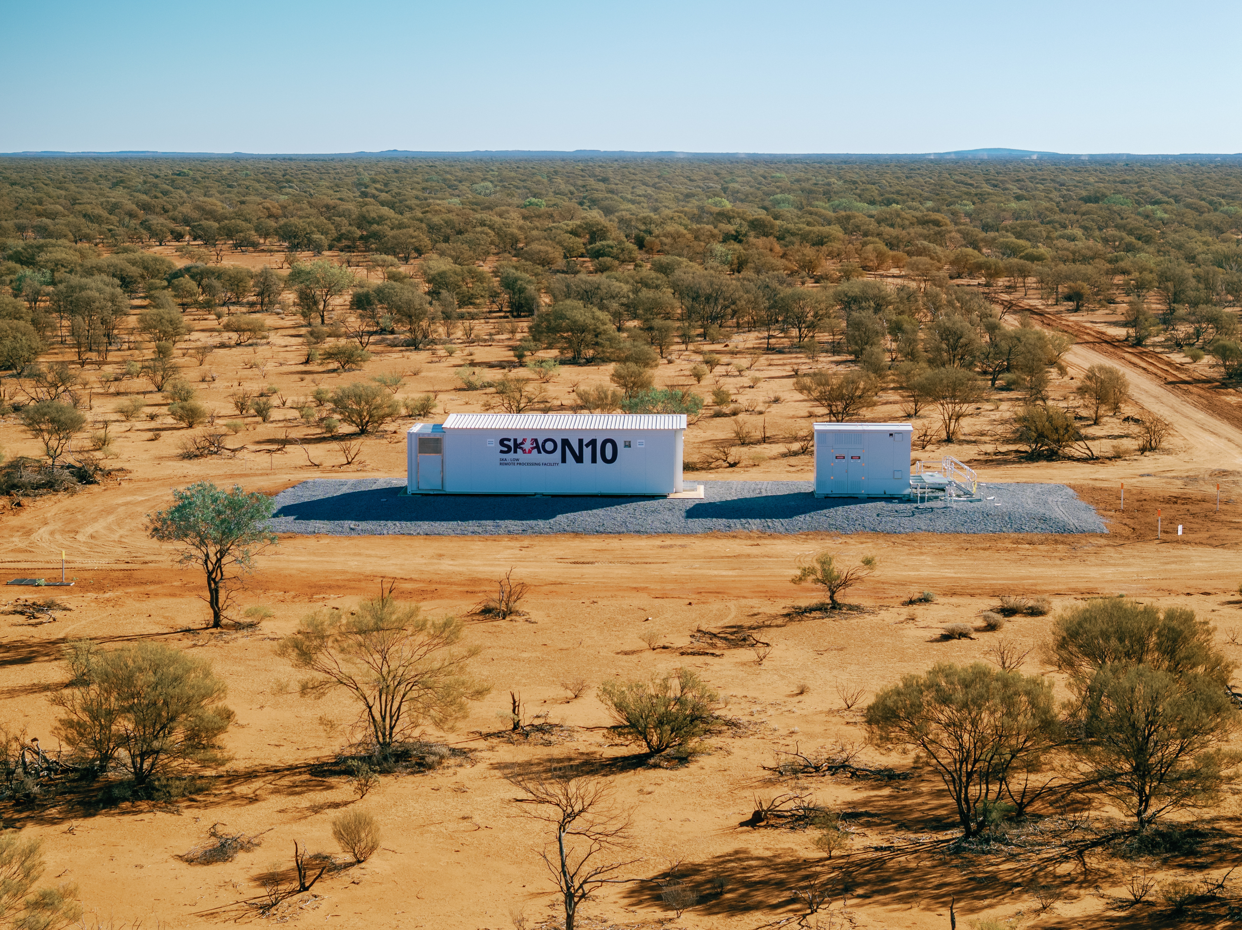
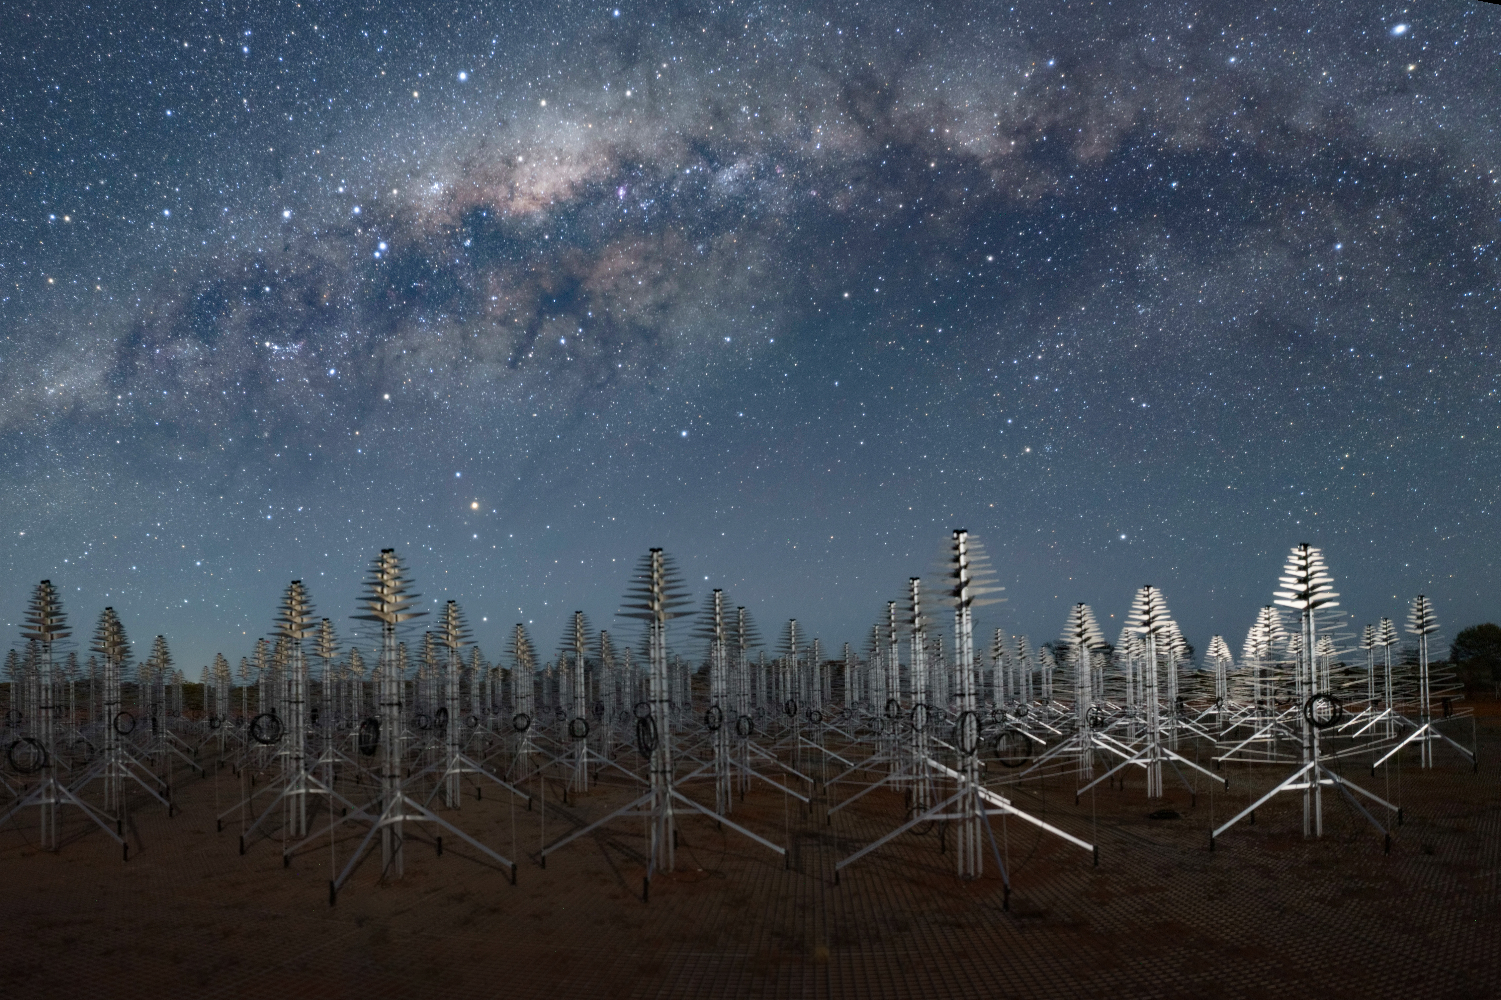
Team Janus Responsibilities
Collaboration: Engineering Operations Australia

Slide 11
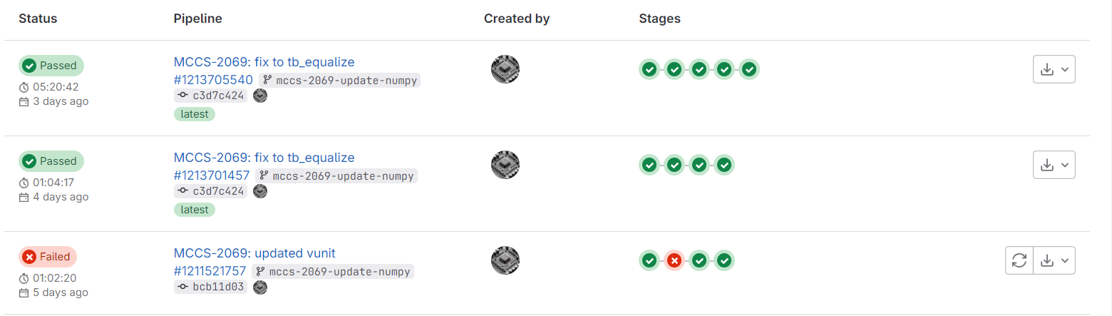
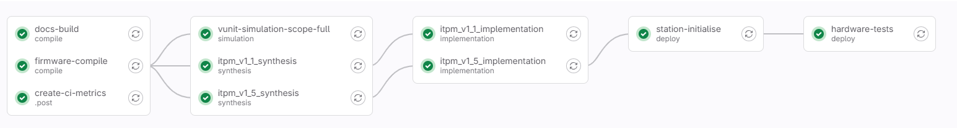
CI Pipeline – Automated Build & Test
Compile Simulation & Synthesis Implementation Deploy Deployment Test

Slide 12
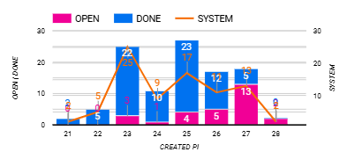
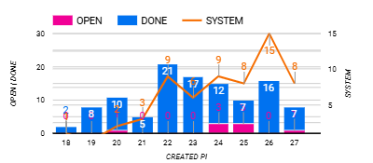
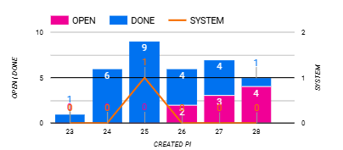
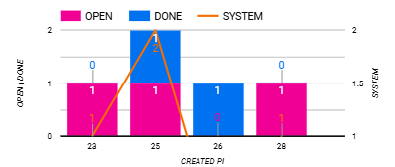
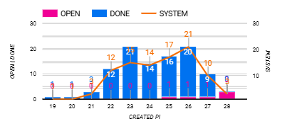
SKA Bugs Reported

Slide 13
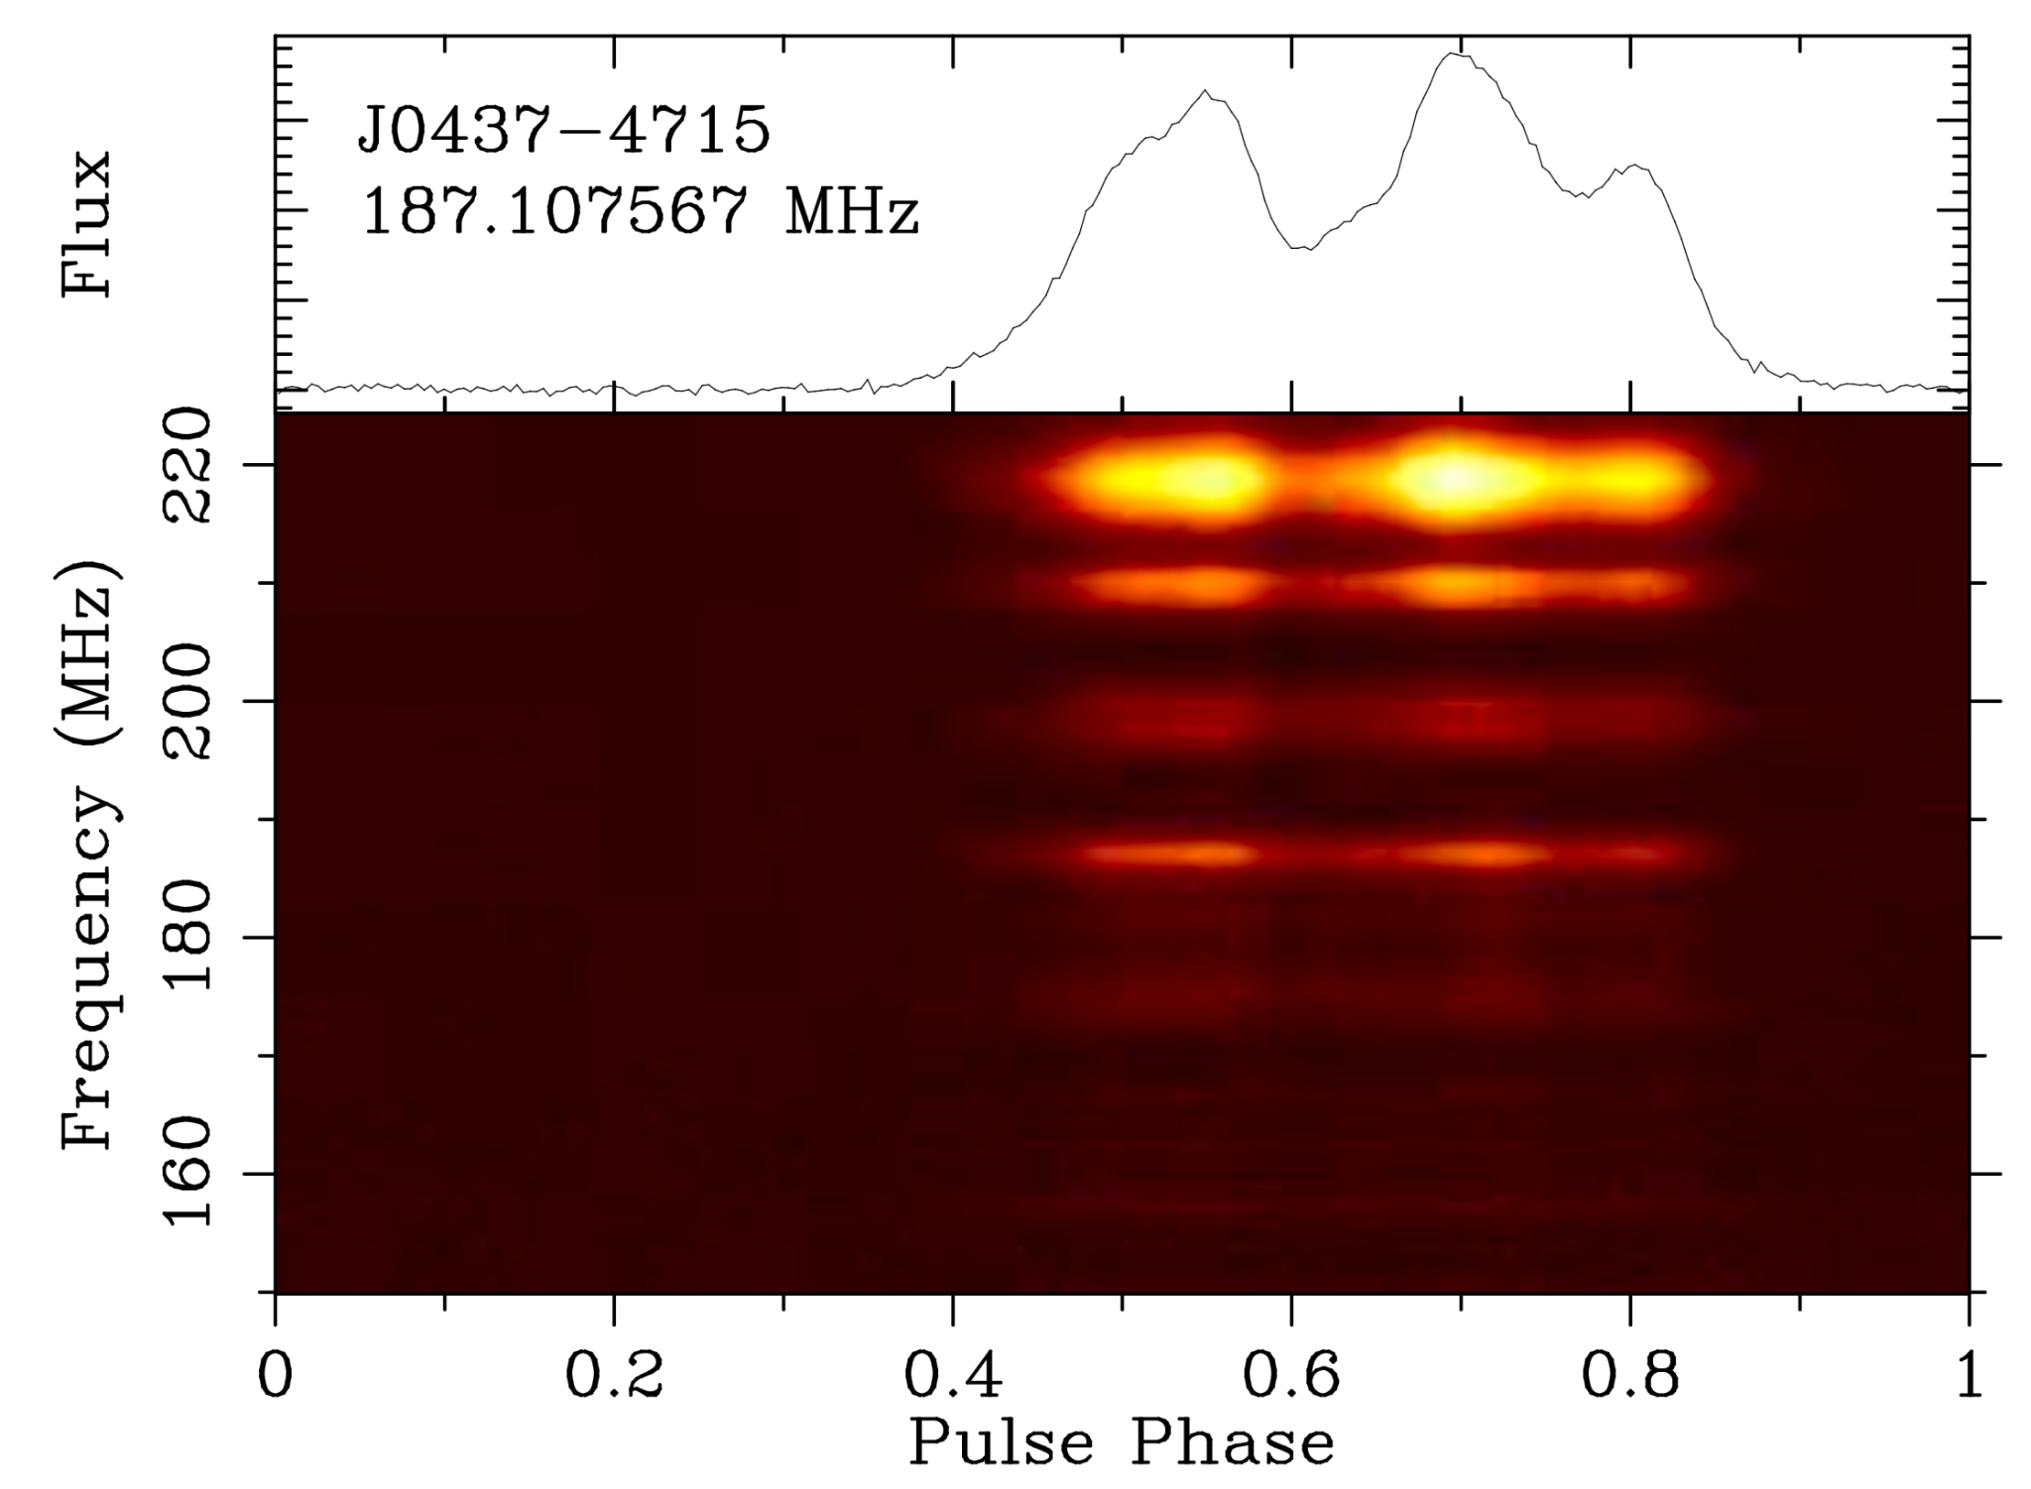
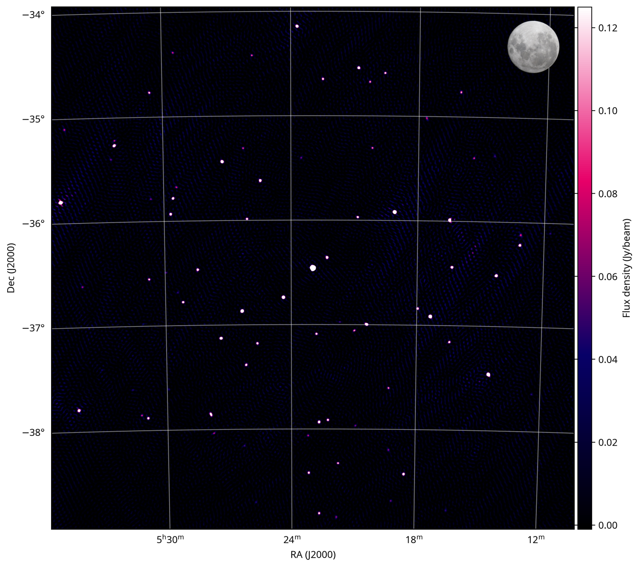
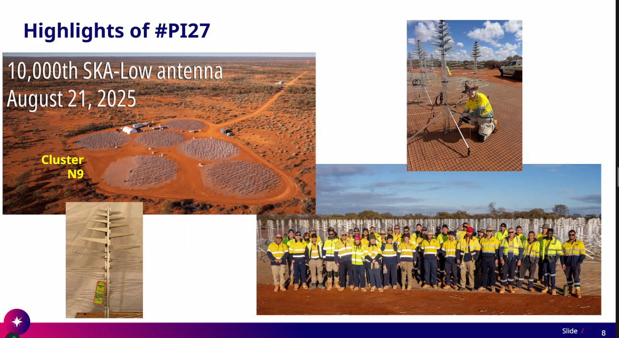
Where are we now?
“a significant milestone in its quest to reveal an unparalleled view of our Universe”
“beyond what we hoped for”

Slide 14
What’s next?
Contract renewal beyond 2025
121,072 more antennas!
Completion of the FPGA firmware roadmap
  Holography
  48 Independent Beams
  Transient Buffer
Formal end of construction & transition to operations
Array Assembly | Stations | Start | End
AA 0.5 | 4 | April 2024 | January 2025
AA 1 | 18 | May 2025 | January 2026
AA 2 |  | April 2026 | January 2027
AA * |  | January 2028 | May 2028
Formal end of construction |  |  | July 2028 or March 2030

Slide 15
Thank you

