Slide 1
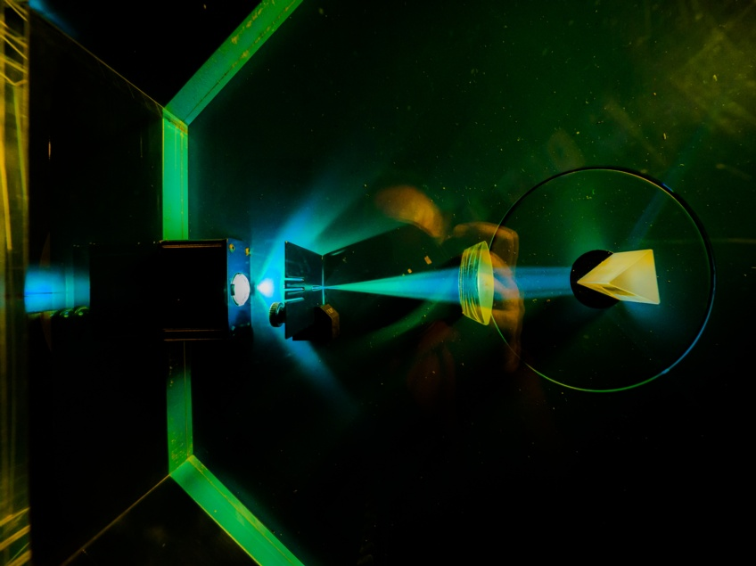


Electronic System Design Group
Management Update
Group Meeting, 25 September 2025
CR03 & Zoom
Image © STFC Alan Ford
Notes:
To edit the background image, select ‘Format’ from the PowerPoint menu and ‘Slide Background’ from the drop-down menu. Within the new list of options that appears on the right of the screen, select the ‘File’ button under ‘Insert picture from’ and select your image from your file browser. Please remove or amend the image credit if you are using a different image to the one provided.

Slide 2
Fire Alarm!
A reminder: the fire alarm in this room will probably be tested at some point in this meeting
  For which, apologies
  You may remain seated

Slide 3
Group Organisation
Ian Brawn
Ronnie Brumfitt
Joseph Hindmarsh
Weiming Qian
Kelvin Gascoyne
Takamasa Awai
John Holden
William John
Simon Moorby
Zhen Ha Ng
Geoffrey Betts
Matt Roberts
Chad Silk
Joshua Davies
Mohamed Siyad
Saeed Taghavi
Dave Templeman
Piers Coode
Jack Day
Martin Torbet
John Coughlan
Adam Barcock
Sooraj Pradeep
Hajira Bazaz
Berk Bilgin
Peter Furey-Duffin
Lucie Sharpe
Departures
  Takamasa Awai
  Summer students Willis Chiu & Ronnie Adoma
Arrivals
  Lucie Sharpe
We’ll be running the usual Graduate Recruitment round this year

Slide 4
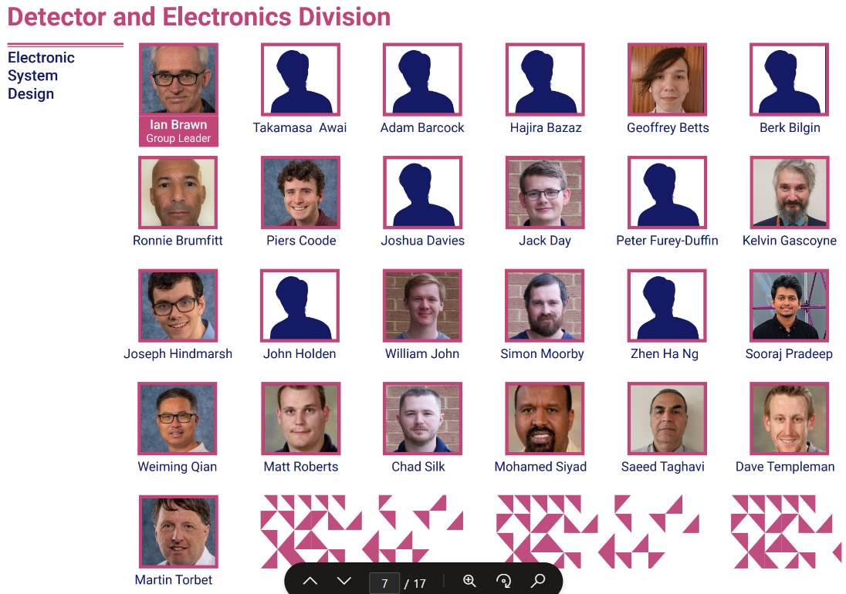
Departmental Organogram
From Dept. Organogram
Portrait sessions
  Normally 1st Wednesday of month
    See Viva Engage, All Company
  9:30—12:30
  R3 Photo Studio, G32
Photos → Kat Lewin-Williams
Also available for
  Passport
  Visa

Slide 5
Projects 2025–26
Slightly Approximate
Fully employed this FY
Next FY: Await funding results for SKA & ATLAS
Notes:
Numbers from
H:\ESDG_business\EffortProfiles\EffortProfile_Projection_2025_d3

Slide 6
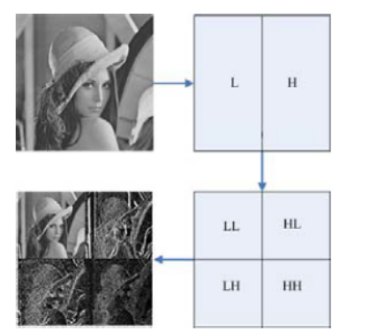
New Opportunity
RAL Space
2D Wavelet Image Compression on Versal FPGA
  Run low & high-pass filters in vertical & horizontal directions
    Result lends itself to compression
Application
  Images of potential landing sites on Mars
  Reduce from 94G before Tx
1st task: resource estimate

Slide 7
ESDG Accommodation in R68 & R66
R68
2.19
2.21
2.22
2.23
2.24
2.25
Stair
Well
2.28
2.29
2.30
2.31
2.32
Lab 2
Lab 1
IB
JH
AB
MS
ST
SP
JH
LS
WQ
GB
MR
ZN
HB
Stair
Well
BB
PFD
Technology
SERVERS
2.15
2.14
MSC
TR3
2.10
MSC
TR1
MSC
TR2
2.09
2.08
Lift
RALSP
Lab
RALSP
Office
RALSP
Office
RALSP
Office
RALSP
Office
Thank you to those who have moved around this summer (twice)
Still planning to acquire 2nd desk for 2.24
Storage office: R66, G07
  Started to populate
  Planning to install shelves
Awaiting new furniture supply contract (July? October?)

Slide 8
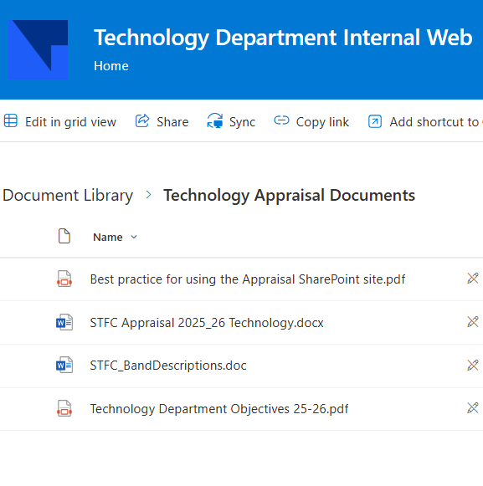
APR
Mid-term reviews are upon us
TD resourses here →
ESDG guidance here
You should have received link to Sharepoint area to upload your form

Slide 9

Xilinx Licenses &Training
Xilinx Licences & Training credits renewed
  4 Floating licenses for ESDG
  1 Floating license for IESG
  40 Training Credits for ESDG
  Bundled into Xilinx Productivity Agreement for discount
Licenses received; not yet training credits
  Ongoing enquiry with Avnet & Xilinx
  Not a Fusion problem!

Slide 10

Windows 11
You should all now have received either
  Update to Windows 11, or
  Email about your replacement machine
If not, let me know
Notes:
£68k

Slide 11

Overseas Travel Approval
  All overseas travel requires pre-approval by STFC
    In addition to any approval required by project/budget holder
  The process is changing
    New process “Saves staff time!”
    Approver = Line Manager
    Requires info on carbon footprint
  Important dates
    Current system closes 29 September
    New system opens 5 October
  I recommend submitting all known requests before transition

Slide 12
Upcoming Meetings
Meeting | Date | Start Time | Location
ESDG Group Meeting | Thursday 28 August | 10:30 am | CR03
ESDG Group Meeting | Thursday 25 September | 10:30 am | CR03
DED Forum | Tuesday 7 October | 3:00 pm | CR12
ESDG Group Meeting | Thursday 30 October | 9:30 am | CR03
ESDG Group Meeting | Thursday 27 November | 10:30 am | CR03
ESDG Christmas Party | Friday 28 November | 12.30 pm | Royal Oak & Rickety Press
DED Forum | Wednesday 3 December | 3:00 pm | Visitor Centre

Slide 13






AOB
technologysi.stfc.ac.uk
@STFC_matters
Science and Technology Facilities Council
Science and Technology Facilities Council
Notes:
The abstract pattern can be removed or repositioned if required. Be careful to ‘Send to Back’ so that it does not obscure any important information.

