Slide 1
Low energy muon cooling
Megan Hanes
Industrial placement student ISIS muon group and University of York
Muon collider meeting
16th January 2026

Slide 2
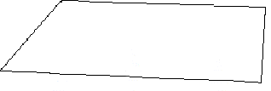
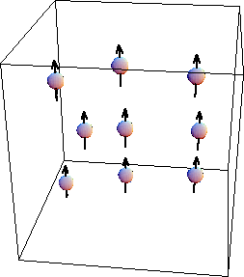
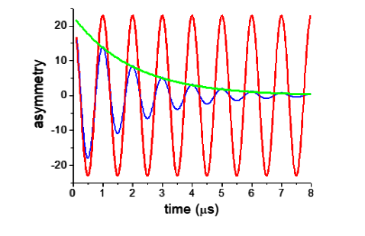
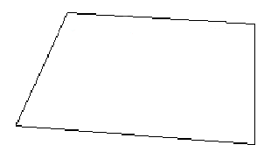
Muon spectroscopy
‘asymmetry’ (t) =
N_{A}(t) – N_{B}(t)
muons
= a₀G_{x}(t) cos(ωt)
detector A
N_{A}(t) + N_{B}(t)
non-relaxing polarisation
relaxing polarisation
magnetic field
detector B
Oscillation frequency -> magnitude of the local magnetic field
Damping -> field homogeneity
Courtesy of Rhea Stewart muon group
Muon spectroscopy involves measuring A(t) and analysing it in terms of the relaxation function G(t).

Slide 3
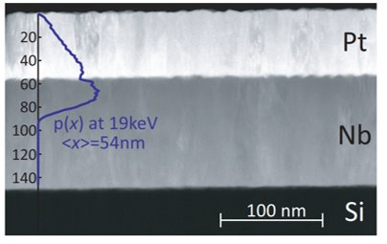
Why low energy muons?
Surface muons with 4 MeV stop in hundreds of microns, far below the surface of materials
To study thin films or surfaces muons must be slowed to the keV range from 4 MeV
Can tune input energy to change implantation depth allowing volume sensitive probing of multilayers
Muons
Layer 1
Layer 2
Stopping distribution
Implantation depth
7keV, <x>=21 nm
27keV, <x>=82 nm

Slide 4
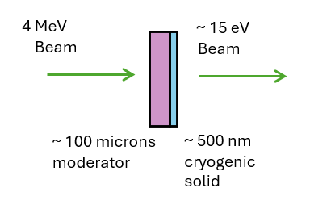
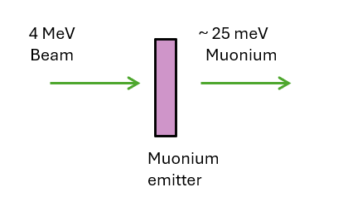

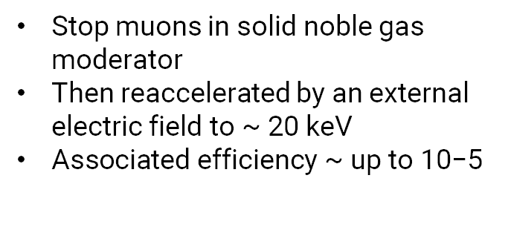
Methods to produce low energy muons
Efficiency = $\frac{Slow muons}{Surface muons}$
PSI
J-PARC
Stop muons in solid noble gas moderator
Then reaccelerated by an external electric field to ~ 20 keV
$\text{Associated} \text{efficiency}\text{ \sim }\text{up} \text{to}\text{ 10−5}$
Laser ionisation of muonium
Associated efficiency ~ up to 10⁻³
ISIS produces fewer surface muons so to be competitive ISIS would need an efficiency of close to 1 %
Notes:
For every one million 4 MeV muons that come in only 10 muons are left at 15 eV
Laser pulse defines pulse of the beam, 50 % spin polarisation
Psi :

Slide 5
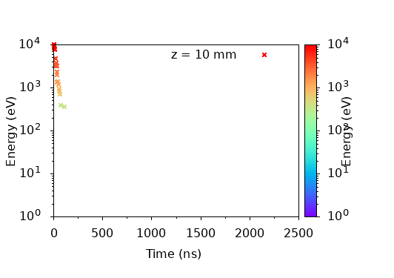
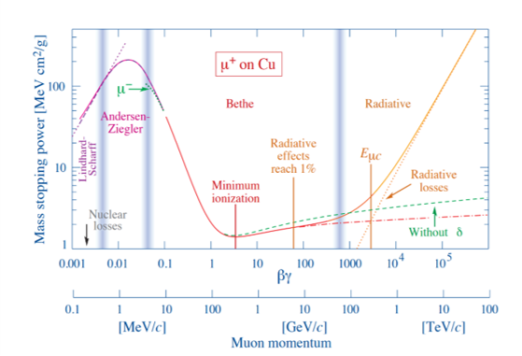
How about using frictional cooling?
This method uses an electric field to restore the energy loss from the medium to reach an equilibrium energy
Charged particles either gain or lose energy to reach equilibrium energy, T_{eq}
Frictional cooling region
Ionisation cooling region
Figure from : Groom, D.E., Klein, S.R. Passage of particles through matter. Eur. Phys. J. C 15, 163–173 (2000). https://doi.org/10.1007/BF02683419

Slide 6
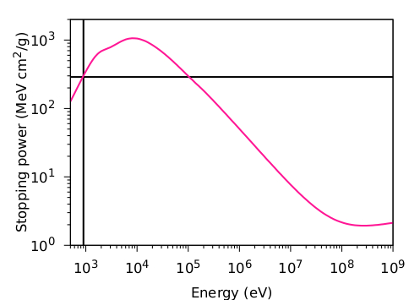
How about using frictional cooling?
This method uses an electric field to restore the energy loss from the medium to reach an equilibrium energy
Charged particles either gain or lose energy to reach equilibrium energy, T_{eq}
T_{eq}
E_{eff}
Ionisation cooling region
Frictional cooling region
Surface muons

Slide 7
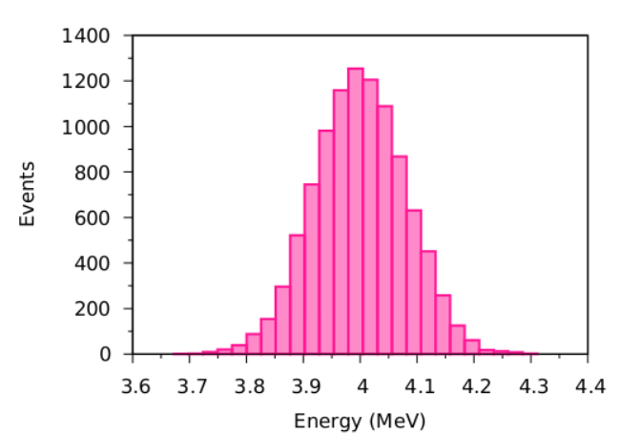
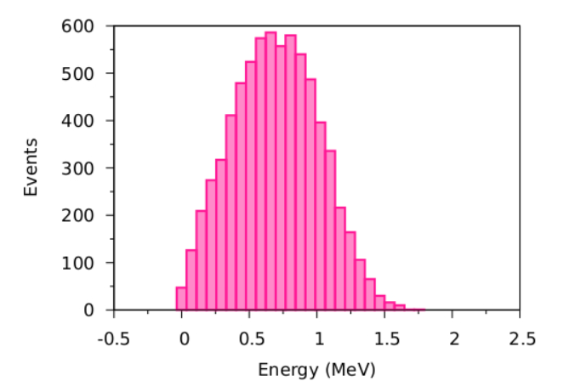
How do we get our muons accepted by the frictional regime?
For the muons to be accepted by the frictional regime they need to have an energy less than 50 keV
Pre-moderation is essential to lower muon energy so they will be accepted by the cell
T_{eq}
E_{eff}
Ionisation cooling region
Frictional cooling region
Pre-moderation
Surface muons
Before
After
To use frictional cooling to produce a slow muon source need to lower 4 MeV muons to below 50 keV first

Slide 8
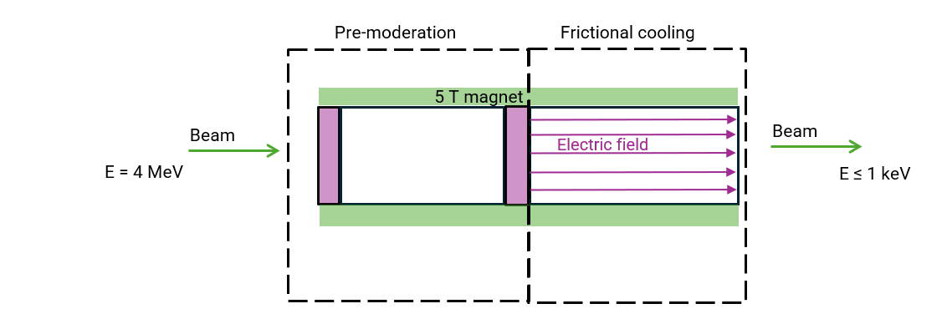
How do we get our muons accepted by the frictional regime?
Option one : mylar degrader
Option two : mylar degrader then neon
Option three :
mylar degrader then opposing electric field
Want to lower the energy of the muons so the distribution leans to the lower energies, so more fall in the acceptance range of cooling cell

Slide 9
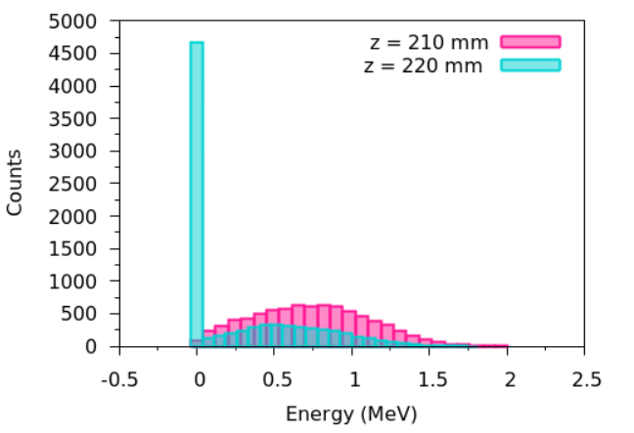
Simulating low energy muons
Initially used G4Beamline with muCool physics list to simulate low energy physics
But this only simulates low energy interactions in helium, for other materials it defaults making energy loss proportional to velocity of the particle between 10 eV and 1 keV
And so created a large bunch of low energy muons
This means for the other materials needed to use something else – SRIM and TRIM
Used SRIM and TRIM to simulate the pre-moderation sections
G4Beamline used for the frictional cooling cell

Slide 10
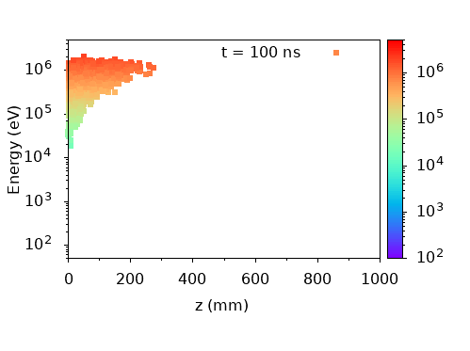
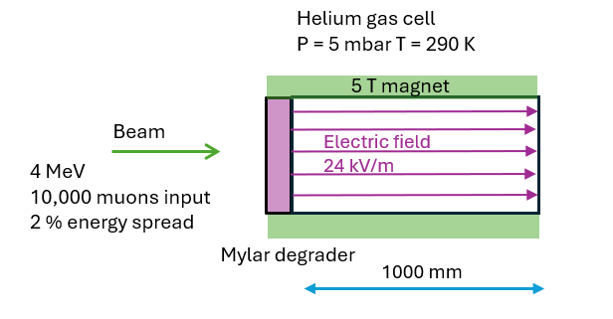
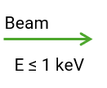
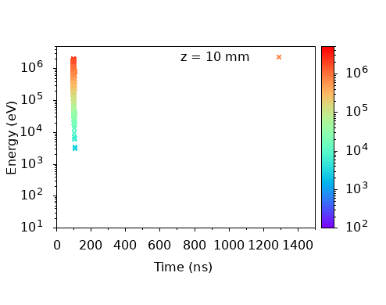
Option one – mylar degrader
1 mm
Only 30 muons make it to less than 1 keV this means not enough pre-moderation
Distribution wasn’t shifted enough to maximise number of muons accepted
Efficiency :
~ 0.3 %

Slide 11
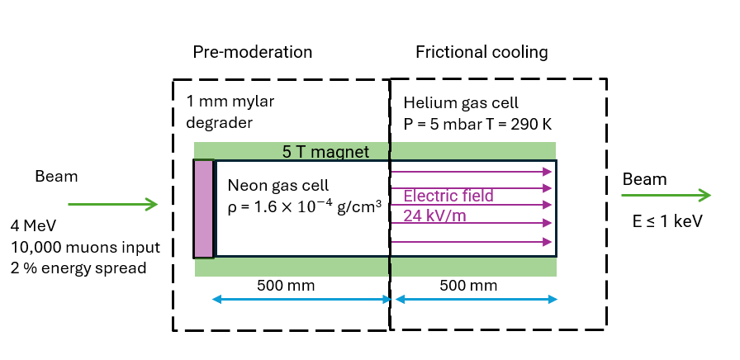
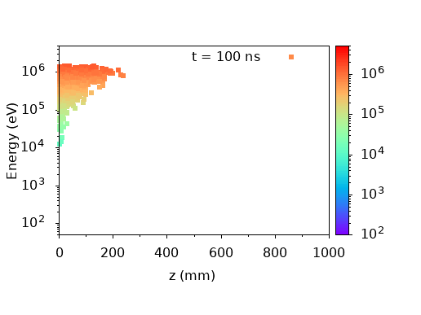

Option two – mylar degrader and neon gas cell
This has less than 10 muons being captured by the frictional cooling regime
Suggests muons are being over degraded and low energy muons are being lost
Efficiency :
< 0.1 %

Slide 12
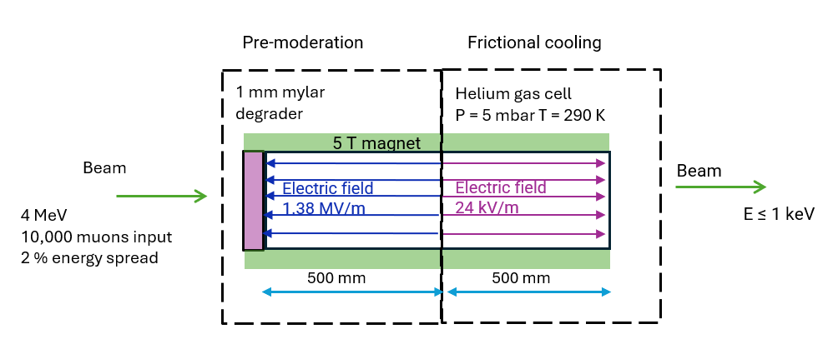
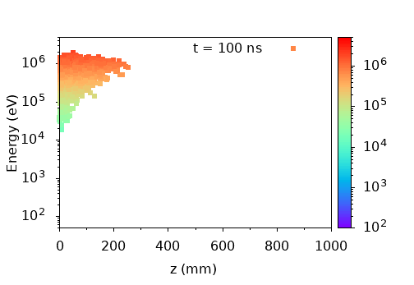
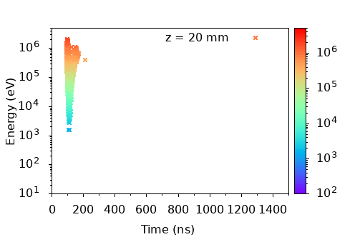
Option three – mylar degrader and opposing electric field
This unoptimised cell is close to efficiency requirement because ~ 100 muons are captured
There are many low energy muons that turn around so aren’t captured
Efficiency :
~ 1 %

Slide 13
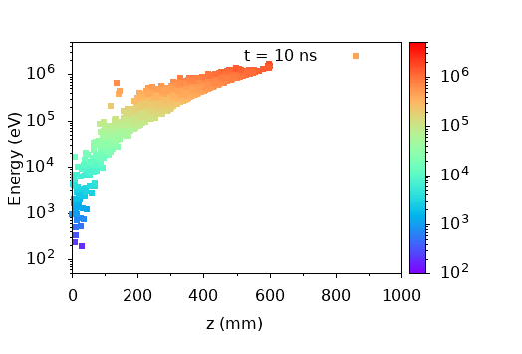
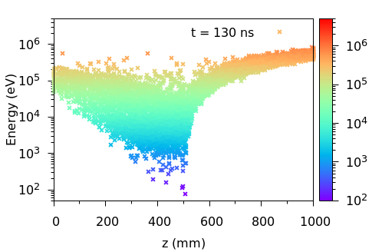
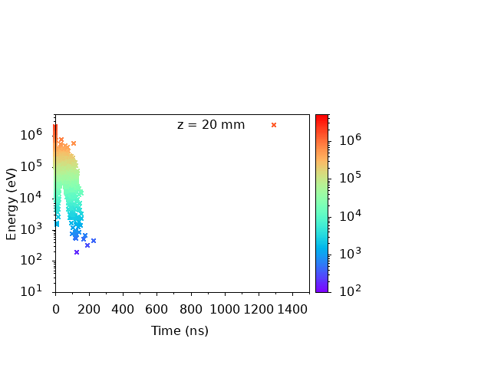
Using RF pulses
To increase the range of muon energies captured by the cell use a decelerating pulse to bring muons to an energy that can be accepted by the cell
Using timed fields to avoid the bunch of muons that were turned around by the dc field being lost
Simulated with the same E-fields as the dc scheme for comparison
Optimising timing and E-fields should improve efficiency
Efficiency :
~ 7 %
Courtesy of Chris Rogers Intense Beams group

Slide 14
In Summary
Low energy muons are unique and powerful probe of surface and thin film science – magnetism, superconductivity, semiconductors…
Aim is to slow 4 MeV muons to the keV range – this is difficult to achieve
Using frictional cooling relies on lowering muon energies to less than 50 keV and so pre-moderation is essential
Current best (but unoptimised) cell achieves ~ 7 % which is close to desired efficiency for operation at ISIS
Next steps are to improve time and z spread, method of extraction and look at beam quality such as beam spot size
Acknowledgements
Rhea Stewart, Peter Baker
Chris Rogers
IDAaaS team
Yu Bao and Yang Li for muCool code to simulate low energy interactions in helium

