Slide 1




RF Power Sources for Muon Cooling Demonstrator
Alexander Spelling

Slide 2
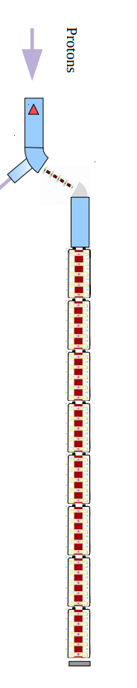
Muon Cooling Demonstrator Layout:
A. Grudiev and R. Losito
MC RF WG meeting #5: Sept 21
Suggested requirement was a 24MW peak power Klystron for each station of 8 cavities at 704MHz and 352MHz.
modulator
RF for cooling: Max. gradient 30 MV/m
klystron
24MW
WG distribution with phase adjustment to feed 2 x 4 cavities
RF for 144 cavities at
~30 MV/m
30m x 14m
18 RF stations
Building -> Gallery :
(underground might be possible)
30m x 15m
Height: 8-10 m
32m
WG
WG
cavity
cavity
cavity
cavity
cavity
cavity
cavity
cavity
14m
Notes:
Demonstrator spec here isn't up to date.
However, the requirements for a 704MHz and 352MHz high power klystron is still required.

Slide 3
Existing Klystron Tubes
Existing high peak power Klystrons are predominantly at higher frequencies than desired.
At 704MHz, immediately available designs exist with lower maximum powers.
Interaction length is inversely proportional to drive frequency.
*352MHz is the focus of Graeme Burt
704MHz is the focus of Alexander Spelling

Slide 4
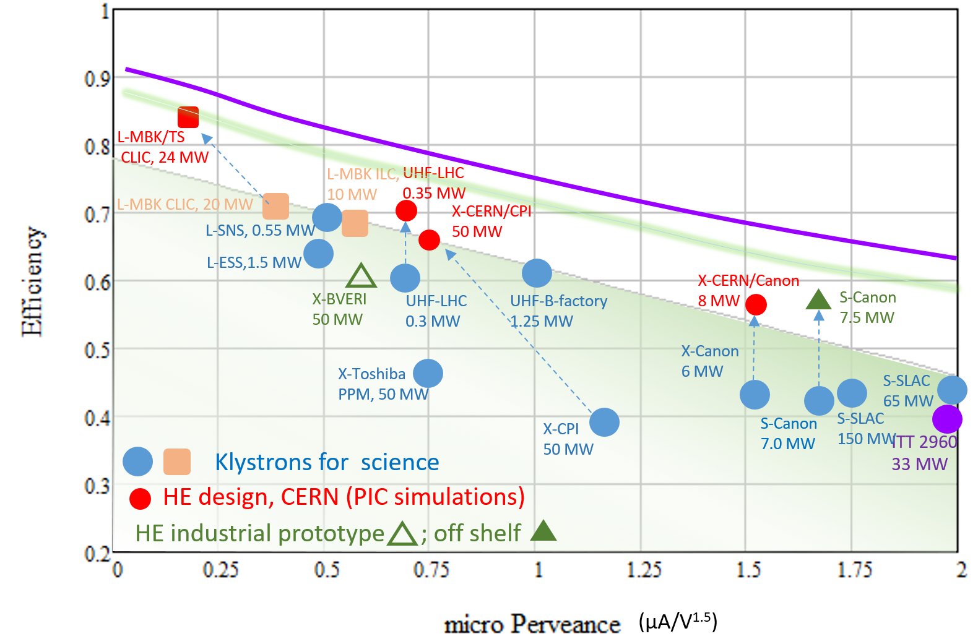
Klystrons for RF Power
Klystron efficiency is typically limited by space charge.
The effect is quantified simply as "perveance"
The perveance is expressed simply by : I / V^{3/2}
High perveance shortens bunching length but decreases the maximum attainable efficiency.
Ultimate limit?
Notes:
-Klystrons typically are represented as microperveance as the beam voltage is in the tens or hundreds of kV whereas the current is usually in the order of tens of amps.

Slide 5
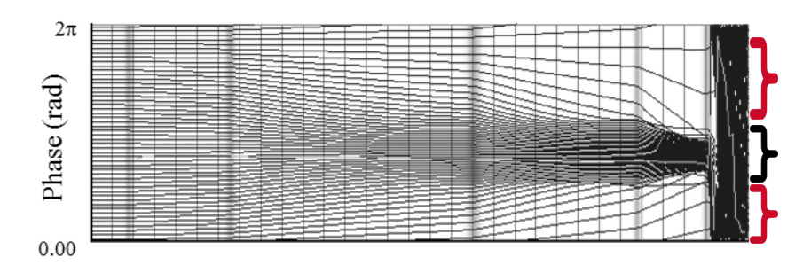
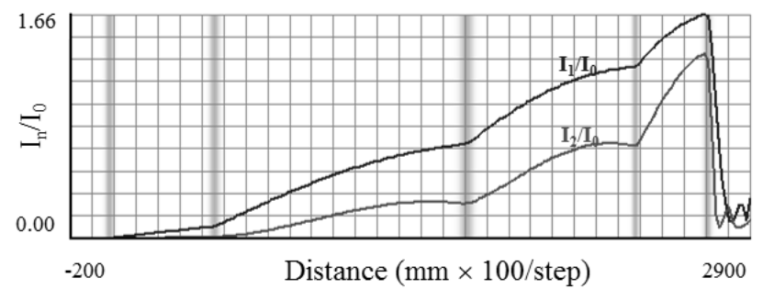
Standard Klystron Bunching Scheme
"Applegate Diagram"
An applegate diagram is a moving window showing the phase relationship between particles.
The standard bunching technique is to add cavities at local maxima.
The output cavity is placed at the point where the harmonic current saturates.
The anti-bunch describes the particles which are not in the useful phase bucket – negative contribution to power extraction
Antibunch
Bunch
Antibunch
[Baikov et al, 2019]
This technique provides moderate efficiencies ~(>70%).
Ideal bunch saturation is not achieved, anti-bunch still populated
Notes:
[2] "Toward High-Power Klystrons With RF Power Conversion Efficiency on the Order of 90%". Andrey Yu. Baikov, Chiara Marrelli, and Igor Syratchev
Annotations added by myself for visual clarity.

Slide 6



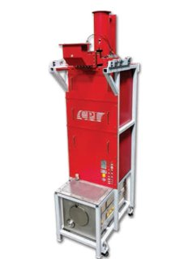
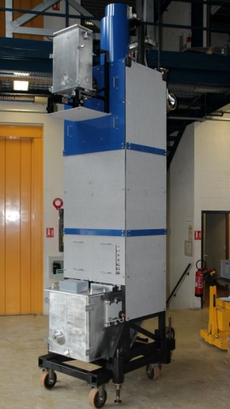
Immediately Available Solutions
Existing solutions at 704MHz are typically single beam devices with peak powers <2MW
E37504
Frequency - 704MHz
Peak Power – 1.5MW
Efficiency – 66%
µPerveance– 0.59
Total Length – 3m
VKP7952 | VKP8292A
Frequency - 704MHz | Frequency - 704MHz
Peak Power – 1.3MW | Peak Power – 1.5MW
Efficiency – 65% | Efficiency – 65%
µPerveance – 0.71 | µPerveance – 0.58
Total Length – 4.72m | Total Length - 3.88m
TH2180
Frequency - 704MHz
Peak Power – 1.5MW
Efficiency – 69%
µPerveance – 0.6
Total Length – 4.5m
CPI VKP-8292A
Thales TH2180

Slide 7

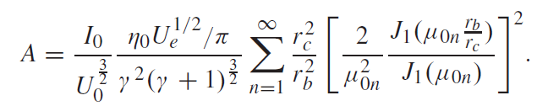

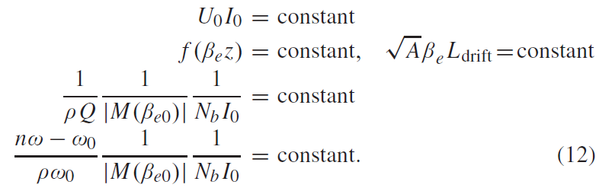
Parametric Scaling Principle (PSP)
Key numbers in klystron scaling are the electron wavelength, Beta, and the bunching parameter, A,
If we scale a klystron's voltage, current, or frequency certain relationships need be maintained
Scaling the frequency down the 1GHz CLIC tube to 704MHz would result in an increase in interaction length of ~1.4x.
Notes:
[1] Scaling Procedures and Post-Optimization for the Design of High-Efficiency Klystrons. Jinchi Cai, Igor Syratchev and Zening Liu.
Bunching Parameter A contains the filling factor, beam perveance, gamma factor, bessel function terms etc.
Scaling the CLIC tube by 1.4x makes the bunching length 2.1m at 70% efficient, we can do better.
1.4x Length increase isn't terrible, the 352MHz equivalent would be ~3x in length.

Slide 8
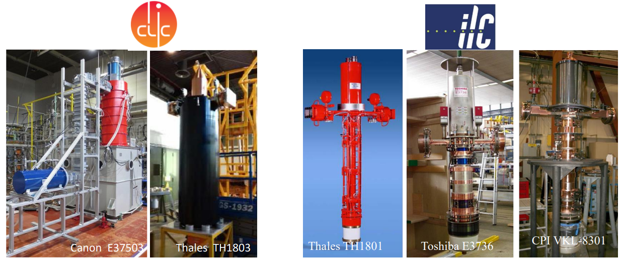
Direct Scaling Solution
A medium-term (3-4 years) solution.
Directly scaling allows the reuse of elements (gun, focussing, collector*)
Frequency: 1.0 GHz
Peak RF Power: 20 MW
Efficiency: 70%
Frequency: 1.3 GHz
Peak RF Power: 10 MW
Efficiency: 65%
*Collector size can be reduced for this scaling example due to lower duty cycle, lower thermal load.
Notes:
Canon E37503, Thales TH1803 is 10 Beam device.
Cavities would still have to be designed – may as well redesign the interaction region with equivalent gun.
Introduction of MBK on this slide – simply multiple beams, perveance is per beam not overall system, shared interaction geometry, interdependent + more points of failure

Slide 9
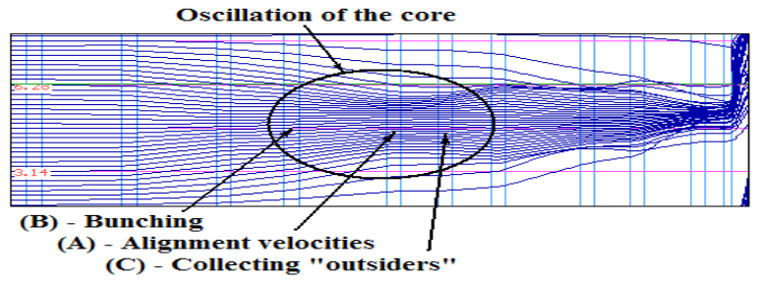
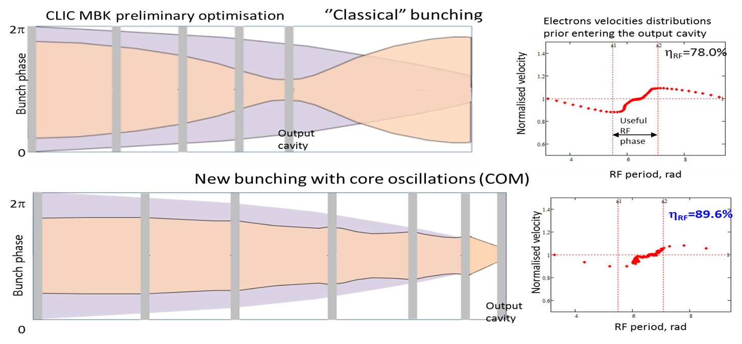
Methods to Enhance Bunch Saturation
New bunching techniques have been recently developed to improve bunching efficiency.
Bunch-Align-Collect (BAC): use of a large number of RF cavities in closely spaced cavity triplets which perform direct oscillations of the bunch core.
2.
Core Oscillation Method (COM): alternating forces of de-bunching from the space- charge and the bunching from the cavities oscillate the bunch core whilst collecting the anti-bunch.

Slide 10
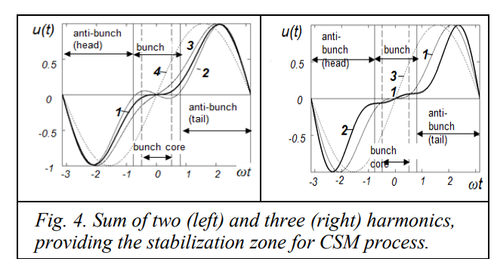
Methods to Enhance Bunch Saturation
New bunching techniques have been recently developed to improve bunching efficiency.
3.
Core Stabilisation Method (CSM): utilises higher order harmonics (2nd and 3rd) to provide a stabilised region for electrons in the bunch core whilst enabling the periphery to continue bunching.
CSM Tube appears ideal for single stage at this frequency as:
Bunching Circuit can be shortened.
Achievable efficiencies >80%
[A Baikov, O Baikova, IVEC 2019]
Notes:
[3] "Simulation of High-Efficiency Klystrons with the COM and CSM bunching" by Andrei Bakov and Olga Baikova for IVEC Busan 2019
+ Allows for a shorter bunching interaction circuit than BAC and COM whilst maintaining reasonably high efficiency. + Requires fewer cavities to implement. - Increased complexity in design due to the higher order harmonic cavities.

Slide 11
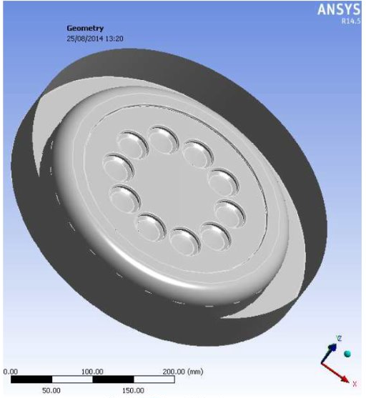
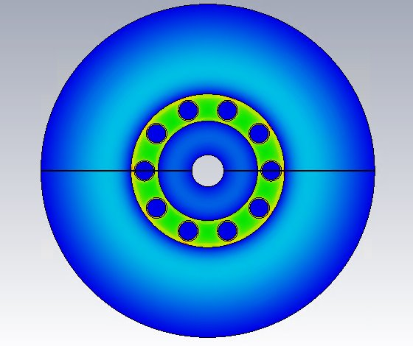
Developing New Interaction Region for Existing Gun Topology
Klystrons can be designed with a new interaction region using the novel bunching techniques (such as CSM) whilst maintaining an existing gun topology.
Extracted Output Power = Gun Power x Efficiency
The design is limited by the properties of the gun (perveance, beampipe spacing etc.)
27MW Ten-cathode gun from Thales TH1803
10-beam 704MHz fundamental cavity design
Notes:
Existing topology means it is feasible.
Perveance is determined by the electron gun.
Beampipes are spaced on a 76.3mm radius from the centre point.
Fundamental cavities are reentrant TM010 mode cavities, 2nd and 3rd harmonic cavities are pillbox.
Similar time scale to scaling – maybe slightly longer

Slide 12
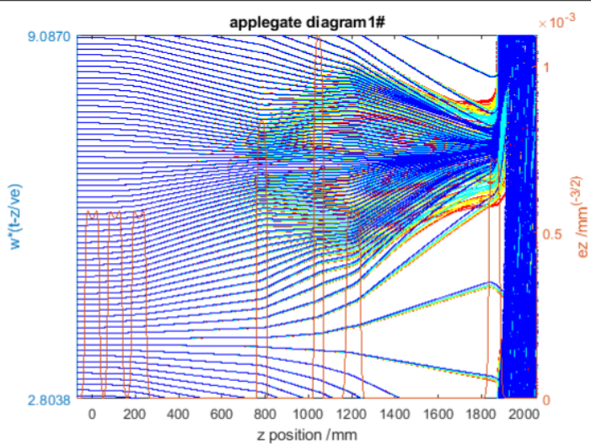
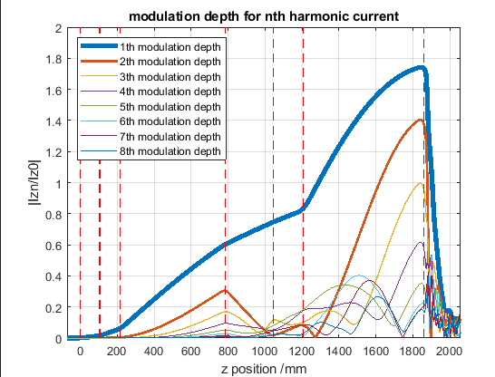
10-Beam CSM Klystron Interaction Region
Designed a 10-beam 7 cavity CSM klystron interaction region using the CERN code KlyC.
10-Beam CSM 704MHz
Beam Voltage: 150kV Interaction Length: 1.86m
Beam Current: 18A Peak Power: 21.3MW
µPerveance: 0.31 Efficiency: ~79%
The Interaction length only includes the region between input and output cavities - does not include the substantial portion that is the collector.

Slide 13
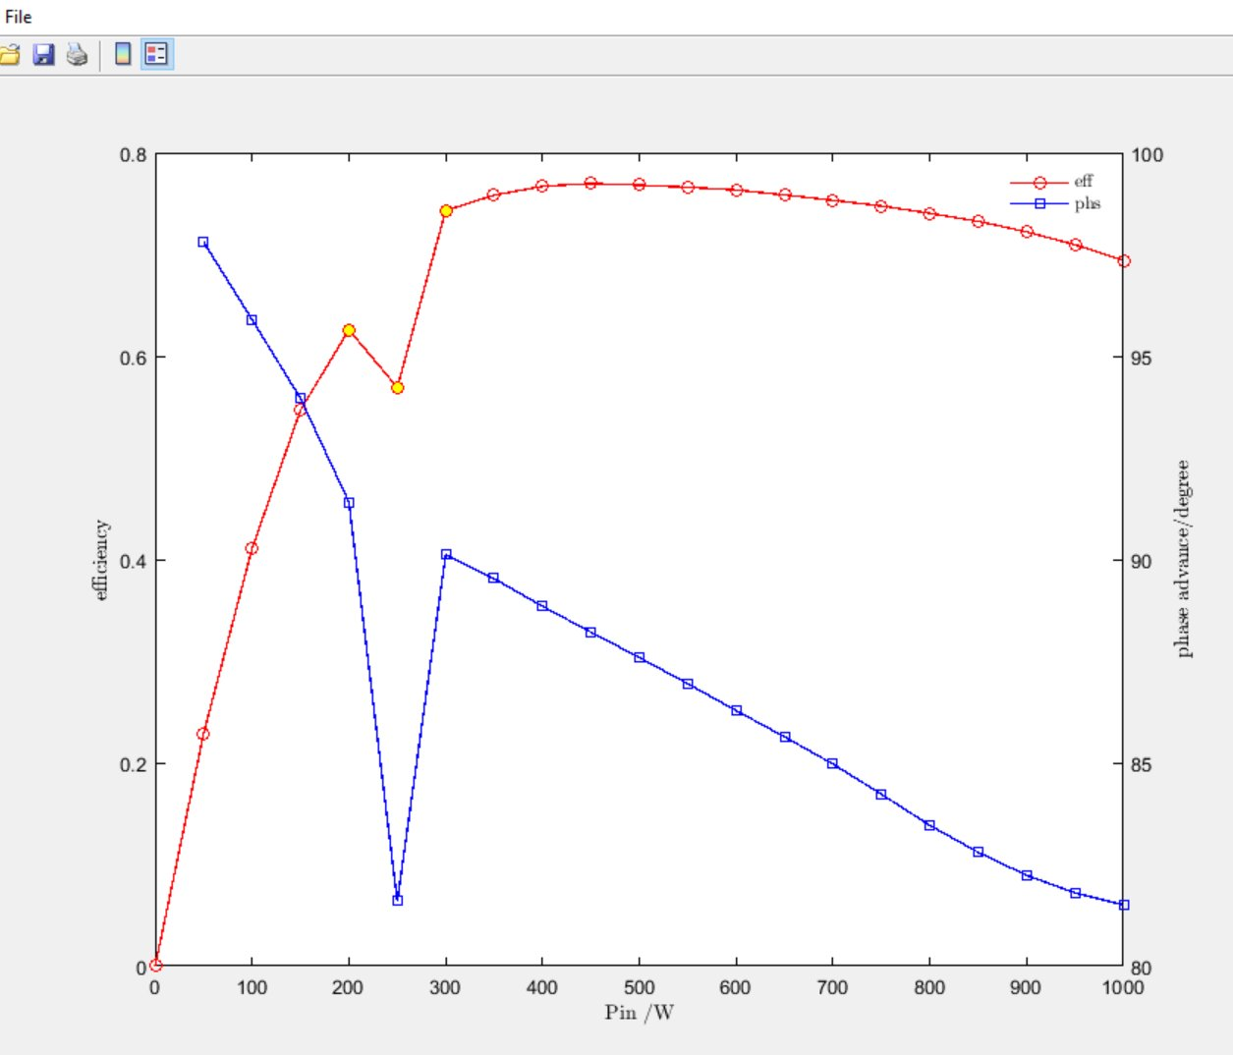
RF Input Power Sweep
Profile of this region suggests instability due to multiple non-converging simulations.
Klystrons typically operate at input RF powers which populate the somewhat linear region of the power-efficiency curve. As such:
Real world efficiencies are therefore lower than saturated efficiencies.
The linear region must facilitate acceptable operation.
However:
Erroneous points do not necessarily represent reflections and may simply be a convergence issue of KlyC.

Slide 14
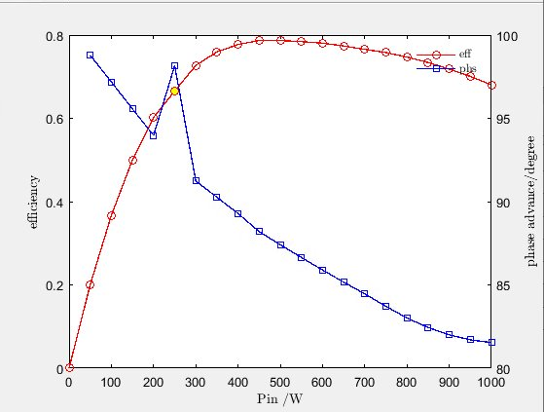
RF Input Power Sweep
Instabilities can suggest potentially reflected electrons. This can be due to a multitude of reasons.
One metric of note is the Filling Factor, which is simply given as:
FF = Beam Radius / Beam Tube Radius.
After testing many iterations, it appeared as though the filling factor of 0.75 (8.25 / 11) exacerbated the effects of the image charge on the beam.
The chosen solution was to increase the tube radius along with adjusting the output cavity gap size until sufficient stable performance was achieved.
Saturated efficiency present at 450 W
Potential erroneous point at ~250w

Slide 15
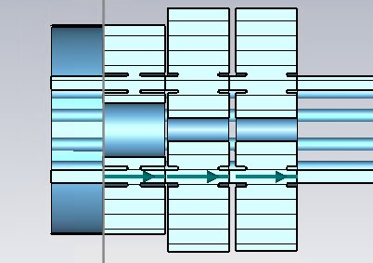
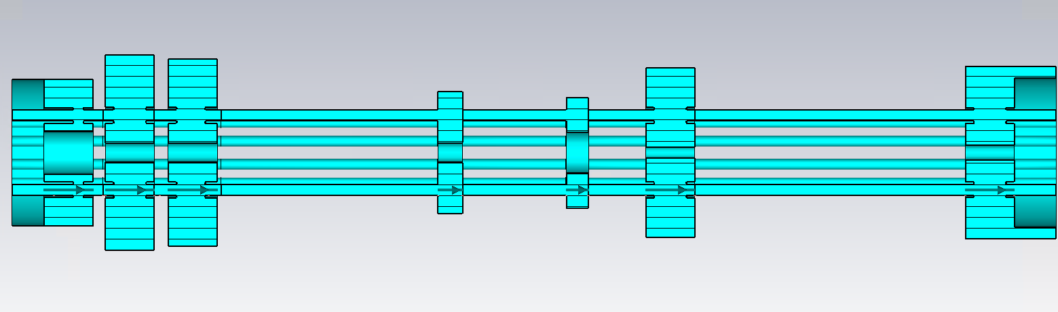
CST Klystron Layout (+ Cavity Considerations)
The optimal solution found in KlyC simulations placed the first 3 cavities too closely. Such a small (<20mm) spacing between cavity walls is not structurally viable - prone to deformation.
Solution was to redesign the cavities with a relatively offset gap, retune to get the desired frequency, and shift the whole cavity by the equivalent offset.
Original design, inadequate spacing.
Modified design, more reasonable spacing.
*Colour change for different simulation material

Slide 16
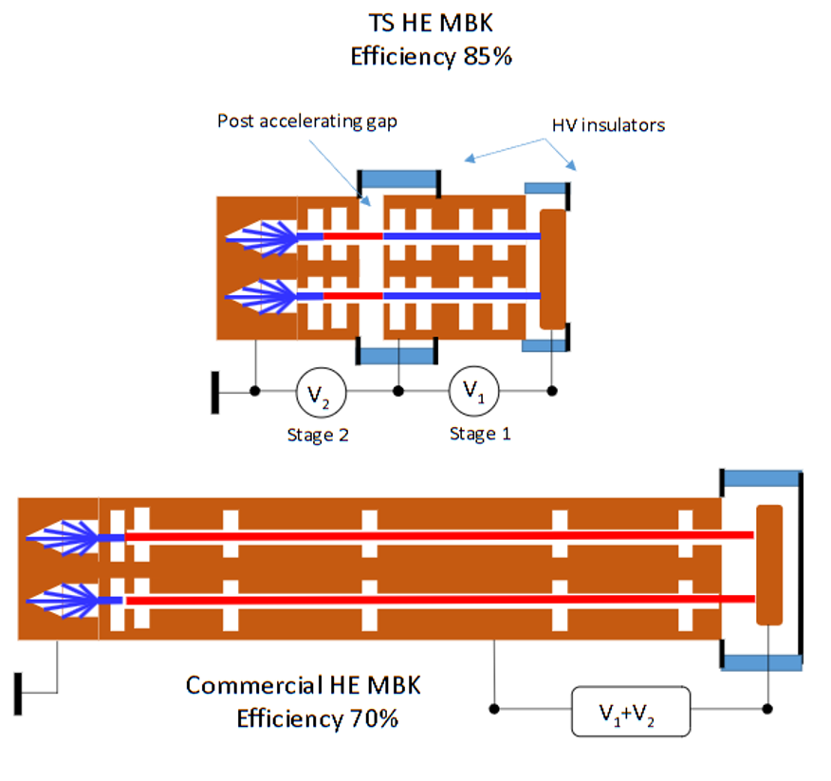
Two-Stage Klystron
Two-Stage (TS) klystrons are a long timescale novel prospect which may be feasible at 352MHz (and potentially 704MHz).
Unlikely to be used in demonstrator but a promising prospect for the future.
Very compact RF interaction circuit
High achievable efficiencies
Greater design complexity.
Very novel, not currently in operation.

Slide 17
Conclusion
Existing single-beam klystrons are readily available at this frequency. (Higher power MBKs exist at 1GHz and 1.3GHz)
Feasible medium-term prospects are presented: reuse of component designs and direct scaling. (3-4 years)
Designed a CSM design in KlyC which reuses the Thales TH1803 Gun and demonstrated the solutions to many design challenges.
Two-Stage Klystrons may be viable at this frequency – is the increased complexity worth the size / efficiency improvements?

