Slide 1
Fluidized Tungsten Target – Engineering Update
Ben Suitters, Dan Wilcox, Chris Densham (RAL)
Will Bishop, John Back (University of Warwick)
Will Thompson, Edgar Vera Cardenas, Roger Lewis (University of Sheffield)

Slide 2
Overview
Context and concept
Challenges
Progress
Opportunities
In many words and too few pictures!

Slide 3
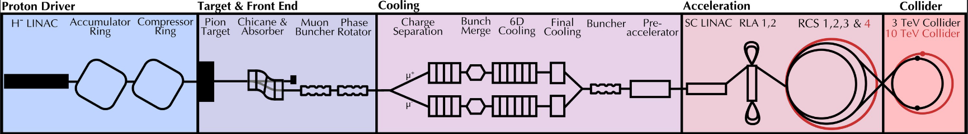
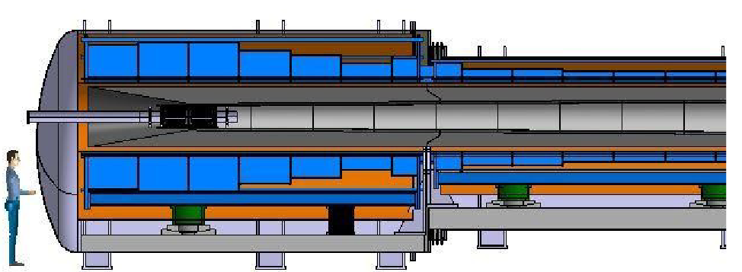
Muon Production Target
Notes:
Cern graphite model

Slide 4
Target Requirements
Maximise pion production by
Minimising support material, coolant pipes, etc
Being axisymmetric
Being narrow
Maximise reliability by
Keeping temperatures low
Reduce thermal shock
Resistance to radiation swelling, changes in mechanical properties, etc

Slide 5
Why is the Muon Collider* particularly difficult?
Among the highest power on target ever proposed (4MW)
Among the shortest, most intense pulses ever proposed (2ns)
Tight space constraints
Power deposition limits on solenoids
*Even if MC is not selected, FCC, ILC etc will face similar problems at beam intercepting devices due to their intensity- those pesky protons have to go somewhere!

Slide 6
Previously…
Determined an engineering simulation is difficult for a fluidized target
Determined experiment is necessary to understand the factors

Slide 7
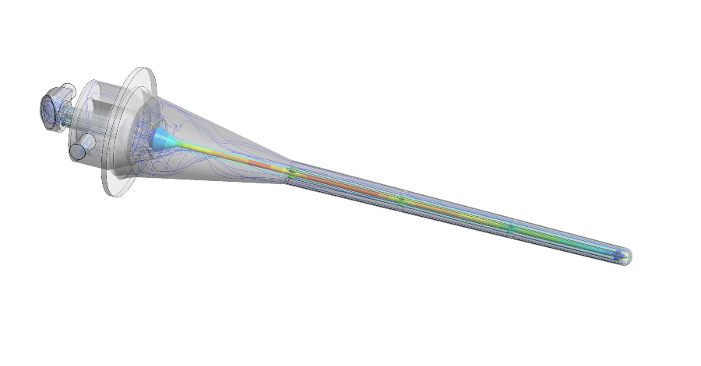
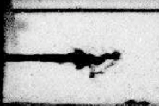
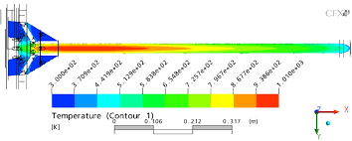
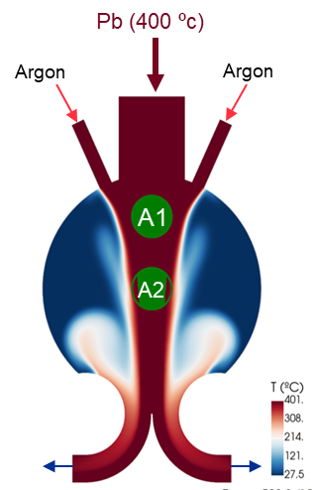
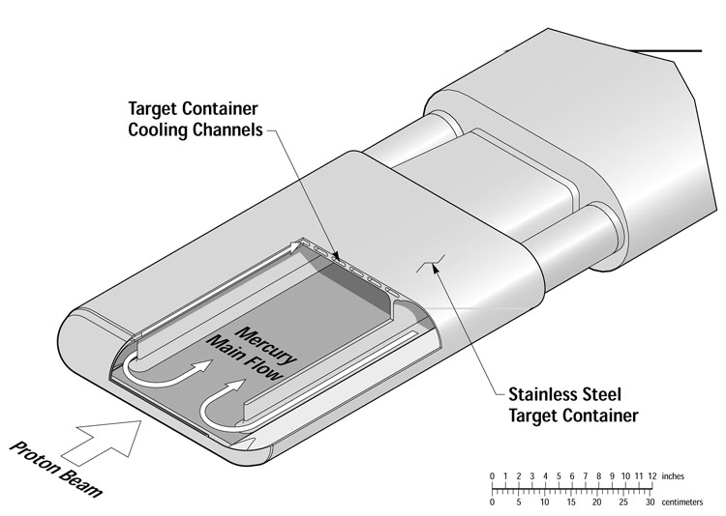
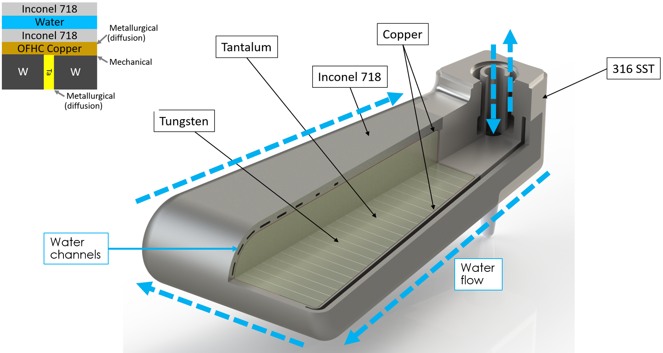
Previously… Target Options
Solid Materials
Tungsten
Graphite
Beryllium
Tantalum
Simpler, known construction
Limited by thermal properties. Fragile.
Fluidized Powder Targets
Liquid Materials
Mercury
Lead
Lead-Bismuth
Gallium
Power spread out across a larger volume
Cavitation, Corrosion, plant complexity
Spreads power like liquids
Resistant to shock
No corrosion
Reliability and Erosion
Plant Complexity

Slide 8
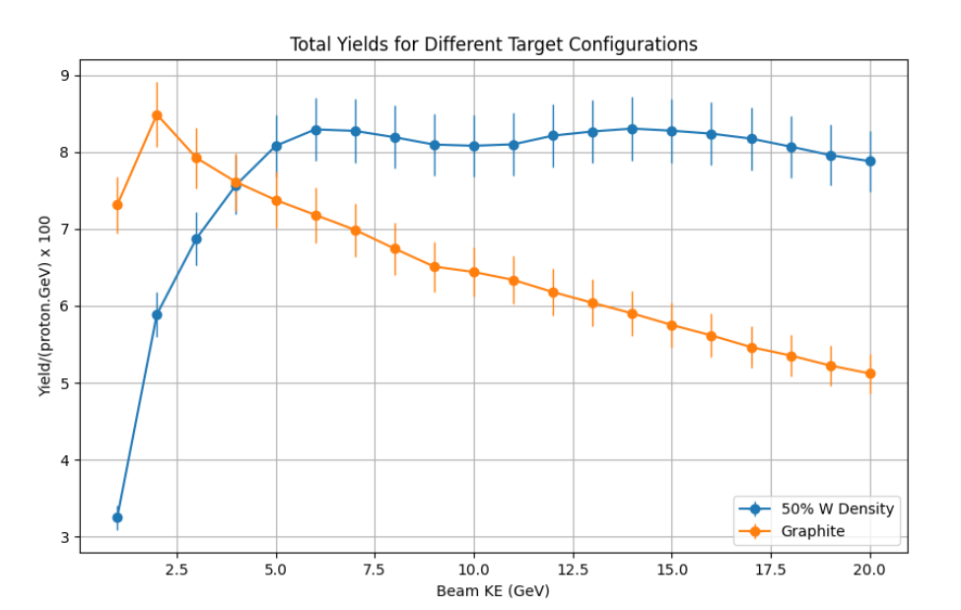
Previously… Target Options
Solid Materials
Tungsten
Graphite
Beryllium
Tantalum
Simpler, known construction
Limited by thermal properties. Fragile.
Fluidized Powder Targets
Liquid Materials
Mercury
Lead
Lead-Bismuth
Gallium
Power spread out across a larger volume
Cavitation, Corrosion, plant complexity
Spreads power like liquids
Resistant to shock
No corrosion
Reliability and Erosion
Plant Complexity
*Preliminary, unoptimized, actual performance will vary.
(W. Bishop)

Slide 9
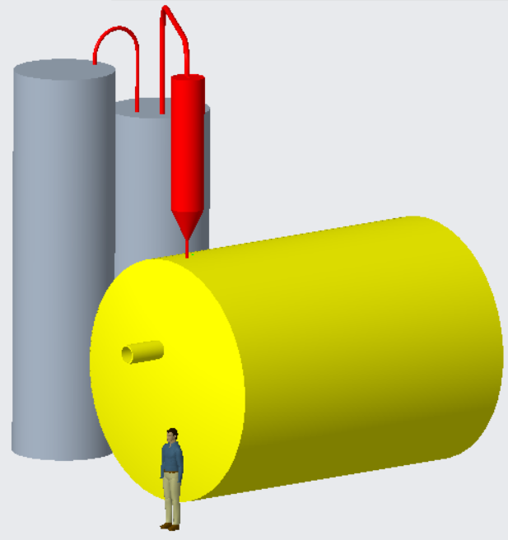
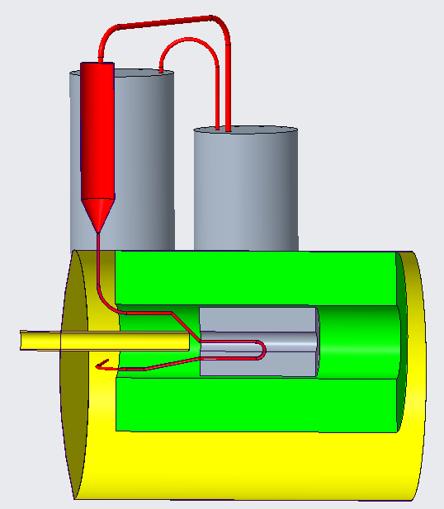

Slide 10
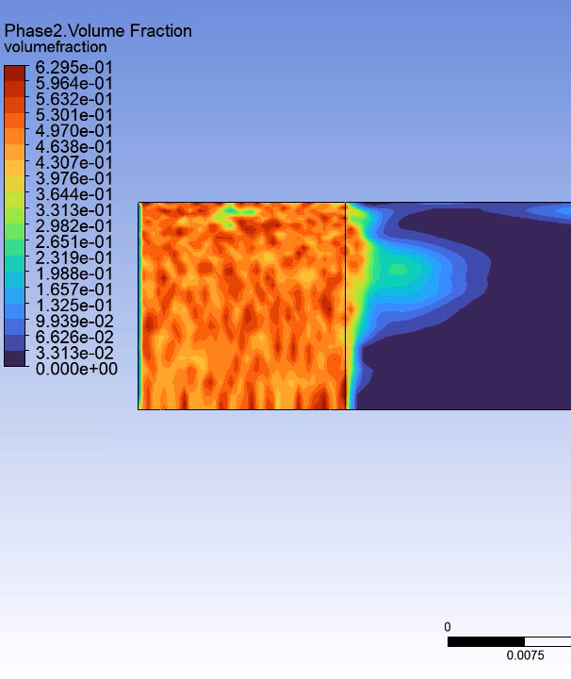
Previously… Current Status
Previous work reimagined in a Muon Collider context
Rough layout devised
Feasibility of key components being assessed
Contact made with UK academic centre
First approximations made of target heating and flow requirements
Target performance optimisation effort underway (see W Bishop)
Simulating fluidization is difficult, and hard to validate!
WRONG!
Gas Flow
15 hours of compute on high power simulation PC = 2.2ms of poorly resolved flow!

Slide 11
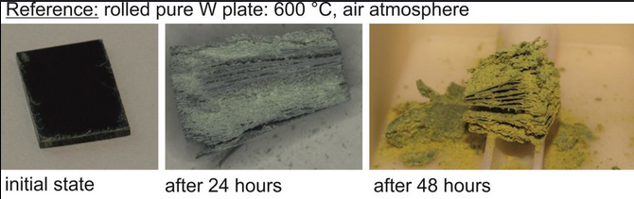
Previously… Thermal Limits
Oxidation risks limiting factor even in helium
Average temperature will be reasonable, but must set some limit!
2J/mm3.pulse a reasonable guess for now
=10kW/cc maximum in tungsten
Remember this number!

Slide 12
Challenges (and their status)
Physics performance
Conveying system design
Pressure/top level system design
Erosion
Bulk fraction/phase
Material science
Radiation damage
Powder degradation

Slide 13
Challenges (and their status)
Physics performance
Conveying system design
Pressure/top level system design
Erosion
Bulk fraction/phase
Material science
Radiation damage
Powder degradation
Well underway! (see W. Bishop talk)

Slide 14
Challenges (and their status)
Physics performance
Conveying system design
Pressure/top level system design
Erosion
Bulk fraction/phase
Material science
Radiation damage
Powder degradation
Well underway! (see W. Bishop talk)
Great progress
Testing commences mid Feb at the Royce institute

Slide 15
Challenges (and their status)
Physics performance
Conveying system design
Pressure/top level system design
Erosion
Bulk fraction/phase
Material science
Radiation damage
Powder degradation
Well underway! (see W. Bishop talk)
Great progress
Testing commences mid Feb at the Royce institute
Sheffield are making good headway

Slide 16
Challenges (and their status)
Physics performance
Conveying system design
Pressure/top level system design
Erosion
Bulk fraction/phase
Material science
Radiation damage
Powder degradation
Well underway! (see W. Bishop talk)
Great progress
Testing commences mid Feb at the Royce institute
Sheffield are making good headway
Difficult for now, but hope on the horizon?

Slide 17
Challenges (and their status)
Physics performance
Conveying system design
Pressure/top level system design
Erosion
Bulk fraction/phase
Material science
Radiation damage
Powder degradation
Well underway! (see W. Bishop talk)
Great progress
Testing commences mid Feb at the Royce institute
Sheffield are making good headway
Difficult for now, but hope on the horizon?
Hard to investigate for now- maybe on the next grant?

Slide 18
Challenges (and their status)
Physics performance
Conveying system design
Pressure/top level system design
Erosion
Bulk fraction/phase
Material science
Radiation damage
Powder degradation
Well underway! (see W. Bishop talk)
Great progress
Testing commences mid Feb at the Royce institute
Sheffield are making good headway
Difficult for now, but hope on the horizon?
Hard to investigate for now- maybe on the next grant?

Slide 19
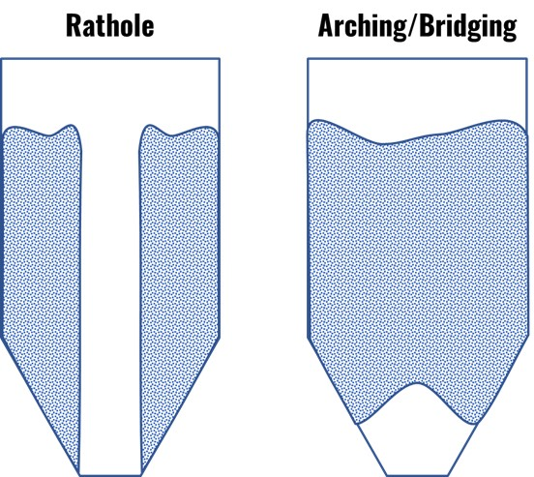
Pressure/System design
Pressure is the energy which pushes the tungsten around the circuit
Tungsten is dense so requires more pressure than other materials
Pressure drop, arching, flow stalling are caused by cohesion and friction between particles

Slide 20
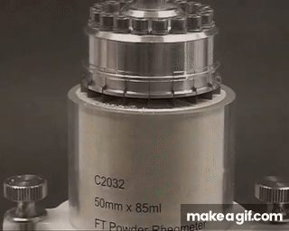
Pressure/System design
Royce Institute are specialists in material characterisation
Royce @ Sheffield do lots of work in powder metallurgy, pharmaceuticals, etc
Their powder tester can get us the data we need to calculate rough pressure drops, flow rates, etc
Key to budgeting for a new test setup

Slide 21
Pressure/System design
Once we have data, we can use industrial experience to specify a system
Questions worth asking to match the “physics ideal”
How narrow a target pipe can we convey through?

Slide 22
Pressure/System design
Once we have data, we can use industrial experience to specify a system
Questions worth asking to match the “physics ideal”
How narrow a target pipe can we convey through?
How densely packed can our powder get and still move freely?

Slide 23
Pressure/System design
Once we have data, we can use industrial experience to specify a system
Questions worth asking to match the “physics ideal”
How narrow a target pipe can we convey through?
How densely packed can our powder get and still move freely?
How difficult will a “Restart” be?

Slide 24
Pressure/System design
Once we have data, we can use industrial experience to specify a system
Questions worth asking to match the “physics ideal”
How narrow a target pipe can we convey through?
How densely packed can our powder get and still move freely?
How difficult will a “Restart” be?
How much erosion will the pipes face?

Slide 25
Pressure/System design
Once we have data, we can use industrial experience to specify a system
Questions worth asking to match the “physics ideal”
How narrow a target pipe can we convey through?
How densely packed can our powder get and still move freely?
How difficult will a “Restart” be?
How much erosion will the pipes face?
How can we create a beam window that is erosion resistant?

Slide 26
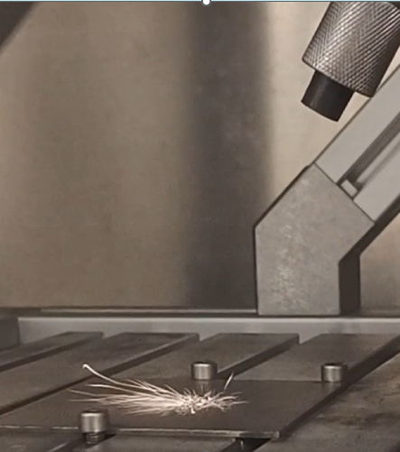
Erosion
University of Sheffield working to understand erosion by high density particles
Among the first work into this area
Cross cutting with fusion, defence, chemical applications
Paper drafted on initial findings
More work with more representative pipe conditions, larger data sets to come

Slide 27
Lots of Questions!
How do we answer them?

Slide 28
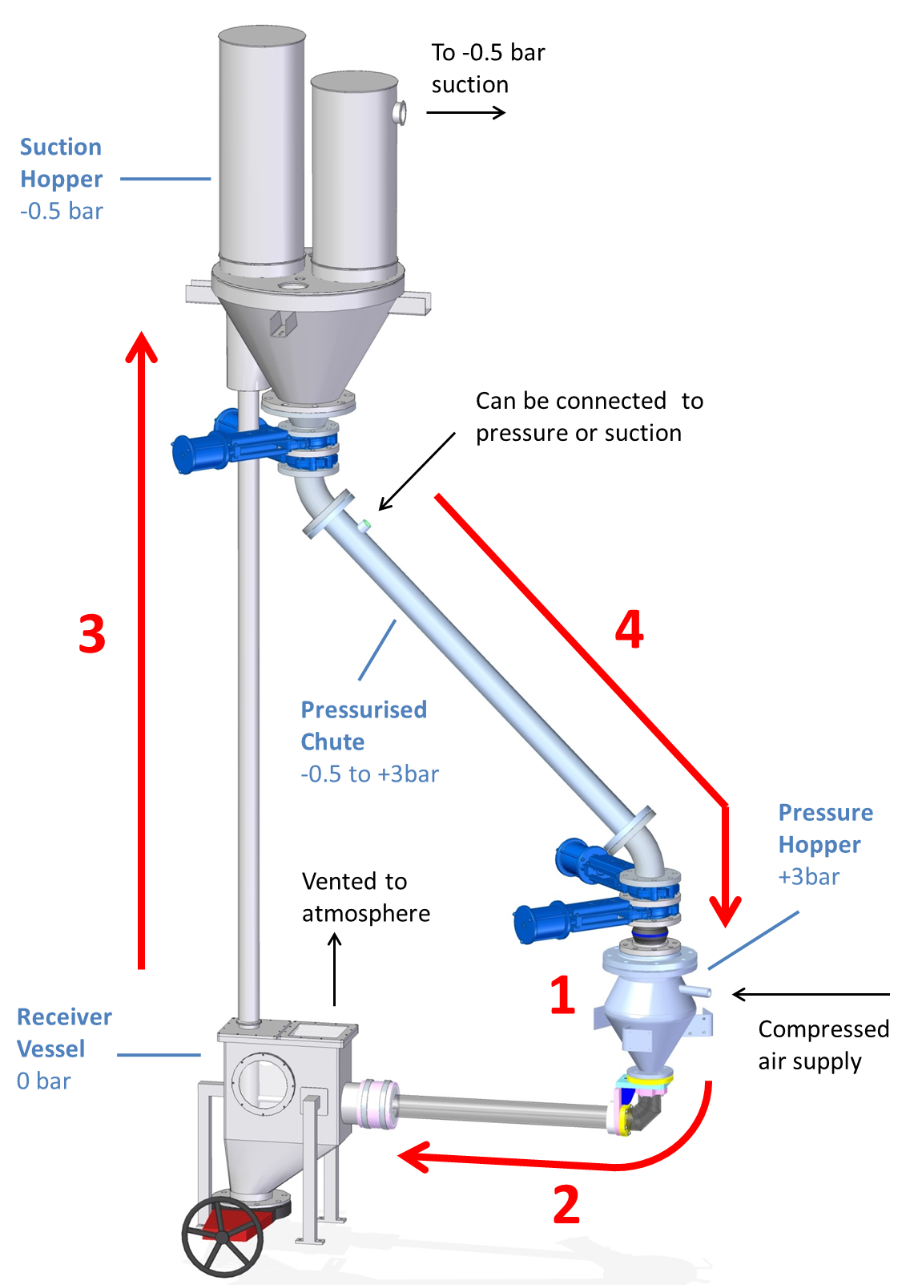
Lots of Questions!
How do we answer them?
Build it and test it, bit by bit!

Slide 29
Testing proposals
Scoped a new test rig, for when the funds become available
Data from our current tests enable the selection of key parameters to investigate
Progression of erosion work from flat plate to in-situ testing on real pipes
Real target geometry can be made outside a beam

Slide 30
Summary
Fluidized tungsten is a promising alternative to solid targets for intense beams
Concept architecture is in place
Engineering characterisation tests planned to enable design of prototype system
Erosion testing improving our understanding of the system
Physics studies progressing… see next talk!
Computational simulation of parts of the system might be possible in the future…

Slide 31

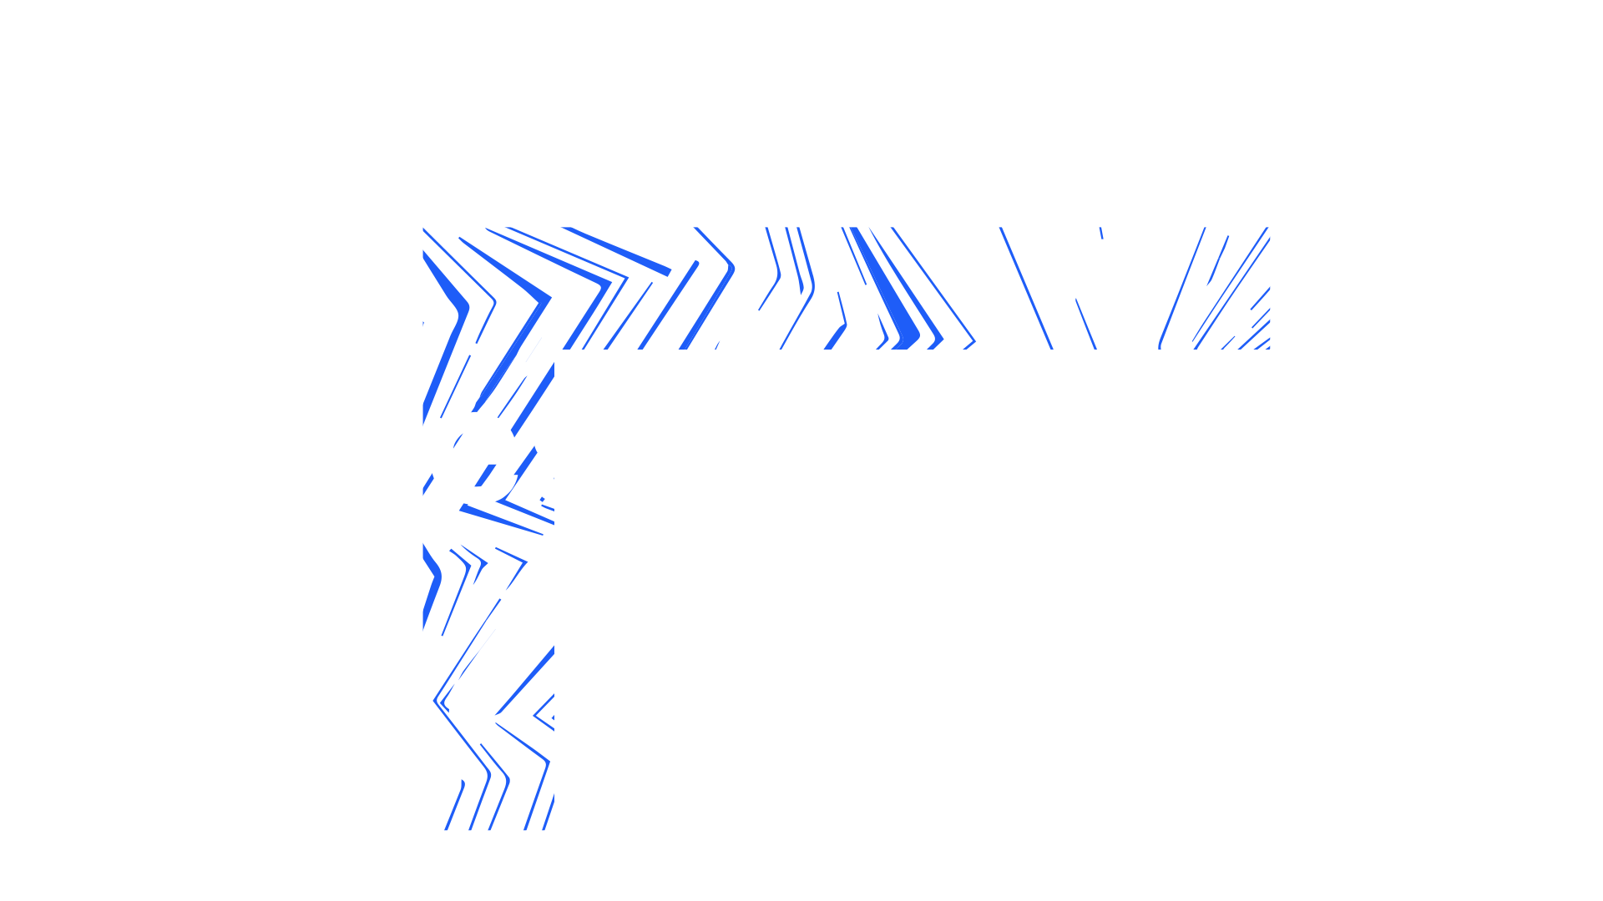

Questions?
Notes:
The abstract pattern can be removed or repositioned if required. Be careful to ‘Send to Back’ so that it does not obscure any important information.

Slide 32
