Slide 1


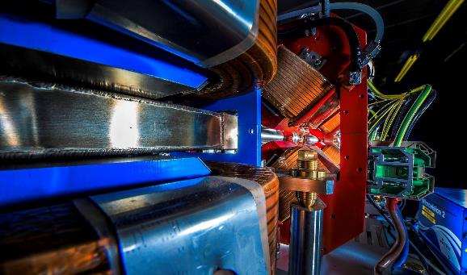
Making a brighter future through advanced accelerators
Welcome to Daresbury Laboratory and ASTeC
Peter McIntosh
Deputy Director of ASTeC
16th January 2026

Slide 2

UK Research and Innovation (UKRI) Science and Technology Facilities Council (STFC)
We work with the UK government to invest ~ £9 billion a year in research and innovation by partnering with academia and industry to make the impossible, possible.
Through the UK’s 9 leading academic and industrial funding councils, we create Knowledge with Impact.

Slide 3

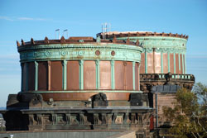
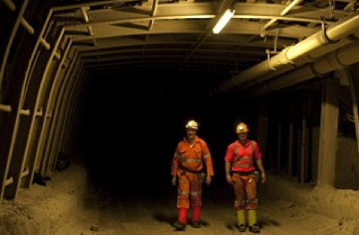
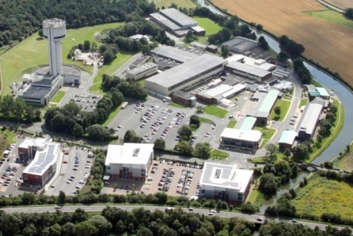
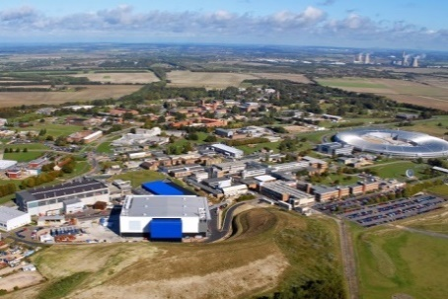
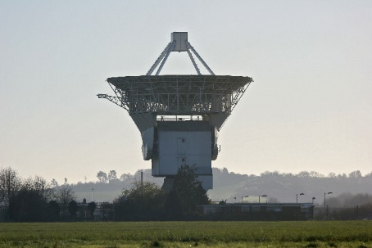
STFC National Laboratories
Astronomy Technology Centre
Boulby Underground Laboratory
Daresbury Laboratory
Rutherford Appleton Laboratory
Chilbolton Observatory
3

Slide 4
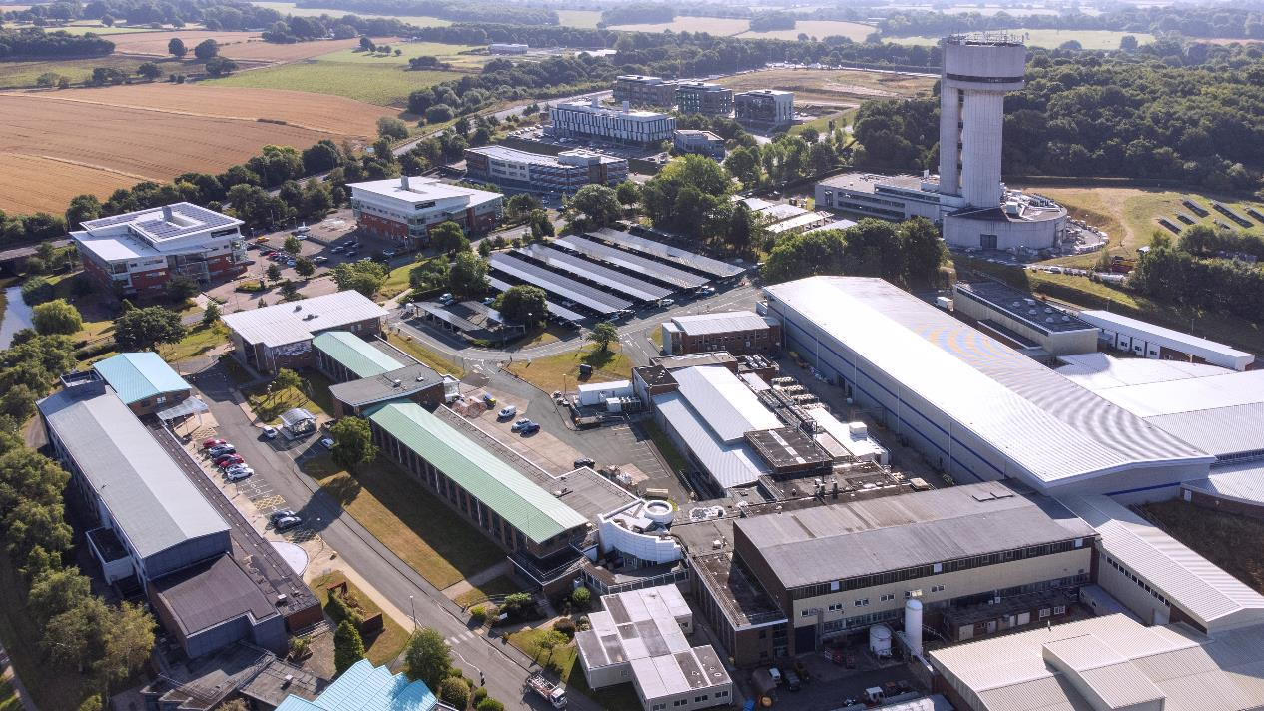
Daresbury Laboratory and Campus
Daresbury Laboratory is an STFC National Laboratory with ~ 650 staff.
Major activities are centred around particle accelerators, scientific computing, high performance computing and nuclear physics.
The wider campus hosts >160 businesses and the Cockcroft Institute.
Approx 2000 people in total.
4

Slide 5






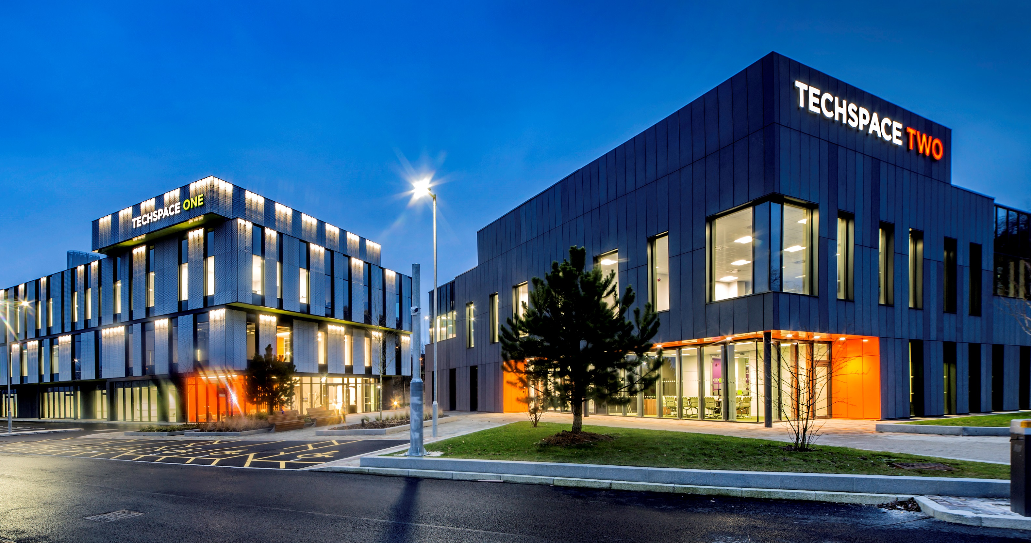
Daresbury Campus Companies
Over 160 high-tech companies:
~20% international companies.
Sector focus:
Advanced Engineering & Materials (55)
Life Sciences & Healthcare (48)
Digital (53)
Energy & Environmental (14)
Sales growth 25% pa
6% company failure rate
76% companies collaborate on campus
Image © STFC John Dawson
5

Slide 6
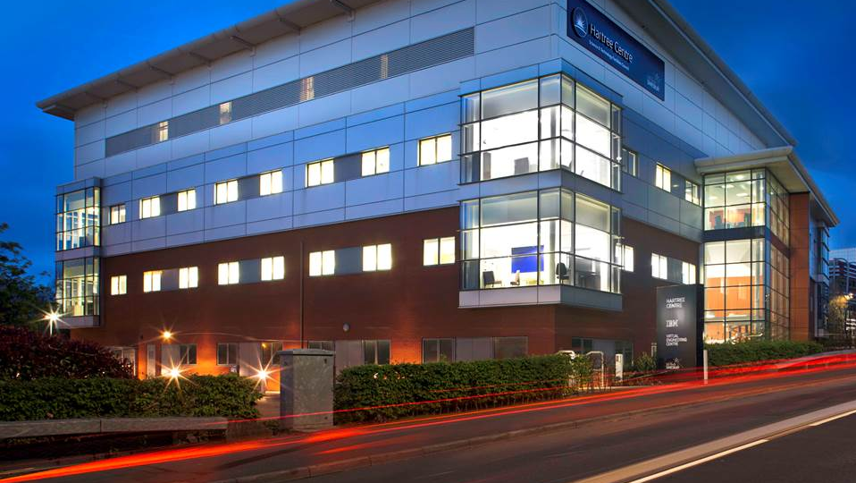

Our track record
The Hartree Centre
STFC’s high performance computing, data analytics and AI research centre
Staff based in the building include:
STFC
IBM Research
University of Liverpool, Virtual Engineering Centre
6
Notes:
First IBM Research base in the UK
25+ IBM Research staff
20 VEC staff
Atos have a hot desking office & permanent technical staff
Fostering collaboration and creating a hub for digital technical expertise to the North West
Key asset in Northern Powerhouse
Partner in LCR4.0 programme – 3 year programme to digitise SMEs in the Liverpool City Region, 100 SMEs engaged in the first year
The University of Liverpool runs an MSc in Big Data and HPC in conjunction with the Hartree Centre

Slide 7
Accelerator Science and Technology Centre (ASTeC)
UKRI’s Centre of Excellence in particle accelerator R&D.
Development of major new types of accelerators and provide In-Kind Contributions overseas.
Based at Daresbury Laboratory with >110 staff.
In partnership with Technology Department, contain all the skills/expertise to develop accelerators from Cradle to Grave:
A One Stop Shop!
Lead and operate CLARA, which is STFC’s flagship accelerator test user facility.
Have an excellent track record in supporting industry to develop and test new products.
An active partner in the Cockcroft Institute.
Have ~350 accelerator professionals, academics, post docs and PhD students active at Daresbury.
7

Slide 8
CLARA Upgrade
A major upgrade of CLARA is now installed, which will increase its capabilities significantly.
Preparing for Friendly User Operations right now.
Upgrades expect to establish CLARA as one of Europe’s premier accelerator test facilities.
CLARA transitioning from a facility under constant development to a full operational facility, able to support an increased community of users.
CLARA Upgraded Beam Parameters:
Up to 250 MeV electron beam
10 Hz to 100 Hz (400 Hz possible at <200 MeV)
10 TW to 120 TW
~1 ps to ~50 fs bunch length
8

Slide 9
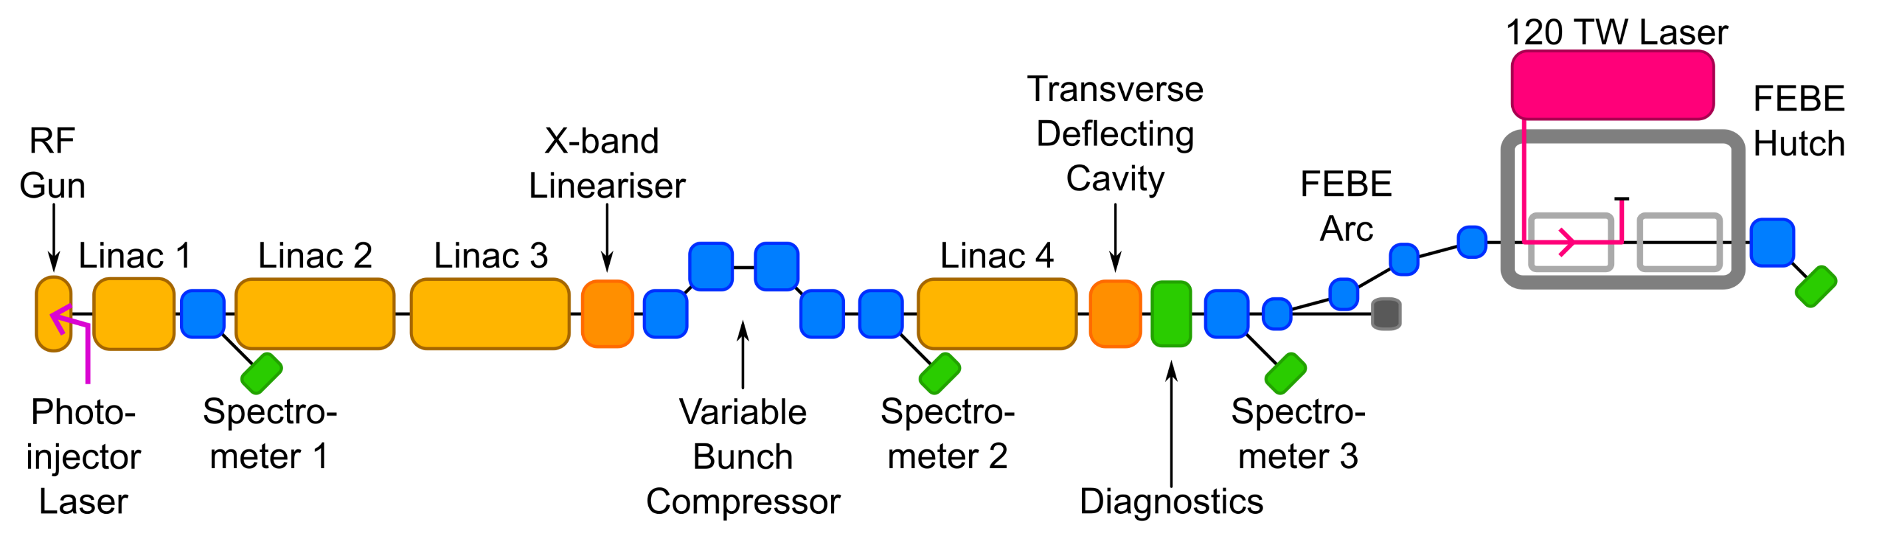
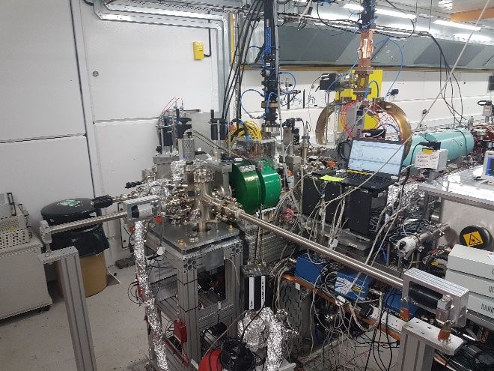
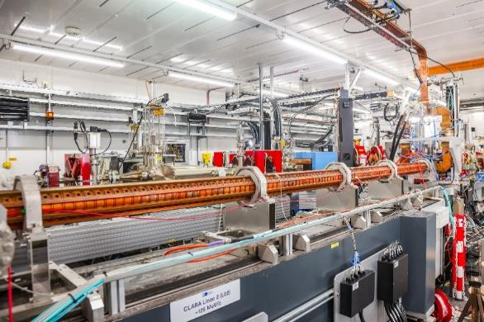
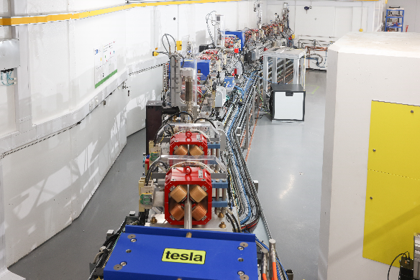
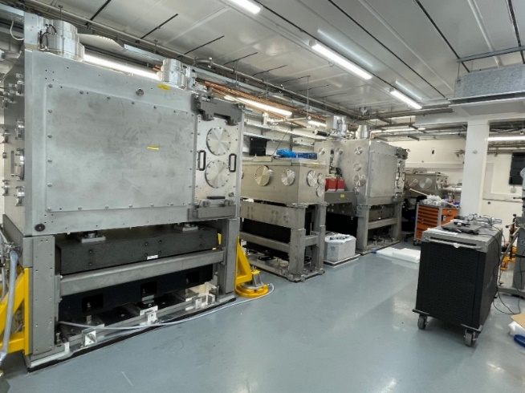
CLARA Layout
Accelerator Hall
~90m x 3.5m x 3m
Generate
Accelerate + Manipulate + Accelerate
Characterise in 6D
Experiment
9
CLARA Gun
S-band Linac
Arc to FEBE hutch
FEBE hutch

Slide 10
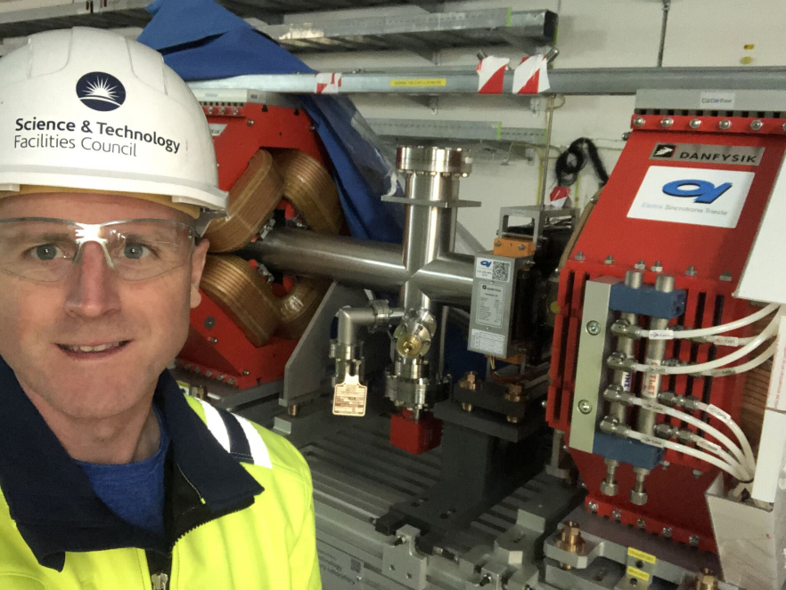
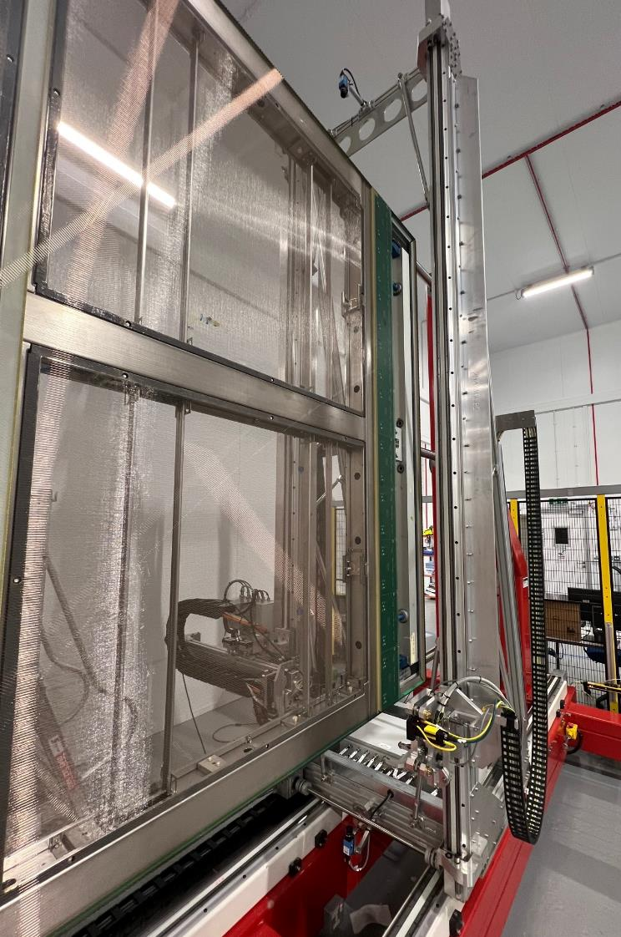
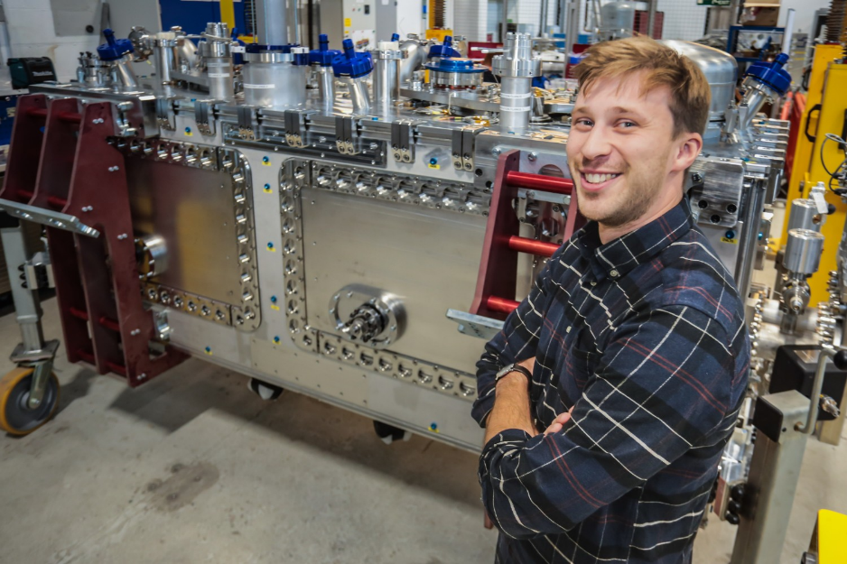
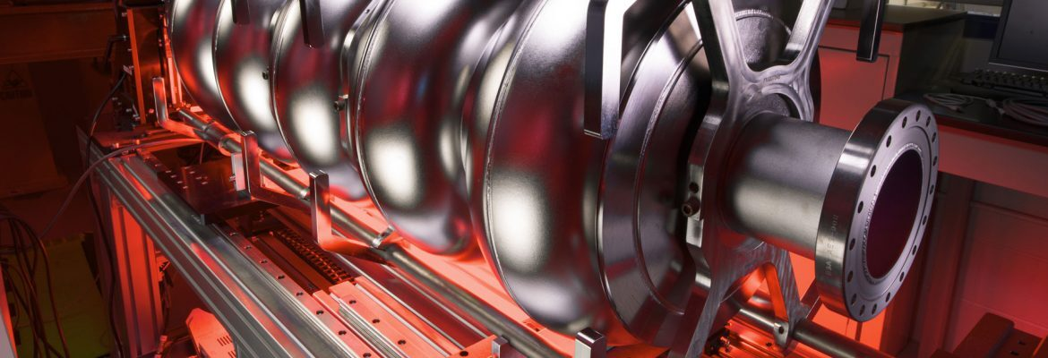
In Kind Contributions
Daresbury delivering major in-kind contributions to international accelerator projects.
European Spallation Source (2015 – 2025)
Superconducting RF Cavities – Complete.
Linac Warm Units – Complete.
RF Waveguide Distribution System – Complete.
LBNF/DUNE (2019 – 2027)
3 High Beta SRF Cryomodules for PIP-II.
137 APA Detectors.
High Luminosity-LHC (2019 – 2027)
Crab Cavity Cryomodules – prototype delivered and tested on SPS.
4 Production Cryomodules.

Slide 11
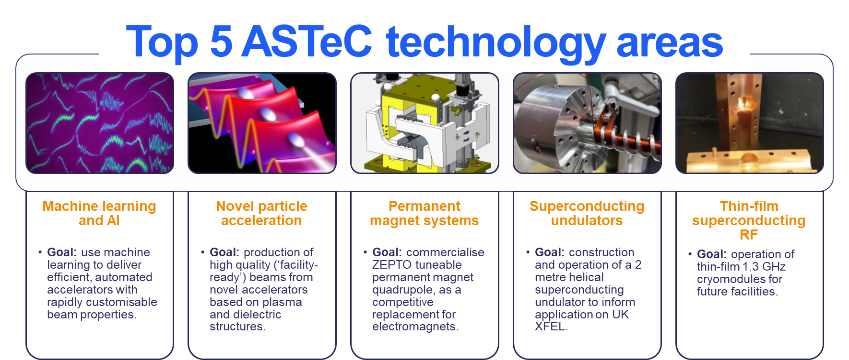
Sustainable Accelerator R&D
ASTeC carries out R&D that aligns with STFC’s Strategic Framework for Accelerators – supports long term infrastructure priorities and/or R&D roadmap for European Strategy for PP.
Emphasis on Future Sustainability of Accelerators.
CLARA accelerator test user facility directly supports academic and industrial communities.
11

Slide 12
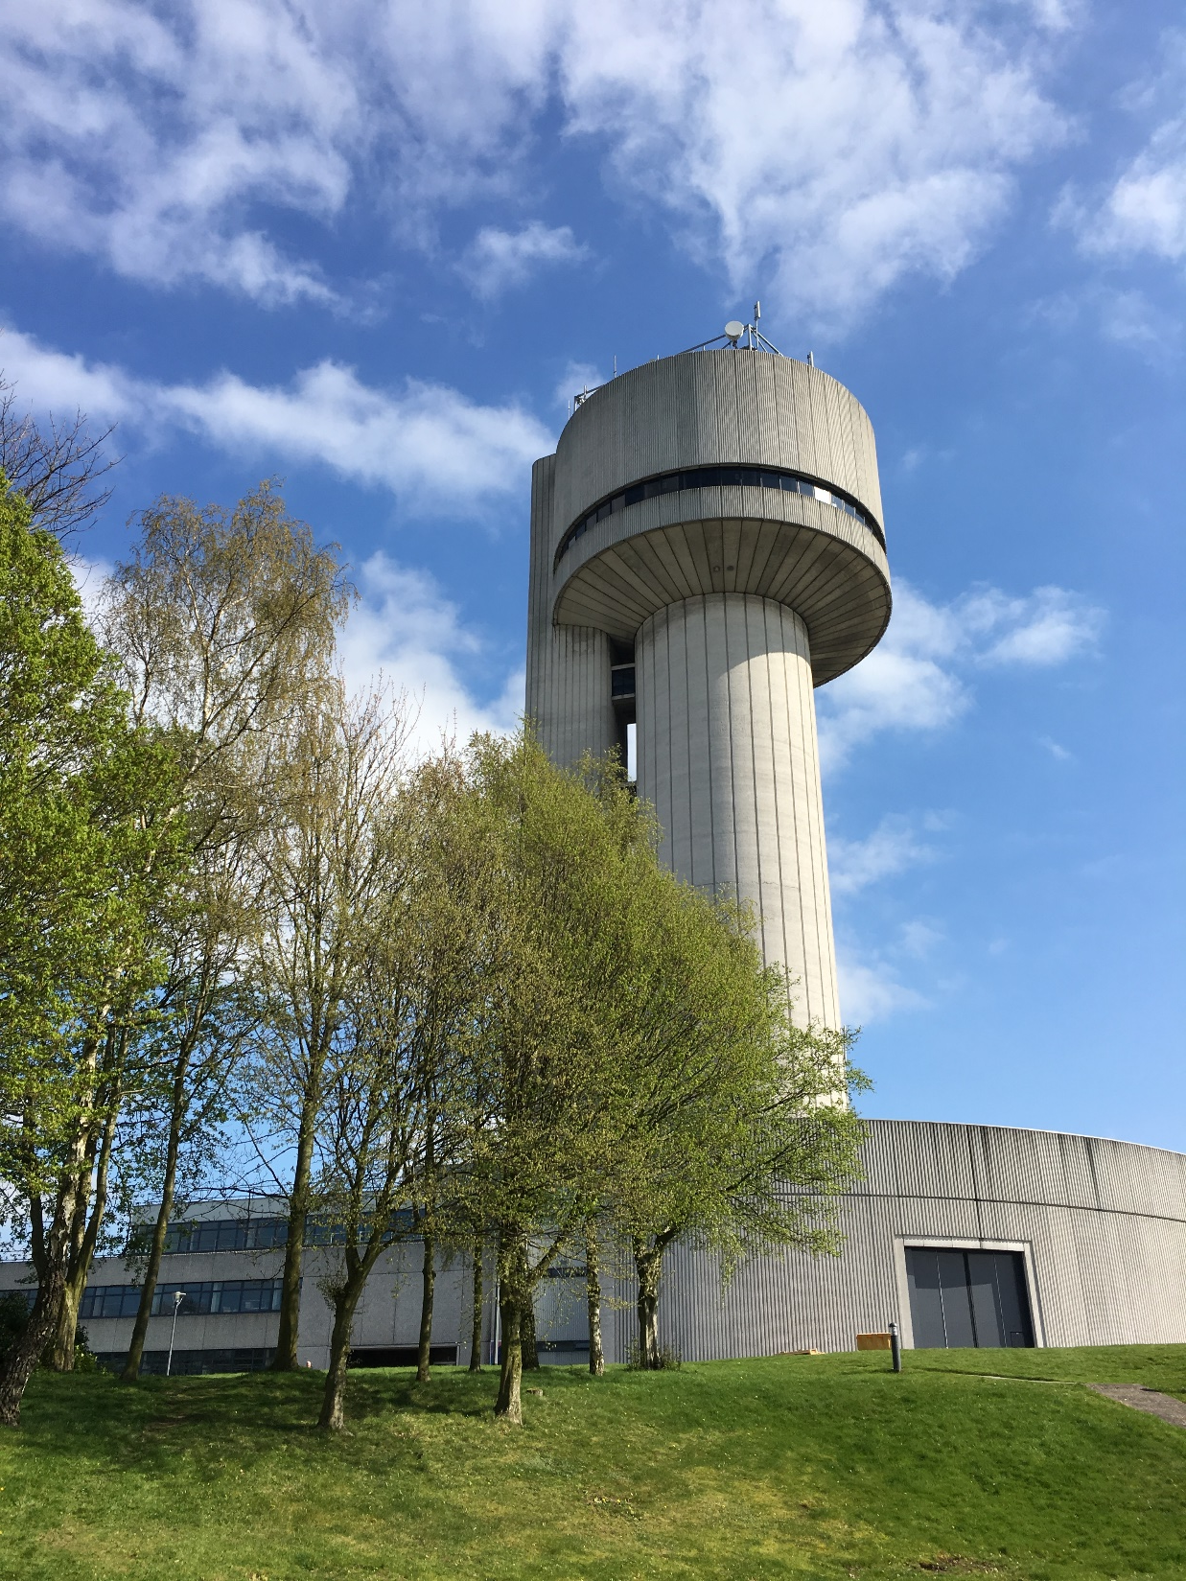
STFC Daresbury Laboratory THANK YOU
www.stfc.ac.uk

