Slide 1
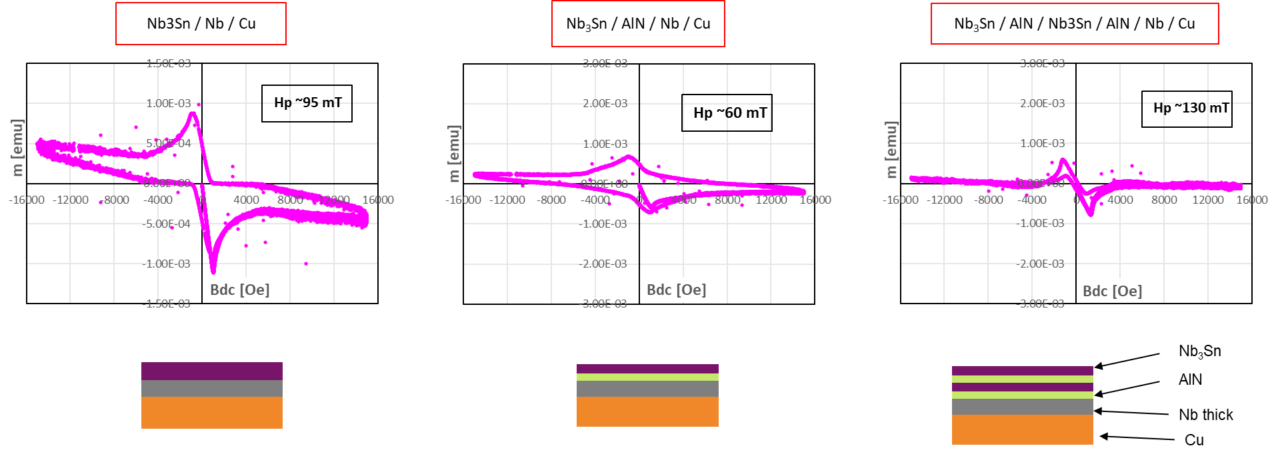
Pushing SRF Thin Films Limits: Theoretical Advances, Deposition Modeling & DFT
DFT
DFT vs 200years old thermodynamics : is it really useful ? (same predictions!!!)
Should it be rather applied to more complex situations where thermodynamic calculation is difficult (interfaces, distorted lattice, local non-unifomity)? Could we define problems to be solved in order of priority ?
Deposition modeling
How do predictions compare with experiment ? Main lines or more precise?
Can it help to compare deposition techniques?
Can it help to design deposition set-ups yet?
Multilayers:
Trapped flux: how do they behave compared to bulk calculation (cf DC magnetization curve, can they be reproduced ?
ML are known to be effective trapping configuration for tapes (cf Clem who proposed them first for coils applications in the 70s). Is it a matter of regime ?
(SI)nS: how many layers to get rid of Nb? with MgB2? With pnicnide (cf A. Miyazaki)?
Superconductivity
Exchange between theory and exp : provide more realist parameters for ξ, λ, M.F.P.,...(films vs bulk). What needs to be measured, how is it already measured in other communities)

