Slide 1

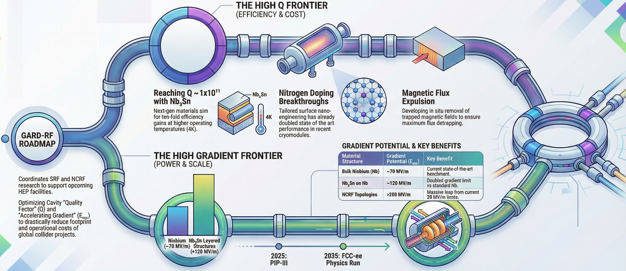



Ongoing
DOE RF Roadmap
Update Exercise
SRF Overview
09/21/2026
Anne-Marie Valente-Feliciano & Matthias Liepe
Emilio Nanni, Sam Posen
Notes:
Tip: Keep titles under 60 characters for readability
To change the photo: Right-click on photo and select change photo

Slide 2
DISCLAIMER
This is a preliminary summary of the ongoing exercise with highlights from presentations & discussions that took place
The Roadmap is not finalized yet.

Slide 3
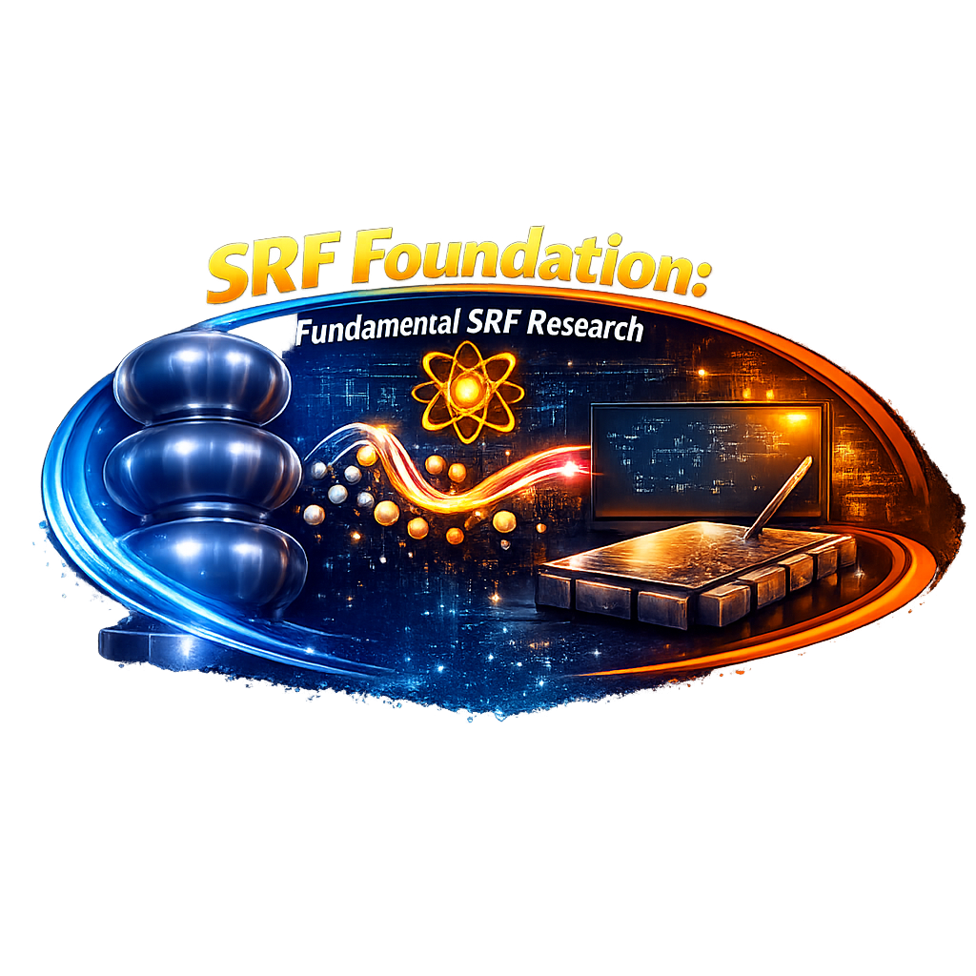


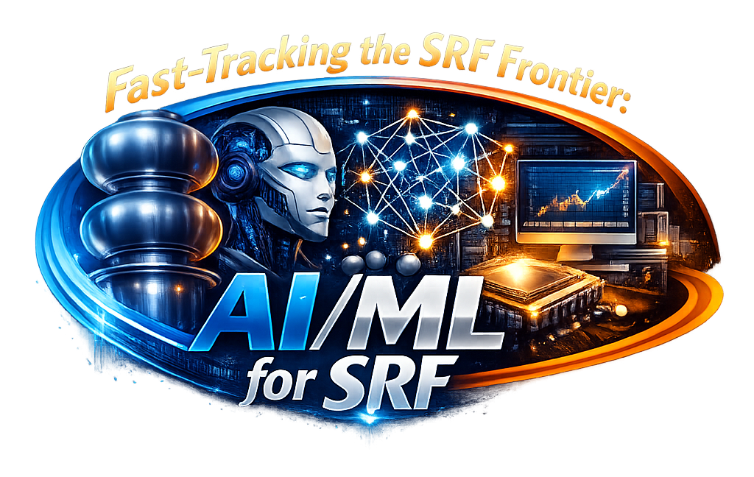
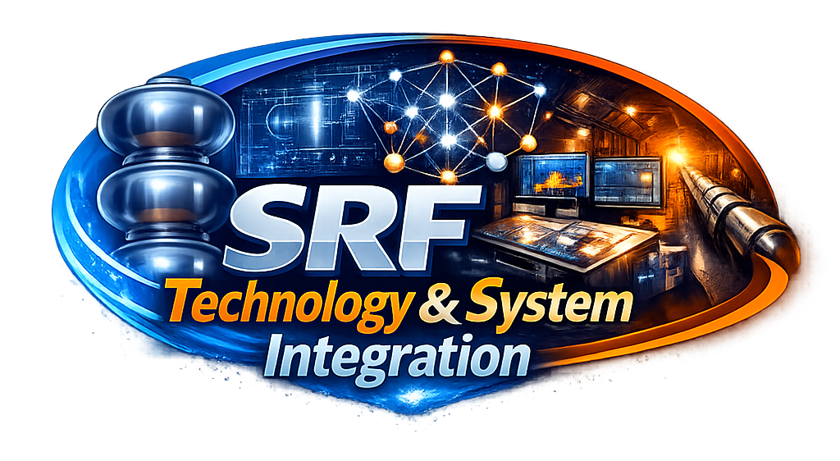
Outline
The last decade for High Q/High G
Current Update Exercise
Challenge areas for the next decade
Concluding Remarks

Slide 4
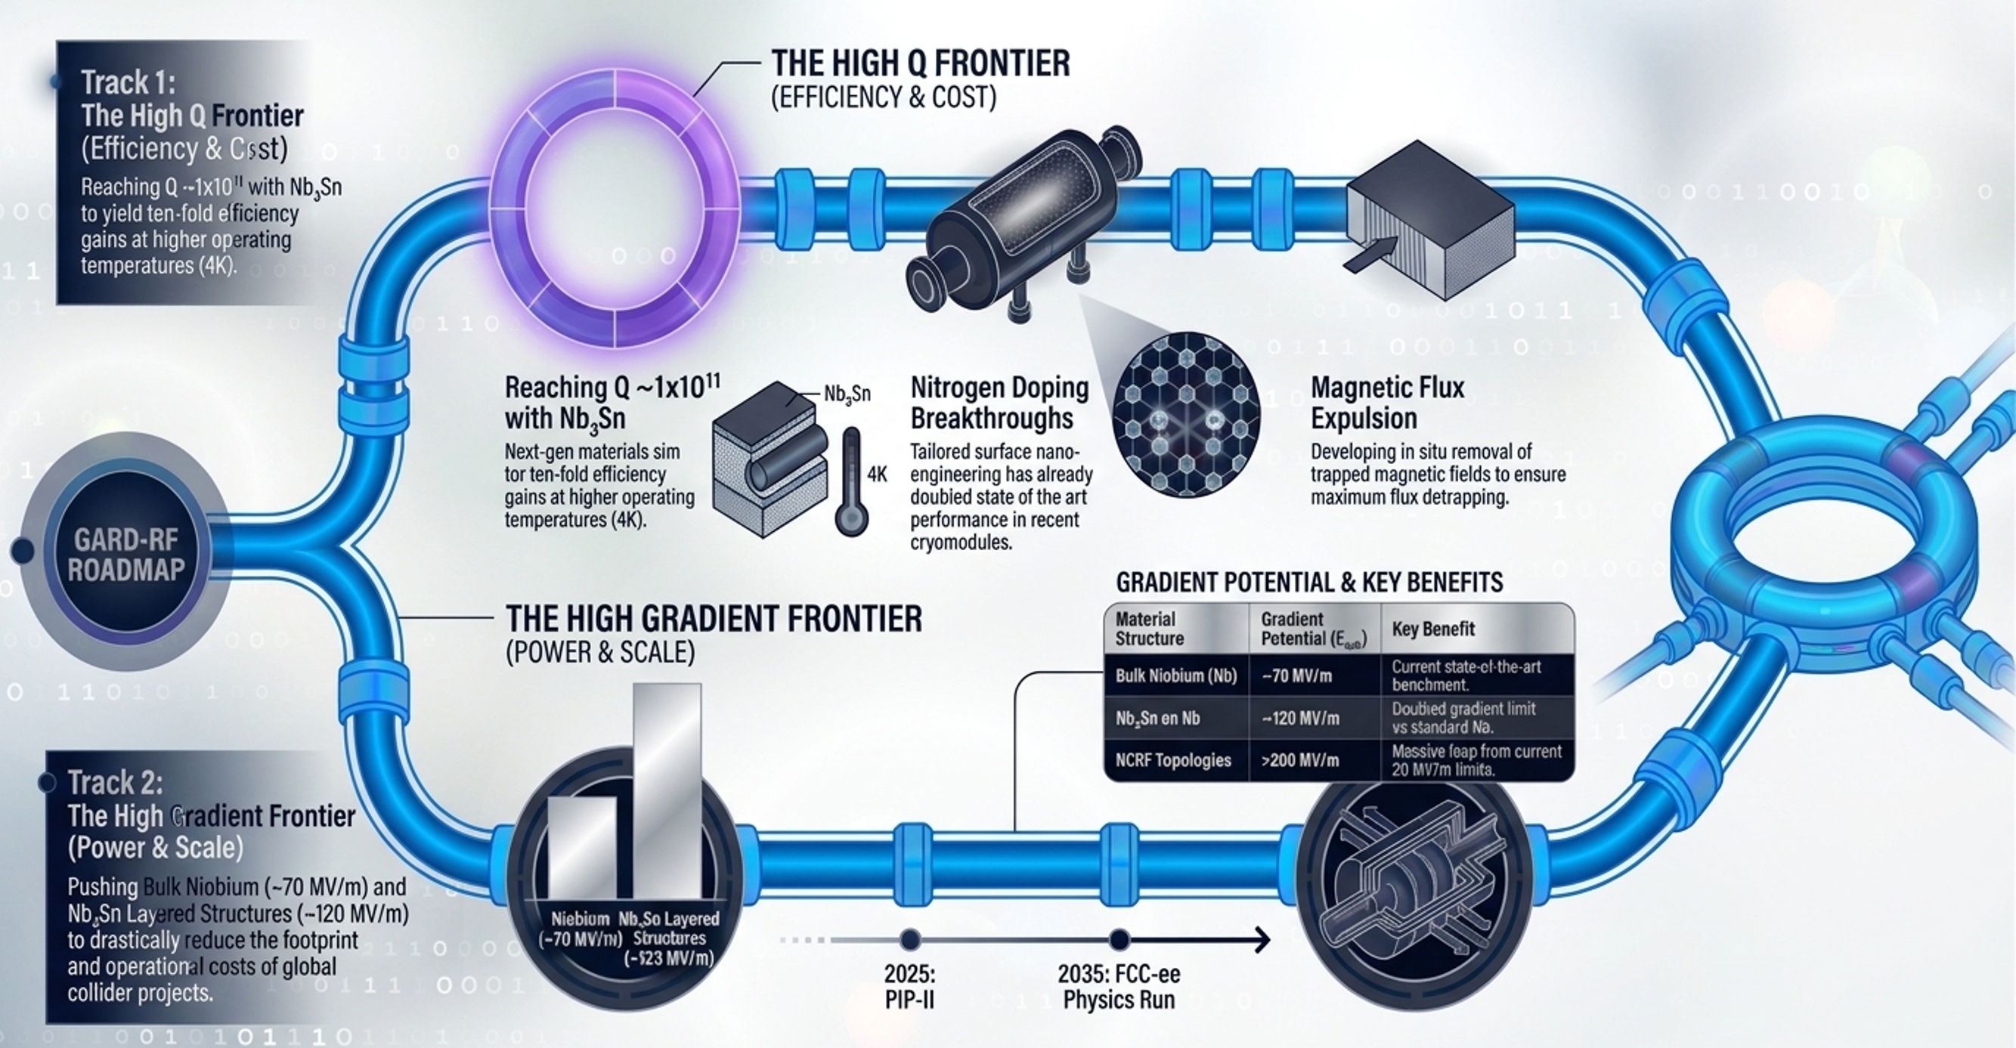
THE LAST DECADE

Slide 5
DOE GARD RF Roadmap - circa 2017

Slide 6
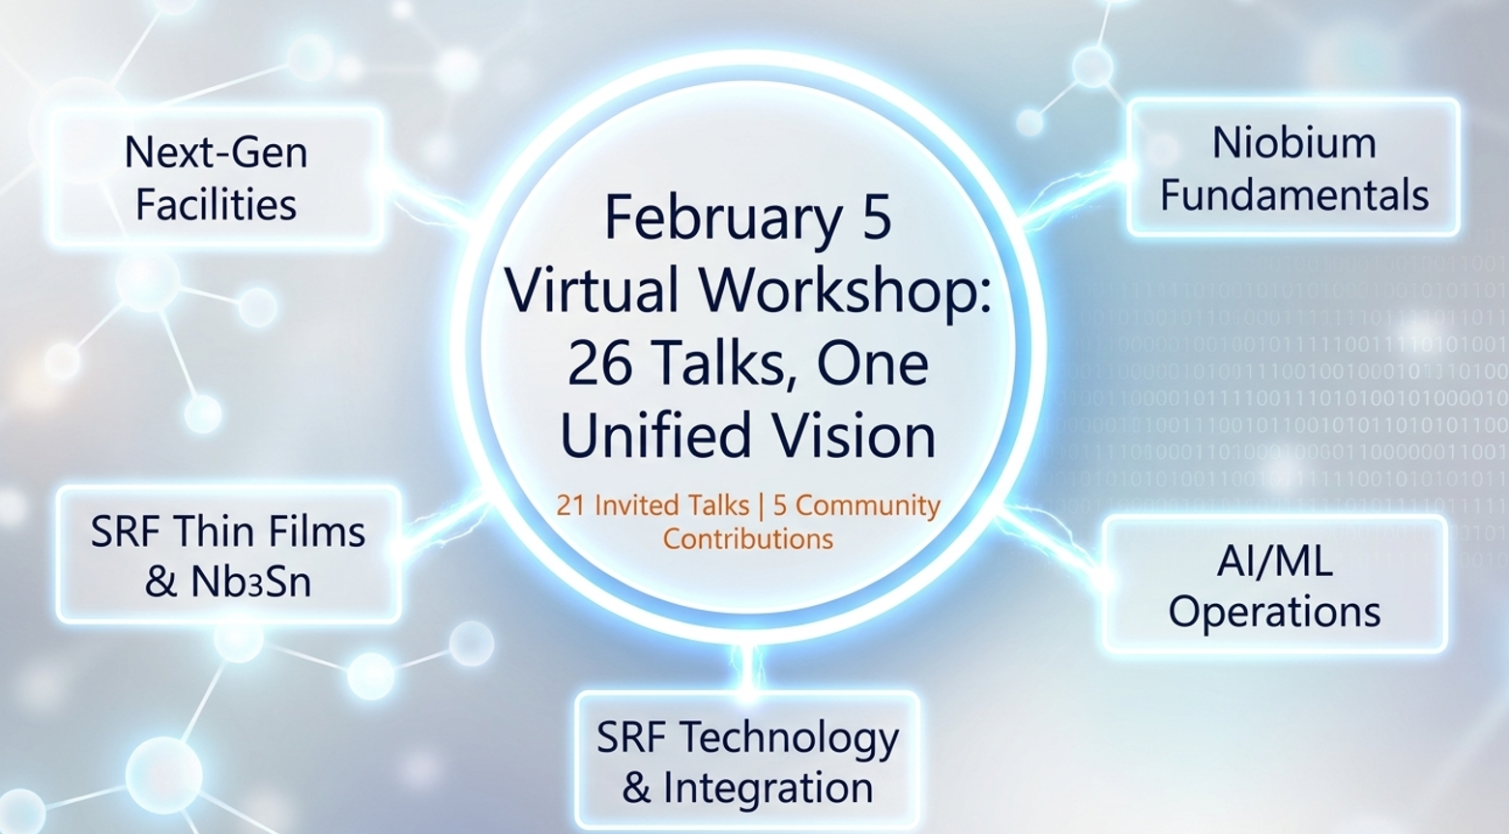
Toward the future: Roadmap update process
Community meetings
4 virtual 1-day events
2-day Workshop with summaries from conveners & extensive discussions

Slide 7
THE DEMAND: NEXT-GEN FACILITY NEEDS
Facility | Fermilab Complex / Muon Collider | EIC-ee | FCC-ee | Industrial / Ion (ATLAS)
Challenge | High intensity, low frequency (352 MHz). | Challenge: High luminosity, 800 kW power. | Challenge: 400 MHz (Nb/Cu) & 800 MHz (Bulk Nb). Or updated baseline | Challenge: Cost-efficient, compact footprints.
Critical Needs | Nb/Cu SRF technology, high-power fundamental couplers (MW range), efficient stray magnetic shielding. | Broadband HOM damping, heavily damped low-loss systems, robot-assisted clean assembly, ultra-low noise LLRF for 197 & 394 MHz crab cavities. | Ultra-high Q₀ at moderate gradients, high-efficiency RF sources (Tristrons). | Nb₃Sn, conduction cooling (liquid-He-free), robust low-loss cryomodules.

Slide 8
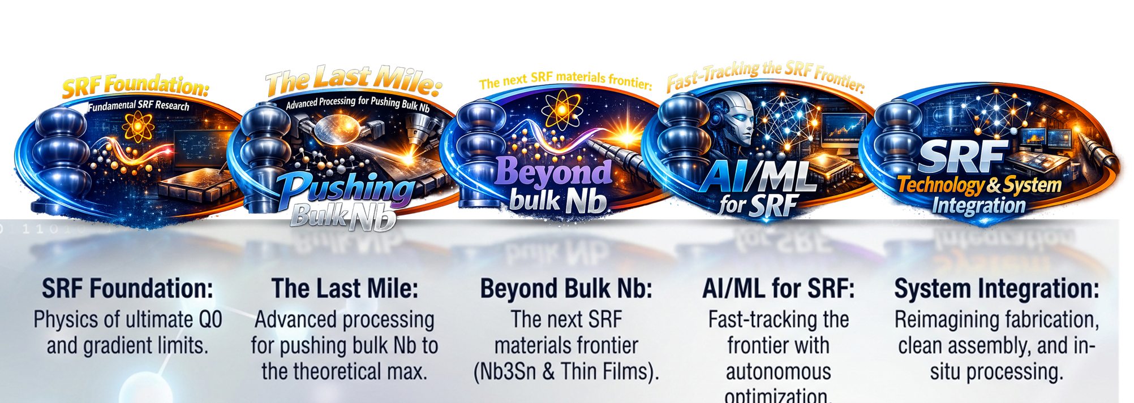
CHALLENGE AREAS IDENTIFIED FOR THE NEXT DECADE

Slide 9
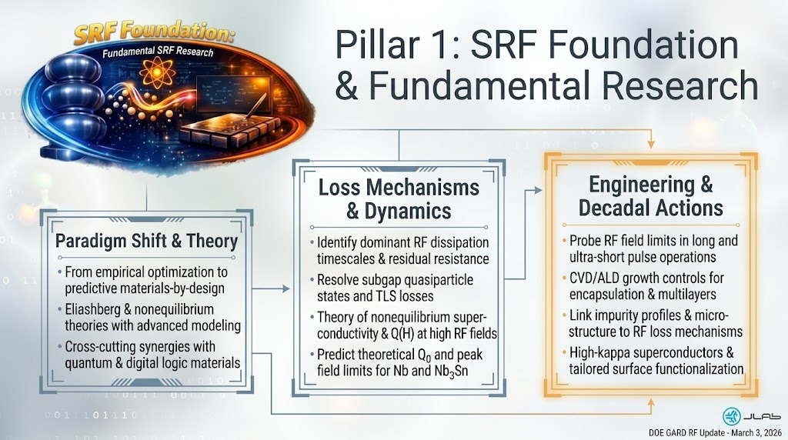
SRF Foundation & Fundamental Research

Slide 10
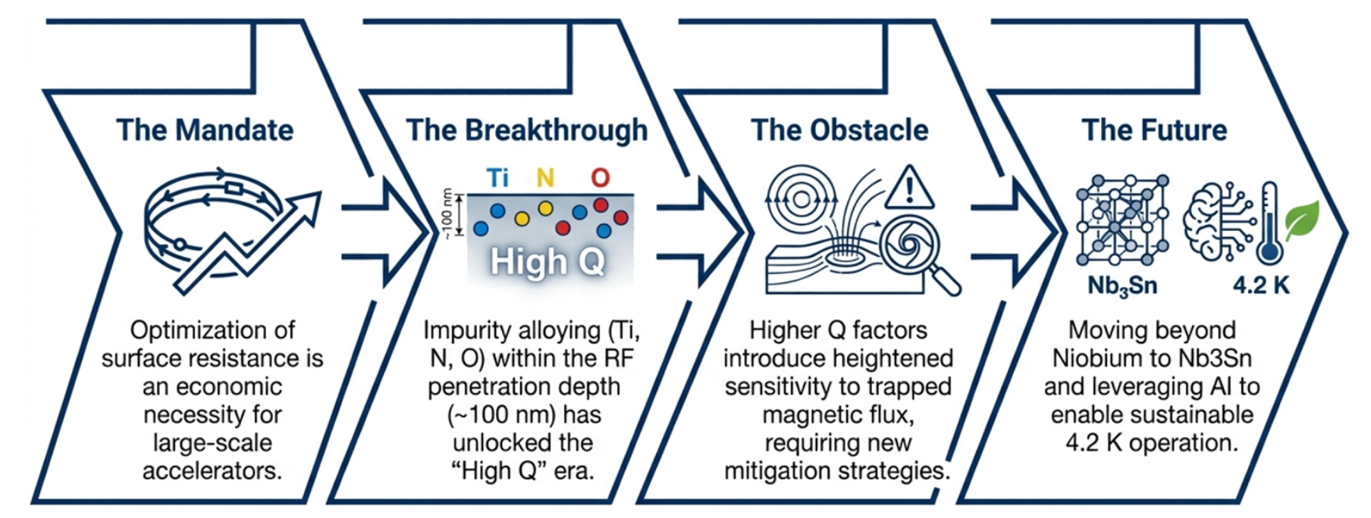
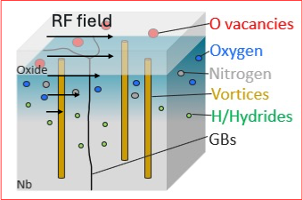
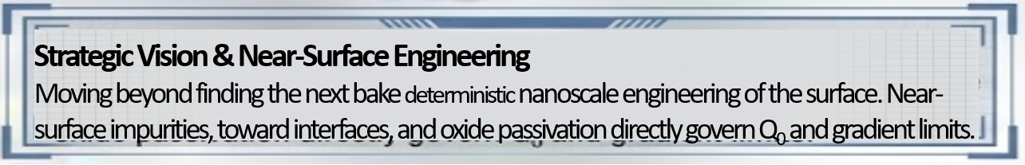
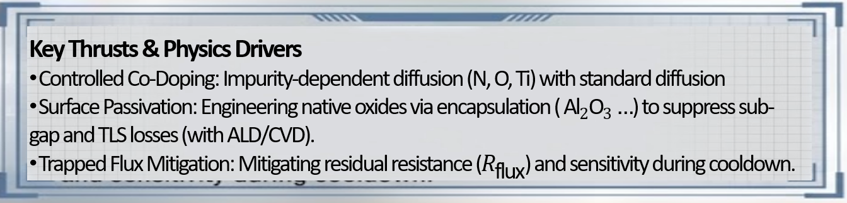
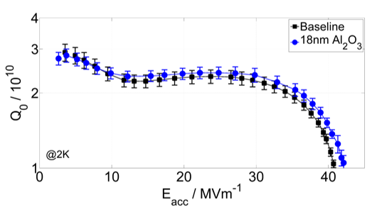
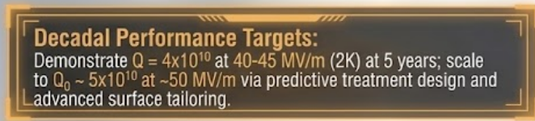

The Last Mile for bulk Nb

Slide 11
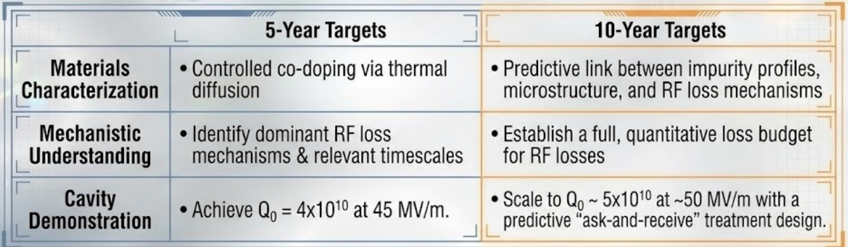

The Last Mile for bulk Nb

Slide 12
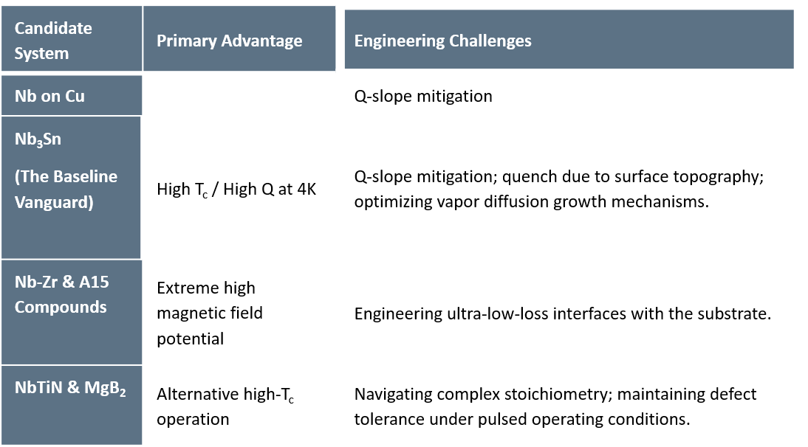
Beyond bulk Nb

Slide 13
Beyond bulk Nb

Slide 14
Beyond bulk Nb
PVD & HiPIMS Optimization
Deployment of High-Power Impulse Magnetron Sputtering (HiPIMS) enables energetic condensation. This drastically increases the usable accelerating gradient of Nb/Cu films, particularly vital for low-frequency structural applications.
Thermodynamic Matching
Thin-film growth cannot be a one-size-fits-all process. Hybrid Growth Approaches must be strictly tailored to the thermal budget limits of the specific film-substrate pairing to prevent delamination or phase degradation.
System Integration Hurdles
Translating raw materials to accelerator-ready cryomodules requires:
Mitigating bi-metallic contamination (e.g., Ti, Si).
Engineering structural mechanical strength.
Managing high tuning sensitivity.
Adapting robotic cleanroom handling protocols for delicate films.

Slide 15
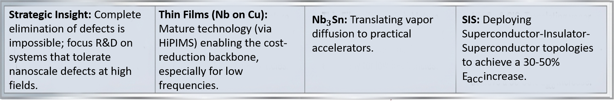
Beyond bulk Nb

Slide 16
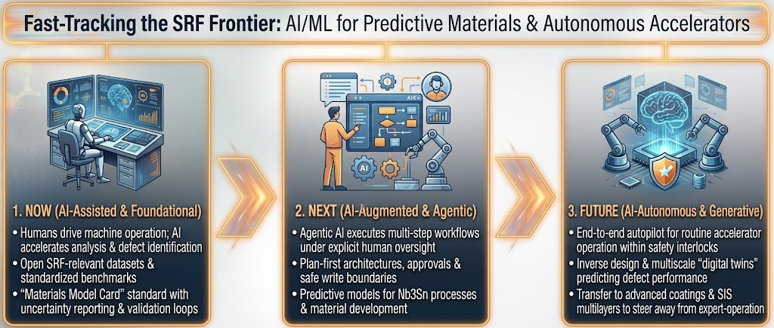
AI/ML FOR SRF OPERATIONS & DISCOVERY

Slide 17
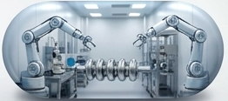
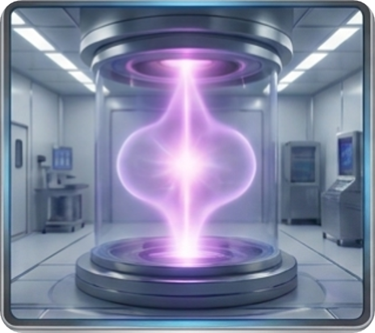
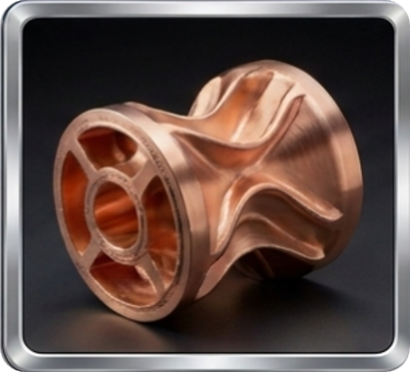

Re-Thinking Fabrication & System Integration
In-situ Processing
Deploying plasma & ozone processing to mitigate field emission & multipacting without requiring cryomodule disassembly
Advanced Manufacturing
Moving past 40-year-old conventional methods to embrace additive manufacturing & novel shapes
Robotic Assembly
A paradigm shift toward robotic-assisted cleanroom assembly, optimizing ergonomics & drastically reducing contamination for gradients > 40 MV/m

Slide 18
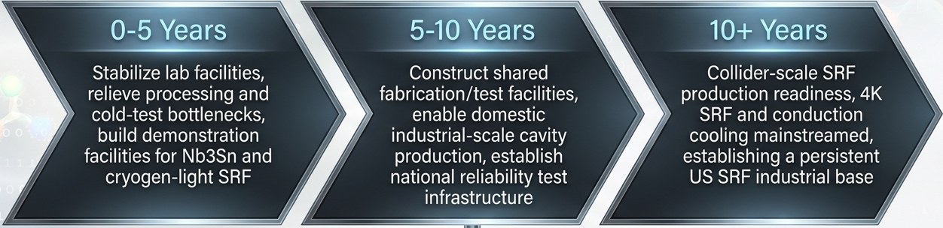
SRF Ecosystem:
Develop Workforce & Evolve Infrastructure from Project-driven to Programmatic Capacity
    Integrated workforce development across universities, labs, and industry

Slide 19
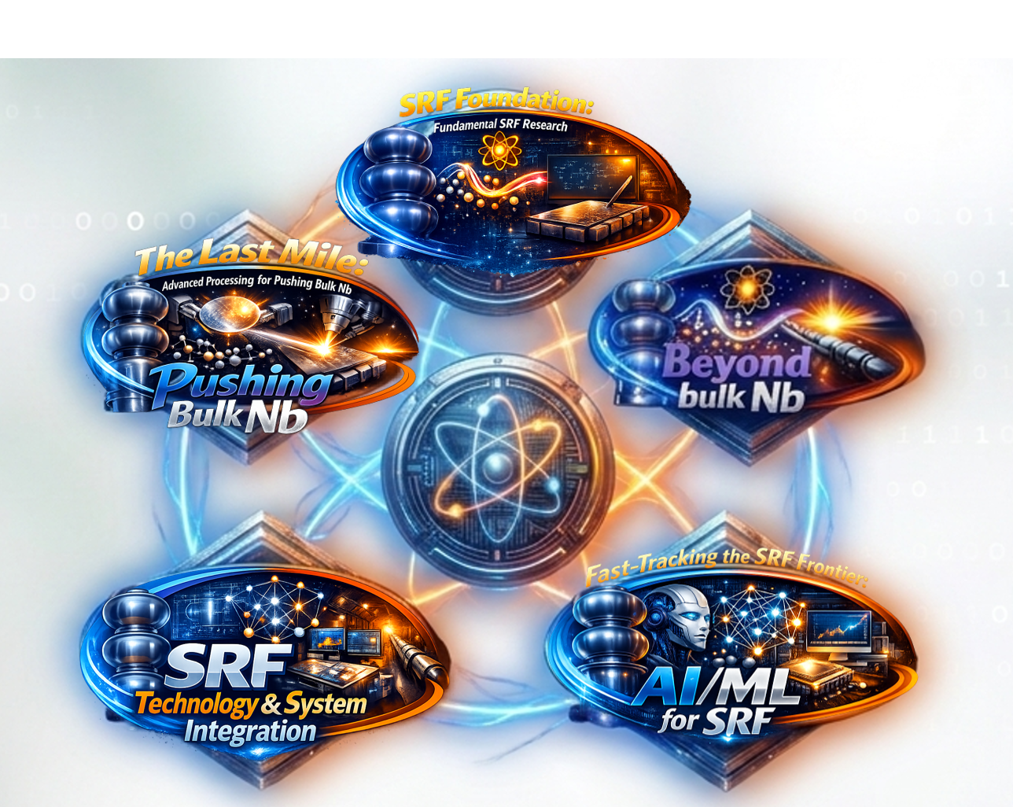
Concluding Remarks
The next decade of SRF will demand a holistic, materials-informed innovative approach (Nb₃Sn, Thin Films) coupled with an integration of novel manufacturing, robotic assembly and AI frameworks.
Alignment of resources and programmatic capacity across ASCR, BES, HENP, and NNSA to support the 2026-2036 roadmap.
Stay tuned!
Updated decadal Roadmap will have 5- & 10-year milestones, calls for action…

