Slide 1

Adsorption of Water on Niobium and Its Surface Oxides in the Medium-Temperature Baking(MTB) Regime: An ab initio Study
SRF Group-LINAC Center-IMP, CAS
Shantong Chen, Didi Luo
21st.September.2026

Slide 2
Outline
Research Background
  Development of MTB Studies
  EELS and TEM Test Results
  In-situ vs. Ex-situ MTB Cavity Vertical Test
Short Introduction of Density Functional Theory(DFT)
DFT Study Results: Adsorption and Desorption
Summary and Future Plan

Slide 3
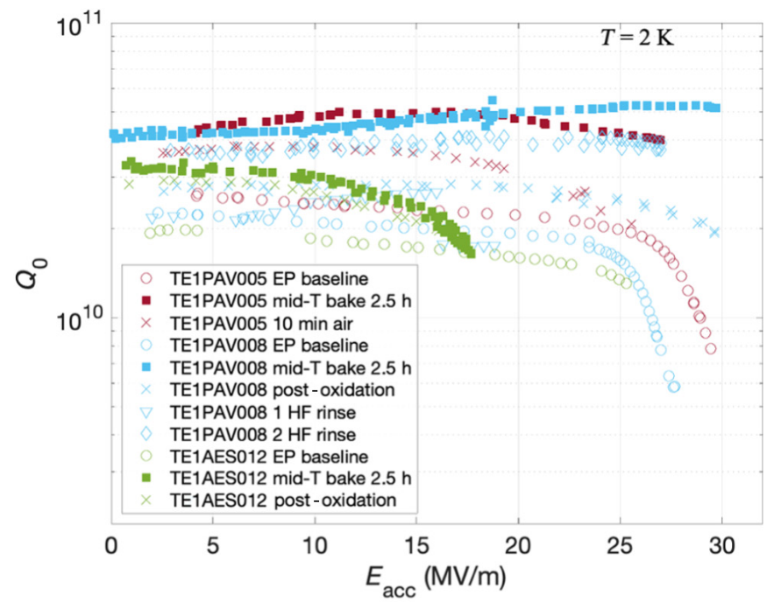
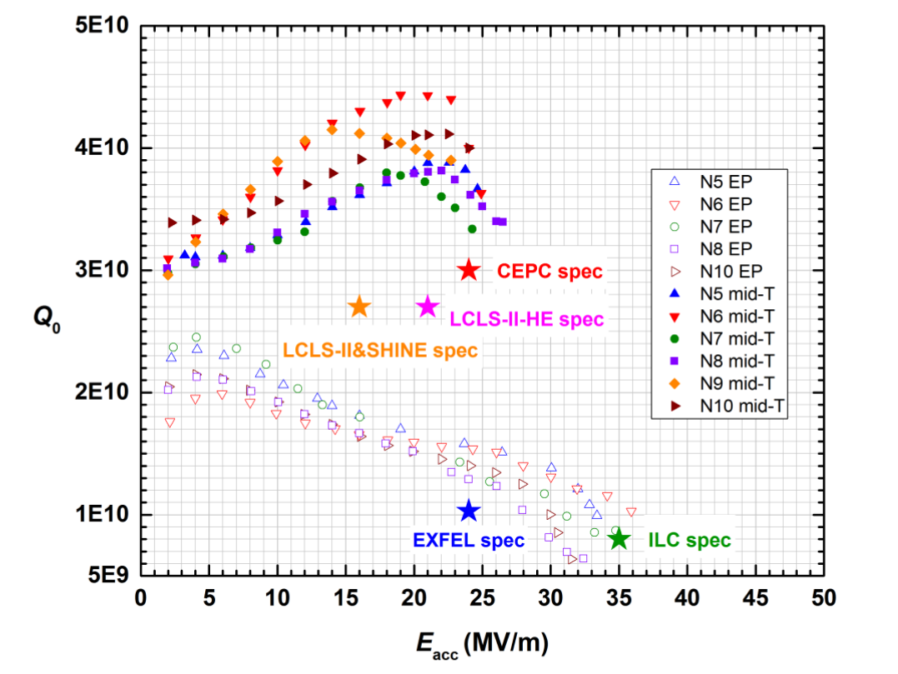
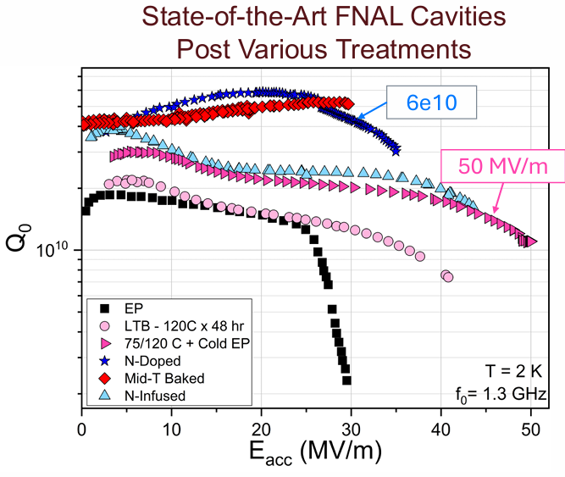
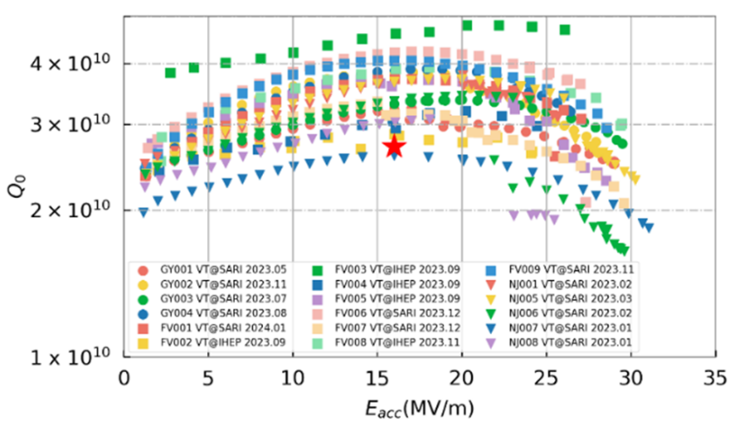
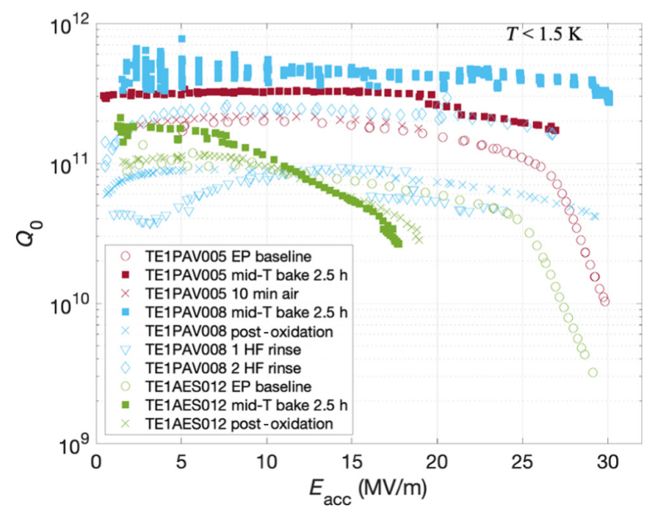
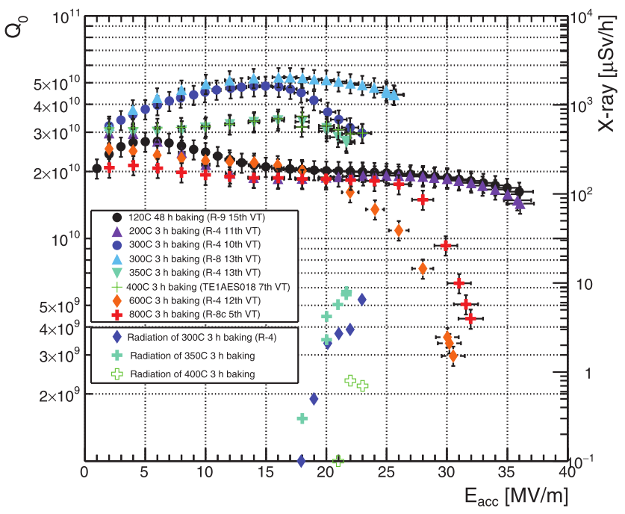
Background and Significance: Development of MTB Studies
MTB(~250-400 ℃)-3 h can efficiently enhance the quality factor Q, and has been implemented in engineering applications.
(250-400 ℃)-3 h
3.8×10¹⁰ @16 MV/m
300 ℃-3 h
3.5×10¹⁰ @16 MV/m
350 ℃-3 h
5×10¹⁰ @30 MV/m
300 ℃-2.5 h
5×10¹⁰ @ 30 MV/m
IHEP[2]-2020
​(200-800 ℃)-3 h
5×10¹⁰ @ 26 MV/m
SHINE[4]-2024
FNAL Performance Comparison [5]-2025
Wide temperature range test→
~250-400 ℃(temperature window)
FNAL[1]-2019
KEK[3]-2021
[1] Posen, S., Romanenko, A., Grassellino, A. et al. (2020). Ultralow surface resistance via vacuum heat treatment of superconducting radio-frequency cavities. Phys. Rev. Appl. 13(1):014024
[2]He, FEISI, WEIMIN, et al. Medium-temperature furnace bake of Superconducting Radio-Frequency cavities at IHEP[J].
[3]Ito, H., Araki, H., Takahashi, K., & Umemori, K. (2021). Influence of furnace baking on Q–E behavior of superconducting accelerating cavities. Progress of Theoretical and Experimental Physics, 2021(7)
[4]ZONG Y, CHEN J F, WANG D, et al. Accelerating gradient improvement in nitrogen-doped superconducting radio-frequency cavities for SHINE[J/OL]. Nuclear Instruments and Methods in Physics Research Section A: Accelerators, Spectrometers, Detectors and Associated Equipment, 2023, 1057: 168724.
[5]Daniel Bafia,High-Q/high-G Developments at FNAL,International Workshop on Future Linear Colliders (LCWS2025) ,2025

Slide 4
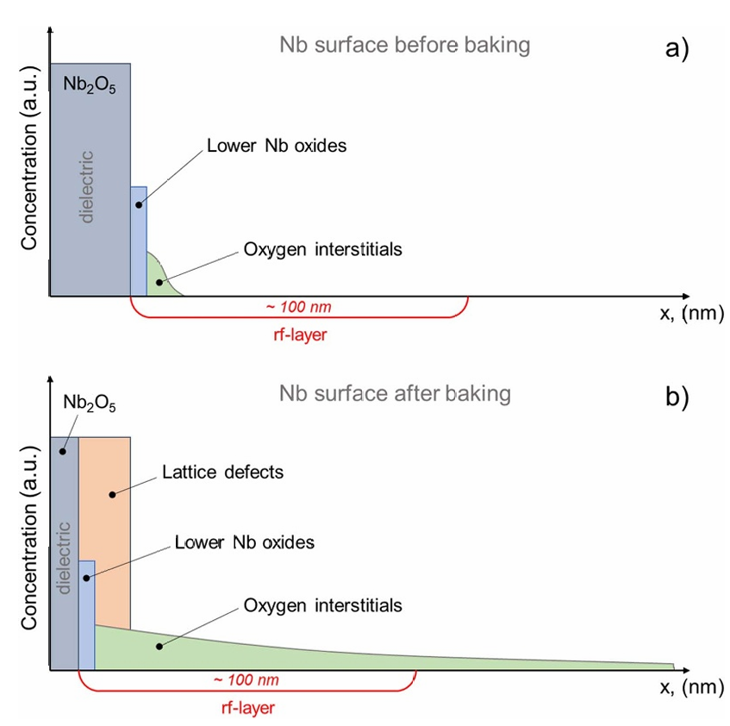
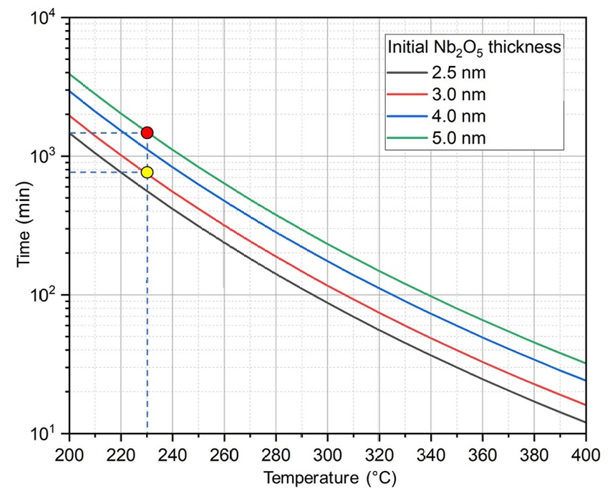
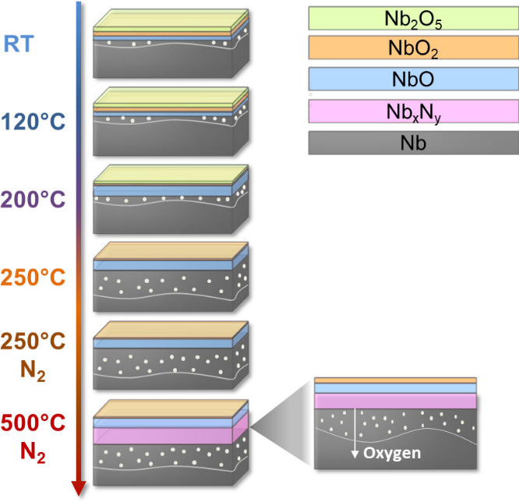
Background and Significance: Oxide Layer Evolution Model
The mechanism by which MTB improves RF performance is closely related to the oxide layer
different temperature conditions → different surface oxide layers
Model of oxide structure evolution at different temperatures
Model of temperature to reduce the initial Nb₂O₅ layer to 1 nm thickness
Model of structure evolution before and after MTB[1]
[1]Tamashevich, YEGOR, ALENA, et al. A model to explain the Q-increase by moderate-temperature treatment in Nb SRF cavities[J/OL]. DOI: 10.48550/arXiv.2306.05159.

Slide 5


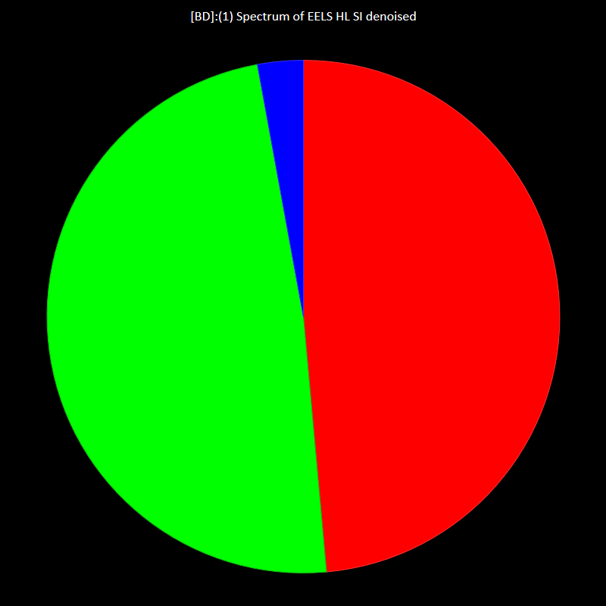
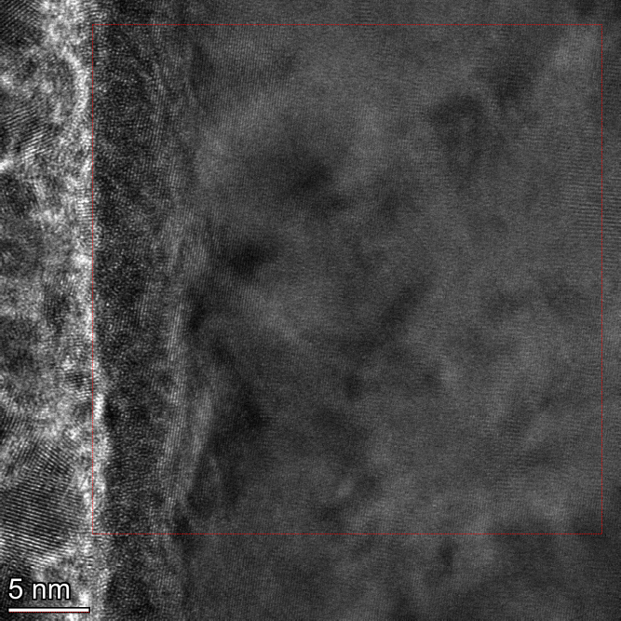
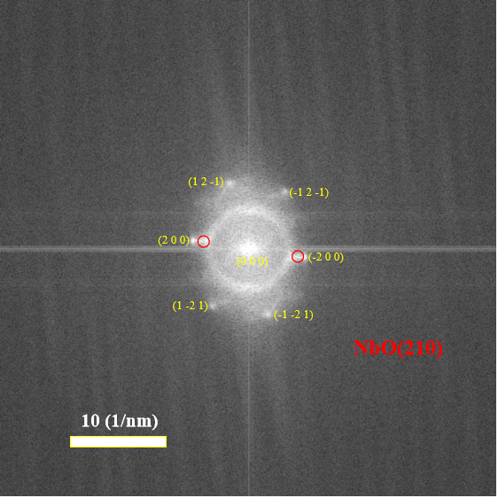

EELS and TEM results
Nb:O=1:1
550℃-40min in-situ Transmission Electron Microscopy(TEM) result
2 nm
2 nm
The measured lattice spacing is 0.1886 nm, compared to NbO(210) at 0.1901 nm.
⭐The component of the oxide layer in the temperature range near the MTB temperature window is mainly NbO.
250℃-10h ex-situ Electron Energy-Loss Spectroscopy (EELS) result(element mapping,expose to air for 3 days after baking)
Related HRTEM work can be found in Didi Luo, The Origin of Medium-Temperature Baking Efficacy: Formation and Role of an Ordered Oxide Template, TTC 2026, Paris
Notes:
for light elements,more prices

Slide 6
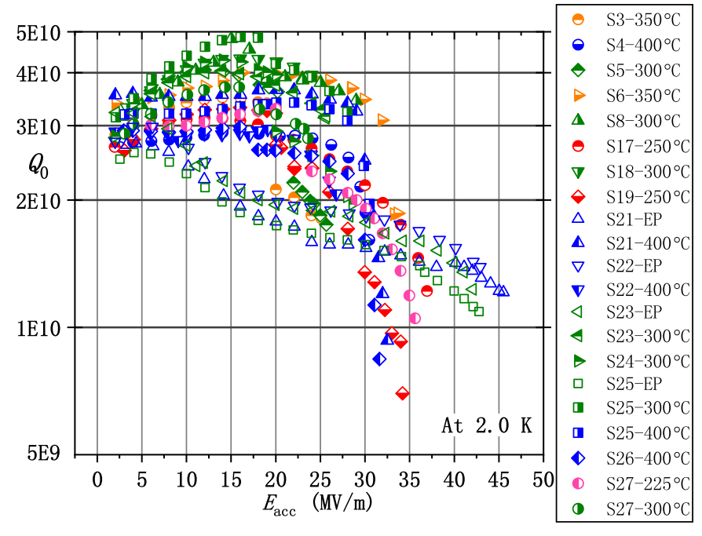
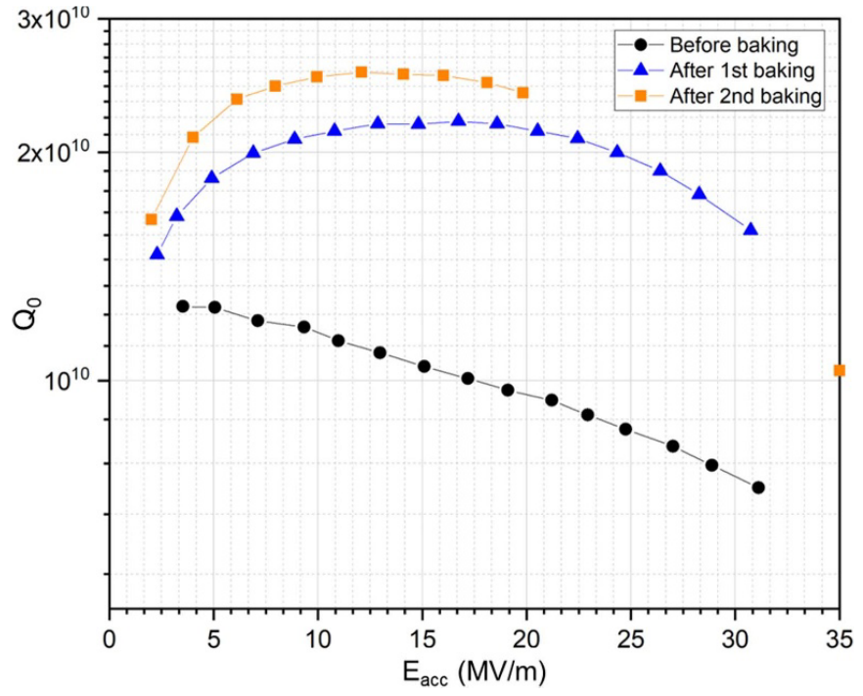
Ex-situ vs. In-situ MTB: with HPR vs. without HPR
Process of 1-cell cavity, IHEP
Process of 1-cell cavity, HZB
Bulk EP
BCP
HTB 950 ℃ 3h
HTB 800℃
Light EP
EP
LTB 75℃ 3h
+120℃ 48h
Vertical test results of 1.3 GHz 1-cell, baseline and with MTB, IHEP[1]
HPR
Vertical test results of 1.3 GHz 1-cell, baseline and with MTB(2 steps), HZB[2]
LTB 120℃
MTB
225℃-400℃ 3h
S21(400℃): 46→32MV/m
S22(400℃): 43→30MV/m
S23(300℃): 42→26MV/m
S25(300℃): 43→27MV/m
Expose to air for years, HPR
After in-situ MTB without HPR, E_{acc} had no degradation
HPR
How do surface oxides interact with water during HPR after MTB?
After ex-situ MTB with HPR, E_{acc} decreased above 30%
MTB 230℃ 24h
(2 steps,13h+11h)
[1]He, FEISI, WEIMIN, et al. Medium-temperature furnace bake of Superconducting Radio-Frequency cavities at IHEP[J].
[2]Y. Tamashevich, A. Prudnikava, A. Matveenko, A. Neumann, O. Kugeler, and J. Knobloch, “Improved RF performance of niobium cavities via in-situ vacuum heat treatment technique,” Superconductor Science and Technology, 2025
Notes:
After the second baking, no points were measured between 20MVm−1 and 35MVm−1 due to an administrative limit imposed to ensure no Q0 degradation takes place in case of a quench. Only at the very end of the test was the data point at 35MVm−1 obtained.
FE above cause Q degrade and lower FE onset, so they set the test limit as 31 MV/m
Anti-Qslope

Slide 7


Method: An ab initio study based on density functional theory(DFT)
Advantages of the DFT method：
First-principle, no empirical parameters needed, reliable results
Reveal the reaction mechanism from the atomic scale
Kohn-Sham equation:
$$\left[−\frac{ℏ^{2}}{2m}∇^{2}+V_{eff}(r)\right]ψ_{i}(r)=ε_{i}ψ_{i}(r)$$
$$E[ρ]=T_{s}[ρ]+E_{ext}[ρ]+E_{Hartree}[ρ]+E_{xc}[ρ]$$
$$E[ρ]=\sum_{i}{⟨}ψ_{i}|−\frac{ℏ^{2}}{2m}∇^{2}|ψ_{i}⟩+\int{V_{ext}}(r)ρ(r)dr+\frac{1}{2}\int{\int{ }}\frac{ρ(r)ρ(r^{′})}{|r−r^{′}|}drdr^{′}+E_{xc}[ρ]$$
Generalized Gradient Approximation(e.g. PBE):
$$E_{xc}^{GGA}[ρ]=\int{f}(ρ,∇ρ)dr$$
Notes:
Kinetic energy
The external potential between the nucleus and electrons
Hartree potential, describes the classical Coulomb repulsion between electrons
exchange correlation potential;

Slide 8
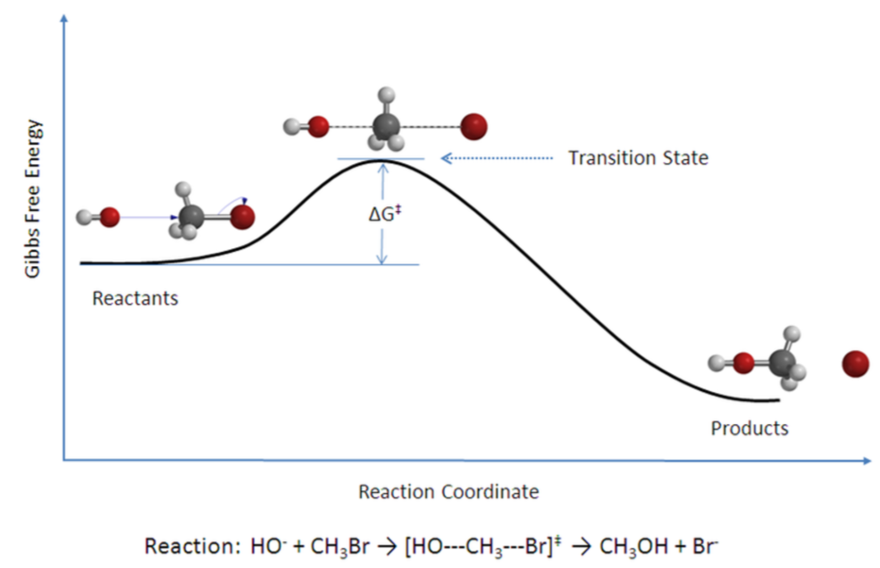
Method: An ab initio study based on density functional theory(DFT)
Adsorption Energy formula:
$$E_{ads}=E_{surface+water}−E_{surface}−E_{water}$$
Adsorption energy between Nb and its oxides with water molecules
Steps：
initial structure model √
calculate structures’ converged energy → adsorption energy → determine stable state √
calculate reaction barrier (not yet)→ deterimine whether the reaction happen at different temperature
reaction energy barrier

Slide 9
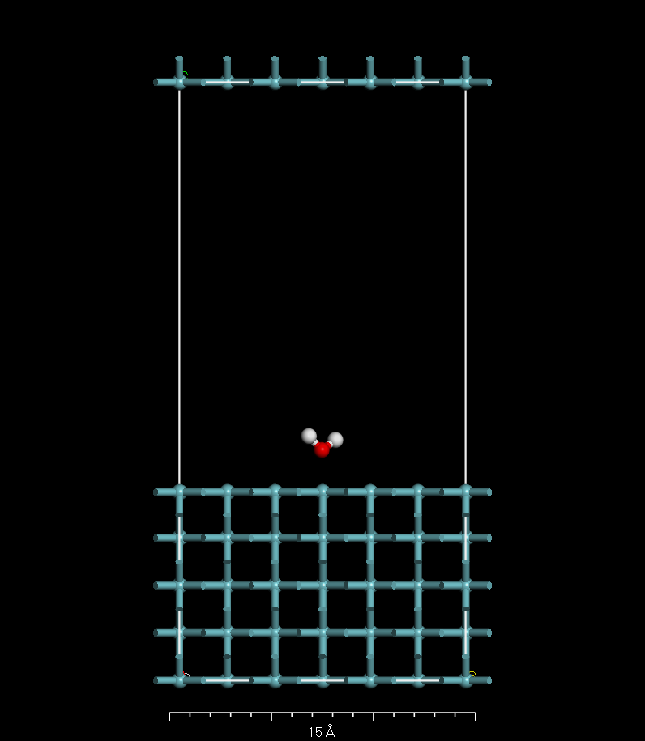
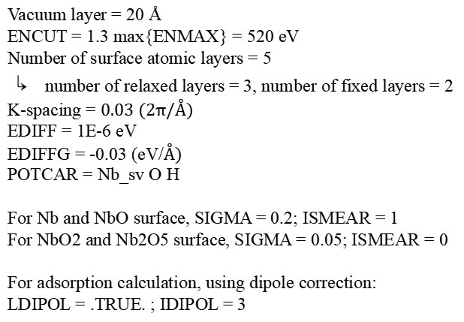
DFT calculation parameter selection
e.g. : Water molecule adsorption on Nb surface(110)
Vacuum layer = 20 Å
ENCUT = 1.3 max{ENMAX} = 520 eV
Number of surface atomic layers = 5
↳ number of relaxed layers = 3, number of fixed layers = 2
K-spacing = $0.03 (2π/Å)$
EDIFF = 1E-6 eV
EDIFFG = -0.03 (eV/$Å)$
POTCAR = Nb_sv O H
For Nb and NbO surface, SIGMA = 0.2; ISMEAR = 1
For NbO2 and Nb2O5 surface, SIGMA = 0.05; ISMEAR = 0
For adsorption calculation, using dipole correction:
LDIPOL = .TRUE. ; IDIPOL = 3
vacuum layer
relaxed
atoms
fixed
atoms
Notes:
periodic
Equivalent

Slide 10
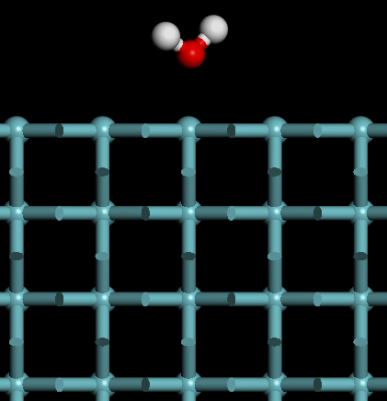
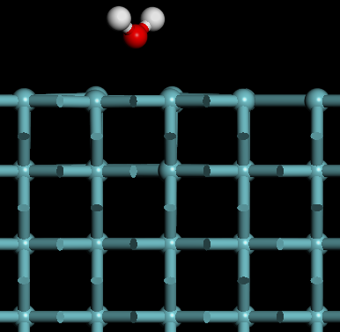
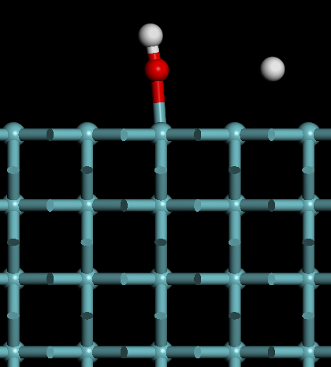
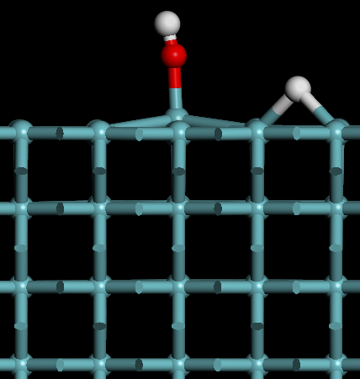
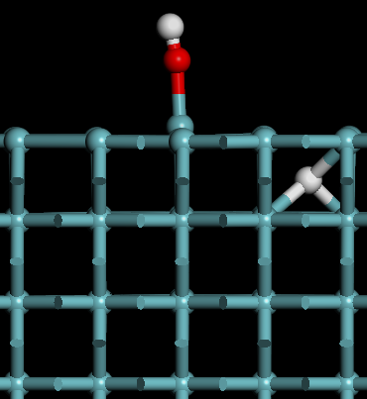
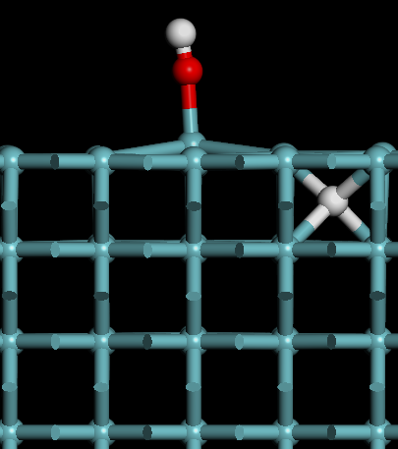
Water molecule adsorption energy on Nb surface
Initial configuration → Convergence result
situation1-Molecular adsoption
situation2-Dissociative adsorption
situation3-Subsurface dissociative adsorption
Results：
OH+H dissociative adsorption energy(-1.46eV)< OH+H subsurface dissociative adsorption energy(-0.93eV)< H₂O molecular adsorption energy(-0.54eV)
Nb metal exhibits high dissociative activity toward water, with water molecules preferentially dissociatively adsorbing, and the diffusion of H toward the subsurface also possesses a certain driving force.
Notes:
preliminary result

Slide 11
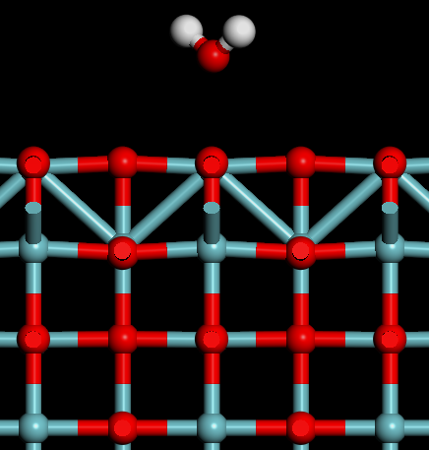
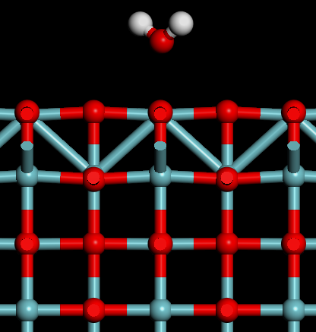
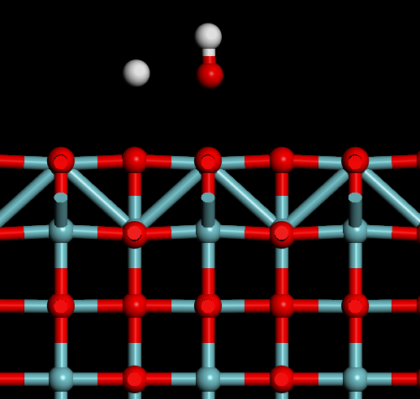
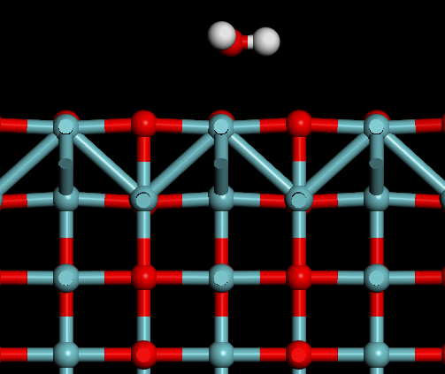
Water molecule adsorption energy on NbO surface
Initial configuration → Convergence result
Molecular adsorption
Dissociative adsorption
Results：
No matter whether the initial configuration was molecular adsorption or dissociative adsorption, after optimization it always converged to molecular adsorption, with an adsorption energy of -0.60 eV.
The dissociated state (OH +H) can't stably exist on the NbO surface, indicating that this surface inhibits O–H bond breaking and is chemically inert to water molecules.
Notes:
Niobium monoxide

Slide 12
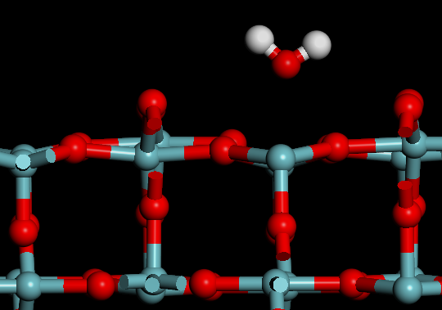
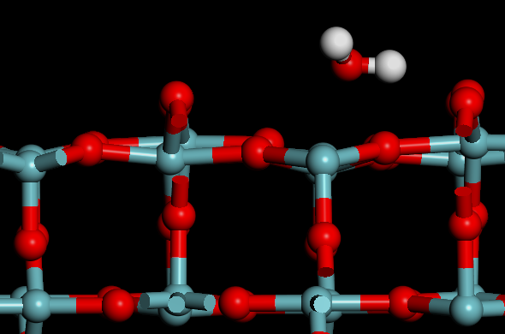
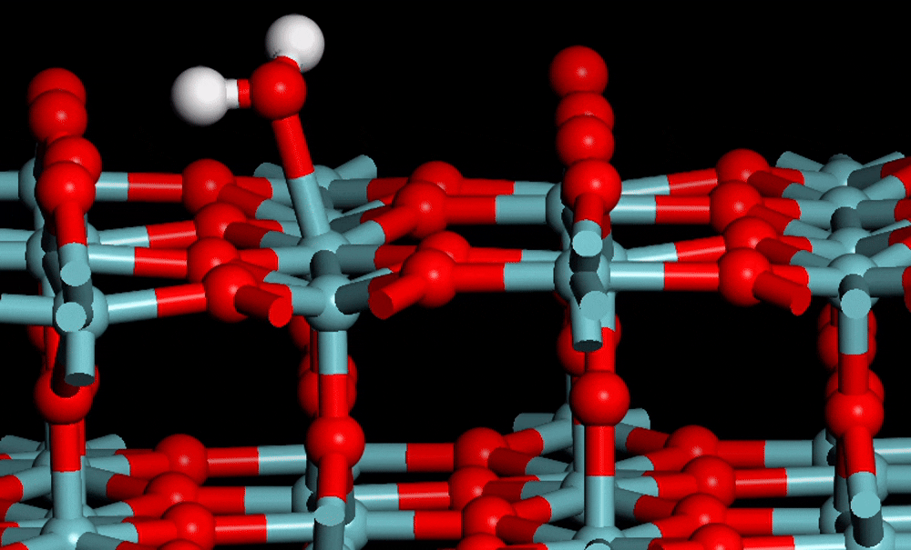
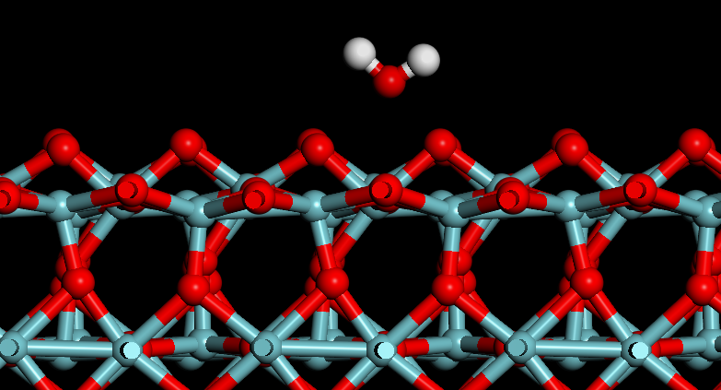
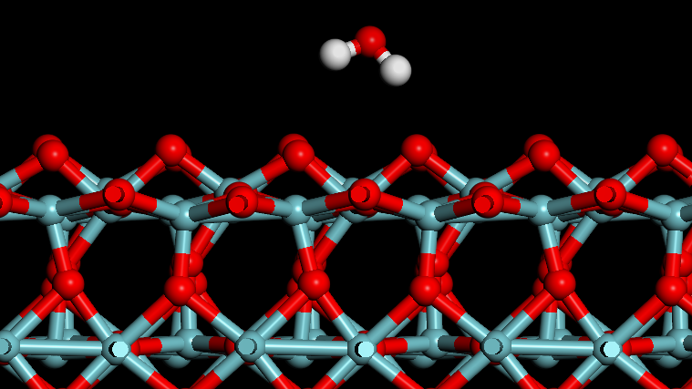
Water molecule adsorption energy on NbO₂ surface
Initial configuration → Convergence result
Molecular adsorption-site 1
The process of dissociative adsorption formation
Results：
dissociative adsorption energy(-1.26eV)< molecular adsorption-site1 energy(-0.96eV)< molecular adsorption-site2 energy(-0.17eV)
The stable adsorption form of water molecules on the NbO₂ surface is dissociative adsorption, with dissociation activity between that of Nb metal and NbO.
Molecular adsorption-site 2
Notes:
Niobium dioxide

Slide 13
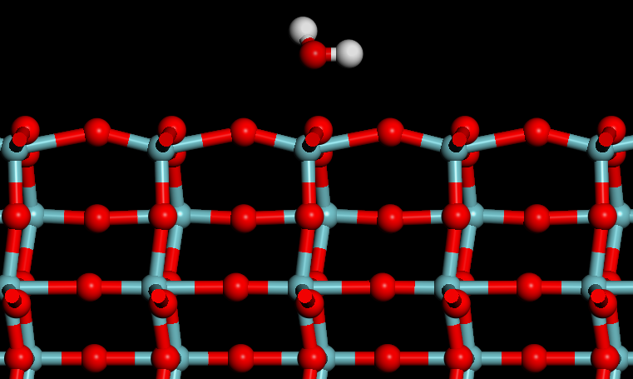
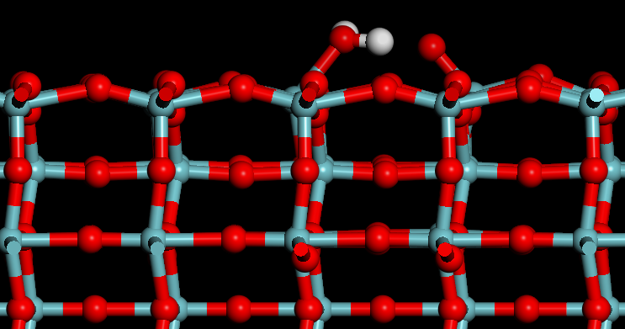
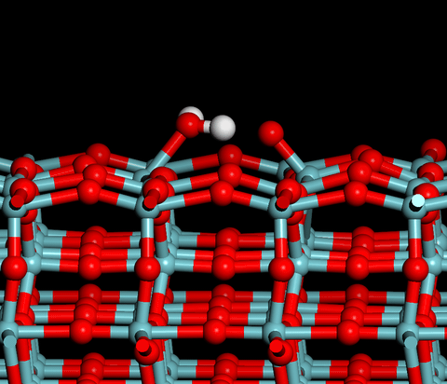
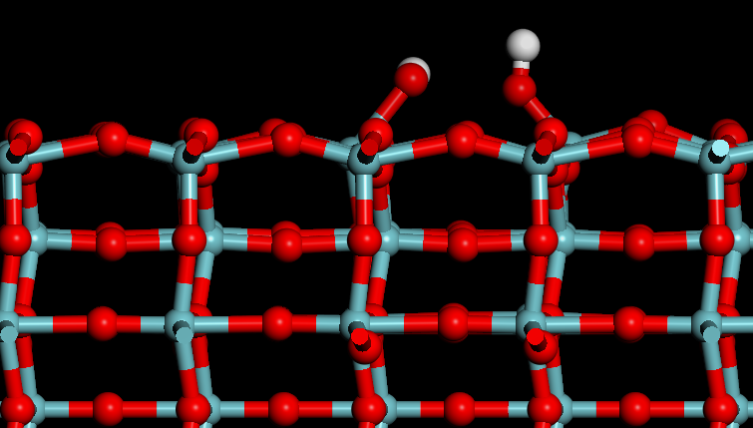
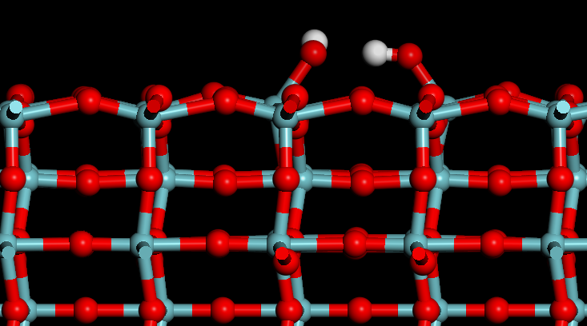

Water molecule adsorption energy on Nb₂O₅ surface
Initial configuration → Convergence result
Pauling relationship:
$$n=exp(\frac{r_{0}−r}{b})$$
Molecular adsoption
Results：
Molecular adsorption energy reaches as high as -1.90 eV, indicating strong adsorption. The O–H bond of the water molecule near the surface O is stretched from 0.972 Å to 1.068 Å, inducing breaking of the surface Nb–O bond. The water molecule is in a semi-dissociated state, loses about 0.23 of its bond order according to the Pauling relationship.
Dissociative adsorption is thermodynamically more stable and forms two hydroxyl groups.
The process from molecular adsorption to dissociative adsorption
Dissociative adsorption
Notes:
Niobium pentoxide

Slide 14

Desorption Rate and Desorption Temperature Estimation
Arrhenius formula:
$$k_{des}=ν exp\left(−\frac{E_{des}}{k_{B}T}\right)$$
$$k_{des} is rate constant,ν is attempt frequency,$$
$$E_{des} is desorption energy barrier, k_{B} is Boltzmann constant, T is temperature.$$
If the additional energy barrier of the desorption process is neglected，let $E_{des}=|E_{ads}|$
room temperature $T=300 K,ν={10}^{13} s^{−1},k_{B}=8.61733×{10}^{−5} {eV}/K$
Surface | Molecular adsorption energy (eV) | dissociative adsorption energy (eV) | Stable adsobed state
Nb(110) | -0.54 | -1.46 | dissociative adsorption
NbO(100) | -0.60 | \ | Molecular adsorption
NbO₂(110) | -0.96 | -1.26 | dissociative adsorption
Nb₂O₅(100) | -1.90 | -2.08 | dissociative adsorption

Slide 15
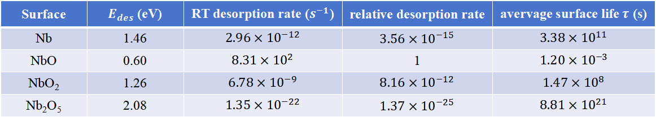
Desorption Rate and Desorption Temperature Estimation
Surface | $E_{des}$ (eV) | RT desorption rate ($s^{−1}$) | relative desorption rate | avervage surface life$τ$ (s)
Nb | 1.46 | $$2.96×{10}^{−12}$$ | $$3.56×{10}^{−15}$$ | $$3.38×{10}^{11}$$
NbO | 0.60 | $$8.31×{10}^{2}$$ | 1 | $$1.20×{10}^{−3}$$
NbO₂ | 1.26 | $$6.78×{10}^{−9}$$ | $$8.16×{10}^{−12}$$ | $$1.47×{10}^{8}$$
Nb₂O₅ | 2.08 | $$1.35×{10}^{−22}$$ | $$1.37×{10}^{−25}$$ | $$8.81×{10}^{21}$$
~10 thousand years
~1 millisecond
~4.68 years
~279 trillion years
*$k_{des}$ refers to the probability of a single adsorbed molecule desorbing in a unit of time
Then we calculate the avervage surface life in all surfaces at several typical baking temperature, we can know if adsorbed water molecules can desorb within hours at the temperature, as shown in the table below.
Surface | RT(300K) | 120℃ | 250℃ | 350℃
Nb | × | × | √ | √
NbO | √ | √ | √ | √
NbO₂ | × | √ | √ | √
Nb₂O₅ | × | × | × | √
Notes:
maybe explain why 350C is a better T for ex-situ MTB, which can make the water molecules desorb from sufaces, even the oxides is pentoxide, so that can advoid to degrade Q as much as possible.

Slide 16
Summary and Future Plan
Summary：
We have some preliminary results of ab initio calculation:
  Model worked and get converged adsorption structures and adsorption energy.
  In Nb and its oxides, only NbO’s most stable adsobed state is molecular adsoption, and its adsorption energy is minimum.
  At room temperature, the lifetime of water molecules on the surface of NbO is approximately milliseconds.
Assumption:The surface of the cavity after MTB is mainly composed of NbO, which can effectively reduce the dissociative adsorption of water molecules on the cavity surface during HPR, thereby improving the cavity's Q value.
Future Plan：
Calculating reaction barriers (Climbing Image Nudged Elastic Band(CI-NEB) method for Minimum Energy Path and Transition State)
Calculating the impact of defective structures on surface adsorption

Slide 17
Thank you for your attention!

