Slide 1
Progress on Bronze-Route Nb₃Sn Thin Films at HZB
Oliver Kugeler on behalf of Ming Lu
23.09.2026
TFSRF2026 Workshop, Chester, UK

Slide 2
Outline
1. Introduction of Nb₃Sn coatings via bronze route
2. Small Sample Optimization and Characterization
3. Nb₃Sn QPR sample Fabrication and RF test
4. Summary and Future work

Slide 3
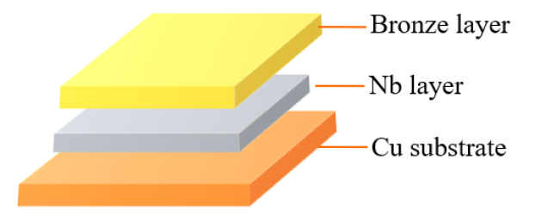
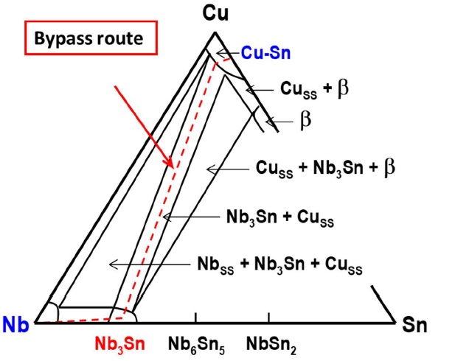
Introduction of Nb₃Sn/Cu by bronze route
Nb₃Sn film on Cu by bronze route
It involves Nb barrier deposition, bronze electroplating, vacuum heat treatment, and final chemical etching.
Precursor structure for bronze route
Bronze layer
Nb layer
Nb₃Sn layer
Nb₃Sn layer
Cu substrate
Cu substrate
Cu substrate
The optimization of Cu-based Nb₃Sn coating involves combining two key aspects: Nb₃Sn/Nb and Nb/Cu.
Phase diagram of Nb-Cu-Sn ternary system at 700℃
Nb₃Sn layer
Nb₃Sn layer
Nb layer
Nb layer
Nb substrate
Cu substrate
Cu substrate
Bohao Zhang
The bronze route offers a promising approach for direct Nb₃Sn on Cu, but film quality is strongly affected by the Sn content, Nb layer, vacuum heat treatment and etching process, etc.
At HZB, we are currently optimizing bronze route recipe to improve the RF performance of Nb₃Sn film.

Slide 4
Outline
1. Introduction of Nb₃Sn coatings via bronze route
2. Small Sample Optimization and Characterization
3. Nb₃Sn QPR sample Fabrication and RF test
4. Summary and Future work

Slide 5
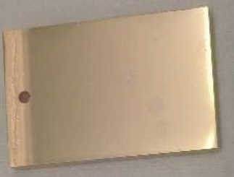
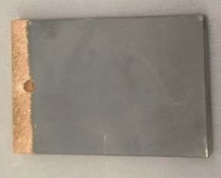
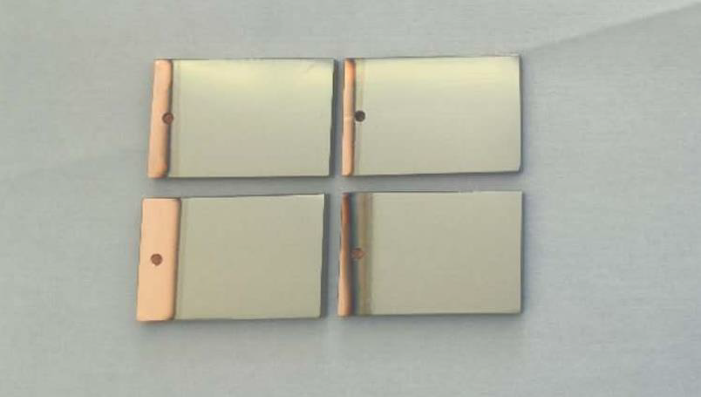
Optimization of bronze route Nb₃Sn/Cu recipe
Tc-oriented study of bronze route parameters:
Cu substrate: OFE, mechanical polishing and Electropolishing
Nb sputtering: HiPIMS power, pressure, substrate temperature, and ex-situ baking temperature
Bronze layer: Sn content and thickness
Vacuum heat treatment: temperature and duration
Chemical etching: etchant composition and duration
Nb layer
Bronze layer
Nb₃Sn layer
Cu substrate
Nb₃Sn layer
Cu substrate
Cu substrate
Electro-polishing Cu
Sputtering Nb
Electro-plating Bronze
Vacuum heat Treatment
Post-chemical polishing
Mechanical polishing Cu

Slide 6
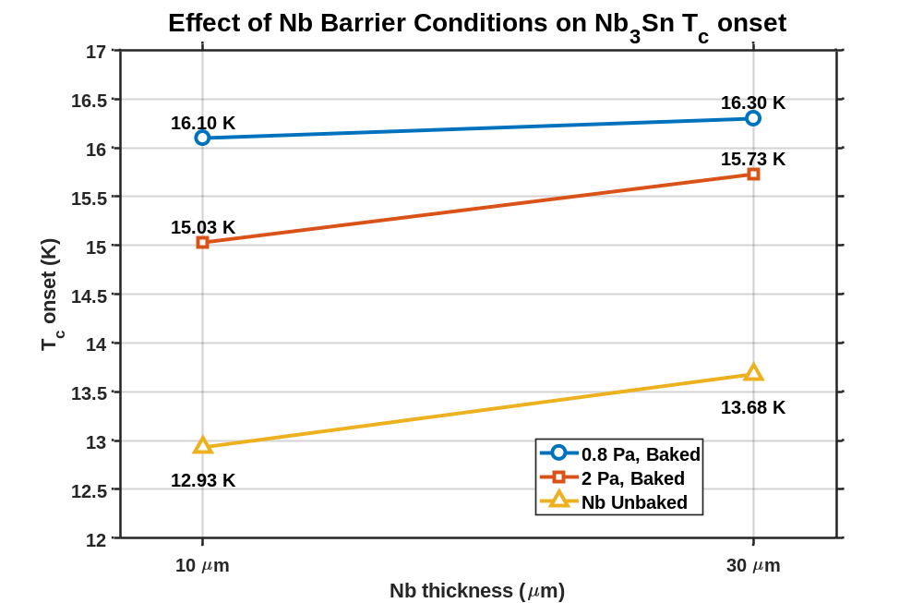
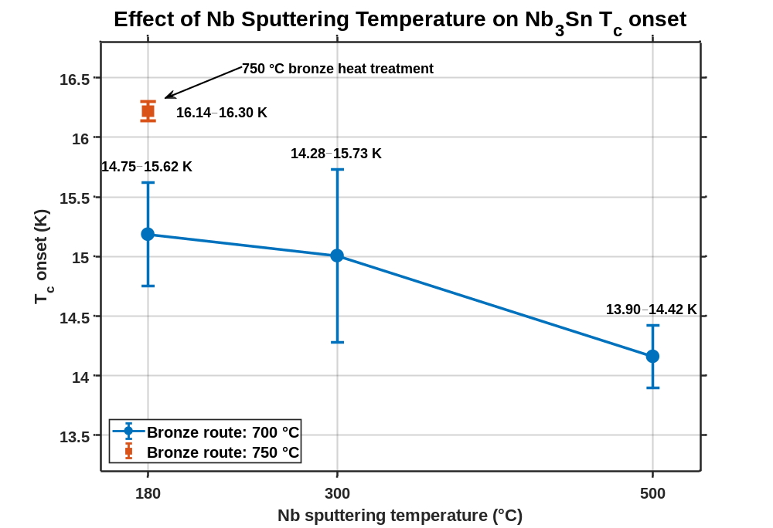
Optimization of the Nb₃Sn preparation process
After Nb film baking
Optimizing HiPIMS Nb pressure, temperature, thickness, and ex-situ baking improves the Nb layer density and surface chemical state, increasing Nb₃Sn T_{c} onset from 12.93 to 16.10 K (PPMS data).
The results showed higher Nb sputtering temperatures may lower the Nb₃Sn T_{c}​ onset, while 750 °C bronze heat treatment gives better T_{c} onset than 700 °C.

Slide 7
Optimization of the Nb₃Sn preparation process
Step | Process | Original Parameters | Upgrade Parameters
1 | Mechanical polishing | Up to 100 µm removal | Up to 100 µm removal
2 | Degreasing | 1% Citranox®, 1 h | 1% Citranox®, 1 h
3 | Cu Electropolishing (EP) | ≈30 µm | ≈30 µm
4 | HiPIMS Nb (sputtering) | Tsub ≈ 180 °C, Ar = 2 Pa, Power = 600 W, Thickness ≈ 10 µm | Tsub ≈ 180 °C, Ar = 0.8 Pa, Power = 400 W, Thickness ≈ 10 µm
5 | High-temperature baking | 700 °C, 20 h | 700 °C, 20 h
6 | Bronze electroplating | ≈10 µm bronze | ≈10 µm bronze
7 | Vacuum Heat treatment | 700 °C, 30 h | 750 °C, 30 h
8 | Surface bronze removal | Aqua regia about 5 min | Aqua regia about 10 min
Optimized steps 4 (denser Nb layer), 7 (large grain size) and 8 (fewer impurities):
Bronze route at 700℃ : Original recipe, Nb₃Sn/Nb/Cu ≈ 1.0 µm / 10 µm / 3 mm.
Bronze route at 750℃ : Upgrade recipe, optimized steps 4+7+8.

Slide 8
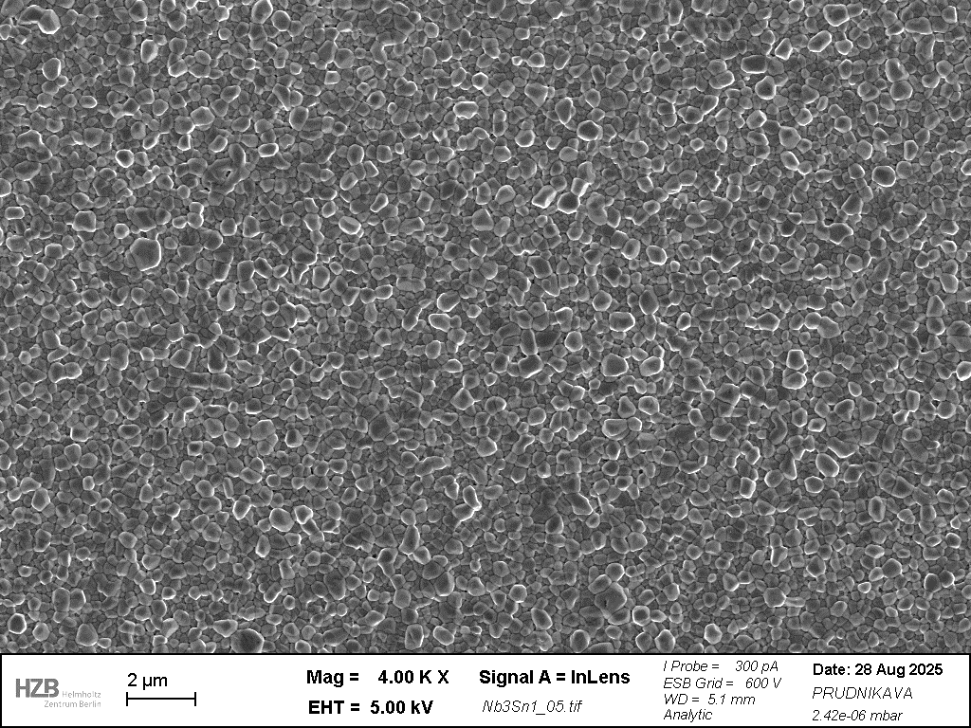
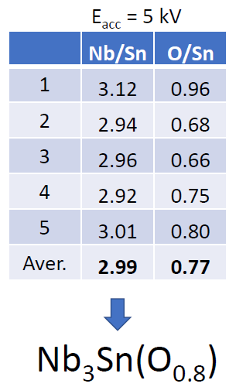
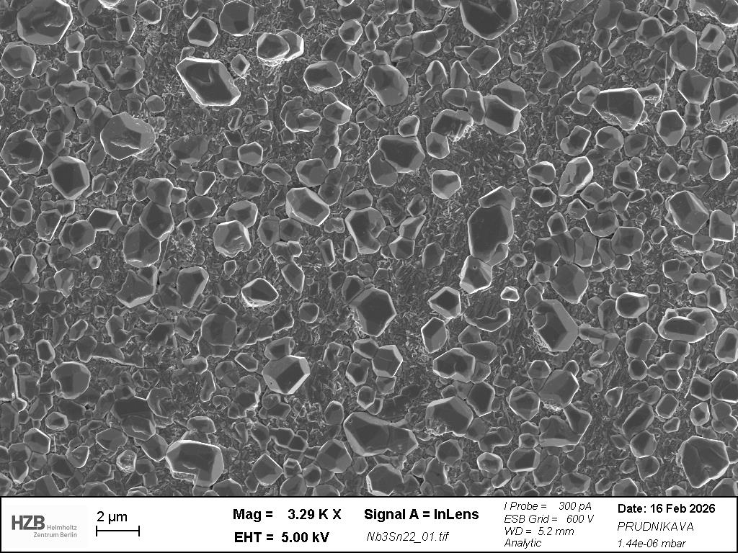
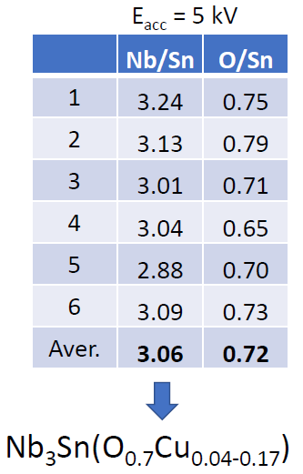
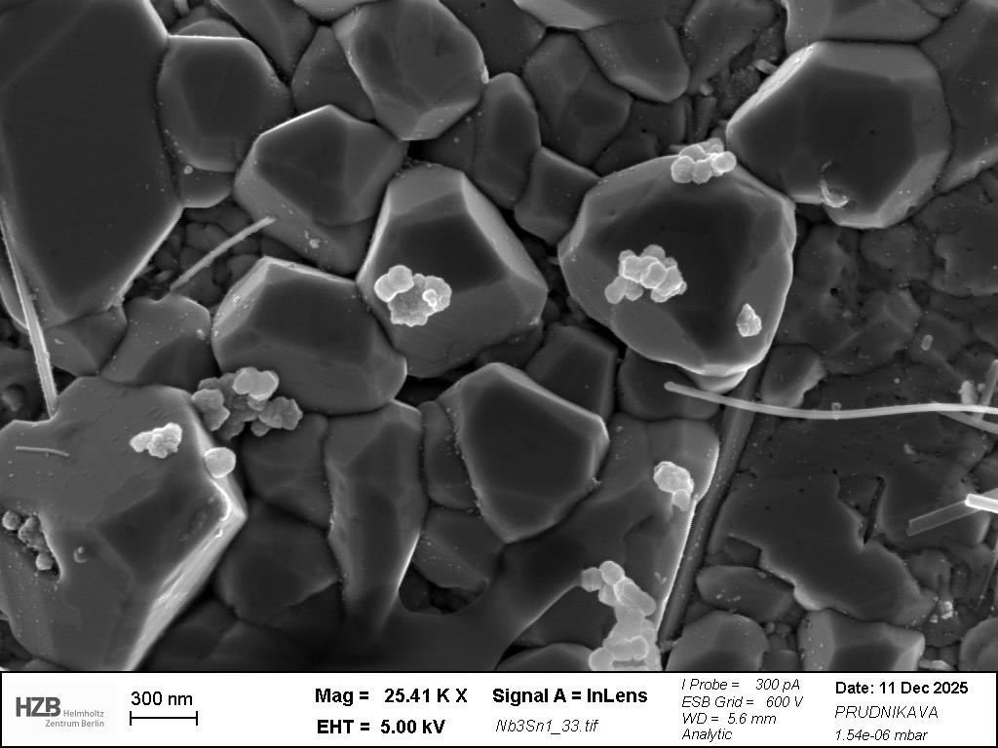
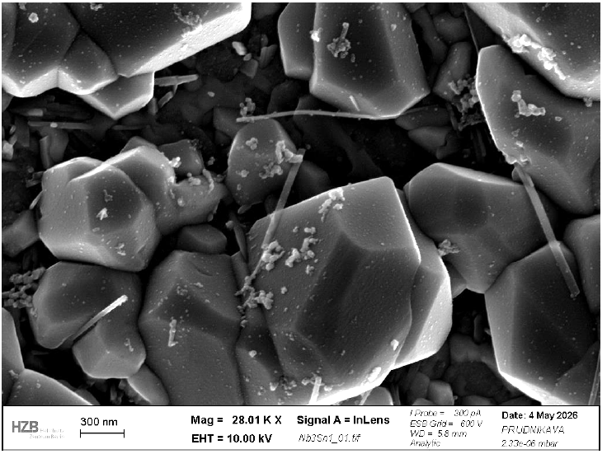
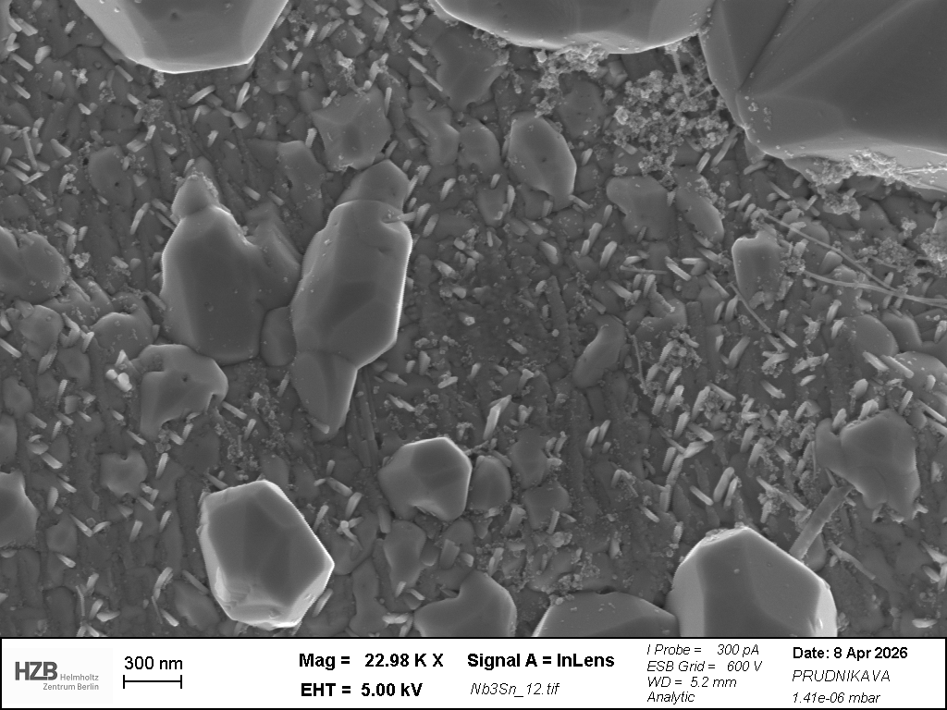
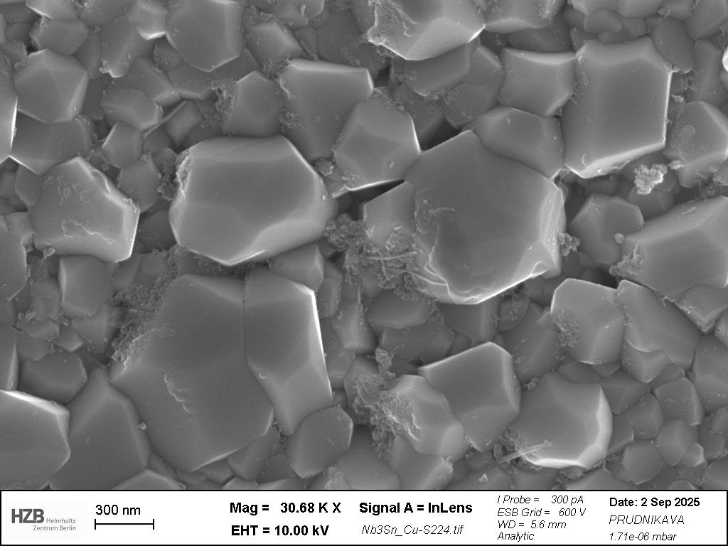
SEM characterization of Cu-based Nb₃Sn
Bronze route: 700℃
Bronze route: 750℃
Cu particles
P-rich nanofibers
Sparse grains areas
O-enriched regions
The 750°C sample exhibits larger, better-defined Nb₃Sn grains and fewer oxide phases than 700°C sample.
However, Cu particles, P-rich nanofibers, sparse grain areas, and O-enriched regions remain, indicating surface inhomogeneity and residual impurities.

Slide 9
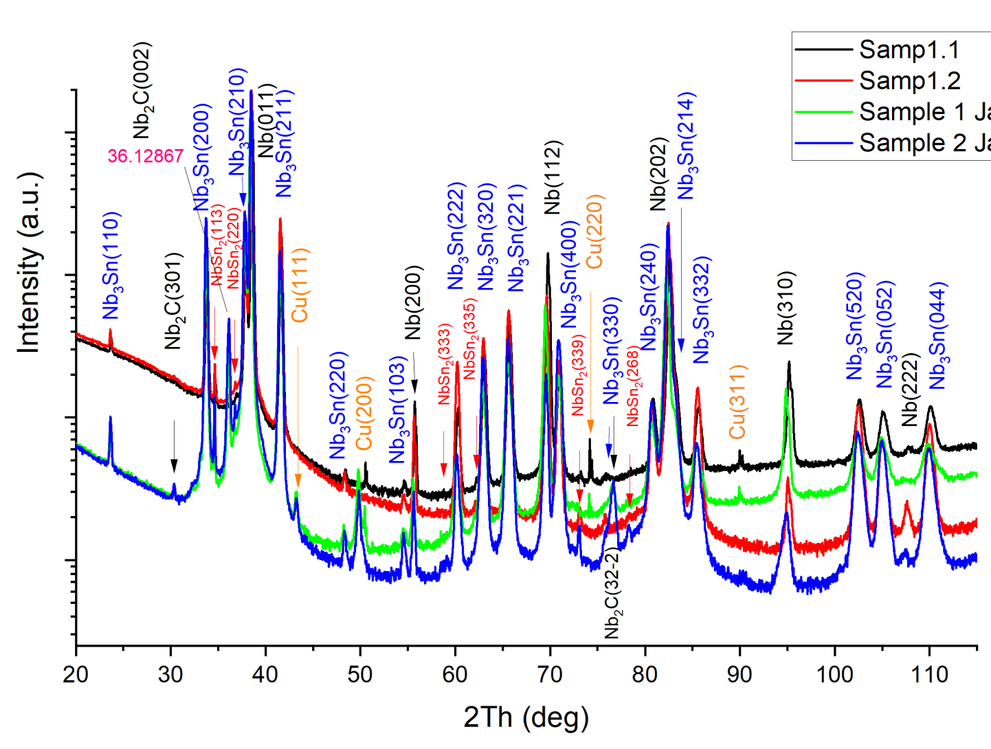
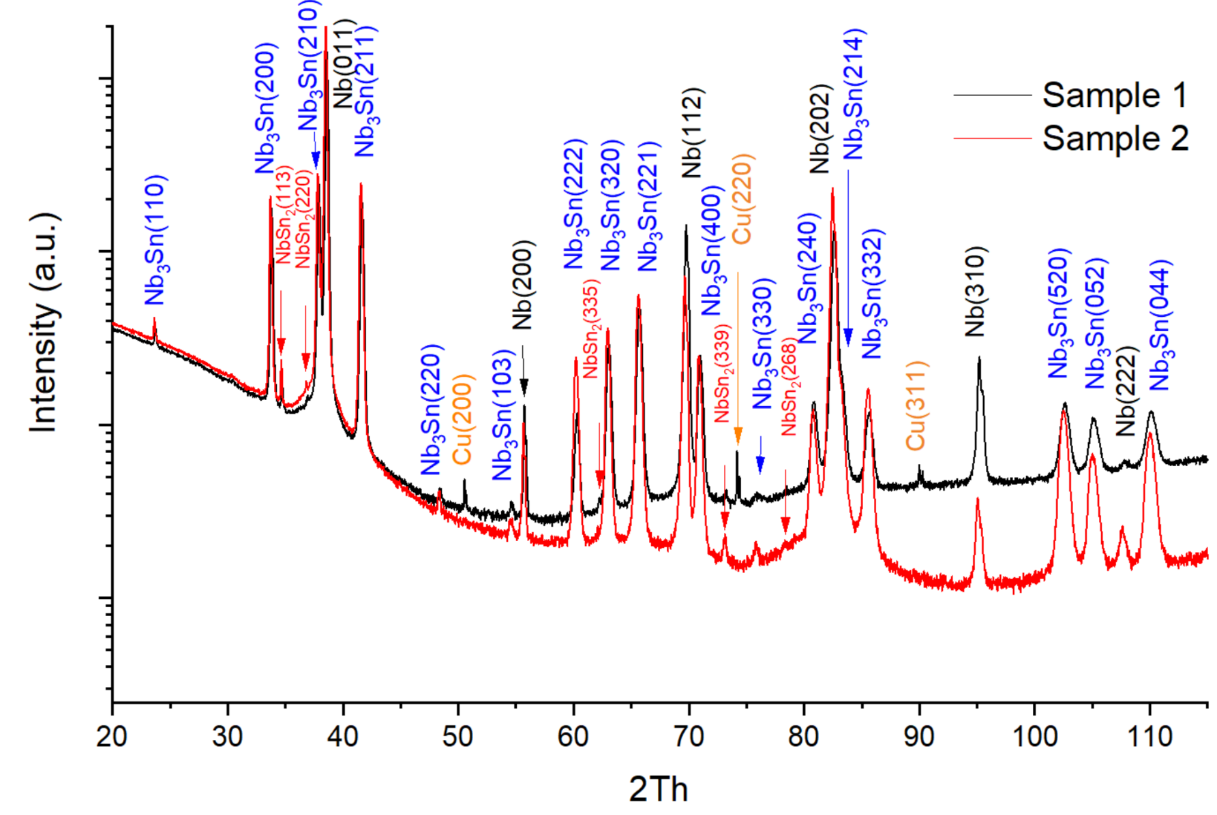
XRD characterization of Cu-based Nb₃Sn
Bronze route: 700℃
Bronze route: 750℃
Alena Prudnikava
XRD results showed minor Cu and NbSn₂ are detected at both 700°C and 750°C samples.
The 750 °C samples showed sharper Nb₃Sn peaks and a smaller FWHM, consistent with larger Nb₃Sn grains than those at 700 °C.

Slide 10
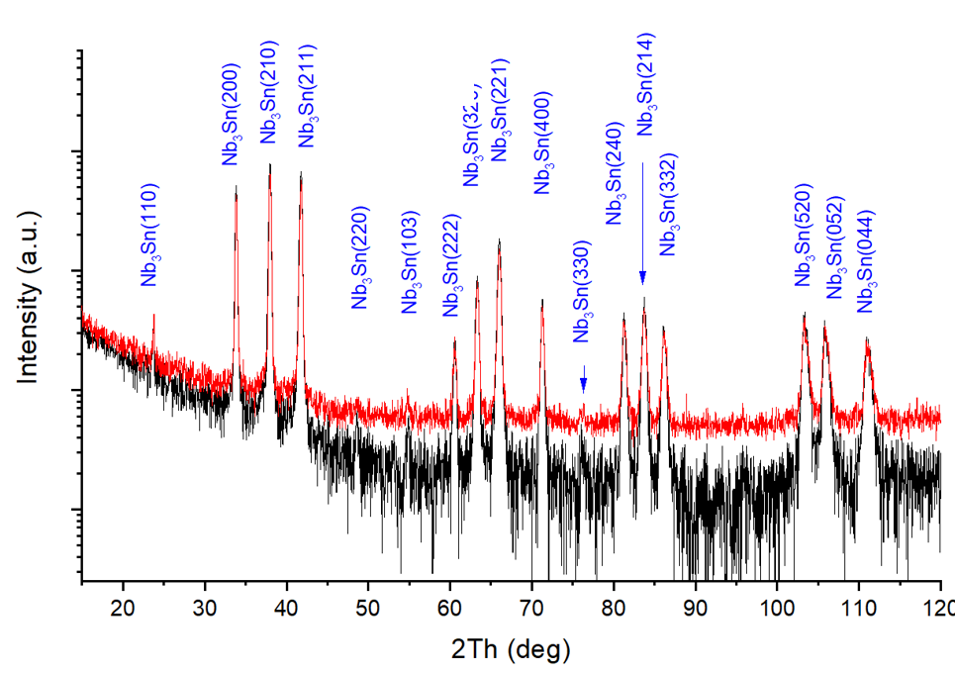
GIXRD characterization of Cu-based Nb₃Sn
Bronze route: 700 ℃ and 750 ℃
Both GIXRD results only detects Nb₃Sn phase.
Other impurities are below the detection limit or amorphous.
Cu,CuO_{x}
NbO_{x},SnO_{x},C-H
Nb₃Sn layer
NbSn₂
Nb barrier layer
GIXRD
Cu substrate
Alena Prudnikava
Phase Composition Diagram of Nb₃Sn/Cu coating

Slide 11
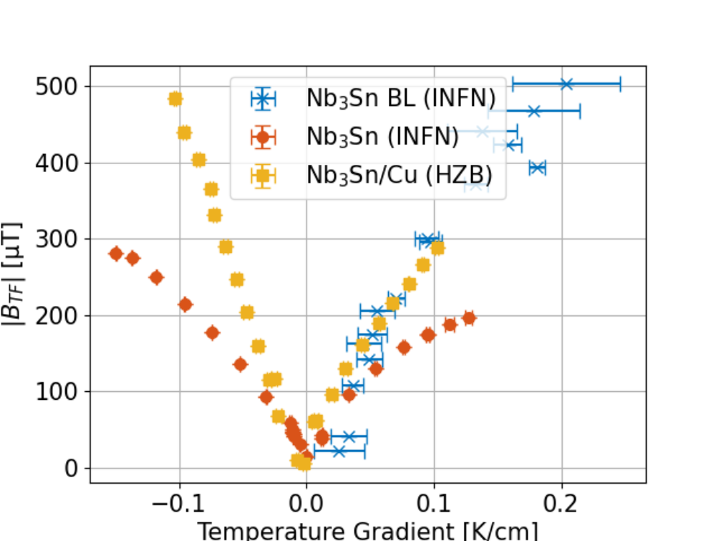
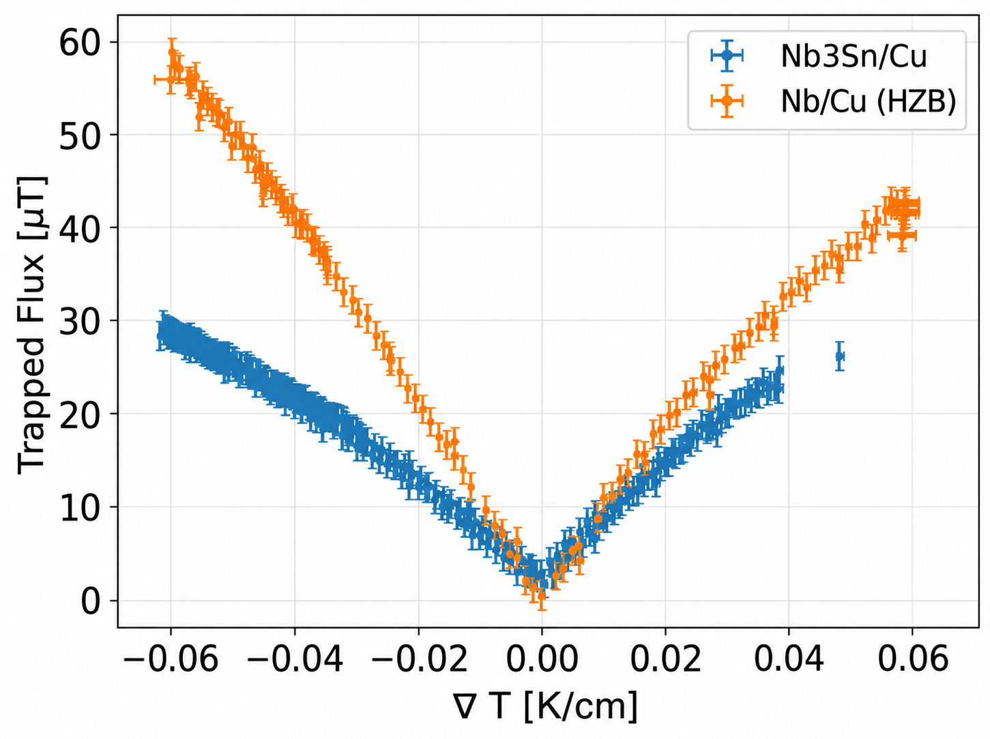
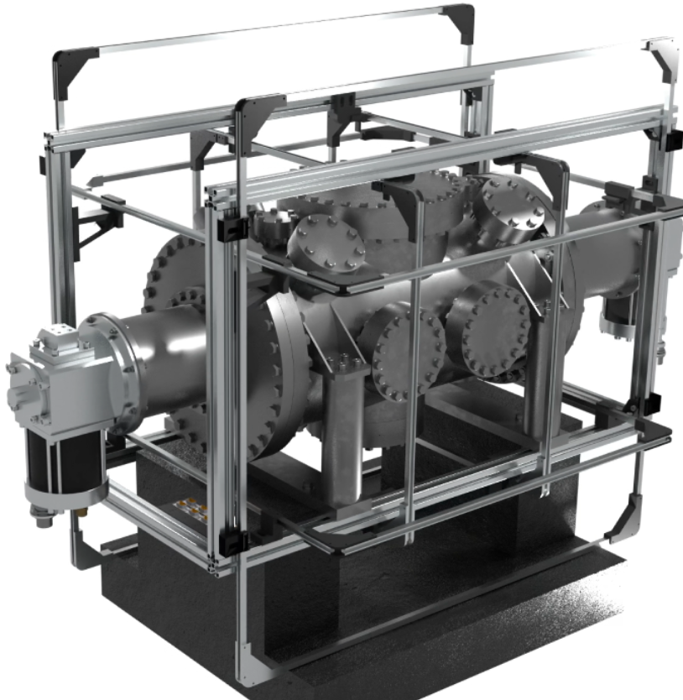
Thermal current test of Cu-based Nb₃Sn surface
Bronze route: 700℃
Bronze route: 750℃
CRAFT
F. Kramer
CRAFT Test conditions: Zero field cooled, Plot trapped flux magnitude of center sensor versus temperature gradient during cooldown.
Under the 0.05 K/cm temperature gradient, flux trapping in the new sample decreased from 200 μT to 25~45 μT, indicating suppressed thermoelectric currents due to improved coating homogeneity and weaker flux pinning.

Slide 12
Outline
1. Introduction of Nb₃Sn coatings via bronze route
2. Small Sample Optimization and Characterization
3. Nb₃Sn QPR sample Fabrication and RF test
4. Summary and Future work

Slide 13
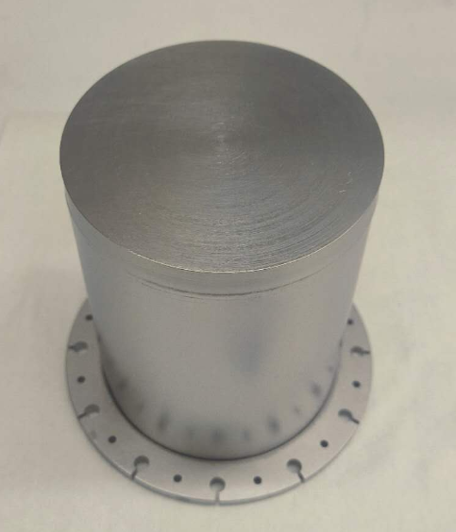
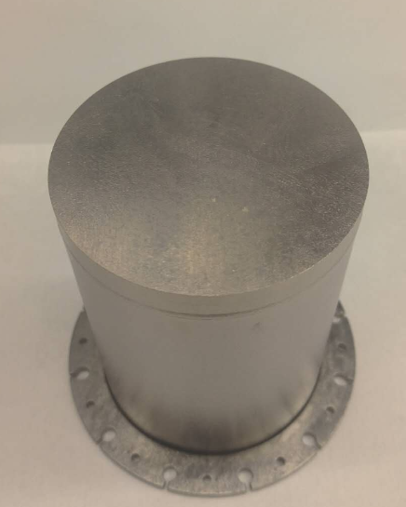
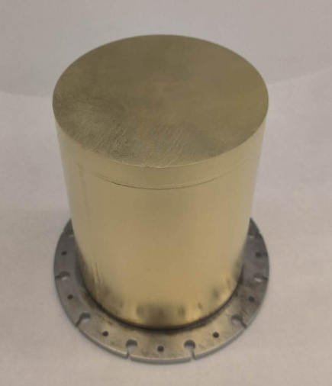
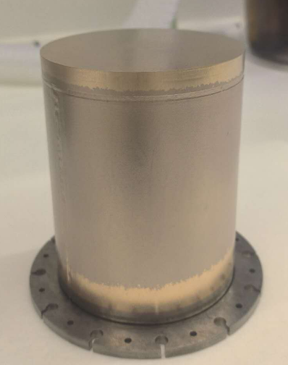
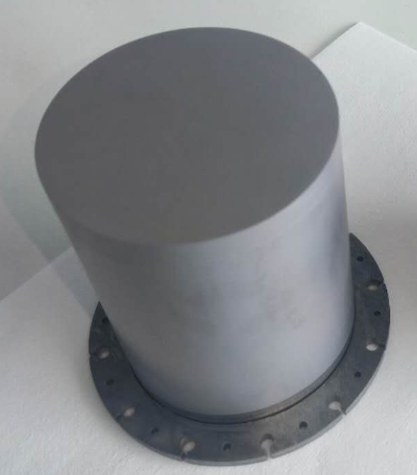
Nb₃Sn/Nb QPR sample fabrication process
Bronze layer
Nb₃Sn layer
Nb substrate
Nb₃Sn layer
Nb substrate
Nb substrate
Nb QPR sample
BCP 120μm + baking
Coating bronze
Synthesized Nb₃Sn
Removing bronze
Nb₃Sn/Nb preparation via bronze route
120 μm BCP + 700 °C (20h) baking to remove hydrogen and release stress;
Before bronze electroplating, the sample need activation and tilting to avoid trapped bubbles.
Increasing annealing temperature from 700 °C to 750 °C, enlarged Nb₃Sn grain size and reduced surface impurities.

Slide 14
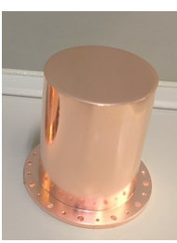
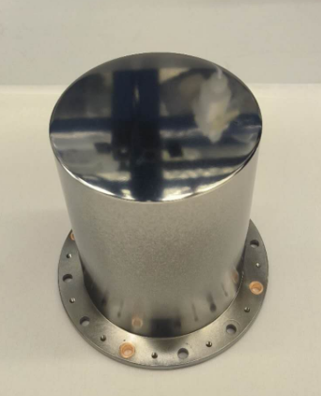
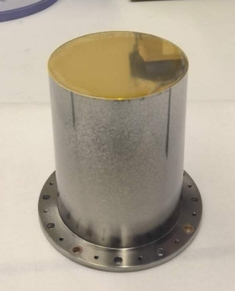
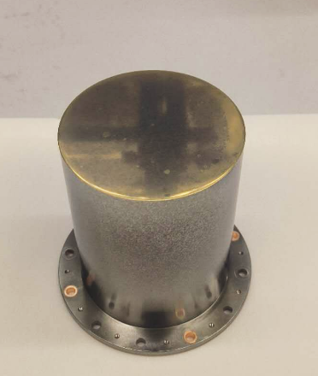
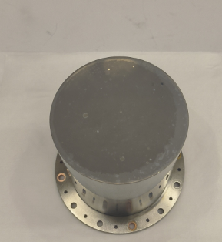
Nb₃Sn/Cu QPR sample fabrication process
Bronze layer
Nb layer
Nb₃Sn layer
Nb₃Sn layer
Cu substrate
Cu substrate
Cu substrate
Electropolishing Cu
Sputtering Nb
Coating bronze
700℃ Heat treatment
Removing bronze
Nb₃Sn/Cu preparation via bronze route
30 μm EP + 700 °C (20h) baking to increase the Nb layer density and release stress;
Due to the thin Nb film at the bottom (<1 μm), the bronze layer was deposited only on the top surface.
The sample still need activation and tilting to avoid surface trapped bubbles.

Slide 15
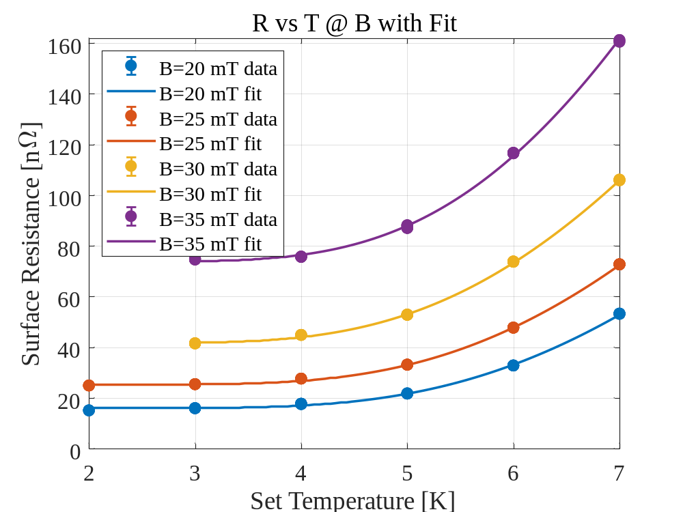
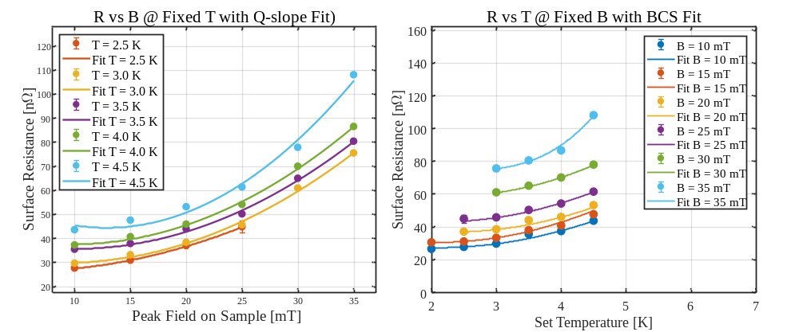

Nb₃Sn QPR sample R_{s}-T test comparison
Sebastian Keckert
Nb₃Sn on Nb
Nb₃Sn on Cu
Corresponds to $Q_{0}={10}^{10}$
R_{s}=17.1 nΩ @4 K, 20 mT, 417 MHz
R_{s}=46.0 nΩ @4 K, 20 mT, 413 MHz
At 4 K, the Cu-substrate Nb₃Sn sample exhibit an R_{s} value 29 nΩ higher than that of the Nb-substrate Nb₃Sn sample. Both samples show severe Q-slope, and simplified BCS model fitting was performed.

Slide 16

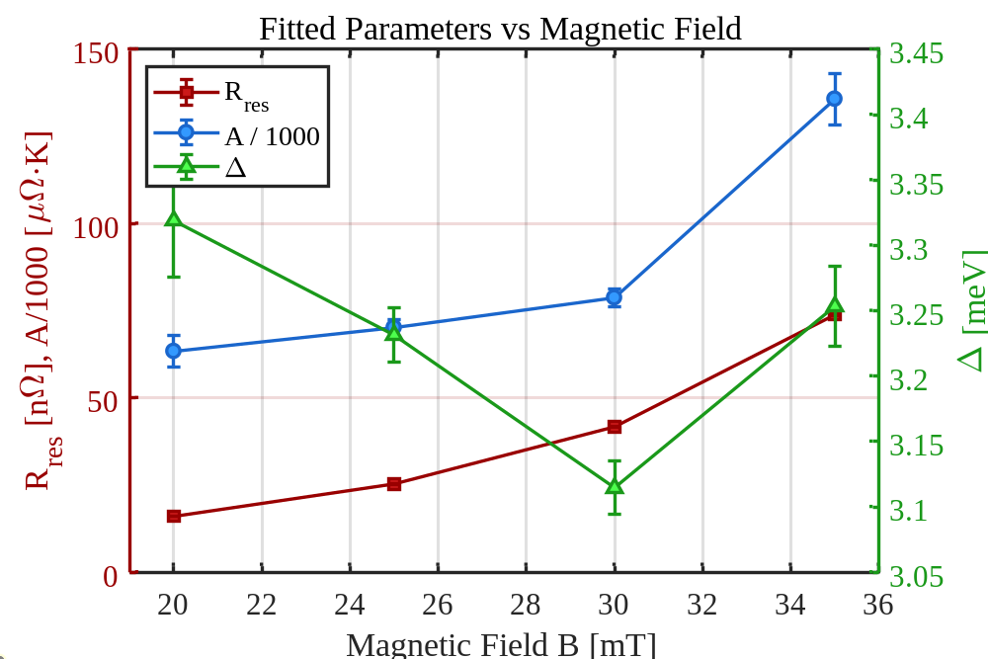
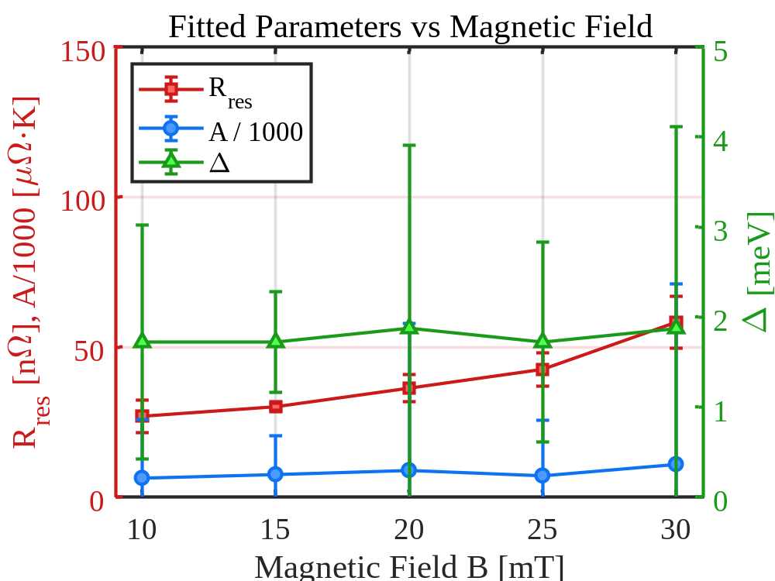
Nb₃Sn QPR sample R_{res} fitting comparison
Nb₃Sn on Nb
Nb₃Sn on Cu
R_{res}=16.04 nΩ @ 20 mT, 417 MHz
R_{res}=36.37 nΩ @ 20 mT, 413 MHz
Compared with the Nb-substrate sample, the Cu-substrate Nb₃Sn shows ~20 nΩ higher R_{res} at 20 mT, a lower Δ across all fields, and a smaller A parameter with weaker field dependence.

Slide 17
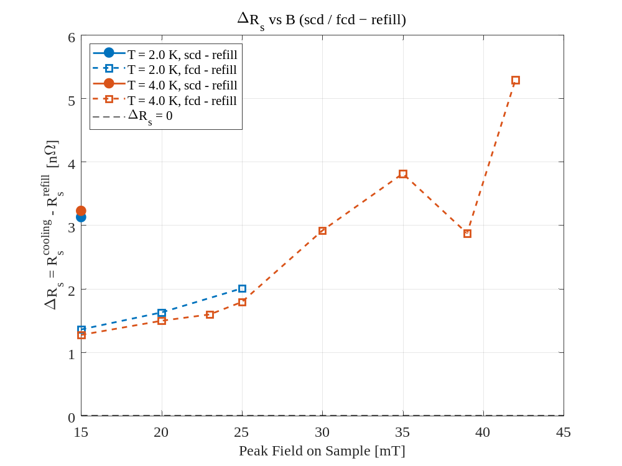
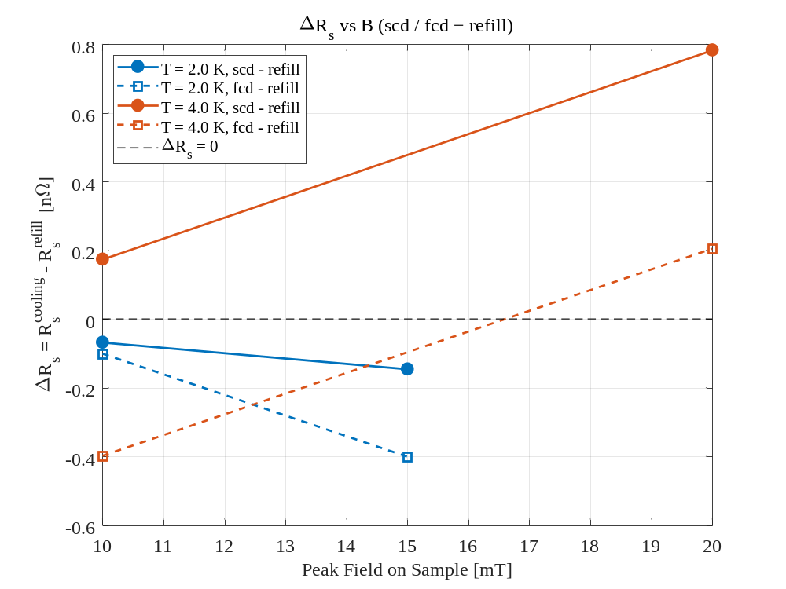
Nb₃Sn QPR sample thermal cycle comparison
Nb₃Sn on Nb
Nb₃Sn on Cu
ΔR_{s}=1.5 nΩ @ 4K, 20 mT, 417 MHz
ΔR_{s}=0.8 nΩ @ 4K, 20 mT, 413 MHz
The both R_{s}​ shows only a minor dependence on the cooling rate, indicating that R_{s}​ via bronze route is not sensitive to the thermal cycling conditions.

Slide 18
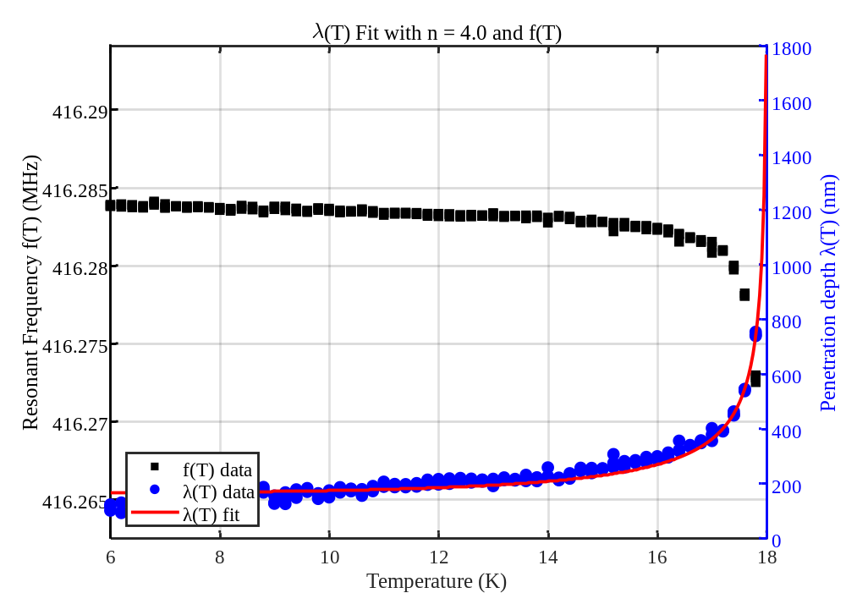
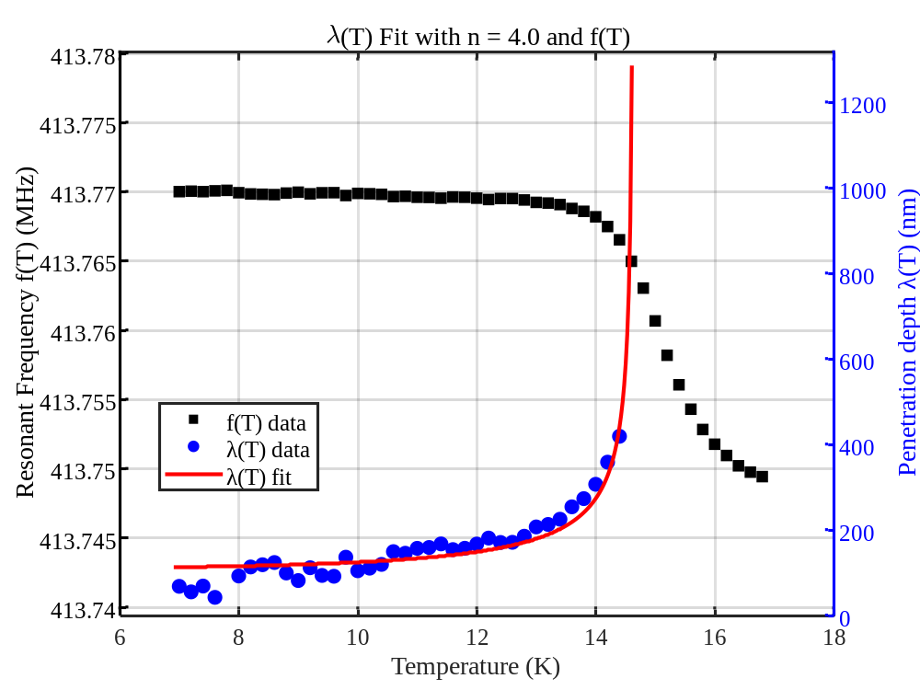
Nb₃Sn QPR sample penetration depth comparison
Nb₃Sn on Nb
Nb₃Sn on Cu
λ(0) = 166.78 ± 3.91 nm
T_{c} = 18.026 ± 0.025 K
λ(0) = 123.6± 5.4nm
T_{c} = 14.71± 0.06 K
Compared with the Nb-substrate Nb₃Sn (18.0 K), the Cu-substrate sample shows a lower λ(0) and lower T_{c} (14.7 K).

Slide 19
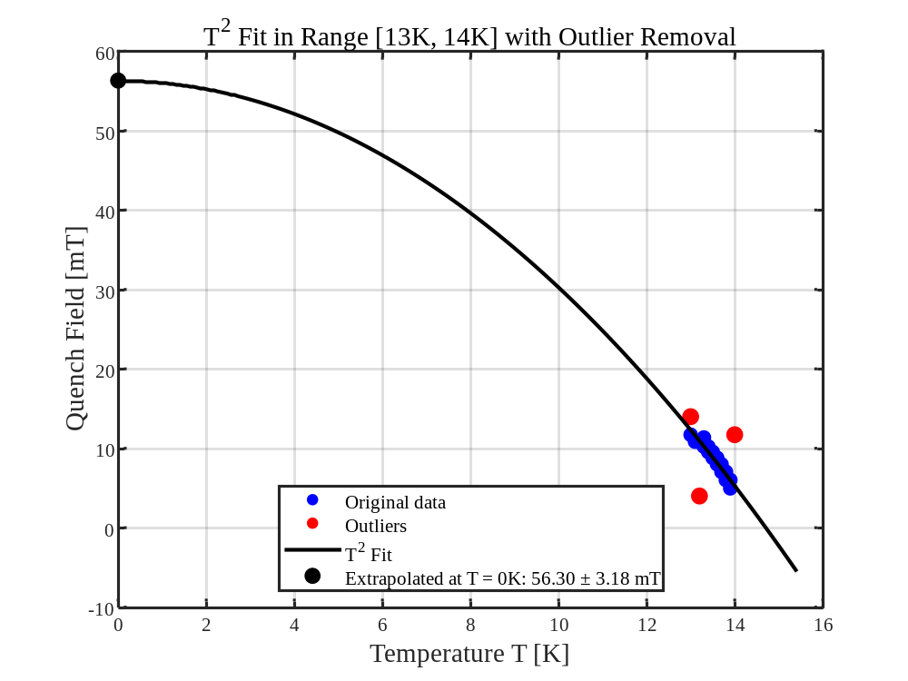
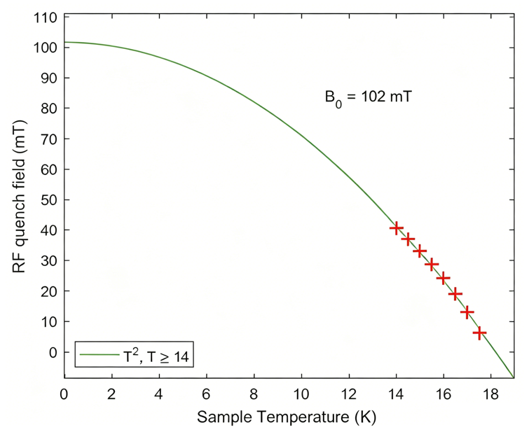
Nb₃Sn QPR sample critical field comparison
B₀=56.3mT
Nb₃Sn on Nb
Nb₃Sn on Cu
Sebastian Keckert
The temperature-dependent quench field data near T_{c} was described by a T² fit.
The Cu-substrate Nb₃Sn exhibits a lower B_{c}(0) (56.3 mT) compared with Nb-substrate Nb₃Sn (102 mT).

Slide 20
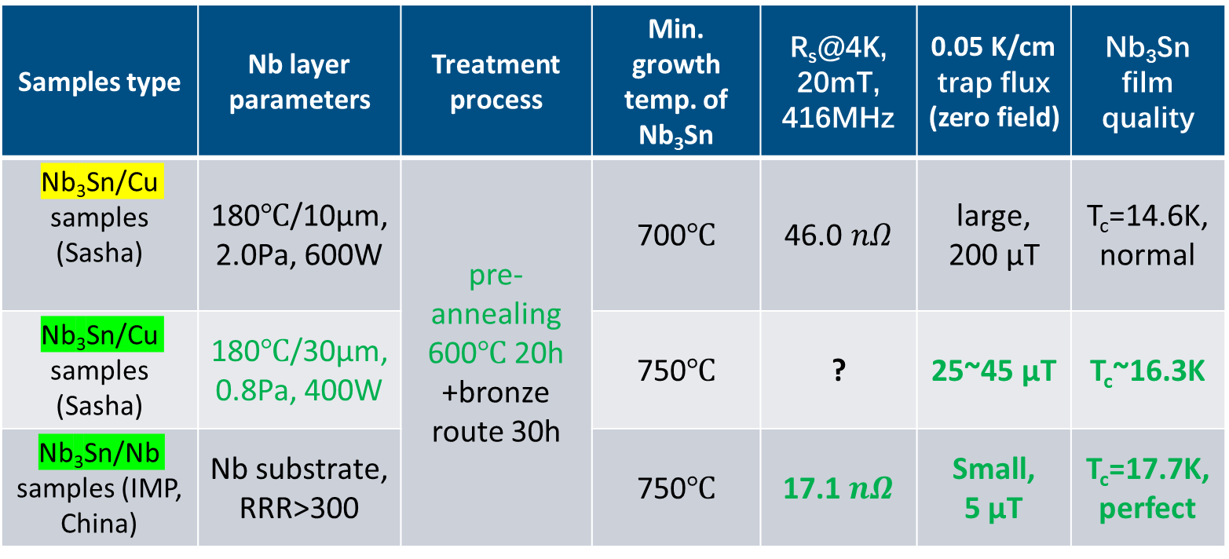
Summary of Cu-based Nb₃Sn coating recipes
Increasing the niobium barrier layer’s density or thickness improved the Nb₃Sn film quality on copper, approaching the quality of Nb₃Sn on high-purity Nb.
Samples type | Nb layer parameters | Treatment process | Min. growth temp. of Nb₃Sn | R_{s}@4K, 20mT, 416MHz | 0.05 K/cm trap flux (zero field) | Nb₃Sn film quality
Nb₃Sn/Cu samples (Sasha) | 180℃/10μm, 2.0Pa, 600W | pre-annealing 600℃ 20h +bronze route 30h | 700℃ | 46.0 $nΩ$ | large, 200 μT | T_{c}=14.6K,normal
Nb₃Sn/Cu samples (Sasha) | 180℃/30μm, 0.8Pa, 400W |  | 750℃ | ? | 25~45 μT | T_{c}~16.3K
Nb₃Sn/Nb samples (IMP, China) | Nb substrate, RRR>300 |  | 750℃ | 17.1 $nΩ$ | Small, 5 μT | T_{c}=17.7K,perfect
SUST, DOI: 10.1088/1361-6668/ae496a
Origin recipe
Upgrade recipe

Slide 21
Work summary and future work plan
Work summary:
  The bronze route fabrication recipe was optimized to improve the T_{c} of Nb₃Sn on Cu substrates.
  QPR samples with Nb₃Sn on both Cu and Nb substrates were fabricated and tested, and possible strategies for further improvement were proposed.
Future work plan:
  Use better Cu and Nb substrate, optimize the Nb layer to reduce strain in Nb₃Sn and thereby further enhance T_{c}.
  Use higher Sn content (10→15 at%) bronze, and longer annealing (30→50 h), and further optimize bronze etching recipe.
  Develop laser treatment, PEP, FE treatment, high-T baking, plasma cleaning to improve the surface quality of Nb₃Sn.

Slide 22
Thank you for your attention.

