Slide 1
Trapped flux generated by thermoelectric currents
F. Kramer, A. Cierpka, O. Kugeler, M. Lu, C. Pira, T. Proslier, J. Knobloch
22.09.2026
Thin Films 2026
Chester

Slide 2
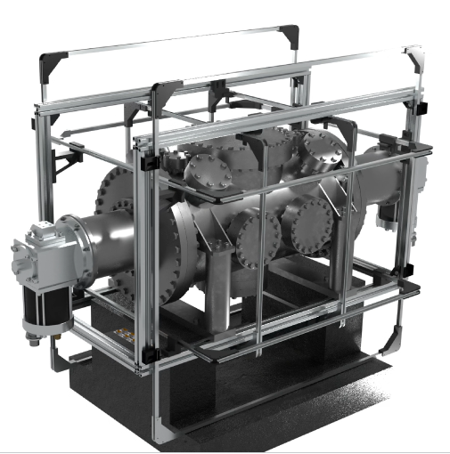
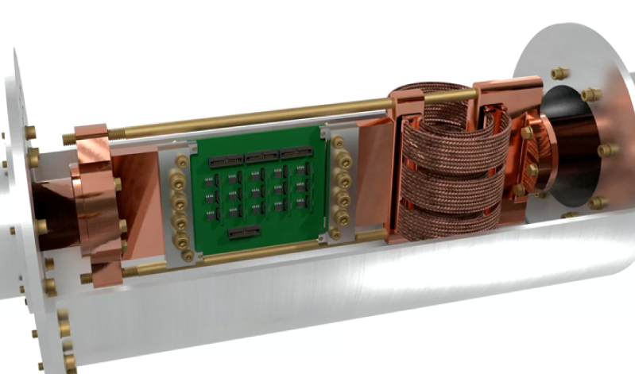
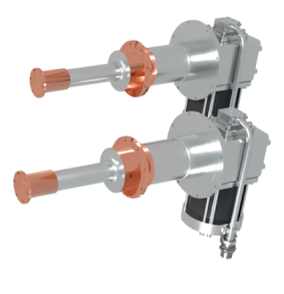
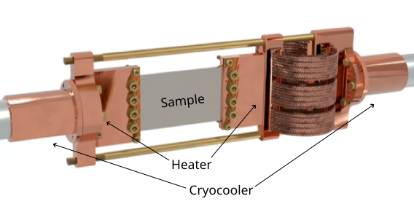
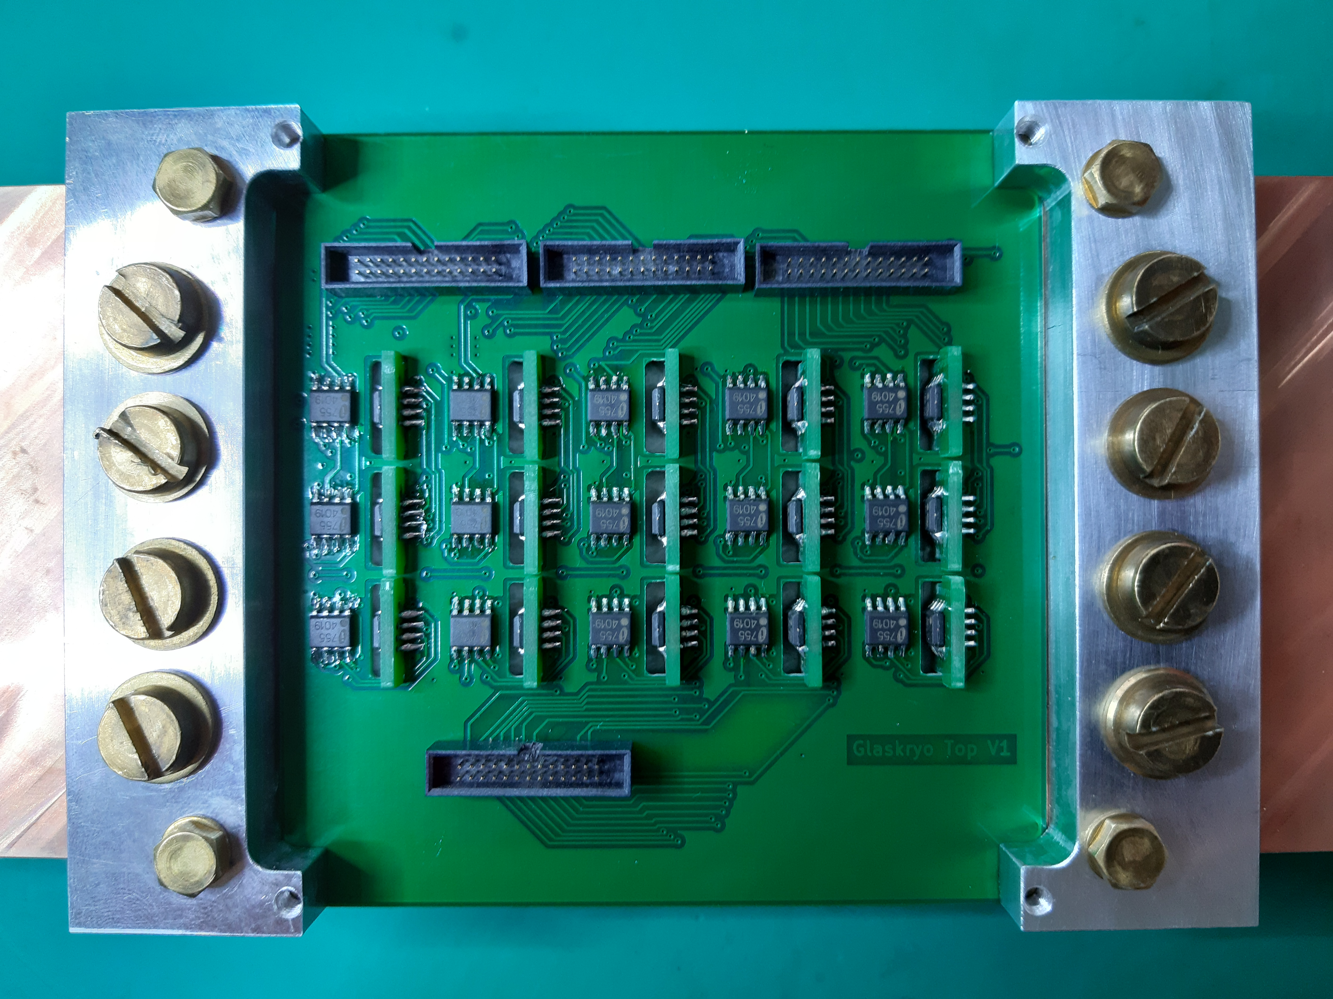
Experimental setup to measure trapped flux
Setup
2 cryocoolers to cool down sample
Sample (100x60x3)mm³, (30x20x3)mm³ clamped in copper blocks at either end
Two heaters at the end of the blocks allow for precise control of temperature gradient and cooldown rate
Multiple AMR sensors for magnetic field measurements
grouping of 3 sensors to measure field vector in 3d
15 AMR sensor groups measure magnetic field just above the sample
2 Cernox sensors measure temperature gradient across sample
Active field compensation with three Helmholtz-coils pairs
“Zero-field” < 30nT at location of reference sensors
Maximum flux density 220µT
Courtesy A. Cierpka

Slide 3
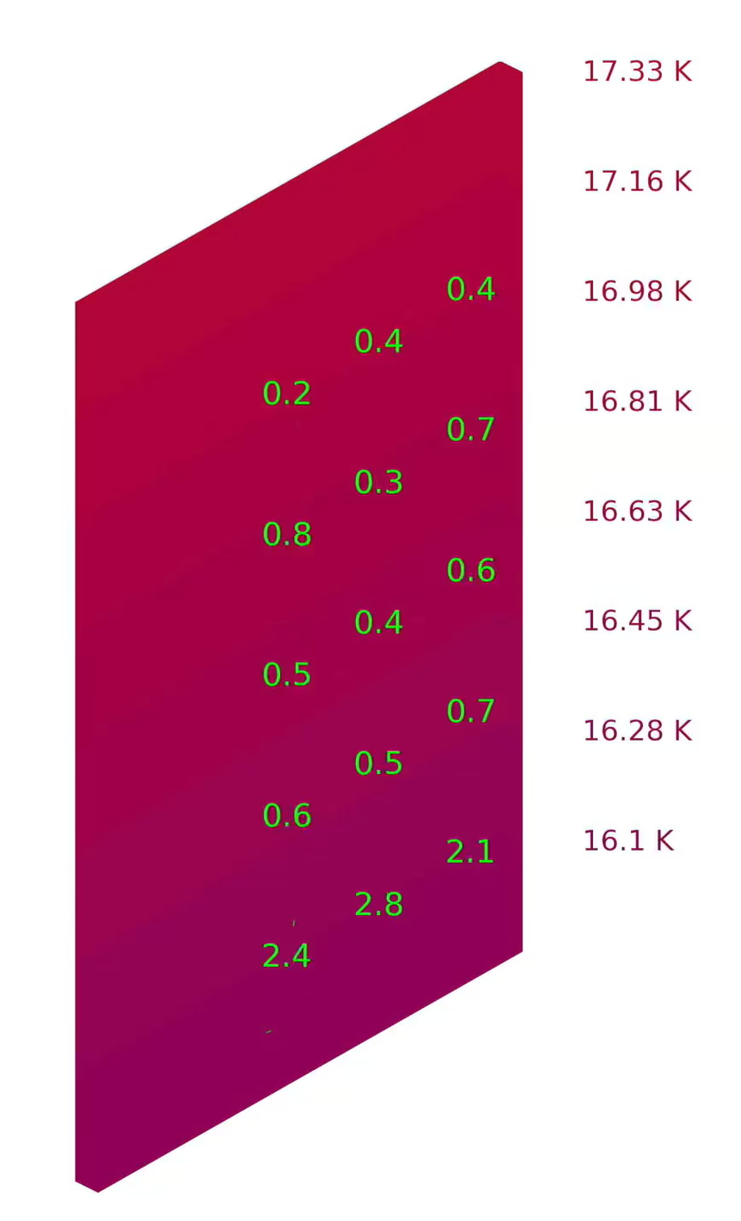
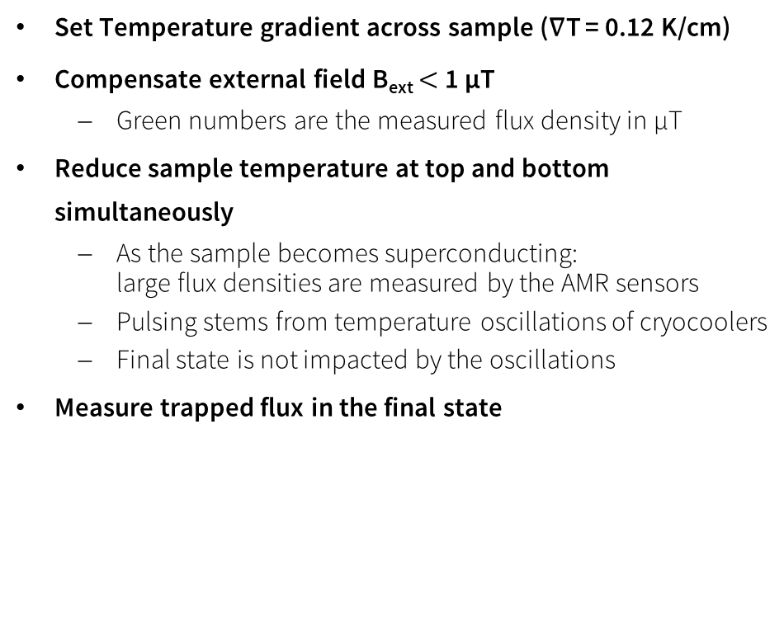
A typical Cooldown with “Nb₃Sn/Cu (HZB)”
Results
Set Temperature gradient across sample (∇T = 0.12 K/cm)
Compensate external field B_{ext} $<$ 1 µT
  Green numbers are the measured flux density in µT
Reduce sample temperature at top and bottom simultaneously
  As the sample becomes superconducting:
  large flux densities are measured by the AMR sensors
  Pulsing stems from temperature oscillations of cryocoolers
  Final state is not impacted by the oscillations
Measure trapped flux in the final state

Slide 4
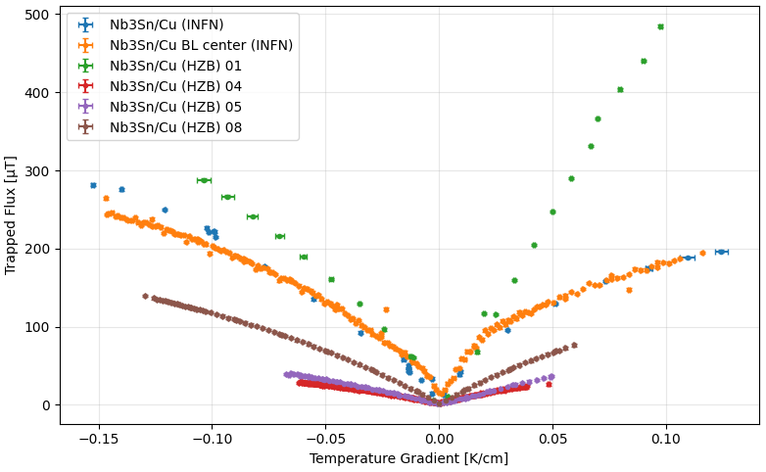
Nb₃Sn on copper substate
Results
Zero field cooled
Plot trapped flux magnitude of center sensor versus temperature gradient during cooldown
Increasing flux density with temperature gradient
Some samples show very large flux density magnitudes several times the earth’s magnetic field
Effect ranges over one order of magnitude between samples despite same material combination:
26µT – 250 µT at 0.05 K/cm

Slide 5
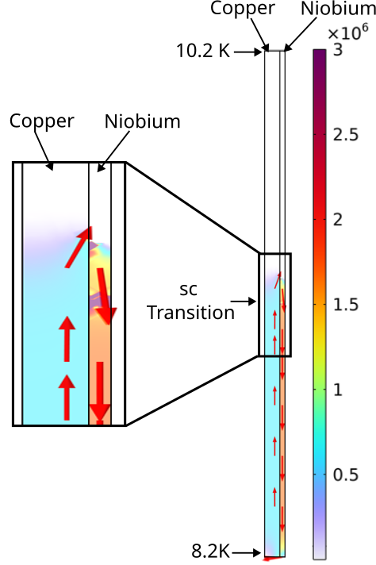
Simulation
Results
CurrenT Density
Simplified geometry to facilitate meshing:
  3mm copper
  1mm niobium
Seebeck coefficients:
  Nb: Temperature dependent
  Cu: Fixed -9 µV/K
Conductivity:
  Nb: RRR 10
  Cu: RRR 50
  Sc Nb: Increase by 5 orders of magnitude between 9.3 K and 9.2 K
Place transition in the middle of the sample
Compute current density
Currents are suppressed by low conductivity of normal conducting Nb
A/m

Slide 6
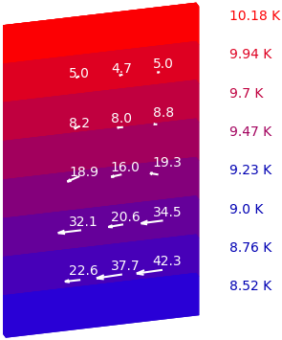
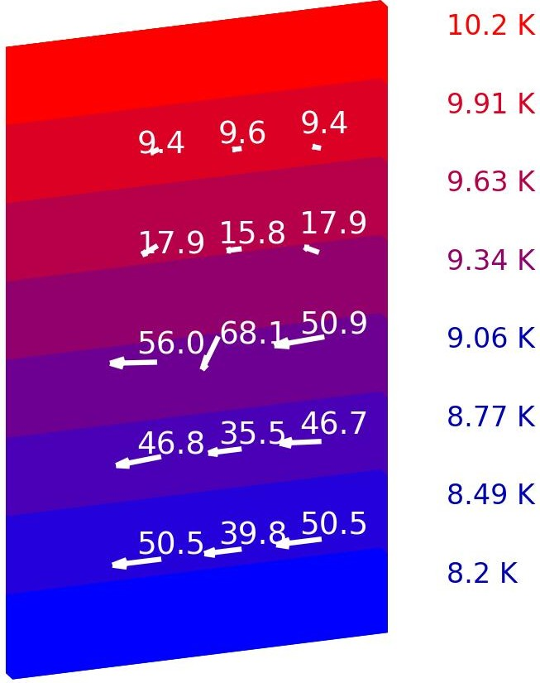
Simulation
Results
Measurement
Simulation
Simulate flux density generated by the current density
Extract flux density at sensor positions
Compare to measurement
  Nb/Cu (10 μm) Sample
  Partially superconducting
Good qualitatively agreement
  Field increased in superconducting area
  Direction from right to left
Magnitude can change drastically by changing conductivity of the copper

Slide 7
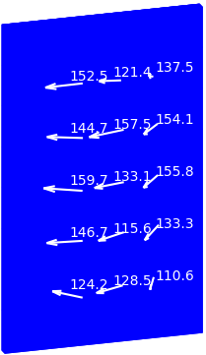
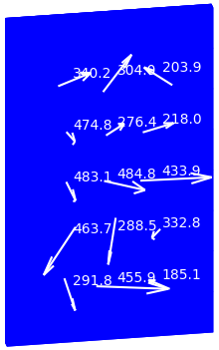
Trapped flux orientation
Results
Nb₃Sn/Cu
Nb₃Sn/Cu
The final state orientation of the trapped flux can be categorized in homogenous and inhomogeneous
The homogenous state is what is expected from simulations
Possibly caused by inhomogeneous T_{c}

Slide 8
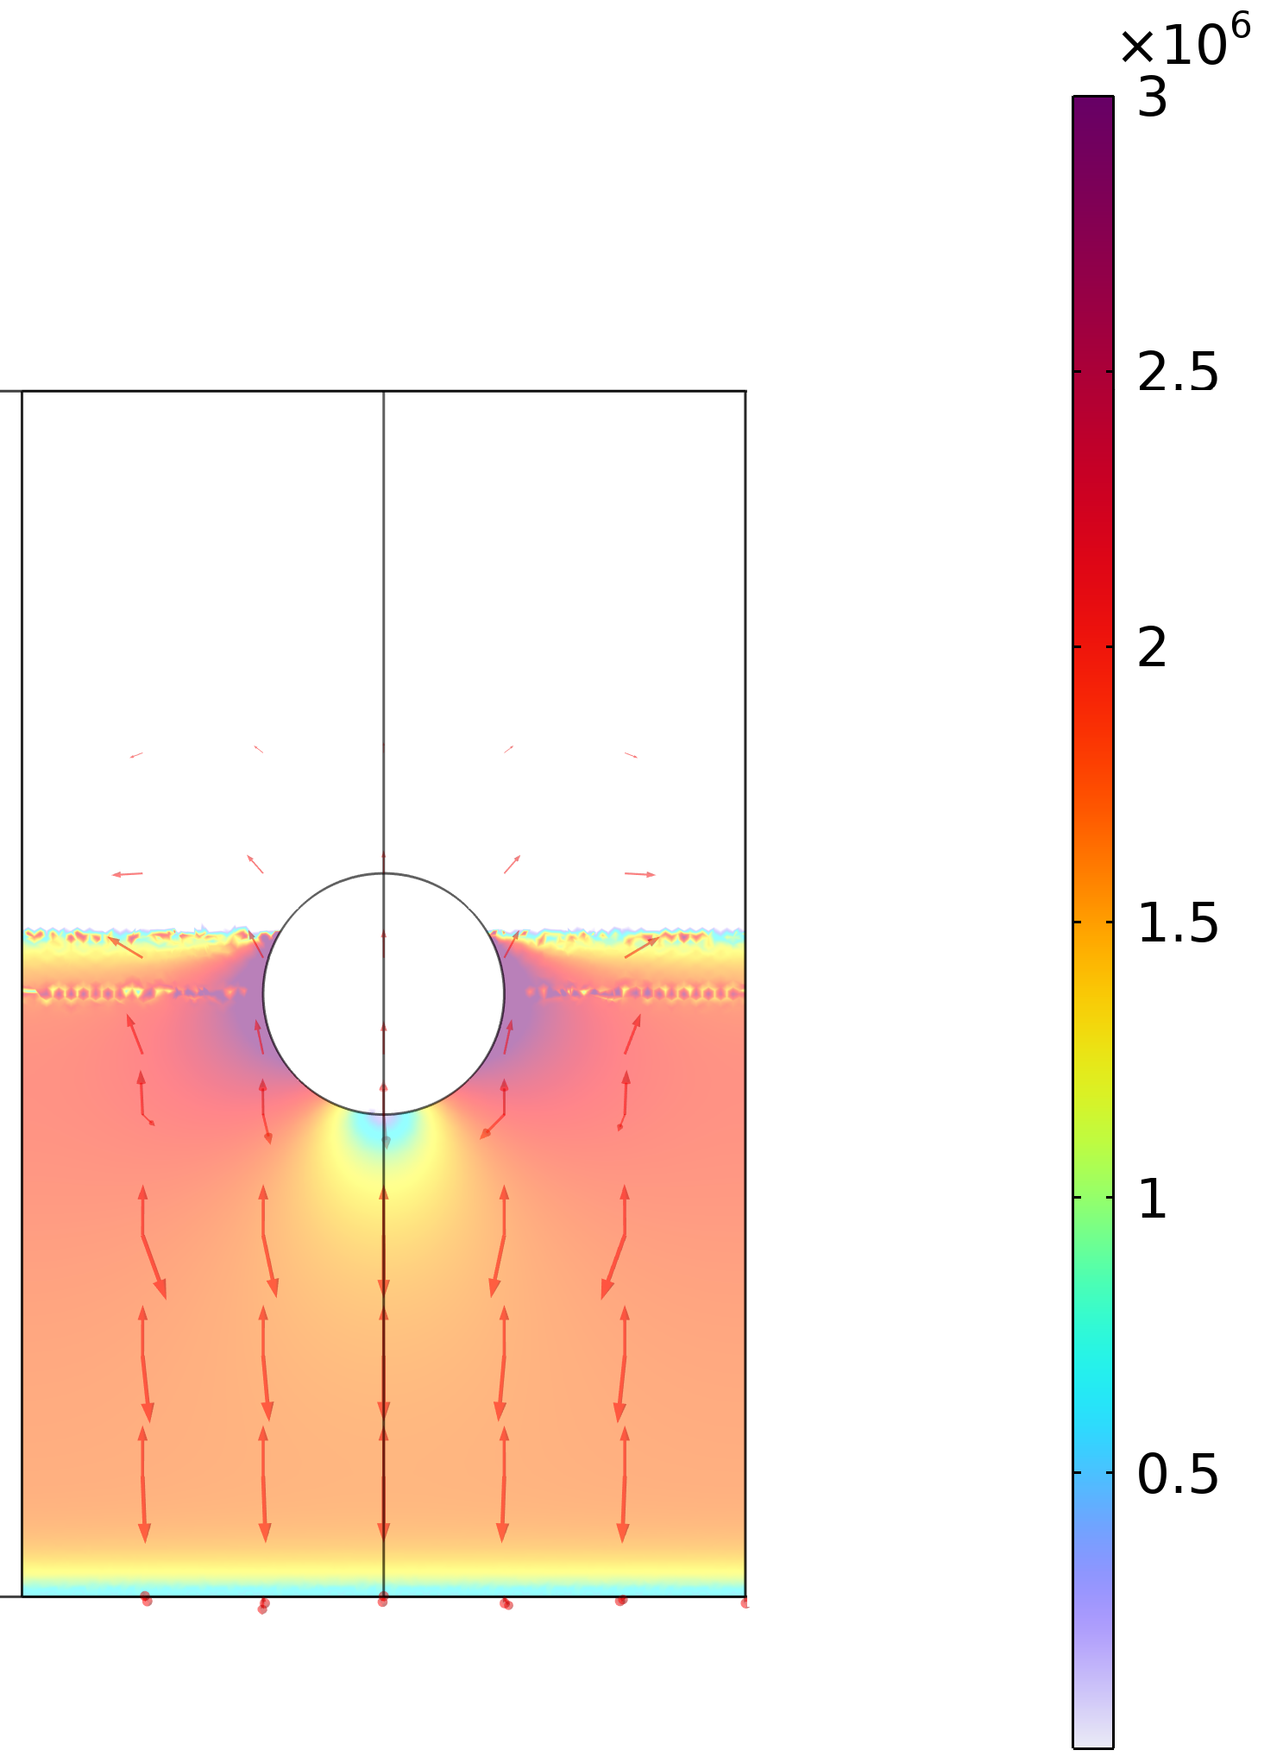
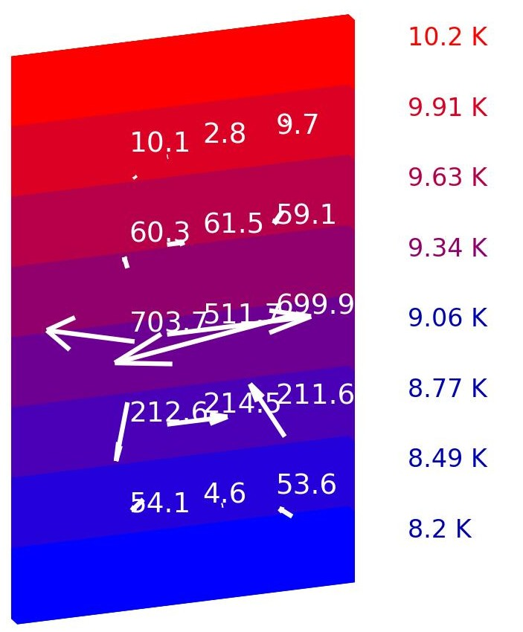
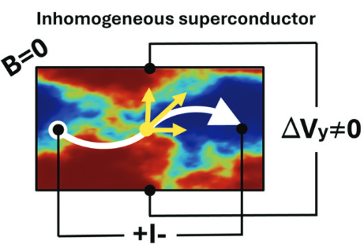
Current Redistribution
Results
A/m
Simulation
An inhomogeneous T_{c} leads to locally a varying resistance in the transition area
This causes a current to flow around low conducting patches
Current redistribution leads to magnetic field redistribution
Simulation shows a large effect
  2 cm large insert of normal conducting niobium in the transition area
First observed in T_{c} measurements with a 4-point resistance measurement [1]
N. Stegani et al., “Inhomogeneity-driven multiform Spontaneous Hall Effect in conventional and unconventional superconductors,” Science and Technology of Advanced Materials, vol. 26, no. 1, p. 2546282, Dec. 2025, doi: 10.1080/14686996.2025.2546282.
[1] R. Vaglio, C. Attanasio, L. Maritato, and A. Ruosi, “Explanation of the resistance-peak anomaly in nonhomogeneous superconductors,” Phys. Rev. B, vol. 47, no. 22, pp. 15302–15303, Jun. 1993, doi: 10.1103/PhysRevB.47.15302.

Slide 9
Insulator Layer
Results
Introduce insulating layer between copper and niobium
Insulate superconductor from substrate or increase the resistance on the path of the thermoelectric current
Current passes though normal conducting Nb
Current density two orders of magnitude smaller
Coating
  Al₂O₃ coating by ALD in CEA Paris
  Nb and Nb₃Sn are DC magnetron sputtered by INFN Legnaro
Will be tested next week
Nb₃Sn
Nb
Al₂O₃
Cu

Slide 10
Conclusion
Conclusion & Outlook
We adapted the setup the accept smaller sample sizes (20x30x3)mm³
Large differences between the samples despite the same material combination
Simulation shows qualitative agreement with measurement
Electrical conductivity amplifies thermoelectric currents
Inhomogeneous Tc could be the cause for inhomogeneous magnetic field
Even imperfect insulator should suppress currents
Outlook
outlook
Test Sample with insulator
Try different coatings
  Film thickness
  Coating area
  Higher Tc
Different substrate materials
Correlate results with microscopic analysis techniques
Presented work is submitted to Superconductor Science and Technology
This work was partially funded by the European Union’s Horizon-INFRA-2023-TECH-01 under GA No 101131435 – 529 iSAS

Slide 11
Backup Slides

Slide 12
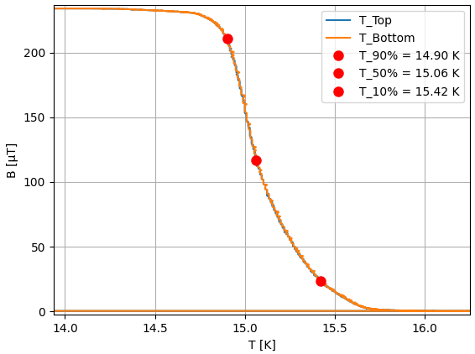
Transition Temperature
Results
We can use CRAFT to estimate T_{c}
Trap magnetic flux during cooldown
Turn off cryocooler and allow sample to slowly warm up
Record temperature and magnetic field during warmup
Transition width can be used to gauge the homogeneity of T_{c}

Slide 13
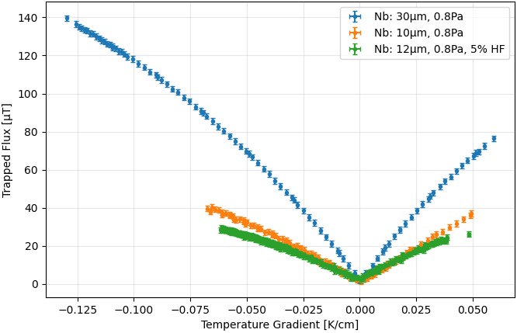
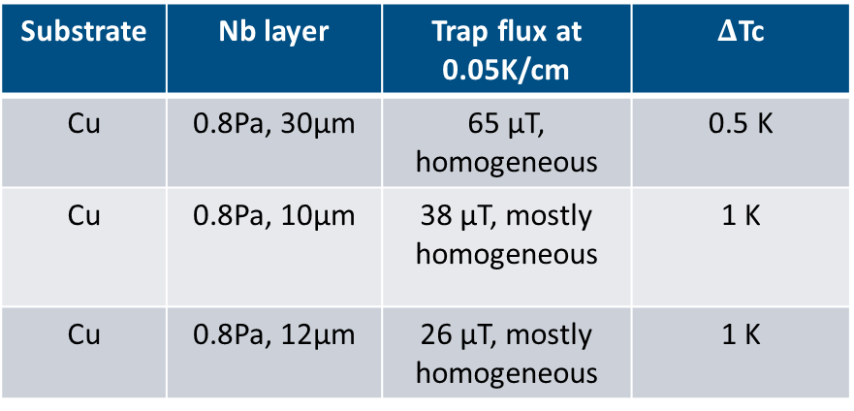
Effect of sample preparation
Results
Manufacturing parameters have large effect on thermoelectric currents
Best parameters shows highest trapped flux values
But: Field is homogeneous
Substrate | Nb layer | Trap flux at 0.05K/cm | $Δ$Tc
Cu | 0.8Pa, 30μm | 65 μT, homogeneous | 0.5 K
Cu | 0.8Pa, 10μm | 38 μT, mostly homogeneous | 1 K
Cu | 0.8Pa, 12μm | 26 μT, mostly homogeneous | 1 K

Slide 14
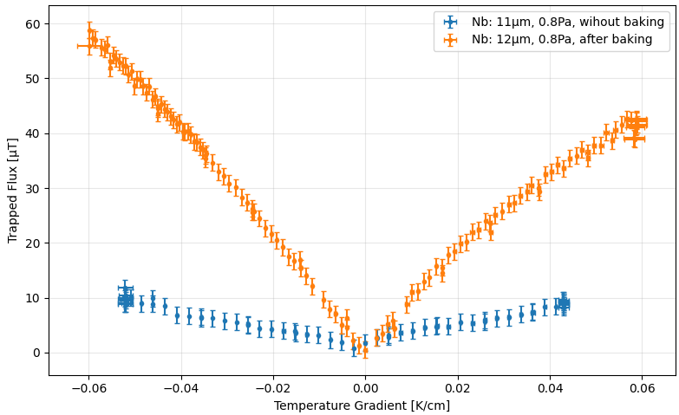
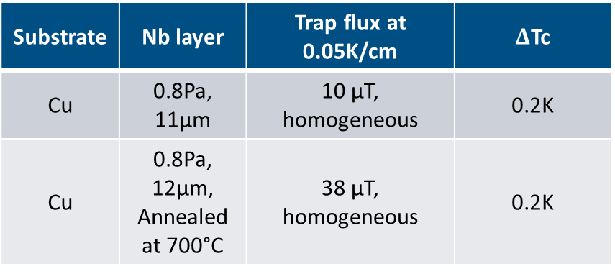
Effect of sample preparation
Results
Manufacturing parameters have large effect on thermoelectric currents
Best parameters shows highest trapped flux values
But: Field is homogeneous
Substrate | Nb layer | Trap flux at 0.05K/cm | $Δ$Tc
Cu | 0.8Pa, 11μm | 10 μT, homogeneous | 0.2K
Cu | 0.8Pa, 12μm, Annealed at 700°C | 38 μT, homogeneous | 0.2K

Slide 15
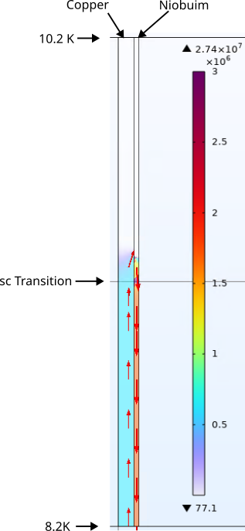
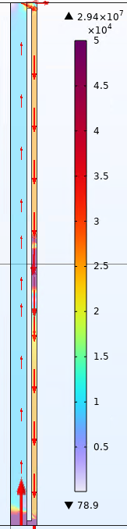
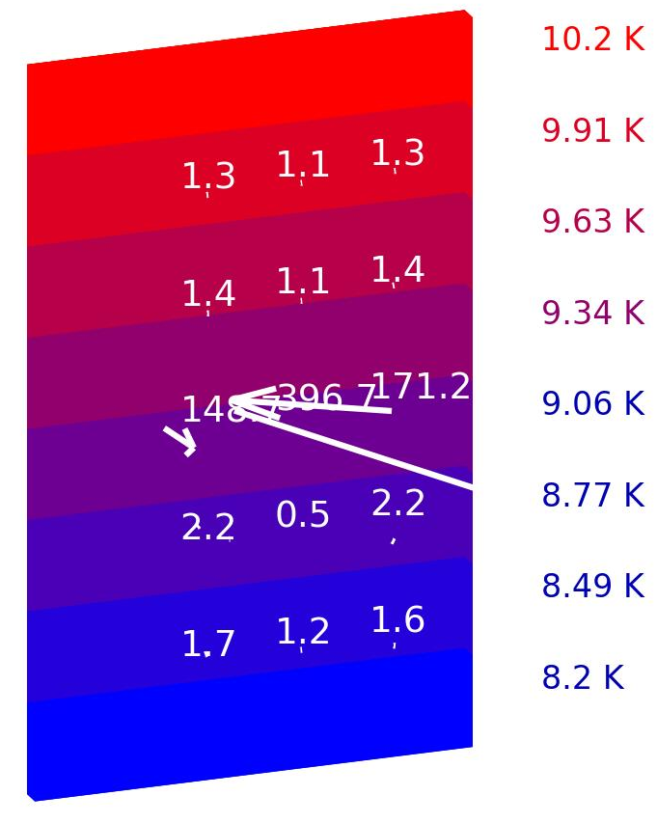
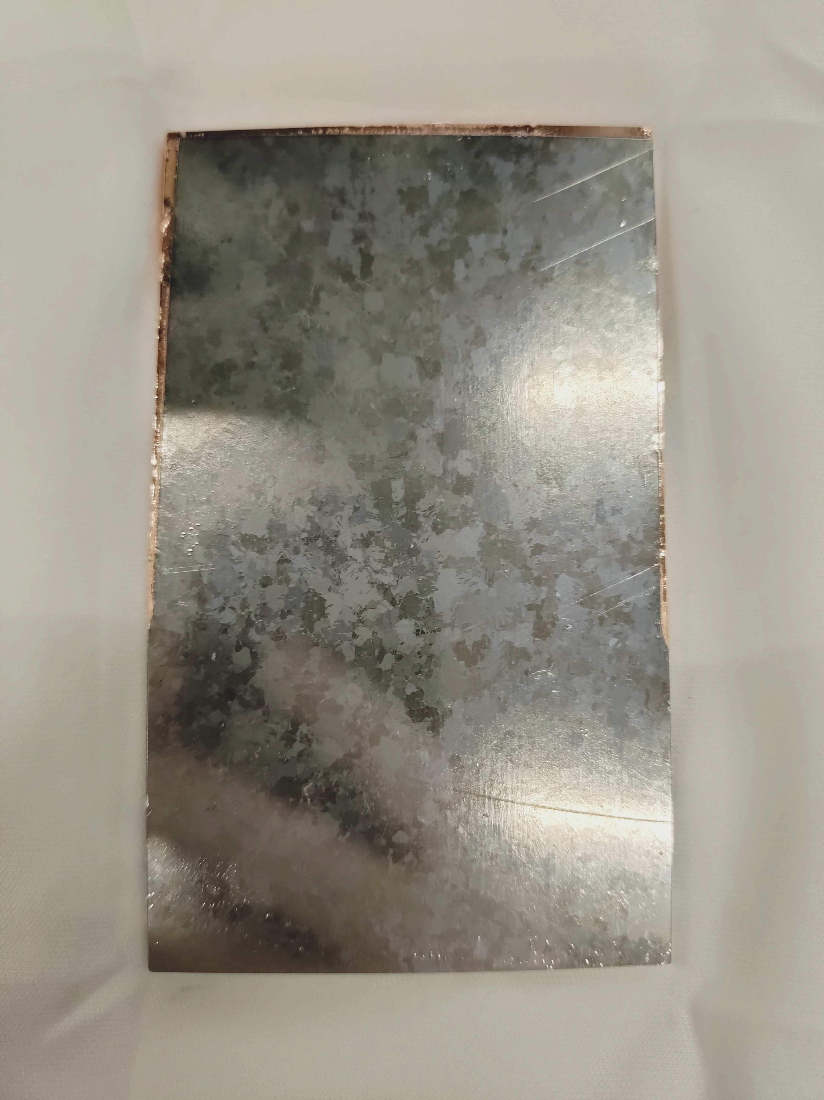
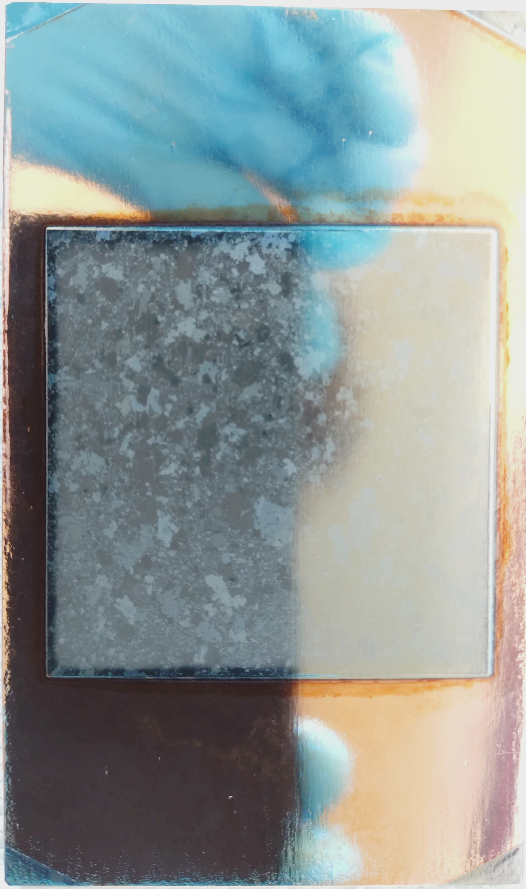
Barrier layer
Results
Introducing a barrier layer should increase the resistance on the path the thermoelectric currents take
Two samples:
  One fully coated: electric connection at ends
  One coated only in the center: floating Nb3Sn

Slide 16
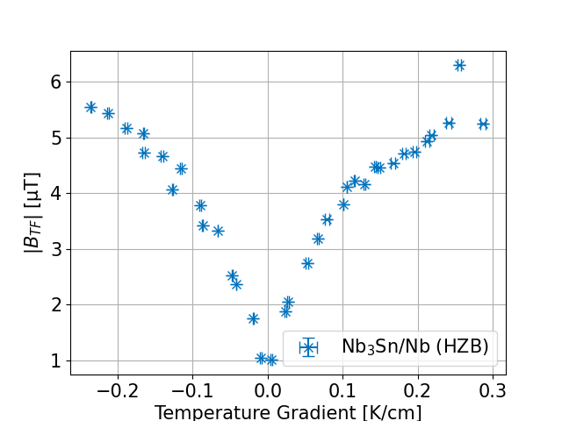
Nb₃Sn on niobium substrate
Results
Zero field cooled
Plot trapped flux magnitude of center sensor versus temperature gradient during cooldown
Increase with temperature gradient
Flux density 2 orders of magnitude smaller

Slide 17
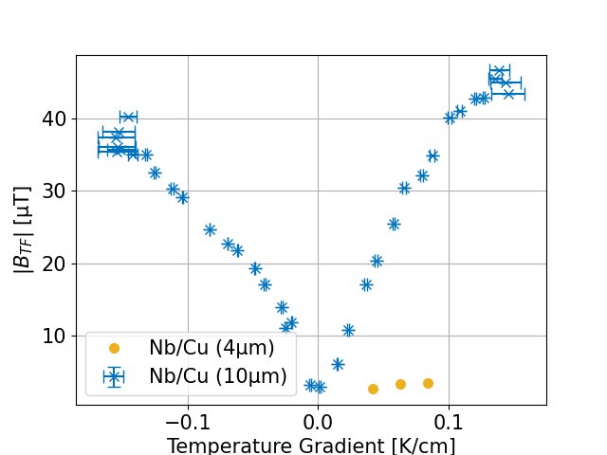
Niobium on copper
Results
Zero field cooled
Plot trapped flux magnitude of center sensor versus temperature gradient during cooldown
Trapped flux at 0.085 K/cm
  Nb/Cu (4µm): 3.5 µT
  Nb/Cu (10µm): 33 µT

Slide 18
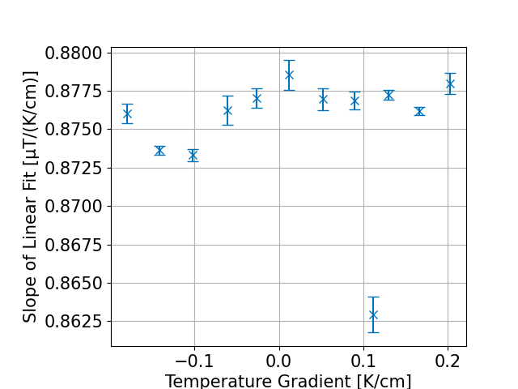
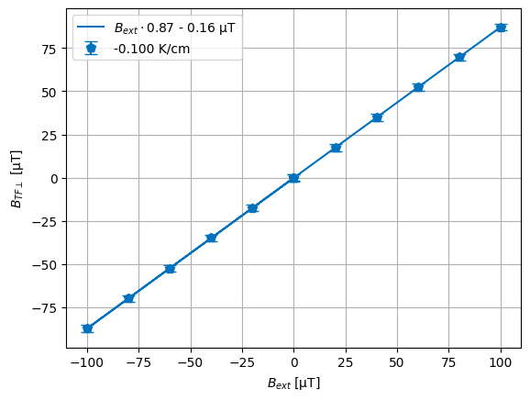
Trapping efficiency
Results
Nb₃Sn/Nb (HZB)
Cool down samples different external fields with constant temperature gradient
Plot trapped flux versus external field
Slope of linear fit is trapping efficiency
No dependency on temperature gradient
  This is in contrast with bulk samples where the trapping efficiency decreases with increasing temperature gradient
All coated samples show trapping efficiencies of 85-92 %

Slide 19
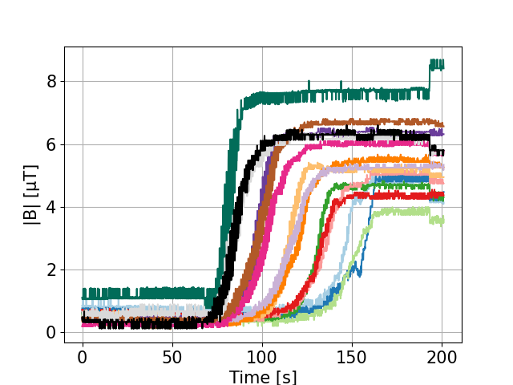
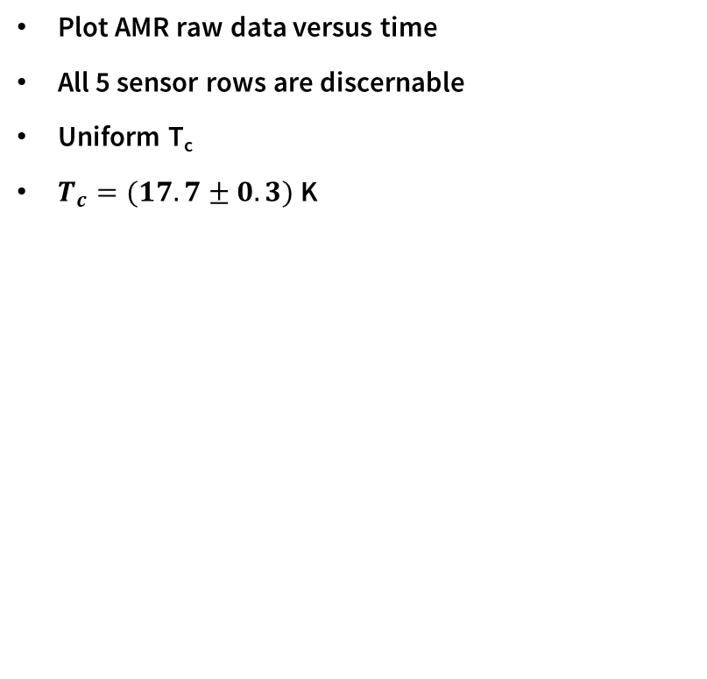
Cooldown dynamics and T_{c}
Results
Nb₃Sn/Nb (HZB)
Plot AMR raw data versus time
All 5 sensor rows are discernable
Uniform T_{c}
$T_{c}=(17.7±0.3)$ K
To be published

Slide 20
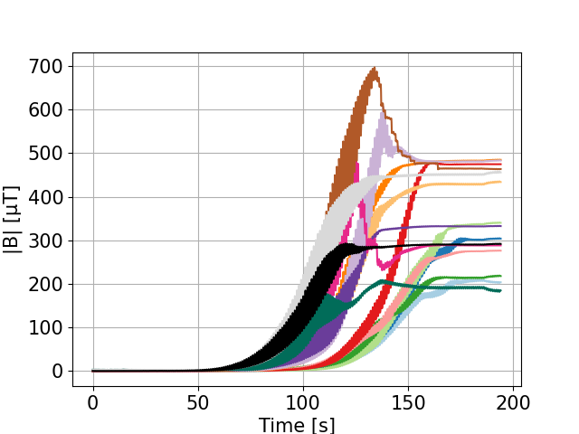
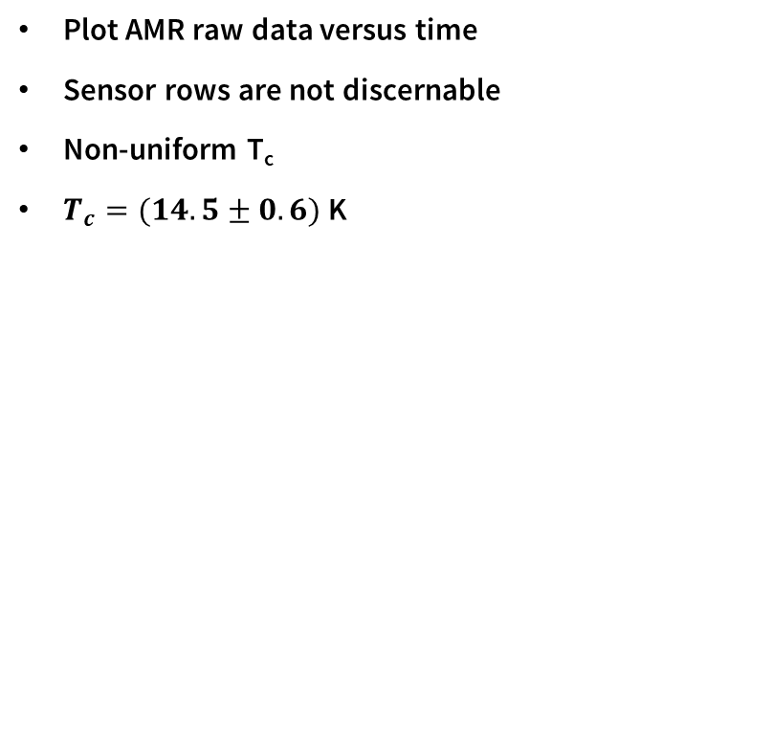
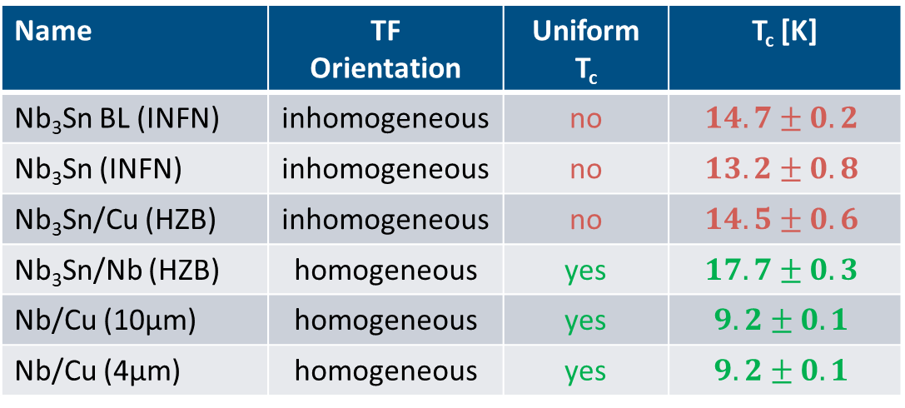
Cooldown dynamics and T_{c}
Results
Nb₃Sn/Cu (HZB)
Plot AMR raw data versus time
Sensor rows are not discernable
Non-uniform T_{c}
$T_{c}=(14.5±0.6)$ K
Name | TF Orientation | Uniform T_{c} | T_{c} [K]
Nb₃Sn BL (INFN) | inhomogeneous | no | $$14.7±0.2$$
Nb₃Sn (INFN) | inhomogeneous | no | $$13.2±0.8$$
Nb₃Sn/Cu (HZB) | inhomogeneous | no | $$14.5±0.6$$
Nb₃Sn/Nb (HZB) | homogeneous | yes | $$17.7±0.3$$
Nb/Cu (10µm) | homogeneous | yes | $$9.2±0.1$$
Nb/Cu (4µm) | homogeneous | yes | $$9.2±0.1$$

Slide 21
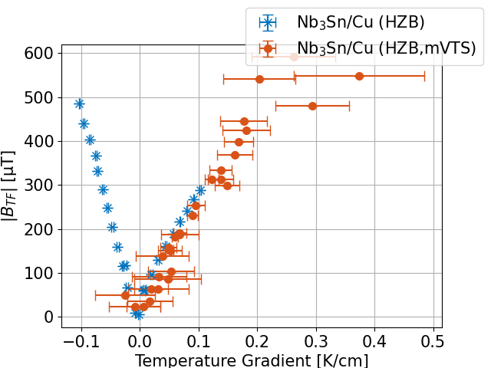
CRAFT vs. mVTS
Results

