Slide 1



Advancements in MgB₂-Coated Cu Superconducting RF Cavities
Ke Chen, Xiaojun Xu, Dmitriy Dikin, and Xiaoxing Xi
Temple University, Philadelphia, Pennsylvania, USA
Eric Lechner
Thomas Jefferson National Accelerator Facility, Newport News, Virginia, USA
Leila Kasaei
Rutgers University, New Brunswick, New Jersey, USA

Slide 2
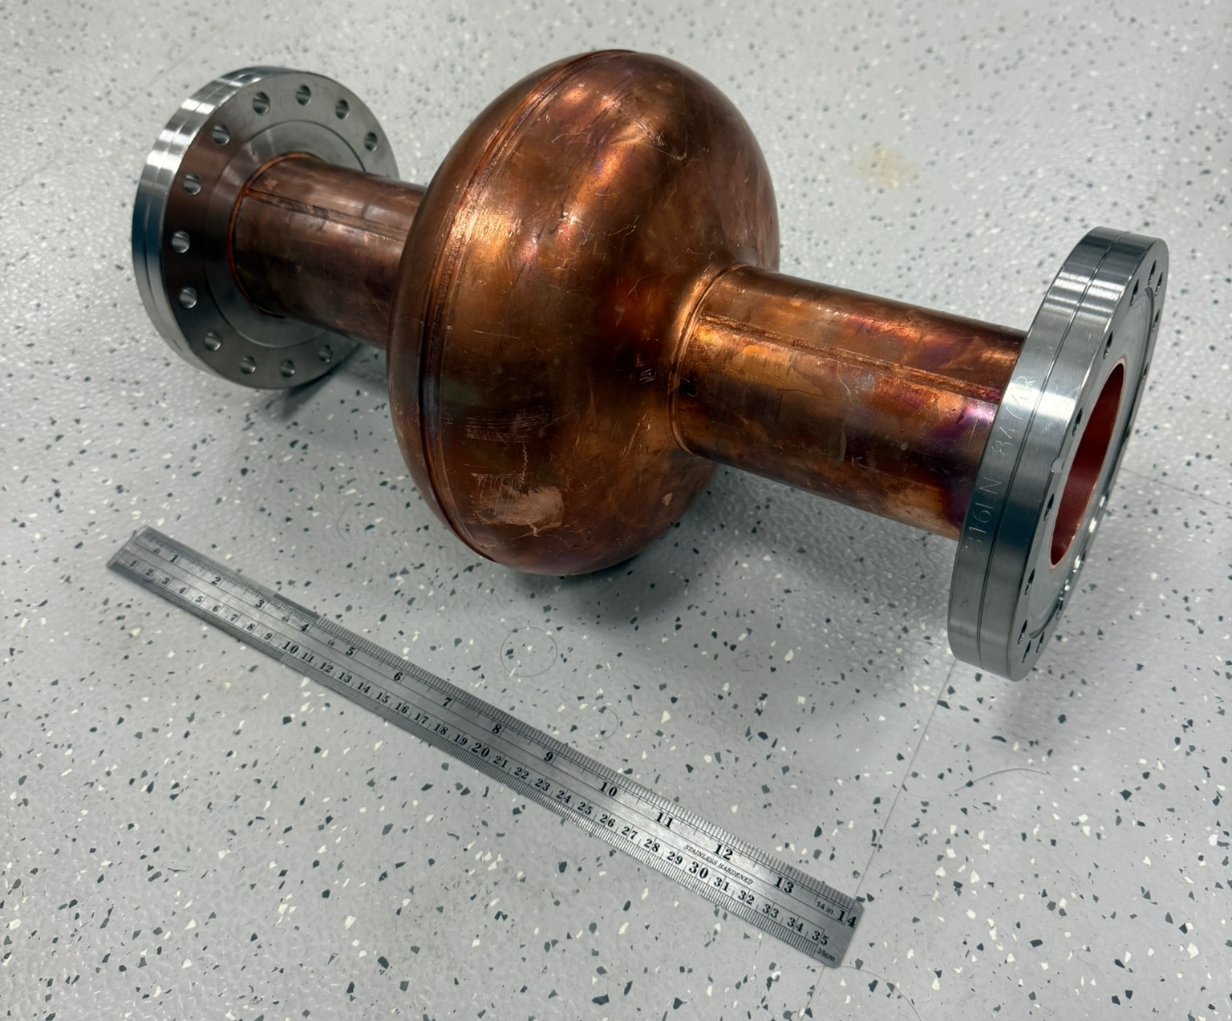
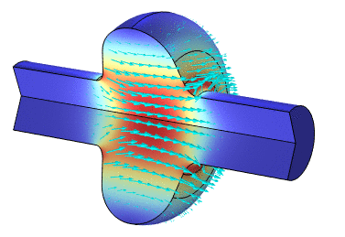
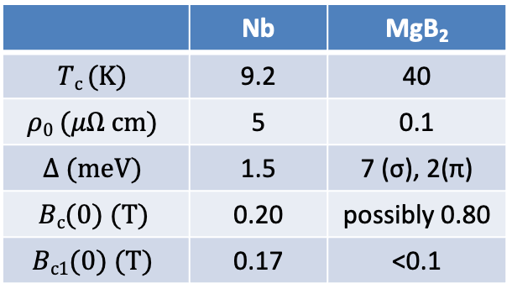
Goal: Coat 1.3 GHz Cu cavities with MgB₂ films for particle accelerators
MgB₂ vs Nb
 | Nb | MgB₂
$$Tc (K)$$ | 9.2 | 40
$$ρ0 (μΩ cm)$$ | 5 | 0.1
$$Δ (meV)$$ | 1.5 | 7 (σ), 2(π)
$$Bc(0) (T)$$ | 0.20 | possibly 0.80
$$Bc1(0) (T)$$ | 0.17 | <0.1
Charged
Particles
RF surface resistance depends on energy gap and residual resistivity. Larger gap and lower resistivity indicate potential low RF loss than in Nb.
Field gradient is ultimately limited by thermodynamic critical field. For MgB₂, B_{c}(0) could be as high as 800 mT, vs. 200 mT for Nb.
Lower critical field B_{c1}(0) may be an obstacle.
Potential to operate at 10-20 K with similar or higher energy gradient than Nb.

Slide 3
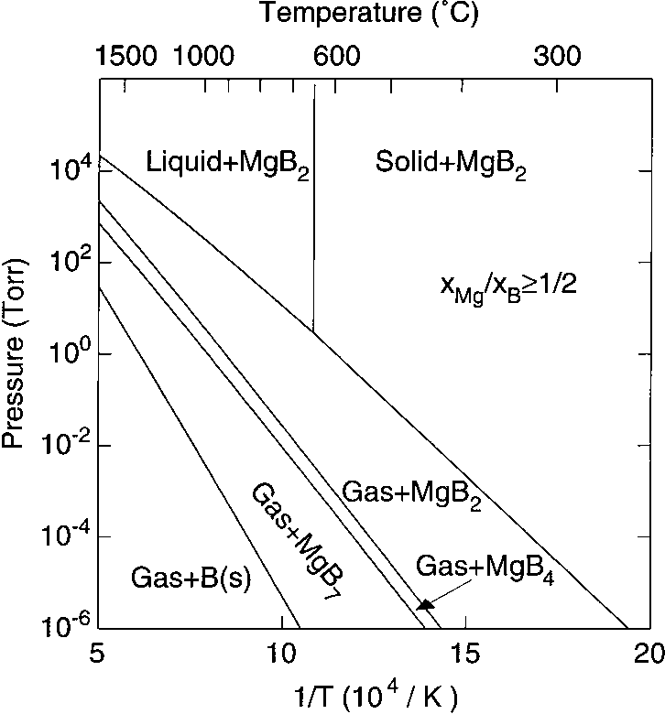
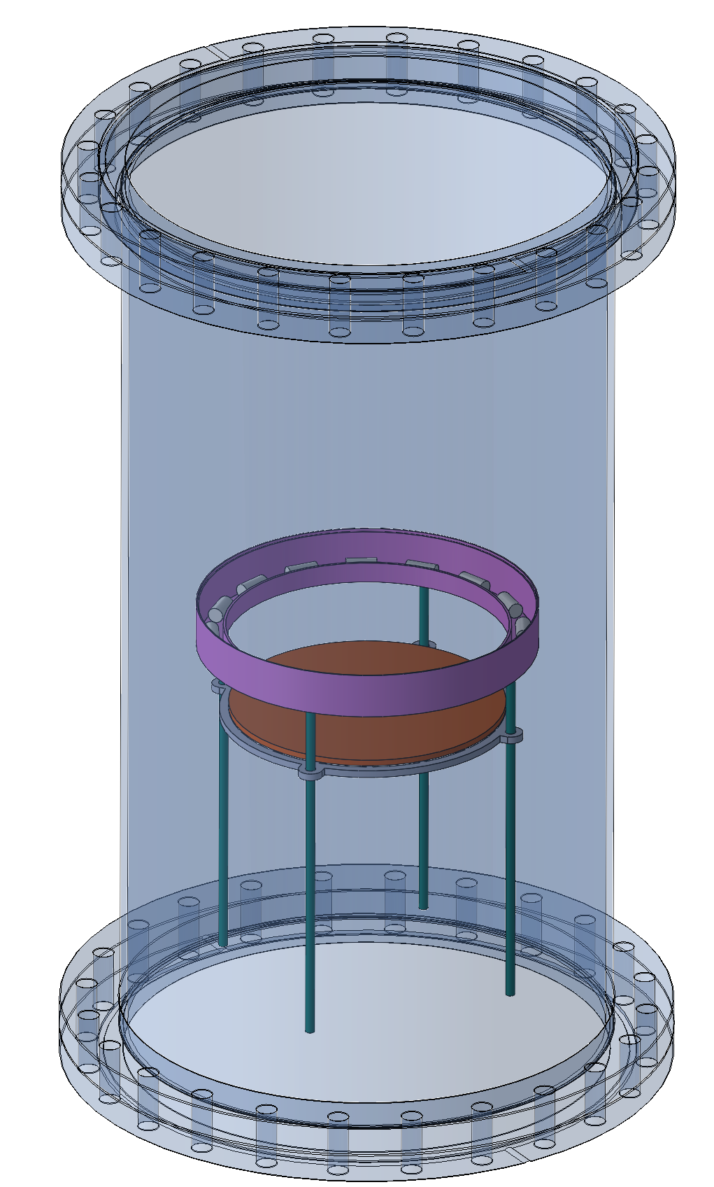
Growth of MgB₂ Films by Hybrid Physical-Chemical Vapor Deposition (HPCVD)
B₂H₆ + H₂
7.9” dia.
Mg heater
Mg shots
Sample
(up to 4.5” dia.)
Sample
heater
Mg: thermally evaporation of Mg pellets (physical vapor) creates high Mg vapor pressure
B: thermal decomposition of B₂H₆ (chemical vapor)
H₂ atmosphere prevents oxidization of Mg
Liquid phase of Mg-Cu alloy at > 485˚C helps to reduce the growth temperature to about 500˚C - first depositing Mg before depositing MgB₂
Pump

Slide 4
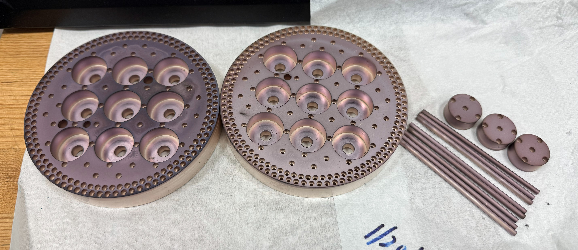
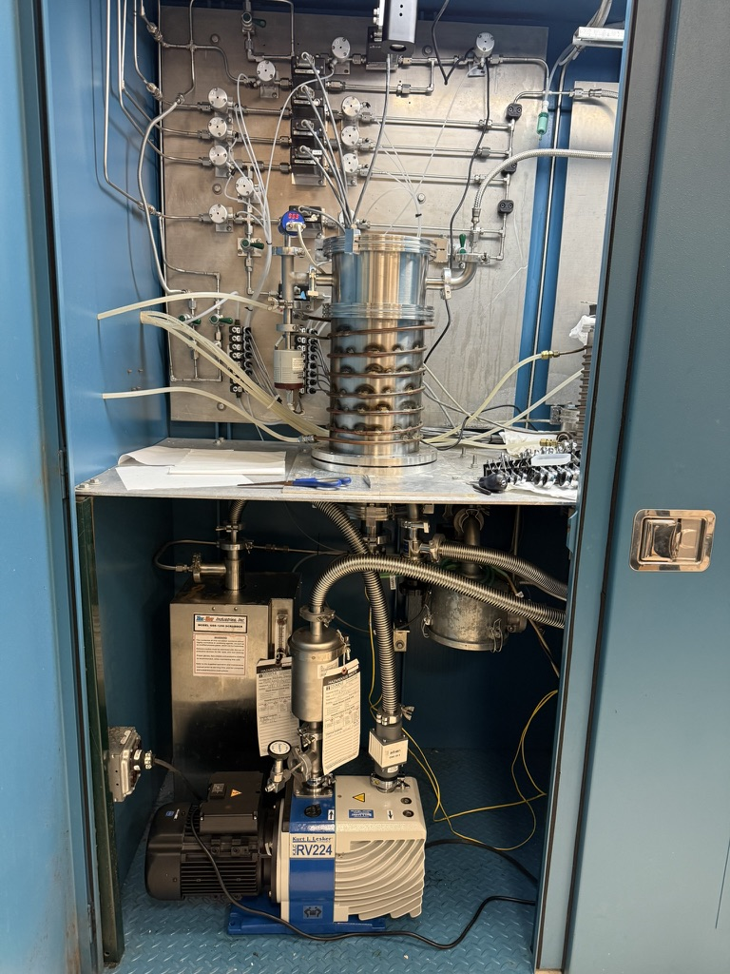
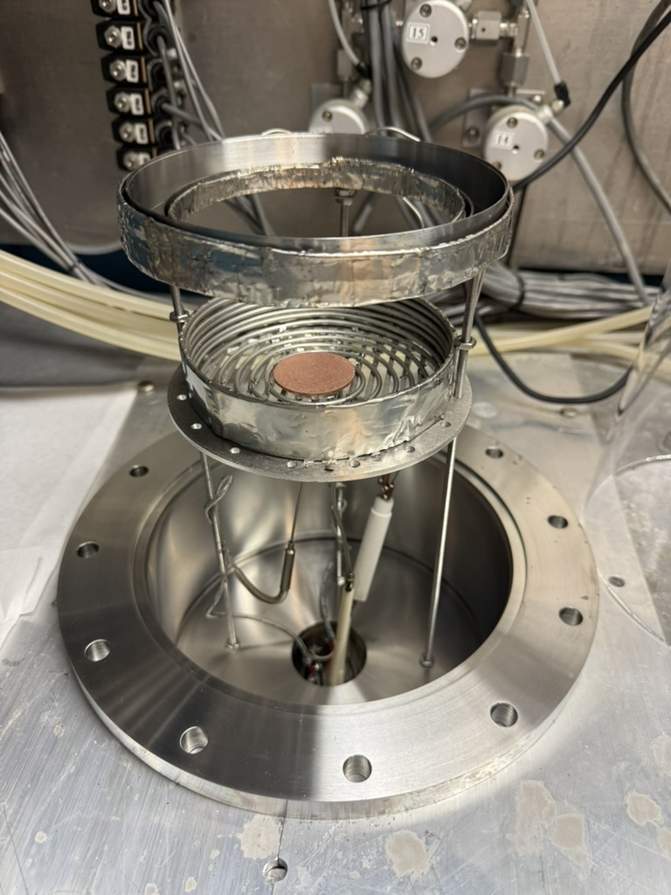
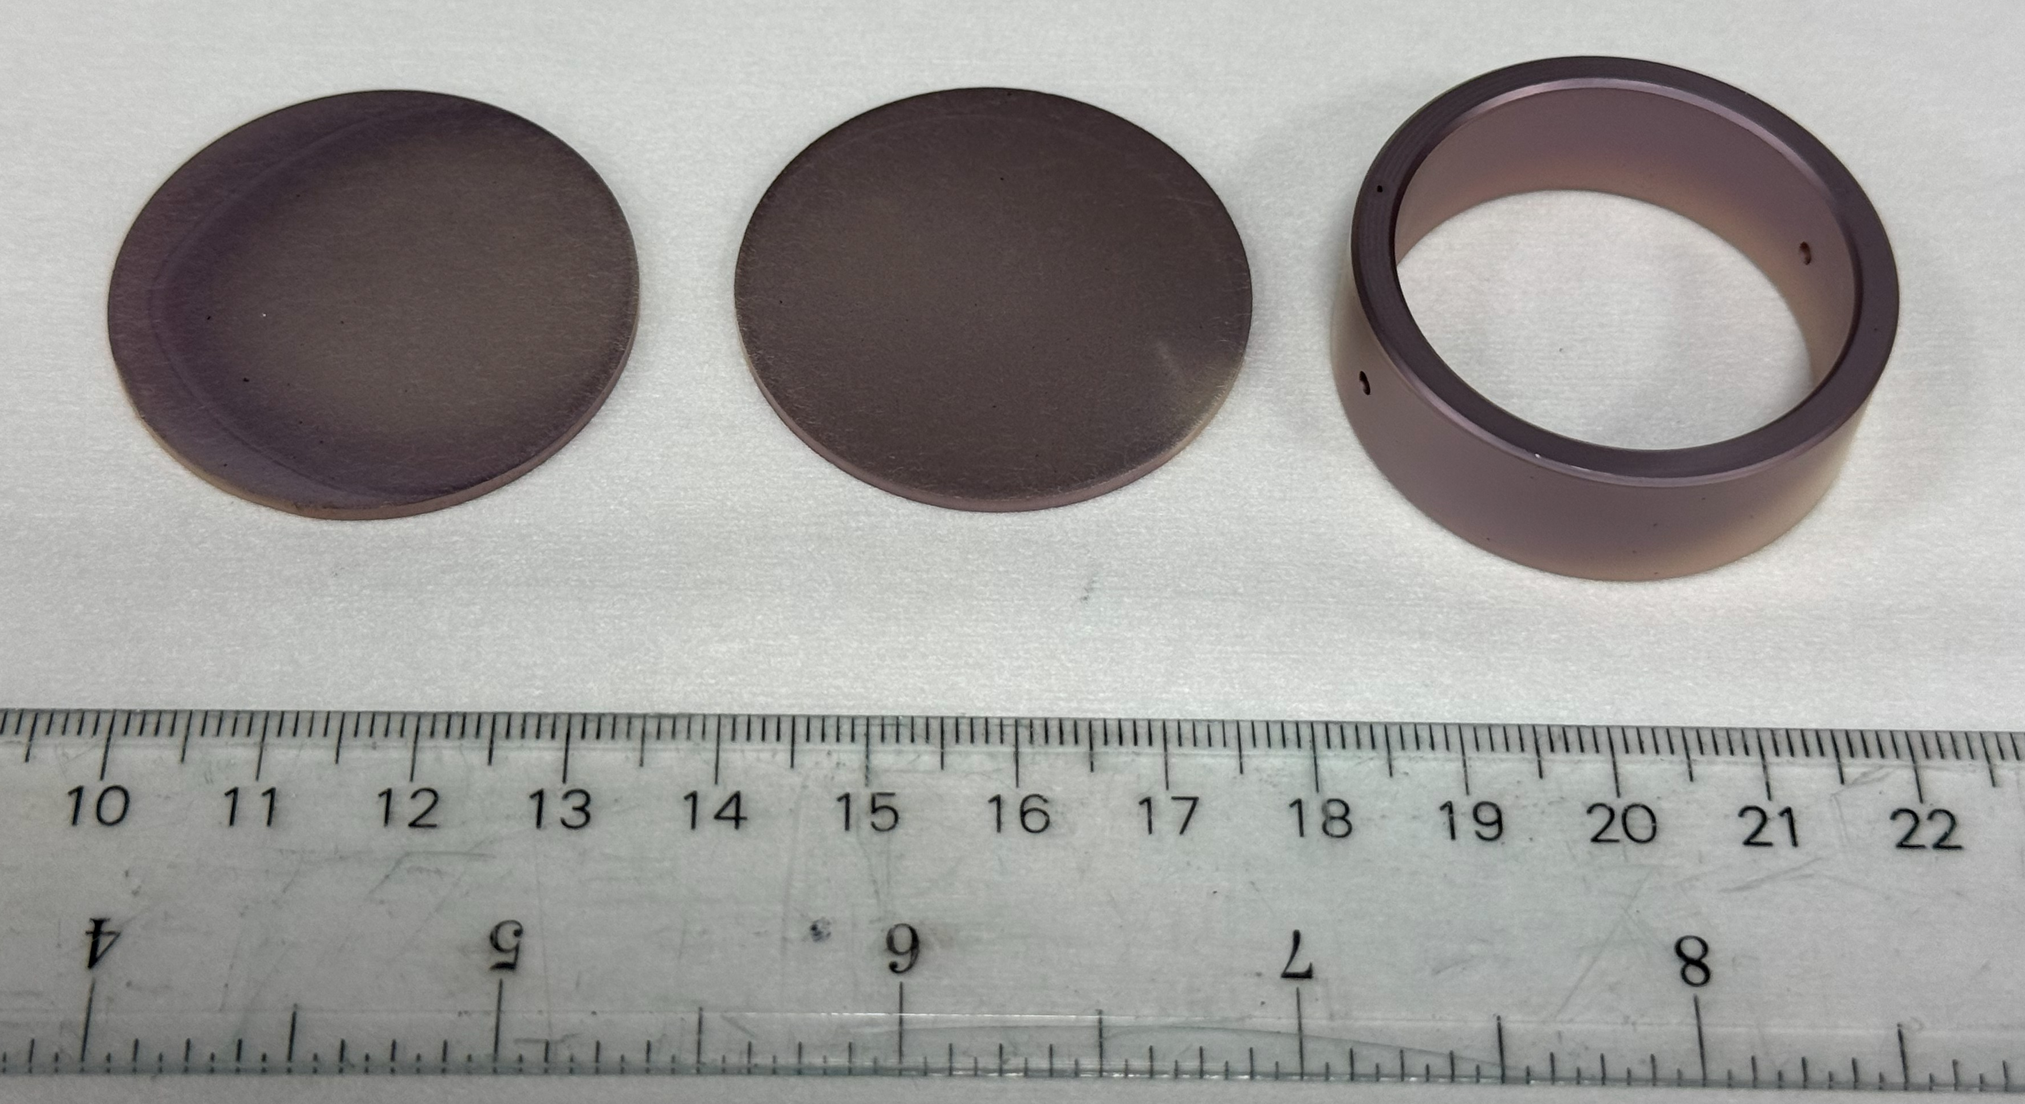
HPCVD deposition system for large samples up to 4.5” in diameter
10 cm
MgB₂-coated Cu parts for axion detection
Deposition system
Inside the reactor chamber
MgB₂-coated Cu disks and ring for dielectric resonator

Slide 5
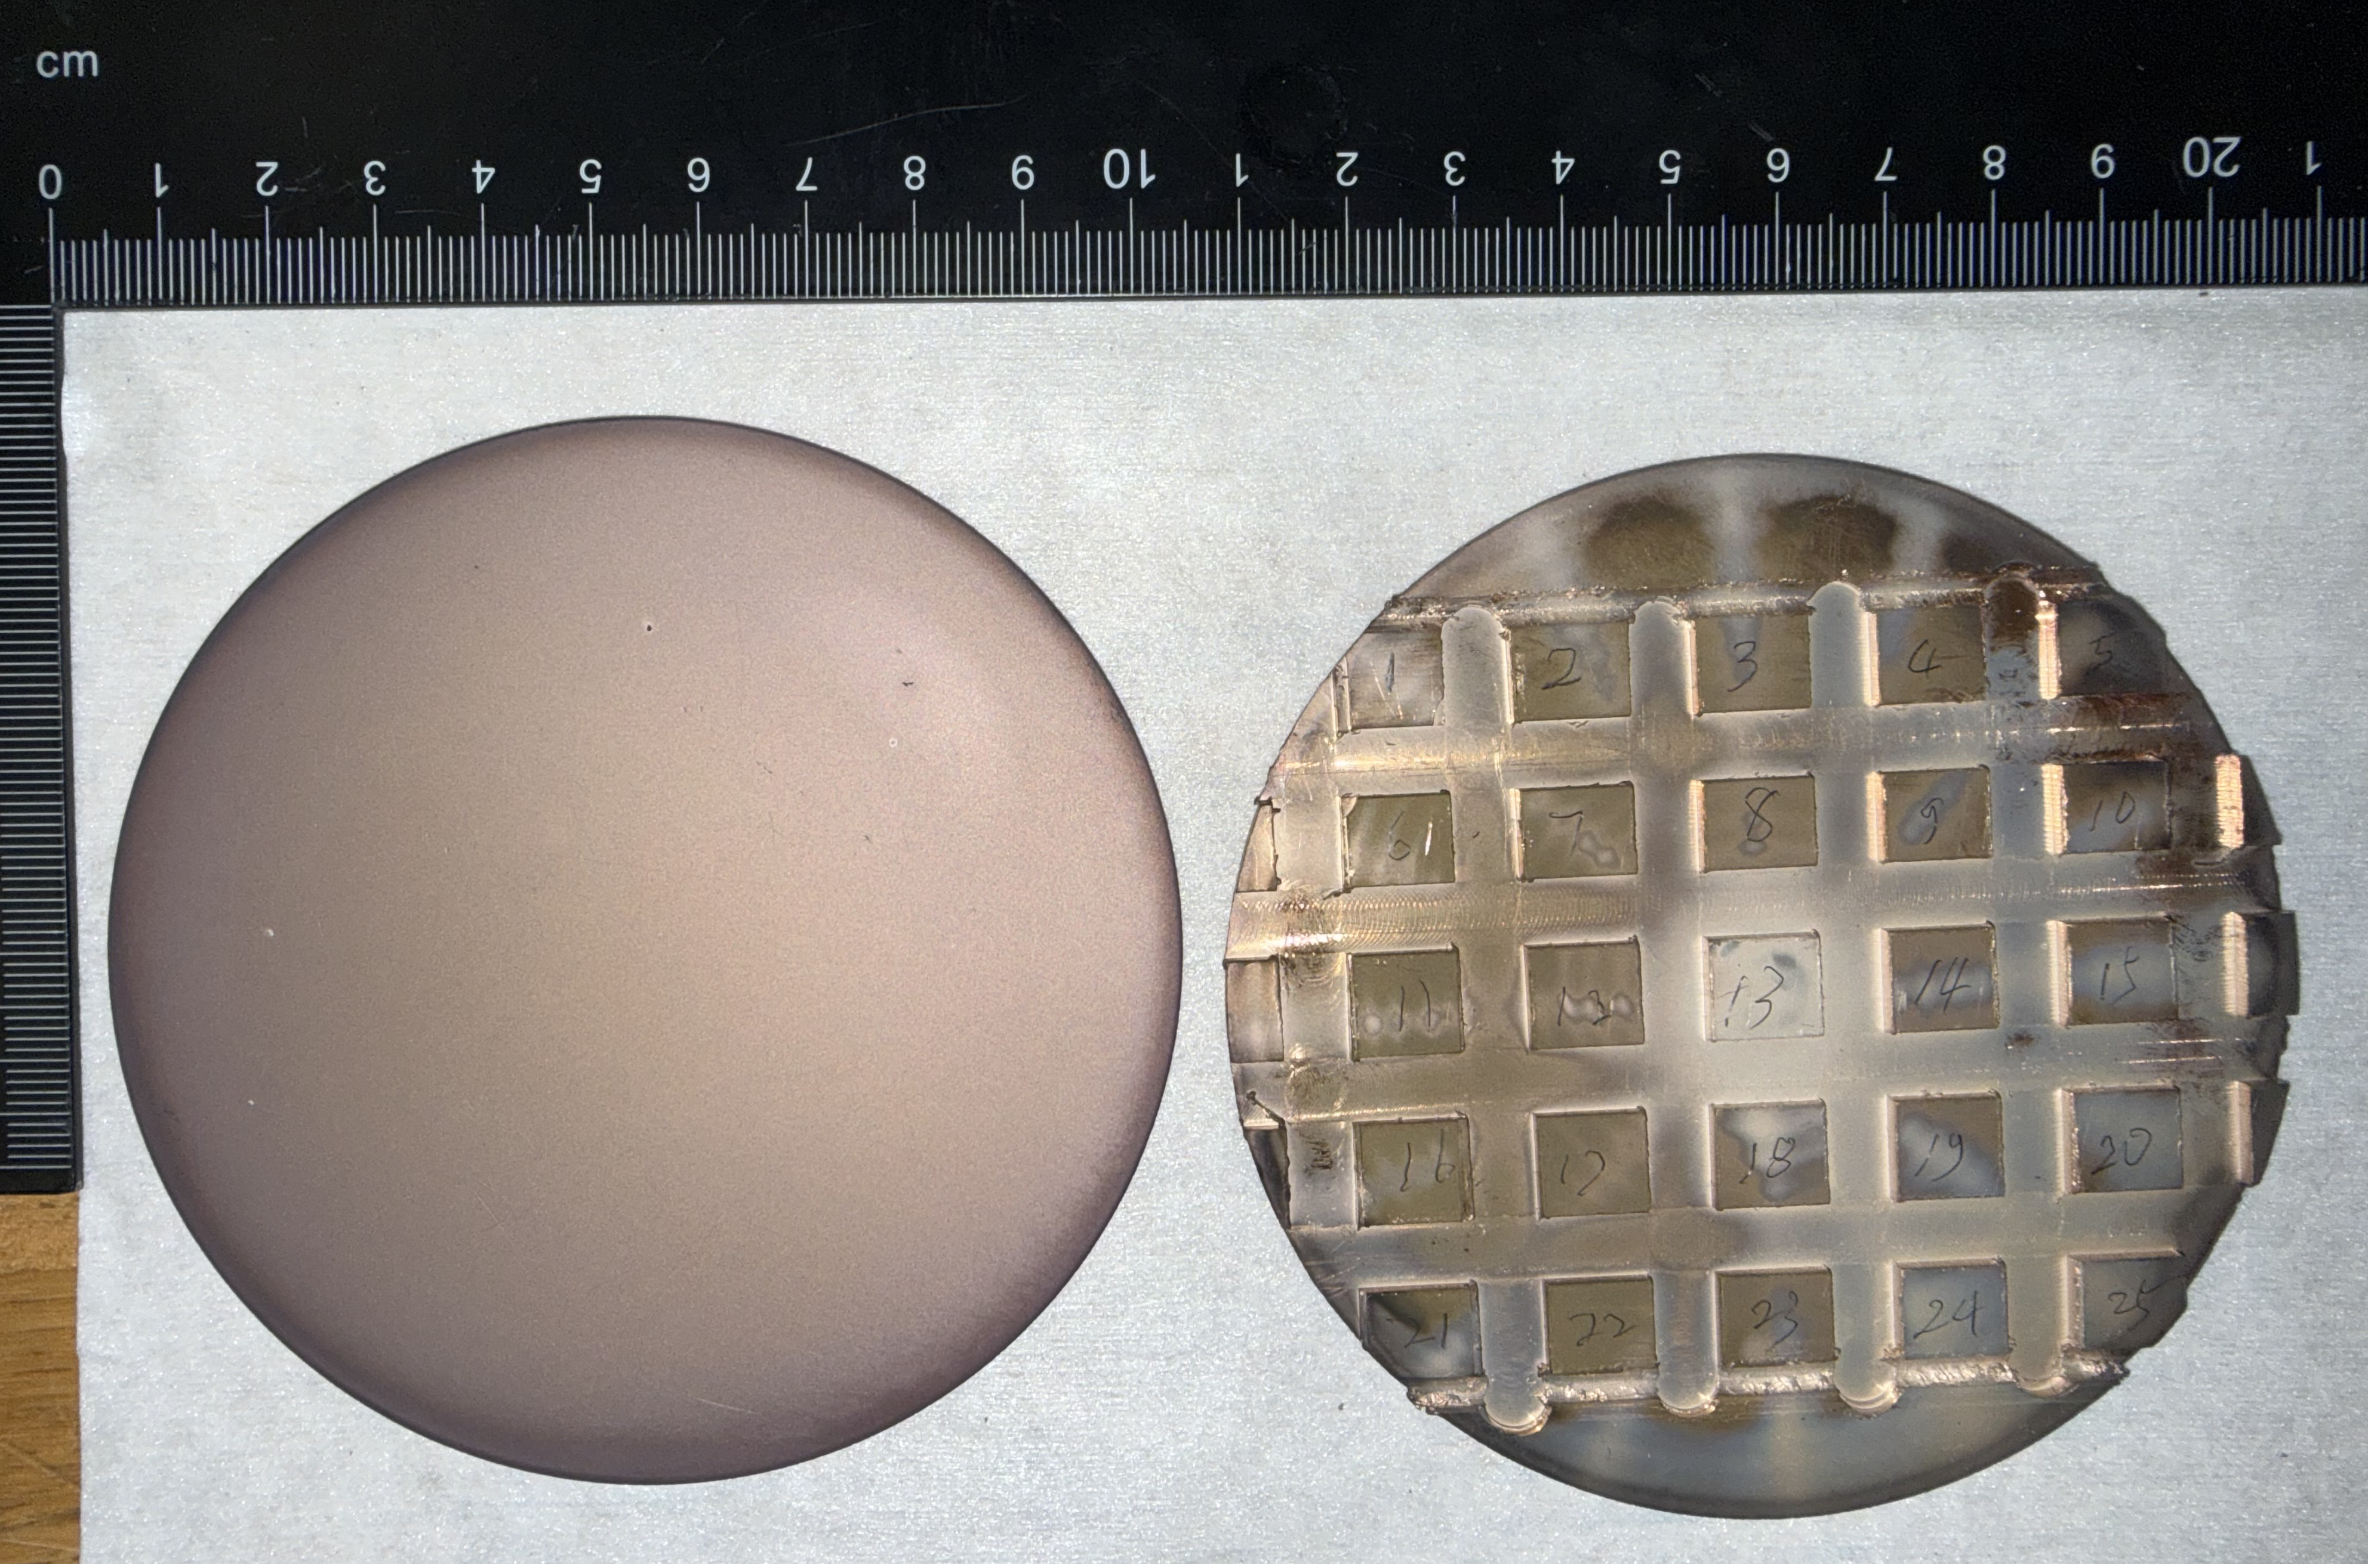
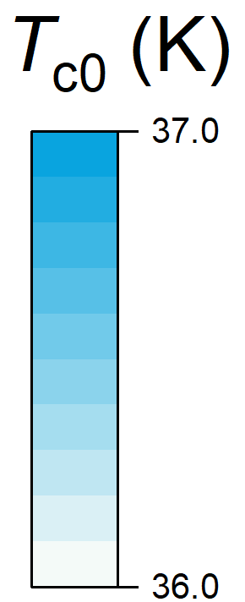

4”-diameter Cu disk coating and characterization by AC Susceptibility
4”-diameter Cu disk pre-cut on the back for easy cutting after deposition
25 1cm x 1cm samples were measured by AC susceptibility to determine T_{c0}
T_{c0}’s vary between 36 to 37 K, indicating uniform film quality

Slide 6
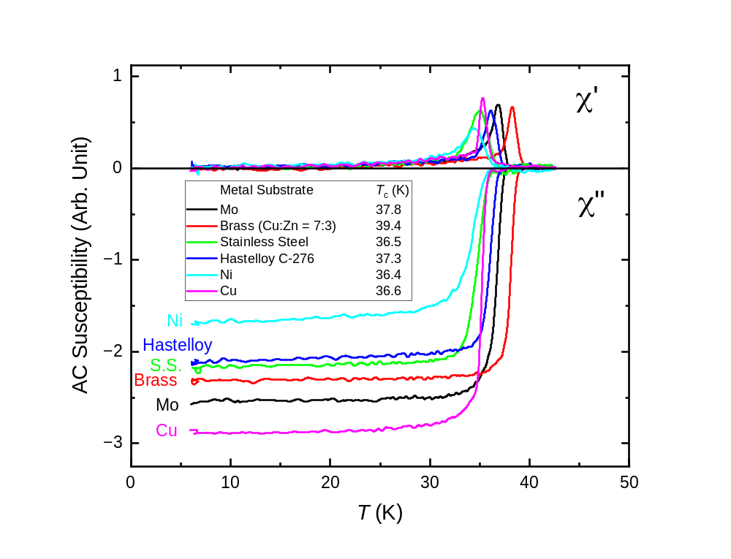
Superconducting Transition of MgB₂ Films on Various Metals
Provides future options of interlayer to block interdiffusion of Cu into MgB₂
MgB₂ films on brass exhibit increased T_{c0} up to 41 K, dropped to 39 K after thermal cycling to room temperature. Only reports of Zn-doped MgB₂ with decreased or little changed T_{c.} Metastable phases?

Slide 7
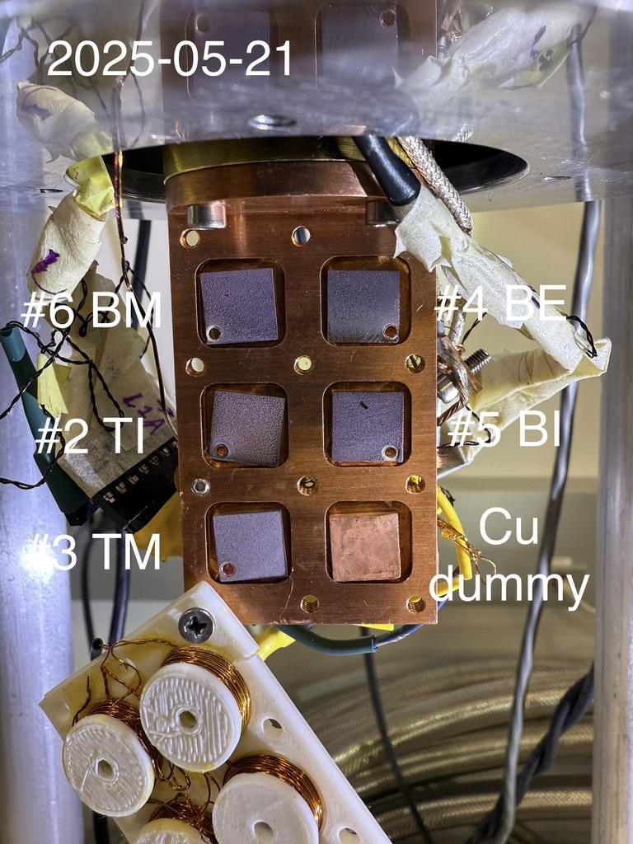
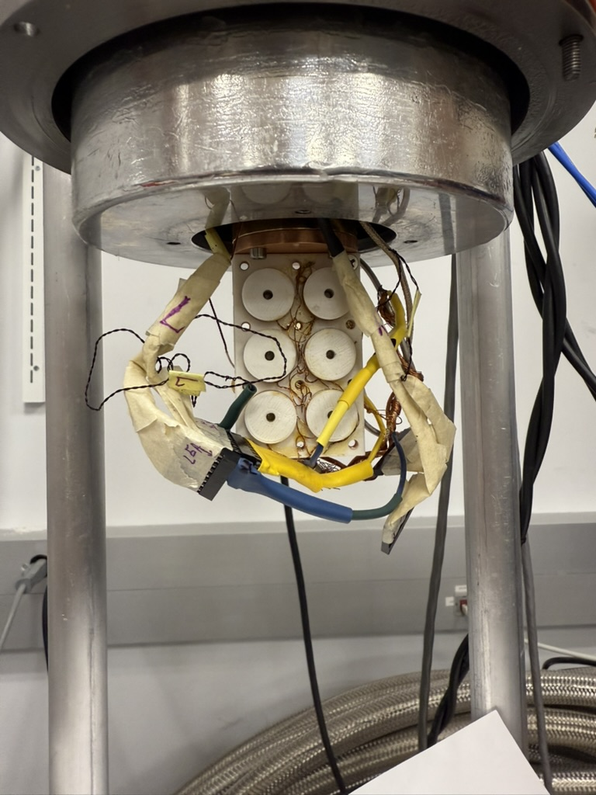
5-sample AC susceptibility measurement
5 samples cooled down to cryogenic temperatures simultaneously
AC susceptibility measurement conducted at 0.5 Hz to reduce signals from 1mm-thick Cu substrates
Each sample measured at temperatures from 5 to 50 K at rate of 0.5 K/min
10 samples can be measured per day

Slide 8
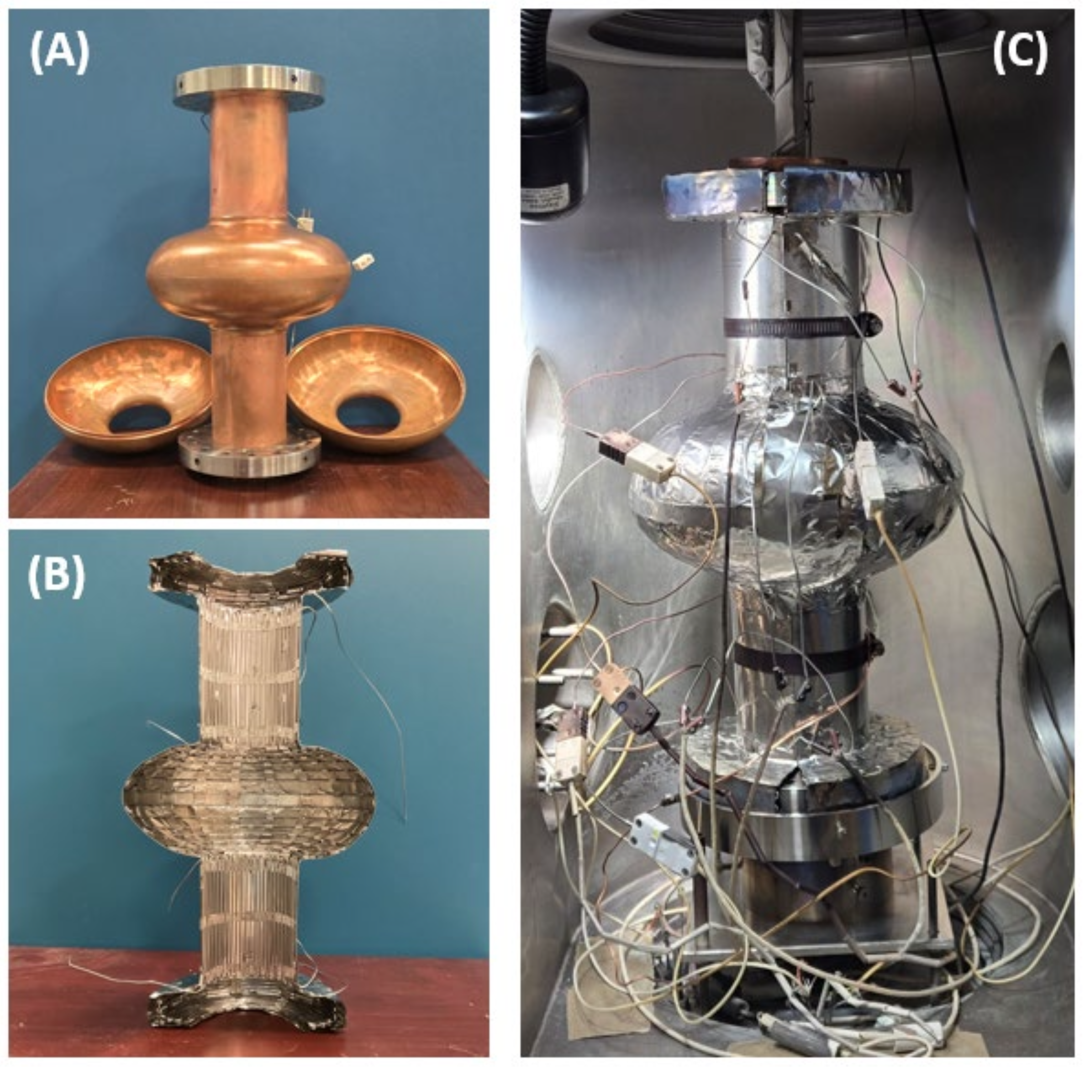
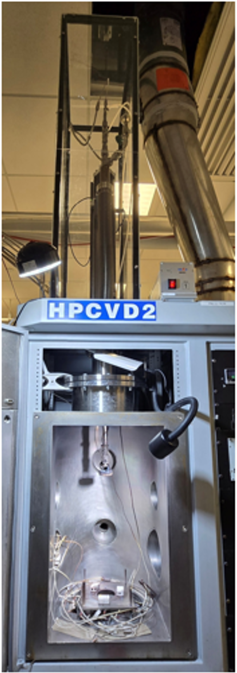
Coating of mockup cavities and witness samples
1
Half-cell mockup
Cu cavity
(from Jefferson Lab)
2
3
5 heating zones:
1&5 flanges
2&4 neck tubes
3 center
with separated heaters and thermocouples
Step-motor driven linear manipulator to provide vertical movement of up to 500 mm
2 clam-shell heaters formed by coaxial heating elements fixed on stainless-steel thermal shield
4
5
IEEE Trans. Appl. Supercond. 36, 3500505 (2026) https://doi.org/10.1109/TASC.2026.3653724

Slide 9
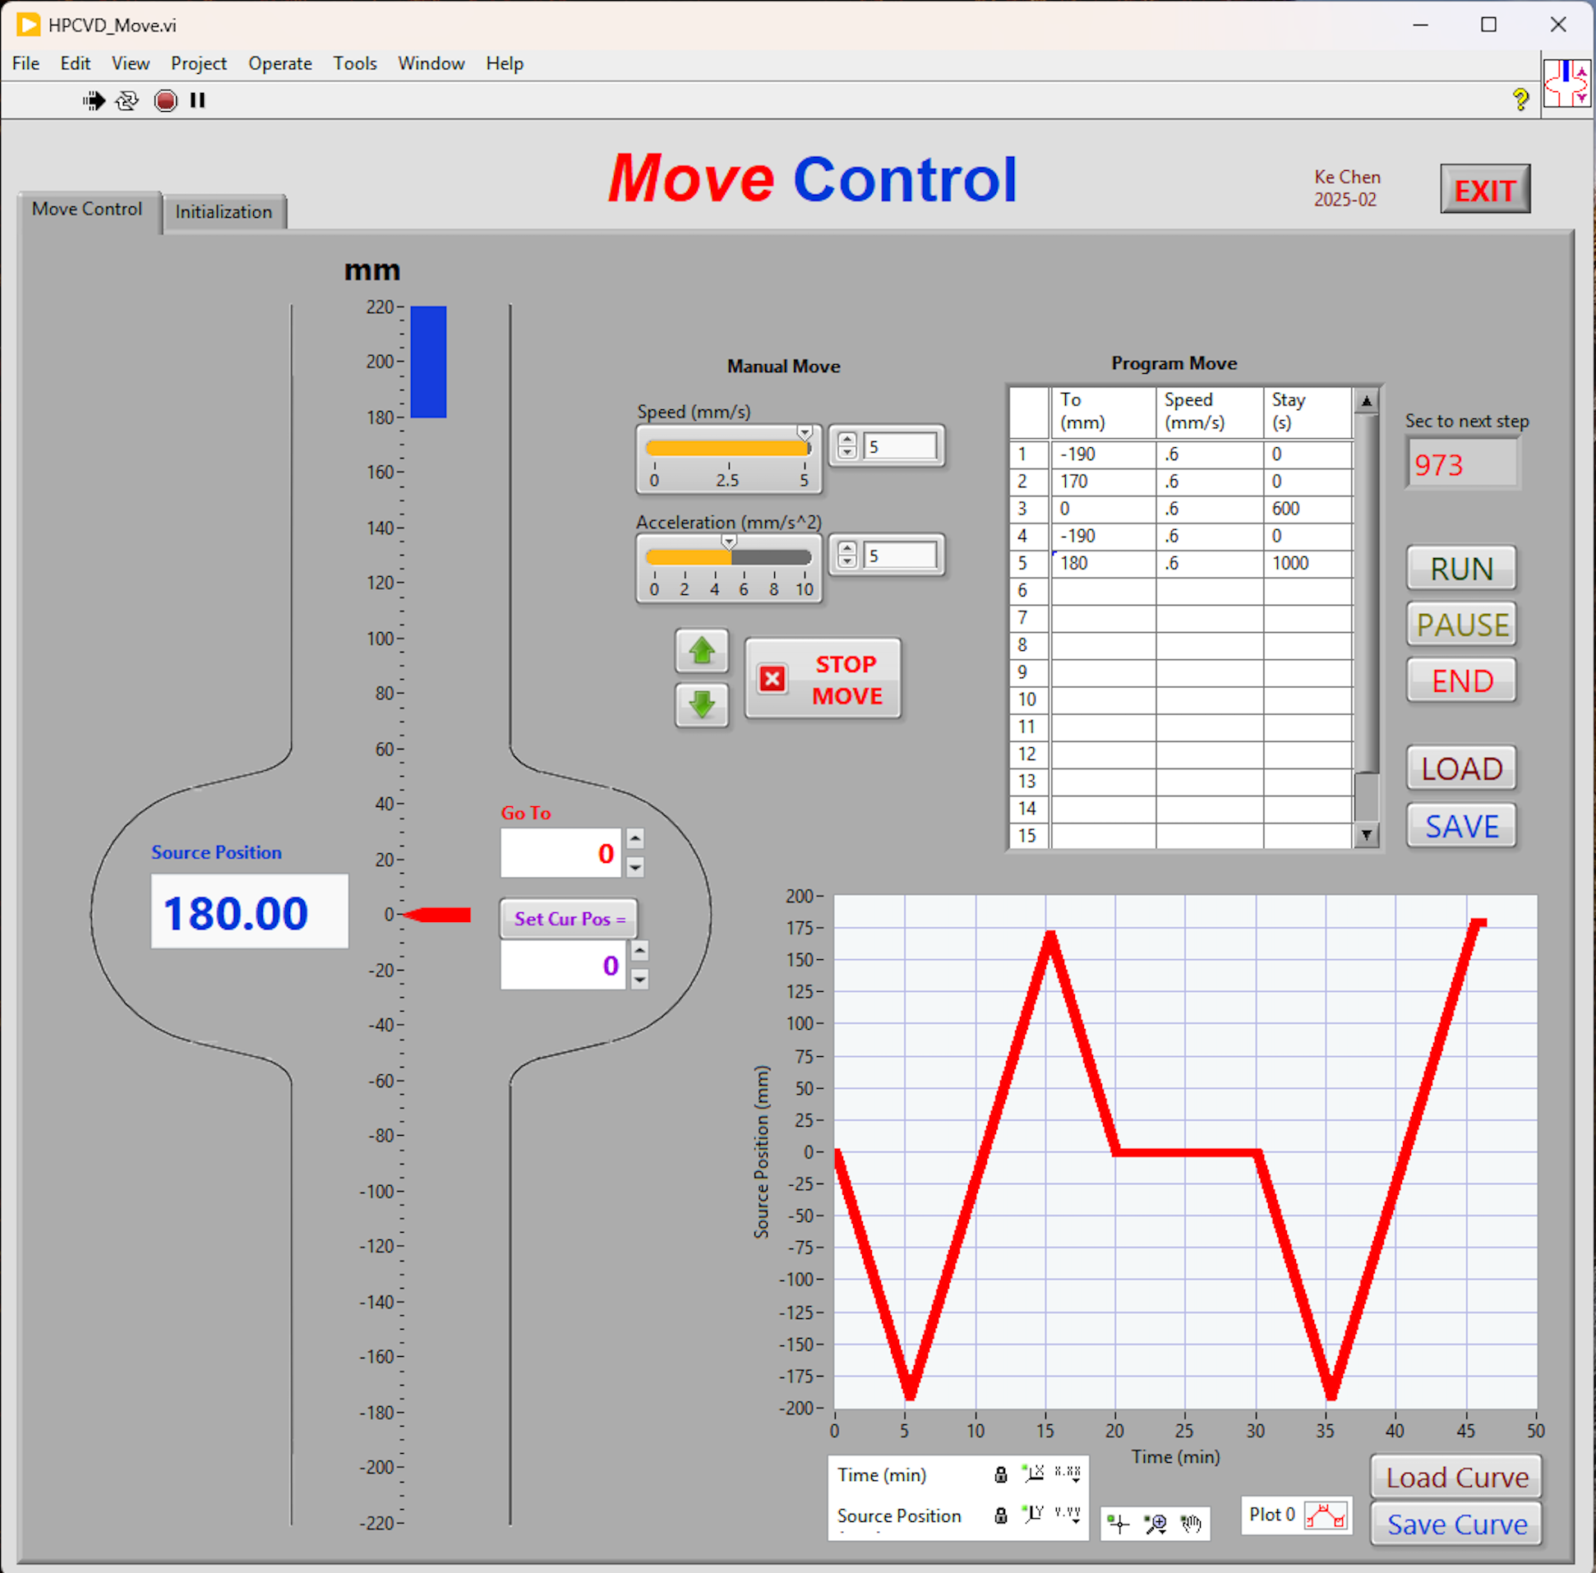
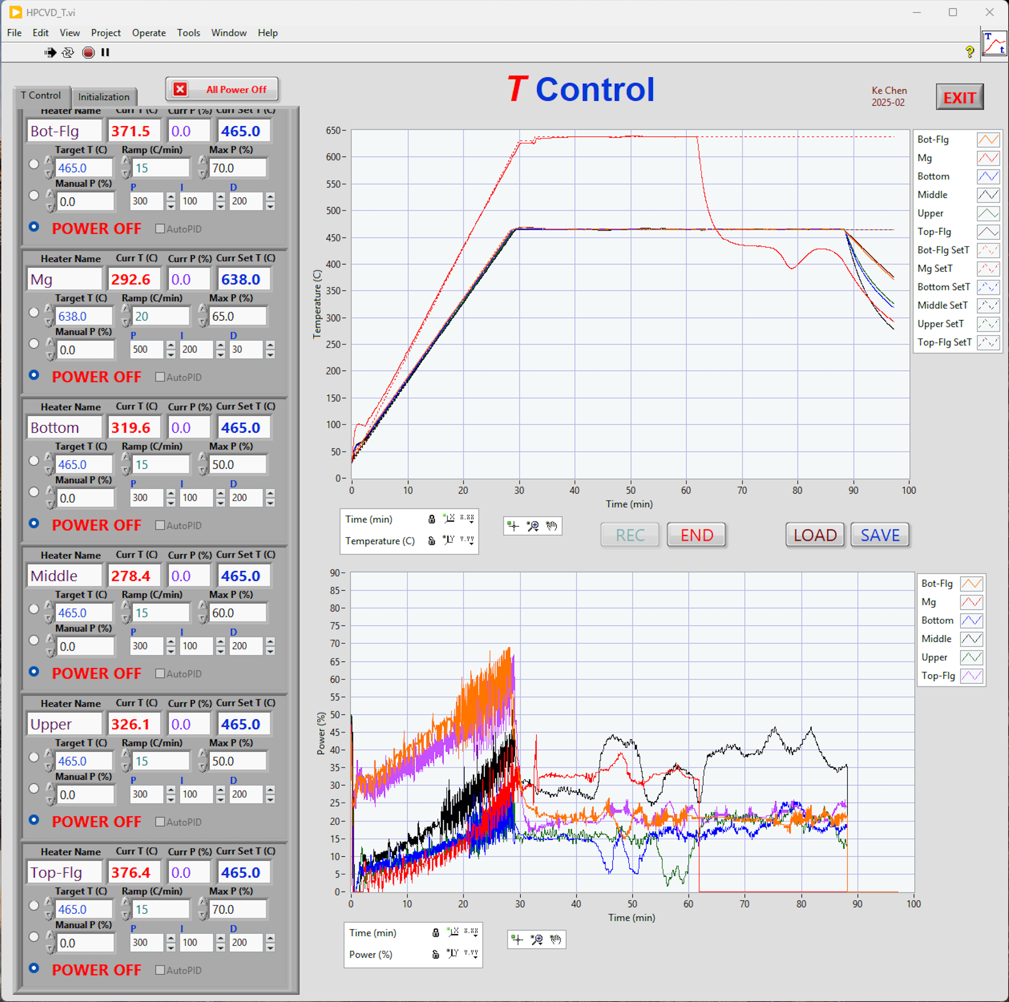
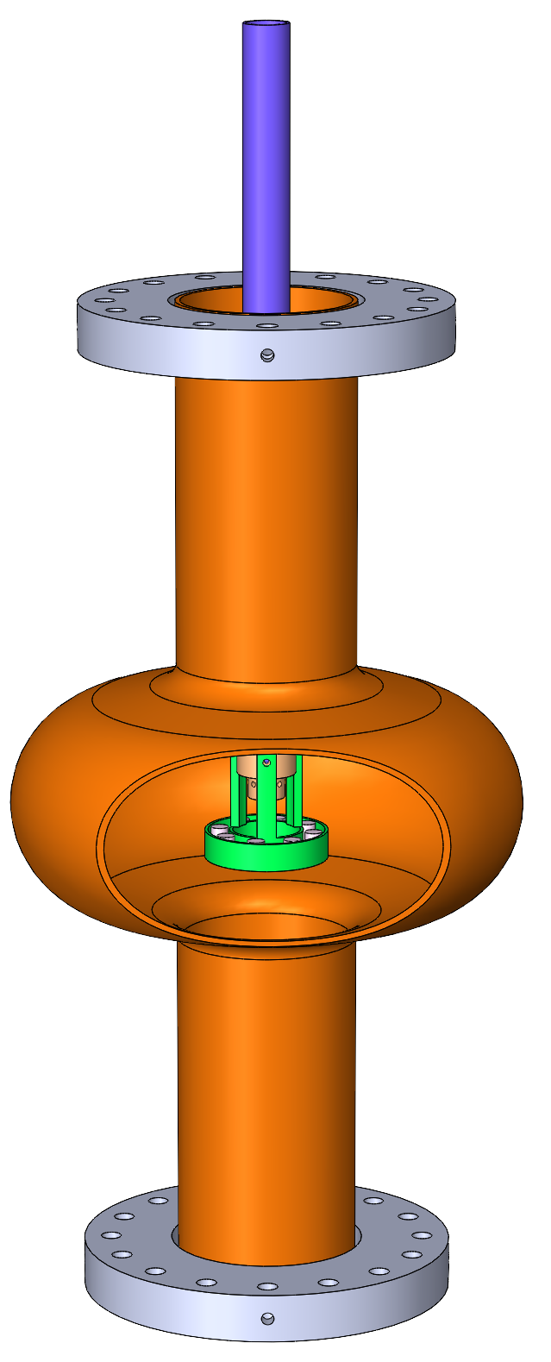
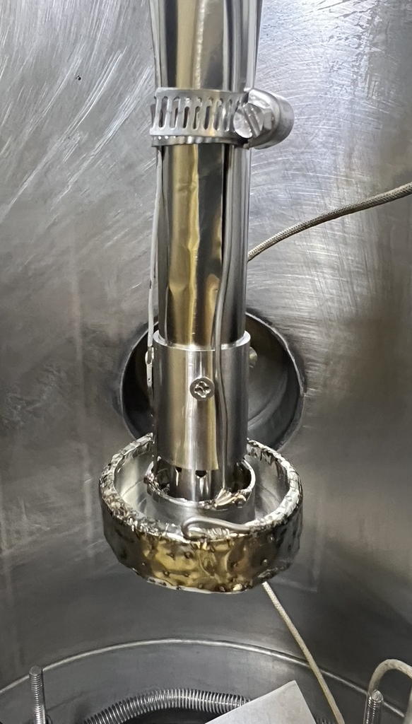
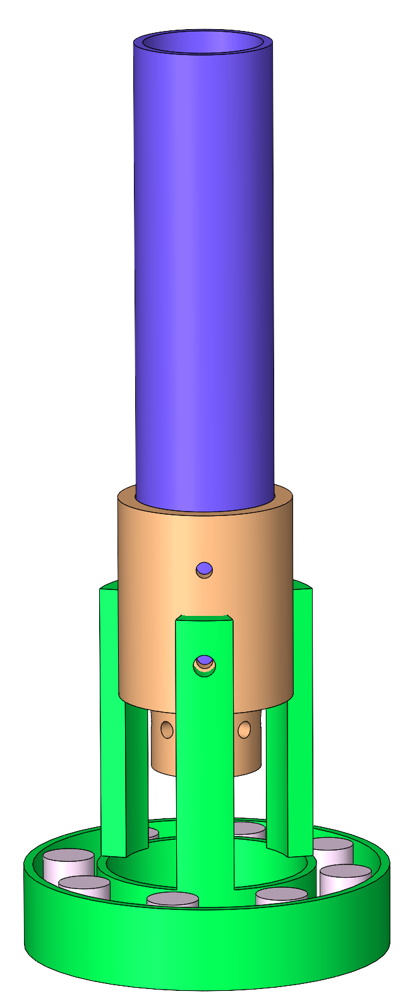
Movable Mg and B sources & growth conditions
H₂+B₂H₆
Chilled water in
Chilled water out
Gas feeding tube Up/Down moveable
H₂+B₂H₆
Growth conditions:
Gas: H₂ (500sccm), B₂H₆(5%)+ H₂(95%) mixture (75sccm). Total pressure: 5 Torr
Mg furnace 635℃, cavity heaters 465℃
Steps:
  Cavity heaters and Mg furnace heat up to target temperatures;
  Mg furnace heater on, B₂H₆ off, sources move through from top to bottom of the cavity in 20 min, slower at the center of the cavity;
  Mg furnace heater off, B₂H₆ on, sources move through from top to bottom of the cavity in 20 min again;
  Both Mg furnace heater and B₂H₆ gas are off, keep cavity heaters temperature at 465℃ to anneal for 20 min.
  All heaters and gases are off to cool in H₂ till room temperature before cavity being taken out.
Mg shots
Mg furnace

Slide 10
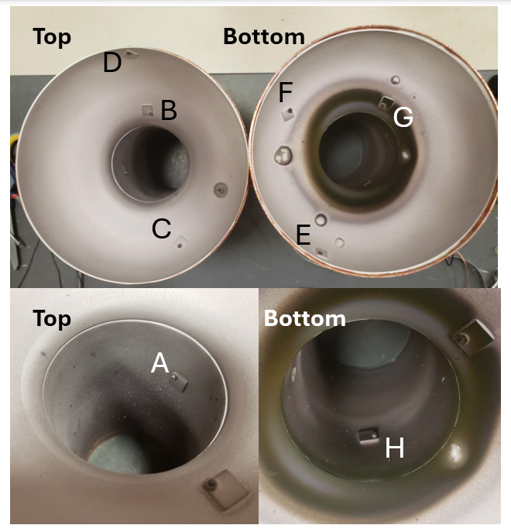
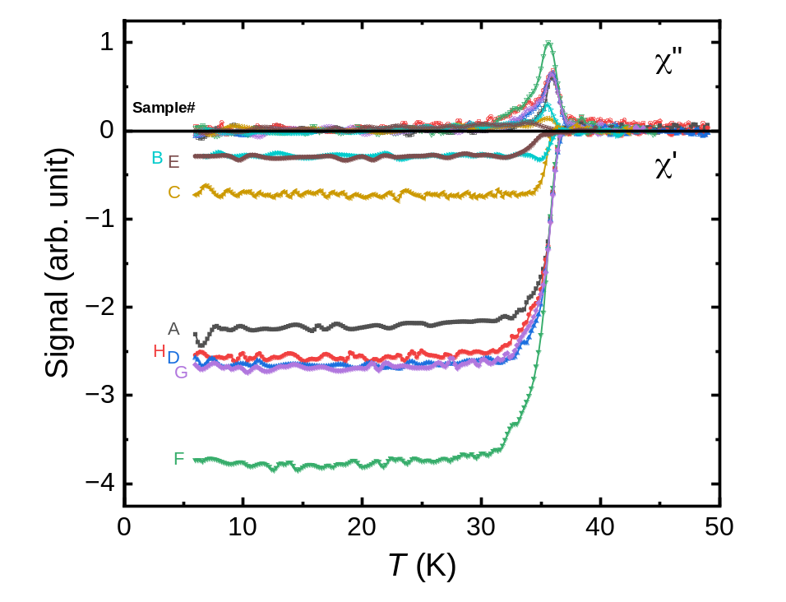
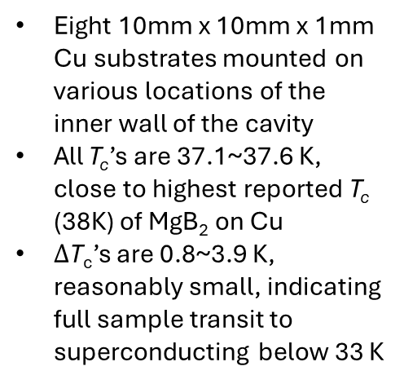
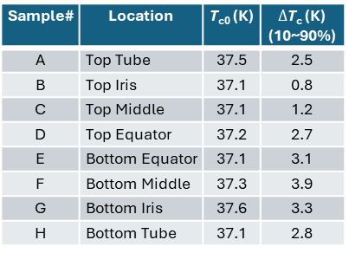
AC susceptibility measurement of witness samples
Sample# | Location | T_{c0} (K) | $∆$T_{c} (K) (10~90%)
A | Top Tube | 37.5 | 2.5
B | Top Iris | 37.1 | 0.8
C | Top Middle | 37.1 | 1.2
D | Top Equator | 37.2 | 2.7
E | Bottom Equator | 37.1 | 3.1
F | Bottom Middle | 37.3 | 3.9
G | Bottom Iris | 37.6 | 3.3
H | Bottom Tube | 37.1 | 2.8
Eight 10mm x 10mm x 1mm Cu substrates mounted on various locations of the inner wall of the cavity
All T_{c}’s are 37.1~37.6 K, close to highest reported T_{c} (38K) of MgB₂ on Cu
$∆$T_{c}’s are 0.8~3.9 K, reasonably small, indicating full sample transit to superconducting below 33 K

Slide 11
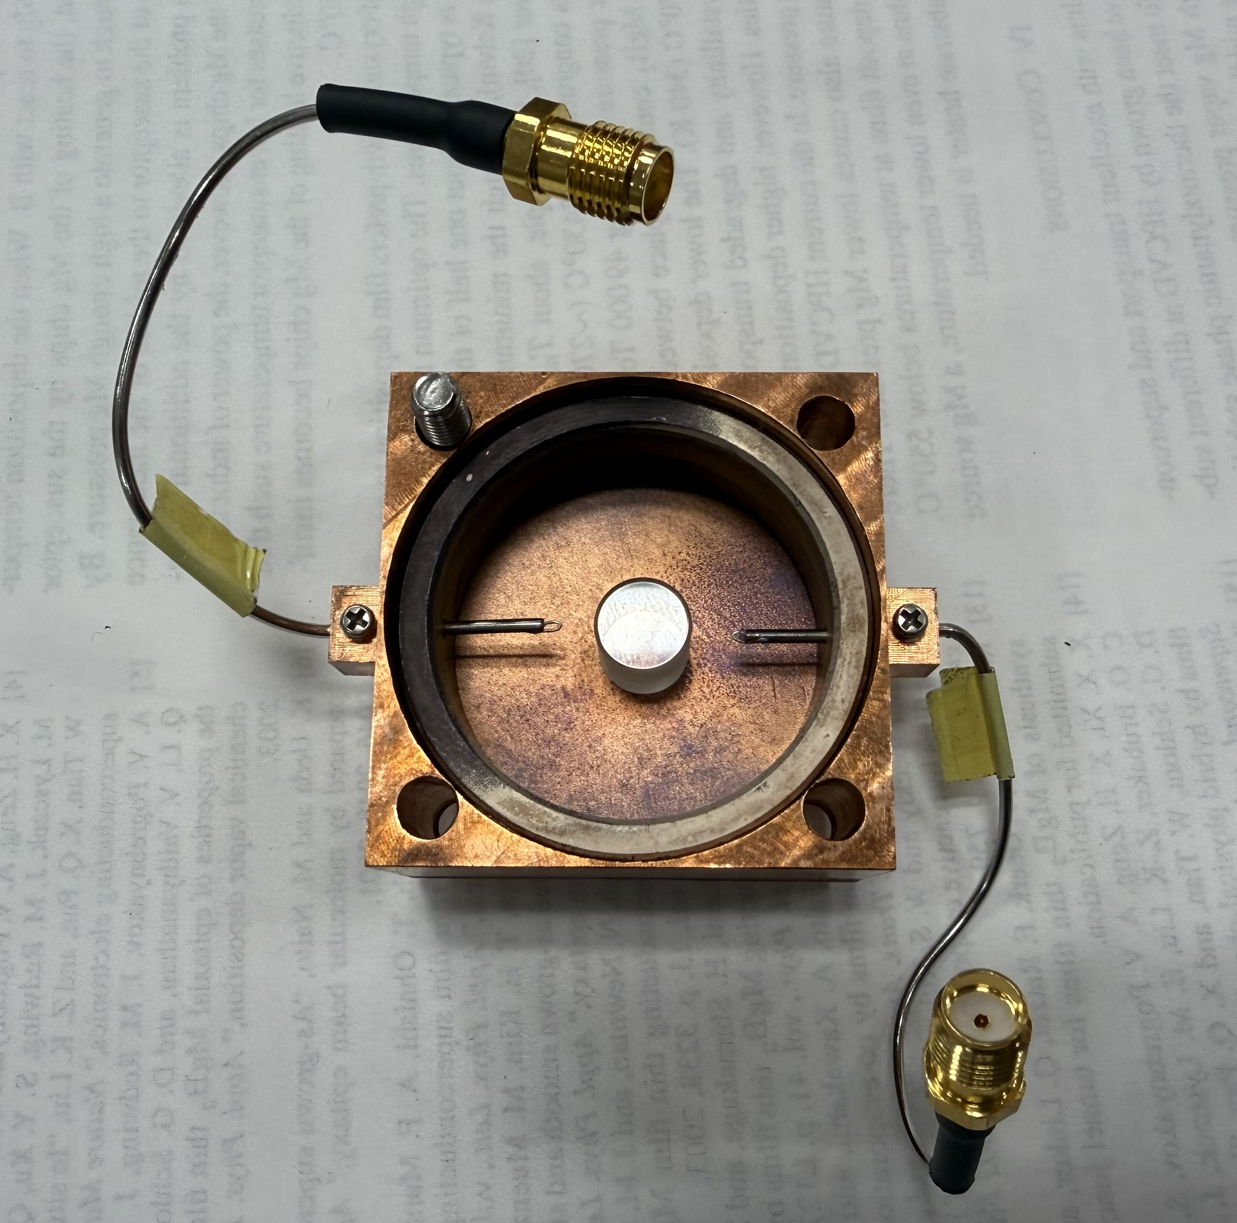

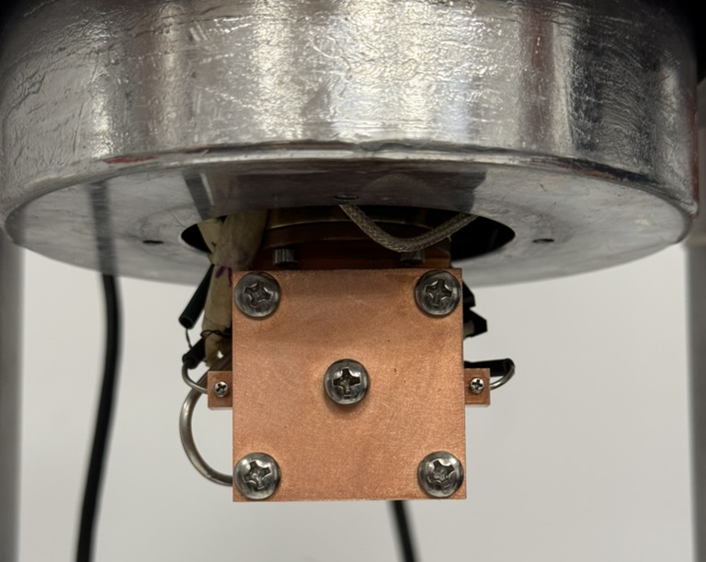
RF Measurement via Dielectric Resonator Technique
Sapphire rod: Φ0.315” X 0.398”
MgB₂-coated Cu cavity inner diameter Φ1.25”
Measured in a cryocooler down to 6 K

Slide 12
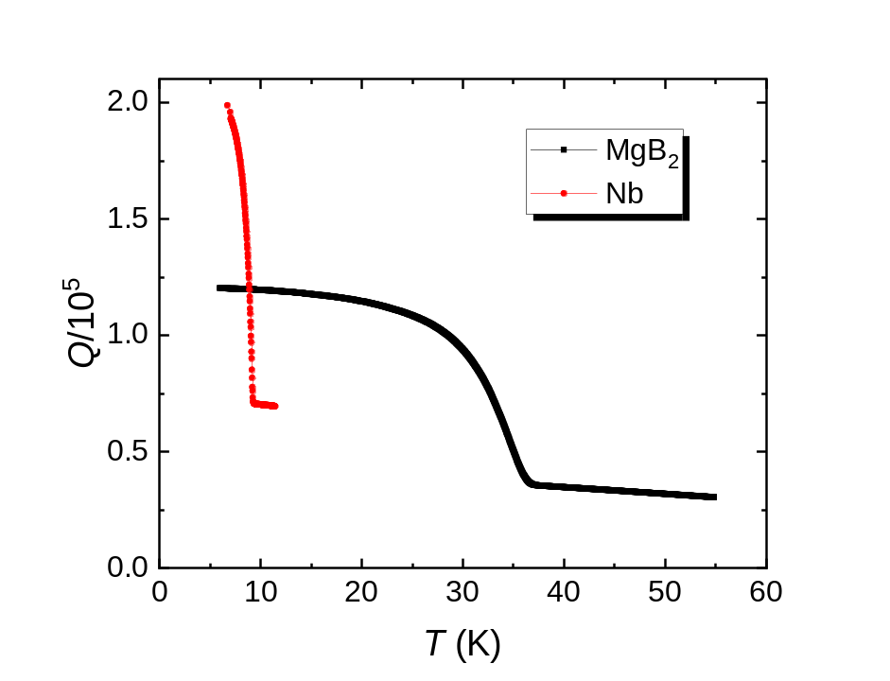
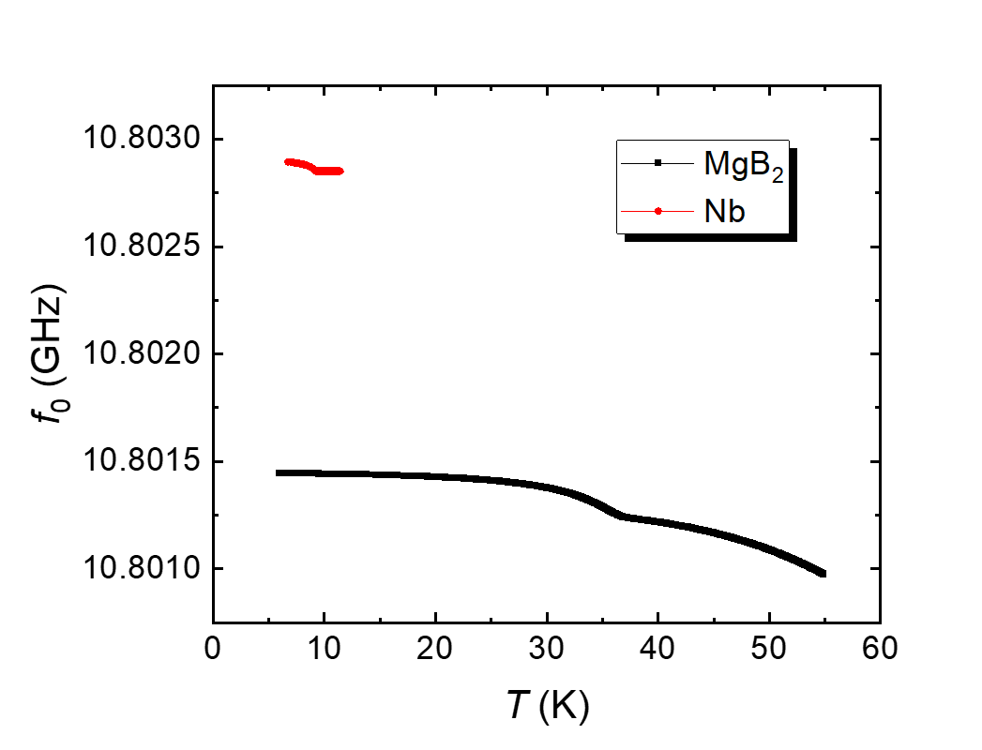
Loaded Q-factors and resonate frequencies: MgB₂ vs Nb

Slide 13
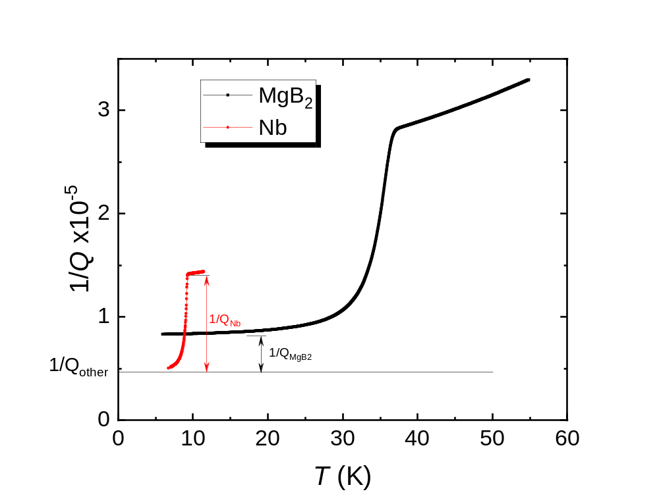
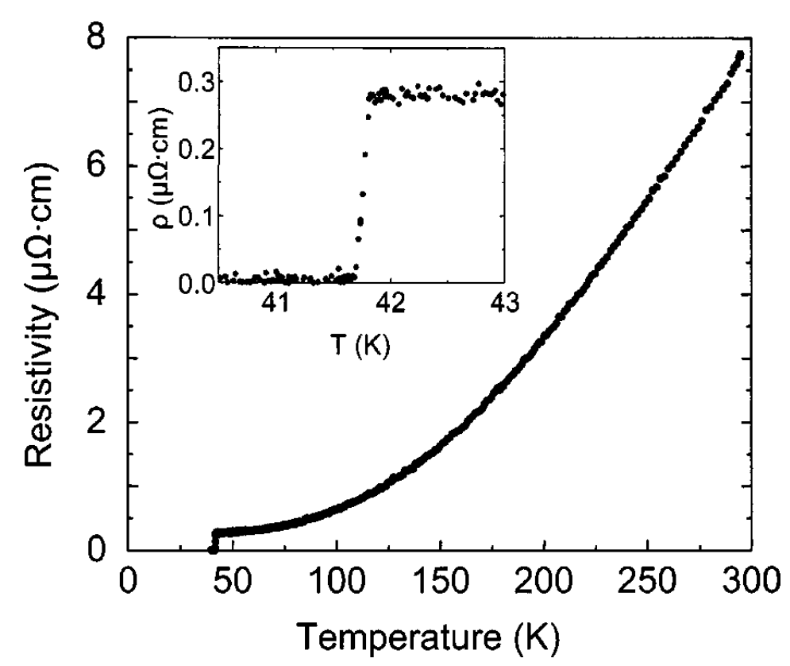
Preliminary Analysis of Surface Resistance of MgB₂ /Cu at 10.8 GHz
The measured Q (loaded) is the total loss:
1/Q = 1/Q_{SC_film} + 1/Q_{other}
1/Q_{other} is estimated at the level marked by the horizontal line in the graph.
R_{Nb}(9.2K) ~ 5 mΩ, R_{Nb}(7K) ~ 0.01 mΩ = 0.02 R_{Nb}(9.2K)
Assuming that 1/Q_{other} are the same for both measurements, R_{MgB2}(6K) ~ 0.35 R_{Nb}(9.2K) = 1.8 mΩ
Possible culprit: Relatively large residual resistance of MgB₂ at low temperatures
Good news: Better than Cu: Rs about 1/4 of Cu (RRR=400), which was measured to be 7.2mΩ for 4~20 K at 11.4 GHz, (Cahill et al., Proceedings of IPAC2016.) Translating to ~1/300 of Cu for 1.3 GHz.
HPCVD
MgB₂ film
RRR ~ 30
Pogrebnyakov et al., APL 82,4320 (2003)

Slide 14
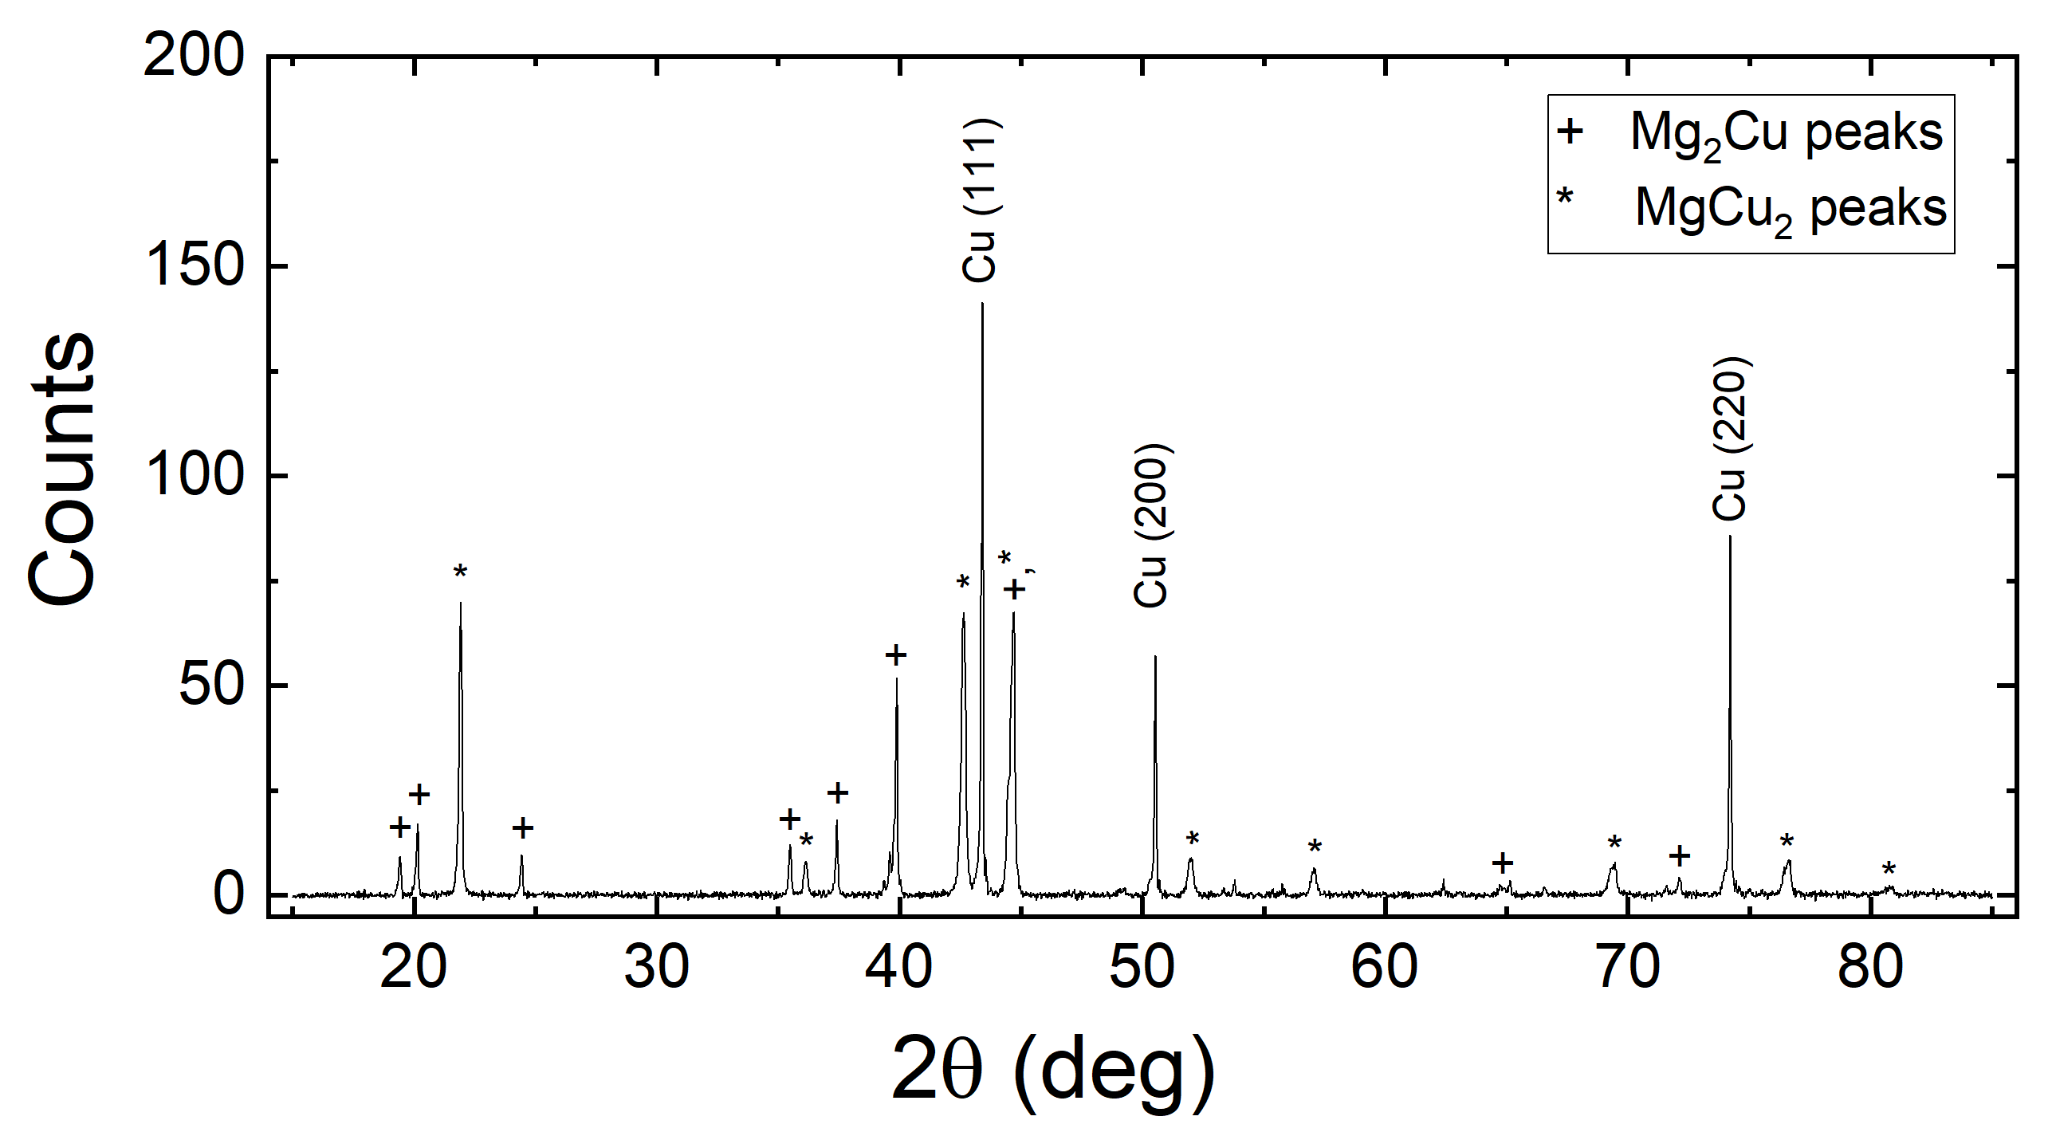
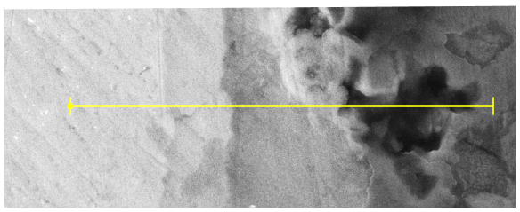
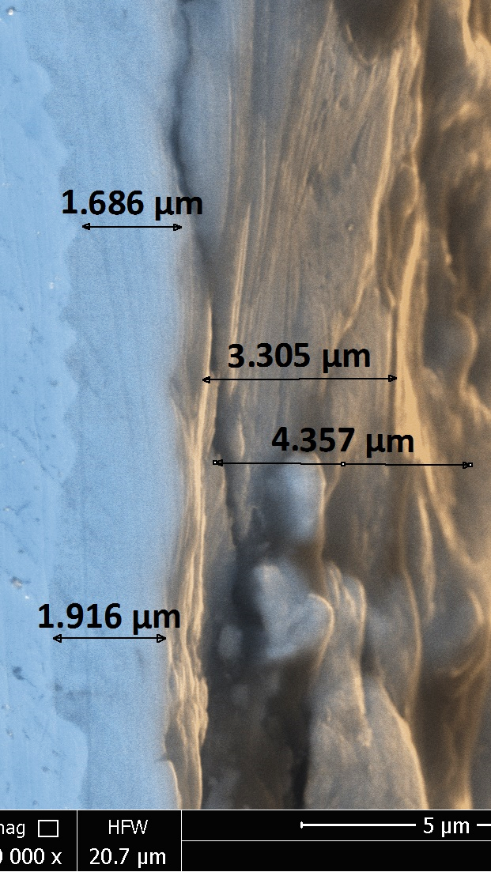
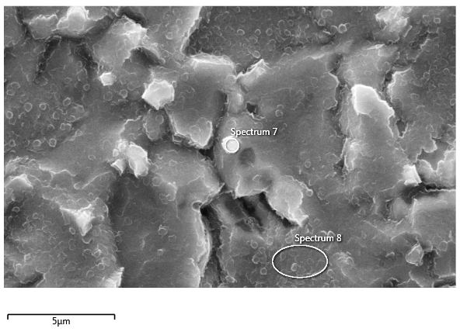
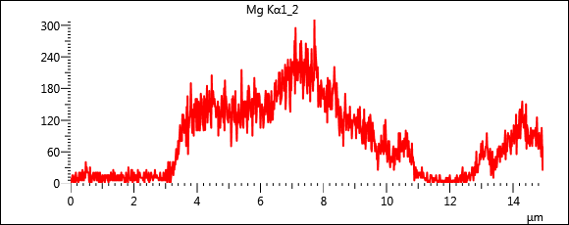
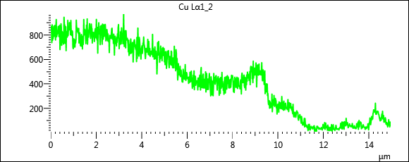
SEM
XRD
Top View
Cross-section View
~2um
Mg-Cu alloy
MgB₂
(tilted surface)
Cu substrate
~4um MgB₂
(cross-section)
Mg
Cu
B | C | O | Mg | Cu | Total | Location
72.99 | 7.05 | 0.92 | 13.49 | 5.55 | 100 | Spectrum 7
56.83 | 2.21 | 0.9 | 27.27 | 12.79 | 100 | Spectrum 8
Both Mg₂Cu and MgCu₂ are present in the sample. These Mg-Cu alloys may be crucial for the growth of MgB₂ films on Cu as it provides Mg needed.
4 um thick MgB₂ film is likely sufficient for the SRF cavity applications.

Slide 15
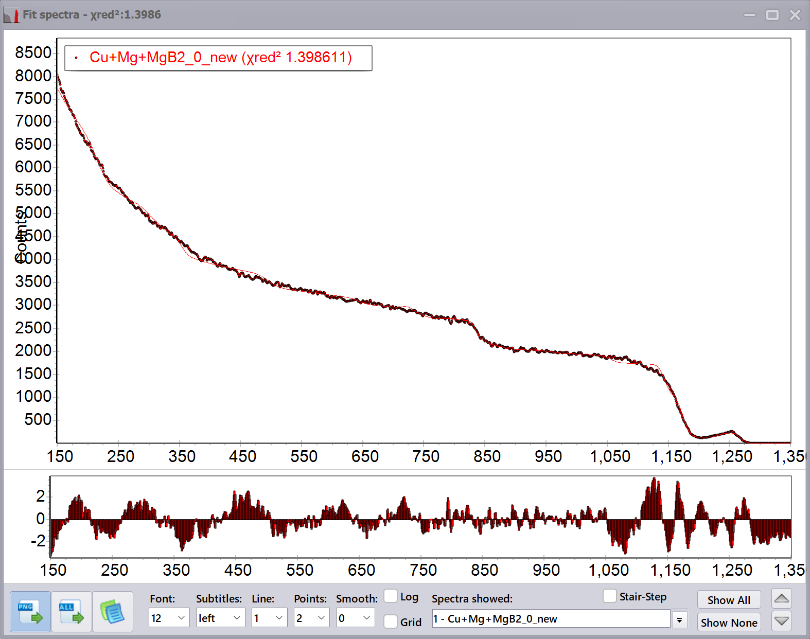
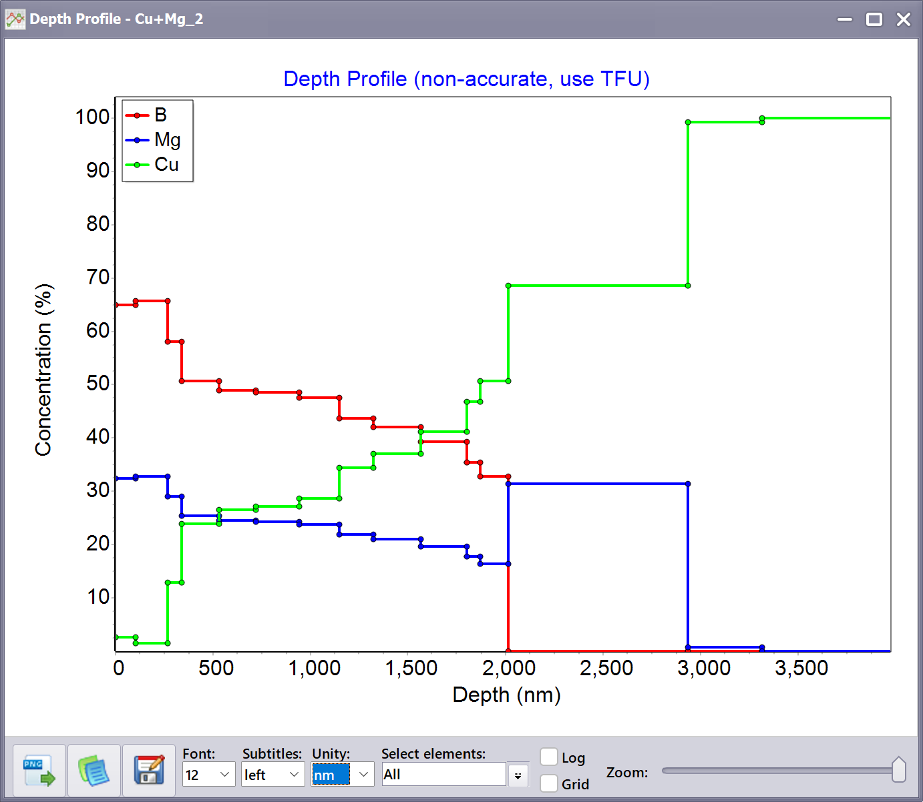
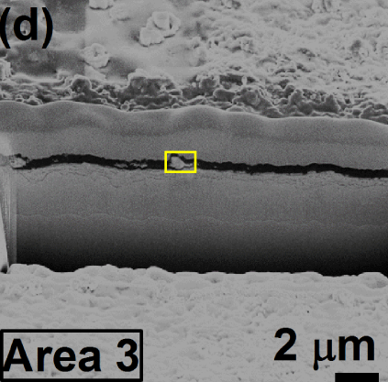
Rutherford Backscattering Spectrometry (RBS) for MgB₂ film on Cu substrate
Detector
θ = 163º
5 cm
2.4 MeV ⁴He⁺⁺
α = 0
β = 17º
Sample
Fitting notes:
Using MultiSIMNRA program to fit with fixed B:Mg=2:1 for the first ~12 layers, then keep B=0 for 2 layers for Mg-Cu alloy.
Results:
Cu exists in the MgB₂ films, possibly in a separated phase.
The concentration of Cu is not zero at the surface.
The thickness of the MgB₂ film is around 2um.
The Mg-Cu alloy beneath MgB₂ is likely only MgCu₂.
Past results show Cu inclusion inside MgB₂ films. [Withanage et al., Supercond. Sci. Technol. 30 (2017) 045001]
New FIB/SEM/Laser triple beam system may help profile MgB₂ films

Slide 16
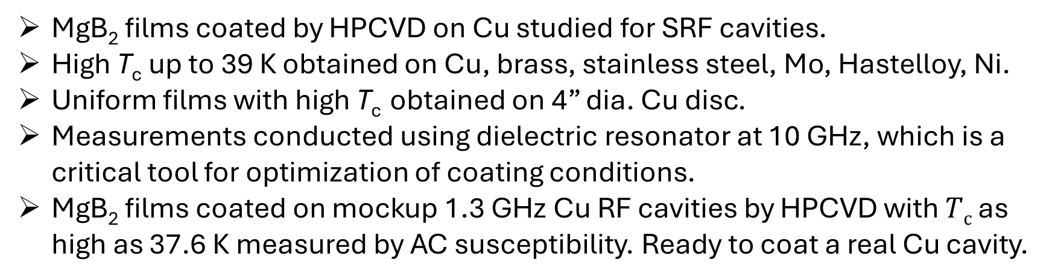
Summary
MgB₂ films coated by HPCVD on Cu studied for SRF cavities.
High T_{c} up to 39 K obtained on Cu, brass, stainless steel, Mo, Hastelloy, Ni.
Uniform films with high T_{c} obtained on 4” dia. Cu disc.
Measurements conducted using dielectric resonator at 10 GHz, which is a critical tool for optimization of coating conditions.
MgB₂ films coated on mockup 1.3 GHz Cu RF cavities by HPCVD with $Tc$ as high as 37.6 K measured by AC susceptibility. Ready to coat a real Cu cavity.
Acknowledgment
Ann-Marie Valente-Feliciano, Thomas Jefferson National Accelerator Facility
Steven Anlage, University of Maryland
Funding from US Department of Energy, Office of Science

Slide 17
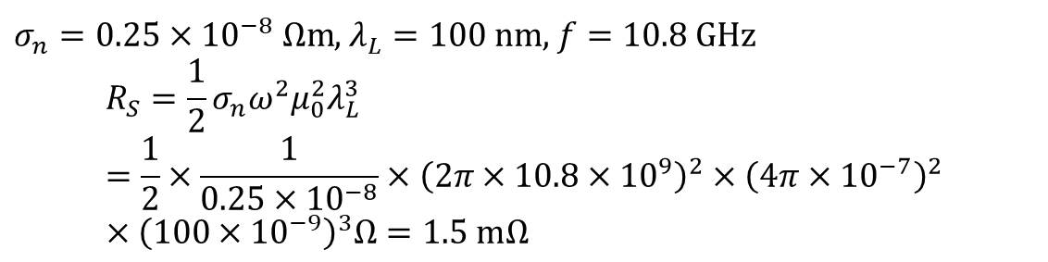
Estimation of RF R_{s} from residual resistance
$σ_{n}=0.25×{10}^{−8} Ωm$, $λ_{L}=100 nm$, $f=10.8 GHz$
$$R_{S}=\frac{1}{2}σ_{n}ω^{2}μ_{0}^{2}λ_{L}^{3}=\frac{1}{2}×\frac{1}{0.25×{10}^{−8}}×{\left(2π×10.8×{10}^{9}\right)}^{2}×{\left(4π×{10}^{−7}\right)}^{2}×{\left(100×{10}^{−9}\right)}^{3}Ω=1.5 mΩ$$

