Slide 1

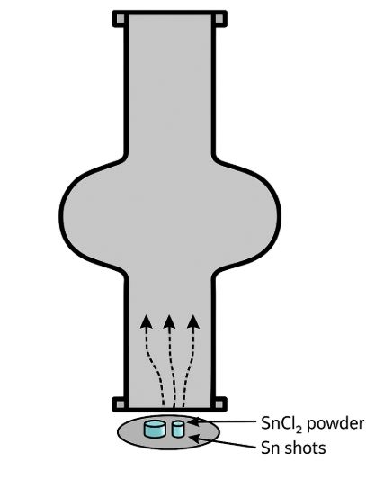

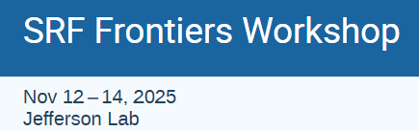
Understanding and Improving the Tin Vapor Diffusion Process at JLab
Uttar Pudasaini
Nb₃Sn
12th International Workshop on Thin Films and New Ideas for Pushing the Limits of RF Superconductivity, Sep 2026
Chester, UK
Sn Vapor
Nb Cavity

Slide 2
Acknowledgements
P. Tiwari, A-M. Valente-Feliciano, E. Lechner, G. Ciovati, O. Trofimova
This material is based upon work supported by the U.S. Department of Energy, Office of Science, Office of Nuclear Physics, under Contract No. 89243126CSC000213.

Slide 3
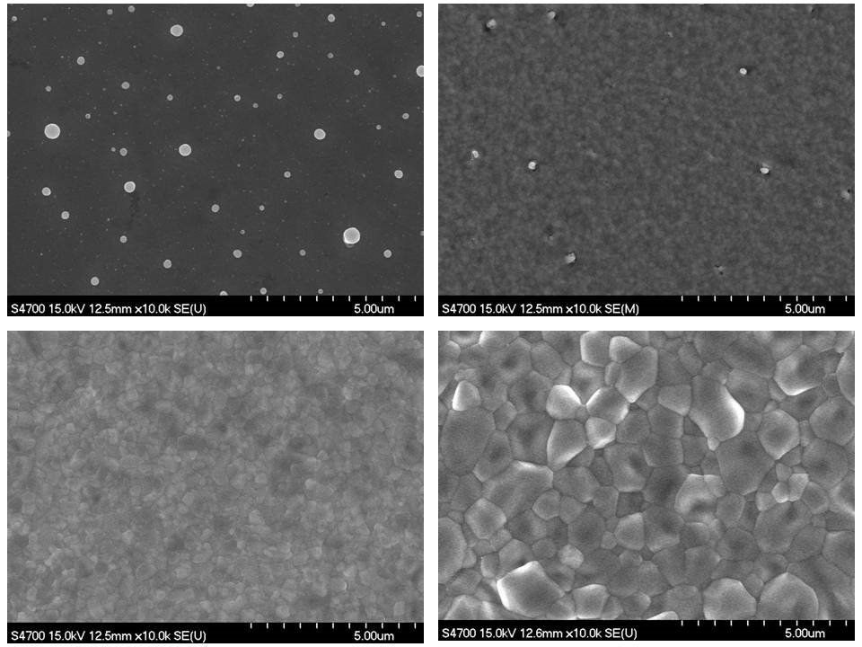
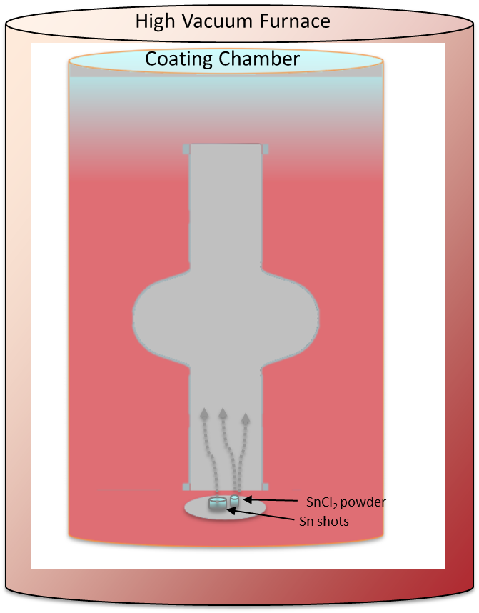
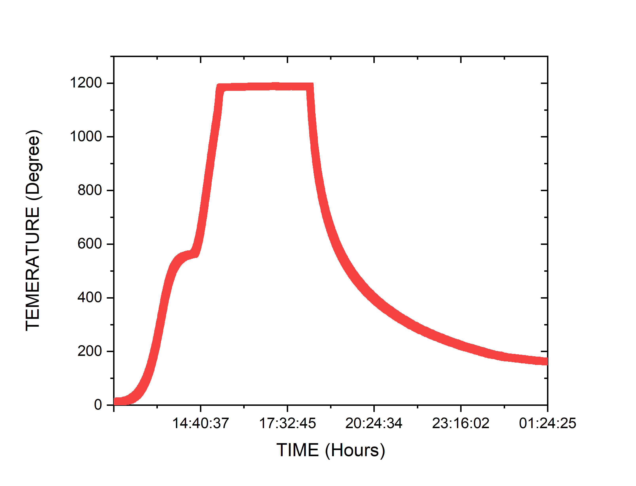
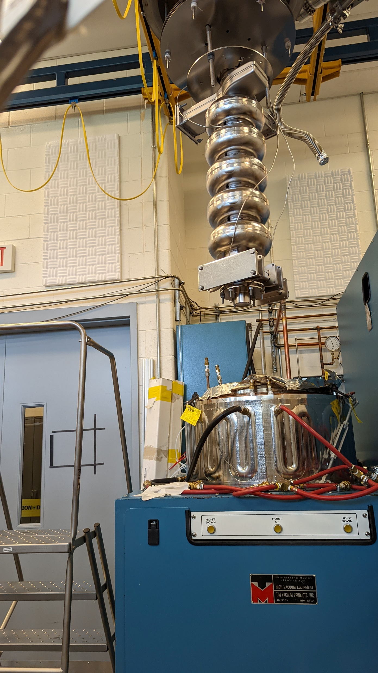
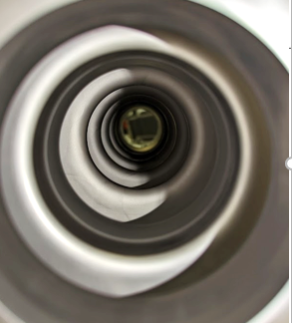

Sn Vapor Diffusion
Growth
Temperature ($° C)$
Nucleation
Sn
Since the 1970s: revived and refining
Create Sn-vapor and transfer to the interior surface of Nb cavity
So far ‘THE’ technique to produce practical Nb₃Sn cavities
“Wuppertal” or “Siemens” configuration
w/ Secondary heater for Sn source

Slide 4
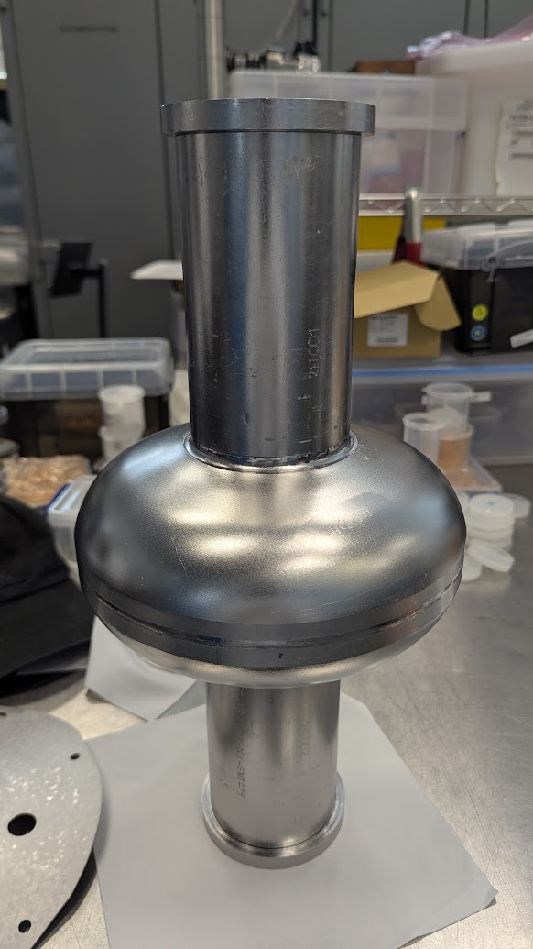
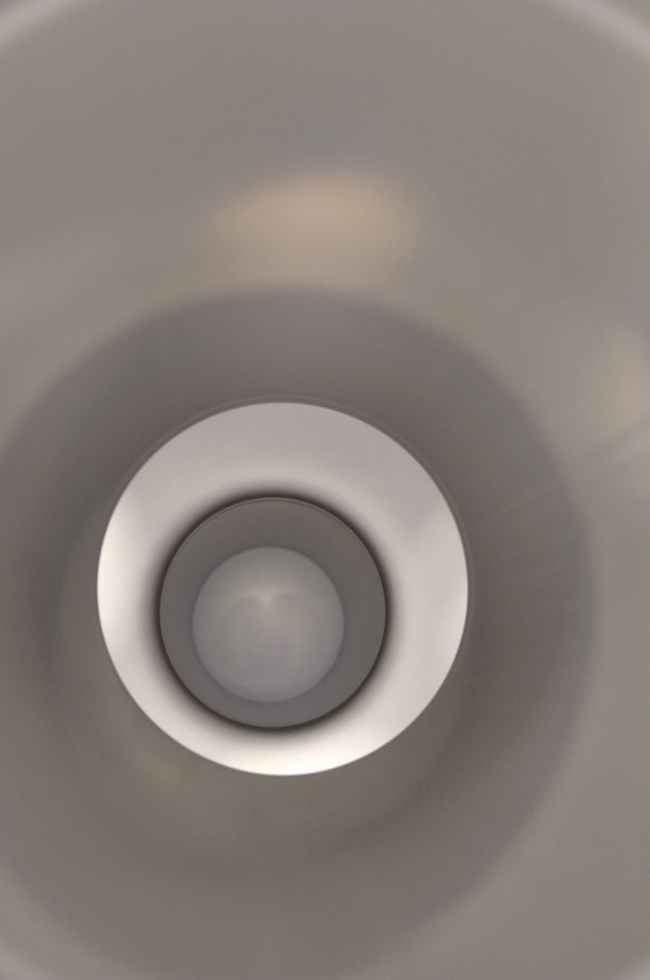
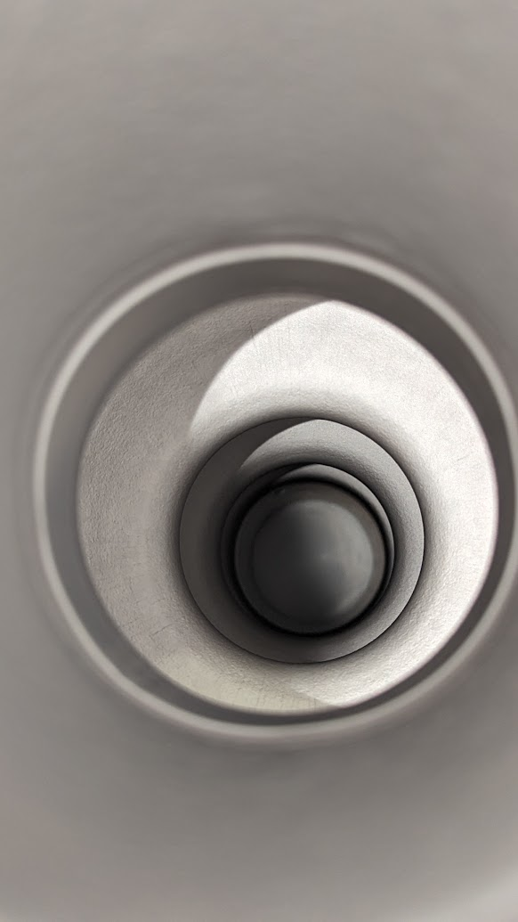
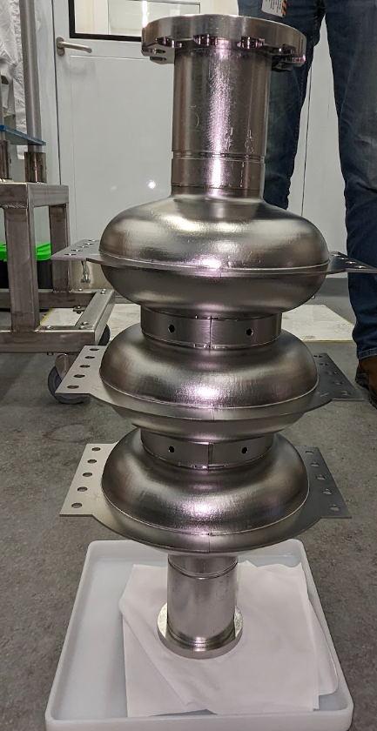
Need for Further Process Understanding
High-performance Nb₃Sn coatings demonstrated — reproducibility remains process-sensitive
Successful coating parameters may not transfer directly across different cavity geometries and scales
Local coating growth environment evolves during processing — influenced by source configuration, vapor transport, cavity geometry, and source depletion
Better understanding of these coupled effects → reproducible, optimized, scalable, and practical process
Learning from “bad” results

Slide 5
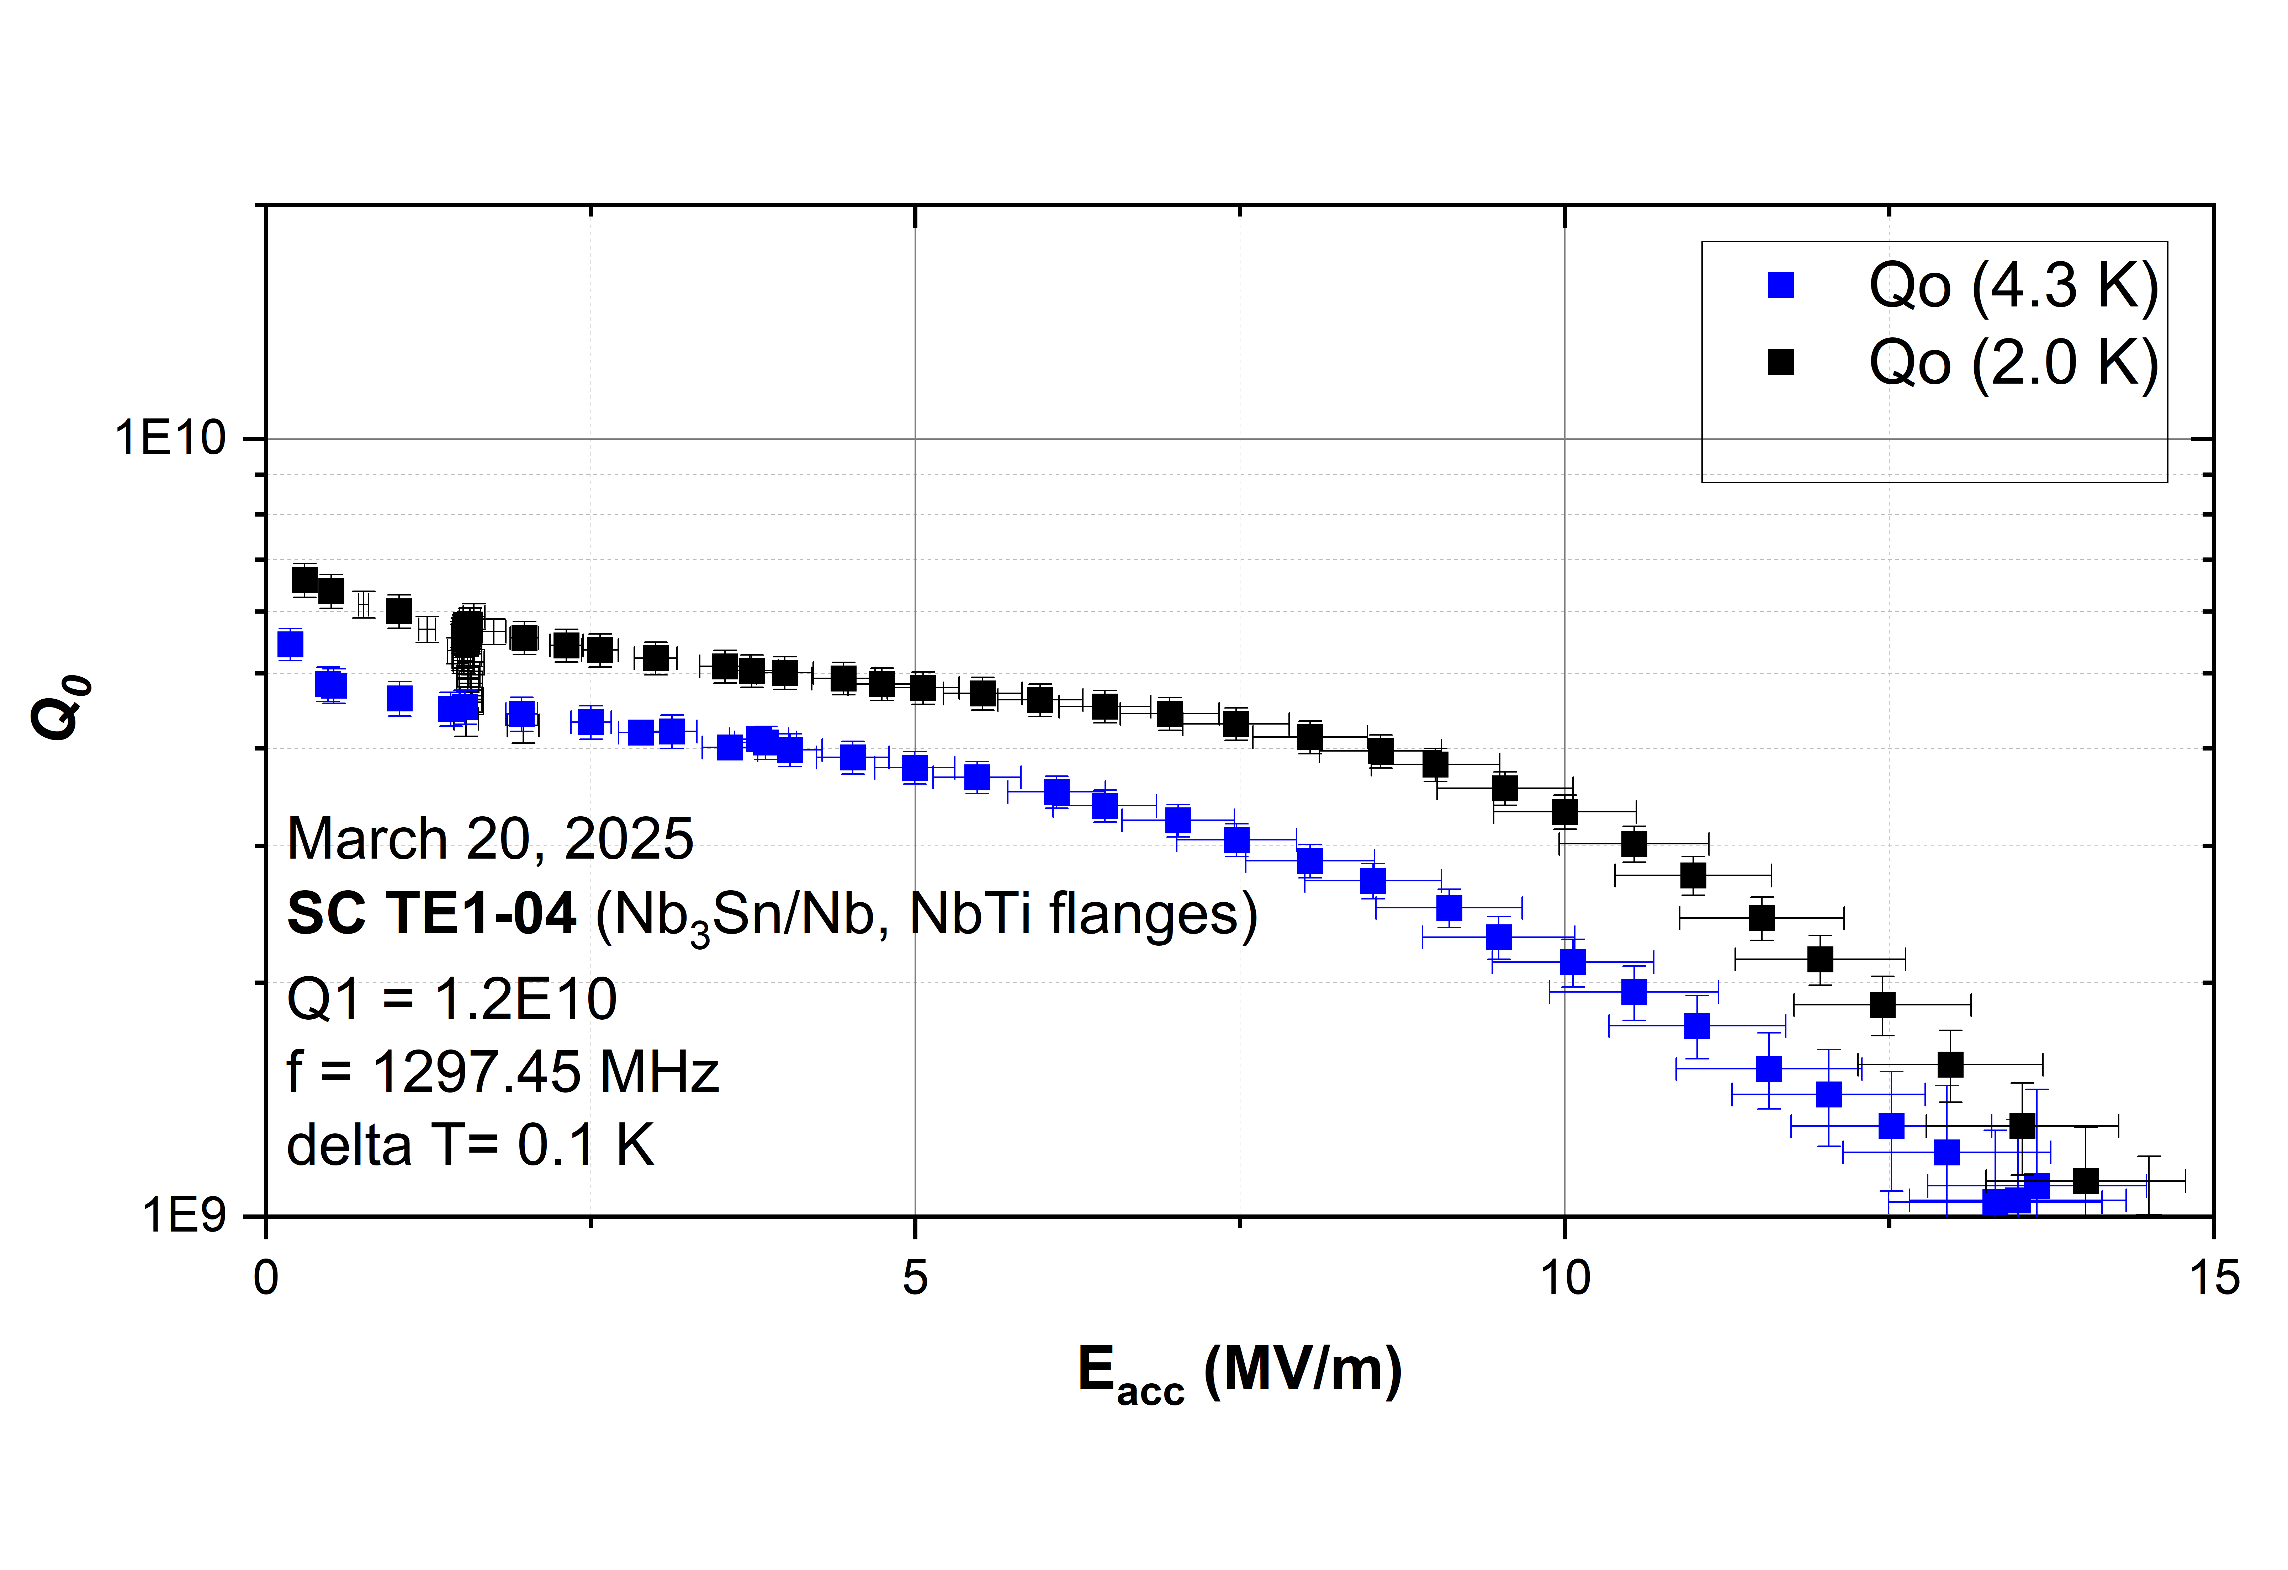
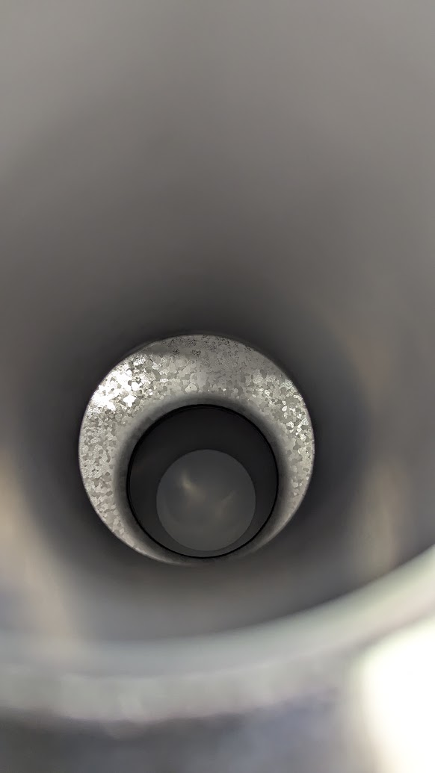
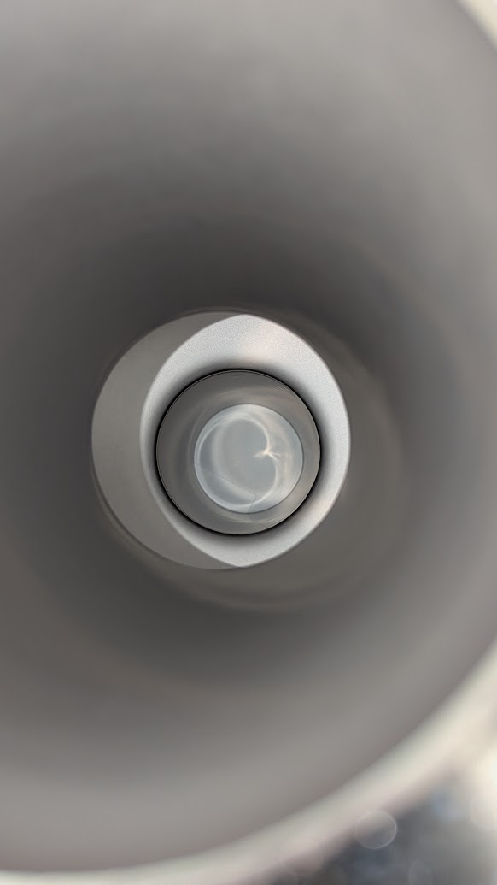
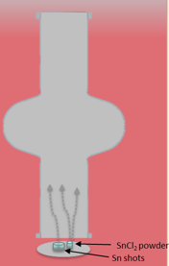
Spatial Non-uniformity in Nb₃Sn Growth
Pronounced local coating asymmetry
Nonuniform region away from direct Sn-source line-of-sight
Total Sn evaporation only ~10% lower than regular coatings
Possible low local Sn flux during nucleation / early growth?
Exact origin not yet verified; RF performance strongly degraded
Takeaway: Local Sn environment during nucleation and the early growth stage is important. Possible insufficient local Sn flux → nonuniform growth → poor RF

Slide 6
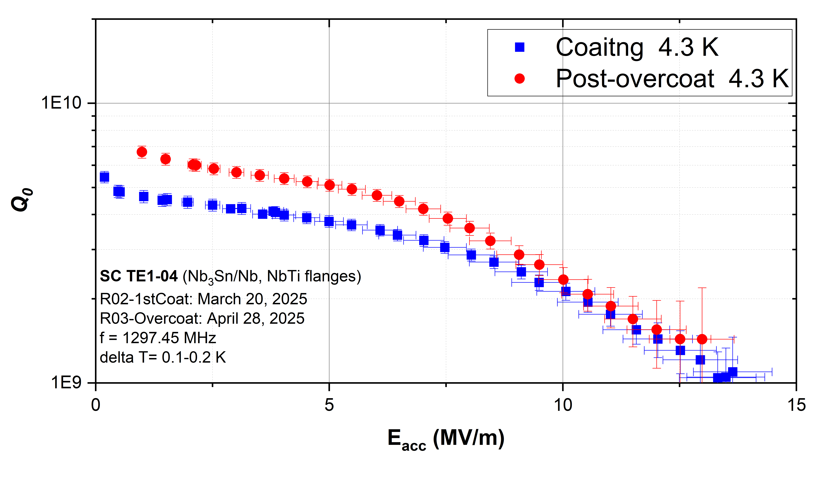
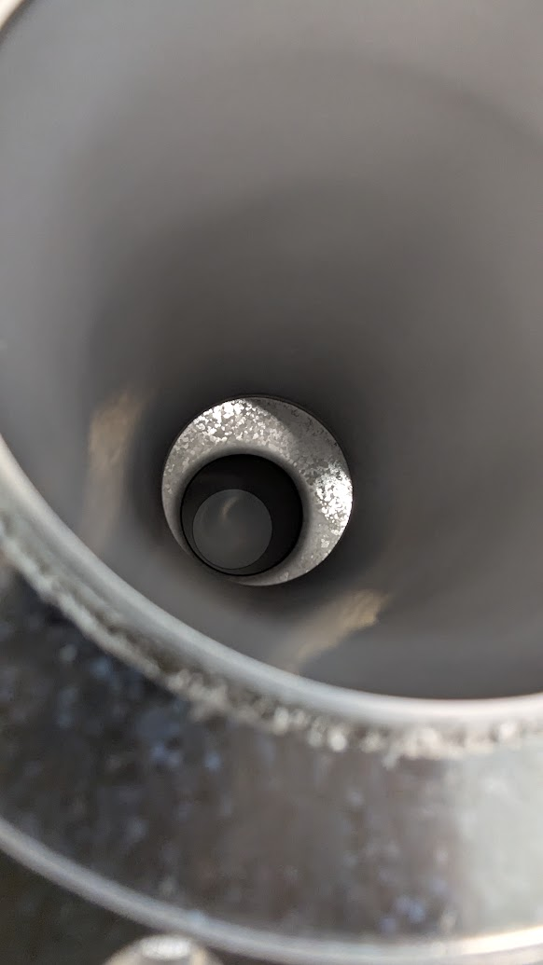
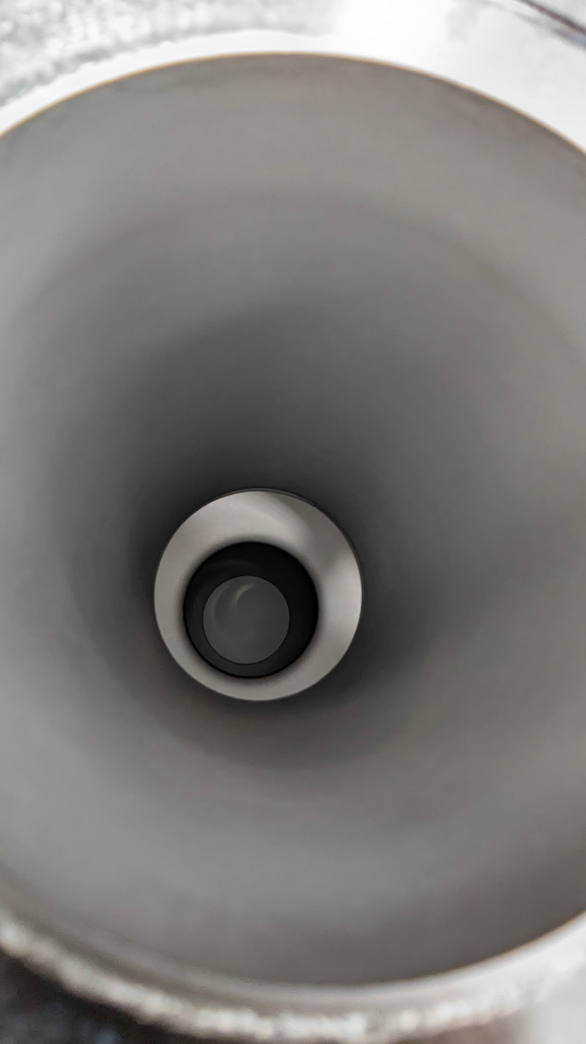
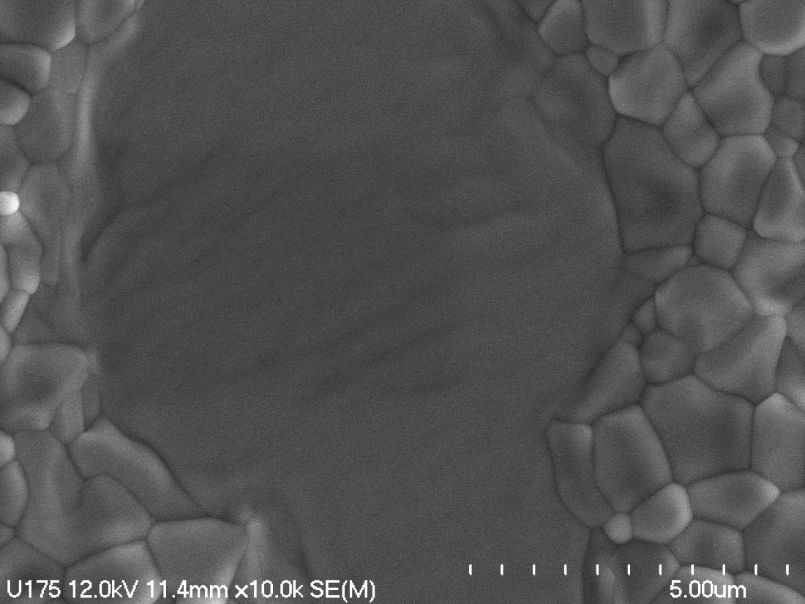
Can Overcoating Recover a Non-Uniform Coating?
Cavity flipped and re-coated – ~½ of standard coating cycle
Low-field Q improved
No significant RF recovery
Initial growth deficiency not easily reversed
Takeaway: Early coating matters — later Sn exposure may not fully recover a locally deficient region.

Slide 7
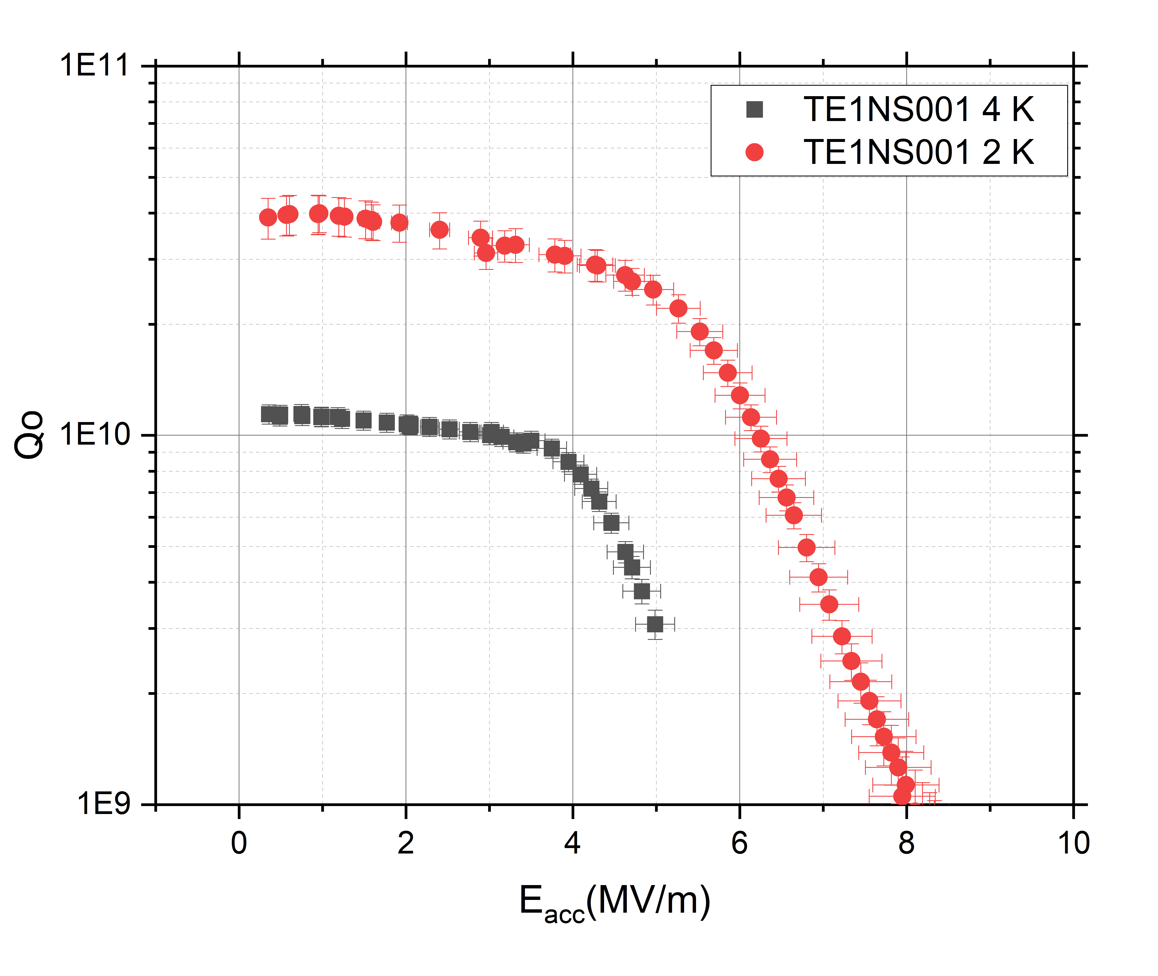
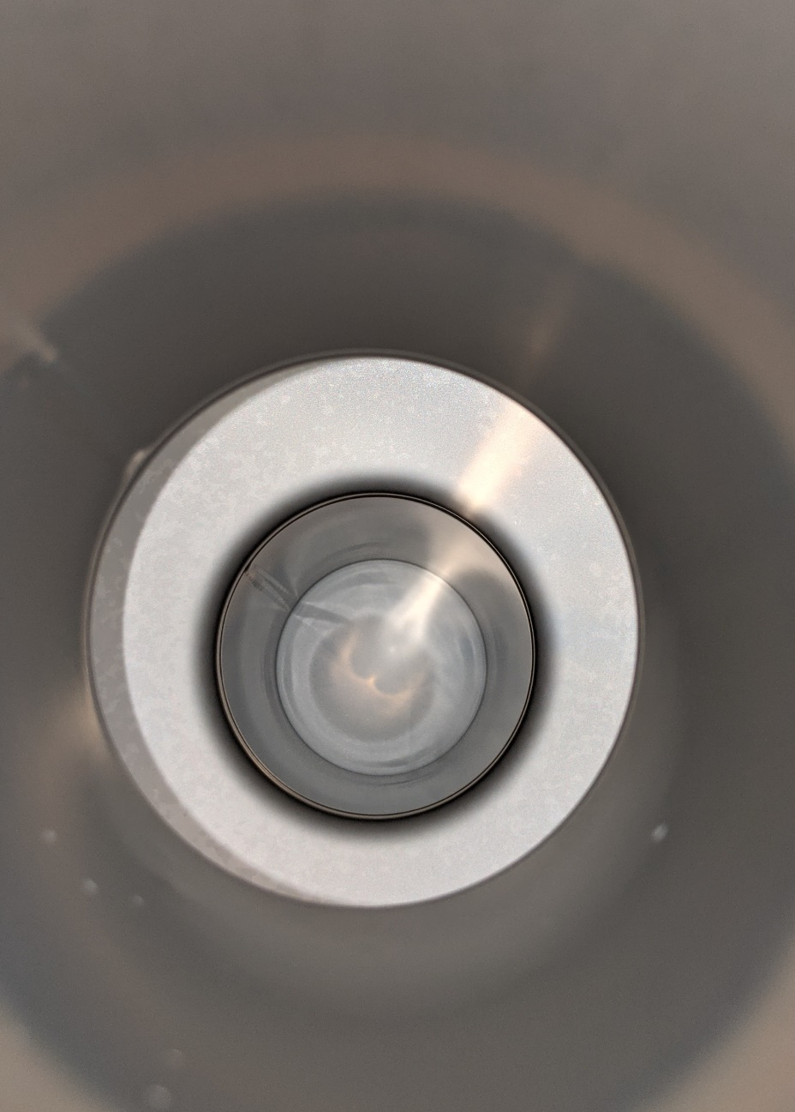
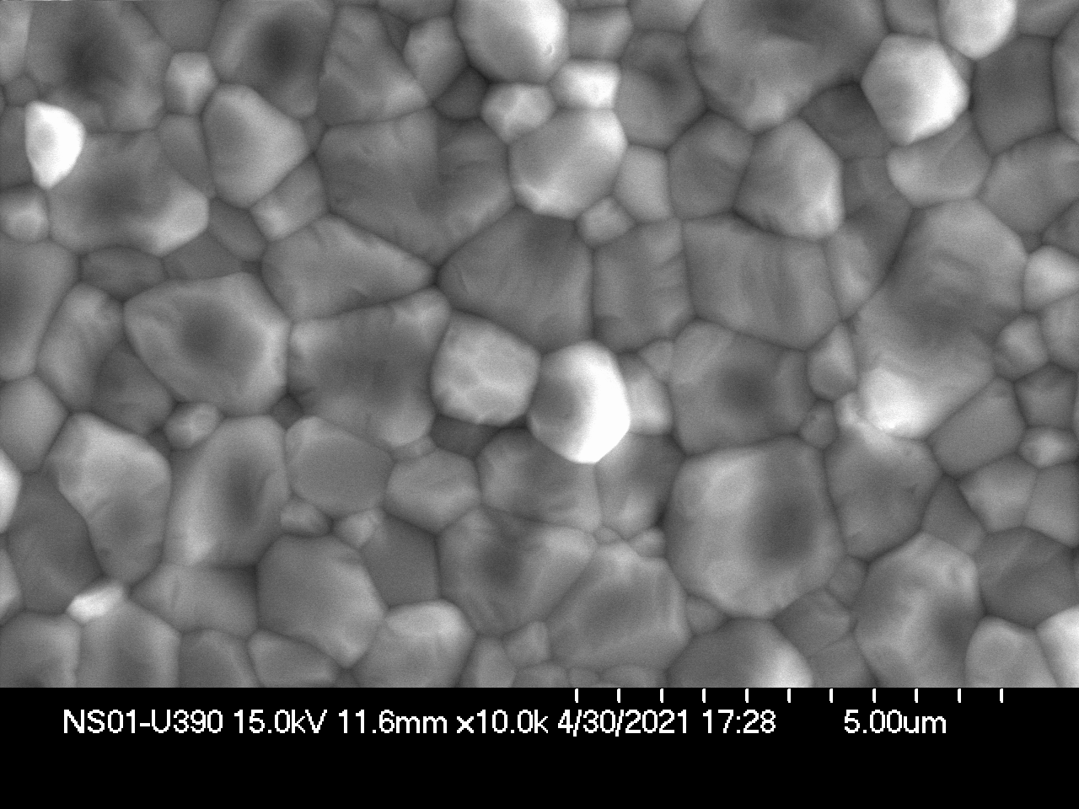
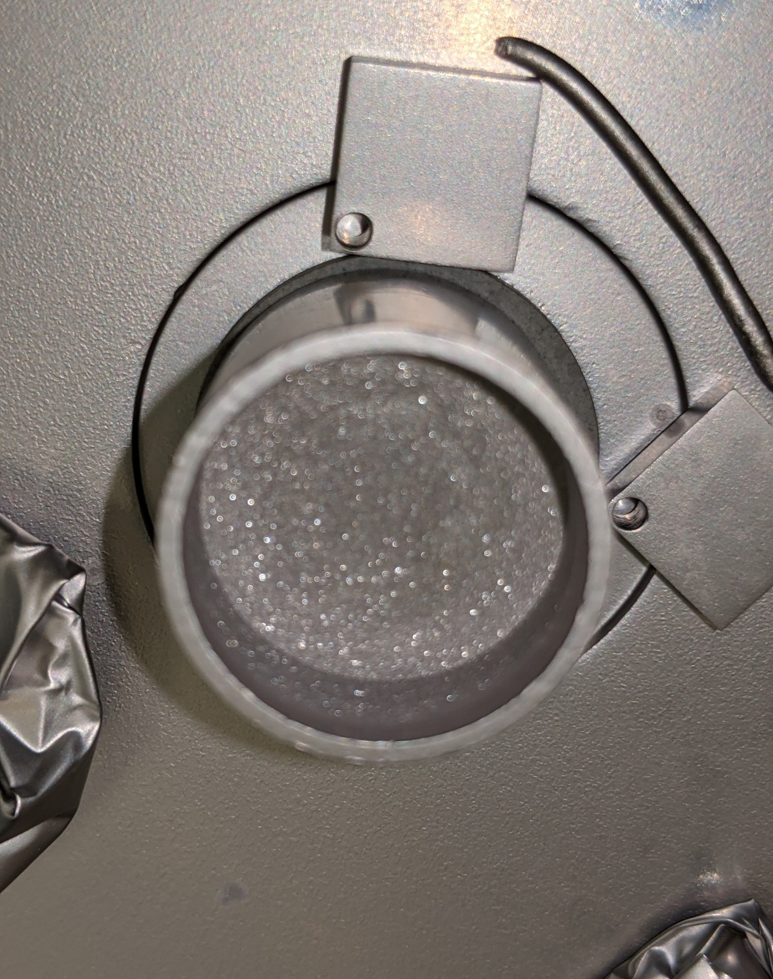
Source Exhaustion: Sn Supply Must Persist
Sn source exhausted during coating
Sn available early – not sustained through full growth stage
Visually good coating – very poor RF performance
Possible surface degradation during late-stage Sn deficiency
Highlights importance of time-dependent Sn availability
Takeaway: Adequate early Sn supply is not enough — Sn availability must be sustained throughout growth.

Slide 8
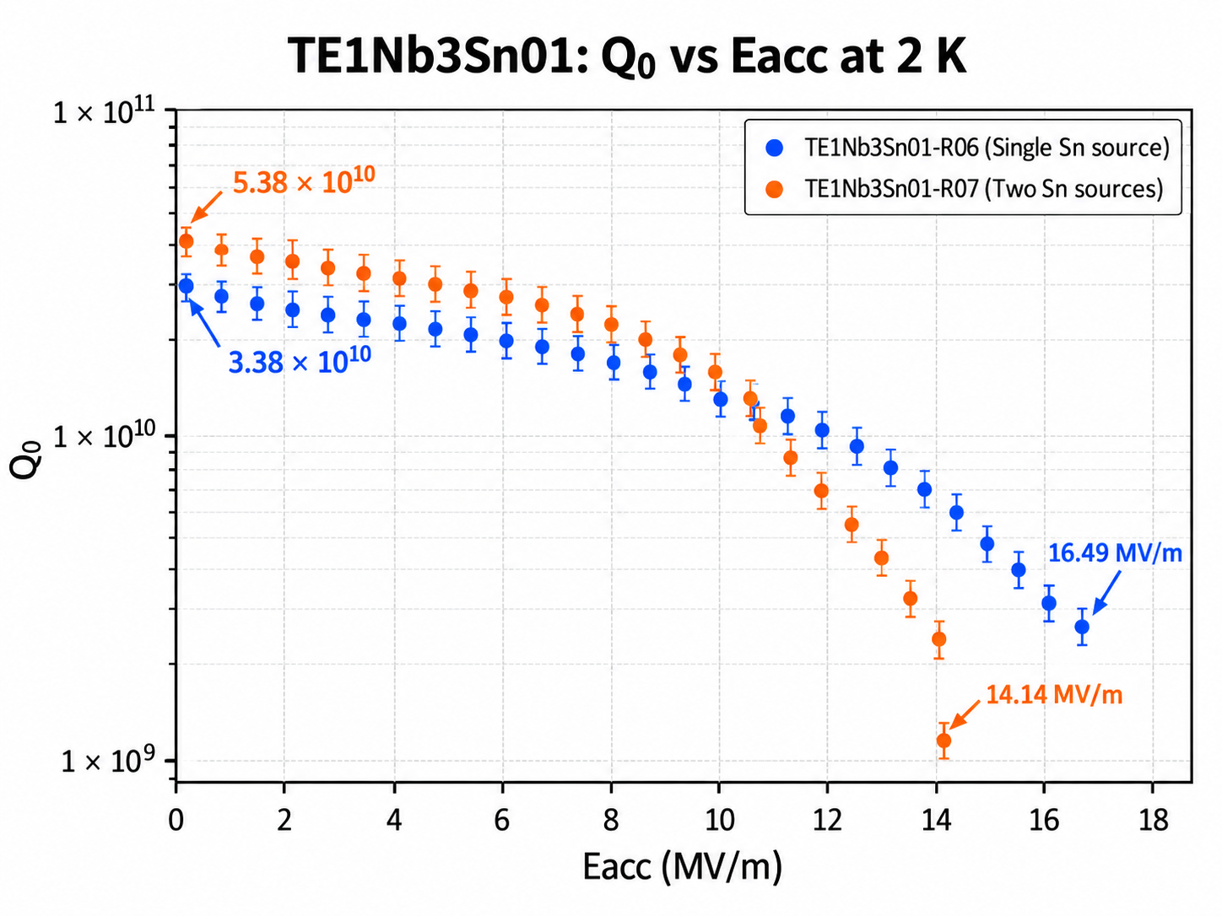
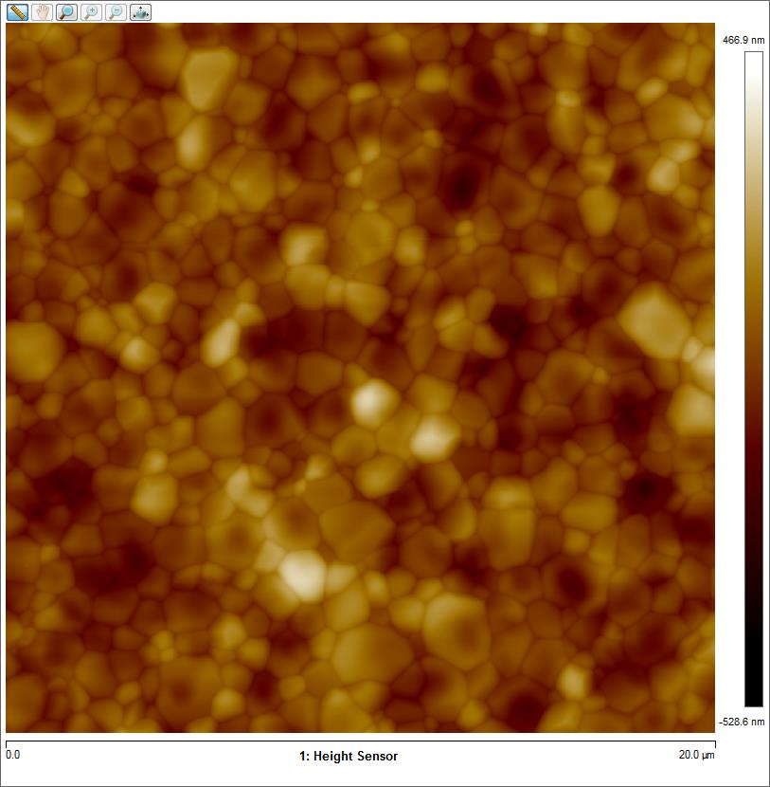
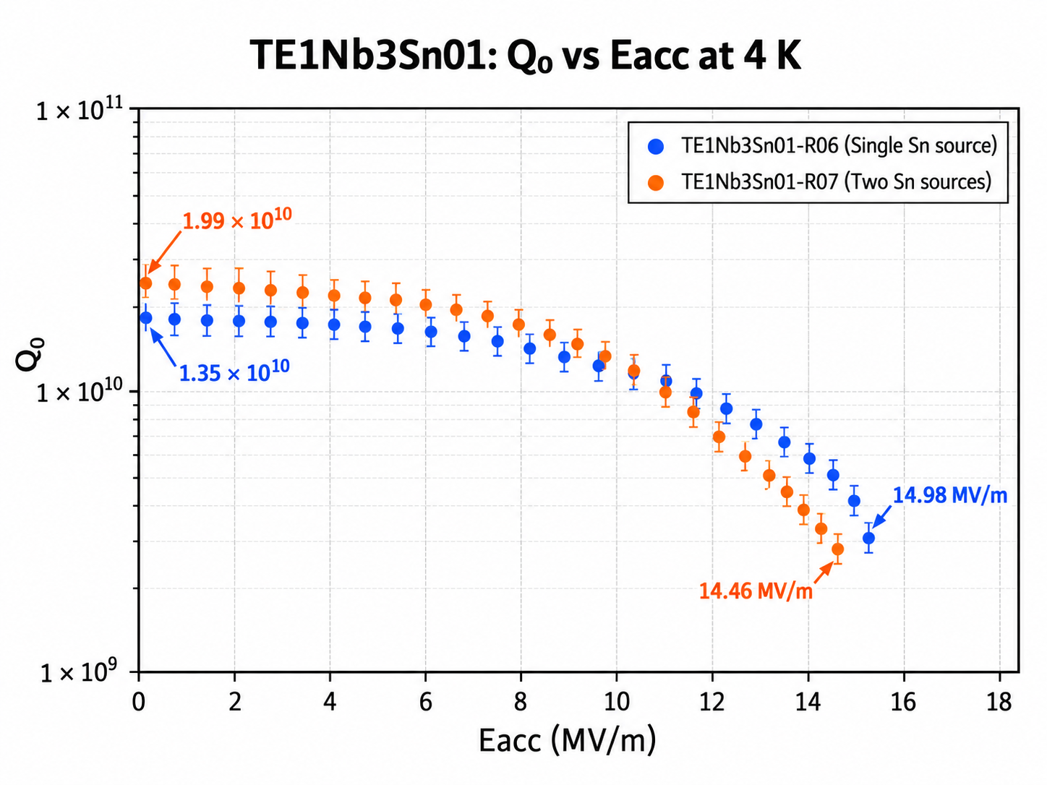
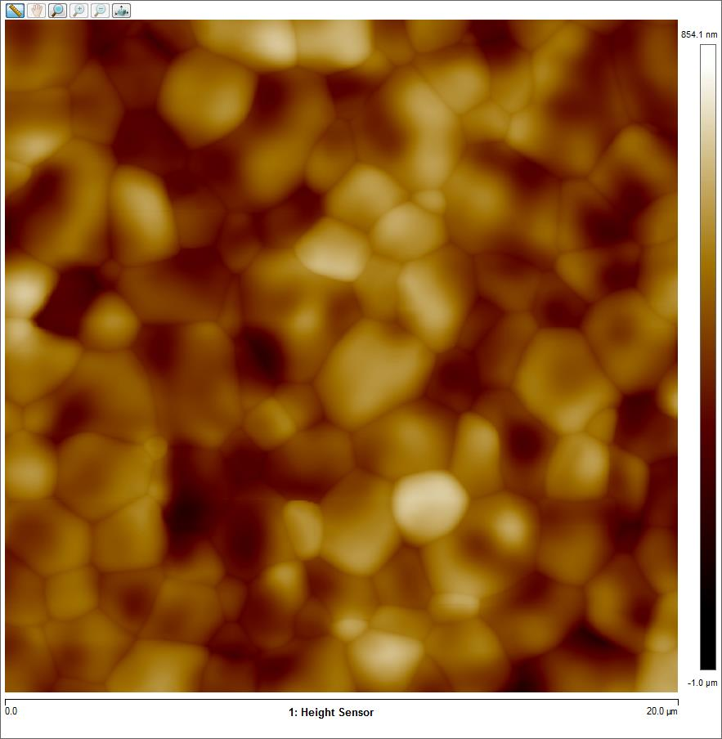
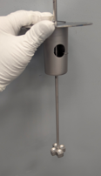
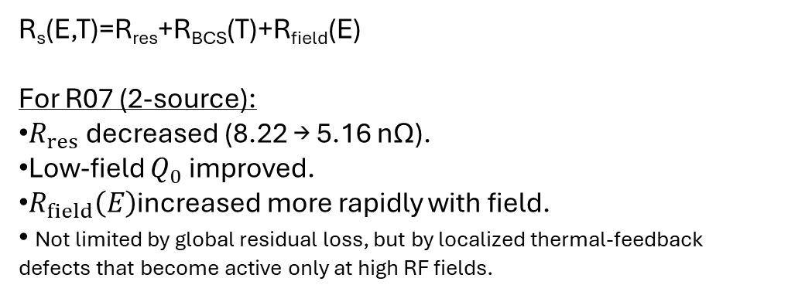
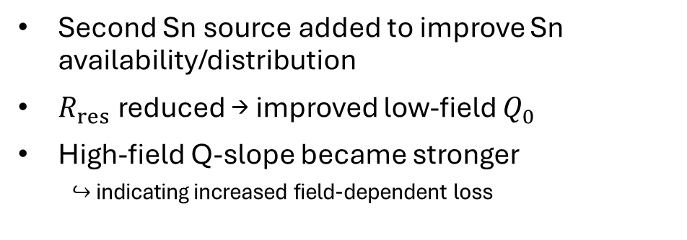
Increasing Sn Supply: More Is Not Necessarily Better
Second Sn source added to improve Sn availability/distribution
$R_{res}$ reduced → improved low-field $Q_{0}$
High-field Q-slope became stronger
  $↪$ indicating increased field-dependent loss
R06
R_{s}​(E,T)=R_{res}​+R_{BCS}​(T)+R_{field}​(E)
For R07 (2-source):
$R_{res}$ decreased (8.22 → 5.16 nΩ).
Low-field $Q_{0}$ improved.
$R_{field}\left(E\right)$increased more rapidly with field.
Not limited by global residual loss, but by localized thermal-feedback defects that become active only at high RF fields.
Higher average roughness and grain size
R07
Takeaway: Optimize Sn-source configuration to balance low residual loss and reduced field-dependent loss.

Slide 9
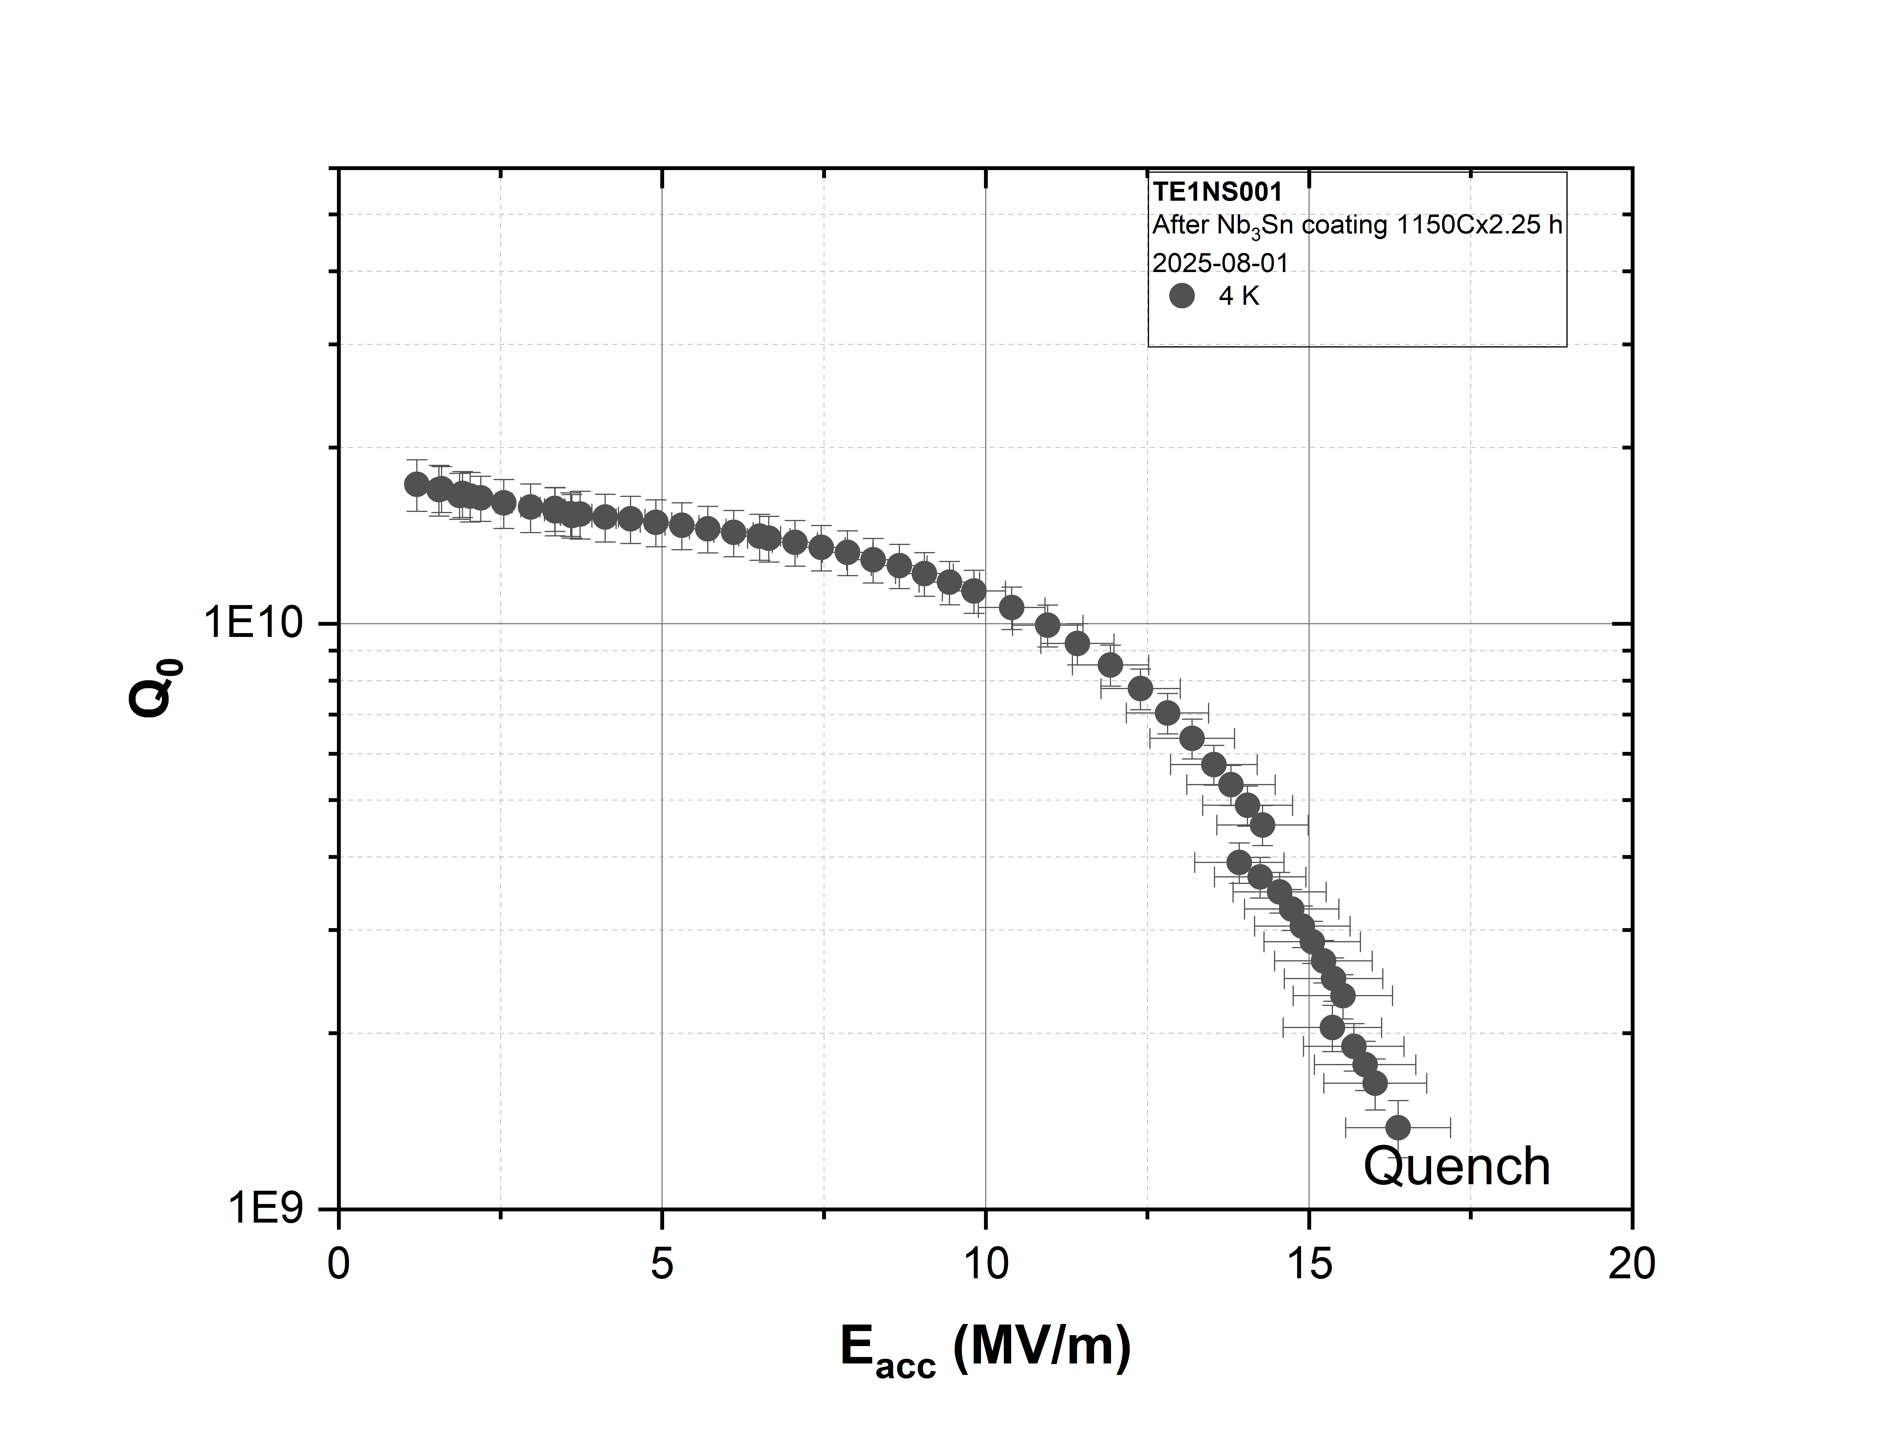
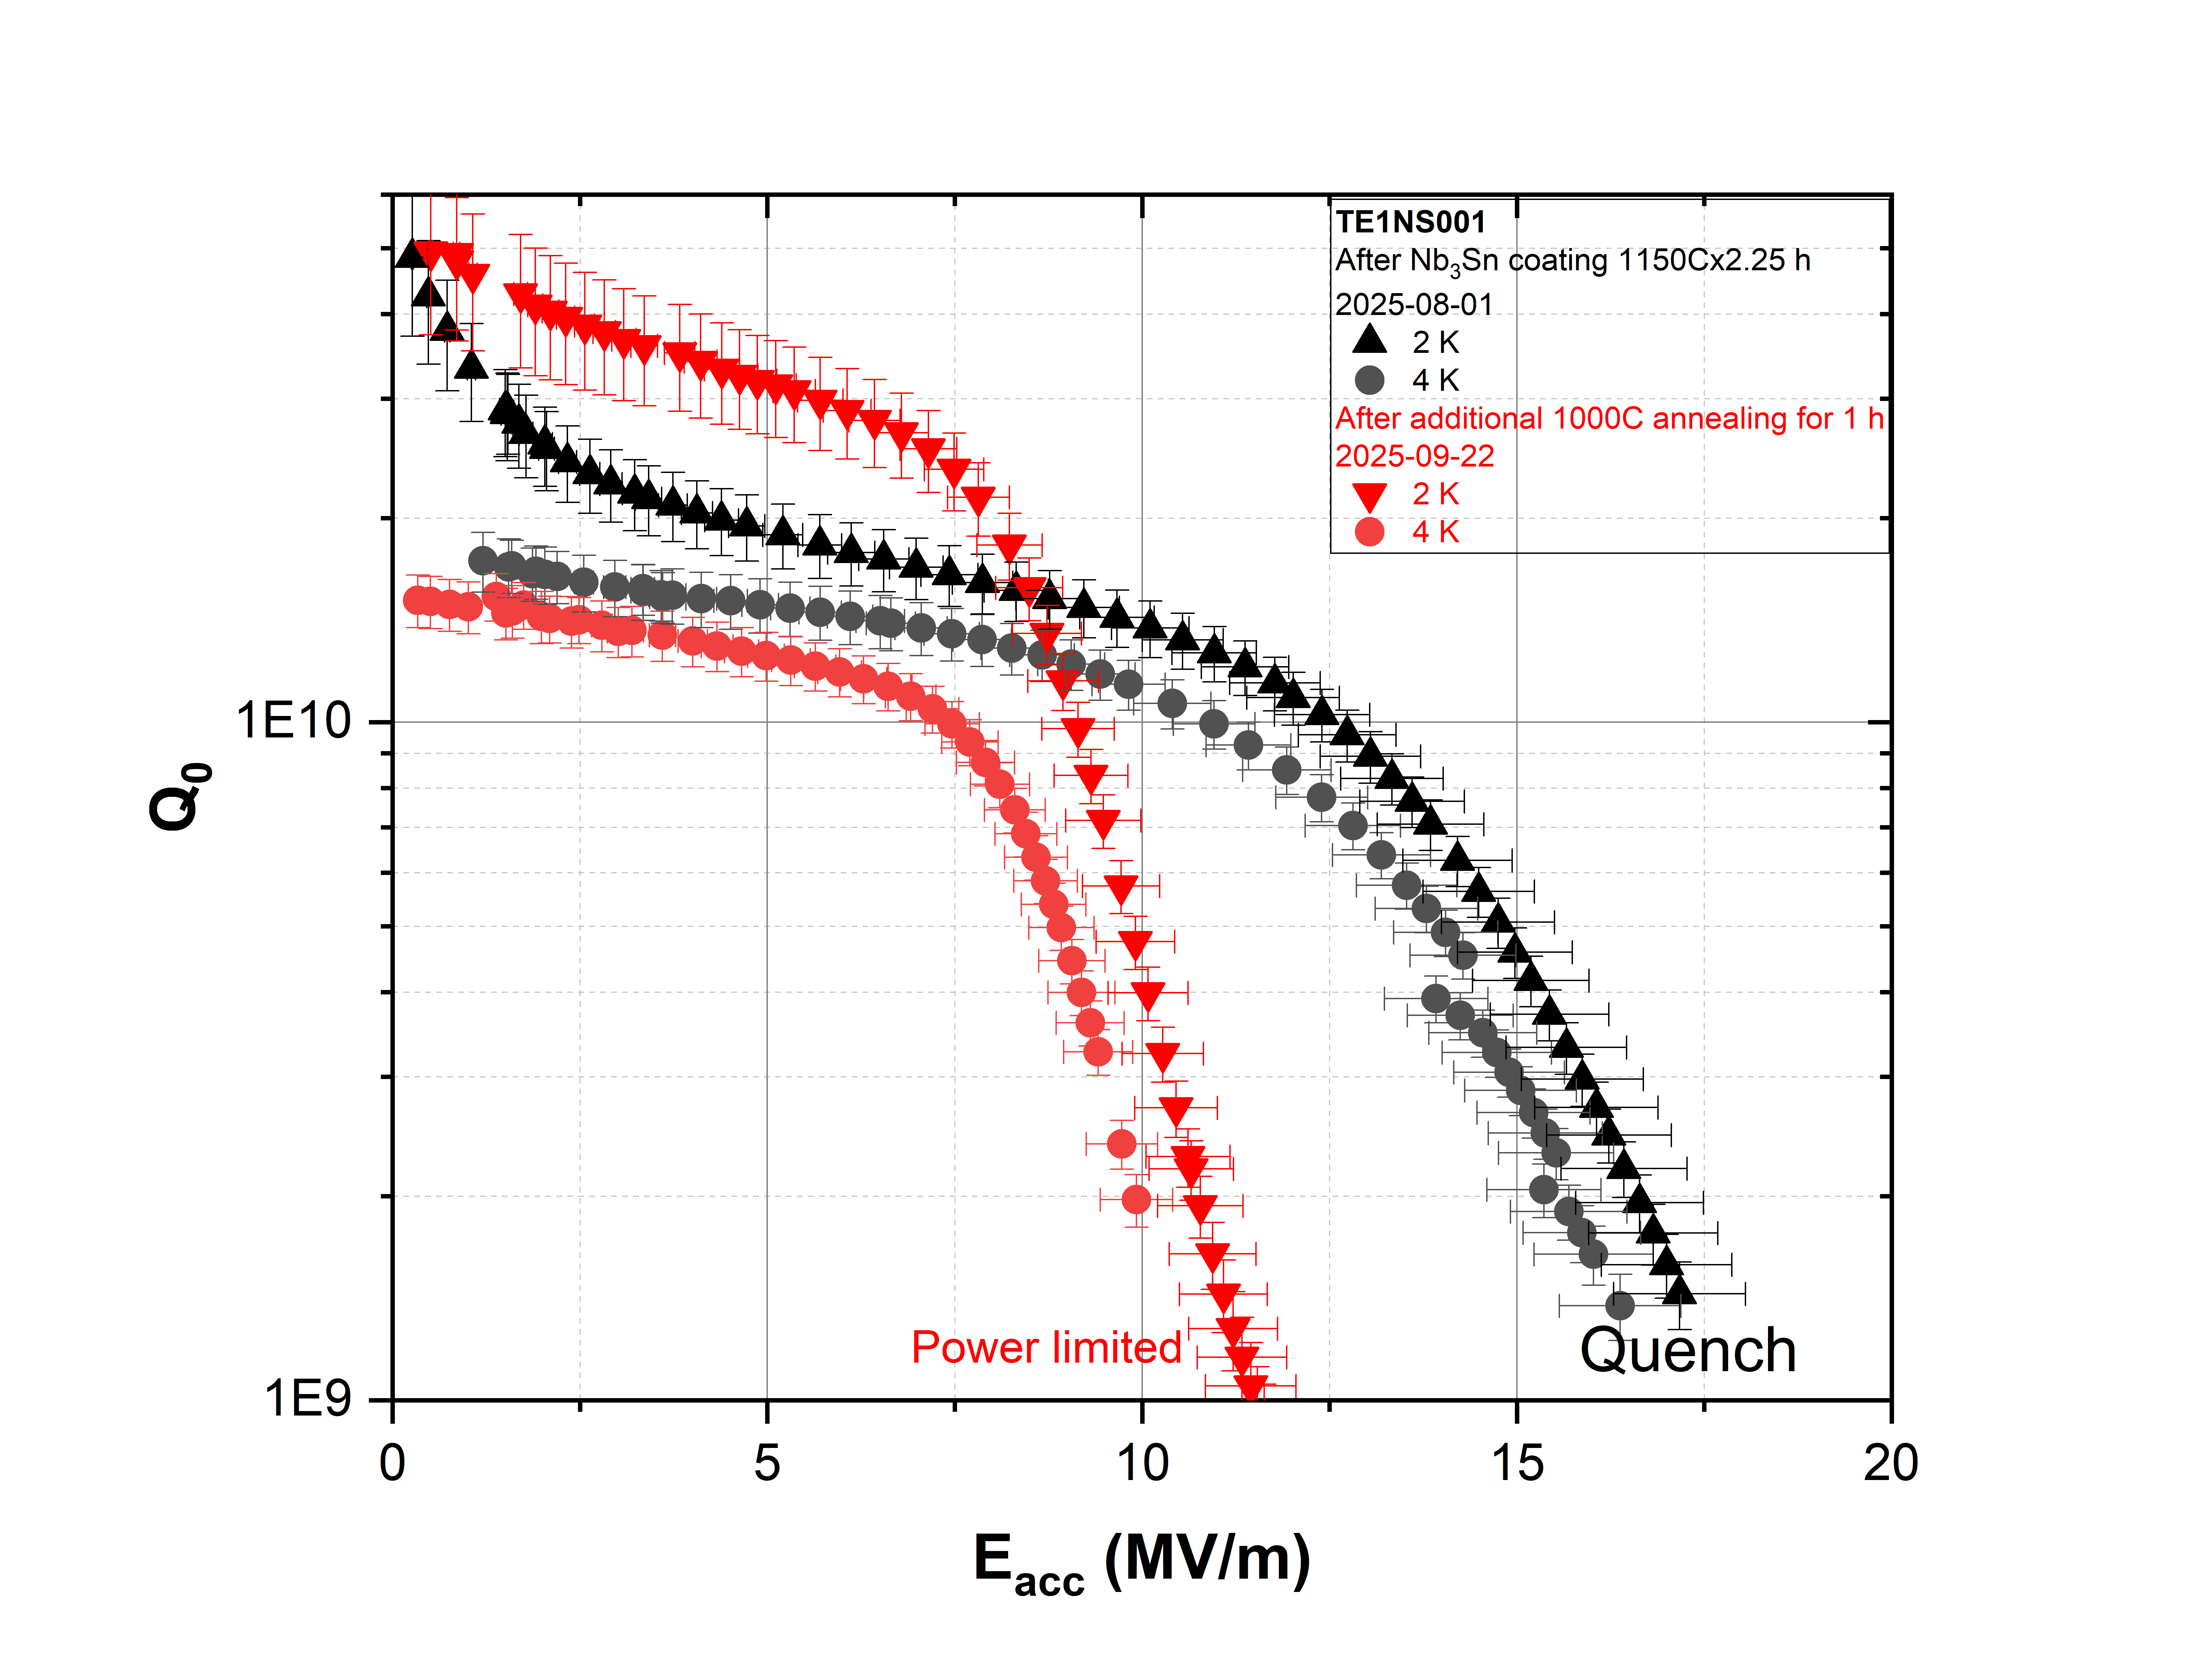
Can Coating Parameters Be Adjusted Independently?
Coating temperature reduced from 1200 °C to 1150 °C
Motivation: lower-temperature process for cavities with Nb-Ti flanges
Acceptable 4 K RF performance, but persistent Q-slope
Sn residue/condensation observed on witness sample
Additional anneal at 1000 °C × 1 h
RF performance degraded after annealing
Takeaway: Coating parameters are strongly coupled — source configuration, thermal history, geometry, and Sn transport all influence the outcome.

Slide 10
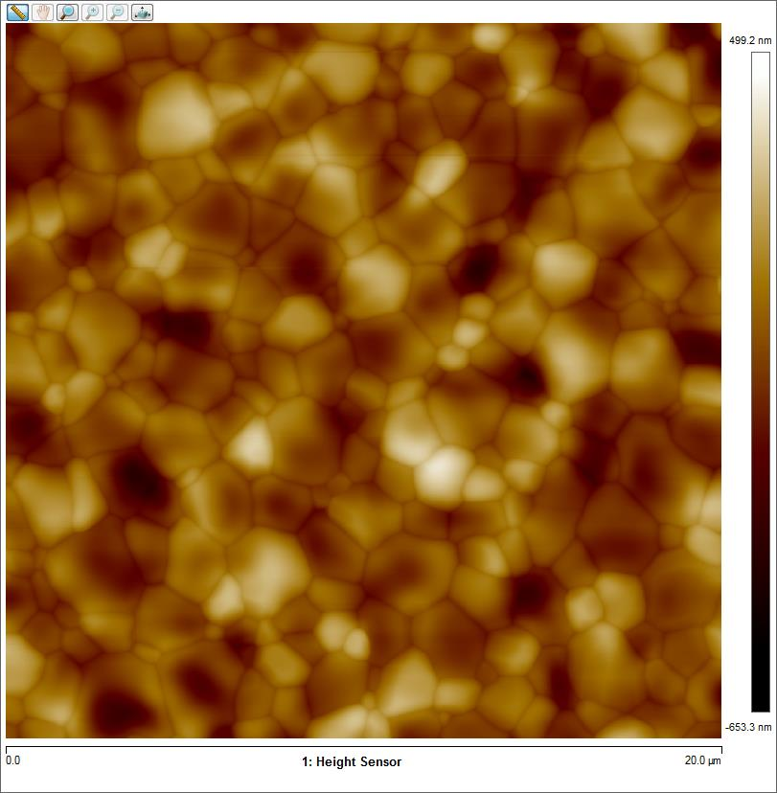
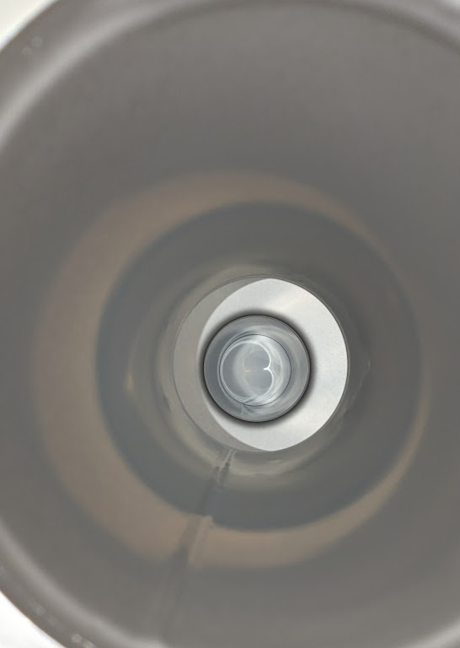
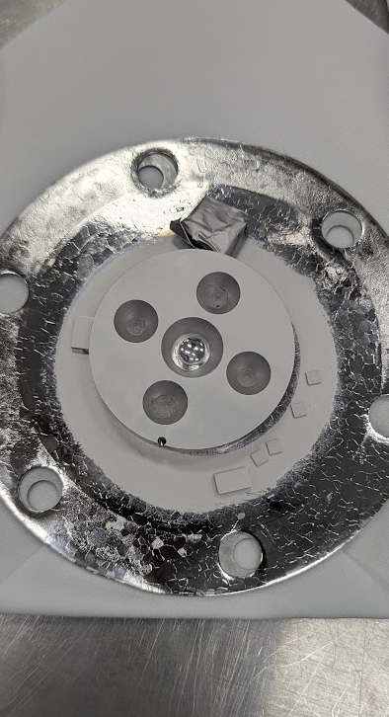
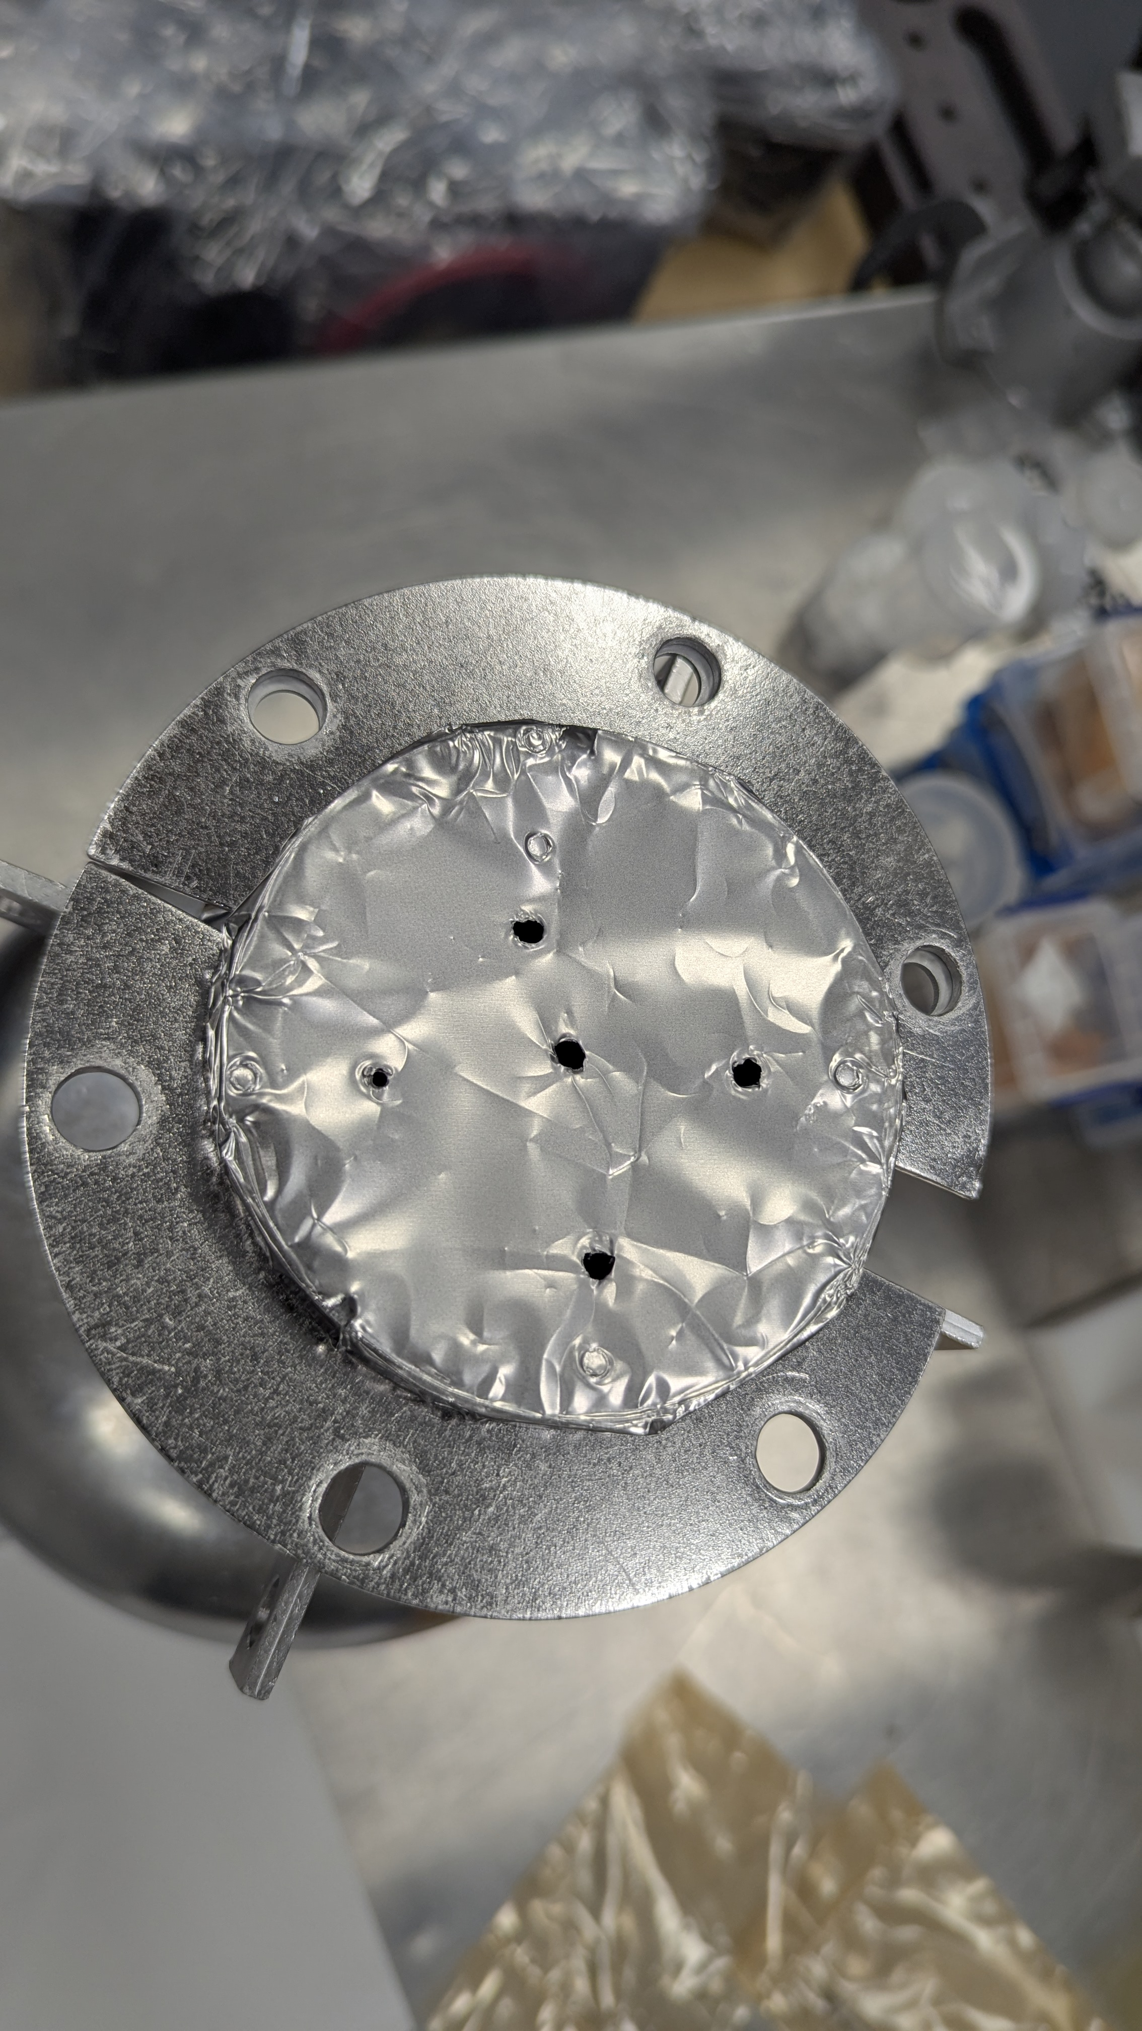
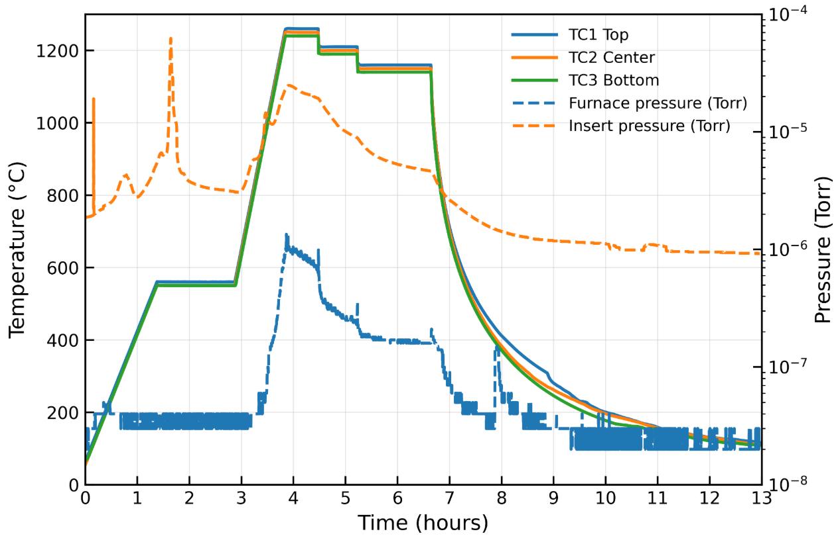
Towards Optimizing Sn Delivery and Suppressing Condensation
Introduced a conical multi-pocket Sn crucible
Added small holes in the top cover to release excess Sn vapor at the end of coating
Improved control of Sn evaporation and spatial delivery for more uniform growth
Avoided source exhaustion while limiting excessive local Sn accumulation
Modified coating conditions reflected in better RF performance
Takeaway: Sn source and vapor-management strategy likely improved coating uniformity while reducing condensation

Slide 11
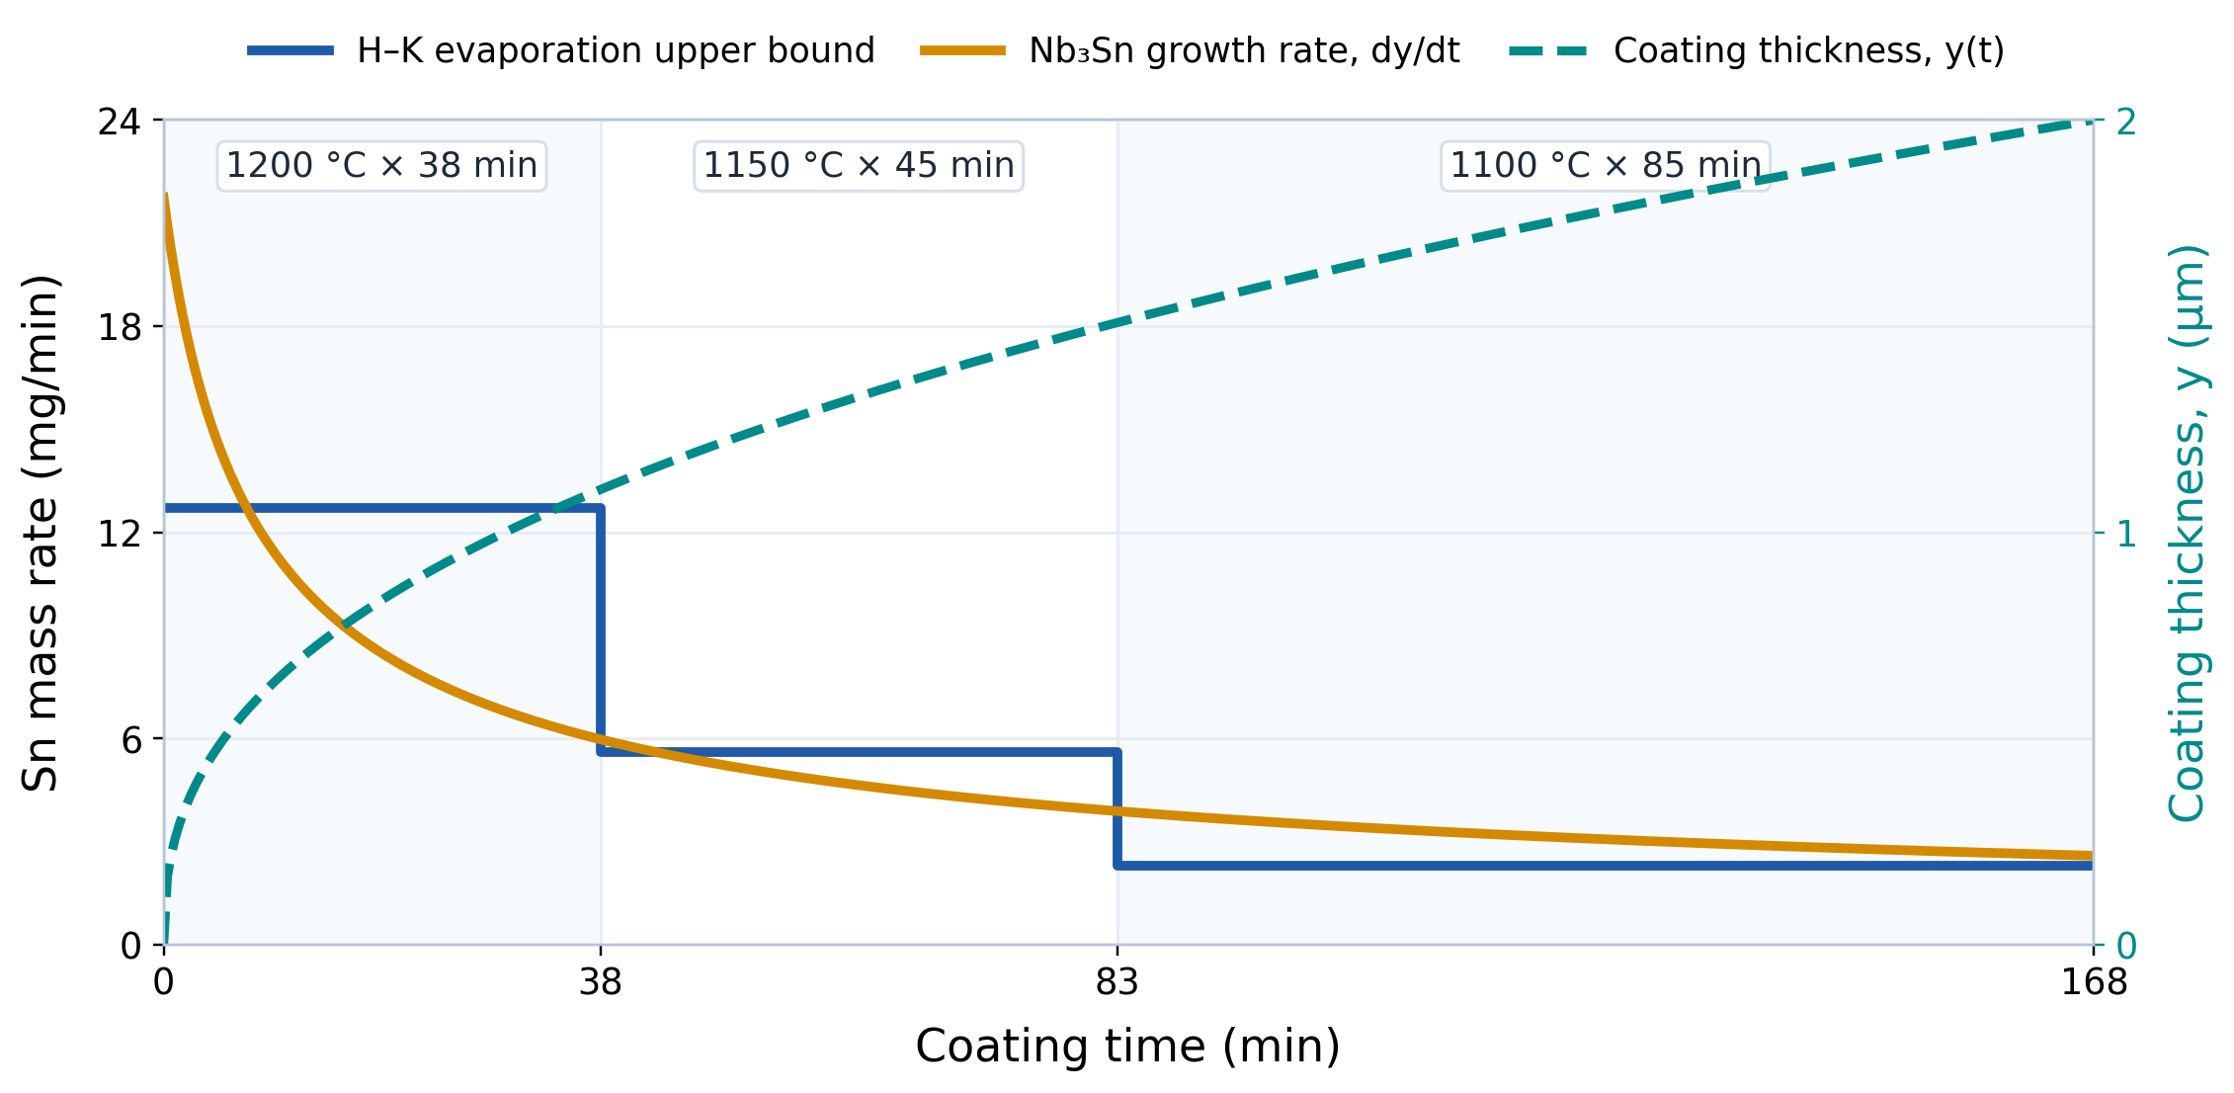
Sn Vapor Balance During Coating
Source evaporation
Hertz–Knudsen upper bound
Jₑᵥₐₚ = α(Pᵥ − P_{local}) / √(2πmk_{B}T)
0.68 in source; initial Sn = 1.1 g
1.3 GHz single-cell coating
Nb₃Sn growth
y(t) ∝ t^{0.4}
dy/dt ∝ t⁻^{0.6}
Final thickness: 2.0 µm over 1700 cm²
Pudasaini, Uttar, et al. "Growth of Nb3Sn coating in tin vapor-diffusion process." J. Vac. Sci. Technol. A 37, 051509 (2019)
Vapor balance
*schematic
dNᵥ/dt = Ṅₑᵥₐₚ − Ṅ_{growth} − Ṅ_{loss}
Net vapor depends on evaporation, growth, consumption, transport losses, and condensation.
∫ evaporation ≈ 0.93 g
free-vacuum upper bound
Sn in 2 µm film ≈ 0.85 g
1700 cm² coated area
Key message: the coating environment is dynamic — Sn evaporation, consumption, and transport losses must be balanced in time and across the cavity.

Slide 12
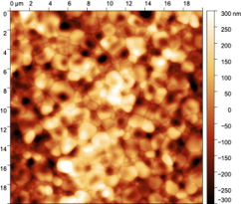
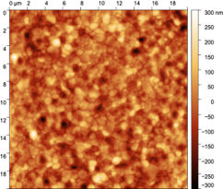
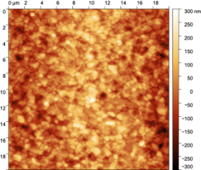
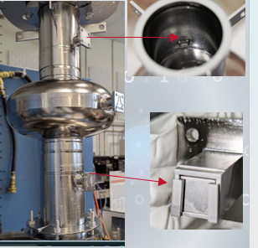
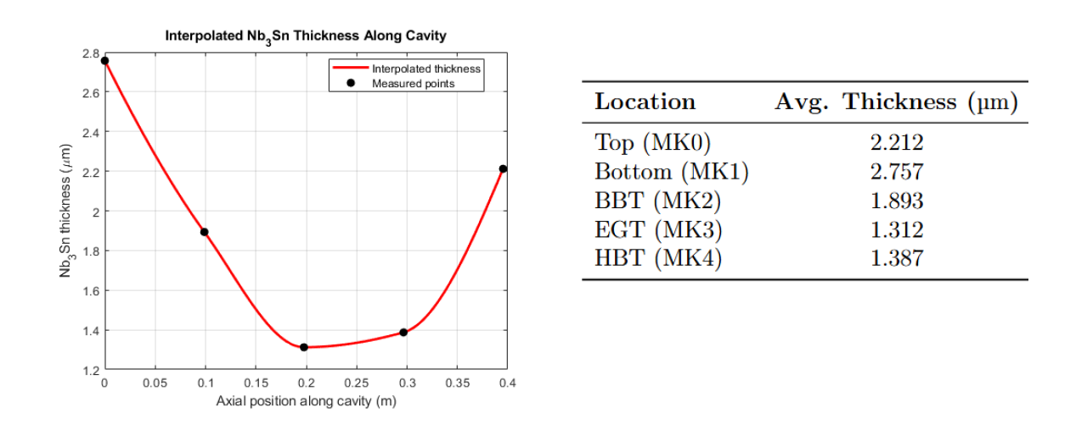
Sample Study: Local Variation in Coating Uniformity
Modified cavity – samples at beam tube and equator
Variables – coating temperature and time
Observation – location-dependent coating variation
Equator – lower thickness; reduced Sn availability in hard-to-reach region
Microstructure – varied with location and coating condition
75 min coating at
1
2
3
1
1
2
2
3
3
Takeaway: Local Sn transport affects coating growth and uniformity across the cavity.

Slide 13
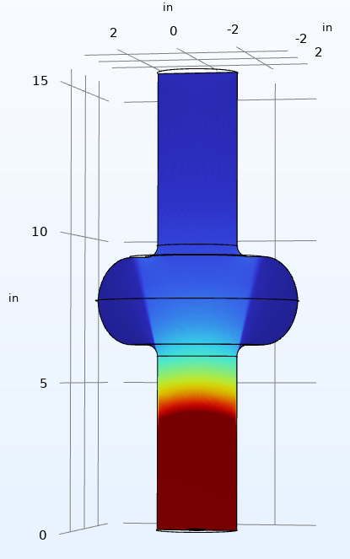
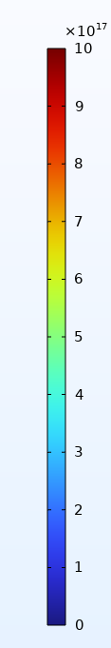
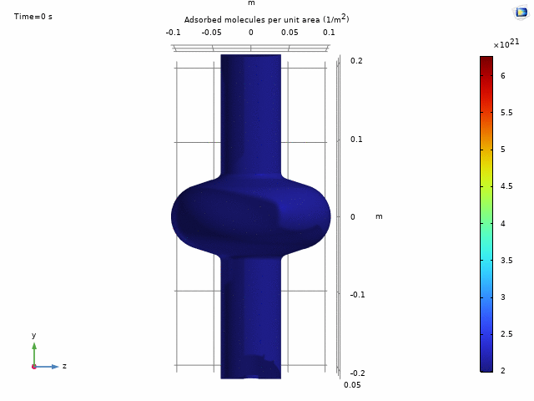
From Local Coating Variation to Sn Transport Modeling
Motivation – understand how cavity geometry redistributes Sn vapor during coating
COMSOL approach – free molecular flow model for Sn transport
Number-density reconstruction – calculated spatial distribution of Sn vapor inside the cavity
Surface interaction – initial effort to relate local vapor environment to coating growth
Growth model – sticking coefficient treated phenomenologically with a spatially varying power-law decay
Current challenge – translating vapor transport into reliable time-dependent coating-thickness evolution
P. Tiwari, ODU
Adsorbed molecule/area
Number density reconstruction
Current status: Very preliminary, but an important step toward quantitatively predicting Nb₃Sn coating growth across different cavity geometries.

Slide 14
Summary & Outlook
Sn delivery and distribution – key to coating uniformity and RF performance
Source condition and initial growth history – major influence on final coating quality
Local variation across the cavity – reduced growth in hard-to-reach regions
Strongly coupled process parameters – temperature, geometry, transport, and surface interaction
Preliminary COMSOL modeling – linking Sn transport with spatial coating evolution
Predictive control of Sn delivery and coating growth across cavity geometries
  Move from empirical coating recipes toward predictive control of Sn delivery and coating growth across cavity geometries.
Sample experiments and materials characterization to validate and improve multi-physics modeling

Slide 15
Thank you for your attention!
Questions?

