Slide 1










Matteo Lazzari
INFN – Legnaro National Laboratories · Università degli Studi di Padova
on behalf of the LNL Surface Treatments & Superconductivity Team
◆ PhD scholarship fully funded by Zanon Research & Innovation
Nb₃Sn thin film development on 1.3 GHz cavities
12th International Workshop on Thin Films and New Ideas for Pushing the Limits of RF Superconductivity, 21–25 September 2026 Chester, United Kingdom
SUPPORTED BY
EU Horizon — iSAS (GA 101131435) & I.FAST (GA 101004730). INFN CSN5 SuperMAD · CSN1 SRF, RD_FCC.
PROJECTS & COLLABORATIONS

Slide 2
ACKNOWLEDGEMENTS
LNL SRF R&D — a collaborative effort
EU HORIZON PROGRAMMES
INFN ACCELERATOR R&D
INTERNATIONAL PARTNERS
INFN–LNL
C. Pira, O. Azzolini, E. Chyhyrynets, T. M. Ezeaba, D. Ford, M. Lazzari, F. Stivanello
HZDR
S. Prucnal, S. Zhou
INFN PD · RM3 · TO · LNF
A. Pepato, P. Rebesan · N. Pompeo, E. Silva · G. Ghigo · C. Gatti, G. Maccarrone, D. Di Gioacchino
Jefferson Lab
A. M. Valente Feliciano
CEA
C. Z. Antoine, I. Curci, Y. Kalboussi, T. Proslier
IEE SAS
E. Seiler, R. Ries
CERN
G. Rosaz, W. Venturini
STFC / UKRI
O. B. Malyshev, R. Valizadeh, C. Benjamin, T. Sian, L. Smith
DESY
M. Wenskat
Lancaster · Liverpool · Siegen
G. Burt, N. Leicester, S. Marks, D. Seal · W. Bradley, S. Simon · X. Jiang, T. Staedler, A. Zubtsovskii
HZB
S. Keckert, O. Kugeler, J. Knobloch
Riga Tech. Univ. · Piccoli
A. Medvids · R. Berton, D. Piccoli, F. Piccoli, G. Squizzato, F. Telatin
TFSRF 2026 · M. Lazzari, INFN–LNL, malazzar@lnl.infn.it
02 / 24

Slide 3

TECHNOLOGY READINESS LEVEL
Each EU project, a step up in TRL
Nb₃Sn-on-Cu has climbed the TRL ladder through successive European programmes.
2021
2023
2025
today
2028
2030
proof of concept
TRL 3
T_{c} > 17 K on small
planar samples
partial-scale prototype
TRL 4
Nb₃Sn RF performance validation on QPR
partial-scale prototype validation
TRL 5
1.3 GHz Nb₃Sn cavity
coated and tested
full-scale prototype demonstration
TRL 6
Nb₃Sn Conduction Cooling Cryomodule
EUROPEAN
COLLABORATIONS
INFN
PROJECTS
TRL SCALE
1
2
3
4
5
6
7
8
9
Basic principles
Concept
Proof of concept
Lab validated
Relevant env.
Demonstrated
Operational prototype
Qualified
Proven in operation
TFSRF 2026 · M. Lazzari, INFN–LNL, malazzar@lnl.infn.it
03 / 24

Slide 4
OVERVIEW
Outline
01
Nb₃Sn on a cavity
Commissioning the coating system and first depositions on a mock-up cavity
02
Future improvements of the system
A rotating cavity: from design to construction
03
Possible new film interface
ALD oxide interlayers
→ Next steps — from the mock-up to an RF-tested Nb₃Sn cavity
TFSRF 2026 · M. Lazzari, INFN–LNL, malazzar@lnl.infn.it
04 / 24

Slide 5
01
PART 01
Nb₃Sn on a cavity
Commissioning the coating system and first depositions on a mock-up cavity
TFSRF 2026 · M. Lazzari, INFN–LNL, malazzar@lnl.infn.it
05 / 24

Slide 6
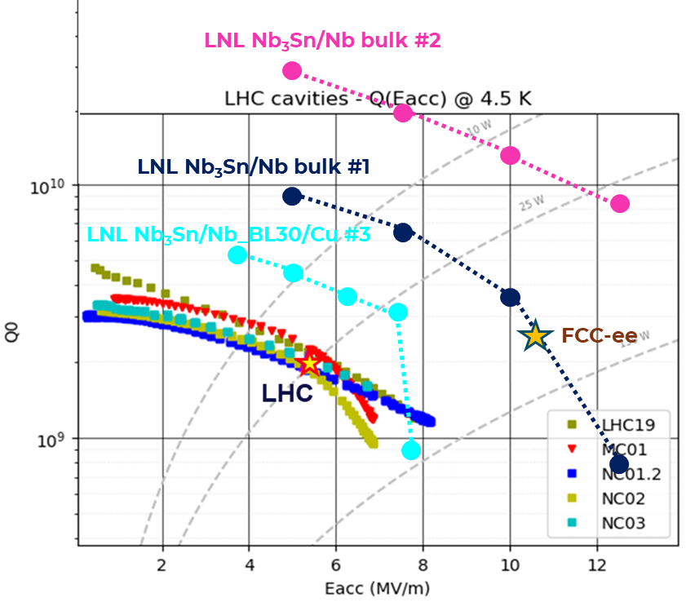
RECAP
01 · Nb₃Sn on a cavity
Moving the recipe onto a 1.3 GHz cavity
The recipe — validated on flat samples & QPR *
DCMS from a single stoichiometric Nb₃Sn target, T_{c} > 17 K on Cu
QPR RESULTS
1
Low cathode power ~250 mW/cm²
2
High deposition pressure 2×10⁻² mbar
3
Deposition temperature 600–650 °C
→ Heat the cavity in vacuum during coating, below the Cu limit
4
No post-annealing
→ A15 phase formed in situ: one single, hot deposition step
5
Nb buffer layer ~30 µm
→ Accommodation and diffusion barrier
Sample #2
Nb₃Sn on bulk Nb
T_{c}
B_{peak}
R_{s}
17.45 K
> 85 mT
< 9 nΩ
* D. Fonnesu et al., Recipe optimization and SRF test of Cu-compatible Nb₃Sn films by DCMS, Sci. Rep. 16, 3539 (2026).
TFSRF 2026 · M. Lazzari, INFN–LNL, malazzar@lnl.infn.it
06 / 24

Slide 7
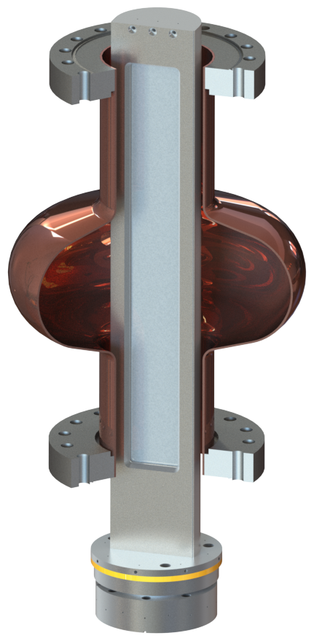
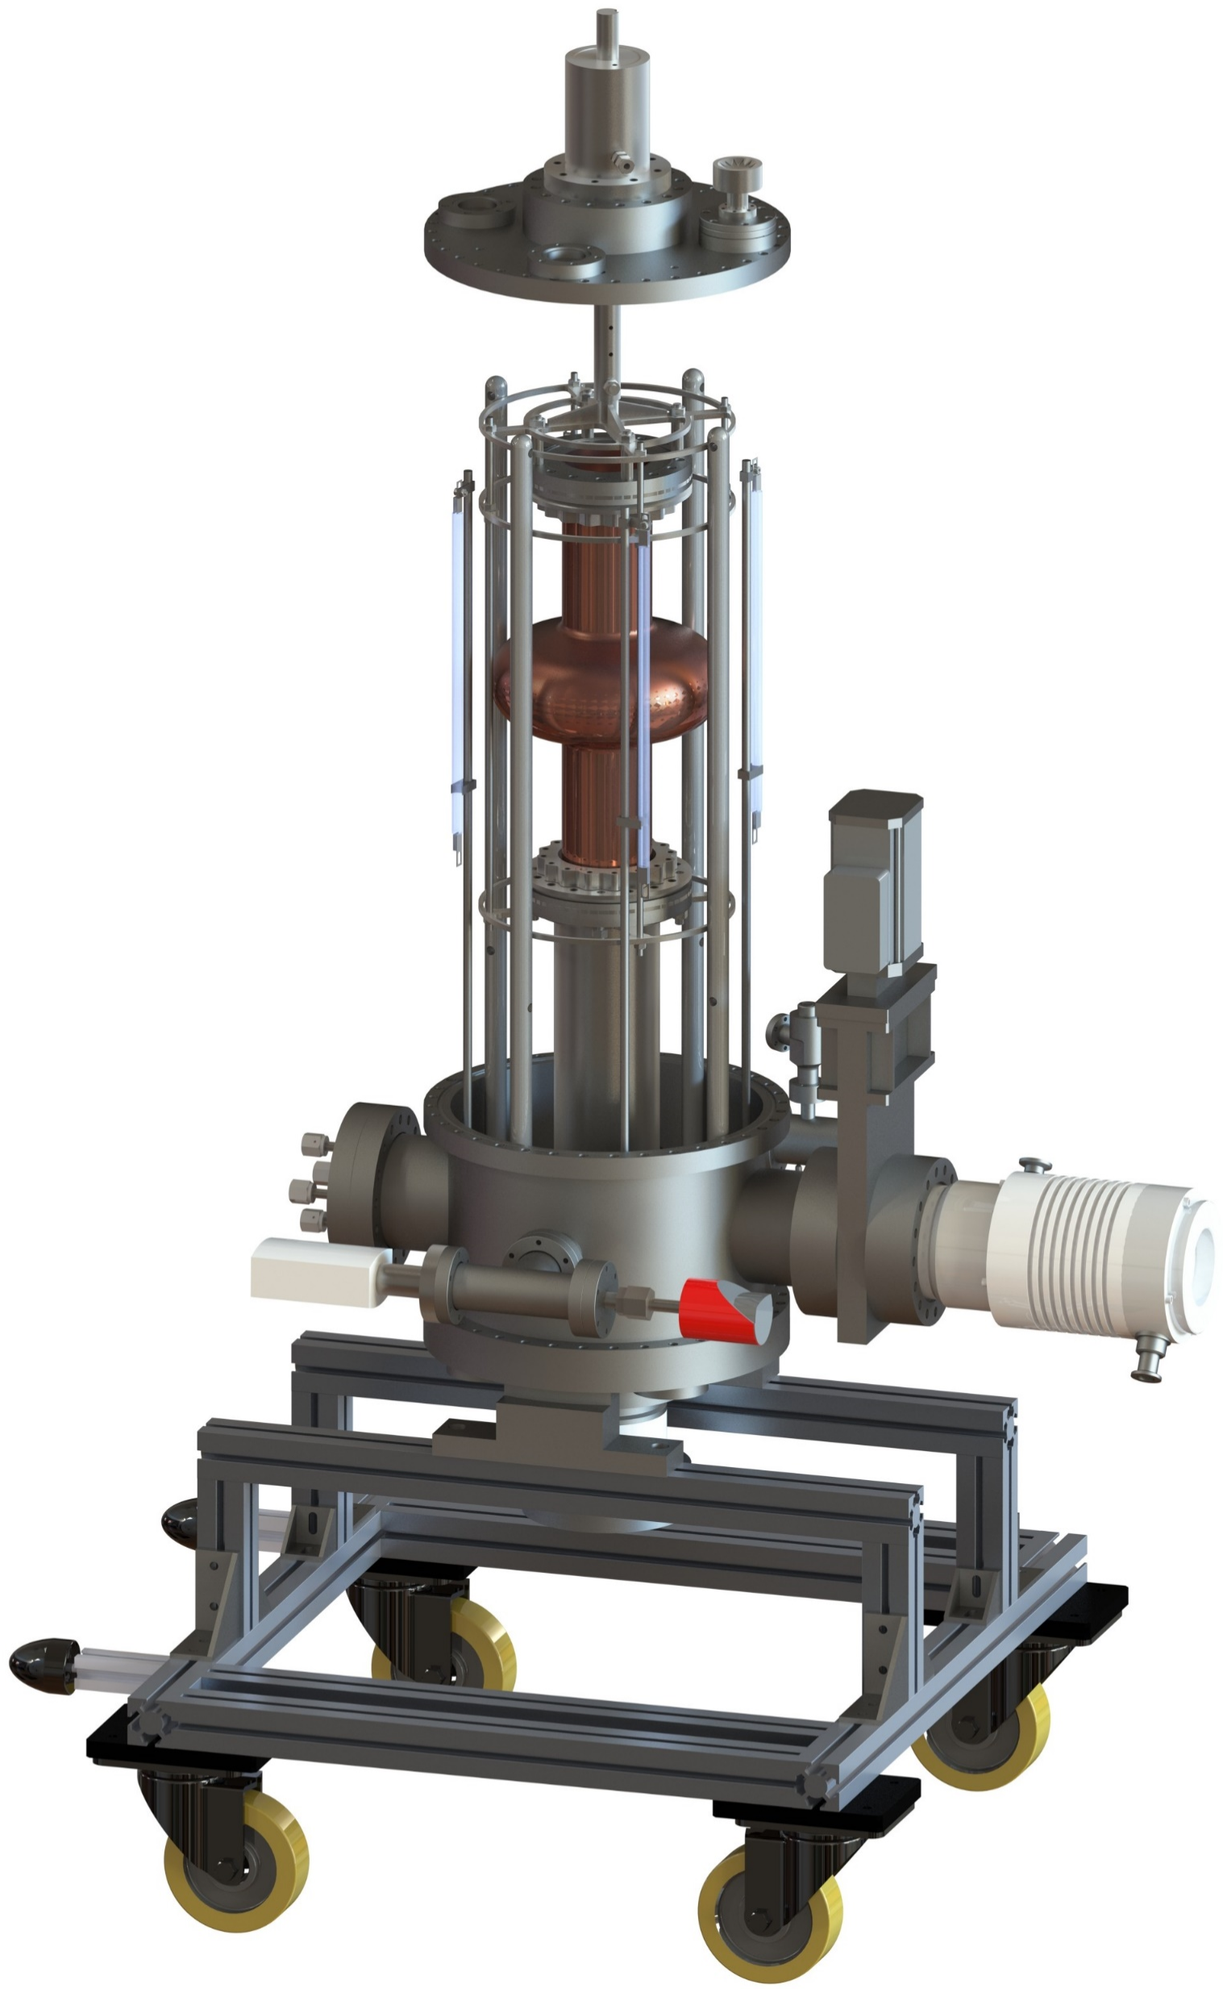
RECAP
01 · Nb₃Sn on a cavity
Moving the recipe onto a 1.3 GHz cavity
The recipe — validated on flat samples & QPR *
DCMS from a single stoichiometric Nb₃Sn target, T_{c} > 17 K on Cu
THE LNL 1.3 GHz COATING SYSTEM
1
Low cathode power ~250 mW/cm²
2
High deposition pressure 2×10⁻² mbar
3
Deposition temperature 600–650 °C
→ Heat the cavity in vacuum during coating, below the Cu limit
4
No post-annealing
→ A15 phase formed in situ: one single, hot deposition step
Magnetron inside the cavity
Full coating system
5
Nb buffer layer ~30 µm
Fixed planar magnetron — rectangular target on the axis
→ Accommodation and diffusion barrier
Rotating cavity — turns around it for an even coating
Heated UHV chamber — substrate up to ~670 °C
* D. Fonnesu et al., Recipe optimization and SRF test of Cu-compatible Nb₃Sn films by DCMS, Sci. Rep. 16, 3539 (2026).
TFSRF 2026 · M. Lazzari, INFN–LNL, malazzar@lnl.infn.it
07 / 24

Slide 8
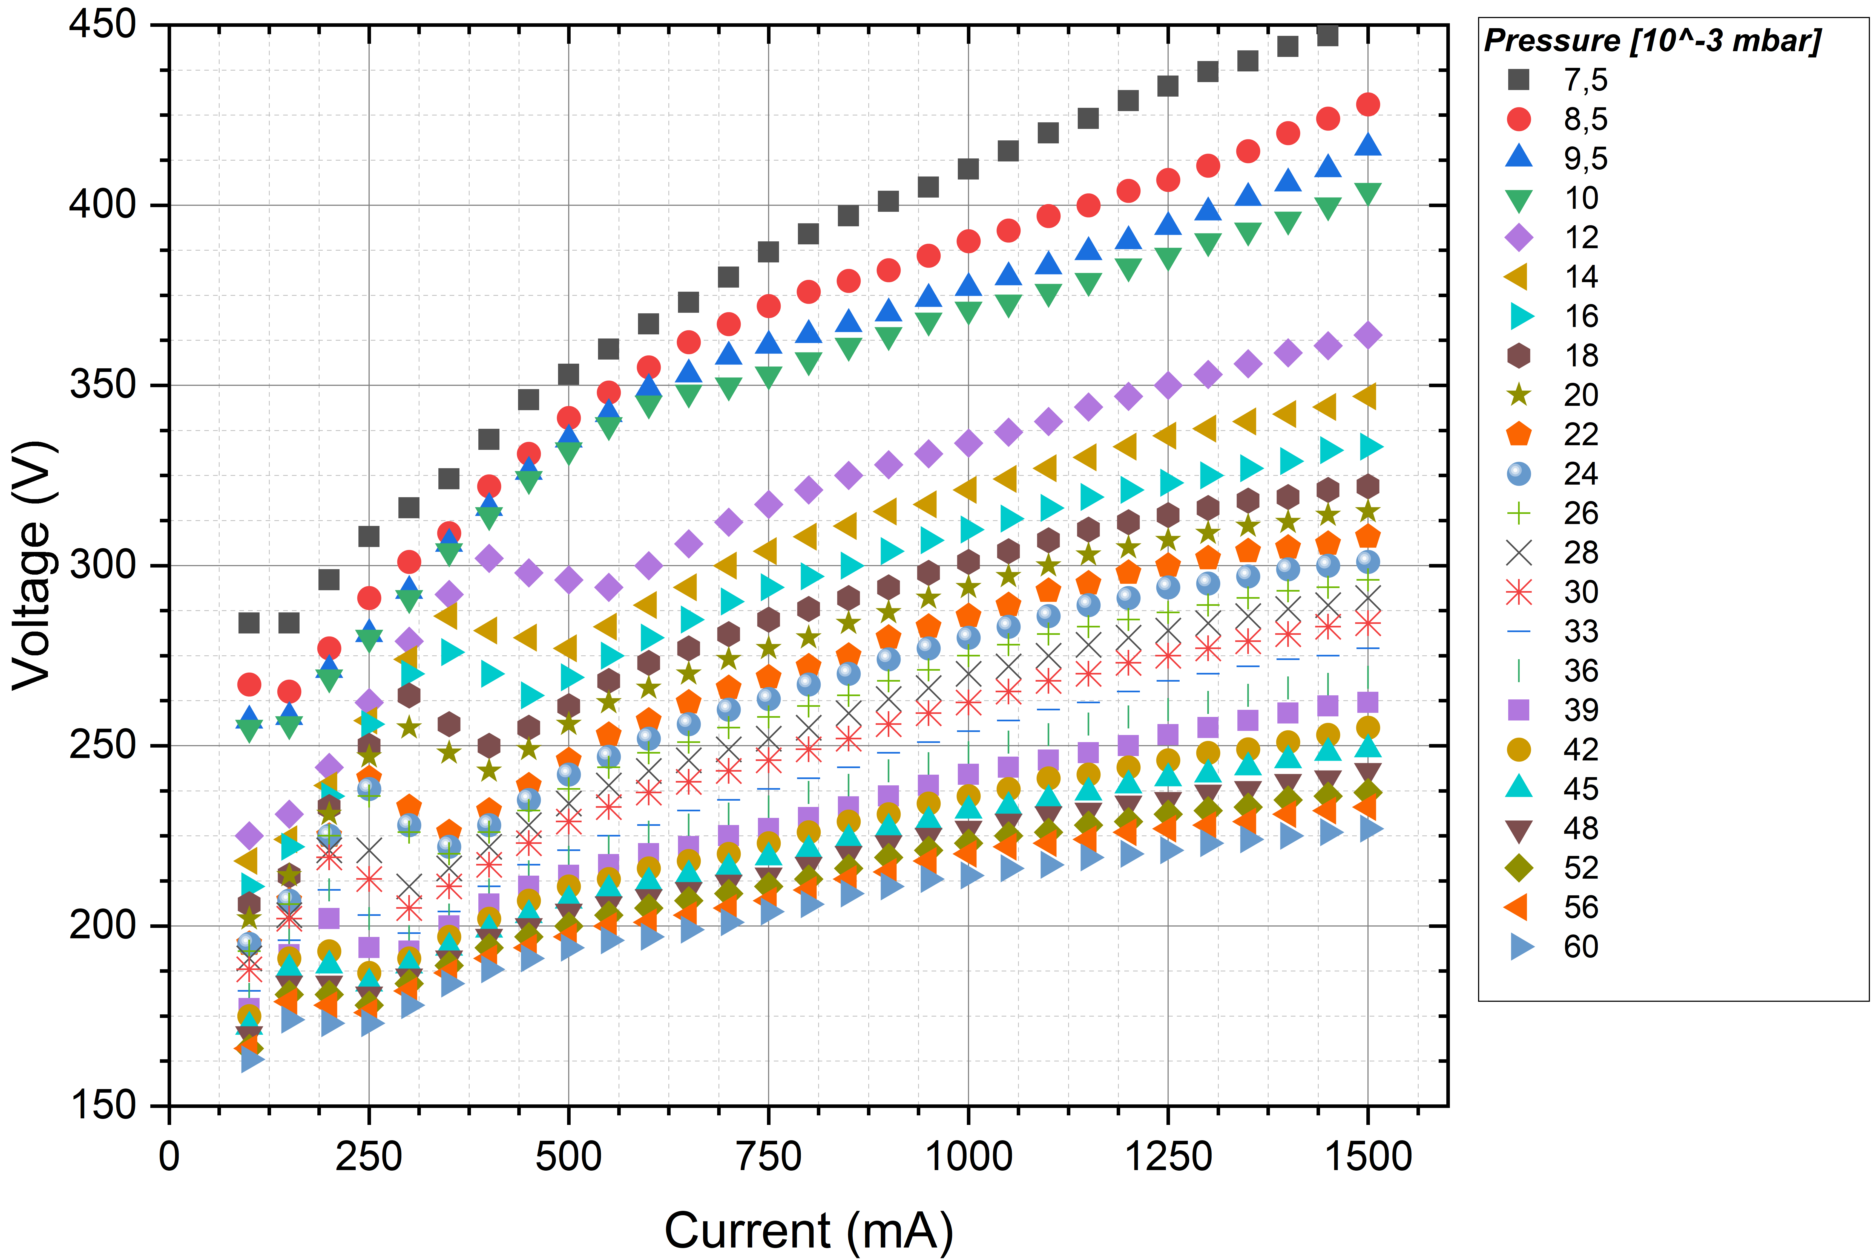
CHARACTERIZATION
01 · Nb₃Sn on a cavity
Magnetron operating window & first depositions
STABLE OPERATING WINDOW
DISCHARGE V–I CURVES
100 – 1500 mA discharge current
7.5×10⁻³ – 6×10⁻² mbar Ar pressure
up to 670 °C substrate temperature
DEPOSITIONS TO DATE
12
8 × Nb
Runs for testing the magnetron set-up
4 × Nb₃Sn
First runs for parameter scaling/optimization study
One curve per Ar pressure
TFSRF 2026 · M. Lazzari, INFN–LNL, malazzar@lnl.infn.it
08 / 24

Slide 9
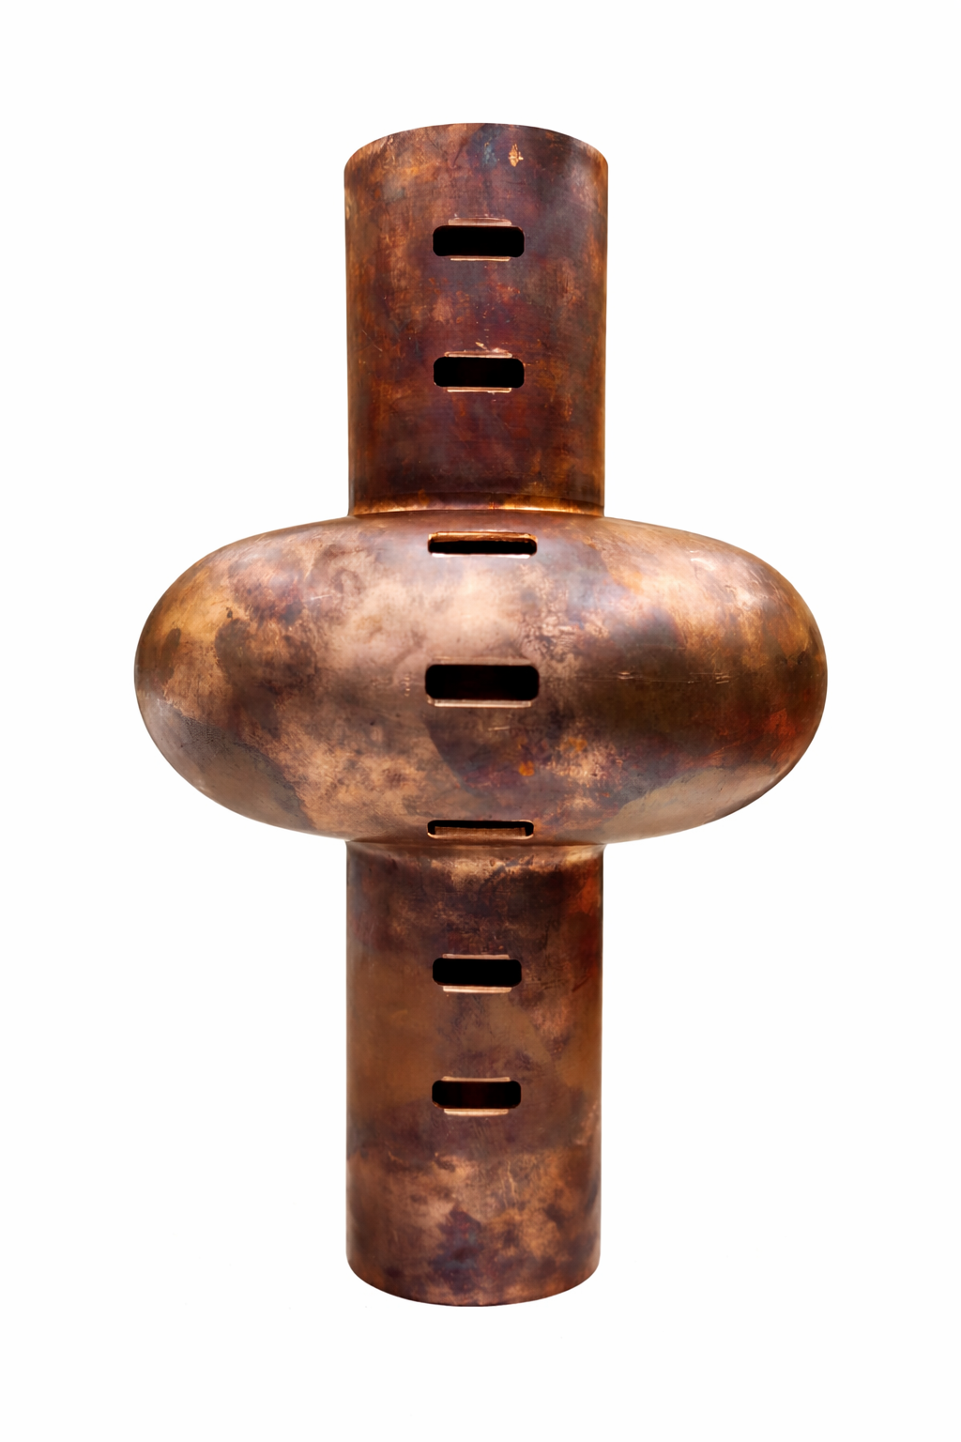
TESTING PLATFORM
01 · Nb₃Sn on a cavity
A mock-up cavity with seven sample positions
Seven positions studied separately
2 cut-off, 3 cell, 2 cut-off
Cavity-like conditions — same pressure and temperature distribution as inside a real cavity
1
2
3
4
5
6
7
Fast testing — samples analysed without coating a full cavity
Same target distance — films compared under equal geometry
Repeatability — controlled, identical starting conditions
Why not real cavities?
Each cavity has its own substrate conditions (grain size, machining stress, actual distance from the target, batch variations)
1–2, 6–7: cut-off (beam tubes), 3–5: cell
TFSRF 2026 · M. Lazzari, INFN–LNL, malazzar@lnl.infn.it
09 / 24

Slide 10
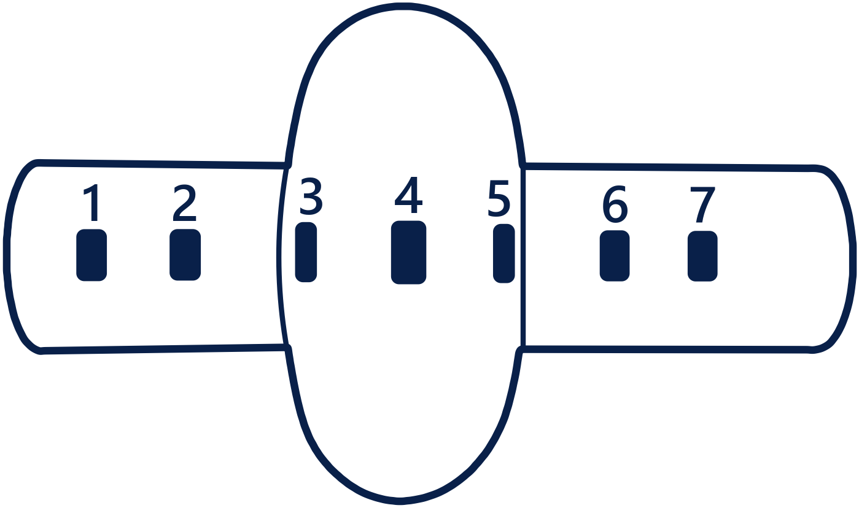
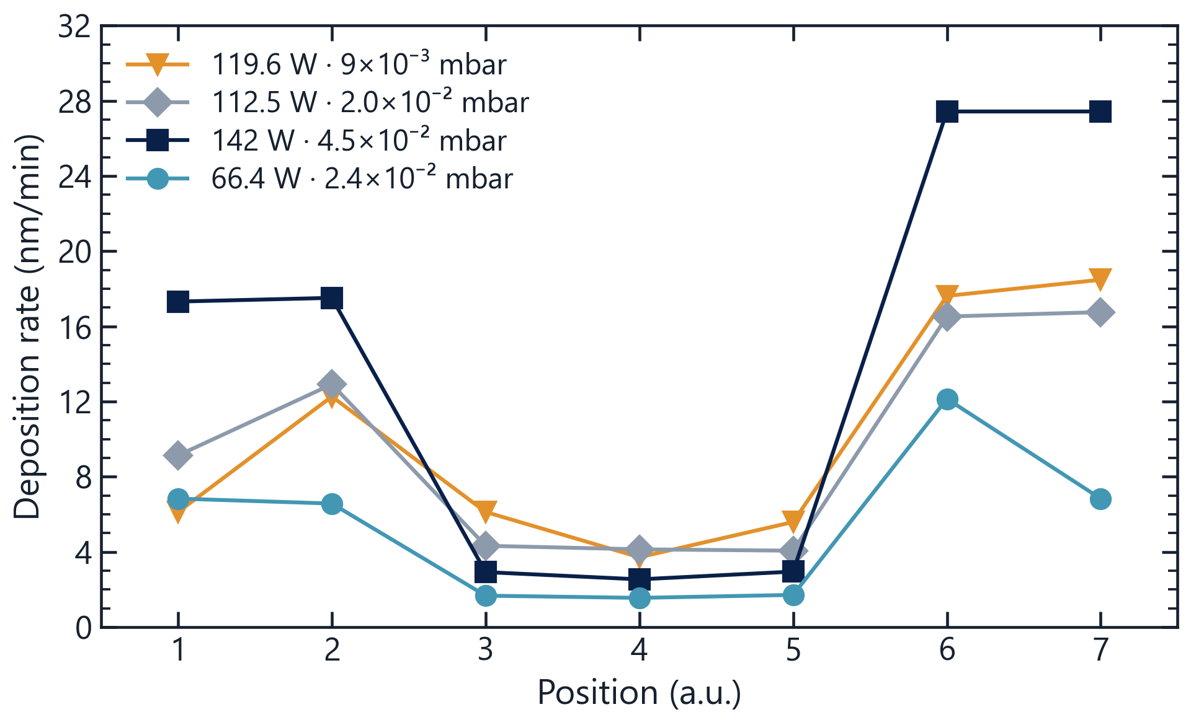
DEPOSITION RATE
01 · Nb₃Sn on a cavity
Magnet choice and process conditions
1
MAGNET CONFIGURATION
2
RATE PROFILE vs PROCESS CONDITIONS
8.0
2.6
3.3
4.9
CUT-OFF
/ EQ.
Deposition time set for a safety thickness on the cell (≈ 10 × Nb₃Sn London penetration depth), without an overly thick, stressed film at the cut-offs.
Two magnet configurations tested → strong field chosen: higher deposition rate.
1 µm on the cell (@ ■ 2.8 nm/min) ≈ 6 h
TFSRF 2026 · M. Lazzari, INFN–LNL, malazzar@lnl.infn.it
10 / 24

Slide 11
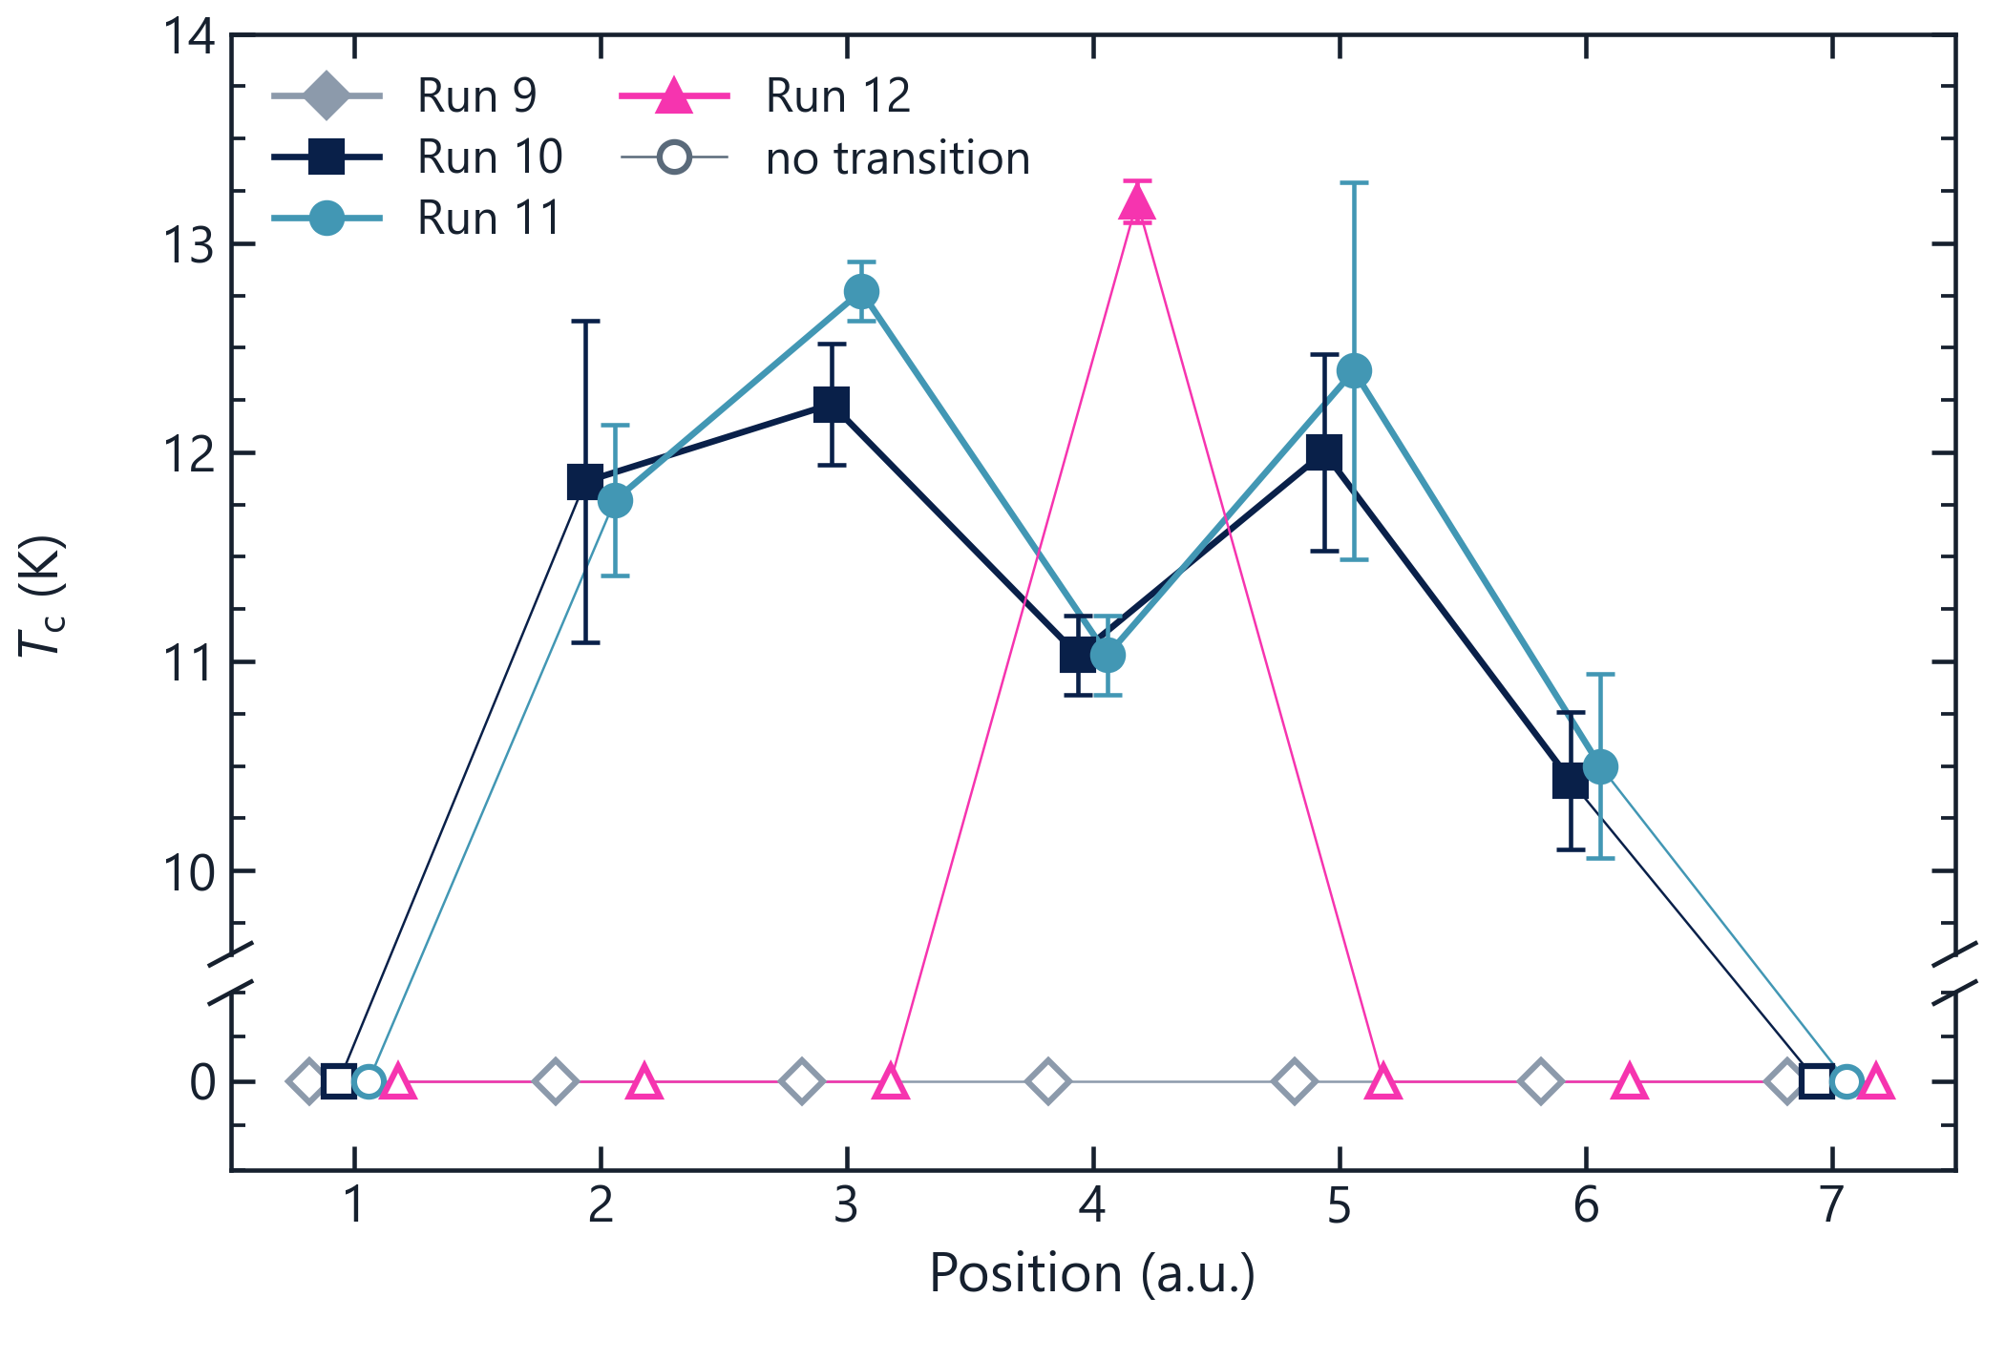
CRITICAL TEMPERATURE
01 · Nb₃Sn on a cavity
Different process conditions, similar T_{c}
DEPOSITION PARAMETERS
 | P (mbar) | Tₛ (°C) | Power (W)
◆ Run 9 | 2.0×10⁻² | 600 | 112.5
■ Run 10 | 4.5×10⁻² | 650 | 142
● Run 11 | 2.4×10⁻² | 650 | 66.4
▲ Run 12 | 1.2×10⁻² | – | 70.8
Key observations
Wide spread of process parameters (pressure, mean power), yet only small changes in T_{c}.
Broad, poorly defined transitions — hint at large variations of pressure and substrate temperature along the cavity.
Run 9: no transition at any position.
Points offset along x for readability , T_{c} measurements: F. A. Costanzo
TFSRF 2026 · M. Lazzari, INFN–LNL, malazzar@lnl.infn.it
11 / 24

Slide 12
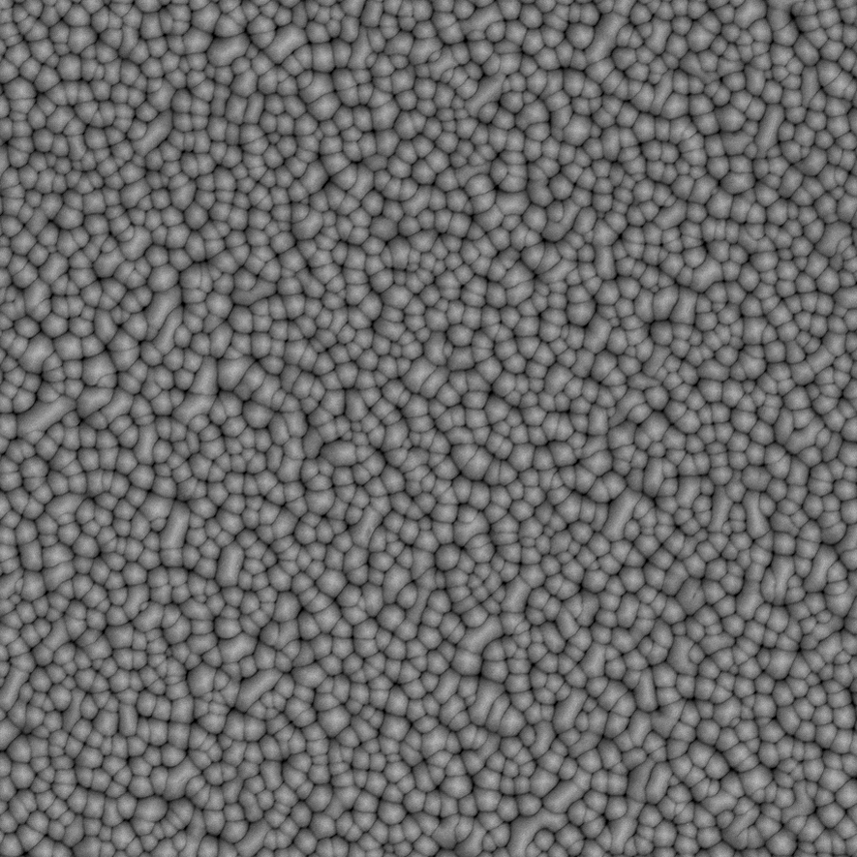
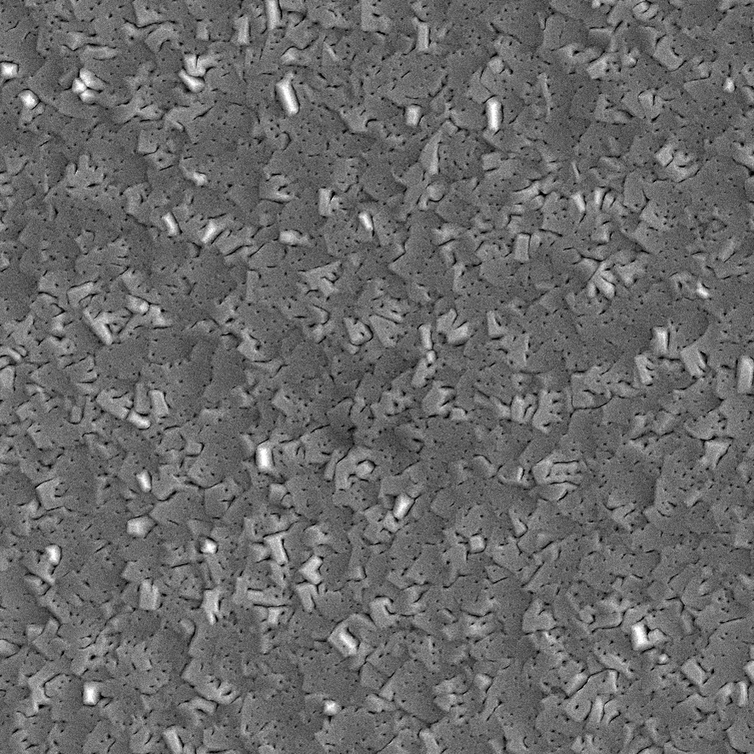
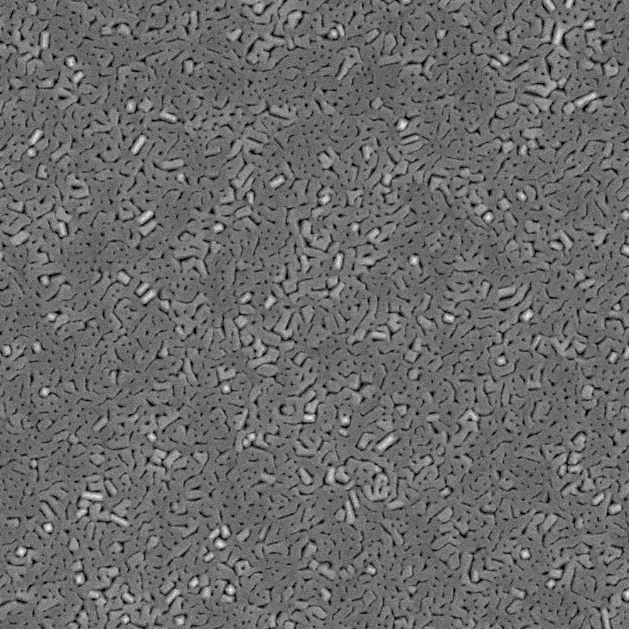
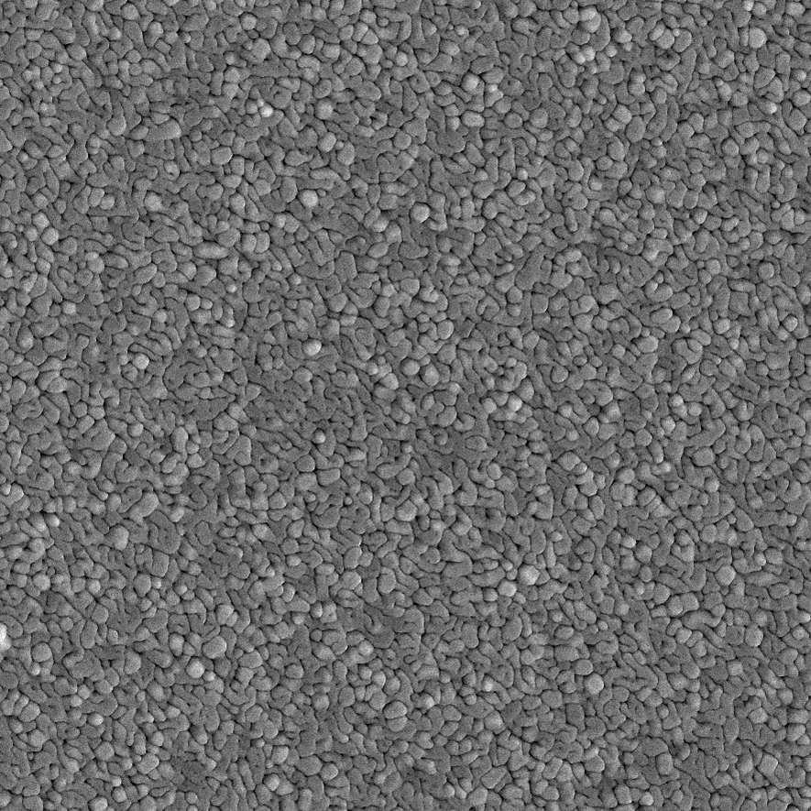
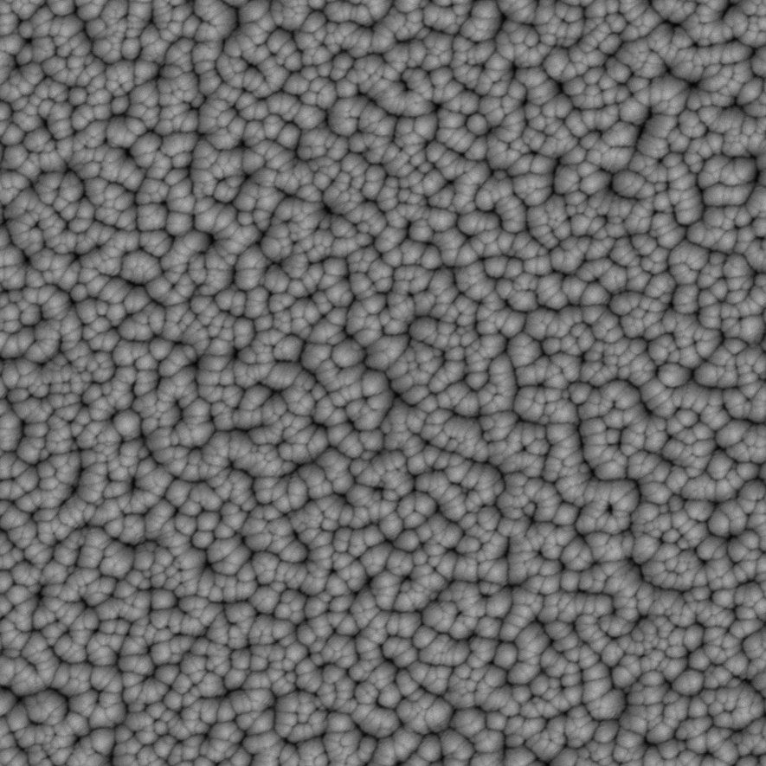
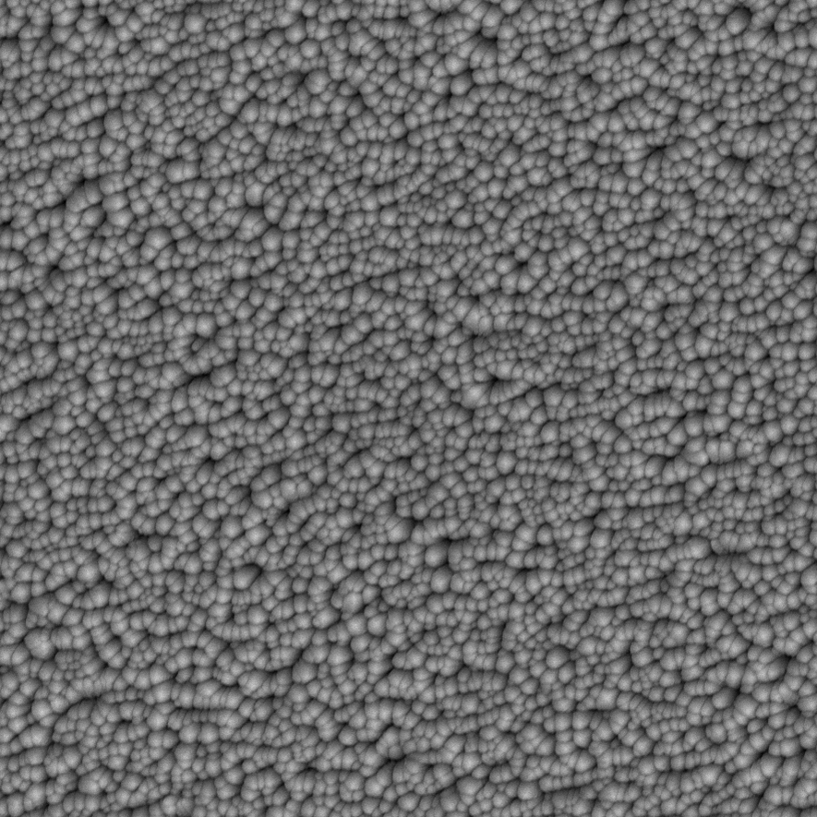
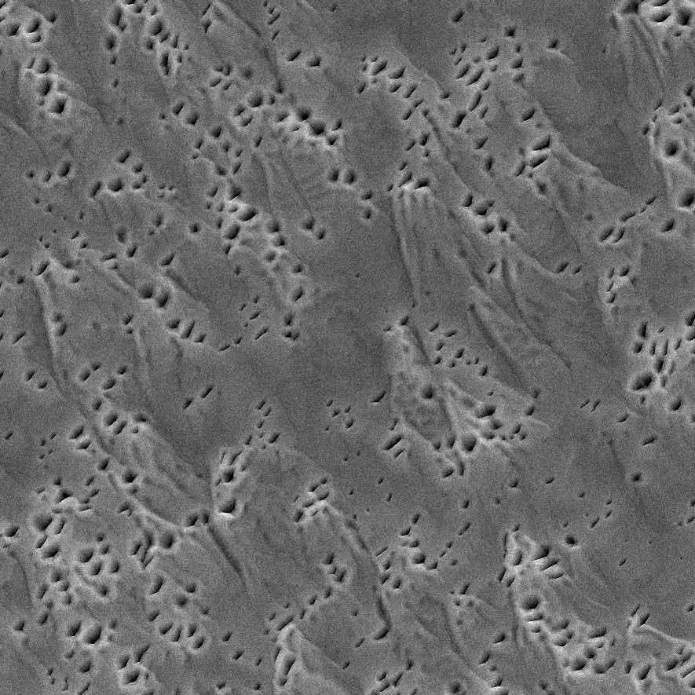
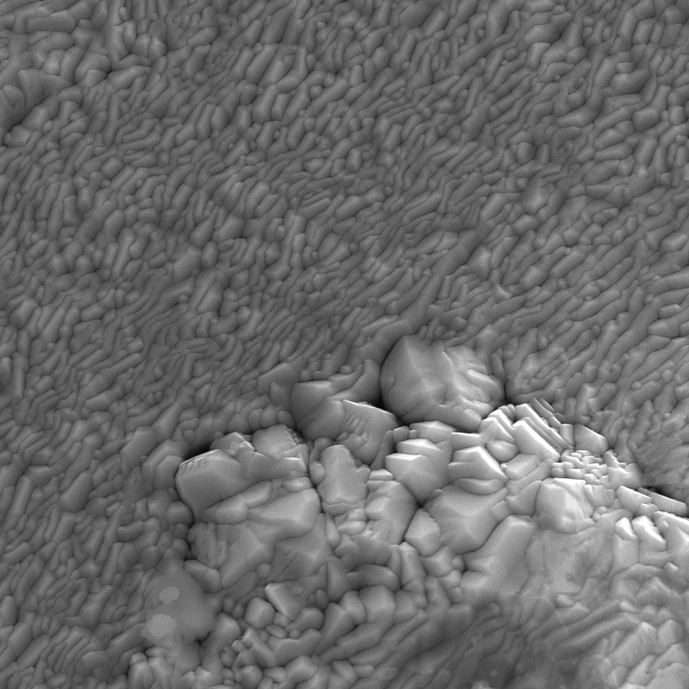
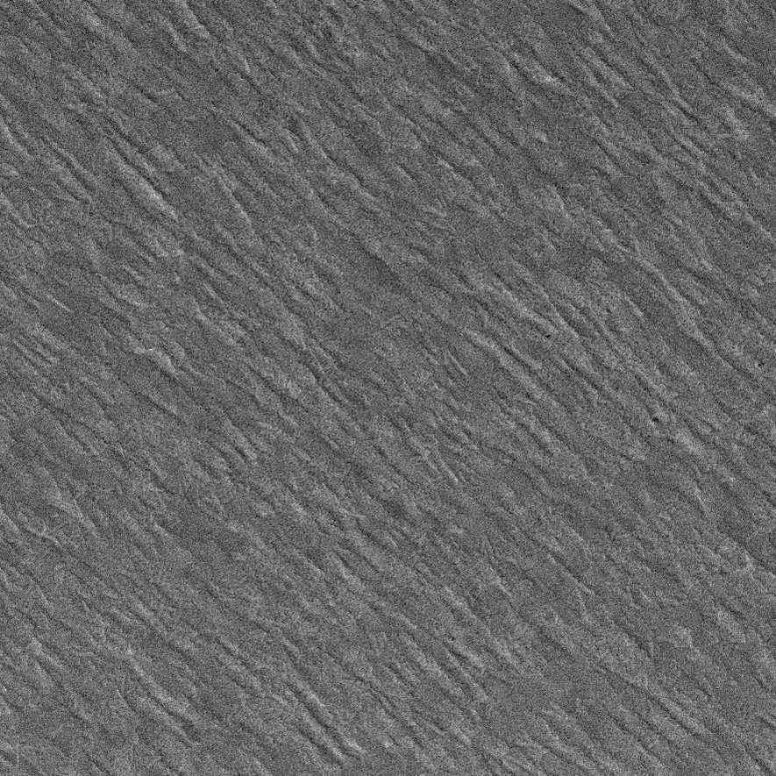
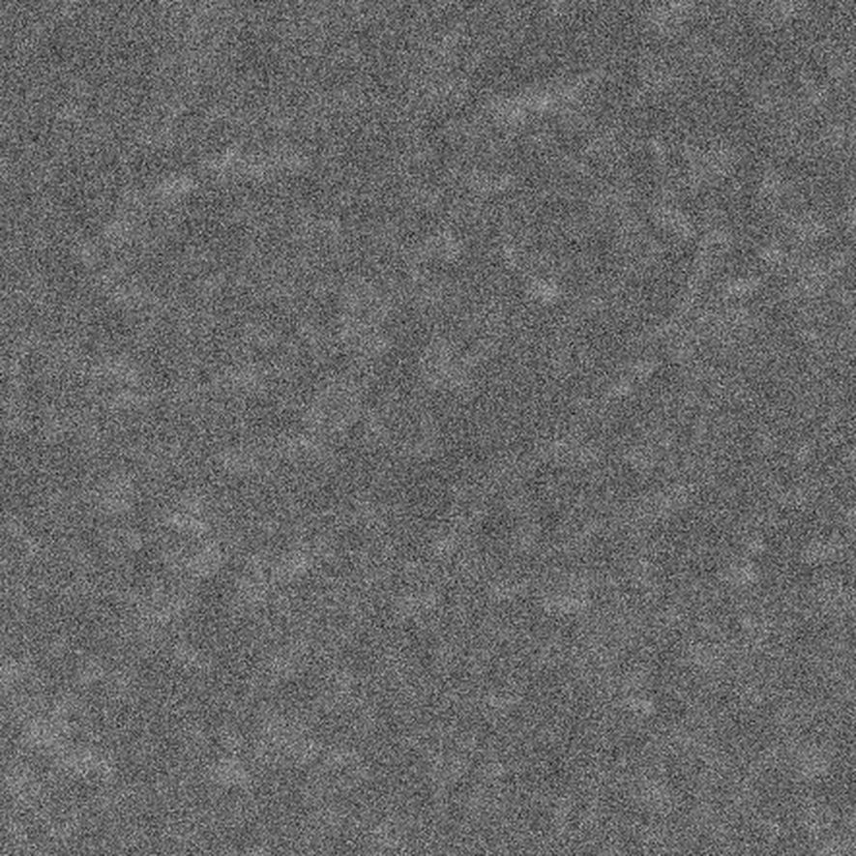
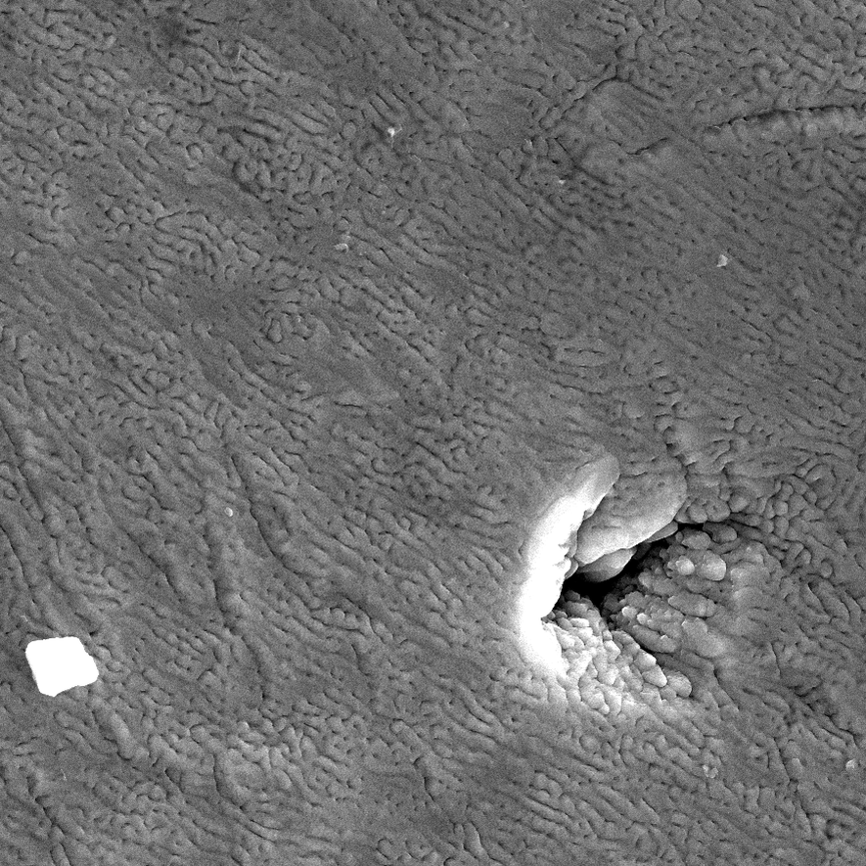
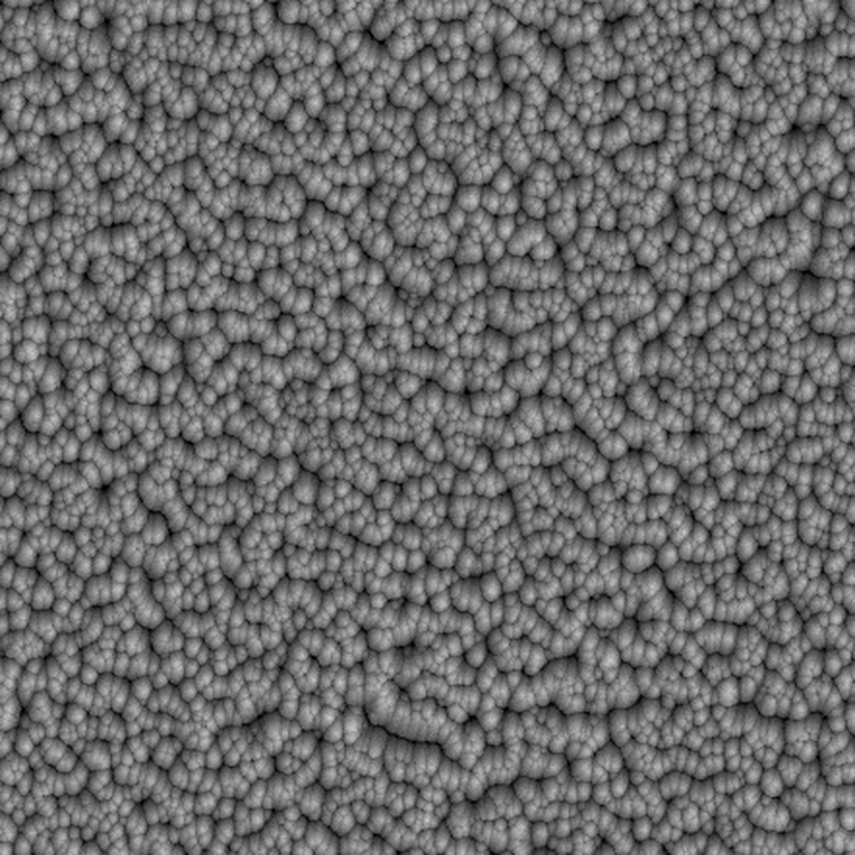
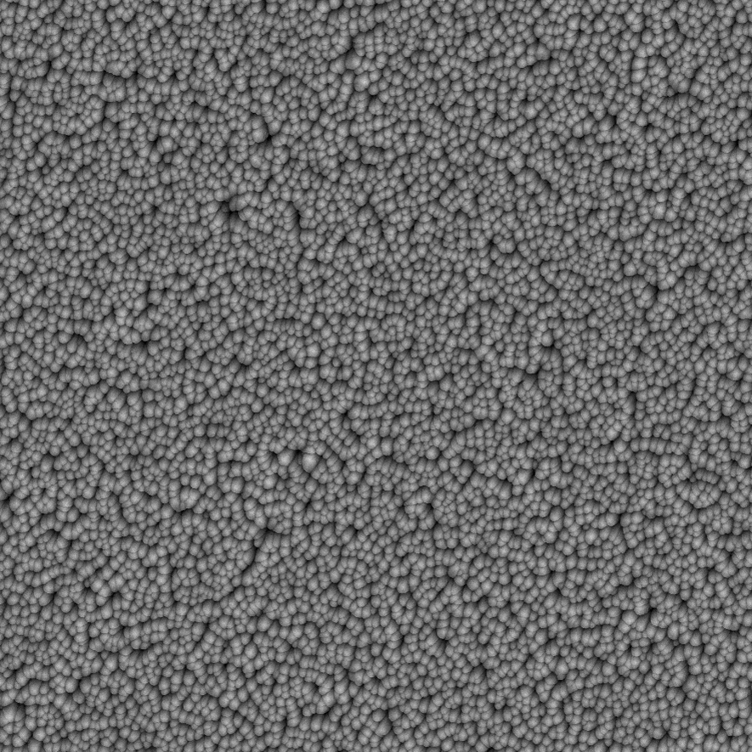
SEM ANALYSIS
01 · Nb₃Sn on a cavity
Morphology, position by position
CUT-OFF
CELL
CUT-OFF
1
2
3
4
5
6
7
Run 10
142 W
4.5×10⁻² mbar
—
11.9 K
12.2 K
11.0 K
12.0 K
10.4 K
—
Run 11
66.4 W
2.4×10⁻² mbar
—
11.8 K
12.8 K
11.0 K
12.4 K
10.5 K
—
SEM, SE 15 kV · all images at the same scale · T_{c} above each image (— : no transition)
5 µm
Several morphologies along the cavity
Causes under investigation: pressure gradient, temperature gradient
Same region, different structure when parameters change
Can we reach a uniform film along the whole cavity?
TFSRF 2026 · M. Lazzari, INFN–LNL, malazzar@lnl.infn.it
12 / 24

Slide 13
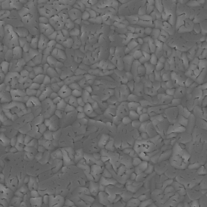
SEM ANALYSIS
01 · Nb₃Sn on a cavity
Morphology, compared with past samples
SMALL SAMPLE
Cu + 15 µm Nb
buffer layer
Flat sample, 2024
SEM InLens · 10 kV · ×15k
MOCK-UP CAVITY
Sapphire
Run 10 · position 3 (cell)
SEM SE · 15 kV · ×10k
1 µm
1 µm
Same scale: both images cropped to a 4.9 × 4.9 µm field (originals taken at ×15k and ×10k)
Comparison in progress
Small samples we already have vs. new films deposited in the cavity
Morphology as a process indicator
Mainly for temperature and pressure consideration
TFSRF 2026 · M. Lazzari, INFN–LNL, malazzar@lnl.infn.it
13 / 24

Slide 14
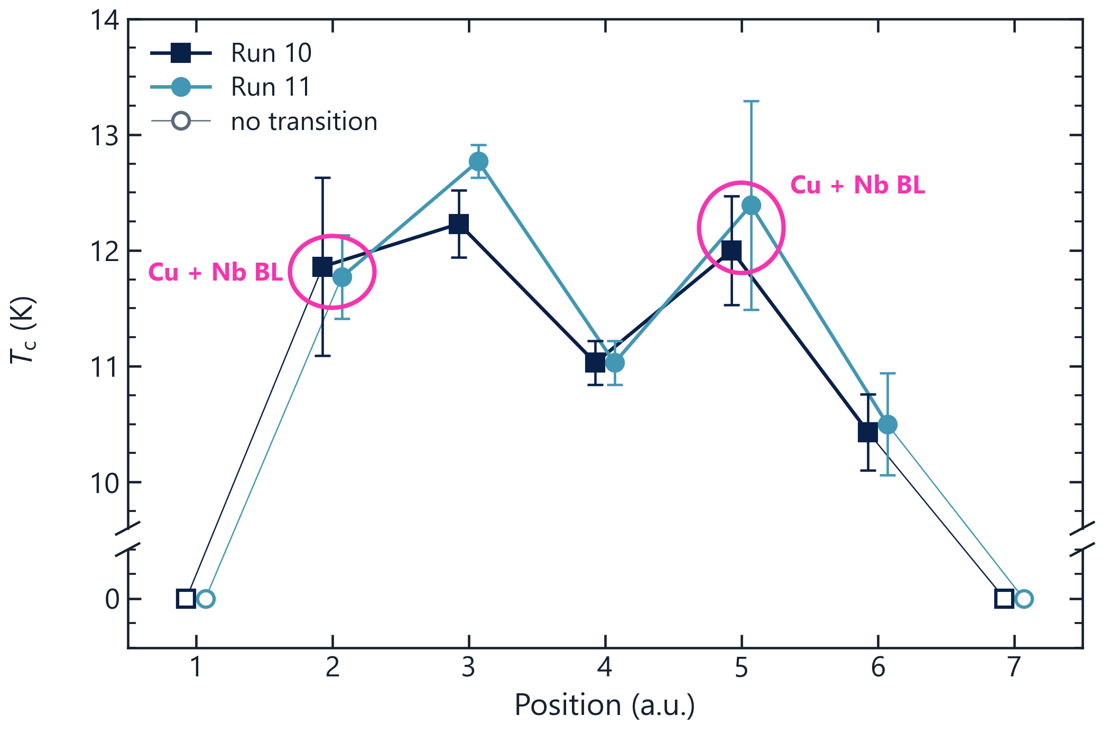
CRITICAL TEMPERATURE
01 · Nb₃Sn on a cavity
Similar T_{c} on different substrates
SUBSTRATE AT EACH POSITION
Position | ■ Run 10 | ● Run 11
1 | Sapphire | Sapphire
2 | Sapphire | Cu + Nb BL 15 µm
3 | Sapphire | Sapphire
4 | Sapphire | Sapphire
5 | Sapphire | Cu + Nb BL 15 µm
6 | Sapphire | Sapphire
7 | Sapphire | Sapphire
Same T_{c}, different substrate
Pos. 2: 11.9 K (sapphire) vs 11.8 K (Cu + Nb BL)
Pos. 5: 12.0 K (sapphire) vs 12.4 K (Cu + Nb BL)
The driver doesn’t seem to be the sputtering parameters alone, but their uniformity along the cavity axis.
Circled: Run 11 on Cu + Nb BL (15 µm), all others on sapphire. Open symbols: no measurable transition
TFSRF 2026 · M. Lazzari, INFN–LNL, malazzar@lnl.infn.it
14 / 24

Slide 15
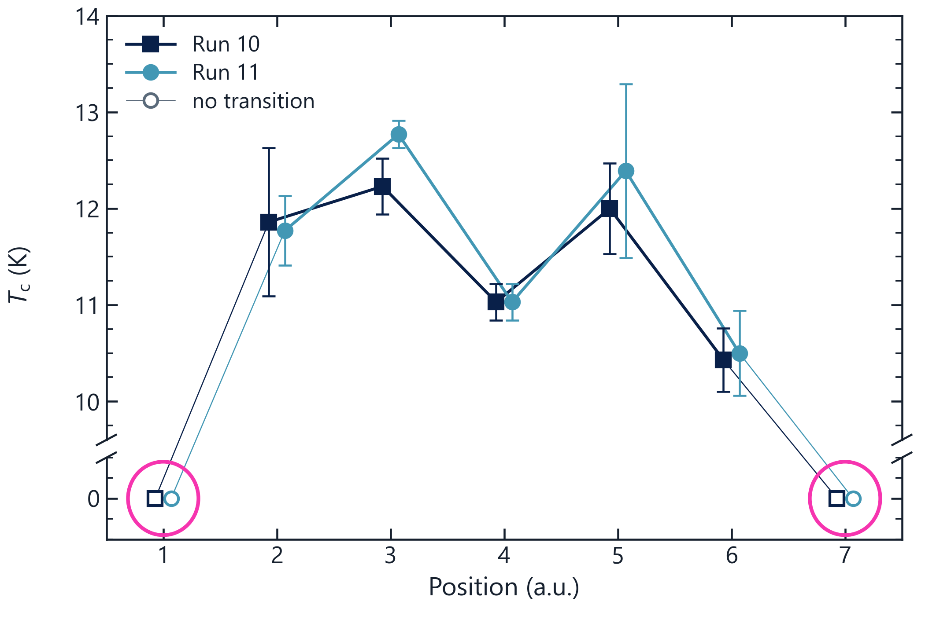
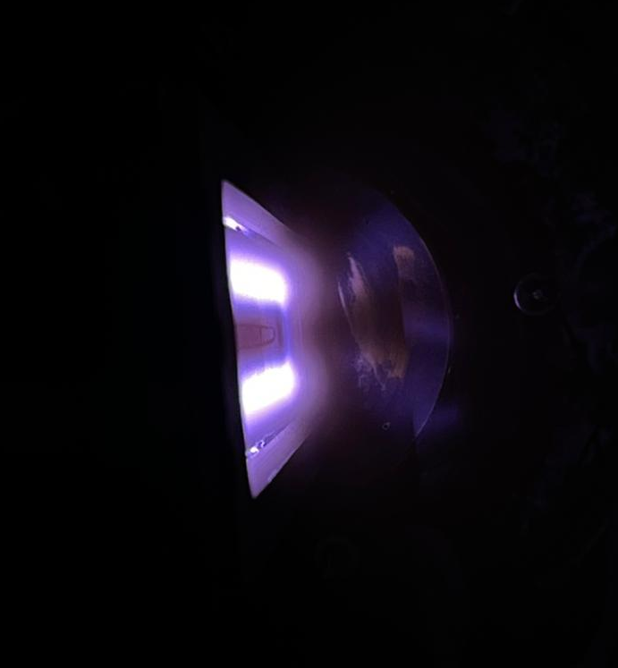
CRITICAL TEMPERATURE
01 · Nb₃Sn on a cavity
T_{c} follows the position; no transition at the ends
Key observations
Same position → similar T_{c} in both runs: the target–substrate distance seems to dominate.
No transition at the ends (pos. 1, 7), likely where the magnetic field no longer closes the plasma.
Same thickness in the cut-off
Plasma not closing
no-plasma region
Circled: end positions 1 and 7 — no measurable transition in either run
TFSRF 2026 · M. Lazzari, INFN–LNL, malazzar@lnl.infn.it
15 / 24

Slide 16
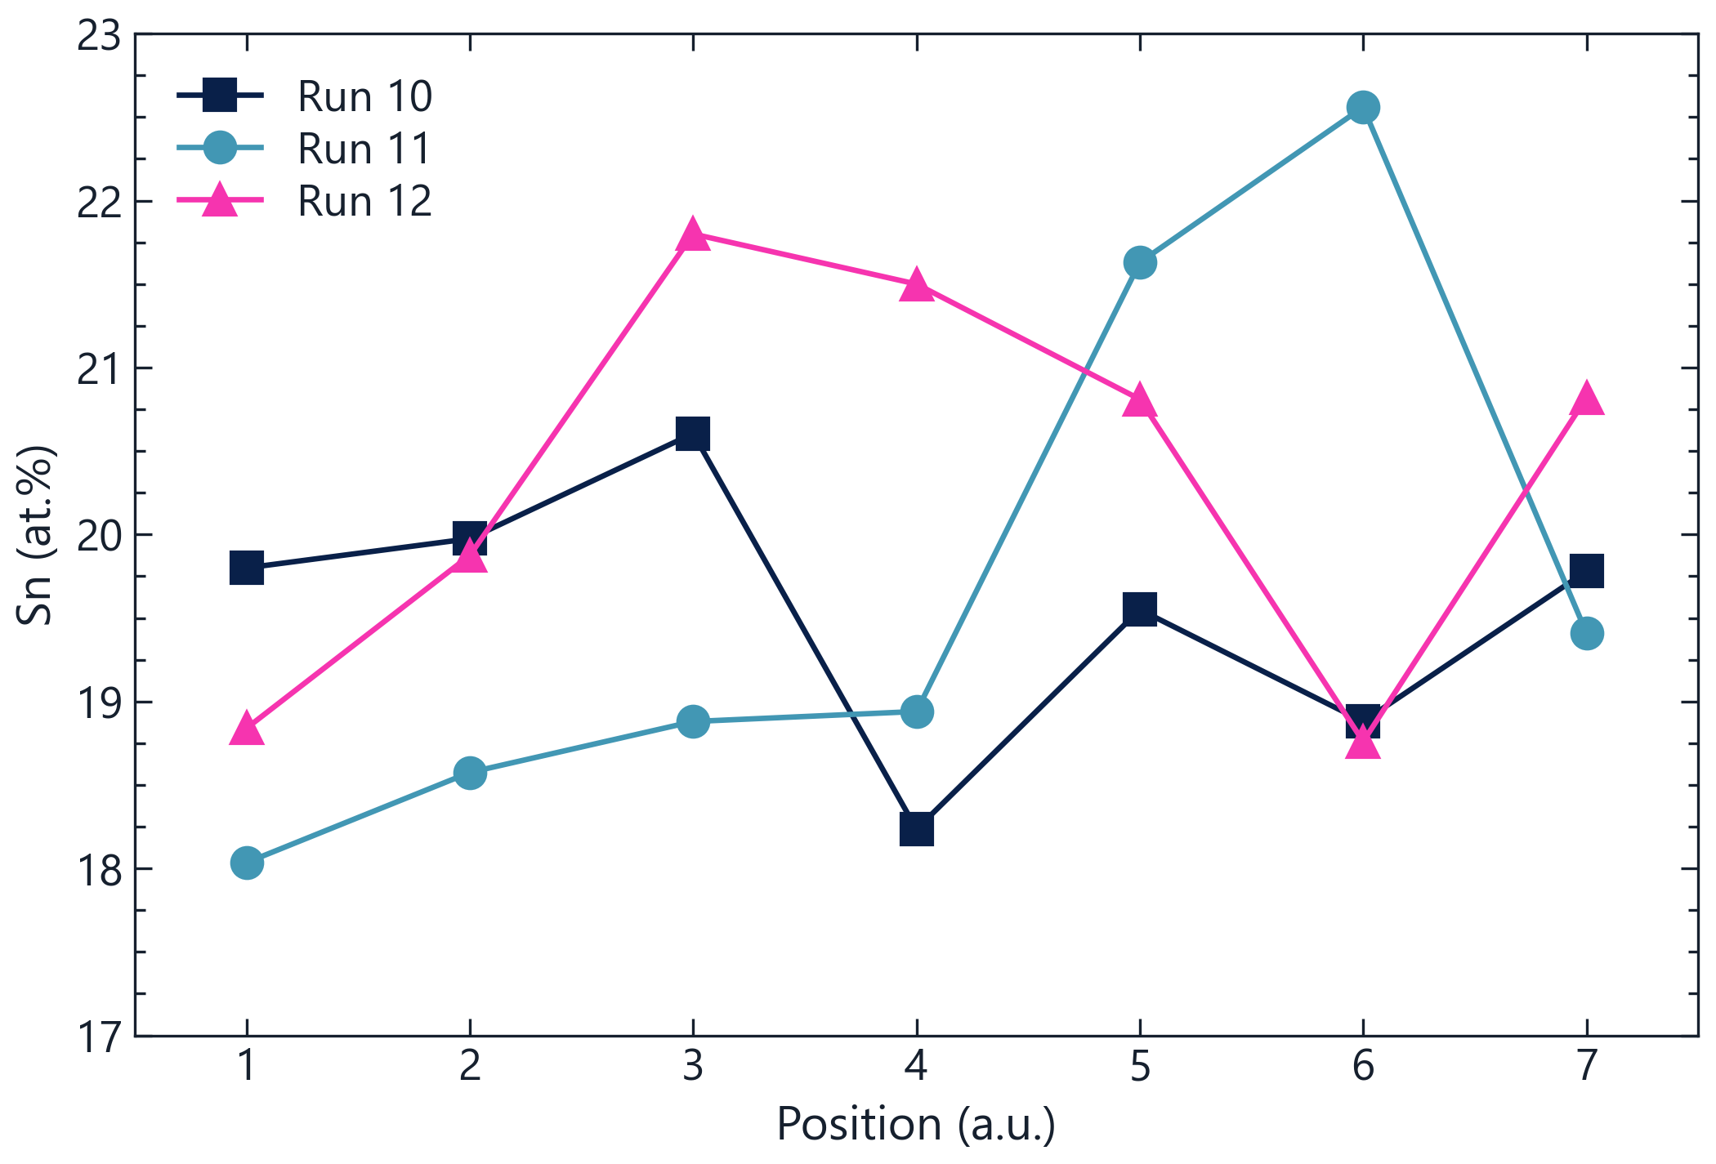
COMPOSITION
01 · Nb₃Sn on a cavity
Sn content along the cavity
Sn CONTENT PER RUN
Required Sn % > 24%
■ Run 10
mean
19.5 at.%
range 18.2 – 20.6
● Run 11
mean
19.7 at.%
range 18.0 – 22.6
▲ Run 12
mean
20.3 at.%
range 18.8 – 21.8
All within the A15 range (18–26 at.%), yet Sn-poor
Sn content measured by EDX at each of the seven positions
TFSRF 2026 · M. Lazzari, INFN–LNL, malazzar@lnl.infn.it
16 / 24

Slide 17
SUMMARY
Lessons learned and further investigations
1
The system works and also the testing procedure
Stable magnetron from 0.1 to 1.5 A and 7.5×10⁻³ to 6×10⁻² mbar, up to 670 °C, 12 depositions (8 Nb, 4 Nb₃Sn).
2
Geometry counts
Deposition rate and T_{c} depend on the position along the cavity.
3
Substrate temperature and pressure
Uniformity has to be investigated along the cavity and also good thermal contact
TFSRF 2026 · M. Lazzari, INFN–LNL, malazzar@lnl.infn.it
17 / 24

Slide 18
02
PART 02
Future improvements of the system
A rotating cavity: from design to construction
TFSRF 2026 · M. Lazzari, INFN–LNL, malazzar@lnl.infn.it
18 / 24

Slide 19
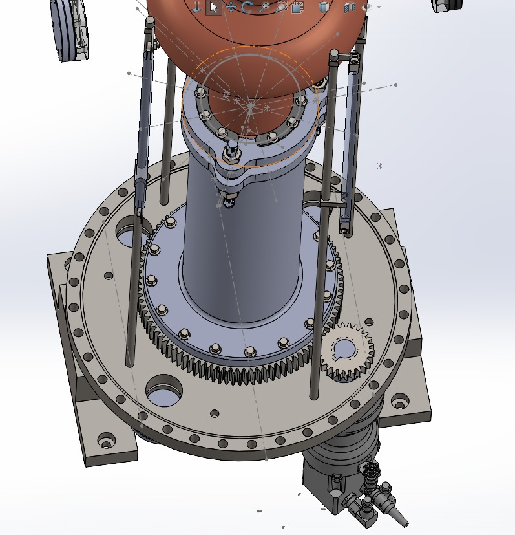
ROTATION SYSTEM
02 · Future improvements of the system
Rotating the cavity: from design to construction
FOUR REQUIREMENTS
1
Clean rotation — no lubricant inside the vacuum
2
x–y adjustment and tilt — to align the rotation axis with the magnetron axis
3
Thermal shielding — of the upper parts of the system
4
Motor outside the vacuum — slow rotation, < 10 rpm
STATUS
✓
Design review — done
✓
Design phase — completed
→
Parts ordered — construction by the end of 2026
Design and mechanical calculations: T. Subasinghe
TFSRF 2026 · M. Lazzari, INFN–LNL, malazzar@lnl.infn.it
19 / 24

Slide 20
03
PART 03
Possible new film interface
ALD oxide interlayers
TFSRF 2026 · M. Lazzari, INFN–LNL, malazzar@lnl.infn.it
20 / 24

Slide 21
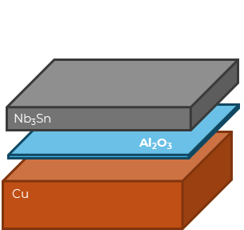
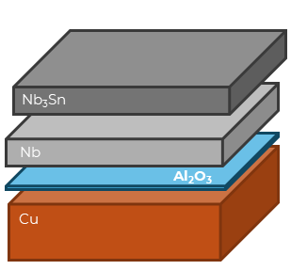
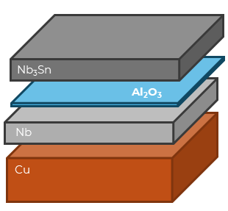
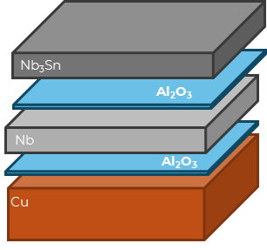


iSAS TASK 3.4 · ADAPTIVE LAYER
03 · Possible new film interface
CEA adaptive layer between Cu and the Nb buffer
SCHEMES TESTED WITH CEA
×
✗ No Nb buffer
✓ ALD under Nb
ALD above Nb
ALD both sides
TWO GOALS
Low T_{c} without the Nb buffer · T_{c} ≈ 17 K with the adaptive layer between Cu and Nb
1
Reduce or completely avoid the thick Nb buffer layer
T_{c} BY BUFFER LAYER
Buffer layer
T_{c} (K)
ΔT_{c} (K)
2
Stop the thermoelectric currents between the layers
✗ No buffer layer
13.8
0.3
16 µm Nb
16.5
0.6
30 µm Nb
16.7
0.5
✓ 30 µm Nb + 18 nm Al₂O₃
16.3
0.5
✓ 30 µm Nb + 25 nm AlZrOₓ
16.9
0.2
✓ 30 µm Nb + 5 nm Al₂O₃ + 22 nm ZrO₂
16.8
0.2
TFSRF 2026 · M. Lazzari, INFN–LNL, malazzar@lnl.infn.it
21 / 24

Slide 22
ALD INTERLAYERS
03 · Possible new film interface
First T_{c} without a Nb buffer layer
!
A run below par
Sample · ALD interlayer | T_{c} (K)
Cu 30 µm (control) | 12.65 ± 0.22
✓ AlZrO (1:4), 48 cycles (≈4.8 nm) | 13.93 ± 0.28
✓ Al₂O₃, 180 cycles (≈18 nm) | 13.20 ± 0.57
✗ Al₂O₃ 50 cy + ZrO₂ 270 cy (≈32 nm) | 11.54 ± 0.32
✓ ZrO₂ · 270 cycles (≈27 nm) | 13.76 ± 0.44
This run went wrong — the value is not representative
✓
Single layers perform alike
Al₂O₃, ZrO₂ and AlZrO: T_{c} 13.2–13.9 K, above the Cu · 30 µm control
✗
The mixed stack lags behind
Al₂O₃ + ZrO₂: 11.5 K, the lowest of the series
10
12
14
16
T_{c} (K), dashed: Cu control (12.65 K)
Next: XRD, EDS
TFSRF 2026 · M. Lazzari, INFN–LNL, malazzar@lnl.infn.it
22 / 24

Slide 23
ROADMAP
Next steps
From the mock-up to an RF-tested Nb₃Sn cavity
2026
End 2026 – 2027
2027
End 2027 – 2028
◆ we are here
Mock-up cavity
system commissioning and first Nb₃Sn films
Small-sample optimisation
+ construction of the rotation system
First coatings on Nb cavities
higher temperatures allowed, easy RF baseline before/after coating
First Nb₃Sn-coated Cu cavity
full RF test campaign
TFSRF 2026 · M. Lazzari, INFN–LNL, malazzar@lnl.infn.it
23 / 24

Slide 24
Thank you
Matteo Lazzari · malazzar@lnl.infn.it
LNL Surface Treatments & Superconductivity Team · INFN–LNL
PhD funded by Zanon Research & Innovation
WITH THANKS TO
D. Ford, F. A. Costanzo, T. Subasinghe, G. Cassarà, E. Chyhyrynets, E. Tochukwu, F. Stivanello, O. Azzolini, C. Pira

Slide 25
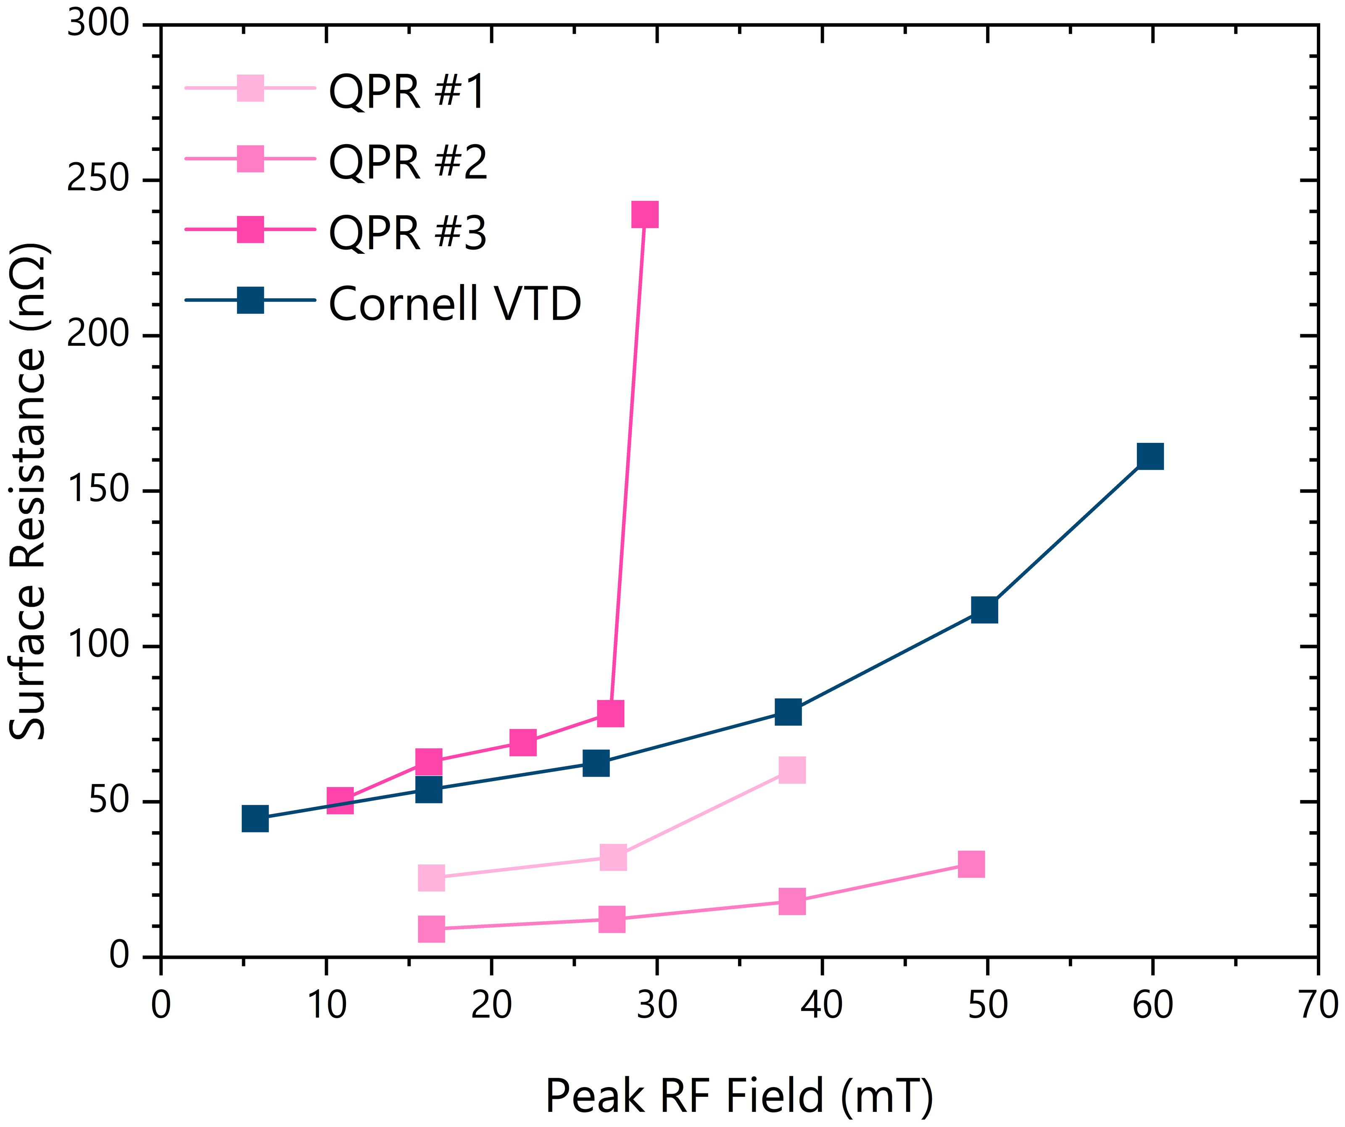
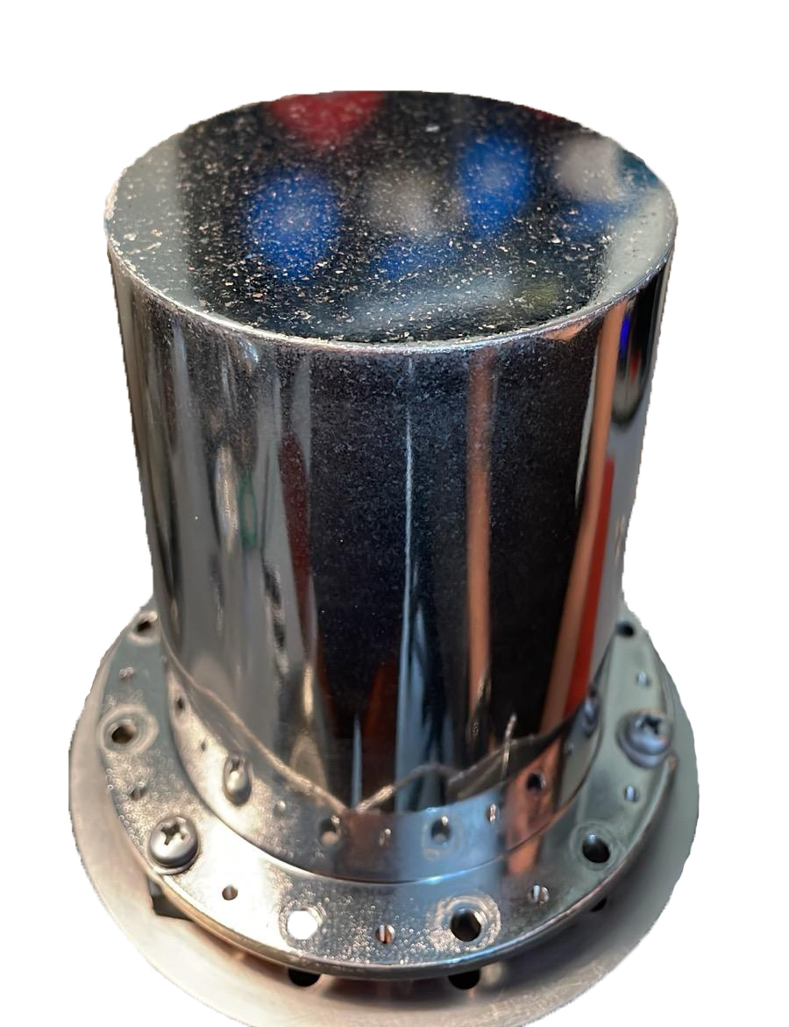
RF VALIDATION
01 · Film & technical solutions
Recipe confirmed on QPR samples
Rₛ vs peak RF field
Defects during NbBL deposition
Q vs Eacc · reaching the FCC-ee target
Sample
Tᴄ
Quench
Rs @ 4K
vs VTD
Surface preparation matters
Sample #1 · bulk Nb · BCP
17.2 K
> 70 mT
~ 25 nΩ
≈ to 40 mT
EP (#2) cuts low-field Rₛ >2× and lifts quench vs BCP (#1); Q ≈ 10× LHC.
#3 — first full-Cu QPR coating: very preliminary.
Sample #2 · bulk Nb · EP + pol.
17.45 K
> 85 mT
< 9 nΩ
better, ≤ 50 mT
Sample #3 · full Cu · NbBL30
prelim.
—
—
first on Cu
4 K · 400 MHz · courtesy O. Kugeler, S. Keckert (HZB)
TTC 2026 · M. Lazzari, INFN–LNL, malazzar@lnl.infn.it
11 / 17

