Slide 1
From 1.3 GHz Demonstrators to 400 MHz FCC-ee Cavities: Challenges in Process Scale-Up
presenter: Caroline Hain
on behalf of: C. Pereira, L. Ferreira, A. Guyot, D. Doretto, S. Forel, S. Zadeh, F. Peauger, W. V. Delsolaro, G. Rosaz
(and many others from TE, SY, EN, and KEK)
12th TFSRF Workshop
21-25 September 2026

Slide 2
Quantitative objectives
1.3 GHz
400 MHz
4×10⁸ @ 12 MV/m, 4.2 K (scaled 400 MHz FCC specs)
1×10¹⁰ @ 20 MV/m, 2 K (R&D goal)
1×10¹⁰ @ 25 MV/m, 2 K (R&D goal)
2-cell, 3.3×10⁹ @ 12.2 MV/m, 4.5 K (FCC specs, bare)
What is the current status?

Slide 3
1.3 GHz R&D progress

Slide 4
Advancements in 1.3 GHz R&D
important factors:
surface state/treatment of Cu (polishing + passivation)
compact, high purity Nb coatings, i.e. strict control over level of impurities (e.g. oxygen, hydrogen, particulates)
example 1.3 GHz cavity

Slide 5
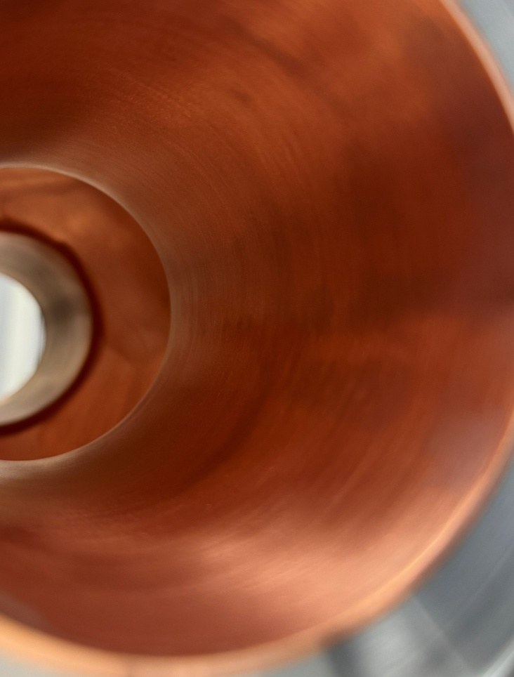
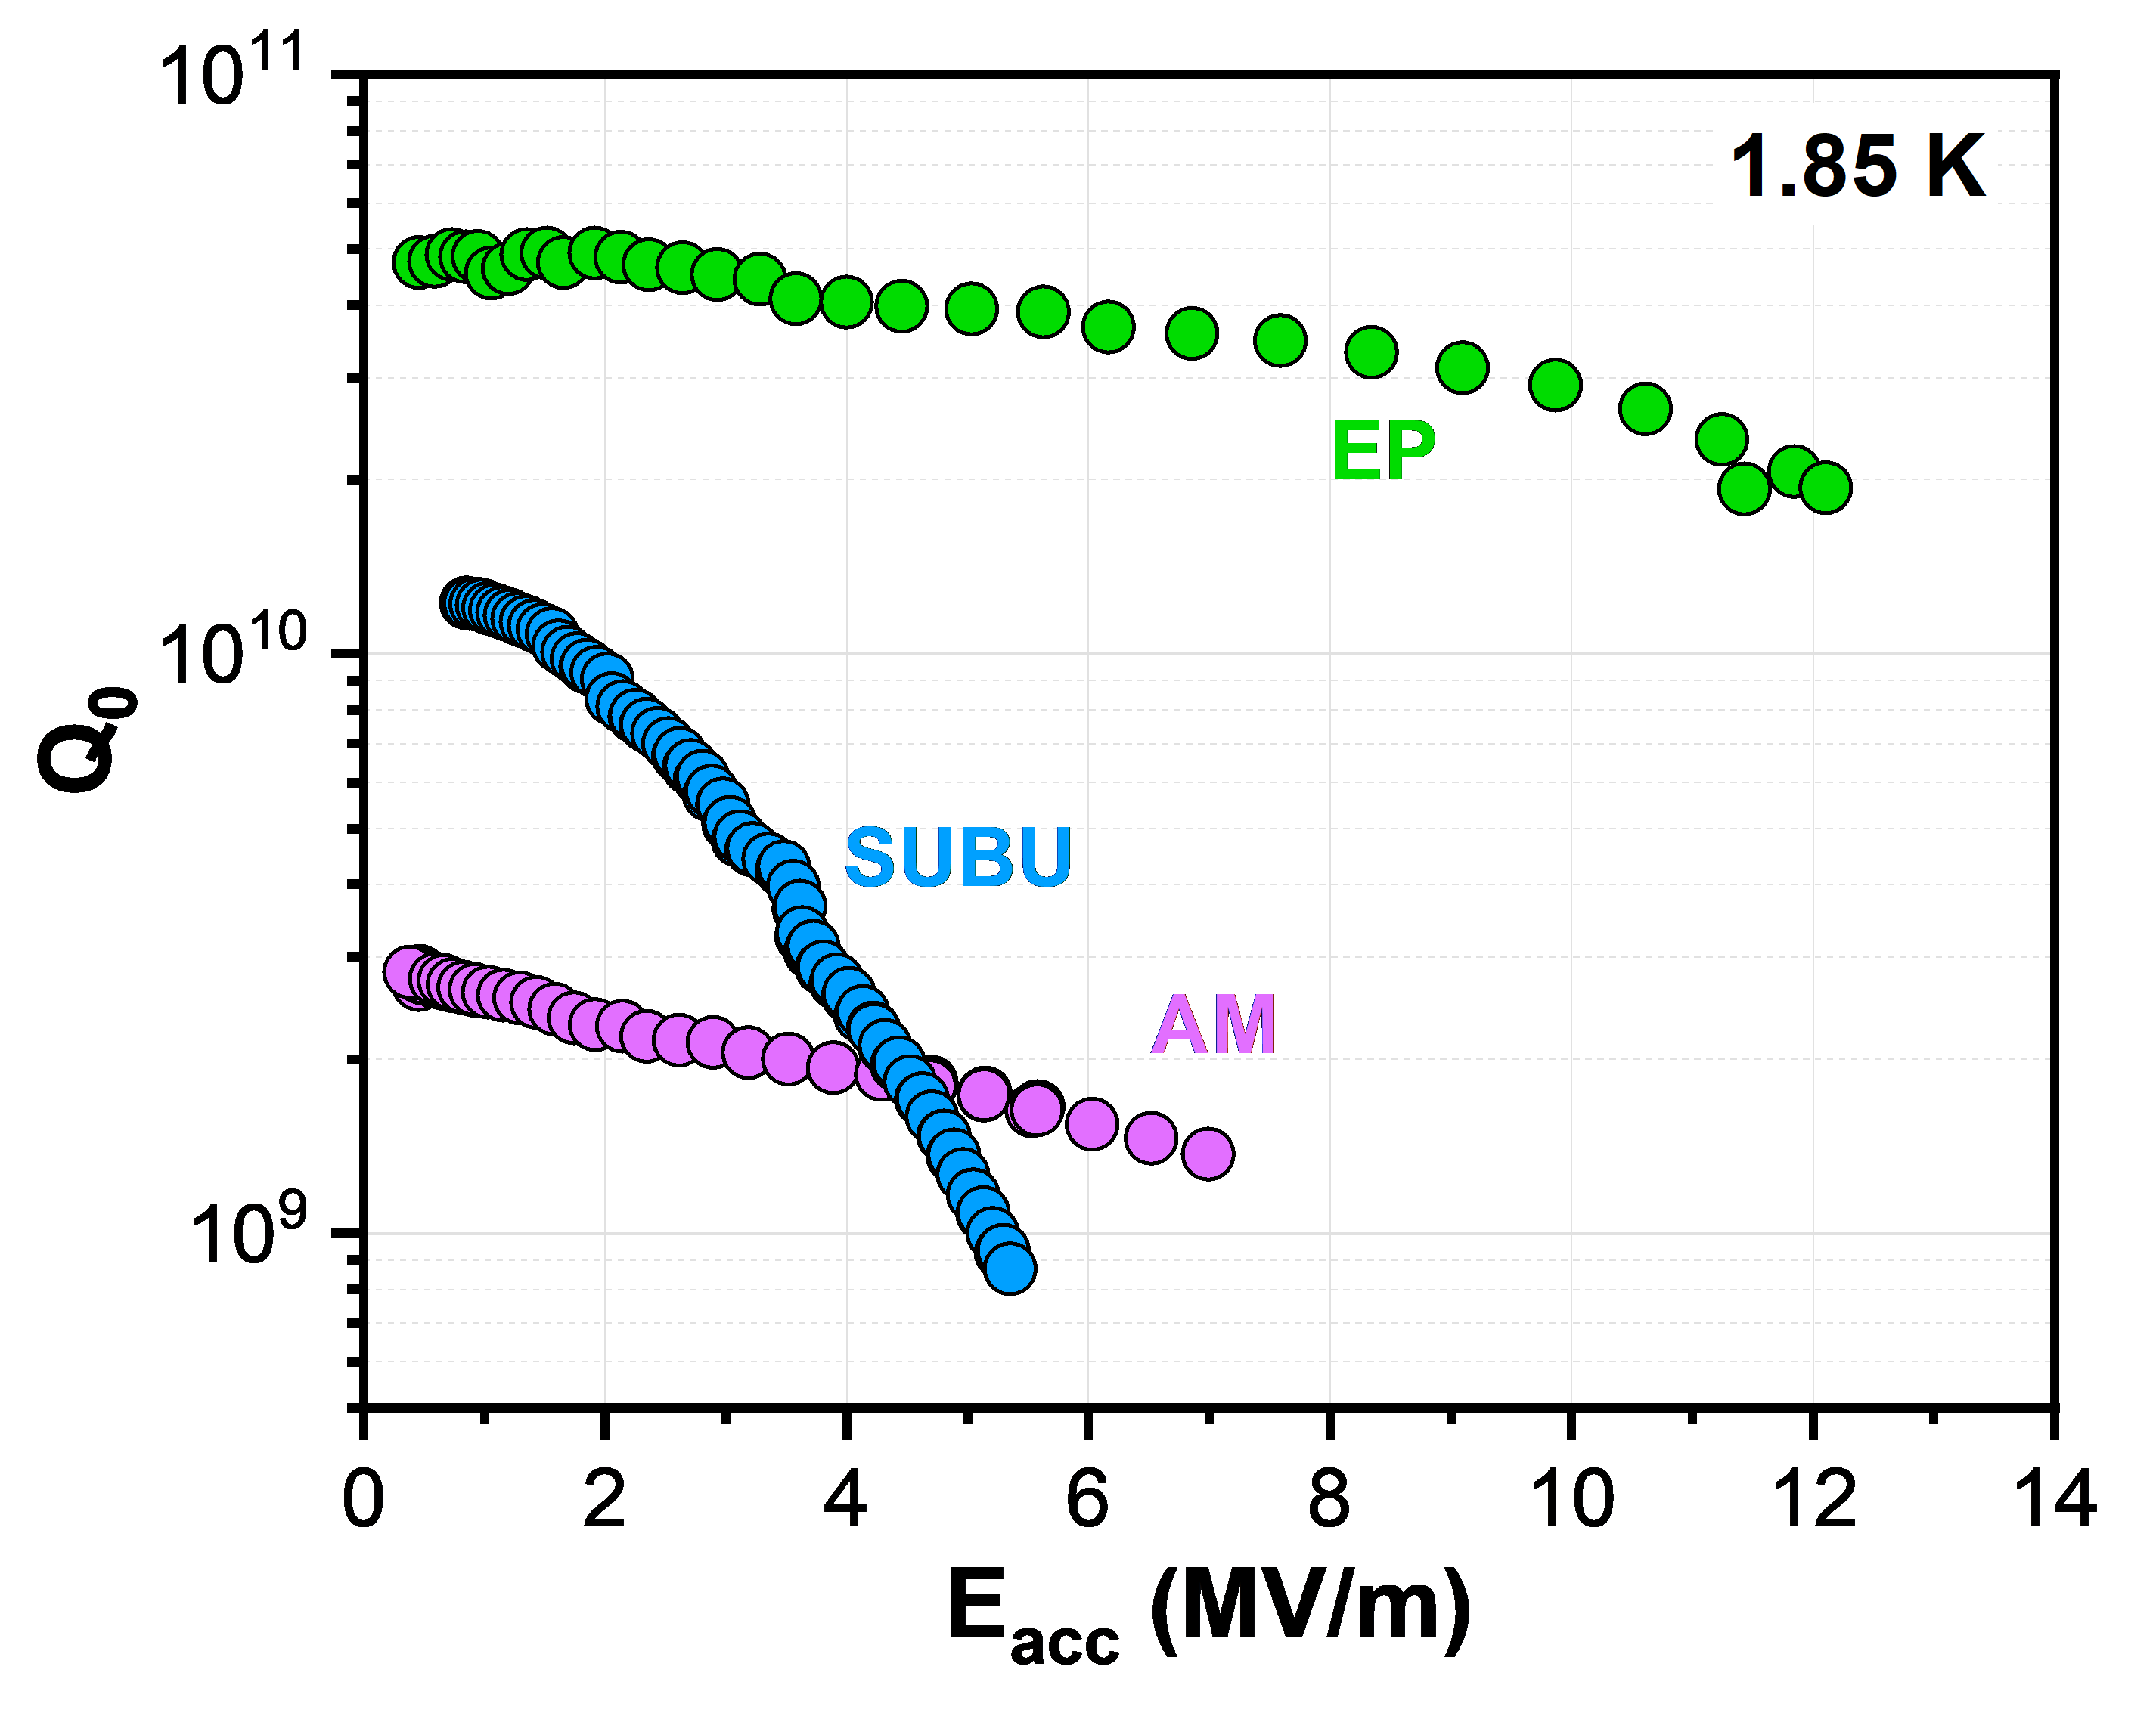
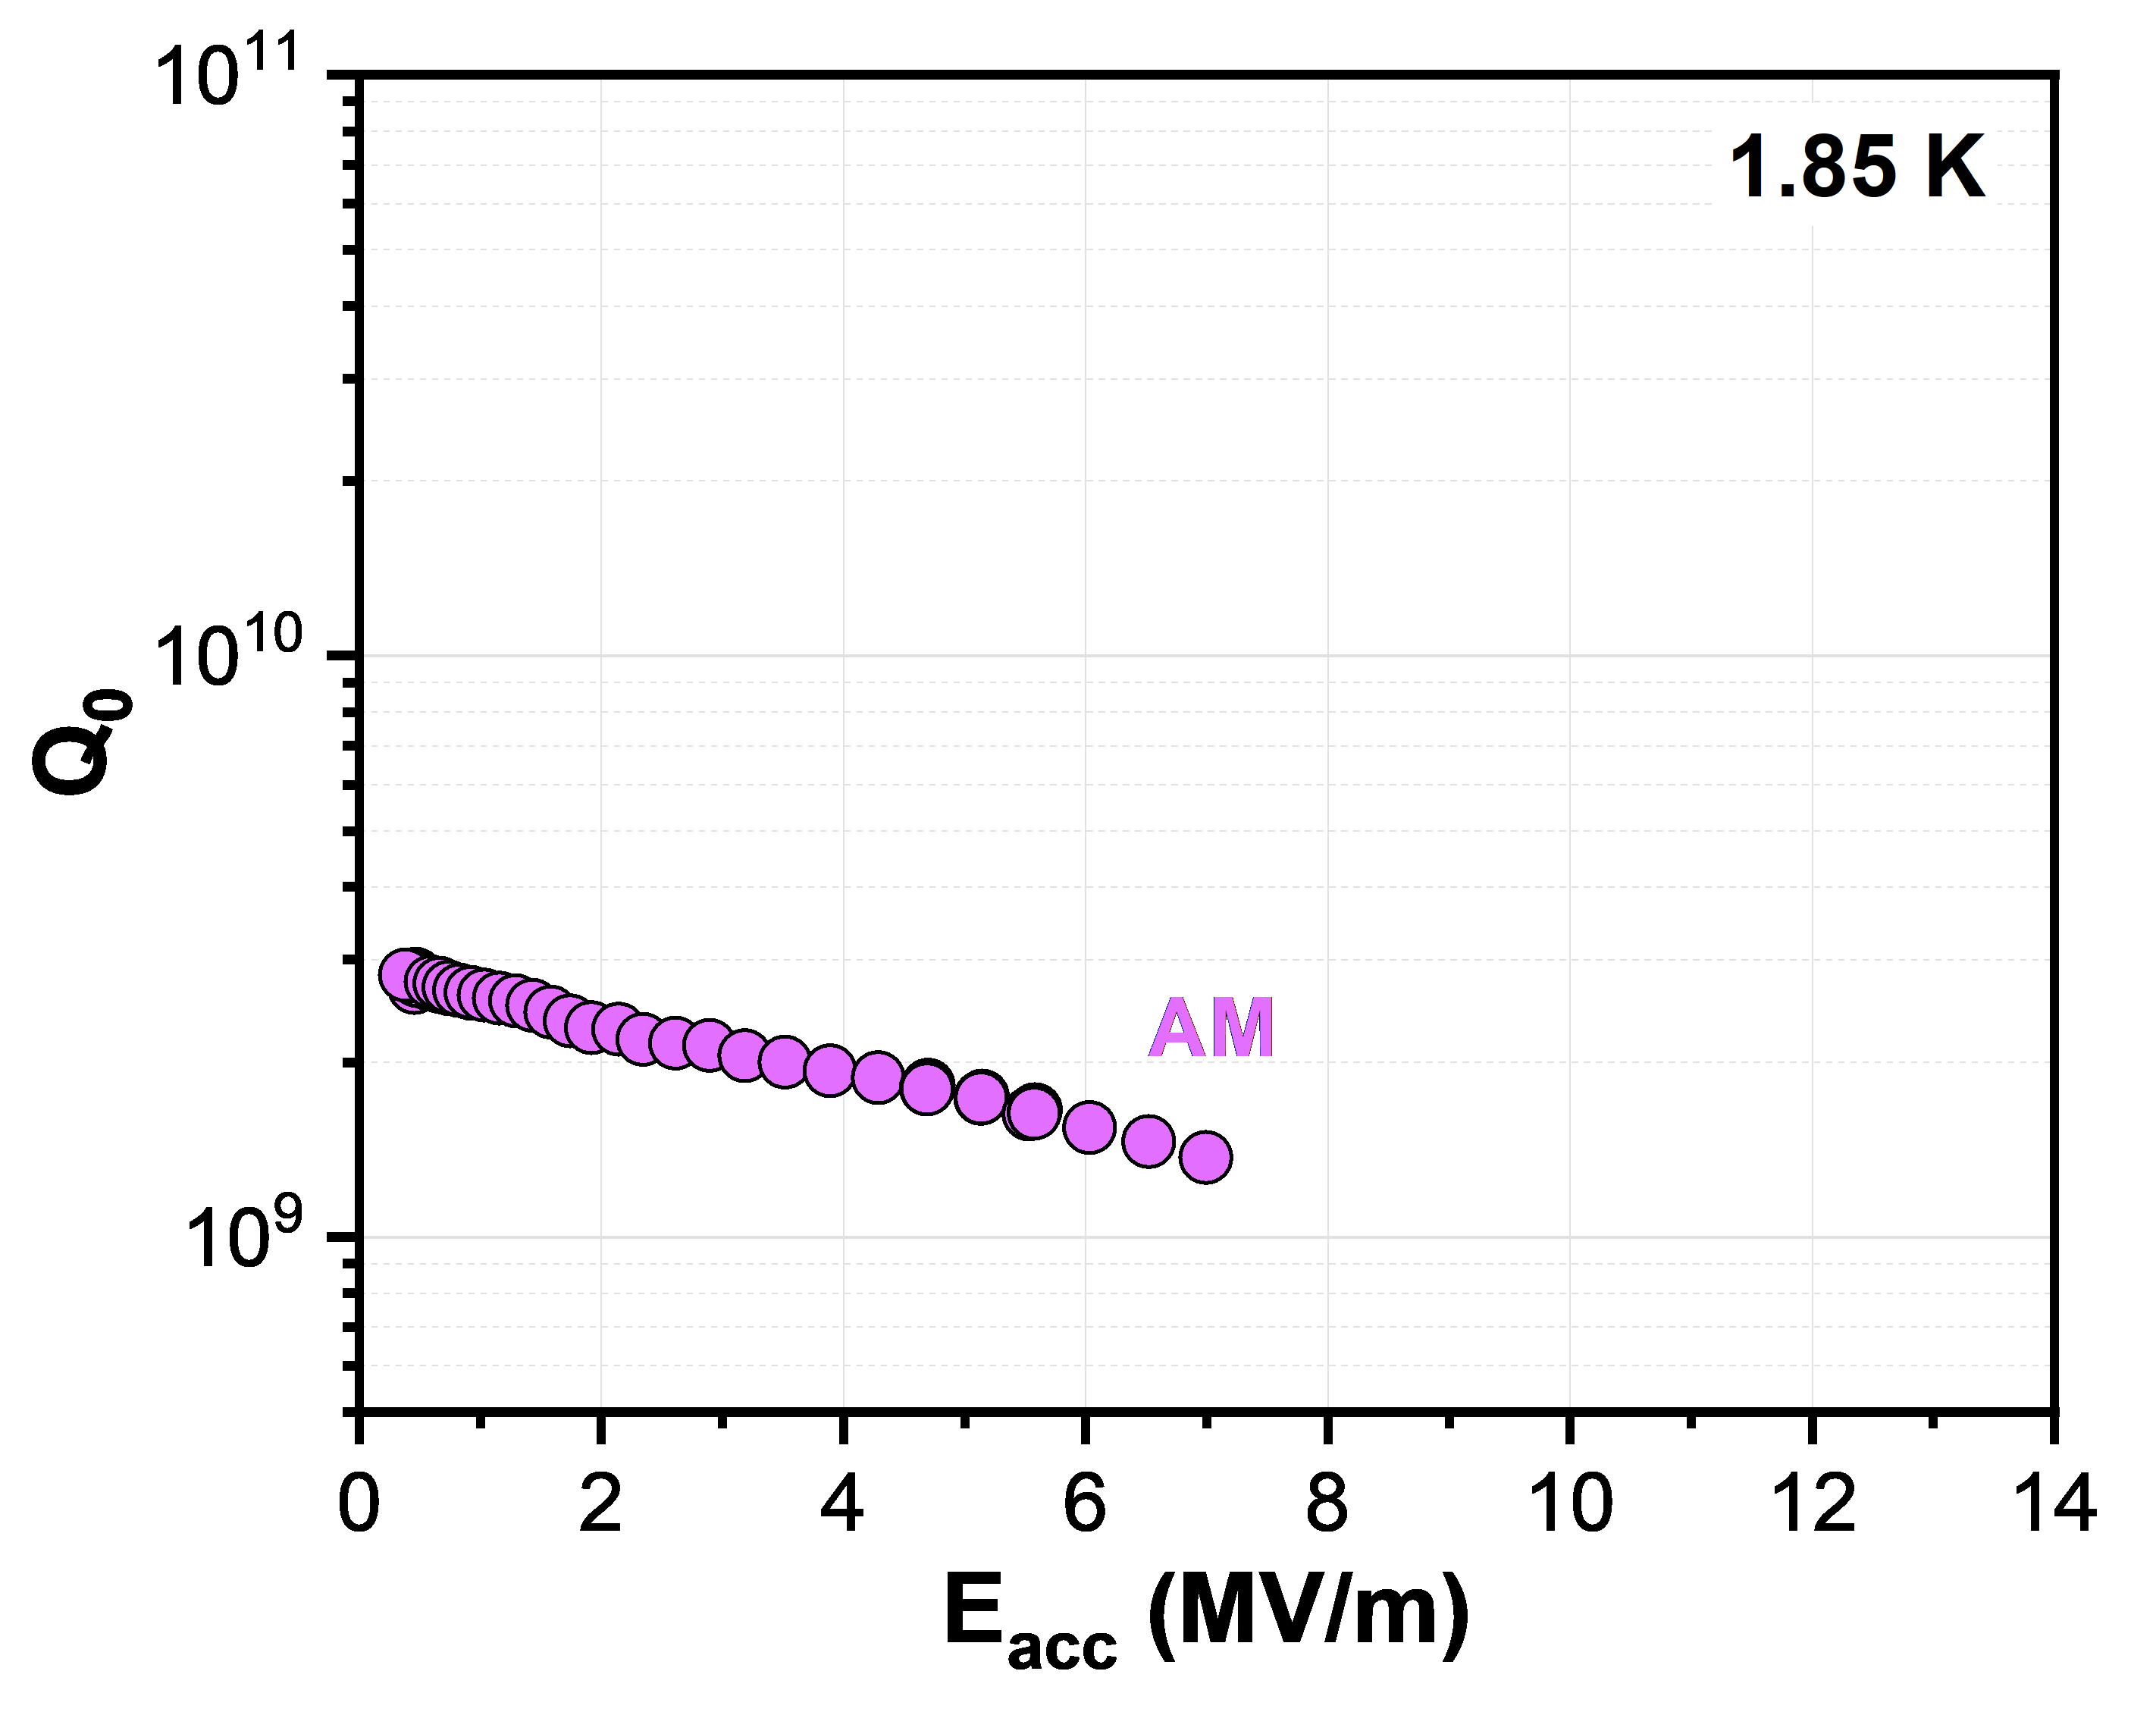
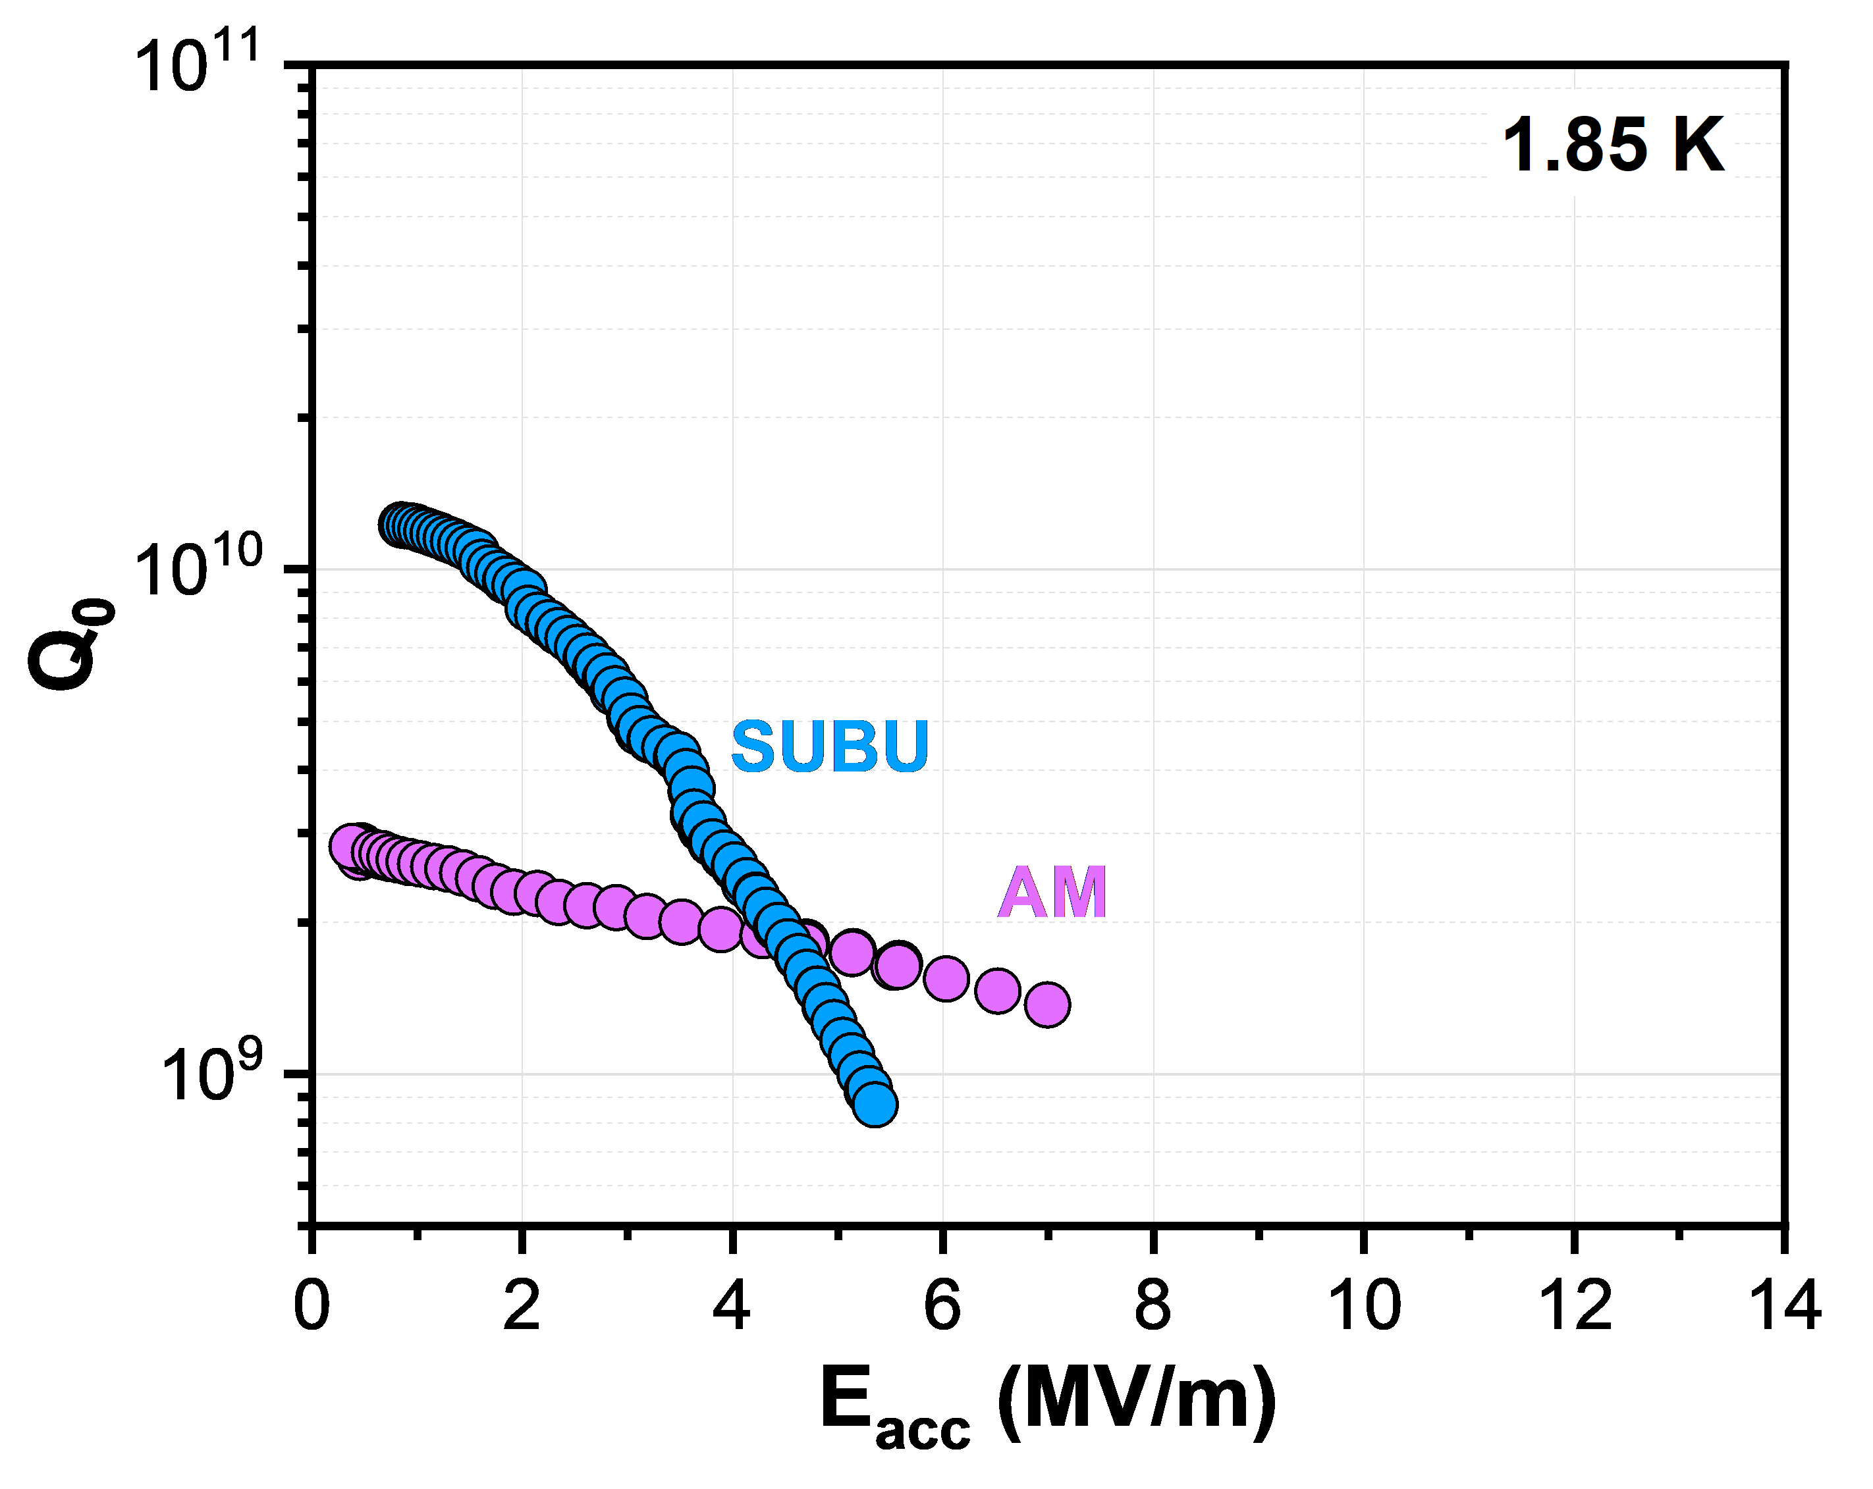
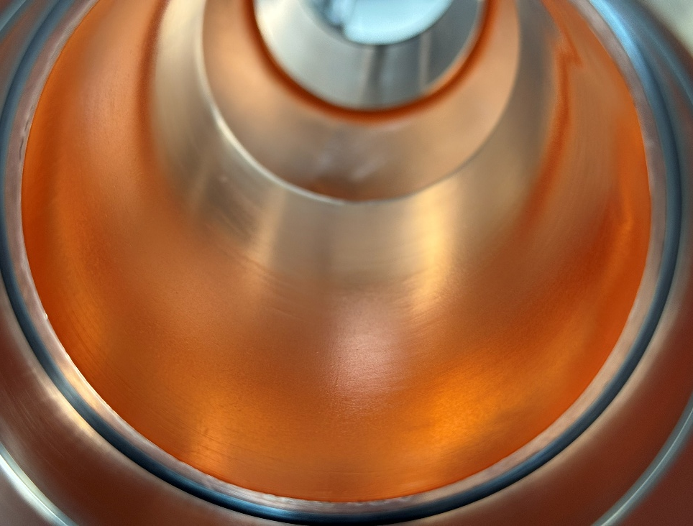
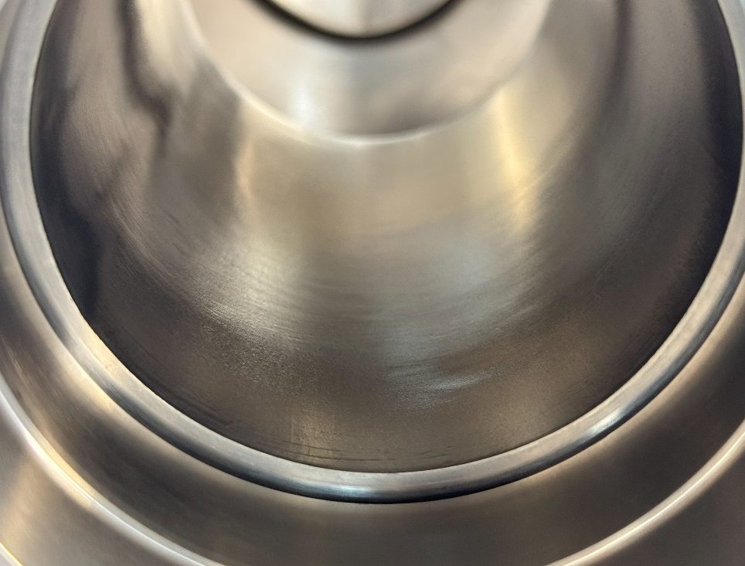
Advancements in 1.3 GHz R&D
important factors:
surface state/treatment of Cu (polishing + passivation)
compact, high purity Nb coatings, i.e. strict control over level of impurities (e.g. oxygen, hydrogen, particulates)
example 1.3 GHz cavity
as-machined (AM)
machining marks, high roughness, mechanically damaged near-surface layer
chemical polishing (with SUBU)
mixture of sulfamic acid, hydrogen peroxide,
n-butanol and ammonium citrate
removes damaged layer, reduces roughness BUT differentially etches crystallographic orientations, can induce micropitting
electropolishing (EP)
mixture of phosphoric acid and n-butanol
reduces microroughness, more uniformly polished surfaces
as-machined, cleaned
electropolished
EP, Nb-coated

Slide 6
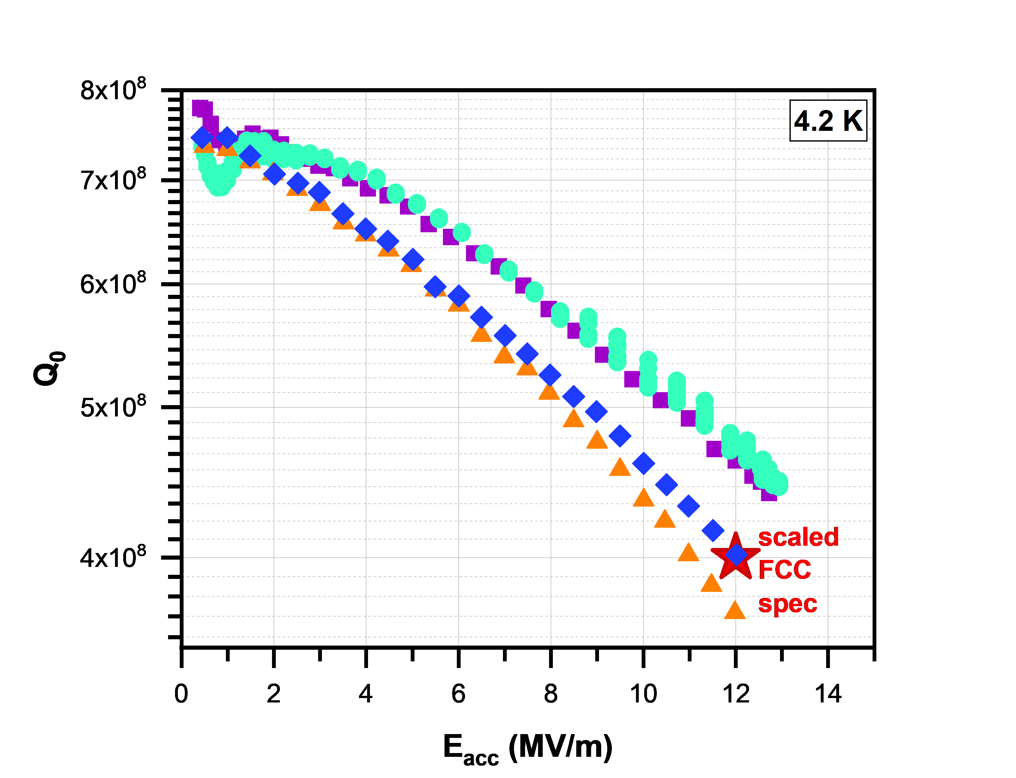
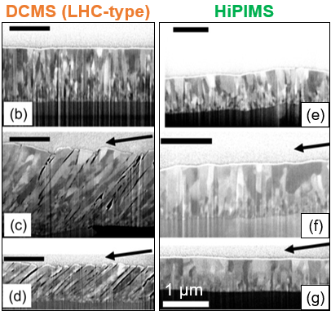
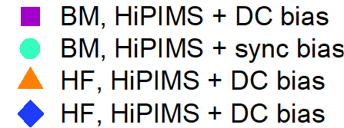
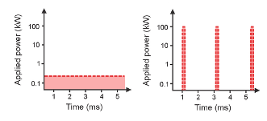
Advancements in 1.3 GHz R&D
important factors:
surface state/treatment of Cu (polishing + passivation)
compact, high purity Nb coatings, i.e. strict control over level of impurities (e.g. oxygen, hydrogen, particulates)
bulk-machined (at CERN)
hydroformed (at KEK)
example 1.3 GHz cavity
EP + HiPIMS
HiPIMS vs DCMS
high plasma density (approx. 10¹⁹ m⁻³) compared to DCMS (approx. 10¹⁶ m⁻³)
increased probability for ionising collisions
high degree of ionisation of sputtered material
K. Brunner (CERN)
H. Araki (KEK)
M. Yamanaka (KEK)
T. Mieno Plasma Science and Technology
M. Ghaemi et al. Surface & Coatings Technology 476 (2024) 130199

Slide 7
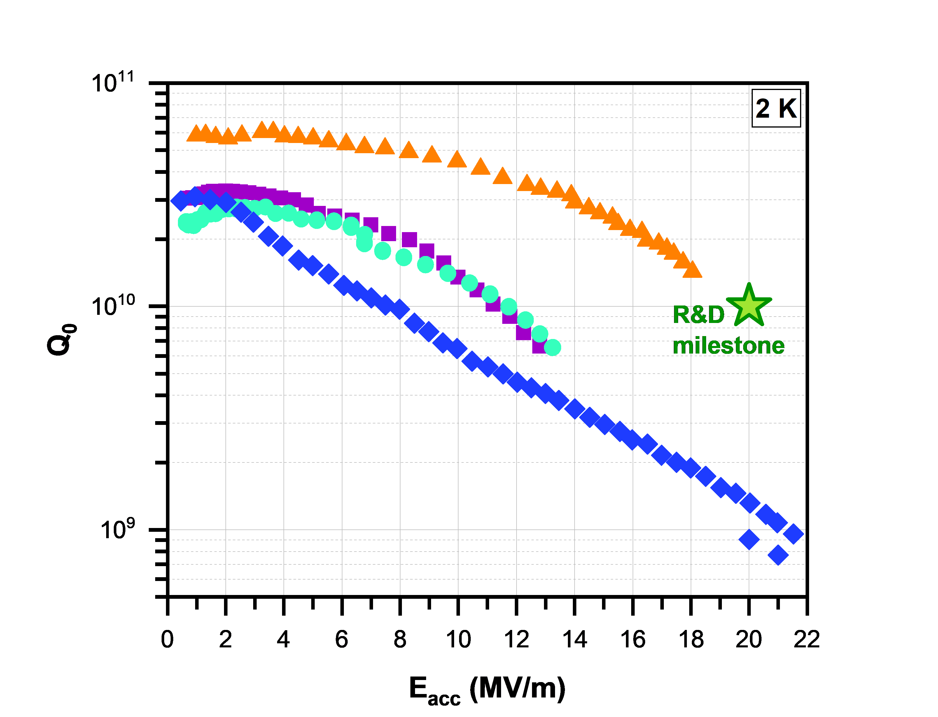
Advancements in 1.3 GHz R&D
important factors:
surface state/treatment of Cu (polishing + passivation)
compact, high purity Nb coatings, i.e. strict control over level of impurities (e.g. oxygen, hydrogen, particulates)
bulk-machined (at CERN)
hydroformed (at KEK)
example 1.3 GHz cavity
EP + HiPIMS
HiPIMS vs DCMS
high plasma density (approx. 10¹⁹ m⁻³) compared to DCMS (approx. 10¹⁶ m⁻³)
increased probability for ionising collisions
high degree of ionisation of sputtered material
K. Brunner (CERN)
H. Araki (KEK)
M. Yamanaka (KEK)
for more
information:
PhD work of C. Pereira
G. Rosaz 11th TFSRF Workshop (2024)
H. Araki 12th TFSRF Workshop (2026)
T. Mieno Plasma Science and Technology
M. Ghaemi et al. Surface & Coatings Technology 476 (2024) 130199

Slide 8
How to transfer this approach to 400 MHz cavities?

Slide 9
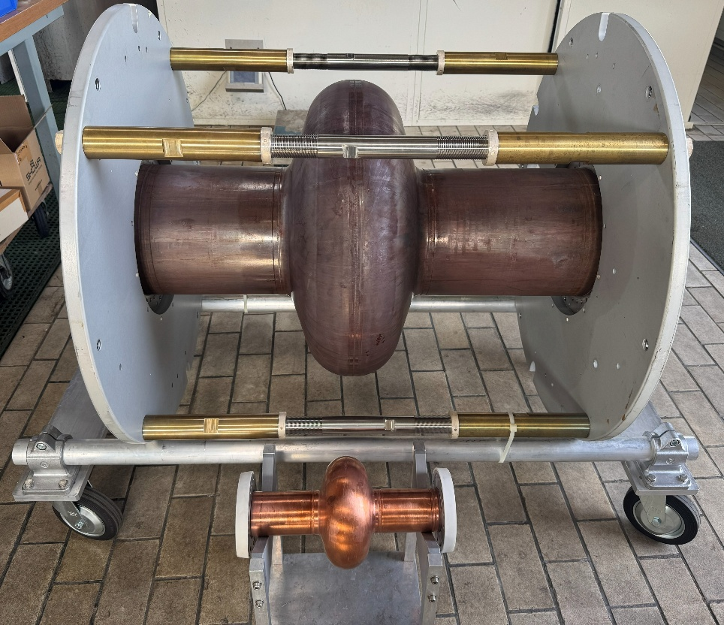
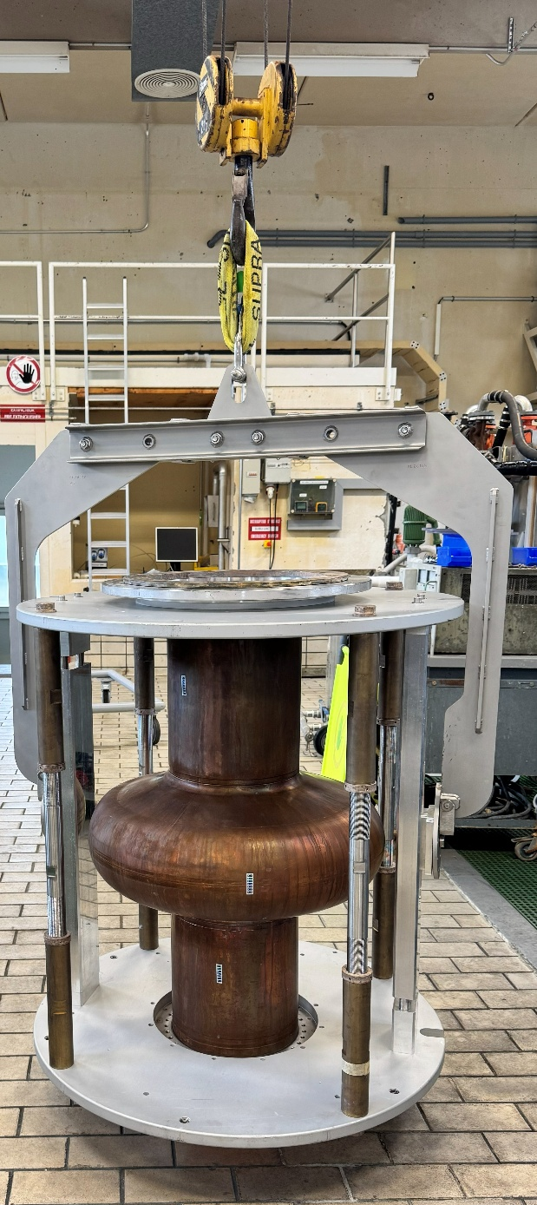
Upscaling to 400 MHz
example 1.3 GHz cavity
moving from 1.3 GHz to 400 MHz cavities can present a challenge
much larger surface area needs to be treated
object handling becomes significantly more difficult, requiring crane support
switching between process steps is time-consuming
400 MHz
1.3 GHz

Slide 10
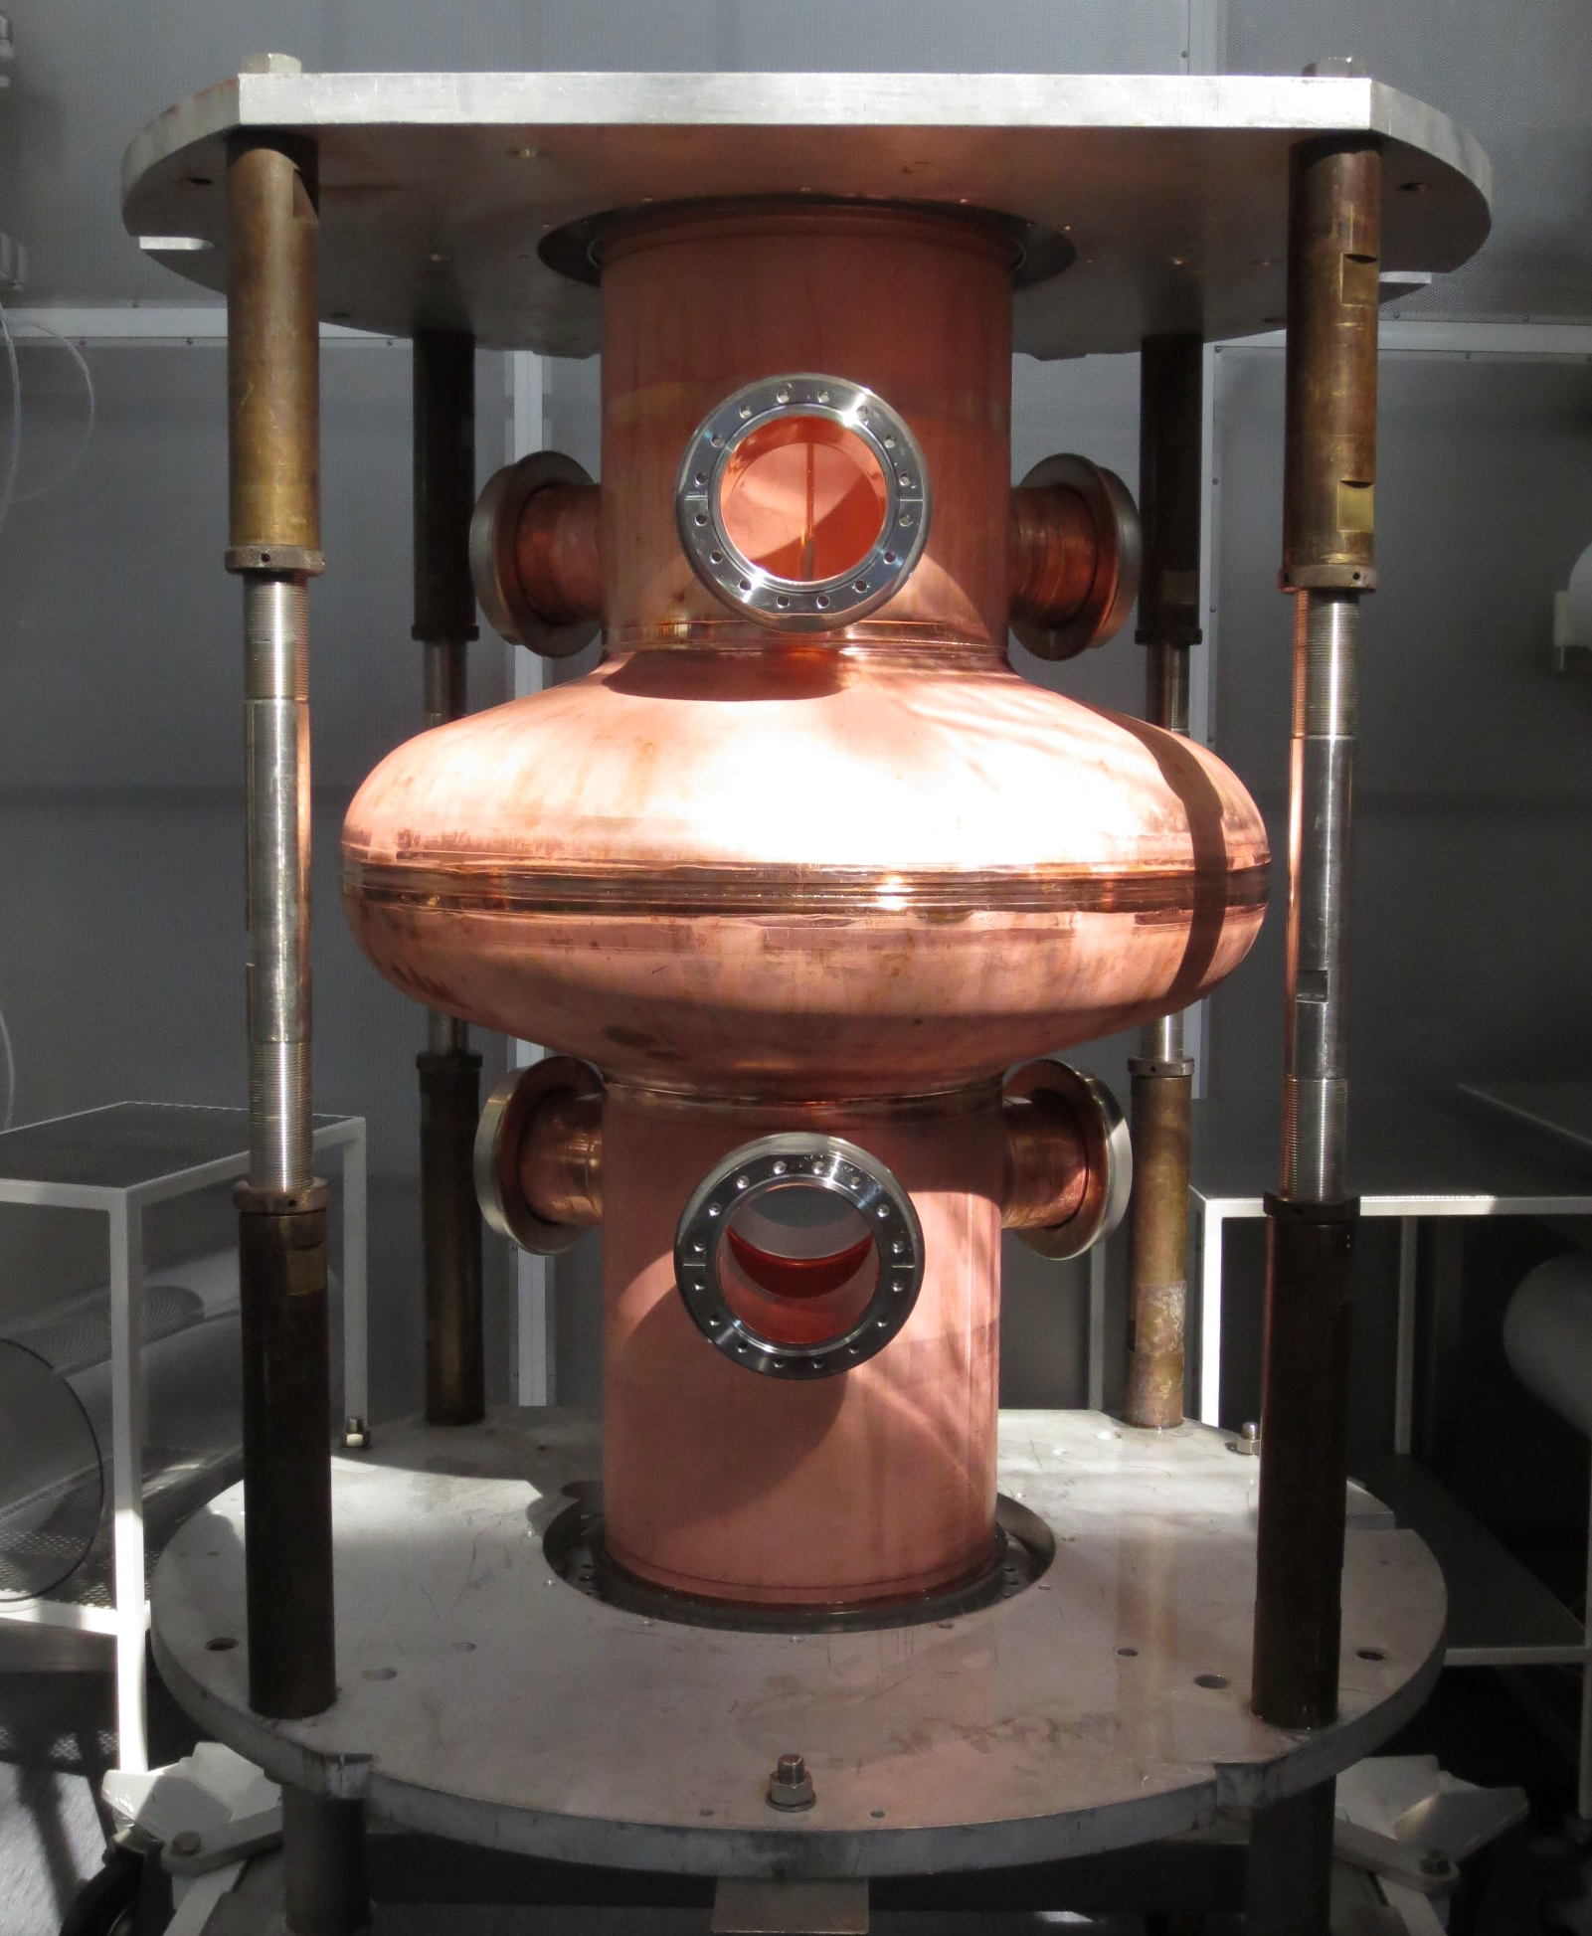
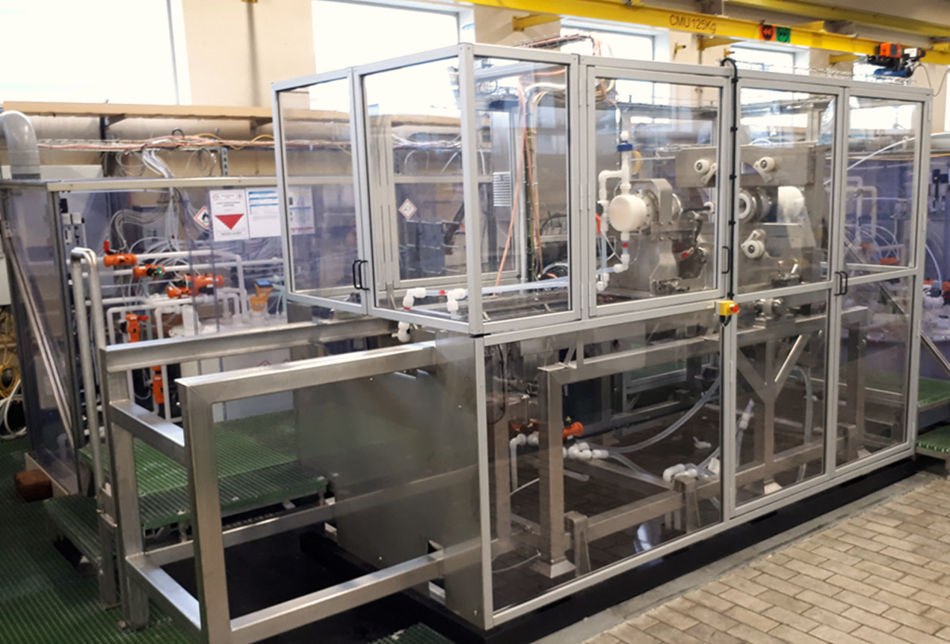
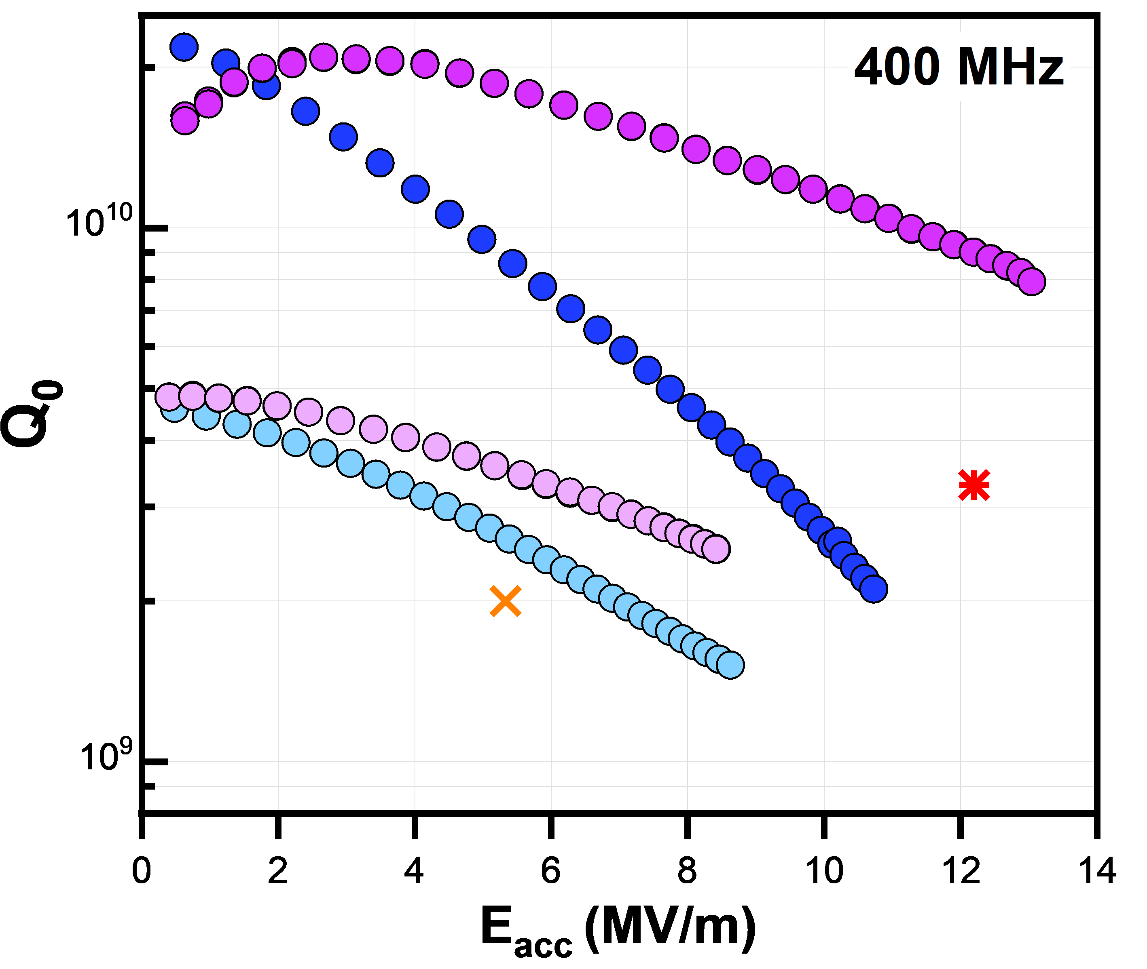
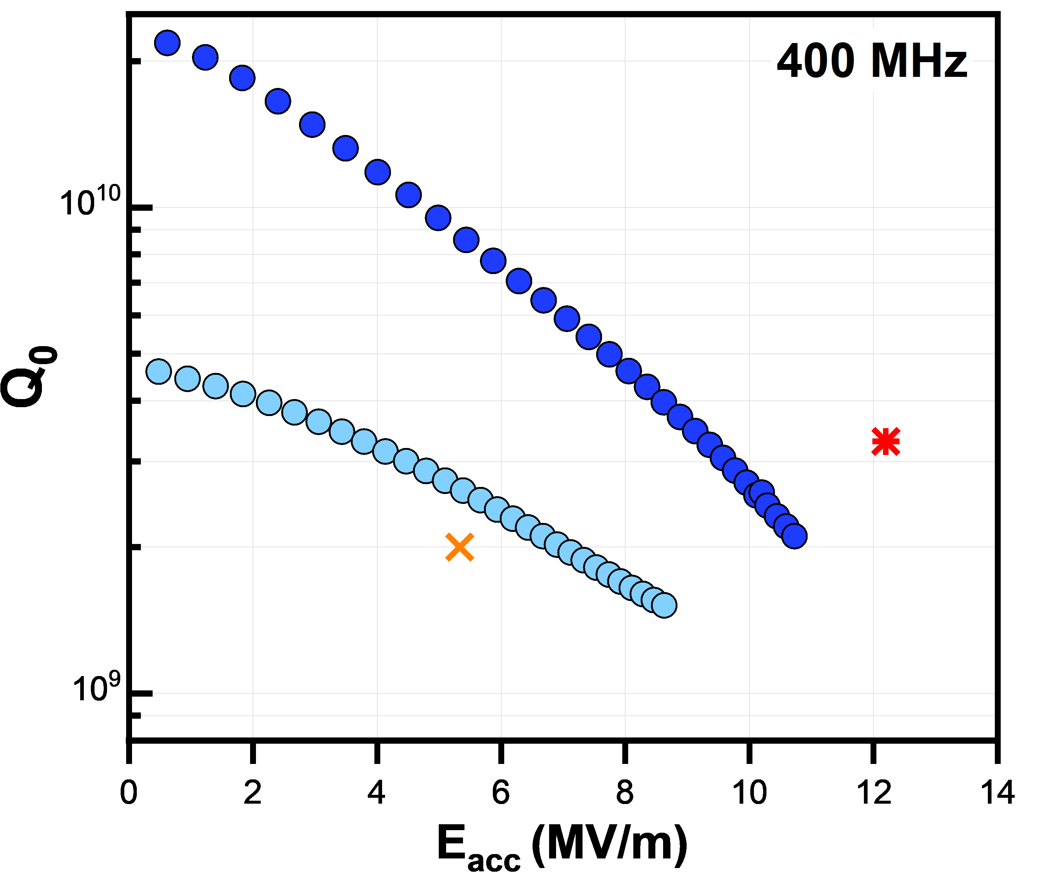
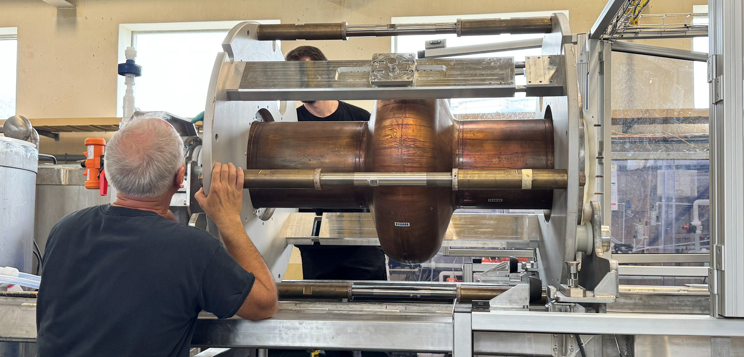
Upscaling to 400 MHz
SUBU + DCMS
moving to EP
SUBU + HiPIMS
electropolishing bench
SUBU
HiPIMS
1.7 K
FCC, 4.2 K
LHC, 4.5 K
SUBU
HiPIMS
4.5 K
LHC, 4.5 K
SUBU
DCMS
2 K
SUBU
DCMS
2 K
example 400 MHz cavity
SUBU
DCMS
4.5 K
SUBU
DCMS
4.5 K
important factors:
surface state/treatment of Cu (polishing + passivation)
compact, high purity Nb coatings, i.e. strict control over level of impurities (e.g. oxygen, hydrogen, particulates)
SUBU surface treatment, DCMS coating → LHC specs met at 4.5 K
SUBU surface treatment, high power impulse magnetron sputtering (HiPIMS) → improvement in Q₀
BUT FCC specifications not met

Slide 11
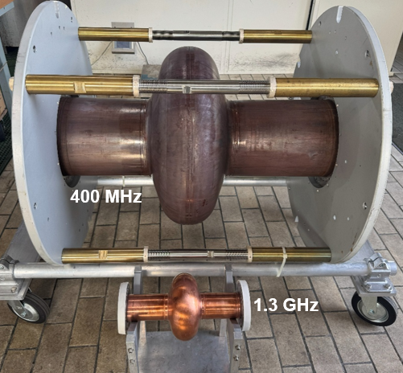
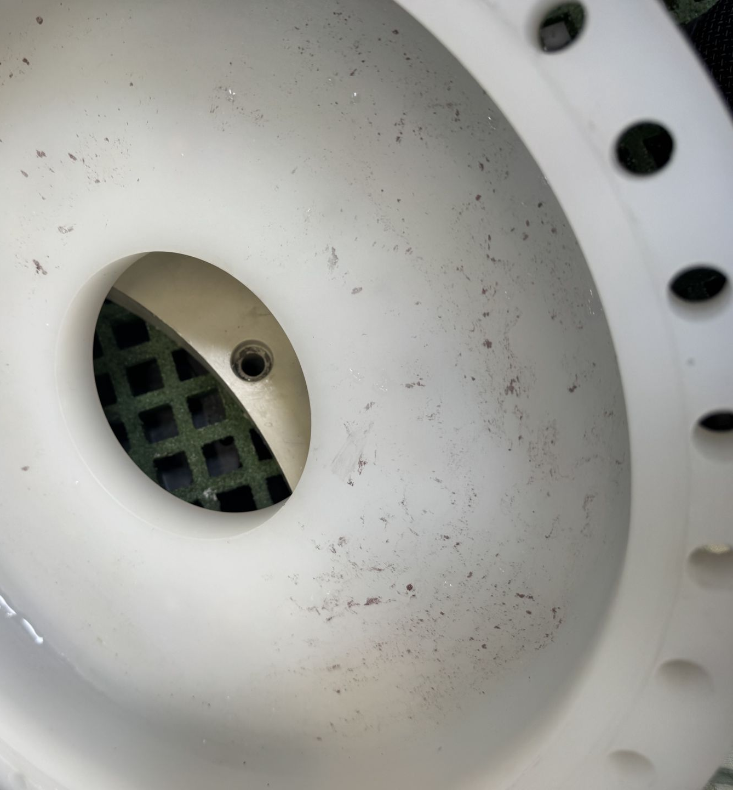
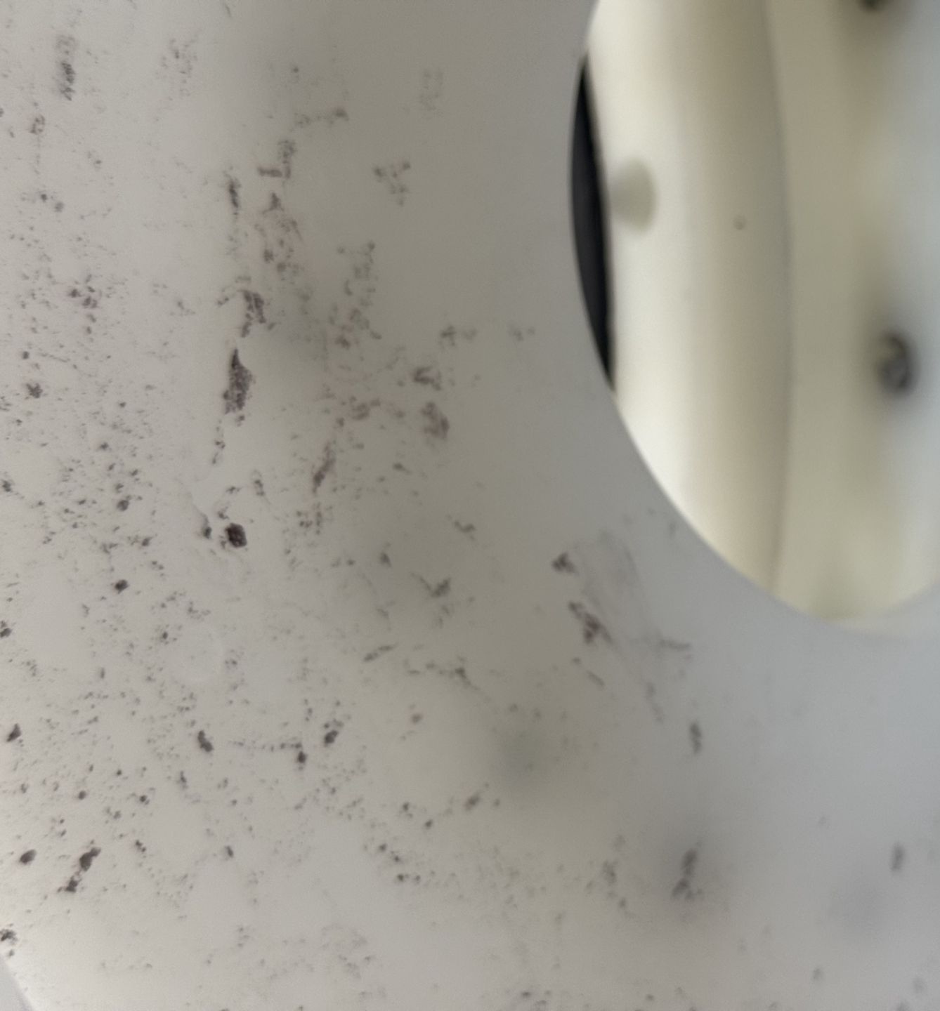
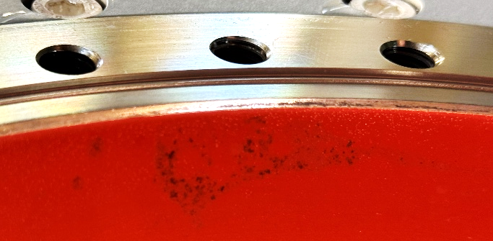
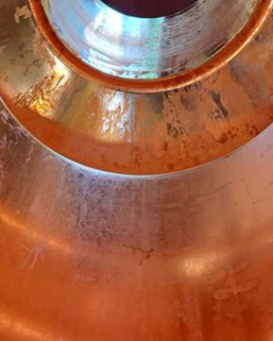
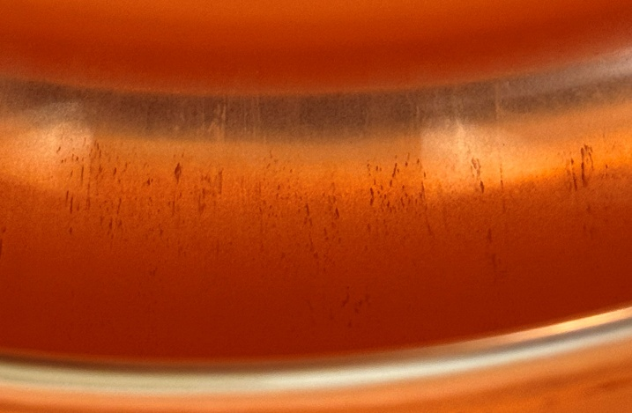
Upscaling to 400 MHz: EP trials
same setup for both 1.3 GHz and 400 MHz cavities
larger volume needs to be treated using the same “plumbing”
insufficient and inhomogeneous rinsing
fine Cu powder collected on the outflow side
oxidation stains
example 400 MHz cavity
takes time to mount/dismount the cavity
preventing oxidation is critical
availability of safe passivation solutions is limited
important factors:
surface state/treatment of Cu (polishing + passivation)
compact, high purity Nb coatings, i.e. strict control over level of impurities (e.g. oxygen, hydrogen, particulates)
delamination

Slide 12
Upscaling to 400 MHz: EP trials
Limited availability of safe passivation solutions
effective
long-lasting protection
highly toxic
fine Cu powder collected on the outflow side
oxidation stains
example 400 MHz cavity
important factors:
surface state/treatment of Cu (polishing + passivation)
compact, high purity Nb coatings, i.e. strict control over level of impurities (e.g. oxygen, hydrogen, particulates)
ammonium citrate
(same as for 1.3 GHz)
much safer
not as robust as Cr (VI)
helps control surface chemistry
delamination

Slide 13
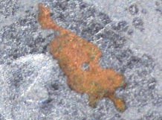
Upscaling to 400 MHz: EP trials
after EP+passivation
EP
HiPIMS
2.2 K
EP
HiPIMS
2.2 K (peel-off)
SUBU
HiPIMS
1.7 K
FCC, 4.5 K
LHC, 4.5 K
SUBU
HiPIMS
4.5 K
SUBU
DCMS
2 K
EP
HiPIMS
4.5 K
EP
HiPIMS
4.5 K (peel-off)
SUBU
DCMS
4.5 K
example 400 MHz cavity
important factors:
surface state/treatment of Cu (polishing + passivation)
compact, high purity Nb coatings, i.e. strict control over level of impurities (e.g. oxygen, hydrogen, particulates)
after coating
Why?
multiple small peel-off zones within the cell!
0.2 mm
0.2 mm

Slide 14
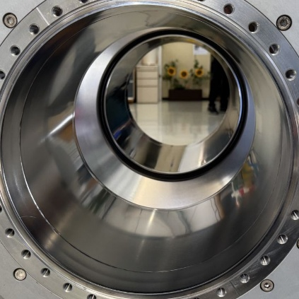
Upscaling to 400 MHz: EP trials
ammonium citrate
(same as for 1.3 GHz)
much safer
not as robust as Cr (VI)
helps control surface chemistry
…and biocompatible!
improvements in monitoring EP bath, passivation solution and environmental conditions
additional high-pressure rinsing after each processing step
after EP+passivation
after coating
example 400 MHz cavity
important factors:
surface state/treatment of Cu (polishing + passivation)
compact, high purity Nb coatings, i.e. strict control over level of impurities (e.g. oxygen, hydrogen, particulates)
0.2 mm
10 mm
0.2 mm

Slide 15
Upscaling to 400 MHz: EP trials
improvements in monitoring EP bath, passivation solution and environmental conditions
additional high-pressure rinsing after each processing step
EP
HiPIMS
2.2 K (peel-off)
SUBU
HiPIMS
1.7 K
EP
HiPIMS
2.1 K
after EP+passivation
after coating
FCC, 4.5 K
LHC, 4.5 K
SUBU
HiPIMS
4.5 K
SUBU
DCMS
2 K
EP
HiPIMS
4.5 K (peel-off)
EP
HiPIMS
4.5 K
SUBU
DCMS
4.5 K
example 400 MHz cavity
important factors:
surface state/treatment of Cu (polishing + passivation)
compact, high purity Nb coatings, i.e. strict control over level of impurities (e.g. oxygen, hydrogen, particulates)
the results indicate that we do not have peel-off

Slide 16
Upscaling to 400 MHz: EP trials
improvements in monitoring EP bath, passivation solution and environmental conditions
additional high-pressure rinsing after each processing step
EP
HiPIMS
2.2 K (peel-off)
SUBU
HiPIMS
1.7 K
EP
HiPIMS
2.1 K
after EP+passivation
after coating
FCC, 4.5 K
LHC, 4.5 K
SUBU
HiPIMS
4.5 K
SUBU
DCMS
2 K
EP
HiPIMS
4.5 K (peel-off)
EP
HiPIMS
4.5 K
SUBU
DCMS
4.5 K
example 400 MHz cavity
important factors:
surface state/treatment of Cu (polishing + passivation)
compact, high purity Nb coatings, i.e. strict control over level of impurities (e.g. oxygen, hydrogen, particulates)
the results indicate that we do not have peel-off
radiation at around 5 MV/m, possibly due to particle contamination → 2nd HPR and retesting ongoing
modified coating parameters compared to the SUBU/HiPIMS cavity

Slide 17
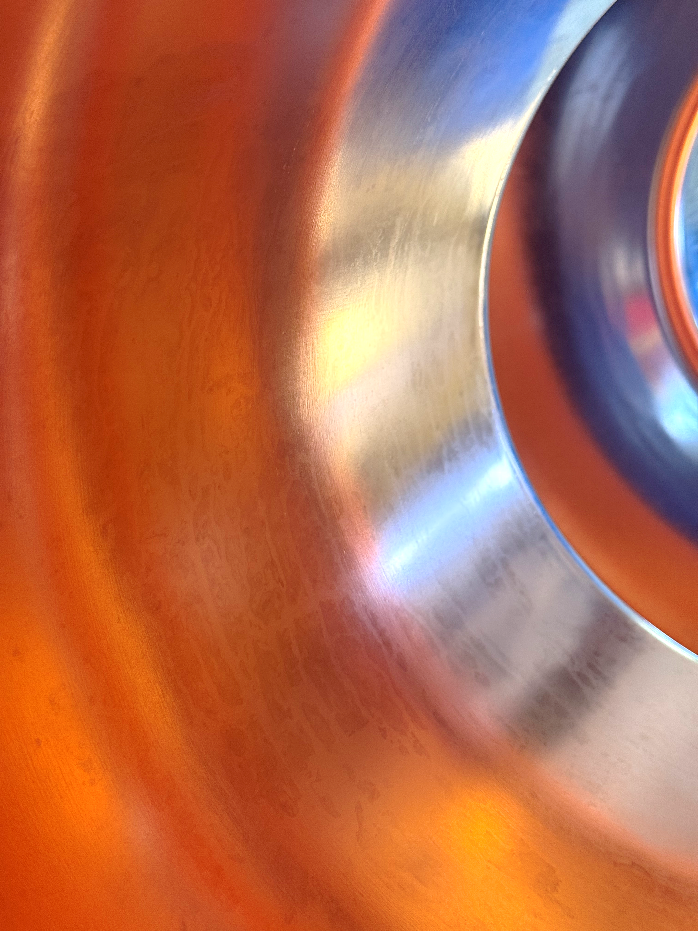
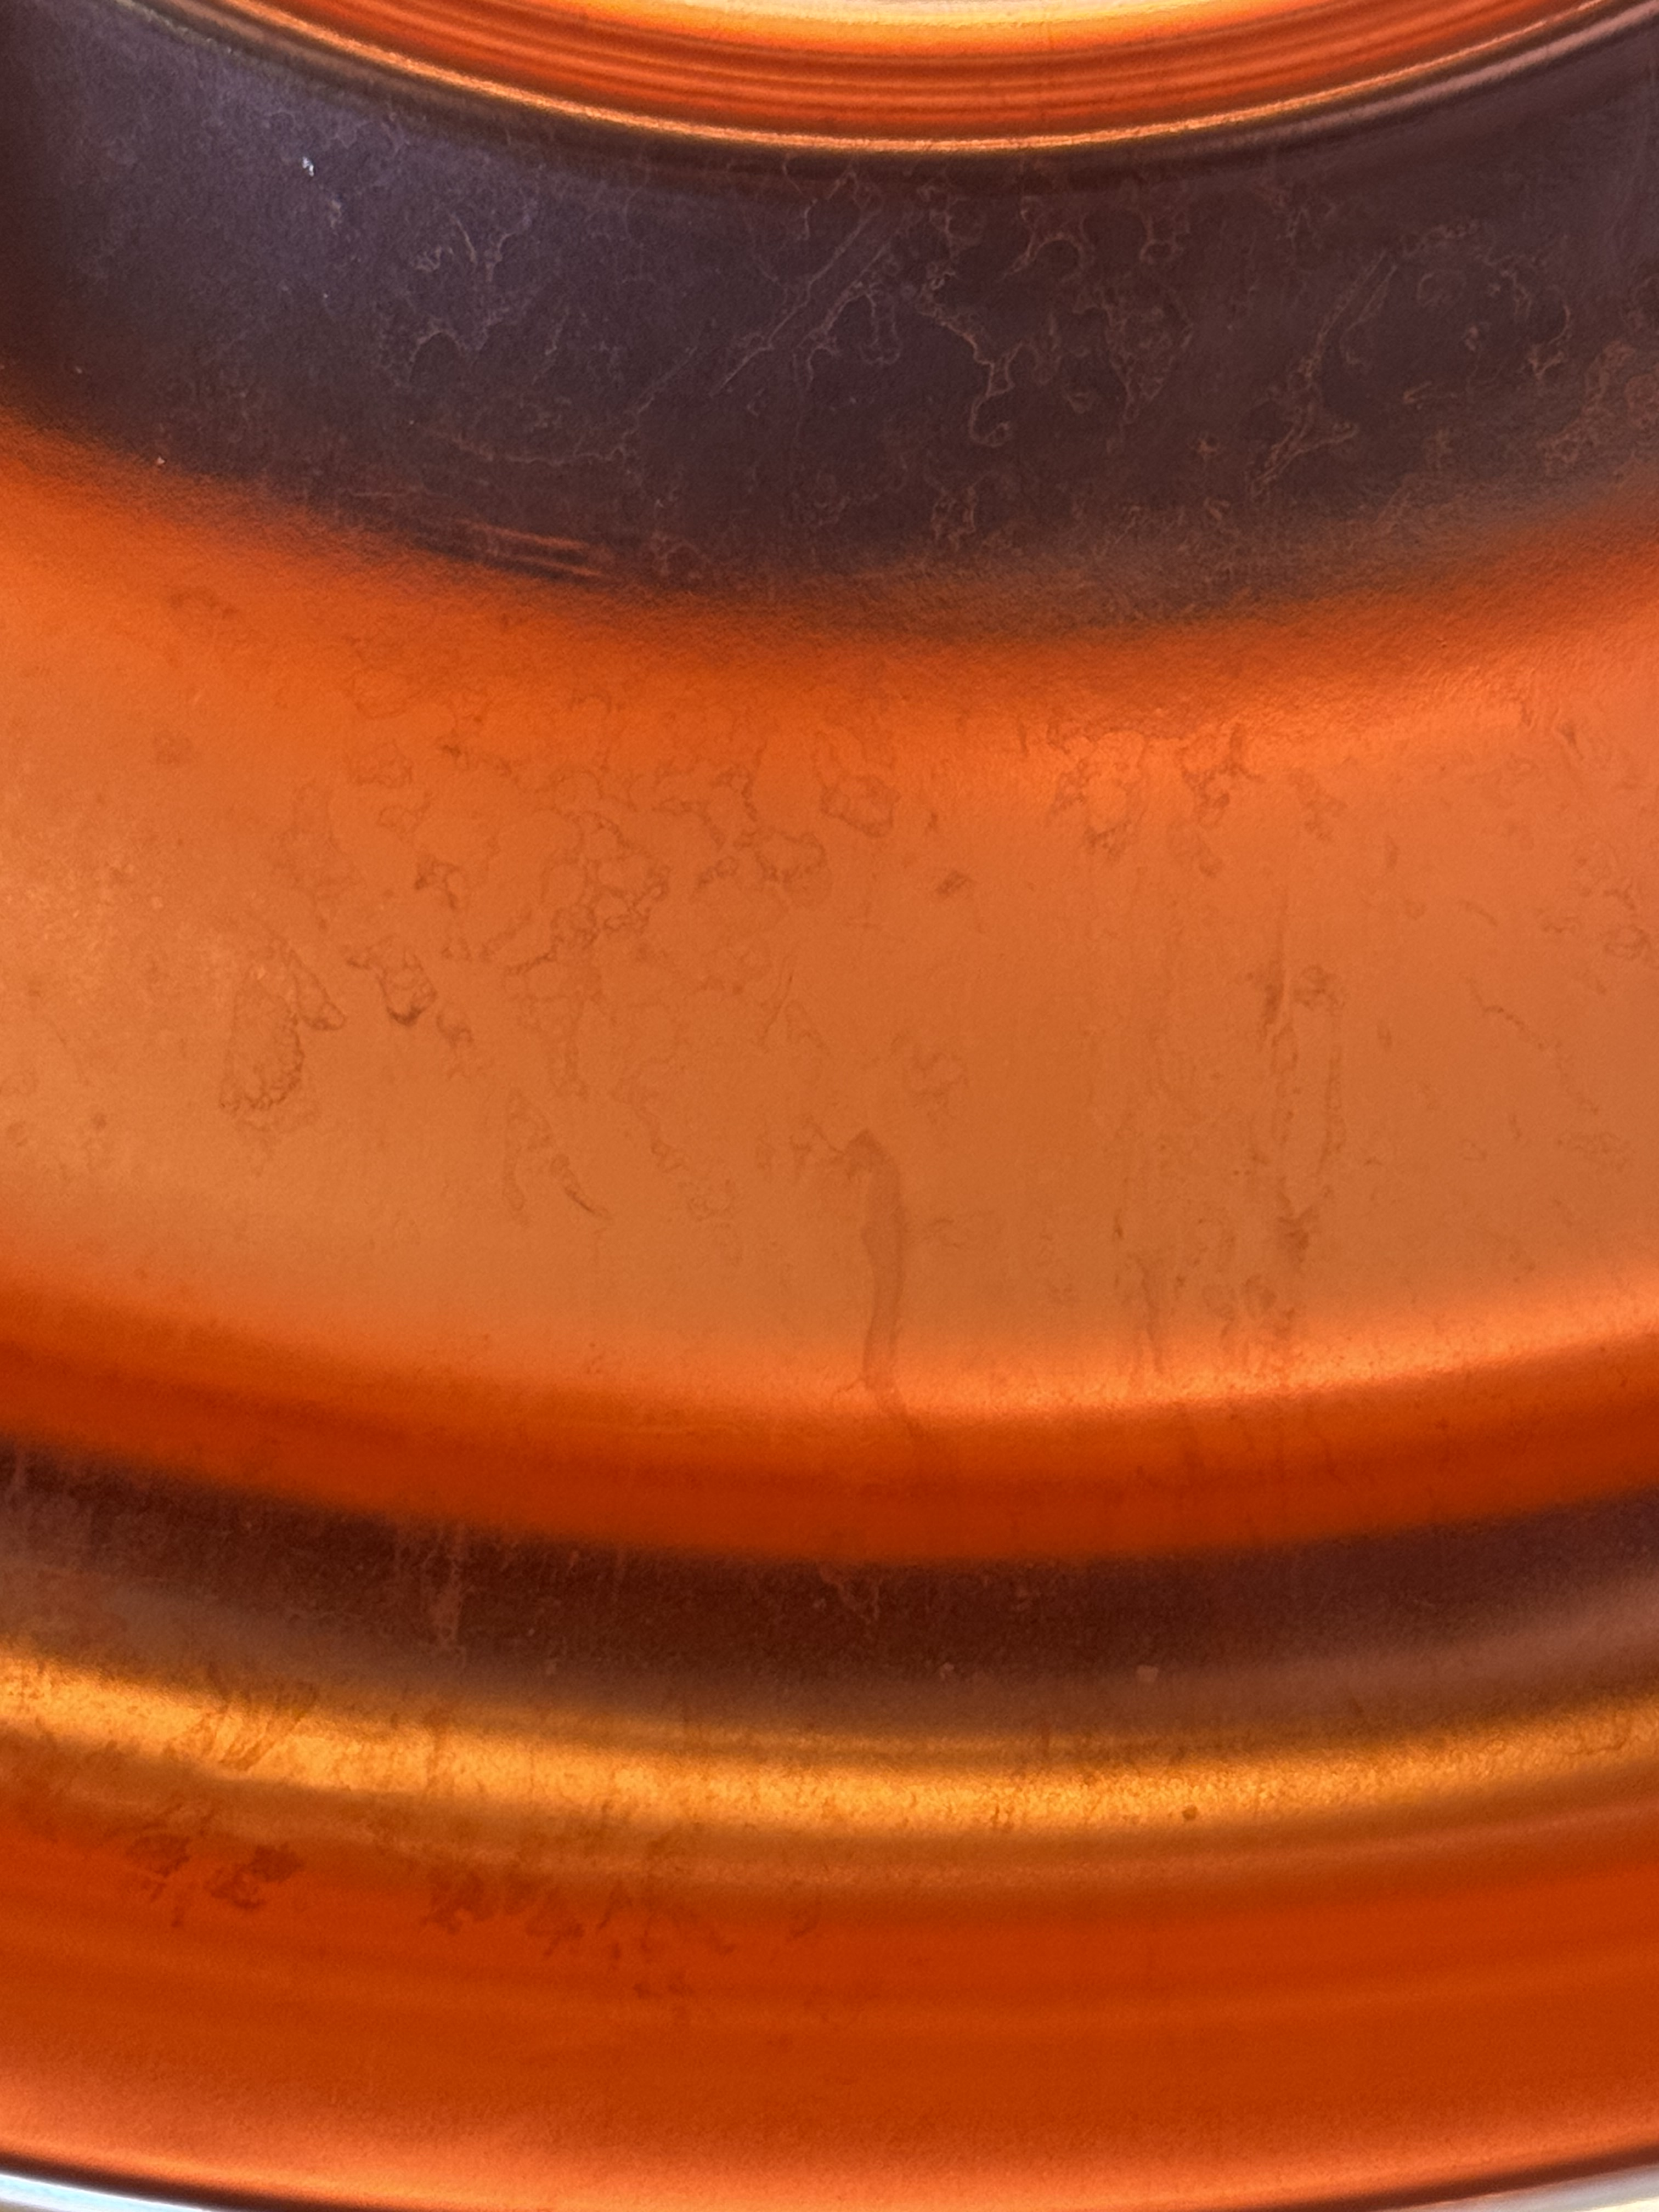
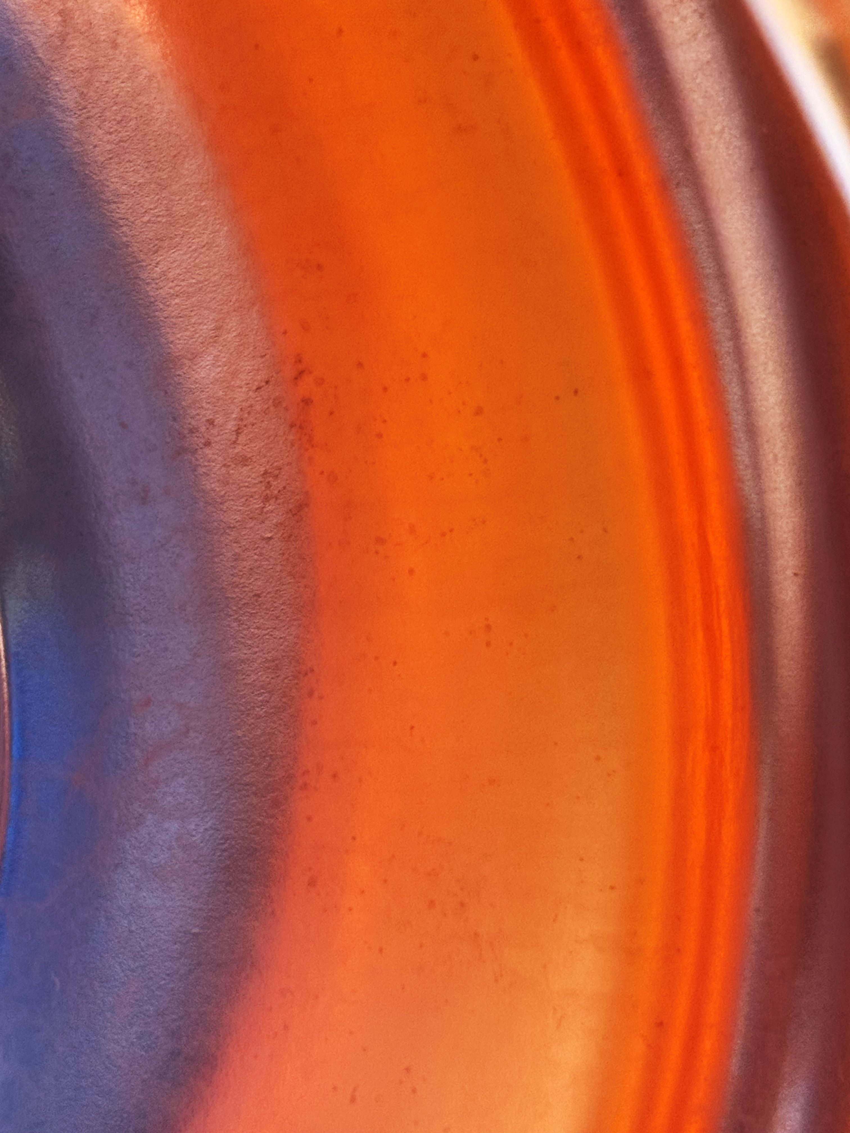
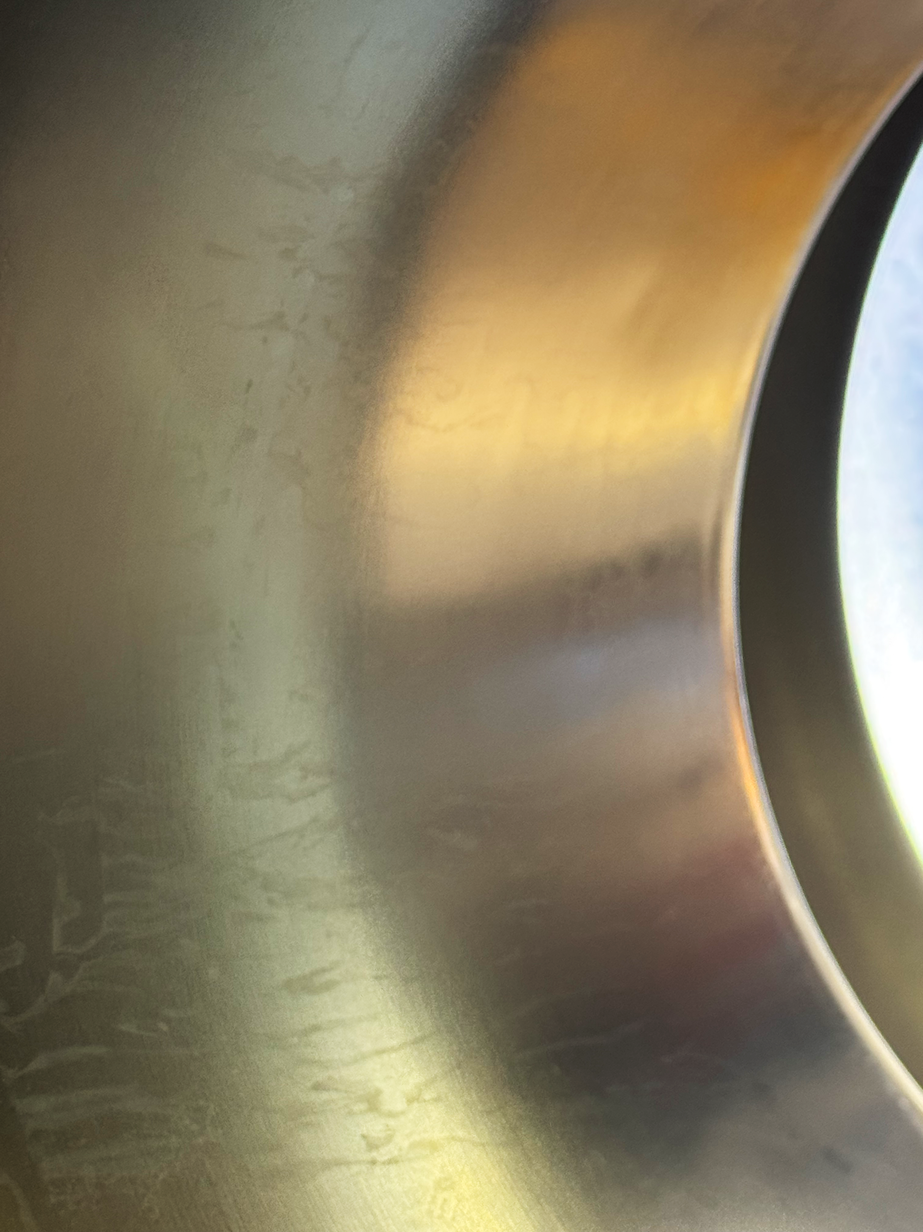
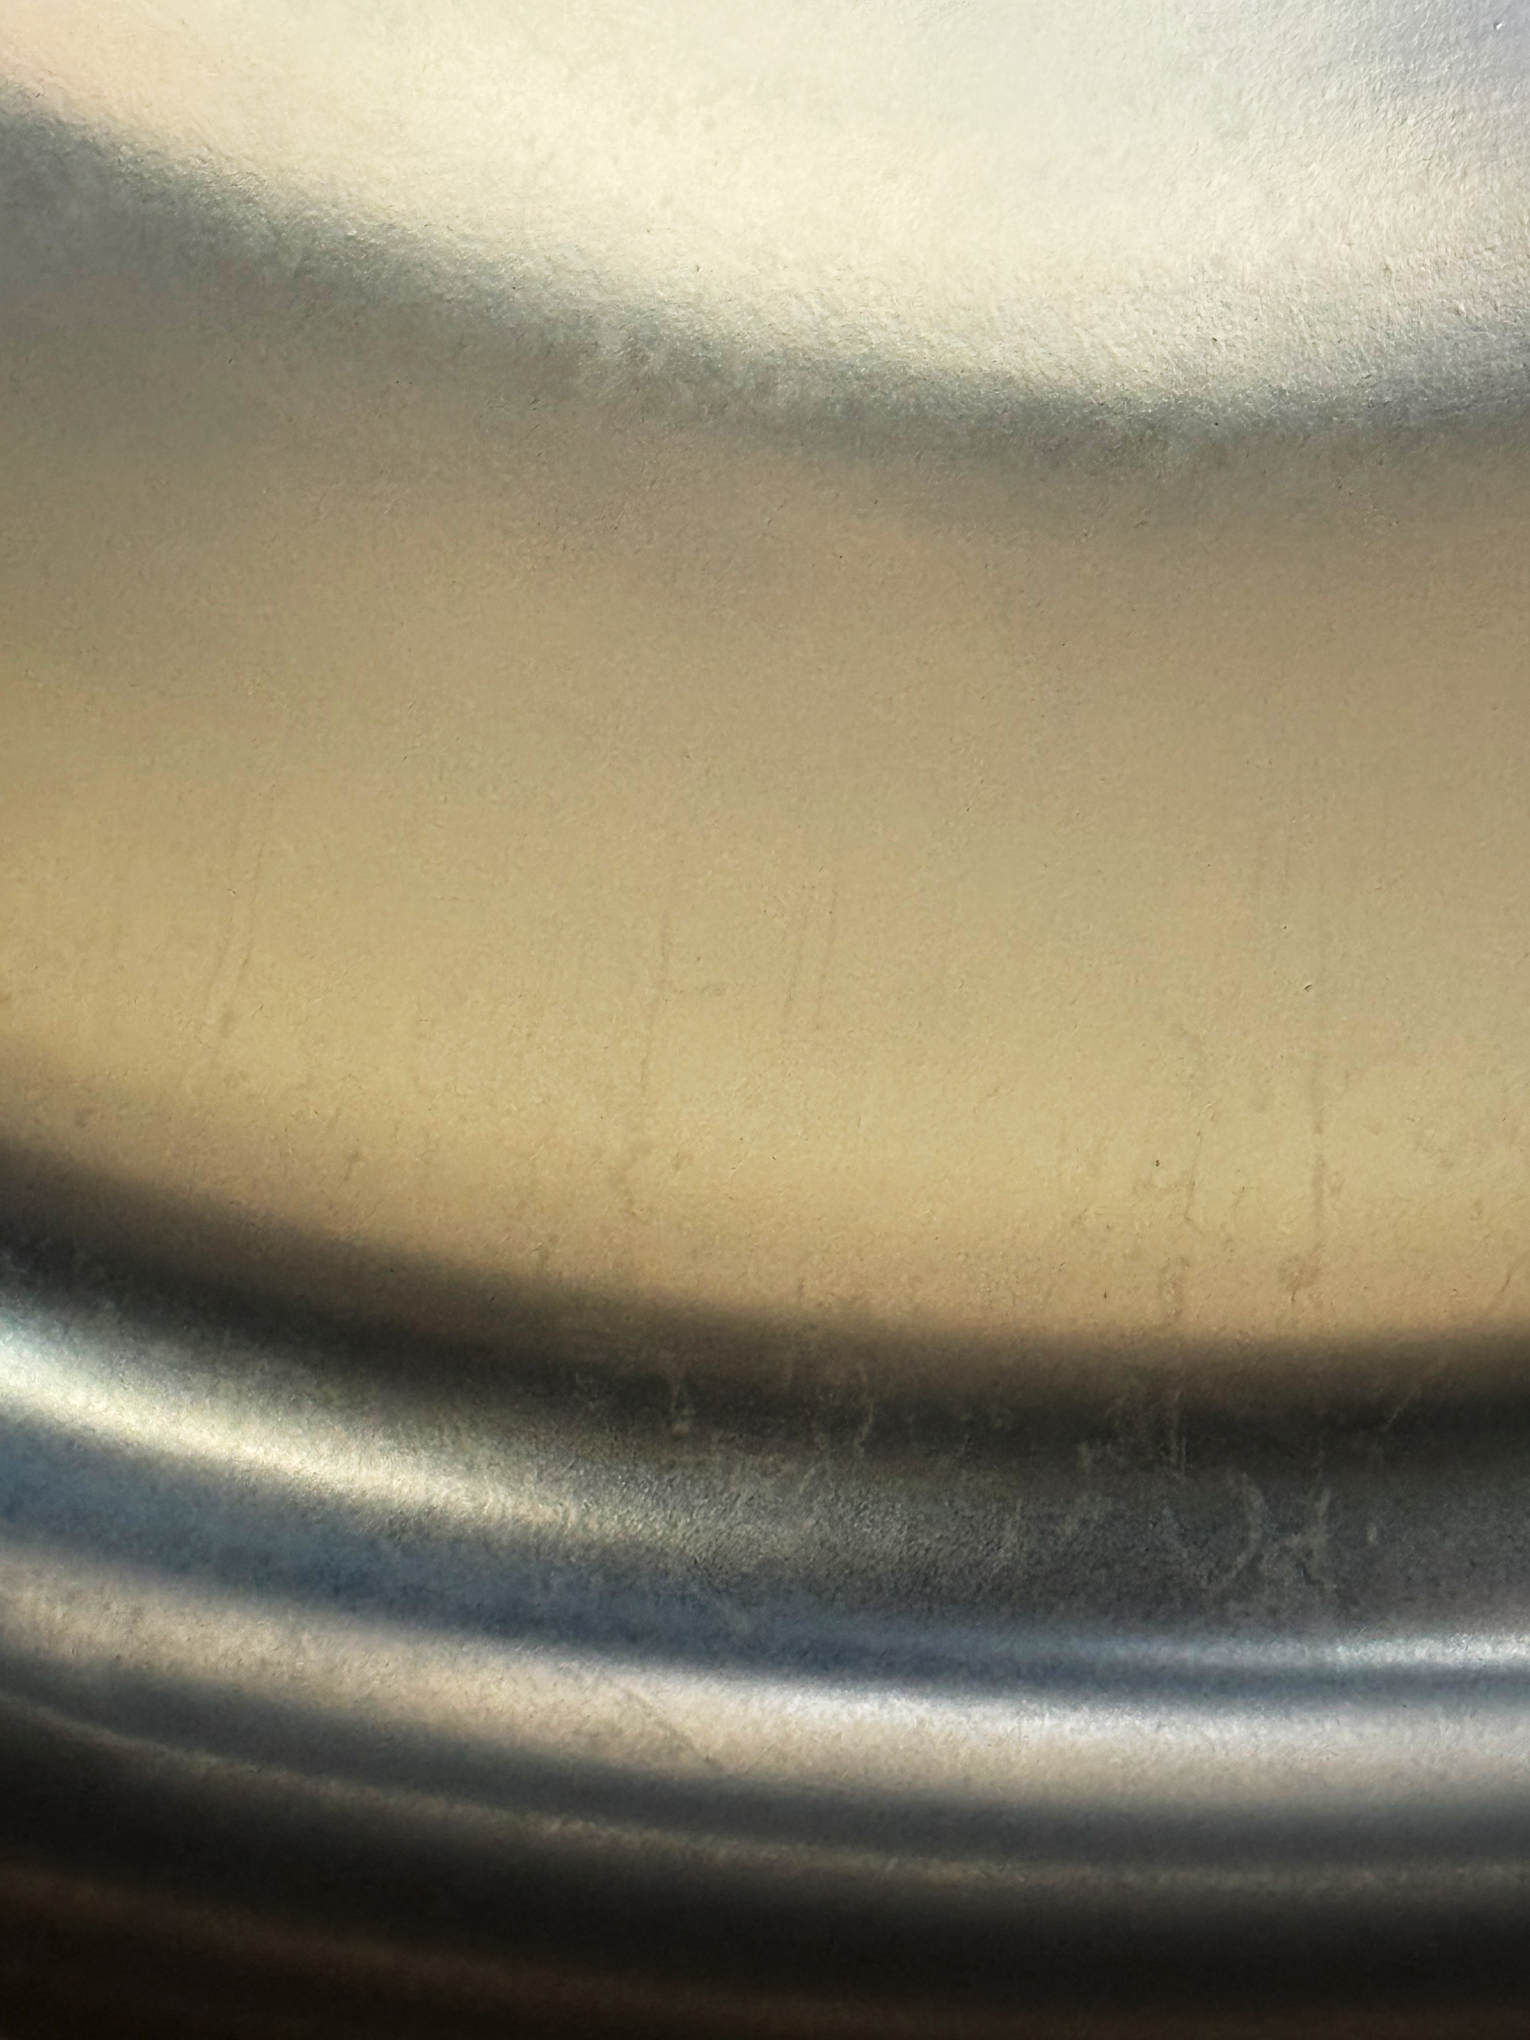
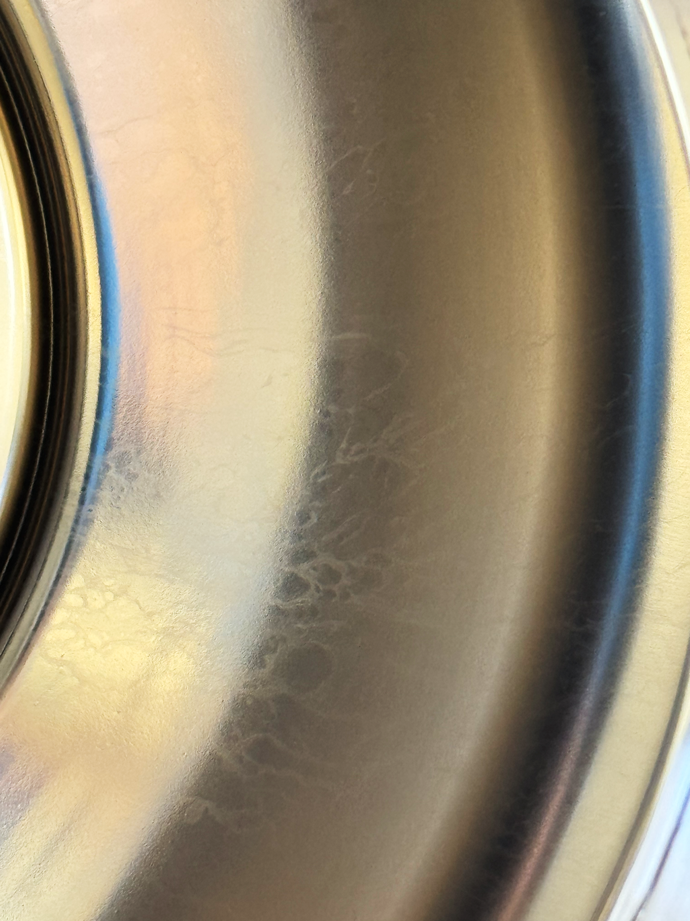
Upscaling to 400 MHz: EP reproducibility
We have a procedure that works!
… or do we?
after EP+passivation
continued challenges with passivating the surface after EP
what is the main driving parameter preventing stable passivation
is it a process or environmental issue or both?
example 400 MHz cavity
after coating
stains visible after coating
no peel-off observed during initial optical inspection
what is the influence of oxidation on the coating and performance?
cavity waiting for HPR
if no peel-off is observed → testing
important factors:
surface state/treatment of Cu (polishing + passivation)
compact, high purity Nb coatings, i.e. strict control over level of impurities (e.g. oxygen, hydrogen, particulates)

Slide 18
what’s next?

Slide 19
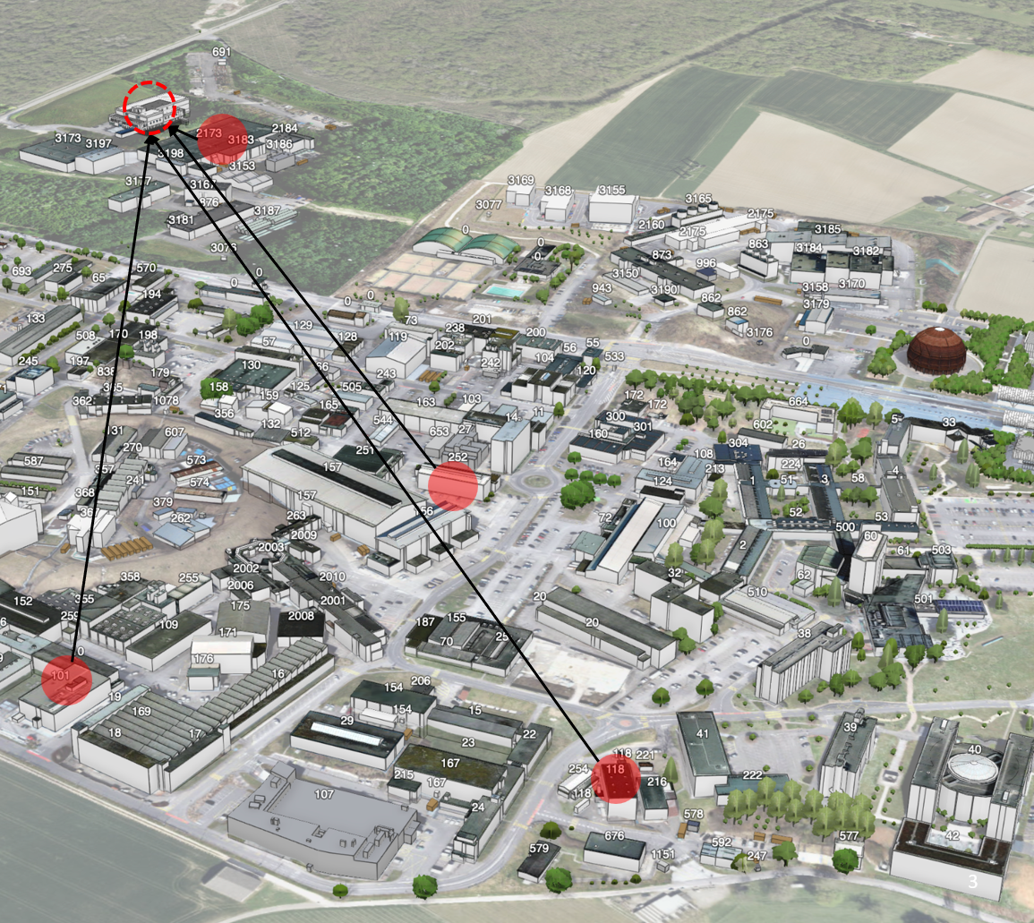

New building for SRF activities: SA18
Replace four obsolete, dispersed facilities with one purpose-built SRF facility:
B.118 surface treatment,
B.252 cavity coatings
SM18 bulk Nb processing and cryomodule assembly,
B.101 1.3 GHz R&D cavity coatings
improved process control and quality through increased height (vertical cathodes), a deep basement (vacuum ovens, chemical plants, mobile cathodes)
interconnected cleanrooms
state-of-the-art surface treatment workshop
provide sufficient scale to train industry, re-internalise selected production steps, and perform major cryomodule repairs
SA18 next to SM18 cryogenic test infrastructure
Delayed by up to 4 years (2034 instead of 2030)
currently available infrastructure in need of significant upgrading
will cause delays → not only for Nb/Cu cavities but also bulk Nb
potential limitations for next R&D activities

Slide 20
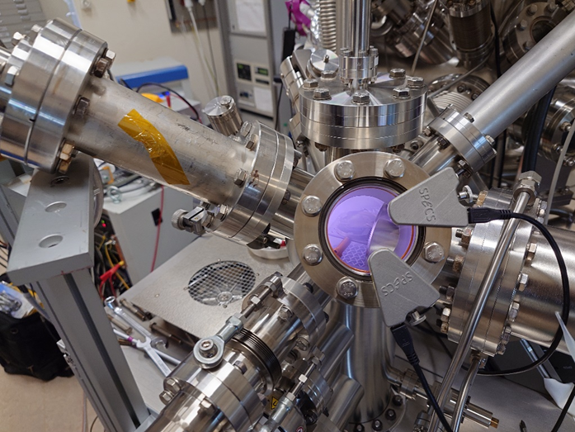
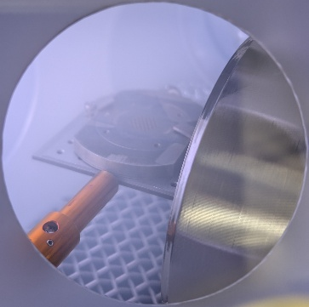
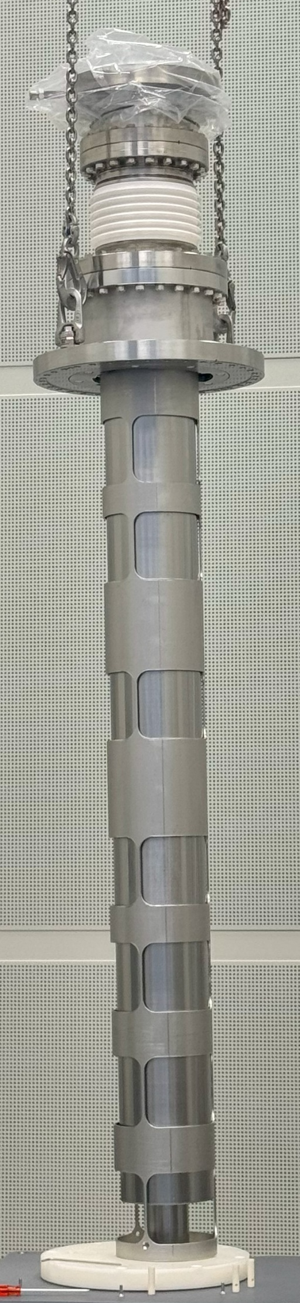
Next steps
so far…
scaled FCC specifications demonstrated on 1.3 GHz cavities
HiPIMS improves the Q₀ demonstrated for 400 MHz cavities
promising results for EP+HiPIMS, however, biggest challenge still related to passivation
ongoing activities:
revisiting chemical passivation strategies (bath composition, drying method, step sequence) through sample campaign
plasma surface treatment for surface cleaning and passivation
  in situ XPS+OES studies
  initial trials on 400 MHz cavities
studies related to optimising anode design (new version being prepared after successful testing)
  enabling HiPIMS + cavity biasing (DC and synchronised)
new coating system in preparation
courtesy of: C. Kouzios, M. Himmerlich
plasma discharge intercepted by the anode stem
To be continued at the next TFSRF Workshop!
Let’s see if it’ll still be on 400 MHz ☺

Slide 21
From 1.3 GHz Demonstrators to 400 (?) MHz FCC-ee Cavities: Challenges in Process Scale-Up
presenter: Caroline Hain
on behalf of: C. Pereira, L. Ferreira, A. Guyot, D. Doretto, S. Forel, S. Zadeh, F. Peauger, W. V. Delsolaro, G. Rosaz
(and many others from TE, SY, EN, and KEK)
12th TFSRF Workshop
21-25 September 2026

