Slide 1
From Nb to Nb₃Sn: Complexity in SRF Coating Development
presenter: Caroline Hain
on behalf of: C. Pereira, K. Brunner, W. V. Delsolaro, G. Rosaz
(and many others from TE, SY, EN)
12th TFSRF Workshop
21-25 September 2026

Slide 2
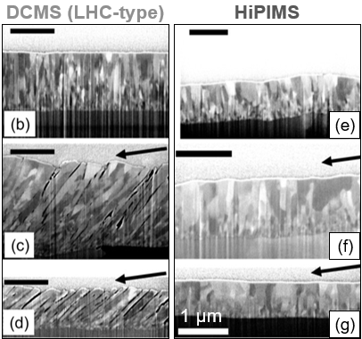
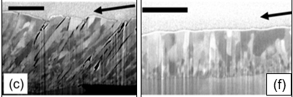
What are the challenges?
Film material challenges for both Nb and Nb₃Sn
high film density and low surface roughness
high purity and low defect density
Additional requirements for Nb₃Sn
correct Nb-to-Sn stoichiometry
formation and ordering of the A15 phase → around 750 °C to provide sufficient atomic mobility
HiPIMS the method of choice
substrate bias/ ion acceleration to tens-hundreds of eV
energetic bombardment enhances adatom mobility and film densification
excessive ion energy can induce atomic displacements and lattice defects
Nb films deposited onto Cu substrates via DCMS (left) and HiPIMS (right)
M. Ghaemi et al. Surface & Coatings Technology 476 (2024) 130199
Balance thermal activation and ion bombardment to achieve dense A15 Nb₃Sn while minimising defect generation and composition shifts.
Cu substrate challenges
low surface microroughness, with minimal surface defects (pits, dents, voids etc.)
oxide-free and free of organic or particulate contaminations
at elevated temperatures, recrystallisation and grain growth can occur
significant softening and loss of mechanical strength at ~400 °C (depending on Cu purity, prior deformation and microstructure)
Maintaining a clean, smooth and mechanically stable Cu substrate while providing the thermal budget required for Nb₃Sn growth.

Slide 3
Let’s focus on temperature

Slide 4
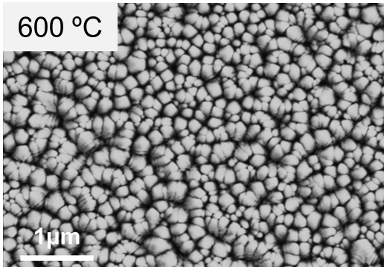
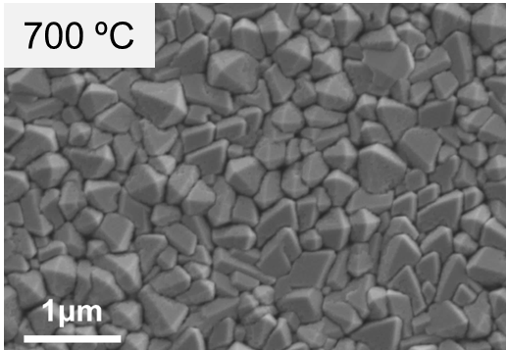
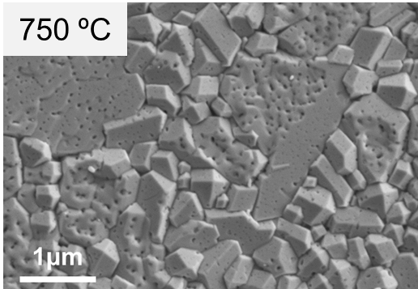
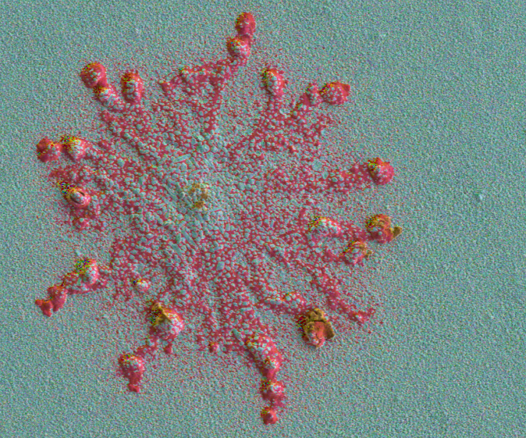
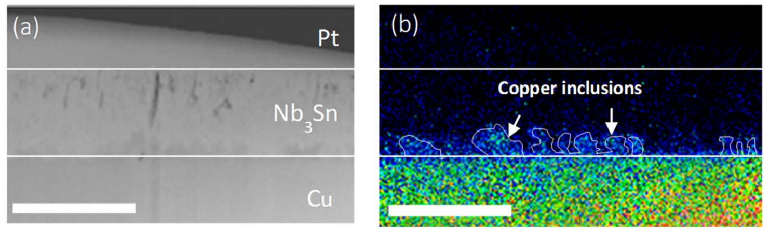
Influence of temperature: Nb₃Sn films
Nb₃Sn deposited on Cu using the same parameters and only changing the temperature
lower substrate temperature → lower adatom mobility
clear influence on porosity level and morphology
Sn
Cu interdiffusion from the substrate
promotes A15 phase formation
create locally non-superconducting regions
compromises superconductive performance
Nb
Pt
Cu
O
Nb₃Sn
50 µm
1 µm
1 µm
Cu

Slide 5
Influence of temperature: Nb₃Sn films
Mitigating Cu interdiffusion
introduce a diffusion barrier layer (DBL) between the Cu substrate and Nb₃Sn
Ta is a promising barrier material and has been shown to suppress Cu diffusion
  α-Ta: stable bcc phase, the required phase for this application
  β-Ta: metastable, tetragonal and brittle, undesirable

Slide 6
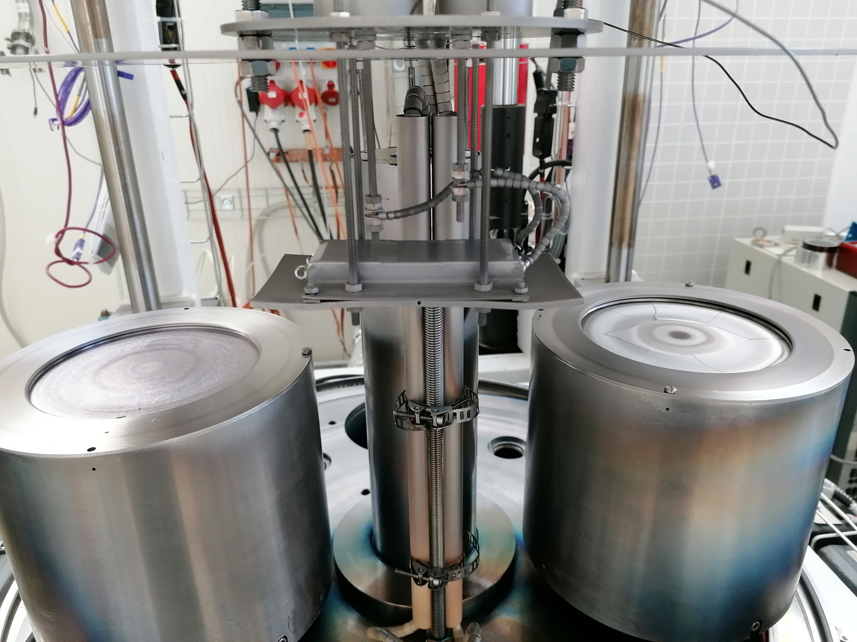
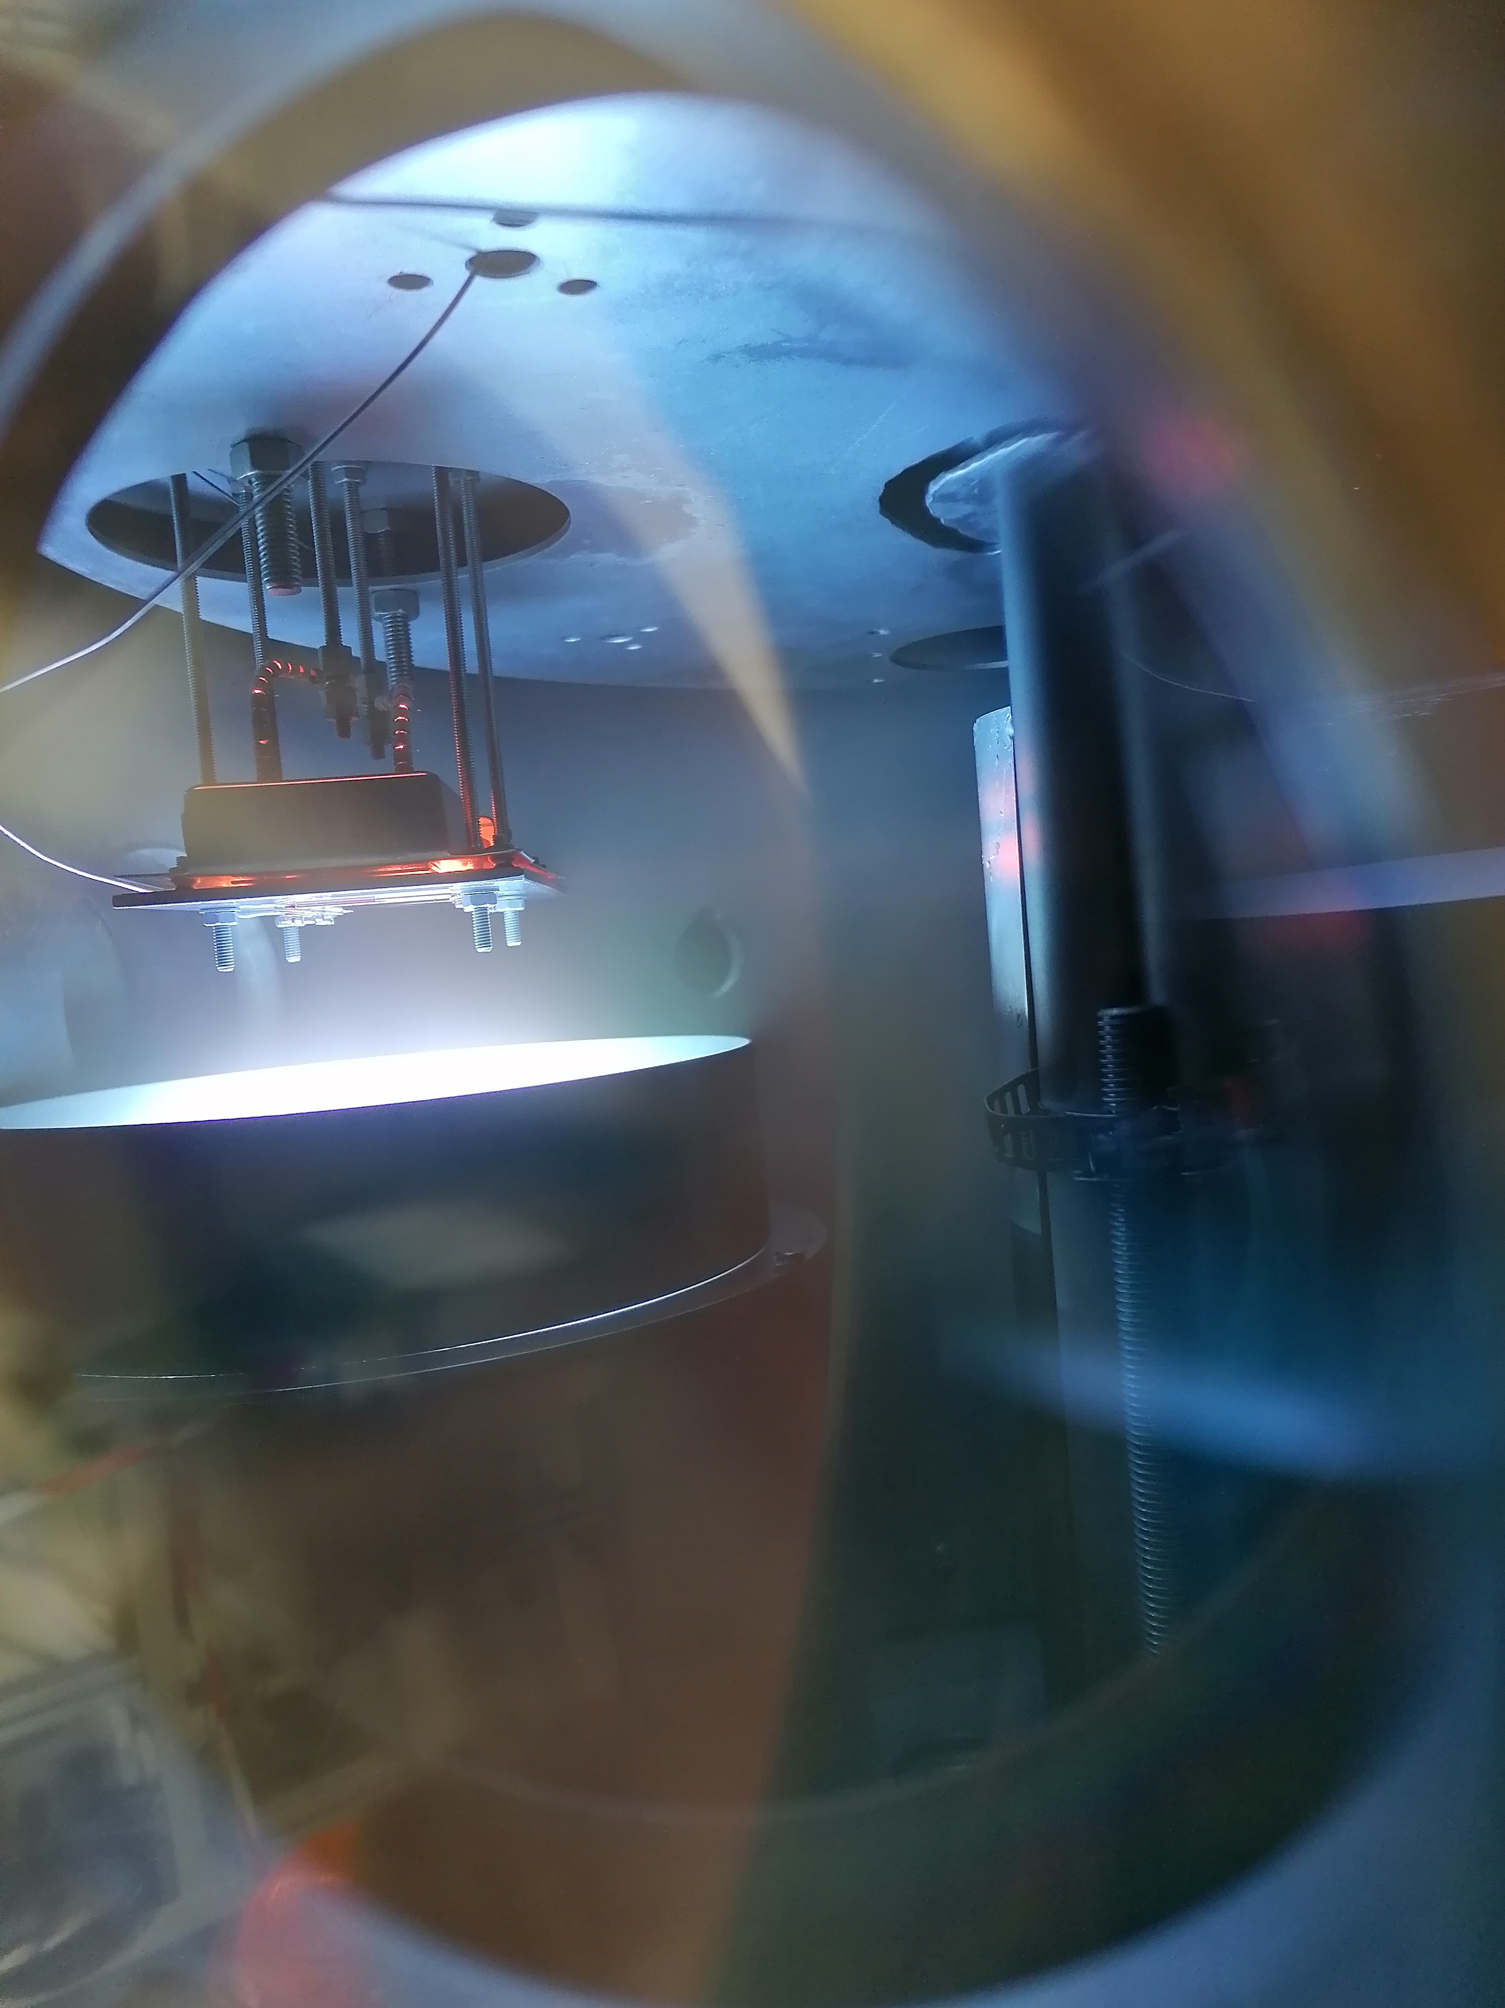
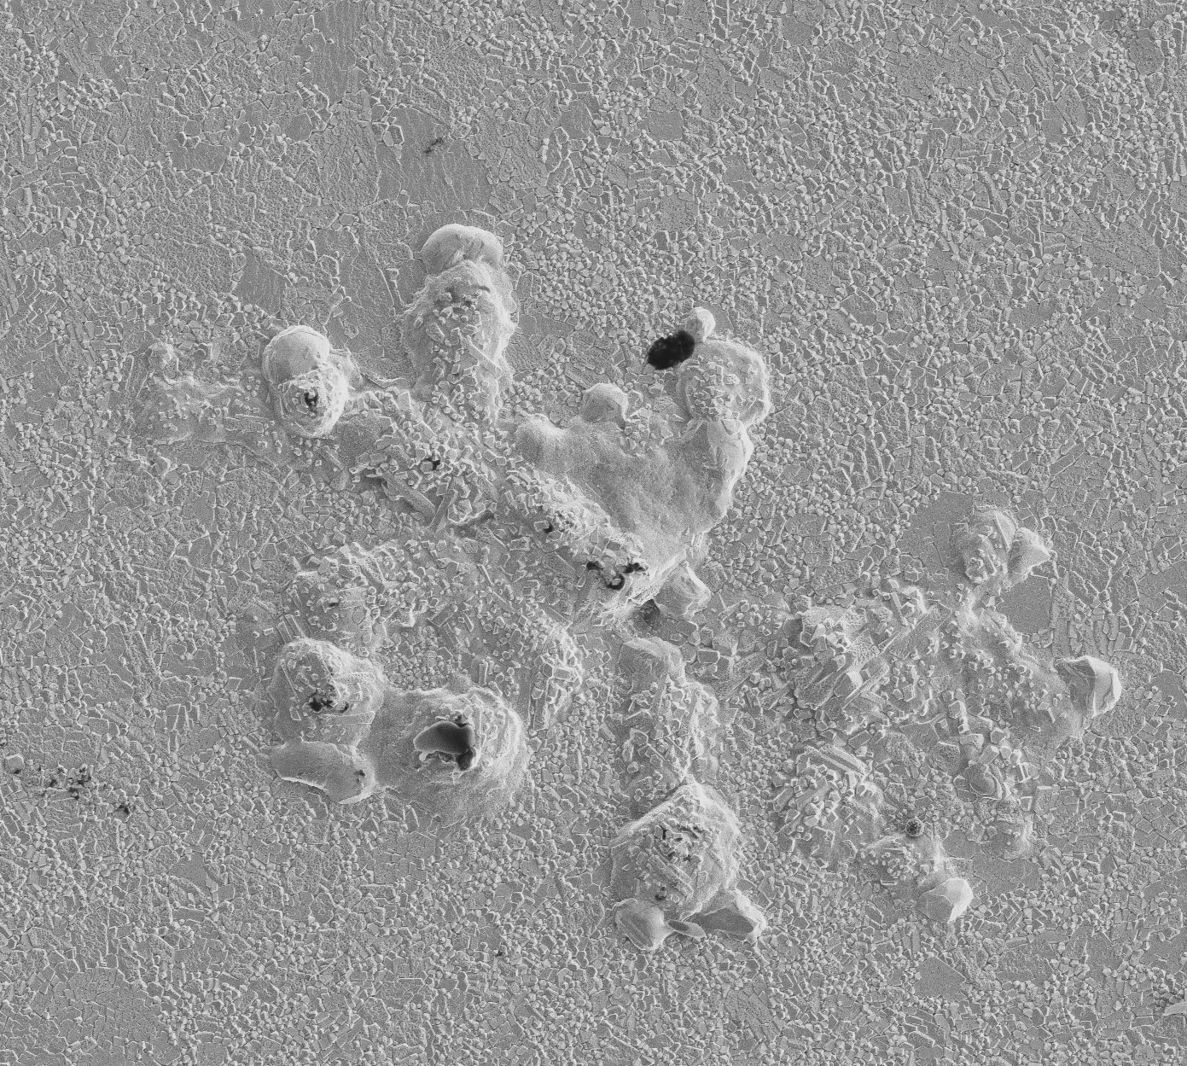
Influence of temperature: Nb₃Sn films
Mitigating Cu interdiffusion
introduce a diffusion barrier layer (DBL) between the Cu substrate and Nb₃Sn
Ta is a promising barrier material and has been shown to suppress Cu diffusion
  α-Ta: stable bcc phase, the required phase for this application
  β-Ta: metastable, tetragonal and brittle, undesirable
Nb₃Sn
Ta
Nb₃Sn
Ta
Cu
2.5 μm
20 μm

Slide 7
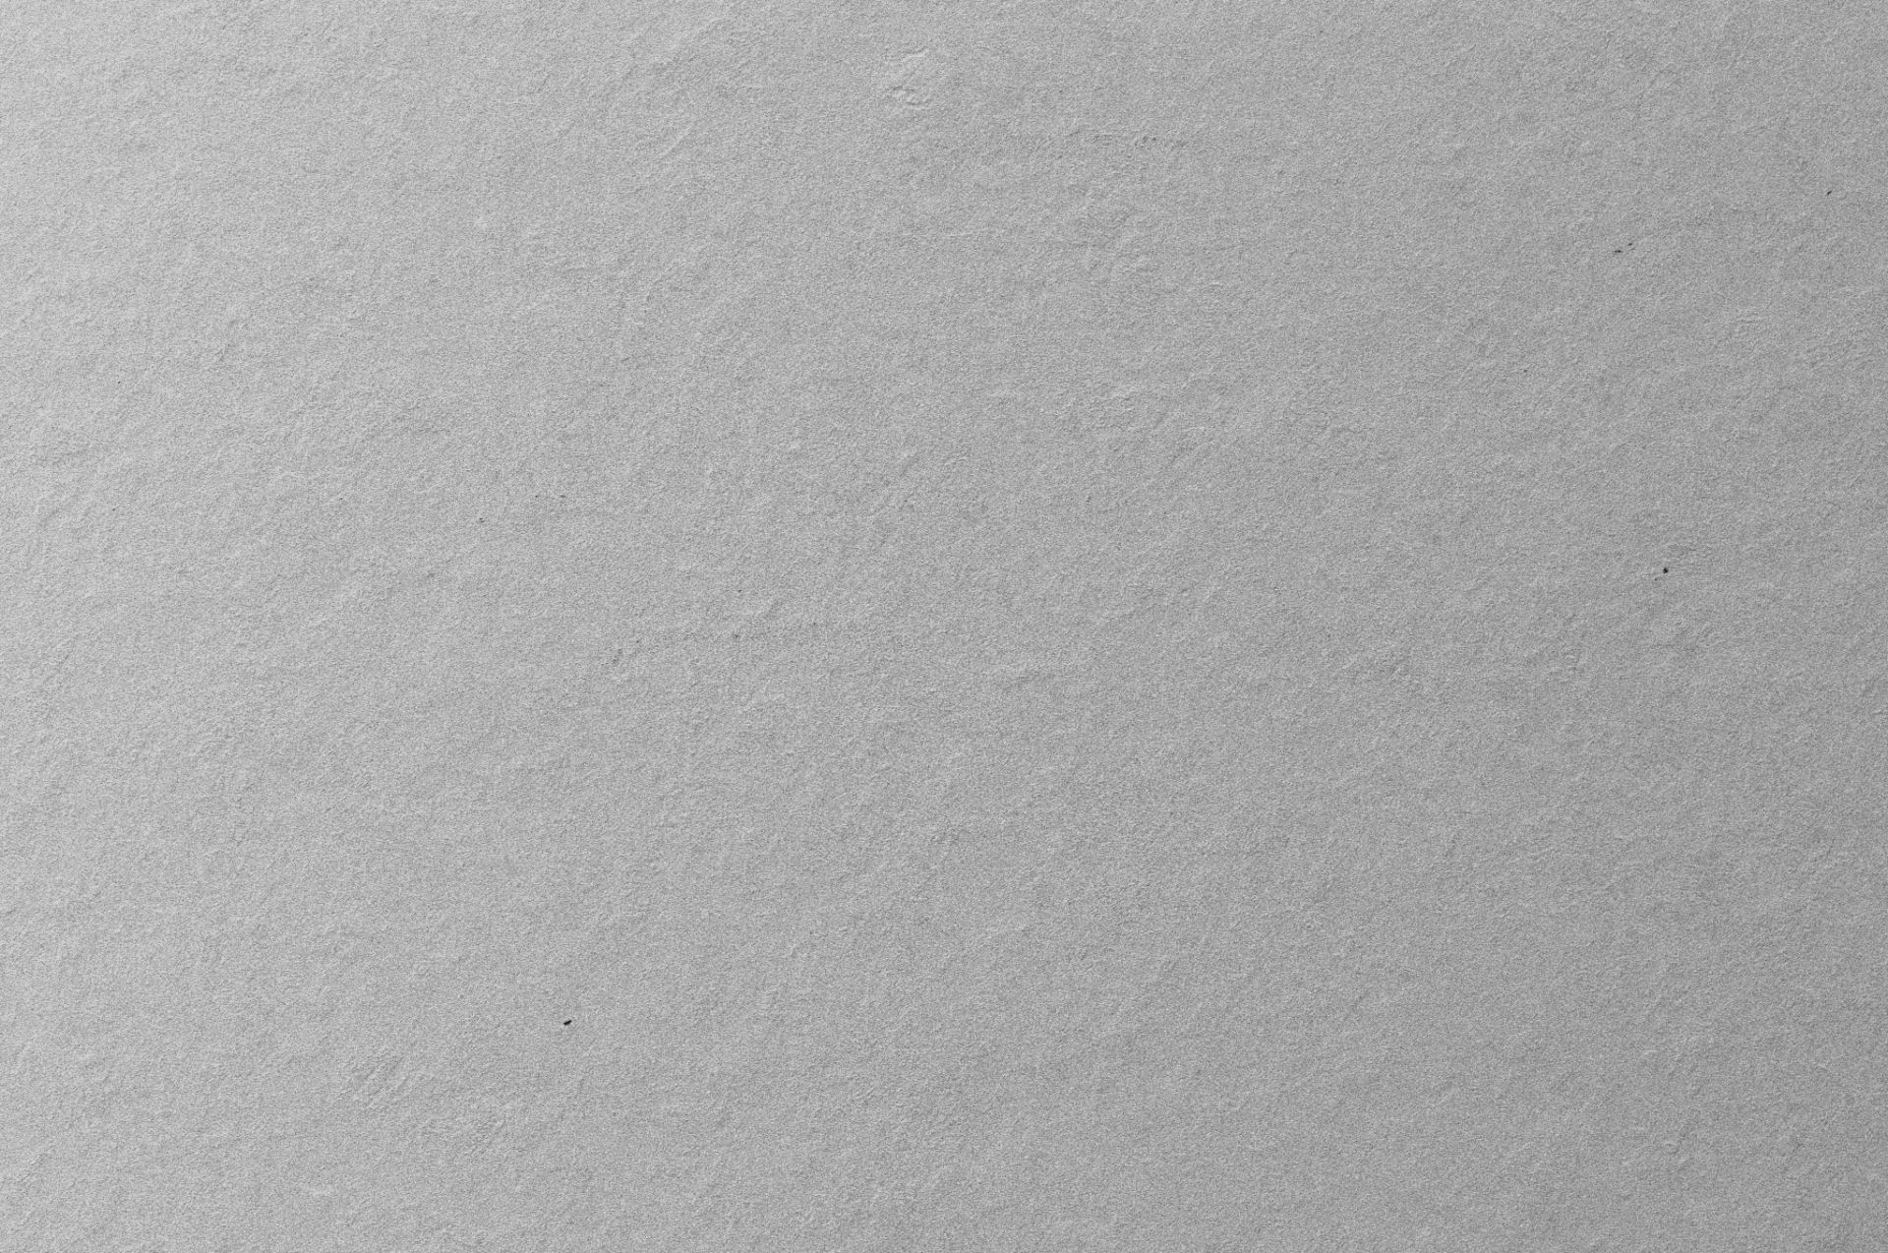
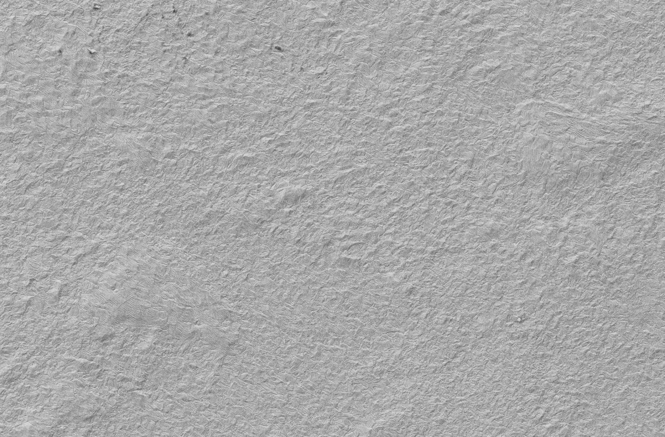
Influence of temperature: Nb films
Is this only happening to Nb₃Sn/Ta/Cu? How do higher temperatures affect Nb/Cu?
150 ºC
500 ºC
600 ºC
higher temperature
→ porosities and other surface defects for Nb/Cu
100 μm
100 μm
100 μm
20 μm
20 μm
20 μm

Slide 8
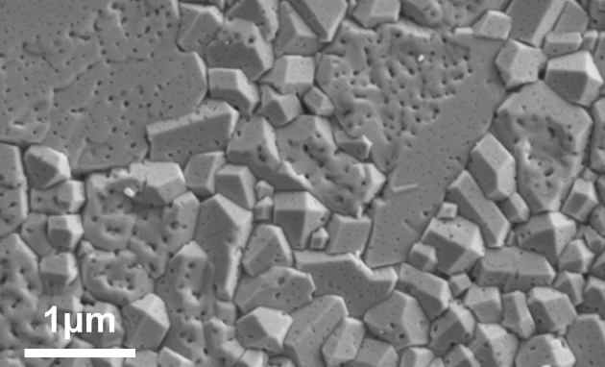
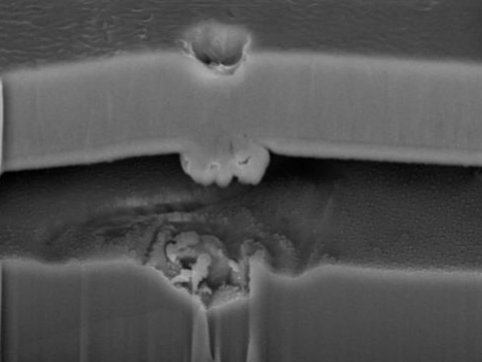
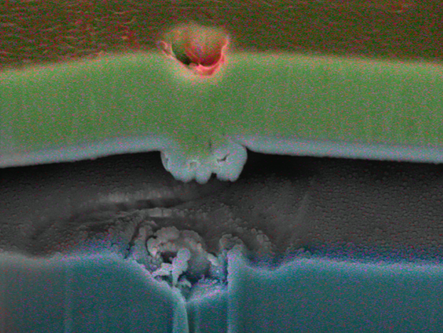
Influence of temperature: Nb films
Is this only happening to Nb₃Sn/Ta/Cu? How do higher temperatures affect Nb/Cu?
500 ºC
600 ºC
750 ºC
Nb
Nb
Nb₃Sn
20 μm
20 μm
Why?
500 ºC
500 ºC
Nb
Cu
C
O
2.5 μm
5 μm
5 μm

Slide 9
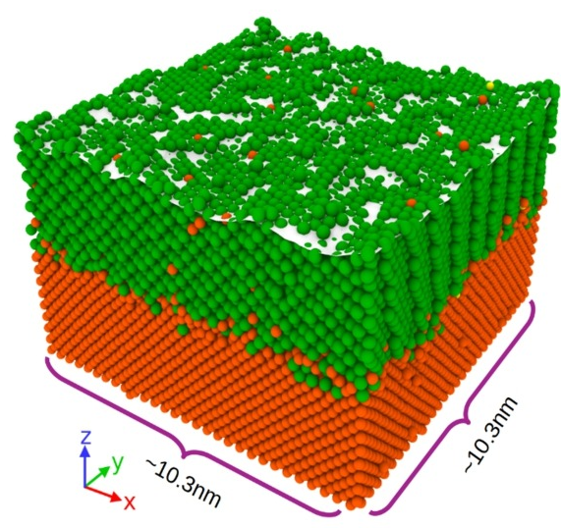
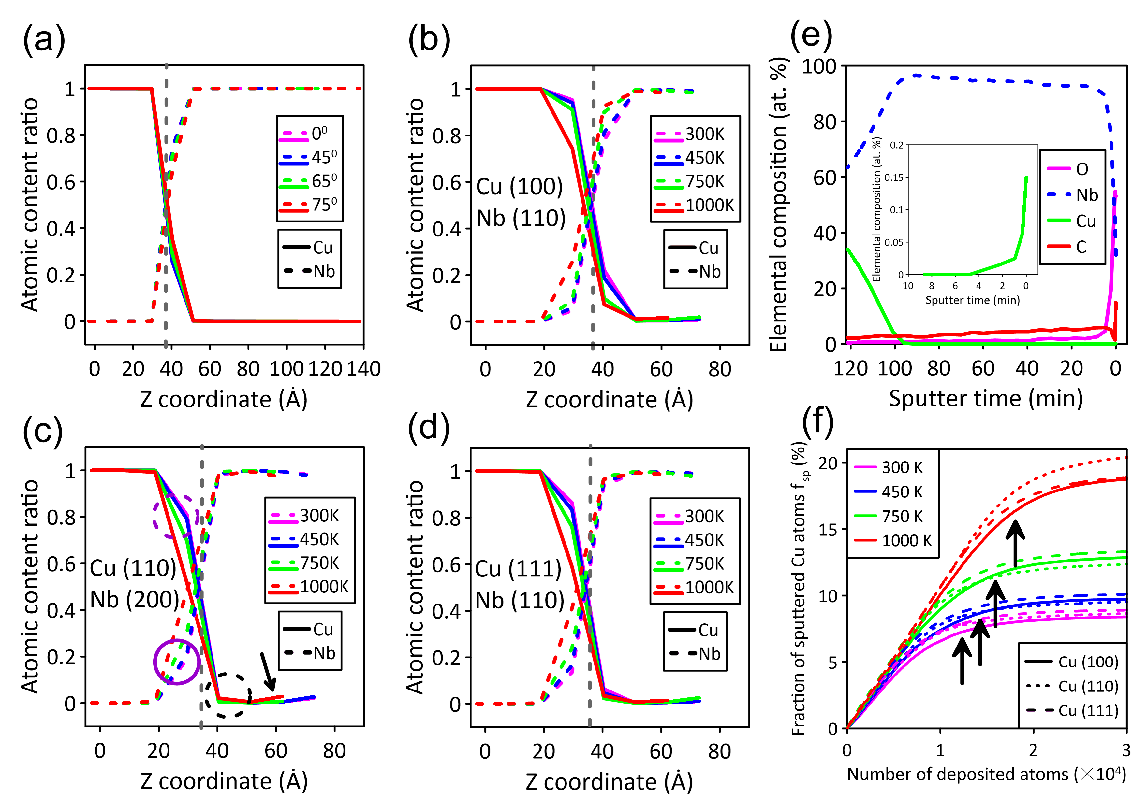
Influence of temperature: Cu substrate
Temperature-dependant Cu atom mobility predicted through molecular dynamic simulations
Why is this happening?
energetic species induce collision cascades that displace Cu atoms from the substrate
local heating from ion bombardment enhances atomic rearrangement and facilitates Cu diffusion
island nucleation and coalescence, Cu adatoms can be incorporated into Nb clusters
Schematic of the constructed surface mesh (white surface) after simulating deposition of 25000 Nb and 5000 Ar atoms on Cu(100) (T = 300 K) at conditions consistent with HiPIMS growth. Nb atoms (green), Cu atoms (orange).
Cumulative fraction of sputtered Cu atoms f_{sp} (with respect to the initial number of Cu atoms in the simulation box) as a function of number of the deposited particles for HiPIMS growth simulations.
M. Ghaemi (University of Helsinki) https://doi.org/10.1016/j.surfcoat.2023.130199

Slide 10
Influence of temperature: Cu substrate
Temperature-dependant Cu atom mobility predicted through molecular dynamic simulations
… and supported by experimental results!
Schematic of the constructed surface mesh (white surface) after simulating deposition of 25000 Nb and 5000 Ar atoms on Cu(100) (T = 300 K) at conditions consistent with HiPIMS growth. Nb atoms (green), Cu atoms (orange).
Cumulative fraction of sputtered Cu atoms f_{sp} (with respect to the initial number of Cu atoms in the simulation box) as a function of number of the deposited particles for HiPIMS growth simulations.
XPS depth profile of Cu, Nb, O, and C in a 150 nm thick Nb layer deposited on Cu via HiPIMS at 420 K.
M. Ghaemi (University of Helsinki) https://doi.org/10.1016/j.surfcoat.2023.130199

Slide 11
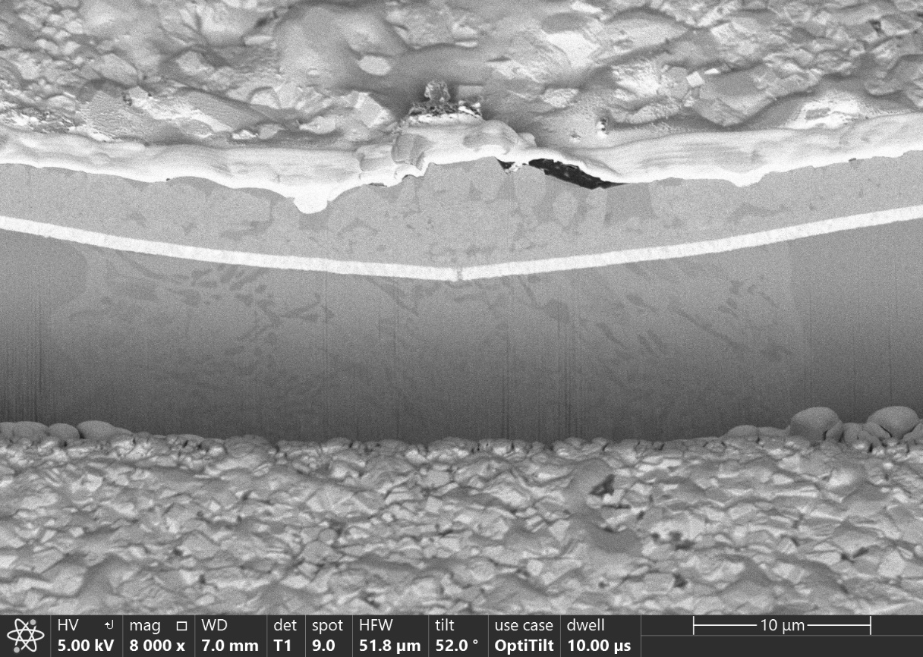
Influence of temperature: Ta DBL
Could this high Cu mobility also be affecting the Ta diffusion barrier layer?
Ta at 750 ºC
Ta at 300 ºC
5 μm
10 μm
Still to be optimised, however, very promising initial result!
New campaign ongoing, latest XPS surface results:
Nb/Cu deposited at 300 ºC → 6 % Cu
Ta/Cu without heating (under various ion acceleration conditions) → below the detection limit!
Cumulative fraction of sputtered Cu atoms f_{sp} as a function of number of the deposited particles for HiPIMS growth simulations.
https://doi.org/10.1016/j.surfcoat.2023.130199

Slide 12
5 μm
10 μm

Slide 13
from samples to cavities

Slide 14
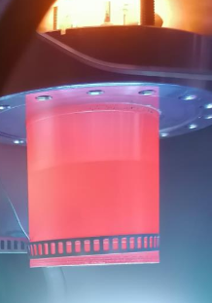
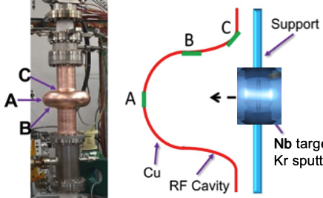
Upscaling: deposition system
How to move from coating samples to coating cavities?
coating samples using planar targets
coating cavities using a cylindrical targets
M. Ghaemi et al. Surface & Coatings Technology 476 (2024) 130199
Nb target
Different aspects need to be considered
two materials are needed: Ta and Nb₃Sn
how to move from planar to cylindrical targets?
“easy enough” for Nb, how about Nb₃Sn?

Slide 15
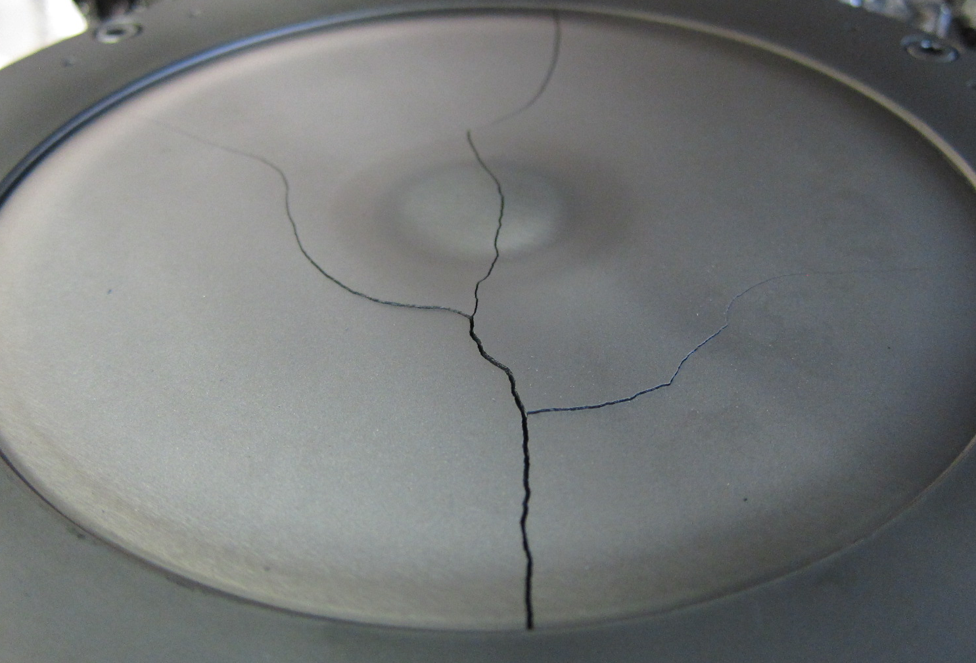
Upscaling: deposition system
How to move from coating samples to coating cavities?
coating samples using planar targets
Nb₃Sn planar target
50 mm
Different aspects need to be considered
two materials are needed: Ta and Nb₃Sn
how to move from planar to cylindrical targets?
“easy enough” for Nb, how about Nb₃Sn?
Already prone to cracking!
brittle (fragile)
can create dust upon cracking
impossible to buy as a cylinder

Slide 16
Upscaling: target strategies
How to prevent target cracking AND coat cavities?

Slide 17
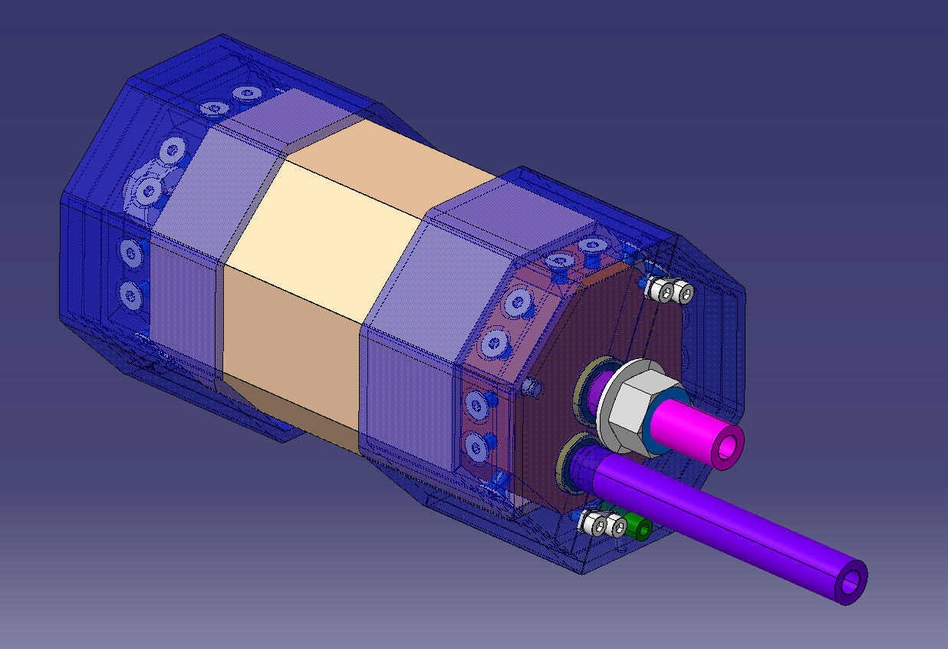
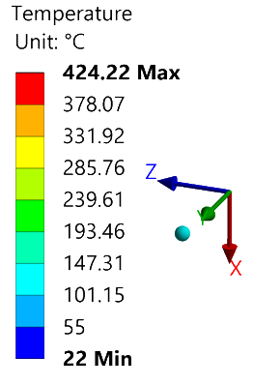
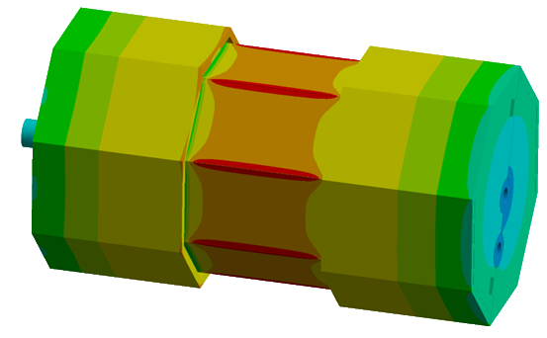
Upscaling: target strategies
How to prevent target cracking AND coat cavities?
moving from a static cathode design to a mobile cathode one (system already available for Nb coating of 1.3 GHz cavities)
using multiple planar targets to mimic a cylindrical geometry
feasible based on simulations (through direct cooling, with the cavity at 800 ºC)

Slide 18
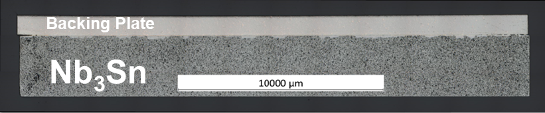
Upscaling: target strategies
How to prevent target cracking AND coat cavities?
moving from a static cathode design to a mobile cathode one (system already available for Nb coating of 1.3 GHz cavities)
using multiple planar targets to mimic a cylindrical geometry
feasible based on simulations (through direct cooling, with the cavity at 800 ºC)
How to prevent target cracking AND coat cavities?
use a backing plate with a similar thermal expansion coefficient as Nb₃Sn (our case Cu-W)
However:
epoxy gluing → high contamination risk
indium sealing → cross-contamination has been observed

Slide 19
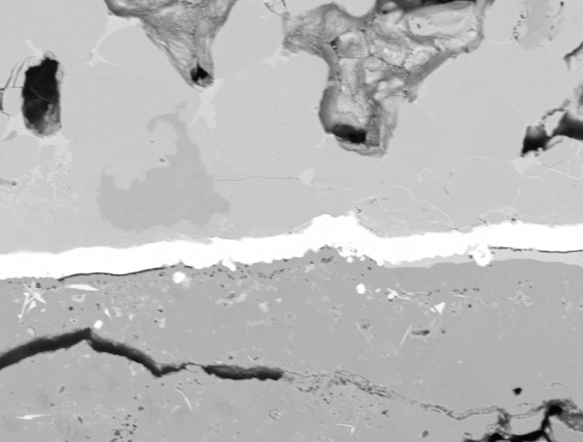
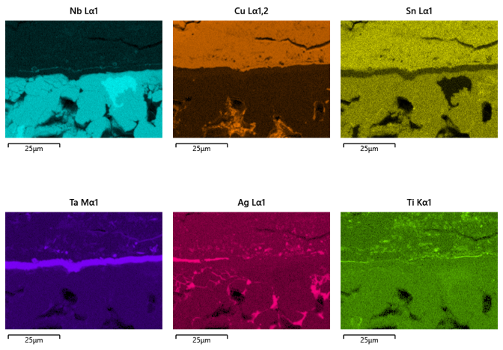
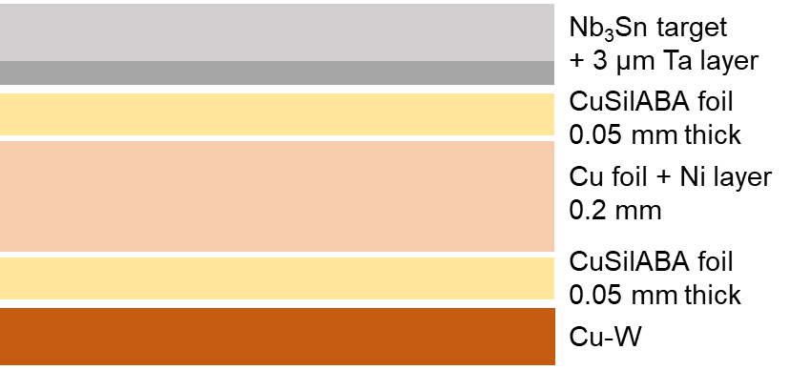
Upscaling: target strategies
Different approaches are currently under investigation:
EN-MME working on developing an in-house brazing recipe
as the backing plate contains Cu it is important to prevent it contaminating the Nb₃Sn target
bonding interface
Nb
Cu
25 μm
Sn
Ta
25 μm
Cu migration still in occurring despite the presence of the Ta layer
the brazing process takes place at 800 ºC
the Nb₃Sn target is not fully dense, i.e. pores are present
New trails ongoing with substituting the Cu foil for a Nb one.
schematic of brazing stack

Slide 20
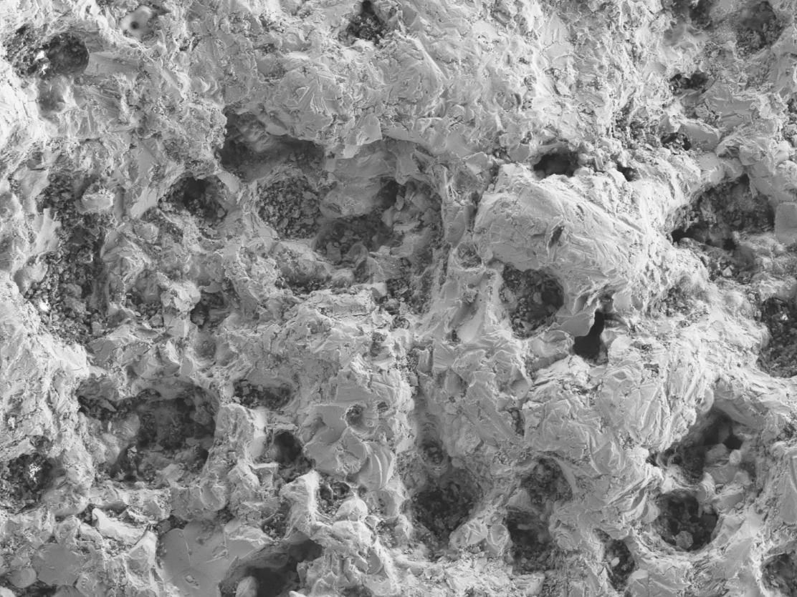
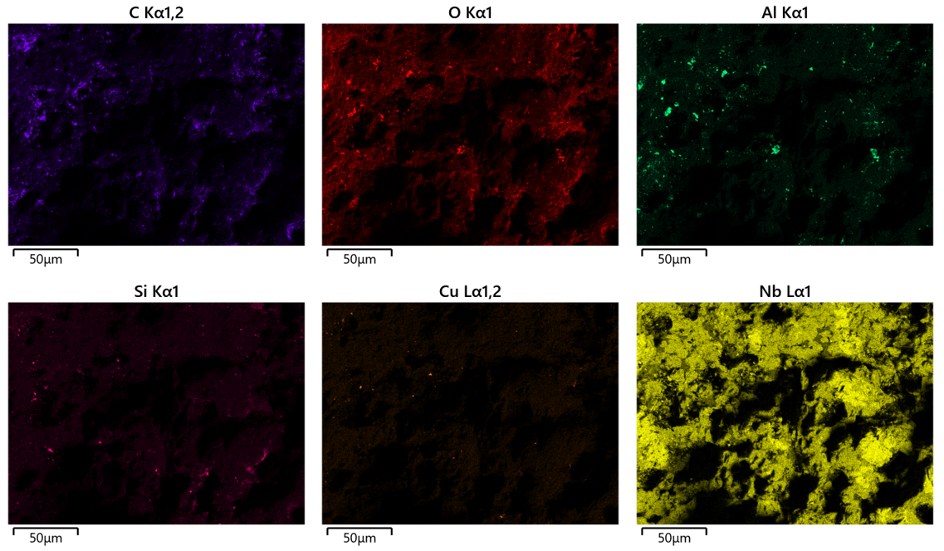
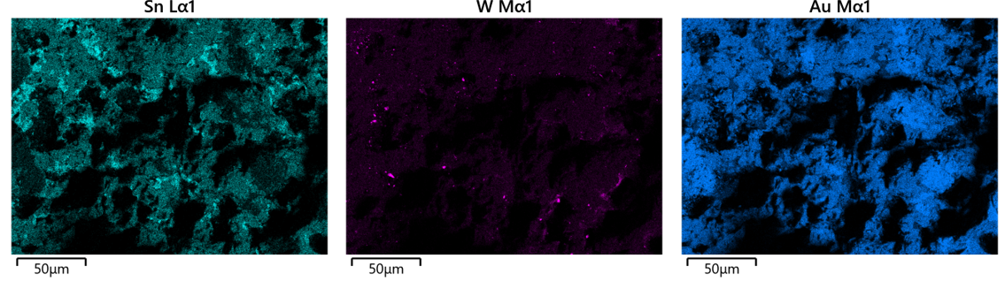
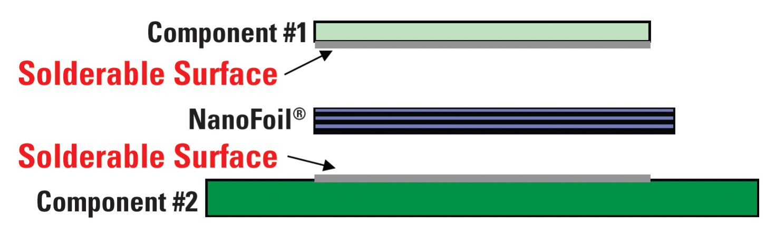
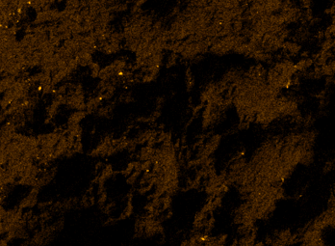
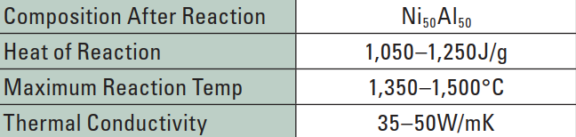
Upscaling: target strategies
Nb₃Sn target surface
Nb
Different approaches are currently under investigation:
EN-MME working on developing an in-house brazing recipe
trying the commercially available “nanofoil bonding” approach
50 μm
Sn
Nb₃Sn target
50 μm
Al
W
Cu
Cu-W backing plate
Cu, W and Al detected on the surface of Nb₃Sn
further analysis needed to determine if only the surface is contaminated or also the bulk
https://www.indium.com/products/nanofoil/

Slide 21
what’s next?

Slide 22
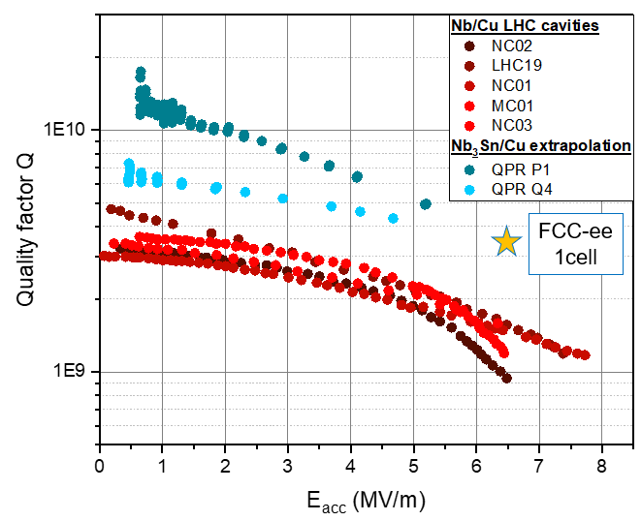
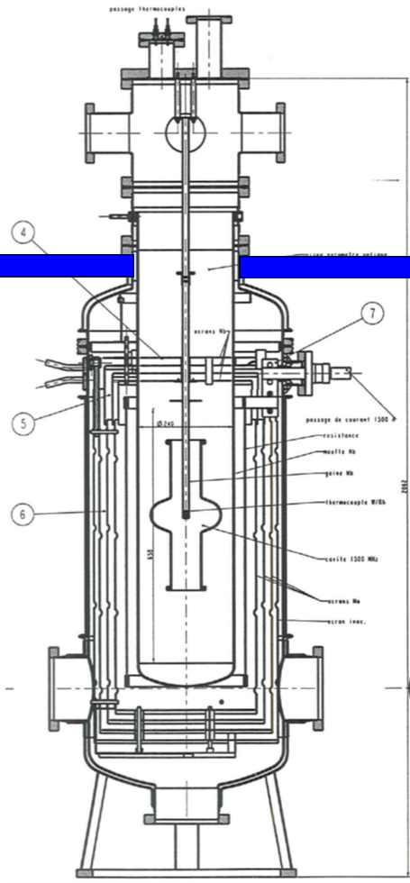
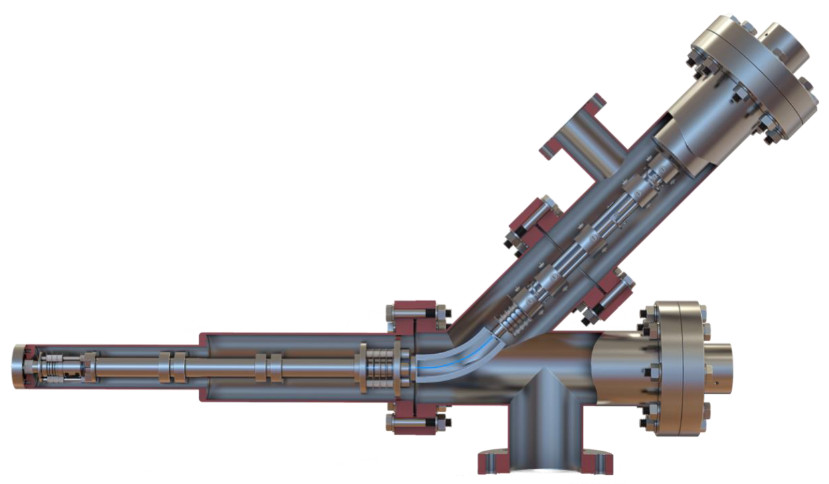
Next steps
so far…
Nb₃Sn has proven to be competitive with Nb
Ta DBL deposition has been modified to take place without additional heating
understanding Cu mobility has improved
ongoing activities:
investigating different bonding routes to enable progress on a cylindrical-like target
further optimisation on the Ta DBL, considering different ion acceleration possibilities (bipolar HiPIMS, unipolar HiPIMS + cavity/substrate biasing)
assisted process development via in situ plasma diagnostics during Nb and Nb₃Sn sputtering (e.g. OES, QMS)
high temperature deposition of Nb on various substrates to further unravel the behaviour of Cu
post-deposition annealing of a Nb/Cu cavity within a vacuum furnace (furnace purity checks happening now!)
To be continued at the next TFSRF Workshop!

Slide 23
From Nb to Nb₃Sn: Complexity in SRF Coating (and Substrate!) Development
presenter: Caroline Hain
on behalf of: C. Pereira, K. Brunner, W. V. Delsolaro, G. Rosaz
(and many others from TE, SY, EN)
12th TFSRF Workshop
21-25 September 2026

