Slide 1
Recent RF test results of Nb/Cu full-seamless
1.3 GHz cavities
Hayato Araki
High Energy Accelerator Research Organization (KEK)

Slide 2


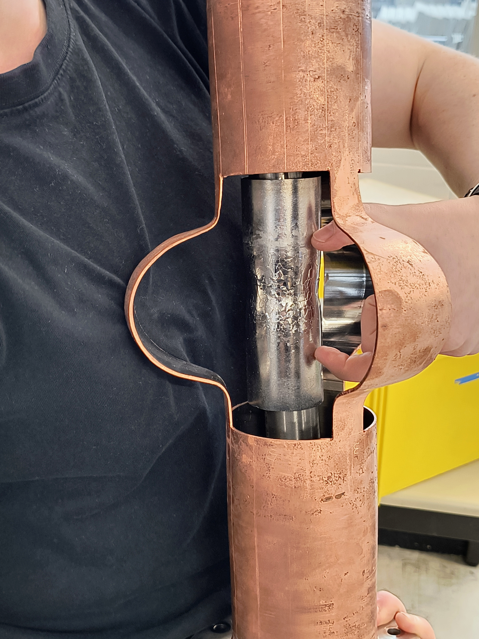
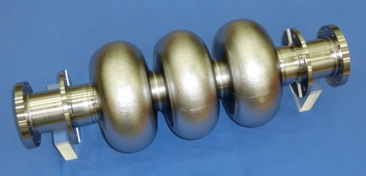
KEK/CERN Collaboration for Nb/Cu R&D
CERN
KEK
  Nb/Cu cavity development from LEP
  HiPIMS coating facility
  Copper tube hydroforming
  FCC
  Bulk Nb cavity development from TRISTAN
  1.3 GHz processing facility
  Bulk Nb hydroforming
  ILC

Slide 3
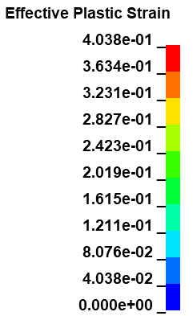
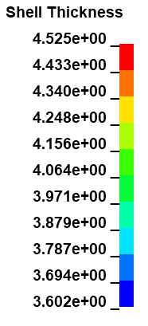
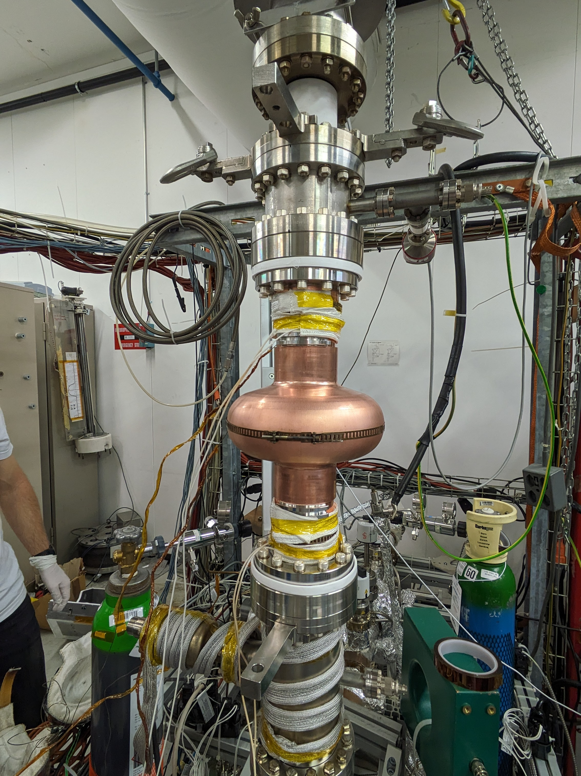
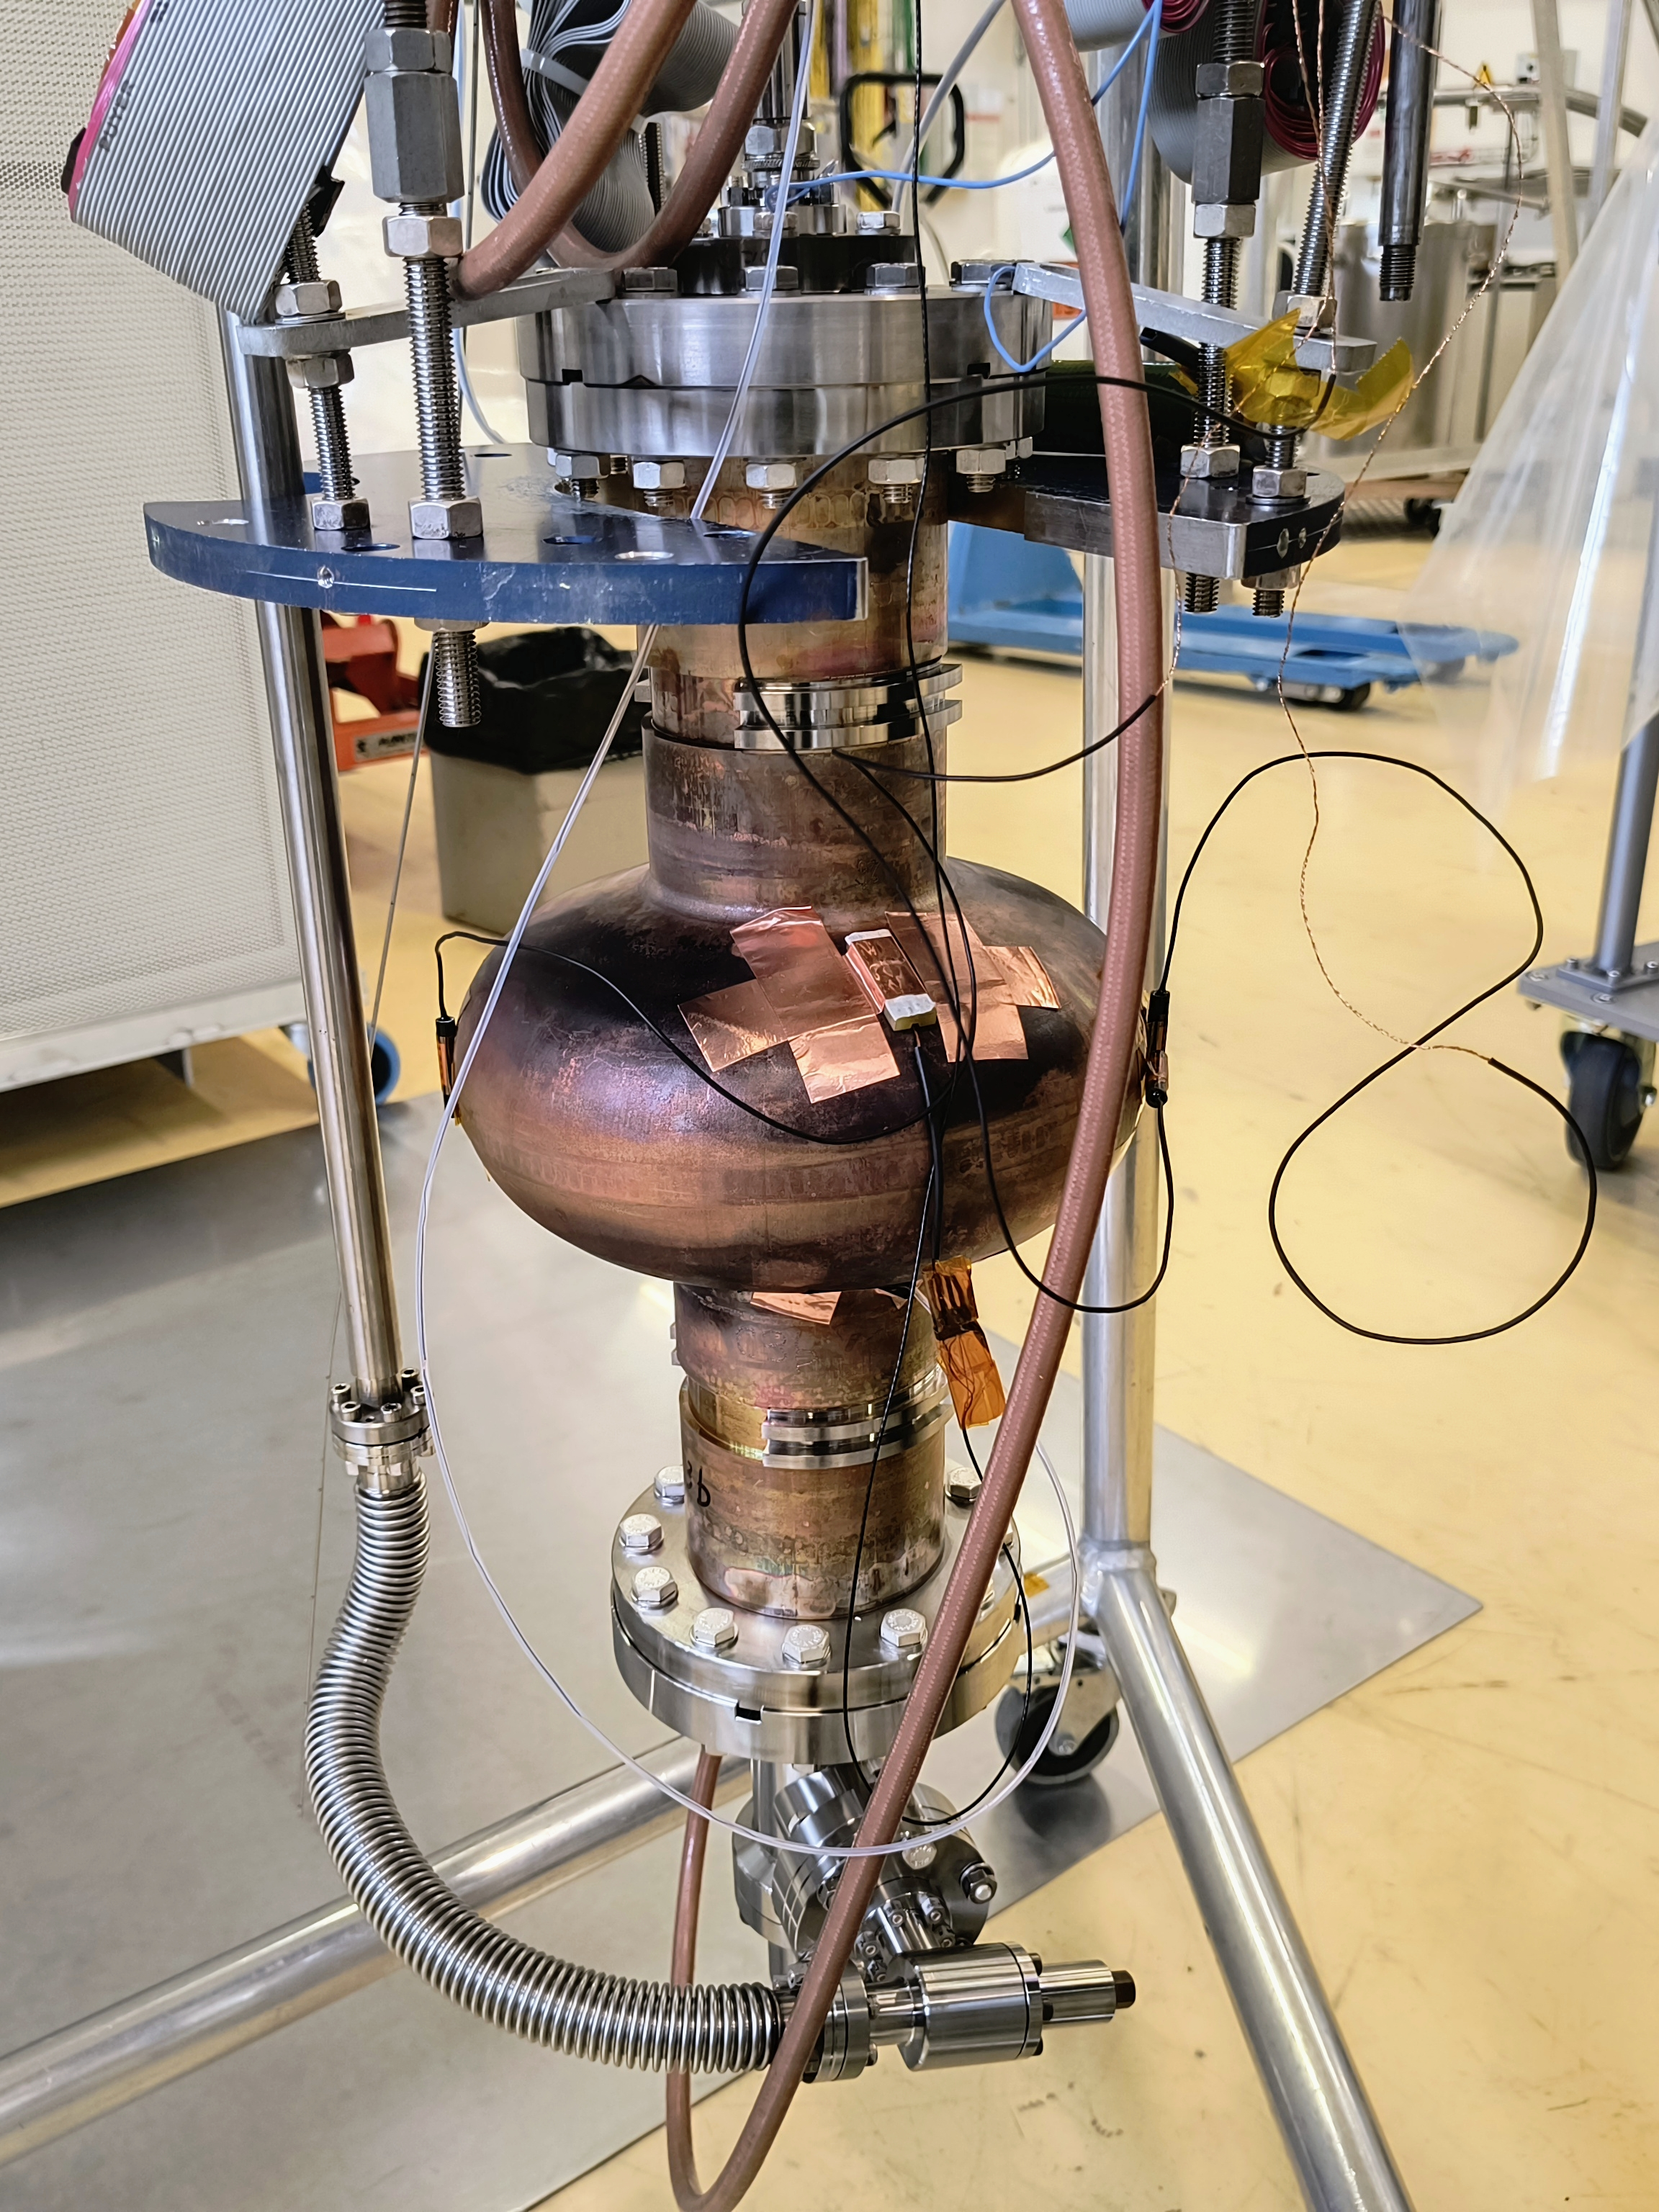
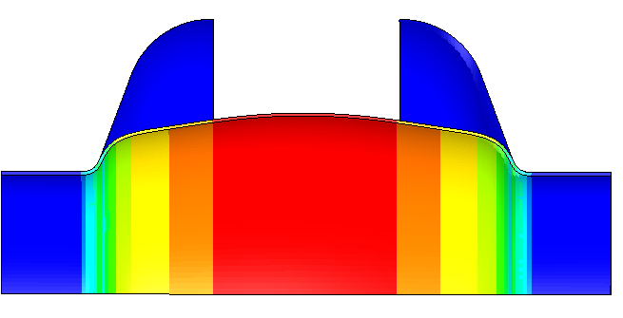
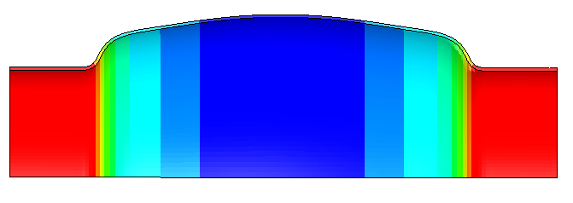
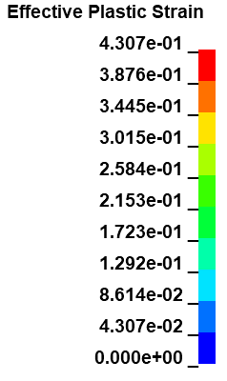
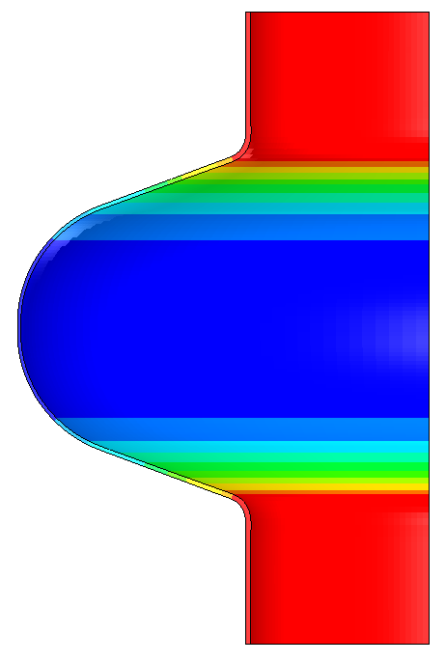
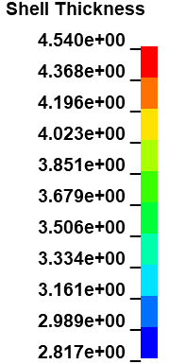
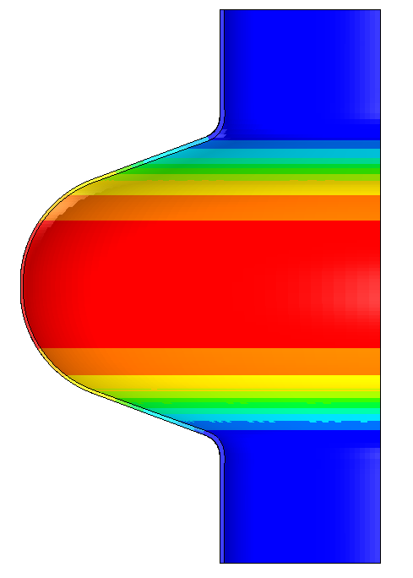
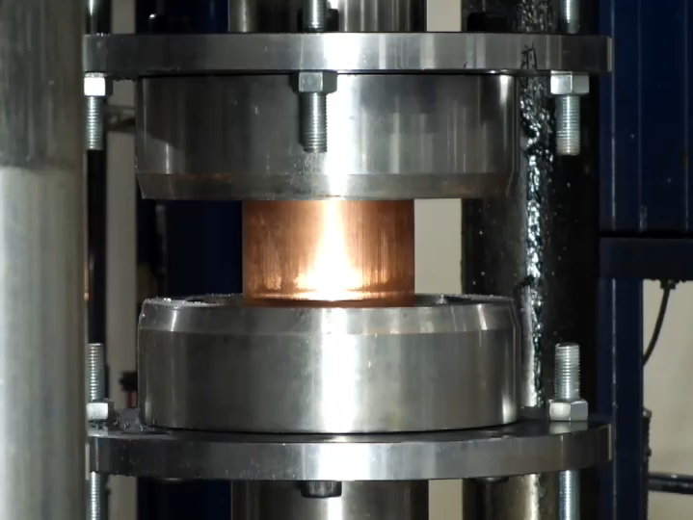
1.3 GHz cavity fabrication
Hydroforming
Simulation
Coating
Measurement

Slide 4
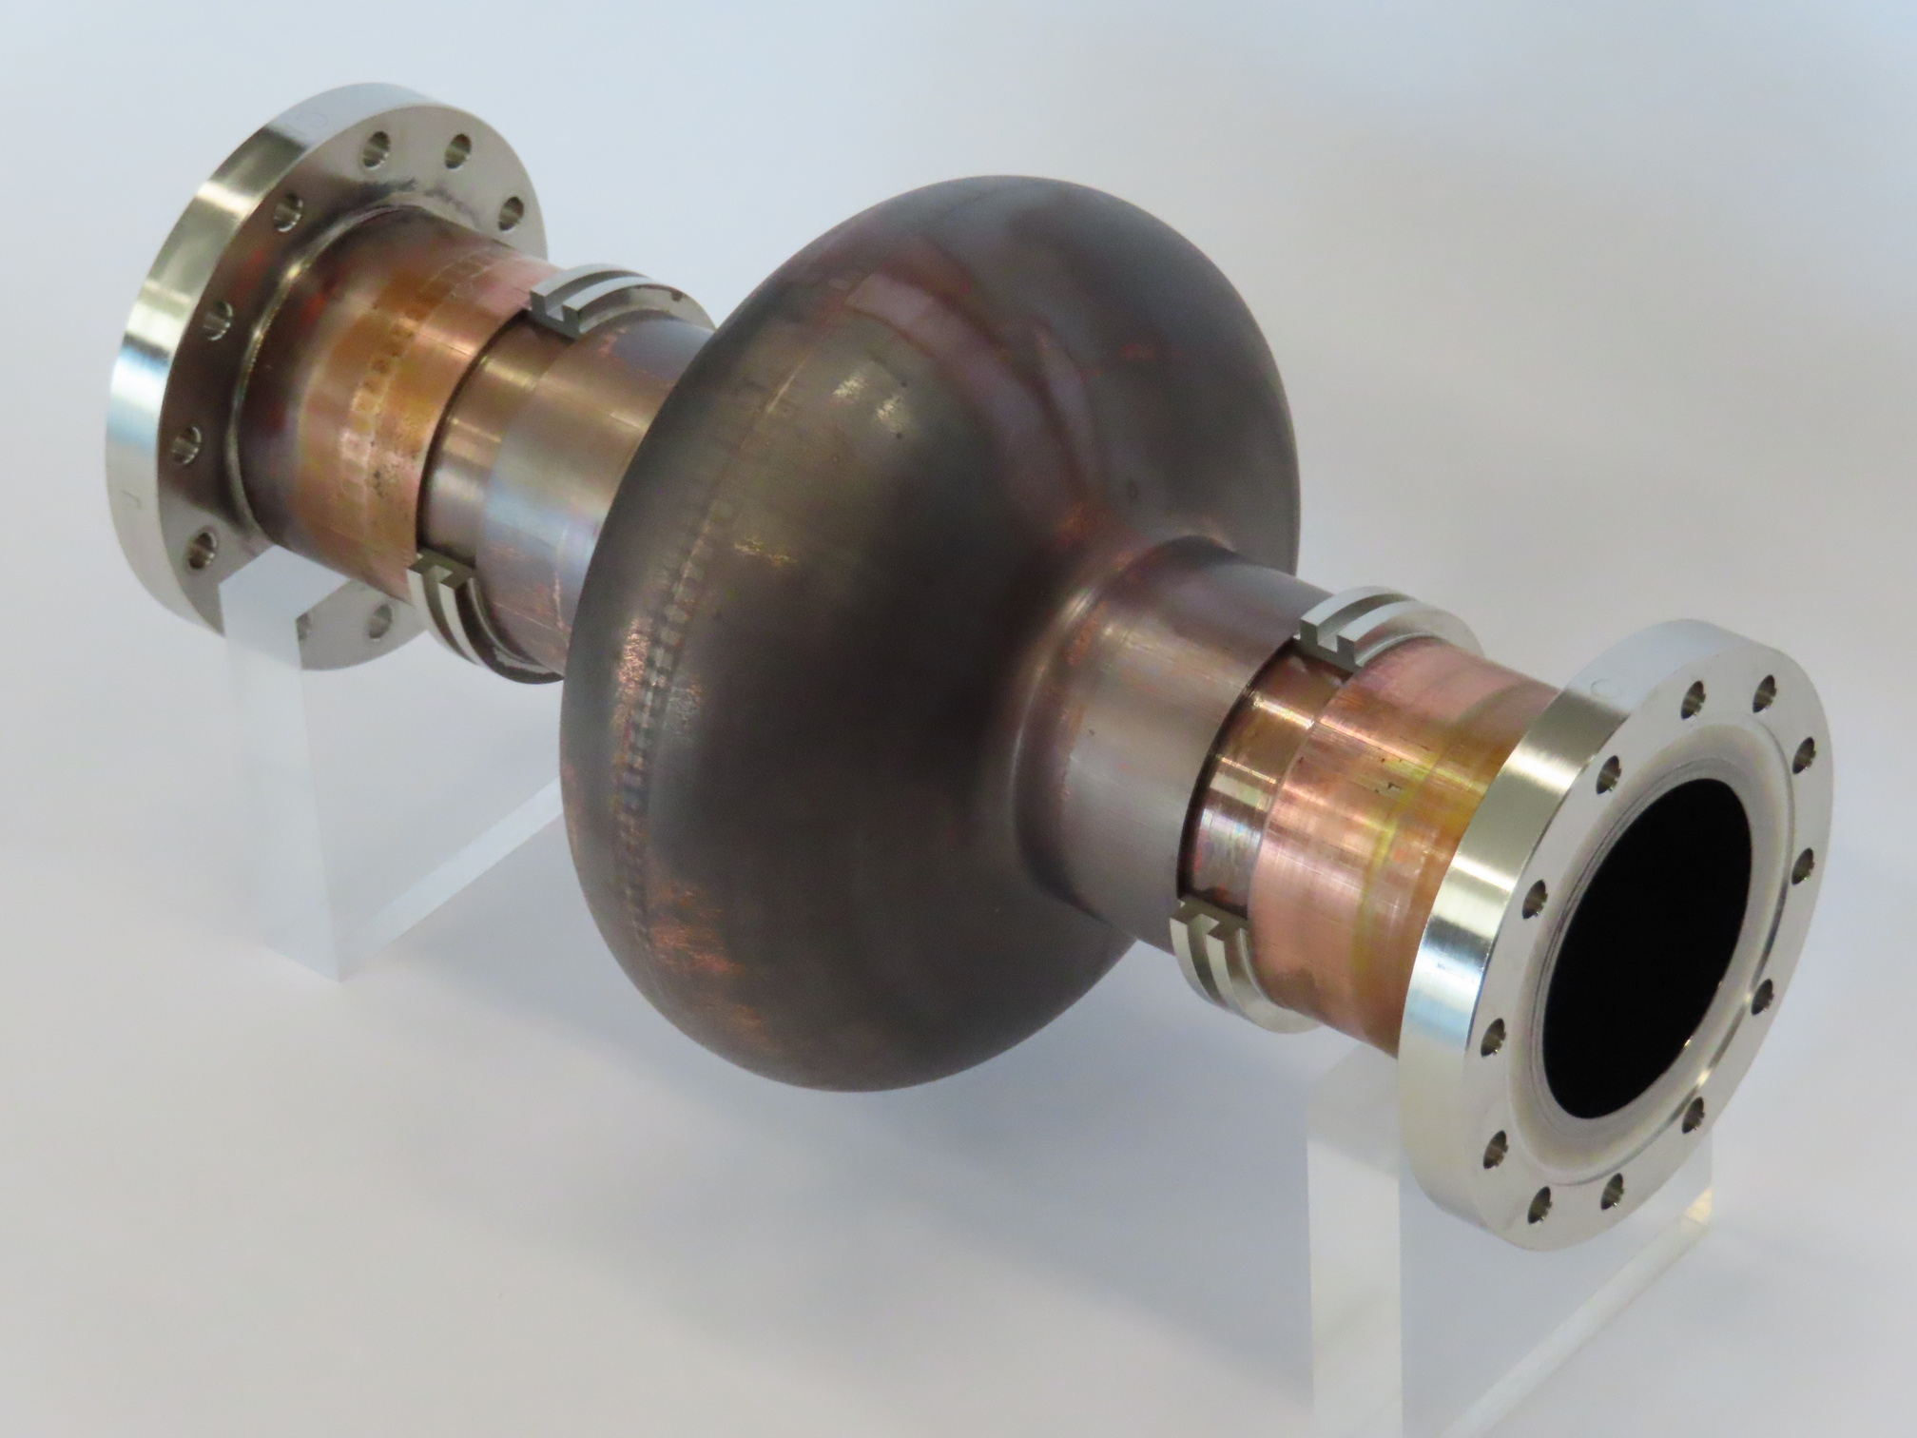
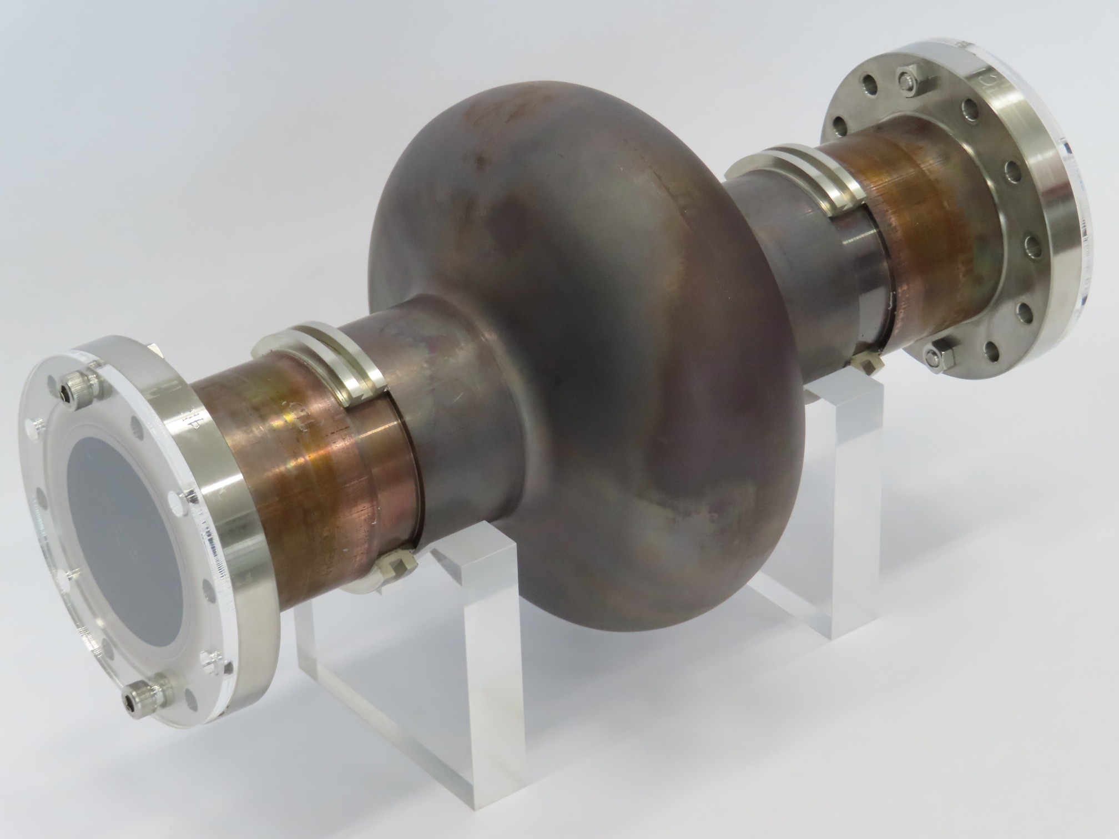
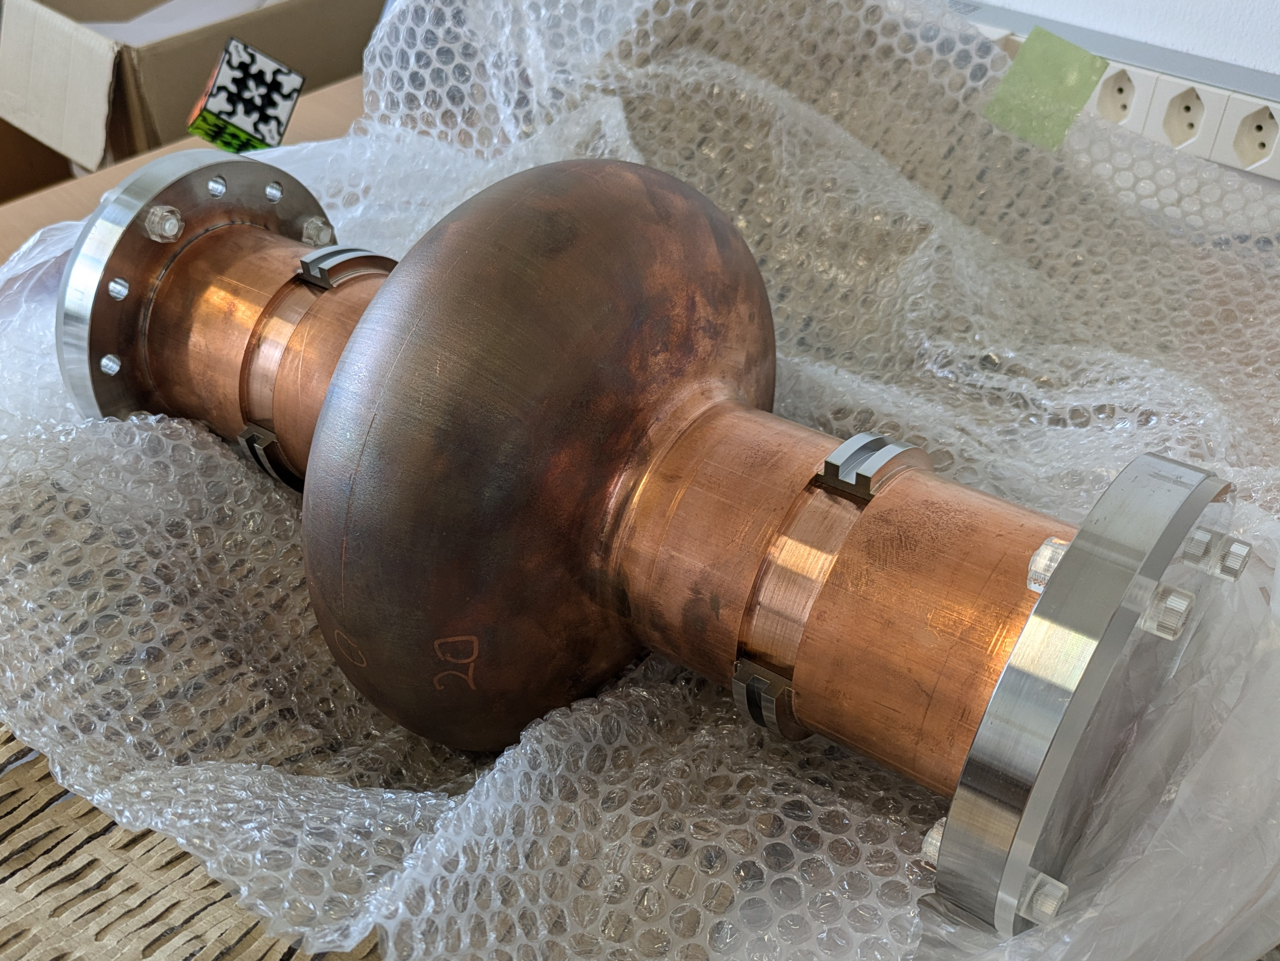
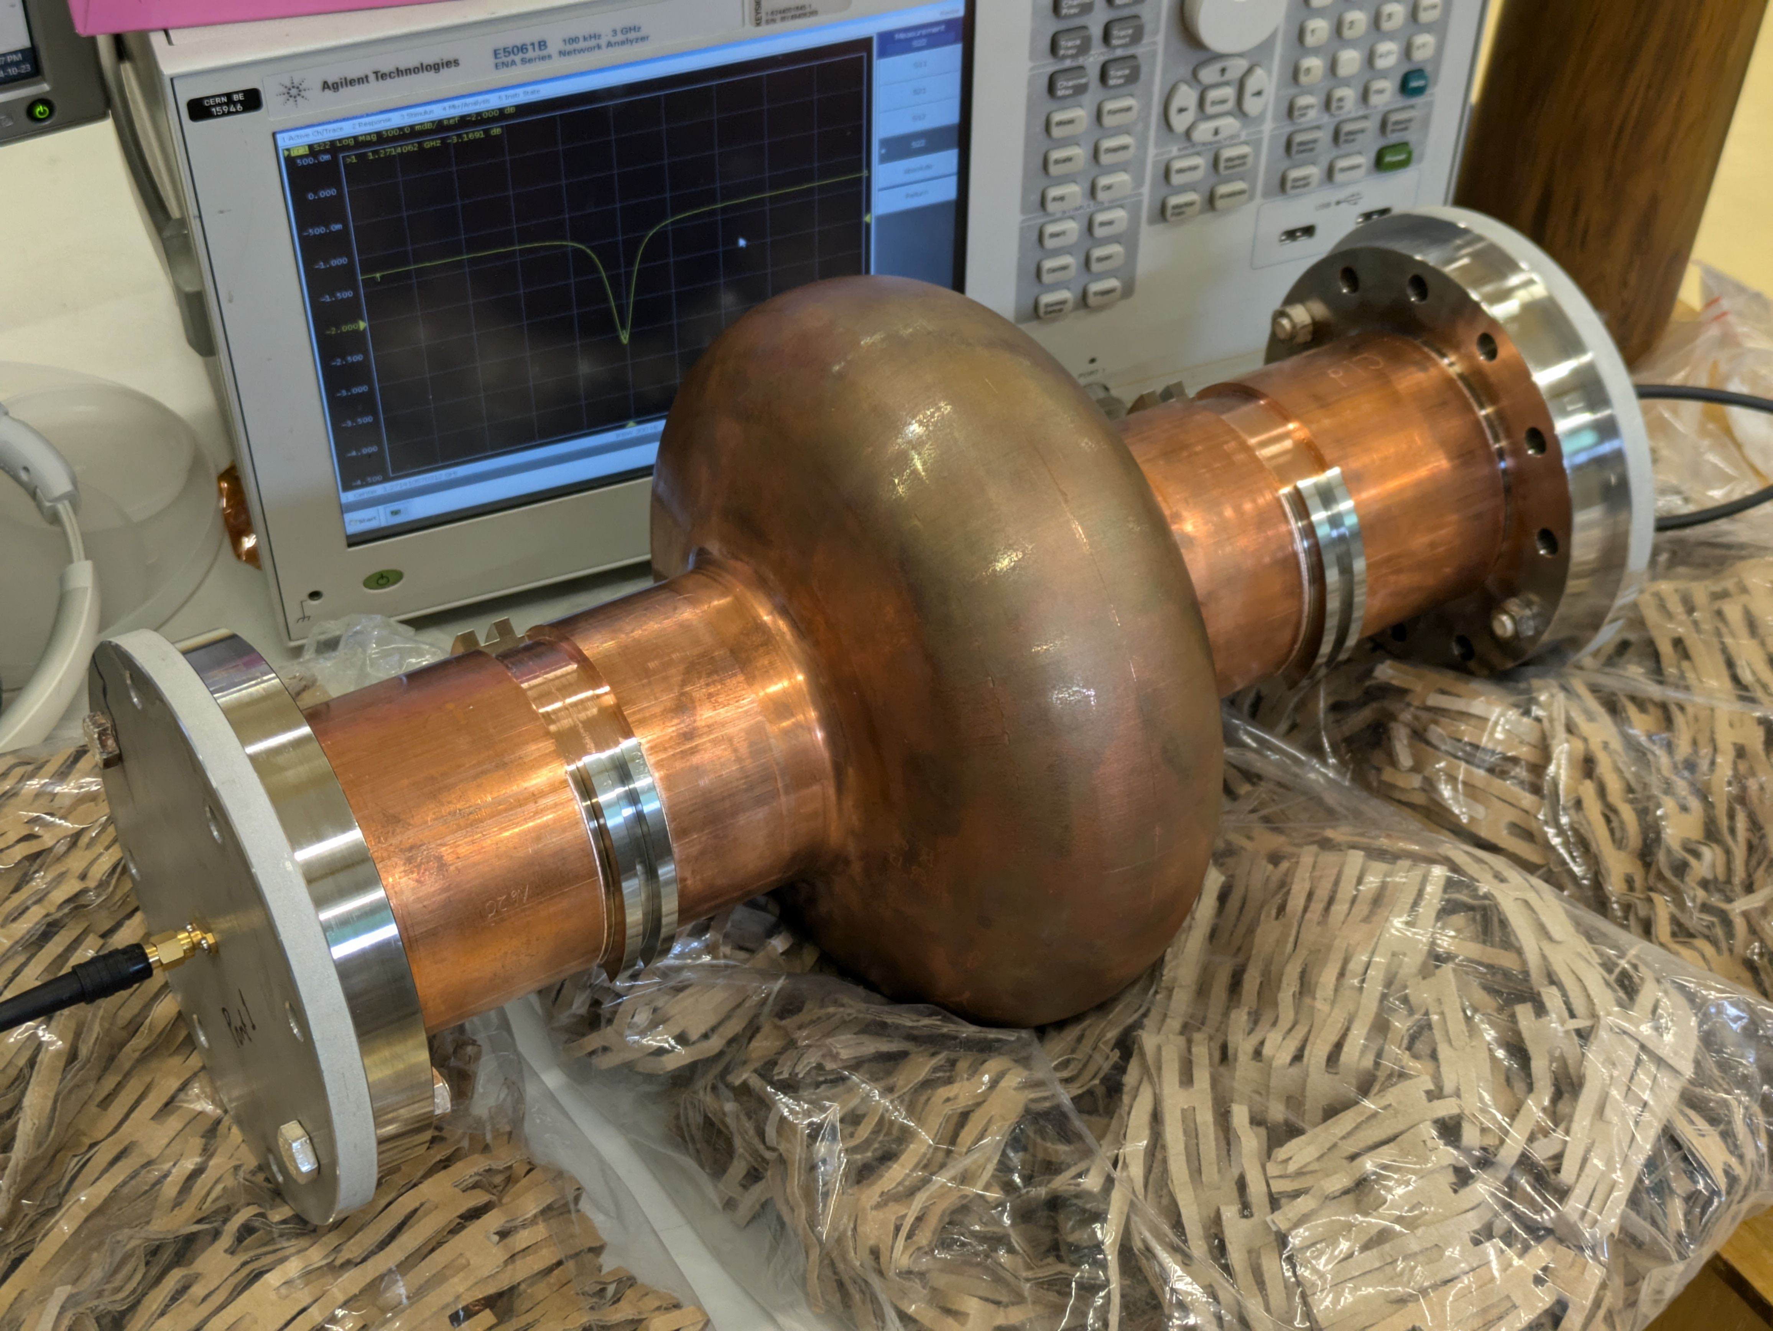

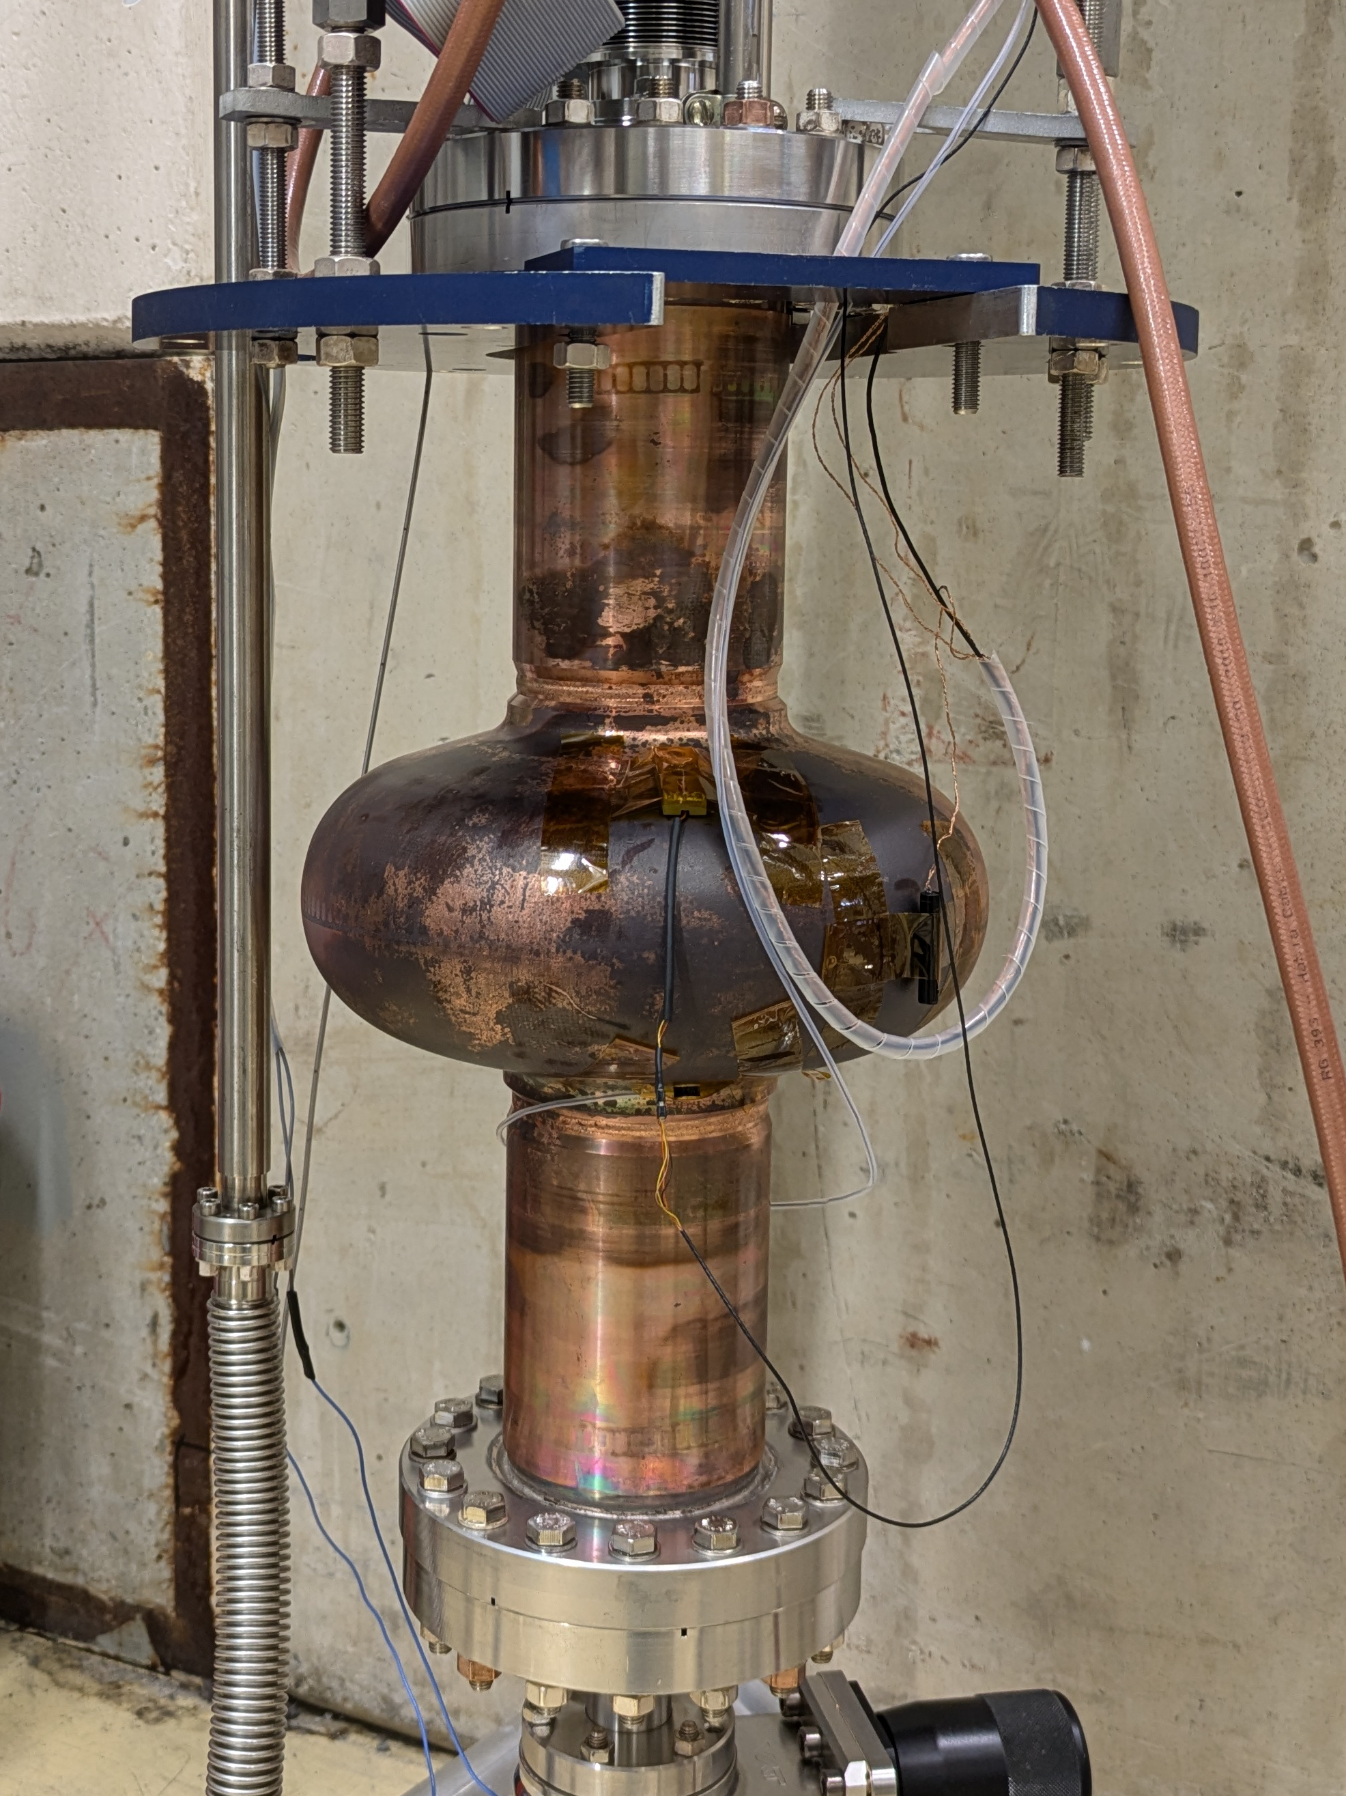
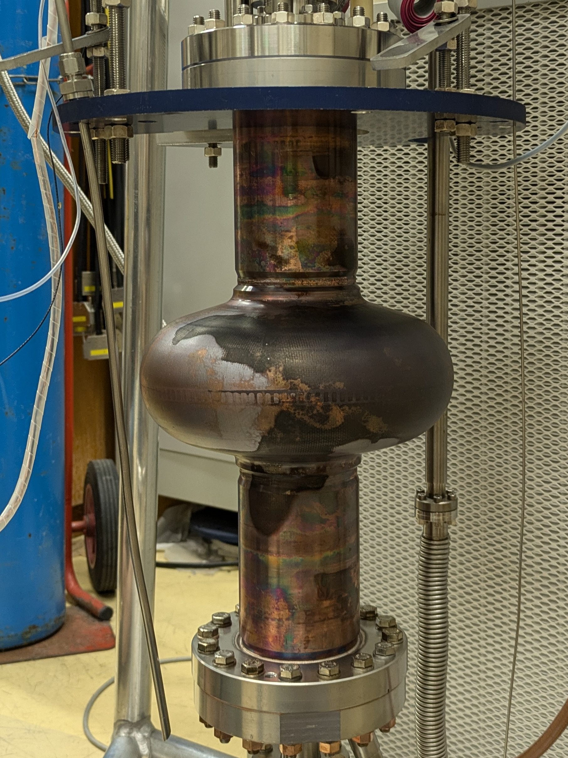
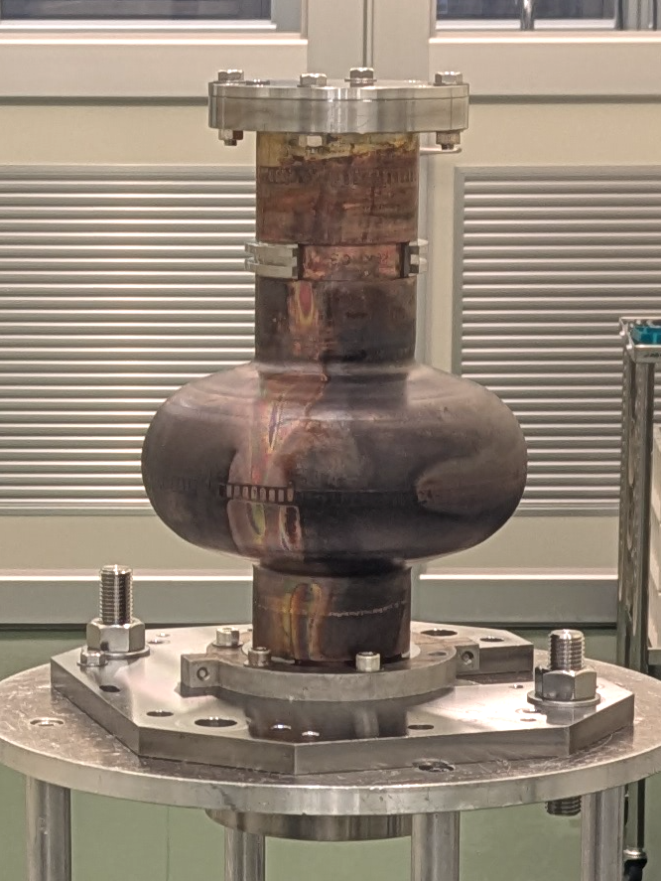
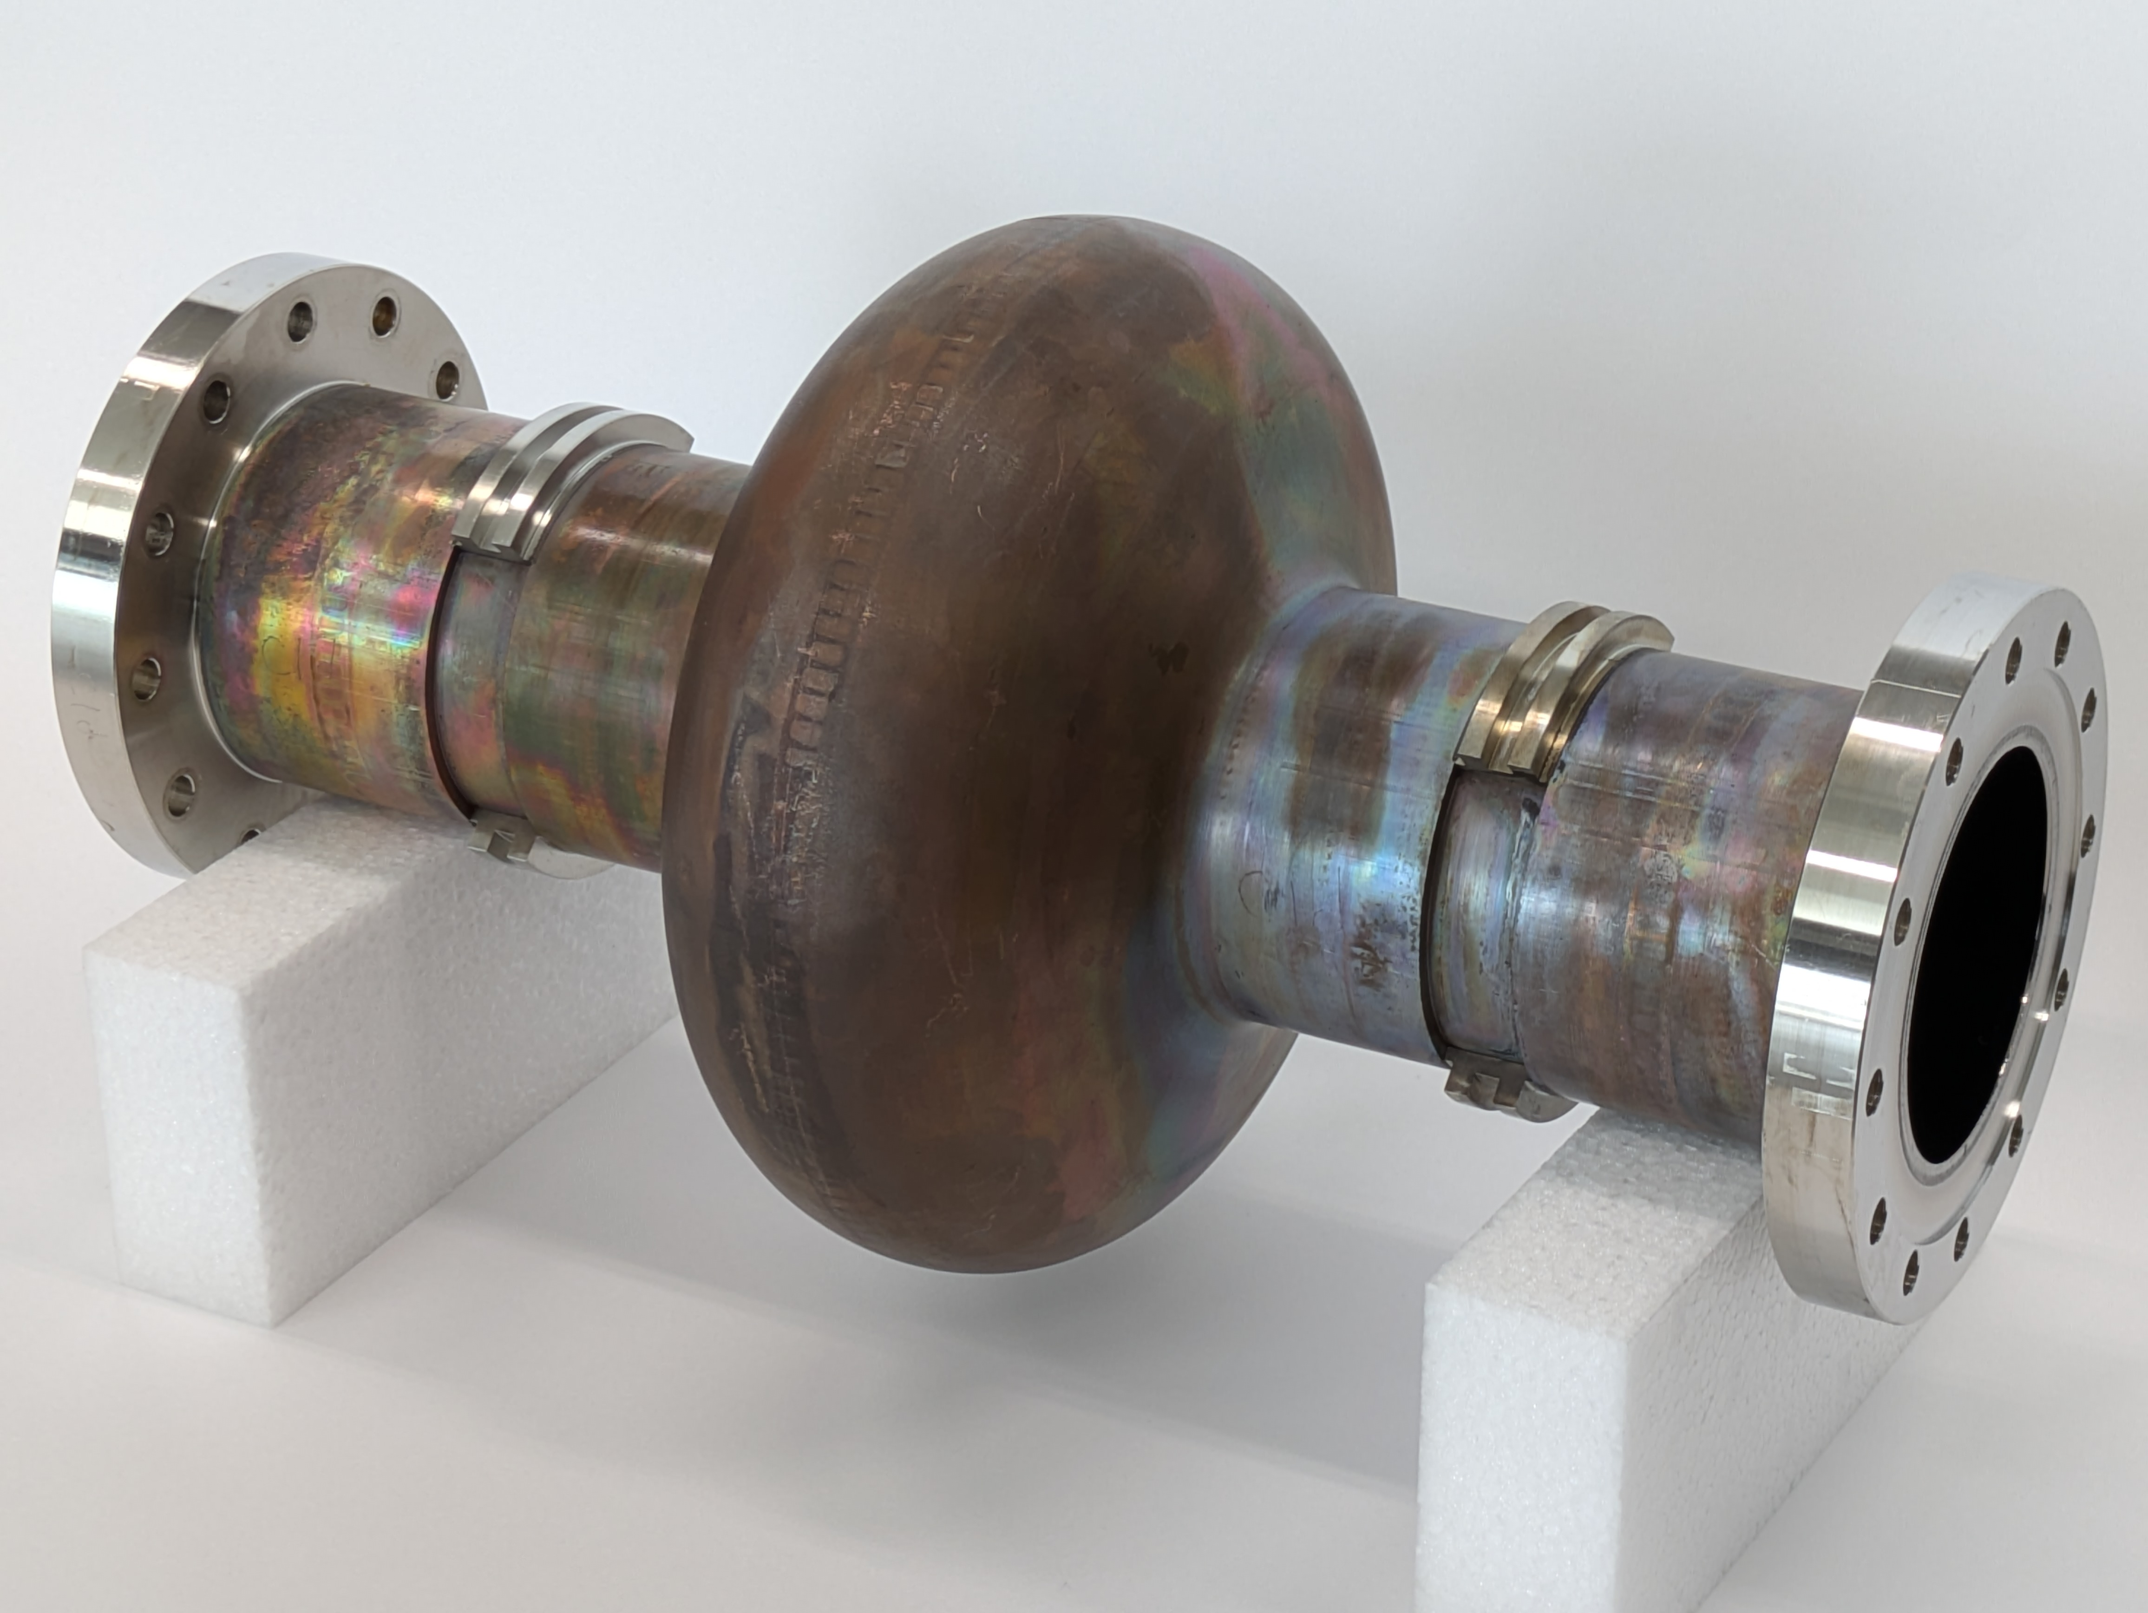
Cavities overview
C1, C1b
The first series of full-seamless
C1c, C1d
Hydroforming + Plasma EP
KEK14, KEK15
Brazed and welded
with CF flanges
C3, C3b
Mechanical polishing
+ Hydroforming

Slide 5
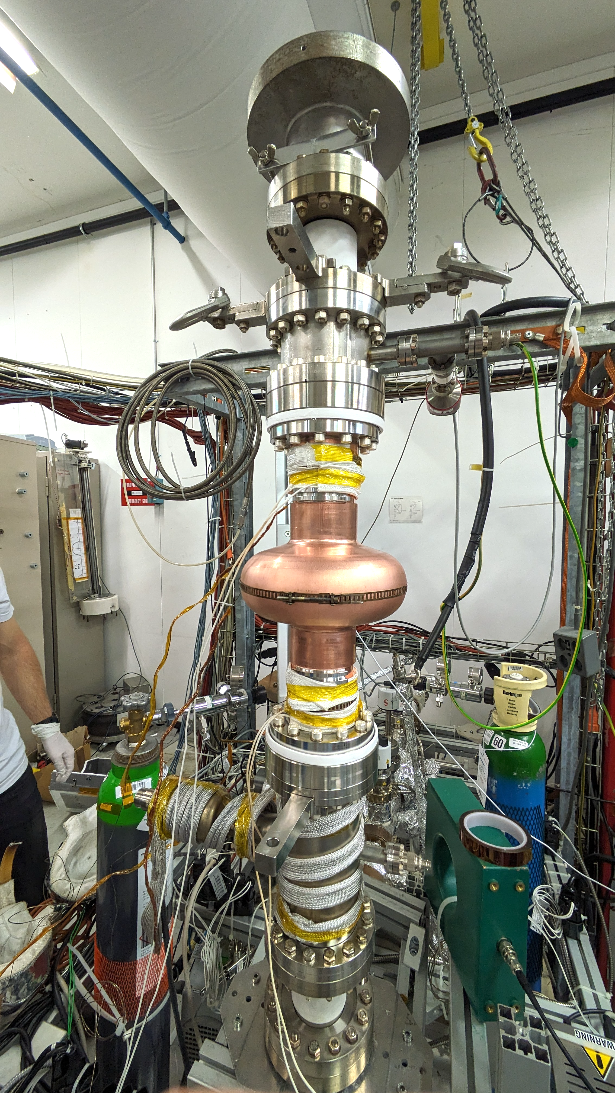
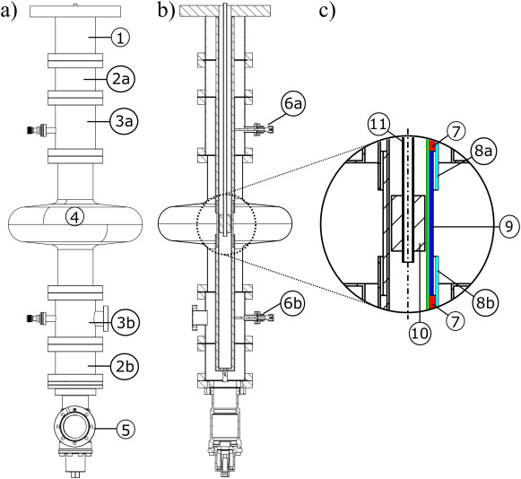
Nb thin film coating
Process parameters
  EP: 40 minutes, target 12 um removed material.
  HPR: 100 bars, 3 hours, cavity dried under vacuum at 50°C
  Bakeout: 48h, 200°C, base pressure ~ 2×10⁻¹⁰ mbar
  Coating: HiPIMS
    Cut-offs: 350W, 2.5×10⁻² mbar Kr, 6 positions/cut-off,
    150°C, unbiased
    Cell: 2 kW, 2.5×10⁻³ mbar Kr, 6 hours,
    150°C, -75V bias voltage
    Targeted thickness at the equator: 6 um
https://doi.org/10.1016/j.surfcoat.2022.128306

Slide 6
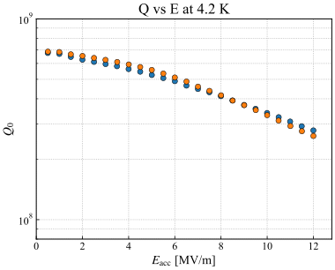
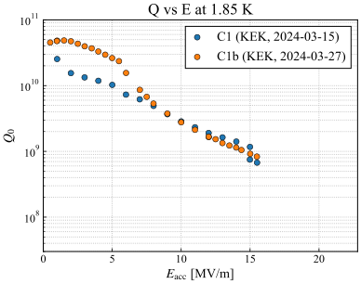
The first series
C1 and C1b (2024-03)
  Our target: Q₀ > 4×10⁸ at 12 MV/m, 4.2 K
    Acc. gradient: Cleared
    Quality factor: Just short of the target
  1.85 K
    High-Q in low field and Q-drop
    Max E_{acc}: 15.5 MV/m

Slide 7
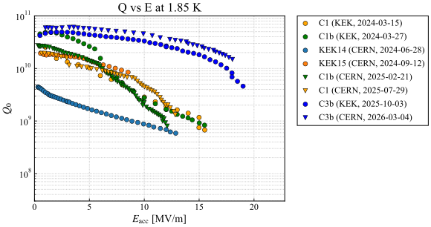
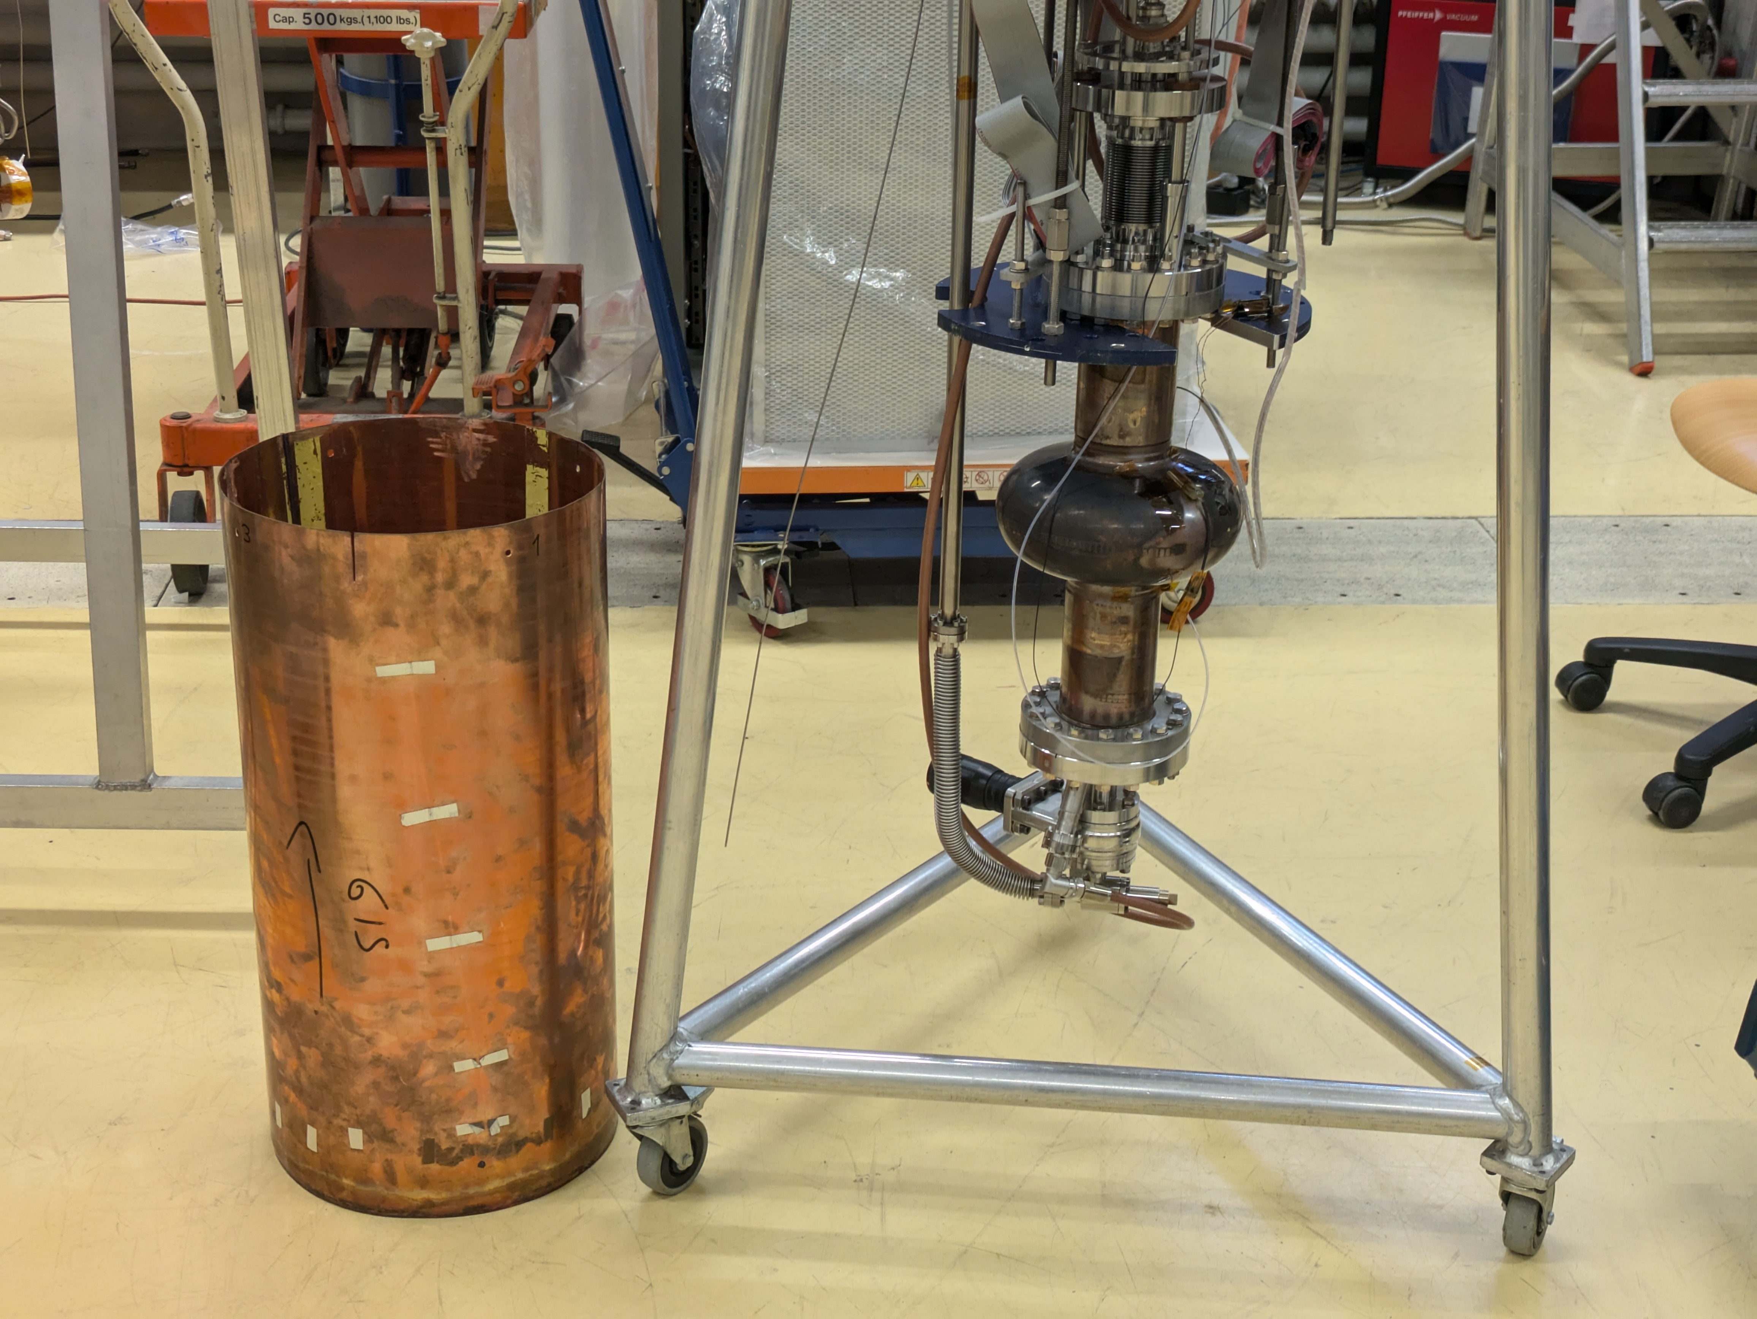
Measurements at CERN
KEK14: measured w/o the shield for small ΔT cooling
KEK14, KEK15, C1 and C1b (2024-06 to 2025-07)
  Consistent results came out from the same cavity measured in both KEK and CERN
  Improved cool-down method
    Spatial temperature difference ΔT at T_{c} affects surface resistance.
    Covering the cavity with a cylindrical shield worked well.

Slide 8
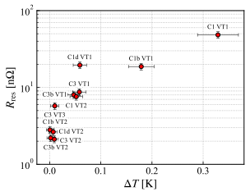
Thermoelectric current
Large ΔT cooling (without shield)
Small ΔT cooling is essential for bilayer structure cavities.
A simple “shield” is effective for vertical cryostat measurement.
Small ΔT cooling (with shield)

Slide 9
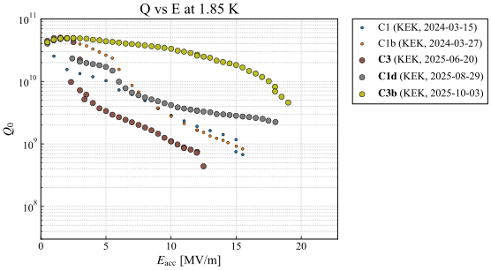
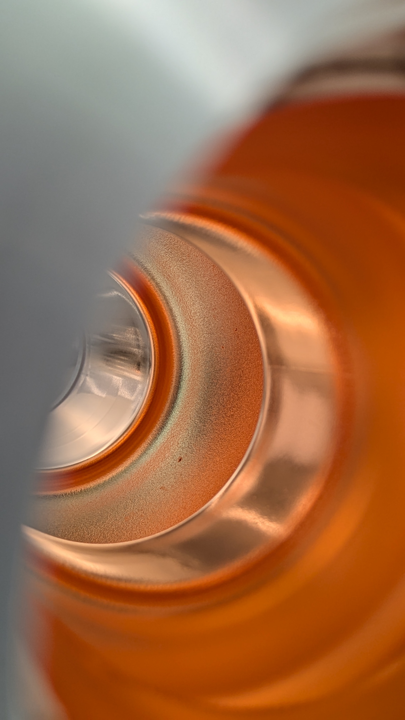
Substrate polishing
C1d (2025-08)
  Plasma EP (~200 um) after HF
  Max. E_{acc} was higher (18 MV/m) than C1/C1b
  Q-drop has occurred
C3 and C3b (2025-06 to 10)
  Mechanical polishing + light EP before HF
  Two cavities received the same treatment
    C3b kept Q₀ > 1×10¹⁰ until 17 MV/m (1.85 K)
    C3 had Q-drop and steep Q-slope
    ← A locally oxidized spot on the substrate

Slide 10
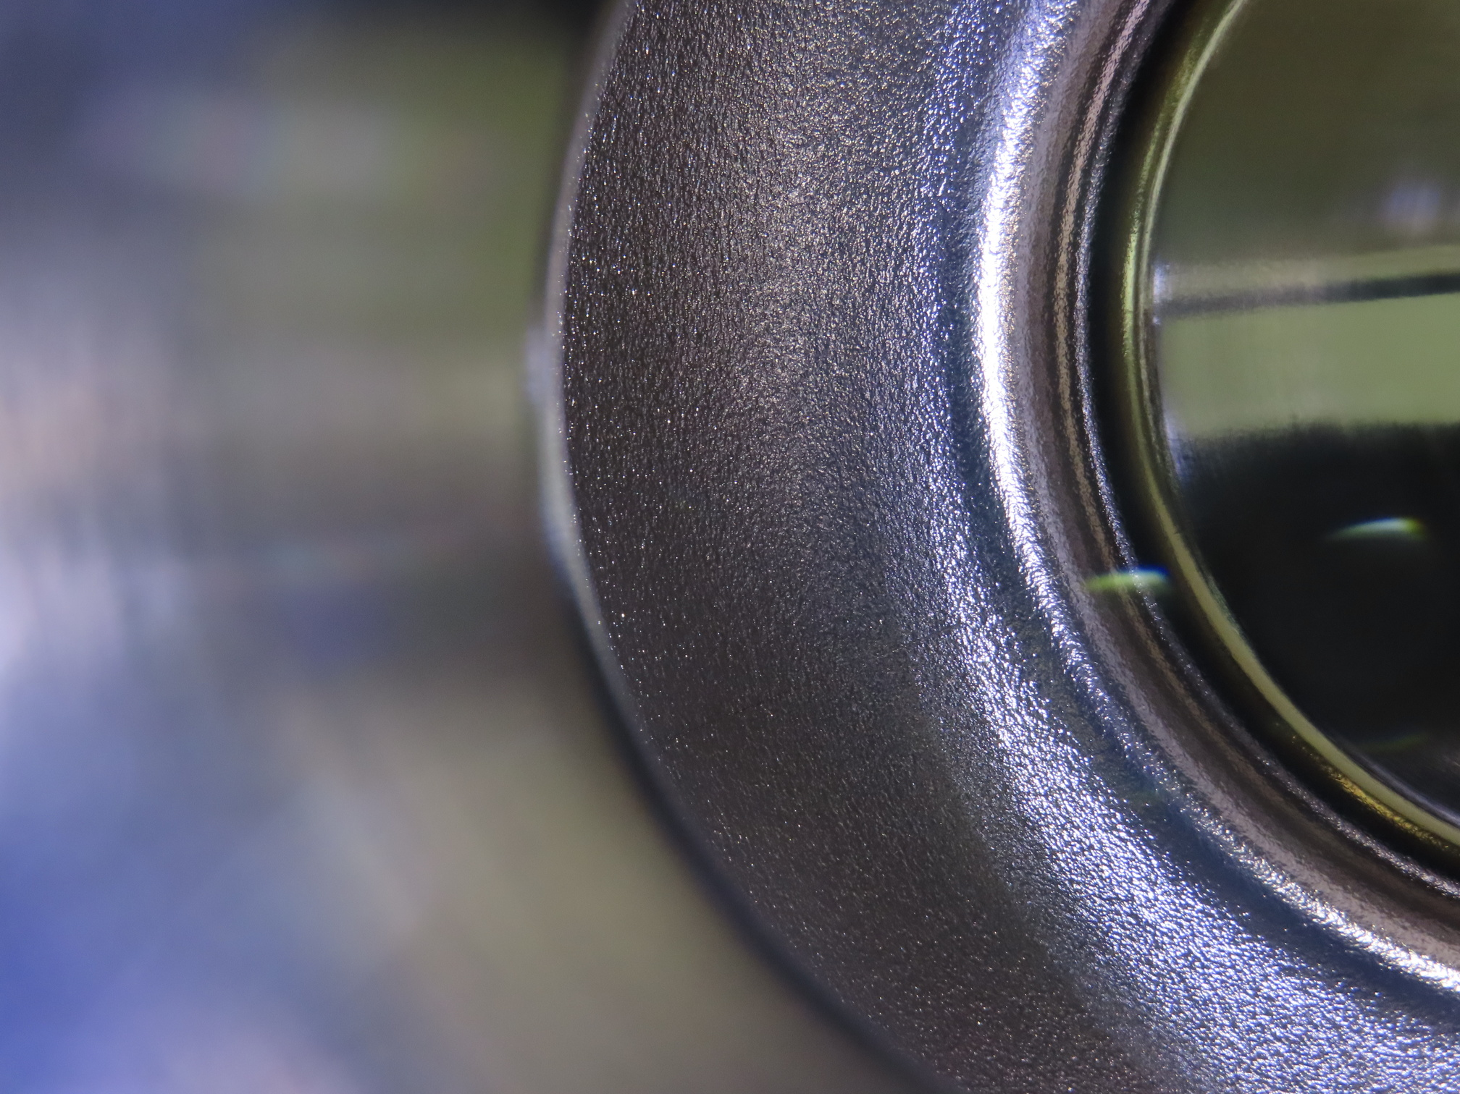
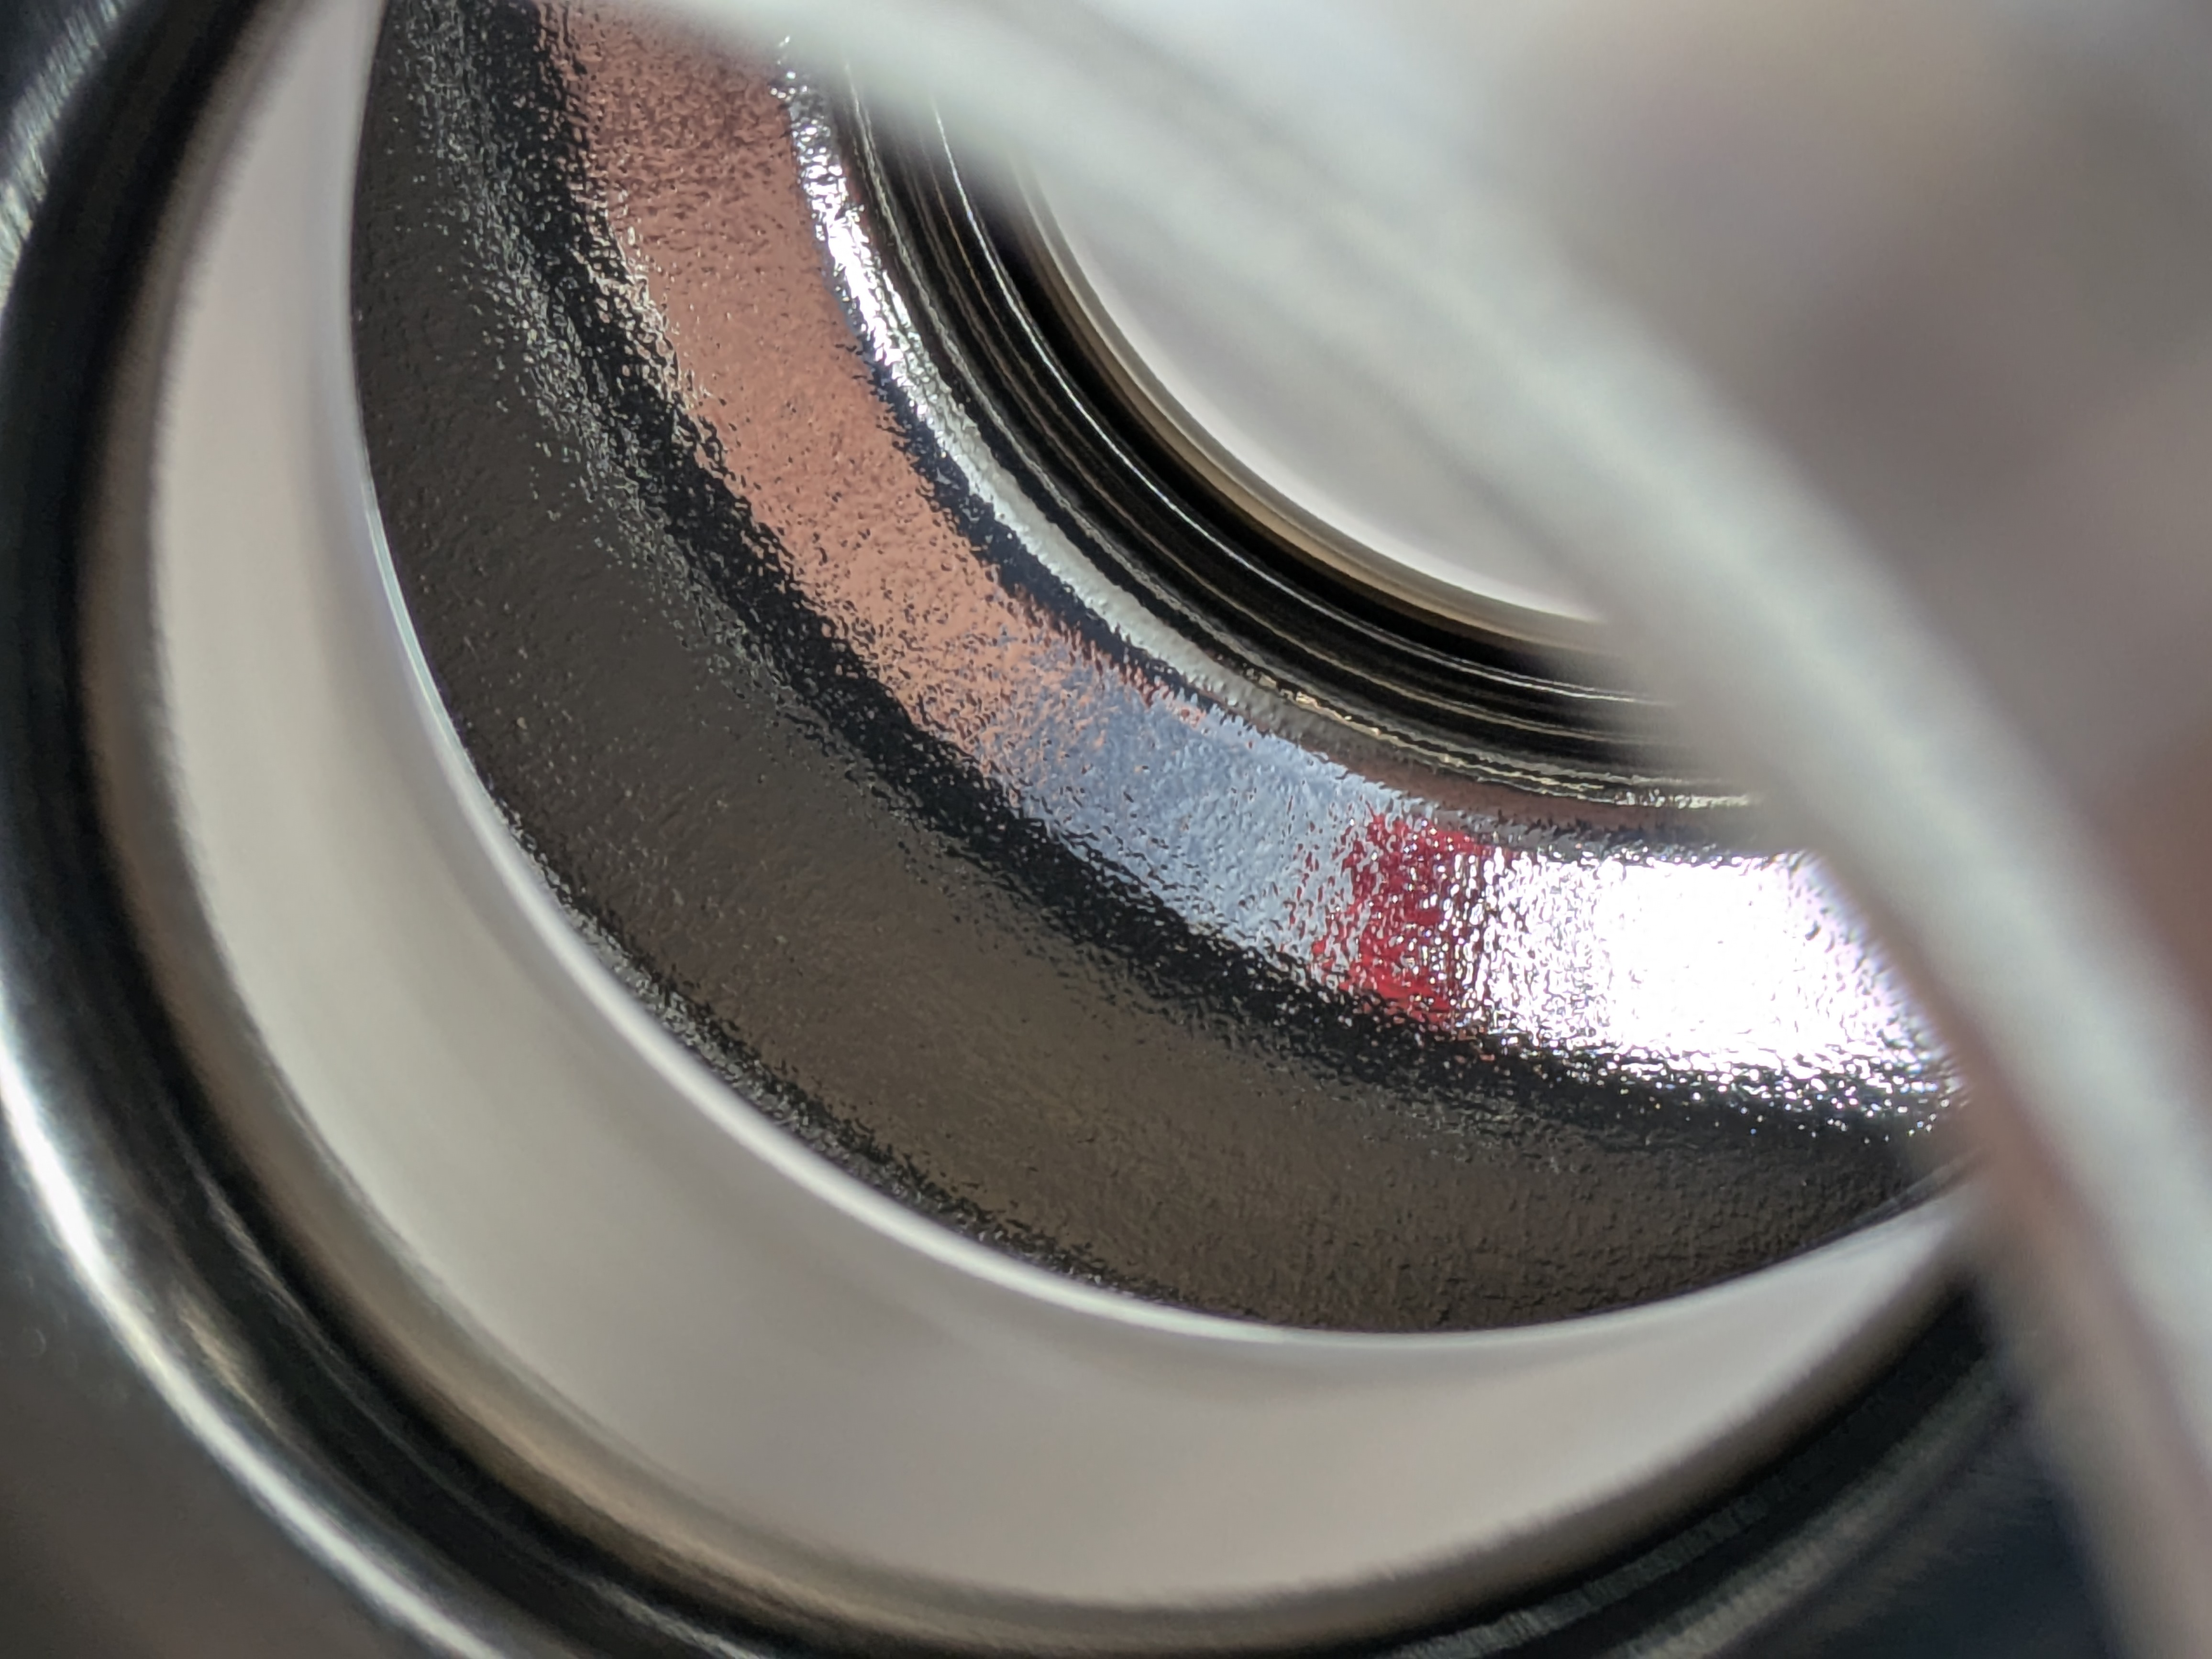
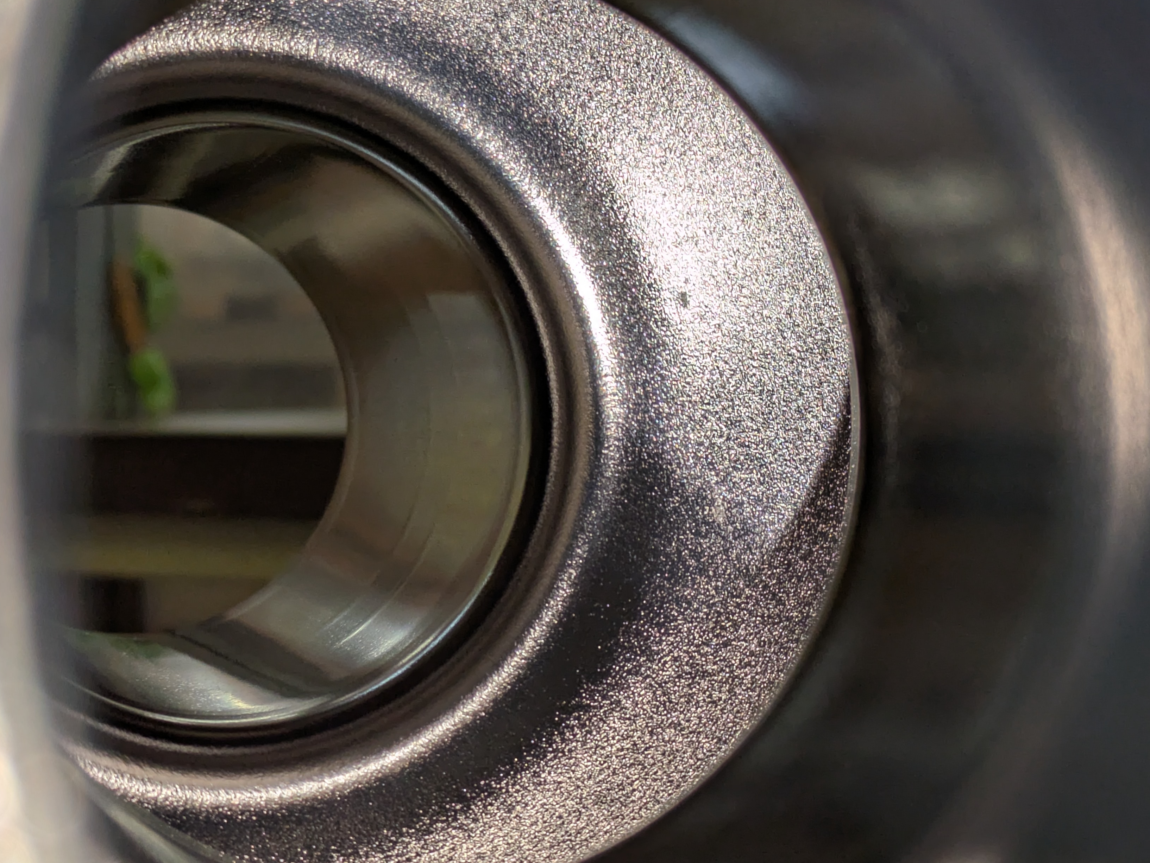
Surface condition comparison
 | C1, C1b | C1d | C3, C3b
Treatment | Baseline | Plasma EP ~200 um after HF | Mechanical polishing before HF
Surface
Roughness (Ra) | 3.3 um | 0.69 um | 2.7 um
Q₀ at 10 MV/m | C1: 3 ×10⁹ C1b: 3 ×10⁹ | C1d: 4 ×10⁹ | C3: 1 ×10⁹ C3b: 3 ×10¹⁰

Slide 11
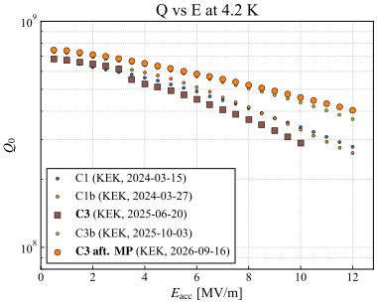
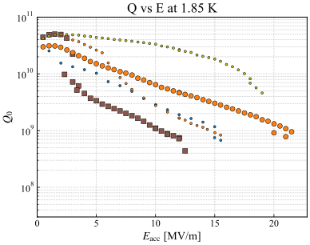
Additional substrate polishing
C3 after 2nd MP (2026-09)
  Cu substrate had 2nd mechanical (buff) polishing followed by Nb re-coating.
  Q in low field was lower than before, but Q-drop did not occur.
  Quench field 21.5 MV/m is the highest in our Nb/Cu cavities.
  Target cleared: Q₀ > 4×10⁸ at 12 MV/m, 4.2 K

Slide 12
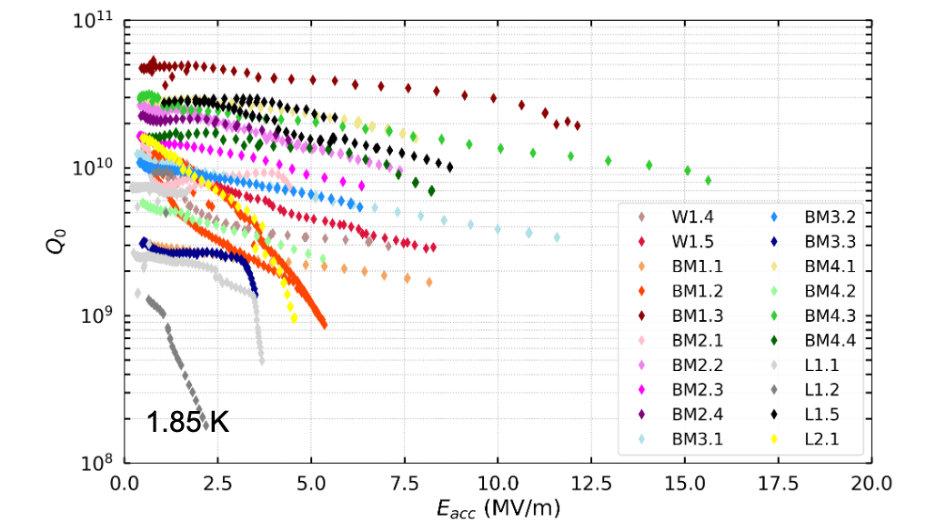
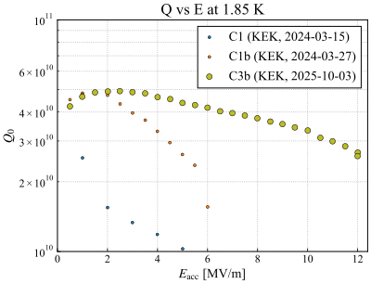
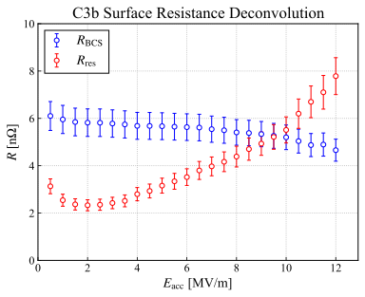
Discussion
Kristof Brunner, TFSRF2024
https://indico.cern.ch/event/1376902/contributions/6111630/
Recovery from Q-drop
  Is “a local defect on substrate” the cause of Q-drop?
  Which stage of the manufacturing process is the cause of the defect?
    In HF cavities, Q-drop occur more frequently than in other seamless cavities.
    Copper material? Tube drawing? Hydrant? Coating preparation?
  Is it possible to recover from Q-drop using other polishing techniques?
Nature of Nb film
  Anti-Q-slope? Dirty?
    In low field (< 2 MV/m), the residual resistance
    decreases as E_{acc} increases.
    BCS resistance decreases up to 12 MV/m.
    MFP of HiPIMS Nb film is shorter than that of
    ILC-treated bulk niobium.

Slide 13

Summary
Common features in our Nb/Cu cavities
  “Q-drop” frequently occurs.
  Spatial temperature gradient at Tc has strong correlation to the residual resistance.
Substrate polishing
  At present, no relationship between surface roughness and RF performance can be confirmed.
    One cavity kept Q₀ > 1×10¹⁰ until 17 MV/m with orange-peeled surface.
  “Q-drop” occurred in one cavity with locally oxidized spot on the substrate; however, this was recovered by mechanically polishing the substrate.
    Max E_{acc} reached 21.5 MV/m at 1.85 K, the highest in our cavities.
    Our target: Q₀ > 4×10⁸ at 12 MV/m, 4.2 K was cleared.
Acknowledgements

