Slide 1

Modelling flux vortex dynamics in type-II superconductors under a thermal gradient-driven phase transition with closed cooling topology
G. T. Telles and A. L. Macpherson
21 September 2026

Slide 2
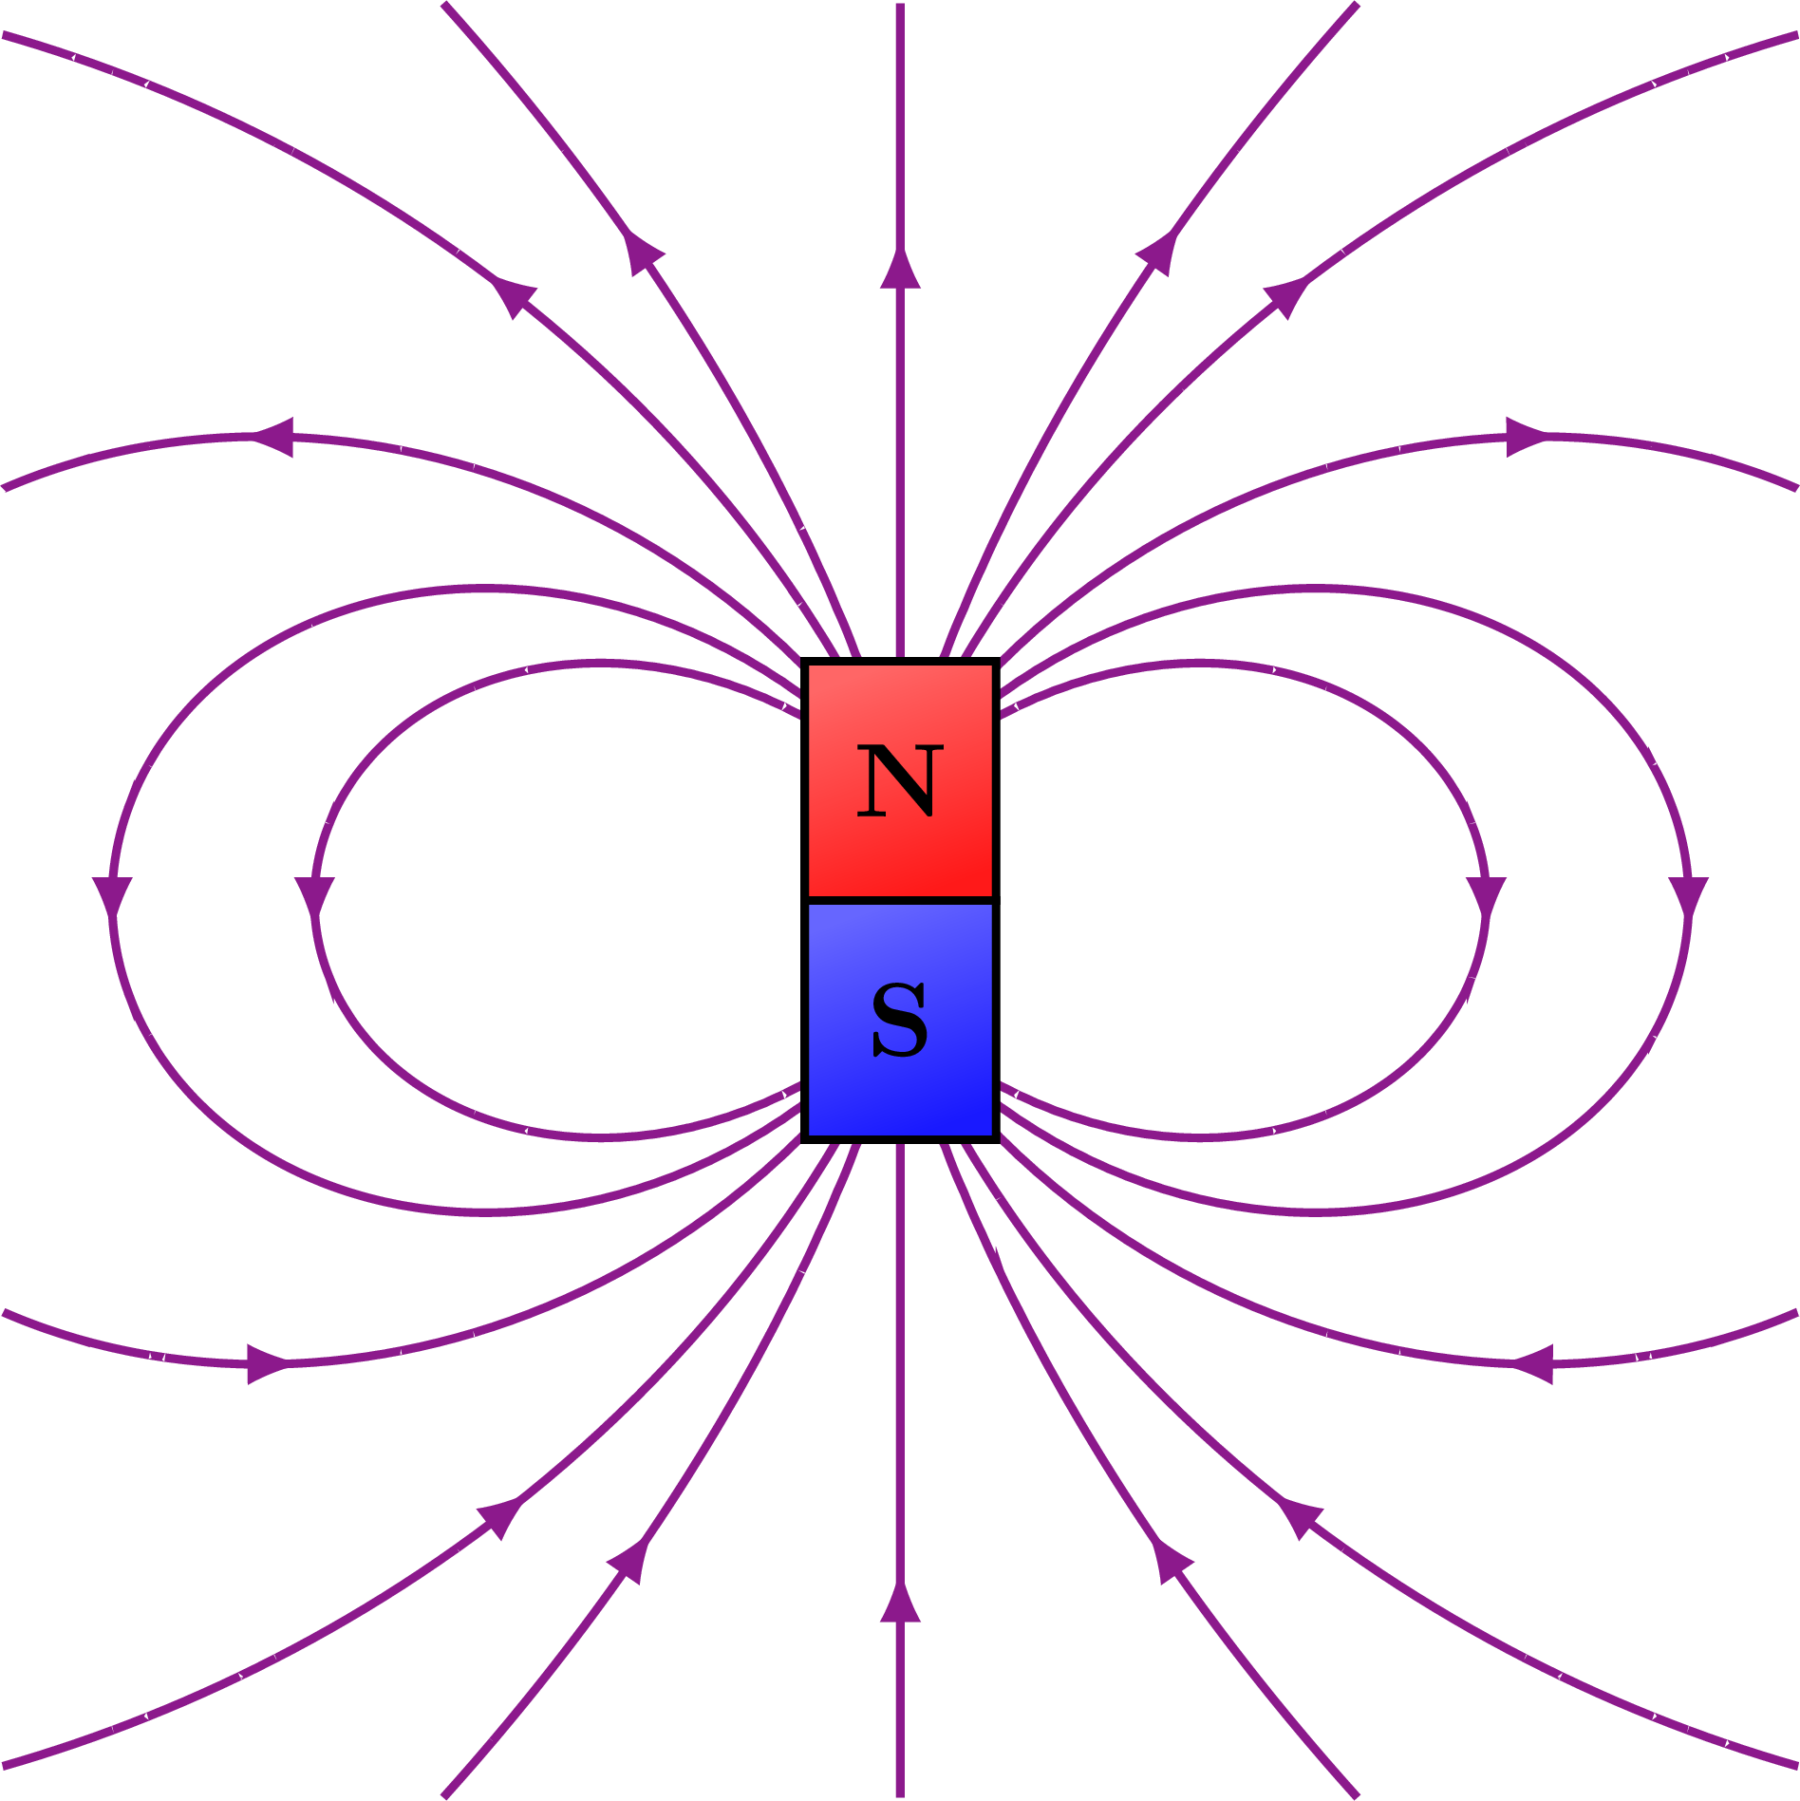


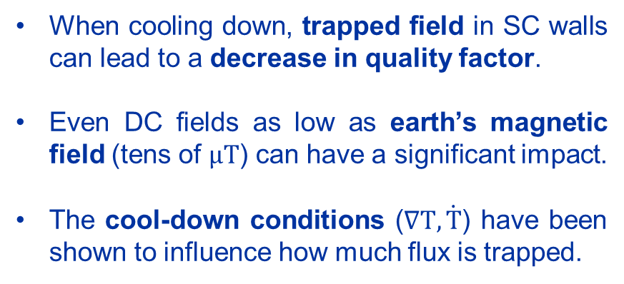
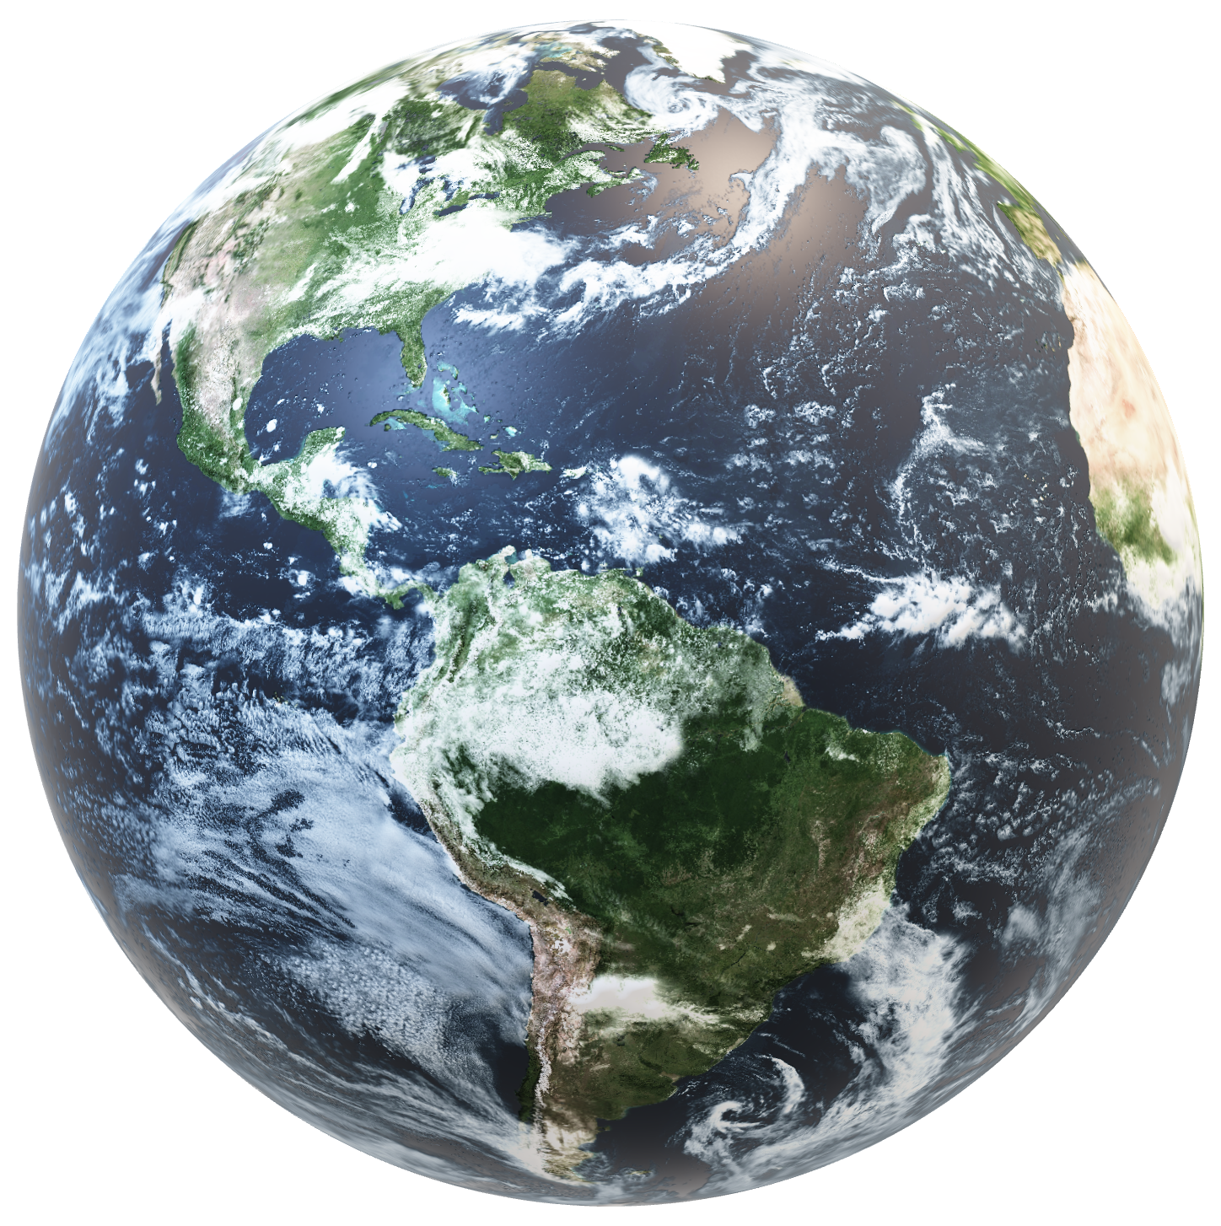
Trapped flux in SRF cavities: decrease in Q
When cooling down, trapped field in SC walls can lead to a decrease in quality factor.
Even DC fields as low as earth’s magnetic field (tens of $μT$) can have a significant impact.
The cool-down conditions ($∇T, \dot{T}$) have been shown to influence how much flux is trapped.
Q
1
A closed cooling topology causes an entirely different response, playing a pivotal role in defining the amount of flux that penetrates the material.

Slide 3
Outline
Vortex dynamics during phase transition
Numerical model: Time-dependent Ginzburg-Landau equations
Results and discussion
Summary and outlook

Slide 4
1. Vortex Dynamics
During phase transition

Slide 5



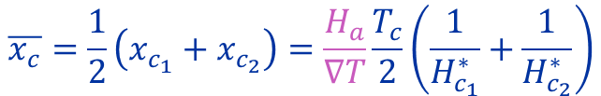



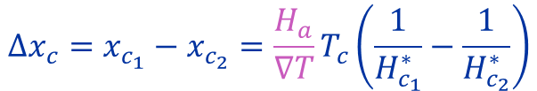





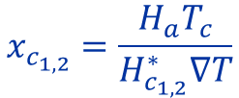





Phase transition fronts move with decreasing T
$$T$$
$$T_{c}$$
$$∇T=\frac{∂T}{∂x}=const.$$
$$T=T_{c}−∇Tx$$
$$x\left(T=T_{c}\right)=0$$
$$v$$
$$H_{c_{1,2}}=H_{c_{1,2}}^{∗} \frac{∇T}{T_{c}}x$$
$$x_{c_{1,2}}=\frac{H_{a}T_{c}}{H_{c_{1,2}}^{∗}∇T}$$
$$x$$
Normal
$$Δx_{c}=x_{c_{1}}−x_{c_{2}}=\frac{H_{a}}{∇T}T_{c}\left(\frac{1}{H_{c_{1}}^{∗}}−\frac{1}{H_{c_{2}}^{∗}}\right)$$
Mixed state
width
$$H$$
Mixed
$$H_{c_{2}}$$
$$H_{c_{1}}$$
Meissner
$$\overline{x_{c}}=\frac{1}{2}\left(x_{c_{1}}+x_{c_{2}}\right)=\frac{H_{a}}{∇T}\frac{T_{c}}{2}\left(\frac{1}{H_{c_{1}}^{∗}}+\frac{1}{H_{c_{2}}^{∗}}\right)$$
Mixed state
position
$$H_{a}$$
$$x_{c_{2}}$$
$$x_{c_{1}}$$
$$x$$
In an open thermal topology, the position and width of the mixed state region are constant over time.
Lower gradients or higher applied fields increase the width and, consequently, vortex formation.
Normal
Mixed
Meissner
3
Slide based on the work of T. Kubo: https://doi.org/10.1093/ptep/ptw049

Slide 6





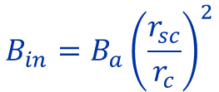
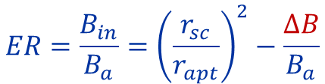


Field is enhanced in a closed thermal topology
$$t$$
SC
SC
SC
$$r_{sc}$$
$$r_{c}$$
$$r_{c}$$
$$r_{apt}$$
NC
NC
NC
$$B_{in}=B_{a}{\left(\frac{r_{sc}}{r_{c}}\right)}^{2}$$
$$ER=\frac{B_{in}}{B_{a}}={\left(\frac{r_{sc}}{r_{apt}}\right)}^{2}−\frac{ΔB}{B_{a}}$$
$$φ=πr_{sc}^{2}B_{a}=const.$$
$$πr_{c}^{2}B_{in}=πr_{sc}^{2}B_{a}$$
Total flux is compressed into the aperture; expulsion ratio follows square radii ratio until vortex formation.

Slide 7



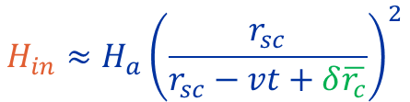

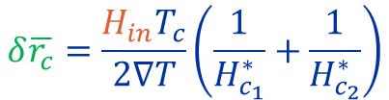







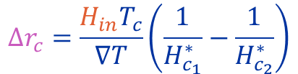
Mixed state changes over time in a closed topology
$$H_{in}≈H_{a}{\left(\frac{r_{sc}}{r_{sc}−vt+δ\overline{r_{c}}}\right)}^{2}$$
$$δ\overline{r_{c}}=\frac{H_{in}T_{c}}{2∇T}\left(\frac{1}{H_{c_{1}}^{∗}}+\frac{1}{H_{c_{2}}^{∗}}\right)$$
$$Δr_{c}=\frac{H_{in}T_{c}}{∇T}\left(\frac{1}{H_{c_{1}}^{∗}}−\frac{1}{H_{c_{2}}^{∗}}\right)$$
Normal
$$H_{c_{2}}$$
Before vortex
formation
$$H$$
Mixed
$$H_{c_{1}}$$
Meissner
$$H_{in}$$
$$T=T_{c}$$
$$δ\overline{r_{c}}$$
$$Δr_{c}$$
$$δr$$
$$r_{sc}−vt$$
$$T$$
$$v$$
As the transition happens, the inner field increases due to the closed topology, pushing the mixed state to a cooler area and increasing its width and, consequently, vortex formation.

Slide 8
2. Numerical Model
Time-dependent Ginzburg-Landau equations

Slide 9




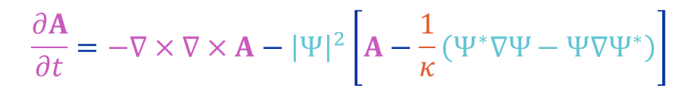
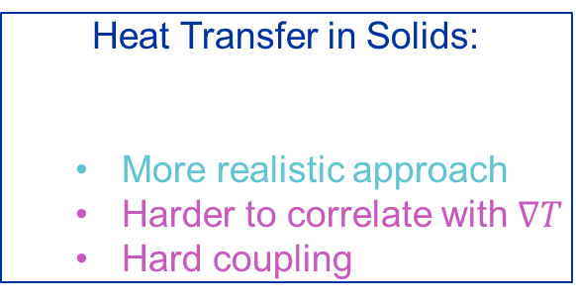



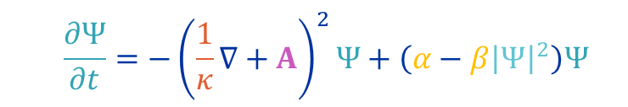



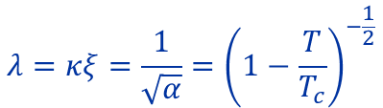
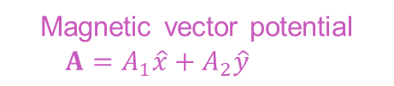







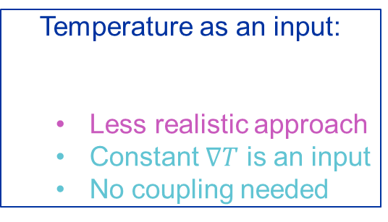
Time-dependent Ginzburg Landau (TDGL) model
Implemented in
$$α=1−\frac{T}{T_{c}}$$
$$T$$
$$κ=\frac{λ}{ξ}$$
GL Parameter
(material-dependent)
Temperature-dependent
coefficients
Superconductivity and Field
$$β=1$$
$$Ψ_{1}$$
$$Ψ_{2}$$
  $$\frac{∂Ψ}{∂t}=−{\left(\frac{1}{κ}∇+A\right)}^{2}Ψ+\left(α−β{\left|Ψ\right|}^{2}\right)Ψ$$
Complex order parameter
$$Ψ=Ψ_{1}+iΨ_{2}$$
$$J$$
$$A_{1}$$
$$A_{2}$$
Magnetic vector potential
$$A=A_{1}\hat{x}+A_{2}\hat{y}+A_{3}\hat{z}$$
$$\frac{∂A}{∂t}=−∇×∇×A−{\left|Ψ\right|}^{2}\left[A−\frac{1}{κ}\left(Ψ^{∗}∇Ψ−Ψ∇Ψ^{∗}\right)\right]$$
$$+ A_{3}\hat{z}$$
$$A_{3}$$
$$B$$
T-dependent material properties:
Heat Transfer in Solids:
  More realistic approach
  Harder to correlate with $∇T$
  Hard coupling
Temperature as an input:
  Less realistic approach
  Constant $∇T$ is an input
  No coupling needed
$$λ=κξ=\frac{1}{\sqrt{α}}={\left(1−\frac{T}{T_{c}}\right)}^{−\frac{1}{2}}$$
$$ρC_{p}\dot{T}=∇⋅\left(k∇T\right)+Q$$
$$T=T_{c}−∇T\left(r−r_{sc}+vt\right)$$
or
$$\frac{H_{c_{1}}}{H_{c_{1}}^{∗}}=\frac{H_{c_{2}}}{H_{c_{2}}^{∗}}=α=1−\frac{T}{T_{c}}$$

Slide 10
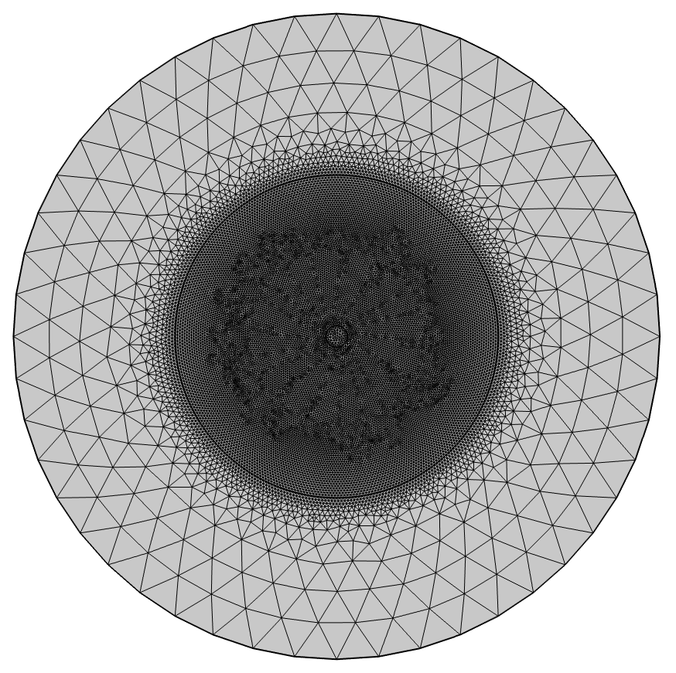
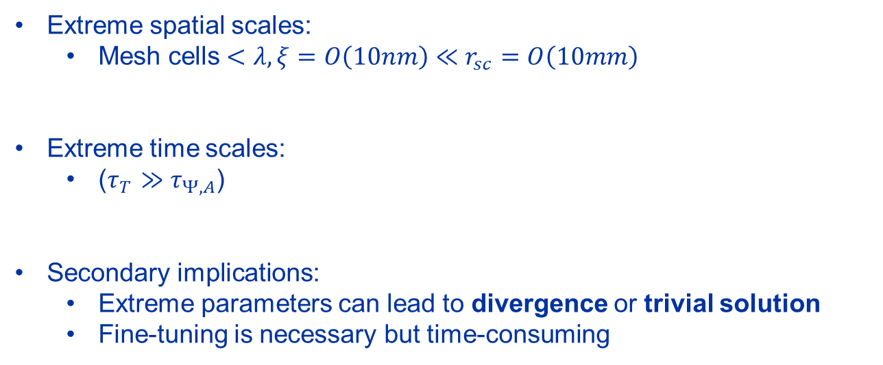
TDGL Simulations vs. MFL Experiments
Extreme spatial scales:
  Mesh cells $<λ,ξ=O\left(10nm\right)≪r_{sc}=O\left(10mm\right)$
Extreme time scales:
  ($τ_{T}≫τ_{Ψ,A}$)
Secondary implications:
  Extreme parameters can lead to divergence or trivial solution
  Fine-tuning is necessary but time-consuming
Too computationally demanding to consider life-sized objects
Conceptual understanding applicable to realistic dimensions when propertly rescaled.

Slide 11
3. Results and Discussion

Slide 12
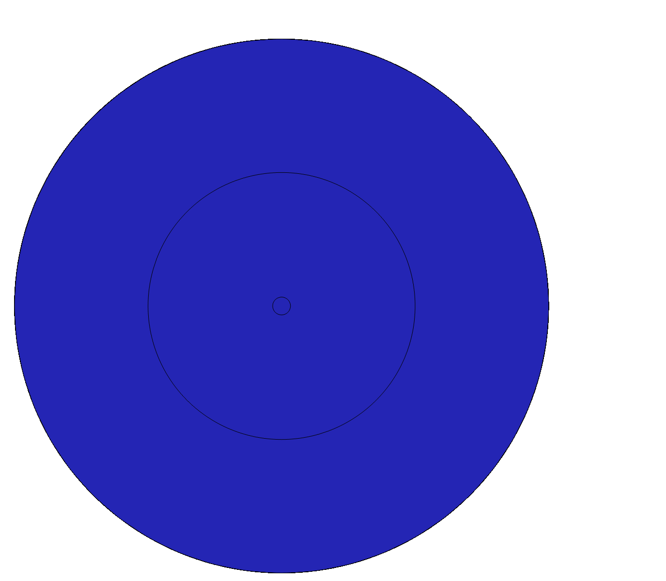
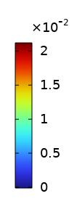
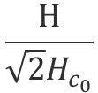
Vortex formation during phase transition
$$\frac{H}{\sqrt{2}H_{c_{0}}}$$
The externally applied magnetic field is initially not strong enough to induce vortex formation
Field is compressed towards the center due to phase transition in a closed topology
There is a threshold beyond which vorteices form. What is this threshold?

Slide 13
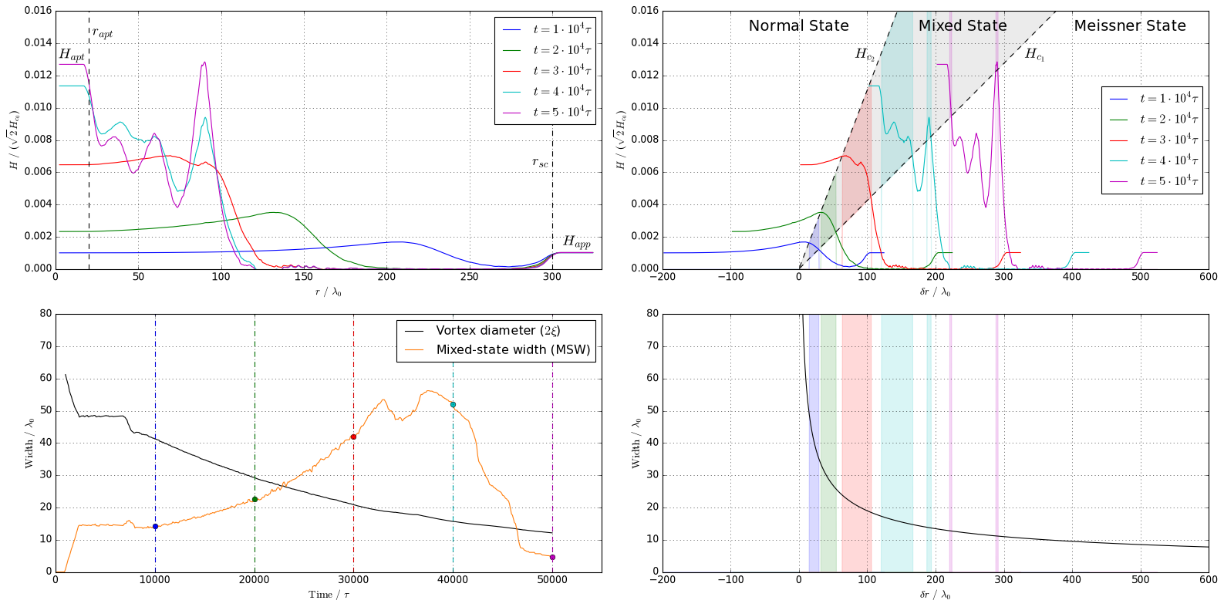



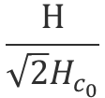








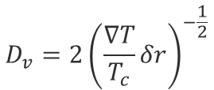


Transition pushes and widens the mixed state
Normal
$$H_{c_{2}}$$
$$H$$
Mixed
$$H_{c_{1}}$$
$$\frac{H}{\sqrt{2}H_{c_{0}}}$$
Meissner
$$H_{in}$$
$$δr$$
$$δr/λ$$
$$T$$
$$Δr_{c}$$
$$T$$
$$H_{in}$$
$$D_{v}={2\left(\frac{∇T}{T_{c}}δr\right)}^{−\frac{1}{2}}$$
$$δ\overline{r_{c}}$$
$$D_{v}$$
Vortex Diameter
As predicted, the compression of the field
Widens the mixed state region
Pushes it to a cooler region
  Decreasing the vortex diameter
$$δr/λ$$

Slide 14
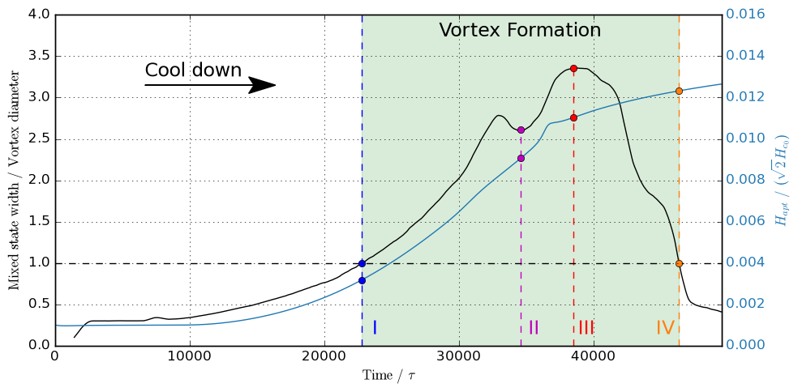
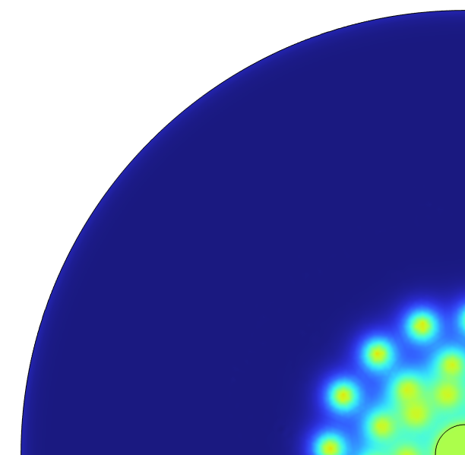
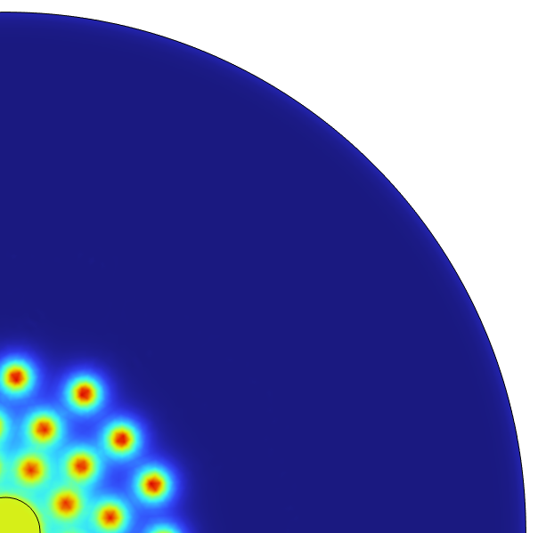
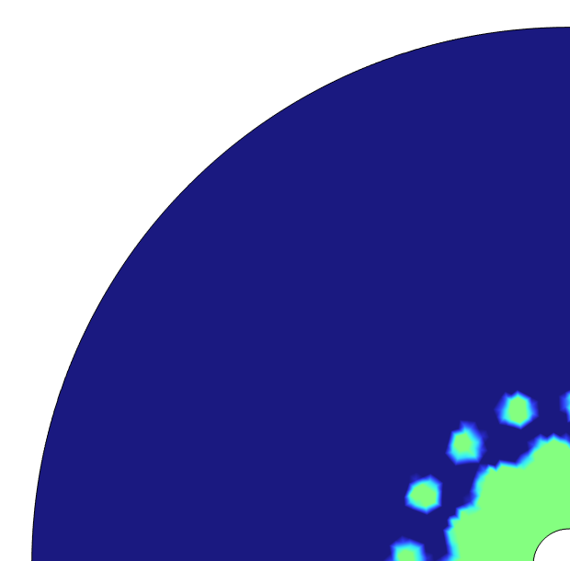
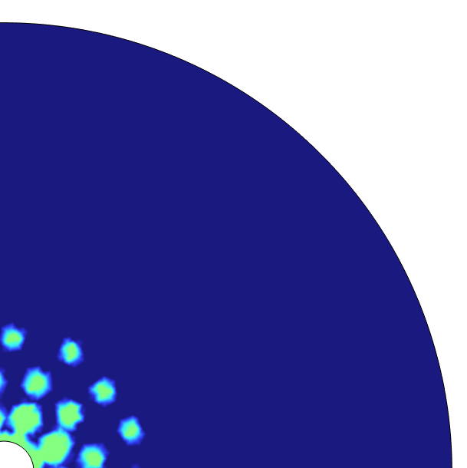
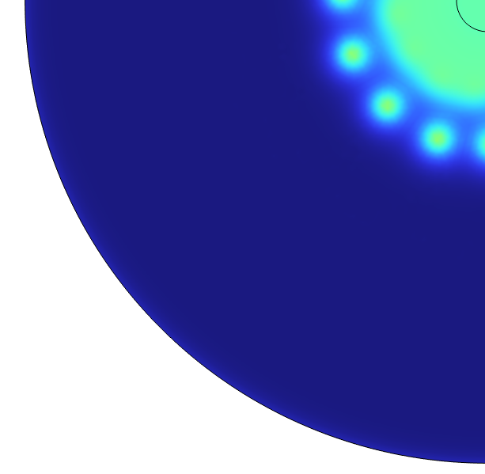
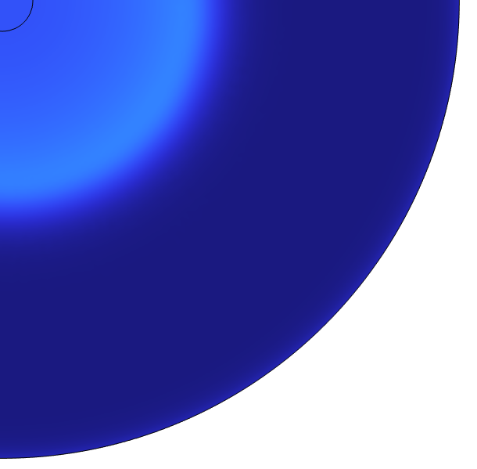
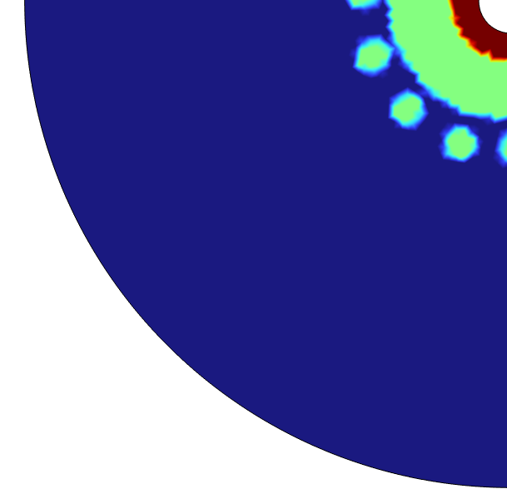
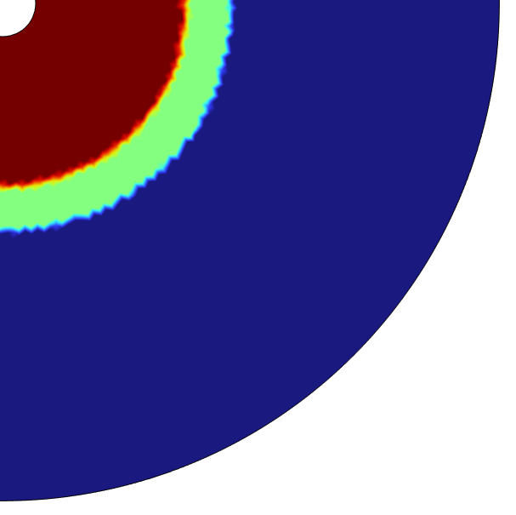
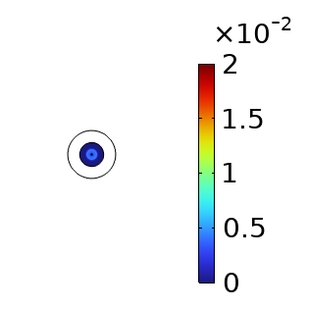













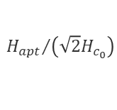





Vortex form only in wide enough mixed state region
$$\frac{H_{apt}}{\sqrt{2}H_{c_{0}}}$$
$$IV$$
$$I$$
$$IV$$
$$I$$
$$III$$
$$II$$
$$III$$
$$II$$
$$×{10}^{−3}$$
Meissner
Mixed
Normal
$$0$$
$$5$$
$$10$$
$$15$$
$$20$$
$$H_{c_{1}}$$
$$H_{c_{2}}$$
$${H_{apt}}/{\left(\sqrt{2}H_{c_{0}}\right)}$$
Phase regions
Beginning of vortex formation
The first row of vortices is fully formed
The mixed state front reaches the aperture radius
End of vortex formation and phase transition
Flux penetrates only when there is enough room for vortices in the mixed state

Slide 15

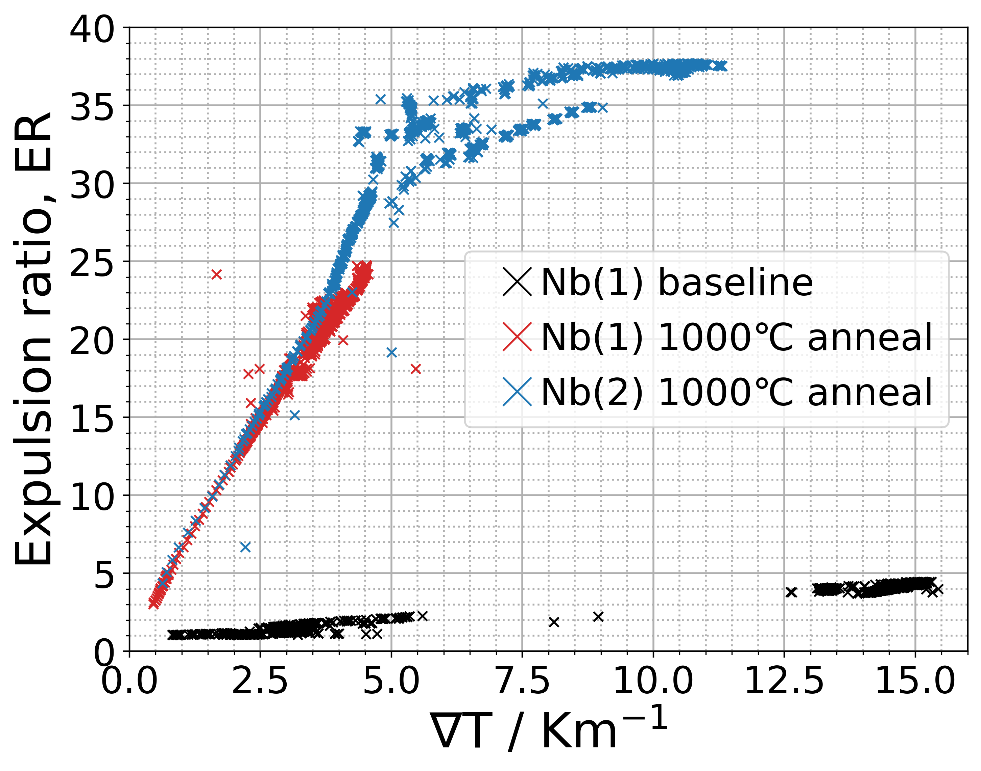
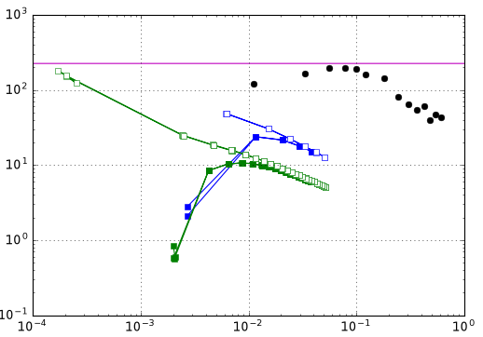
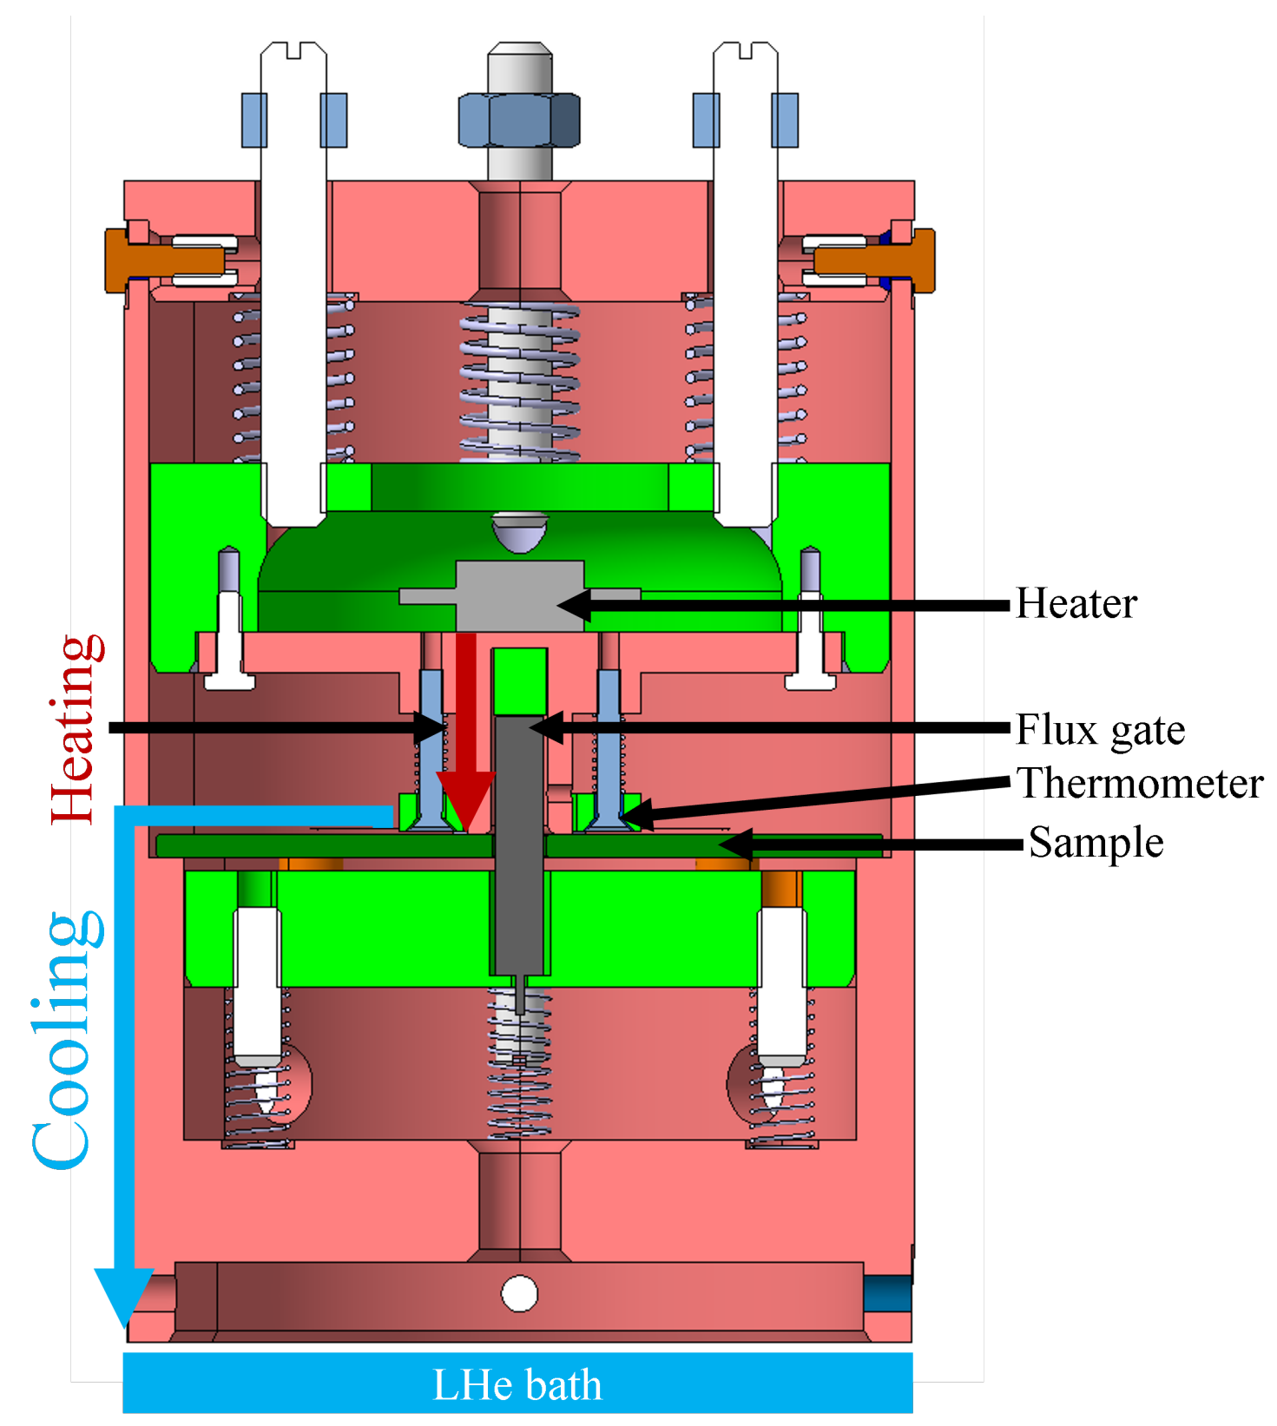
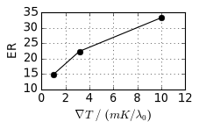
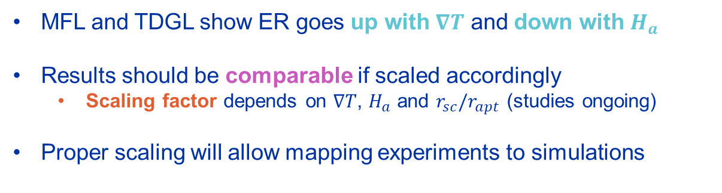

Simulations vs. Experiments: matching behavior
Magnetic Flux Lens (MFL)
MFL
Full expulsion ${\left(r_{sc}/r_{apt}\right)}^{2}$
2
Expulsion Ratio, ER
TDGL
TDGL
MFL
Magnetic Field / mT
MFL and TDGL show ER goes up with $∇T$ and down with $H_{a}$
Results should be comparable if scaled accordingly
  Scaling factor depends on $∇T$, $H_{a}$ and $r_{sc}/r_{apt}$ (studies ongoing)
Proper scaling will allow mapping experiments to simulations
Beyond the scaling factor, flux trapping and extrinsic thermal current sources also have to be considered.
MFL schematic and some of the data by D. Turner: https://proceedings.jacow.org/srf2023/papers/mopmb003.pdf

Slide 16
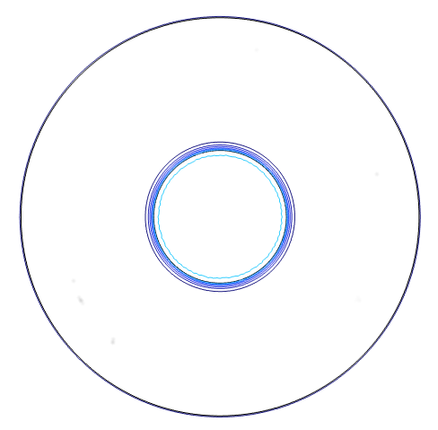
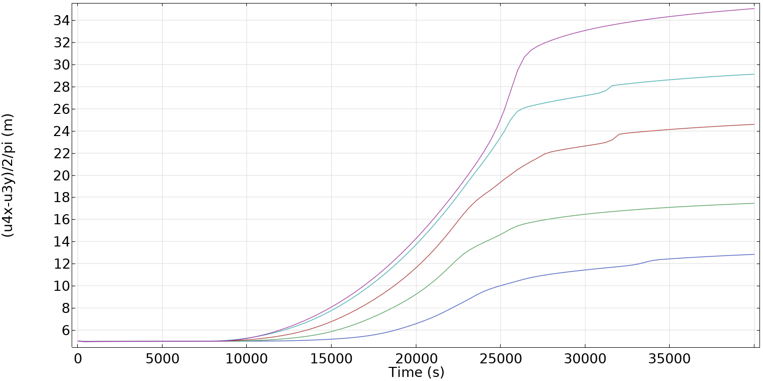
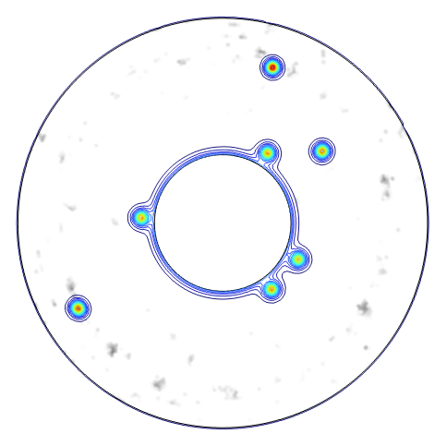
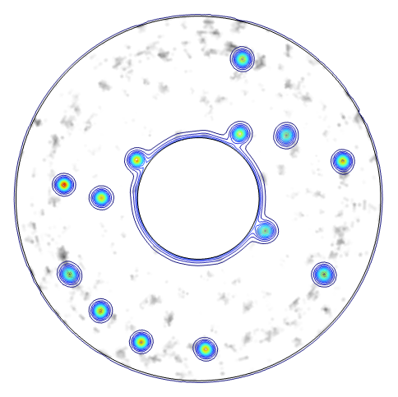
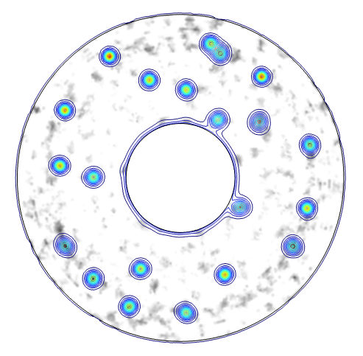
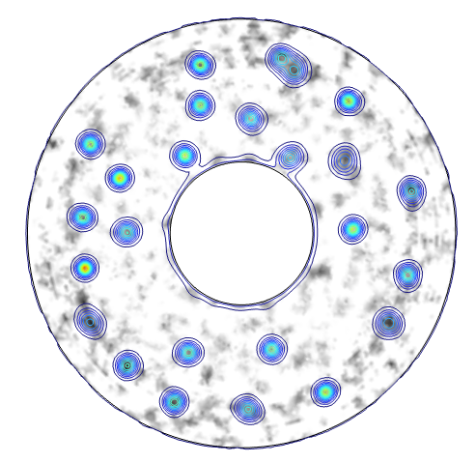
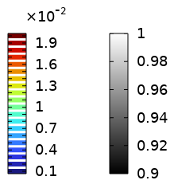



More defects means more trapped field (ongoing)
Defect Density
Aperture flux / $φ_{0}$
$$\frac{H}{\sqrt{2}H_{c_{0}}}$$
$$\frac{T_{c}}{T_{c_{0}}}$$
As expected, dense pinning landscapes can have a significant impact on the trapped flux.

Slide 17
4. Summary and Outlook

Slide 18
Summary and Outlook
Thermal Gradient
Closed Topology
Ongoing
(analytic)
(TDGL simulations)
Cool-down conditions affect the mixed state
Vortices form within the mixed state
Quality factor and performance drop
Inner magnetic flux is compressed
Mixed state widens and displaces
Flux penetrates as vortices more easily
Scaling factor definition
Pinning landscapes
(mapping simulations to experiments)
Next Steps
Thin films, multilayers
3D environment
Extrinsic thermal currents and external field sources
Main take-away message:
Closed-topology cooling facilitates flux penetration
Negative impact in the performance of SRF cavities

Slide 19
Thank you!
Merci beaucoup!
guilherme.theophilo.telles@cern.ch

Slide 20


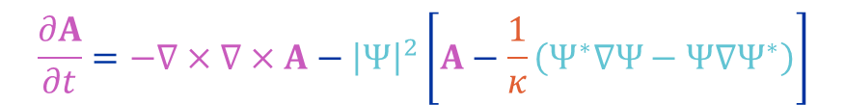
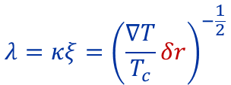






Time-dependent Ginzburg Landau (TDGL) equations
$$κ=\frac{λ}{ξ}$$
GL Parameter
(material-dependent)
Temperature-dependent
coefficients
$$α=1−\frac{T}{T_{c}}$$
$$β=1$$
Complex
order parameter
  $$\frac{∂Ψ}{∂t}=−{\left(\frac{1}{κ}∇+A\right)}^{2}Ψ+\left(α−β{\left|Ψ\right|}^{2}\right)Ψ$$
$$J$$
Magnetic vector potential
$$\frac{∂A}{∂t}=−∇×∇×A−{\left|Ψ\right|}^{2}\left[A−\frac{1}{κ}\left(Ψ^{∗}∇Ψ−Ψ∇Ψ^{∗}\right)\right]$$
$$B$$
Temperature-dependent material properties:
$$T=T_{c}−∇T\left(r−r_{sc}+vt\right)=T_{c}−∇Tδr$$
$$λ=κξ=\frac{1}{\sqrt{α}}={\left(1−\frac{T}{T_{c}}\right)}^{−\frac{1}{2}}$$
$$λ=κξ={\left(\frac{∇T}{T_{c}}δr\right)}^{−\frac{1}{2}}$$
$$\frac{H_{c_{1}}}{H_{c_{1}}^{∗}}=\frac{H_{c_{2}}}{H_{c_{2}}^{∗}}=α=1−\frac{T}{T_{c}}$$
$$\frac{H_{c_{1}}}{H_{c_{1}}^{∗}}=\frac{H_{c_{2}}}{H_{c_{2}}^{∗}}=\frac{∇T}{T_{c}}δr$$

Slide 21















Physics coupling in COMSOL Multiphysics®
$$T$$
$$T$$
$$T$$
$$ρC_{p}\dot{T}=∇⋅\left(k∇T\right)+Q$$
or
$$T=T_{c}−∇T\left(r−r_{sc}+vt\right)$$
$$Ψ_{1}$$
$$Ψ_{2}$$
$$Ψ_{1}$$
$$Ψ_{2}$$
$$Ψ_{1}$$
$$Ψ_{2}$$
$$Ψ=Ψ_{1}+iΨ_{2}$$
$$A_{1}$$
$$A_{1}$$
$$A_{2}$$
$$A_{1}$$
$$A_{2}$$
$$A=A_{1}\hat{x}+A_{2}\hat{y}+A_{3}\hat{z}$$
$$A_{3}$$
The model can have from three to six physics interfaces depending on the dimentionality of the problem and whether the temperature is calculated from heat inputs or directly imposed.
Heat Transfer in Solids:
  More realistic approach
  Harder to correlate with $∇T$
  Hard coupling
Temperature as an input:
  Less realistic approach
  Constant $∇T$ is an input
  No coupling needed
Both options were implemented in a 2D environment

Slide 22



The model in COMSOL Multiphysics®
  $${\dot{Ψ}}_{1}=\frac{1}{κ^{2}}\left(Ψ_{1.xx}+Ψ_{1.yy}\right)+\frac{2}{κ}\left(A_{1}Ψ_{2.x}+A_{2}Ψ_{2.y}\right)+\frac{Ψ_{2}}{κ}\left(A_{1.x}+A_{2.y}\right)−Ψ_{1}\left(A_{1}^{2}+A_{2}^{2}\right)+Ψ_{1}α−Ψ_{1}\left(Ψ_{1}^{2}+Ψ_{2}^{2}\right)$$
  $${\dot{Ψ}}_{2}=\frac{1}{κ^{2}}\left(Ψ_{2.xx}+Ψ_{2.yy}\right)+\frac{2}{κ}\left(A_{1}Ψ_{1.x}+A_{2}Ψ_{1.y}\right)+\frac{Ψ_{1}}{κ}\left(A_{1.x}+A_{2.y}\right)−Ψ_{2}\left(A_{1}^{2}+A_{2}^{2}\right)+Ψ_{2}α−Ψ_{2}\left(Ψ_{1}^{2}+Ψ_{2}^{2}\right)$$
$${\dot{A}}_{1}=−\frac{1}{κ}\left(Ψ_{2}Ψ_{1.x}−Ψ_{1}Ψ_{2.x}\right)−\left(Ψ_{1}^{2}+Ψ_{2}^{2}\right)A_{1}+A_{1.yy}−A_{2.xy}$$
$${\dot{A}}_{2}=−\frac{1}{κ}\left(Ψ_{2}Ψ_{1.y}−Ψ_{1}Ψ_{2.y}\right)−\left(Ψ_{1}^{2}+Ψ_{2}^{2}\right)A_{2}+A_{2.yy}−A_{1.xy}$$
$$ρC_{p}\dot{T}=∇⋅\left(k∇T\right)+Q$$

Slide 23
Summary and Outlook (in text)
Cavity performance is affected by trapped field, which can change depending on the cool-down conditions.
Vortex formation during transition is determined by the phase interfaces delimiting the mixed state, which in turn is impacted by the applied magnetic field and the thermal gradient.
To evaluate transition in a closed thermal topology, a detailed multiphysics model based on time-dependent Ginzburg-Landau equations was implemented accouting for the temperature dependence of material properties.
Analytical development and simulation results agree in that, in a closed topology, the inner field delimited by the expanding SC region increases over time, changing the width and position of the mixed state. This leads to an increasing ratio between mixed state width and vortex diameter, up to a point when the mixed state is wide enough to hold vortices, enabling their formation.
Investigation on the effects of pinning and a precise definition of the scaling factor are ongoing, to achieve a better comparison between simulation and experiments.
The simulation model will be expanded into a three-dimensional environment, to account for assymetries along the z-axis, extrinsic sources of thermal currents and thin films and multilayer superconductors.

