Slide 1


Coordinated
thin film SRF activities in Europe
Oleg B. Malyshev (ASTeC/STFC/UKRI, UK)
on behalf of collaborating team

Slide 2
Thin film SRF in Europe
Started in 1980-1990s at a few HEI:
  CERN, CEA, DESY, INFN, …
Successful use in several accelerators:
  LEP-200, ALPI, LHC, ELETTRA, SOLEIL, SLS, …
But
  TF SRF remains a low attention activity in a shadow of bulk Nb cavities.
  There were collaborations between 2-3 partners but no cross-European collaboration and coordination.
2015: EC call on Horizon 2020:
  To bust accelerator related technologies
  To involve academia and labs outside HEI
  First time: Work Package fully focused on thin film SRF

Slide 3
Coordinated European projects
ARIES
(2017-2021) WP15
R&D on small samples, effect of substrate on superconducting thin film quality
IFAST
(2021-2025) WP9
1st Nb₃Sn coated Nb cavity
iSAS
(2024-2028) WP3
Nb₃Sn coated Cu cavities
QPR tests
R&D on Nb₃Sn thin films deposited with PVD and ALD
Functional layers
Magnetic field trapping
Mechanical properties and tunability
EPITA
(2026-2030) WP4
Nb₃Sn coated Cu cavities
Horizontal RF test
Conduction cooling
Industry involvement
Post deposition treatment
9 parters
7 countries
15 parters
8 countries
4 parters
3 countries
21 parters
7 countries
TRL-3
TRL-4
TRL-5
TRL-6

Slide 4
European strategy on RF cavities
ESPP-U 2020
RFCP
From WG2 recommendations in 2025:
reduce construction and operation costs
The 2020 Update of the European Strategy for Particle Physics is the European roadmap on long-term future of particle physics
WG2 – Thin films
RF Coordination Panel was by the European Laboratory Directors Group (LDG) in Nov. 2022 for implementation ESPP-U 2020 on high gradient RF structures:
identify the main R&D activities needed by various collider schemes
highlighting top priorities
coordinating across national institutes and CERN
high-T_{c} TF coated cavities could boost performance, cut reliance on strategic
Luck of resources (both staff and funds)
help to reduce environmental impact
Access to RF testing facilities
Challenges in industrialisation

Slide 5
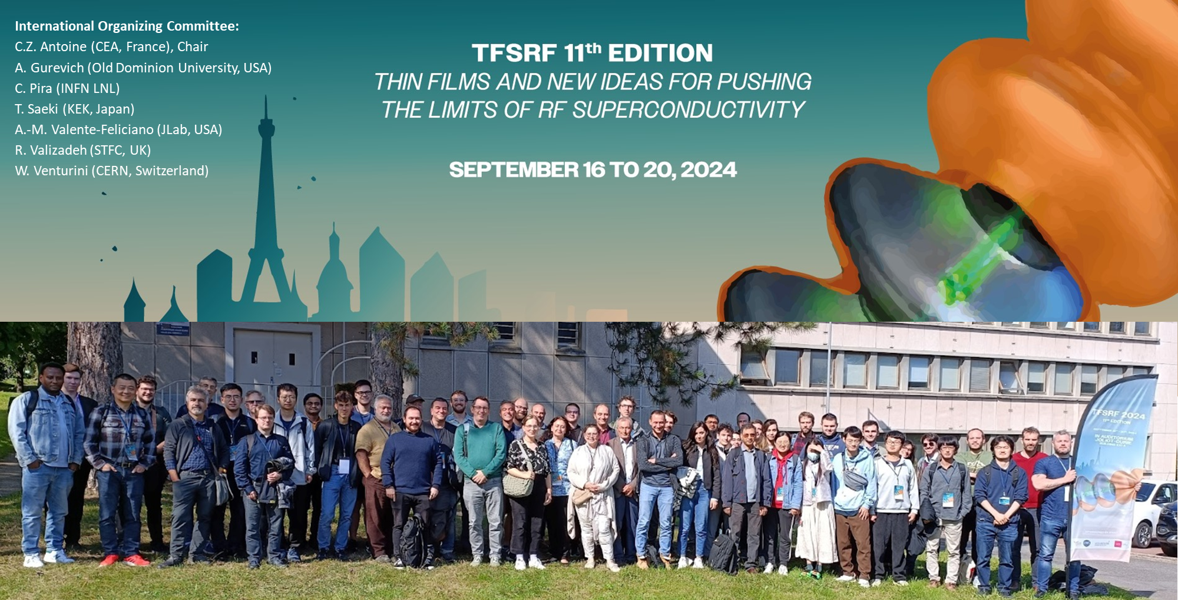
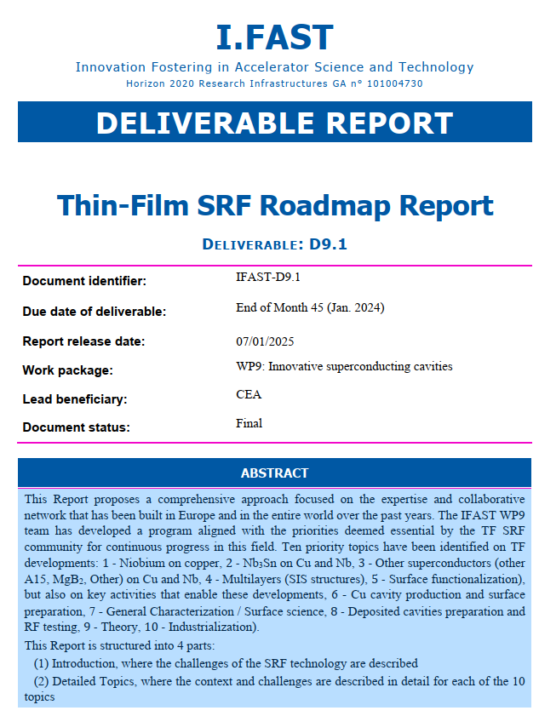
European Roadmap for thin film SRF
  Work started during TF SRF 2024
    ~60 participants, worldwide
    10 discussion sessions (priority topics)
    Surveys pre-sent to the participants (1 answer/lab asked)
    8-10 different labs replied to the surveys
  Work continued in the framework of IFAST (WP 9: Innovative SC cavities)
    Deliverable Report: IFAST D9.1, see https://zenodo.org/records/14731412

Slide 6
Horizon Europe project called EPITA
WP4: Superconducting thin film coated RF cavities
01/05/2026 – 30/04/2030
WP coordinators: Oleg B Malyshev and Thomas Proslier

Slide 7
WP: Superconducting Thin Films coated RF cavities
Objective: Deliver a new class of coated superconducting radiofrequency (SRF) cavities
Main aim: developing and validation a new class of thin-film coated SRF cavities, operated in a horizontal cryostat & cooled by compact cryocoolers:
  design and fabrication high-Q copper cavities coated with Nb₃Sn, optimised for operation at 4.2 K.
  demonstrating stable, efficient conduction cooling using commercial cryocoolers to eliminate liquid helium infrastructure.
  integrate and test these cavities in a horizontal cryomodule for industrial, medical, and scientific applications.
  industrialisation via technology transfer to partners.

Slide 8




















EPITA WP4 partners
 | HEI/Universities | Industry
Beneficiaries:
Associated partners
Collaborators | Polytechnique
Observers

Slide 9
WP: Superconducting Thin Films coated RF cavities
Success metrics:
  testing of a cryomodule for a 1.3 GHz cavity at 4.2 K.
  copper cavity production and
  coating with Nb₃Sn
  RF testing of cavity in cryostat to validate readiness for beam operation (Q>10¹⁰, field up to 23 MV/m);
  identification of new alloys with high thermal conductivity (>150 W/(m⋅K) at 4.2 K) and high temperature stability (>650 °C) for depositing superconducting thin films with critical temperature T_{c} ≥ 15 K.
TRL progress: from 5 to 6
    Validation of SRF cavity technology for future operation with a beam.

Slide 10
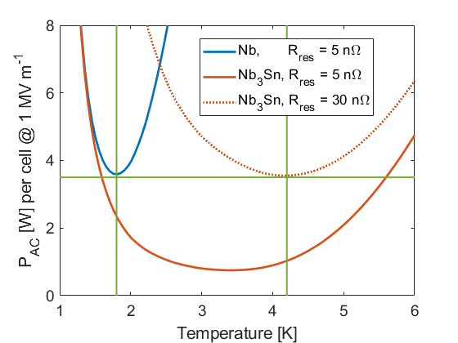
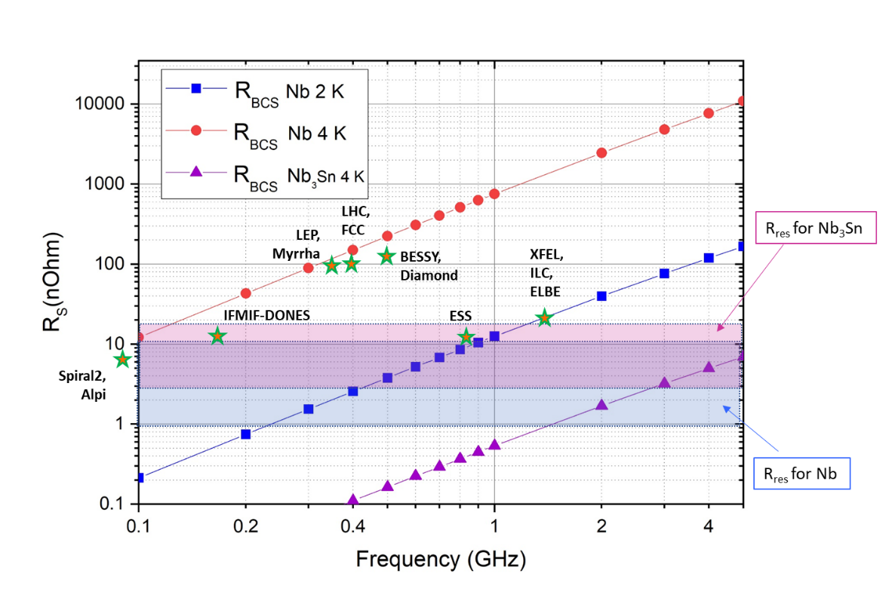
Why Nb₃Sn?
Calculated AC power dissipation of Nb and Nb₃Sn cavity at 1.3 GHz. Courtesy of Sebastian Keckert (HZB).
Calculated components of surface resistance (R_{s}) for Nb and Nb₃Sn
at T =2 & 4.2 K. Courtesy of C. Antoine (CEA) and D. Seal (STFC).
Nb₃Sn at T = 4 K outperforms both:
  Nb at T = 4 K at any frequency
  Nb at T = 2 K for f > 1.3 GHz.
  i.e. all projects shown with stars would benefit in their RF performance in case of Nb₃Sn instead of Nb at 4.2 K.
See “Thin-Film SRF Roadmap Report”, IFAST deliverable D9.1

Slide 11
List of Tasks
Task 4.4: Superconducting Thin Film Development
R&D on deposition parameters and post treatment
Task 4.3: 1.3 GHz cavity production and coating
Focus on cavities
Task 4.1: Strategy and Industrialisation
Del: Industry. Report on industrialisation perspective and recommendations. M42.
Del: Test stand. Horizontal RF test of conduction cooled cavity at CEA and with off-axis couplers at HZB. M46.
Del: Cavities. Report on 1.3 GHz cavity with coupler ports coated. M40.
Del: Targets. Production and tests of Nb₃Sn cylindrical sputtering targets. M36.
MS: Thin Film SRF workshop and lead roadmap discussion. M10.
Task 4.2: Horizontal RF test of conduction cooled 1.3 GHz cavity with off-axis couplers
MS: Cryostat for use with Nb₃Sn cavities, coupler adaptation. M28.
MS: Test for development of small scale Nb₃Sn targets. M36.
MS: Report on different types of 1.3 GHz cavity manufacturing and surface preparation. M22.

Slide 12
Task 4.1: Strategy and Industrialisation
Task leader: Reza Valizadeh, UKRI.

Slide 13

Task 4.1: Strategy and Industrialisation
Develop a long-term strategy to transition TF-SRF technology from R&D to industrial level, targeting higher TRLs and future use in accelerator applications across science, health, and industry.
Industrial partners will help identify current challenges and explore solutions for the industrialisation of TF-SRF cavity production.
The Task will organise a TF-SRF workshop, participate in relevant conferences sessions, and support meetings to coordinate academia and industry efforts toward European TF-SRF industrialisation strategy.
AI generated image.
Courtesy of R. Valizadeh (UKRI)

Slide 14
Task 4.2: Horizontal RF test of conduction cooled 1.3 GHz cavity with off-axis couplers
Task leader: Oliver Kugeler, HZB.

Slide 15
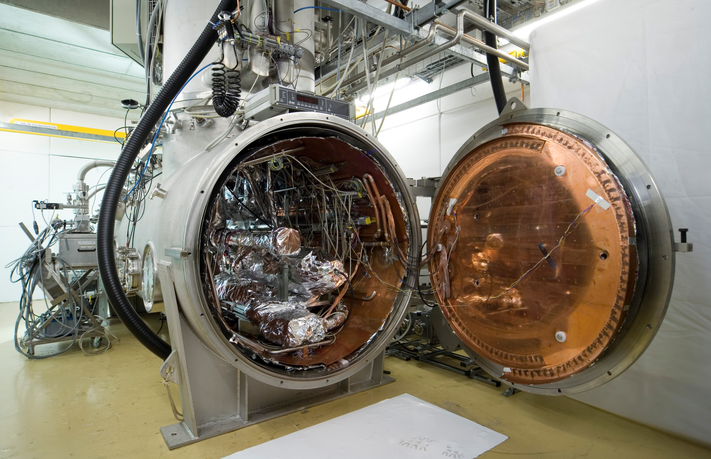
Task 4.2: Horizontal Cavity Integration and RF Tests
Integrating the Nb₃Sn-coated SRF cavity from Task 4.3 into a cryostat and test it under beam-relevant conditions,
two key challenges:
  conduction cooling with a cryocooler
  off-axis couplers
HZB will design a beam-compatible TESLA-type cavity with added ports for a power coupler and pickup antenna, with RI supporting high-power coupler integration.
Horizontal SRF testing facility Hobicat at HZB

Slide 16
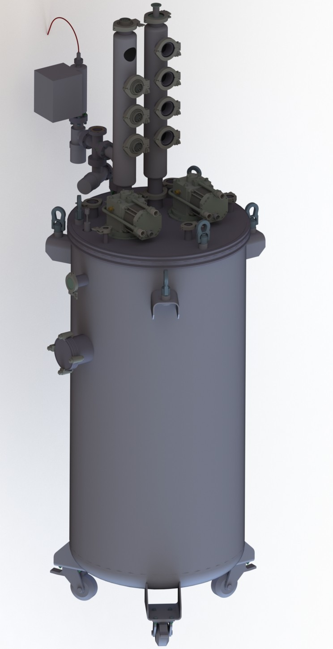
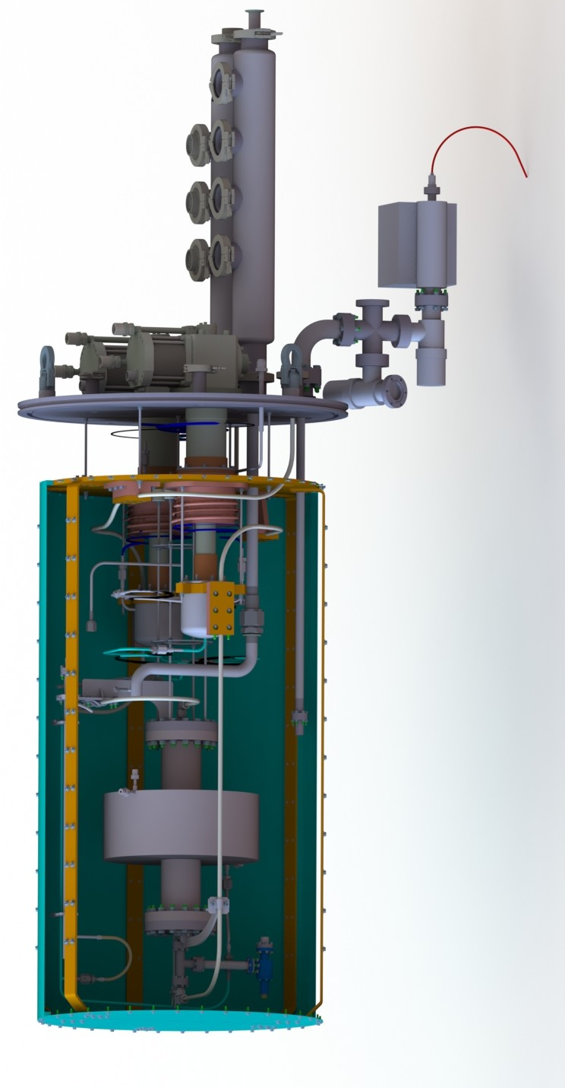
Task 4.2: Horizontal Cavity Integration and RF Tests
CEA will design a cryostat using a closed-loop liquid helium system for vertical and horizontal testing of 1.3 GHz cavities at 4.2 K.
Vertical SRF testing facility at CEA
Notes:
CEA will design a cryostat using a closed-loop liquid helium system for vertical and horizontal testing of 1.3 GHz cavities at 4.2 K.
This system will feature a 3D-printed Cu-based double-wall structure embedded in the Nb₃Sn coated cavities.
The two approaches will assess the impact of microphonics from cryocoolers and helium boiling, respectively, on cavity RF performance and develop mitigation strategies.

Slide 17
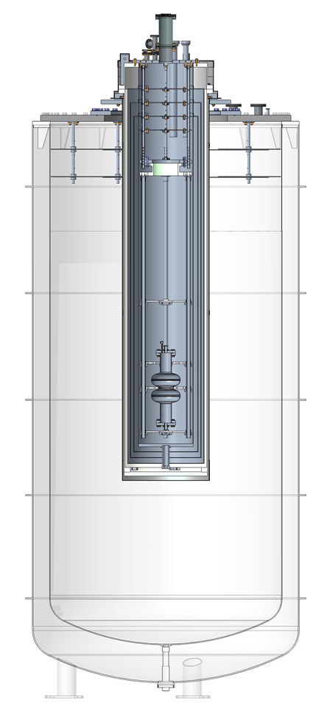
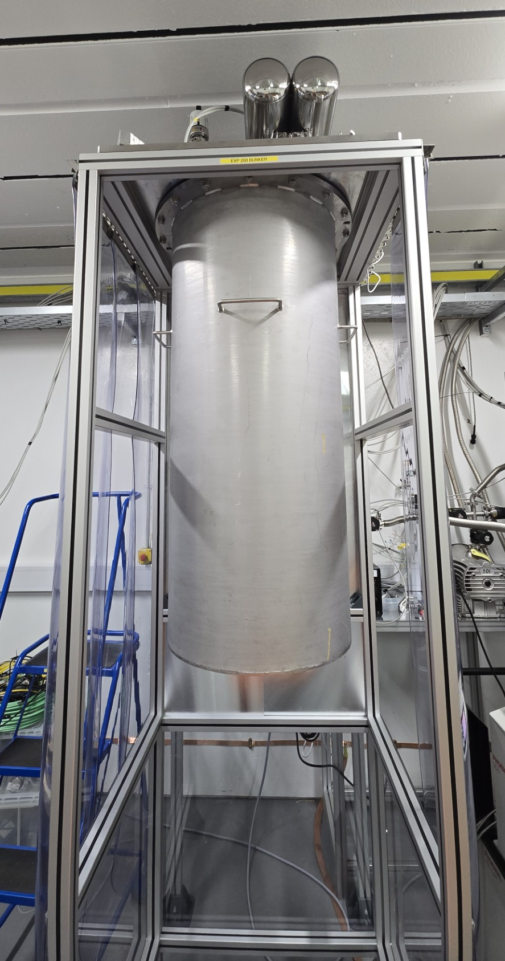
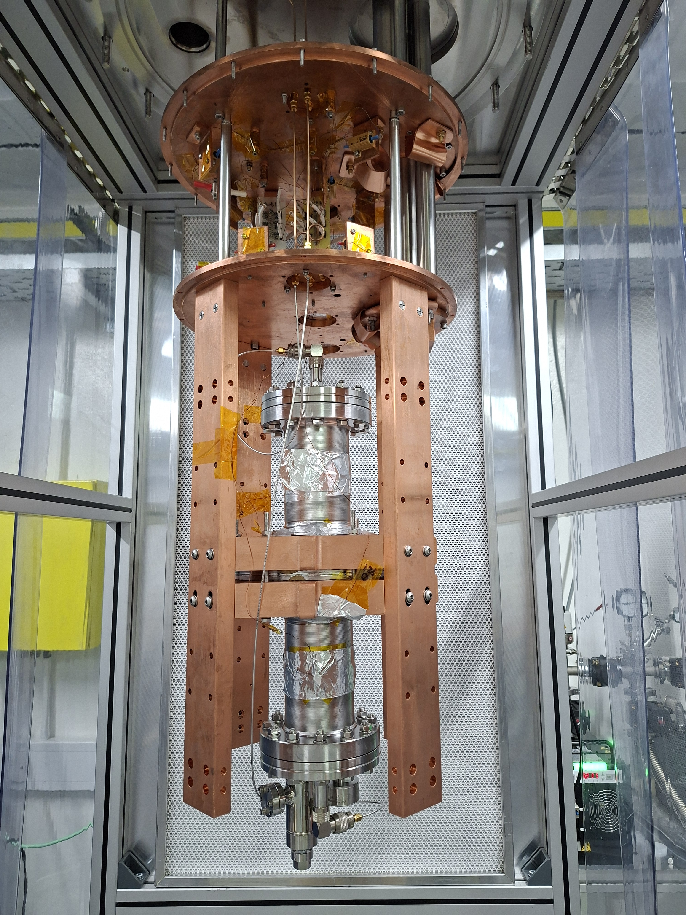
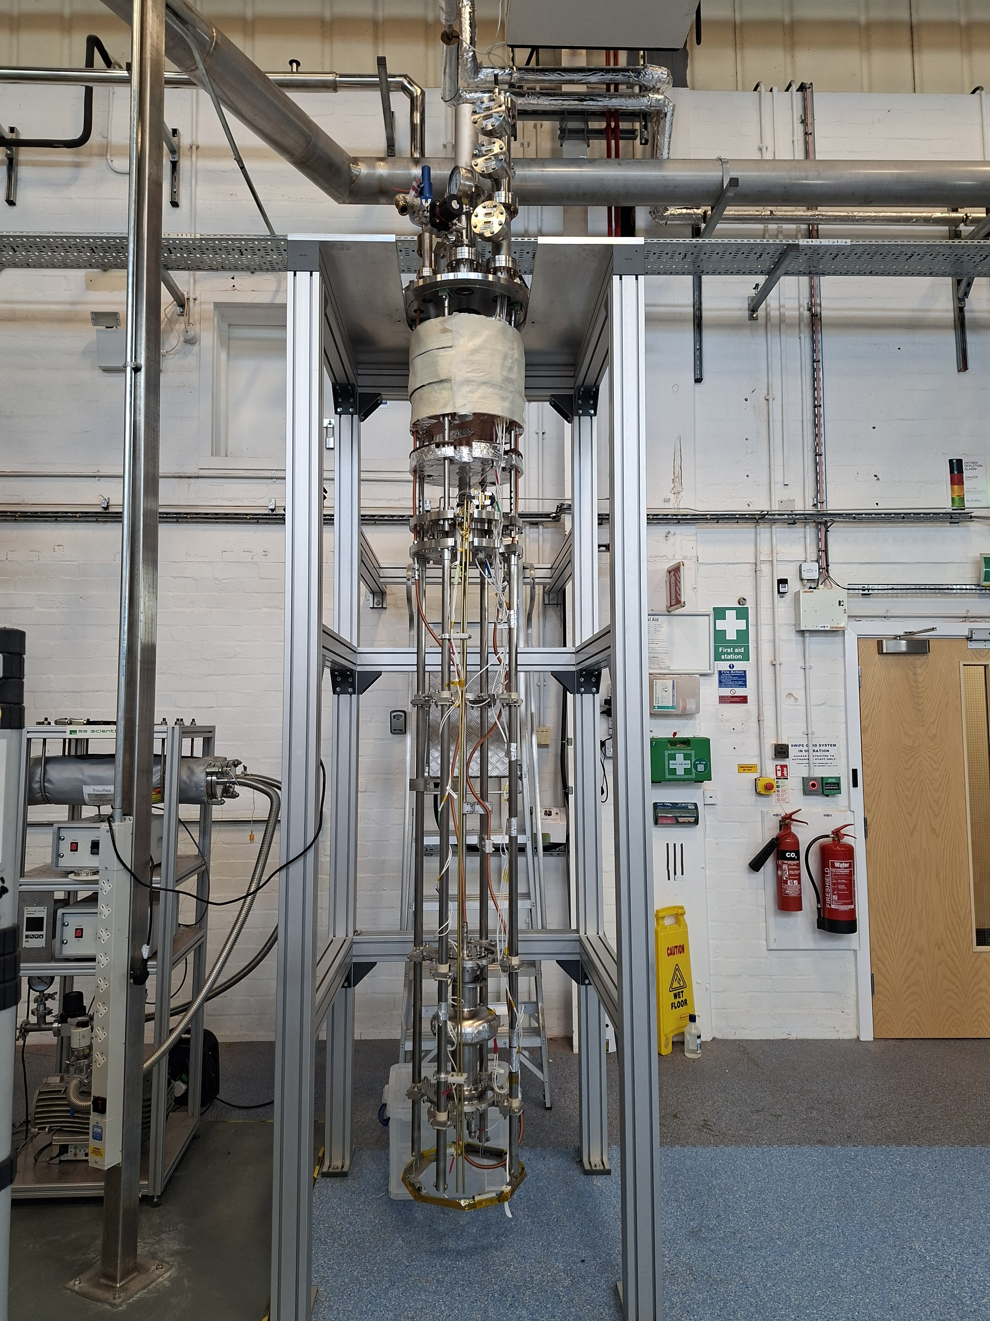
Task 4.2: SRF Tests
UKRI is commissioning two facilities for vertical RF testing of 1.3 GHz cavities
EXP100 – high power LHe based facility
for RF tests at 1.9 and 4.2 K
EXP200 – low power LHe-free facility using a cryocooler and conduction cooling for RF tests at 3 ≤ T ≤ 20 K

Slide 18
Task 4.3: 1.3 GHz Cavity Production and Coating
Task leader: Cristian Pira, INFN.

Slide 19
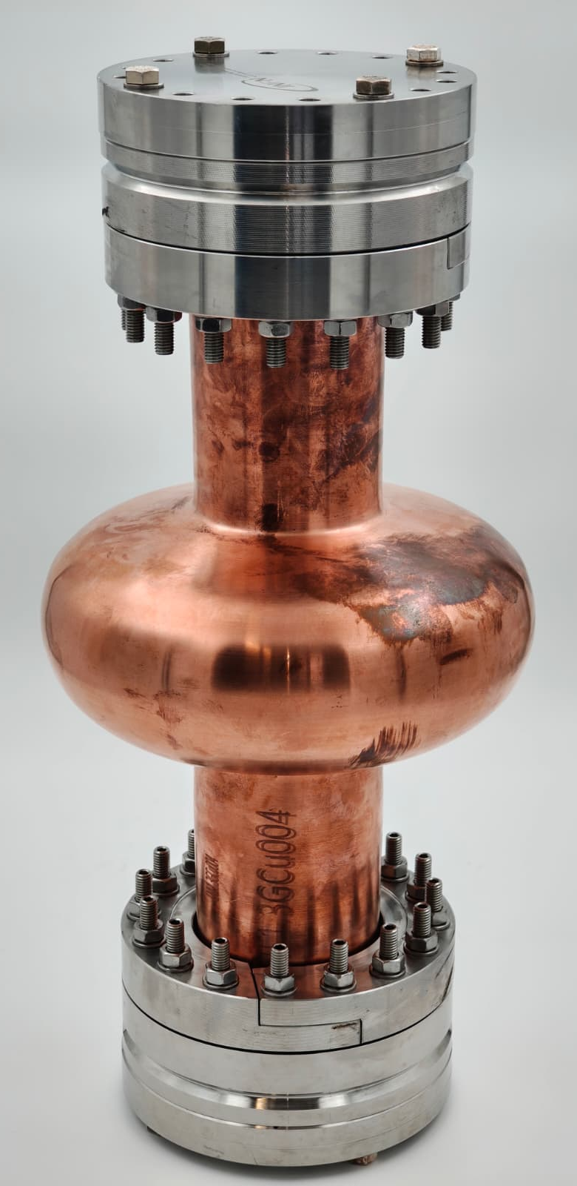
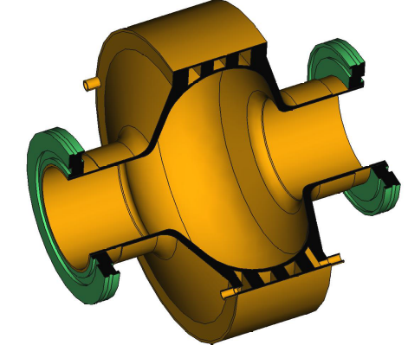
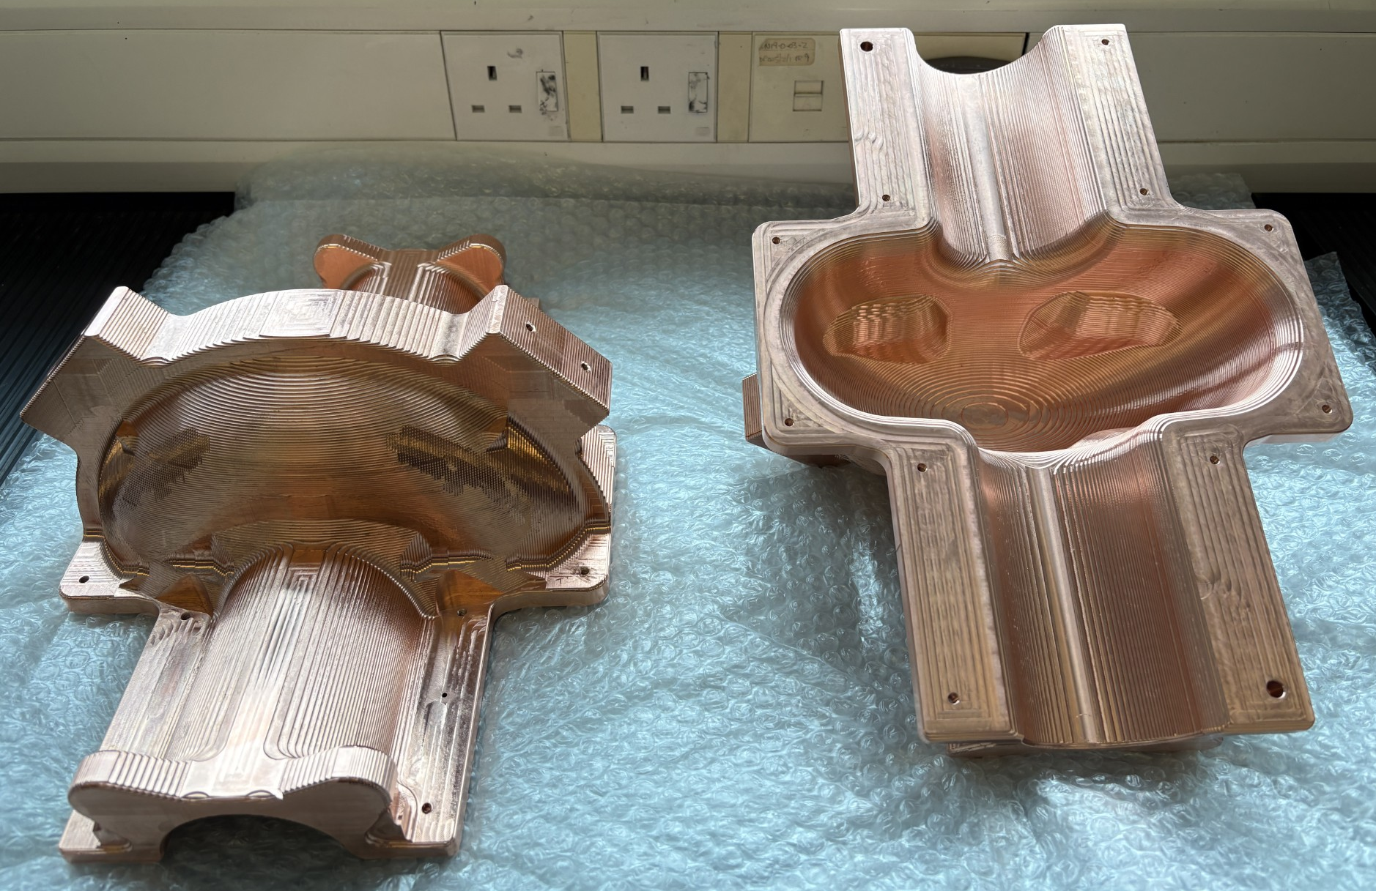
Task 4.3: 1.3 GHz Cavity Production
Deliver single cell 1.3 GHz copper cavities, with integrated power coupler and pick up ports and coated with Nb₃Sn superconducting thin films, for use in Task 4.2.
Cavities will be produced through
  seamless fabrication at INFN and
  equator Electron Beam welding at Zanon and RI.
Additive Manufacturing will also be explored by CEA and INFN.
Cavity polishing will be performed at INFN, Zanon and CEA.
Zanon will build a new industrial coating facility based on experience gained in I.FAST, with systems optimised to also coat the power coupler and pickup ports doors.
3D printed Cu cavity with in-wall cooling channels at CEA
A seamless Cu 1.3 GHz cavity produced by Picoli
Longitudinally split
1.3 GHz cavity production, coating and RF testing at LancU -UKRI

Slide 20
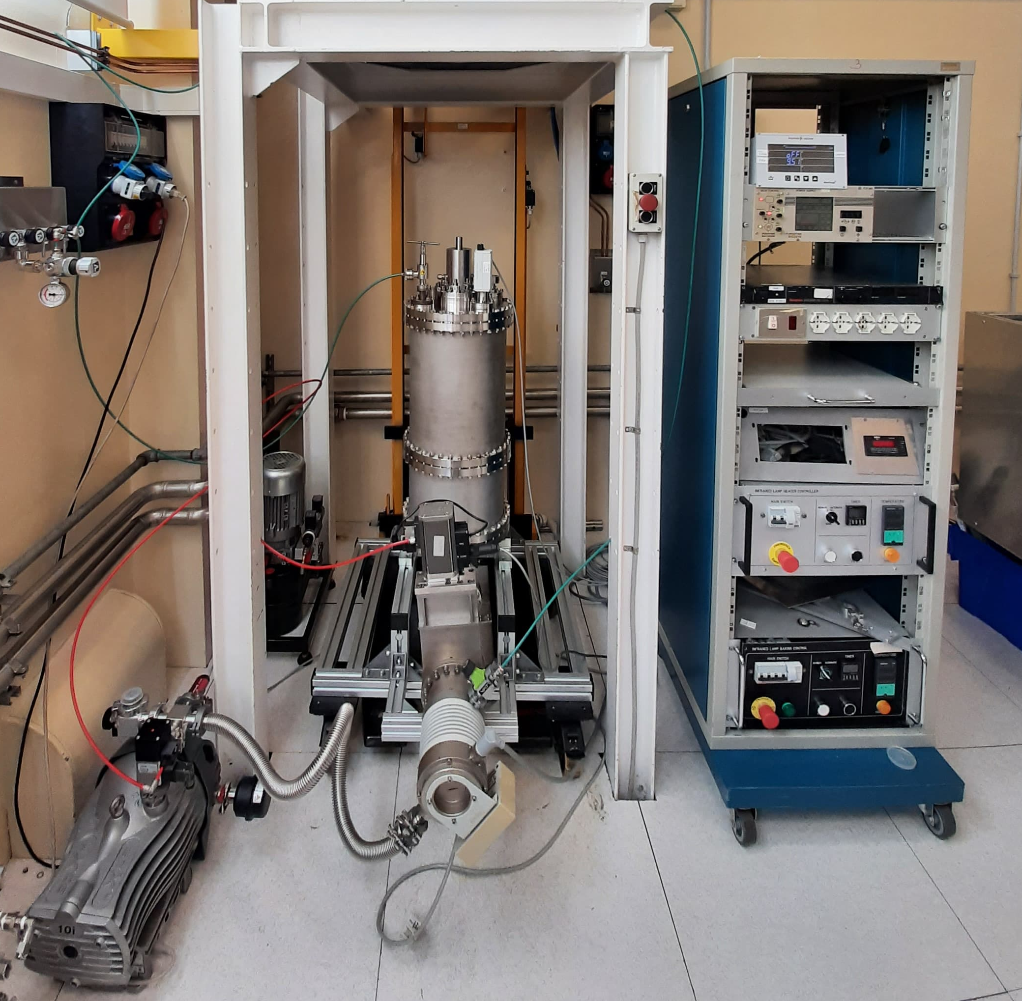
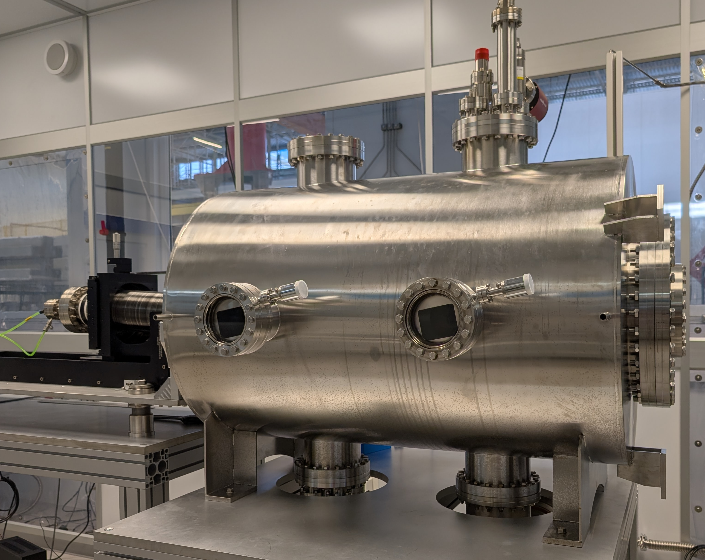
Task 4.3: 1.3 GHz Cavity Coating
PVD facility for 1.3 GHz cavities at INFN
PVD facility for 1.3 GHz cavities at UKRI
Notes:
Superconducting TF coating will be carried out at CEA, INFN, and UKRI using different setups to reduce failure risk.
The baseline coating protocol will follow I.FAST developments.
It also includes deposition target development.

Slide 21
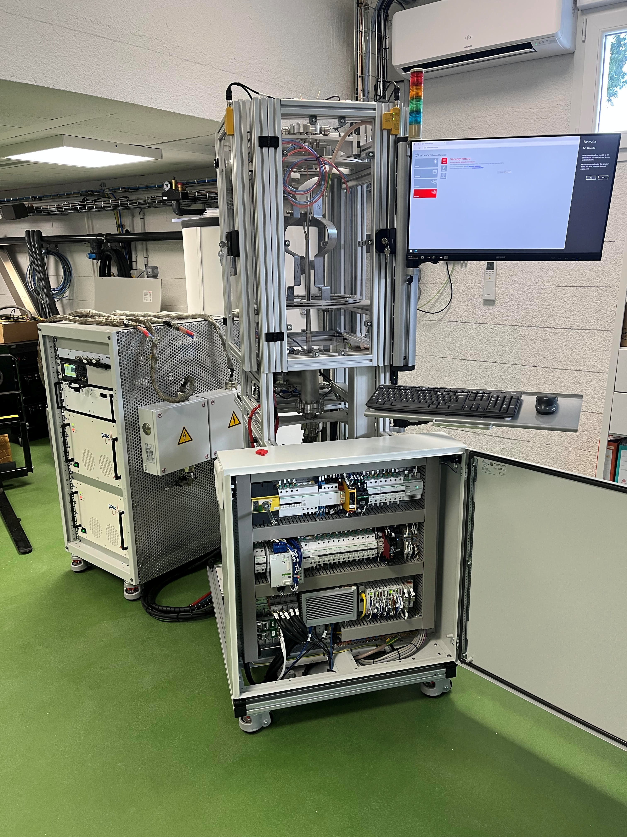
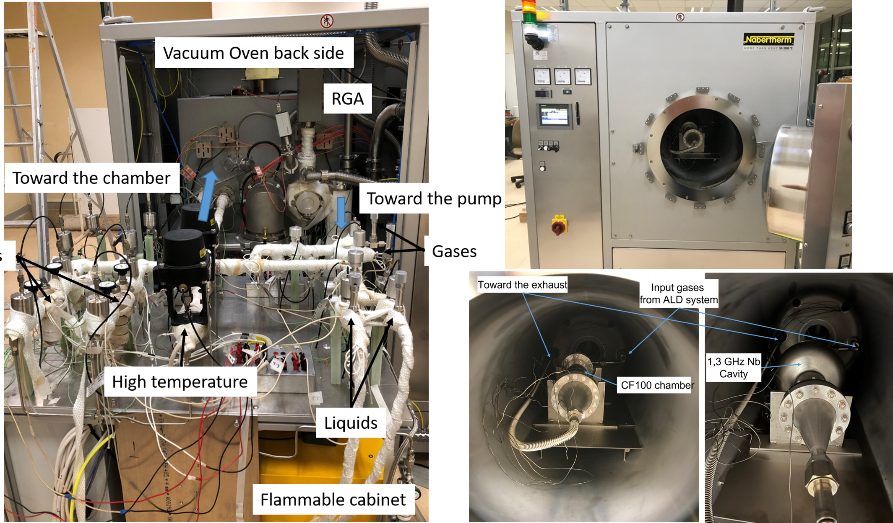
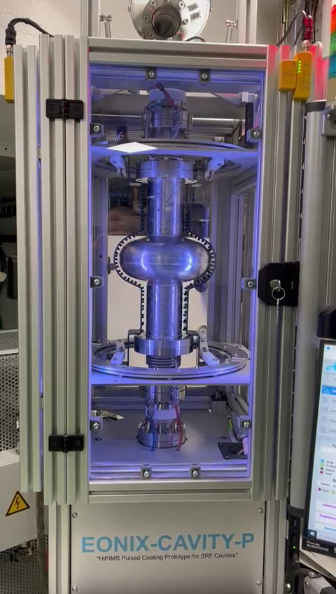
Task 4.3: 1.3 GHz Cavity Coating at
Atomic Layer Deposition (ALD) system at CEA
Thermo-currents mitigation / diffusion barriers – adaptative layers
HiPIMS deposition system at CEA
1.3 GHz to 600 MHz
Notes:
while CEA will assess the possibility of including interlayers via Atomic Layer Deposition (ALD)

Slide 22


Task 4.4: Superconducting Thin Film Development
Task leader: Thomas Proslier, CEA.

Slide 23
Task 4.4: Superconducting Thin Film Development
Deliver a Nb₃Sn cylindrical deposition targets for Task 4.3:
  Development of high-purity and high-density Nb₃Sn targets via Spark Plasma Sintering (SPS) at CEA, cold powder spray coating at UKRI, and infusion at INFN
  Characterisation of targets
Substrate material
  Novel alloys with high-temperature stability and thermal conductivity will also be developed for depositing superconductors at T > 600 °C
Optimising deposition and post-deposition
  Deposition of superconducting TF on planar samples at CEA, IEE, INFN, TUD, UKRI
    Nb₃Sn and other A15 compounds
  post thermal treatments at HZDR and RTU
  Surface and material characterisation
  Superconducting properties evaluation at DC, AC and RF conditions

Slide 24
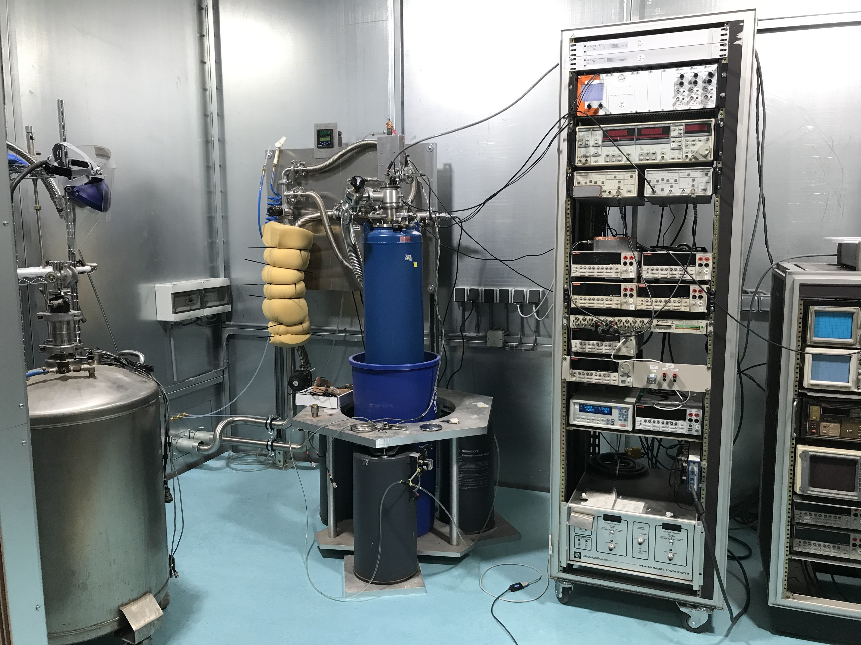
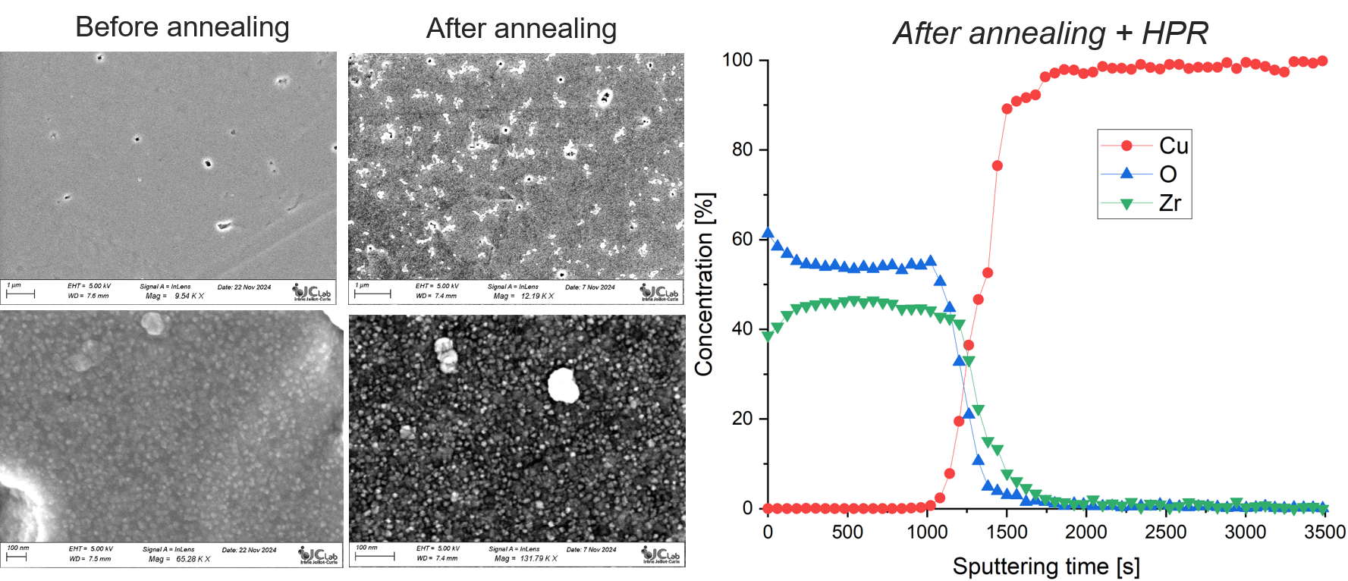
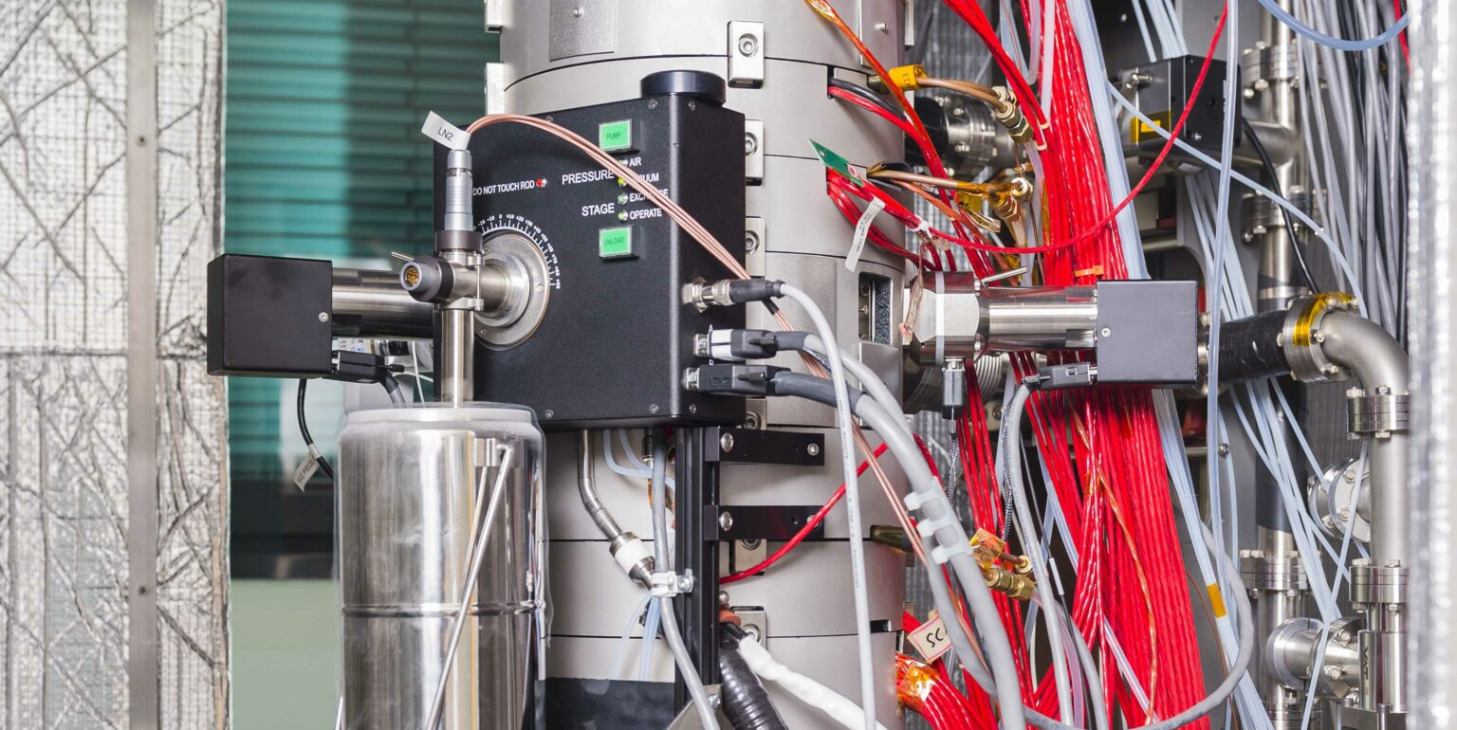
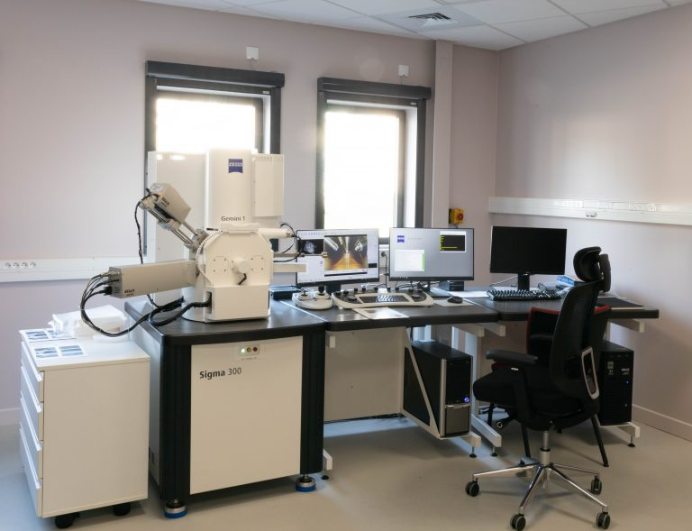
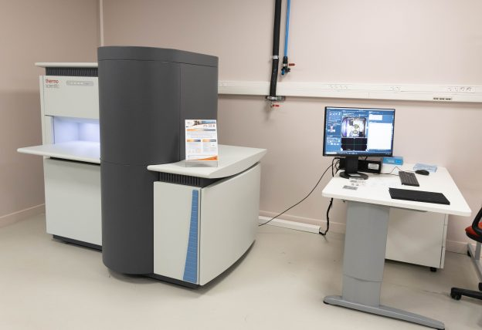
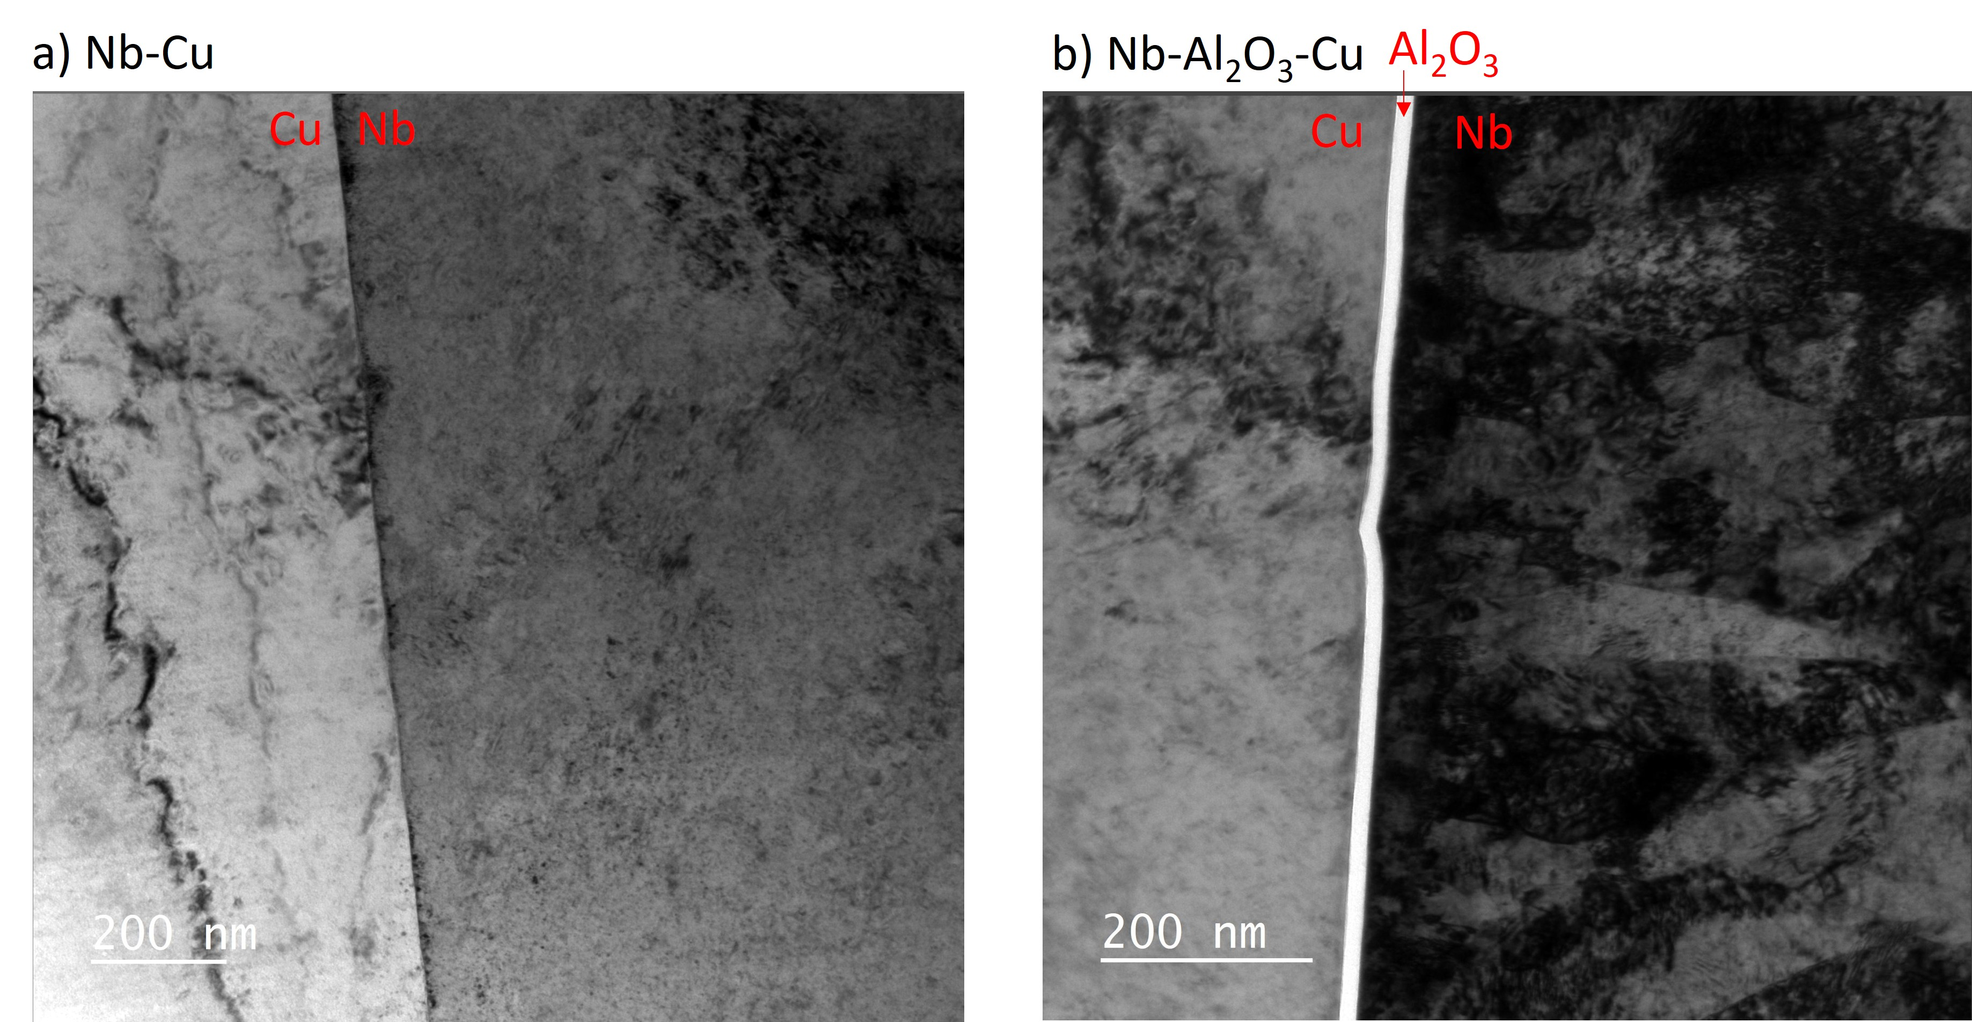

Task 4.4: Superconducting Thin Film Development
Thin film characterisation tools:
Tunneling spectroscopy (CEA): cartography of the superconducting properties -> prediction of RF performances
XPS-SEM (CNRS): Chemical composition depth profile and imaging
XRR-XRD (Polytechnique): structure
TEM-FIB (Paris-Saclay – LPS): atomic arrangement/interfaces

Slide 25
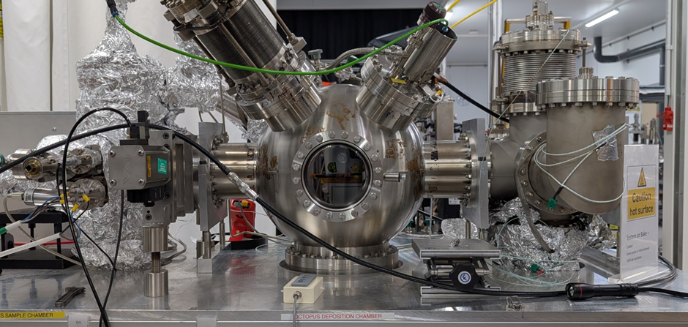
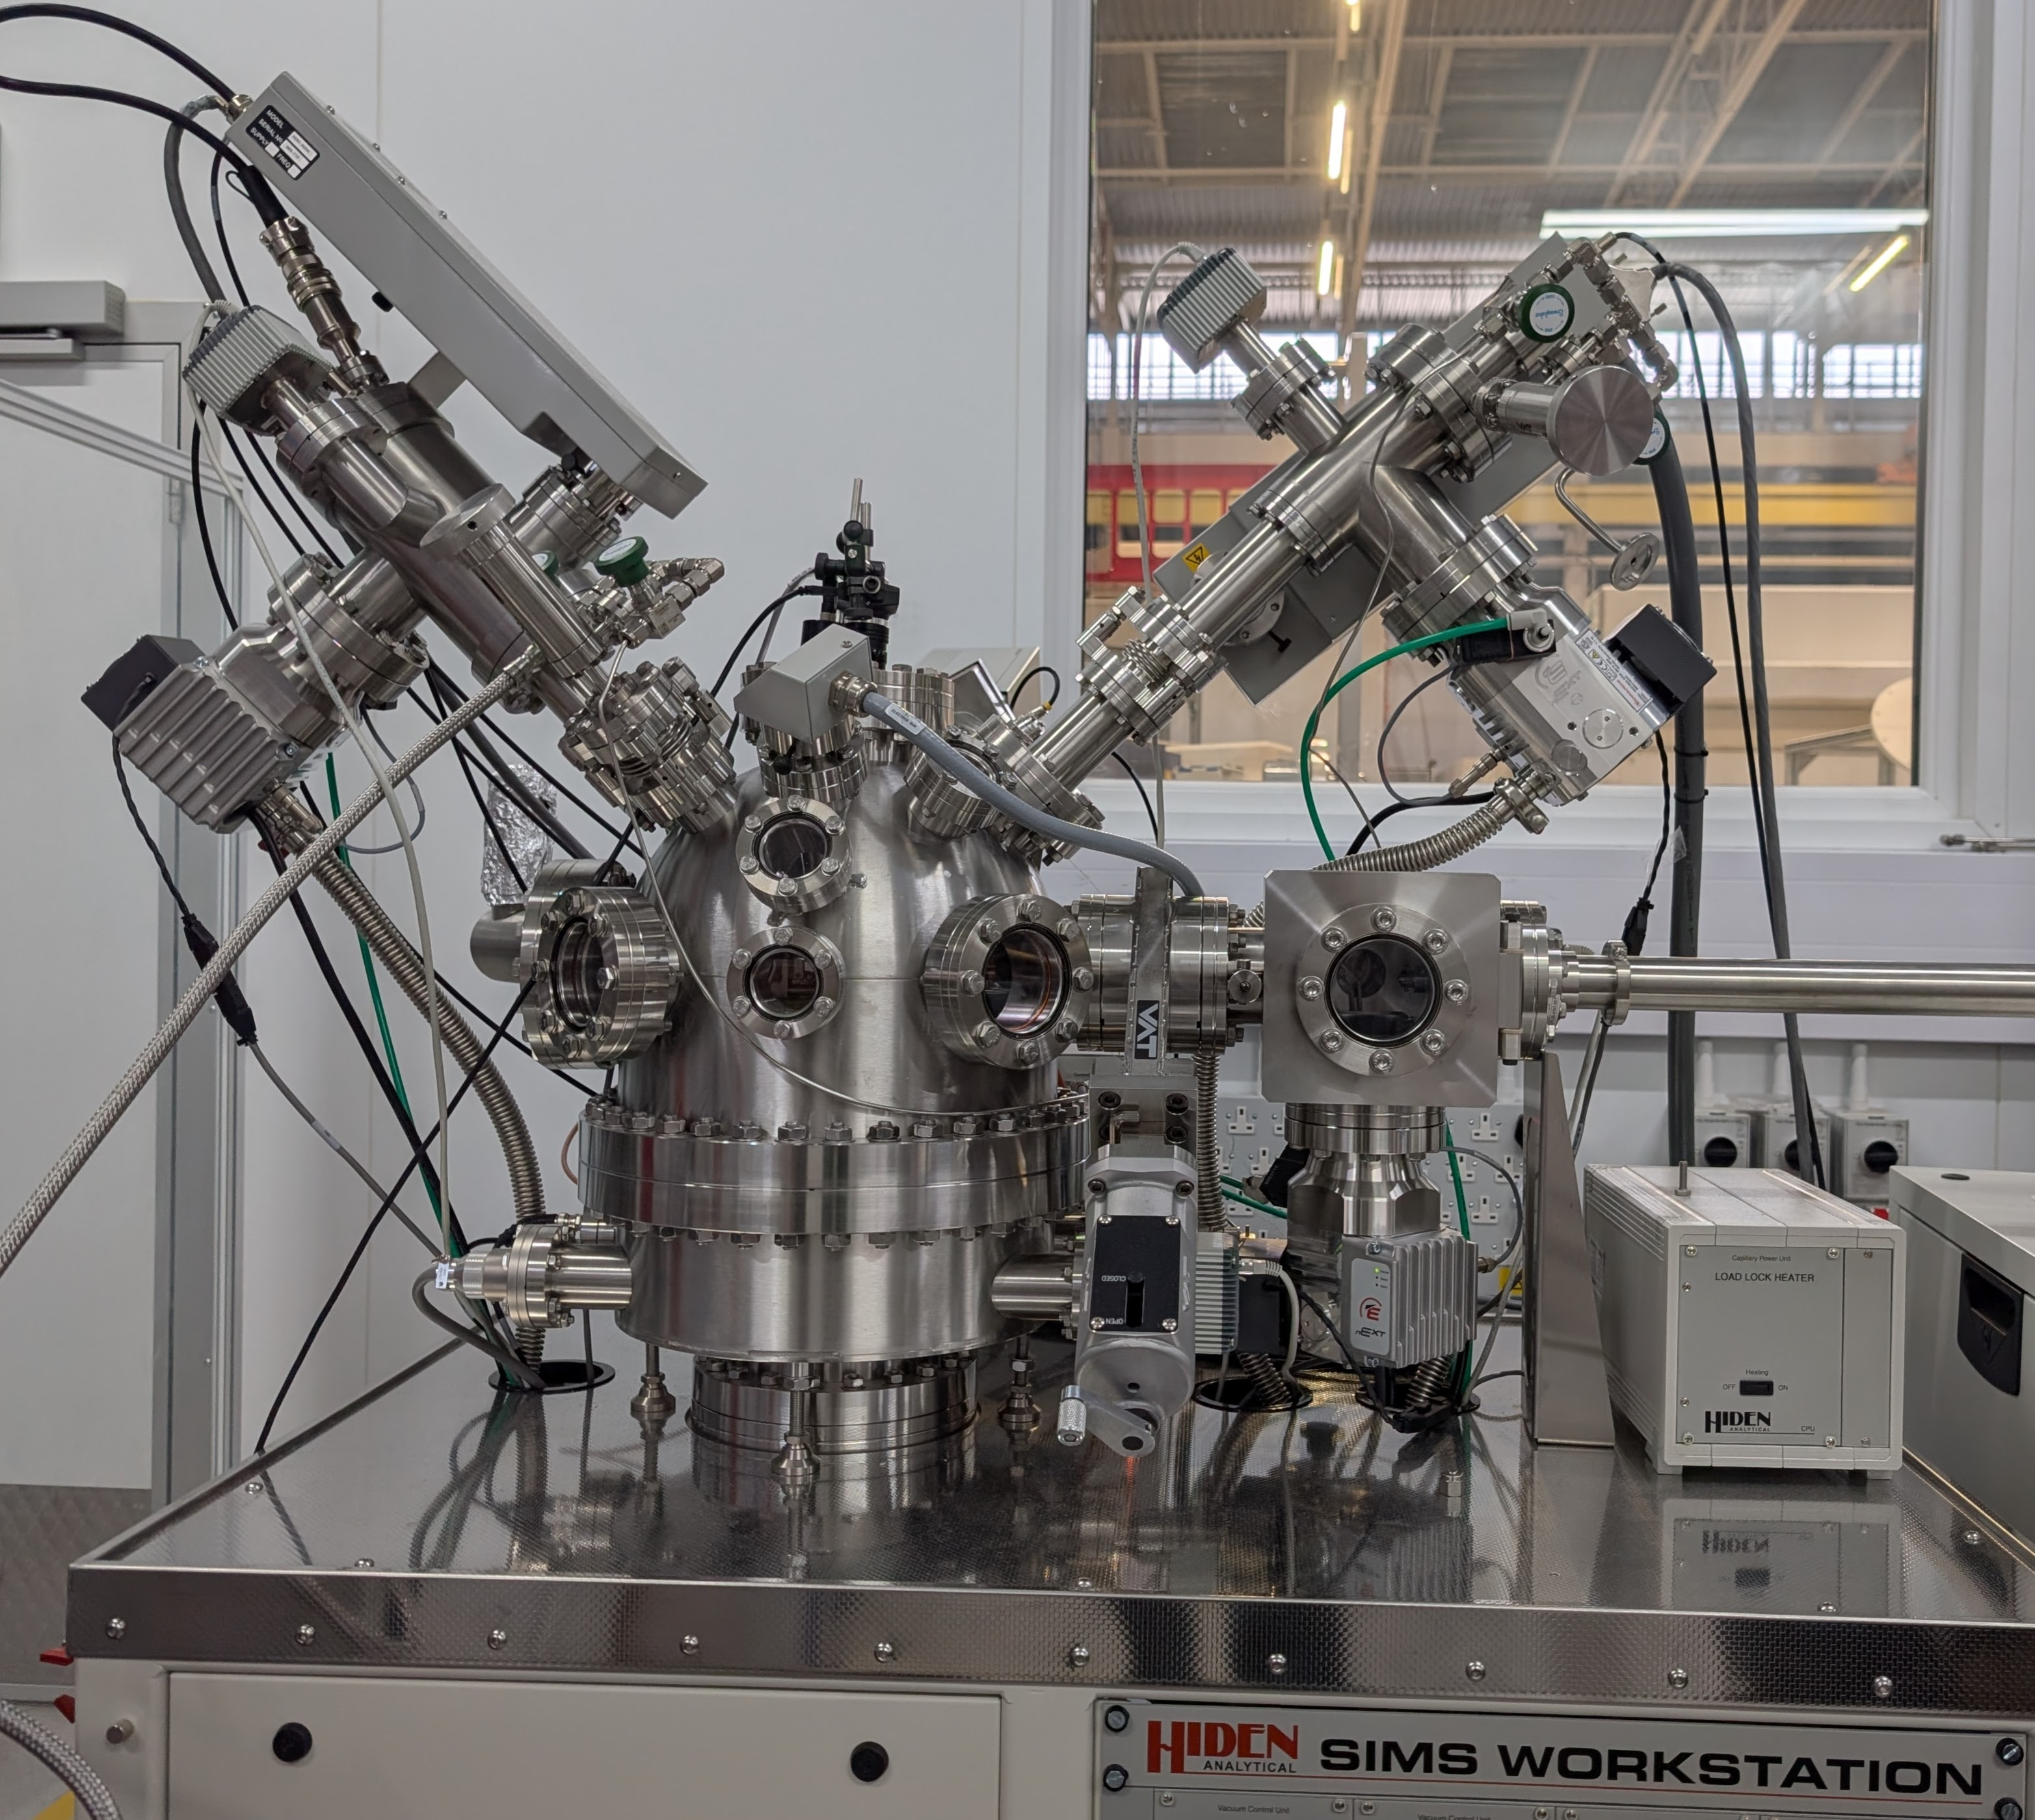
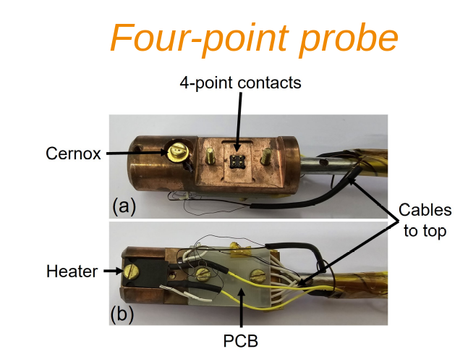
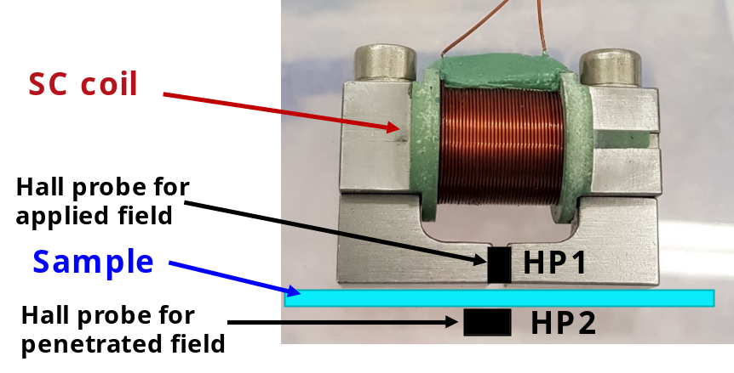
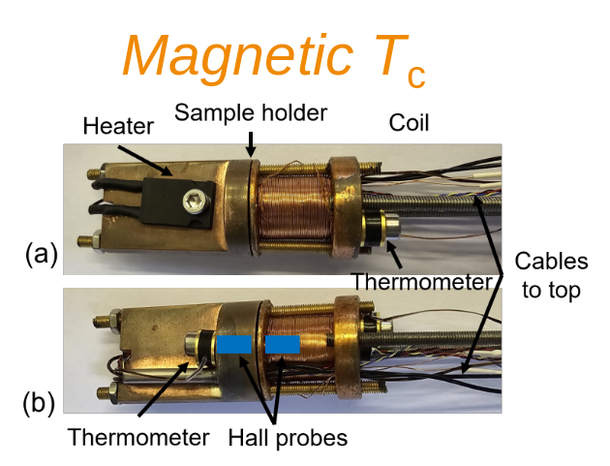
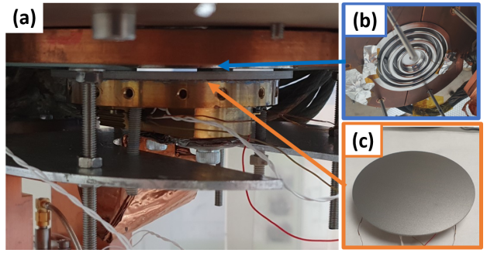
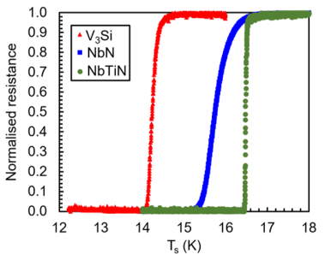
Task 4.4: Superconducting Thin Film Development
PVD deposition facility
Sample characterisation with SIMS, XPS, SEM, EDX
The 7.8 GHz Choke cavity for low power SRF test on planar samples
Magnetic Field Penetration Facility

Slide 26
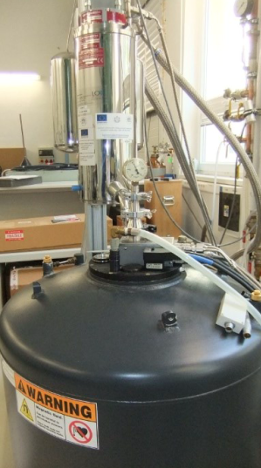
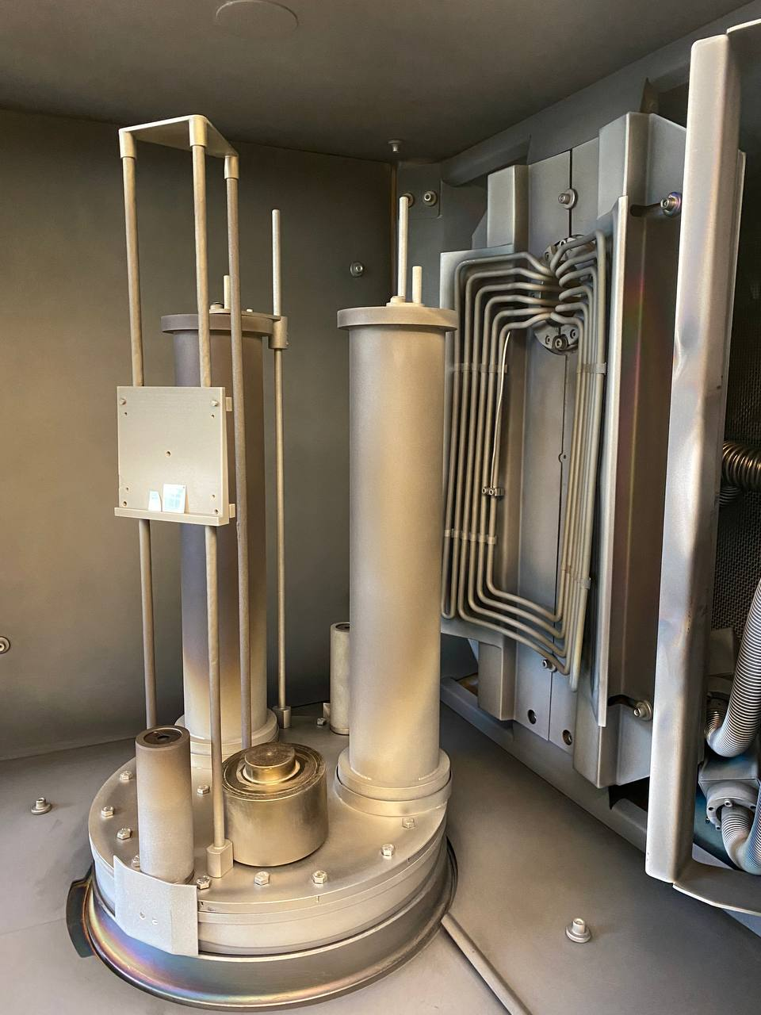
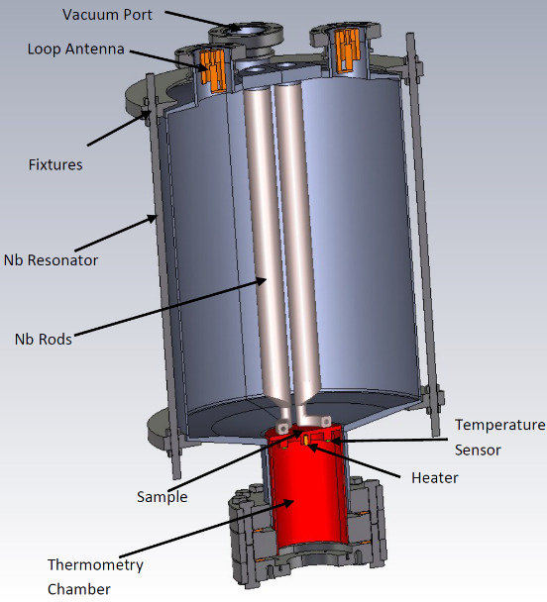
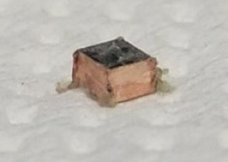
Task 4.4: Superconducting Thin Film Development
IEE
T_{c} measurements and AC susceptibility with a commercial PPMS at IEE
DC/HiPIMS for coupons & QPR (Siegen): new superconducting alloys.
QPR RF testing
(HZB and DESY)

Slide 27
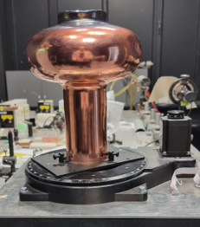
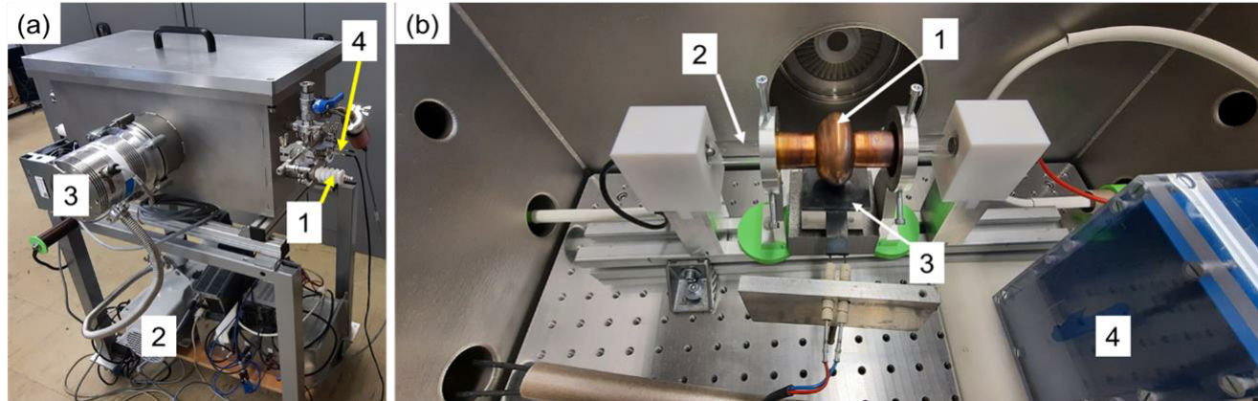
Task 4.4: Superconducting Thin Film Development
Post-deposition thin film treatment
Facility for flash lamp annealing (FLA) of 6 GHz and 1.3 GHz coated copper cavities at HZDR
composition, depth-profile, trace contamination with RBS/PIXE, XRD
Tc with SQUID
Laser treatment facility for 1.3 GHz cavity at RTU

Slide 28
Collaborating team
Claire Antoine
Thomas Proslier
Yasmine Kalboussi
Ivana Curci
Stéphane Berry
David Longuevergne
Oliver Kugeler
Sebastian Keckert
Alena Prudnikova
Jens Knobloch
Michael Schuster
Andre Frahm
Felix Kramer
Alex Cierpka
Shengqiang Zhou
Slawomir Prucnal
Marc Wenskat
Xin Jiang
Aleksandr Zubtsovskii
Eugen Seiler
Fedor Gömöry
Graeme Burt
Harry Marks
Daniel Turner
Nathan Leicester
Oleg B. Malyshev
Reza Valizadeh
Christopher Benjamin
Daniel Seal
Afshan Ashraf
Shrikant Pattalwar
Liam Smith
James Conlon
Cristian Pira
Eduard Chyhyrynets
Davide Ford
Alessandro Salmaso
Giovanni Marconato
Rocco Paparella
Davide Piccoli
Ambra Gresele
Arturs Medvids
Jevgenijs Kaupuzs
Aleksandrs Michko
Pavels Onufrijevs
Alexander Navitski
Vitalii Shcherbinin
Michael Pekeler
Dorothea Fonnesu

Slide 29

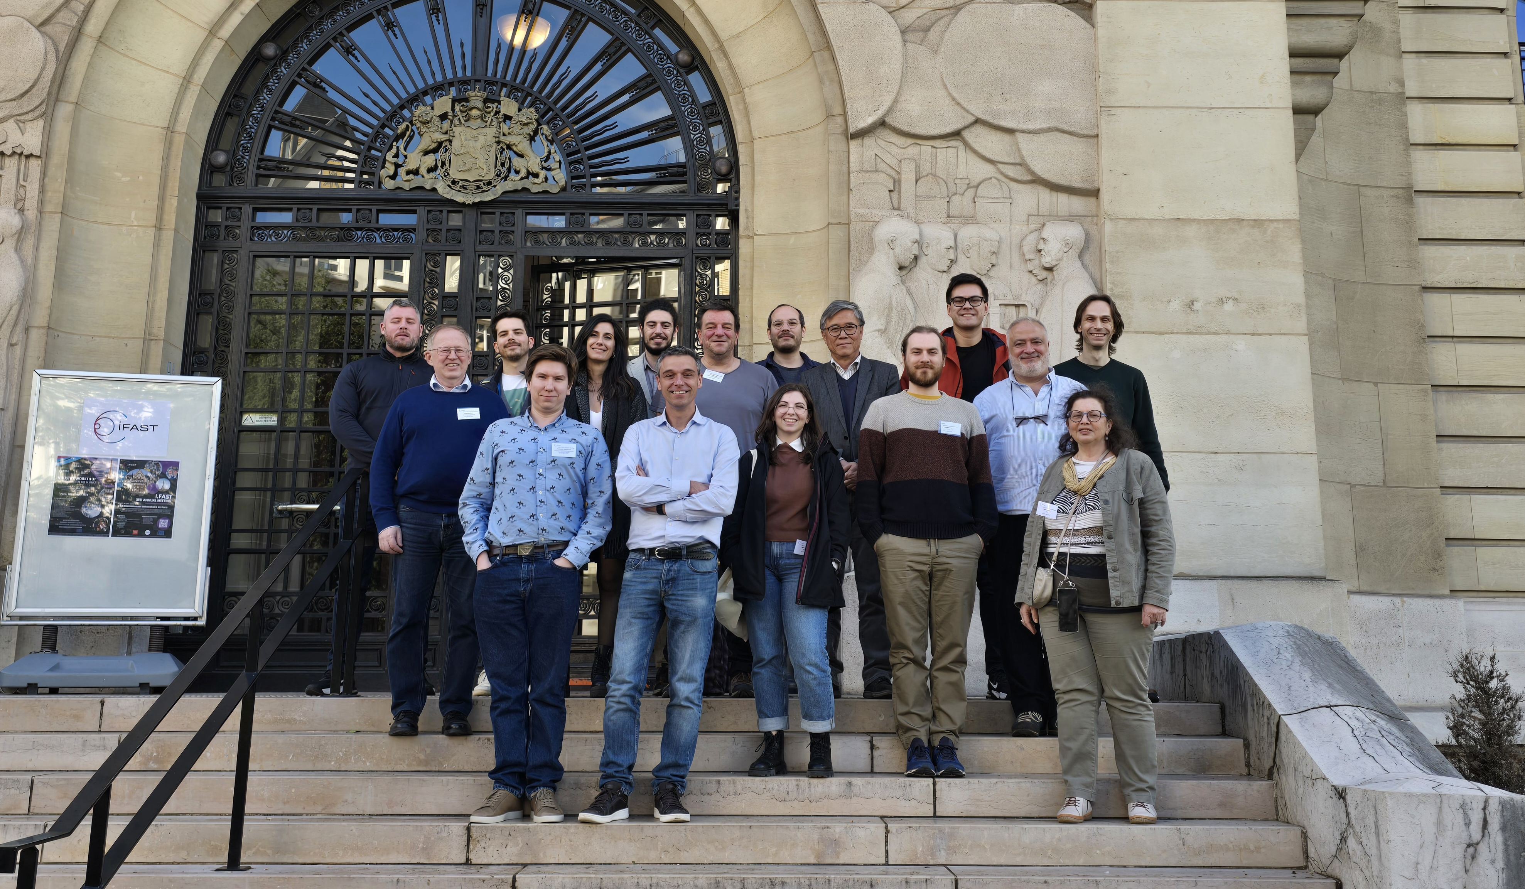
More details from IFAST, iSAS and EPITA collaborations will be reported in the talks at this workshop
Thanks for your attention
EPITA WP4 team (representatives only). A Photo from 4th IFAST Annual meeting

Slide 30
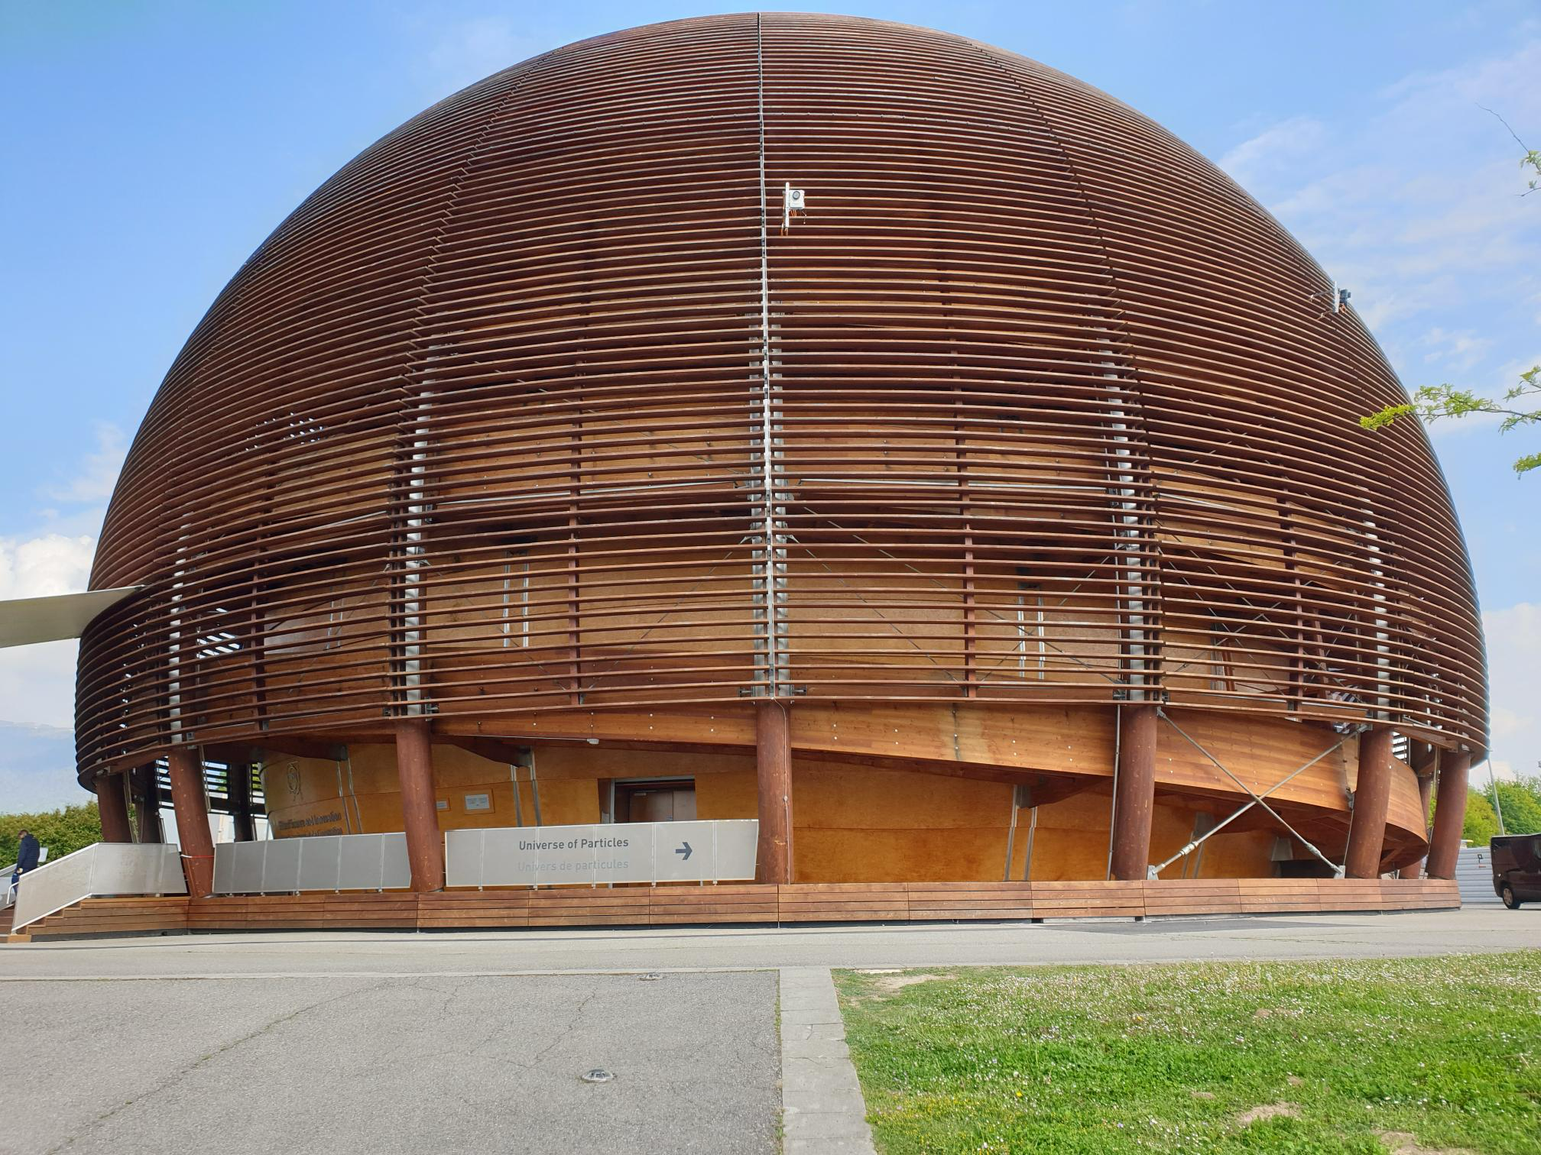



This project received funding from the European Union’s Horizon Europe
Research and Innovation Programme under CA No 101290927

Slide 31
Partners’ expertise, complementary roles, infrastructure
UKRI: TF coating and characterisation in dedicated lab, testing facilities for SC coatings and vertical cavity testing
  Lancaster U.: RF cavity design and testing
HZB: cavity design, HoBiCaT cavity test stand
DESY/HUH: QPR
CEA: cryostat design, vertical and horizontal cavity testing, deposition techniques in dedicated lab and film characterisation
  CNRS + Paris-Saclay U + Polytechnique: TF characterisation
INFN: design and fabrication of copper cavities, TF coating and characterisation in dedicated lab, DC and RF testing facilities for SC
  Piccoli: fabrication of copper cavities
Zanon, RI: EU leaders in SC cavity preparation, production and welding facilities
IEE: testing facilities for SC coatings
HZDR: testing facilities for SC coatings
RTU: Laser treatment
Siegen U: thin film coating and characterisation
Observers :
  Academic: CERN, JLab
  Industrial: Euclid Techlab, NovAccel Co. Ltd, Shakespeare Ltd.

