Slide 1
Study on the synergistic optimization of material and thickness of diffusion barrier layer based on copper-based Nb₃Sn film by bronze method
Bohao Zhang*, Teng Tan
Institute of Modern Physics, Chinese Academy of Sciences
University of Chinese Academy of Sciences
Advanced Energy Science and Technology Guangdong Laboratory
TFSRF 2026 September 22, 2026
zhangbohao@impcas.ac.cn
1

Slide 2
Outline
1. Background and motivation
2. Sample preparation
3. Results and discussion
4. Summary and outlook
2

Slide 3
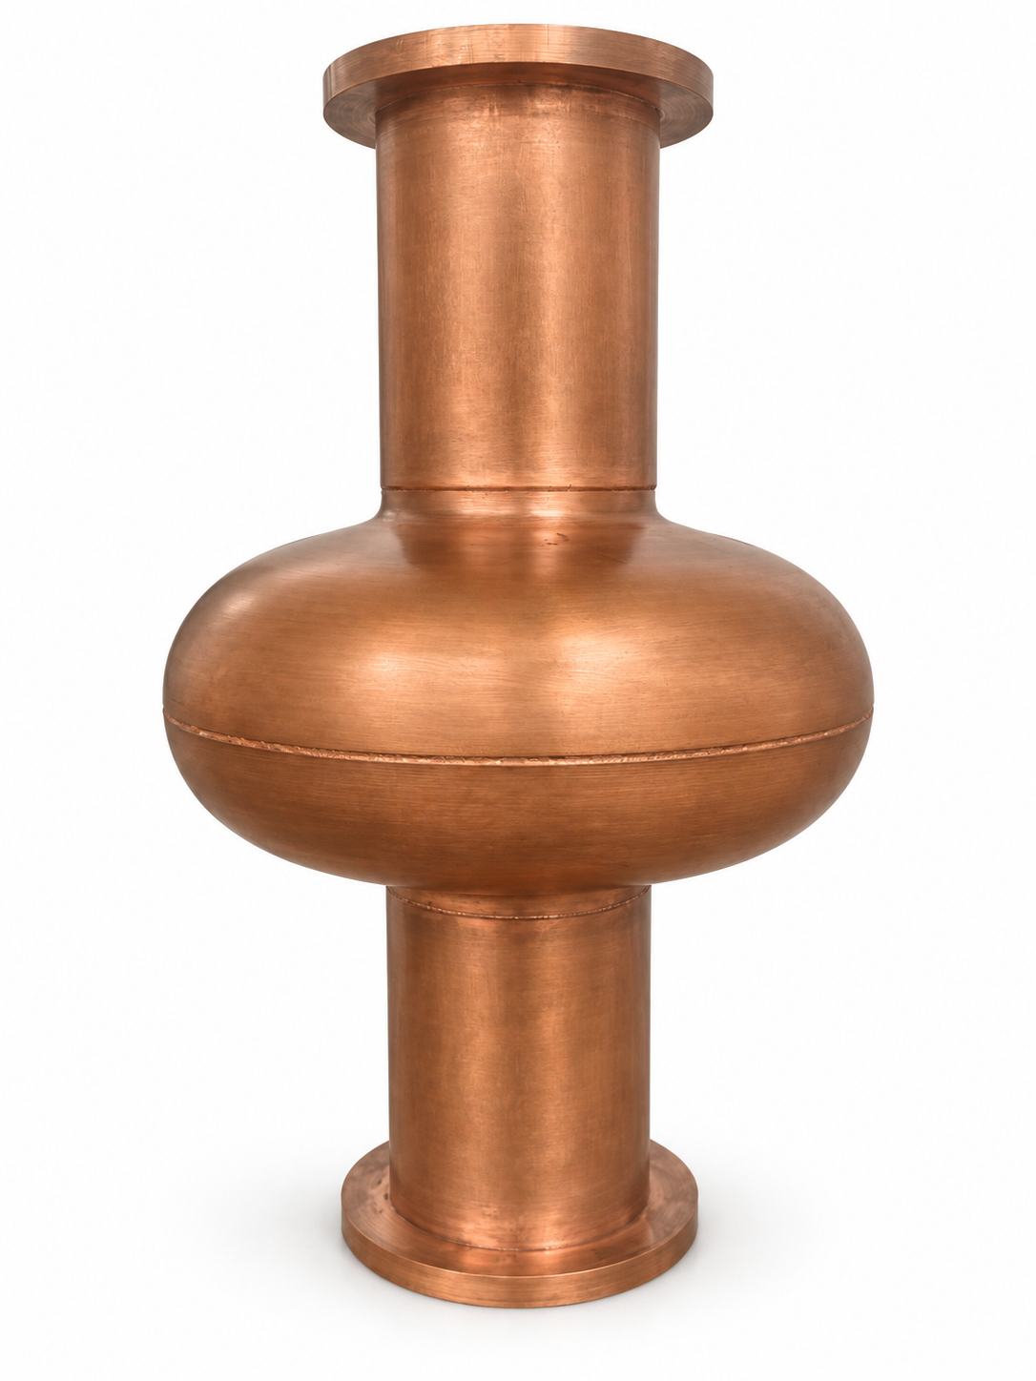
Nb₃Sn and Cu Combine RF and Thermal Functions
Nb₃Sn provides better superconducting properties while Cu substrate is used for heat dissipation and supporting the resonant cavity.
SRF surface
Nb₃Sn
T_{c} ≈ 18 K
Potential for operation at 4.2 K
Cavity substrate
Cu
High thermal conductivity
Easy machining and lower cost
1.3 GHz Cu cavity
Cu provides heat removal and structural support.
Bulk Nb: T_{c} ≈ 9.2 K
High-performance Nb cavities typically operate near 2 K.
Background: Posen & Liepe (2014); Ilyina et al. (2019).
3

Slide 4
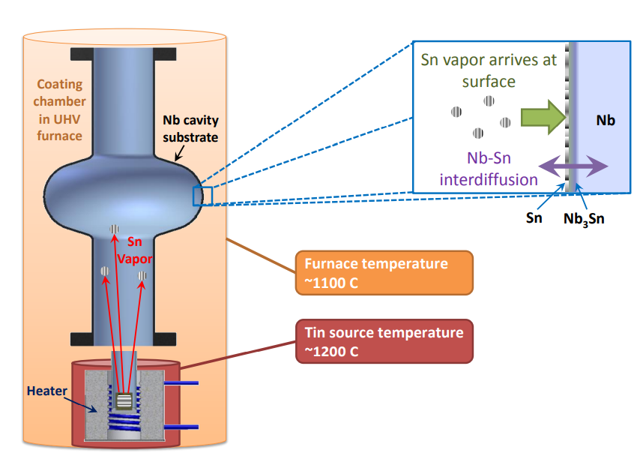
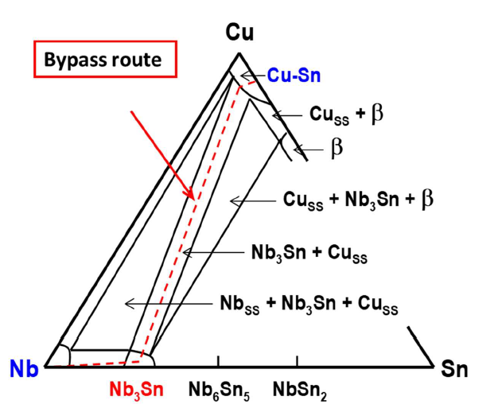
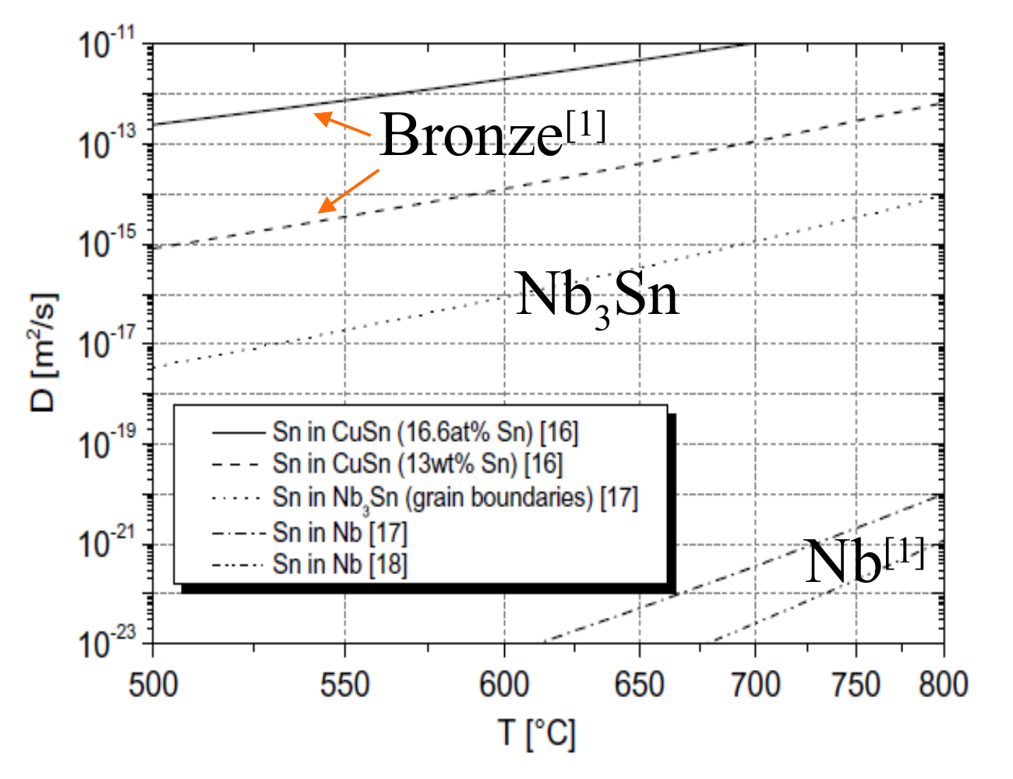
Why the Bronze Route Works on Cu
Bronze method can reduce the reaction temperature，provides faster Sn transport than Nb and reduce the stability of other niobium-tin phases
Sn-vapor diffusion
Cu–Nb–Sn at 700 °C
Sn diffusion
Cavity ≈1100 °C
Sn source ≈1200 °C
Cu melts at 1083 °C
A route toward Nb₃Sn
without Sn-rich intermediate phases
Cu–Sn provides faster Sn transport
than diffusion through Nb
The bronze route combines a lower reaction temperature with faster Sn transport.
Müller & Schneider (2008); Mei et al. (2009).
4

Slide 5
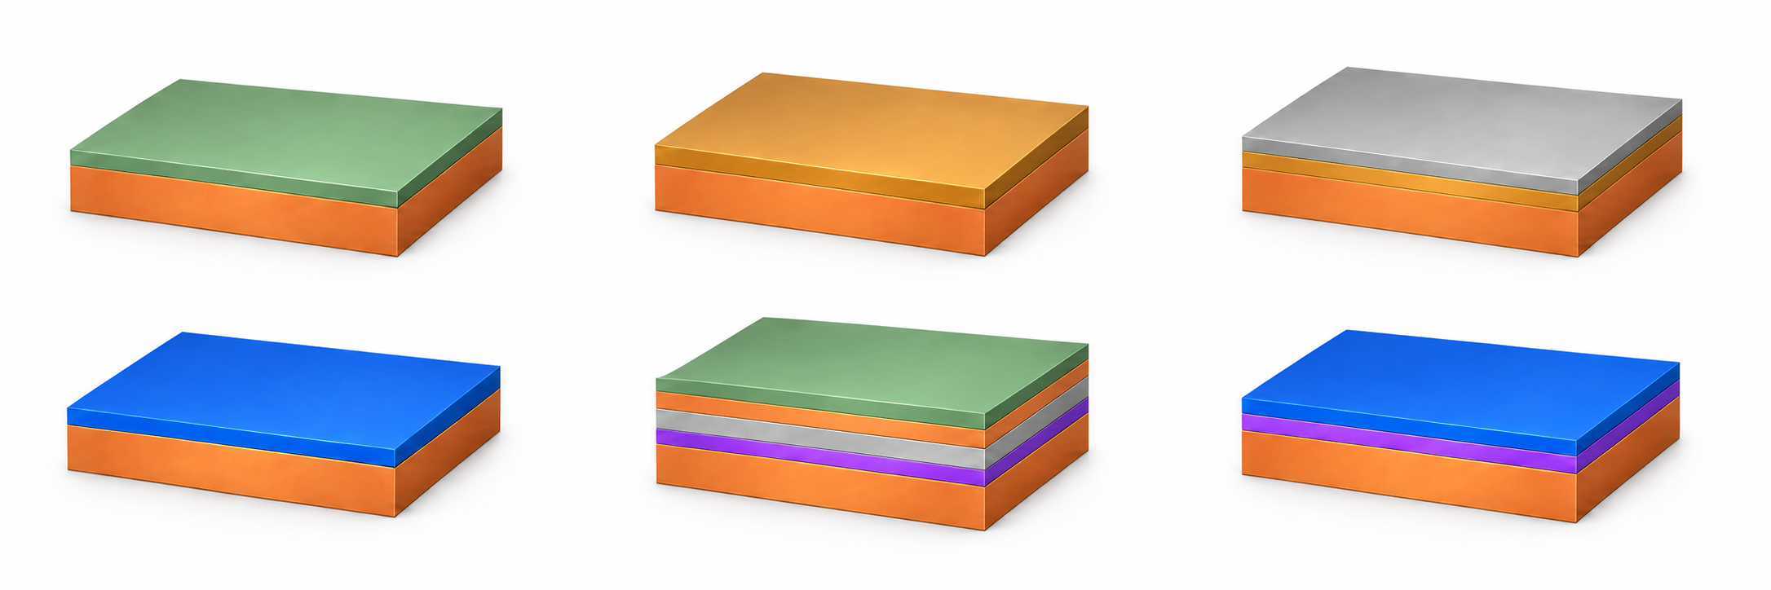
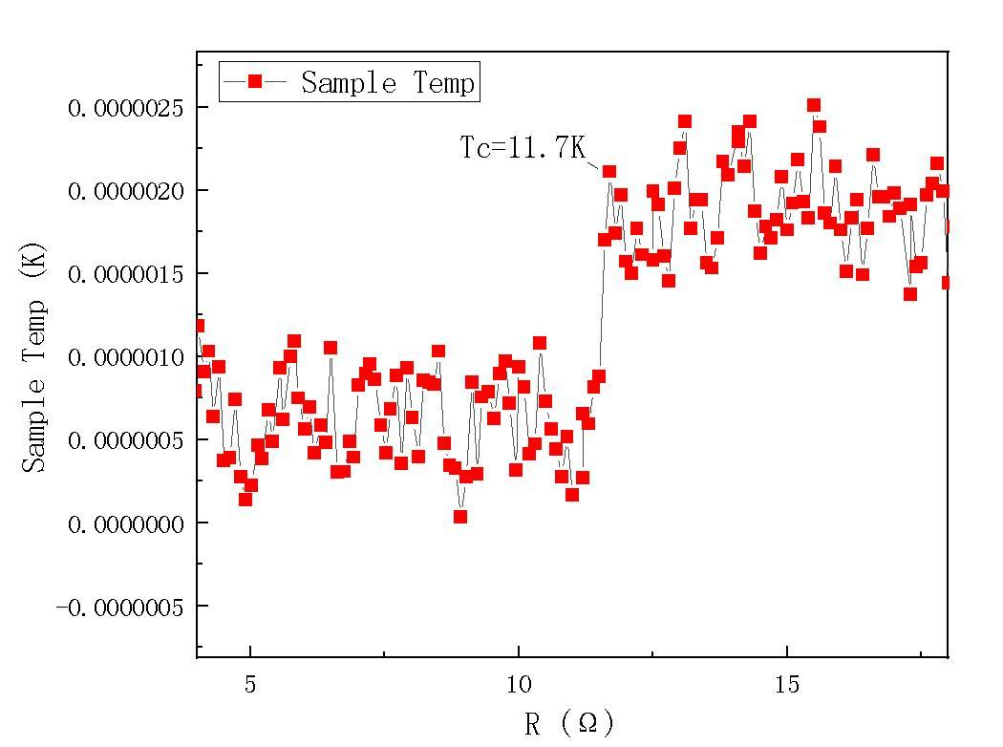
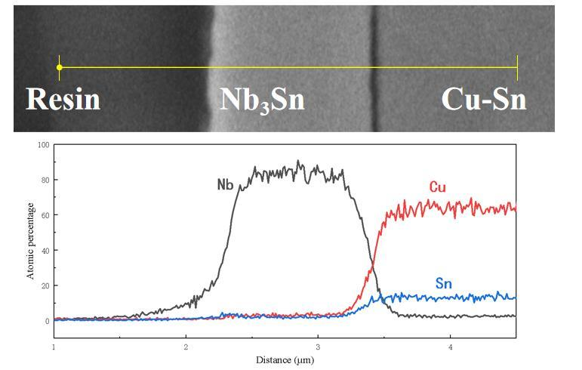
First Attempt: A Sn-Rich Bronze Layer
Could a Sn-rich bronze layer supply enough Sn to form better Nb₃Sn?
01
02
03
04
Deposit Sn on Cu
Anneal to form bronze
Deposit Nb
Anneal to form Nb₃Sn
→
→
→
Sn
Sn-rich bronze
Nb
Nb₃Sn
Cu
Cu
Sn-rich bronze
Cu
Cu
Expectation: more Sn in the bronze layer → sufficient Sn during the Nb–Sn reaction
Observed transition
Cross-section and elemental distribution
T_{c} ≈ 11.7 K
Severe
Sn deficiency
The intended improvement
was not achieved.
This route was abandoned due to severe Sn deficiency.
5

Slide 6
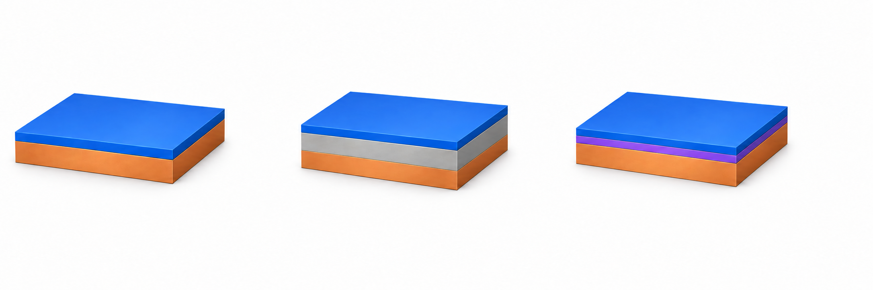
Diffusion Barriers May Limit Cu/Sn Transport
The next question is whether a thin barrier can retain Sn while limiting Cu ingress.
No barrier layer
Thick Nb interlayer
Barrier layer
Nb₃Sn
Nb₃Sn
Nb₃Sn
Thick Nb
barrier layer
Cu substrate
Cu substrate
Cu substrate
Sn loss
Cu ingress
Sn loss / Cu ingress
Tens of micrometres of Nb
Thin barrier to test
Red: Sn diffusion toward Cu
Blue: Cu diffusion toward the film
Goal: limit interdiffusion and maintain Nb–Sn reaction without an ultrathick Nb layer.
Conceptual 3D schematic; not to scale. Red arrows: Sn toward Cu; navy arrows: substrate Cu toward the film. Based on Ilyina et al. (2019).
6

Slide 7
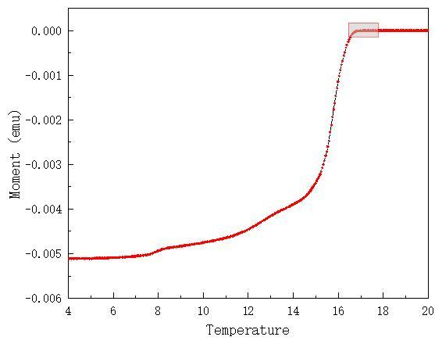
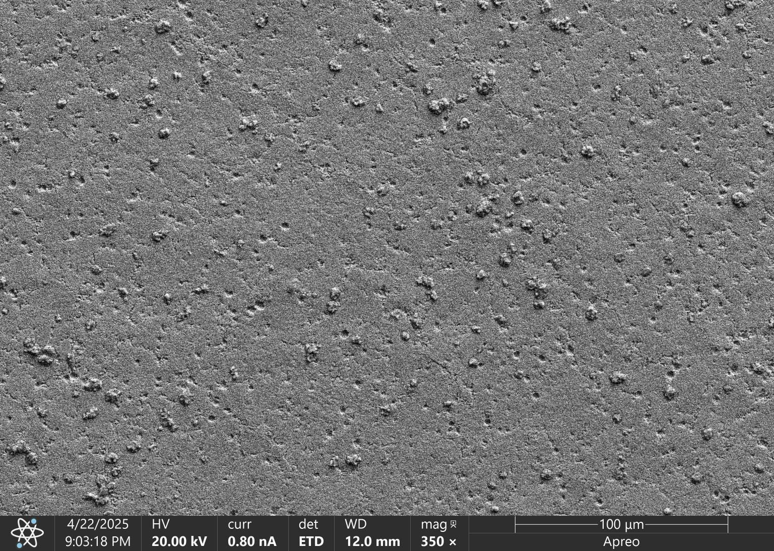
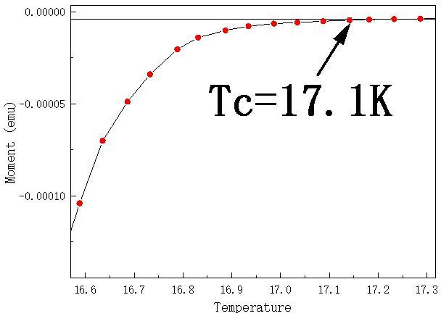
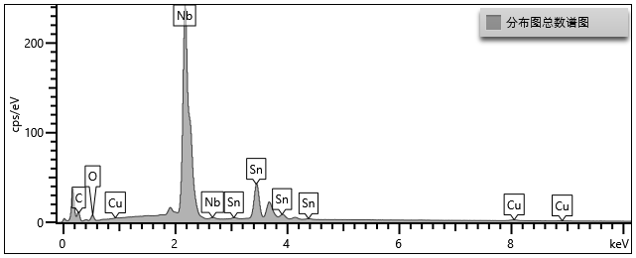
Revised Route: Added Cu/Sn Layers and a Barrier
A revised layer design retained the bronze-route advantages and gave promising preliminary results.
Revised layer design
Preliminary results
Sn
T_{c} ≈ 17.1 K
Surface morphology
Diffusion Cu
Nb
barrier layer
Cu substrate
↓ Anneal; remove residual bronze
Nb₃Sn
EDS composition — Nb : Sn ≈ 3 : 1
barrier layer
Element | Weight (%)
O | 5.72
Cu | 0.91
Nb | 66.98
Sn | 26.39
Total | 100
Cu substrate
Cu/Sn layers: Sn supply via bronze.
Barrier: limit Cu/Sn interdiffusion
between substrate and coating.
These results motivated the present study of barrier-layer material and thickness.
7

Slide 8
Why Optimize Barrier Material and Thickness?
Promising preliminary results still leave two issues to address.
Thick niobium interlayer
Overly thin tantalum barrier
Nb₃Sn
Nb₃Sn
Thick Nb
Ta barrier layer
Cu substrate
Cu substrate
A thick niobium layer may improve the
preparation pressure
An overly thin tantalum barrier cannot
effectively block tin diffusion.
Research goal
Reduce barrier thickness while maintaining
effective blocking of element diffusion.
8

Slide 9
Outline
1. Background and motivation
2. Sample preparation
3. Results and discussion
4. Summary and outlook
9

Slide 10






Experimental Information and Parametern
Five samples share the same Nb/Cu/Sn stack and thermal cycle; only the barrier changes.
Sample | Barrier | Nominal thickness | Comparison role
Ta 1.0 | Ta | 1.0 µm | Ta thickness reference
Ta 0.5 | Ta | 0.5 µm | Response to thinner Ta
Cr 1.0 | Cr | 1.0 µm | Cr thickness reference
Cr 0.5 | Cr | 0.5 µm | Response to thinner Cr
No barrier | — | 0 | Interdiffusion control
Magnetron sputtering and heat treatment
01 OFHC Cu substrate + Ta / Cr barrier
02 Nb 6 µm / Cu 2 µm / Sn 3 µm
03 210 °C × 40 h → 400 °C × 20 h
→ 700 °C × 50 h
04 Remove residual bronze; characterize films
Representative Ta-barrier preparation sequence
→
→
→
→
→
Cu substrate
After electropolishing
Ta barrier
Multilayer coating
After annealing
After bronze removal
Characterization: M–T, XRD, SEM/EDS and scratch testing
10

Slide 11
Outline
1. Background and motivation
2. Sample preparation
3. Results and discussion
4. Summary and outlook
11

Slide 12
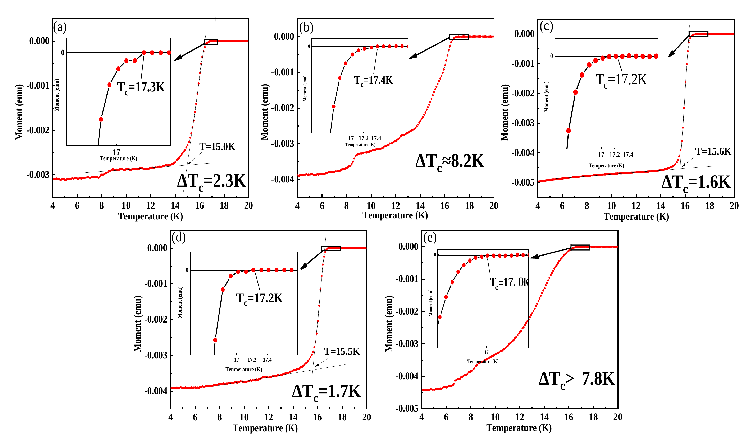
Cr Retains Narrow Transitions at Both Thicknesses
All five films show T_{c} near 17 K. The superconducting transition width of Cr samples with different thicknesses is less than 2k.
Cr: 1.6–1.7 K at both thicknesses
Ta 1.0 µm: 2.3 K
No barrier: >7.8 K*
T_{c,onset} | Ta 1.0 | Ta 0.5 | Cr 1.0 | Cr 0.5 | No barrier
K | 17.3 | 17.4 | 17.2 | 17.2 | 17.0
12

Slide 13
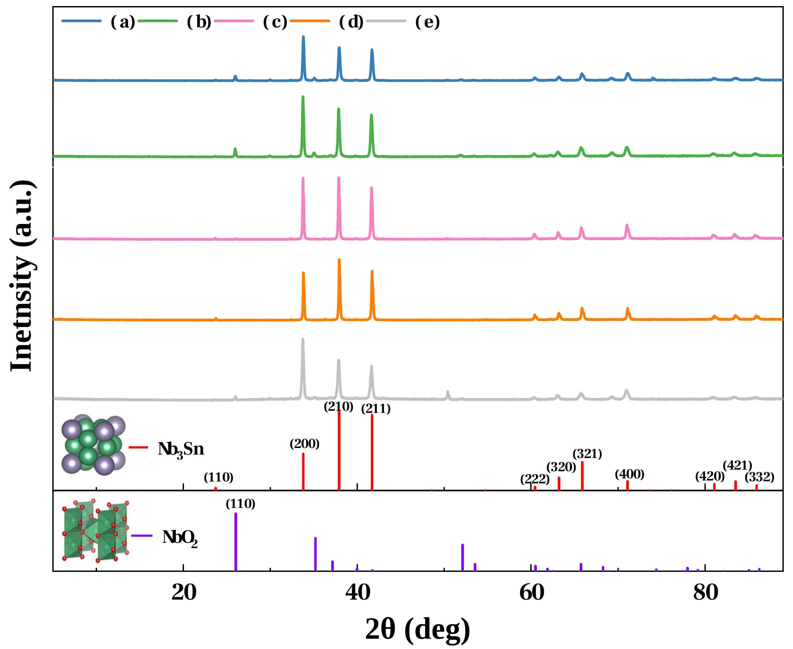
XRD Detects Nb₃Sn Without Competing Nb–Sn Phases
After annealing, XRD detects Nb₃Sn in all five samples and no Nb₆Sn₅ or NbSn₂.
XRD results
Barrier samples show stronger (200), (210) and (211) reflections.
The change of the barrier layer may not only affect the degree of reaction, but also affect the growth orientation of Nb₃Sn
Tantalum and no barrier layer samples have obvious NbO₂, which related to the oxygen introduced during the preparation process.
Possible Cr–Nb reaction
During the annealing process, chromium and niobium may undergo interfacial reaction to form dichromium niobium.
Cr₂Nb may change the blocking effect and may also affect the nucleation and growth of Nb₃Sn above.
13

Slide 14
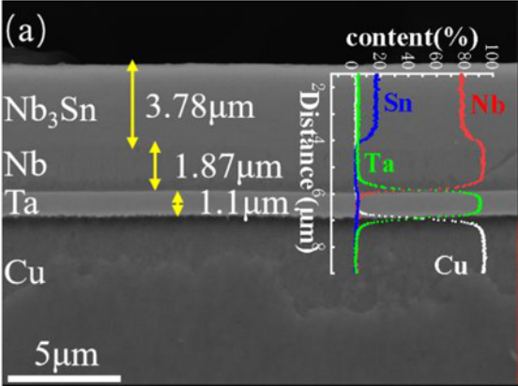
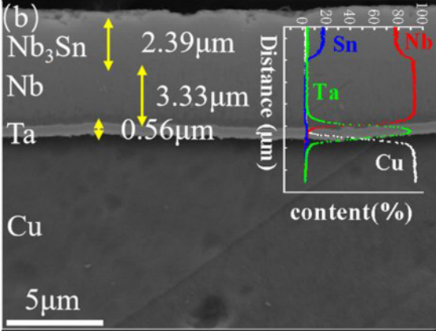
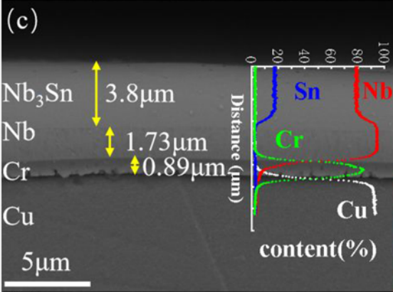
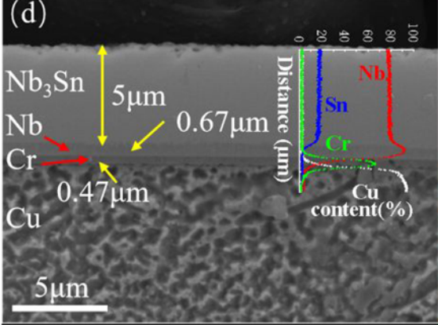
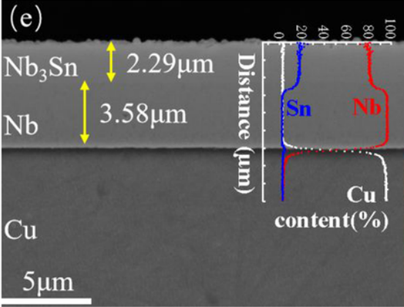
Cr and Ta Show Opposite Layer-Thickness Trends
Reducing the barrier from 1.0 to 0.5 μm increases the reacted layer thickness for chromium but decreases it for tantalum.
Ta 1.0 µm
Ta 0.5 µm
Cr 1.0 µm
Cr 0.5 µm
No barrier
EDS interpretation
The niobium–tin ratio is uniform within the reacted layer in all samples.
Under these conditions, the reaction is more complete with a 0.5 μm chromium barrier.
Material and thickness
A thicker barrier is not always better. Thickness and material need to be selected together.
14

Slide 15
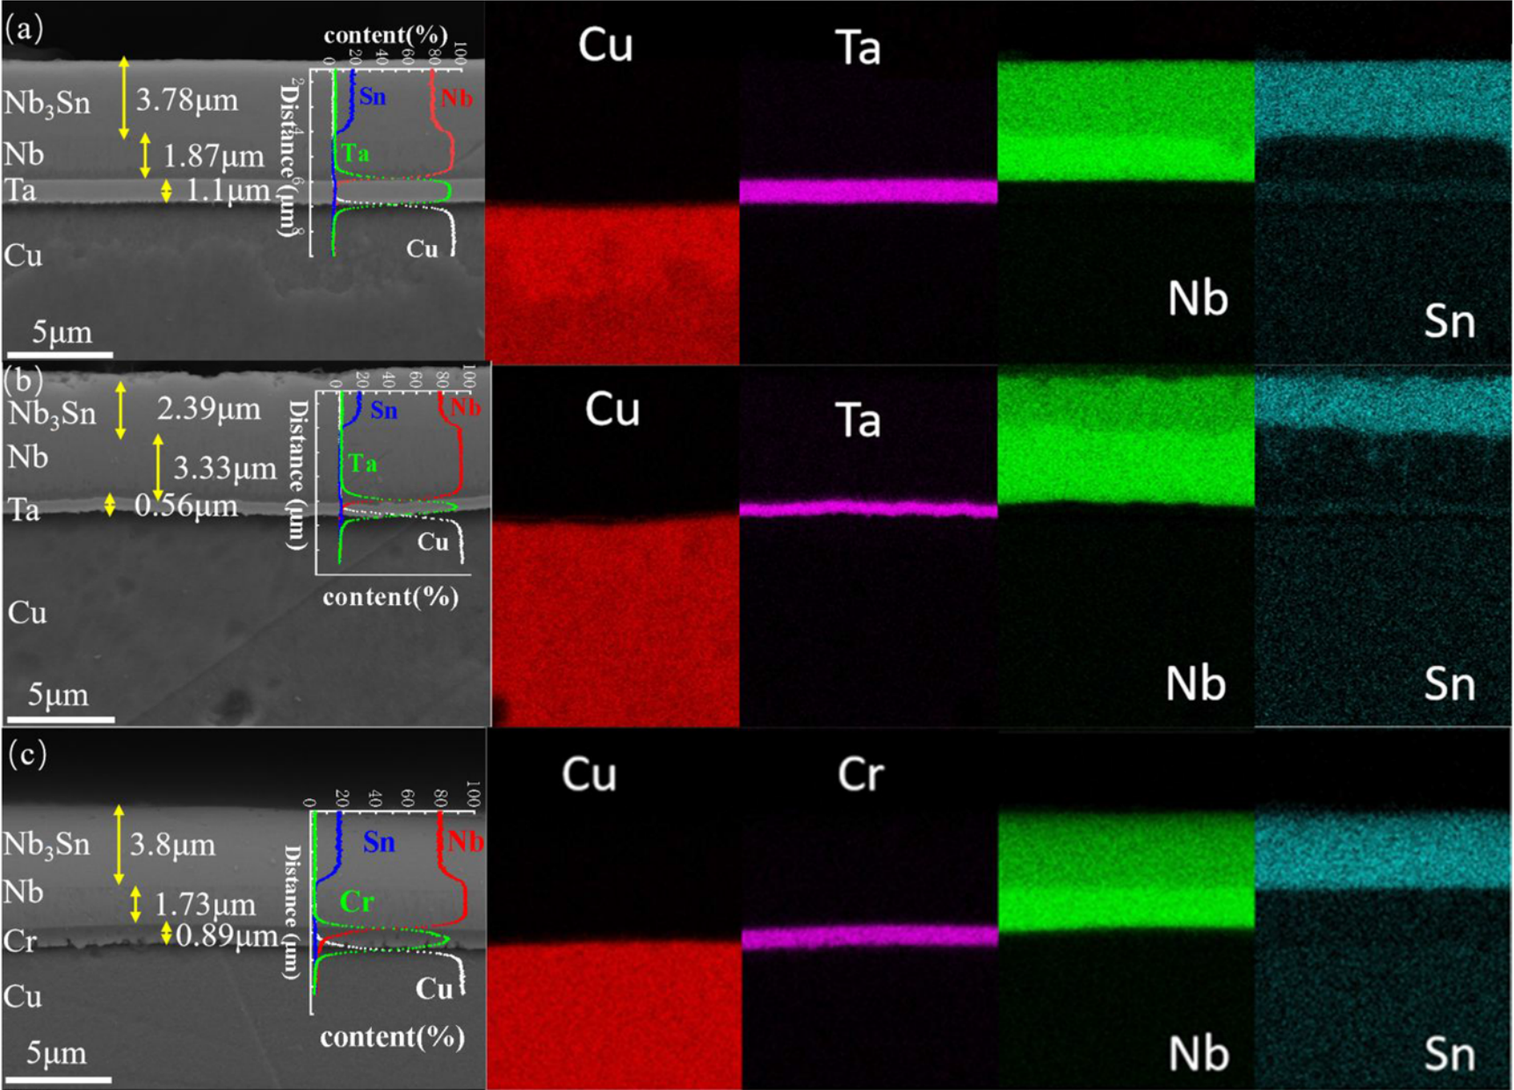
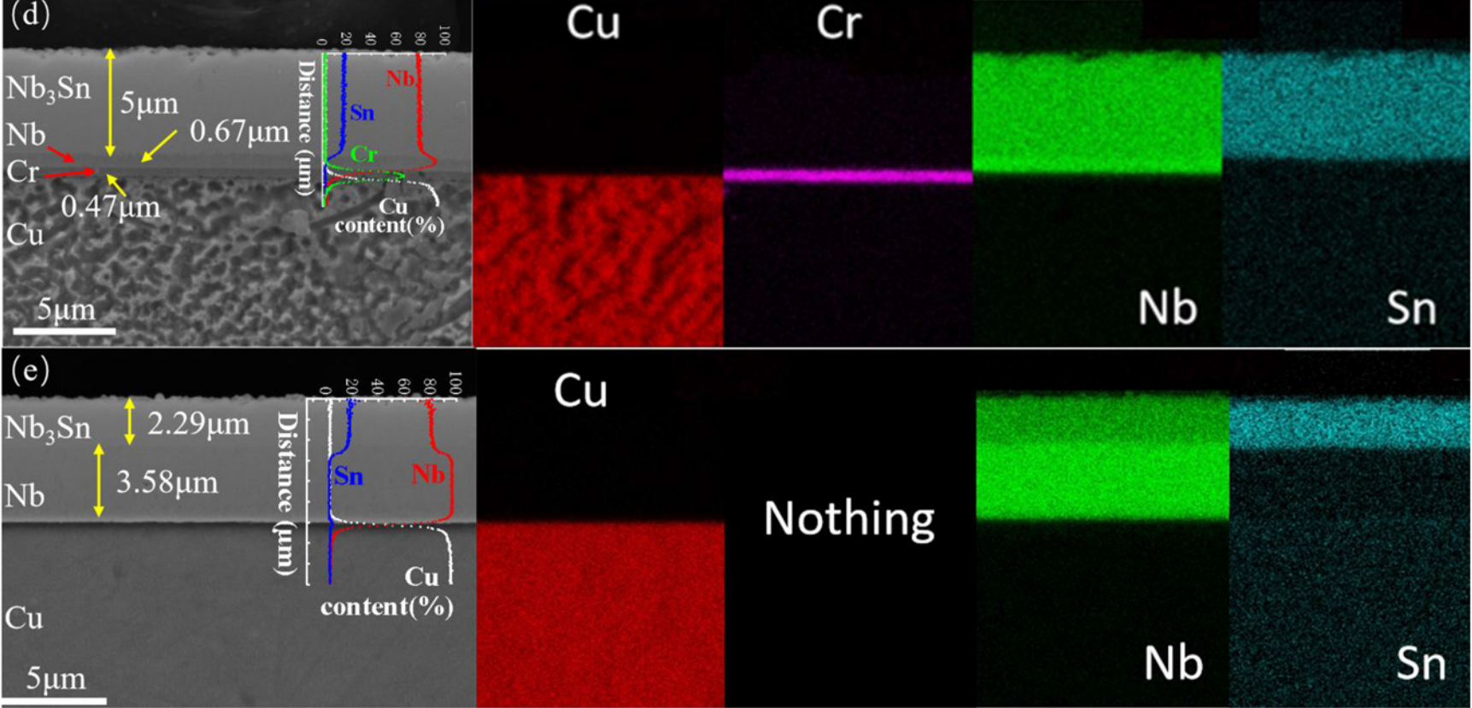
Barrier Layers Suppress Sn Diffusion Toward Cu
Cross-sectional SEM and EDS reveal tin redistribution and the effect of the barrier layer.
(a) Ta 1.0 µm · (b) Ta 0.5 µm · (c) Cr 1.0 µm
(d) Cr 0.5 µm · (e) No barrier
Without a barrier, tin can be detected in the copper substrate region, and the tin content in the copper substrate is higher than that in the niobium layer which no reaction.
Interfacial tin enrichment is observed for tantalum but not for chromium, supporting a possible chromium–niobium interface reaction.
Without a barrier, during heat treatment, a part of tin enters the copper substrate and does not remain in the area where it needs to react with niobium.
The element distribution gives indirect support. Whether dichromated niobium is formed and how much blocking effect it contributes, it also requires subsequent direct interface analysis.
15

Slide 16
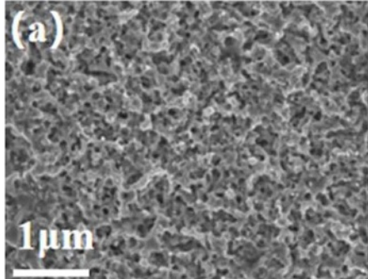
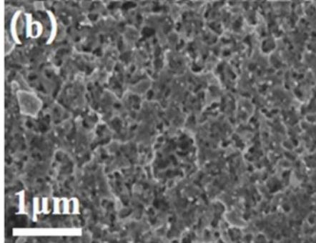
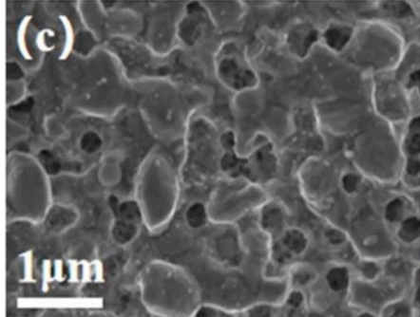
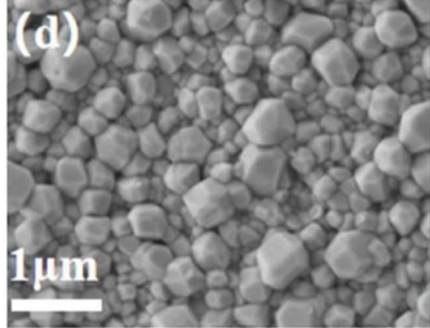
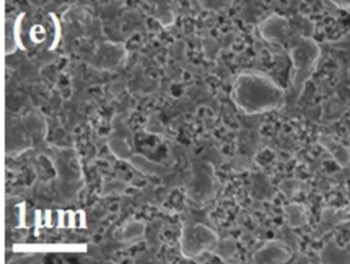
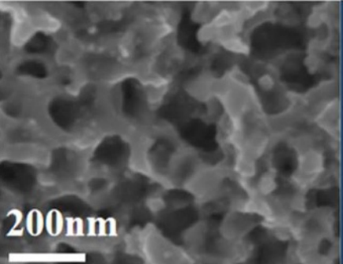
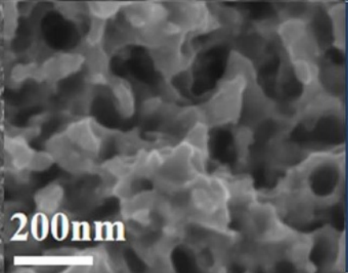
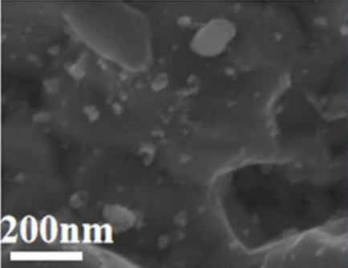
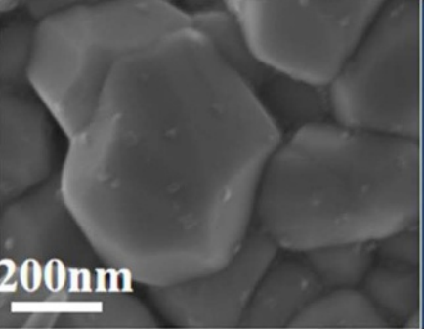
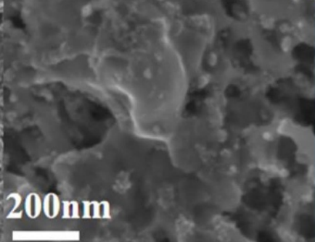
Cr 0.5 µm Gives the Densest Surface in This Set
All five surfaces have Nb:Sn close to 3:1.
Cr 0.5 μm has clearer grain faces, a denser surface and the lowest local oxygen content (8.26 at%).
Ta 1.0 µm
Ta 0.5 µm
Cr 1.0 µm
Cr 0.5 µm
No barrier
The other four samples show finer grains and porous surfaces.
Surface EDS: Nb and Sn contents and atomic ratio
Together with XRD, oxygen may be a factor affecting surface growth. More oxygen is conducive to the formation of oxides, and oxides may influence the normal growth of Nb₃Sn grains, resulting in fine-grained and porous surfaces
Sample | Ta 1.0 µm | Ta 0.5 µm | Cr 1.0 µm | Cr 0.5 µm | No barrier
Nb (at%) | 42.40 | 39.78 | 41.56 | 44.42 | 41.92
Sn (at%) | 13.48 | 12.52 | 13.83 | 14.95 | 13.17
Nb:Sn | 3.15:1 | 3.18:1 | 3.01:1 | 2.97:1 | 3.18:1
the introduction of oxygen is mainly related to the preparation process.
For RF applications, we must continue to pay attention to the surface oxidation and surface treatment of Nb₃Sn .
16

Slide 17
Adhesion Is Similar Across All Five Samples
Complete film failure occurs at L_{c3} = 10.7–11.7 N, with no clear trend across this sample set.
Adhesion hypothesis
Barrier layers may improve film adhesion, similar to silver in copper–niobium composite cavities.
Scratch-test result
All five samples were tested under the same scratch conditions.
Failure loads were around 11 N. No clear adhesion improvement was observed with tantalum or chromium barriers.
Test conditions
Linear load
Scratch speed
Scratch length
Criterion
Next: FIB–SEM sections of scratch tracks to locate the failure interface.
0.1 → 30 N
6 mm min⁻¹
3 mm
Film failure: L_{c3}
17

Slide 18
Outline
1. Background and motivation
2. Sample preparation
3. Results and discussion
4. Summary and outlook
18

Slide 19
Diffusion Barriers Support Nb₃Sn Growth on Cu
The small-sample results establish the barrier strategy and show how material and thickness affect performance.
01
Suitable barriers reduce interdiffusion
02
Material and thickness affect the result
A suitable barrier reduces copper–tin interdiffusion and supports film growth without a niobium layer tens of micrometres thick.
Aims at stable, high-quality superconducting films below 5 μm on copper after subsequent optimization of the film structure.
Chromium is more robust across 0.5–1.0 μm in this set. The 0.5 μm chromium barrier gives the best overall results.
1 μm tantalum remains a feasible choice.
Next: apply the small-sample process to a 1.3 GHz single-cell copper cavity to test its applicability.
19

Slide 20
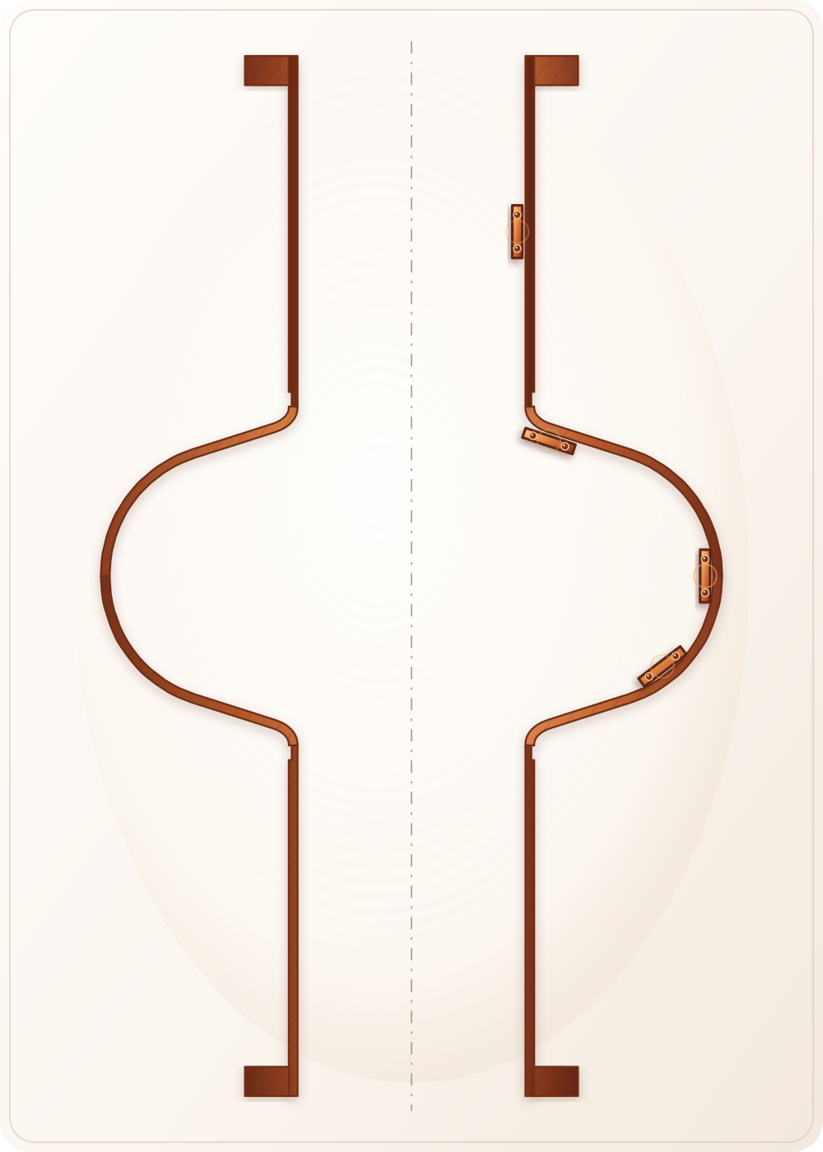
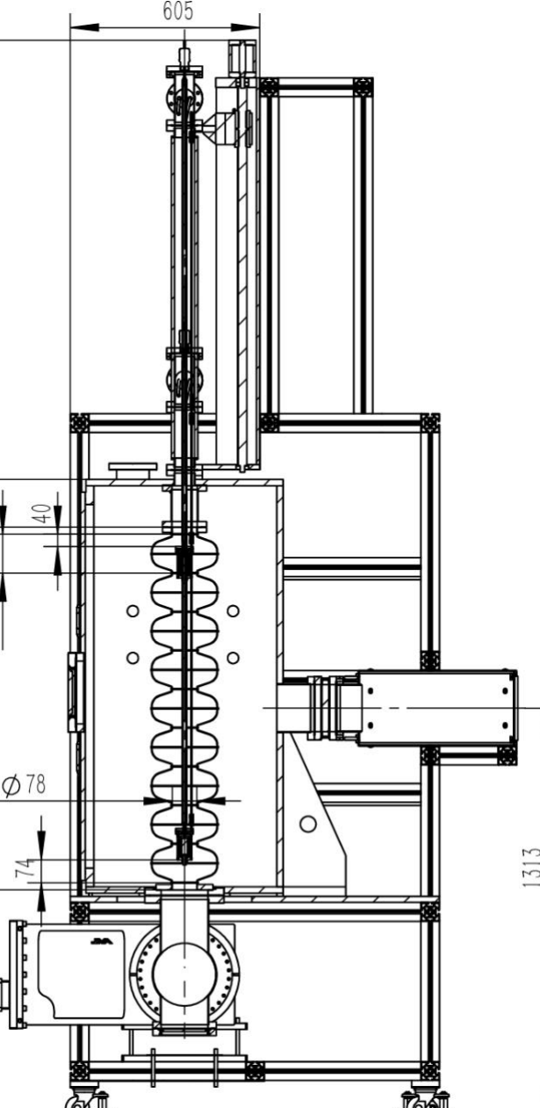
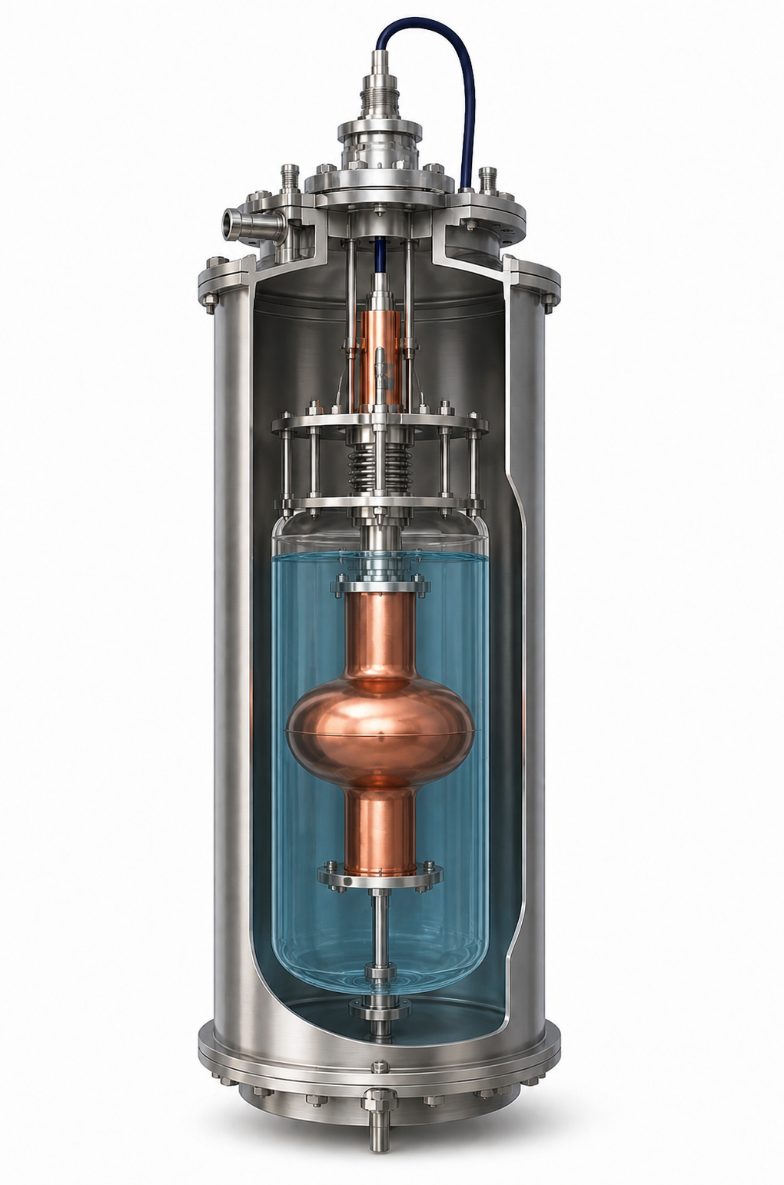
Cavity Coating Starts with Cu Coupon Tests
Cooperate with Shanghai University of Science and Technology, carry out subsequent research using their whole cavity coated magnetron sputtering platform
Cavity-wall coupon test
Full-cavity coating
Vertical test
Planned: October
Cu coupon-test schematic
Magnetron-sputtering platform
4.2 K vertical RF test
Q₀(E_{acc}) · quench
Copper coupon tests are underway at different cavity positions, assessing uniformity, morphology, adhesion and superconducting properties.
After coupon verification: full-cavity coating in October, followed by niobium, copper and tin deposition and bronze heat treatment.
Target: a 1.3 GHz single-cell copper-based Nb₃Sn cavity by the end of 2026, followed by vertical RF testing.
20

Slide 21
Thank You
Bohao Zhang
Institute of Modern Physics, Chinese Academy of Sciences
zhangbohao@impcas.ac.cn
Questions and Discussion
21

Slide 22
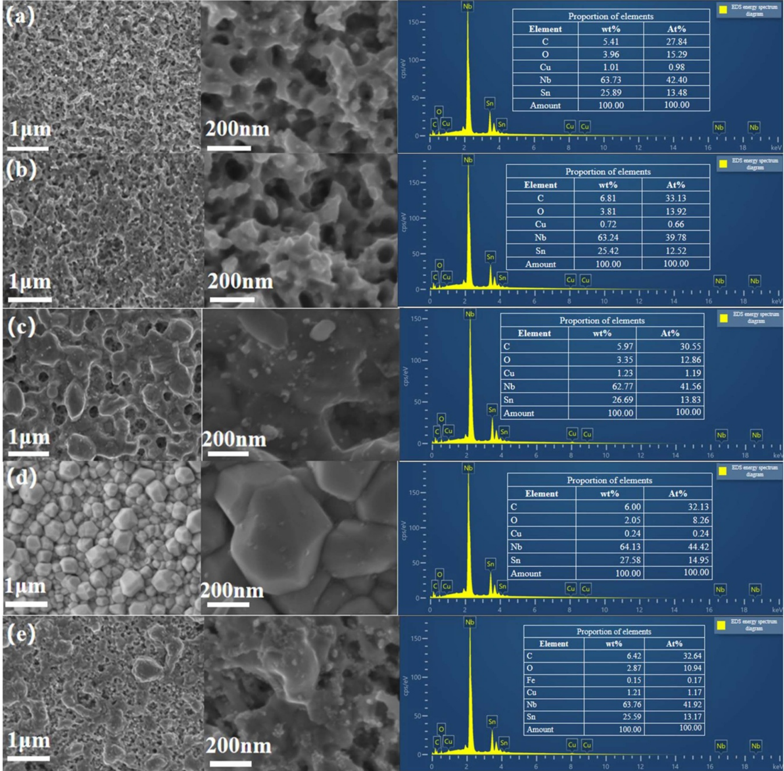
Backup: Complete Surface SEM and EDS Evidence
(a) Ta 1.0 µm · (b) Ta 0.5 µm · (c) Cr 1.0 µm · (d) Cr 0.5 µm · (e) no barrier
BACKUP
22

Slide 23
Backup: Complete Process Parameters
Full experimental details: substrate treatment, targets, sputtering, layer deposition, annealing, and bronze removal.
Substrate preparation and common sputtering conditions
Layer deposition, annealing and residual-bronze removal
Stage
Material / solution
Key parameters
Follow-up
Layer / step | Thickness | Power | Time / condition
Ta | 0.5 / 1.0 µm | 160 W | 20 / 40 min
Cr | 0.5 / 1.0 µm | 160 W | 13 / 26 min
Nb | 6 µm | 160 W | 4 h
Cu diffusion layer | 2 µm | 160 W | 47 min
Sn | 3 µm | 25 W | 100 min
High-vacuum anneal | 210 °C × 40 h → 400 °C × 20 h → 700 °C × 50 h | — | Ramp: 0.5 °C min⁻¹
Residual bronze removal | Cold-mounted in epoxy; only the polishing face exposed; H₃PO₄:HNO₃ = 3:1 | — | 10 min at room temperature; DI water → absolute ethanol → high-purity N₂
Coupon
High-purity OFHC Cu
10 × 20 × 1.5 mm³
—
Electropolishing
85 wt.% H₃PO₄ :
99 wt.% n-butanol
= 55:45 by volume
OFHC Cu counter-electrode
(sample recorded as cathode)
30–50 mA cm⁻²; 5–10 min
Rinse with DI water
Acid passivation
and cleaning
Dilute sulfamic acid
5–10 min at room temperature
15–20 min ultrasonic DI-water cleaning
Absolute ethanol rinse
High-purity N₂ drying
Targets
Circular targets
purity ≥99.95%
2 in (50.8 mm) diameter; 3 mm thick
Same specification for all targets
Sputtering
Ar 5 sccm
Base 1 × 10⁻⁵ Pa; working 0.5 Pa
substrate 25 °C
Target gap: 8 cm
23

Slide 24
Backup: References and Numerical Definitions
Primary paper, Nb₃Sn-on-Cu and bronze-route background, and definitions used in the figures and tables.
BACKUP
1. Zhang, B. et al. Supercond. Sci. Technol. 39, 075033 (2026). DOI: 10.1088/1361-6668/ae787f.
2. Ilyina, E. A. et al. Supercond. Sci. Technol. 32, 035002 (2019). DOI: 10.1088/1361-6668/aaf61f.
3. Posen, S. & Liepe, M. Phys. Rev. ST Accel. Beams 17, 112001 (2014). DOI: 10.1103/PhysRevSTAB.17.112001.
4. Lu, M. et al. Chinese Phys. Lett. 39, 115201 (2022).
DOI: 10.1088/0256-307X/39/11/115201.
5. Godeke, A. Nb₃Sn properties review. OSTI 898943.
6. Yamanaka, M. et al. Phys. Rev. Accel. Beams 29, 033101 (2026). DOI: 10.1103/1jh5-65xh.
7. Dong Peng. Fourth National Accelerator SRF Technology Conference report, pp. 16, 20–21.
Definitions
T_{c,onset}: onset temperature. ΔT_{c}: transition width. L_{c3}: load at complete film failure.
*For Ta 0.5 µm and no barrier, the paper estimates transition widths relative to the Nb transition at 9.2 K.
Background and figure sources are listed in the notes of the relevant slides.
24

