Slide 1
Experience with Vertex Detector Background at SLD, and Implications for
FCC-ee (Z pole running)
Chris Damerell, RAL: c.damerell@rl.ac.uk
15th October 2025
Reading the FCC-ee Feasibility Report of 31 March 2025, I was concerned to find that the background we encountered in the SLD Vertex Detector was not mentioned. Since I believe that this background will probably scale with luminosity, and hence return with increased intensity at FCC-ee (Z), I embarked on a reminder of our experiences. Preparing this has been an adventure: thanks for advice from SLD veterans, particularly Su Dong, Fred Wickens and Marty Breidenbach, plus other experts, including Frank Zimmerman, Katsunobu Oide, Witold Kozanecki, Andrea Ciarma, Graham Wilson, Phil Allport, Jens Dopke, Laci Andricek, Jerome Baudot.
SLD’s (almost) forgotten history:
Background information: 1979-1981 Proof of principle for precision tracking (<5 μm) with silicon pixel detectors in form of CCDs, in t6 test beam at CERN PS, followed 1983-1986 by the ACCMOR Collaboration (Amsterdam, CERN, Cracow, Munich, Oxford, Rutherford), SPS North Hall, hadroproduction of charm. World’s first pixel-based vertex detector, just TWO CCDs covering the entire spectrometer aperture. Thanks to Ivana Hristova, this complete detector will soon ‘return home’ from Manchester U to our PPD display area, since our wonderful former post-doc Prof Steve Watts has recently retired.
1981: Prediction by Burt Richter, based on expected Final Focus QSR, that SLC beampipe radius could be the ‘size of a drinking straw’. We (RAL CCD group) were hooked. 10 mm would suffice.
In contrast, LEP was then offering 10 cm! (a Villars workshop). I pointed out that this would be bad for heavy flavour physics, but was told to ‘shut up and let them do what they felt would be safe’. That beampipe eventually shrank, but only a bit.

Slide 2
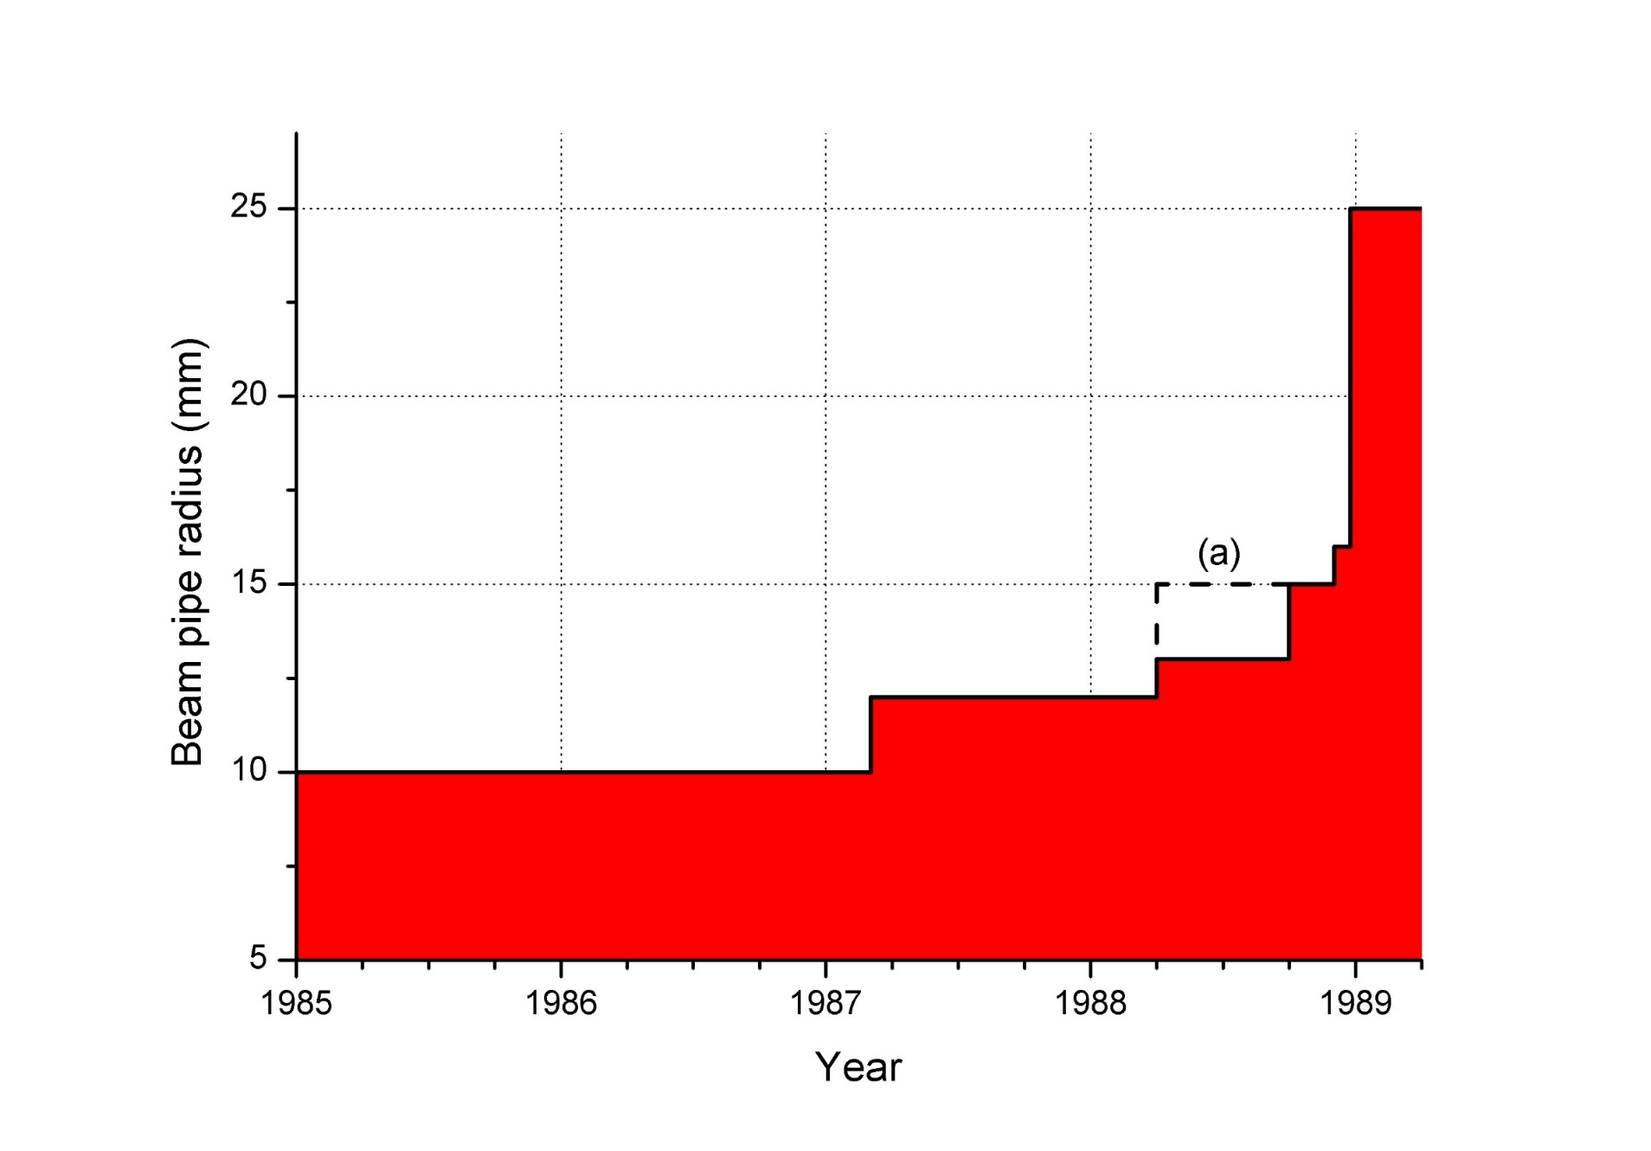
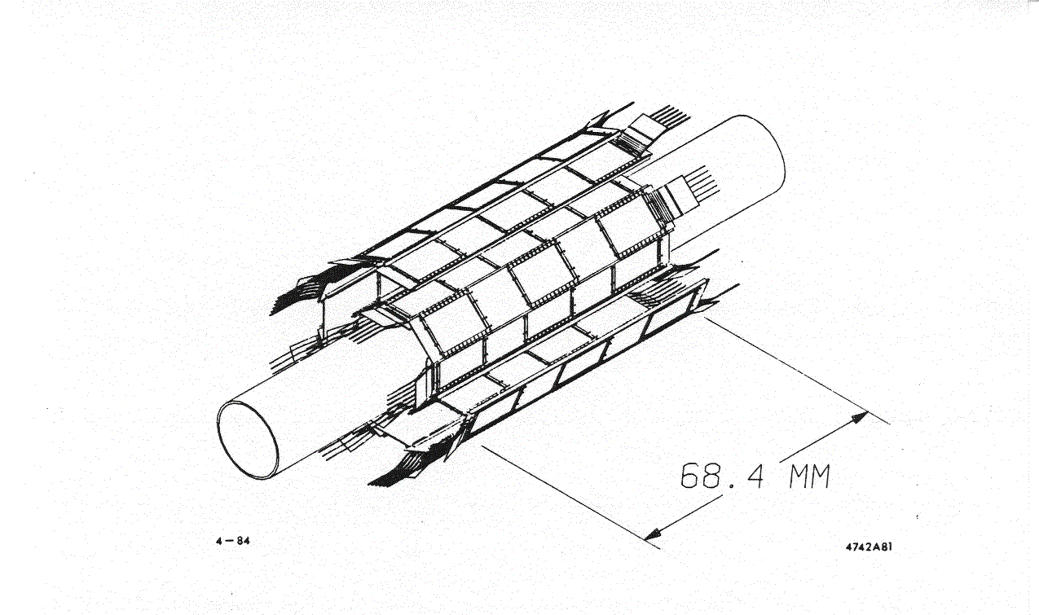
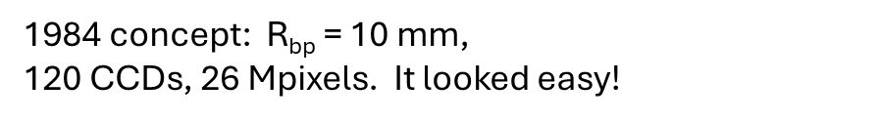
1989: Mark II started their pioneering run with the first Zs at SLAC, and their wire scans pushed us out in radius. The nature of this background (Incoherent Pair Creation, IPC) was slowly understood. [Note that Daniel Schulte (then a grad student of Bjorn Wiik) wrote his thesis and his simulation program Guinea-Pig as recently as 1996.] Since then, G-P is used by everyone.
Generator of Unwanted Interactions for Numerical Experiment Analysis – Program Interfaced to Geant
The Mark II microstrips, with 300 μm thick silicon and coarse granularity, were virtually free of background, since they stayed beyond the ‘firewall’ seen by the wire scans. We expected it would be the same for us – a friendly background-free environment as we had enjoyed in ACCMOR.
SLD’s planned beampipe radius vs time, 1985-1989, driven by SLC and Mark II wire scans.

Slide 3
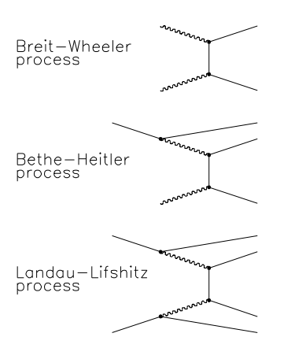
So, what are these ‘incoherent pairs’?
Synchrotron radiation
Pinch effect – beams focus each other – Luminosity enhancement H_{D}.
Associated SR – named beamstrahlung by the great accelerator physicist John Rees of SLAC (1978). Highly colinear with the beam and disappears down the exit beampipe, but intense and needs a carefully designed distant dump - ~400 kW at FCC-ee(Z). [Who claimed it was ‘negligible’ at FCC-ee?]
Incoherent Pair Creation: IPC Three processes contribute: LL, BH, BW.
As with any processes described by Feynman Diagrams, the event rate is simply the cross-section multiplied by the luminosity.
1934
‘Study of Electromagnetic and Hadronic Background In the Interaction Region of the TESLA Collider’
Daniel Schulte(DESY and Hamburg U) April, 1997 Supervisor: B. Wiik
Three processes. To keep track, just count the Rs!

Slide 4
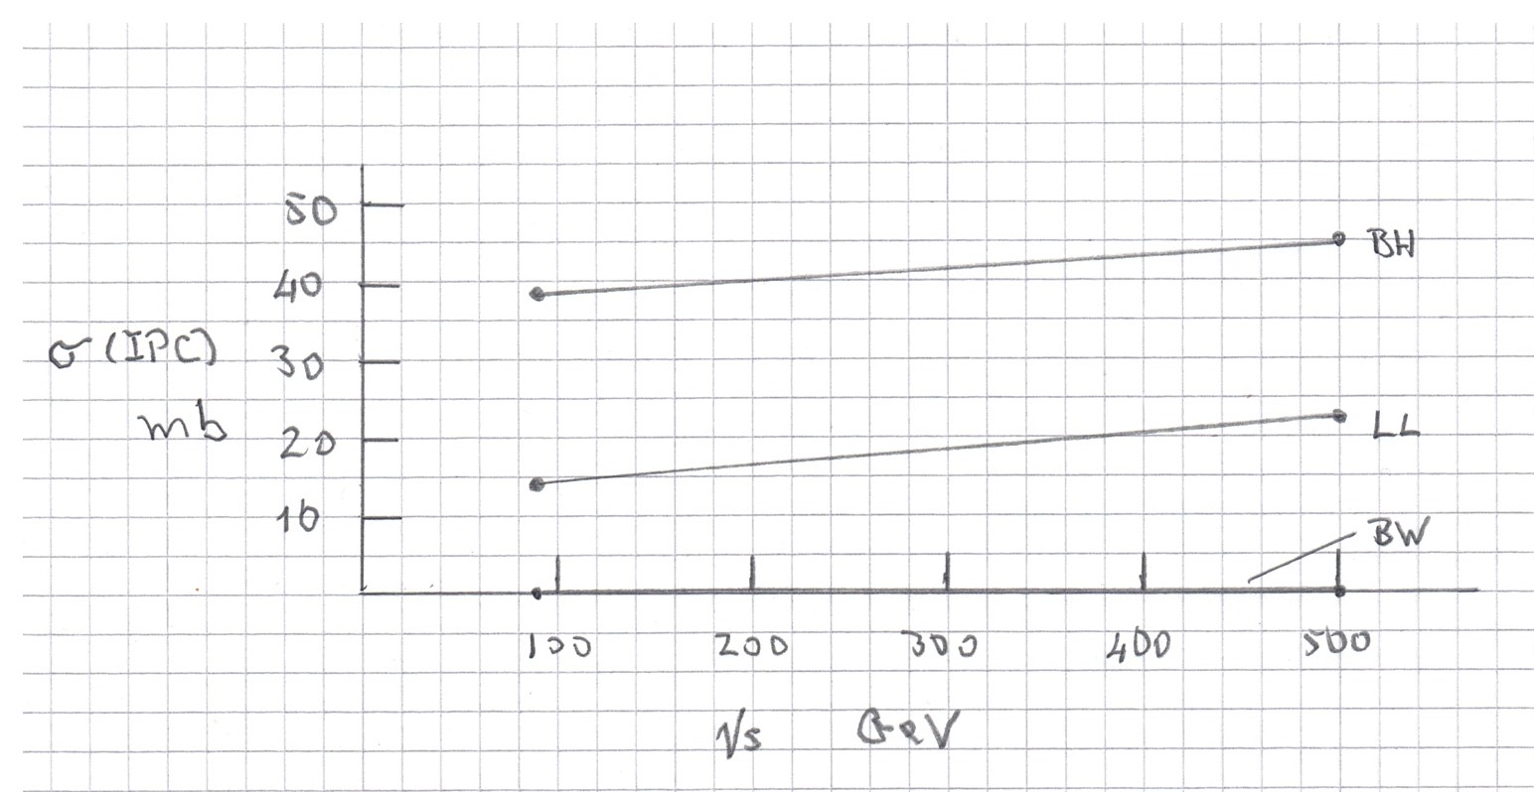
Total cross-section for incoherent pair creation vs E_{CM}
Formulae from Daniel’s thesis. Beware of what you find in published papers, which frequently apply a low energy cutoff. This is inappropriate for our purposes, since every positron, however feeble, becomes a little bomb when it enters solid material, though it may form positronium for a fraction of a ns.
Total IPC cross-section at Z⁰ (92 GeV) is 53 mb.
[Positron annihilation can be switched on or off in GEANT4++]
‘Beam size effect’ not taken into account (typically ~30% reduction in all EM processes together, incl. IPC cross-section).

Slide 5
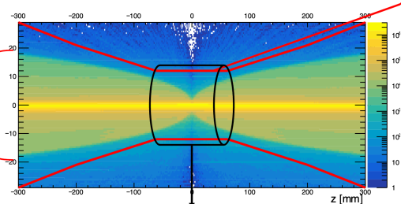
Using G-P code since 1996, everyone is able to set a safe beampipe radius, beyond the hard edge of this ‘firewall’, according to their solenoid field. One future example:
R [mm]
5 times expanded scale
C-cubed collider at E_{CM} = 250 GeV. SiD Detector, Solenoid field 5 T.
Diagram shows SiD beampipe, R_bp = 12 mm, and cylindrical inner VXD layer.
Mark II had 0.5 T solenoid, SLD had 0.6 T, hence need for larger beampipe, R_bp = 25 mm.
In all cases, there’s a smattering of pair products kicked beyond the edge of the firewall, which create a minor background of charged particles traversing the vertex detector.

Slide 6
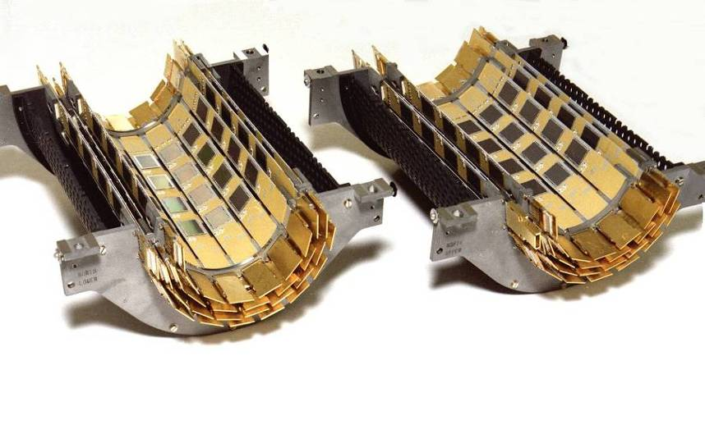
So how could SLD cope with a 25 mm radius beampipe? ‘480 CCDs is ridiculous!’
1992, VXD2. R_{bp} = 25 mm, 480 CCDs, 8 per ladder, 120 Mpixels.
4 layers, but look at the longitudinal gaps in each layer.
Hard work with such small CCDs, hence skimpy coverage: only 2 hits guaranteed on a track.

Slide 7
1992: SLD moved in with a once-only ‘push-pull’ transition. Despite the stretched coverage of the vertex detector, it proved capable of delivering excellent physics, thanks to ‘topological vertexing’ from David Jackson, as opposed to just counting tracks with a certain cut on impact parameter significance, as at LEP. His program ZVTOP, which has evolved twenty years later into LCFIVertexPlus by the ILC group from Tokyo U, is widely used. SLD physics played a special role in running on the Z⁰, thanks to our powerful combination of a longitudinally polarised e- beam (tried unsuccessfully at LEP), pixel-based vertex detector, excellent drift chamber tracking, , RICH-based particle ID, liquid argon ECAL, and massive HCAL.
Thanks to Burt Richter when a DOE Panel, pushed by Fermilab, failed to shut us down since ‘SLC will never work’. Over a decade, it approached its design luminosity, and provided the inspiration for a future TeV-scale linear collider, for which the community is still working diligently, 30 years later.
Getting back to SLD, when we switched on VXD2, we were shocked by the density of background hits - compact clusters which were identified as soft x-rays emerging through the thin beampipe (1 mm beryllium lined with 100 μm titanium, later reduced to 50 μm, which made no significant difference). In some cases, what was observed were evidently daughters of higher energy x-rays, such as the Au-Lα line at 9.7 keV produced by fluorescence from thin-film gold ground-planes on the CCDs.

Slide 8
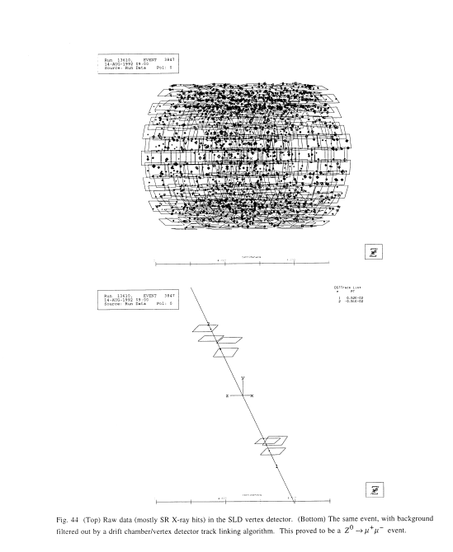
VXD2 1992-1994 120 Mpixels
On 14/8/92, SLD was running at
~1,000 Z/wk, 5.95 Z/hr
L = 5.95E28 cm⁻² s⁻¹
L (goal) of FCC-ee(Z) = 140E34 cm⁻² s⁻¹
So FCC-ee(Z) would see 2.9 times this bgd, per BX,
~6000 hits per BX.
They dream of reading out in 1 μs, so would see
6000x50 = 300,000 hits. Occupancy would still be ‘only’ ~1.5%, but I’d ask the detector people about all this, including claiming air-cooling, before asserting ‘feasibility’.
What more did we learn from VXD3?
After track finding, Z⁰→μ⁺ μ⁻
Raw data, integrating over 19 bunch crossings, readout time 152 ms.
~2100 hits, mostly compact few-pixel clusters. Size of blobs represents cluster signal charge, which extends far above MIP peak.
Occupancy ~0.01% - negligible

Slide 9
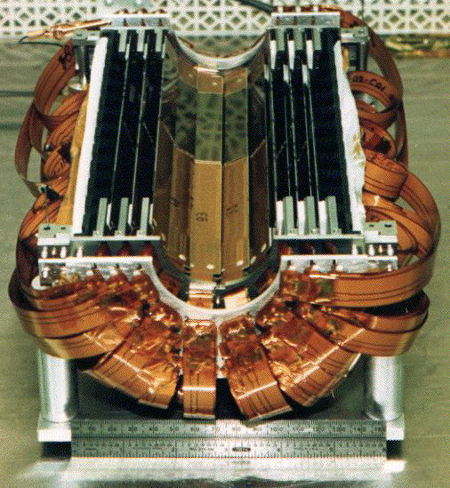
1996, VXD3. R_{bp} = 25 mm, 96 stitched CCDs, one inner, one outer on each ladder of 15.9 cm active length. 307 Mpixels.
Finally, a detector matched to the physics needs.

Slide 10
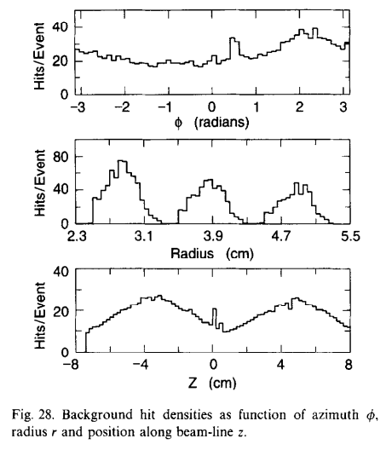
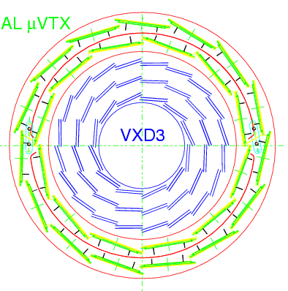
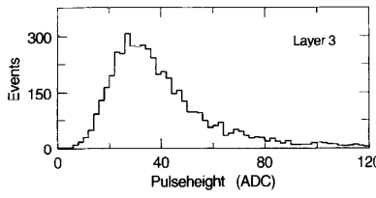
The background persisted when we upgraded in 1996 to VXD3, with 10 times larger CCDs, made with e2V’s newly established stitching capability (CCD active area 8x1.6 cm², 2 CCDs per ladder along the beamline, with 1 mm overlap at Z = 0 between inner and outer). VXD3 delivered 3 widely spaced points per track, with single point precision of 3.5 μm in Rφ and Z, eventually.
This coverage revealed features of the background: approximately flat in azimuth and in z; modest attenuation radially through each layer (0.4% X₀ per layer); tiny reduction in hit rate in each layer from inward-facing to outward-facing CCDs
VXD3 CCD parameters
Pixels 20x20 μm X15 μm active thickness,
4 readout ports, one in each corner.
OPAL μVTX
Layer 3,
Outer CCDs
Positive Z
VXD3 signal parameters
8-bit ADC, 40 e- per count,
256 counts = 10200 e-
Most probable MIP signal = 1200 e-, 30 ADC counts.
2x2 kernel threshold 240 e-, 6 ADC counts.
X-rays, 40x3.6 eV/count = 144 eV/ count 36.8 keV full range.
Layer 3,
Inner CCDs
Negative Z
Cluster signal (ADC)
Track-associated hits, normal incidence
Z (cm)
Ramps in Z reflect longer integration time of more distant signals from 8 readout ports.
Inward-facing CCDs have slightly higher hit rate than outward-facing ones.

Slide 11
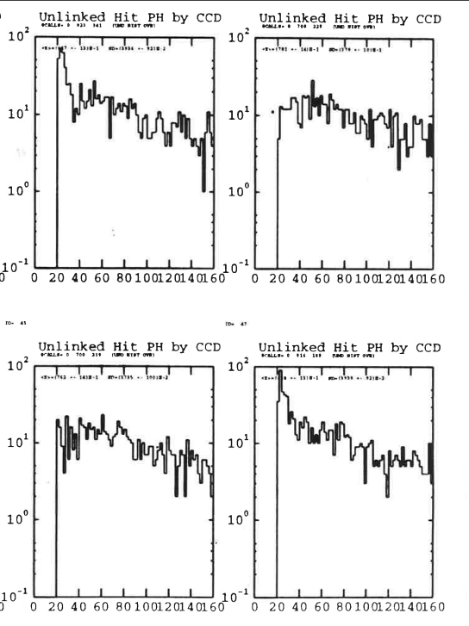
Recently recovered Su Dong, unpublished work from 1997 by himself and Glen Crawford.
VXD3 data, cluster signals of background hits (unlinked) in run data, so track-related hits are excluded from the plots.
Amplitude refers to a 2x2 kernel used to define clusters for position determination, where the cluster sizes are similarly compact for signal and background, apart from oblique tracks.
We have no record of what ‘by CCD’ means, but presumably distinguishes between inward-facing and outward-facing.
We are clearly seeing a broad spectrum of x-rays, as also seen in the VXD2 background hits (Slide 7)
Data and meeting notes from the ‘backgrounds task force’ are believed to exist on a broken computer which holds all SLD records. Su Dong is trying to retrieve the data from a possibly readable disk.
We’re also trying to find someone who remembers having been on this task force, and what more they learned – Tom Markiewicz, Tracy Usher, …?
Edge noise?
Cluster signal (ADC)
23 keV
MIP most probable

Slide 12
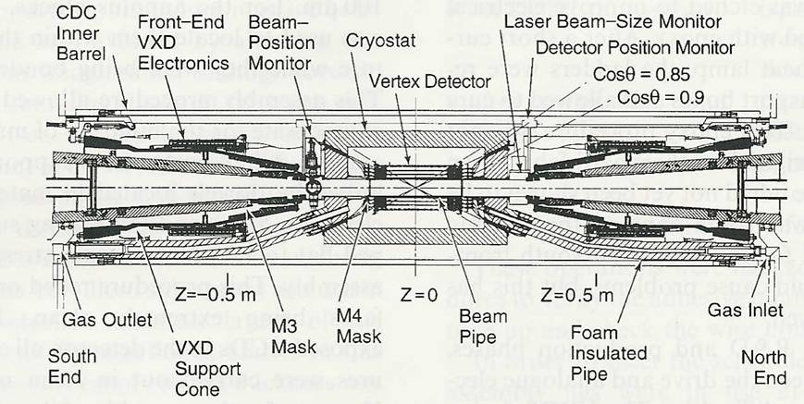
Cross-section of ‘R20 module’
So what’s the source of this observed flux of x-rays emerging through the thin section of SLD beampipe?
Foam
Beampipe to inner quad. ‘No Entry’
for low energy e⁺⁻ in Beam Volume. Some of the high tail will scrape by.
M3 mask
M4 mask
We subdivide this region into two volumes,
the Beam Volume and the Detector Volume,
separated by the inner beampipe.
Beam Volume is pretty much hermetic tungsten, apart from the transparent inner section.
Graphite sheet on face of tungsten/silicon LumiCal
1 mm inner beryllium beampipe,
plus 50-100 μm titanium liner
L = 24 cm. ‘Achilles Heel’
Thick tungsten mask M3

Slide 13
In SLD, we took steps to suppress backscattering of the electrons which follow the field lines from the interaction region, and are safely enclosed within this volume till being buried, mostly in a graphite sheet on the face of the LumiCal.
But Takashi Maruyama (no longer with us) believed that there was in addition ‘some other backscattering going on’. His studies are now lost, but we think there’s a particular contribution from the positron component of the pairs. They would follow a similar flow as the electrons into the graphite, but then what?
As in a PET scanner, they annihilate just before stopping, or form positronium which in solid material will also annihilate within a nanosecond or so, hence producing a ‘fireworks display’ of ~511 keV gammas at each end of the Beam Volume.
What then? We expect a simulation would reveal messy electromagnetic showers, as in an ECAL but with a dangerous long aperture within it, allowing a small fraction of the shower products to fly freely to the region of transparent beampipe adjacent to the Vertex Detector.
We surely have a mix of electrons and x-rays of diminishing energy over time, as the showers die down. But here’s an important point. Electrons would typically be trapped within the Beam Volume by the solenoid field, hence drained away safely to the ends of the Beam Volume, and stopped. But some fraction of the x-rays would encounter the transparent section of beampipe and fly straight out into the Detector Volume, encountering the Vertex Detector., where many of them would be absorbed in active silicon by the photoelectric effect.
As well as all this handwaving, we have two contrasting simulations.

Slide 14
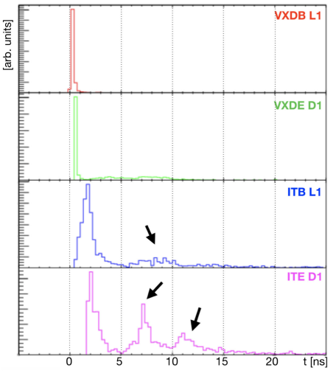
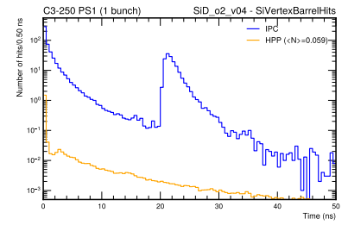
Paper on which the background statement in the Feasibility Study of March 2025 is based.
Hence my Q on 8 Sept ‘Do you have positron annihilation in your simulation?’
A: ‘We have had full GEANT simulation of our background since 2015’. We don’t need to change a word in the Feasibility Study’
I wonder …
Draft of ‘Beam-Beam Backgrounds for the Cool Copper Collider’, D Ntounis et al
Prompt spike can be largely suppressed by 1 or 2 mm increase in radius
Backsplash spike: are these charged particles or x-ray hits? Reply awaited.

Slide 15
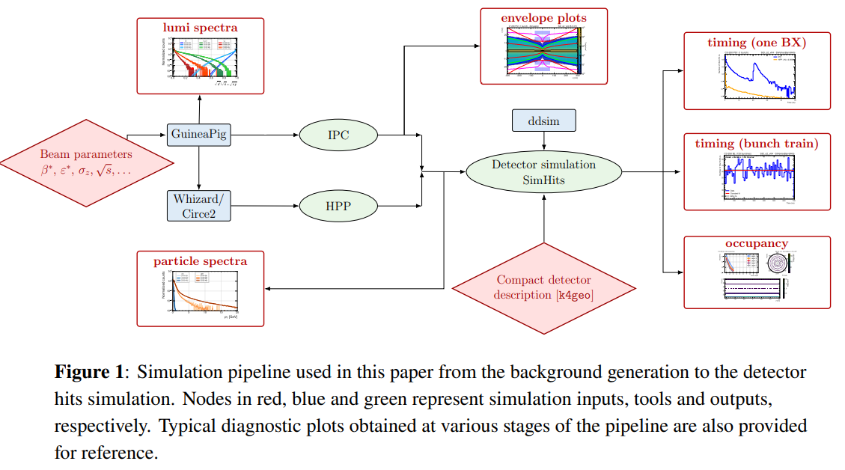
This beautiful pipeline (work led by Lindsey Gray) is poised to make a serious evaluation of the backgrounds we observed at SLD, and to extend them to predict the expectations for FCC-ee(Z). I’ve suggested that this verification should include, for just one bunch crossing, the observation of the evolution of the EM shower in the Beam Volume. I learned from GEANT experts Alberto Ribon and Mihaly Novak of CERN, of the mode of ‘stepping actions’, with which to observe the evolution of complex processes a nanosecond at a time, or whatever you like. So you should see the tracks handed from GP to GEANT, and their evolution.

Slide 16
Even if the suggested simulations succeed in replicating the backgrounds seen in SLD in normal running, we know that SLC could generate x-ray background from the IR with only one beam operating.
Our most dramatic example was with VXD3 after installation, but not yet cabled up.
A fire in a damping ring, while preparing for the 1996 run …
An unauthorised SLC test with undamped beam. When we switched on VXD3, it had suffered damage (loss of signal) from massive ionising radiation.
The inefficiency was confined to Layer 1, mostly to the inward-facing CCDs.
Thanks to the Lazarus effect (‘freezing out’ of trap centres), cooling from 220K to 185K fixed the problem.
----------------------------------------------------
There’s also the possibility of a second source of background during normal running, of comparable or greater magnitude than the IPC source, namely tails on beams, far beyond expectations for a Gaussian phase space population. These are well known to accelerator experts, having been seen at SLC, LEP, While they are supposedly eliminated in damping rings, they can be re-populated by non-linear dynamical effects.
These could generate a steady flow of wide angle QSR into the Beam Volume, which would ‘cascade down’ just as with the hypothetical positron source.

Slide 17
In summary, I’d say that the study of backgrounds at FCC-ee is in its infancy.
Whatever the future holds, there’s time to understand the situation with comprehensive simulations, and work to solve these questions before 2045, not be once again caught by surprise. We had a lot of good luck in SLD, but this doesn’t always happen (failed vertex detector at UA1, challenging backgrounds at SuperKEKb vertex detectors)
However, this requires a welcoming open minded investigation.
Here’s a final example from SLD: Bob English’s heater wires to keep the cryostat seals flexible. Just as we were testing these in Lab 6 R1 in 1986, there occurred the tragic explosion of the Shuttle Challenger..
As Richard Feynman Remarked: ‘Nature cannot be fooled’.

Slide 18
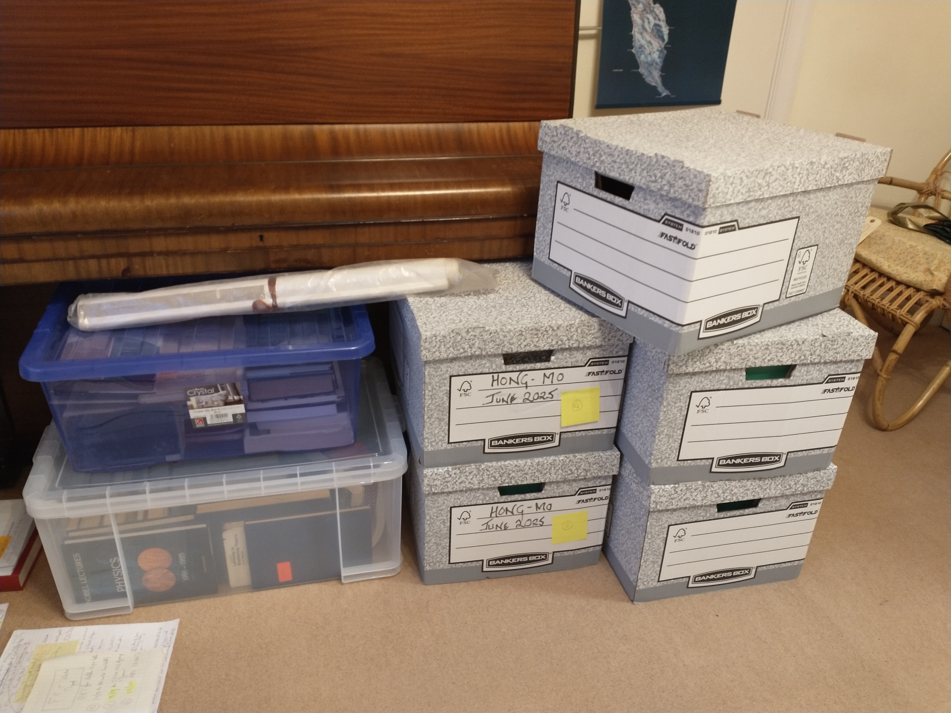
Chan Hong Mo, a wonderful office-mate of many years, not seen since covid, now sadly departed. The surviving record of his work preserved for his family. As Steve Weinberg noted, his theoretical work was discarded by the entire community, but not proved to be wrong. What if it turns out to be right, in 10 or 100 years? Those papers may be studied for centuries, and change hands for millions.
His beautiful book: The Birth of China, Seen Through Poetry

