Slide 1
IOP Membership Benefits
Tony Whitehead
Fellowship Manager

Slide 2
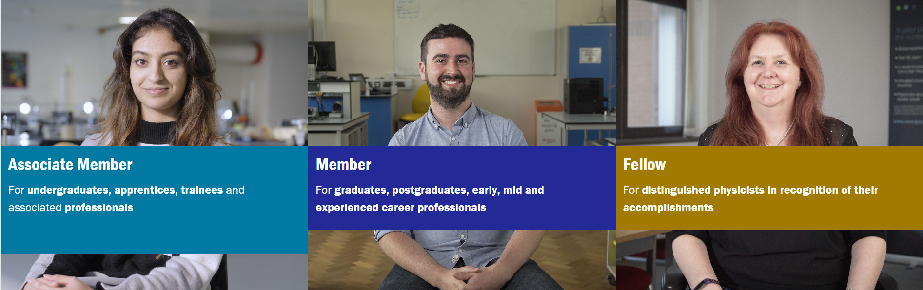
Membership Categories & Application Process

Slide 3



Physics World Magazine

Slide 4
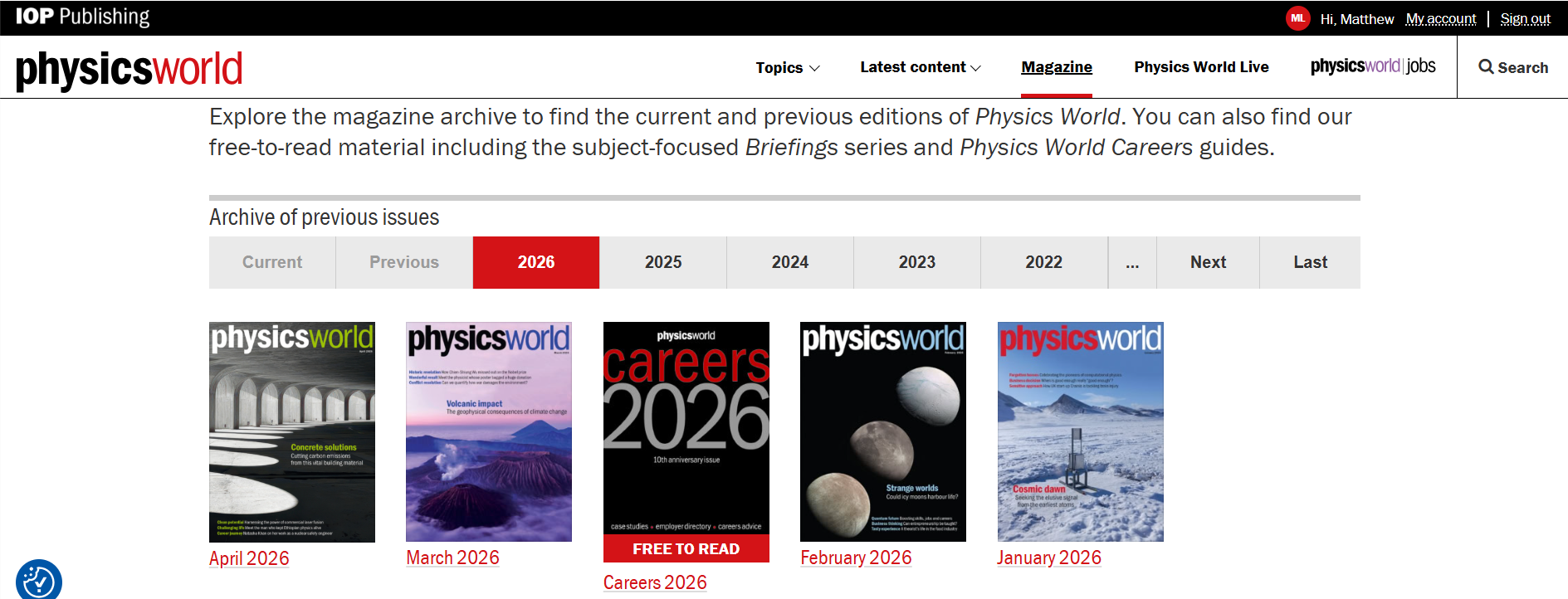
PhysicsWorld.com

Slide 5
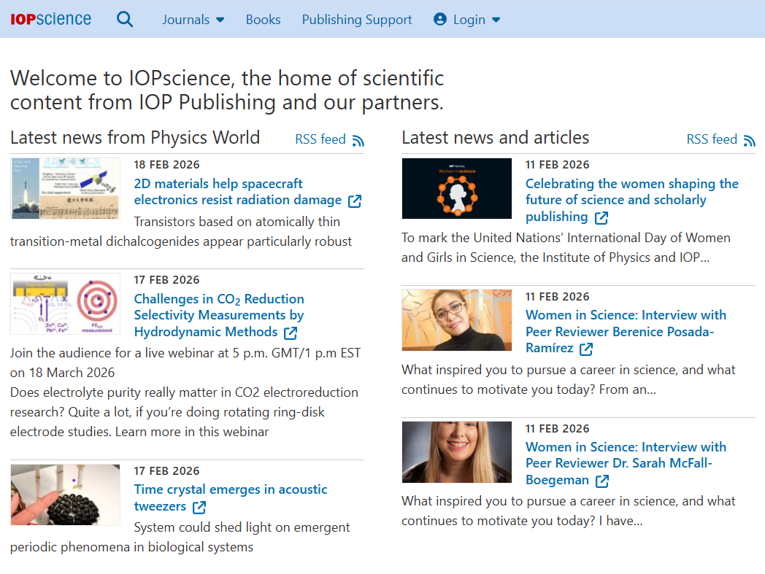
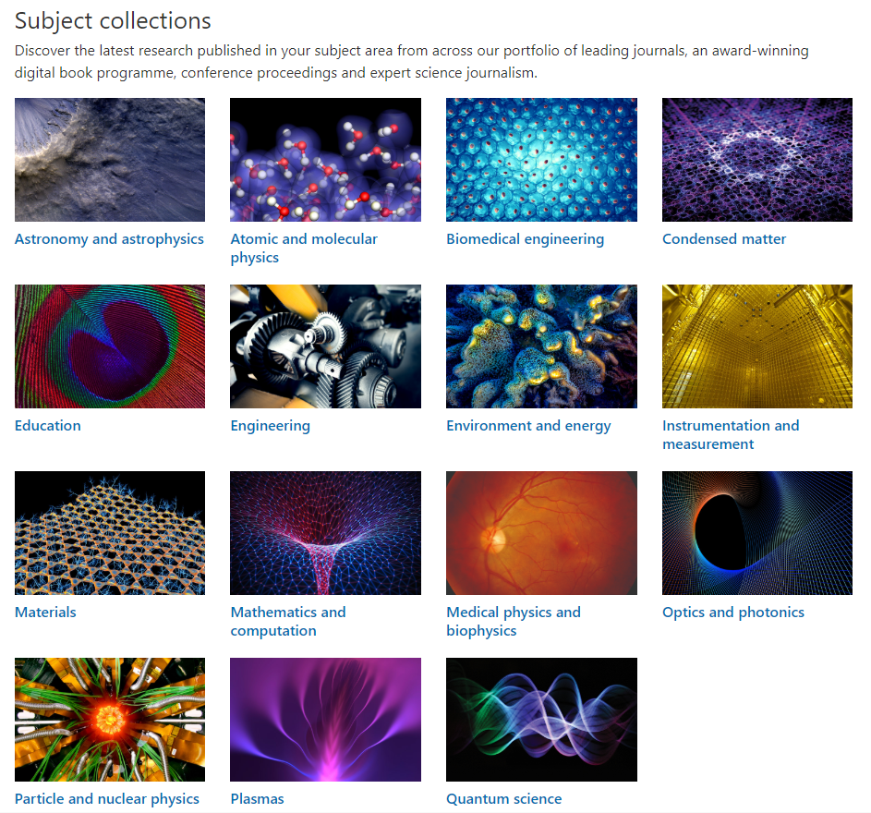
IOPscience: Home of IOPP Journals & Articles

Slide 6
Journals & Articles Members Publishing Discount
Members of the Institute of Physics (IOP) are eligible to receive a 25% discount on the article publication charge (APC) for all IOPP-owned, fully gold open access titles and our partner title NJP (owned by IOP and DPG).
T&C's apply.
Paying for open access - IOPscience - Publishing Support

Slide 7
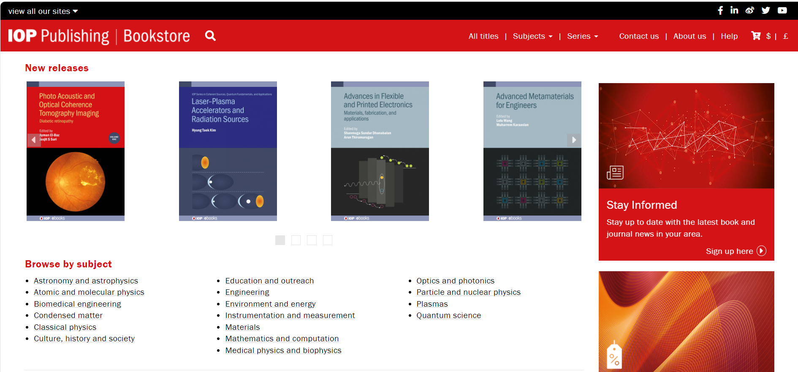
IOP Bookstore – 30% Off

Slide 8
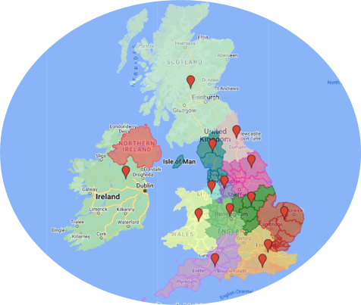
Nations & Branches
IOP Ireland
IOP Scotland
IOP Wales
East Anglia
East Midlands
Lancashire
and Cumbria
London and South East
Manchester
and District
Merseyside
North East
South Central
South West
West Midlands
Yorkshire

Slide 9
Special Interest Groups
A
Applied Mechanics Group
Astroparticle Physics Group
Atomic and Molecular Interactions Group
B
Biological Physics Group
British Carbon Group
British Radiofrequency Spectroscopy Group (Magnetic Resonance Group)
Business Innovation and Growth Group
C
Combustion Physics Group
Computational Physics Group
D
Dielectrics and Electrostatics Group
E
Early Career Members Group
Electron Microscopy and Analysis Group
Energy Group
Environmental Physics Group
F
Food Physics Group
G
Gravitational Physics Group
H
High Energy Particle Physics Group
Higher Education Group
History of Physics Group
I
Instrument Science and Technology Group
Ion and Plasma Surface Interactions Group
L
Liquids and Complex Fluids Group
Low Temperature Group
M
Magnetism Group
Materials and Characterisation Group
Mathematical and Theoretical Physics Group
Medical Physics Group
Molecular Physics Group
N
Nanoscale Physics and
Technology Group
Neutron Scattering Group
Nonlinear and Complex Physics Group
Nuclear Industry Group
Nuclear Physics Group
O
Optical Group
P
Particle Accelerators and Beams Group
Physical Acoustics Group
Physics Communicators Group
Plasma Physics Group
Polymer Physics Group
Printing and Graphics Science Group
Q
Quantum Business Innovation and Growth (qBIG) Group
Quantum Electronics and Photonics Group
Quantum Optics, Quantum Information and Quantum Control Group
S
Semiconductor Physics Group
Shock Wave and Extreme Conditions Group
Space Group
Structural Condensed Matter Physics Group
Superconductivity Group
T
Theory of Condensed Matter Group
Thin Films and Surfaces Group
Tribology Group
V
Vacuum Group
W
Women in Physics Group

Slide 10
Benefits of Engaging with Groups, Nations & Branches
Use Engagement to Inspire Personal Reflection to Support Continuous Professional Development
Network with Peers in Your Local Area or By Areas of Special Interest.
Expand Knowledge by Attending Events
Provides a Platform to Share Good Practice & Collaborate
Boosts Your CV
Influence & Inspire the Next Generation of Physicists
Volunteer at Member Visits, Outreach Events & Talks
Influence Policy
Share Knowledge & Ideas

Slide 11

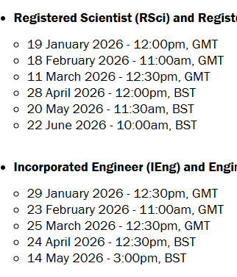






Professional Registrations

Slide 12
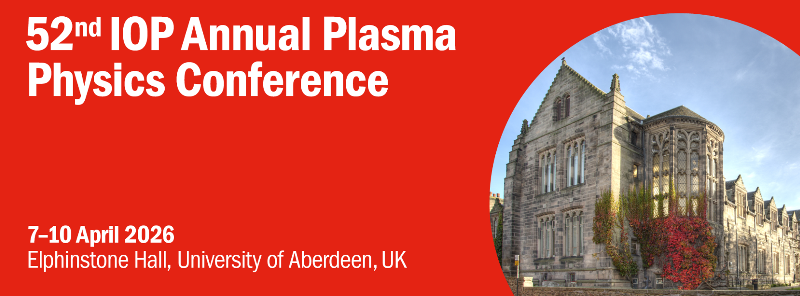
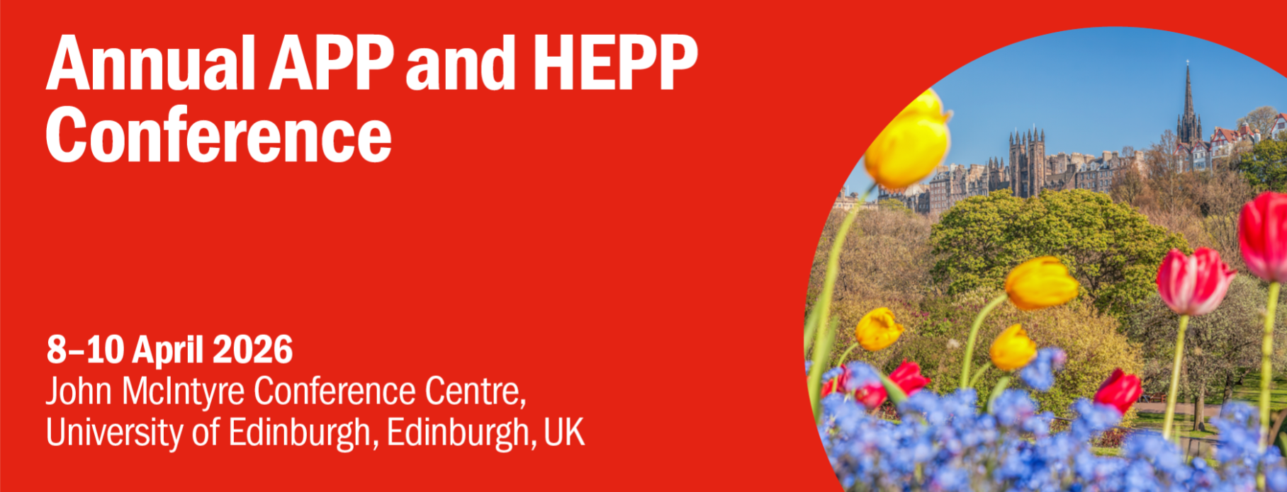


2026 Conferences

Slide 13
Support Grants – UK & Ireland
Grant Name | Amount | Purpose
IOP Accessibility Fund | Up to £500 | To enable members who could not otherwise go to an event or conference because they are a parent or carer. Minimum of 12 months as a member.
Public Engagement Grant Scheme | Up to £3,000 | To run physics-based activities in the UK and Ireland that improve people’s relationship with physics in their family or community groups.
IOP Teacher Training Scholarships | Up to £30,000 | For those starting teacher training in England in September 2025 who are passionate about physics and have the potential to become inspirational teachers.
Kelvin Maxwell Fund | Variable | A fund to inspire audiences and physicists exclusively in Scotland.
IOP Ireland Outreach Grants | Up to €1,000 | To support outreach activities and initiatives in Ireland and Northern Ireland.
Returners Funding Support | Variable | To support IOP members who are on or returning from a career break by covering the registration fee to attend an IOP event or conference

Slide 14
Support Grants – All Members
Grant Name | Amount | Purpose
Bell Burnell Graduate Scholarship Fund | Variable | Is for full- or part-time graduates wishing to study towards a doctorate in physics and from groups that are currently underrepresented in physics.
The Physics Benevolent Fund | Variable | To provide support for members, or their dependants, during unemployment, ill-health or a career break.
International Member Grant | Up to £500 | A grant of £500 to support members outside of the UK and Ireland to run activities in partnership with their national physics societies.
Early Career Researchers Fund | Up to £300 | For early career researchers who are members of the IOP to attend international meetings and visit international facilities.
Research Student Conference Fund | Up to £300 | This grant provides support for PhD students to attend a conference or major event.
CR Barber Trust | £100-£300 | For PhD students who want to attend an overseas conference to help cover registration fees, travel expenses or accommodation.

Slide 15
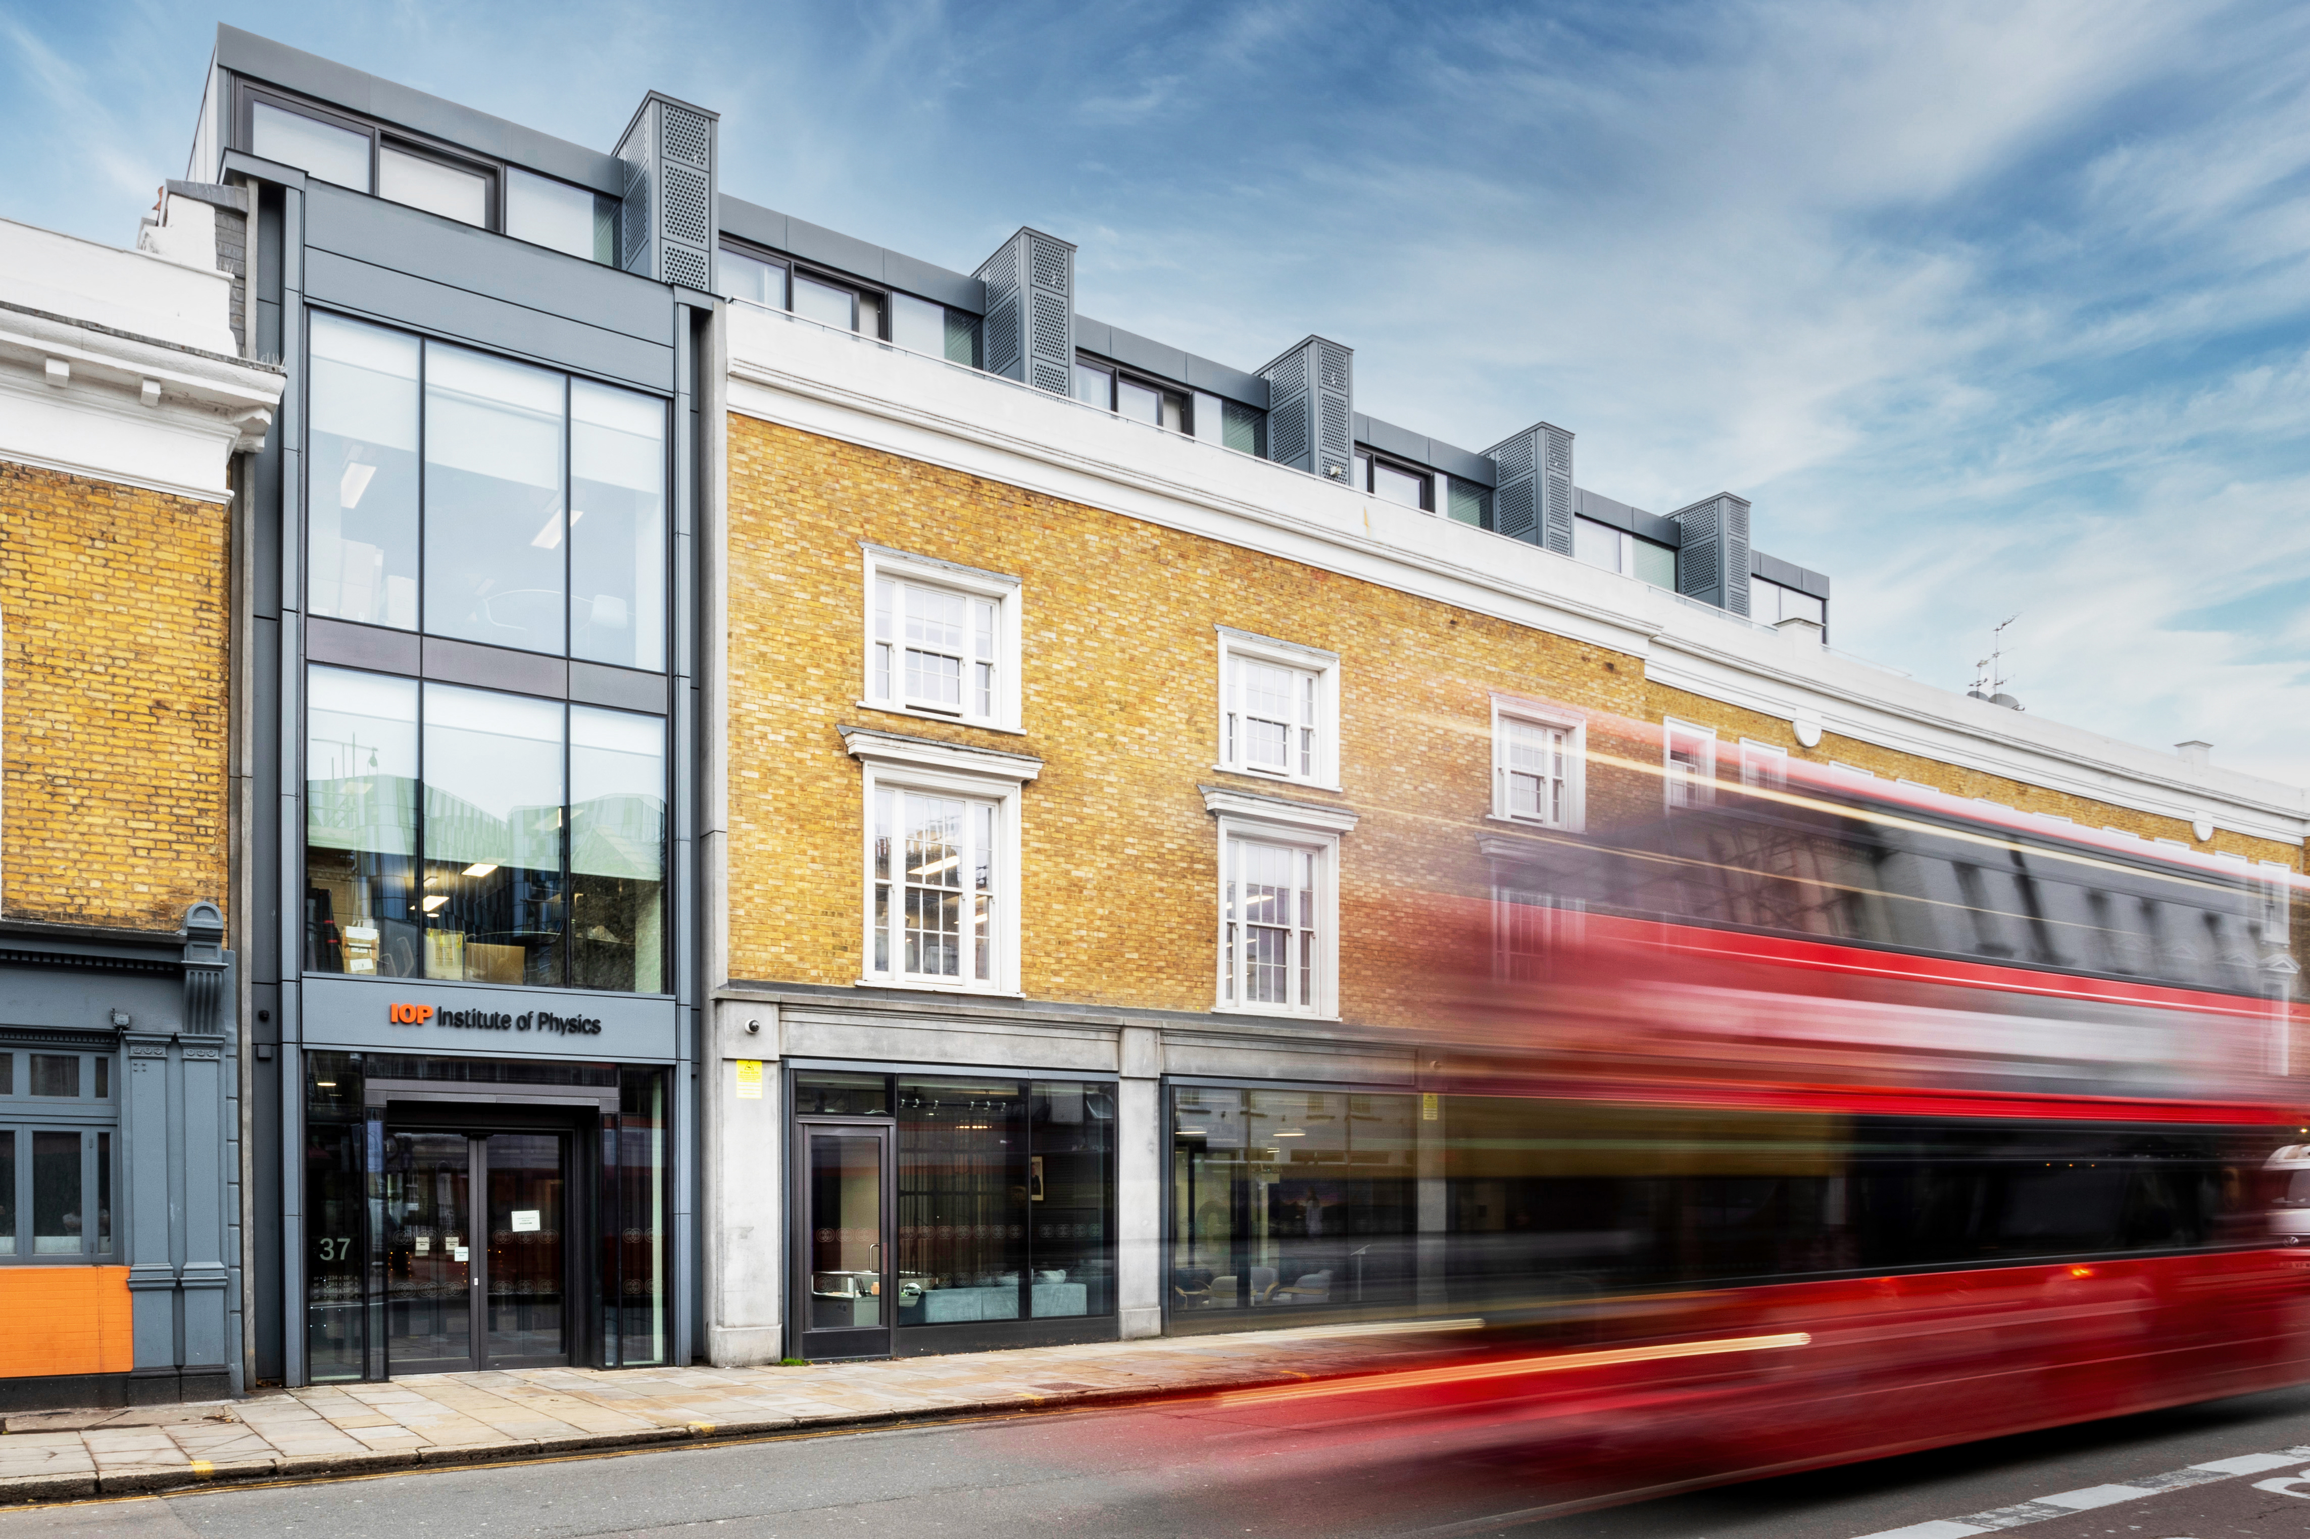
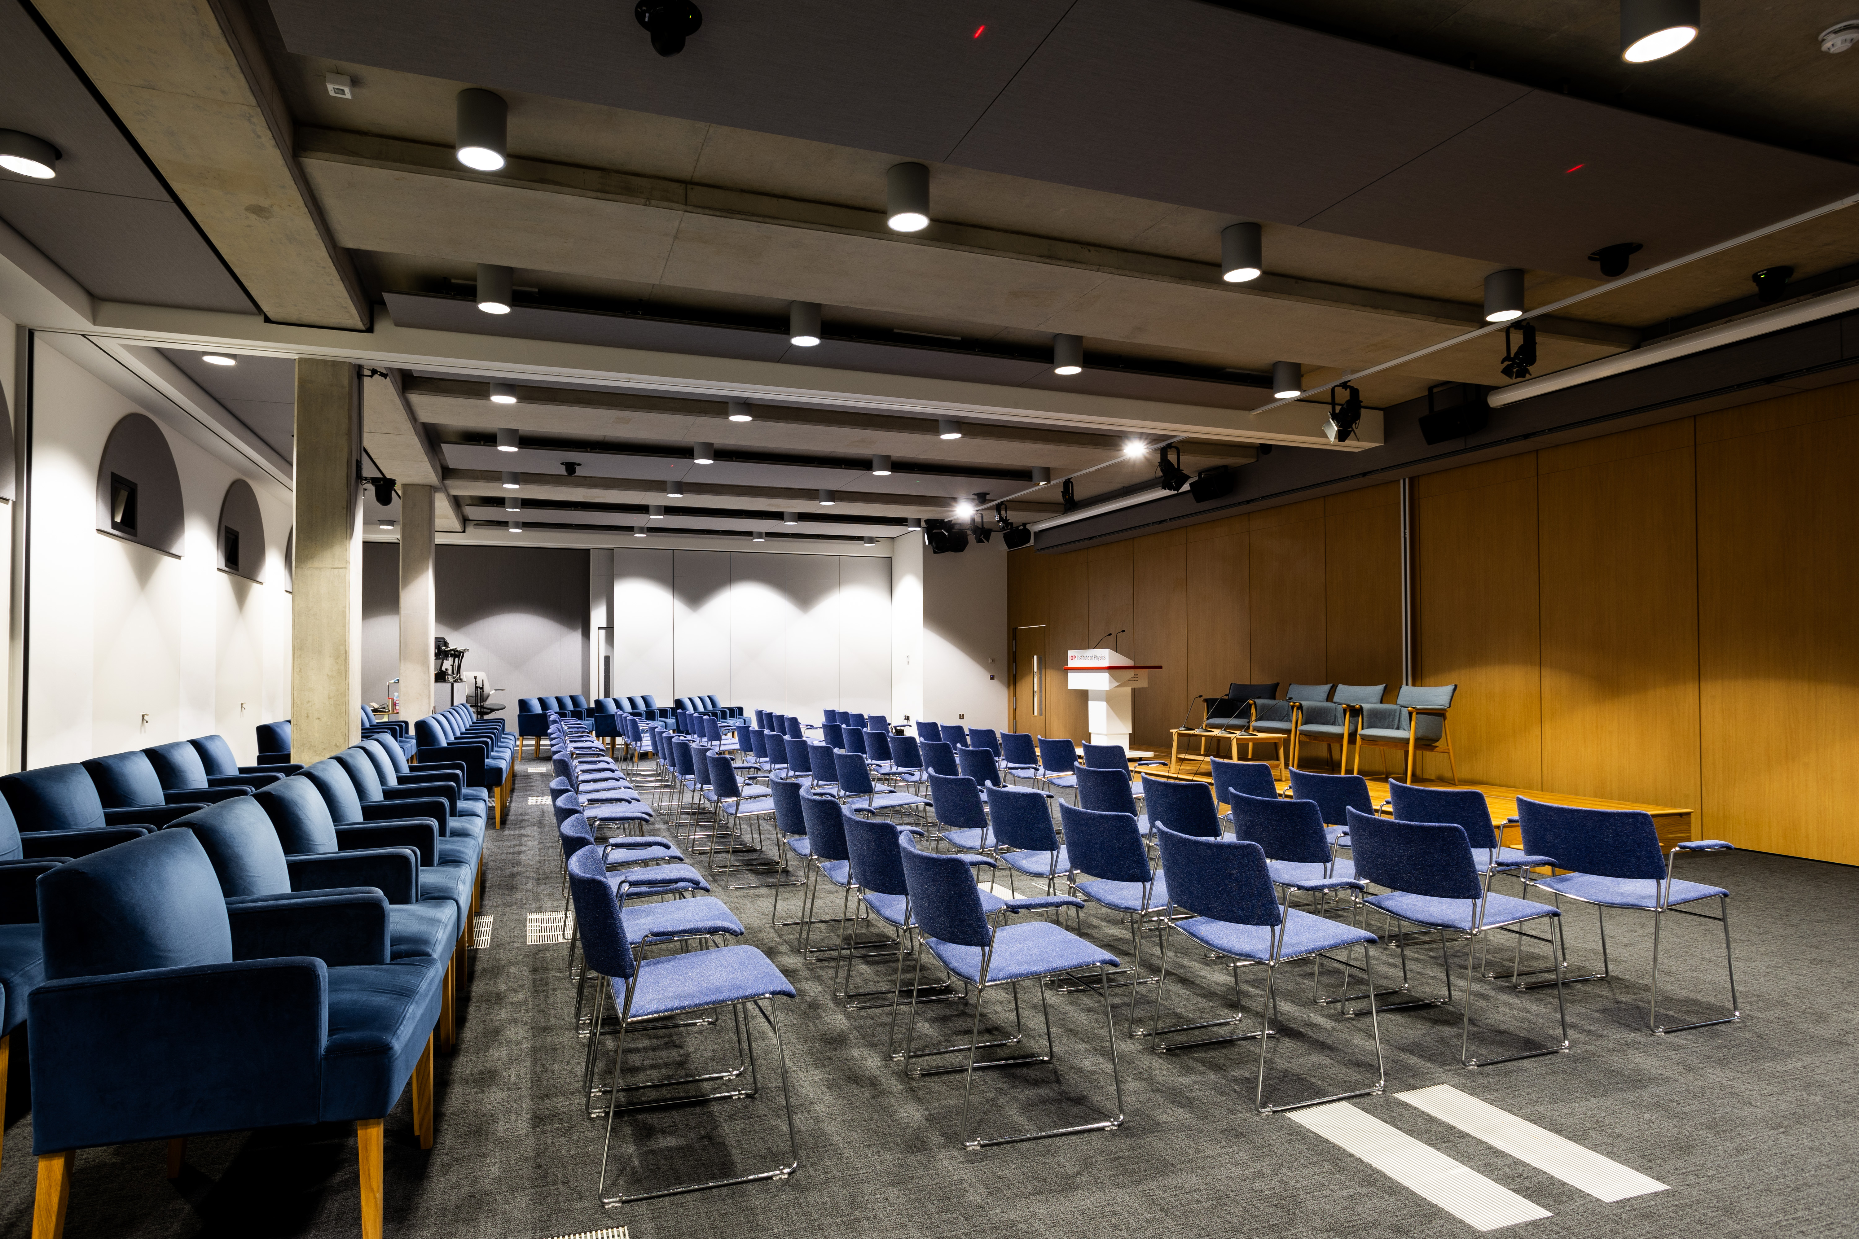
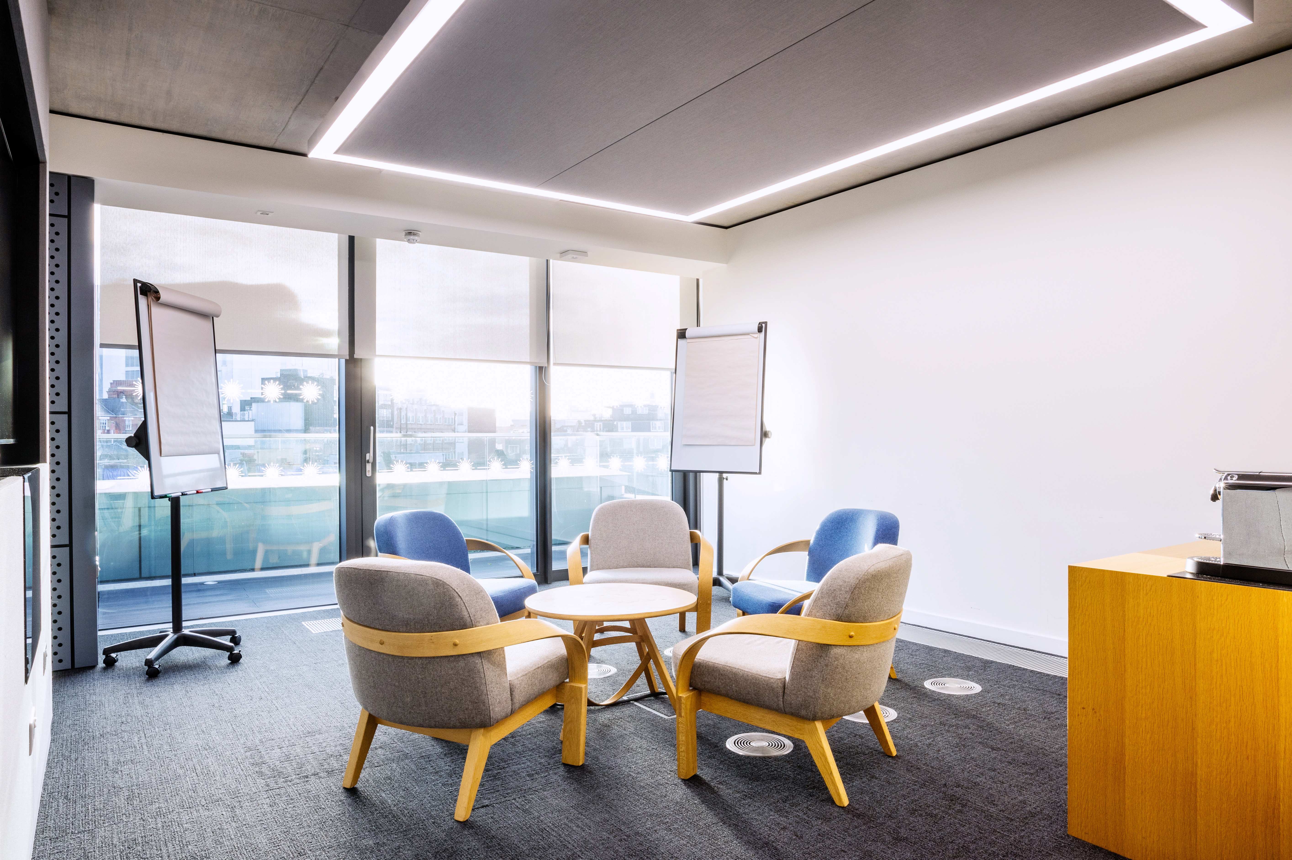
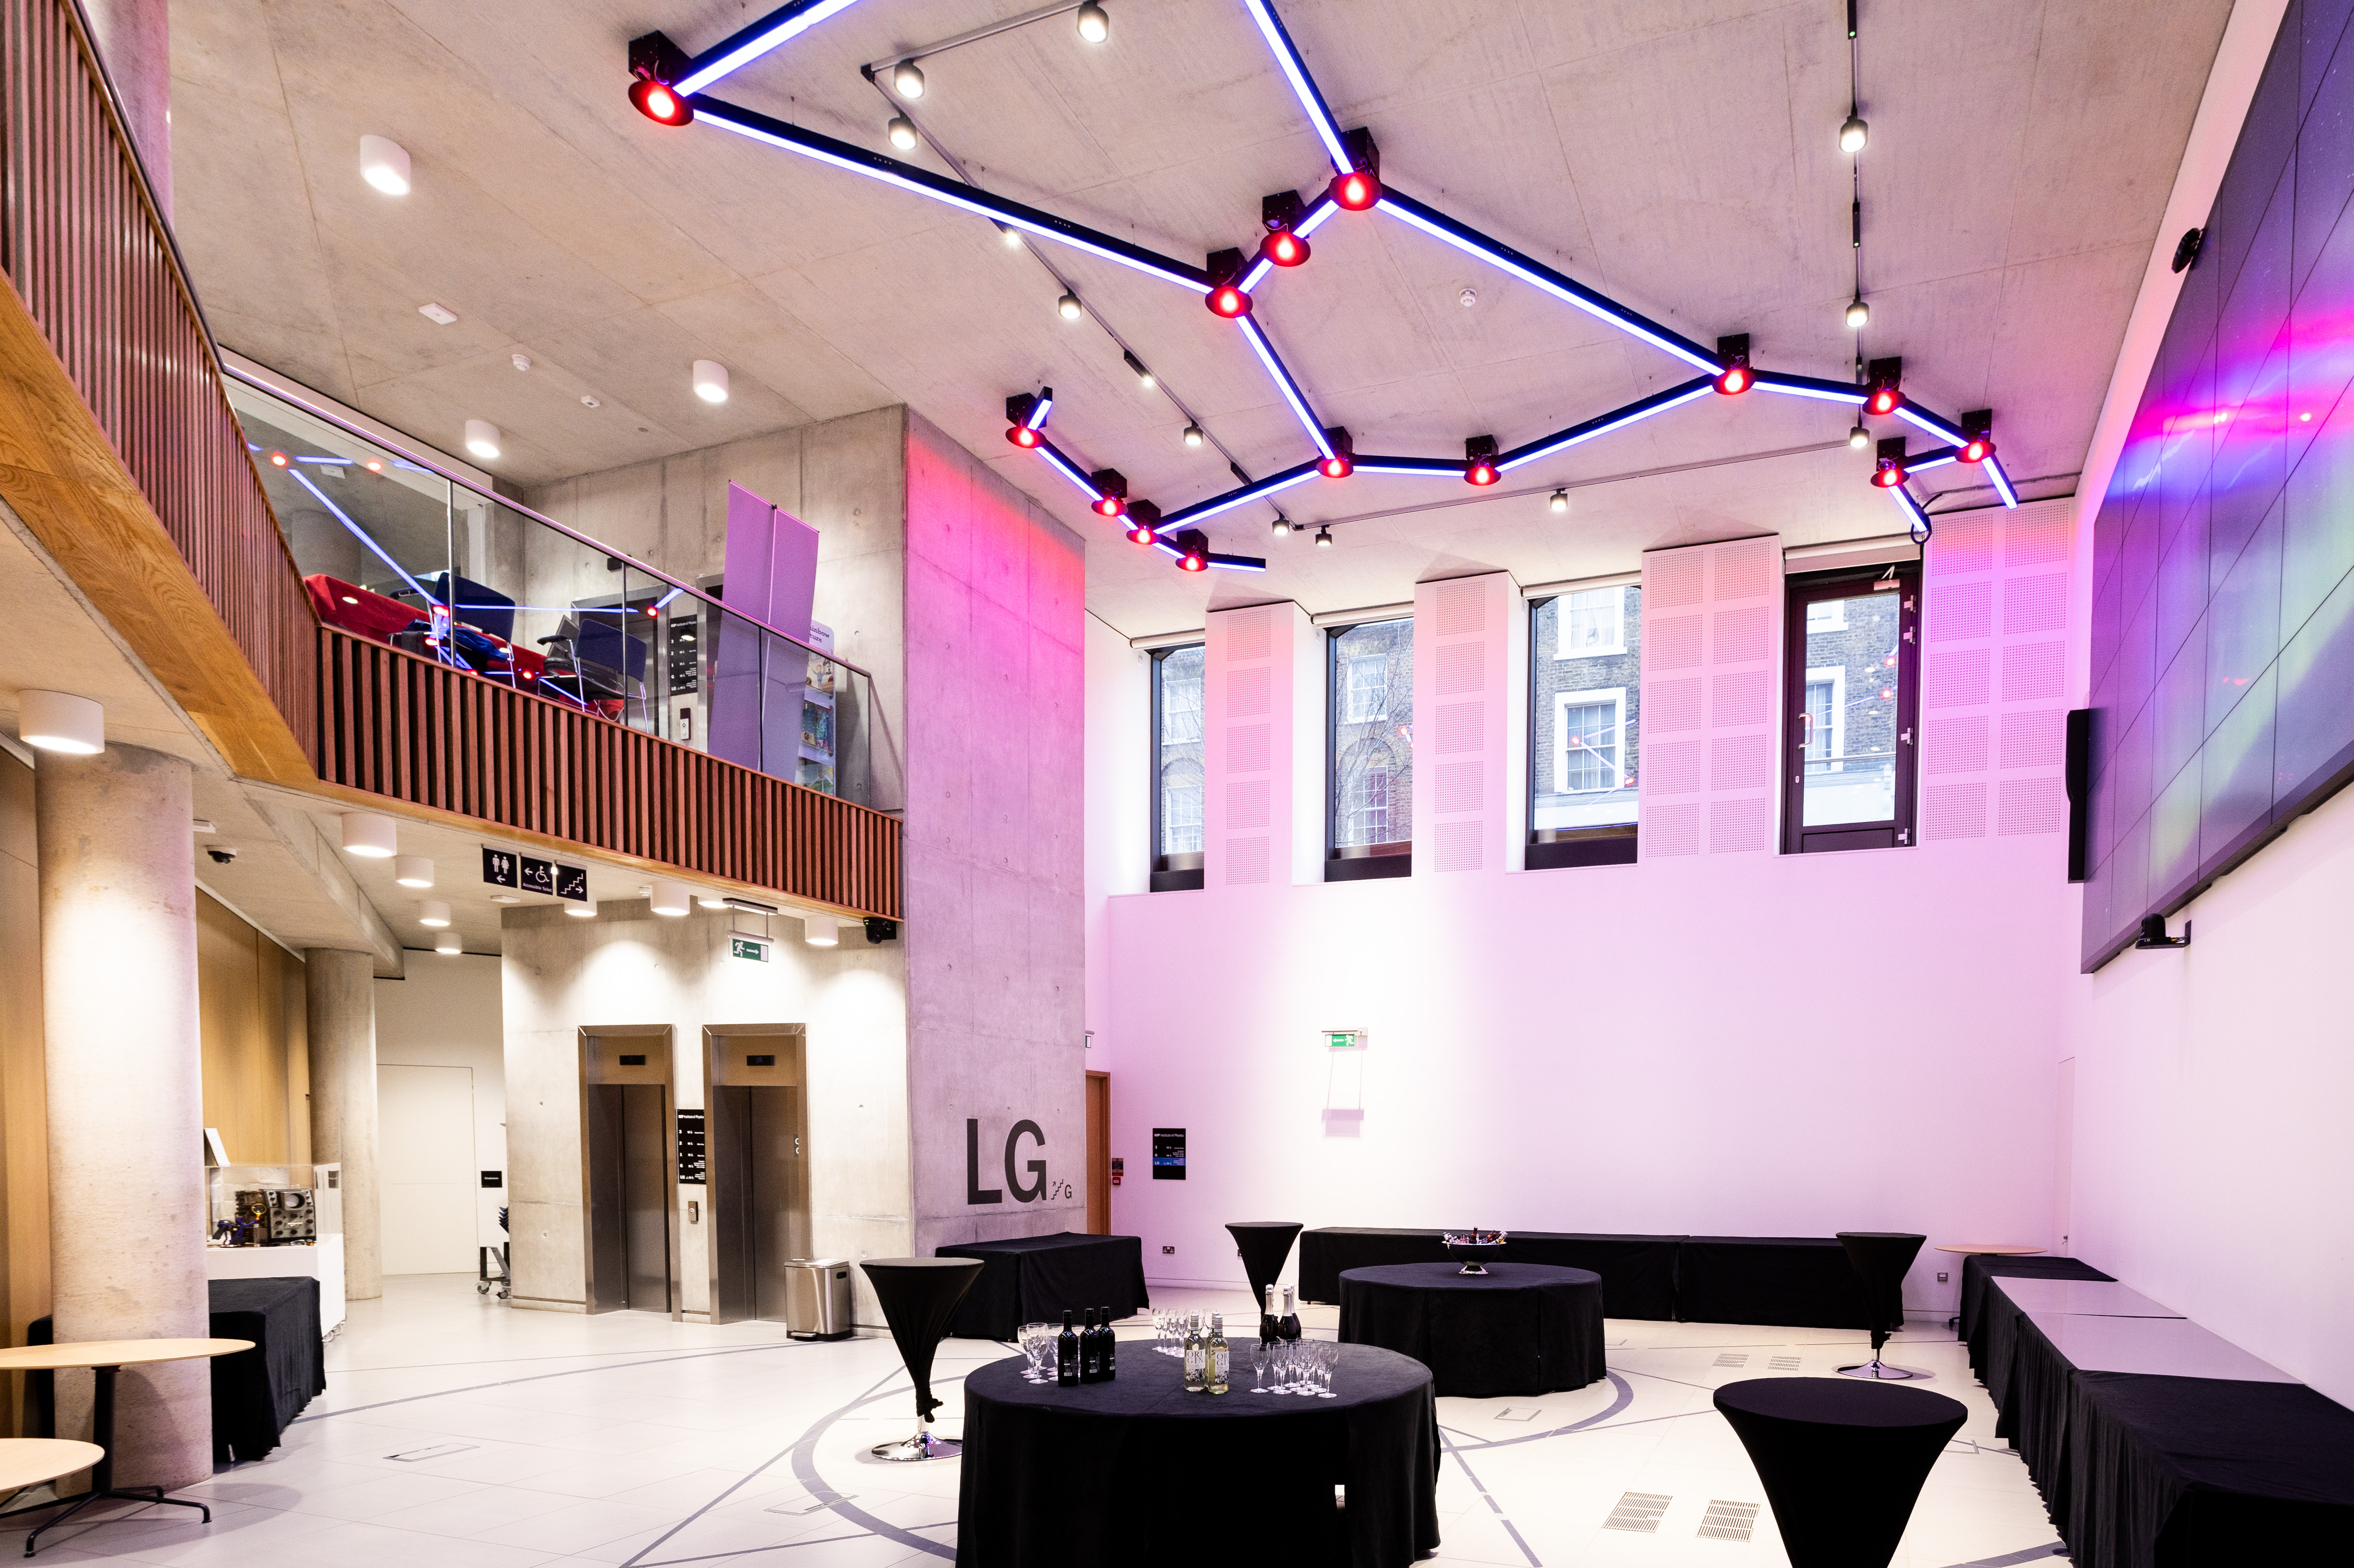
IOP Office Conference / Meeting Space Discounts
5 minute walk from
London Kings Cross
Seminar Room 4: Free of Charge (Capacity of 8)
30% Discount on Meeting and Conference Room Hire

Slide 16
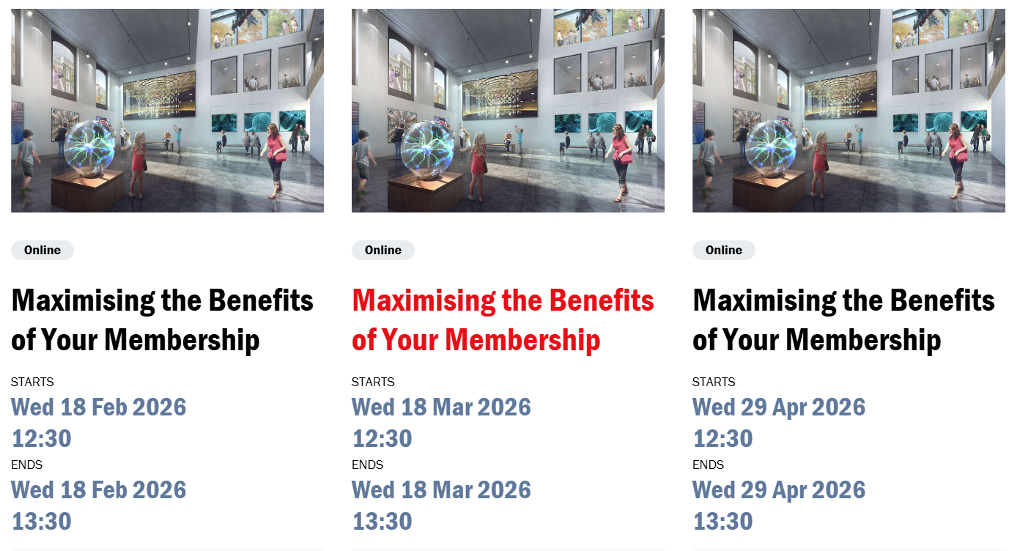
To Find Out More
Sign up to the membership teams 'Maximising the Benefits of Your IOP Membership' webinar:

