Slide 1

Decay Spectroscopy of Medical Imaging Radionuclide Terbium-152
E.B.O’Sullivan^{1,2}, S.M.Collins^{1,2}, J.M.Daugas³, L.Domenichetti³, J.Heery¹, J.Henderson¹, U.Köster³, C.Michelagnoli³, T.Parry¹, S.Pascu¹, P.H.Regan^{1,2}, R.Shearman²
1. University of Surrey, Guildford, UK
2. National Physical Laboratory, Teddington, UK
3. Institut Laue-Langevin, Grenoble, France
IoP Nuclear Conference 2026

Slide 2

¹⁵²Tb: Medical Imaging
β⁺ / EC decay to ¹⁵²Gd – Positron Emitter
T1/2 = 17.8784(95) h
Iβ+ = 20.3(15)%
QEC = 3990(40) keV [1]
First-in-human trials show promise in PET imaging: ¹⁵²Tb-DOTATOC and ¹⁵²Tb-PSMA-617 used successfully in human patients [2,3]
Terbium isotope – applications in theragnostics
Nuclear Data Sheets for A = 152, M.J. Martin
Preclinical investigations and first-in-human application of ¹⁵²Tb-PSMA-617 for PET/CT imaging of prostate cancer, C. Müller et. al
Clinical evaluation of the radiolanthanide terbium-152: first-in-human PET/CT with ¹⁵²Tb-DOTATOC, R.P. Baum et. al
Fig. 2: Left: Coincidence gates and total projection.
Right: Gates placed on the 344 keV 2⁺→0⁺ ground state transition, and two new transitions at 3401 keV (Ei = 3745 keV) and 3205 keV (Ei = 3549 keV).
Fig. 2: Left: Coincidence gates and total projection.
Right: Gates placed on the 344 keV 2⁺→0⁺ ground state transition, and two new transitions at 3401 keV (Ei = 3745 keV) and 3205 keV (Ei = 3549 keV).
Notes:
Two main areas of nuclear medicine
Non invasive techniques eliminate the need for surgery – reduces risk to patient
Nuclear medicine distinct from radiotherapy in that the source is inside the patient’s body
Diagnostics – compared to external radiation source (e.g. xrays) we get a better image of delicate and complex structures
Therapy – compared to external radiation source, the dose to surrounding healthy tissue is minimised

Slide 3
Theragnostics: Therapy + Diagnostics
Terbium theragnostic quartet: four different medical uses
Shared chemistry – compatible with the same delivery mechanism
Personalised medicine – treatment plan tailored to individual patients
Isotope | T_{1/2} | Decay | Use
¹⁴⁹Tb | 4.118(25) h [4] | Alpha | Radionuclide Therapy
¹⁵²Tb | 17.8784(95) h [5] | Beta+ / EC | PET Imaging
¹⁵⁵Tb | 5.2346(36) d [6] | EC | SPECT Imaging
¹⁶¹Tb | 6.9637(29) d [7] | Beta- | Radionuclide Therapy
PRISMAP Radionuclide Portfolio, https://www.prismap.eu/radionuclides/portfolio/149Tb
Determination of the Terbium-152 Half-Life from Mass-Separated Samples from CERN-ISOLDE and Assessment of the Radionuclide Purity, S.M. Collins et. al
Half-life determination of ¹⁵⁵Tb from mass-separated samples produced at CERN-MEDICIS, S.M. Collins et. al
Determination of the ¹⁶¹Tb half-life, S.M. Collins et. al

Slide 4
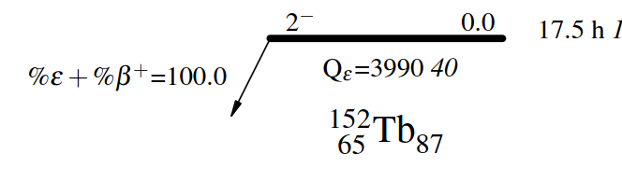
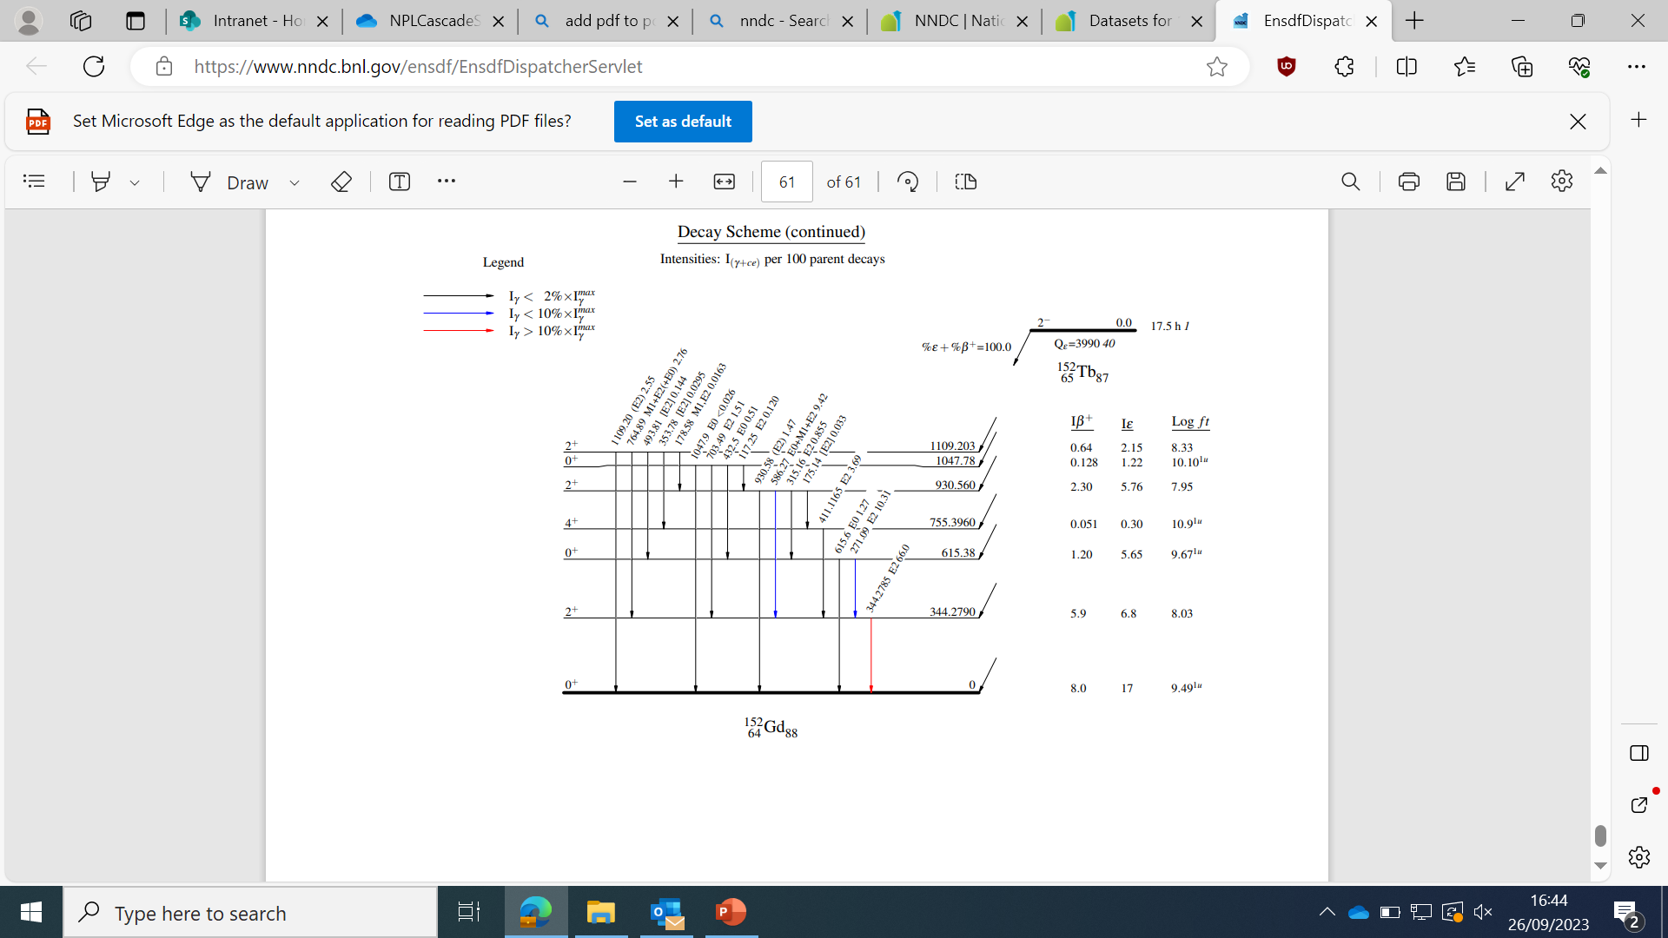
Nuclear Data: ¹⁵²Gd
¹⁵²Tb → ¹⁵²Gd decay last studied in 2003, using a pair of HPGe detectors [8]
Highest energy level identified at 3358 keV – 600 keV below QEC
248 out of 635 known transitions unplaced
RIPL-3 level density calculation – 400 states with J^{π}=1⁻,2⁻,3⁻ predicted in range 3-4 MeV [9]
Pandemonium effect: unknown high energy states leads to inaccurate beta dose, for example in ⁸⁶Y [10].
~100 known levels
Properties of ¹⁵²Gd Collective States, J. Adam et al.
RIPL — Reference input parameter library for calculation of nuclear reactions and nuclear data evaluations, R. Capote et al.
State-of-the-art γ-ray assay of ⁸⁶Y for medical imaging, A.C. Gula et. al.

Slide 5
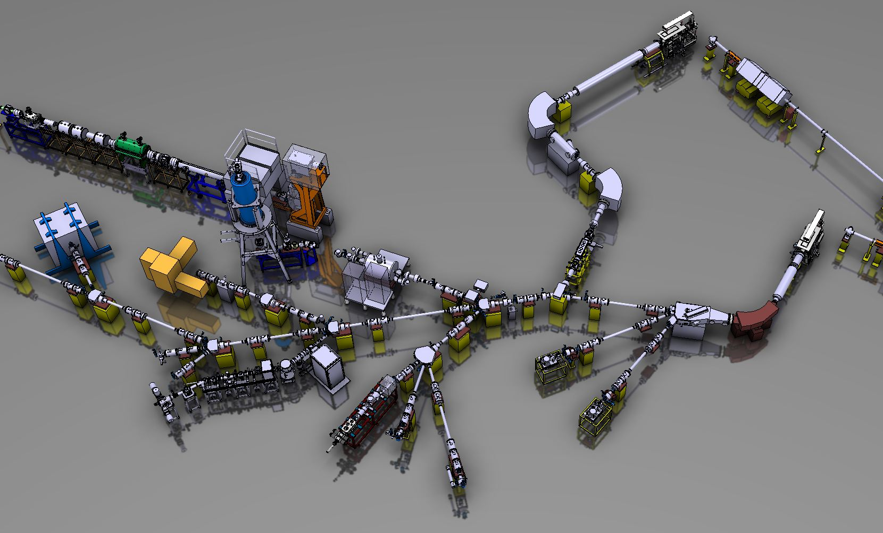

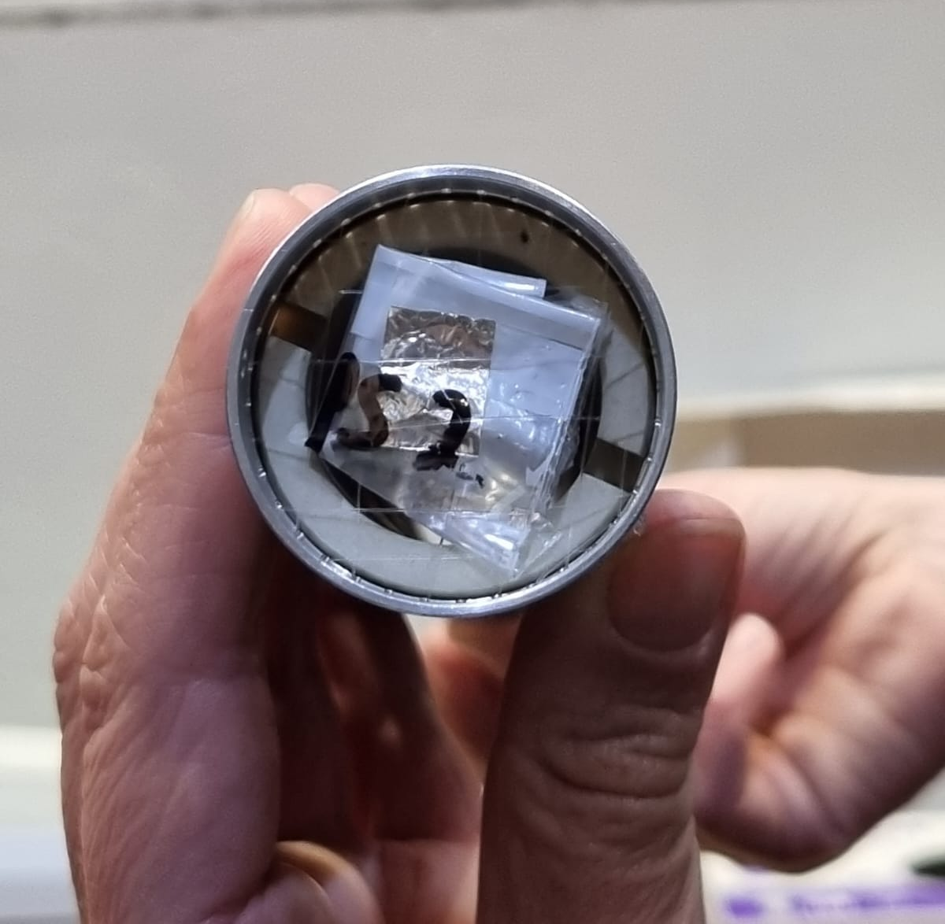
¹⁵²Tb Decay Spectroscopy
Sources prepared at CERN ISOLDE: 1.4 GeV proton beam on a tantalum target
Samples purified by laser ionisation and mass separation and implanted onto a pair of Al foils plus one Mylar foil
Delivered to ILL Grenoble for measurement: 1x10⁵ Bq and 5x10⁵ Bq at start of experiment (3rd May 2023)

Slide 6
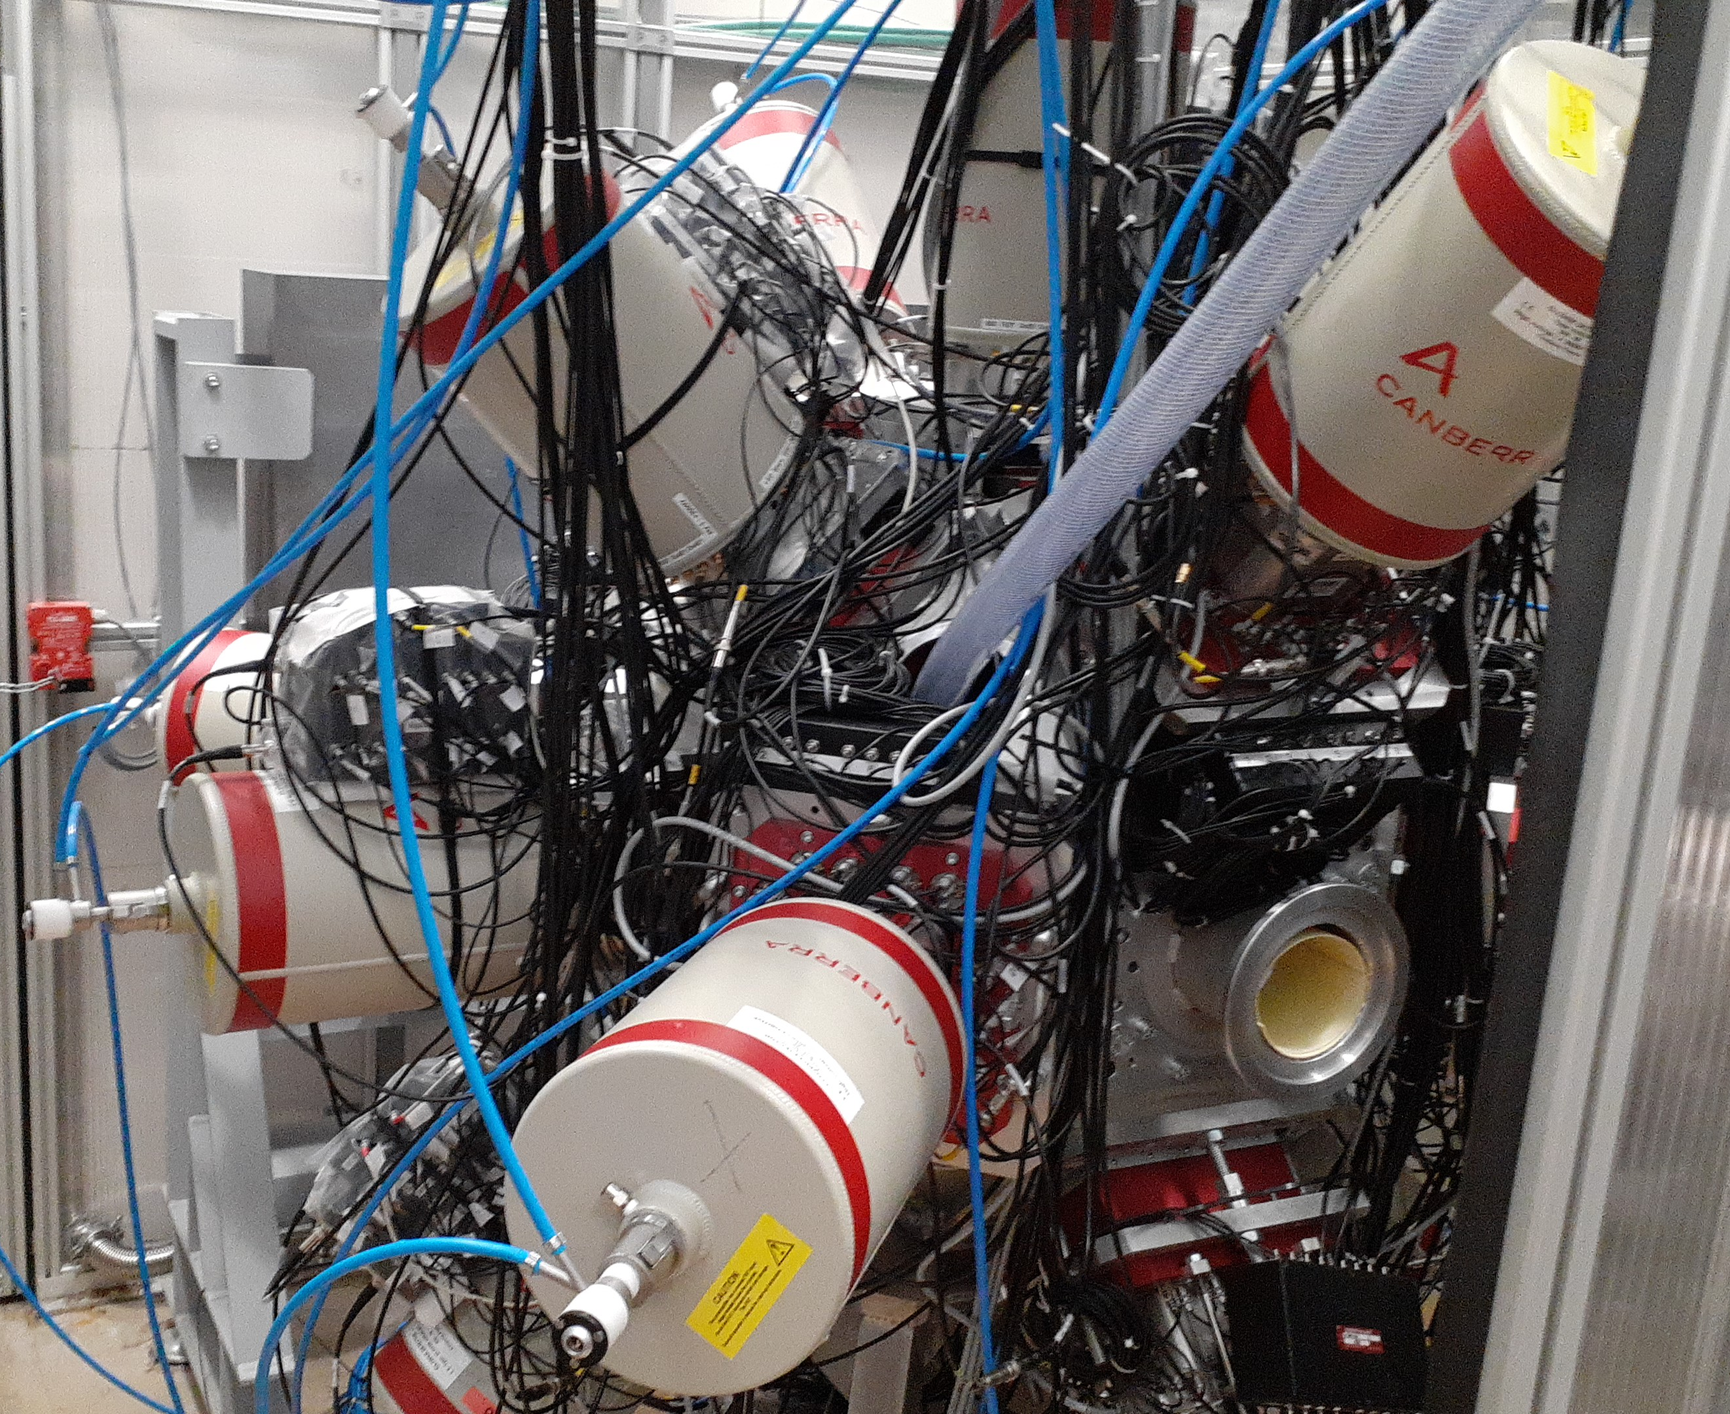
Gamma-Gamma Spectroscopy
FIssion Product Prompt Gamma-Ray Spectrometer (FIPPS) [11]
64 HPGe crystals, 16 clovers with BGO shielding (14 crystals excluded)
Absolute efficiency ~9% at 344 keV
7 days measurement time
Electron-Gamma spectroscopy carried out in parallel – PN1/LOHENGRIN
FIPPS (FIssion Product Prompt γ-ray Spectrometer) and its first experimental campaign, C. Michelagnoli et. al

Slide 7
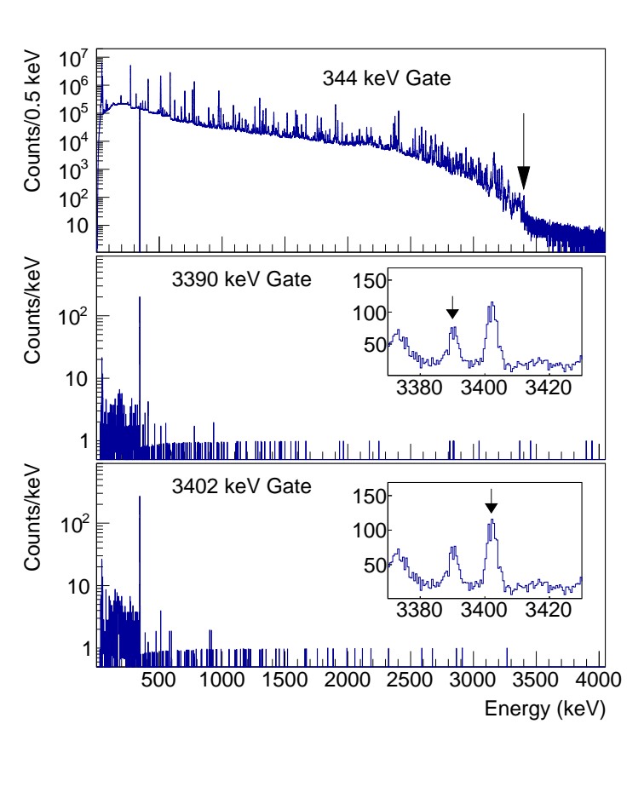
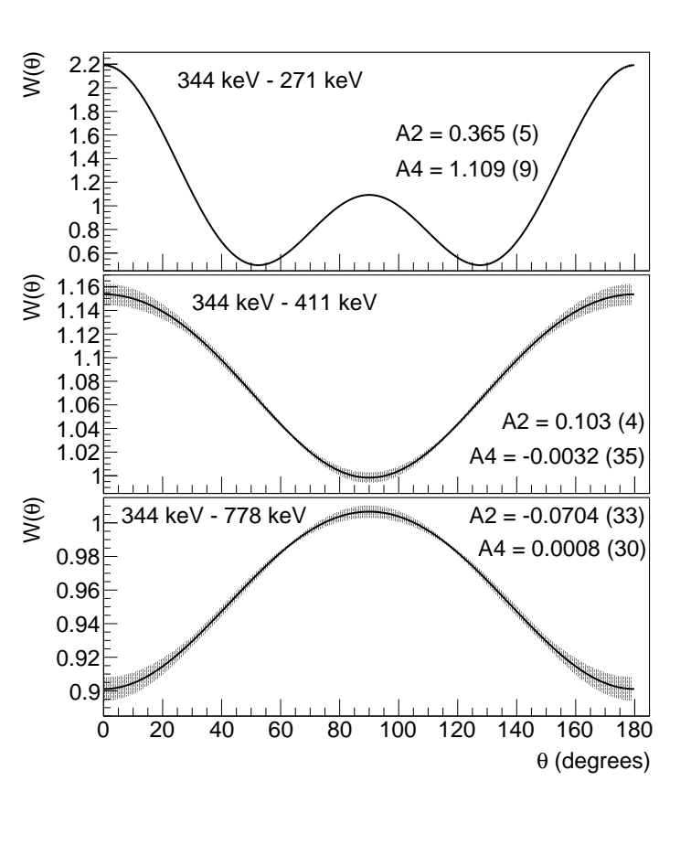
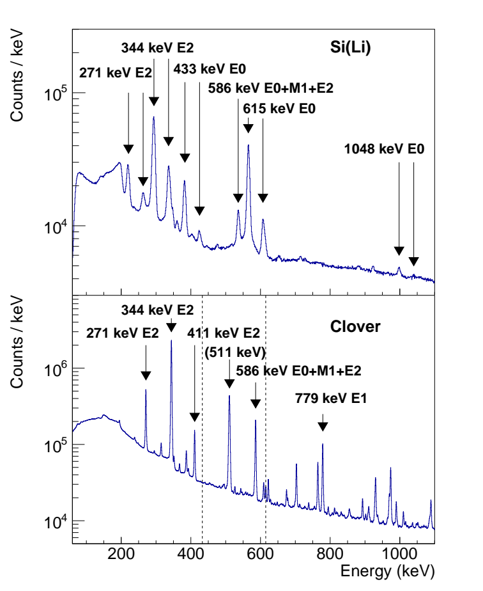
Coincidence Analysis
Gamma-gamma – level scheme placments
Angular correlations – level spin assignments
Electron-gamma – E0 intensities and ICCs [13]

Slide 8
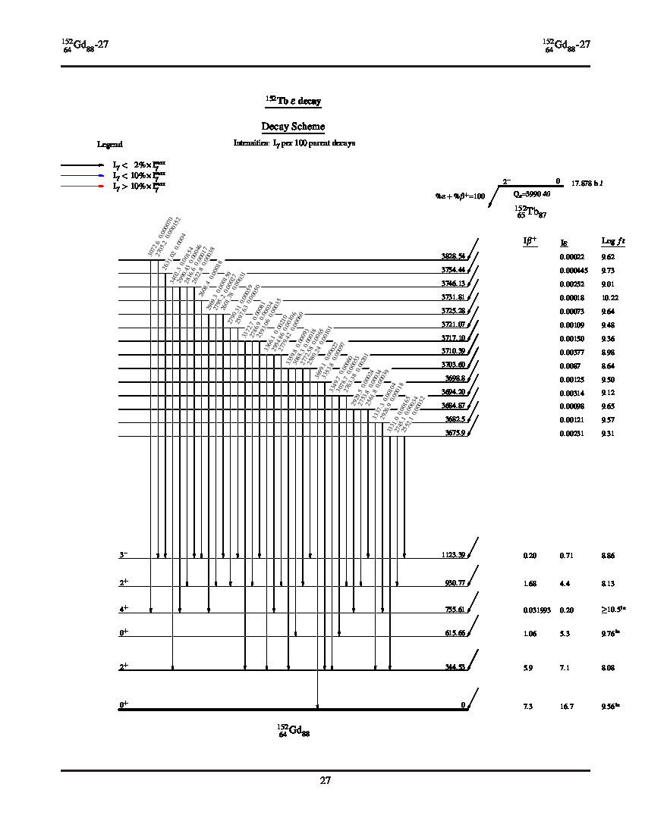
Updated Level Scheme
~x2
 | Evaluated Data | This Work
Levels | 103 | 200
Gammas Observed | 635 | 1099
Gammas Placed | 387 | 752
J^{π} Assignments | 50 | 93

Slide 9
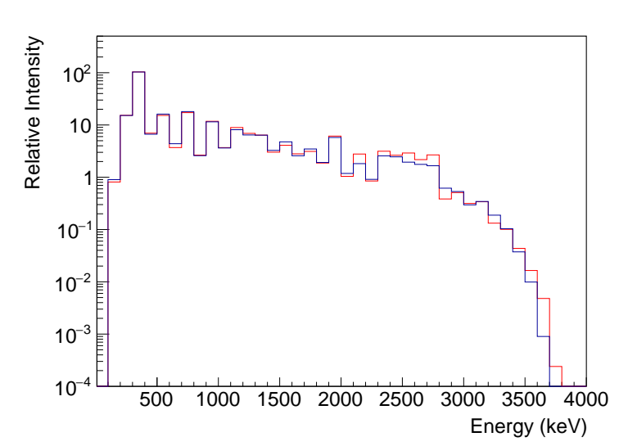
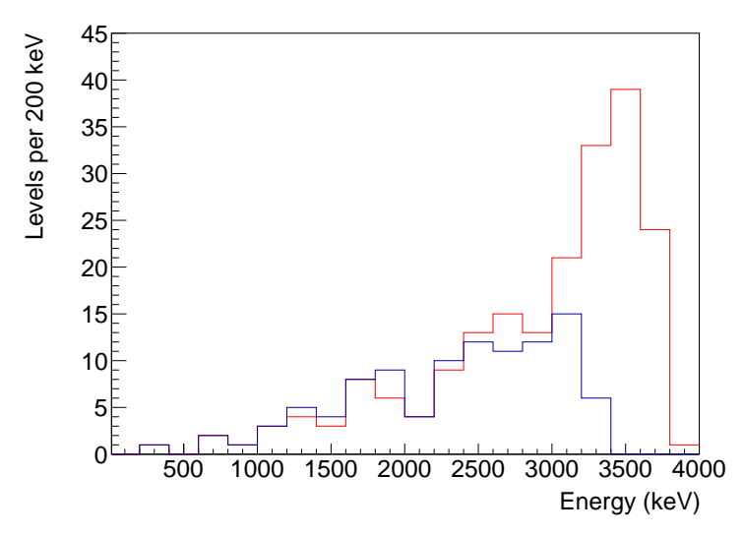
Updated Level Scheme
Gamma intensity: 155.3 (69) per 100 decays (1.3% increase)
Average energy emited: 1260 (5) keV / decay (4.5% increase)
Decay strength shifted to higher energy levels – greater density of states, weaker population of individual levels

Slide 10
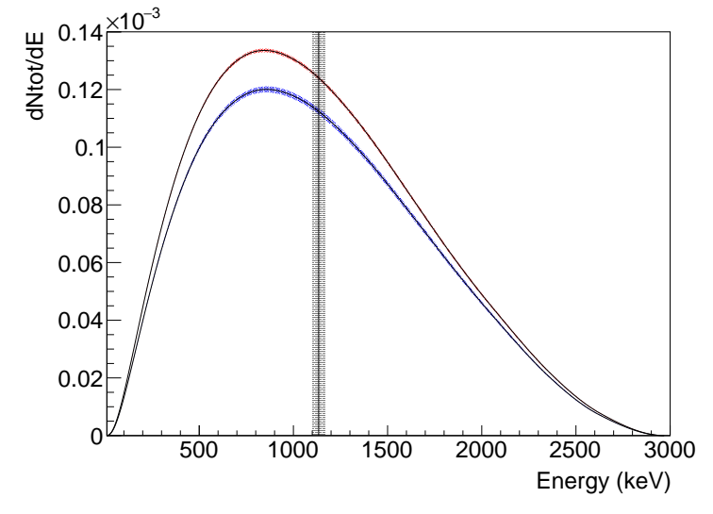
Beta Decay Strength
Beta Spectrum
¹⁵²Tb
Ex2
I(β+EC)2
Iγ1
Ex1
I(β+EC)1
Iγ2
0
I(β+EC)0
¹⁵²Gd
Beta feeding shifted to higher energy levels – lower energy betas
Electron capture preferential at low decay energy
Little change in average β⁺ energy
Positron emission probability 18.5(44) per 100 decays - 8.9% reduction
Infer beta feeding from balance of gamma-ray intensity feeding / deexciting each level

Slide 11
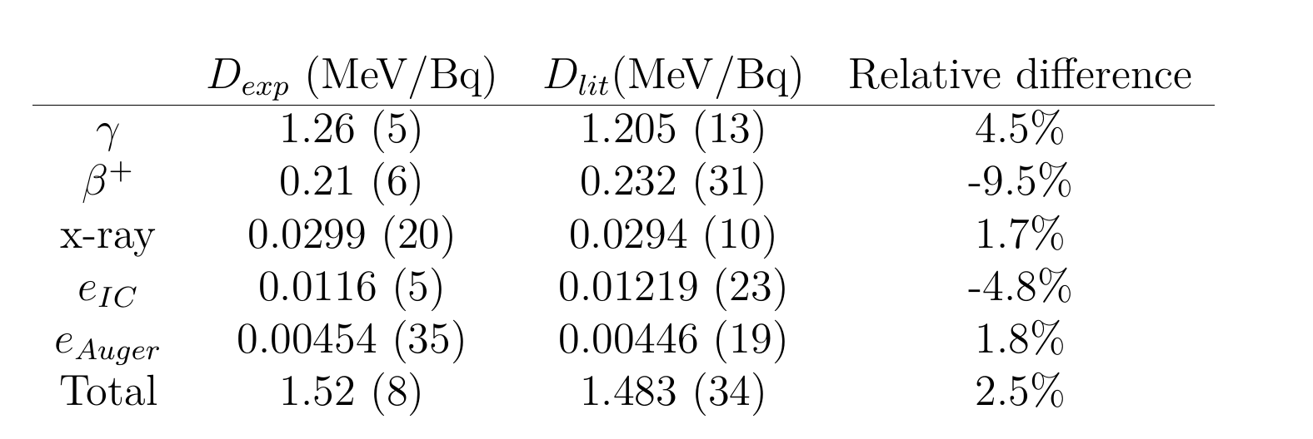
Dosimetry Implications
Reduced beta dose, increased gamma dose
Absorbed dose calculations complex – betas have ~mm range, gammas more likely to escape
Reduced positron emission probability – reduced imaging performance per decay
Large uncertainties – previous results neglected systematic uncertainties

Slide 12
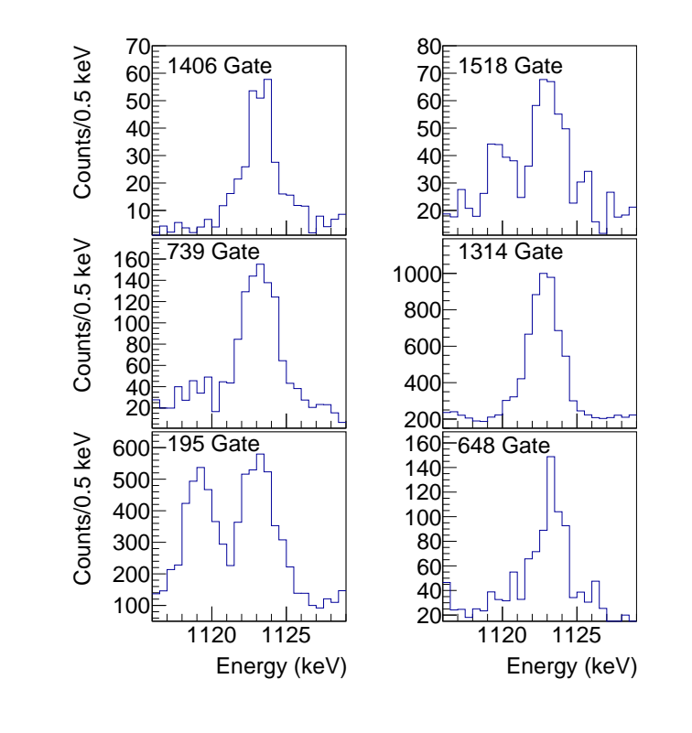
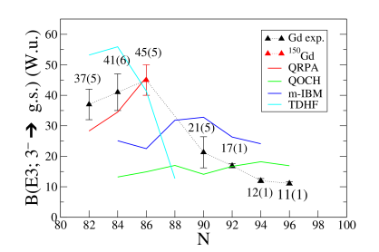
Nuclear Structure Implications
B(E3) for Gd isotopic chain missing value for 152Gd – location of maximum undetermined [14]
First evidence of 1123-keV 3- to ground transition – branching ratio 0.83% (+7 -14)
14) Increasing Octupole Collectivity across the 𝑍 =64 Isotopic Chain: B(E3) Values in 150Gd, S. Pascu et al.

Slide 13
Conclusions
Expanded level scheme for ¹⁵²Tb decay
Showed increase in gamma dose, decrease in beta dose and positron emission probability
Limited by uncertainty in gamma intensity, and finite efficiency of detector at high energy
Future Work:
Total Absorption Spectroscopy at ISOLDE – more direct measure of beta feeding, requires extensive level scheme
Absolute standardisation of gamma intensity at NPL – improve precision of relative gamma intensity and decay strength to ground state
Lifetime measurement of 3- state at IFIN-HH – calculate B(E3) complete systematics for Gd isotopic chain

Slide 14




References:
Nuclear Data Sheets for A = 152, M.J. Martin, Nuclear Data Sheets 114 (2013) 11
Preclinical investigations and first-in-human application of ¹⁵²Tb-PSMA-617 for PET/CT imaging of prostate cancer, C. Müller et al, EJNMMI Research 9 (2019) 68
Clinical evaluation of the radiolanthanide terbium-152: first-in-human PET/CT with ¹⁵²Tb-DOTATOC, R.P. Baum et al, J. Nucl. Med. 53 (2012) 12
PRISMAP Radionuclide Portfolio, https://www.prismap.eu/radionuclides/portfolio/149Tb
Determination of the Terbium-152 Half-Life from Mass-Separated Samples from CERN-ISOLDE and Assessment of the Radionuclide Purity, S.M. Collins et al, Appl. Radiat. Isot. 202 (2023) 111044
Half-life determination of ¹⁵⁵Tb from mass-separated samples produced at CERN-MEDICIS, S.M. Collins et al, Appl. Radiat. Isot. 190 (2022) 110480
Determination of the ¹⁶¹Tb half-life, S.M. Collins et al, Appl. Radiat. Isot. 182 (2022) 110140
Properties of ¹⁵²Gd Collective States, J. Adam et al, EPJA 18 (2003) 65
RIPL — Reference input parameter library for calculation of nuclear reactions and nuclear data evaluations, R. Capote et al., Nuclear Data Sheets 110 12 (2009), 3107–3214
State-of-the-art γ-ray assay of ⁸⁶Y for medical imaging, A.C. Gula et al. Phys. Rev. C 102 (2003) 034316
FIPPS (FIssion Product Prompt γ-ray Spectrometer) and its first experimental campaign, C. Michelagnoli et al, EPJ Web Conf. 193, (2018) 04009
Towards complete decay spectroscopy of 152Tb, E.B. O’Sullivan et al, Radiation Physics and Chemistry 232 (2025) 112641
Electron-gamma spectroscopy of 152Tb, E.B. O’Sullivan et al, Physica Scripta 100 (2025) 065308
Increasing Octupole Collectivity across the 𝑍 =64 Isotopic Chain: B(E3) Values in 150Gd, S. Pascu, Phys. Rev. Lett. 134 (2025), 092501
EOS acknowledges funding via a PhD scholarship bursary from the EPSRC. The work performed at NPL was supported by the National Measurements System Programmes Unit of the UK’s Department for Science, Innovation and Technology. PHR also acknowledges funding from the UK Science and Technologies Facilities Council under grant numbers ST/P005314/1, ST/V001108/1, ST/L005743/1 and ST/ P005314. Thank you to the CERN-ISOLDE teams, including target, RILIS, operations, and RP.

