Slide 1

A Novel Approach to Observing Nuclear Excitation by Electron Capture (NEEC)
J. Fuller, D.G. Jenkins, C.D. Murphy
UK Ministry of Defence © Crown owned copyright 2026/AWE

Slide 2
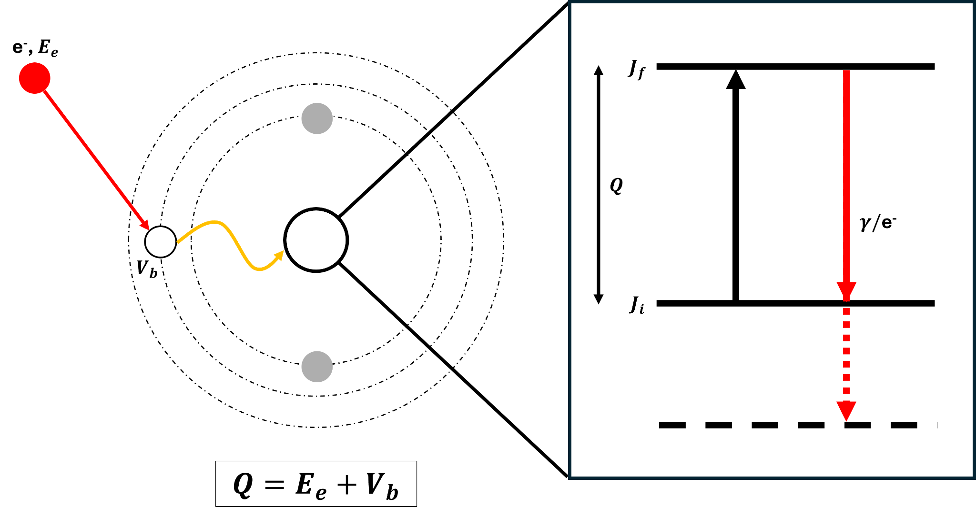
Nuclear Excitation by Electron Capture (NEEC)
1

Slide 3
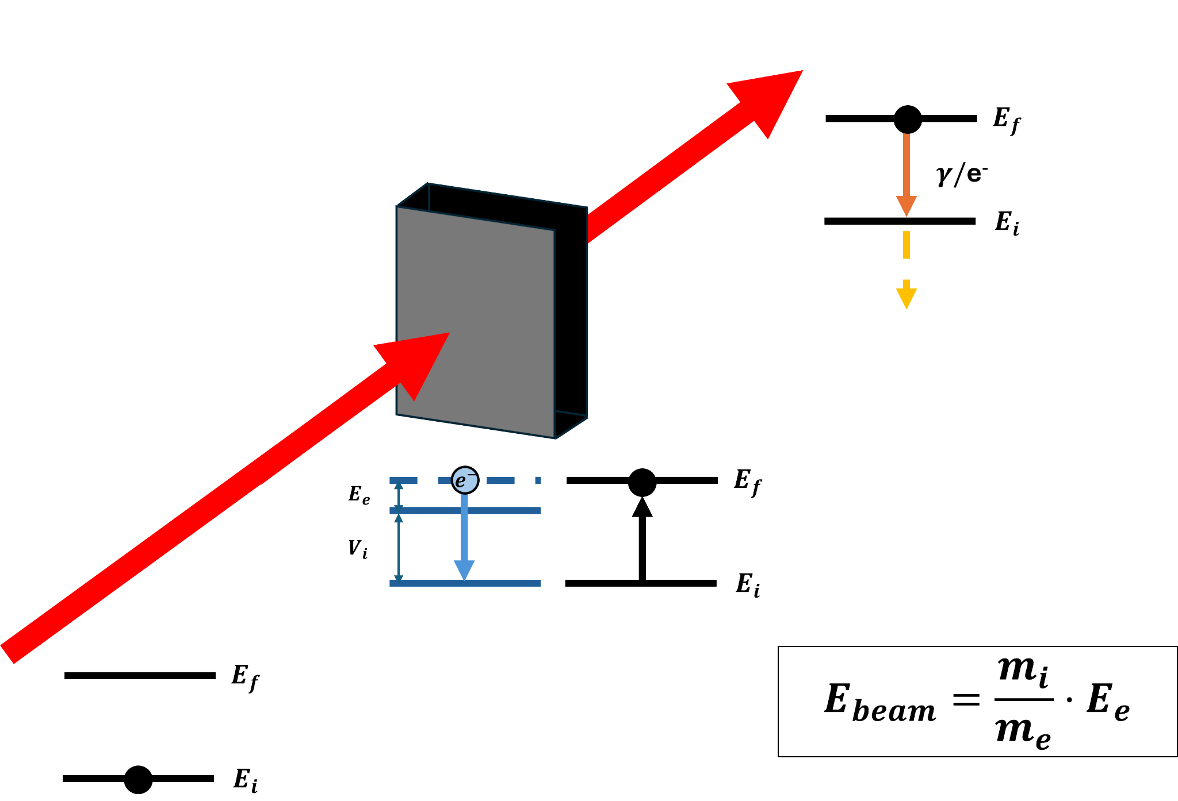
NEEC in Ion-Beams
A beam of ion with mass 𝑚_{i} and energy E_{beam} is incident upon a target.
A target electron is captured into an incident ion’s atomic orbital, inducing NEEC.
The excited state will then decay via either internal conversion or 𝜸 decay.
2

Slide 4
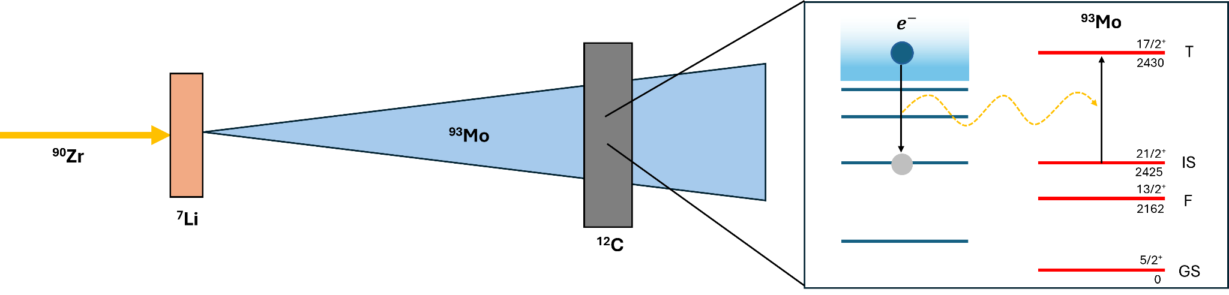
Previous Reported Observation
Previous Observation [1]:
NEEC claimed using secondary beam of ⁹³Mo
Reported probability: P_{exc} = 0.01 per ion
Subsequent Theoretical Predictions [2]:
P_{exc} ≲ 10⁻¹¹
A 9-order of magnitude discrepancy
[1] Chiara. C.J., Nature (2018)
[2] Wu. Y, Keitel. C, Palffy. A, Physical Review Letters (2019)
3

Slide 5
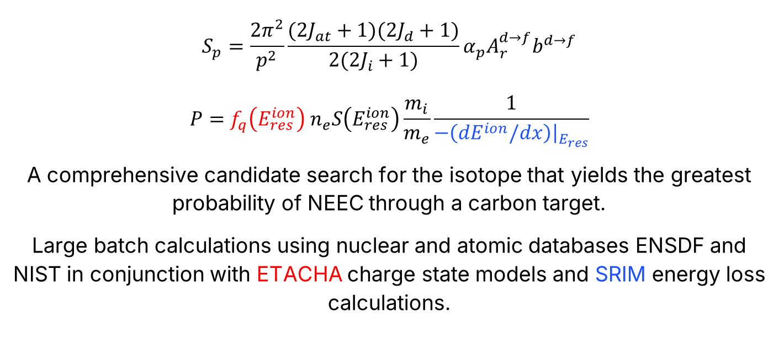
NEEC Candidate Searching
$$S_{p}=\frac{2π^{2}}{p^{2}}\frac{(2J_{at}+1)(2J_{d}+1)}{2(2J_{i}+1)}α_{p}A_{r}^{d→f}b^{d→f}$$
$$P=f_{q}{\left(E_{res}^{ion}\right)}_{ }n_{e}S\left(E_{res}^{ion}\right)\frac{m_{i}}{m_{e}}\frac{1}{−\left(dE^{ion}/dx\right){\left.​\right|}_{E_{res}}}$$
A comprehensive candidate search for the isotope that yields the greatest probability of NEEC through a carbon target.
Large batch calculations using nuclear and atomic databases ENSDF and NIST in conjunction with ETACHA charge state models and SRIM energy loss calculations.
4

Slide 6
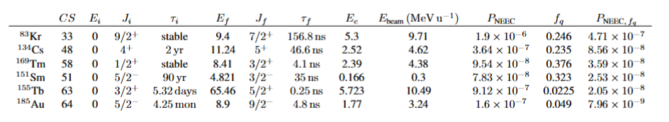
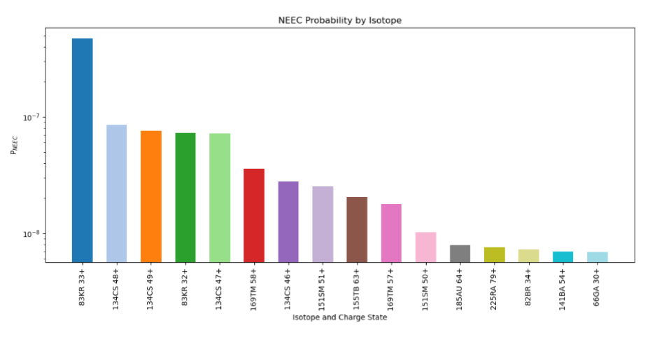
NEEC Candidate Searching
5

Slide 7
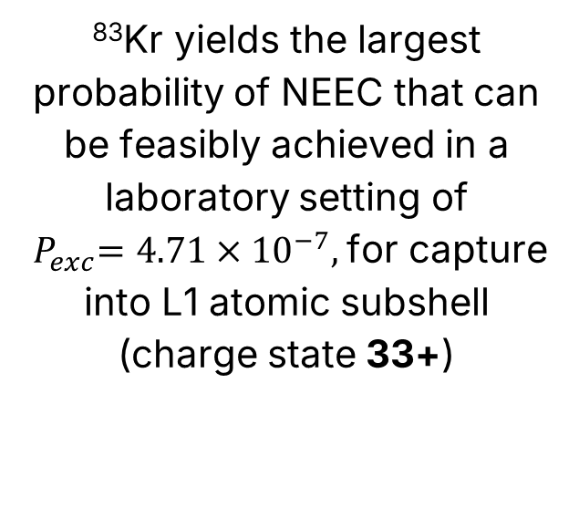




NEEC in ⁸³Kr
$$e^{−}$$
⁸³Kr
$τ=156.8$ ns
7/2⁺
⁸³Kr yields the largest probability of NEEC that can be feasibly achieved in a laboratory setting of ${ P}_{exc}=4.71×{10}^{−7},$ for capture into L1 atomic subshell (charge state 33+)
$E_{e}=5.3$ keV
9.41
N
$V_{i}=4.11$ keV
M
L
9/2⁺
0
K
6

Slide 8
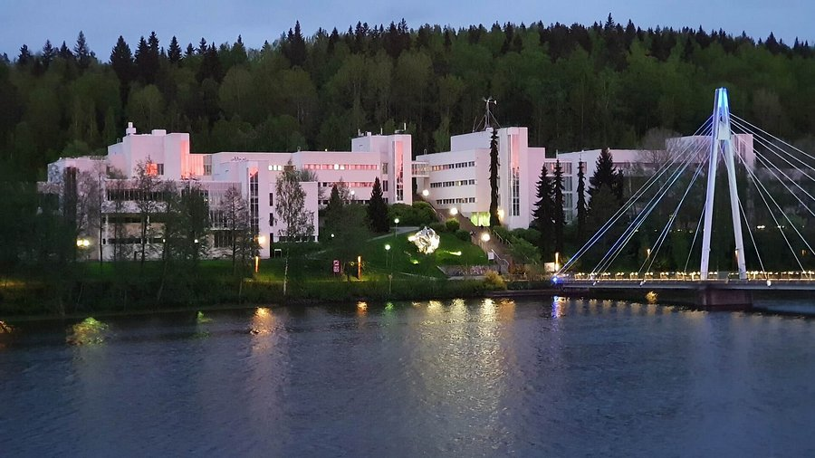
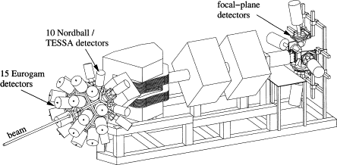
Jyväskylä Accelerator Laboratory
7

Slide 9
The Setup
33⁺
32⁺
RITU
Magnetic Dipole
¹²C
0.15 mg/cm²
⁸³Kr
9.75 MeV/u
8

Slide 10
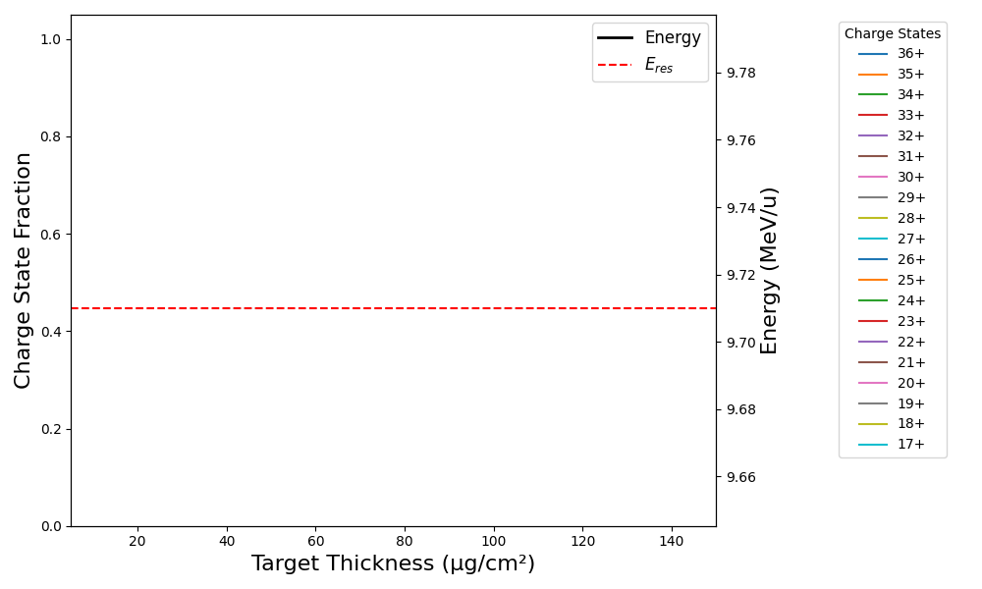
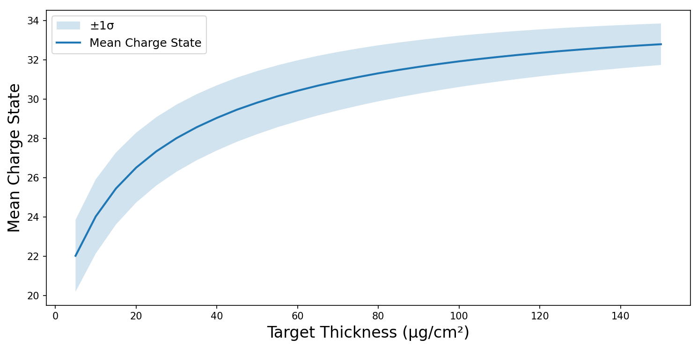
The Setup
33⁺
32⁺
RITU
¹²C
0.15 mg/cm²
⁸³Kr
9.75 MeV/u
9

Slide 11
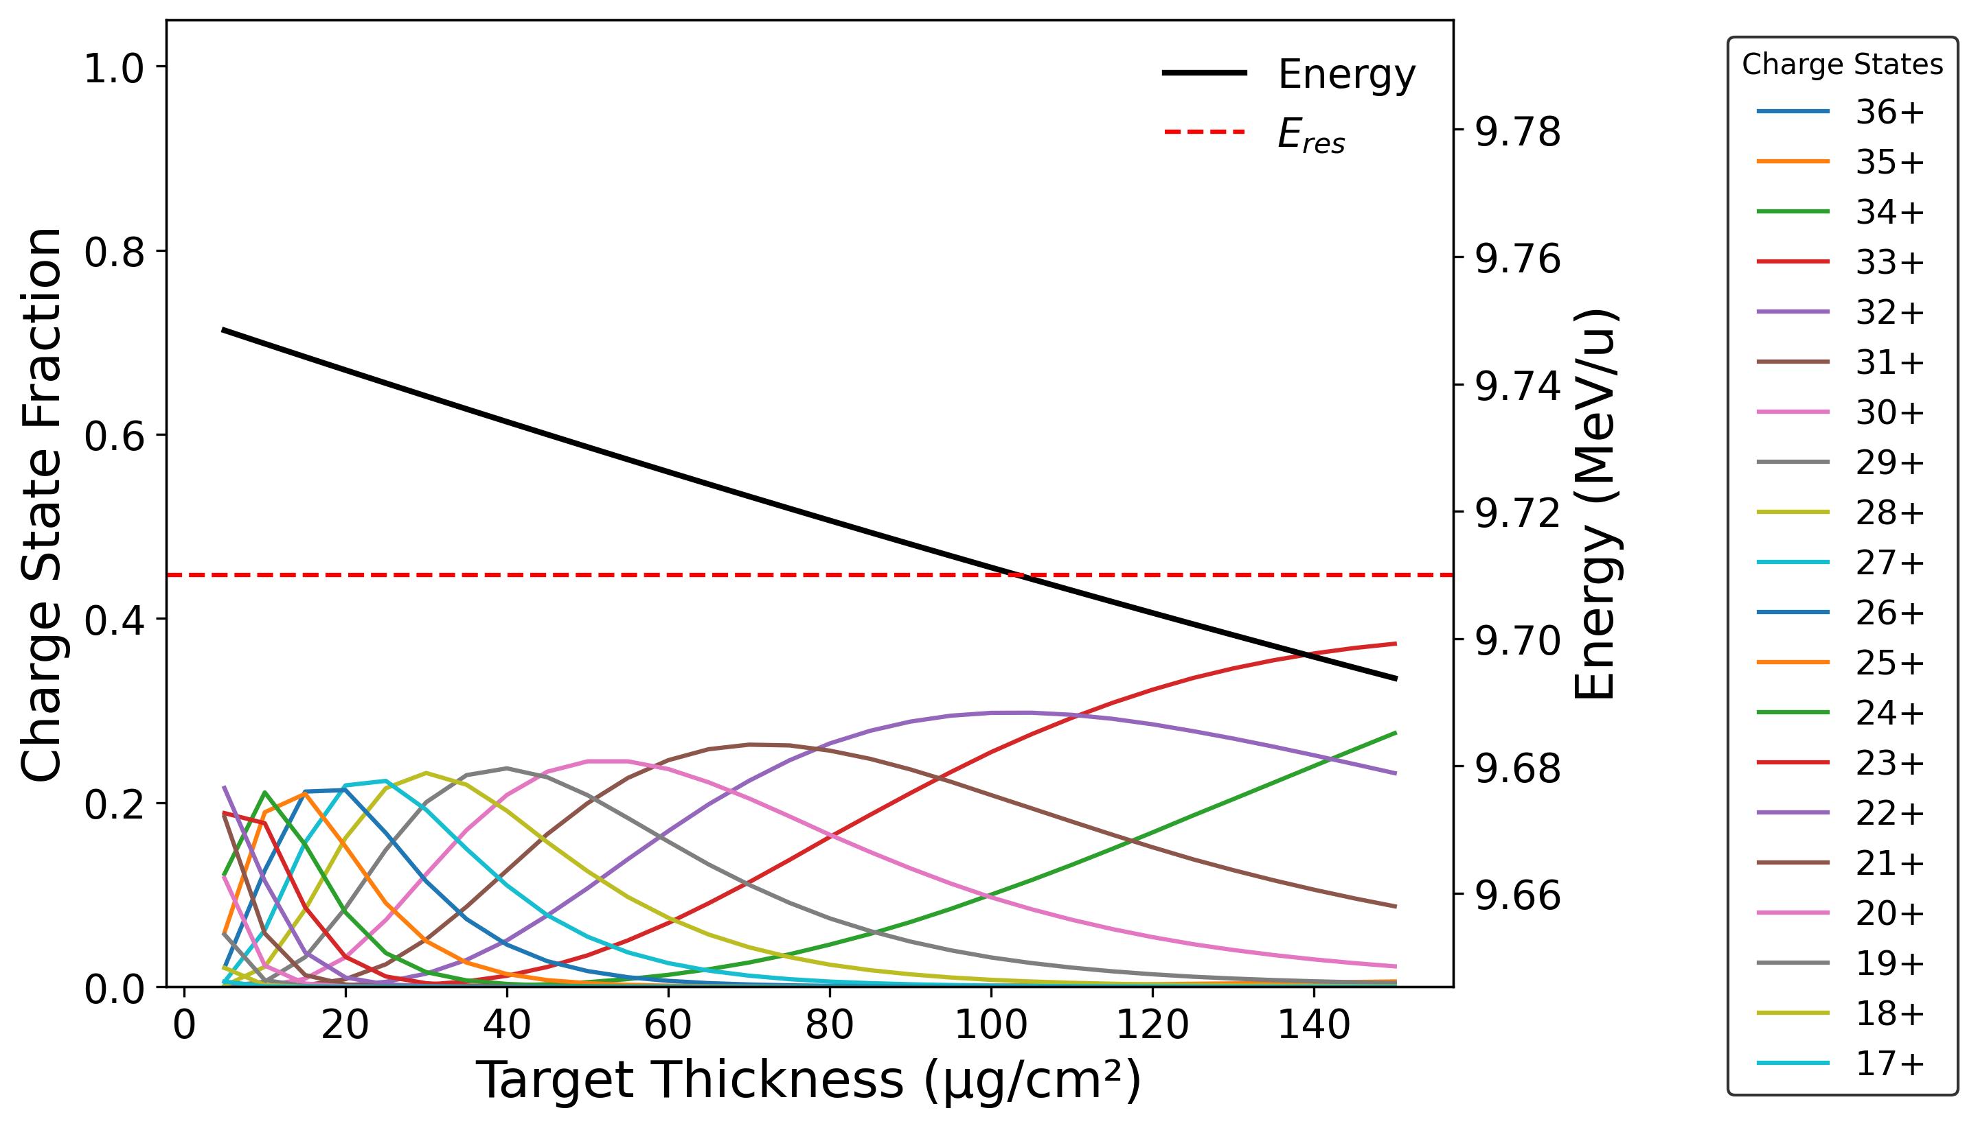
The Setup
33⁺
32⁺
RITU
¹²C
0.15 mg/cm²
⁸³Kr
9.75 MeV/u
10

Slide 12
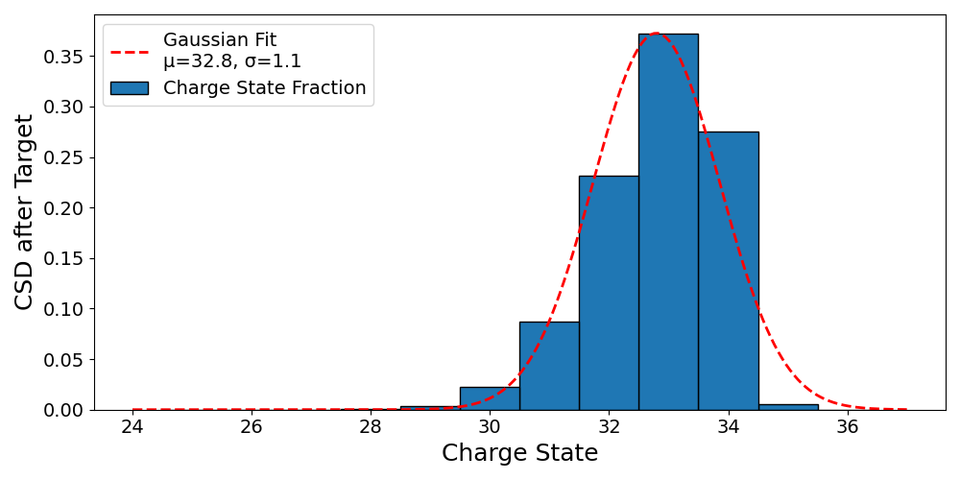
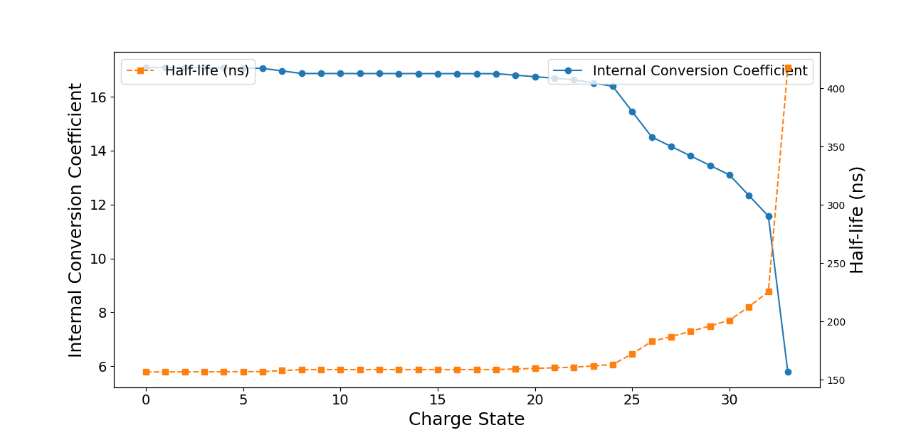
The Setup
33⁺
32⁺
RITU
¹²C
0.15 mg/cm²
⁸³Kr
9.75 MeV/u
11

Slide 13
The Setup
32⁺
33⁺
32⁺
RITU
¹²C
0.15 mg/cm²
⁸³Kr
9.75 MeV/u
12

Slide 14

The Setup
32⁺
33⁺
e⁻
32⁺
32⁺$→$33⁺
RITU
¹²C
0.15 mg/cm²
⁸³Kr
9.75 MeV/u
13

Slide 15
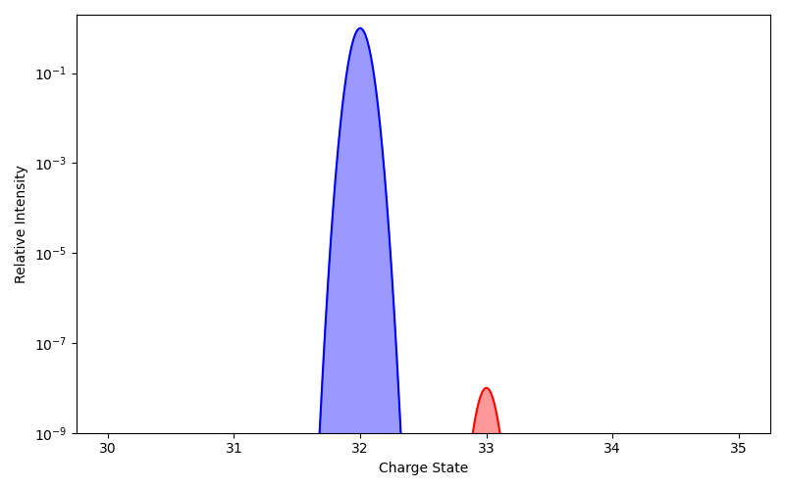
The Setup
32⁺
33⁺
e⁻
32⁺
32⁺$→$33⁺
RITU
¹²C
0.15 mg/cm²
⁸³Kr
9.75 MeV/u
14

Slide 16
Reducing Background
Primary nuclear excitation mechanism for an ion beam incident upon a target is Coulomb excitation
Coulomb excitation has an angular dependence, so restricting apertures along the beamline will reduce significantly background nuclear excitation mechanisms
Coulomb Excitation
No Excitation/NEEC
15

Slide 17
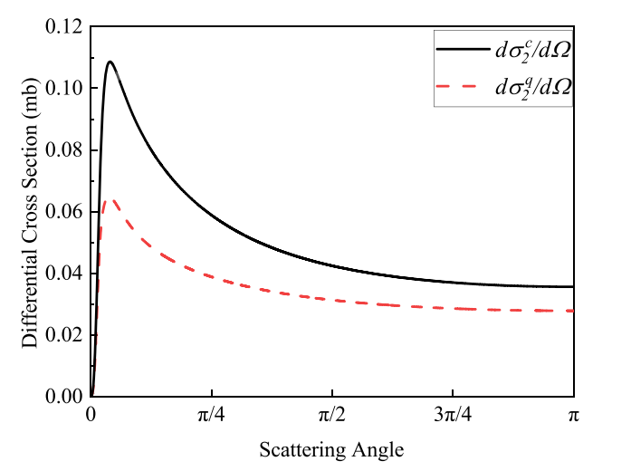
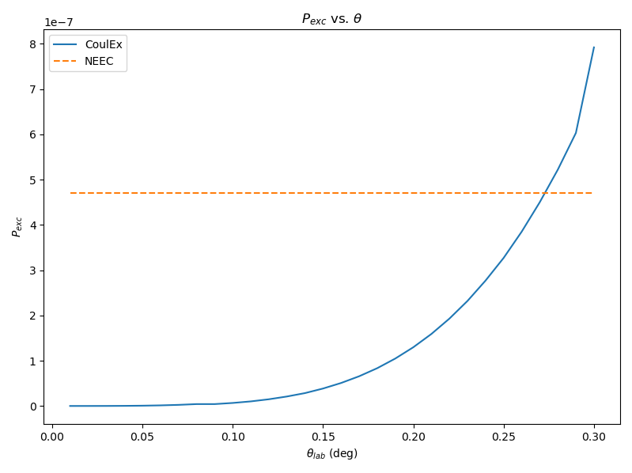

Reducing Background
Restricting apertures to prevent the detection of nuclei scattered greater than 0.25$∘$ ensures NEEC is the primary nuclear excitation mechanism, and population of higher charge states at RITU can be attributed to NEEC easily.
Li. Z, Li. T, Wang. X, Phys. Rev. C (2024)
16

Slide 18
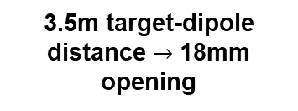
The Setup
32⁺
33⁺
e⁻
32⁺
32⁺$→$33⁺
RITU
3.5m target-dipole distance $→$ 18mm opening
¹²C
0.15 mg/cm²
⁸³Kr
9.75 MeV/u
17

Slide 19
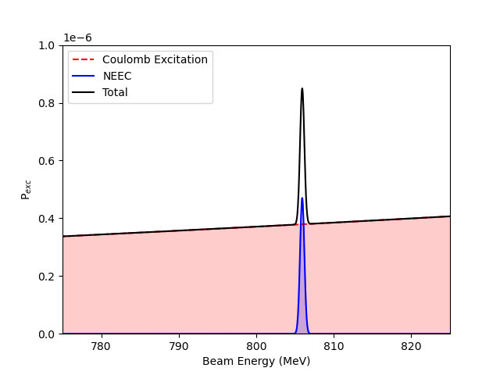
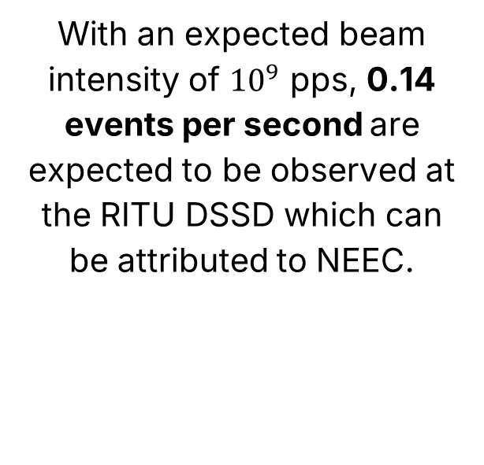
Statistics
With an expected beam intensity of ${10}^{9}$ pps, 0.14 events per second are expected to be observed at the RITU DSSD which can be attributed to NEEC.
18

Slide 20
Conclusion
NEEC remains unconfirmed with major theoretical discrepancy
Proposed is a novel approach to observing nuclear excitation by electron capture, using an ion with a significant NEEC probability, with background suppressed via angular selection
19

Slide 21
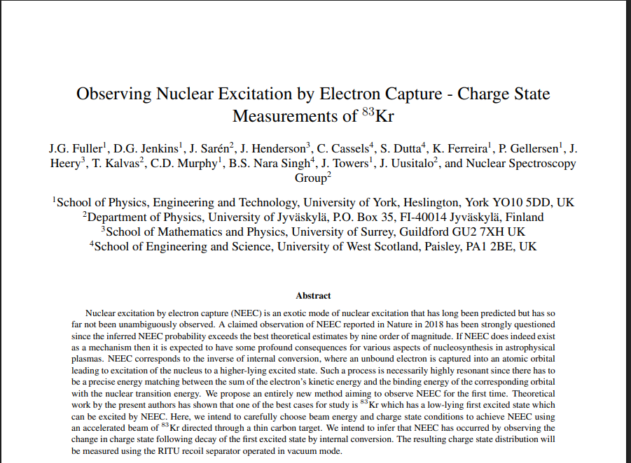
The Proposal
5 days of beam time approved at JYFL, expected to take place in the coming year.
20

Slide 22
Acknowledgements
University of York
D.G. Jenkins, C.D. Murphy, J. Towers, K. Ferreira, P. Gellersen
University of Surrey
J. Henderson, J. Heery
University of Jyväskylä
J. Sarén, J. Uusitalo, T. Kalvas
University of West Scotland
B.S. Nara Singh, C. Cassels, S. Dutta
21

