Slide 1
First Cross-Section Measurements of the ⁹³Sr(α,xn) Reactions: Implications for the Weak r-Process
Claire Jameson

Slide 2


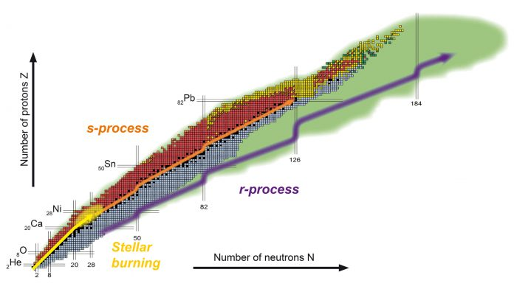
Heavy Element Nucleosynthesis
Beyond iron: neutron induced reactions become important.
r-process: near neutron dripline – rapid.
r-process is less well understood, the search for r-process sites is ongoing.
F.-K. Thielemann, 2023.

Slide 3
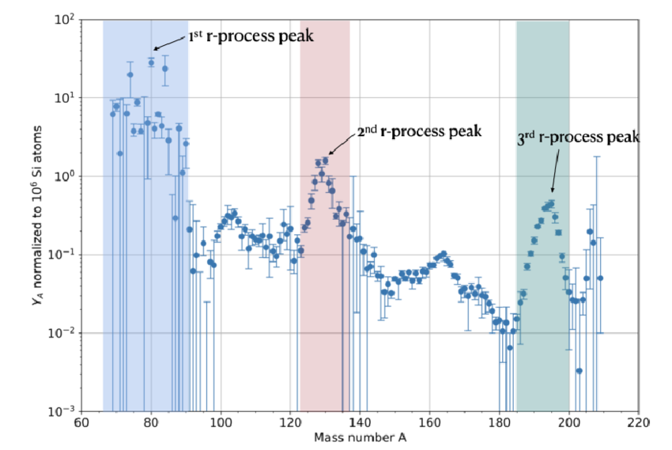
r-Process Abundances
r-process abundances are calculated by subtracting s-process abundances from solar abundances.
Peaks occur due to accumulation near closed neutron shells.
S. NIKAS et al.,2022.

Slide 4
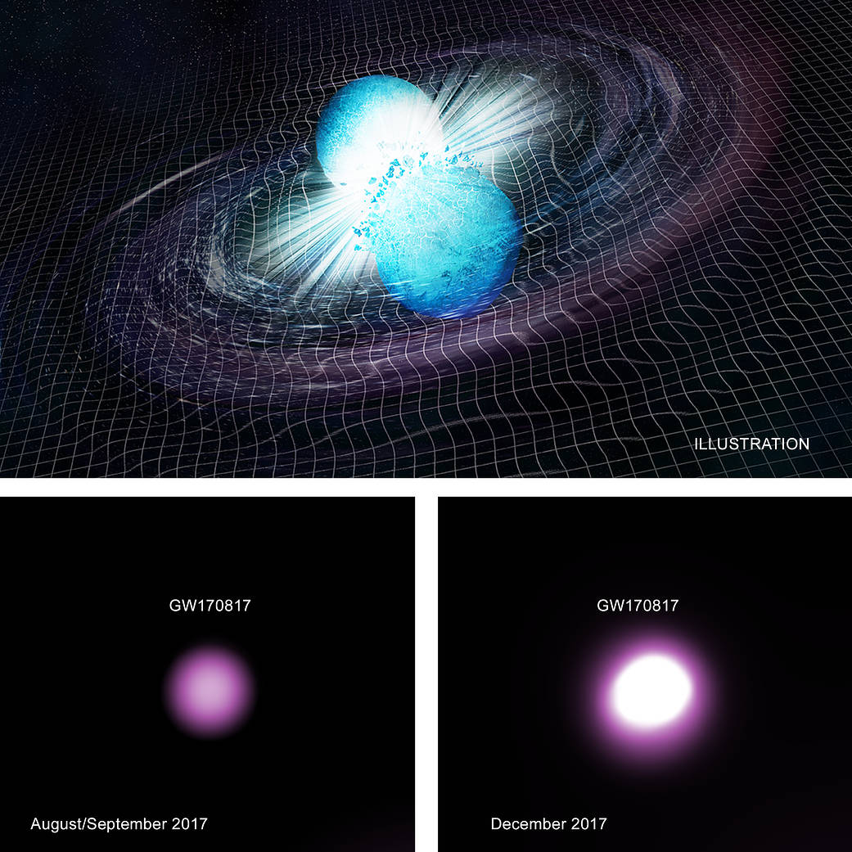
r-Process Sites
GW170817 confirmed that neutron star mergers are an r-process site.
Simulations of neutron star mergers as the only r-process site do not match observations.
An additional process may be contributing to the production of the lighter heavy elements –
the weak r-process.
CXC/M. Weiss; X-ray: NASA/CXC/Trinity University/D. Pooley et al.

Slide 5
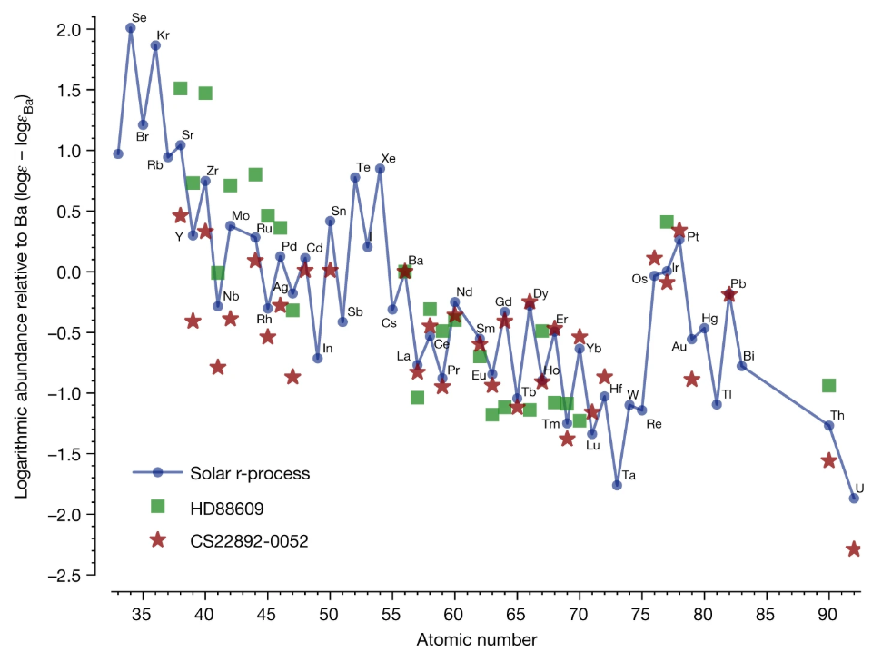
Weak r-Process Abundances
Ultra-metal poor (UMP) stars show enhancement around the first r-process peak.
Formed before s-process could play a key role so expected to reproduce r-process abundances.
D. Watson et al., 2019

Slide 6
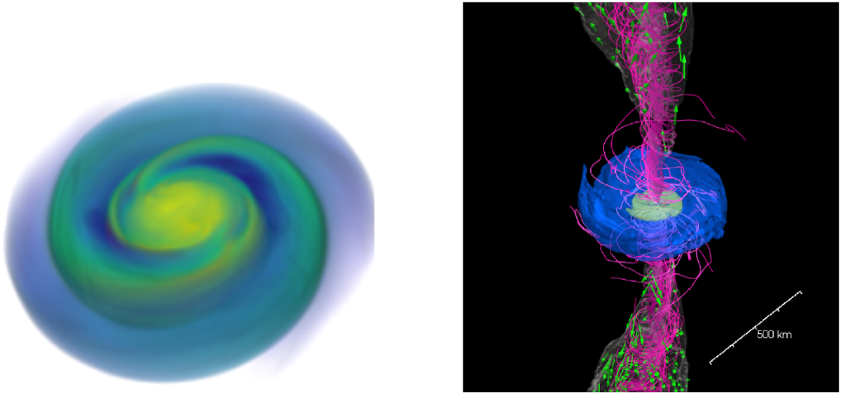
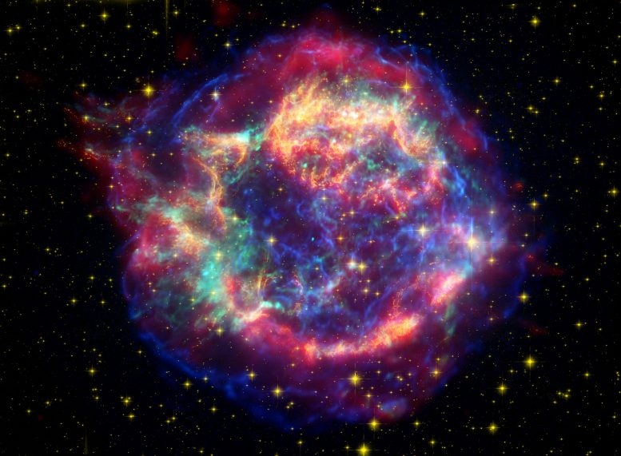
Weak r-Process Sites?
Foucart, F., 2023
Neutrino-driven winds around neutron star mergers and core-collapse supernovae are likely candidates.
NASA/JPL-Caltech/ O. Krause (Steward Observatory)

Slide 7
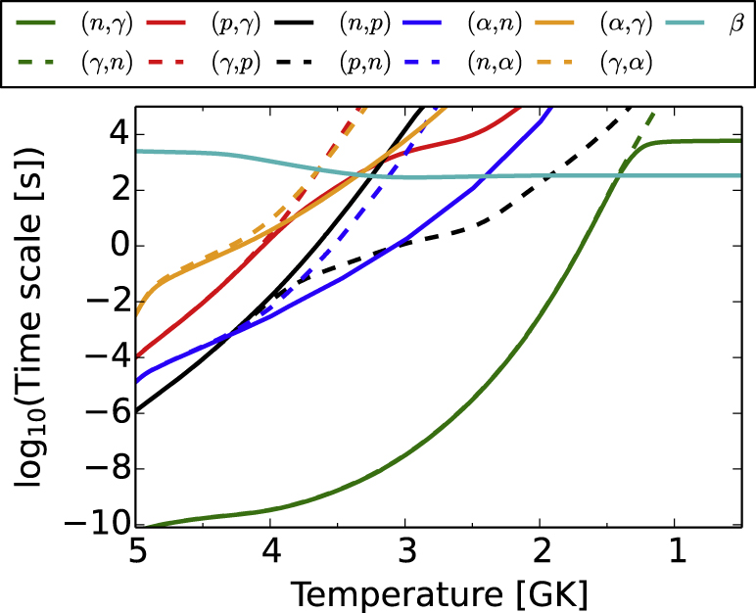
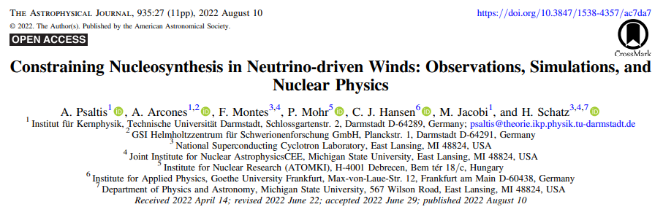
Impact of ⁹³Sr(α,xn)
(α,n) reactions are key to the weak r-process
Varying ⁹³Sr(α,xn) by a factor of 3 changes the final abundances of weak r-process tracers (Rb, Mo, Ru, Pd) by a factor of up to 5.
J. BlISS et al., 2017.

Slide 8
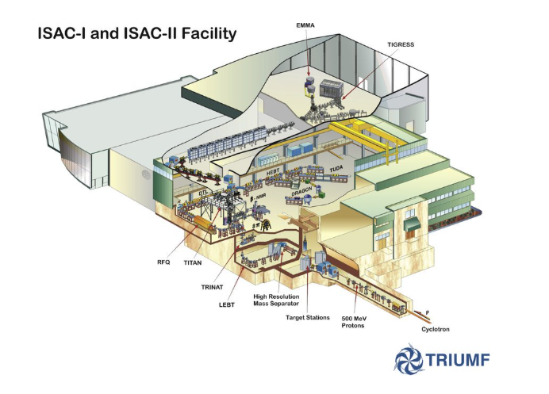
TRIUMF
Beam: ⁹³Sr at 279MeV
Target: ⁴He
Aim: to measure the reaction cross section.
G. Ball et al., 2016.

Slide 9
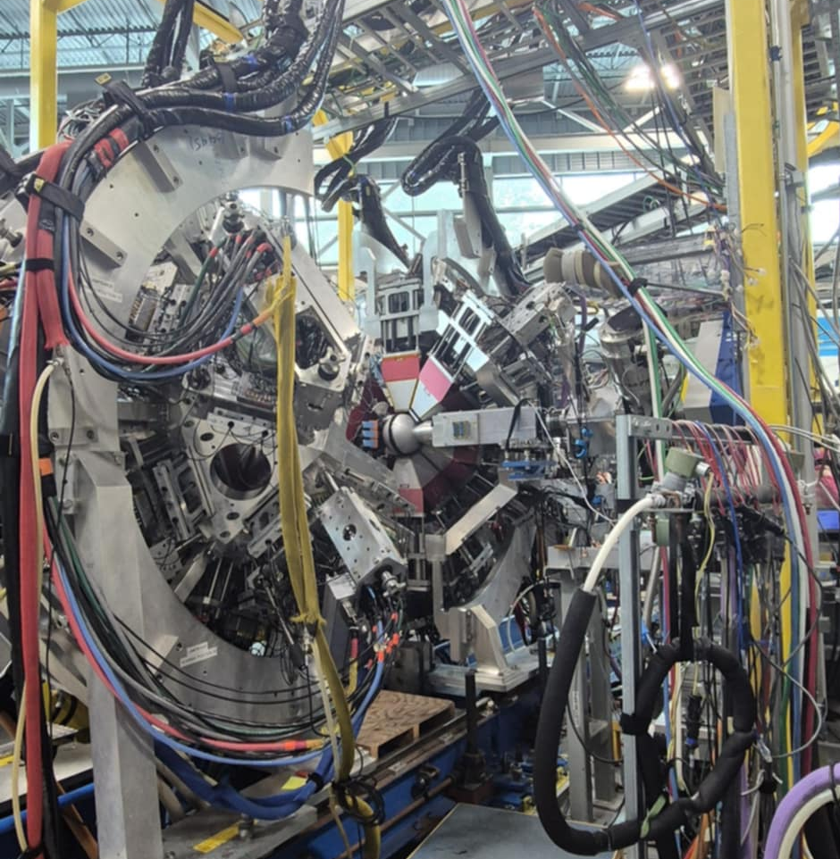
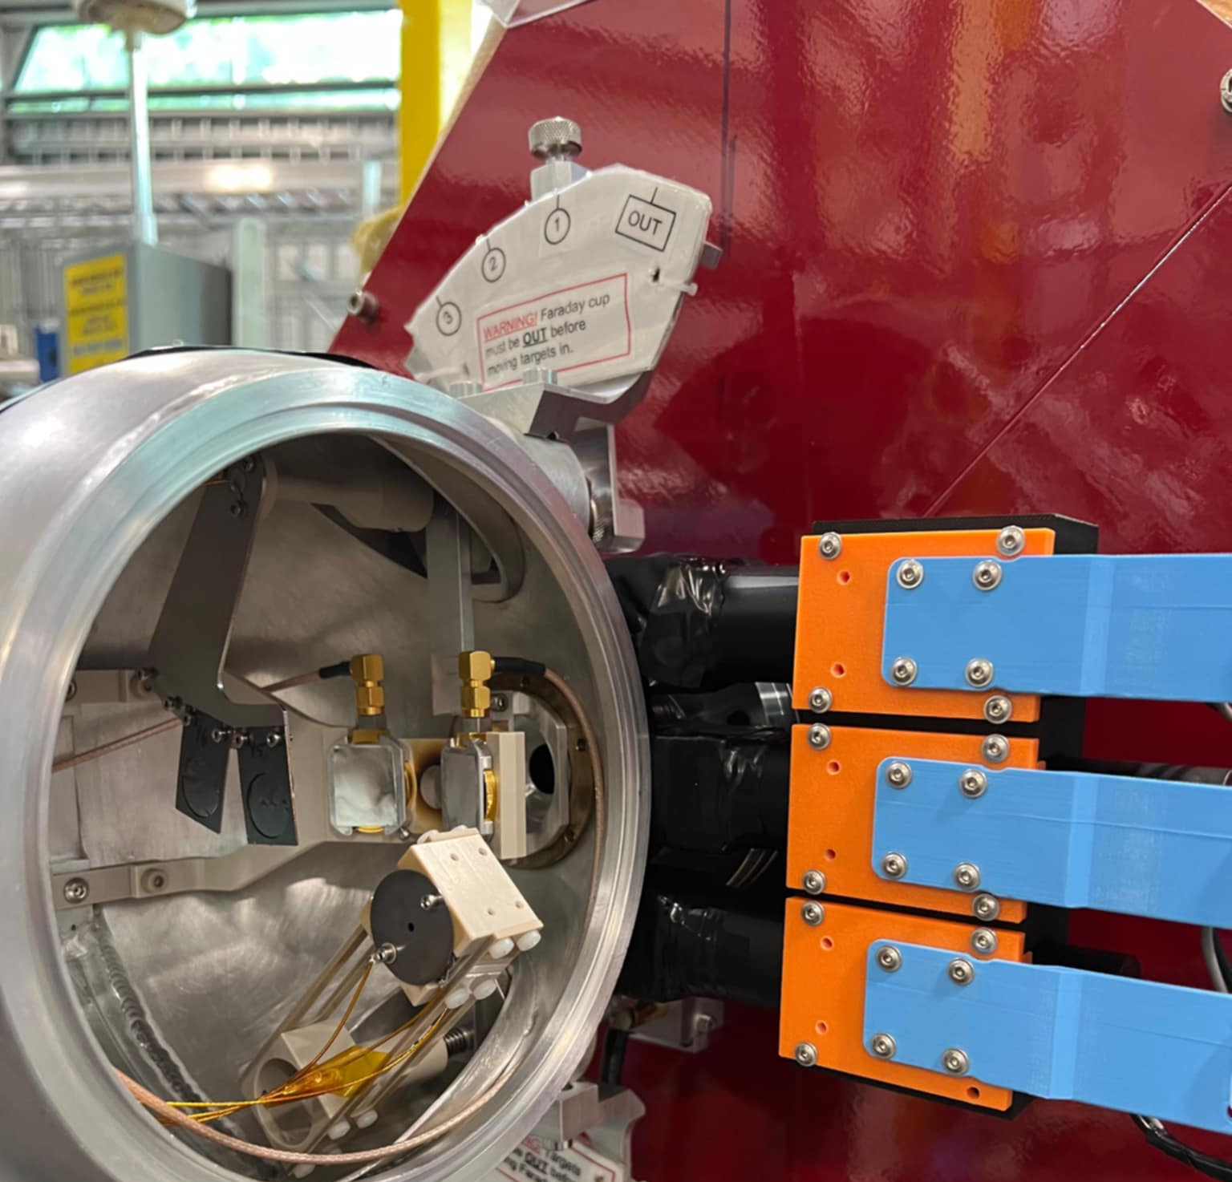
TIGRESS and DEMAND

Slide 10
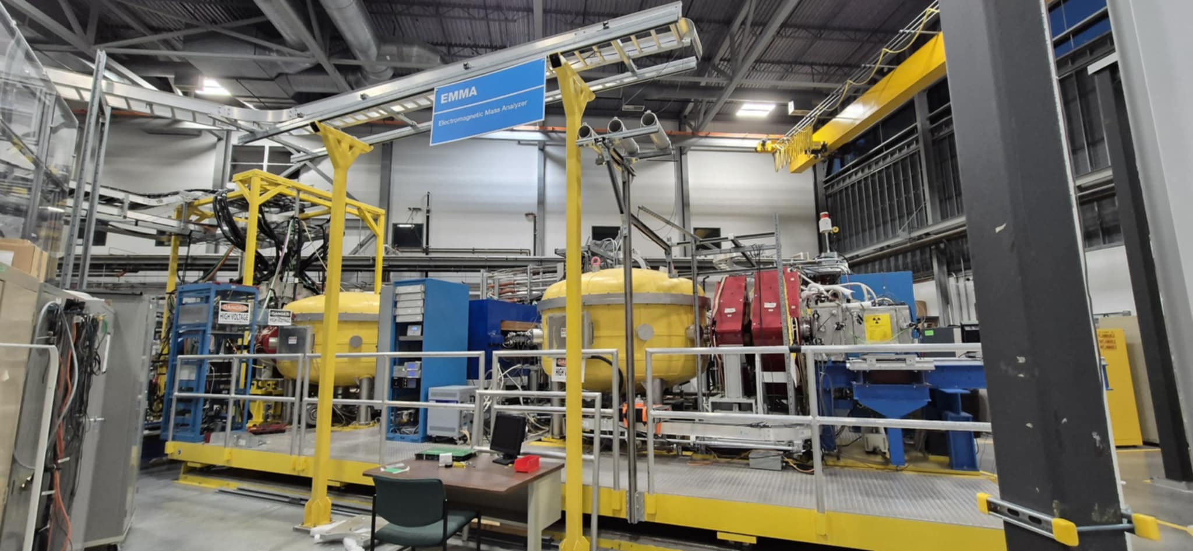
EMMA

Slide 11
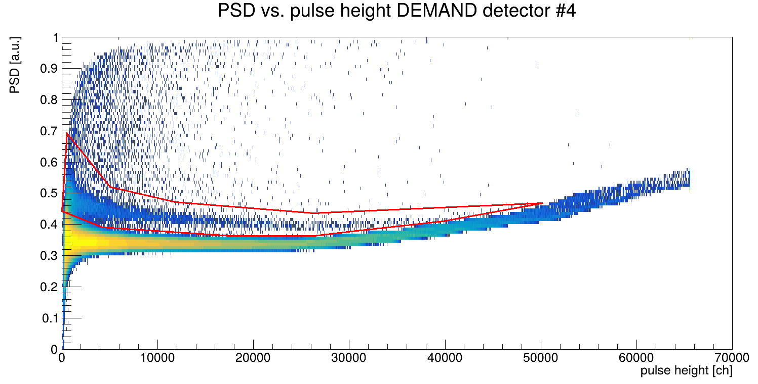
Pulse Shape Discrimination (PSD)
Gating on neutrons allows for easier gating on other histograms.

Slide 12
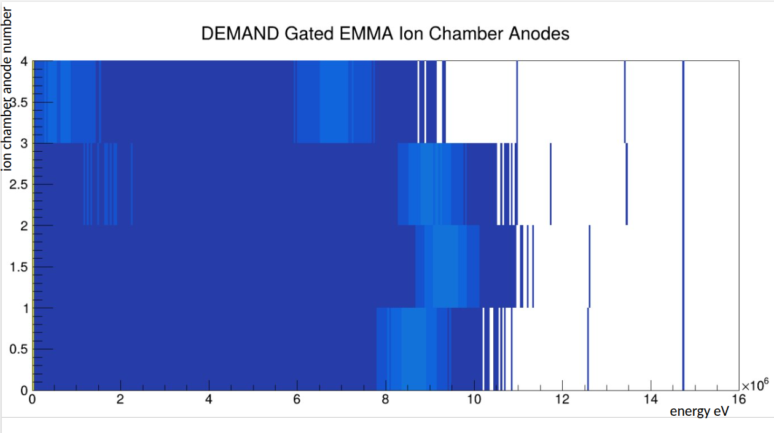
Ionisation Chamber Gating
Selection of ⁹⁶Zr recoils.

Slide 13
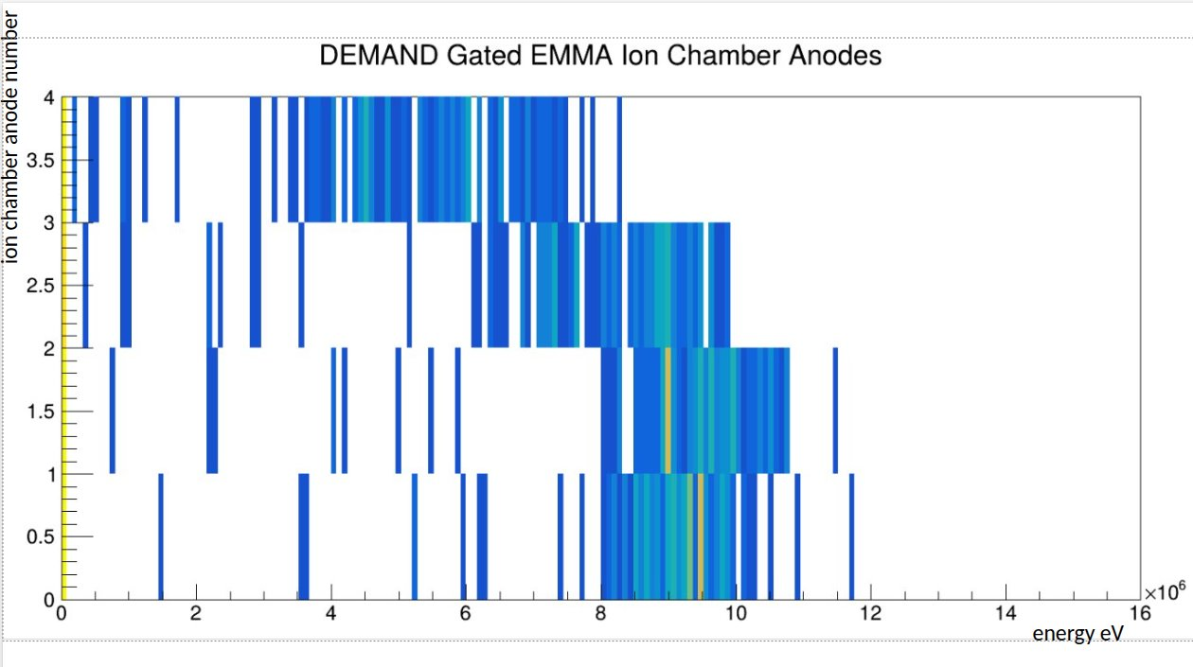
Ionisation Chamber Gating
Selection of ⁹⁶Zr recoils.

Slide 14
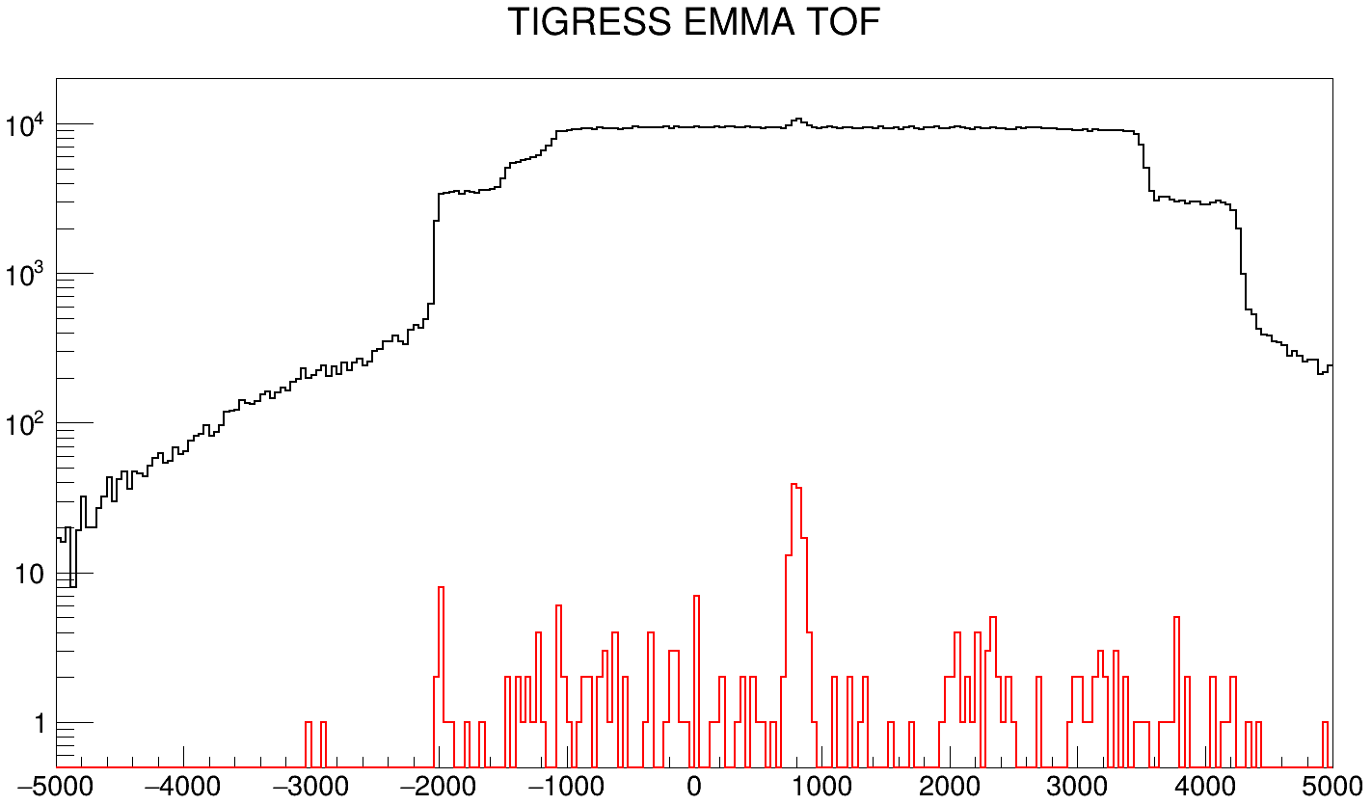
Time of Flight (TOF) Peaks
DEMAND/EMMA
TIGRESS/EMMA

Slide 15
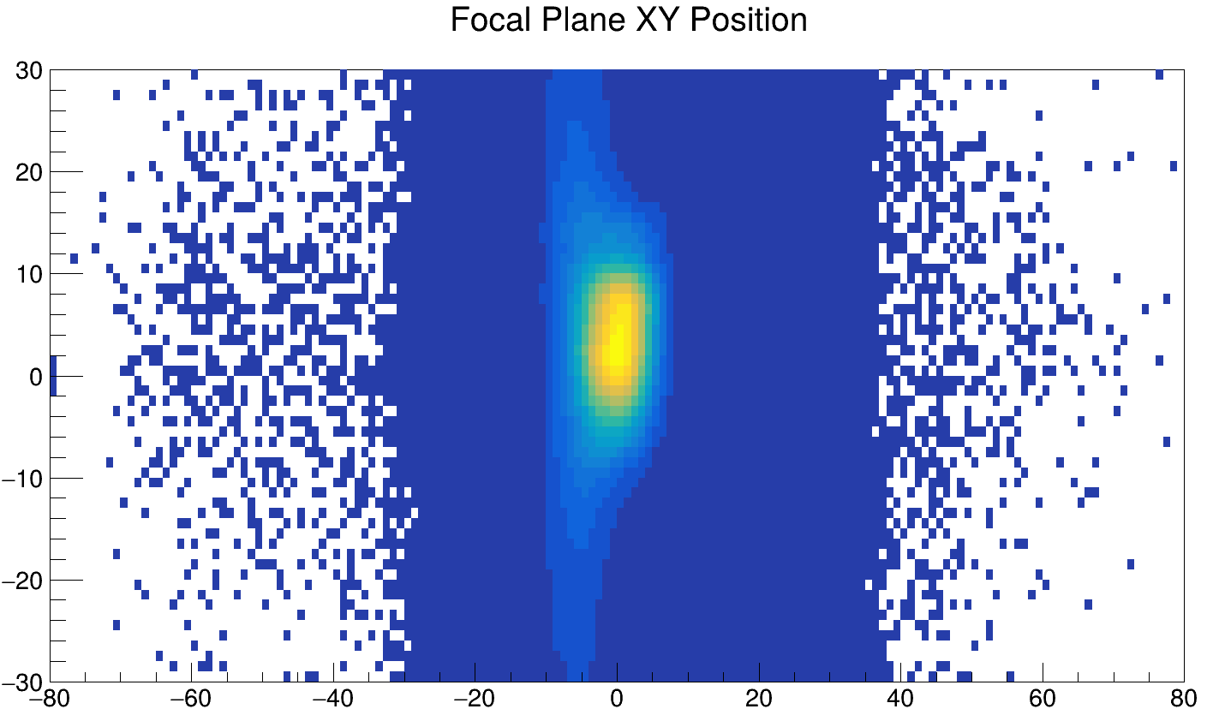
EMMA PGAC Position

Slide 16
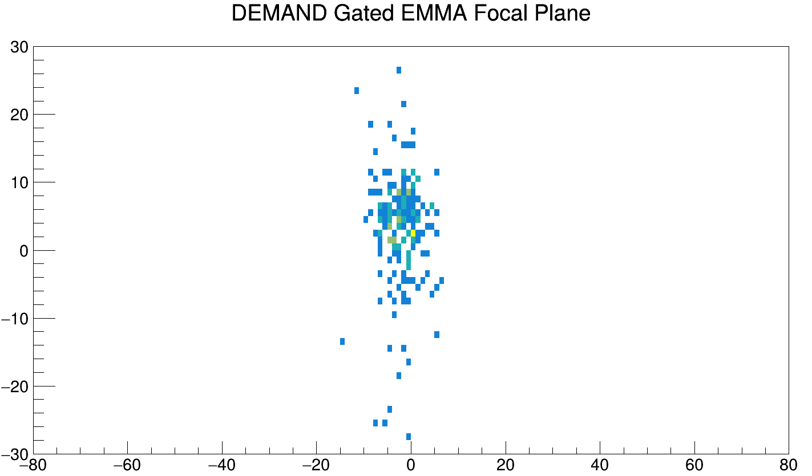
EMMA PGAC Position

Slide 17
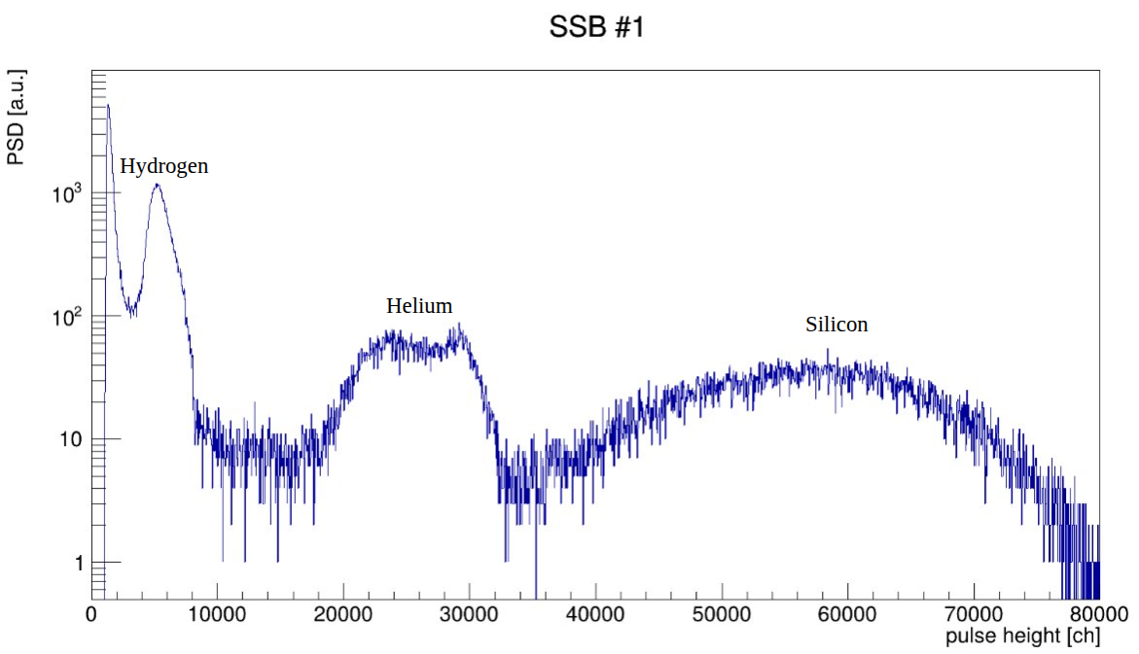
Silicon Surface Barrier Detectors
Measurement of scattered He for beam normalisation.

Slide 18
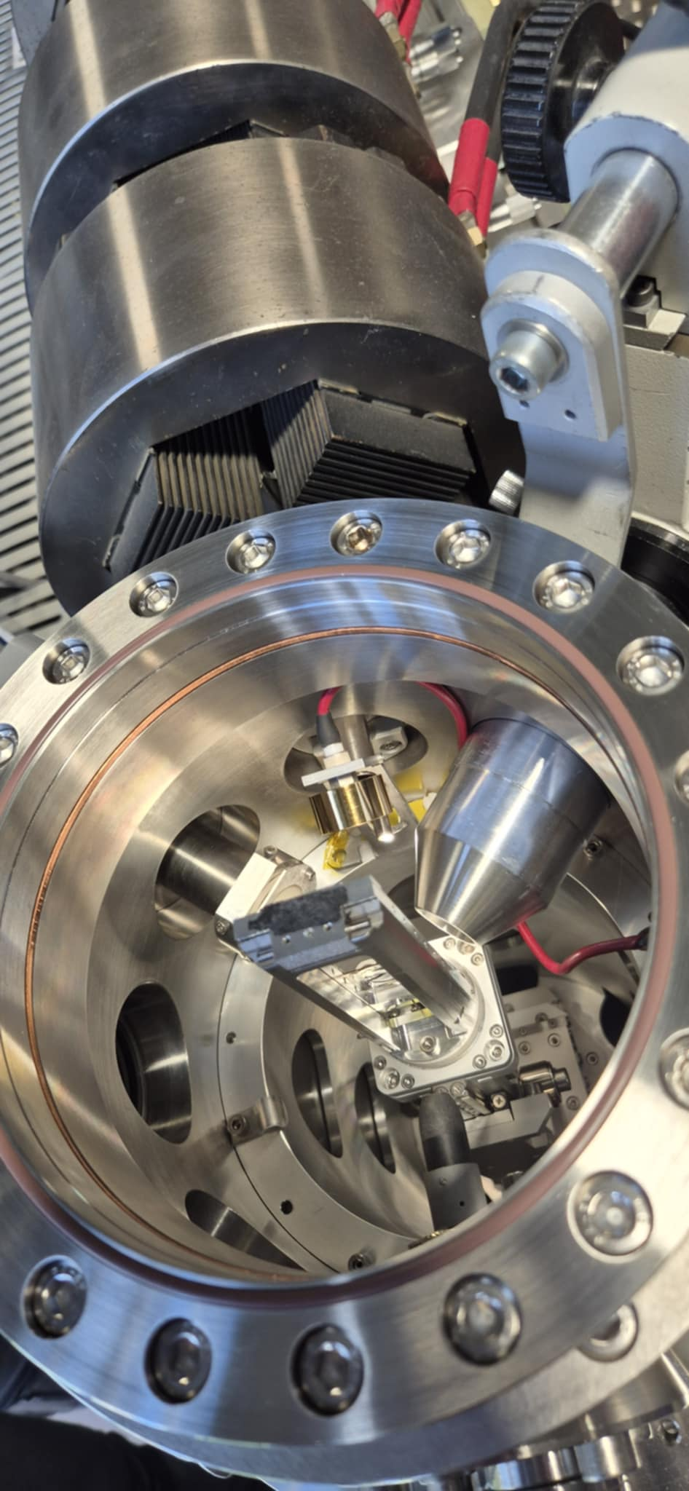
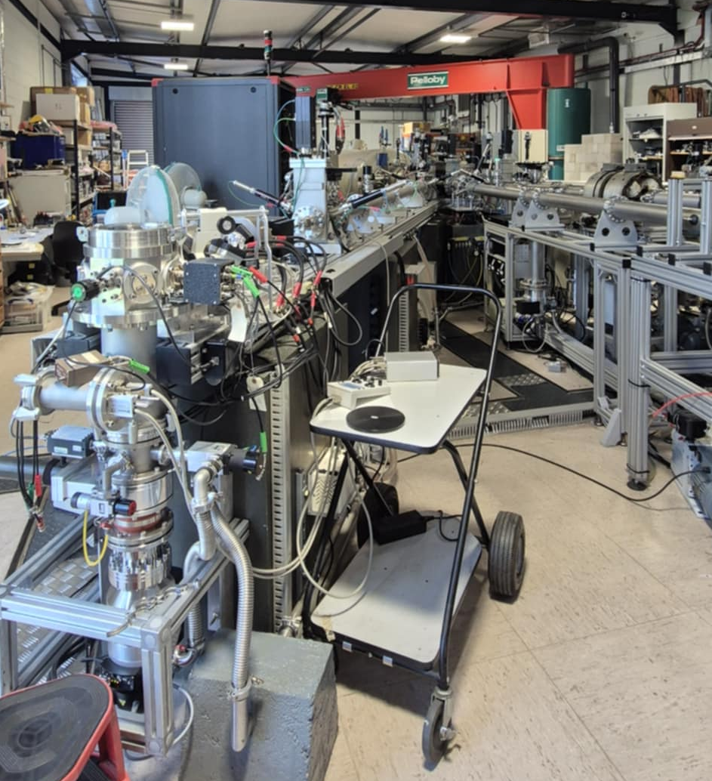
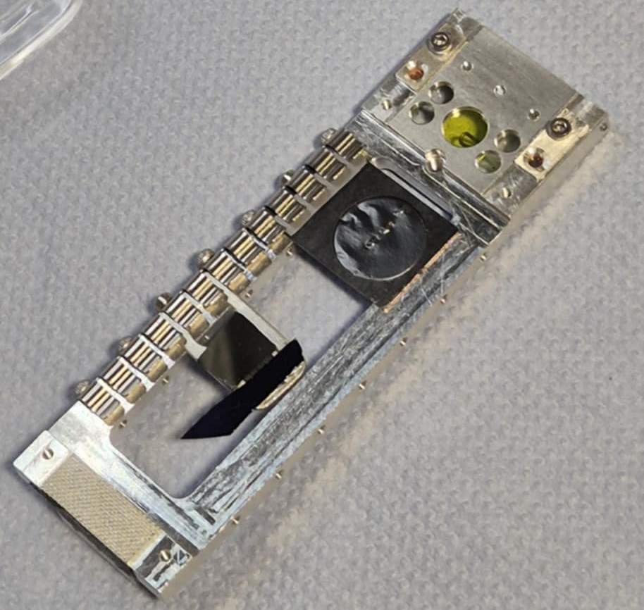
Target Composition Analysis

Slide 19
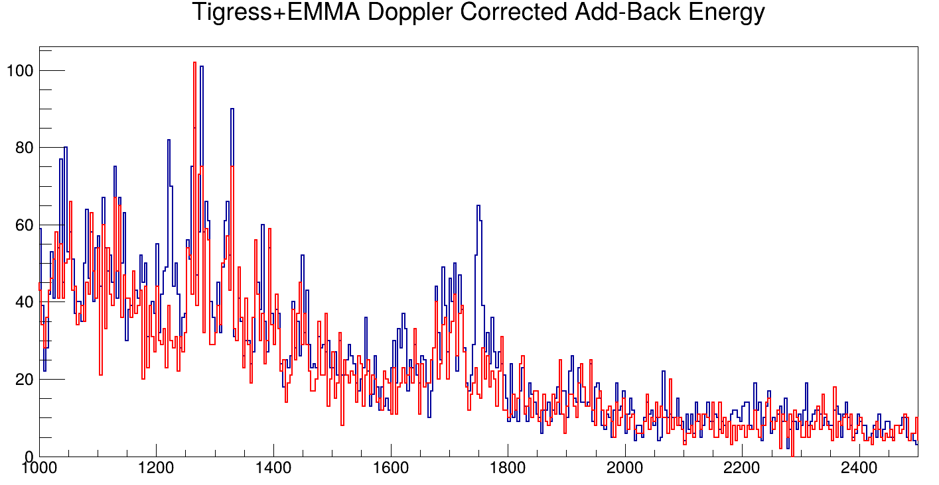
Preliminary Results
Data
  Background
1222.7
1750.42

Slide 20
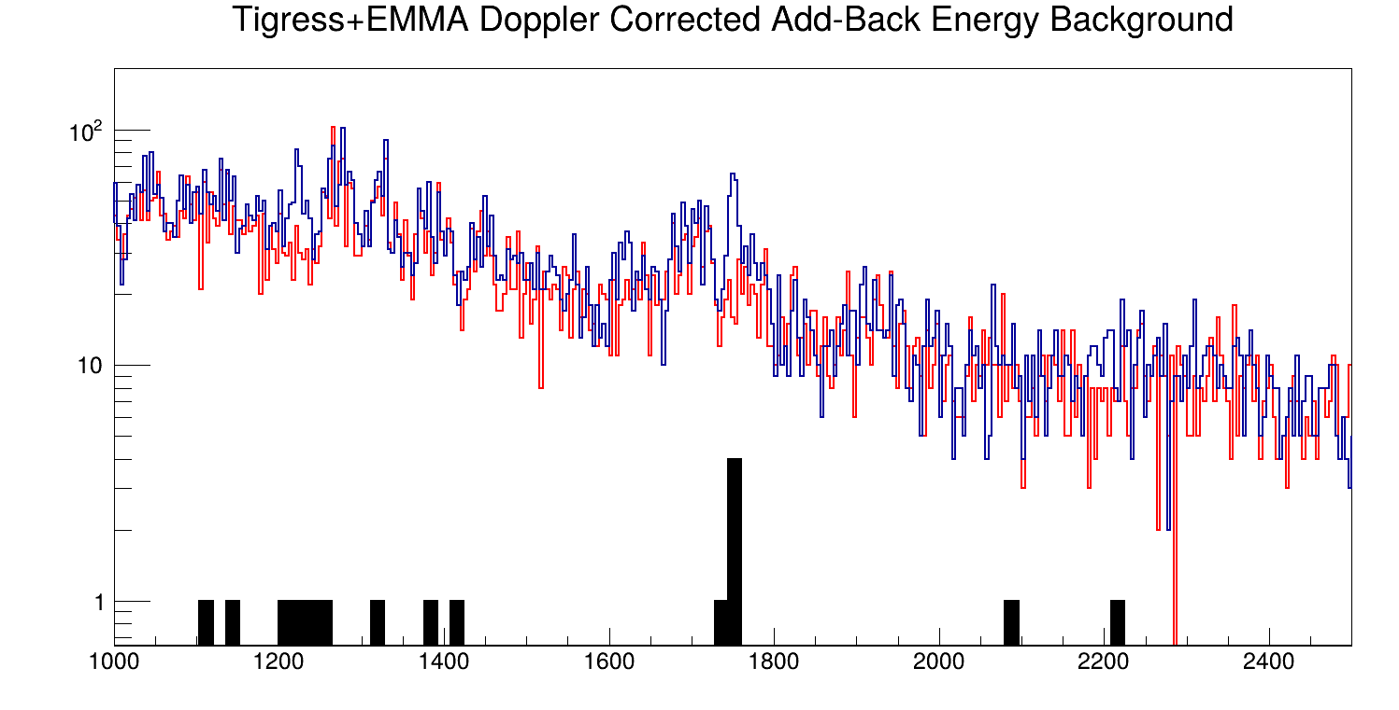
Preliminary Results
Data
  Background
  Triple Coincidences

Slide 21
Summary and Future Work
Preliminary calculations (with efficiency estimates) result in a cross-section which is smaller than the TALYS calculated value by a factor of between 2 and 5.
Efficiency calculations will be calculated and incorporated into the cross-section calculation, and the 2n reaction channel will be analysed.

Slide 22
With thanks to:
Matthew Williams, Gavin Lotay,
and all of my other collaborators
Thank you for listening.

