Slide 1





Probing the ¹⁰B + α pathway for primordial stars at LUNA:
Experimental techniques and preliminary results
Rhys Bonnell
University of Edinburgh

Slide 2
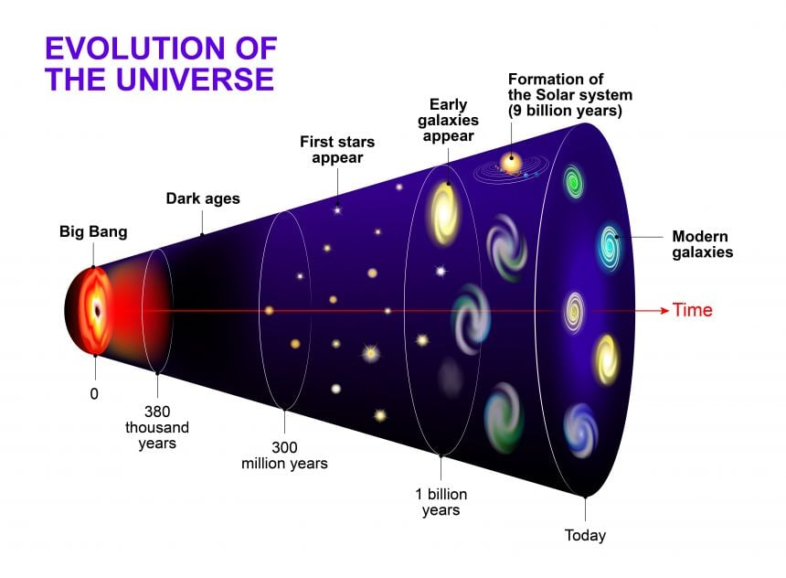
Astrophysical interest for Pop III Stars
Population III (Pop III) stars are composed entirely of primordial gas – hydrogen, helium and very small amounts of lithium and beryllium.
Pop III stars considered to have been massive
Their large mass led to a faster evolution rate
All fuel burned, remnants seen in metallicity of current stars
pp-chain insufficient against core contraction, requires CNO burning to counter contraction
How were the CNO elements produced?
A cosmic timeline of the evolution of our stars, galaxy and Universe after the Big Bang. Image credit: Shutterstock

Slide 3
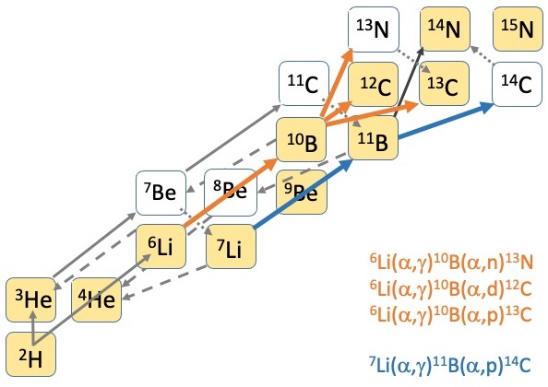
The (potential) early reaction branches
Two interesting branches are α capture on ⁶Li and ⁷Li
One branch can provide the recycle of deuterium fuel ⁶Li(α,γ)¹⁰B(α,d)¹²C
Another branch can provide a possible neutron source ⁶Li(α,γ)¹⁰B(α,n)¹³N
Only beneficial if cluster enhancements present
Cluster enhancements already seen such as the Carbon-12 Hoyle state

Slide 4
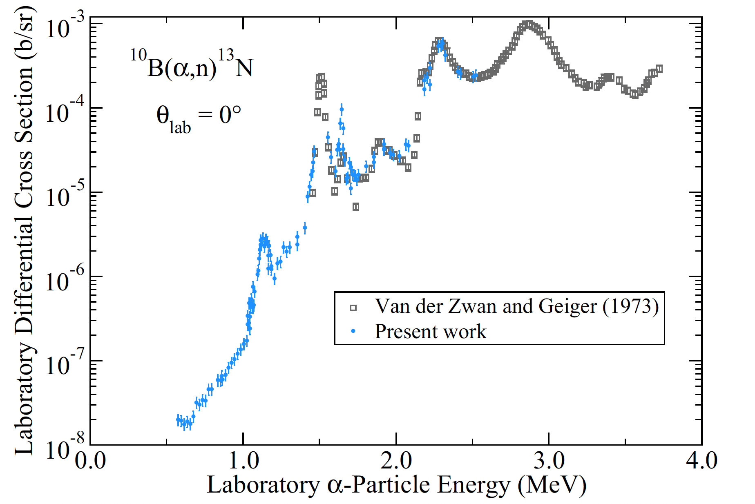
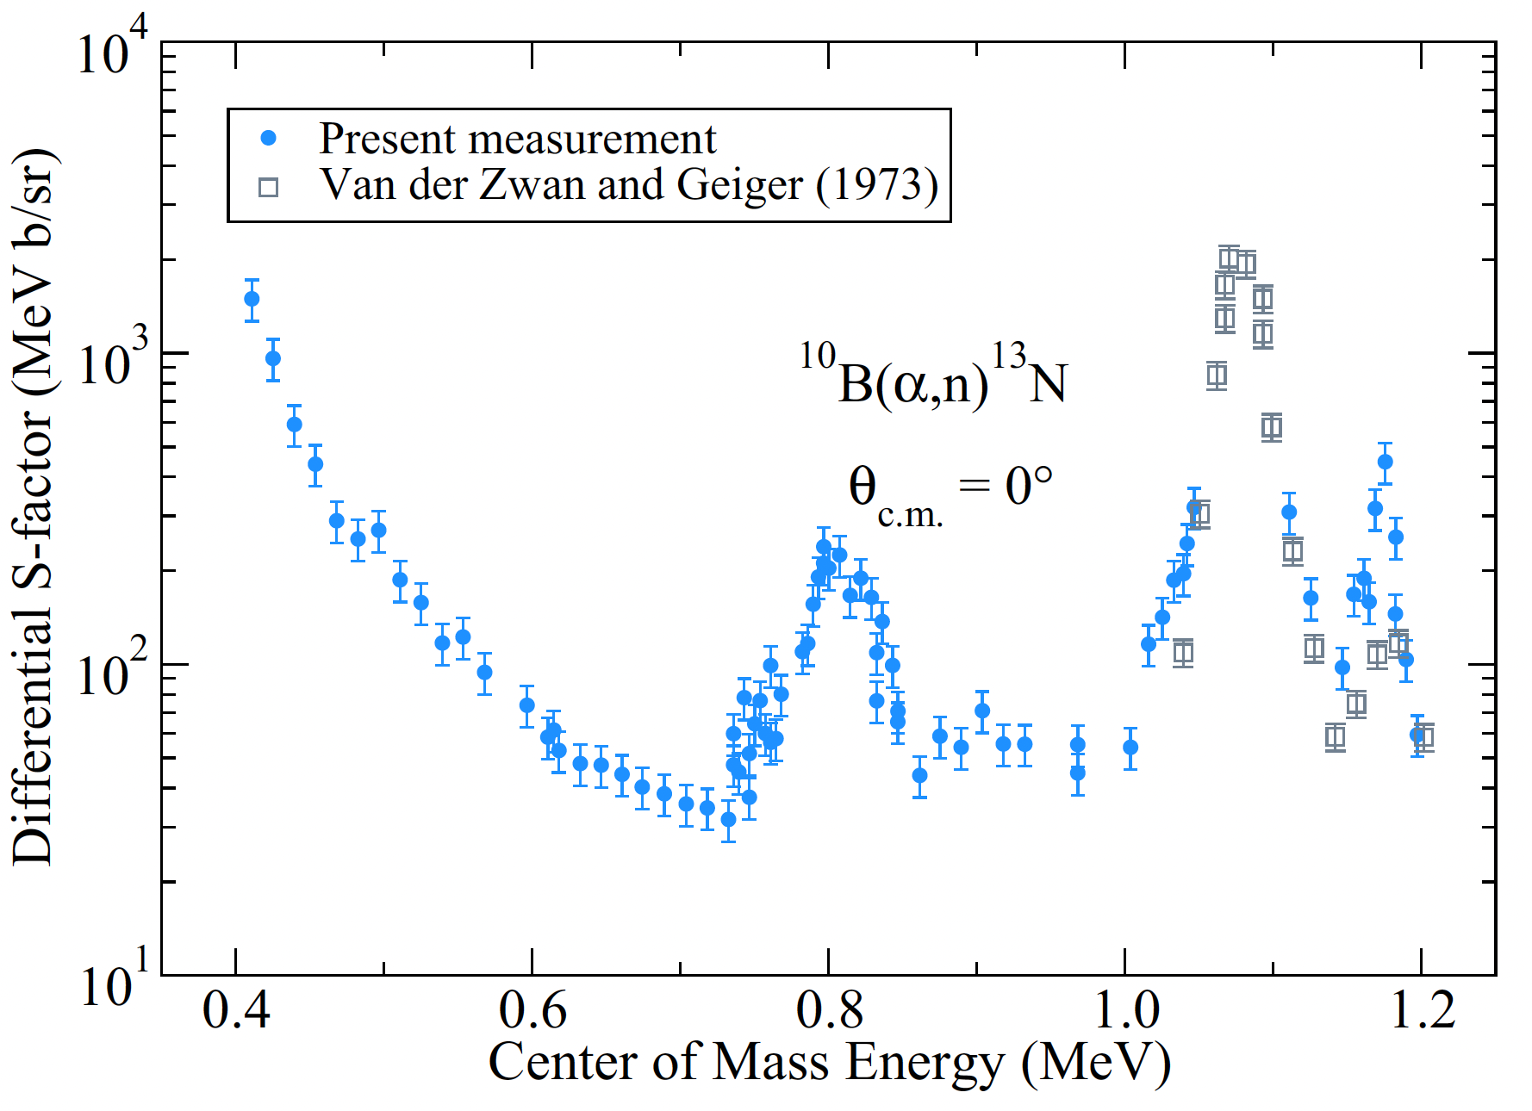
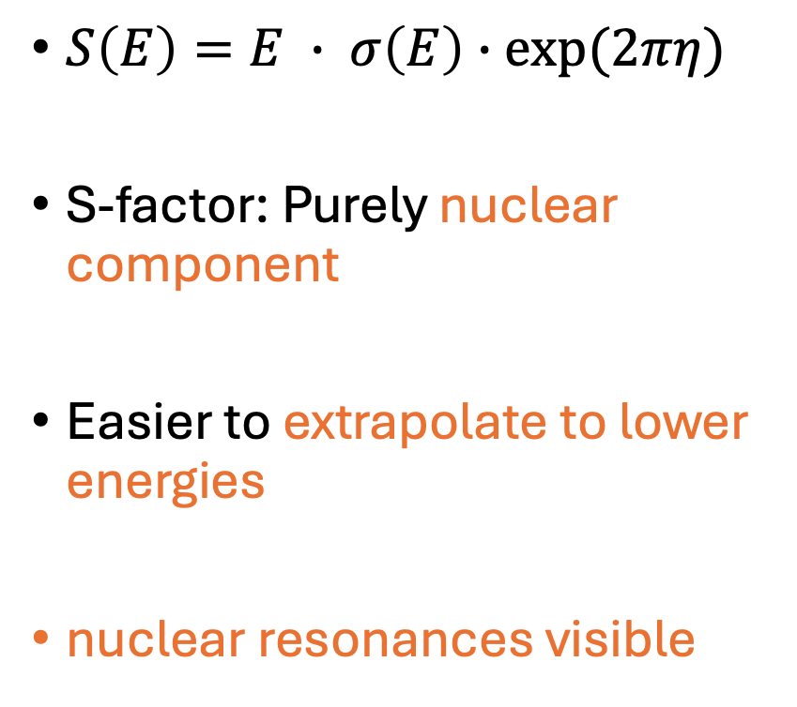
The Astrophysical S-factor
$S\left(E\right)=E ∙ σ\left(E\right)∙exp⁡(2πη)$
S-factor: Purely nuclear component
Easier to extrapolate to lower energies
nuclear resonances visible
Q.Liu et.al: PHYSICAL REVIEW C 101, 025808 (2020)

Slide 5
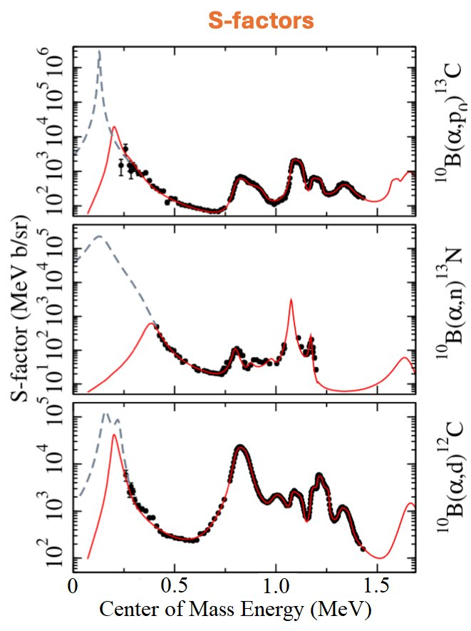





Cluster effects on enhancing fusion probabilities
courtesy J.deBoer
d + α → ⁶Li + α → ¹⁰B + α → ¹⁴N
α ⊕ d α ⊕ d ⊕ a ¹²C ⊕ d
Do clusters exist near ¹⁰B+α threshold?
Previous measurements suggest enhancement near threshold
Magnitude of enhancement unknown
Further data needed in all exit channels
Not measured astrophysical region of interest

Slide 6
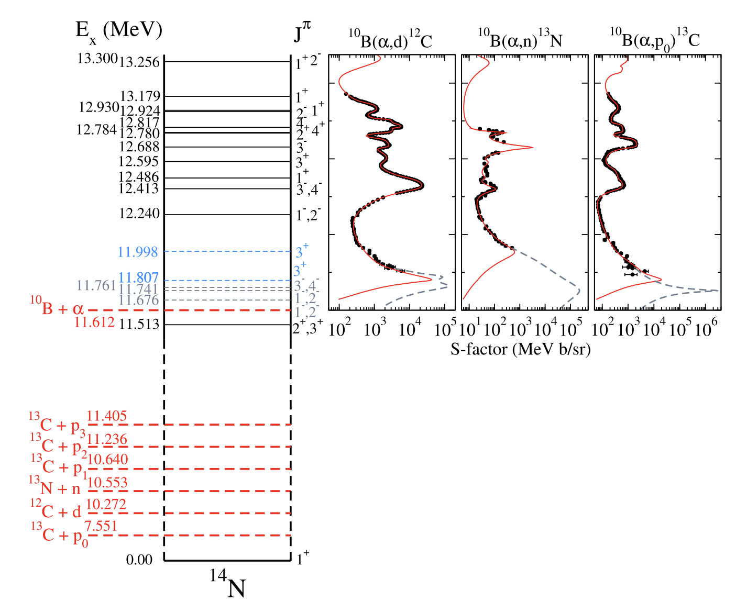
The ¹⁰B(α,n)¹³N reaction and previous studies
¹⁰B(α,n)¹³N [Q = 1.054 MeV]
Lowest literature measurement is E_{α} ≃ 575 keV [Q. Liu et al., Phys. Rev. C 101, 025808 (2020).]
Potential enhancements at E_{α}< 575 keV may be present but must be measured for all channels
Wiescher et al. Rev. Mod. Phys. 97 (2025) 025003

Slide 7
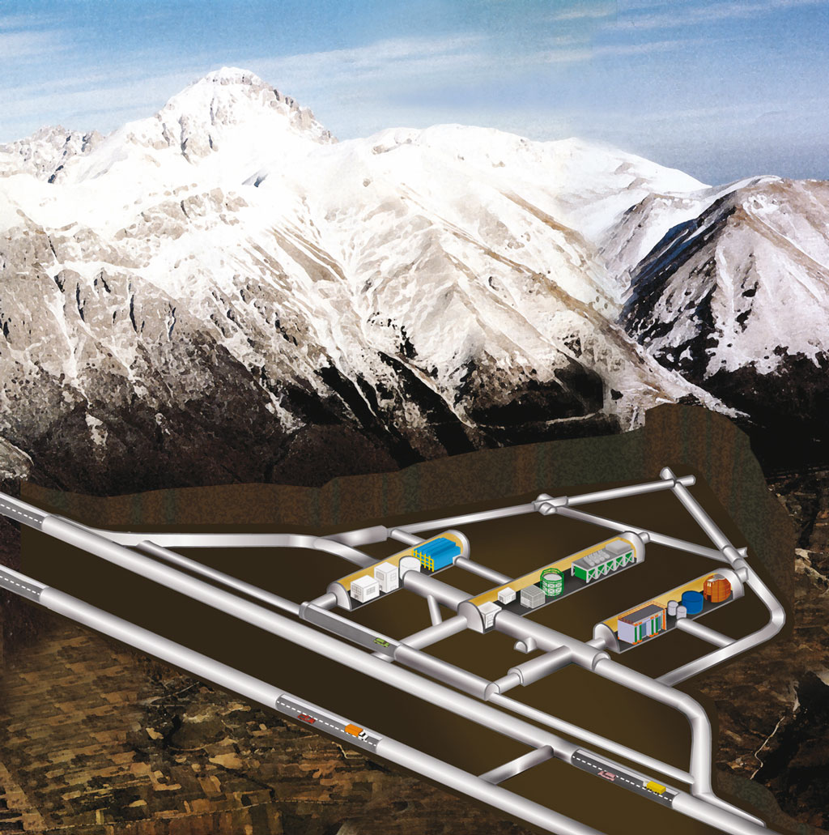
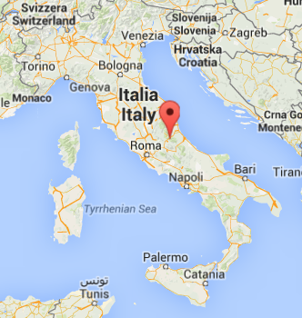
The LUNA Facility
ultra-low background @LUNA
LUNA: Laboratory for Underground Nuclear Astrophysics
at Laboratori Nazionali del Gran Sasso
Cosmic ray attenuation: μ → 10⁻⁶
n → 10⁻³
~ 1400 m
(3800 m.w.e.)
LUNA 1
50 kV
(1991-2001)
LUNA 2
400 kV
(2000 → present)
LUNA MV
(2023 → present)

Slide 8
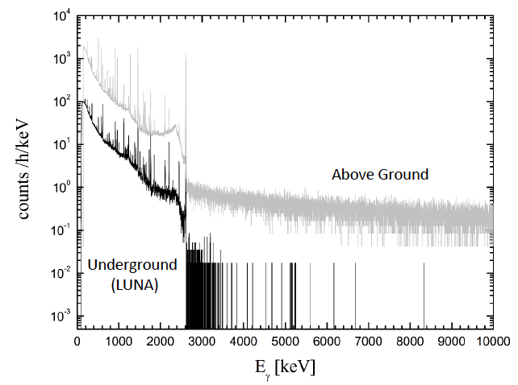
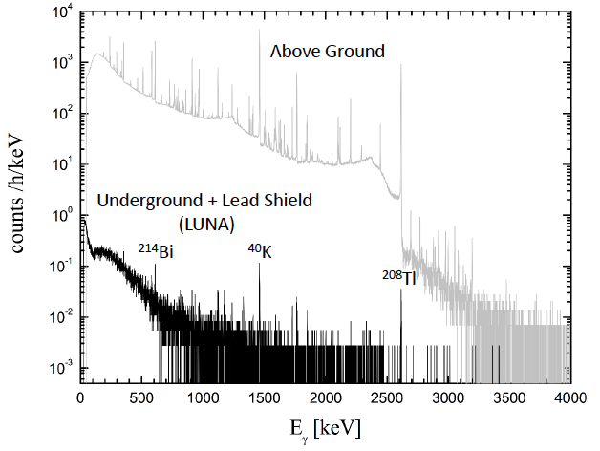
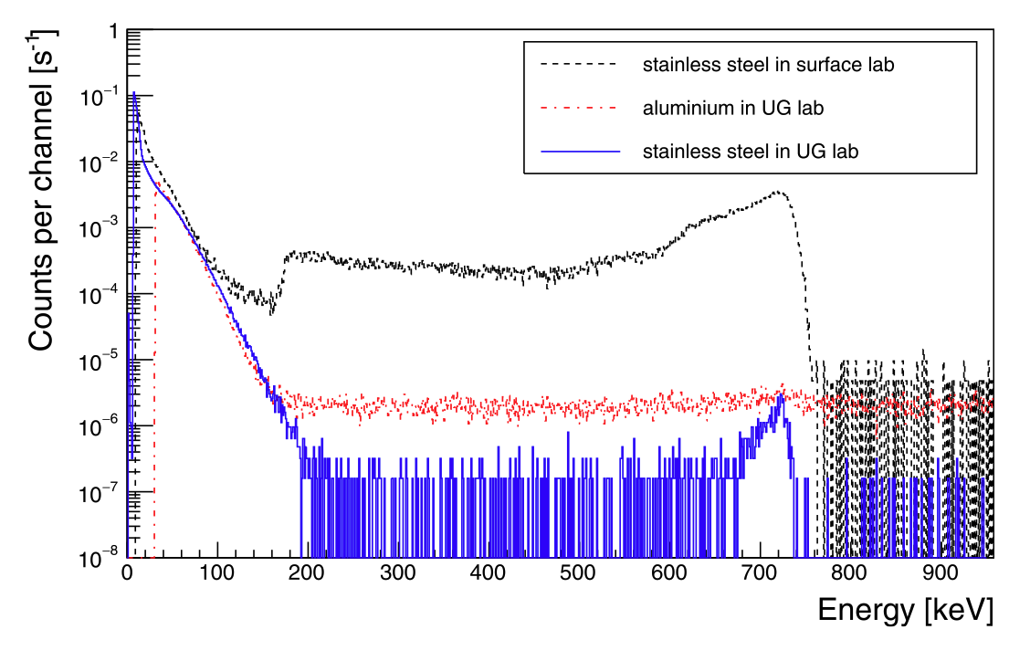
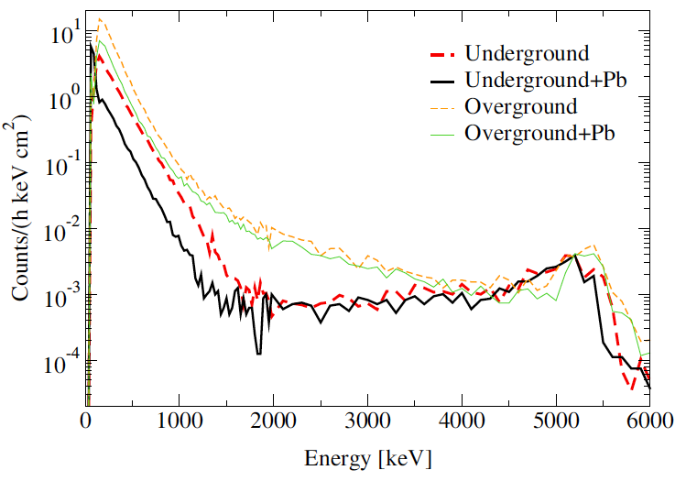
gamma-ray detection
Background Suppression
@LUNA
Ideal location
for low-energy studies
Costantini et al. Rep. Prog. Phys. 72 (2009)
086301
neutron detection
charged-particle detection
intrinsic
α-particle activity
Csedreki et al. NIMA 994 (2021)
165081
Bruno et al EJPA 51 (2015) 94

Slide 9
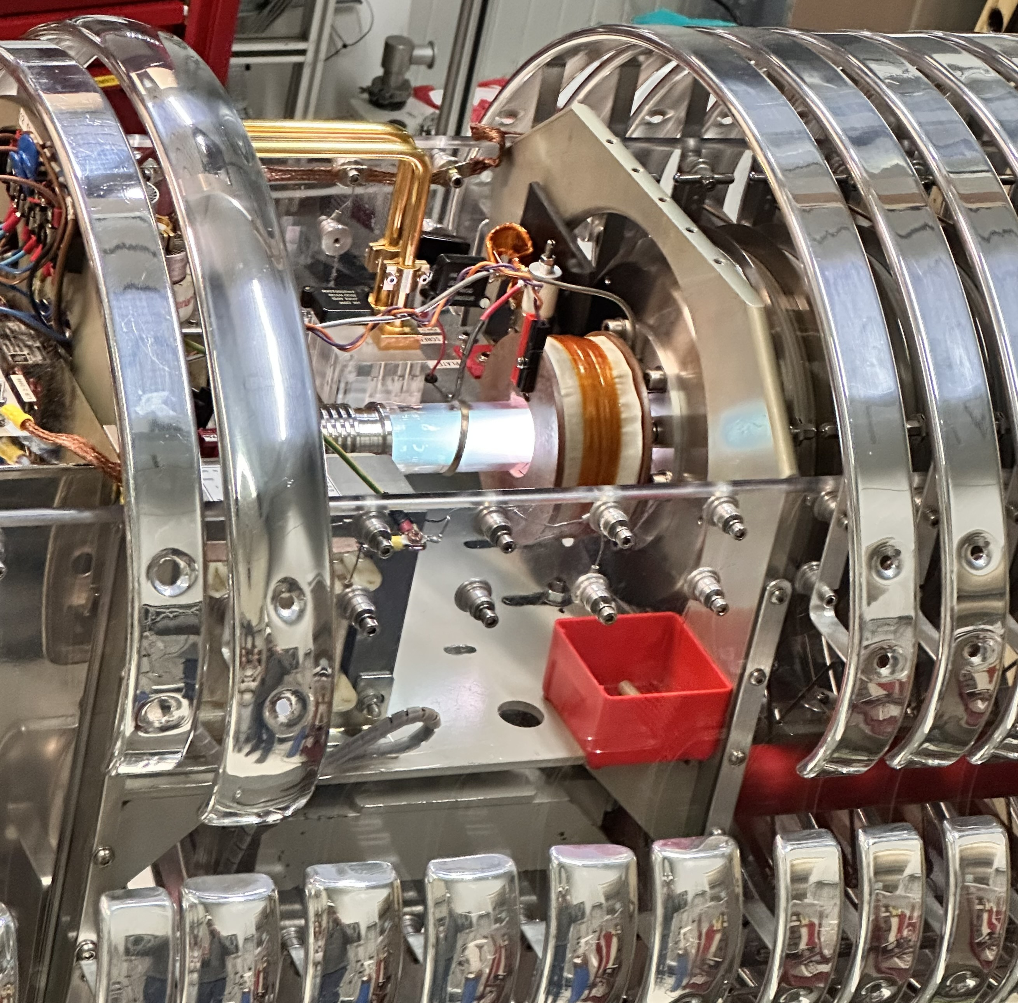
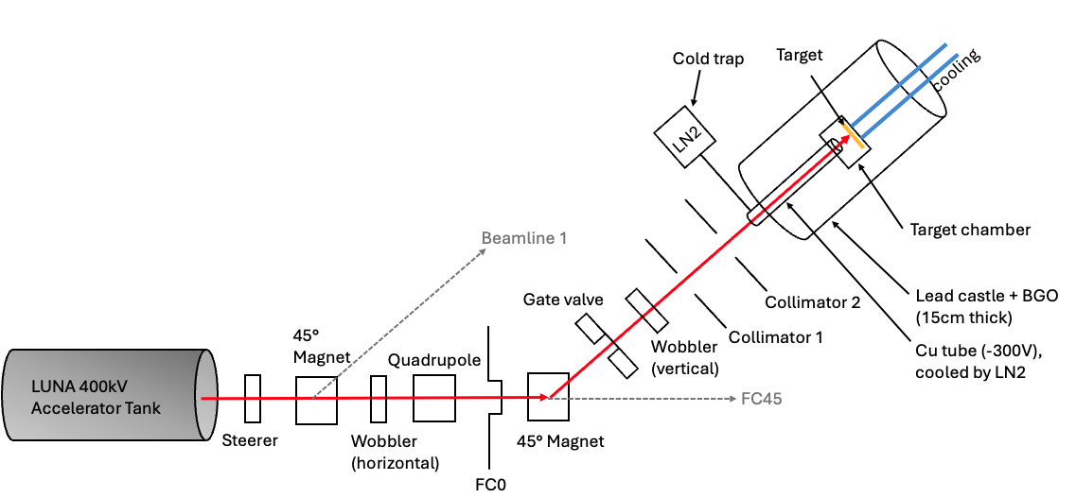
¹⁰B + α Reaction Studies @LUNA
⁴He⁺ plasma
LUNA Facility:
400keV accelerator
H⁺ and He⁺ beams
I = 100 – 300 uA
ΔE = 100 eV
Goal:
Measure ¹⁰B+α reactions down to lowest accessible energies

Slide 10
Enriched Boron-10 Targets
FIB-SEM (milled cross section)
Enriched ¹⁰B₄C targets
Multiple thickness used: 50,100,200nm
Sputtered ¹⁰B₄C on tantalum
¹⁰B₄C layer
⁴He⁺ range
Pt deposition
Mean projected 400 keV 4He+ range in tantalum: ~700 nm
Beam-exposed (blistered) surface portion

Slide 11
¹⁰B(α,n)¹³N Reaction Channel
¹⁰B(α,n)¹³N
Q = 1.054 MeV
11680 keV
10B+a
11510 keV
13N+n
β+
13C (+n)
S_{α} = 11.612 MeV
14N

Slide 12
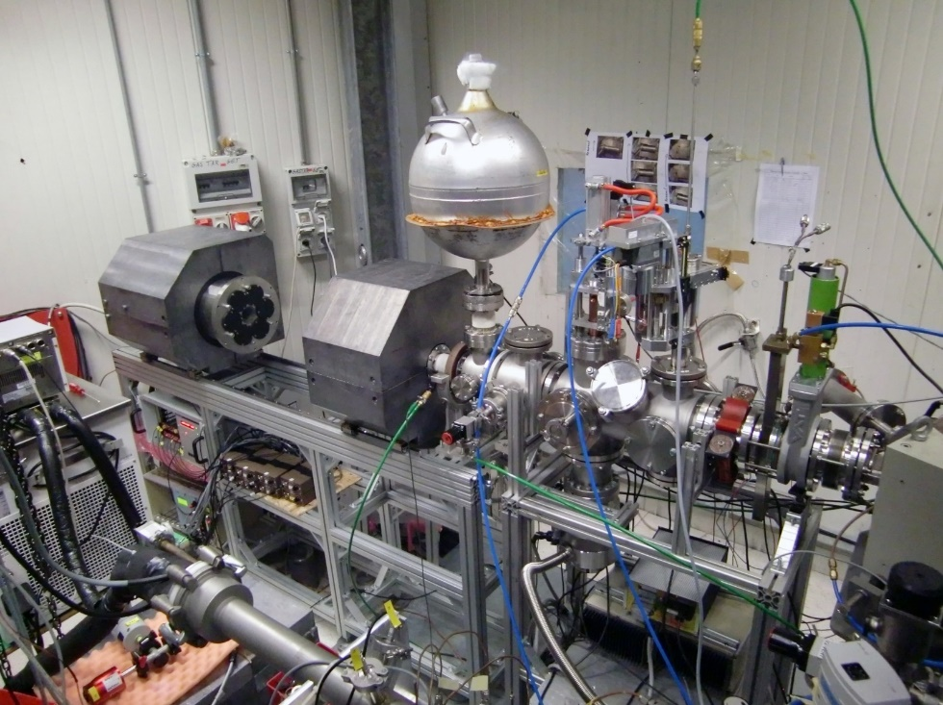
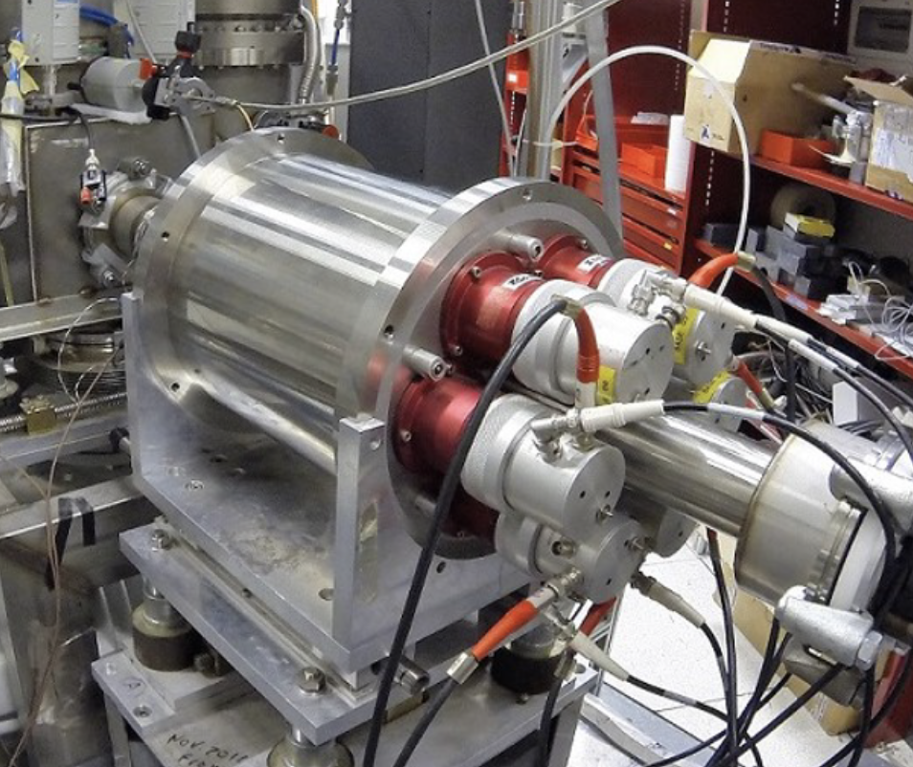
Neutron-channel ¹⁰B(α,n)¹³N: Activation Technique
LUNA BGO in lead shielding mounted to beam line 2
Lead shielding
BGO crystals
activation technique (¹³N lifetime ~ 10 min)
coincident measurement of 511 keV annihilation γ rays following β⁺ decay of ¹³N
6-segments BGO detector
coincidence in opposite crystals → reduce intrinsic and environmental background
BGO 6
BGO 1
BGO 5
511keV
BGO 2
511keV
BGO 4
BGO 3
LUNA BGO Detector
LUNA BGO no shielding

Slide 13
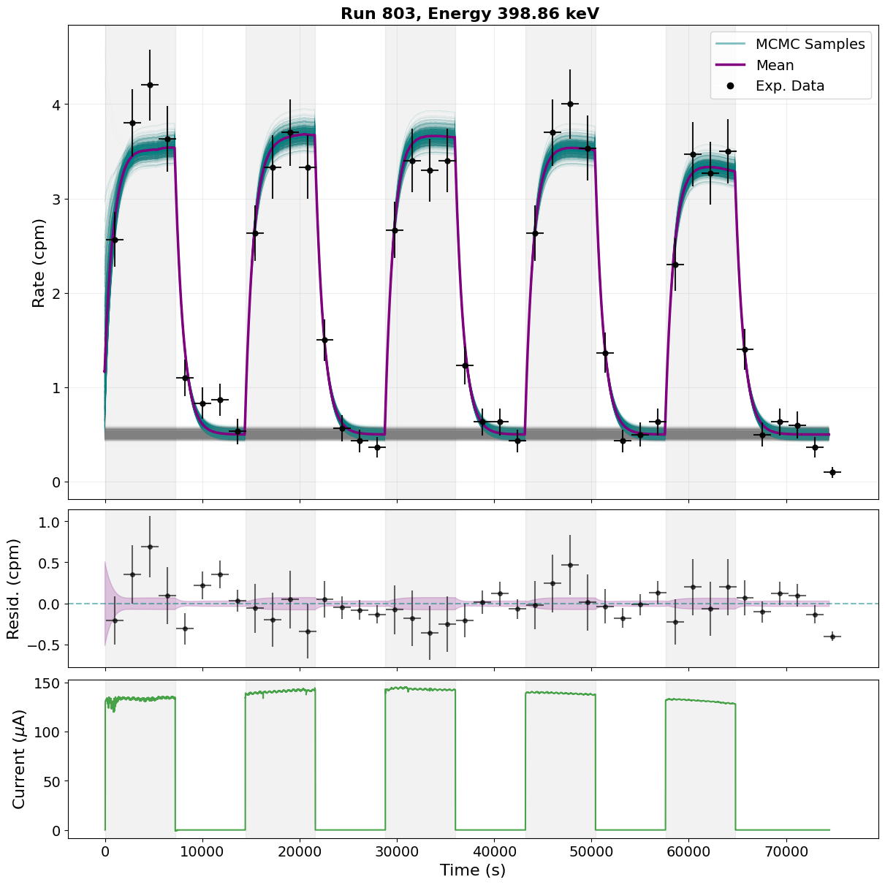
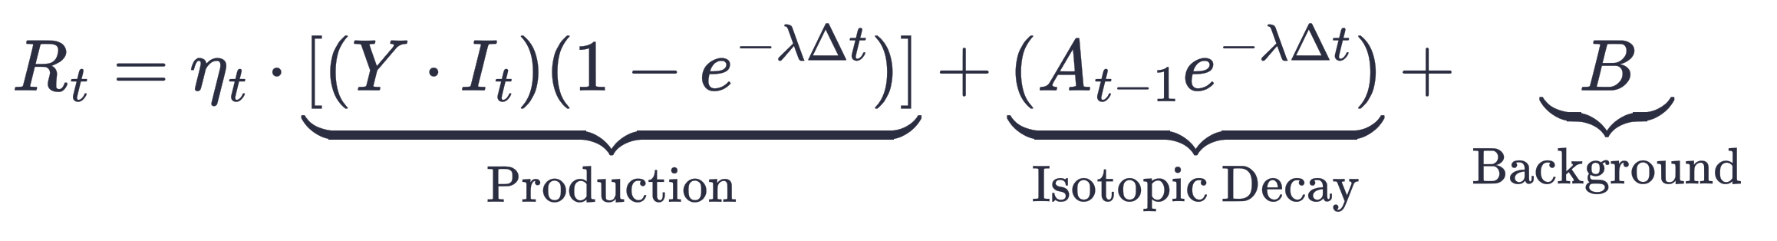
Activation Fitting ¹⁰B(α,n)¹³N
E_{α} = 400 keV
Yield obtained from fitting rate function
Target degrades from beam bombardment which is accounted for in the fitting function

Slide 14
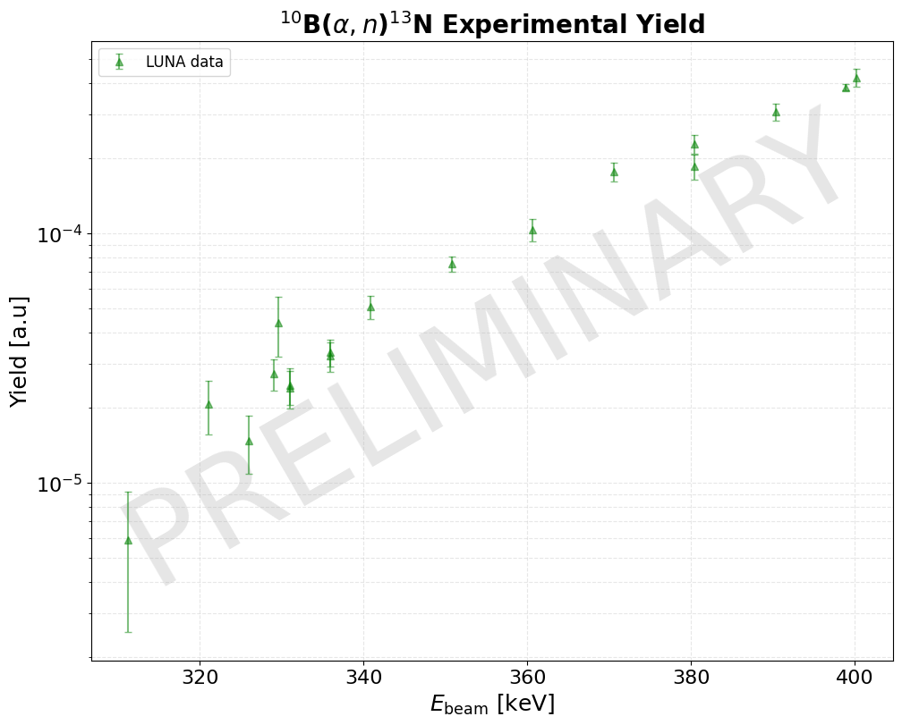
Preliminary yield results
Lowest energy measurement to date (previous lowest point 575 keV Q.liu et al)
Lowest point at 310 keV has reached the limit of sensitivity
Still undergoing analysis and further review

Slide 15











PhD Students
Lavinia
Dalla Vedova
Rhys Bonnell
Post-Doc
PI
THE LUNA COLLABORATION
http://luna.lngs.infn.it
Alessandro
Compagnucci
Marialuisa Aliotta
Special thanks to Peter Black and Thomas Davinson
https://www.erc-nuclear.uk
M. Wiescher, J. deBoer, V. Picciotto,
K. Manukyan + local staff and students

Slide 16
Backup slides

Slide 17
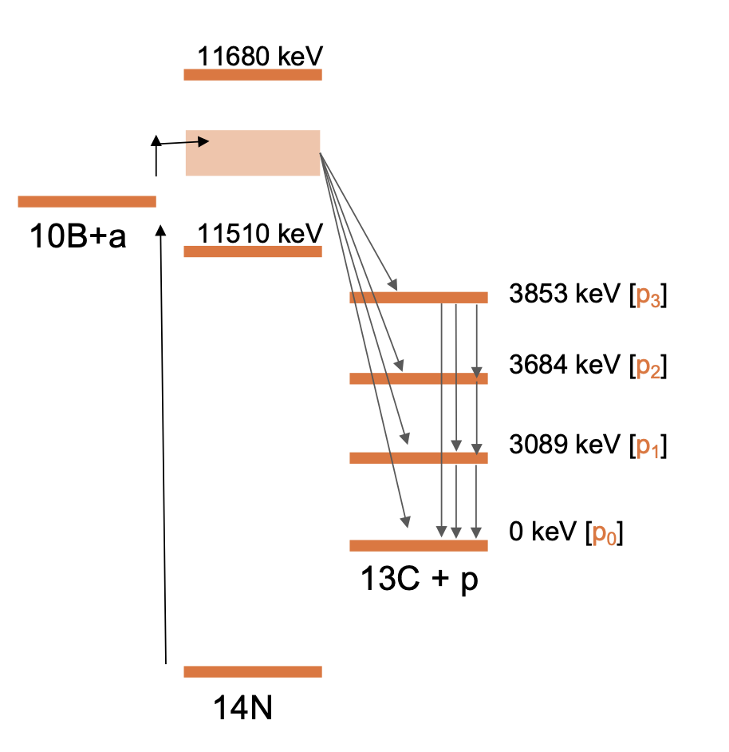
¹⁰B+α Reaction Channels
¹⁰B(α,p_{i})¹³C
Q = 4.061 MeV
¹⁰B(α,d)¹²C
Q = 1.340 MeV
¹⁰B(α,n)¹³N
Q = 1.054 MeV
11680 keV
11680 keV
10B+a
11510 keV
10B+a
11510 keV
13N+n
β+
12C+d
S_{α} = 11612 keV
13C (+n)
S_{α} = 11.612 MeV
14N
14N

Slide 18
¹⁰B(α,p_{i})¹³C
Q = 4.061 MeV
S_{α} = 11612 keV

Slide 19
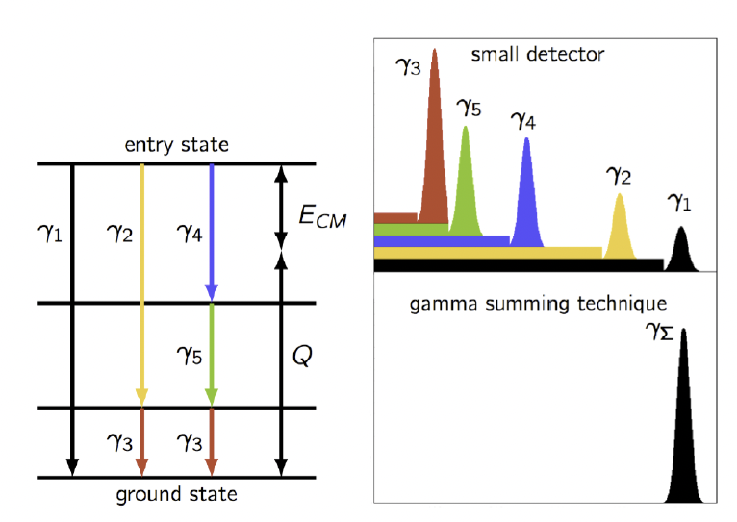
γ-summing technique (Addback) for ¹⁰B(α,p_{i}γ)¹³C measurement
BGO 6
BGO 1
BGO 5
3089 keV
BGO 2
¹³C can be populated in 4 states and γ-decay can occur through multiple levels
The γ-rays are commonly emitted within a few fs of each other
Full energy gamma ray can be obtained through summing/addback of all detectors
169 keV
595 keV
BGO 4
BGO 3
Image from: C.S. Reingold1 et al
Eur. Phys. J. A (2019) 55: 77, DOI 10.1140/epja/i2019-12748-8

Slide 20
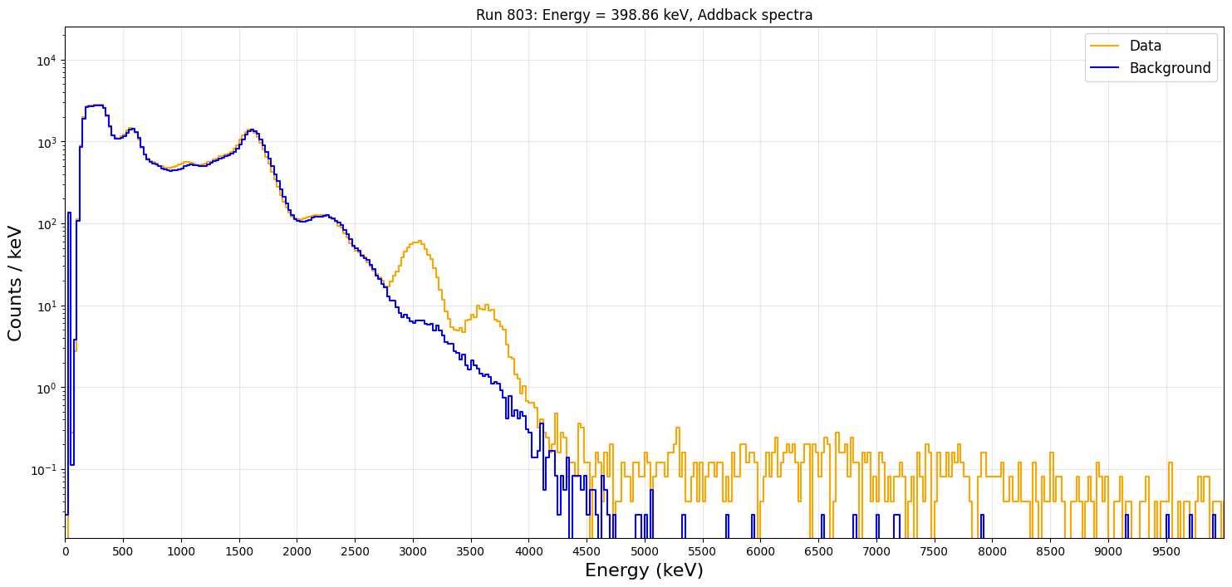
¹⁰B(α,p_{i}γ)¹³C: Addback
1022 keV
p₁γ
P₂γ
P₃γ [very low cross-section]

Slide 21
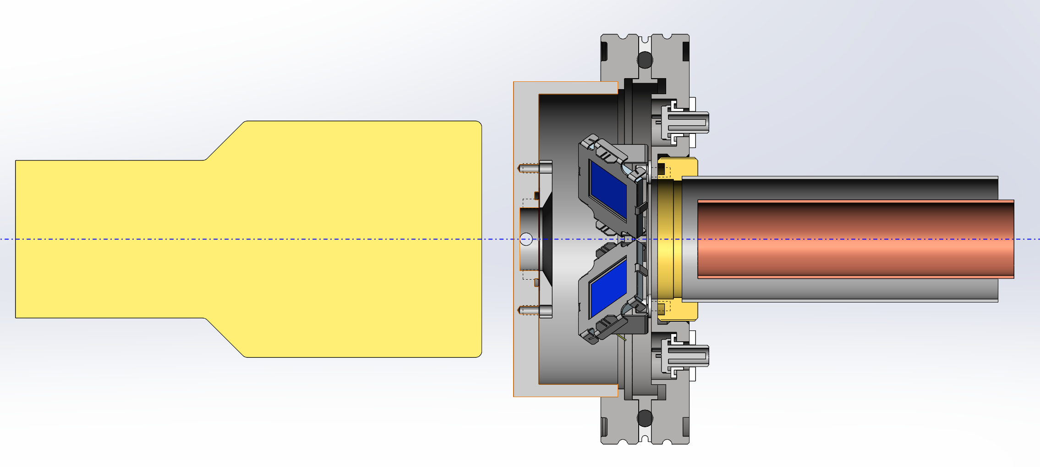
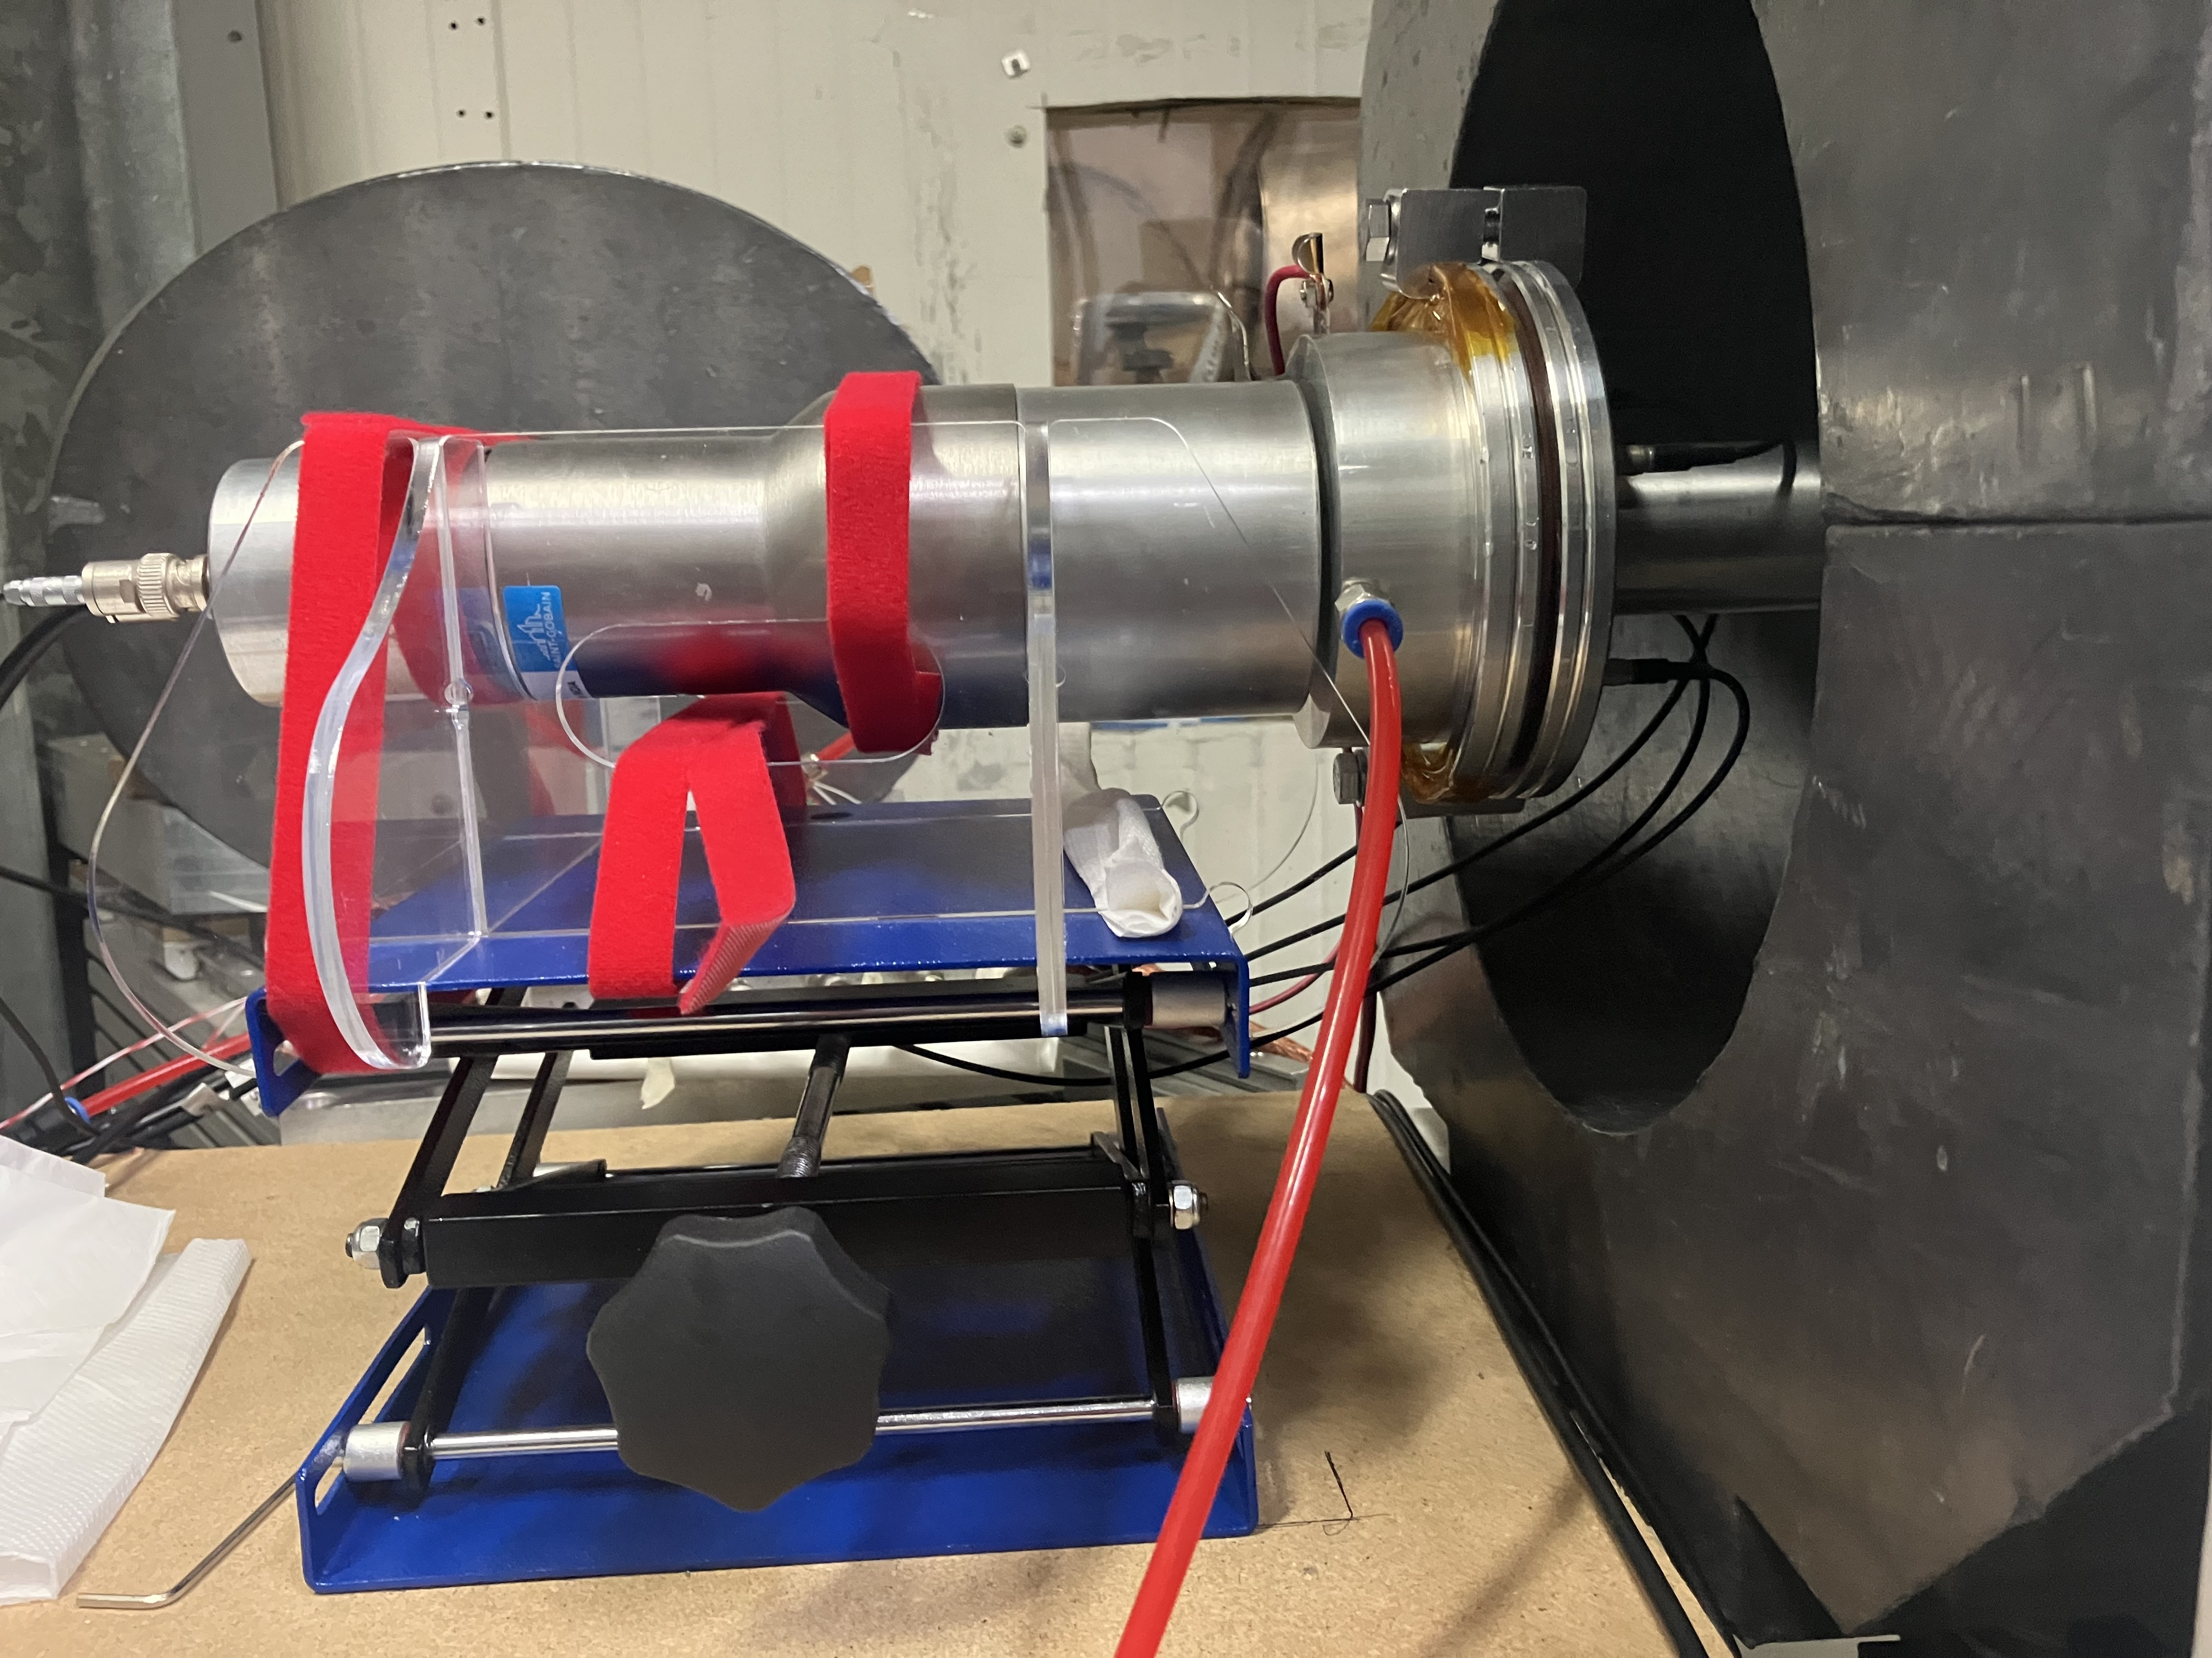
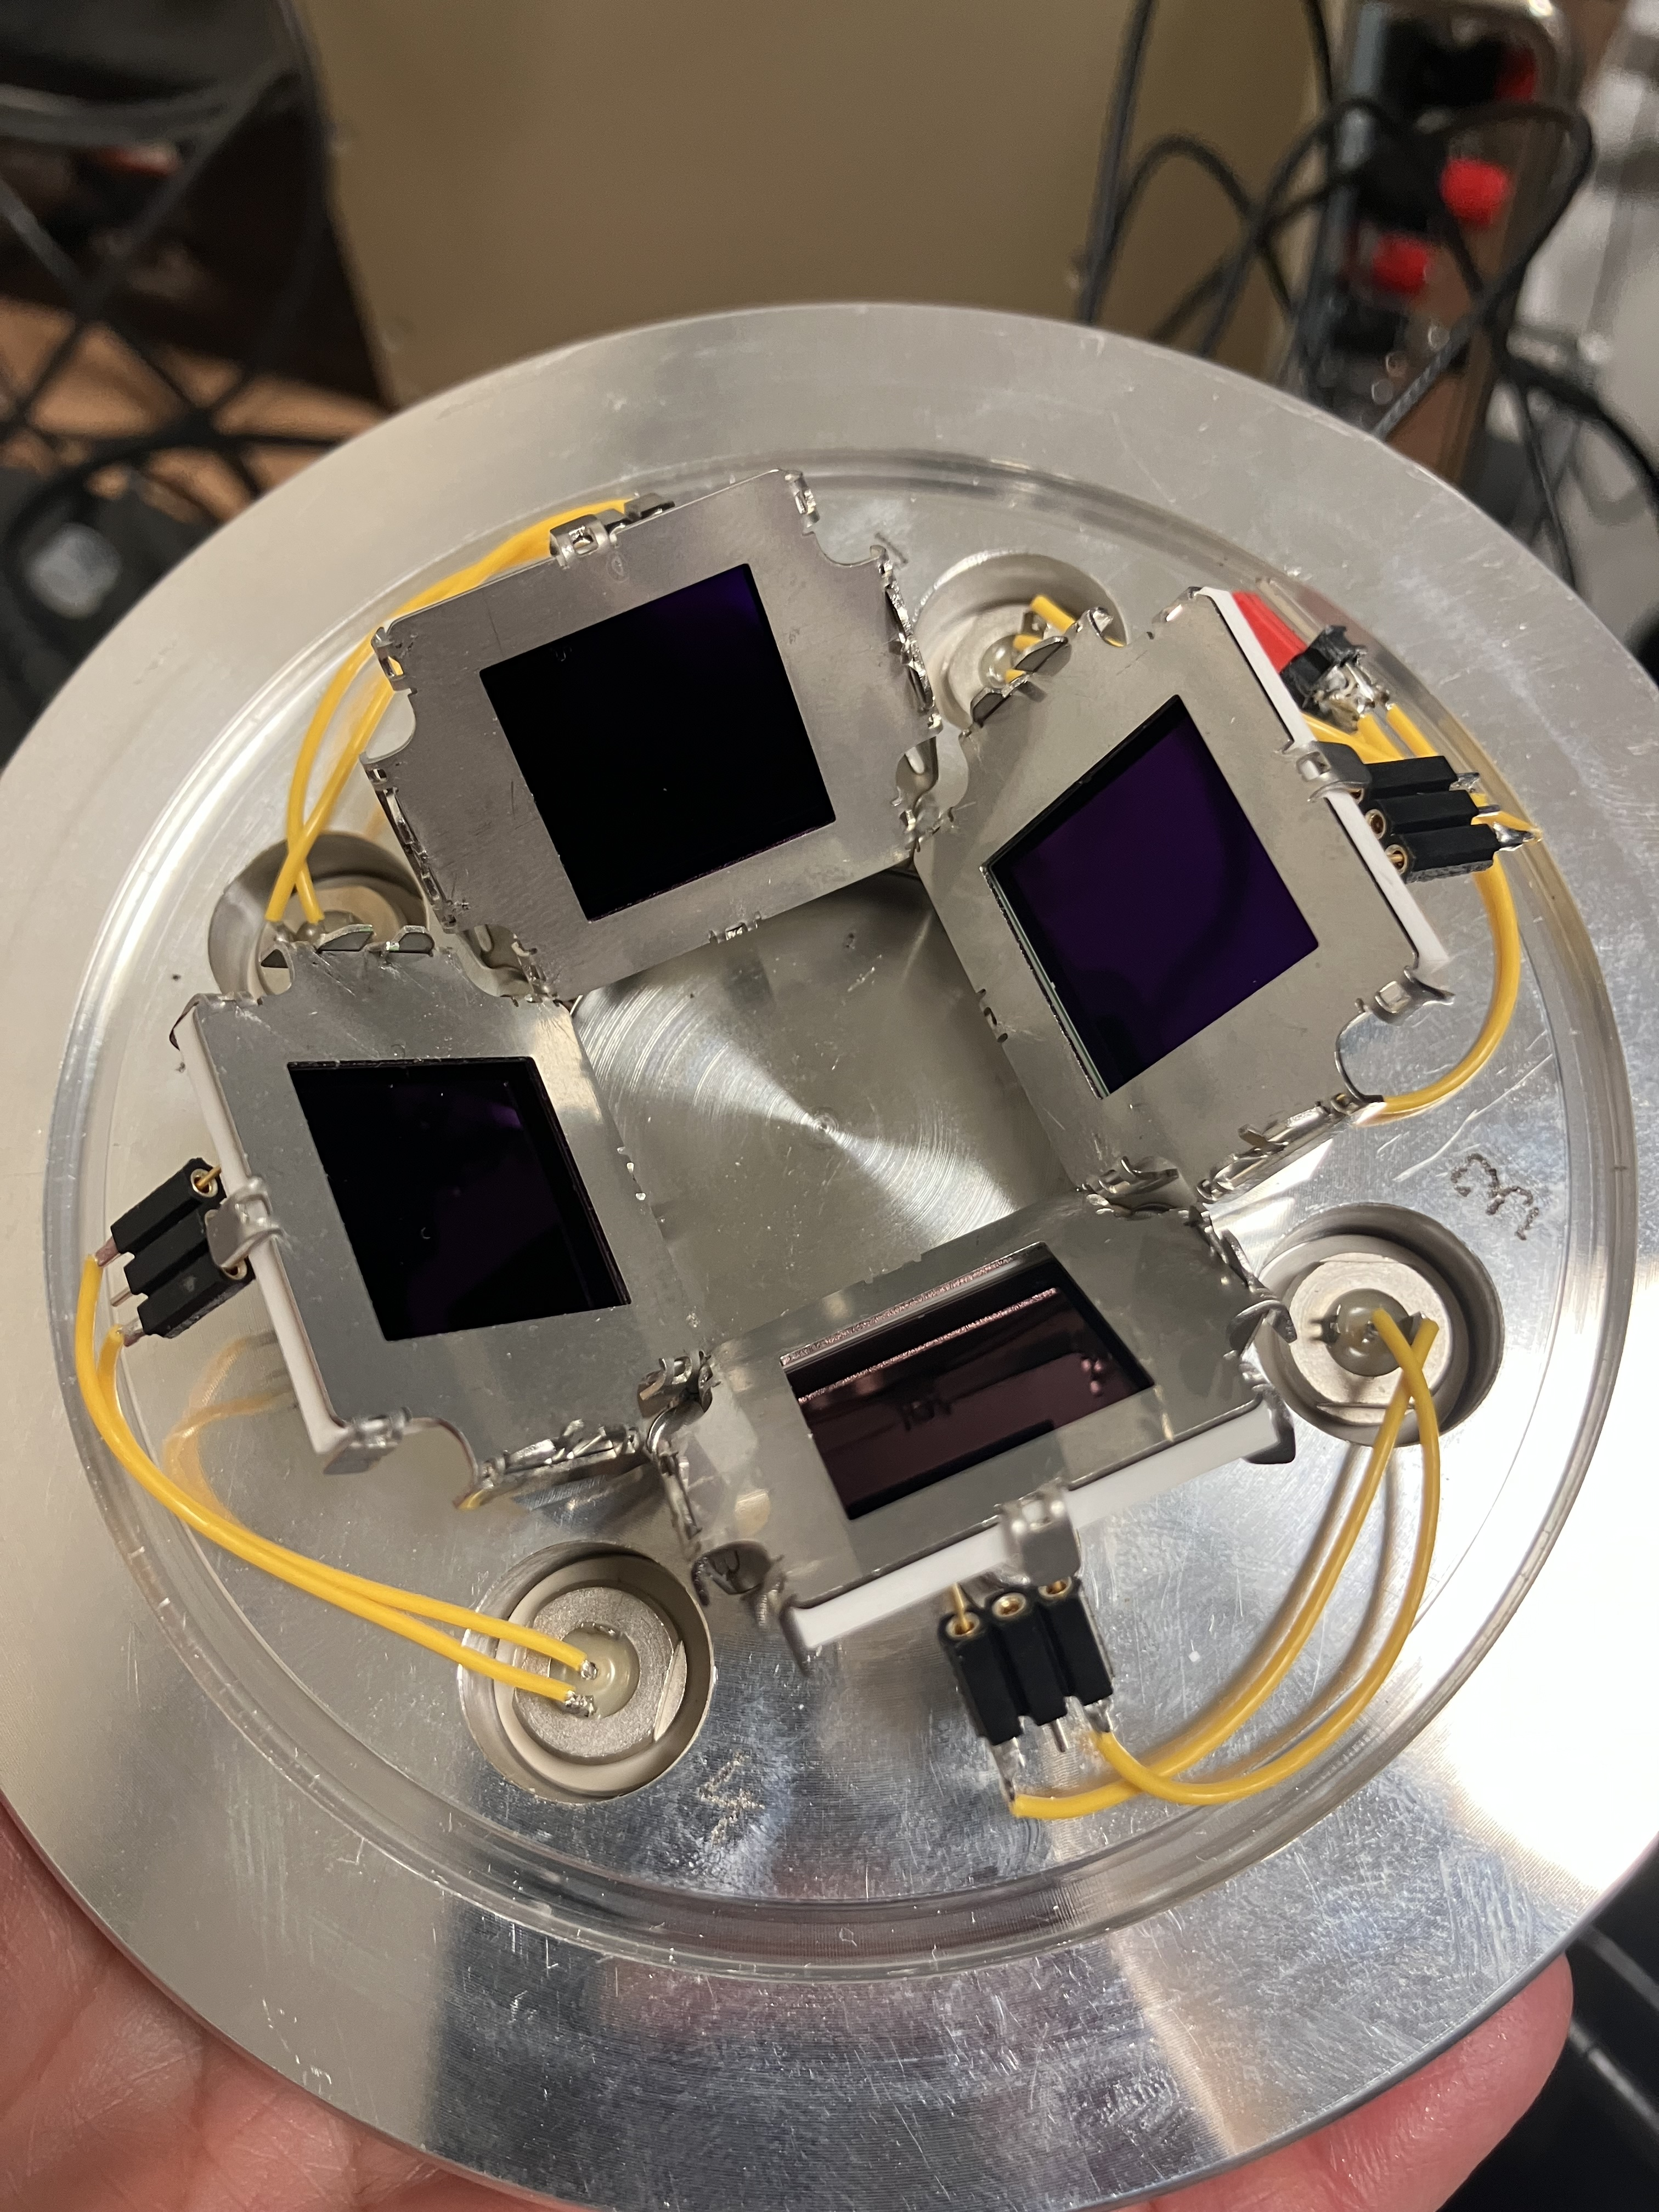
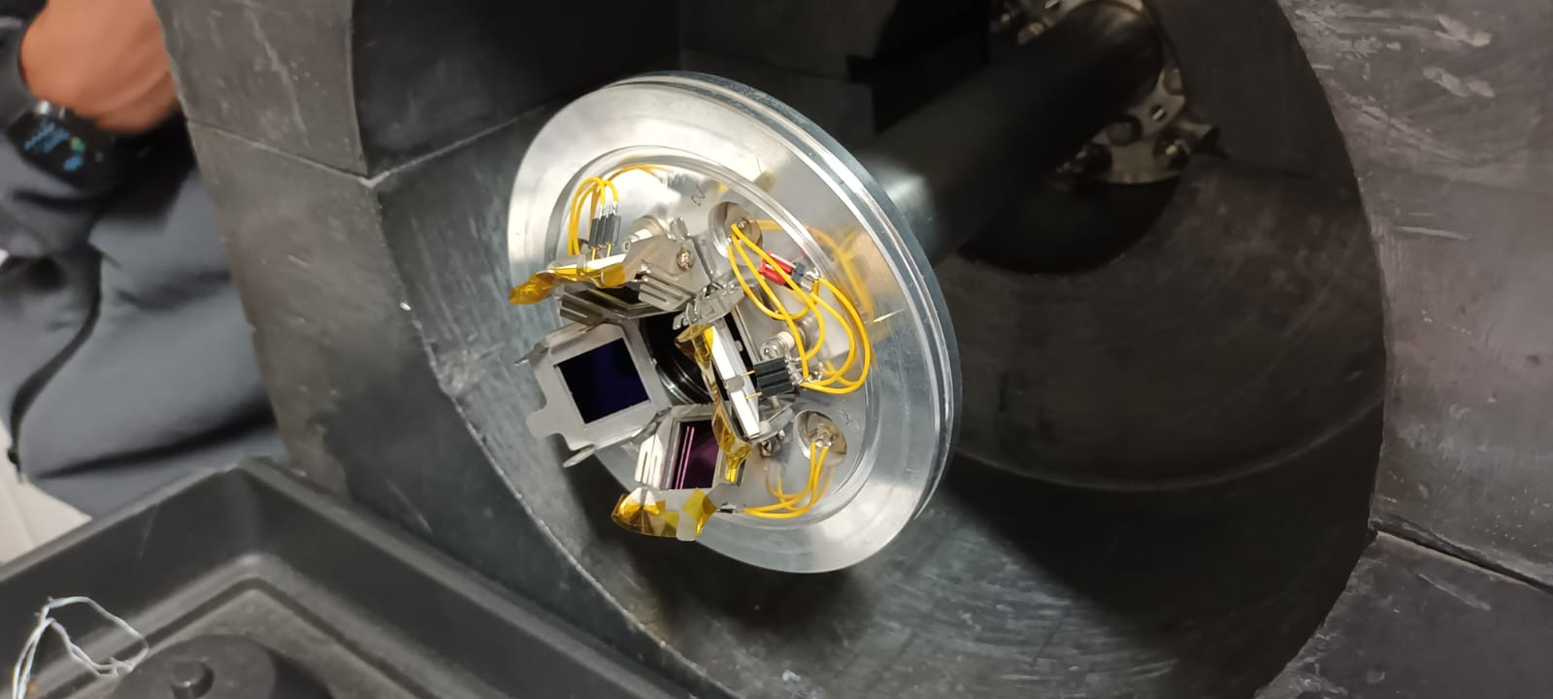
Charged particle ¹⁰B(α,d)¹²C, ¹⁰B(α,p)¹³C (Set-Up)
2nd beamline
four 18x18 mm²
Silicon detectors, @ θ = 135º
γ or neutron detector
Beam
¹⁰B target
(water cooled)
cold finger
design: Peter Black

Slide 22
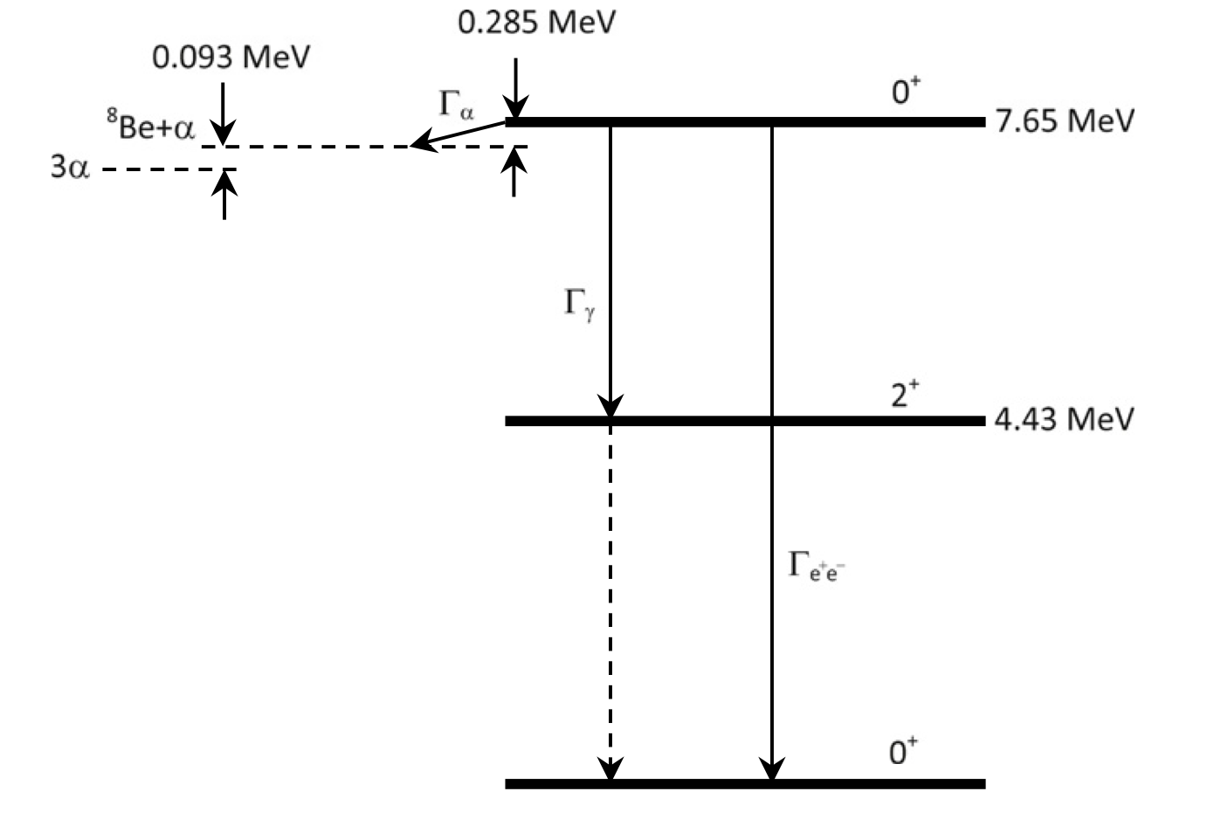
Hoyle state (Example of alpha clustering enhancement)
α+α+α → ¹²C*
α+α → ⁸Be → ⁸Be+α → ¹²C*
A cluster of three alpha particles to form Hoyle state
Increases alpha reaction rate by a factor of about 10⁷
Image from: M.Freer,H.O.U.Fynbo /ProgressinParticleandNuclearPhysics78(2014)1–23

