Slide 1
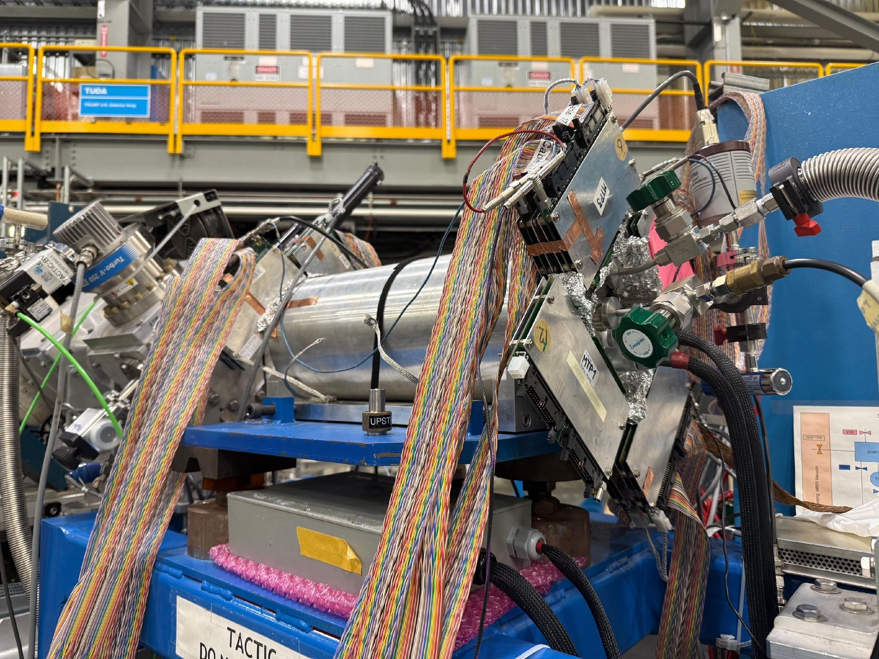
Direct measurement of ²⁷Al(ɑ,p)³⁰Si with TACTIC
Annabelle Cyster¹, Alison Laird¹, Soham Chakraborty¹
¹University of York
IOP Nuclear Physics Conference, Brighton
15th April 2026

Slide 2
Outline
Introduction
TACTIC’s core components
μRWELL Micro Pattern Gaseous Detector (MPGD)
Recent measurement of ²⁷Al(ɑ,p)³⁰Si
First cross-section measurement, Nov 2022
Developments and future analysis
Notes:
Change maroon border to be thinner

Slide 3
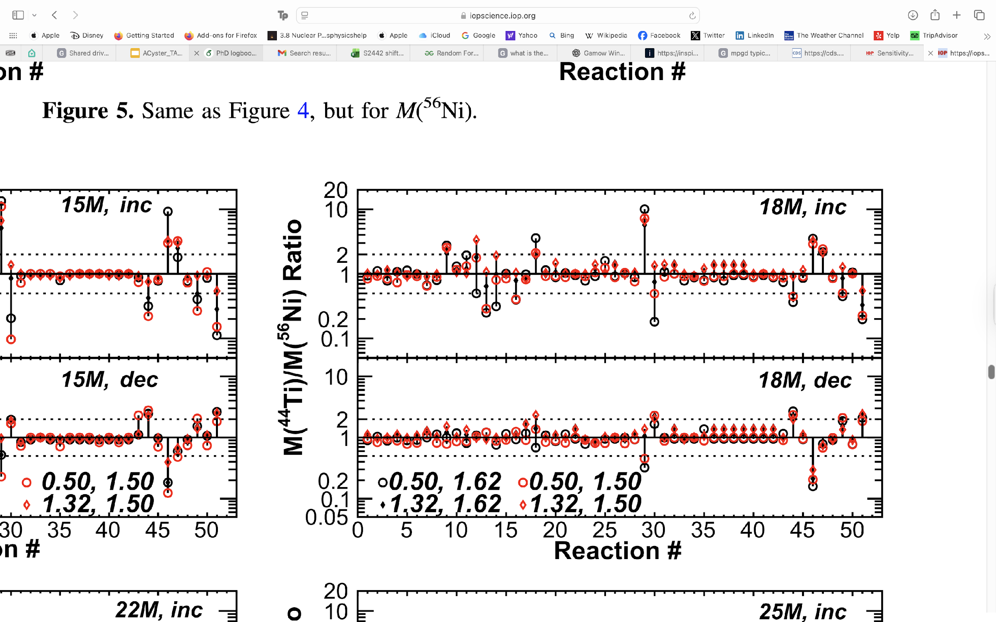
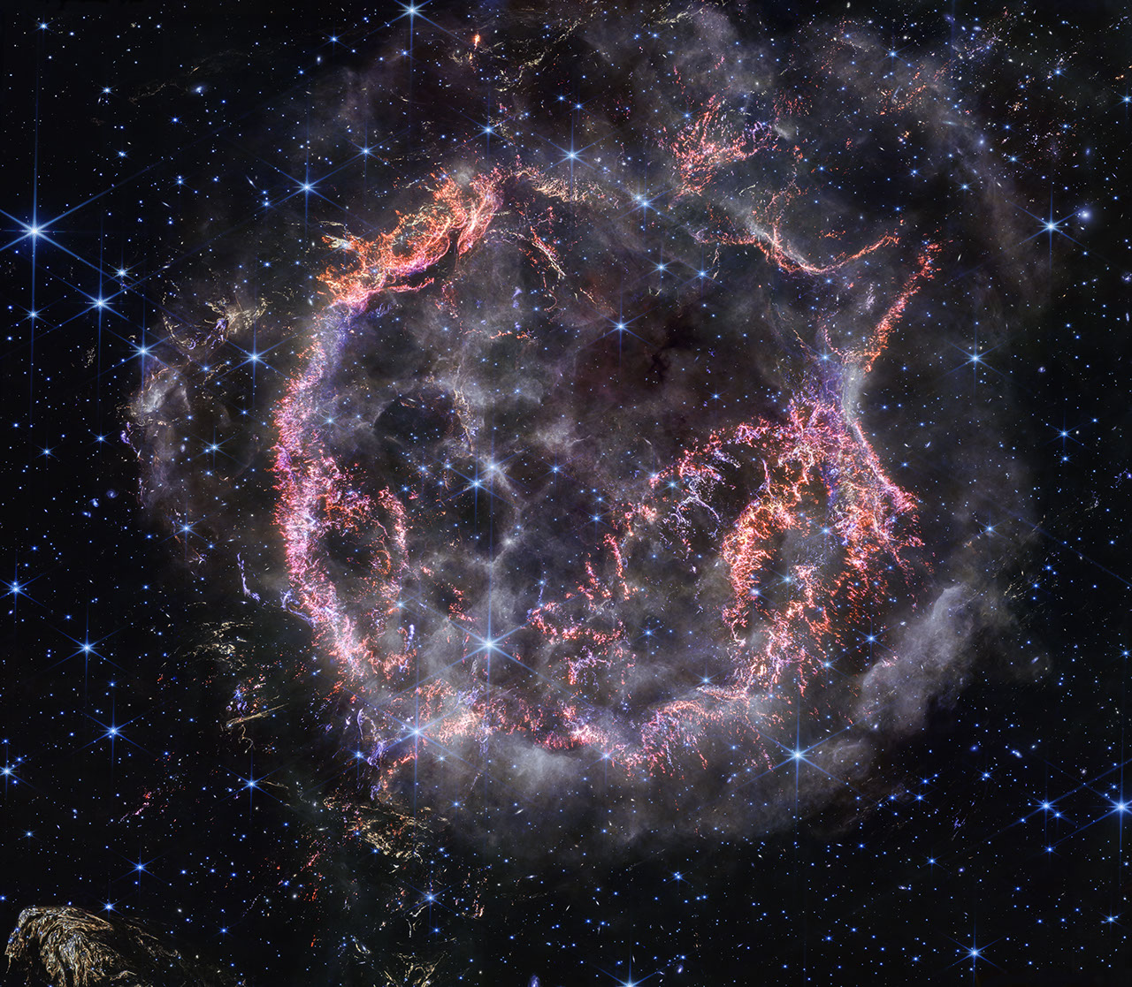
Astrophysical motivation
Core collapse supernovae are critical for enriching the interstellar medium
The ²⁷Al(ɑ,p)³⁰Si reaction has been found important in constraining ⁵⁶Ni abundances
Characteristic gamma rays from the decay of ⁵⁶Ni can be observed
Cassiopeia A
Credit: JWST NirCam
Ratio of ⁴⁴Ti to ⁵⁶Ni production, with reaction sensitivity. Reaction 11 = ²⁷Al(ɑ,p)³⁰Si [4]
Notes:
- an increase in the reaction rate decreases 56Ni yields.
-explain plot and importance of ratio!!
6Ni is produced in complete silicon burning under (near) NSE or QSE conditions.It dominates the iron-group yield and sets:the supernova light curve (via ${}^{56}Ni→^{56}Co→^{56}Fe$)

Slide 4
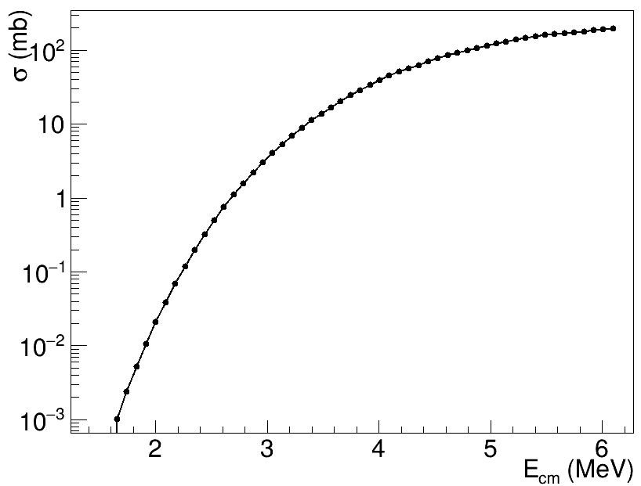
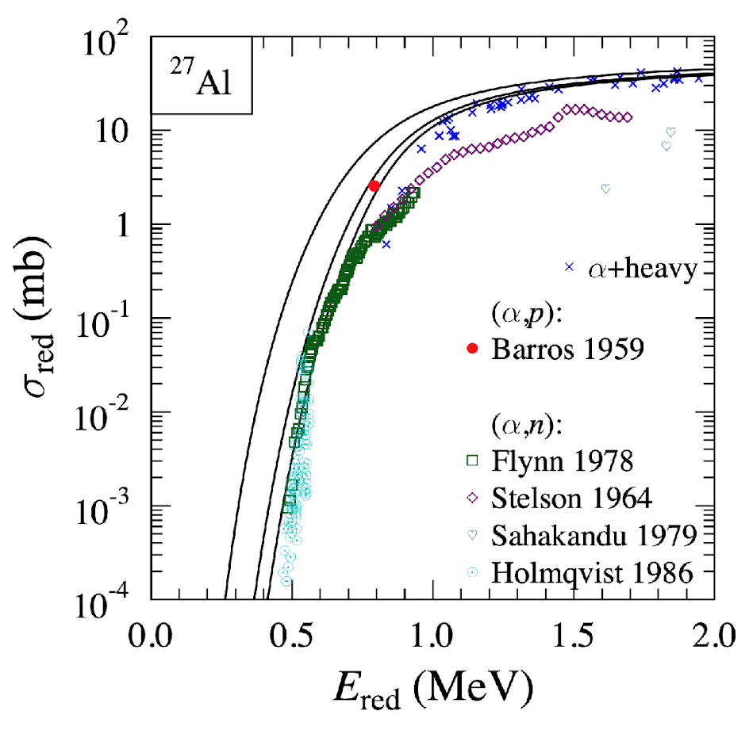
New measurement of ²⁷Al(ɑ,p)³⁰Si
Measurement of the ²⁷Al(α,p)³⁰Si reaction cross section in the Gamow window has never been experimentally performed
Gamow window
Single measurement at E_{CM} = 5 MeV with spectrograph,1959 [5]
E_{CM} range measured
Gamow window calculated for T₉ = 3 GK, corresponding to explosive Si burning
Predicted reaction cross sections for ²⁷Al(α,p)³⁰Si in E_{CM}, calculated via Hauser-Feshbach models

Slide 5
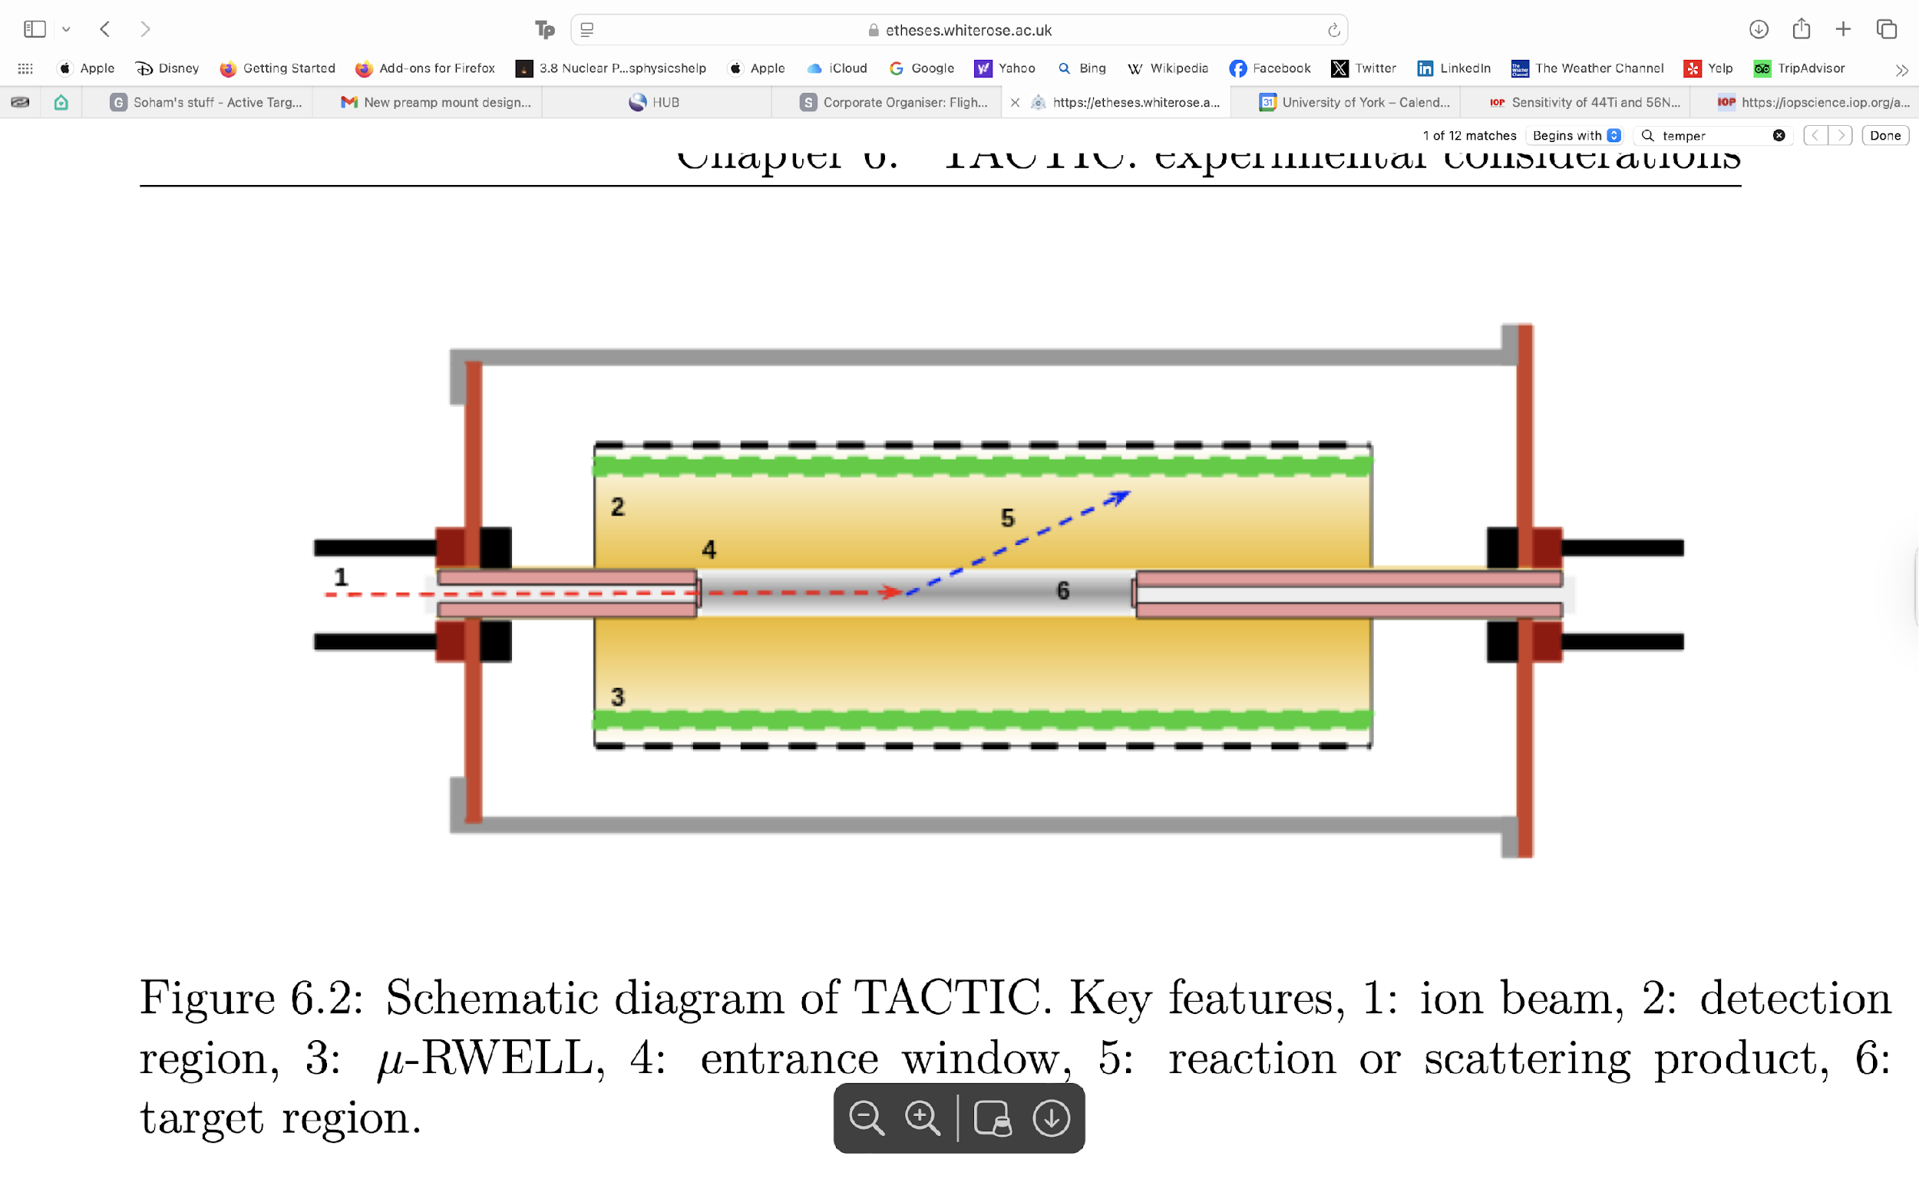
Introduction to TACTIC
Beam
Detection region
μRWELL
Entrance window
Reaction or scattering product
Target region
Exit collimator
TRIUMF
Annular
Chamber for
7
Tracking and
𝜇RWELL
Identification of
Charged particles
Schematic of TACTIC and principle of operation [1]
Cylindrical Active Target Time Projection Chamber
Thick target technique
Excitation function measured over entire energy range
Time-efficient measurement
Notes:
Summarise text. Too much
Add in animation so people know where to look
Direct measurements of alpha-induced charged-particle reactions, important for understanding nucleosynthesis in different cosmic environments
tracking and identification of the reaction products through differential energy loss
Less text below images

Slide 6
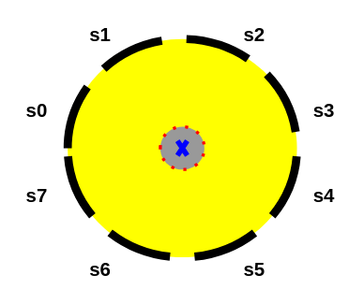
Sector segmentation
Segmented into 8 sectors in ɸ
Split into upstream and downstream halves
60 readout pads in each sector
480 pads total
Schematic of TACTIC’s sector layout [1]

Slide 7
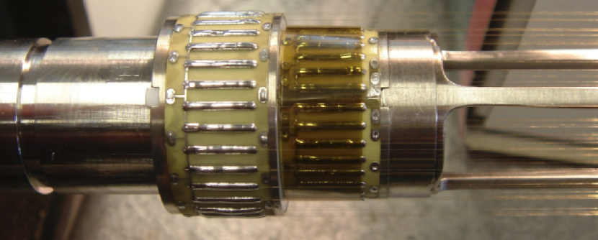
Core components
μRWELL
Cathode cage enables high beam intensities, > 10⁶pps
Most active target TPCs are rate-limited, ~10⁵pps
Cathode cage structure [2]
Notes:
Get rid of Al kapton window
Make animation for each section of slide

Slide 8
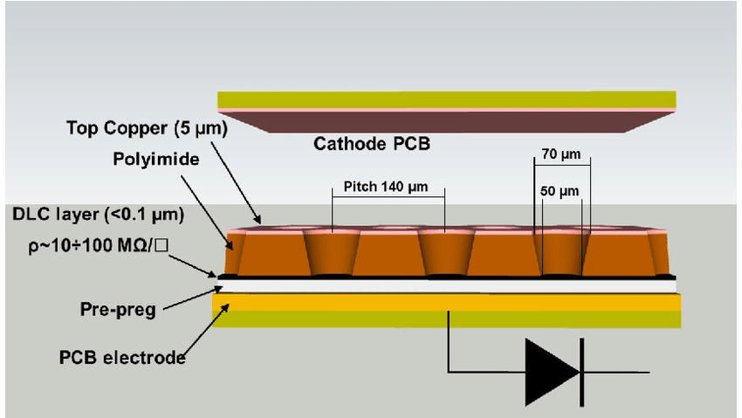
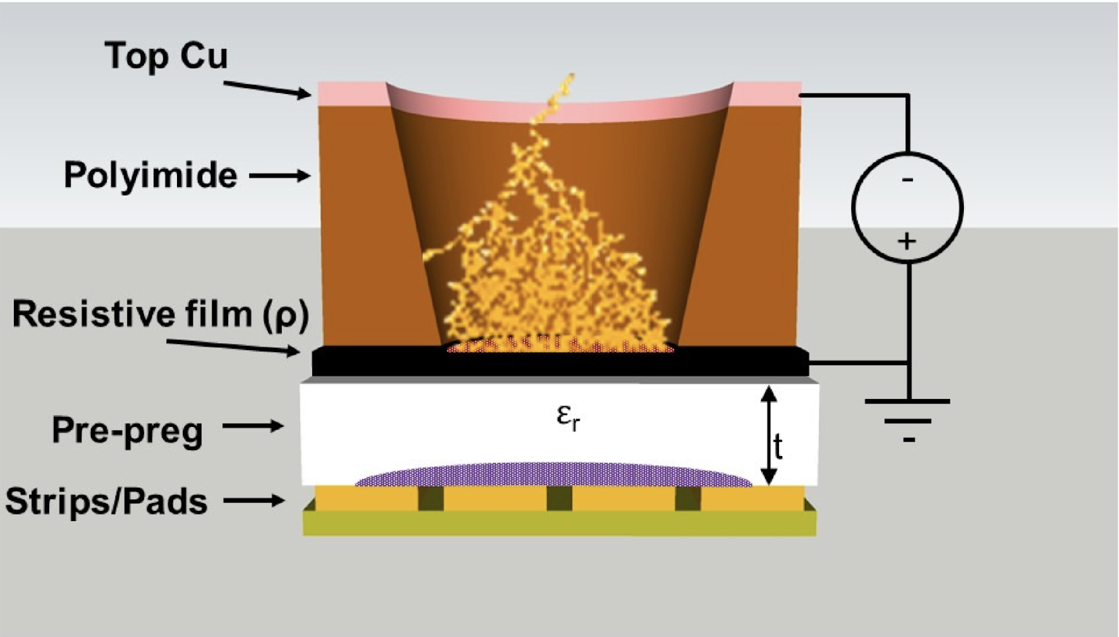
The μRWELL MPGD
Diamond-Like Carbon layer (DLC)
Robust against electrical discharge
High gain in a single amplification stage (>10⁴)
2D Readout capability
High-rate capability
Layout of μRWELL [3]
Notes:
Highlight gain
Less text
To detect the reaction products over a wide range of energies (~10 keV to several MeV), the novel μRWELL (micro-Resistive WELL) detectors are used as the gas multiplication stage. First-ever μRWELL integration in cylindrical geometry

Slide 9

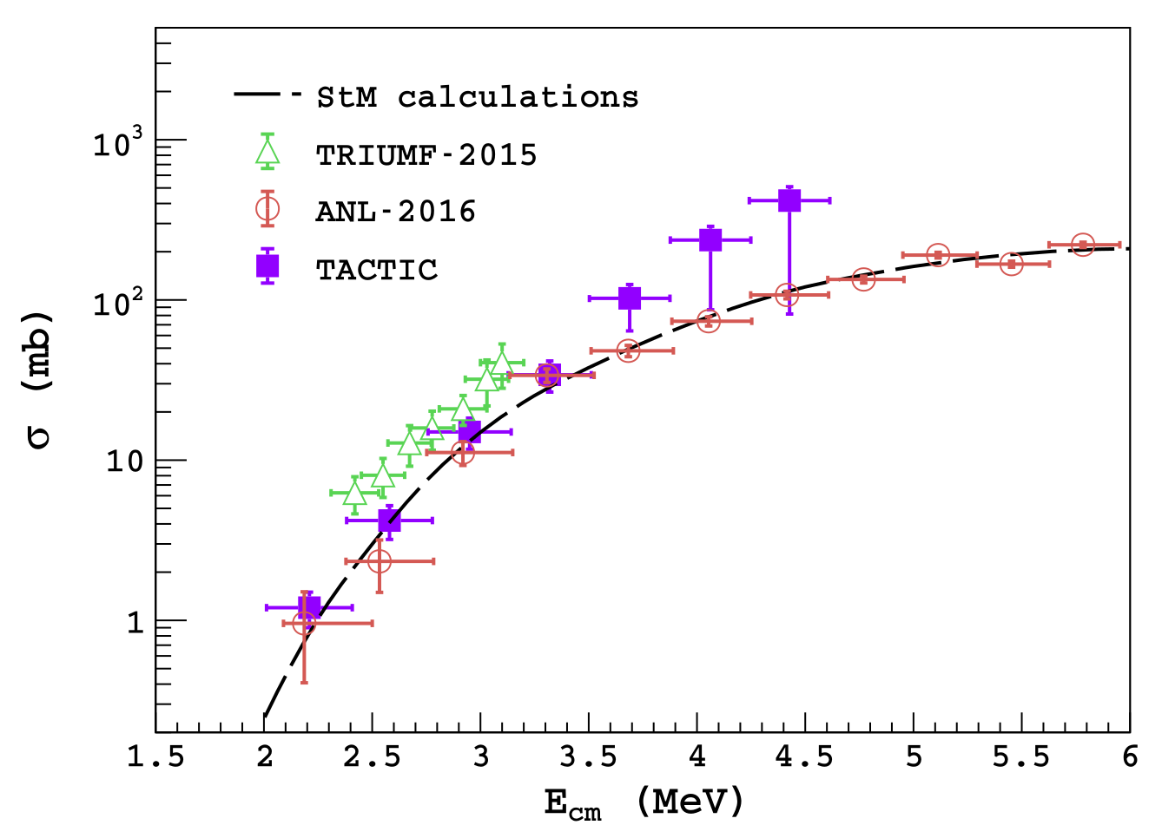
First successful measurement
First successful cross-section measurement with TACTIC: November 2022
²³Na(ɑ,p)²⁶Mg reaction cross section in Gamow window
Experimental parameters
Beam particle: ²³Na (6+)
Beam energy: 1.7 MeV/u
Target gas: He:CO₂ 90:10 1 bar
Beam intensity: 5.3 x10⁶ pps
Run time: 3 hours
Geometrical efficiency: ~6.1% (with 1 sector implemented)
Cross sections measured with TACTIC [1] for the ²³Na(ɑ,p)²⁶Mg reaction and comparison with published cross sections

Slide 10
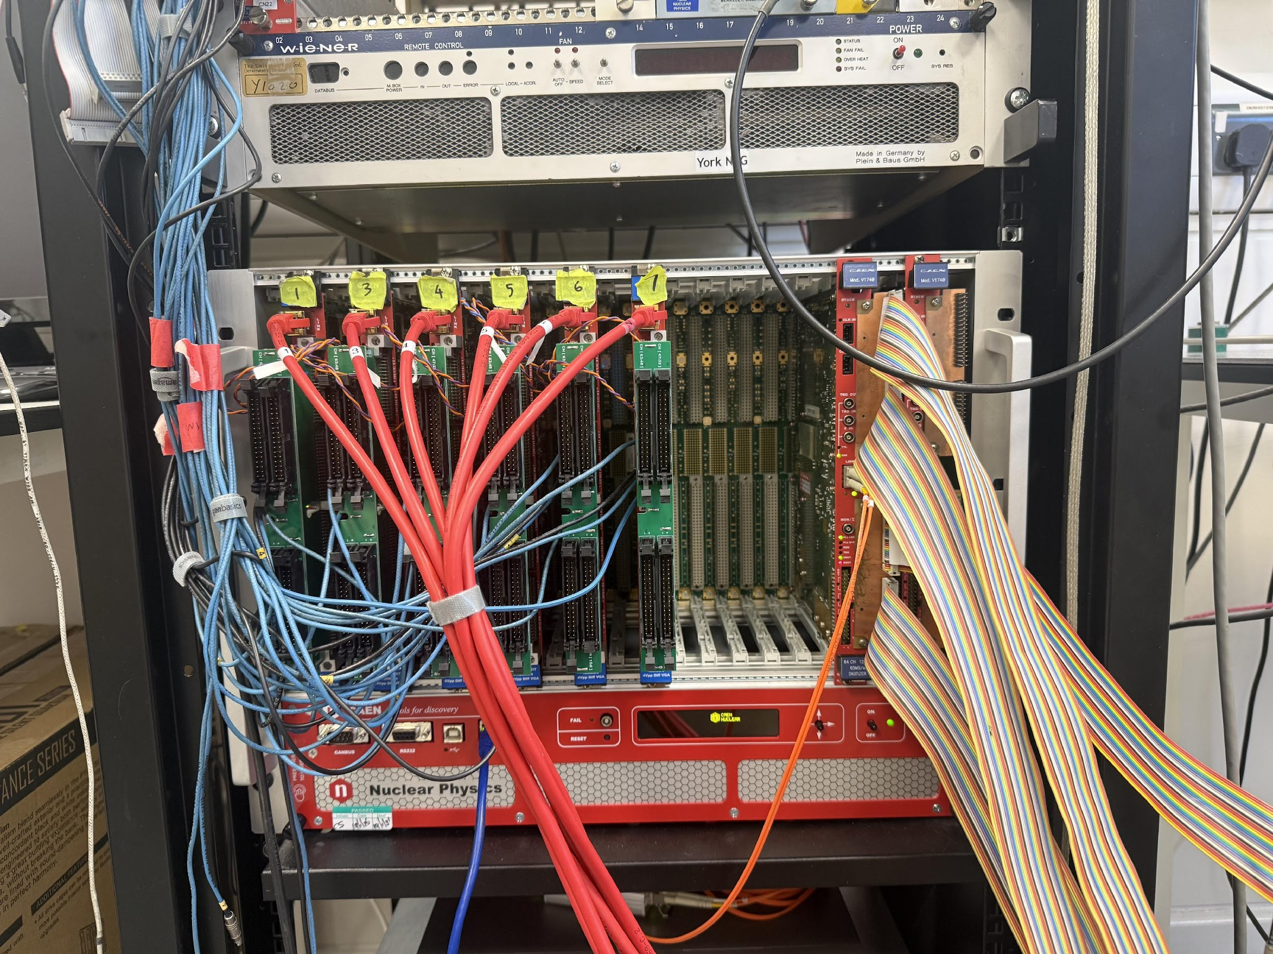
Recent upgrades
Instrumented 6 TACTIC sectors, compared to 1 during ²³Na(ɑ,p)²⁶Mg measurement
Upgraded DAQ: Caen V2745 digitisers with zero suppression capability
Sectors implemented during S2442. Green denotes full sector, orange denotes ½ sector (downstream)
Notes:
125 MS/s ADCs

Slide 11
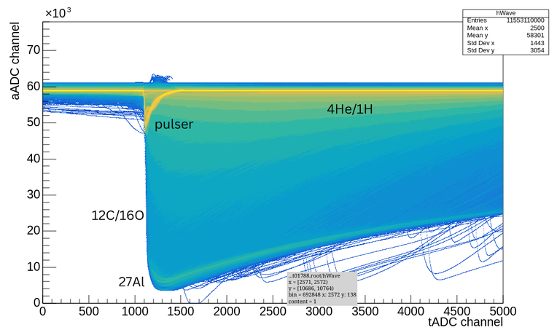
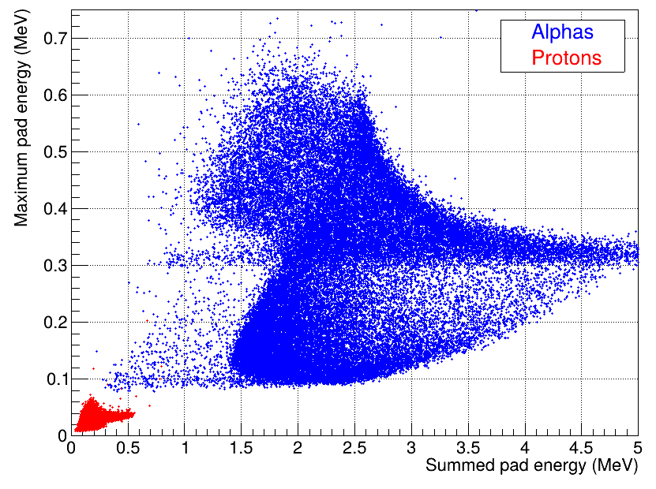
Particle ID and vertex reconstruction
Beam species: ²⁷Al (6+)
Beam energy: 1.65 MeV/u
Intensity: 5x10⁵ -> 9x10⁵ pps
Gas: 90:10 He:CO₂ at 1 bar
Waveforms are recorded for pulse shape analysis:
Vertex reconstruction
Particle identification
E_{summed} vs E_{max} for protons and alphas. Multiplicity cut > 5, Energy threshold > 10 keV
Notes:
- Key challenge is separating elastic scattering from reaction. Heavier ions deposit more energy. Seen here is a clear separation between reaction protons and elastic scattering

Slide 12
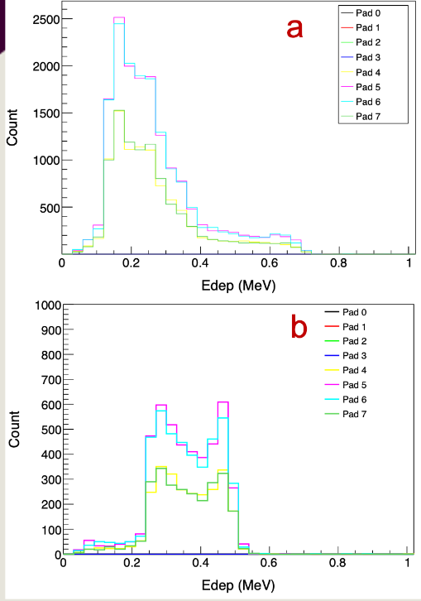
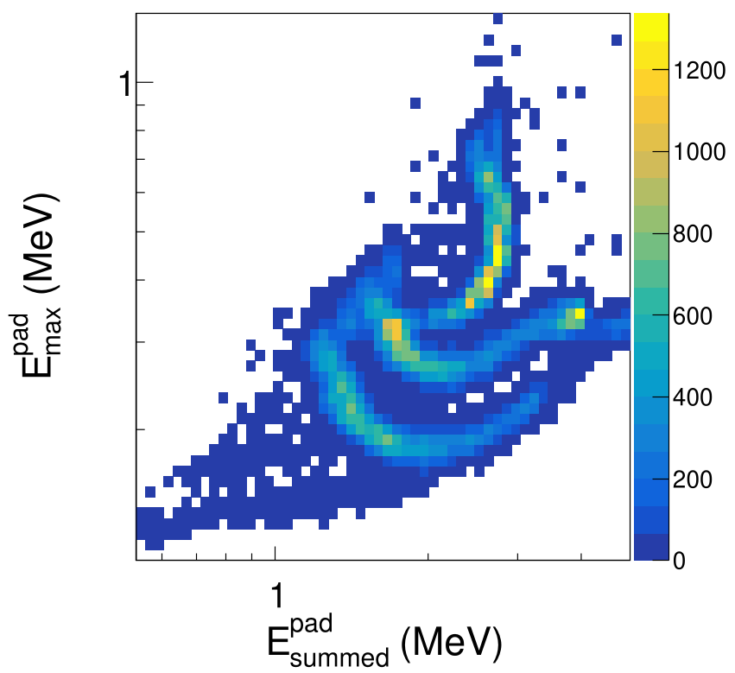
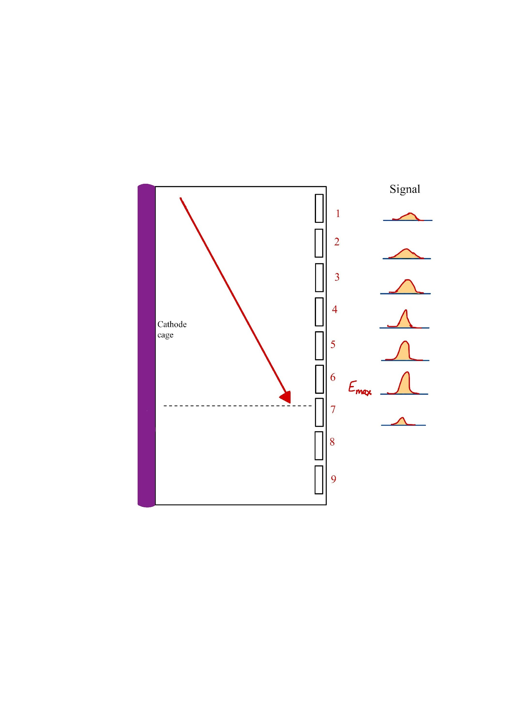
Alpha source calibration
Source composition
¹⁴⁴Gd - 3.27 MeV
²³⁰Th - 4.77 MeV
²⁴⁴Cm - 5.90 MeV
Source position
Signal
E_{max}
Triple alpha spectra, (a) pad 32, (b) pad 19. Multiplicity cut > 5, 50 keV threshold
Cathode cage
E-∆E plots for triple alpha source, with multiplicity cut 5, and 50 keV threshold
Notes:
Gd – stops inside gas.

Slide 13
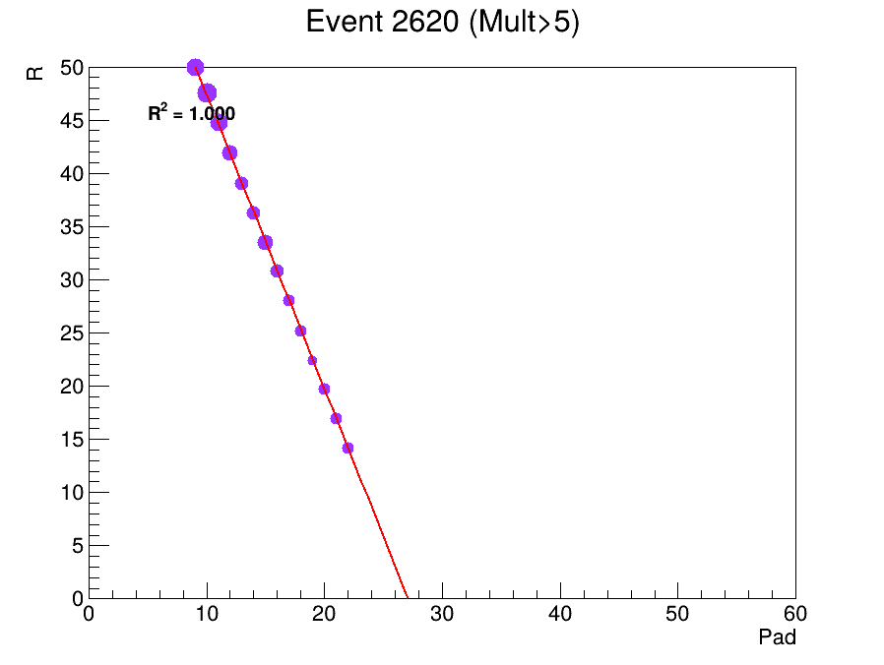
Track visualisation
Alpha Source
¹⁴⁴Gd - 3.27 MeV
μRWELL pad plane
Assumptions
Straight tracks
Begin at R = 0 mm
Signals begin to form at R = 12 mm
R
Cathode cage, R=12 mm
Pad
Notes:
Remove black points
NPTool simulations of alpha source tracks showing energy deposition weighted tracks
The linear fit applied to the track can be used to determine the vertex position in Z

Slide 14
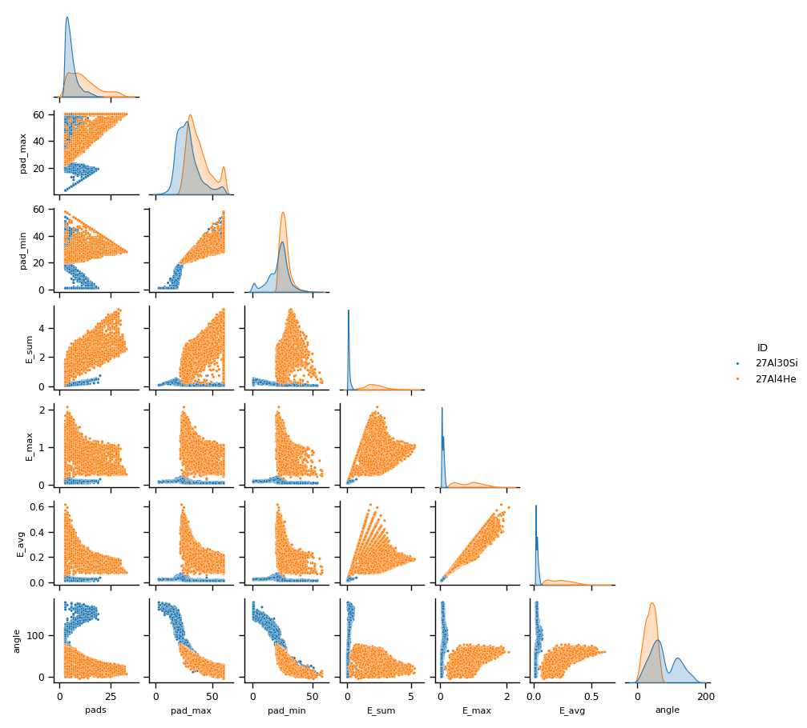
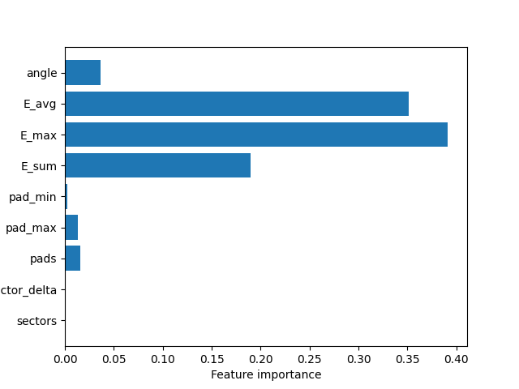
Machine learning for PID
²⁷Al(ɑ,p)³⁰Si
Random forest classifier algorithm
Protons
angle E_avg E_max E_sum pad_min pad_max
Alphas
Train on simulation data → Extract feature importance
Apply to experimental data → simulation guides optimal cuts and PID strategy
pads pad_max pad_min E_sum E_max E_avg angle
Notes:
Remove red and make new legend for blue/orange
Less text

Slide 15
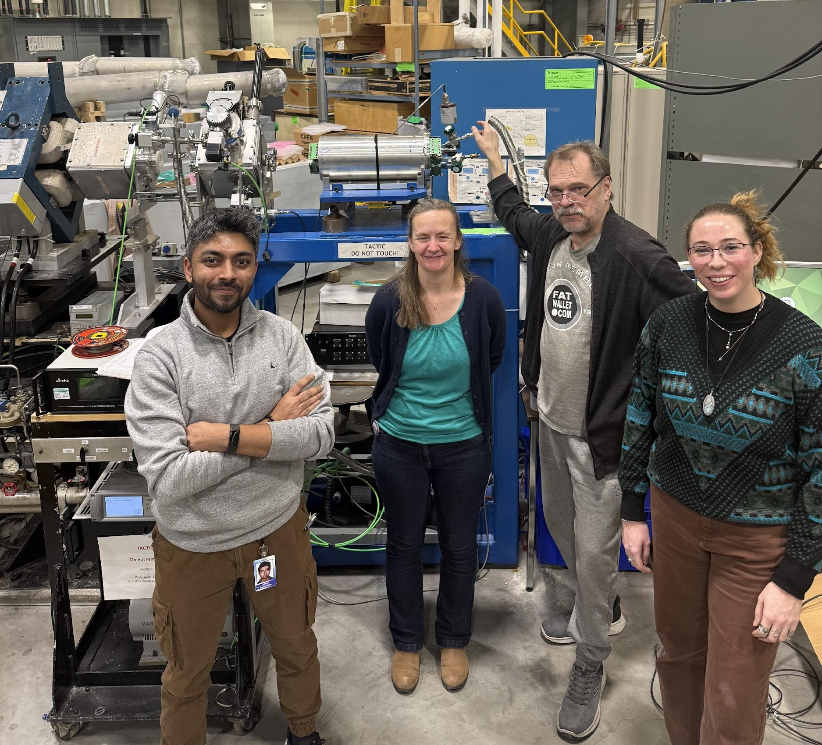
Summary
First measurement of astrophysically significant ²⁷Al(ɑ,p)³⁰Si within Gamow window at TRIUMF
Upgrades to TACTIC: implemented 6 sectors, digitiser update
Development of machine learning PID and analysis strategy for improved cross-section calculation

Slide 16
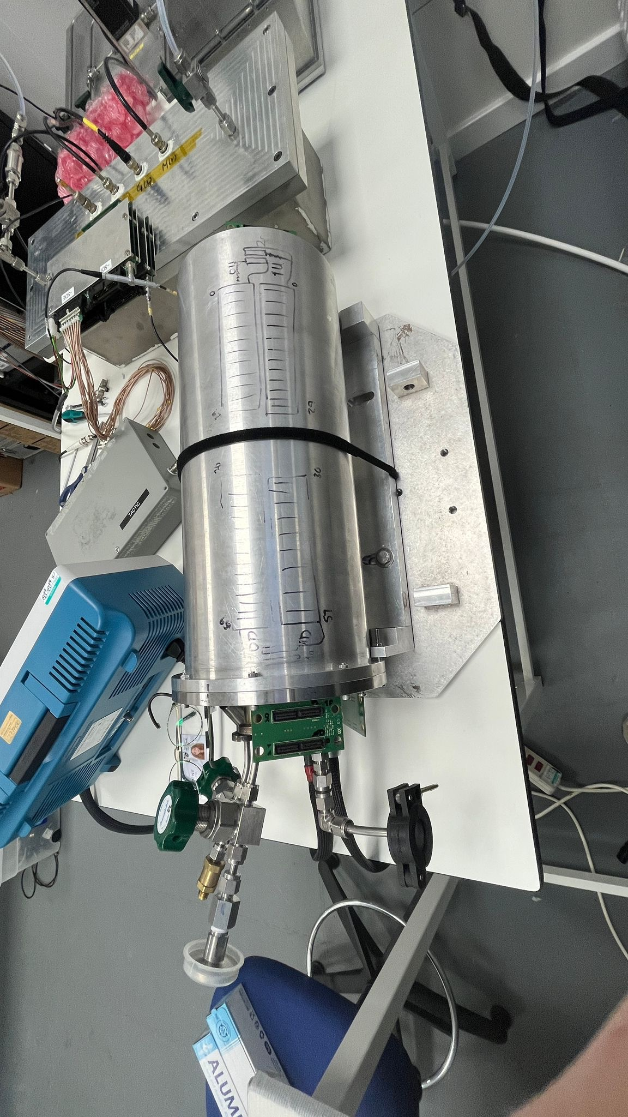
Next steps
Testing in York nuclear physics labs ahead of TRIUMF 2027 measurements
Investigating the use of methane as a fill gas for (p,ɑ) measurements
Structural improvements: preamp mounts, end flange
Implementing Si end detectors to enhance the detection capabilities of recoils and protons significantly
Commissioning paper in progress
2 accepted experimental proposals for TRIUMF in 2027:
²⁶Al(ɑ,p)²⁹Si
¹⁷F(ɑ,p)²⁰Ne
References
[1] Chakraborty, Soham (2023) Development of TACTIC: a novel detector for nuclear astrophysics. PhD thesis, University of York.
[2] L. Martin, TACTIC: the TRIUMF Annular Chamber for Tracking and Identification of Charged particles, PhD thesis (2015).
[3] G. Bencivenni et al 2019 JINST 14 P05014
[4] S. Subedi et al. APJ 2020
[5] Mohr, Peter. (2015). Cross sections of a-induced reactions for targets with masses A ~20-50 at low energies.

Slide 17

^{Thank you for listening ☺}
Annabelle Cyster
Annabelle.cyster@york.ac.uk
Many thanks to my supervisors Alison Laird and Christian Diget, Soham Chakraborty, members of the York Nuclear Physics Group, and all collaborators at TRIUMF who took part in the experiment. Thanks also to Julien Bordes for his support with NPTool.

Slide 18
Spare slides

Slide 19
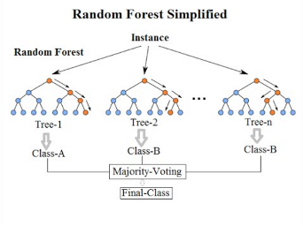
Random forest classifier algorithm
Train on NPTool simulation data → map observables to particle type
Extract feature importance → identifies which detector parameters drive PID (energy loss vs topology)
Use seaborn distributions → visualise separation between classes and correlations
Apply to experimental data→ same features used on real data, with simulation guiding optimal cuts and PID strategy

Slide 20
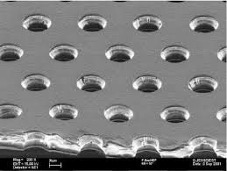
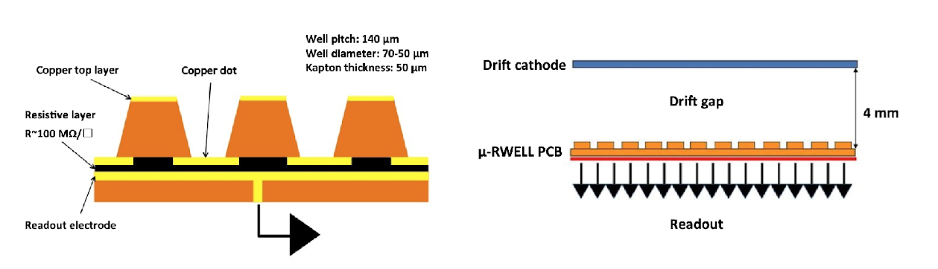
Evolution of TACTIC
TACTIC developments began, 2007
Gaseous Electron Multipliers (GEMs) were first mounted as the readout stage
Implementation of μRWELL MPGD as gas amplification stage
Successful cross section measurement of ²³Na(ɑ,p)²⁶Mg, 2022
Implemented new DAQ and 6 x sectors for first measurement of ²⁷Al(ɑ,p)³⁰Si in Gamow window, 2025
Development continues …
Novel μRWELLs were employed as the gas amplification stage (year?)

