Slide 1






Collinear laser spectroscopy at COLLAPS and analysis of ¹⁵¹⁻¹⁷⁵Tm
IOP Brighton 2026
Presentation by Jack Hughes
sgjhugh3@liverpool.ac.uk

Slide 2
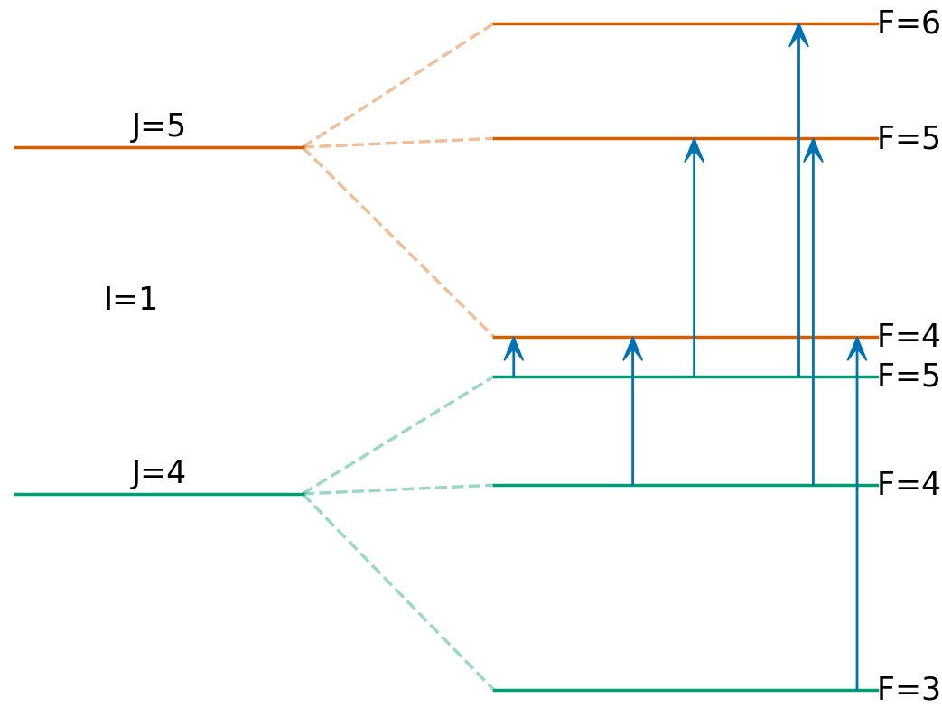

Hyperfine Splitting
Hyperfine structure arises from fine structure of electron energy levels due to interactions between electrons and the nucleus.
With enough resolution, a single electronic transition can be seen to split into multiple transitions between different levels.
$$F=I+J ≥F≥\left|I−J\right|$$
IOP Brighton 2026

Slide 3
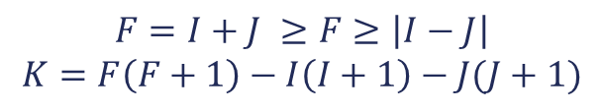
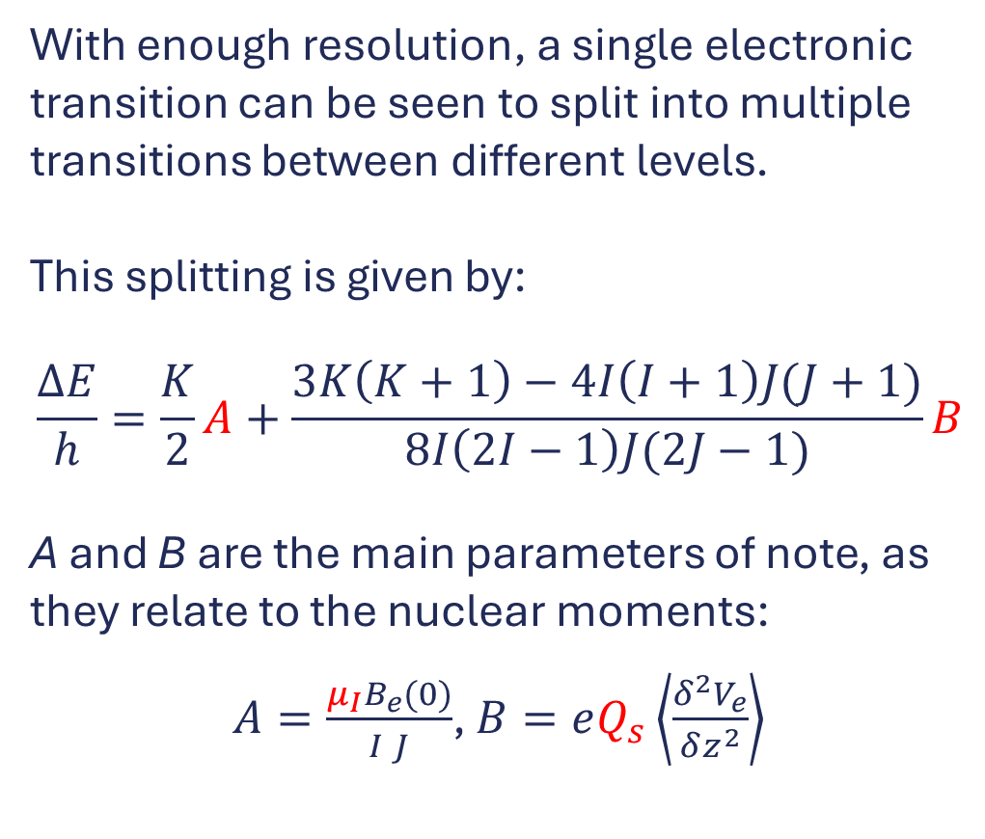
Hyperfine Splitting
With enough resolution, a single electronic transition can be seen to split into multiple transitions between different levels.
This splitting is given by:
$$\frac{ΔE}{h}=\frac{K}{2}A+\frac{3K\left(K+1\right)−4I\left(I+1\right)J(J+1)}{8I\left(2I−1\right)J(2J−1)}B$$
A and B are the main parameters of note, as they relate to the nuclear moments:
$A=\frac{μ_{I}B_{e}(0)}{I J}$, $B=eQ_{s}\left\langle \frac{δ^{2}V_{e}}{δz^{2}}\right\rangle$
$$F=I+J ≥F≥\left|I−J\right|$$
$$K=F\left(F+1\right)−I\left(I+1\right)−J(J+1)$$
IOP Brighton 2026

Slide 4
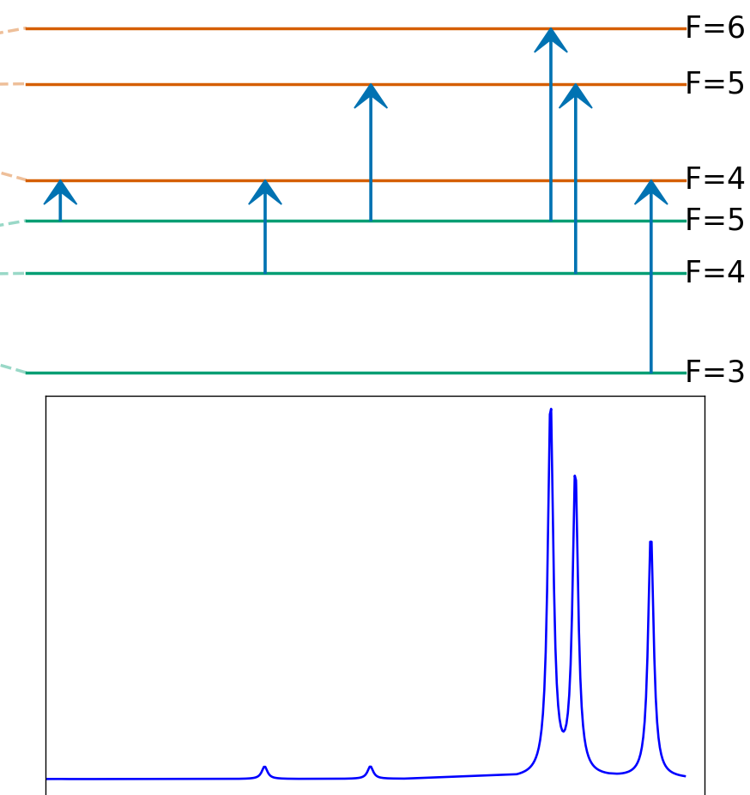
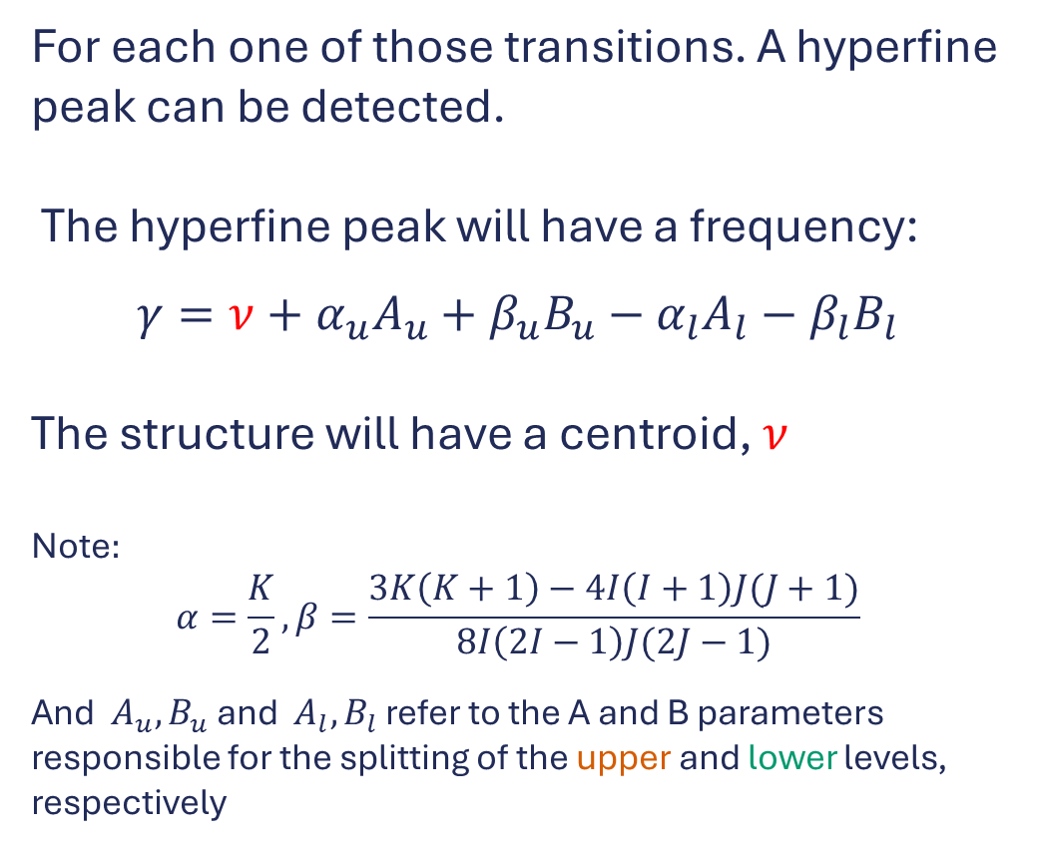
Hyperfine Structure
For each one of those transitions. A hyperfine peak can be detected.
The hyperfine peak will have a frequency:
$$γ=ν+α_{u}A_{u}+β_{u}B_{u}−α_{l}A_{l}−β_{l}B_{l}$$
The structure will have a centroid, $ν$
Note$:$
$$α=\frac{K}{2}, β=\frac{3K\left(K+1\right)−4I\left(I+1\right)J(J+1)}{8I\left(2I−1\right)J(2J−1)}$$
And ${A_{u},B}_{u}$ and $A_{l},B_{l}$ refer to the A and B parameters responsible for the splitting of the upper and lower levels, respectively
Intensity
frequency
IOP Brighton 2026

Slide 5
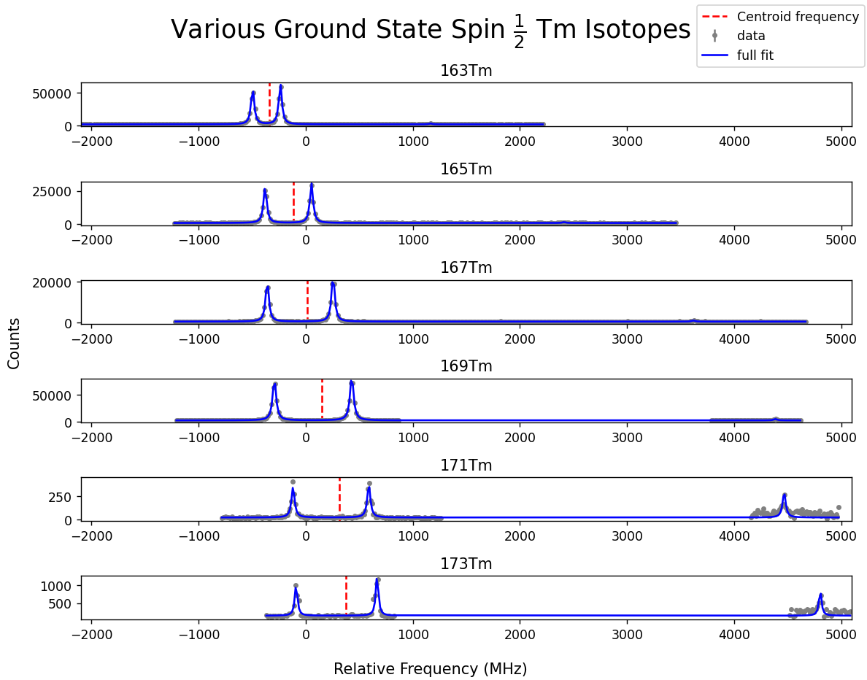
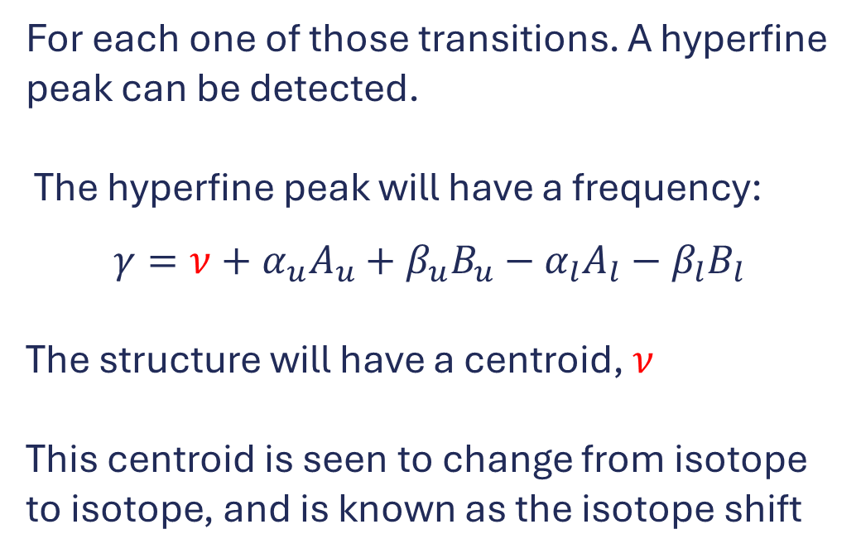
Centroid Shift
For each one of those transitions. A hyperfine peak can be detected.
The hyperfine peak will have a frequency:
$$γ=ν+α_{u}A_{u}+β_{u}B_{u}−α_{l}A_{l}−β_{l}B_{l}$$
The structure will have a centroid, $ν$
This centroid is seen to change from isotope to isotope, and is known as the isotope shift
IOP Brighton 2026

Slide 6
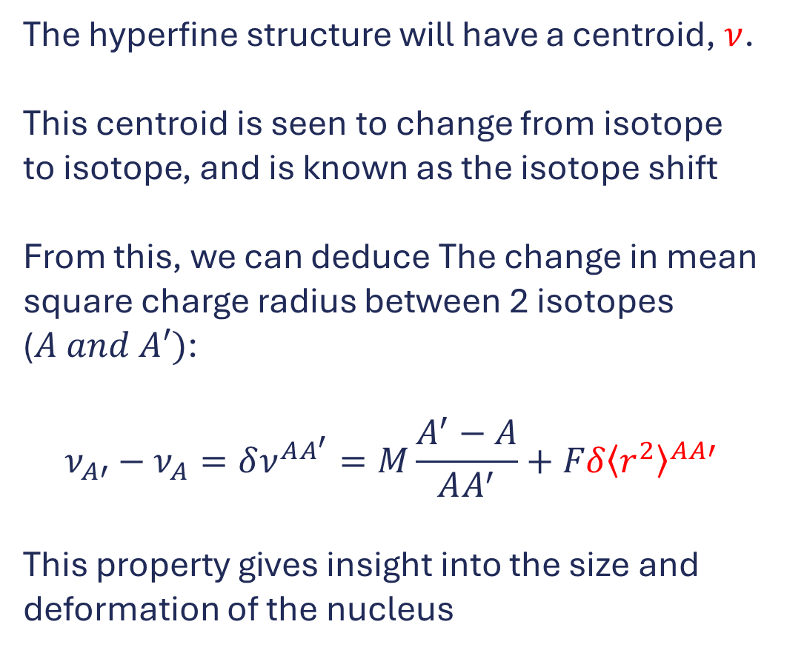
Centroid Shift
The hyperfine structure will have a centroid, $ν$.
This centroid is seen to change from isotope to isotope, and is known as the isotope shift
From this, we can deduce The change in mean square charge radius between 2 isotopes ($A and A′)$:
$$ν_{A′}−ν_{A}=δν^{AA^{′}}=M\frac{A^{′}−A}{AA^{′}}+Fδ{\left\langle r^{2}\right\rangle }^{AA′}$$
This property gives insight into the size and deformation of the nucleus
IOP Brighton 2026

Slide 7
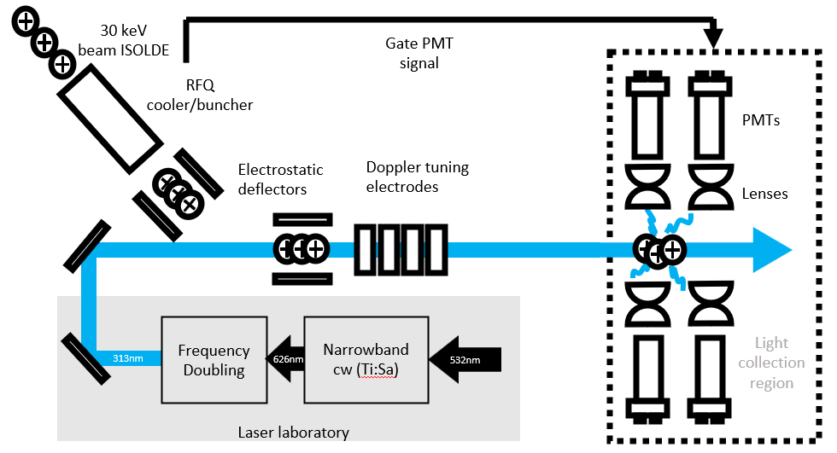
COLLAPS
Continuous radioactive ion beam from ISOLDE arrives into the cooler/buncher.
The cooler buncher converts the continuous beam into pulsed bunches.
Bunches are then released and accelerated from the cooler/buncher.
IOP Brighton 2026

Slide 8
COLLAPS
Ion bunches are deflected so that they overlap with the laser.
The speed of the ions is adjusted by the tuning electrodes.
Laser frequency experienced by the ions is dependent on their speed.
Scanning the voltage on the tuning plates has the same effect as scanning the laser frequency directly
IOP Brighton 2026

Slide 9
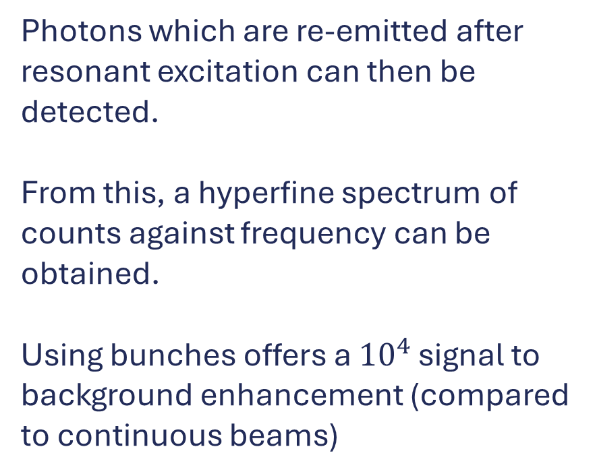
COLLAPS
Photons which are re-emitted after resonant excitation can then be detected.
From this, a hyperfine spectrum of counts against frequency can be obtained.
Using bunches offers a ${10}^{4}$ signal to background enhancement (compared to continuous beams)
IOP Brighton 2026

Slide 10
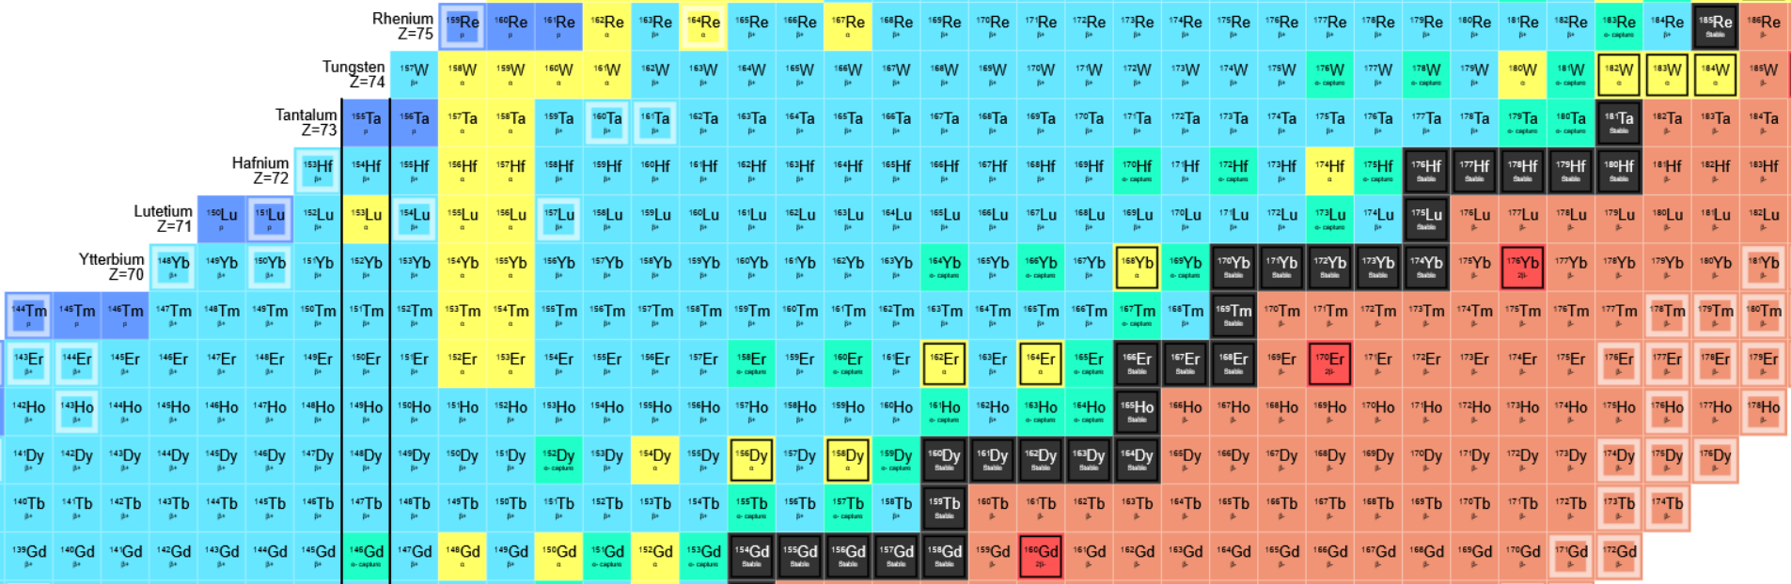
Motivation
Target isotope
The eventual goal is to reach the heavily neutron deficient side of thulium to reach ¹⁴⁷Tm. This is because ¹⁴⁷Tm is a proton emitter with a 15% proton emission branch.
A model independent change in charge radii measurement of a proton emitter would provide valuable information to benchmark theory models.
Previously measured
IOP Brighton 2026

Slide 11
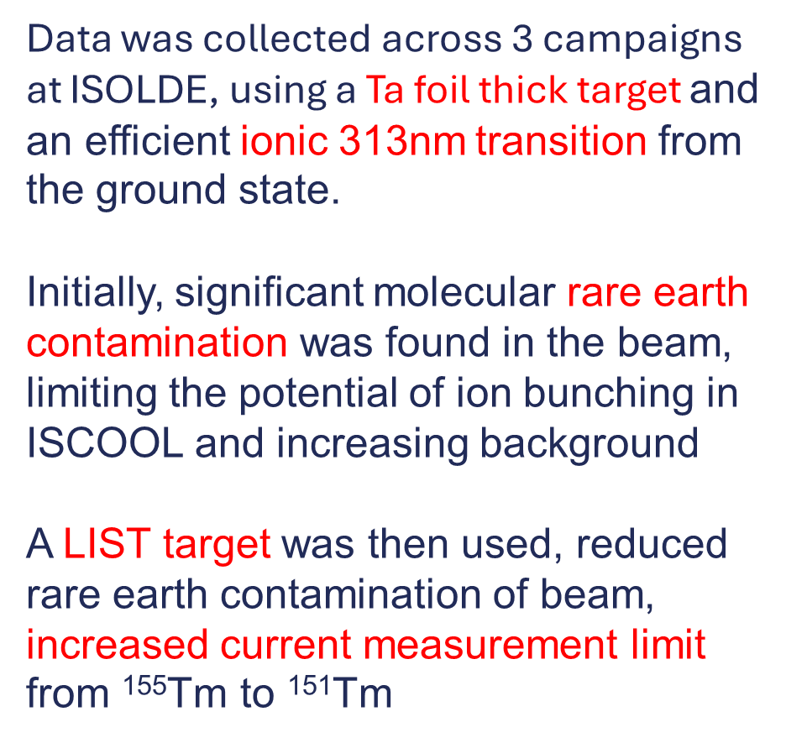
Data collection
Isotopes measured initially
Data was collected across 3 campaigns at ISOLDE, using a Ta foil thick target and an efficient ionic 313nm transition from the ground state.
Initially, significant molecular rare earth contamination was found in the beam, limiting the potential of ion bunching in ISCOOL and increasing background
A LIST target was then used, reduced rare earth contamination of beam, increased current measurement limit from ¹⁵⁵Tm to ¹⁵¹Tm
All isotopes measured
IOP Brighton 2026

Slide 12
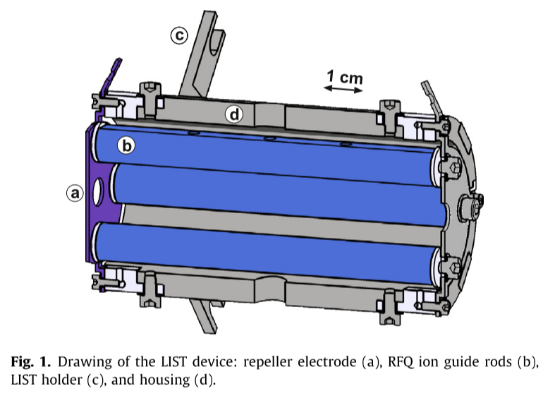
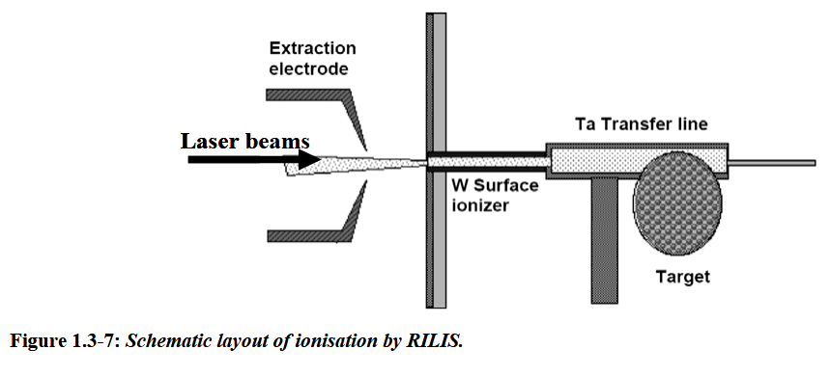
LIST target vs ion guide target
Fink, D. A., Richter, S. D., Bastin, B., Blaum, K., Catherall, R., Cocolios, T. E., Fedorov, D. v, Fedosseev, V. N., Flanagan, K. T., Ghys, L., Gottberg, A., Imai, N., Kron, T., Lecesne, N., Lynch, K. M., Marsh, B. A., Mendonca, T. M., Pauwels, D., Rapisarda, E., … Wendt, K. D. A. (2013). First application of the Laser Ion Source and Trap (LIST) for on-line experiments at ISOLDE. https://doi.org/10.1016/j.nimb.2013.06.039
Bouquerel, Elian & Berthier, B & Lettry, J & Stora, Thierry. (2009). Atomic Beam Merging and Suppression of Alkali Contaminants in Multi Body High Power Targets: Design and Test of Target and Ion Source Prototypes at ISOLDE.
IOP Brighton 2026

Slide 13
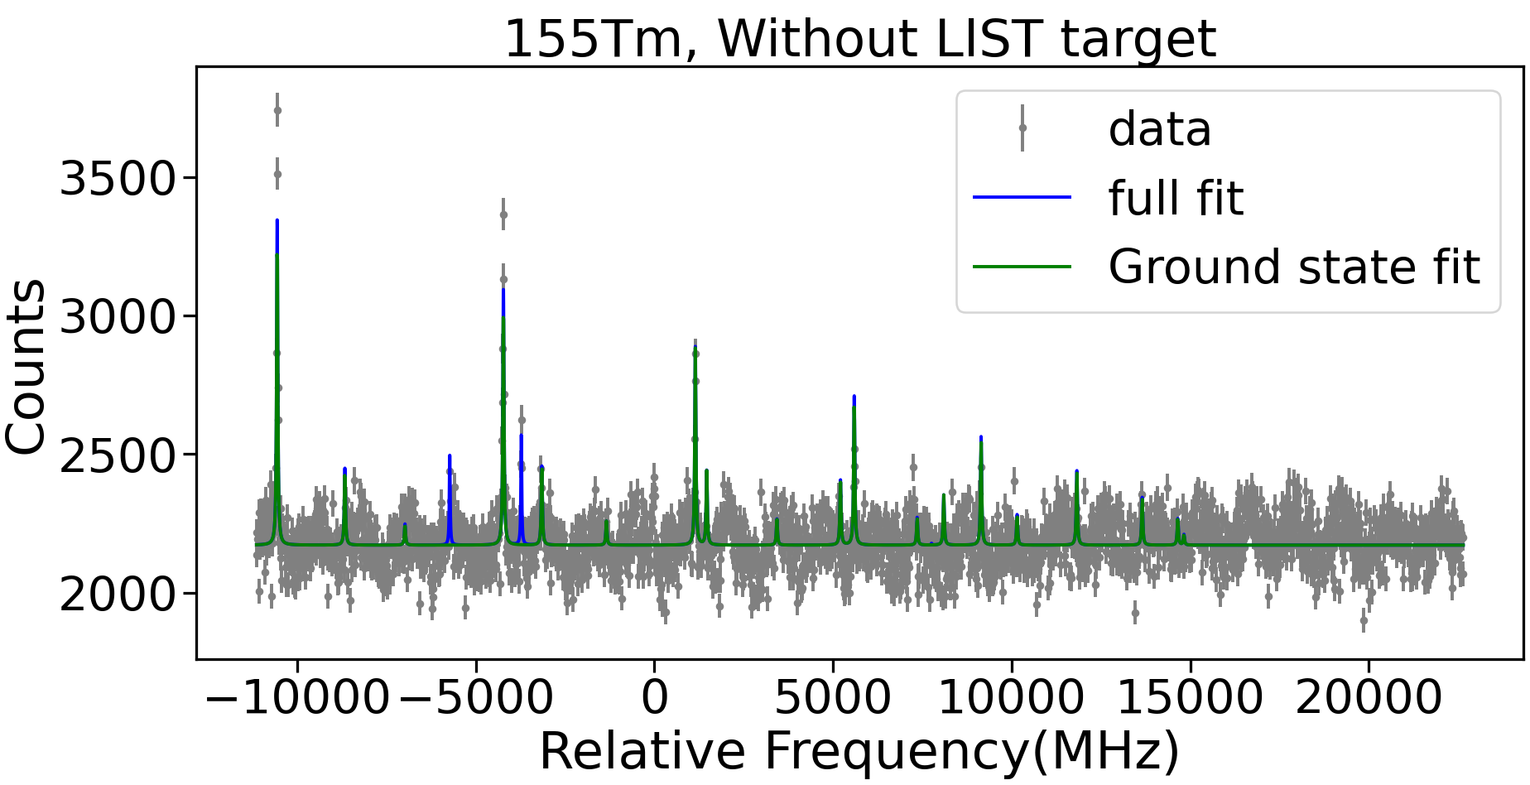
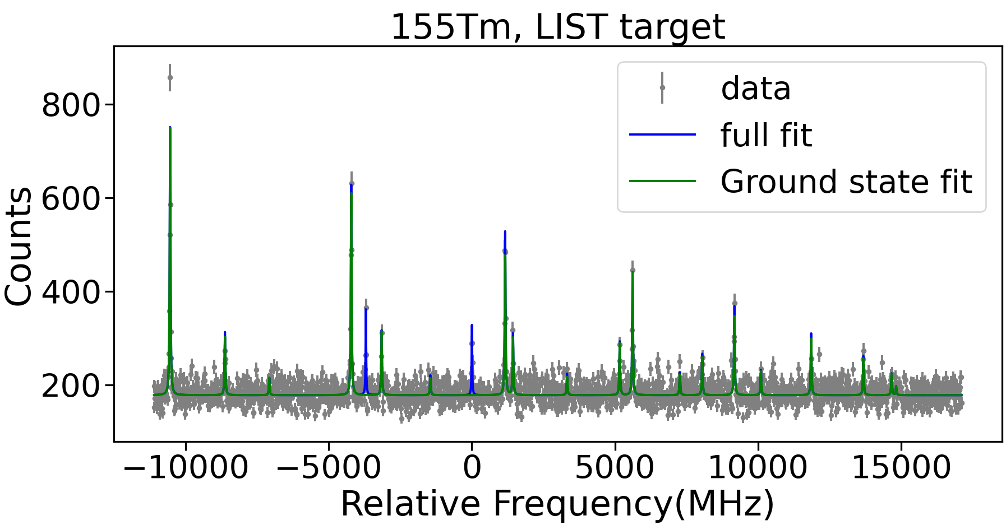
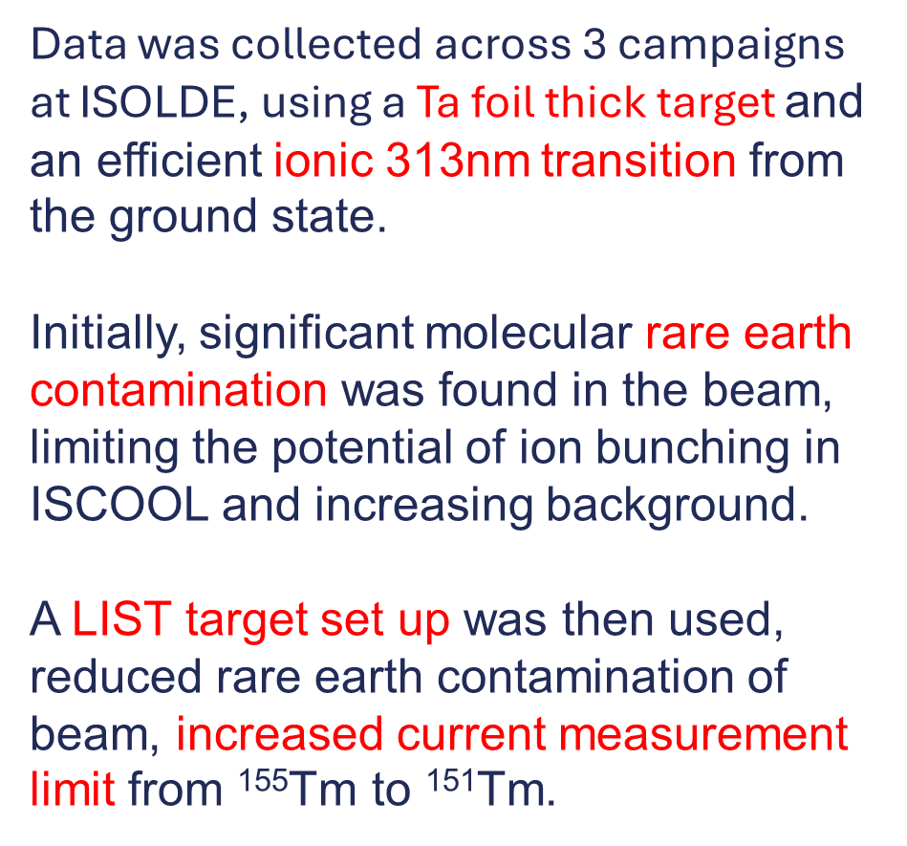
Data collection
Signal to background: 1.7
Data was collected across 3 campaigns at ISOLDE, using a Ta foil thick target and an efficient ionic 313nm transition from the ground state.
Initially, significant molecular rare earth contamination was found in the beam, limiting the potential of ion bunching in ISCOOL and increasing background.
A LIST target set up was then used, reduced rare earth contamination of beam, increased current measurement limit from ¹⁵⁵Tm to ¹⁵¹Tm.
Signal to background: 4.8
IOP Brighton 2026

Slide 14
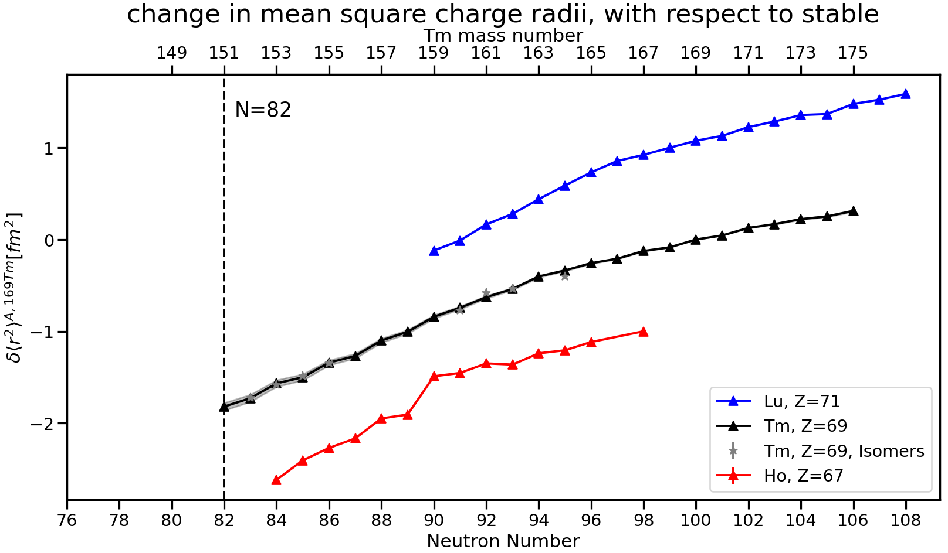
Results:
Charge radii
Charge radii is what would be expected of the mid-shell region.
A kink would be expected to be seen after the N=82 shell closure
And perhaps an increase at N=78 (¹⁴⁷Tm)
Preliminary
?
IOP Brighton 2026

Slide 15
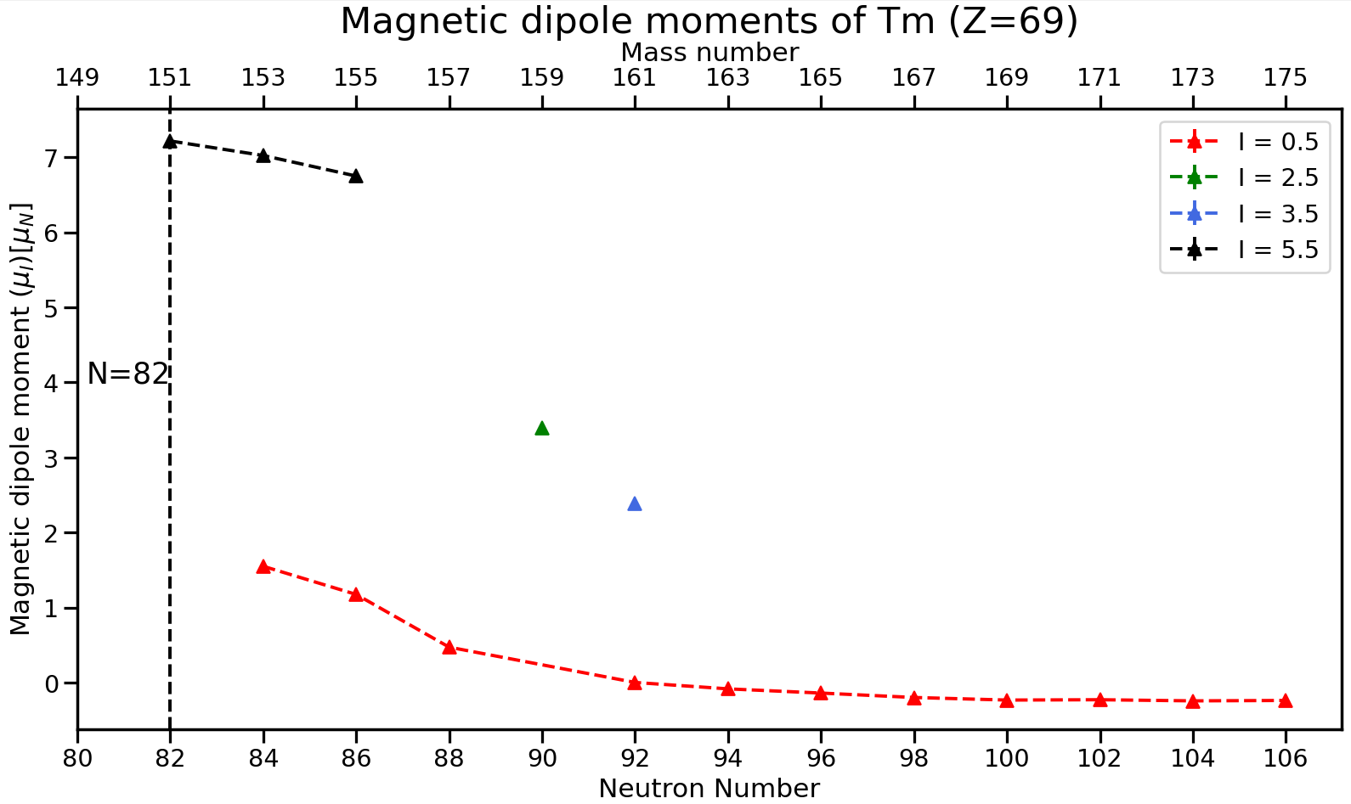
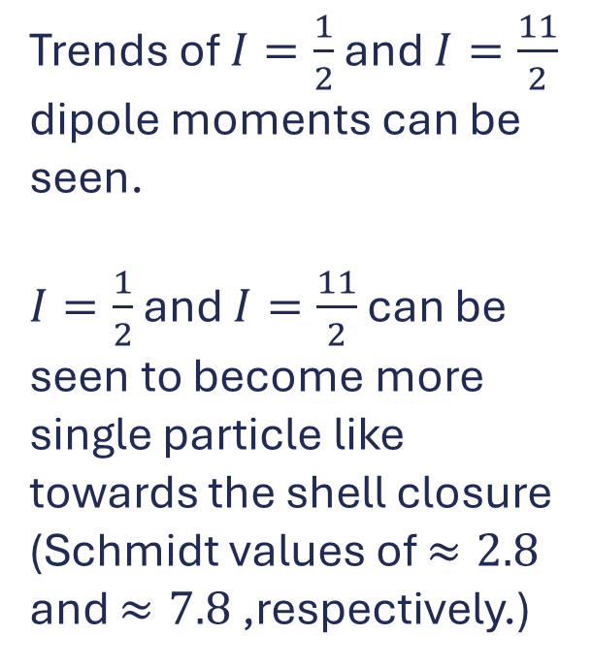
Results: Nuclear moments
Trends of $I=\frac{1}{2}$ and $I=\frac{11}{2}$ dipole moments can be seen.
$I=\frac{1}{2}$ and $I=\frac{11}{2}$ can be seen to become more single particle like towards the shell closure (Schmidt values of $≈2.8$ and $≈7.8$ ,respectively.)
Preliminary
IOP Brighton 2026

Slide 16
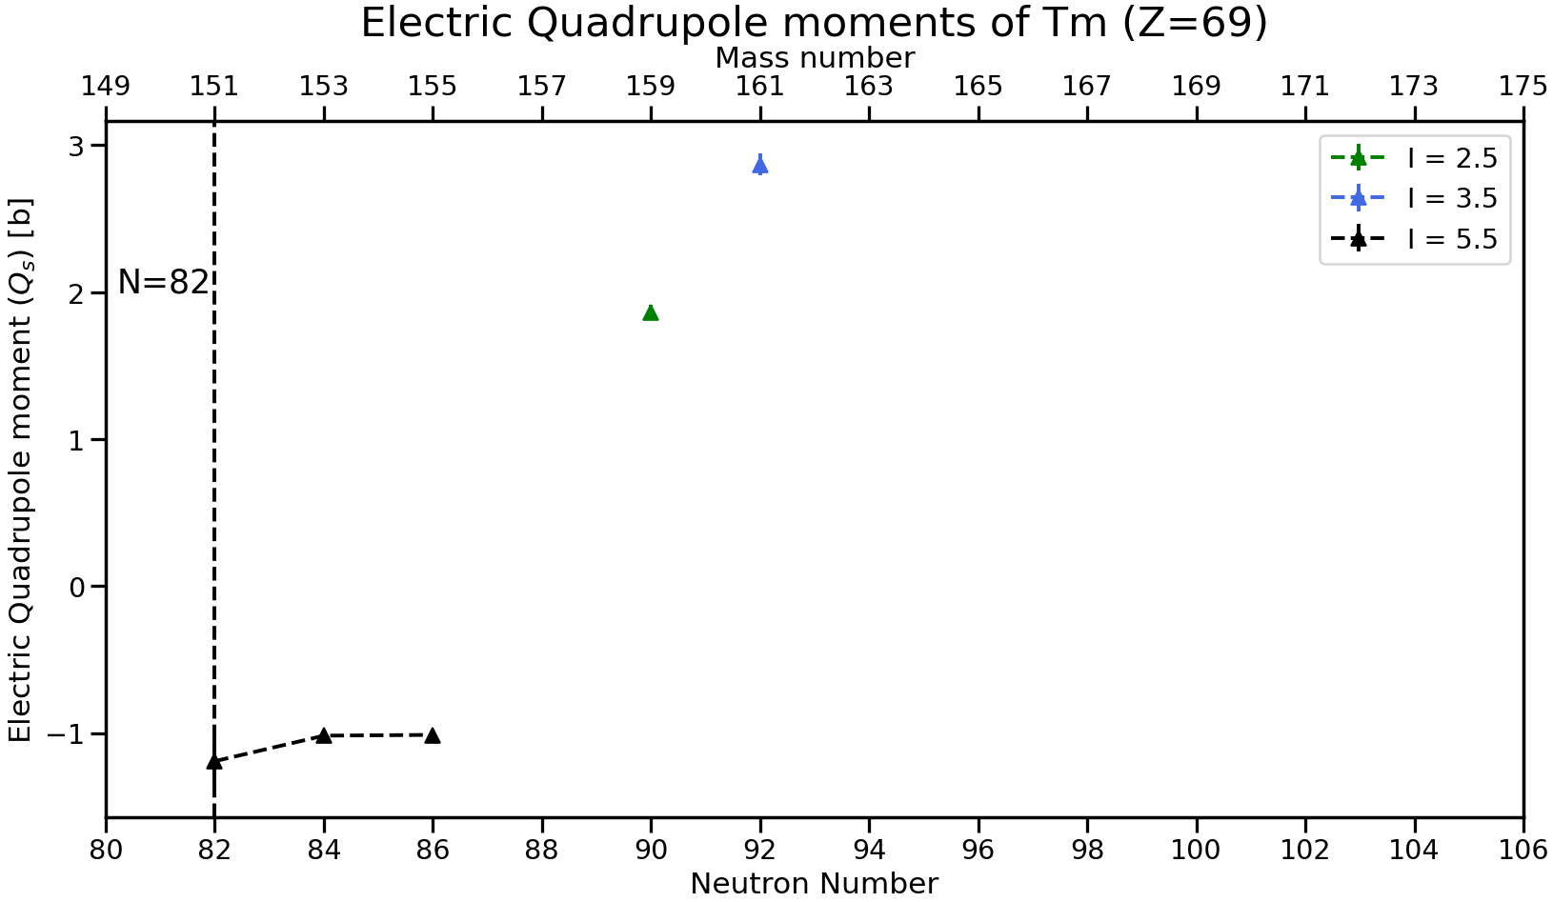
Results: Nuclear moments
Only odd-evens are shown here.
Preliminary
IOP Brighton 2026

Slide 17
Conclusions and future work
Measurements of the ground states and isomers of ¹⁵¹⁻¹⁷⁵Tm have been made using colinear laser spectroscopy, with many being made for the first time.
Obtain theory values for Mass and Field shift. And compare to current results calculated using previous reference data.
Seek DFT calculations of the charge radii and nuclear moments.
Using current data, can speculate about the charge radii and moments of the proton emitter ¹⁴⁷Tm.
Potentially use PI-LIST to measure past the shell closure to likely observe a kink at the N=82 shell closure and measure ¹⁴⁷Tm.
IOP Brighton 2026

Slide 18
Thank you for your attention!
Any questions?
IOP Brighton 2026
Presentation by Jack Hughes
sgjhugh3@liverpool.ac.uk
Thanks to all involved with the data collection and analysis at COLLAPS and the running of ISOLDE

Slide 19
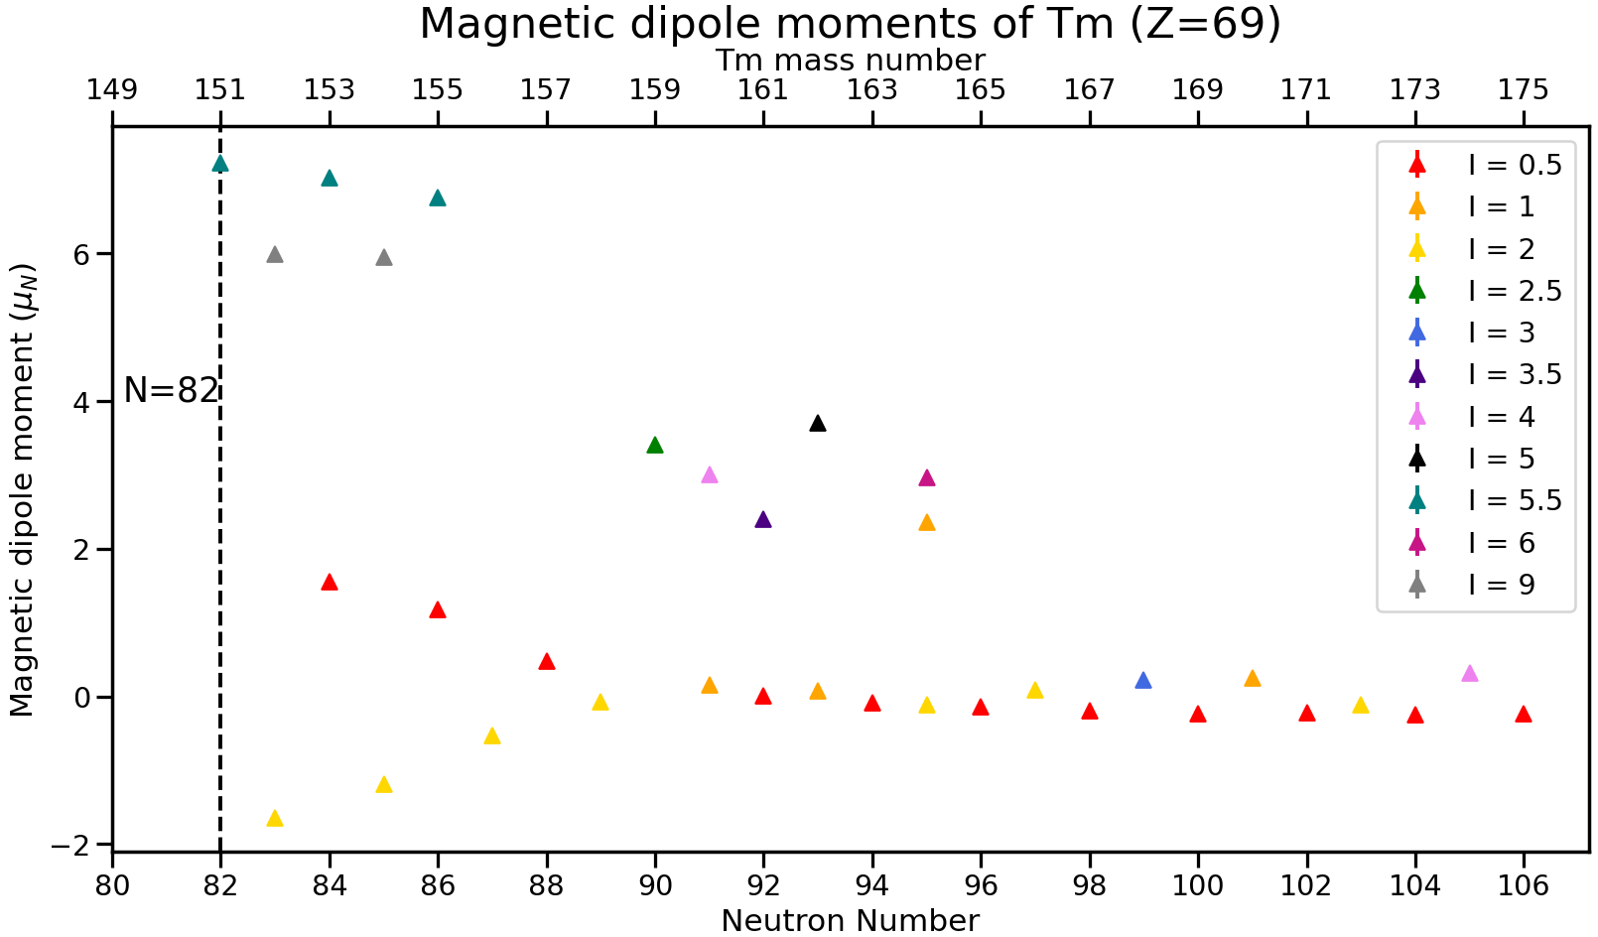
Results: Nuclear moments
Preliminary
IOP Brighton 2026

Slide 20
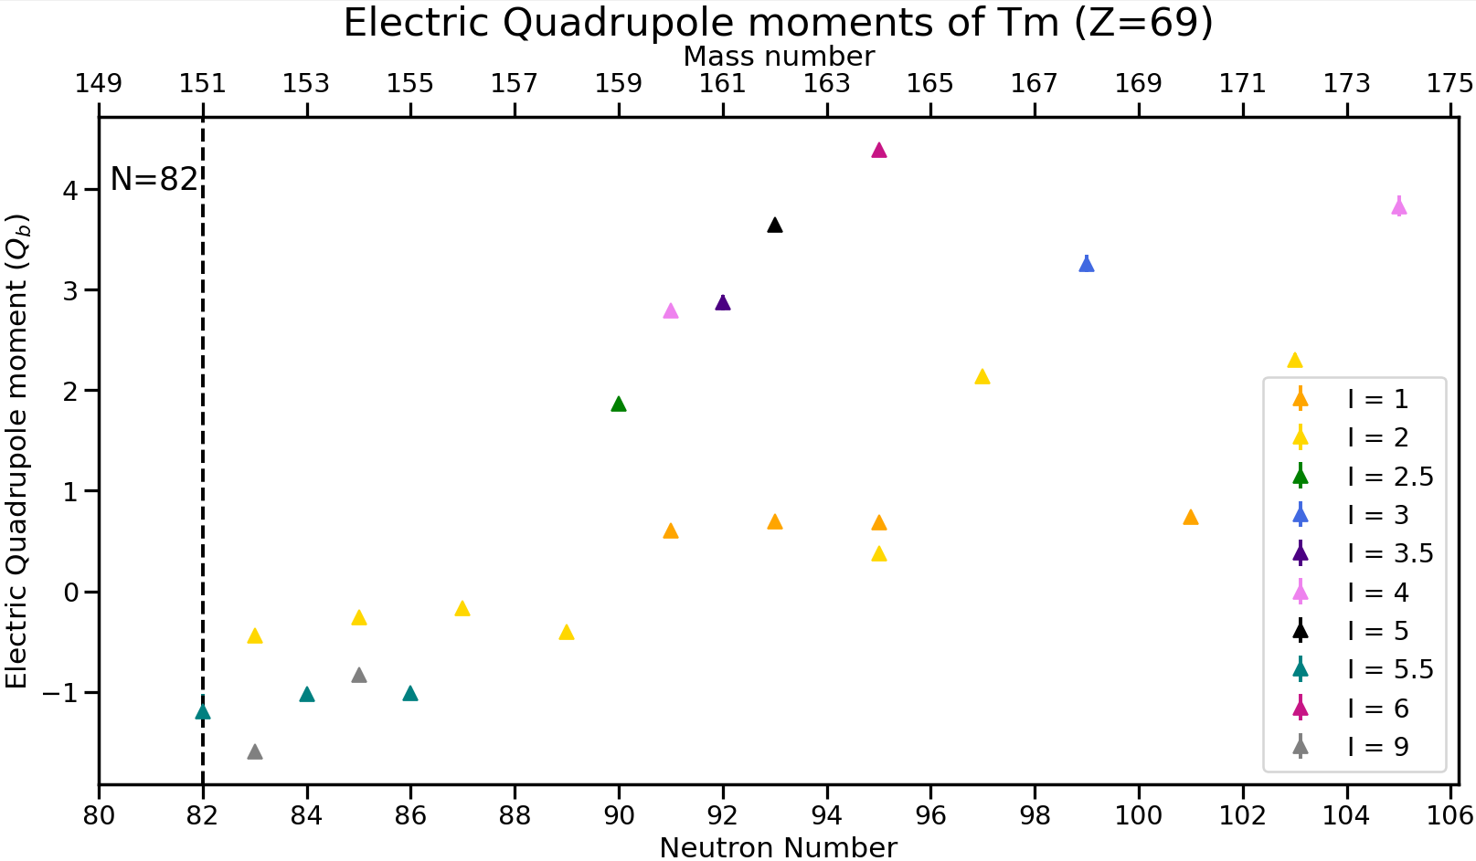
Results: Nuclear moments
Preliminary
IOP Brighton 2026

