Slide 1

Lifetime measurements of the 2₁⁺ state in ¹²⁸Nd and ¹³²Sm *using the charge plunger method
Dr Jacob Heery

Slide 2
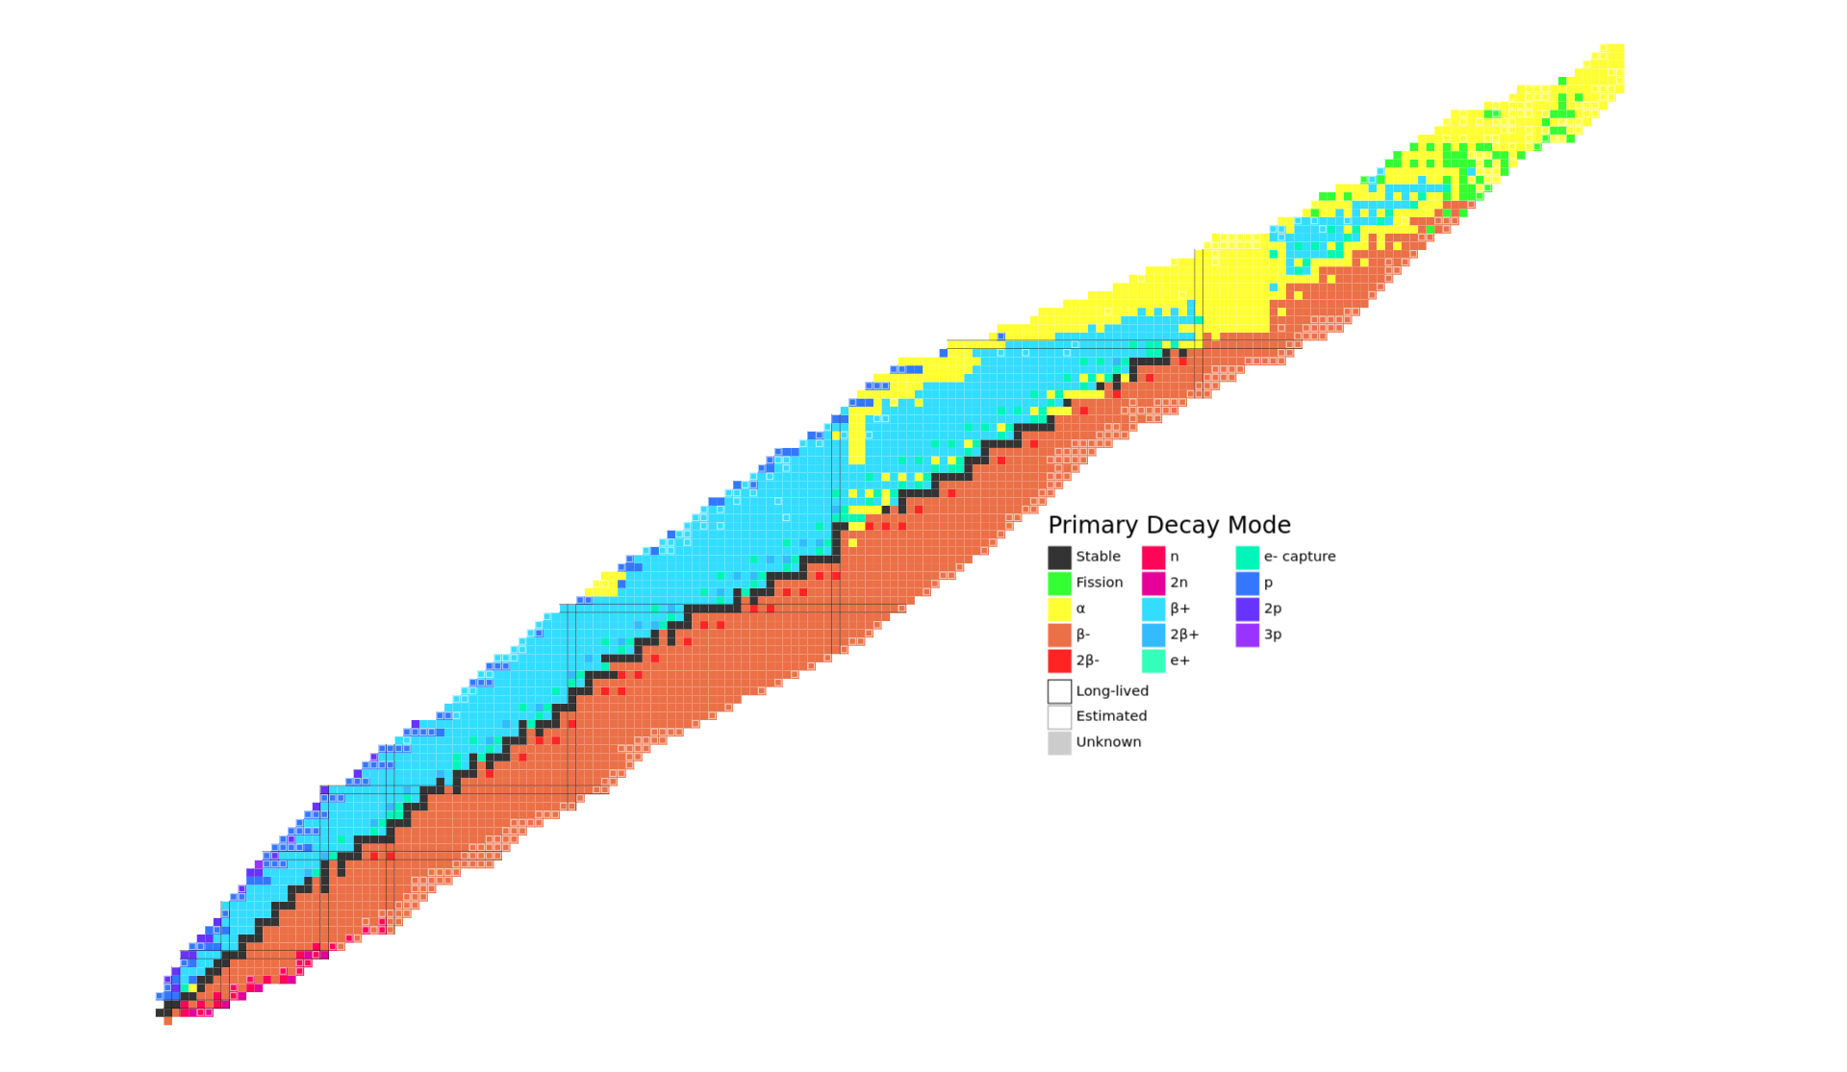
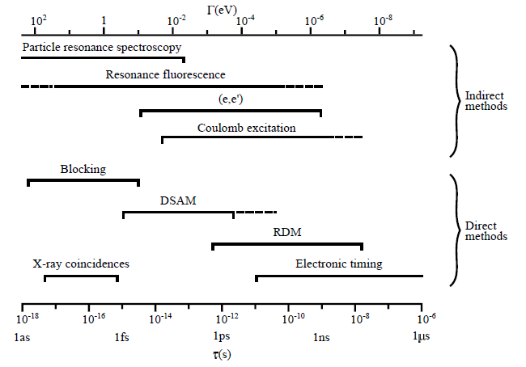
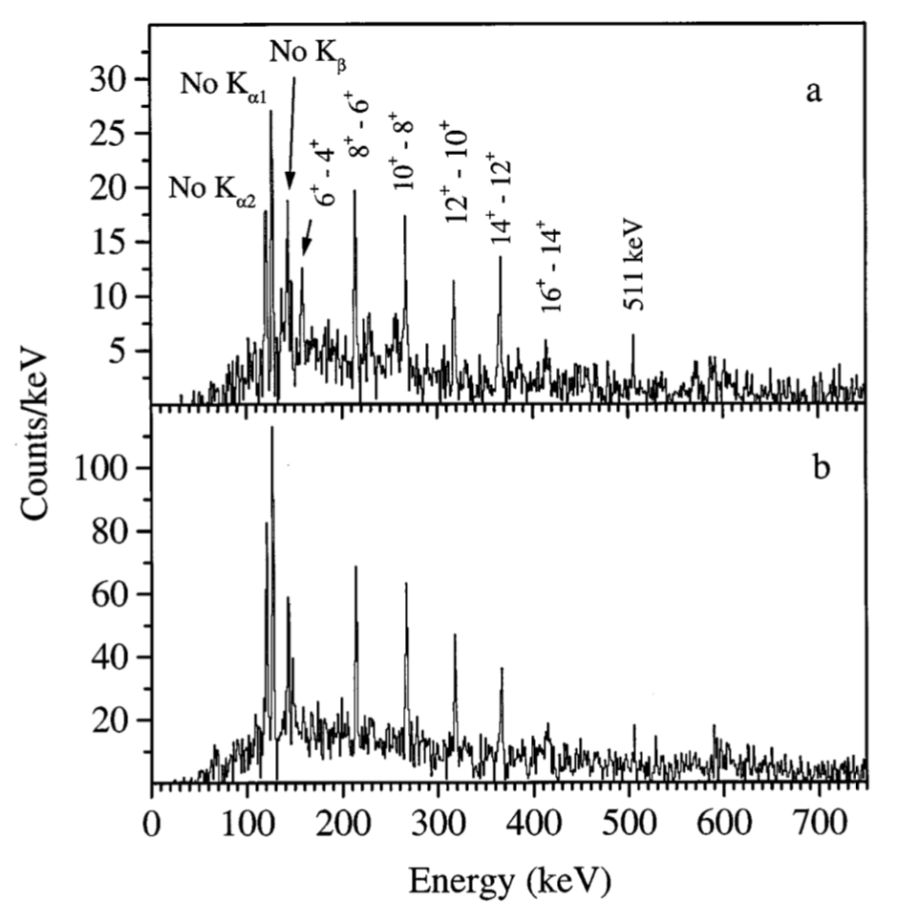
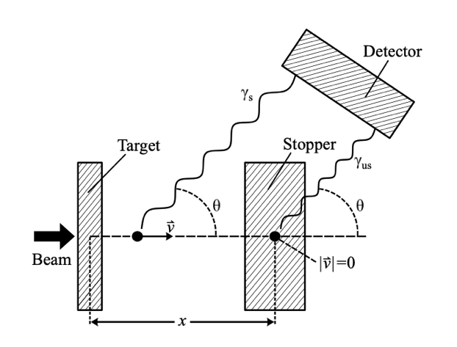
Lifetime measurements in nuclei
P. J. Nolan, J. F. Sharpey-Schafer, Reports on Progress in Physics, 42(1):1–86, (1979)
Spectroscopic limit
2⁺→0⁺
4⁺→2⁺
²⁵⁴No recoil-gated γ rays
Recoil Distance Doppler-Shift (RDDS)
Short distance
γ_{s}
γ_{us}
How to measure lifetimes for states which de-excite with large internal conversion coefficients?
E_{γ}
Long distance
E_{γ}
A. Dewald, O. Möller, P. Petkov, Progress in Particle and Nuclear Physics, 67(3):786–839, (2012)
M. Leino, Eur. Phys. J. A. 6, 63-69 (1999)

Slide 3
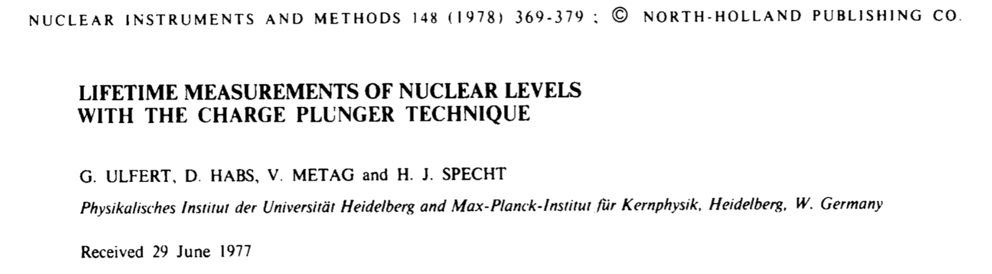
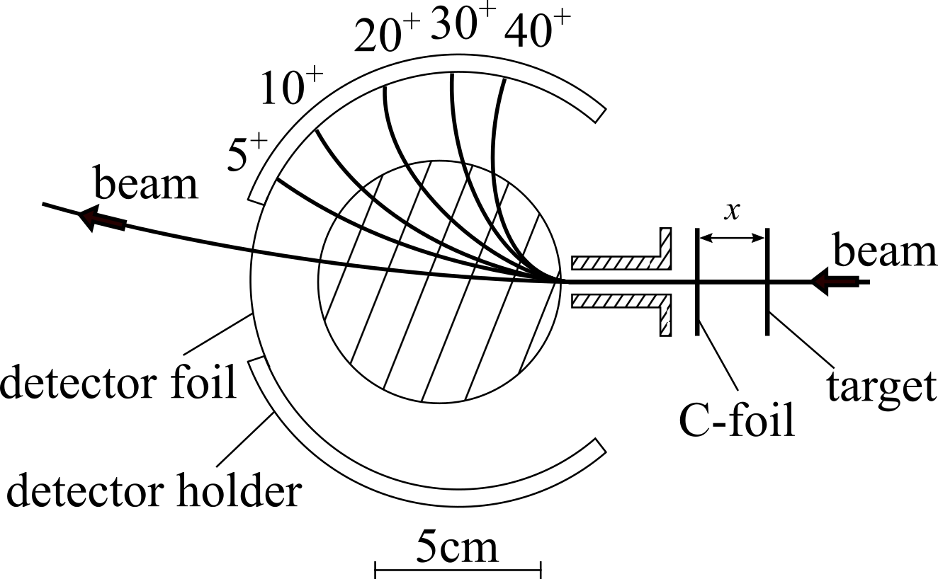
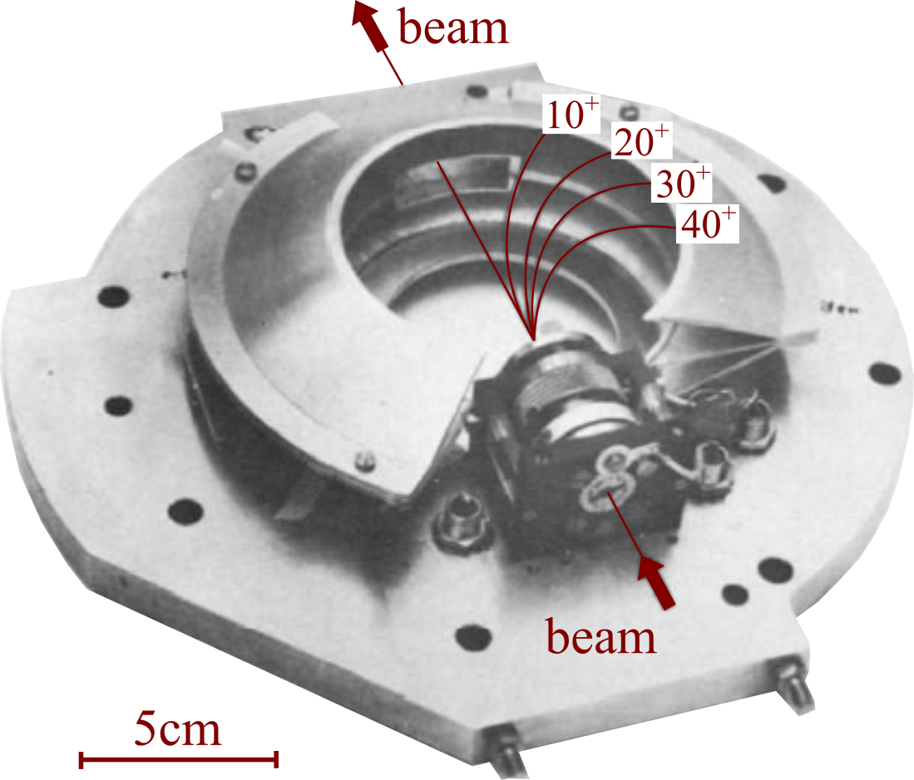
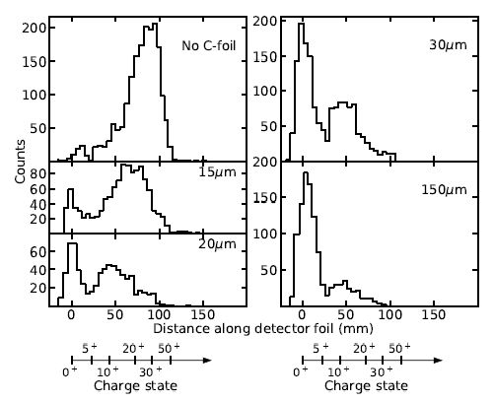
The charge plunger method
Basic concept
Infer an internal conversion event through the change in the ion charge state
No need to detect the conversion electron!

Slide 4
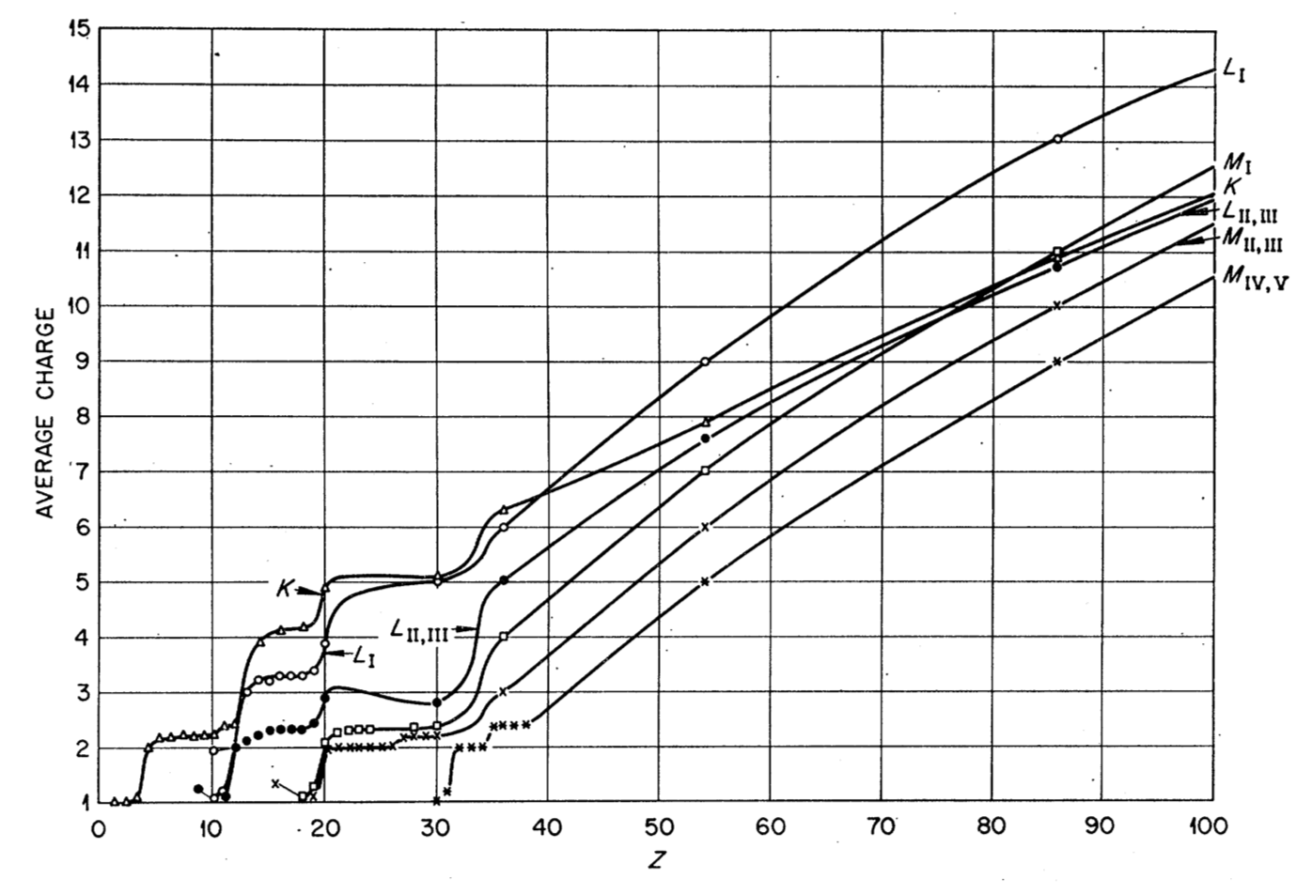
Auger electron emission
T. Carlson, W. Hunt, M. Krause, Phys. Rev., 151, 41 (1966)
Increase in charge due to Auger emission following a vacancy in an inner atomic orbital
Internal conversion
Auger emission
Several Auger electrons are emitted during the atomic relaxation.
→ Large increase in ionic charge following internal conversion.

Slide 5
Basic concept of the charge plunger method
Charge state of the ion is is reset after travelling through foil

Slide 6
Basic concept of the charge plunger method
A γ-ray transition doesn’t create a vacancy in an atomic orbital

Slide 7
Basic concept of the charge plunger method
Internal conversion creates a vacancy in an inner atomic shell, leading to the emission of several Auger electrons

Slide 8
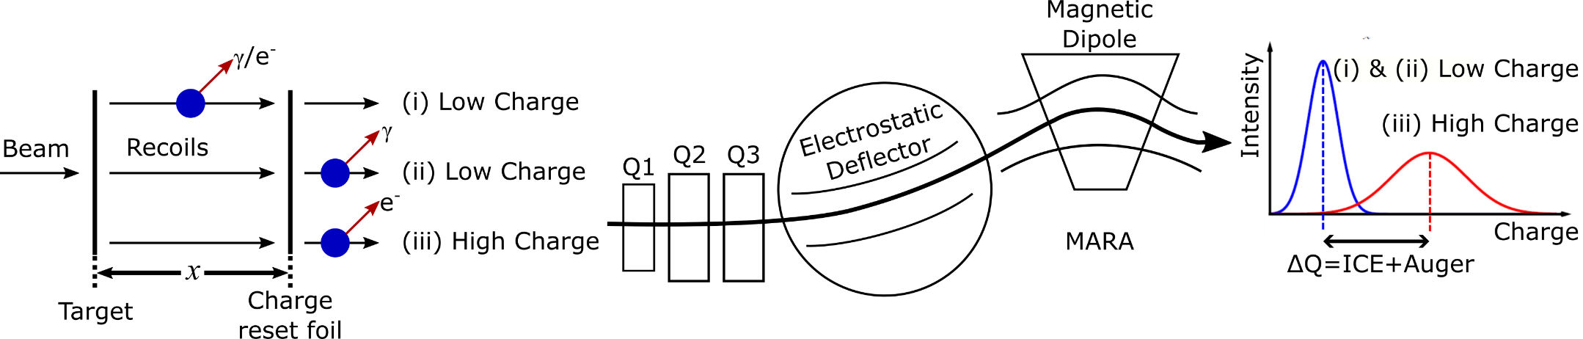
Basic concept of the charge plunger method
Relative intensities depend on:
recoil velocity
Target-to-reset foil distance
internal conversion coefficient
lifetime of the excited state

Slide 9
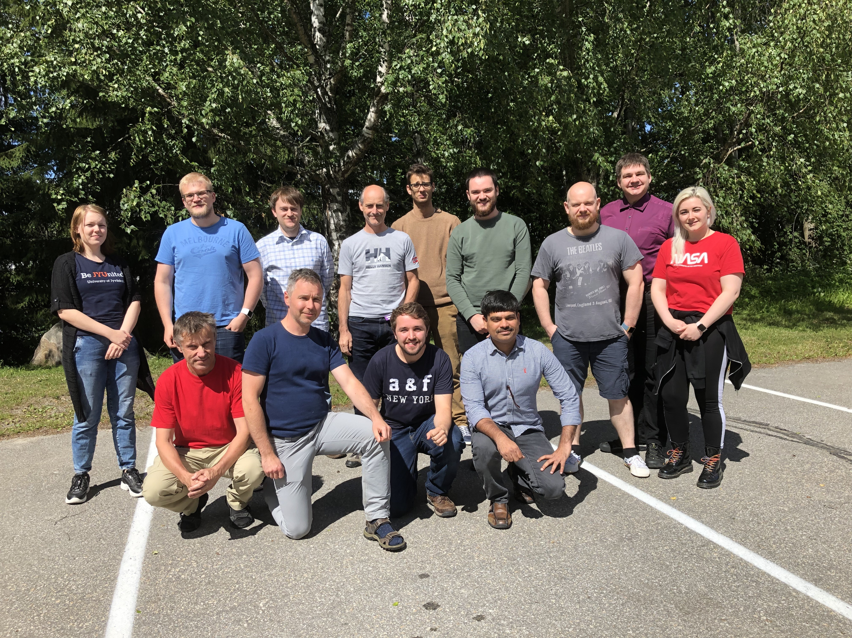
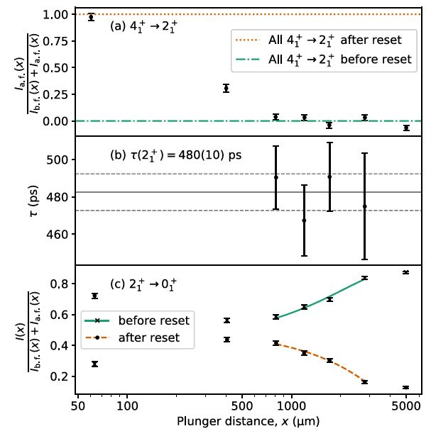
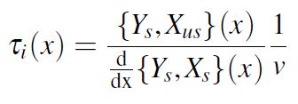


Commissioning experiment - 2019
¹⁷⁸Pt – DDCM analysis
Collaboration between:
University of Jyväskylä
University of Manchester
University of Liverpool
University of the West of Scotland
$$I_{b}\left(x\right)=I_{L}\left(x\right)−\frac{I_{H}\left(x\right)}{α}$$
$$I_{a}\left(x\right)=\left(\frac{1+α}{α}\right)I_{H}\left(x\right)$$
¹⁸⁰Pt –DDCM analysis
I_{a}
¹⁷⁸Pt - Bateman analysis
I_{b}

Slide 10
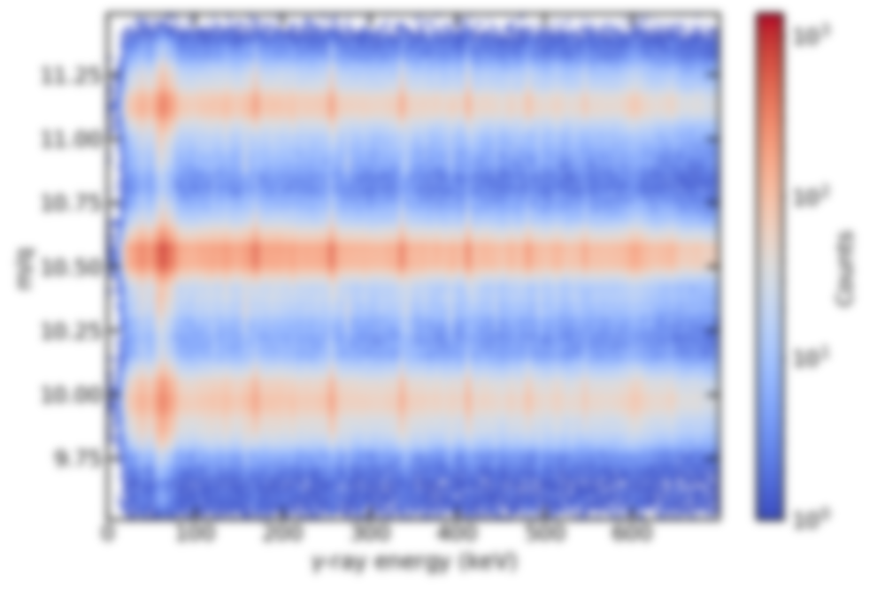
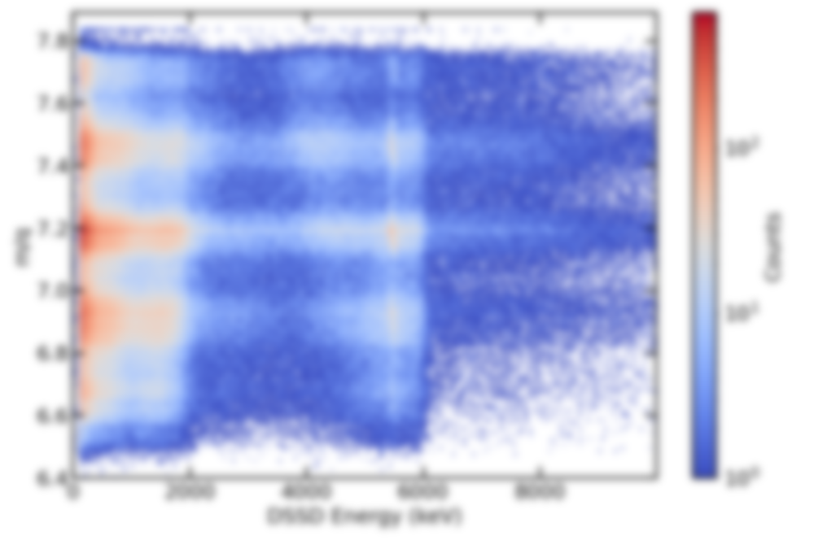
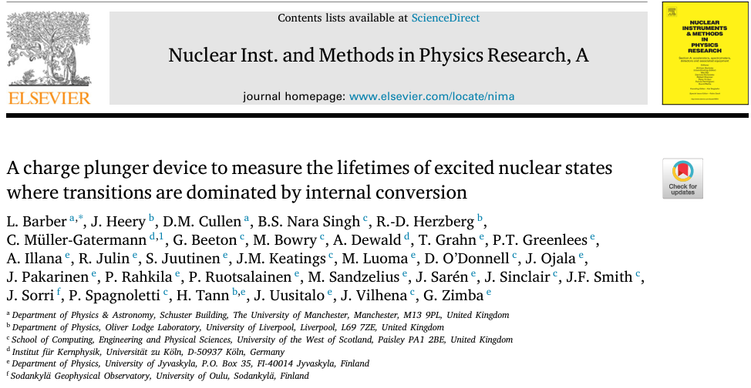
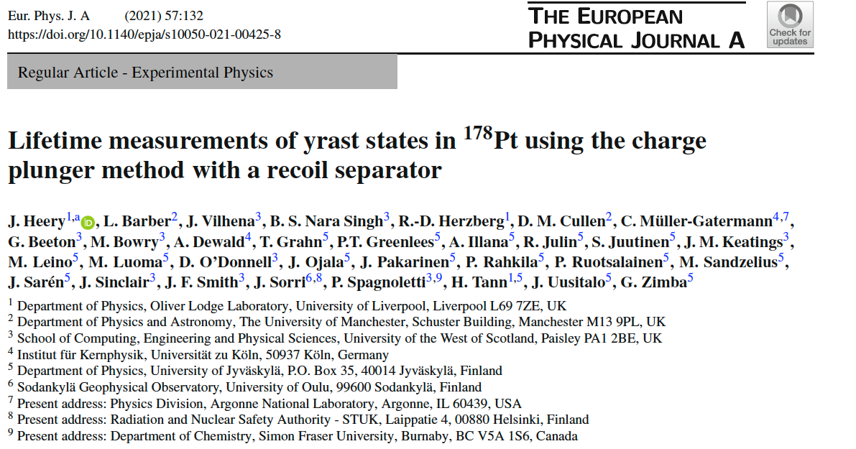


Commissioning experiment
DDCM analysis
Bateman analysis
$$I_{b}\left(x\right)=I_{L}\left(x\right)−\frac{I_{H}\left(x\right)}{α}$$
$$I_{a}\left(x\right)=\left(\frac{1+α}{α}\right)I_{H}\left(x\right)$$
Fit single Q₀ using rigid rotor model
Previous result: 412(30) ps [C. B. Li et al., PRC 90, 047302 (2014)]

Slide 11
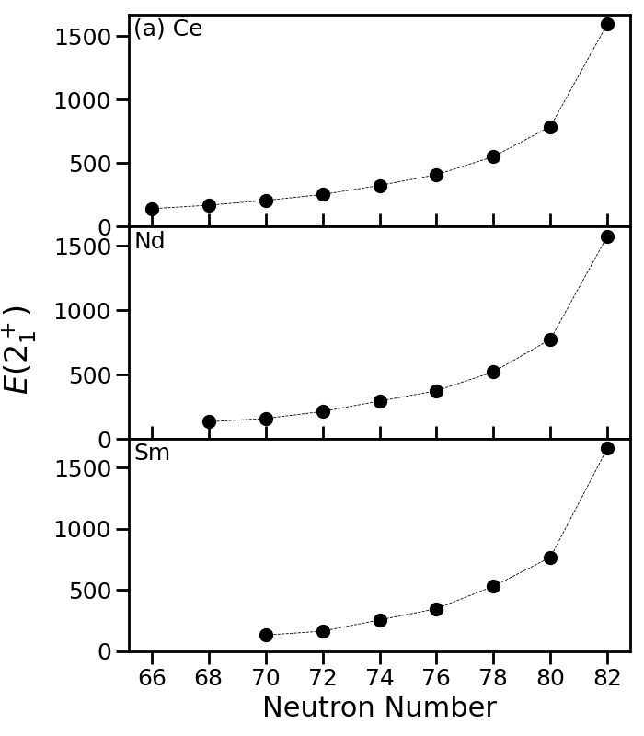
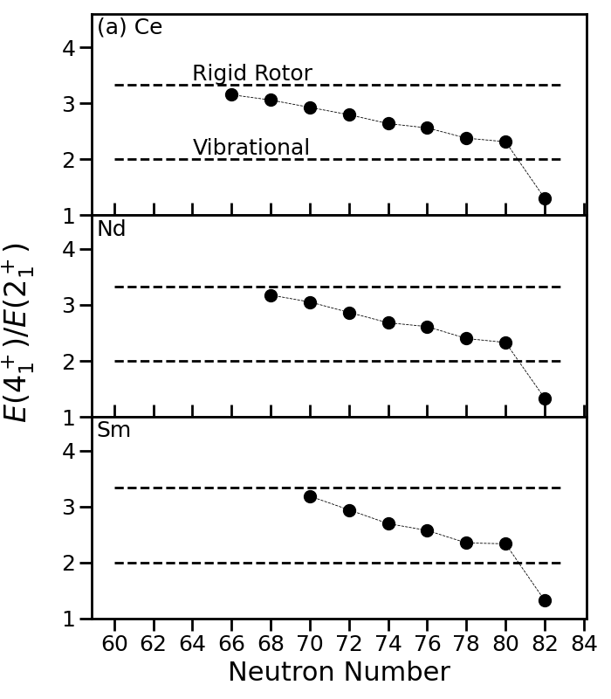
Deformation in light rare-earth nuclei
The Z=60, N≤70 region approaches the “perfect” rigid rotor
Smooth evolution of E(2₁⁺) and R₄₂ values
But B(E2) values hint at something more…

Slide 12
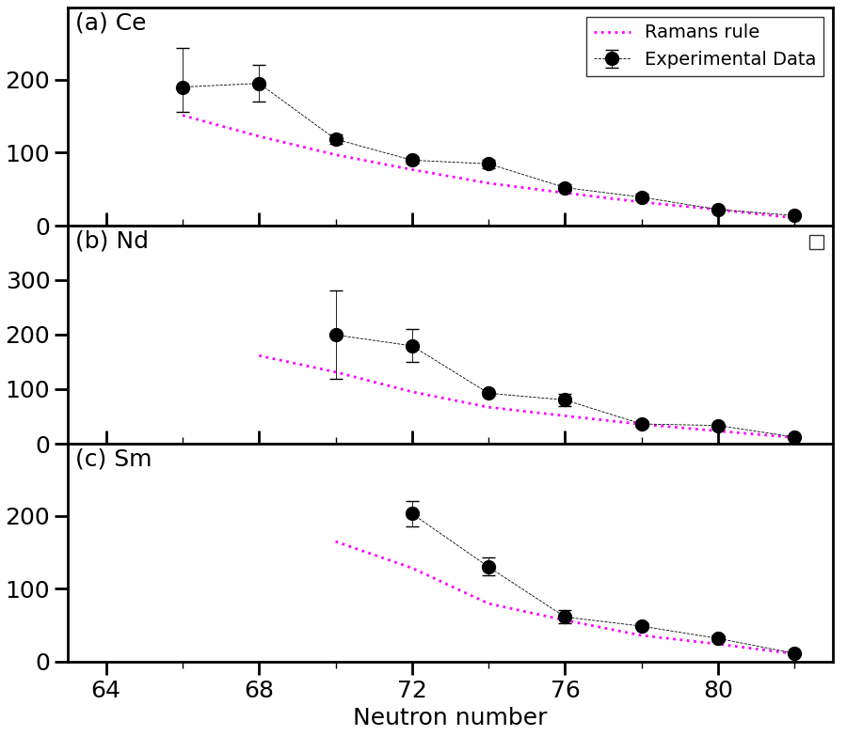
Deformation in light rare-earth nuclei
Unexpected kinks in B(E2) values at N=68 (Ce), 72 (Nd) and 74 (Sm)
Evidence for some shell effect?

Slide 13
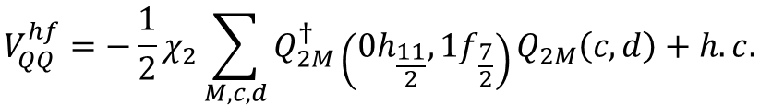

Quasi-SU3 coupling of neutron orbitals across N=82
1f7/2
Enhancement attributed to quasi-SU(3) coupling of 0h11/2 and 1f7/2 neutron orbitals across N=82 shell gap. A strong quadrupole component in the nucleon-nucleon coupling between the ΔJ=2 orbitals.
0h9/2
82
0h11/2
2s1/2
1d3/2
1d5/2
0g7/2
50
$$H=H_{0}+V_{P}+V_{QQ}+V_{m}^{MU}$$
1f7/2
0h9/2
$$V_{QQ}^{hf}=−\frac{1}{2}χ_{2}\sum_{M,c,d}{Q_{2M}^{†}}\left(0h_{\frac{11}{2}},1f_{\frac{7}{2}}\right)Q_{2M}\left(c,d\right)+h.c.$$
82
V_{QQ}
0h11/2
2s1/2
1d3/2
1d5/2
K. Kaneko et al., Phys. Rev. C, 103, L021301 (2021)
0g7/2
50

Slide 14
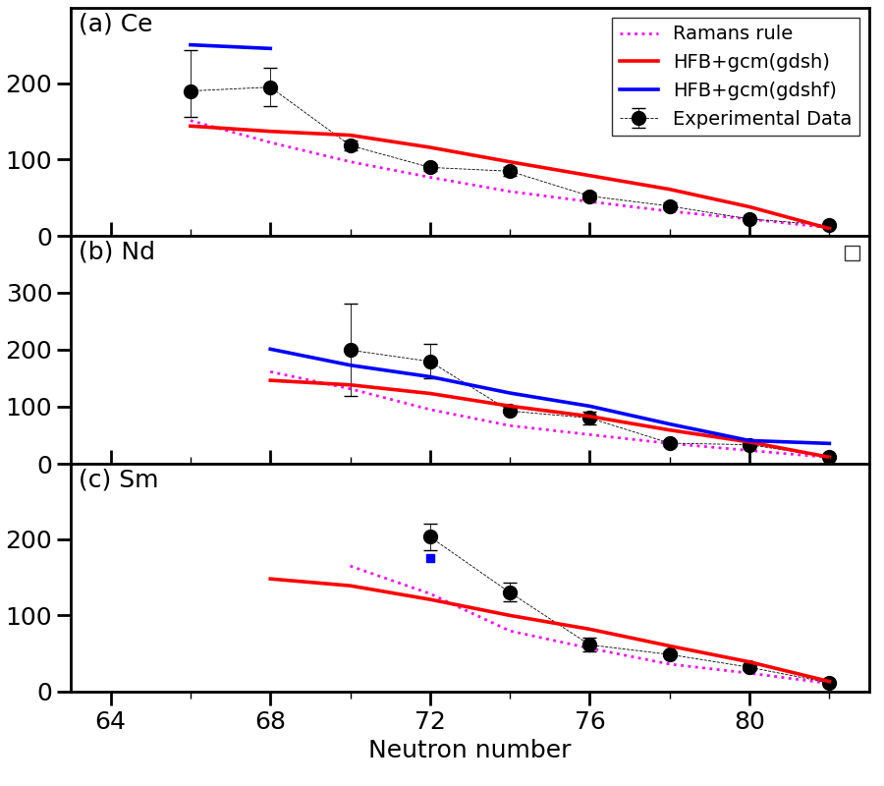
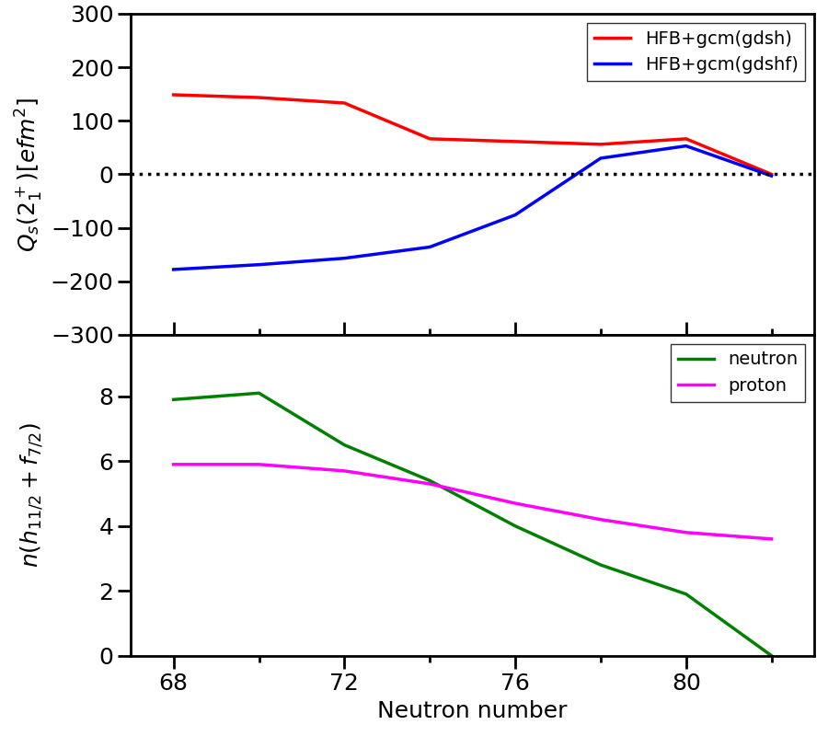
Quasi-SU3 coupling of neutron orbitals across N=82
Increase in B(E2) values replicated by including 1f7/2 neutron orbital in projected shell model calculations
Nd
Inclusion of f7/2 leads to prolate deformation in Nd isotopes
Increase in occupancy of h11/2+f7/2 correlates to increase in B(E2)

Slide 15
Quasi-SU3 coupling of neutron orbitals across N=82
Increase in B(E2) values replicated by including 1f7/2 neutron orbital in projected shell model calculations
Nd
Inclusion of f7/2 leads to prolate deformation in Nd isotopes
?
?
Increase in occupancy of h11/2+f7/2 correlates to increase in B(E2)

Slide 16

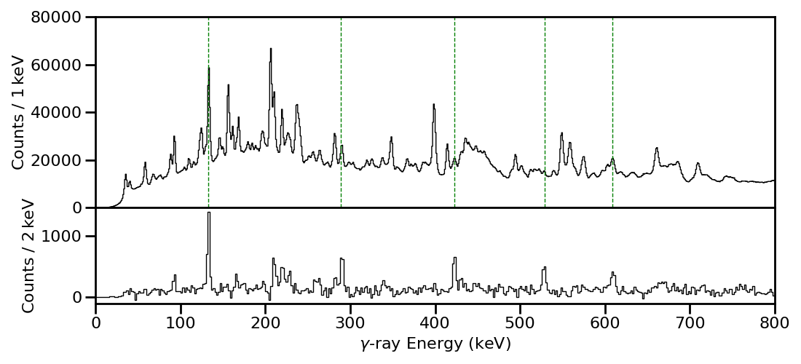
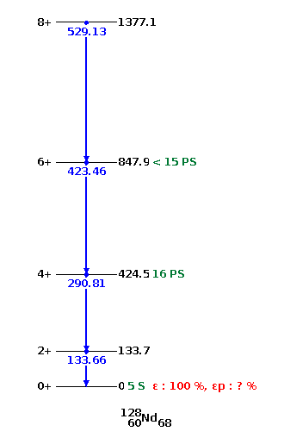
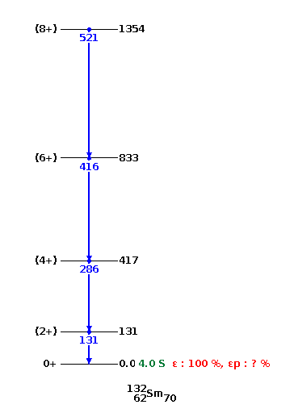
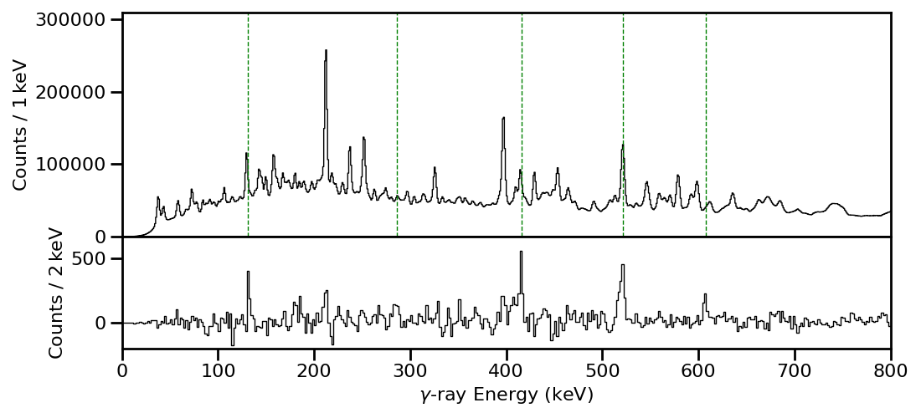
Experiment - CPM measurements on light rare-earth nuclei
⁷⁸Kr(⁵⁴Fe,2n2p)¹²⁸Nd @ 350 MeV
⁷⁸Kr(⁵⁸Ni,2n2p)¹³²Sm @ 350 MeV
¹²⁸Nd
- ¹²⁸Ce
Jurogam3+APPA+JYTube+MARA
Gate 4⁺→2⁺, 6⁺→4⁺, 8⁺→6⁺
¹³²Sm
- ¹³²Nd
Gate 4⁺→2

Slide 17
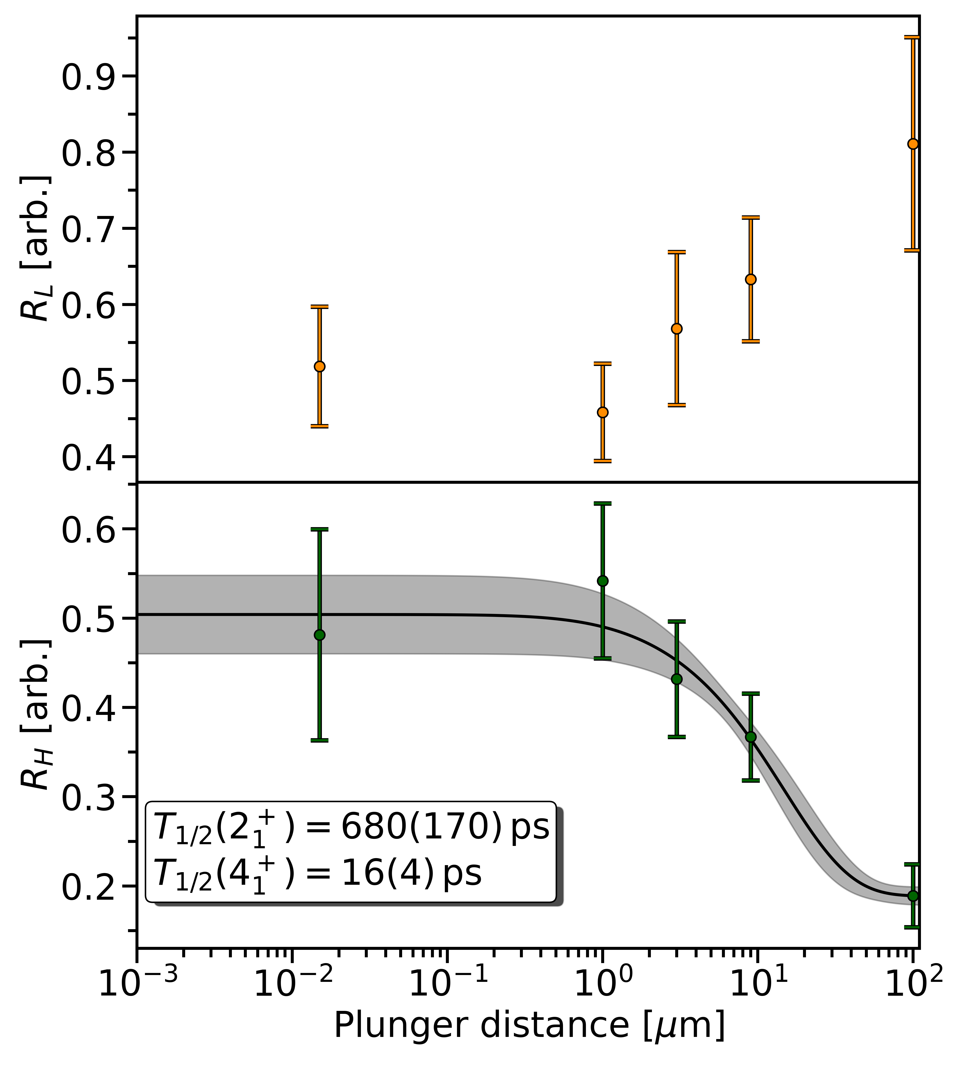
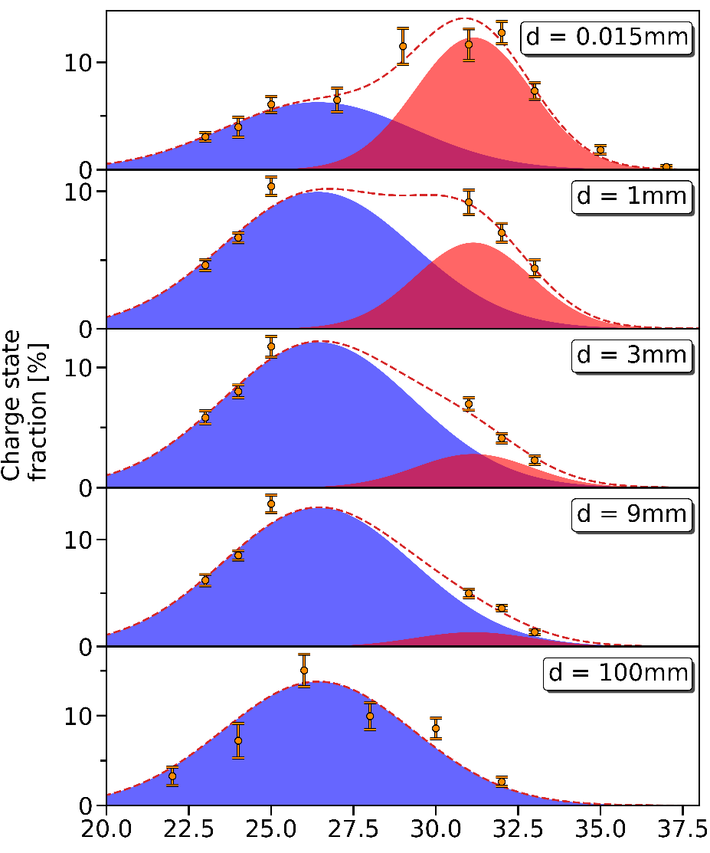
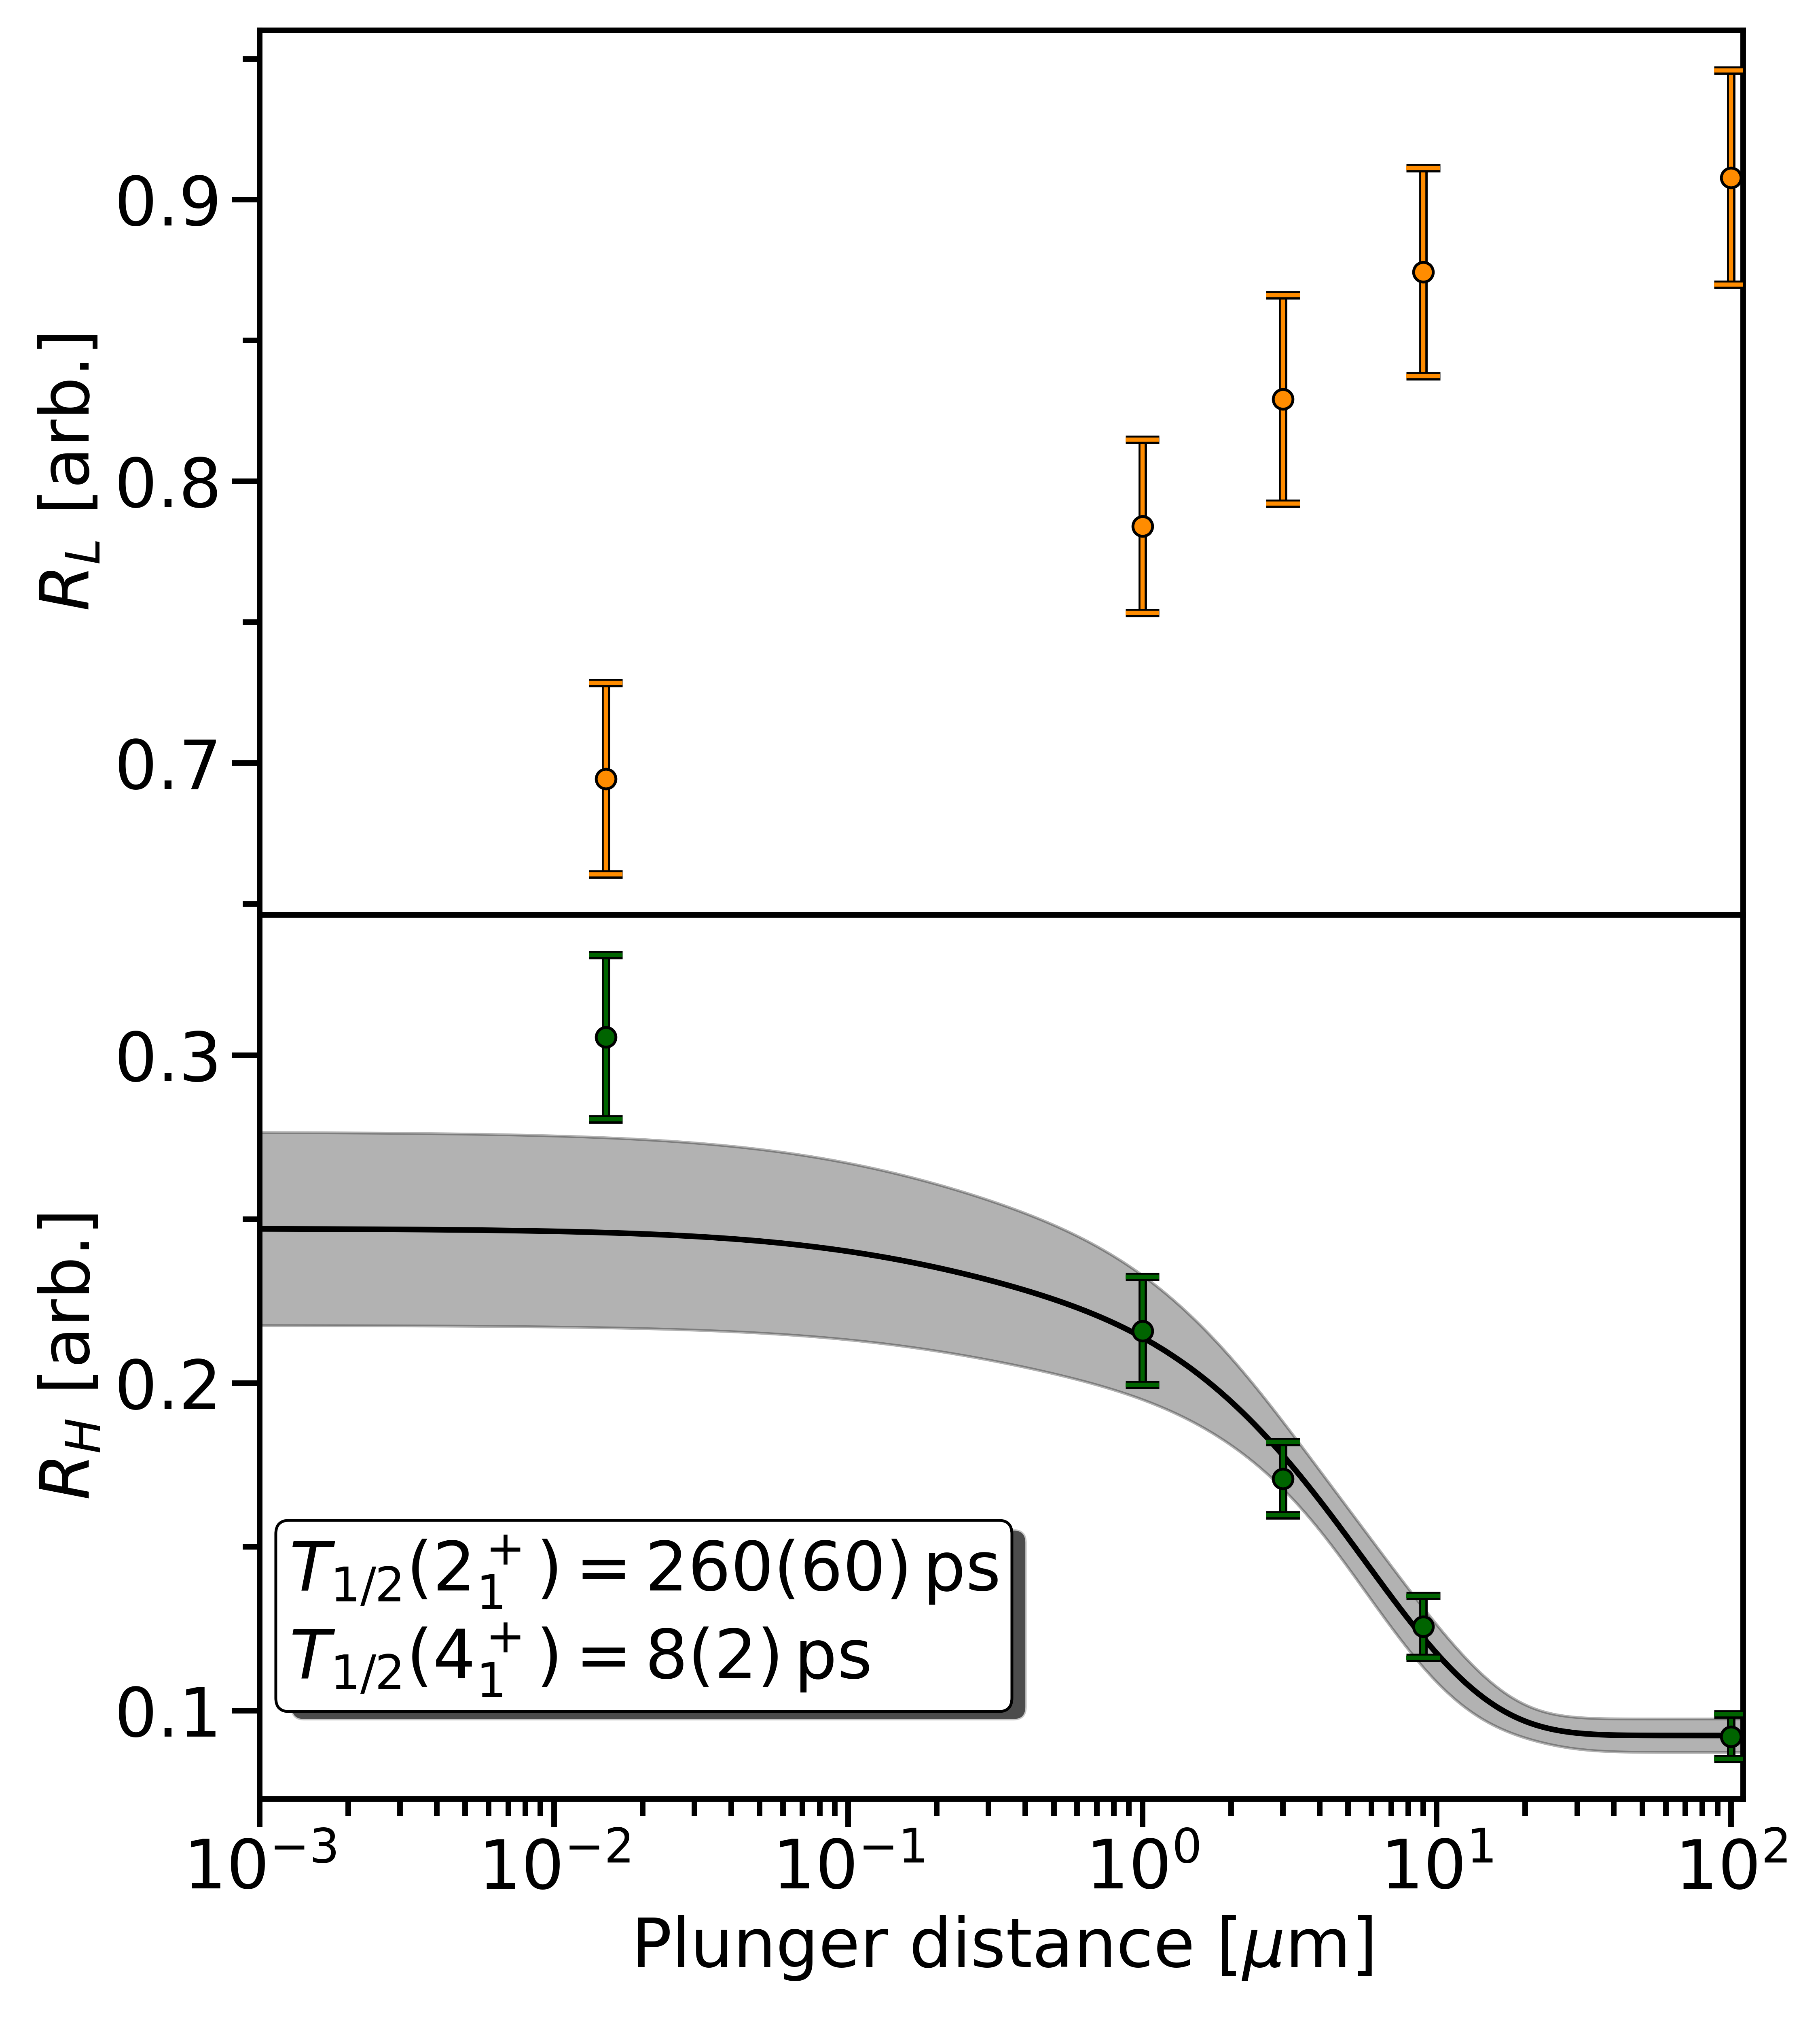
Results - CPM measurements on light rare-earth nuclei
¹²⁸Nd charge state distribution
Literature:
T_{1/2}(2+->0+) = 300(30) ps
T_{1/2}(4+->2+) = 8(+18)(-14) ps
¹²⁸Nd
¹²⁸Ce
Literature:
T_{1/2}(4+->2+) = 16(4) ps

Slide 18
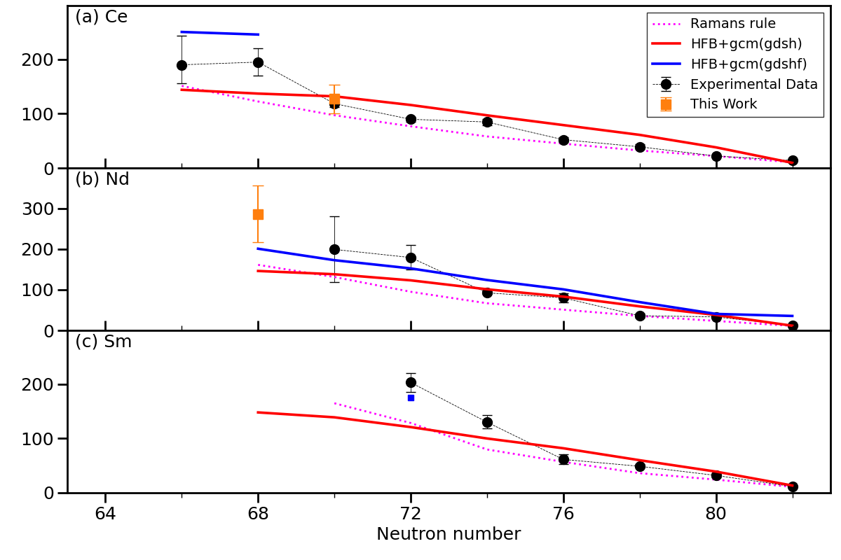
B(E2) preliminary result

Slide 19


Summary
Lifetime measurements provide a method of accessing the nuclear wavefunction – an extremely useful test of nuclear theories
The charge plunger method allows for lifetime measurements on states which de-excite with large internal conversion coefficients
Rare-earth nuclei around A=130 display rigid rotor behaviour, but B(E2) values suggest some shell effects
Quadrupole coupling of h_{11/2} – f_{7/2} neutron orbitals across N=82 shell gap is thought to play a role (quasi-SU3 interaction)
Experiment performed at JYFL to measure lifetime of 2₁⁺ state in ¹²⁸Nd and ¹³²Sm
Results indicate higher B(E2) values with the necessary inclusion of f_{7/2} orbital in calculations

Slide 20
Thanks to All my collaborators

