Slide 1




Particle identification with Bragg spectroscopy at ISS
Michał Włodarczyk and the ISS collaboration

Slide 2
1. Motivation
Solenoidal spectroscopy
Measure the differential cross sections of protons in transfer reactions in solenoidal magnetic field
Spin-parity assignments of excited states of exotic nuclei
Magnetic field
Proton's trajectory
Deuterated
target
Silicon detector array
Heavy
ion beam
Recoiling nucleus

Slide 3





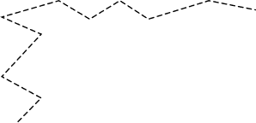

1. Motivation
Radioactive
beam
Beam production with the ISOL method
High intensity radioactive beams
Small energy and momentum spread
May introduce contamination for short-lived species (~200 ms)
  Beam decays in-flight
Acceleration
Charge
breeding
Primary
beam
Thick target
Beam
dump
Diffusion
Mass
separation
Lasers
Ion beam
Ionisation

Slide 4
1. Motivation
Need to identify beam components on an event-by-event basis.
For low mass beams (A < 30), silicon-based detectors are used
For heavier beams, their performance deteriorates, so a different approach is required
Magnetic field
Proton's trajectory
Deuterated
target
ΔE-E
Silicon detector array
telescope
Heavy
ion beam
Recoil nucleus’
trajectory

Slide 5
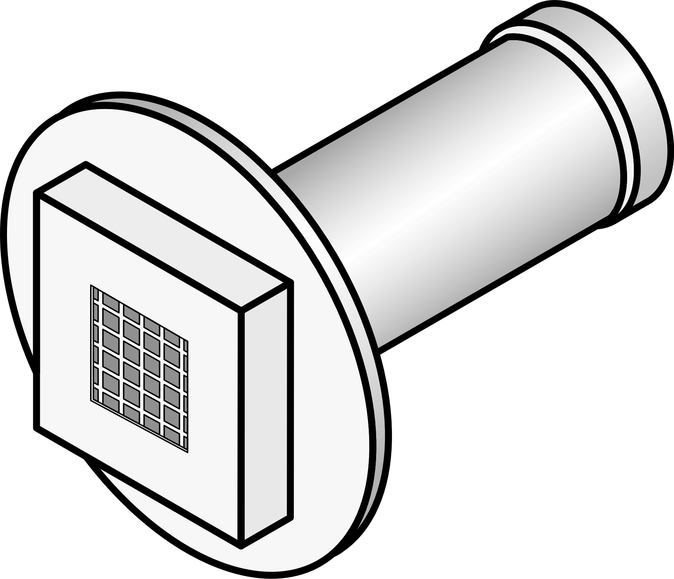
1. Motivation
Need to identify beam components on an event-by-event basis.
For beams with higher mass (A > 30), a different approach was needed
A gas-filled detector was chosen due to its resolving power, radiation tolerance, and low cost
Magnetic field
Proton's trajectory
Ionisation chamber
Deuterated
target
Silicon detector array
Heavy
Ion beam
Recoil nucleus’
trajectory
5

Slide 6
2. Background
Gaseous detectors
Chamber filled with a gas
Ionising radiation creates electron-ion pairs
6
Notes:
How proportional counters work

Slide 7
2. Background
Gaseous detectors
Chamber filled with gas
Ionising radiation creates electron-ion pairs
Potential difference accelerates charge carriers
Voltage drop across a resistor in an RC circuit measured
Signal proportional to the energy deposited in the gas
V_{R}
C
R
V_{R}
V
Time
7
Notes:
High voltage -> avalanches

Slide 8
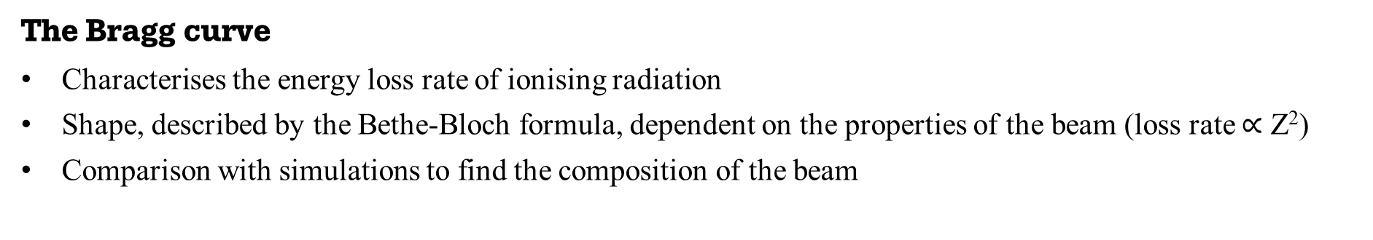
2. Background
The Bragg curve
Characterises the energy loss rate of ionising radiation
Shape, described by the Bethe-Bloch formula, dependent on the properties of the beam (loss rate $∝$ Z²)
Comparison with simulations to find the composition of the beam
Energy loss
Depth
8

Slide 9
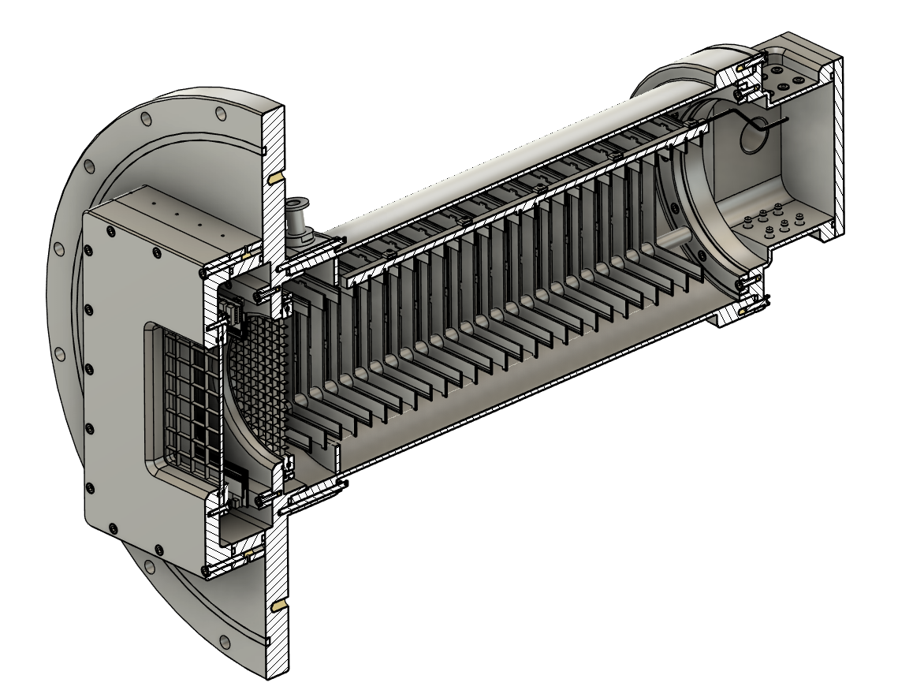
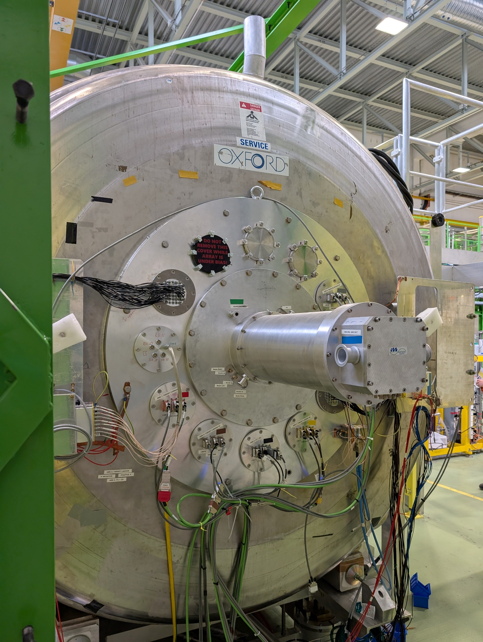
3. Design
Two independent chambers
Flange attached on the downstream side of the MRI magnet
Two 0.9 μm thick mylar windows supported from the upstream side
60 cm
`
9
Notes:
sneezing

Slide 10
3. Design
Segmented Bragg chamber
13 segments to trace the Bragg curve
Segmentation improves the rate capability
Tilted grid geometry found unsuitable
Filled with CF₄ at a tuneable pressure (~100 mbar)
10
Notes:
Graph showing energy losses

Slide 11
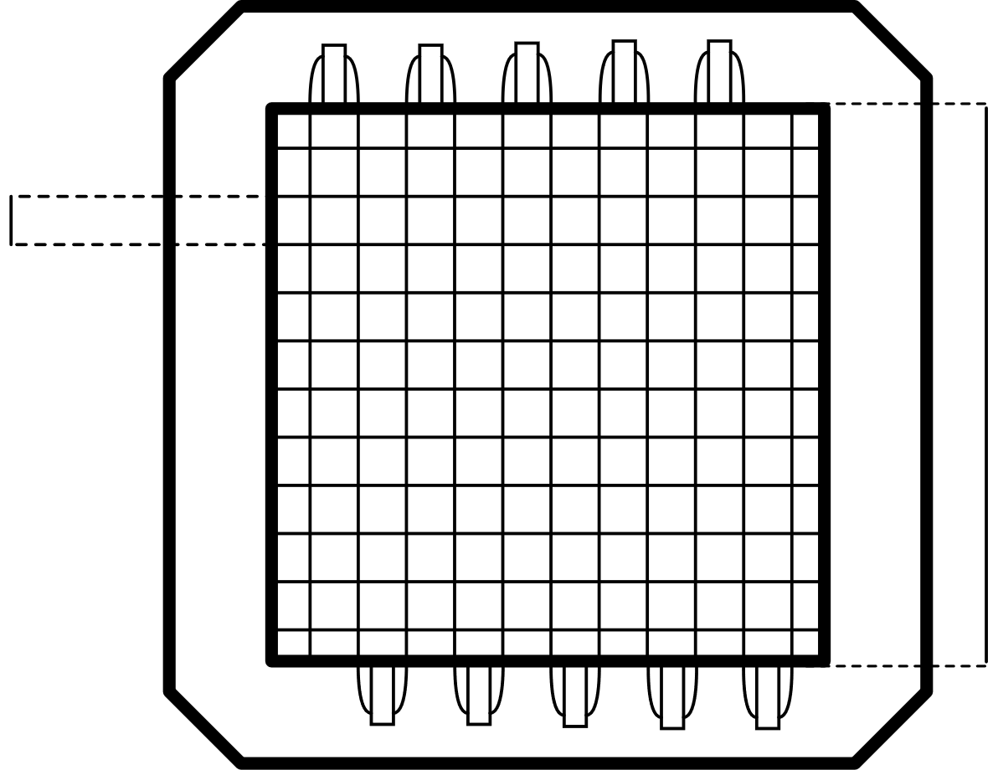
3. Design
Multi-Wire Proportional Counter (MWPC)
Chamber filled with C₃F₈ at 5 mbar
Anodes made of thin, evenly-spaced wires connected by delay lines
Beam tuning and pile-up rejection
High voltage applied (~ 700V)
1mm
14 cm
11
Notes:
How the ionisation works

Slide 12
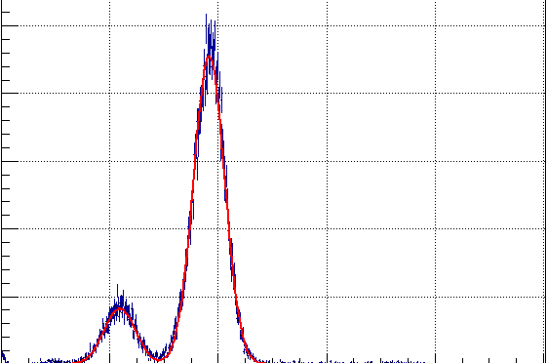
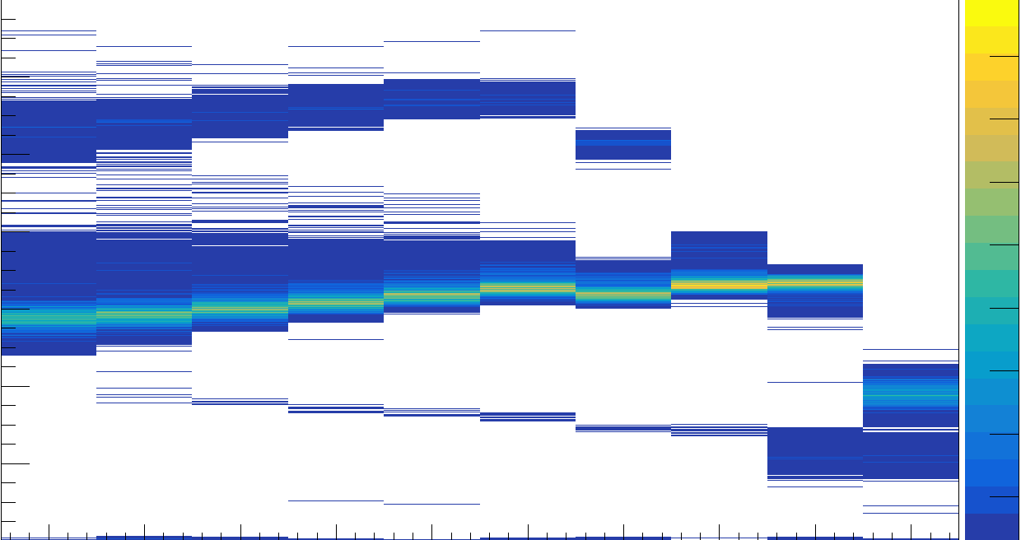
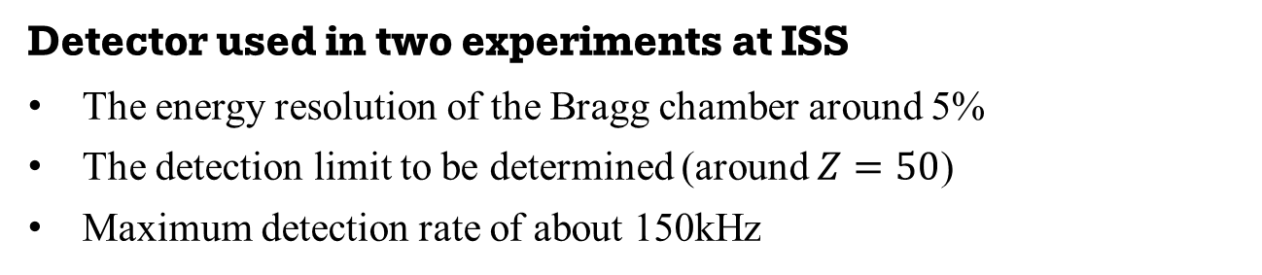
4. Results
Detector used in two experiments at ISS
The energy resolution of the Bragg chamber around 5%
The detection limit to be determined (around $Z=50$)
Maximum detection rate of about 150kHz
¹²⁹Xe
⁹⁴Rb
⁹⁴Kr
Projection from segment 9
Unreacted ⁹⁴Kr beam
500
80
⁹⁴Kr
120
Counts
400
70
100
60
Counts per 100 keV
Energy loss (MeV)
300
80
50
60
40
200
30
40
⁹⁴Rb
20
100
20
10
20
40
60
80
100
0
1
2
3
4
5
6
7
8
9
Energy loss (MeV)
Segment
12

Slide 13
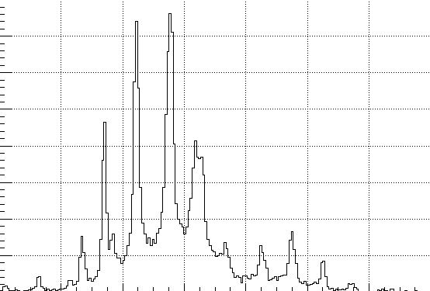
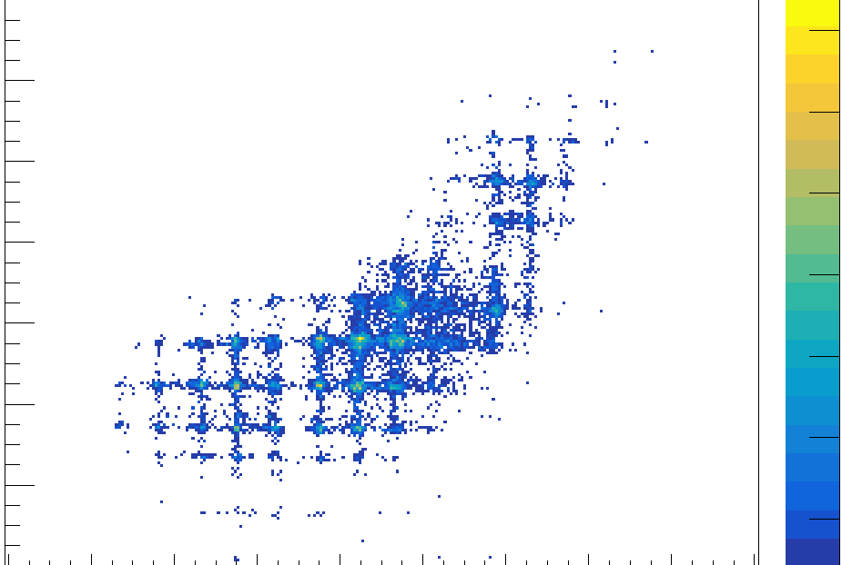
4. Results
Detector used in two experiments at ISS
The spatial resolution of the MWPC of 1mm
The maximum counting rate of about 300 kHz
Projection on the Y axis
Hitmap measured by MWPC
35
700
-0
Counts
30
600
Y position (mm)
Counts per 50 um
-2
500
25
-4
400
20
-6
300
15
-8
200
10
100
-10
5
-10
-8
-6
-4
-2
0
-6
-4
-2
0
2
4
6
8
10
12
Y position (mm)
X position (mm)
13

Slide 14
5. Summary
The detector achieved satisfactory performance
Energy and positional resolution in agreement with expectations
Maximum event rate of about 150 kHz
  Sufficient to allow for event-be-event analysis
    Wasn’t possible during the beamtime
The detection limit to be determined
14

Slide 15
Thank you to the collaborators
S. Bennett¹, D. K. Sharp¹, S. J. Freeman¹, F. Browne¹, P. T. MacGregor², A. Dolan²,
L. P. Gaffney³, A. Heinz⁴, O. Orlandi⁵, M. Rocchini⁶, F. Rowntree³, P. Spagnoletti³
¹University of Manchester, UK,
²CERN, Switzerland,
³The University of Liverpool, UK,
⁴Chalmers University of Technology, Sweden,
⁵The University of Florence, Italy,
⁶INFN - Division of Florence, Italy.
This project has received funding from the European Union’s Horizon Europe Research and Innovation programme under Grant Agreement No 101057511.
15

