Slide 1


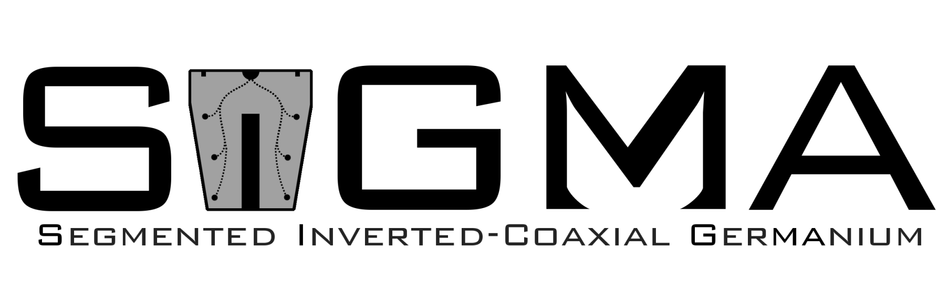

Position Resolution of Adaptive Grid Search Method for Multi-site Interactions in 'SIGMA’ Detector.
Presenter: Nawaf Altasan

Slide 2
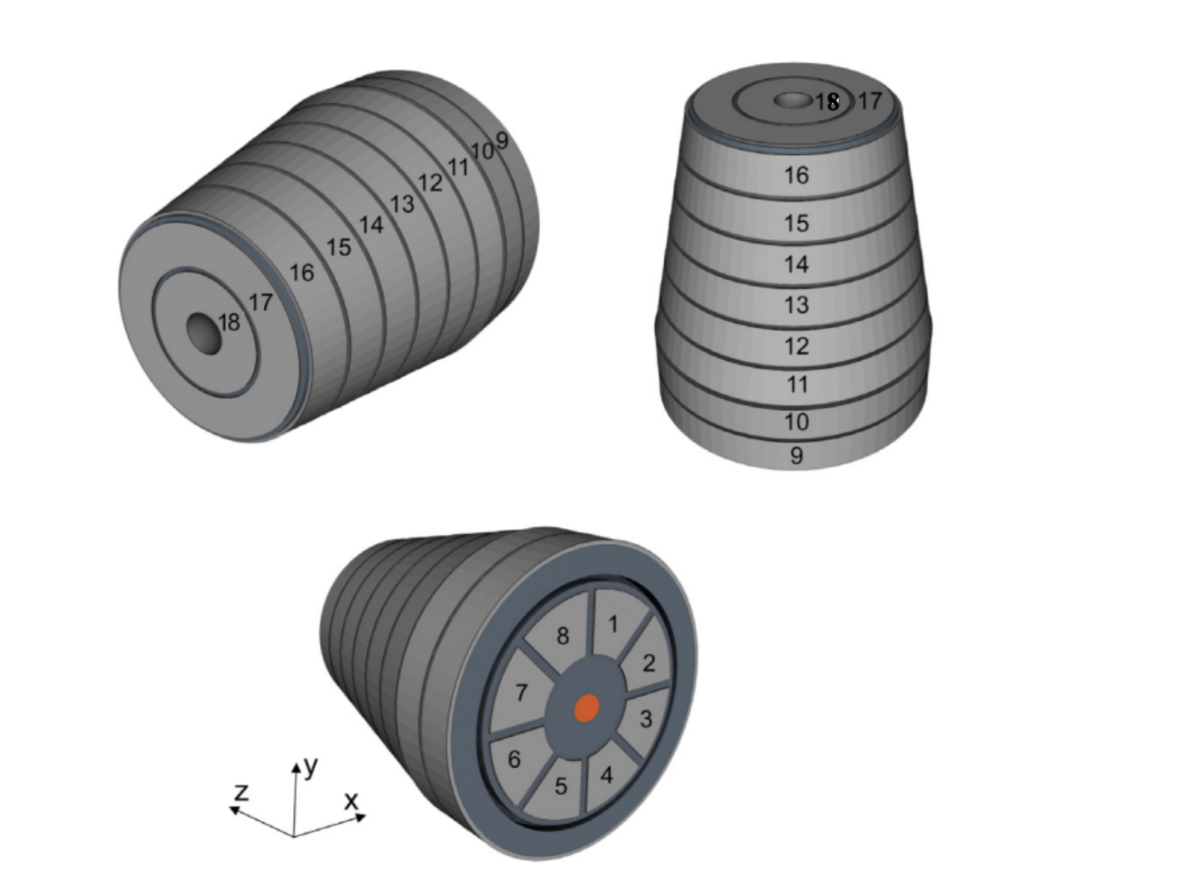
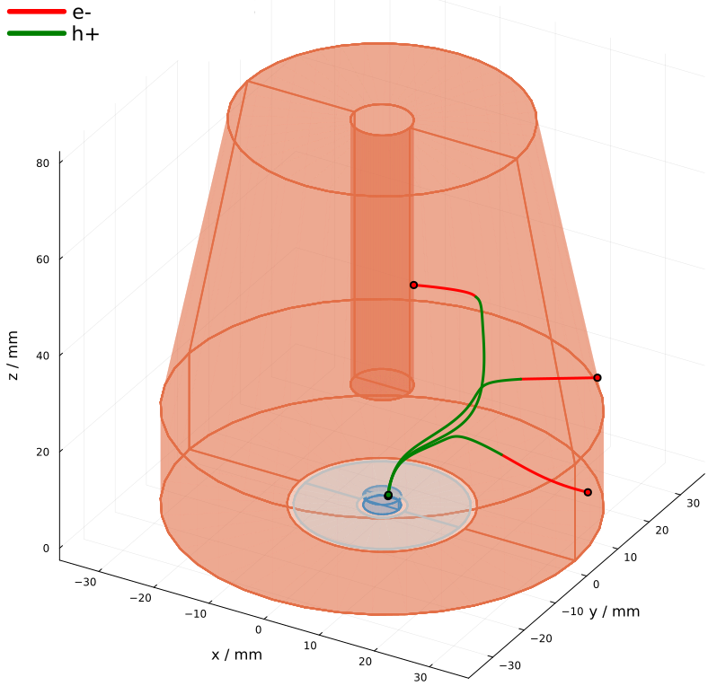
What is SIGMA?
SIGMA is a p-type Segmented inverted coaxial high-purity germanium detector.
Consists of 18 segments and point contact (PC).
  8 azimuthal segments
  8 longitudinal segments
  2 radial segments.
Long drift, excellent position resolution

Slide 3
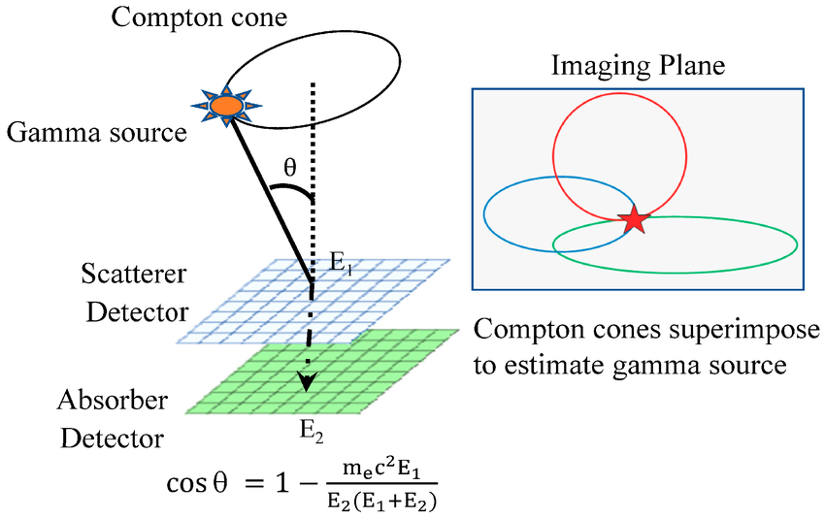
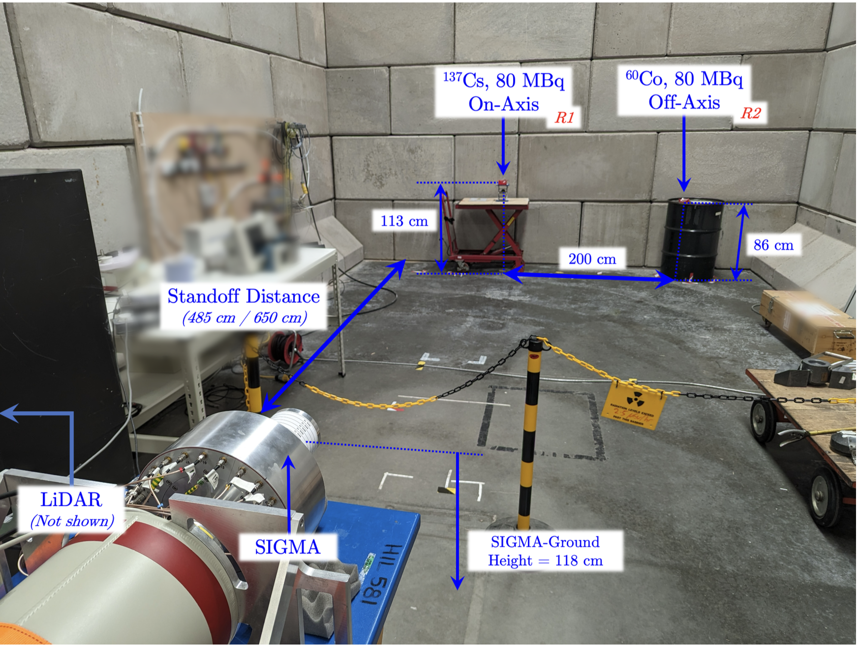
What is the Purpose of SIGMA?
SIGMA is a position sensitive detector that can be applied in:
[1]
[2]
Nuclear decommissioning
[1] Parajuli, R.K., Sakai, M., Parajuli, R. and Tashiro, M., 2022. Development and applications of Compton camera—A review. Sensors, 22(19), p.7374.
[2] Griffiths, O., 2025. Proof of Concept Gamma-Ray Imaging using the Segmented Inverted Coaxial Germanium (SIGMA) Detector for Industrial Applications (Doctoral dissertation, University of Liverpool).

Slide 4
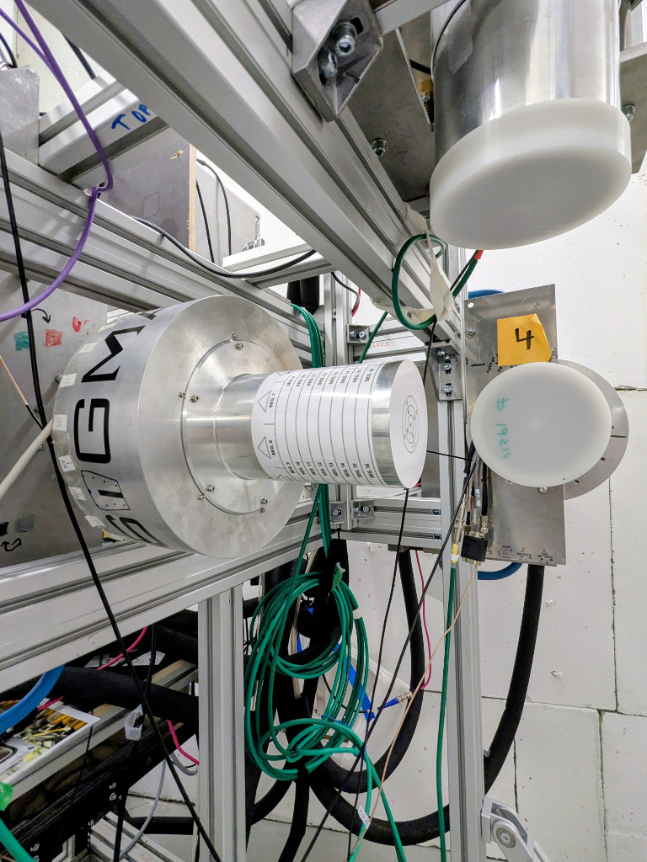
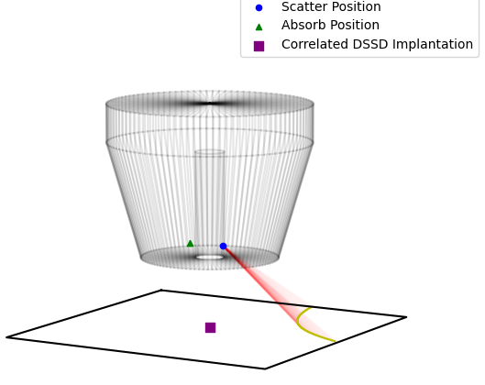
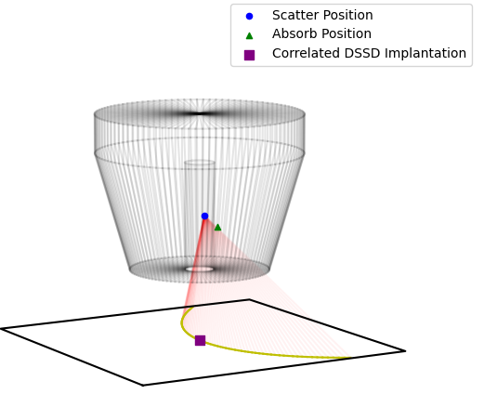
What is the Purpose of SIGMA?
Jyvaskyla decay correlation measurements
Large Distance
Veto-out event
Veto-in event

Slide 5
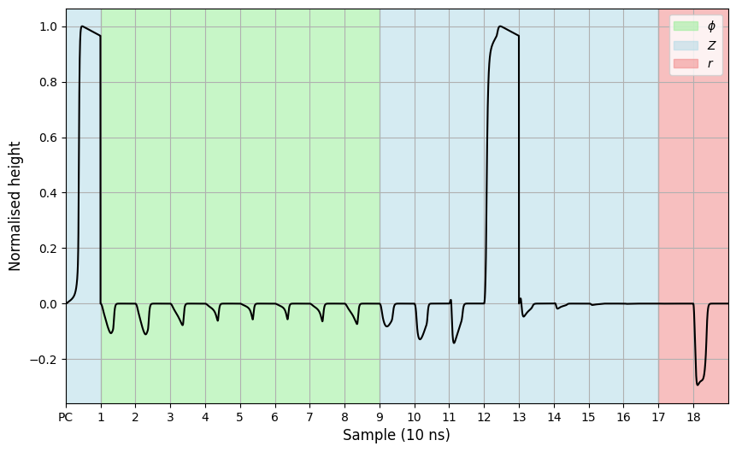
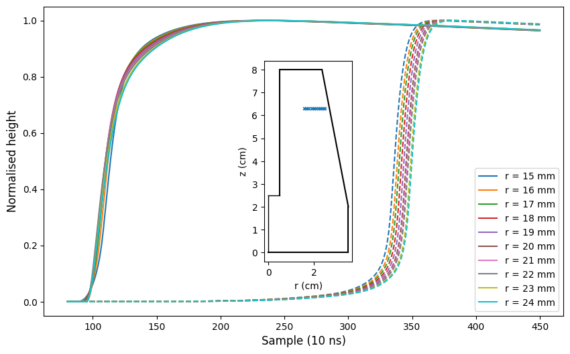
Localising the Position of Interaction
Signals from each segment combined into a Superpulse
Pulse Shape Analysis (PSA), localises (x,y,z) position of Ɣ-ray interaction
Segment

Slide 6
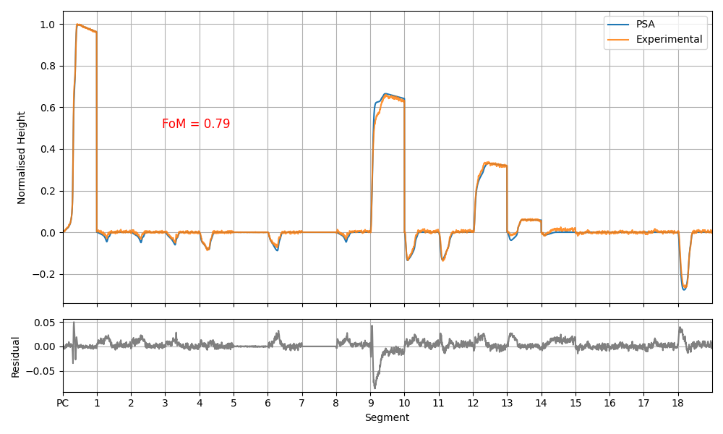
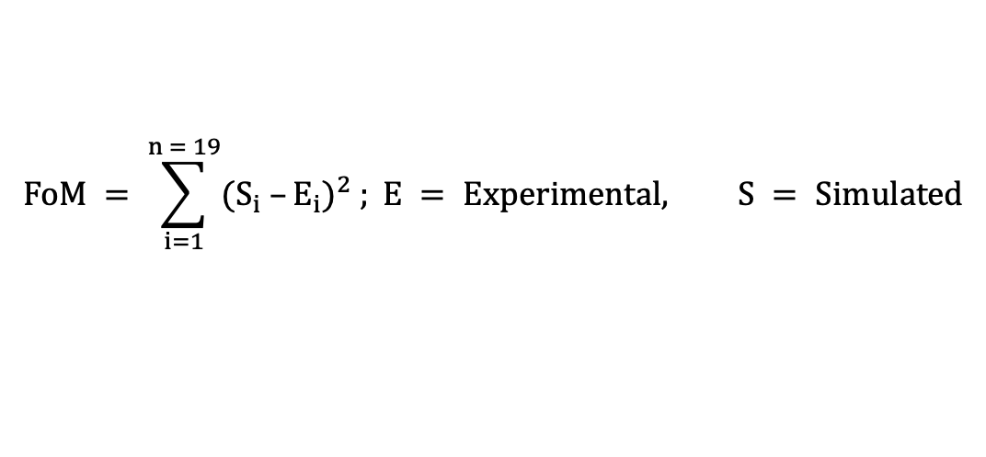
Pulse Shape Analysis (PSA)
PSA relies on a validated AGATA Detector Library (ADL) database.
This database is created on 1 mm grid covering the entire detector volume with 204,000 points.
Finding best match is based on Figure of Merit (FoM) calculation.
$$FoM = \sum_{i=1}^{n = 19}{{(S_{i} –E_{i})}^{2} ; E = Experimental, S = Simulated}$$

Slide 7
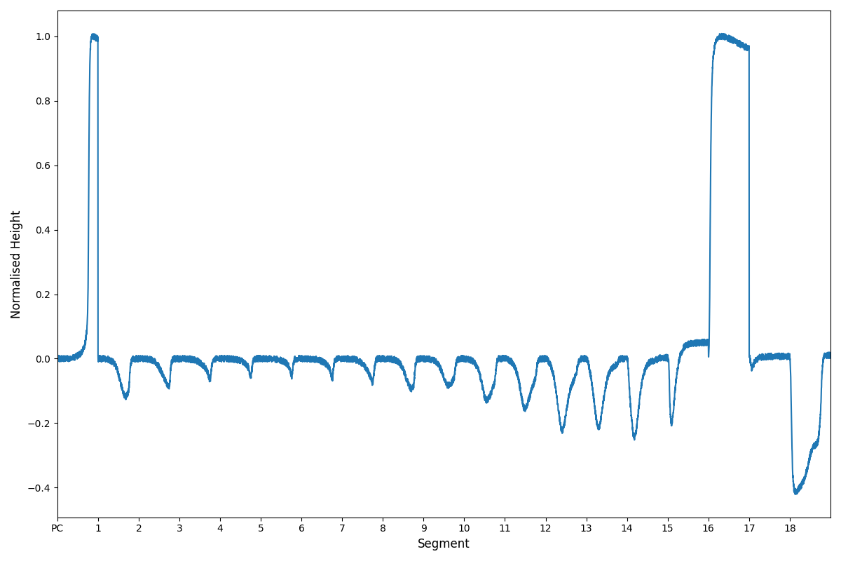
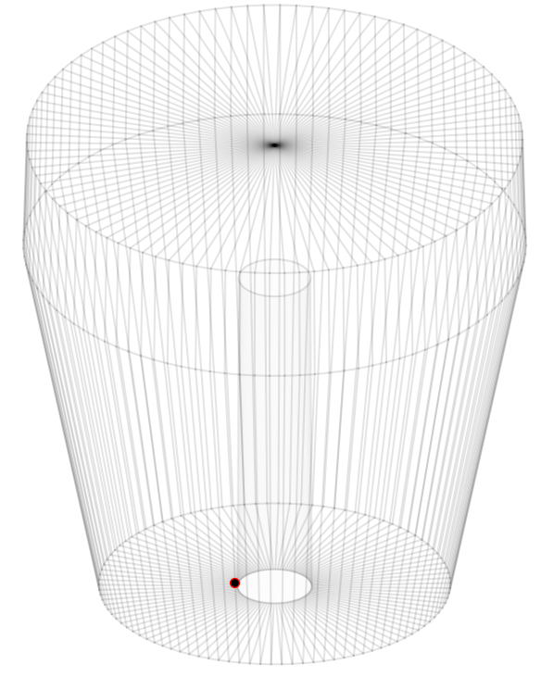
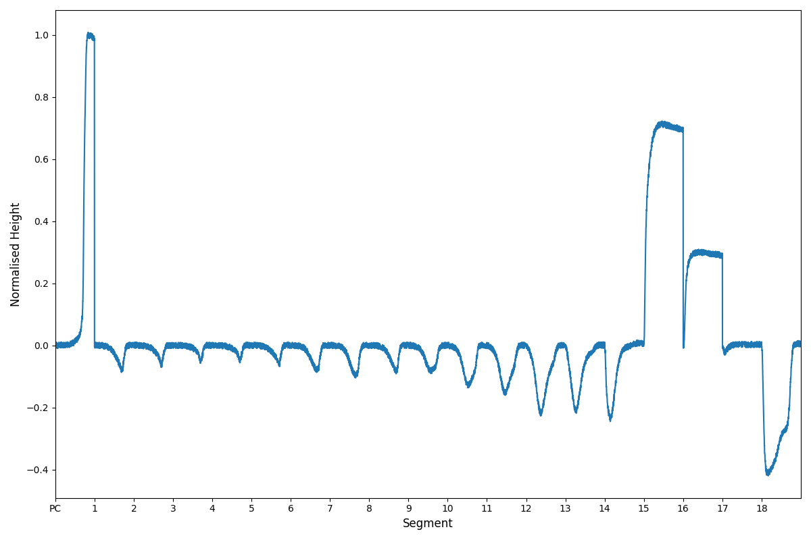
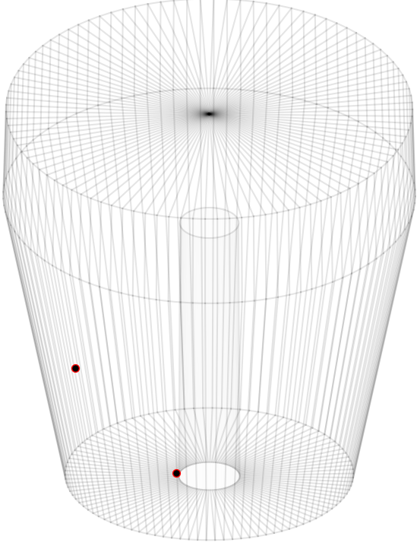
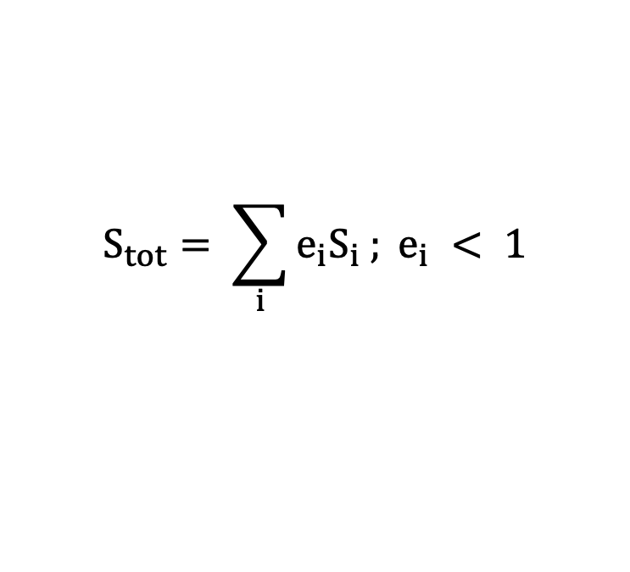
Multi and Single fold Interactions
Single-fold
Fold refers to the number of segments that collected charge in one interaction
In single-fold, only one segment collected charge.
In multi-fold, multiple segments collected charge.
In the multi-fold case, the signals are convolved linearly as:
Multi-fold
$$S_{tot}= \sum_{i}{e_{i}S_{i} ; e_{i} < 1}$$

Slide 8
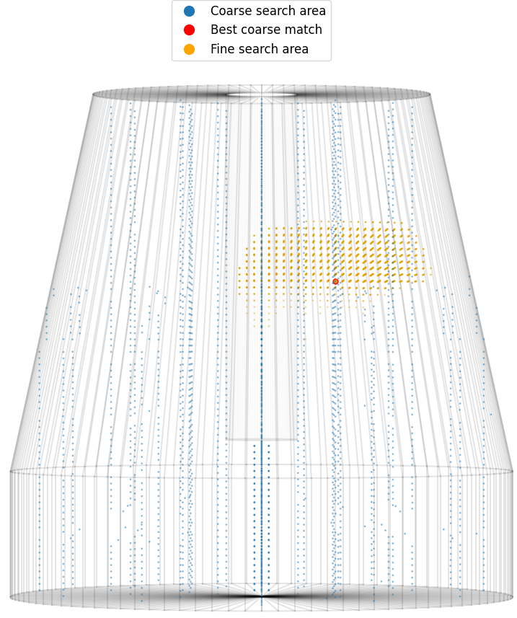
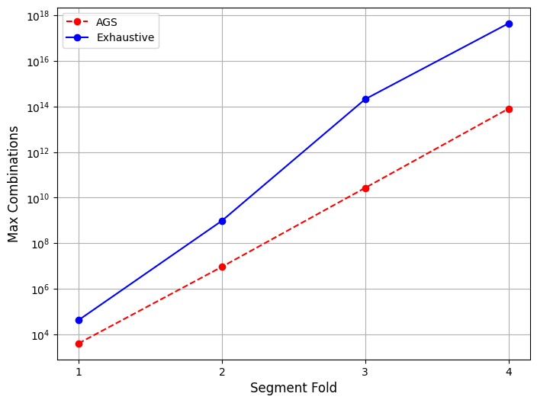
Adaptive Grid Search (AGS)
In PSA, single-fold case is computationally trivial, whereas the multi-fold case is computationally expensive.
AGS method reduces the computational cost by dividing the search areas into coarse and fine areas.
First, a coarse search is done on small number of grid points
Then, a fine search on 1 mm grid around the best coarse area.

Slide 9
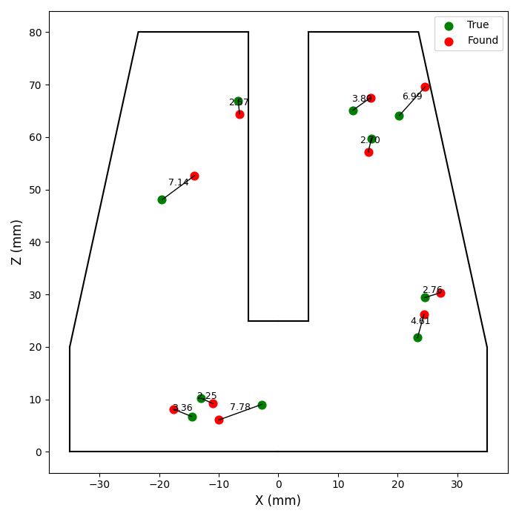
Position Resolution
Position Resolution (PR) is defined as the mean Euclidean deviation distance between the true and PSA found positions.
Knowing the true position is only possible through GEANT4 (G4) simulation.
By validating the G4 simulated output and experimental data, an estimation of PR can be calculated.

Slide 10
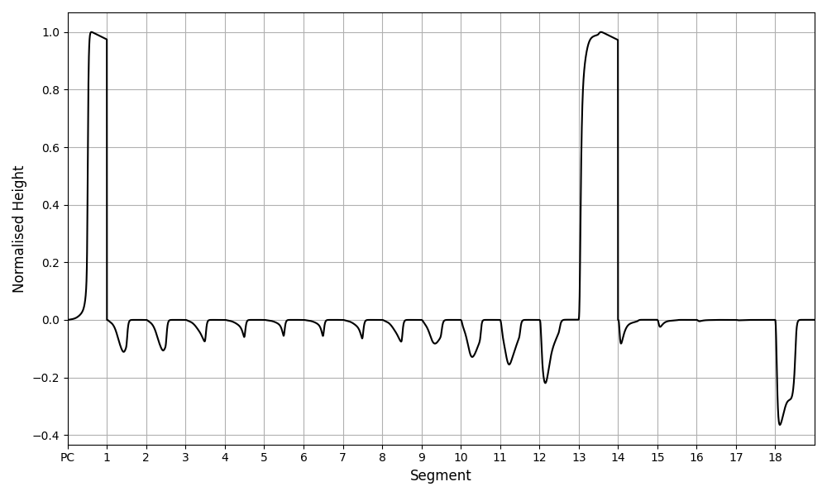
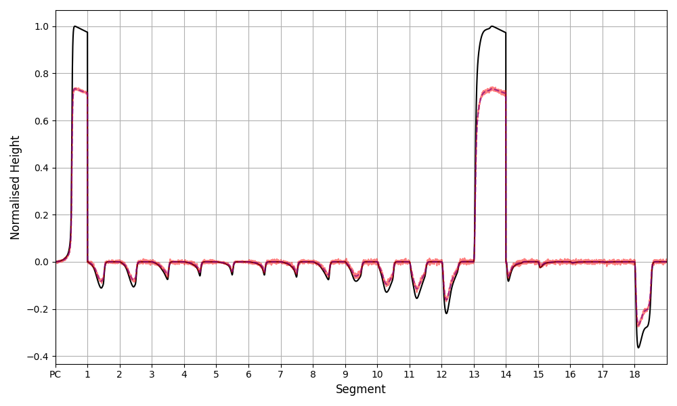
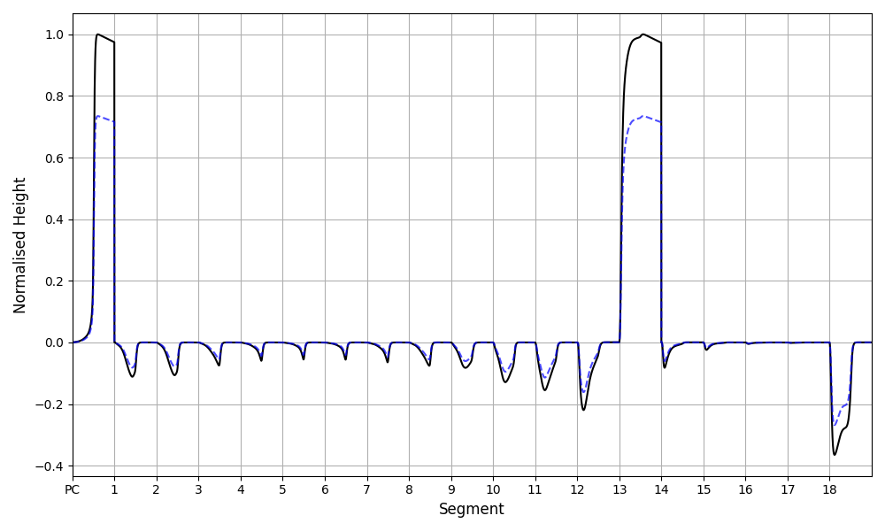
Generating Simulated Traces
Raw G4 positions
ADL database
Raw G4 energy
Normalisation by total energy
Adding noise

Slide 11
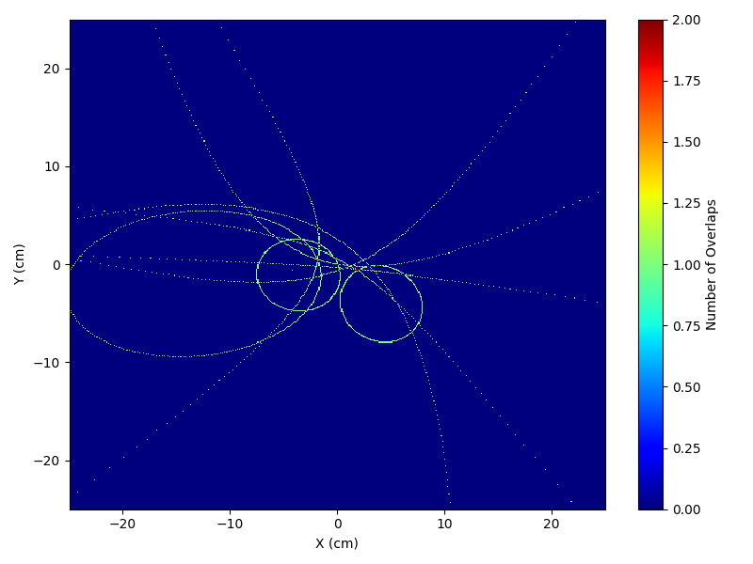

Compton Imaging
Compton Imaging (CI) is used to reconstruct gamma-ray sources using Compton kinematics.
It requires at least two interactions
In SIGMA it is scatter and absorption.
CI is one method to estimate PR of multi-fold PSA.
Figure from [1]
10 Cones
10,000 Cones
[1] Parajuli, R.K., Sakai, M., Parajuli, R. and Tashiro, M., 2022. Development and applications of Compton camera—A review. Sensors, 22(19), p.7374.

Slide 12
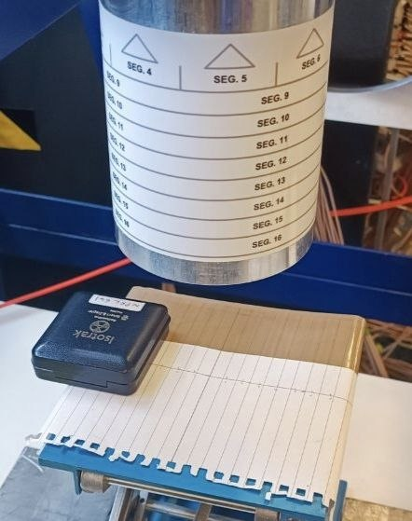
Validation Setup
In the validation setup, two sources are used for Compton imaging with two different positions.
Measurement 1:
  ¹³⁷Cs at 10 cm standoff and +7 cm in y-direction.
Measurement 2:
  ⁶⁰Co at 10 cm standoff and -7 cm in y-direction.

Slide 13
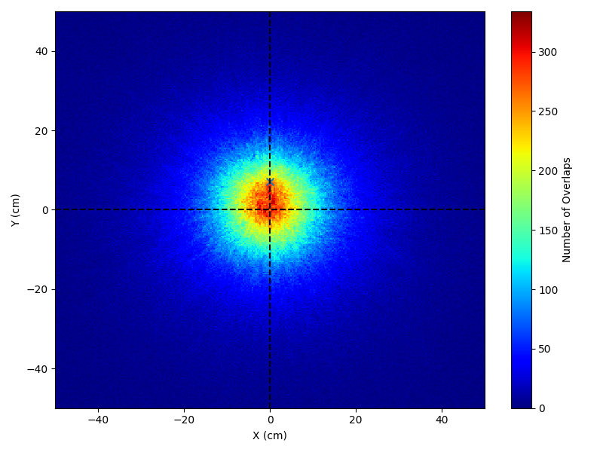
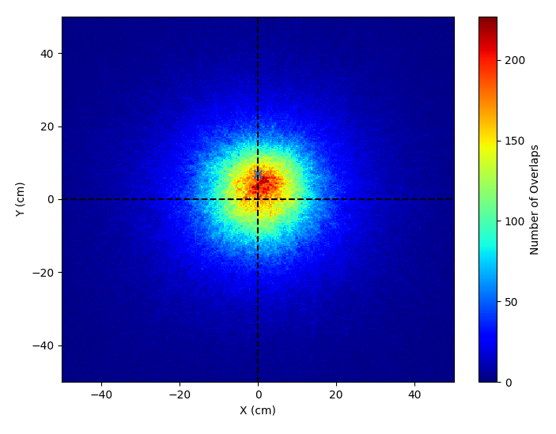
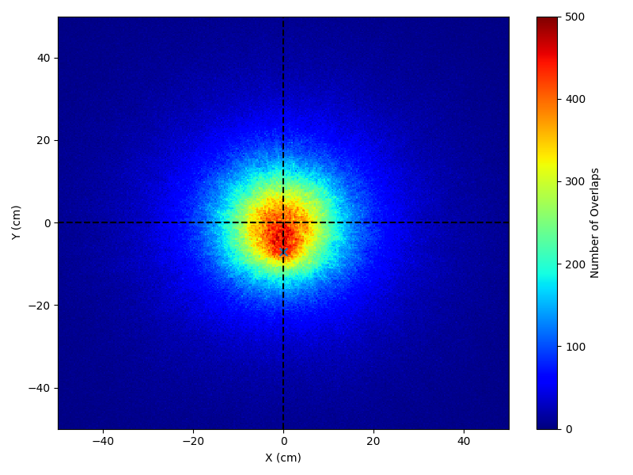
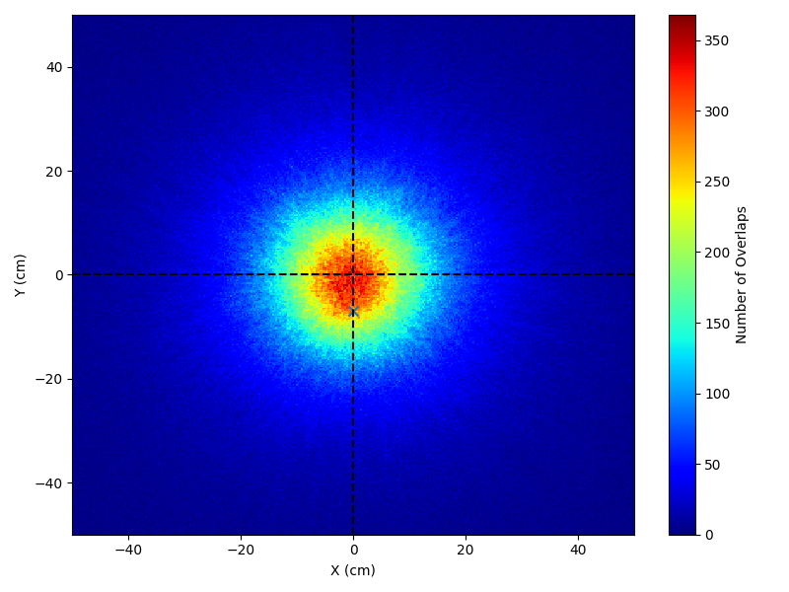
Validation Results
Simulation
Experimental
¹³⁷Cs Exp
Measurement 1
¹³⁷Cs at 10 cm standoff and +7 cm in y-direction.
⁶⁰Co Sim
⁶⁰Co Exp
Measurement 2
⁶⁰Co at 10 cm standoff and -7 cm in y-direction.
Hotspot corresponds to most probable source location.

Slide 14
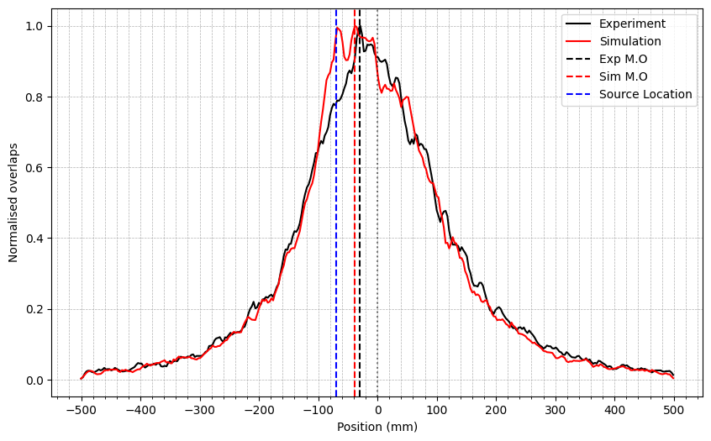
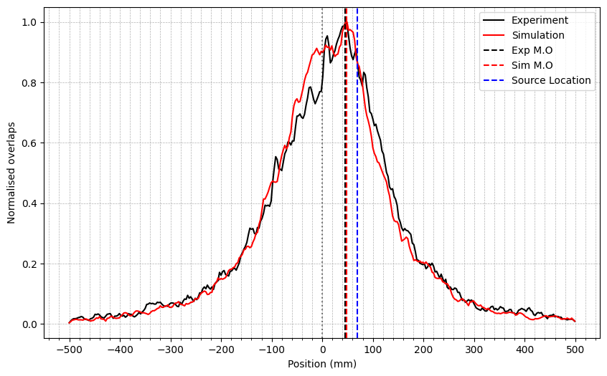
Maximum Overlaps Slices
Intensity slice through y taken at maximum x intensity
⁶⁰Co
¹³⁷Cs
Good agreement is observed between G4 generated signals and experimental data.
AGS PSA has been validated against experimental setup.
The offset between reconstructed and true positions arises from multiple sources of uncertainty.

Slide 15
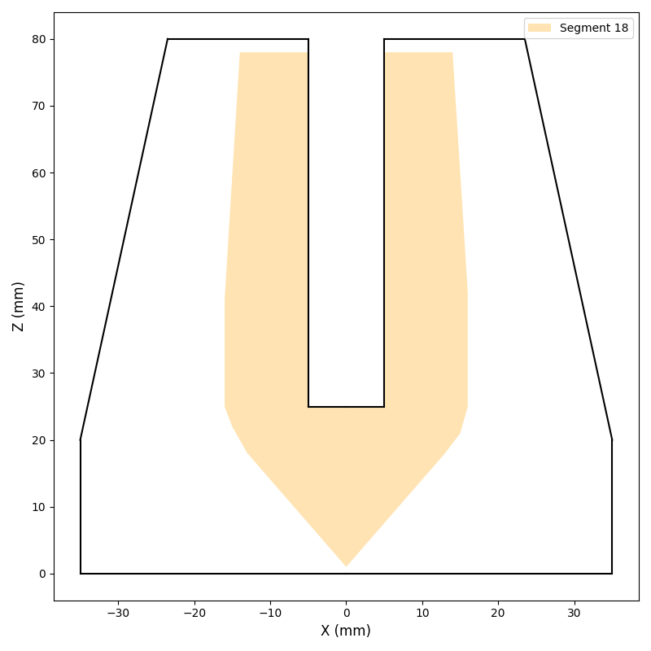
Position Resolution Estimation
Based on the validated datasets, a minimum position resolution achievable with PSA can be estimated.
Due to the large volume of segment 18, the position resolution is degraded when it is included.
 | Position Resolution (mm) |  | Efficiency drop by removing S18 (%)
Dataset | No Segment 18 | With Segment 18
¹³⁷Cs | 5.57 ± 0.02 | 6.24 ± 0.02 | 50.42
⁶⁰Co | 6.42 ± 0.02 | 7.25 ± 0.02 | 52.45

Slide 16
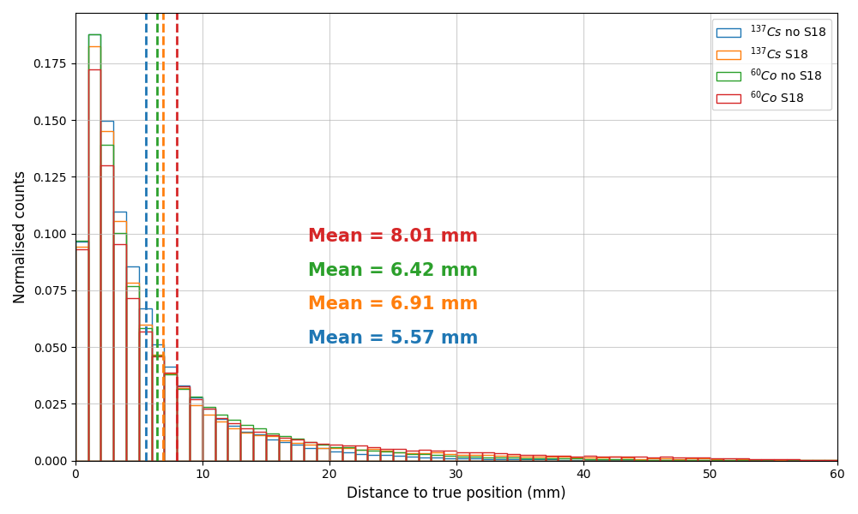
Position Resolution Distribution
Most of the found positions lie closer to true position.
The distances then falls nearly exponentially.

Slide 17
Future Plans
SIGMA has been integrated in an experiment in Jyväskylä focal plane.
Applying PSA would help identify gamma rays from nuclei of interest from uncorrelated background events.
By vetoing out background radiation a better P/T ratio could be achieved.

Slide 18
Thank you for listening
Any Questions?
Thanks to SIGMA group:
Prof. Laura Harkness
Dr. Ellis Rintoul
Dr. Daniel Judson
Dr. Owain Griffith
Dr. Sneha Das
Dr. Fraser Holloway
Emily Richardson

