Slide 1


B(E2) measurements of heavy N=Z nuclei at FRIB
Mike Bentley, RyoTaniuchi, Bob Wadsworth,
and the FRIB E21034 collaboration
Motivation and Background
E21034 Experiment at FRIB
New results
2⁺ lifetime, hence B(E2) 2⁺→0⁺ in N=Z ⁸⁸Ru
New shell-model approach
IOP Nuclear Physics Conference: April 2026

Slide 2
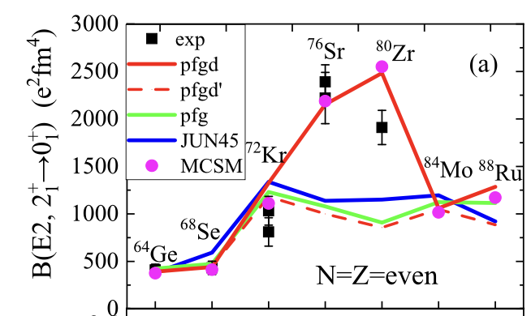
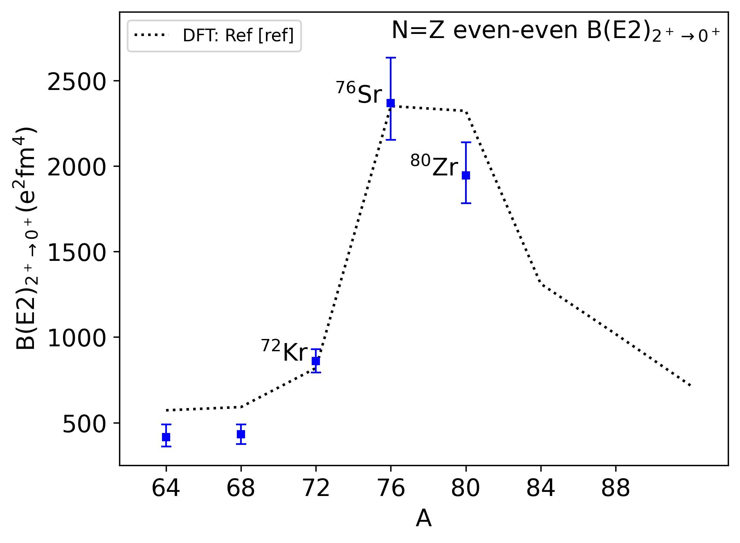
Motivation: ⁸⁸Ru
A~80 N=Z:
Highest deformation/collectivity
Shape Mixing and co-existence
Pseudo- and quasi-SU(3) valence space
How (and why) does collectivity develop?
HFB calculations:
J. P. Delaroche, et al., PRC81,014303 (2010)
Kaneko et al. Physics Letters B 817 (2021) 136286
Challenges for shell-model
Large valence space (incl ds orbitals
New interactions (e.g. ZBM3)
New approaches (e.g. DNO-SM calculations)
⁸⁸Ru ?
R.D.O.Llewellyn et al., PRL 124, 152501 (2020)

Slide 3
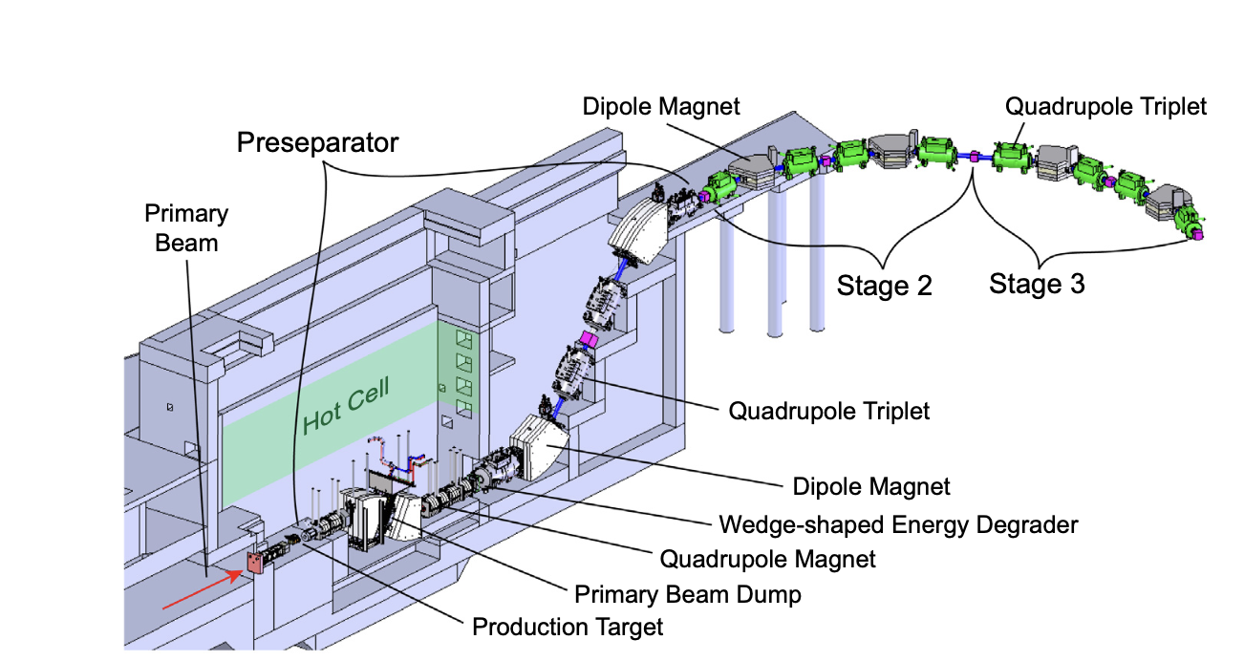
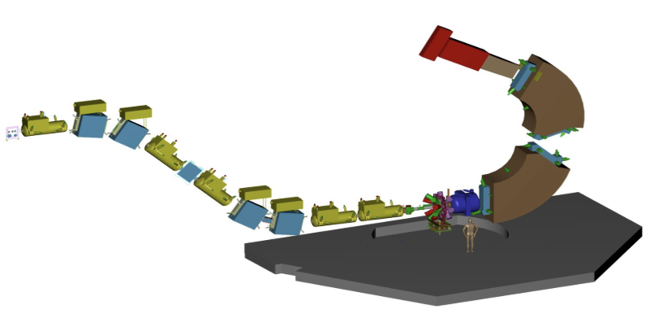
Experiment 21034: April 2023
ARIS Separator
Primary beam: ¹²⁴Xe
227 MeV/u 5kW
S800 Spectrograph
Secondary beams:
⁸⁹Ru (~100-150 pps)
⁸⁸Tc (~3000 pps)
⁸⁹Ru – 1n → ⁸⁸Ru
⁸⁹Ru purity 0.04% !!

Slide 4
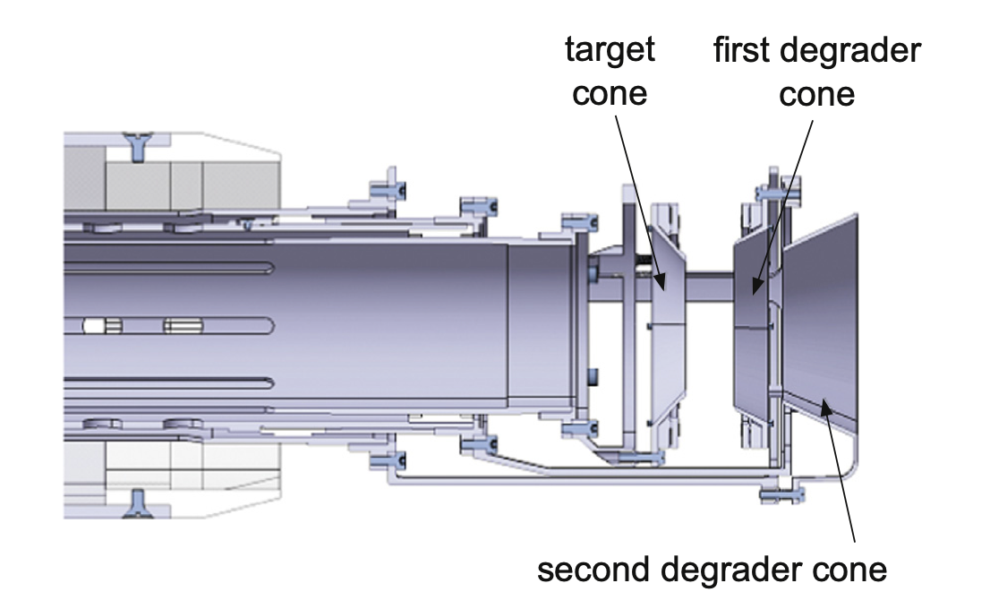
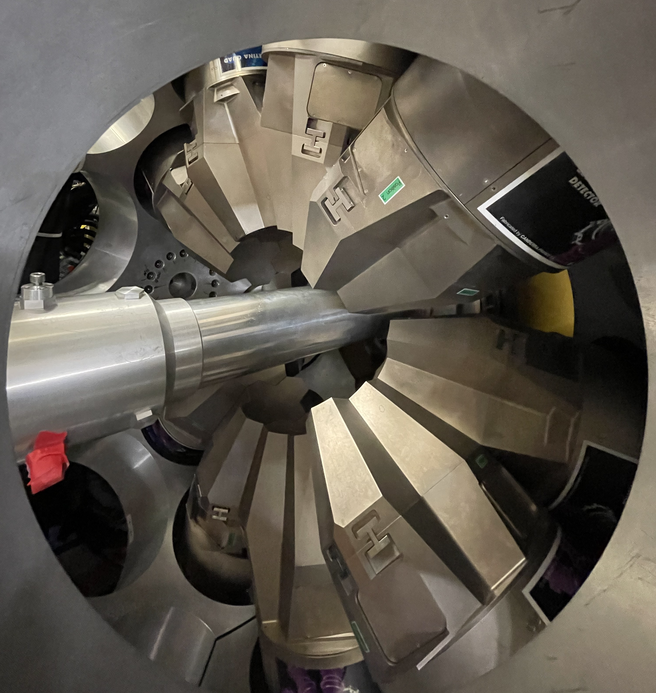
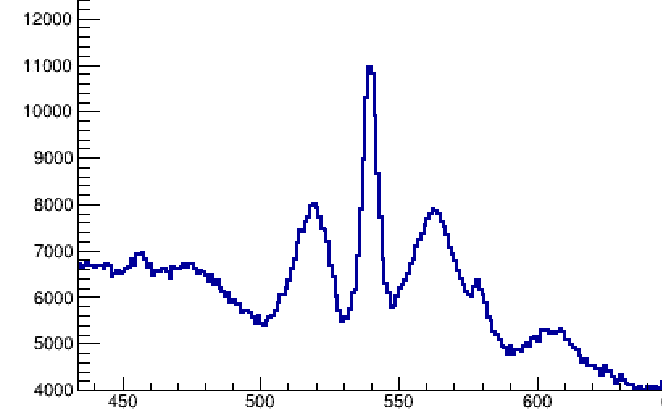
Experiment:
Target and γ rays
TRIPLEX PLUNGER
E21034: April 2023
Gretina – 12 quads (48 crystals)
Iwasaki et al.,NIMA 806 (2016) 123–131
S
M
F
540-keV
~16 ps
2mm
Be
200μm
Ta
120μm
Ta
D1
D2
Secondary
beams
F
M
S
TARGET
1mm
1.5 mm

Slide 5
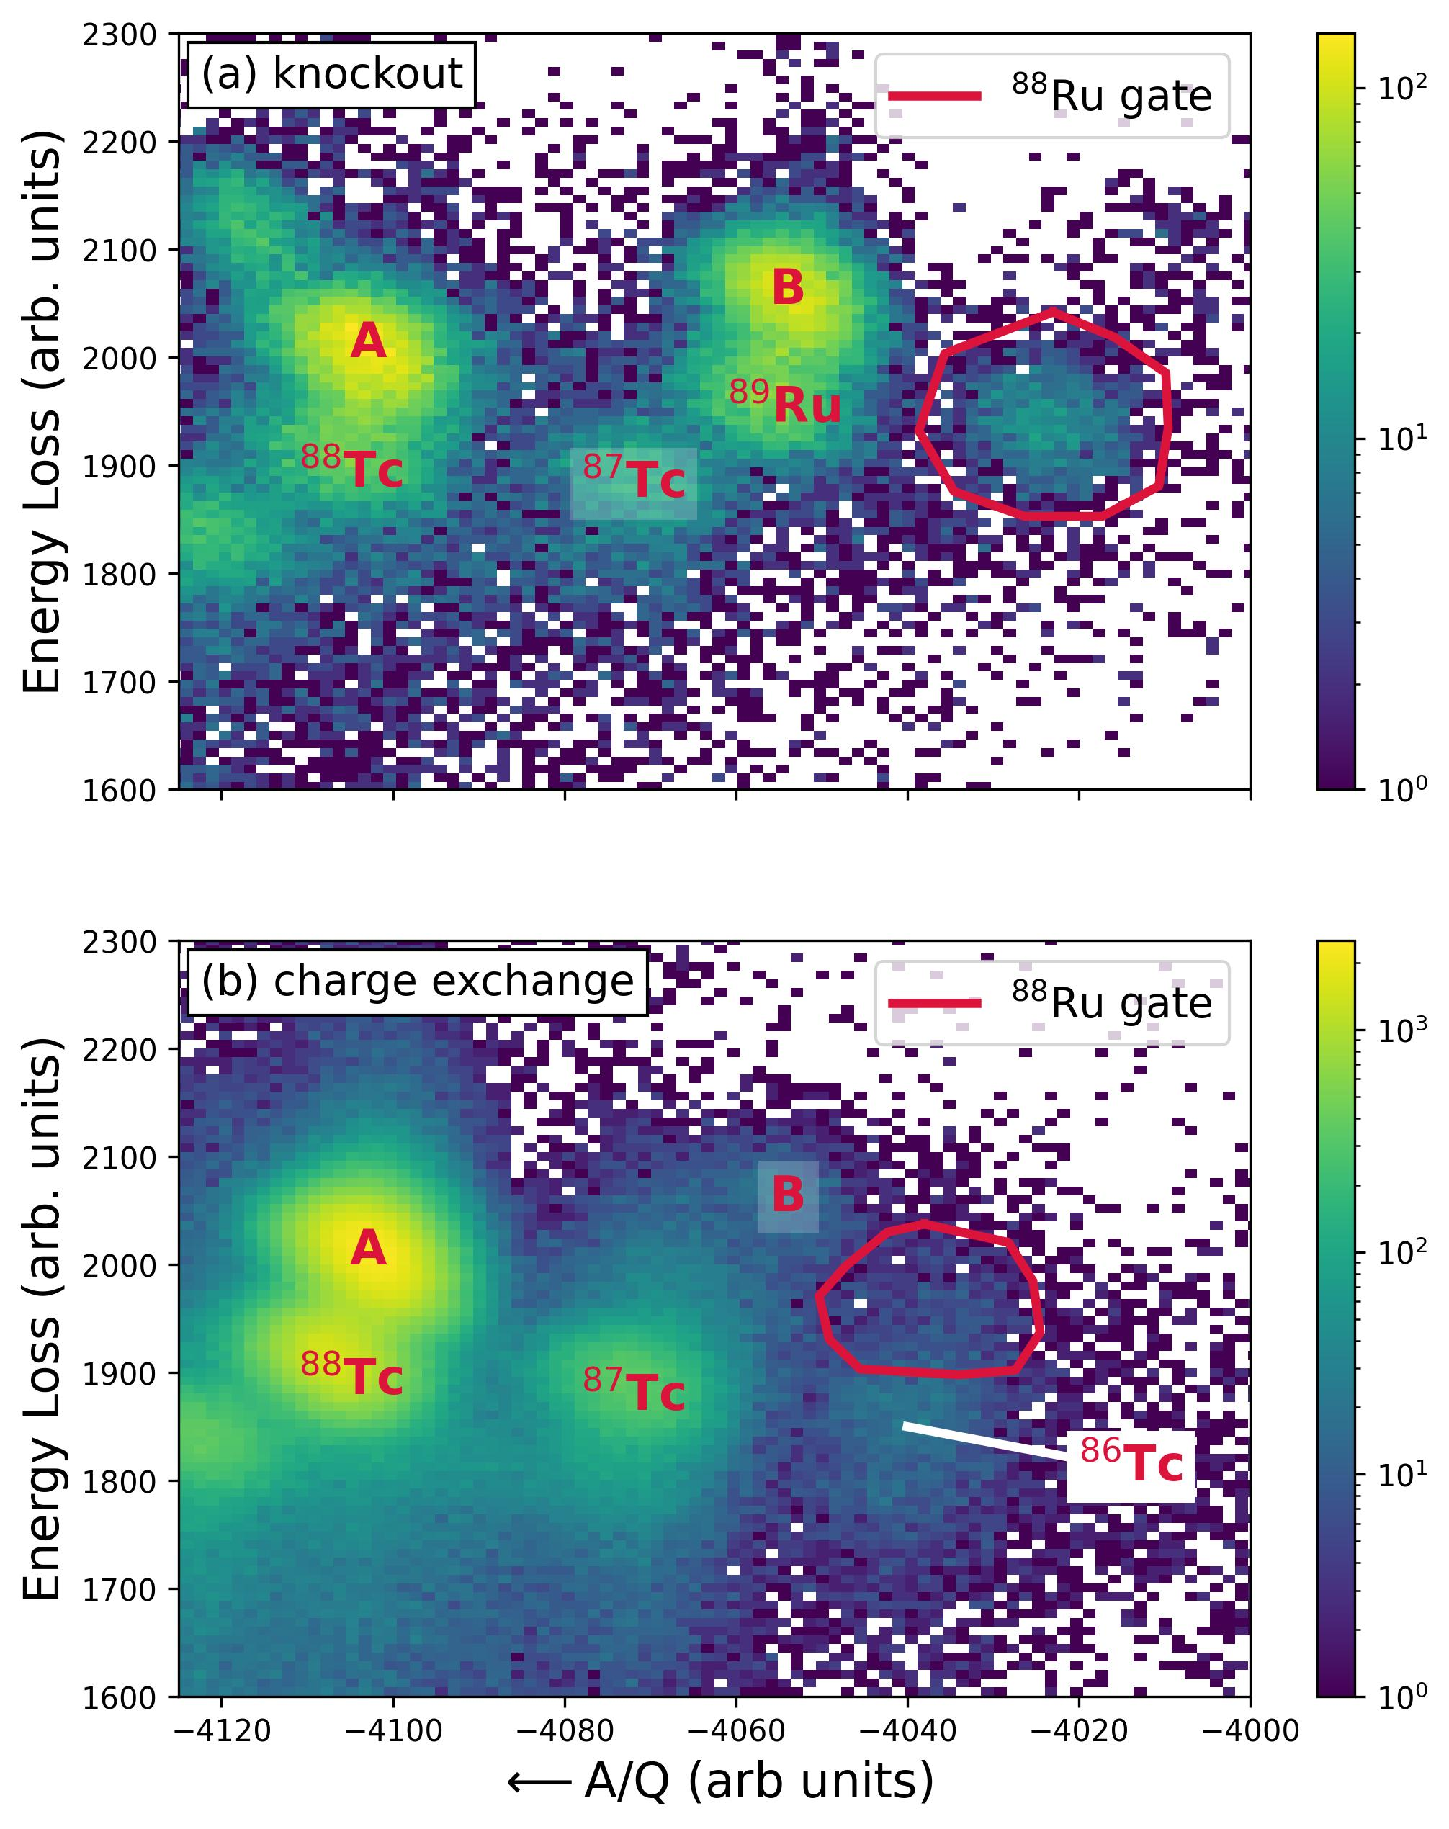
Experiment:
Reactions and PID
⁸⁸Ru (-1n knockout)
Energy loss (arb)
⁸⁸Ru (charge exchange!)
Gated on incoming ⁸⁹Ru
A/Q. (arb)
N=Z
(A/Q=2.0)
Energy loss (arb)
Gated on incoming ⁸⁸Tc
A/Q (arb)
N=Z
(A/Q=2.0)
M. A. Bentley et al. Phys. Rev. Lett. (2026) – in press

Slide 6
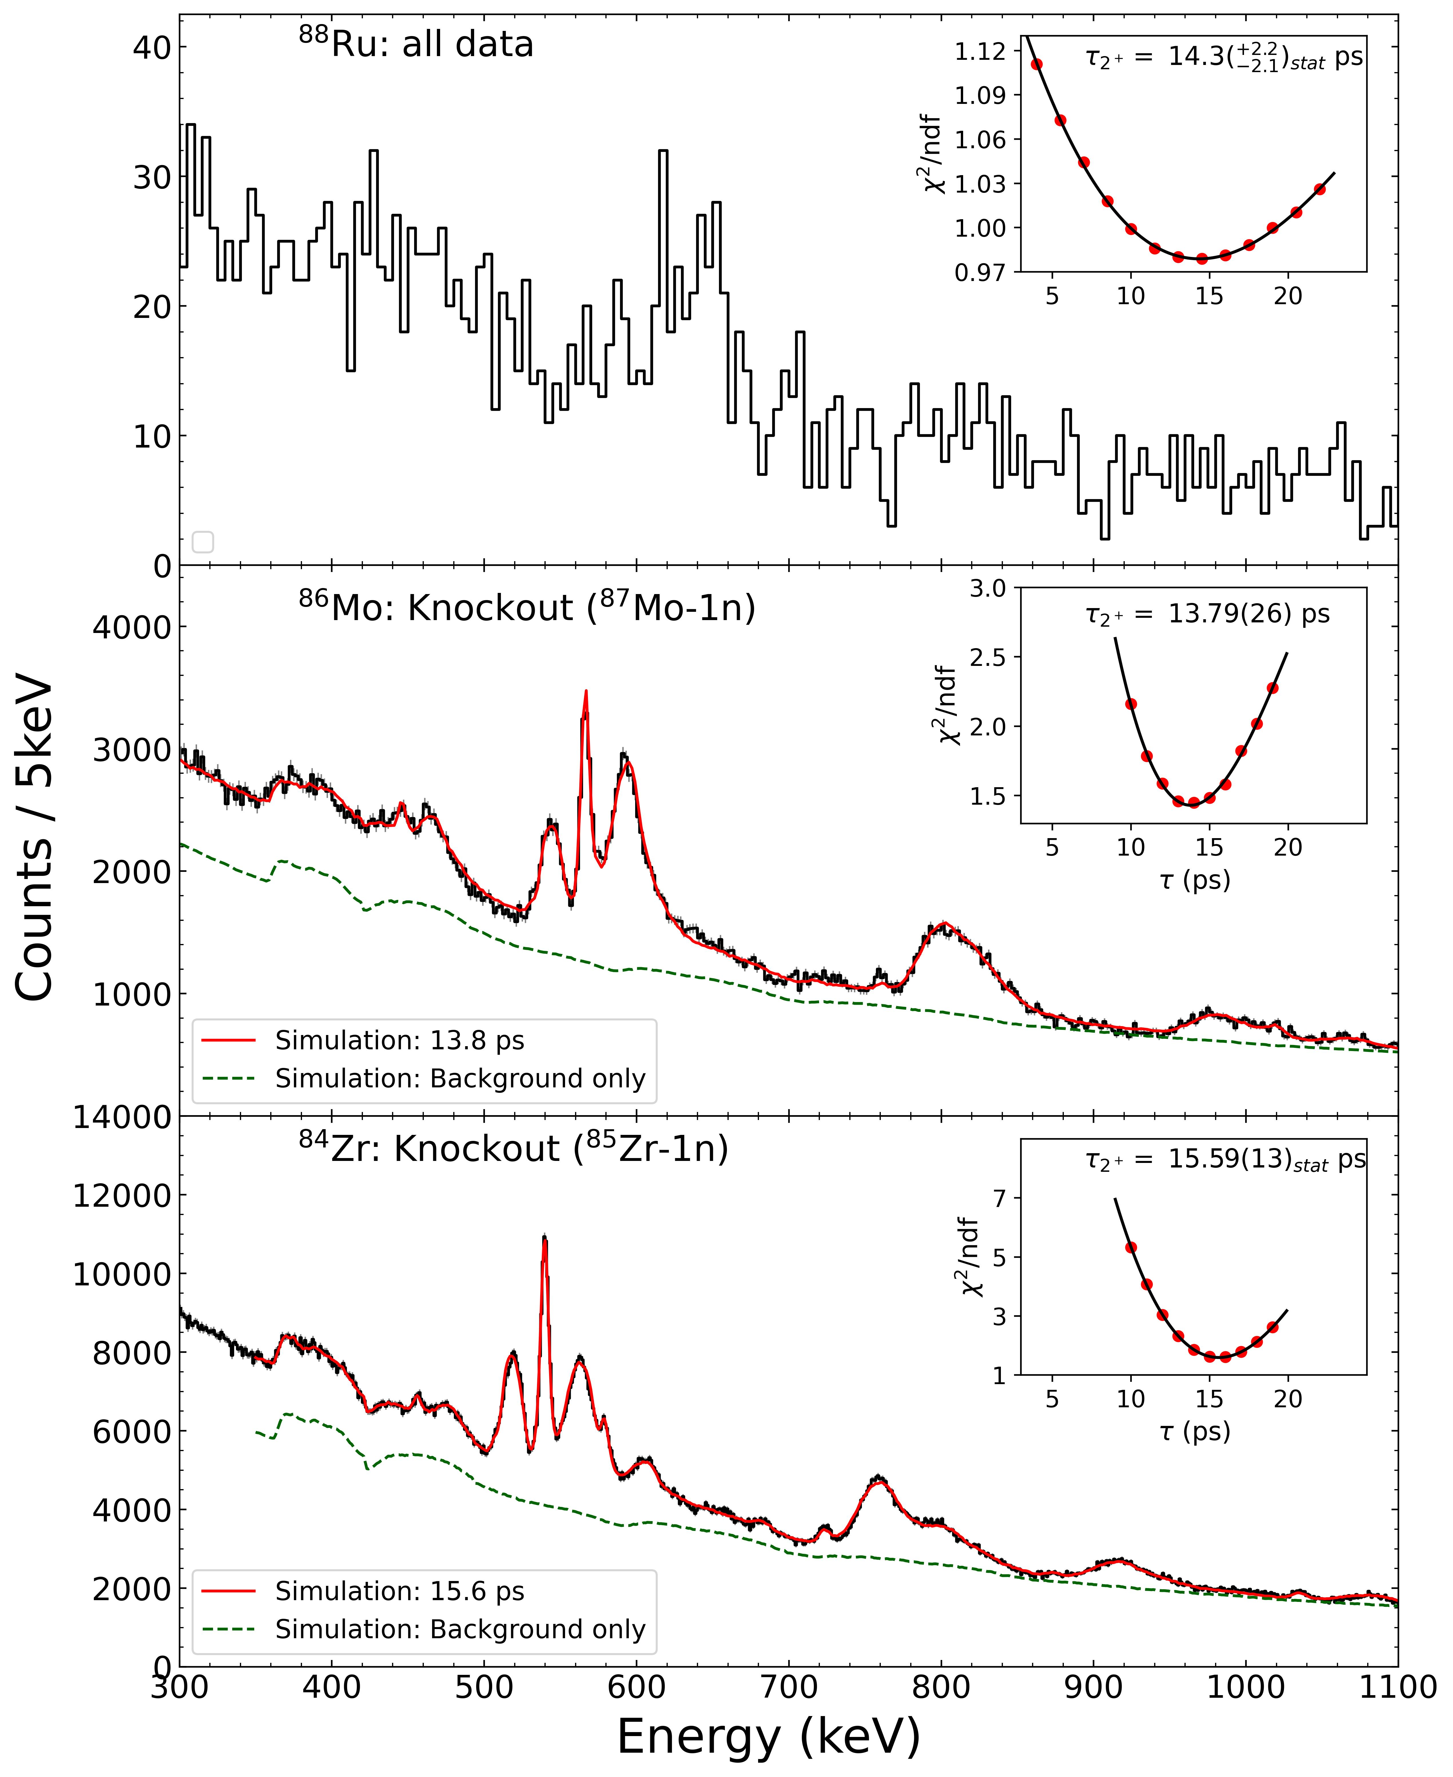
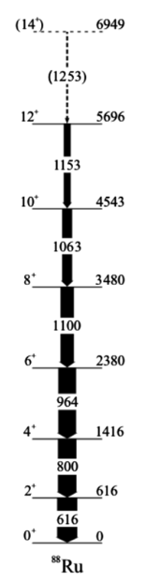
⁸⁸Ru
616 keV
800 keV
Counts / 5keV
⁸⁶Mo
2⁺
Counts / 1keV
3⁺
N=44 isotones
2₂⁺
4⁺
4₂⁺
T₂₊ = 13.8(1.0) ps
6⁺
NEW
⁸⁴Zr
2⁺
Counts / 1keV
3⁺
2₂⁺
4⁺
⁸⁸Ru
4₂⁺
T₂₊ = 15.6(1.0) ps
6⁺
Cederwall et al., PRL 124, 062501 (2020)
Lit: 20.3(11) ps (!!)
M. A. Bentley et al. Phys. Rev. Lett. (2026) – in press

Slide 7
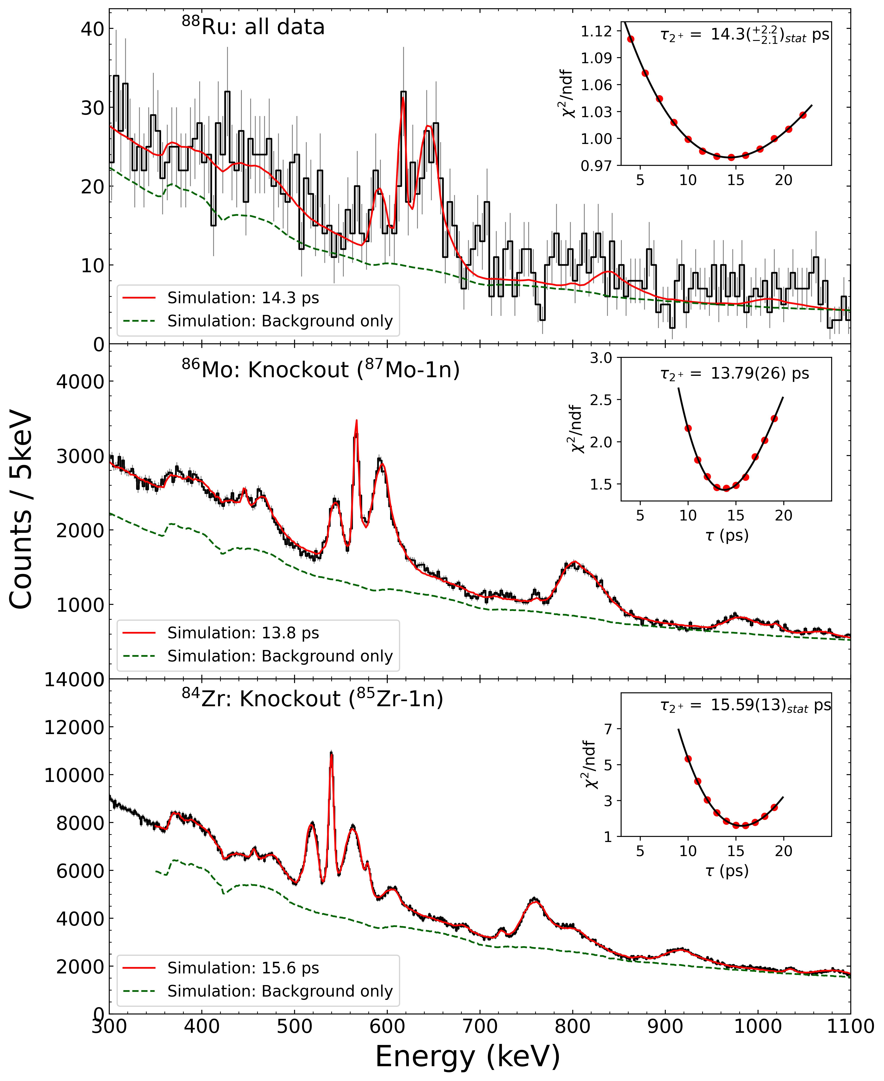
⁸⁸Ru
Counts / 5keV
NEW
T₂₊ = 14.3^{+2.5} ps
_{-3.4}
B(E2) (2⁺ → 0⁺) =
640⁺²⁰⁰ e²fm⁴
⁸⁶Mo
₋₁₀₀
2⁺
Counts / 1keV
3⁺
2₂⁺
4⁺
4₂⁺
T₂₊ = 13.8(1.0) ps
6⁺
NEW
⁸⁴Zr
2⁺
Counts / 1keV
3⁺
2₂⁺
4⁺
⁸⁸Ru
4₂⁺
T₂₊ = 15.6(1.0) ps
6⁺
Cederwall et al., PRL 124, 062501 (2020)
Lit: 20.3(11) ps (!!)
M. A. Bentley et al. Phys. Rev. Lett. (2026) – in press

Slide 8
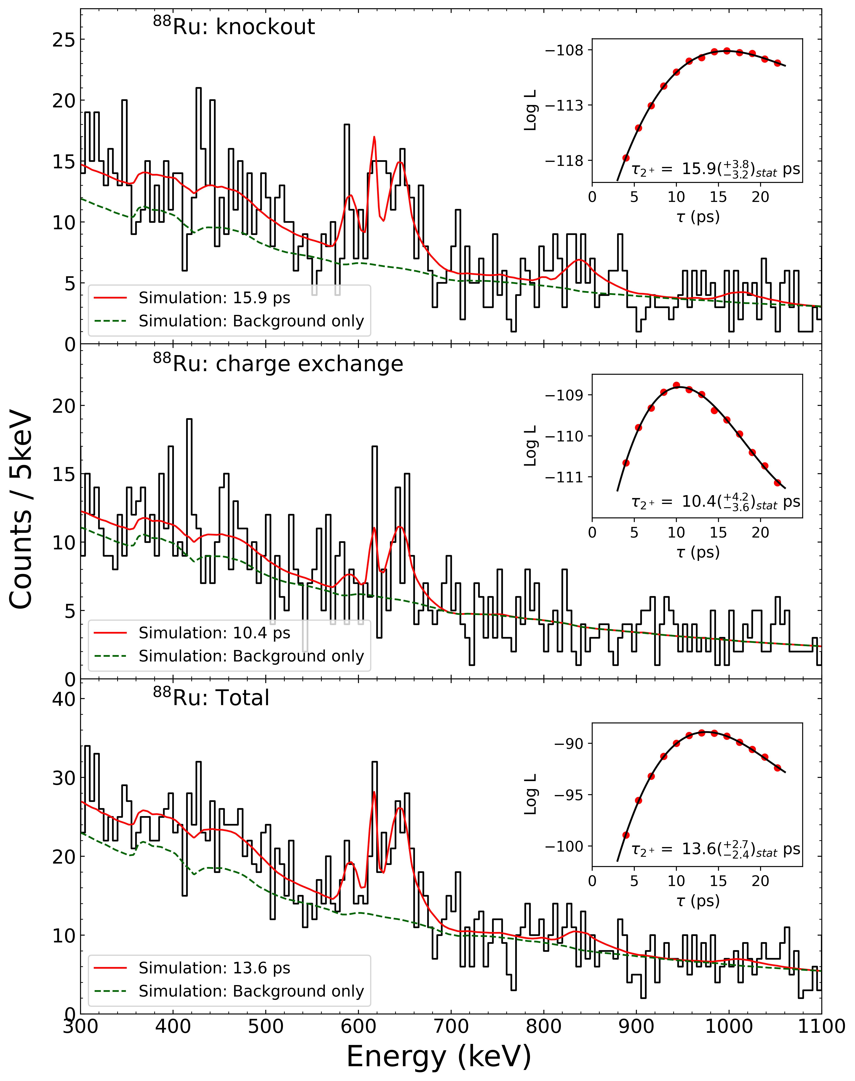
Maximum Likelihood Fits
Knockout from ⁸⁹Ru
⁸⁸Ru: ⁸⁹Ru-1n
T₂₊ = 15.9(35_{stat}) ps
⁸⁸Ru: ⁸⁸Tc (CE)
Weighted Average:
13.5(26)ps
Charge Exchange from ⁸⁸Tc
T₂₊ = 10.4(39_{stat}) ps
⁸⁸Ru: Total
T₂₊ = 13.6(26_{stat}) ps
14.3(22_{stat}) ps from χ²

Slide 9
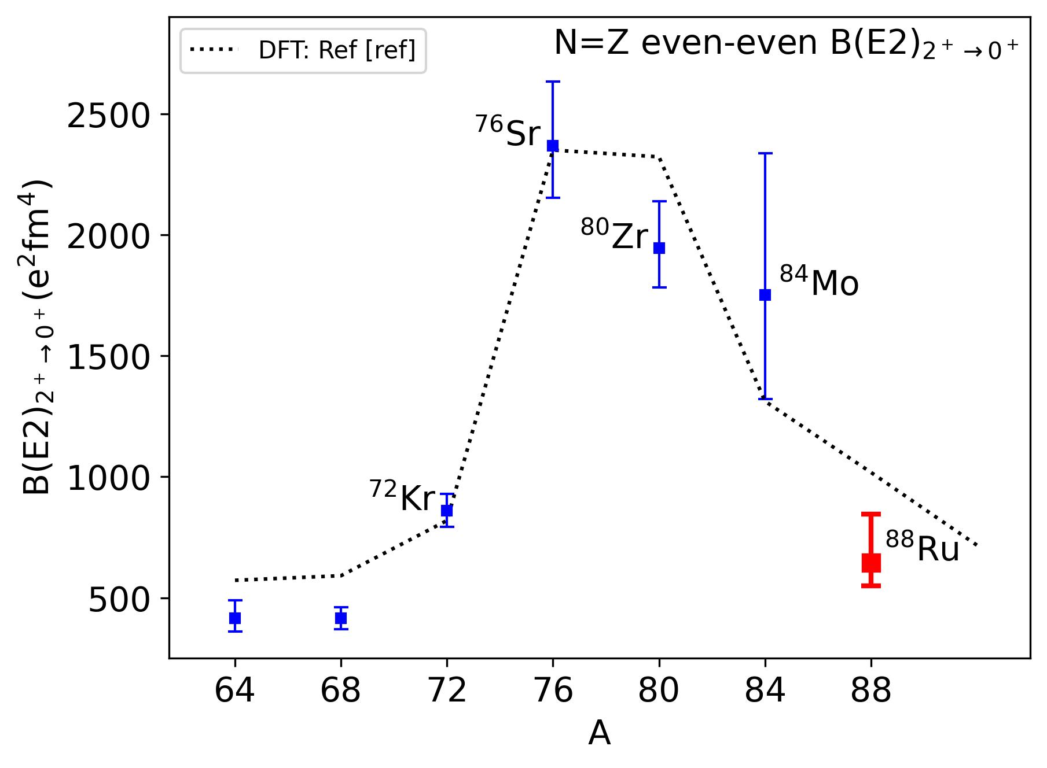
Development of collectivity along N=Z
DFT calculations:
J. P. Delaroche, et al., PRC81,014303 (2010)
⁸⁴Mo – new results
J. Ha, et al., Nature Physics 16, 10631 (2025)
⁸⁸Ru – this work

Slide 10
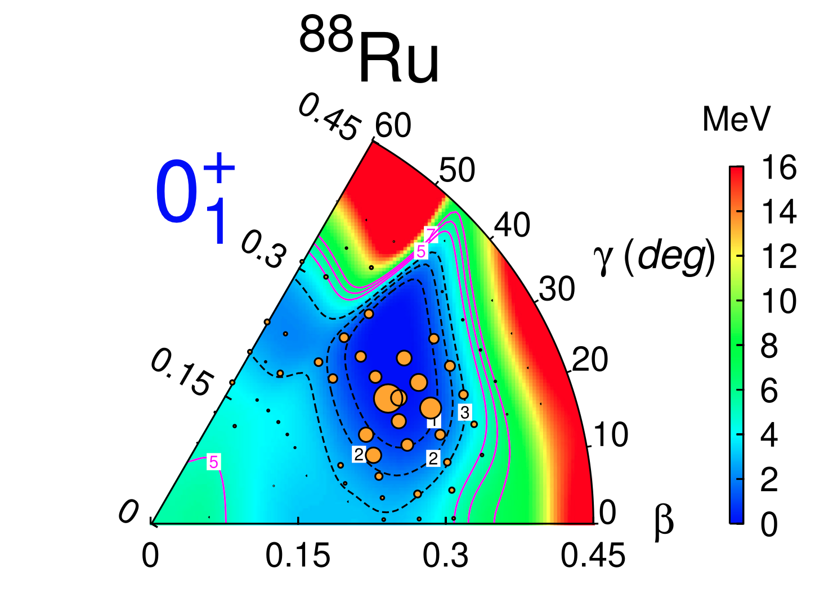
Shell-model: new approach and results
J.Ha et al., Nature Physics 16, 10631 (2025)
A.P Zuker et al, Phys Rev C 92, 024320 (2015)
F. Nowacki, D. Dao, A.Poves
Large-scale SM: New interaction ZBM3, spans the space: p_{3/2}f_{5/2}p_{1/2} – g_{9/2}d_{5/2} s_{1/2}
B(E2) results:
LSSM-ZBM3 (ε_{p}=1.5, ε_{n}=0.5): 558 e²fm⁴
Experiment:
640⁺²⁰⁰ e²fm⁴
₋₁₀₀
New Discrete Non-Orthogonal (DNO) shell-model approach:
D.D.Dao and F.Nowacki, PRC105, 054314 (2022)
DNO-SM (ZBM3): 616 e²fm⁴
M. A. Bentley et al. Phys. Rev. Lett. (2026) – in press

Slide 11
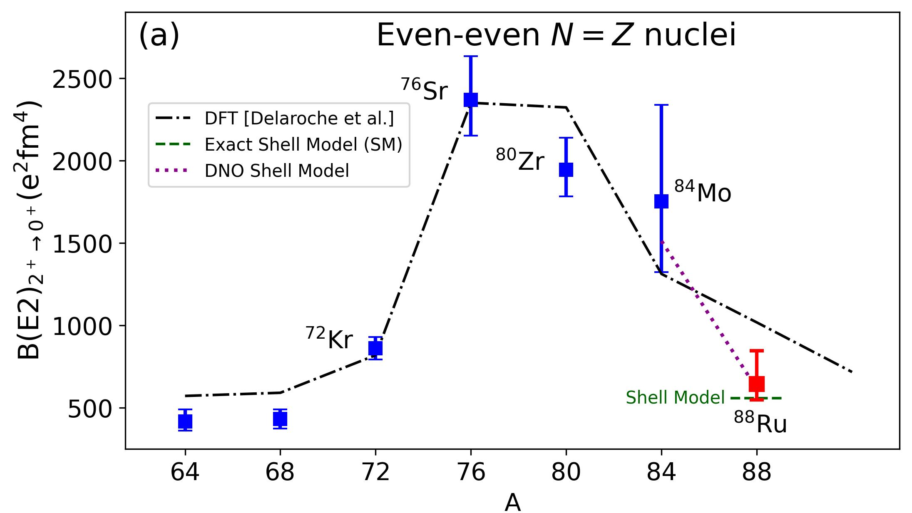
Shell-model: new approach and results
DNO Shell Model
M. A. Bentley et al. Phys. Rev. Lett. (2026) – in press

Slide 12
Conclusions
Successful FRIB experiment – overcoming many challenges
New data for B(E2) for the heaviest N=Z even-even nucleus ⁸⁸Ru
New shell-model approaches for these deformed N=Z systems
ZBM3 interaction, DNO-SM approach…
Shell-model now can handle the full range of N=Z data

Slide 13
Thanks:
M.A.Bentley, R.Taniuchi, R.Wadsworth, J.Dobaczewski, D.G.Jenkins, W.Marshall, S.Paschalis, M.Petri. University of York, U.K.
A.Gade, M.Basson, T.Beck, J.Chen, A.Douglas, P.Farris, S.Gillespie, A.Hill, H.Iwasaki, , J.Jung, J.Pereira, R.Salinas, A. Sanchez, J.Swartz, C.Tinson, D.Weisshaar. FRIB/MSU, USA
X.Pereira-Lopez, IBS Daejeon, Korea
K.Wimmer, GSI/FAIR, Germany
B.Cederwall, KTH Stockholm, Sweden
M.Doncel, University of Stockholm, Sweden
D.Dao, F.Nowacki CNRS, Strasbourg, France
S.M.Lenzi, Padova, Italy
Thanks to FRIB team – especially Marc Hausmann and Brad Sherill (ARIS)

