Slide 1



Lifetime measurements in neutron-rich barium and cerium isotopes using the fast-timing technique
Faye Rowntree

Slide 2
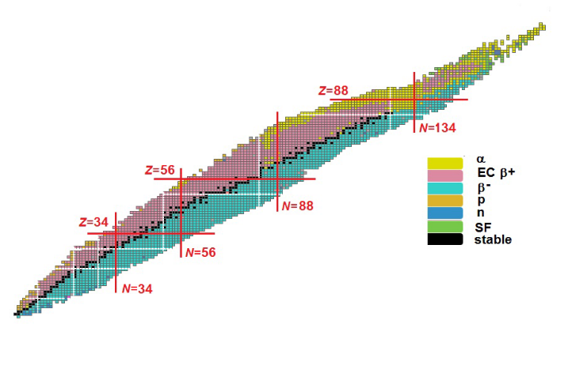
Octupole Deformation
Octupole deformation arises around the octupole “magic” numbers
Regions just past the shell model “magic” numbers
actinides
lanthanides
P. Butler, Journal of Physics G Nuclear and Particle Physics, 43 (7) (2016)

Slide 3
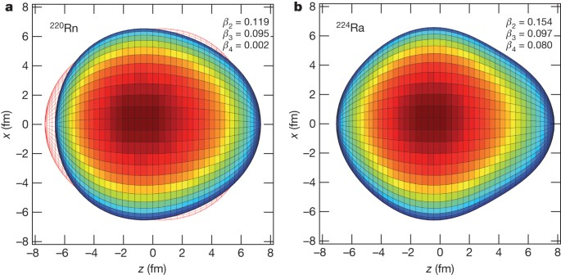
Octupole Deformation
Previously seen in the neutron-rich actinides
Separation of centre of mass and centre of charge
Creates an enhanced dipole moment – sensitive to single particle effects
vibrational
stable
L. Gaffney, P. Butler, M. Scheck, et al, Nature 497, 199–204 (2013)

Slide 4
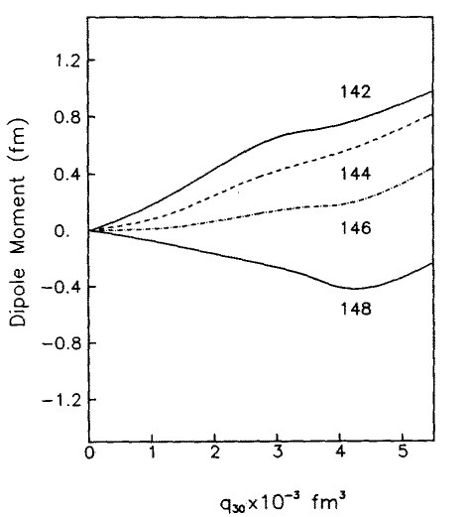
Octupole Deformation
¹⁴²⁻¹⁴⁸Ba
electric dipole moment (D₀)
electric quadrupole moment (Q₀)
electric octupole moment (Q₃)
Fast Timing
Coulex
J. L. Egido and L. M. Robledo, Nuclear Physics A 518, 475-495 (1990)
Notes:
Egido and Robledo D0 vs Q3 plot instead

Slide 5
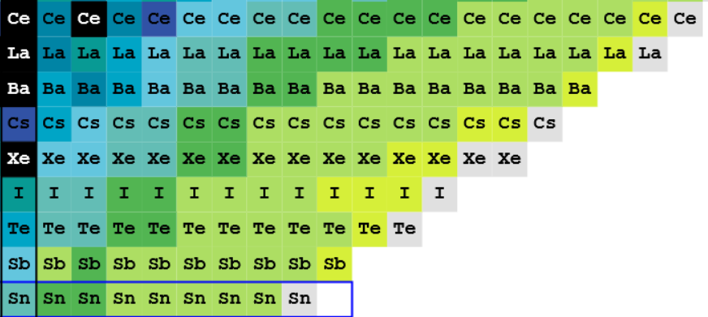
The Lanthanides
N=82
National Nuclear Data Centre (NNDC)
58
Cs
β
57
56
τ
55
γ
54
Ba
53
52
51
La
Z=50
Cs → Ba → La → Ce
Ce

Slide 6
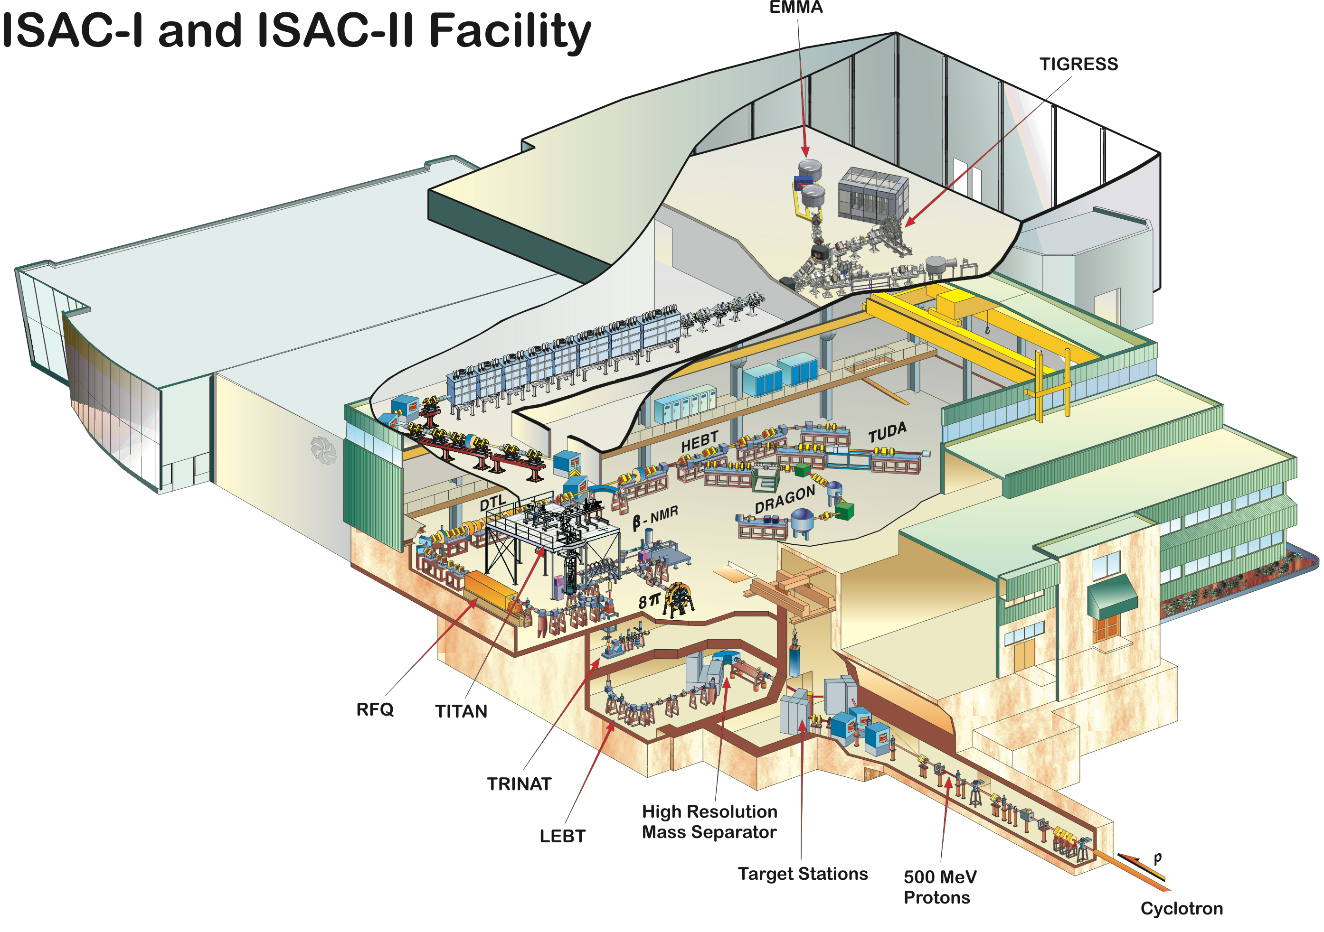
ISAC-I
RIB produced via isotope separation on-line (ISOL) technique
500 MeV protons delivered from the TRIUMF cyclotron hit UC target
Proton-induced fission – Cs is surface ionised
Ions separated by mass
RIB delivered to GRIFFIN
GRIFFIN
TRIUMF website

Slide 7
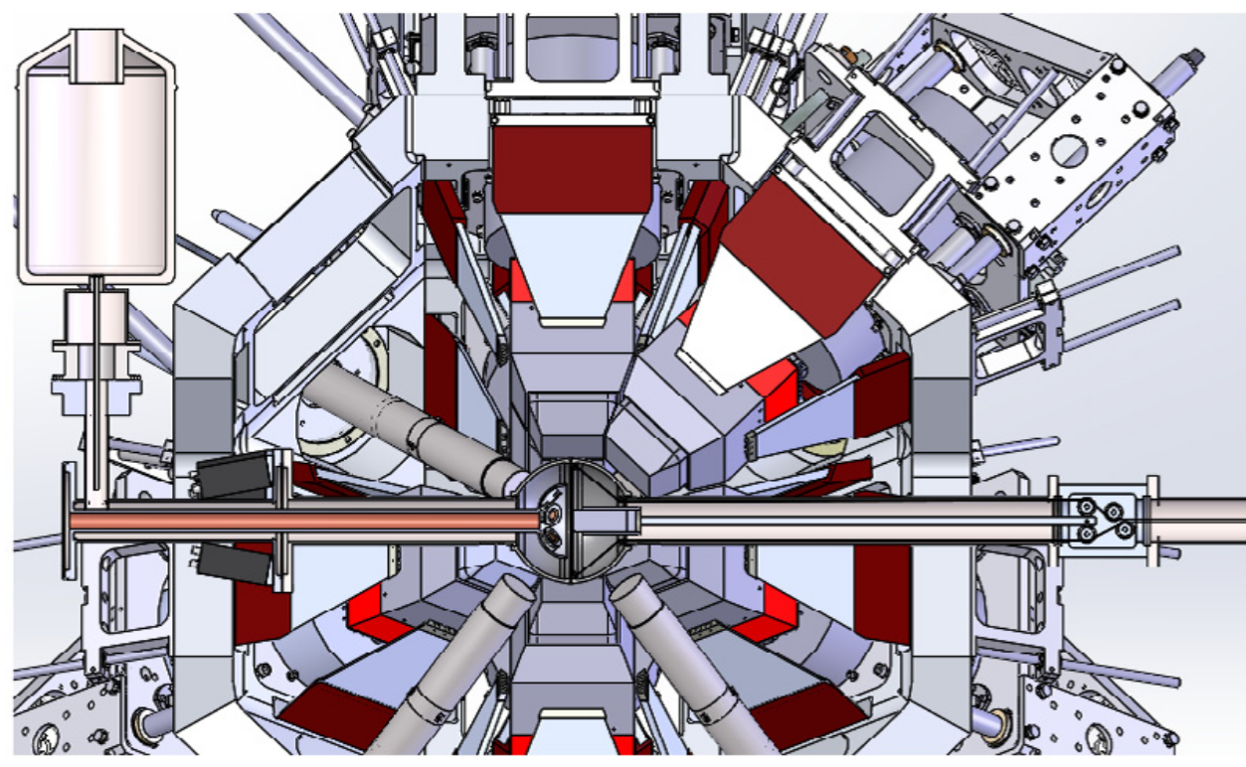
GRIFFIN
HPGe
ZDS
Moving Tape
PACES
…tape removes decay products
RIB hits tape…
LaBr₃(Ce)
BGO
A. B. Garnsworthy et al., Nuclear Instruments and Methods A, 918 (2019)

Slide 8
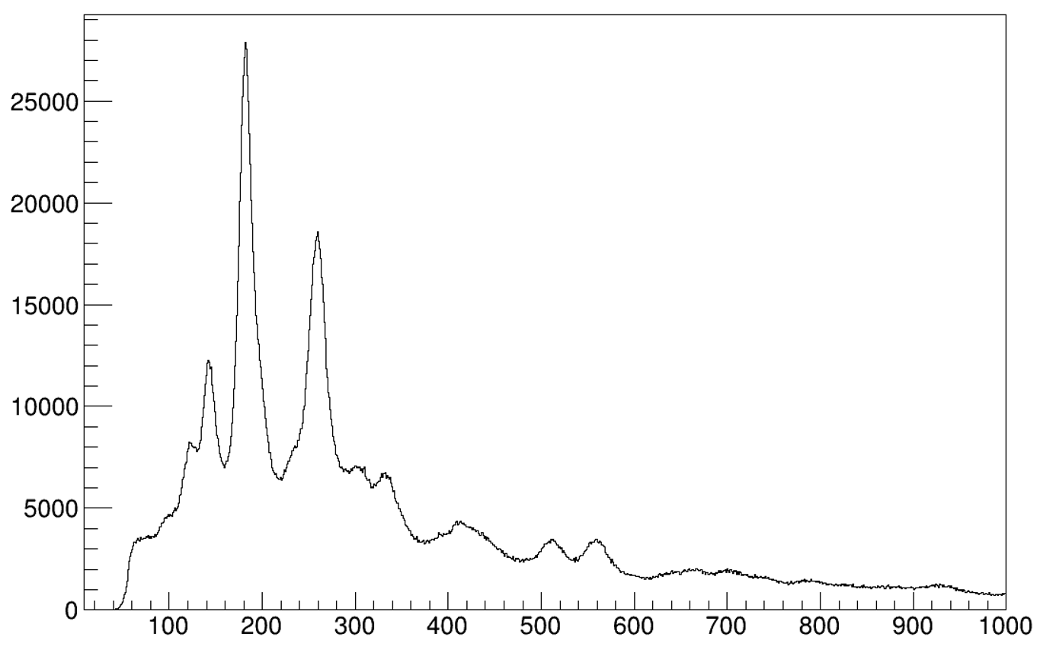
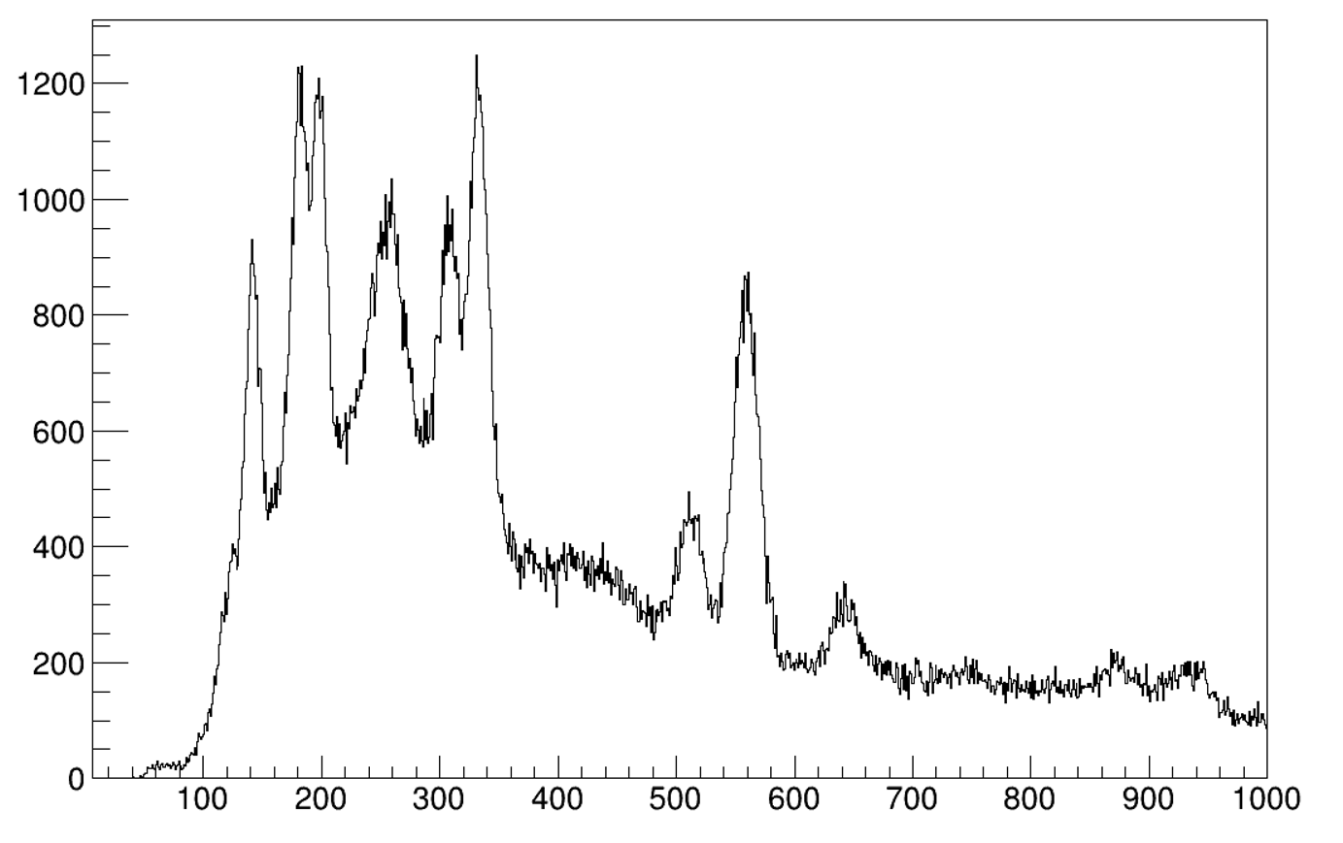
Fast Timing
β_{feeder}
γ_{feeder}
Event 1:
Energy
Event 2:
Energy
TAC:
Time difference
State of interest
γ_{decay}
γ_{decay}
Counts
Counts
Gate on 337 keV
4⁺ → 2⁺
(feeder transition)
Gate on 181 keV
2⁺ → 0⁺
(decay transition)
Energy /keV
Energy /keV

Slide 9
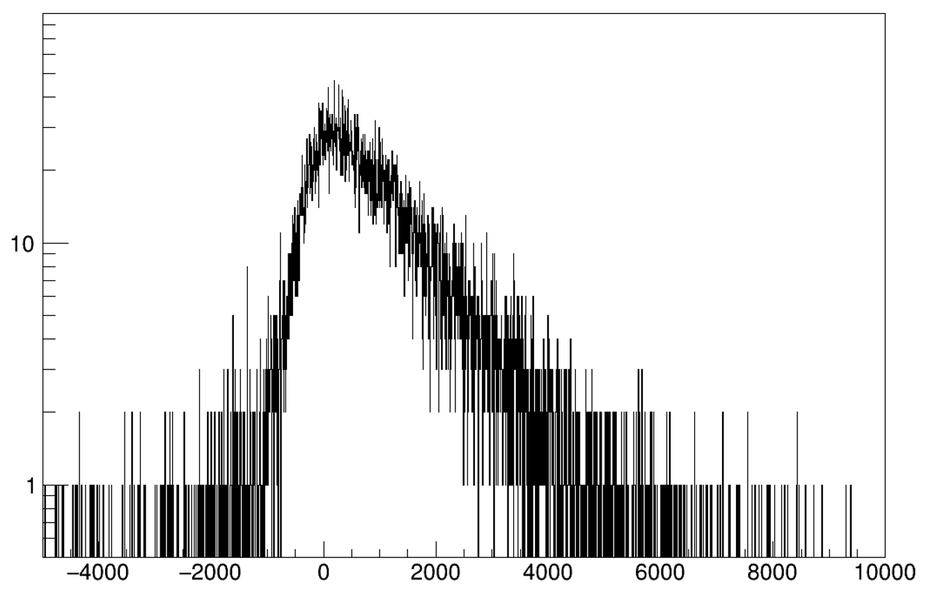
Fast Timing
β_{feeder}
γ_{feeder}
Event 1:
Energy
Event 2:
Energy
TAC:
Time difference
State of interest
γ_{decay}
γ_{decay}
Counts
γ
Detector 1
TAC
γ
Detector 2
delay
Time /ps

Slide 10
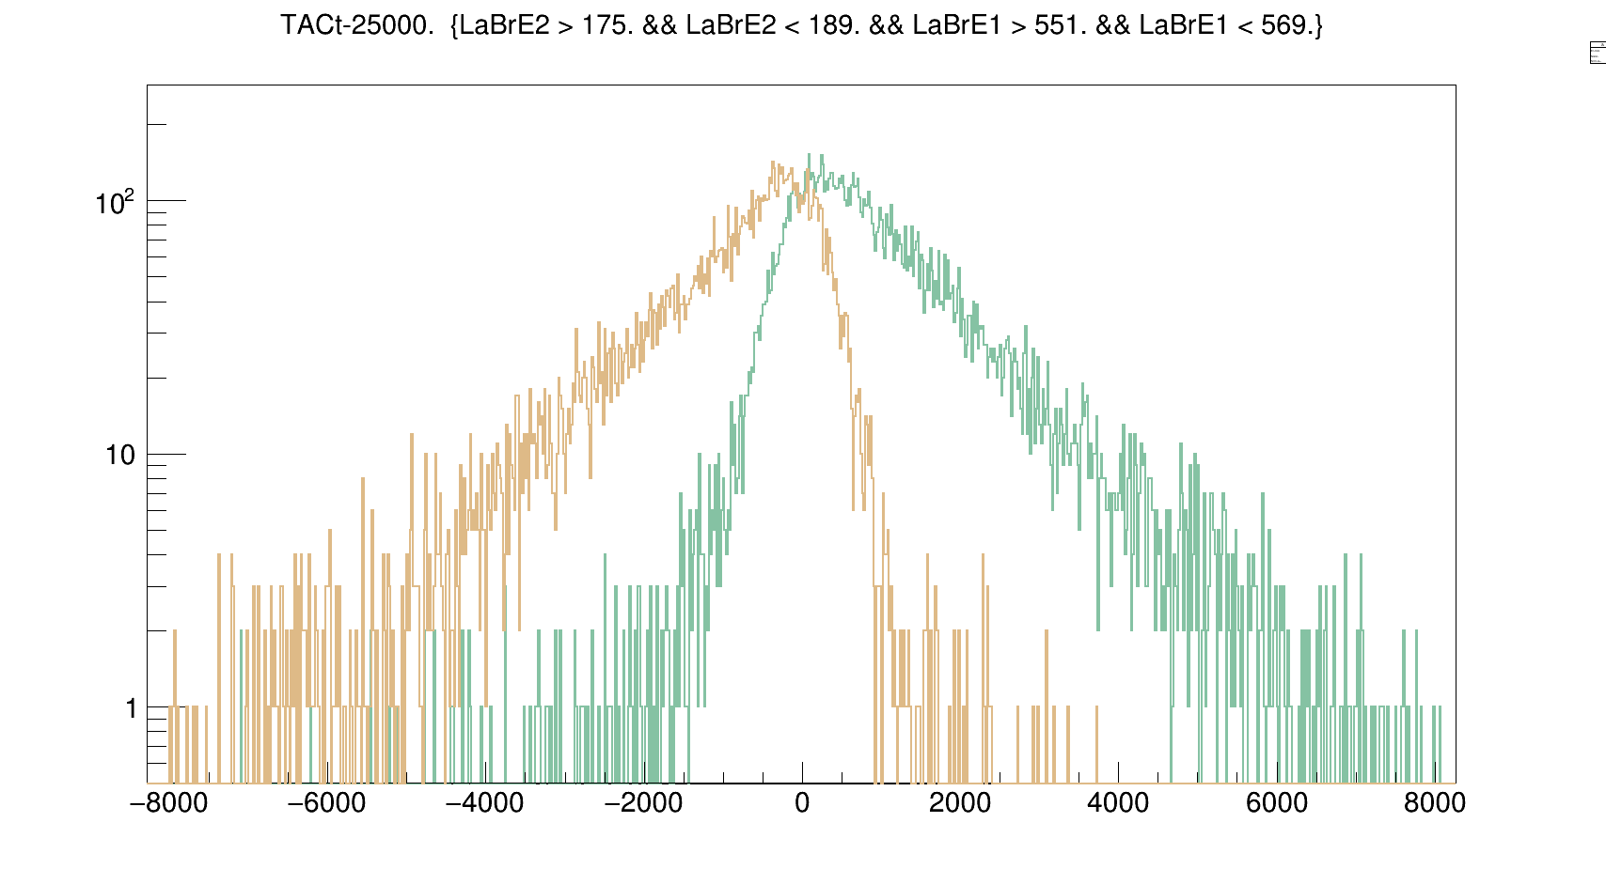
Fast Timing
β_{feeder}
γ_{feeder}
State of interest
γ_{feeder}
γ_{decay}
γ_{decay}
Detector 1 (start)
Counts
TAC
ΔC
γ_{decay}
Detector 2 (stop)
delay
antidelayed
delayed
γ_{decay}
Detector 1 (start)
TAC
γ_{feeder}
Detector 2 (stop)
delay
Time /ps

Slide 11
Time Sync
Each detector has a GRIF16 digitiser, which has its own clock
Clock oscillates at nominal frequency, producing a logic pulse
Each logic pulse is counted – time stamps
System is triggerless
1
2
3
4
5

Slide 12
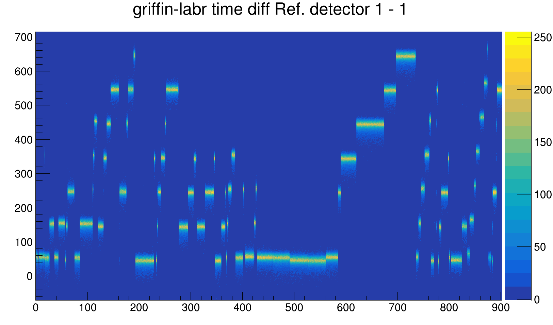
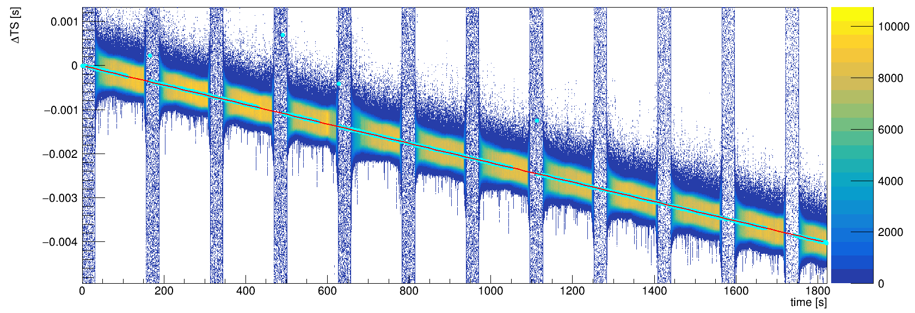
Time Sync
1
2
3
4
5
Time Difference (ns)
1
2
3
4
Time Steps
Time (s)
1
2
3
4
5
Time Difference (us/s)
1
2
3
4
5
Time Drifts
Time (s)

Slide 13
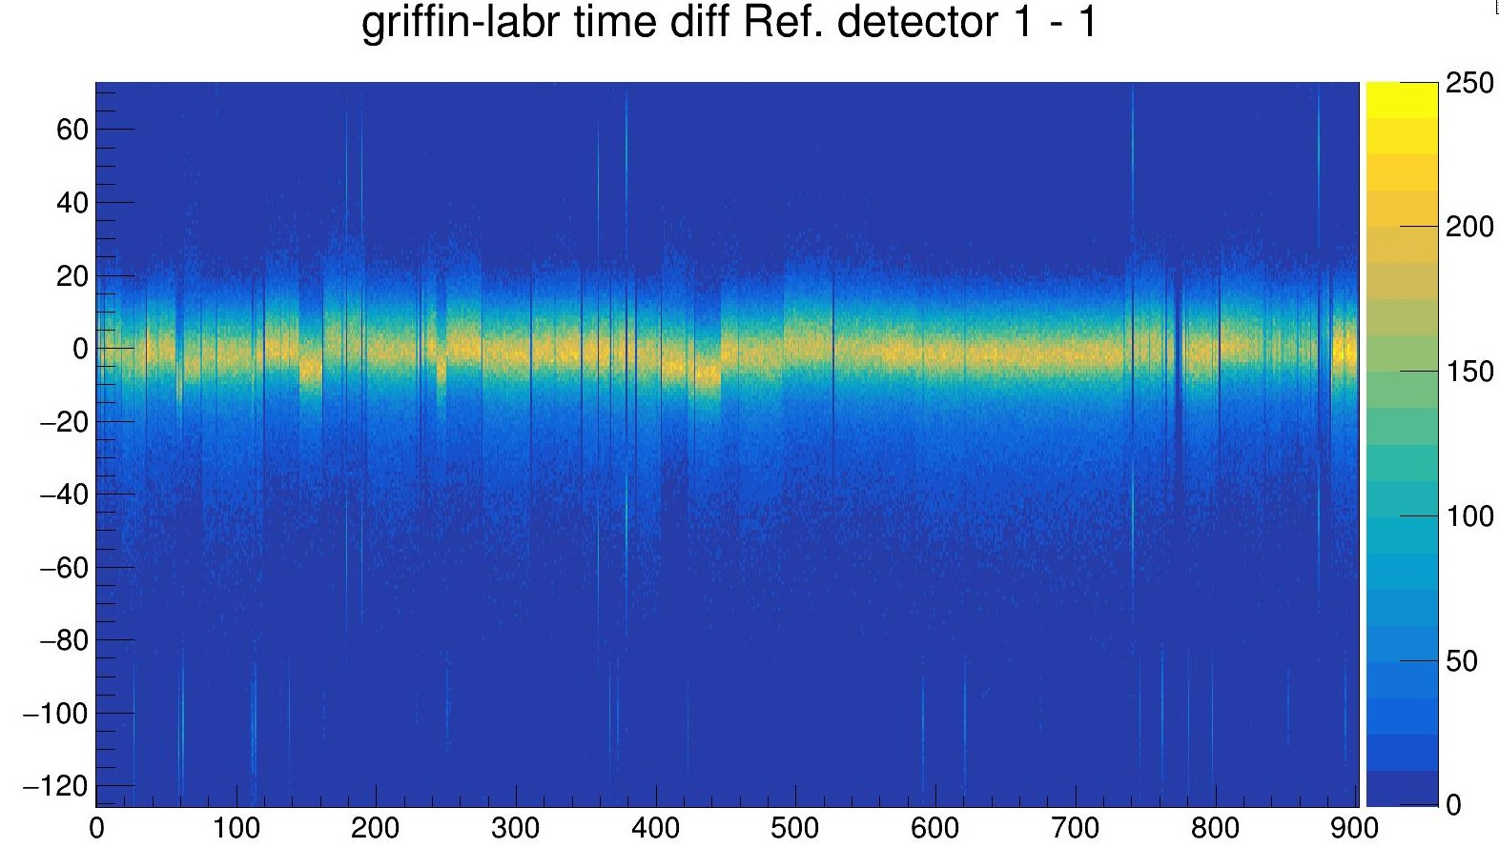
Time Step
Time Difference (ns)
Time Difference (ns)
Time (s)
Time (s)
Each subrun has a distinct time difference between HPGe array and all other detectors
Apply a shift offset
Re-calibrate data

Slide 14
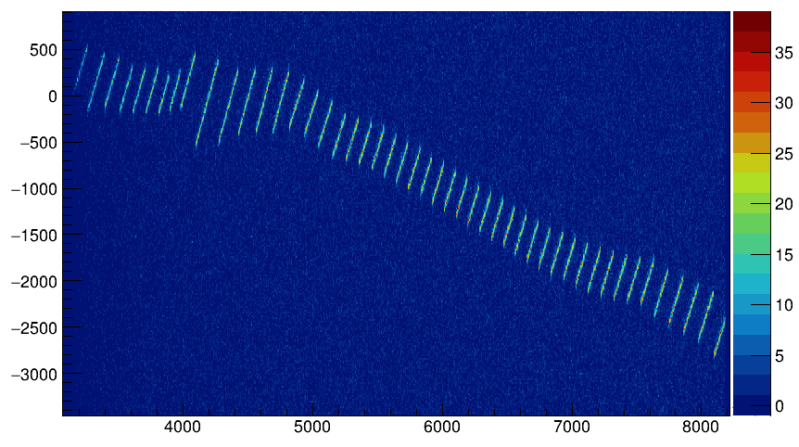
Time Drift
Drift ~ 2.2 us/s
Time Difference (s)
Time Difference (ns)
Time (s)
Time (s)
Time drift between individual HPGes – and their BGOs
Apply offset relative to synced HPGes
Re-calibrate data – fine drift!

Slide 15
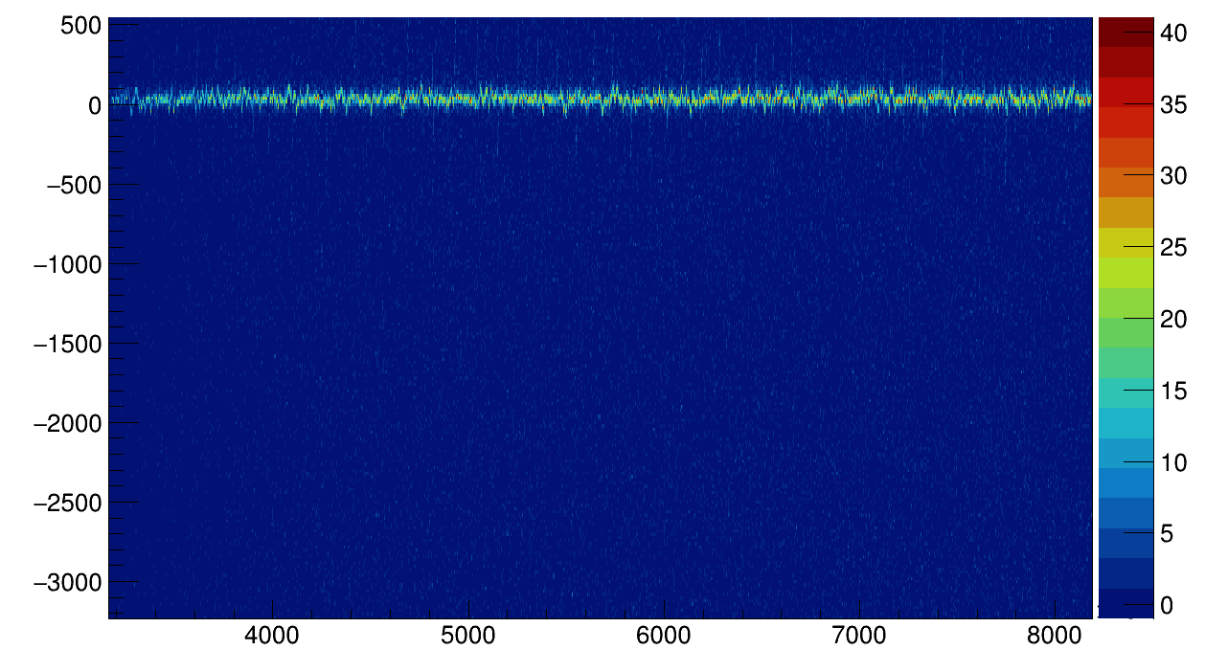
Time Drift
Time Difference (ns)
Time Difference (ns)
Time (s)
Time (s)
Time drift between individual HPGes – and their BGOs
Apply offset relative to synced HPGes
Re-calibrate data – fine drift!

Slide 16
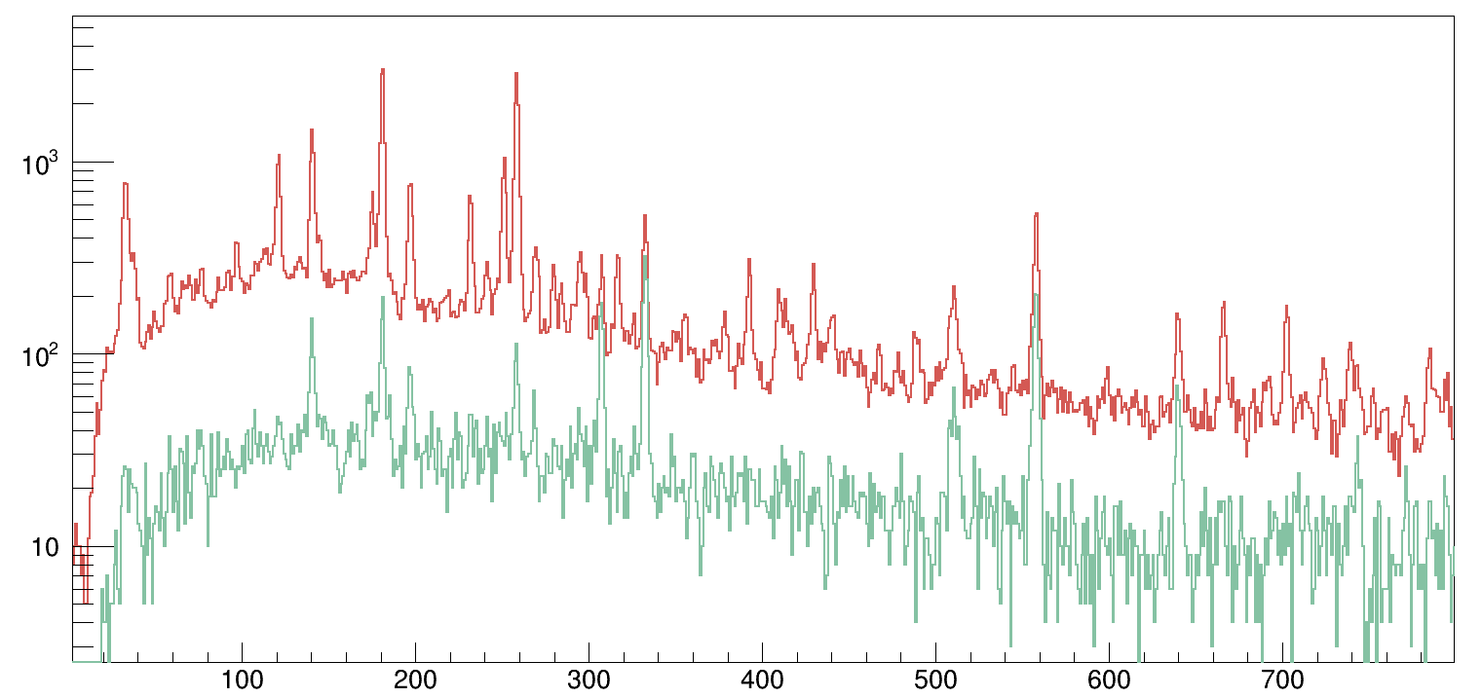
Time Drift
HPGe spectrum – LaBr gate on 2⁺ → 0⁺
¹⁴⁶Ba
Increased peak-to-background ratio
Reduced random coincidences
Counts
3⁻ → 4⁺
1⁻ → 2⁺
4⁺ → 2⁺
3⁻ → 2⁺
without correction
with correction
Energy /keV

Slide 17
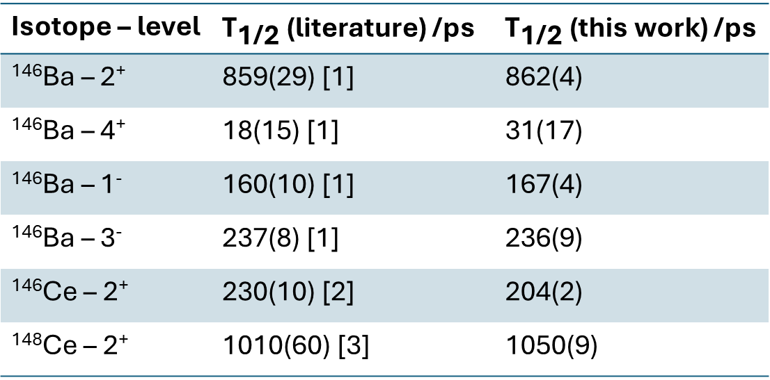
Results
Isotope – level | ${\text{T}}_{\text{1/2} }$(literature) /ps | ${\text{T}}_{\text{1/2} }$(this work) /ps
¹⁴⁶Ba – 2⁺ | 859(29) [1] | 862(4)
¹⁴⁶Ba – 4⁺ | 18(15) [1] | 31(17)
¹⁴⁶Ba – 1⁻ | 160(10) [1] | 167(4)
¹⁴⁶Ba – 3⁻ | 237(8) [1] | 236(9)
¹⁴⁶Ce – 2⁺ | 230(10) [2] | 204(2)
¹⁴⁸Ce – 2⁺ | 1010(60) [3] | 1050(9)
[1] H. Mach et al., Phys. Rev. C 41 (1990)
[2] C. Goodin et al., Phys. Rev. C 79 (2009)
[3] R Lică et al., J. Phys. G: Nucl. Part. Phys. 44 (2017)

Slide 18
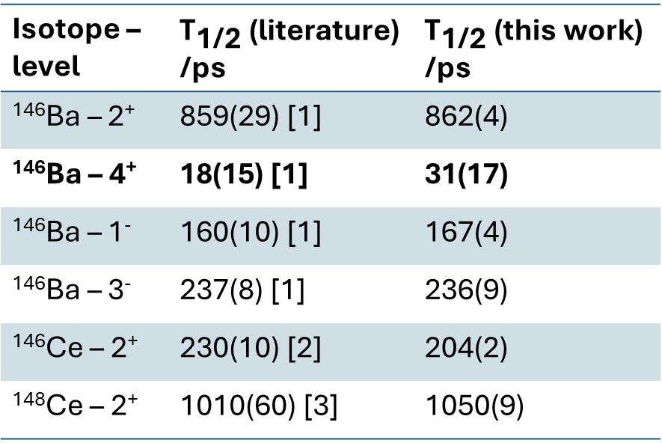
γγγ – centroid difference
Isotope – level | ${\text{T}}_{\text{1/2} }$(literature) /ps | ${\text{T}}_{\text{1/2} }$(this work) /ps
¹⁴⁶Ba – 2⁺ | 859(29) [1] | 862(4)
¹⁴⁶Ba – 4⁺ | 18(15) [1] | 31(17)
¹⁴⁶Ba – 1⁻ | 160(10) [1] | 167(4)
¹⁴⁶Ba – 3⁻ | 237(8) [1] | 236(9)
¹⁴⁶Ce – 2⁺ | 230(10) [2] | 204(2)
¹⁴⁸Ce – 2⁺ | 1010(60) [3] | 1050(9)
3⁻
LaBr
4⁺
LaBr
2⁺
HPGe
0⁺
[1] H. Mach et al., Phys. Rev. C 41 (1990)
[2] C. Goodin et al., Phys. Rev. C 79 (2009)
[3] R Lică et al., J. Phys. G: Nucl. Part. Phys. 44 (2017)

Slide 19
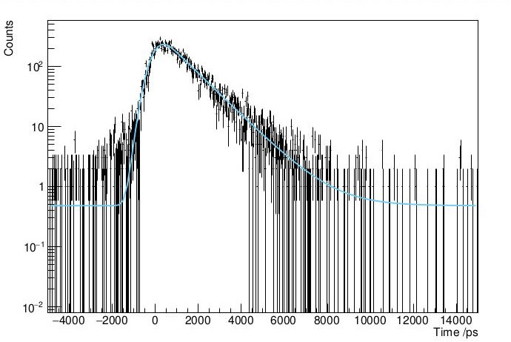
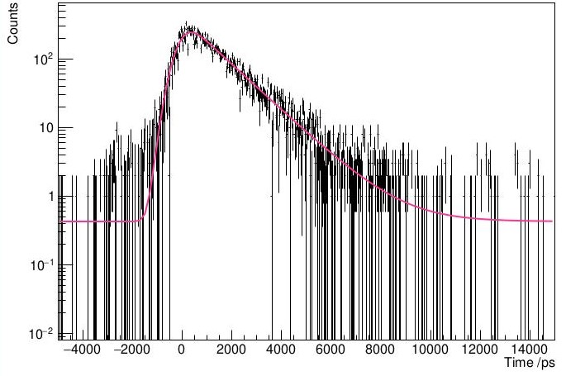
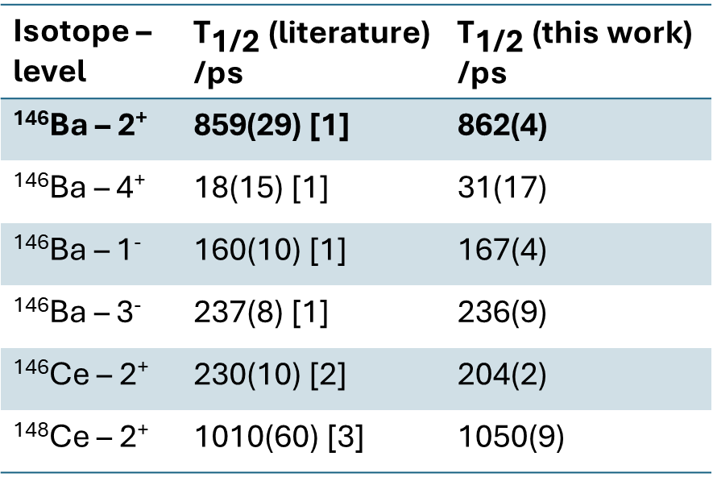
γγ - convolution
1⁻ → 2⁺, 2⁺ → 0⁺
Isotope – level | ${\text{T}}_{\text{1/2} }$(literature) /ps | ${\text{T}}_{\text{1/2} }$(this work) /ps
¹⁴⁶Ba – 2⁺ | 859(29) [1] | 862(4)
¹⁴⁶Ba – 4⁺ | 18(15) [1] | 31(17)
¹⁴⁶Ba – 1⁻ | 160(10) [1] | 167(4)
¹⁴⁶Ba – 3⁻ | 237(8) [1] | 236(9)
¹⁴⁶Ce – 2⁺ | 230(10) [2] | 204(2)
¹⁴⁸Ce – 2⁺ | 1010(60) [3] | 1050(9)
4⁺ → 2⁺, 2⁺ → 0⁺
[1] H. Mach et al., Phys. Rev. C 41 (1990)
[2] C. Goodin et al., Phys. Rev. C 79 (2009)
[3] R Lică et al., J. Phys. G: Nucl. Part. Phys. 44 (2017)

Slide 20
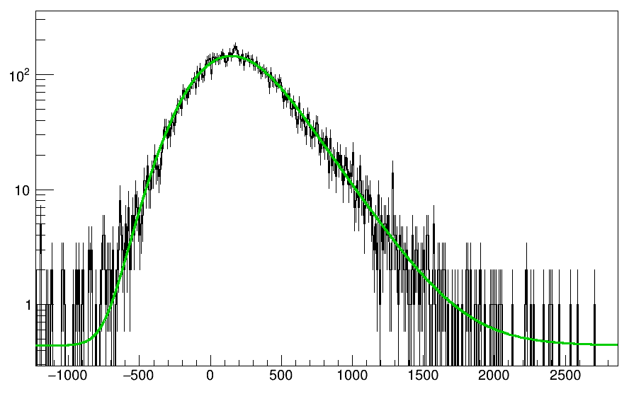
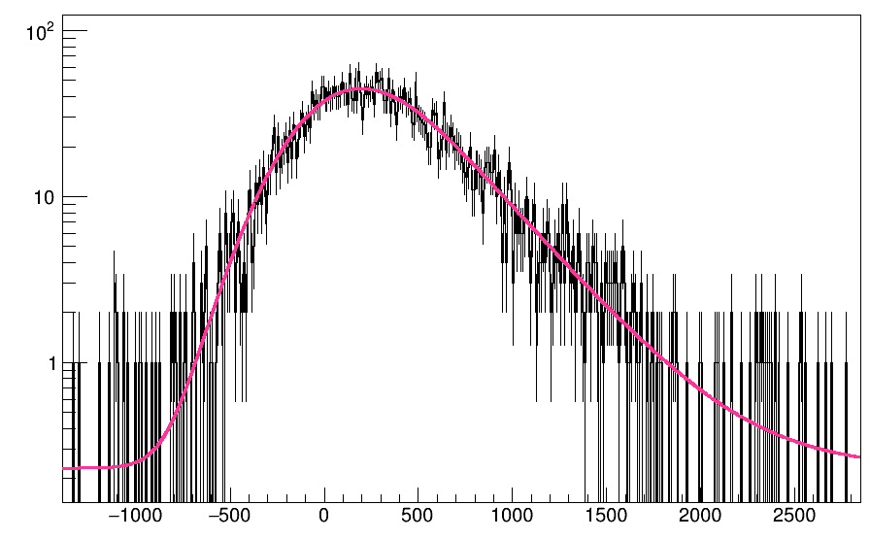
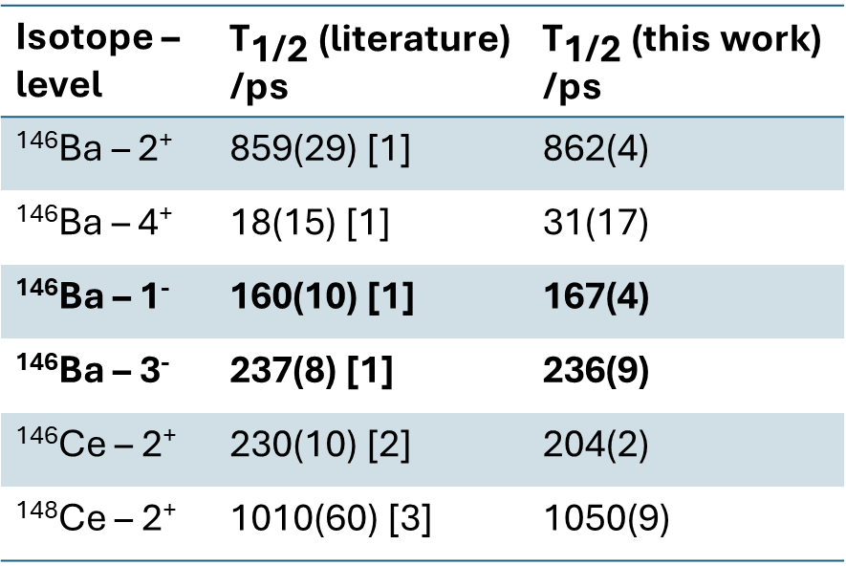
βγγ - convolution
Counts
β → 1⁻, 1⁻ → 2⁺, 2⁺ → 0⁺
Isotope – level | ${\text{T}}_{\text{1/2} }$(literature) /ps | ${\text{T}}_{\text{1/2} }$(this work) /ps
¹⁴⁶Ba – 2⁺ | 859(29) [1] | 862(4)
¹⁴⁶Ba – 4⁺ | 18(15) [1] | 31(17)
¹⁴⁶Ba – 1⁻ | 160(10) [1] | 167(4)
¹⁴⁶Ba – 3⁻ | 237(8) [1] | 236(9)
¹⁴⁶Ce – 2⁺ | 230(10) [2] | 204(2)
¹⁴⁸Ce – 2⁺ | 1010(60) [3] | 1050(9)
Time /ps
Counts
β → 3⁻, 3⁻ → 4⁺, 4⁺ → 2⁺
[1] H. Mach et al., Phys. Rev. C 41 (1990)
[2] C. Goodin et al., Phys. Rev. C 79 (2009)
[3] R Lică et al., J. Phys. G: Nucl. Part. Phys. 44 (2017)
Time /ps

Slide 21
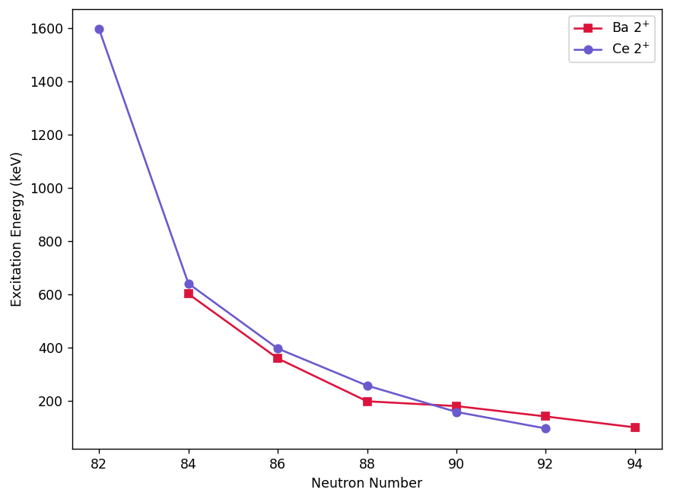
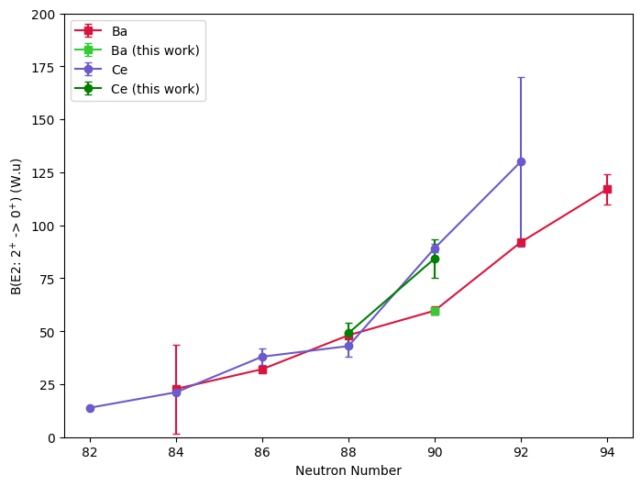
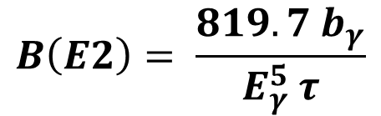
Systematics
$$B\left(E2\right)= \frac{819.7 b_{γ}}{E_{γ}^{5} τ}$$
NNDC - ENSDF

Slide 22
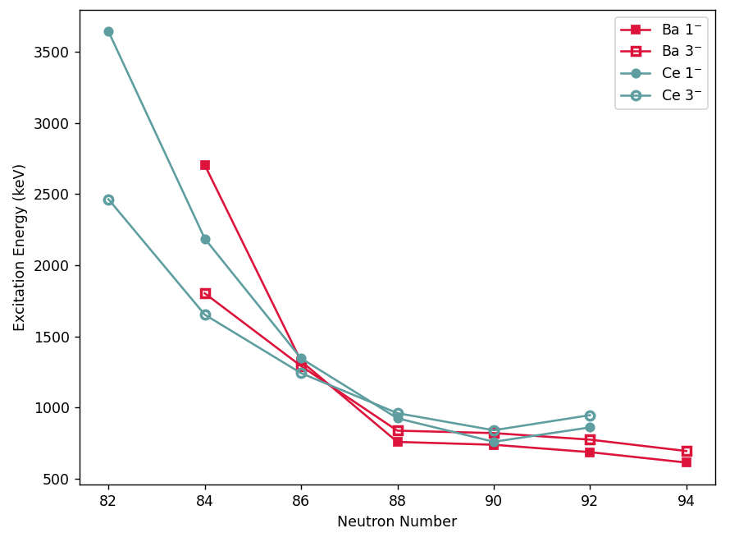
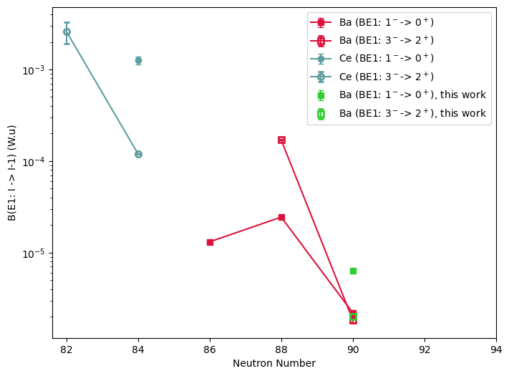
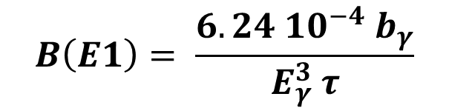
Systematics
$$B\left(E1\right)= \frac{6.24 10^{−4} b_{γ}}{E_{γ}^{3} τ}$$
NNDC - ENSDF

Slide 23
Summary and Outlook
Validated βγ(γ) and γγ(γ) fast-timing methods
Improved coincidence building process
Calculated B(Eλ)s and compared to current literature
Expand results to A = 144, 148, and 150
Compare unknown half lives and B(Eλ)s to systematics

Slide 24
Thank you to my collaborators
L. Gaffney¹
J. Ojala¹
M. M. Satrazani¹
P. Spagnoletti¹
F. Ali²
C. Andreoiu³
N. Bernier^{4,5}
M. Bowry⁴
S. S. Bhattacharjee⁴
R. Cabellero-Folch⁴
R. Coleman²
A. Diaz Varela²
F. H. Garcia³
A. B. Garnsworthy⁴
G. Grinyer⁶
M. P. Hladun⁶
J. Keatings⁷
R. Lefleur²
B. K. Luna⁸
K. Mashtakov⁷
J. L. Mitchell⁶
B. C. Olaizola Mampaso⁴
C. Petrache⁹
A. J. Radich²
M. M. Rajabali⁸
Y. Saito^{4,5}
L. Sexton^{4,10}
J. P. Siuryte^{4,10}
J. Smallcombe⁴
J. F. Smith⁷
C. Svensson²
E. Timakova⁴
K. Whitmore³
D. Yates^{4,5}
1 University of Liverpool, Liverpool, UK
2 University of Guelph, Guelph, Canada
3 Simon Fraser University, Vancouver, Canada
4 TRIUMF, University of British Columbia, Vancouver, Canada
5 University of British Columbia, Vancouver, Canada
6 University of Regina, Regina, Canada
7 University of the West of Scotland, Glasgow, UK
8 Tennessee Technological University, Cookeville, Tennessee, USA
9 Paris-Saclay University, Paris, France
10 University of Surrey, Guildford, UK

